Slide 1


CONNECTICUT STATE DEPARTMENT OF EDUCATION
Initial Referral
and
Evaluation
CT-SEDS
July 1, 2022
Notes:
The purpose of this portion of the training is to introduce you to the initial referral and evaluation process all the way through to eligibility determination.
While many of the modules available within CT SEDS are sequential in their process, the initial referral and evaluation module is not quite as linear. It is multifaceted with the need to navigate to several different documents and pages over the course of the evaluation process.
We do want to acknowledge that each user present today may have different roles and responsibilities within their own school or program. You may not be actively involved in the initial referral process at this level, however, we do believe that seeing this process may help you better understand how the system responds and how to navigate through other modules.
we will include screenshots of certain stages as well as some real time video use of certain panels and Pages. this presentation is not designed to be a comprehensive dive into each aspect of the module, however we believe that understanding and being familiar with the processes outlined will be extremely helpful as you work through accessing the rest of the program's capabilities. Please use this as an opportunity to see what is available and how it can be used, rather than trying to commit each step to memory. At the end of today’s session you will be directed to several different resources that will help support your work moving forward.
We would like to recommend that you try to refrain from actively navigating through your own system while we're doing our presentation.
Ours will move quickly through each stage of the process and we are concerned that you may not be able to follow along, losing some important information or guidance as you try to navigate.
we want you to please make note that we are currently working from the system as it has been launched for the July 1st date. it is expected that there will be additions and revisions as districts begin to use the system and as we are able to upgrade certain aspects of the program.
districts will be notified as those changes and revisions are made.
As of right now, the modules that are currently available are Referral and Evaluation, IEP, 504, service plan, restraint and seclusion, and service documentation.
remember our Focus for this presentation will be strictly on the initial referral and evaluation process

Slide 2
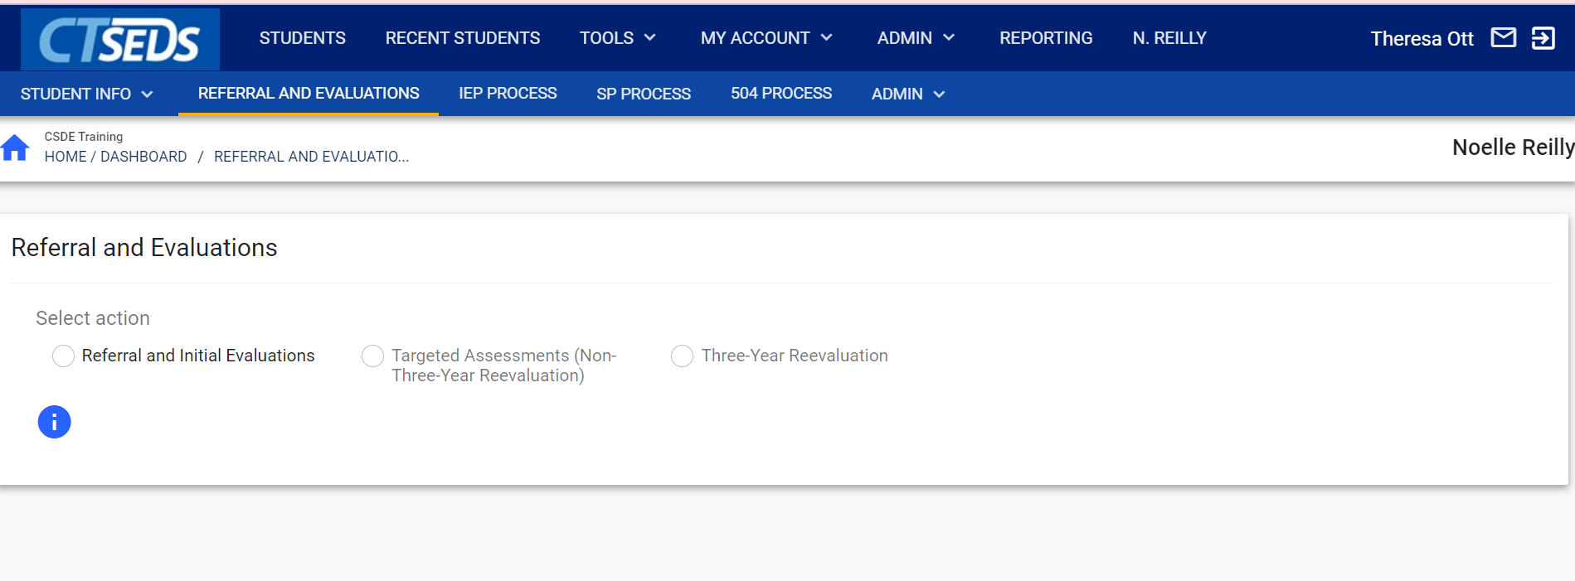

Referral and Evaluations
CONNECTICUT STATE DEPARTMENT OF EDUCATION
Notes:
As a reminder, prior to scheduling the meeting, we have updated parent contact information, identified team members for the student, and now you are ready to begin the actual referral process.
You will need to access the student file as demonstrated earlier, either through Students, Recent Students, or from your home page.

Slide 3
Referral and Evaluations
CONNECTICUT STATE DEPARTMENT OF EDUCATION
Notes:
Click for Animation. While in the student file, you will click on REFERRAL AND EVALUATIONS at the top of the screen.

Slide 4
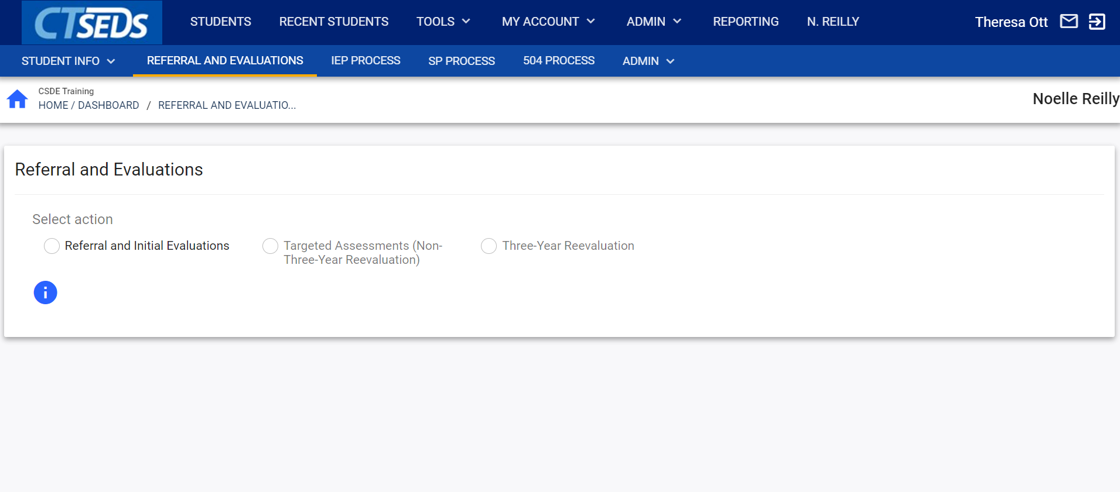
CONNECTICUT STATE DEPARTMENT OF EDUCATION
Notes:
Once you click on referral and evaluations you'll be brought to the page you see here. This is where we can see the available actions to begin an evaluation process. There are three choices: referral and initial evaluation, targeted assessment, and three-year reevaluation.

Slide 5
CONNECTICUT STATE DEPARTMENT OF EDUCATION
Notes:
Click for Animation. Since our student is not yet eligible for special education services, the screen will only allow the user to choose referral and initial evaluation.

Slide 6
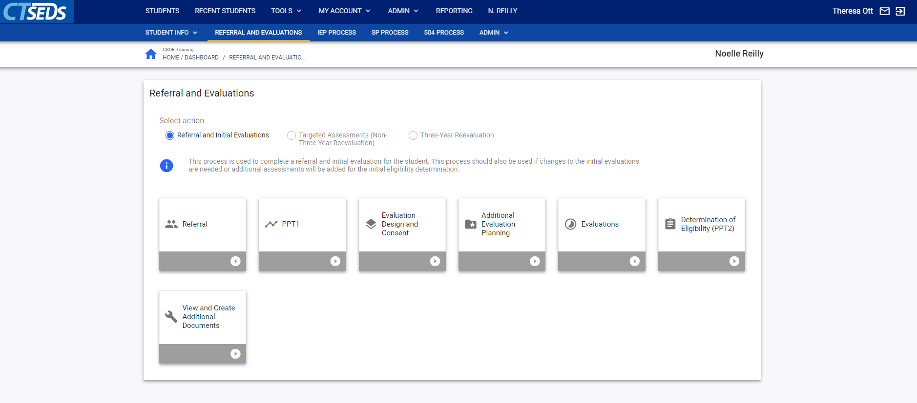
CONNECTICUT STATE DEPARTMENT OF EDUCATION
Notes:
Here the user can see the various sections that make up the referral and evaluation process.
each of these tiles represents a step in the process. While you are able to move from tile to tile and access various sections- the intention is for you to move through the process from left to right.
At this point we have not accessed the tiles and they are gray in color.
When we have completed this step the tile will turn green.
if we have started -but not yet completed a step- it will be red.
This will be demonstrated as we move through the process.

Slide 7
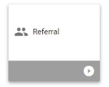
Referral (header indicating which Tile you are on)
Demographic and Parent Information
Referral to Determine Eligibility
Documents
CONNECTICUT STATE DEPARTMENT OF EDUCATION
Notes:
We will be showing you a videotaped recording of the initial referral process shortly, but here are a few things to keep in mind as we move forward.
When you click on the Referral Tile and are taken to the Referral page, a number of headings will display.
The title of the page, “Referral”, will be followed by Demographic and Parent information, Referral to Determine Eligibility, and Documents.

Slide 8
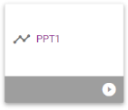
PPT 1
Demographic and Parent Information
Scheduling a PPT Meeting
  CREATE NOTICE OF PLANNING AND PLACEMENT TEAM MEETING
Record of Meeting
CONNECTICUT STATE DEPARTMENT OF EDUCATION
Notes:
Also included in the video will be the PAGE for PPT 1.
On this page you will see the header, PPT 1, Demographic and Parent Information, Scheduling a PPT Meeting (which includes a link for creation of the PPT Notice), and Record of Meeting.
PLAY VIDEO HERE
(after video)
Now that we have created the referral and sent the meeting notice to parents, we will need to continue with the completion of documenting PPT1.
It’s the day of the meeting- we have met as a team, we have reviewed the referral and we have made our decision.
This means we will need to go back to the student file in CT SEDS, navigate to the Referral and Evaluation Module and return to the PPT 1 Tile.

Slide 9
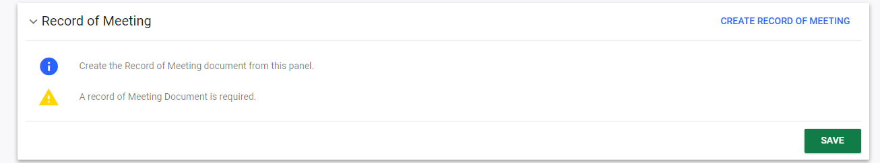
CONNECTICUT STATE DEPARTMENT OF EDUCATION
Notes:
Within the initial referral process, we are now required to complete a Record of Meeting. This will document the events of the meeting when there is no IEP being developed or revised.
The user can create the required record of meeting by clicking the Blue Link shown at the top right corner in the panel.
This of course can be completed during or after the meeting has been conducted as it is a reflects the results of that meeting.

Slide 10
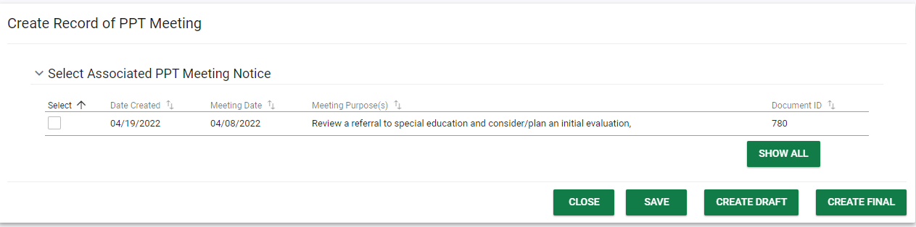
Record of Meeting
CONNECTICUT STATE DEPARTMENT OF EDUCATION
Notes:
When you click on the panel you will then need to select the date of the meeting for which the record is being recorded.

Slide 11
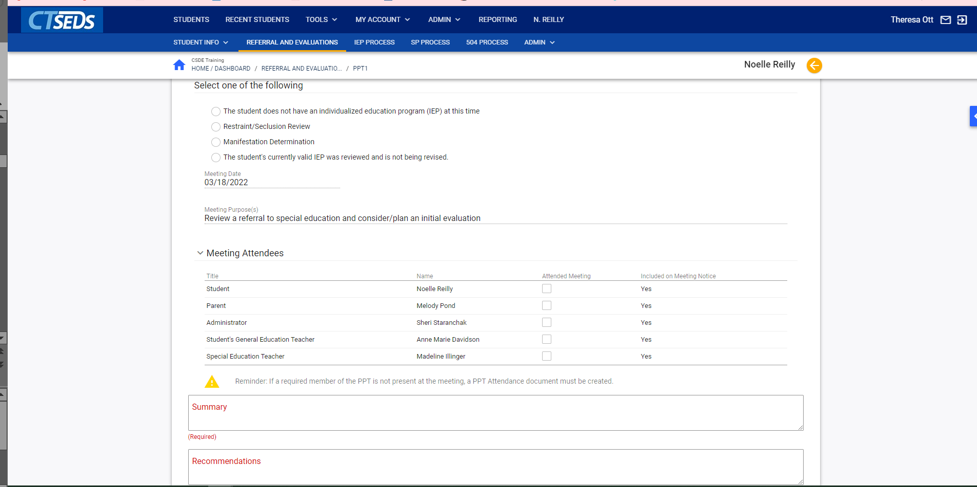
CONNECTICUT STATE DEPARTMENT OF EDUCATION
Notes:
This will trigger a pop-up screen to open so that you can then complete the required document.
Please note, this is a new document
A Record of Meeting is required any time a PPT meeting is held and there is no IEP either developed or revised.
Here are some examples of when this document will be required.
In the case of an Initial Referral Meeting when there is no IEP developed.
In the case of an eligibility meeting when the student is found NOT eligible, so there is no IEP developed.
For a meeting to review Restraint/Seclusion data when the team decides that no changes should be made to the current IEP
and
a Manifestation Determination, again, when there are no changes being made to the IEP
And in the case of a Review/Revise meeting when the team determines to continue the student’s current IEP, therefore there are no changes being made.
You would include a brief summary of the meeting reason and discussion, and list the PPT Recommendations in the appropriate text box.
You will then save the document and use the orange arrow in the top right to return to the PPT 1 landing page.
The Record of Meeting should not be viewed as a replacement for the meeting summary (or meeting minutes) you may have used previously. The Meeting summary is an optional document. Its use will be decided by each district and it is not accessible through the CT SEDS system.

Slide 12
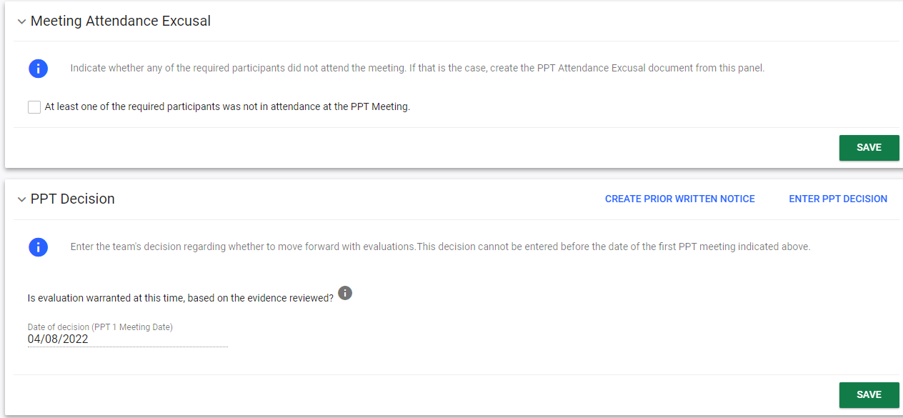
Continuing with PPT 1
CONNECTICUT STATE DEPARTMENT OF EDUCATION
Notes:
Once back on the landing page, we will see additional panels to consider.
If a member of the team is absent, we would then create the PPT attendance excusal document.
It will be pre-populated with the names of IEP team members that were included on the PPT invitation. You would click on the absent team member’s name, document the reason for their absence and then hit save.
You will then need to enter the PPT Decision and create the Prior Written Notice.

Slide 13
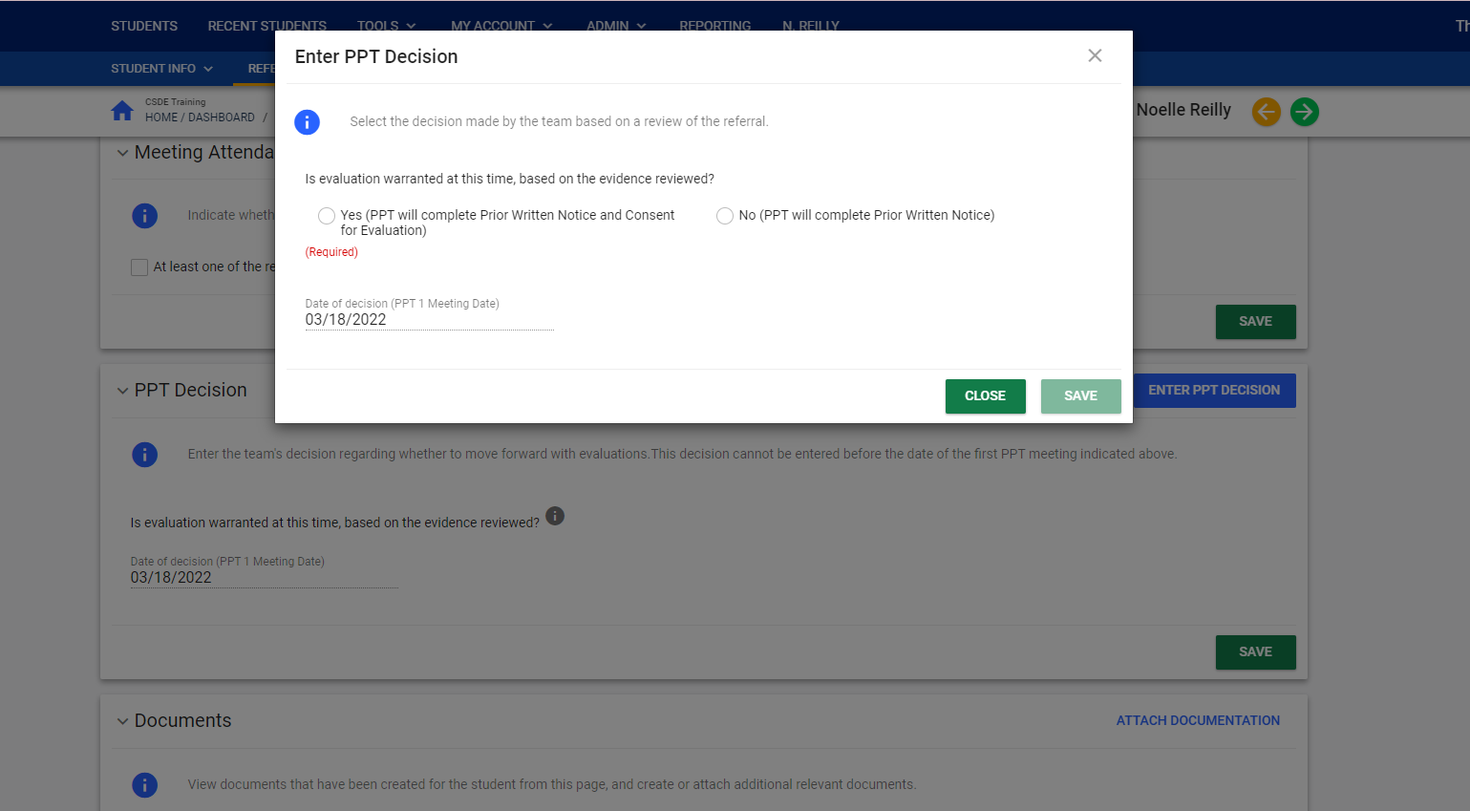
CONNECTICUT STATE DEPARTMENT OF EDUCATION
Notes:
When you click on the enter PPT decision panel this is the popup that will appear you will respond appropriately - noting whether the team has decided to move forward with an evaluation or not- and hit save.

Slide 14
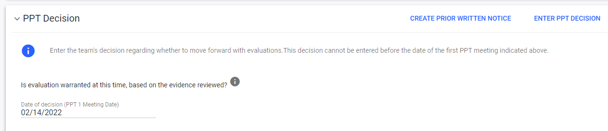
This panel has two actions
CREATE PRIOR WRITTEN NOTICE
ENTER PPT DECISION
CONNECTICUT STATE DEPARTMENT OF EDUCATION
Notes:
As a reminder, our meeting has been held. We have documented any required team member that was unable to attend.
We have also recorded the events of the meeting in the Record of Meeting, and entered the PPT Decision.
It is now necessary for us to return to the PPT decision panel in order to access the prior written notice document
You will find the link to create prior written notice in the upper right hand corner of the PPT decision panel
when you click on that link it will take you directly to the prior written notice

Slide 15
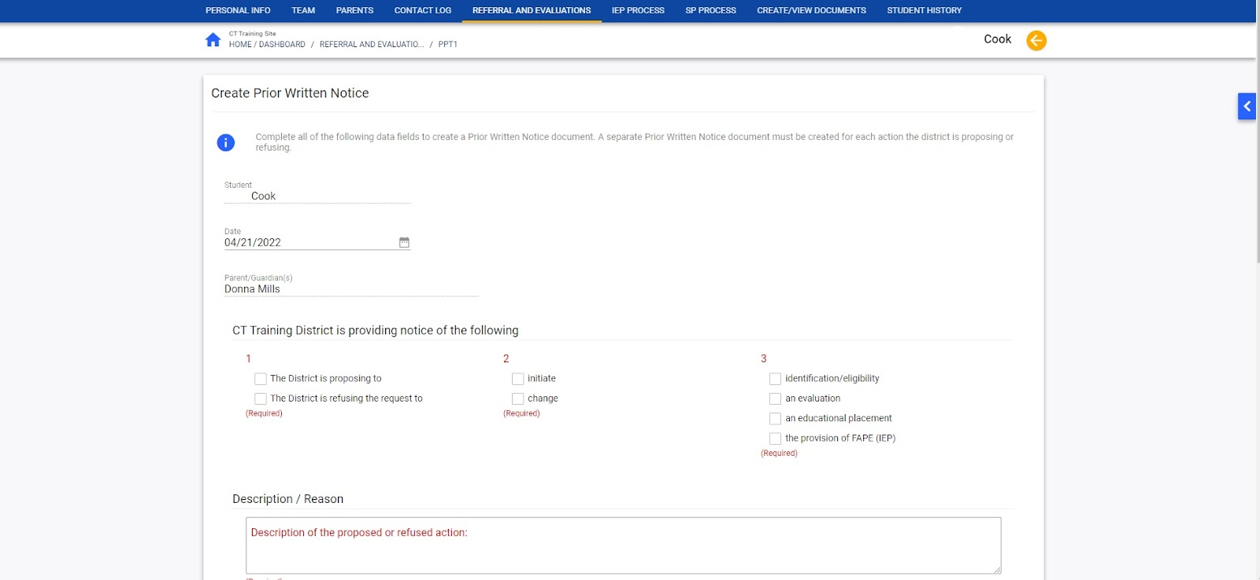
CONNECTICUT STATE DEPARTMENT OF EDUCATION
Notes:
The same decisions must be made in Filling in this document as with previous software.
The main difference here is that rather than having a drop down list with many different choices for actions refused or proposed, the user will need to make choices from a limited set of options.
As discussed during the IEP quality training sessions, you will need to choose whether you are proposing an action or refusing an action, Identify whether the action is an initiation or a change and then choose from one of four actions that are related to the students program.
Identification and eligibility
Evaluation
educational placement
Or
provision of FAPE
Another important difference to note is that the user must generate a separate PWN for each action considered. It is no longer possible to create one PWN with multiple actions. For example, if a student is found eligible for an IEP, you will create a PWN with the action for Identification and Eligibility and another for the provision of FAPE (as you are now providing the IEP). Once one PWN has been created and finalized, you may create another by clicking on the link in the PPT Decision Panel, or at the bottom of the page under “create document”.

Slide 16
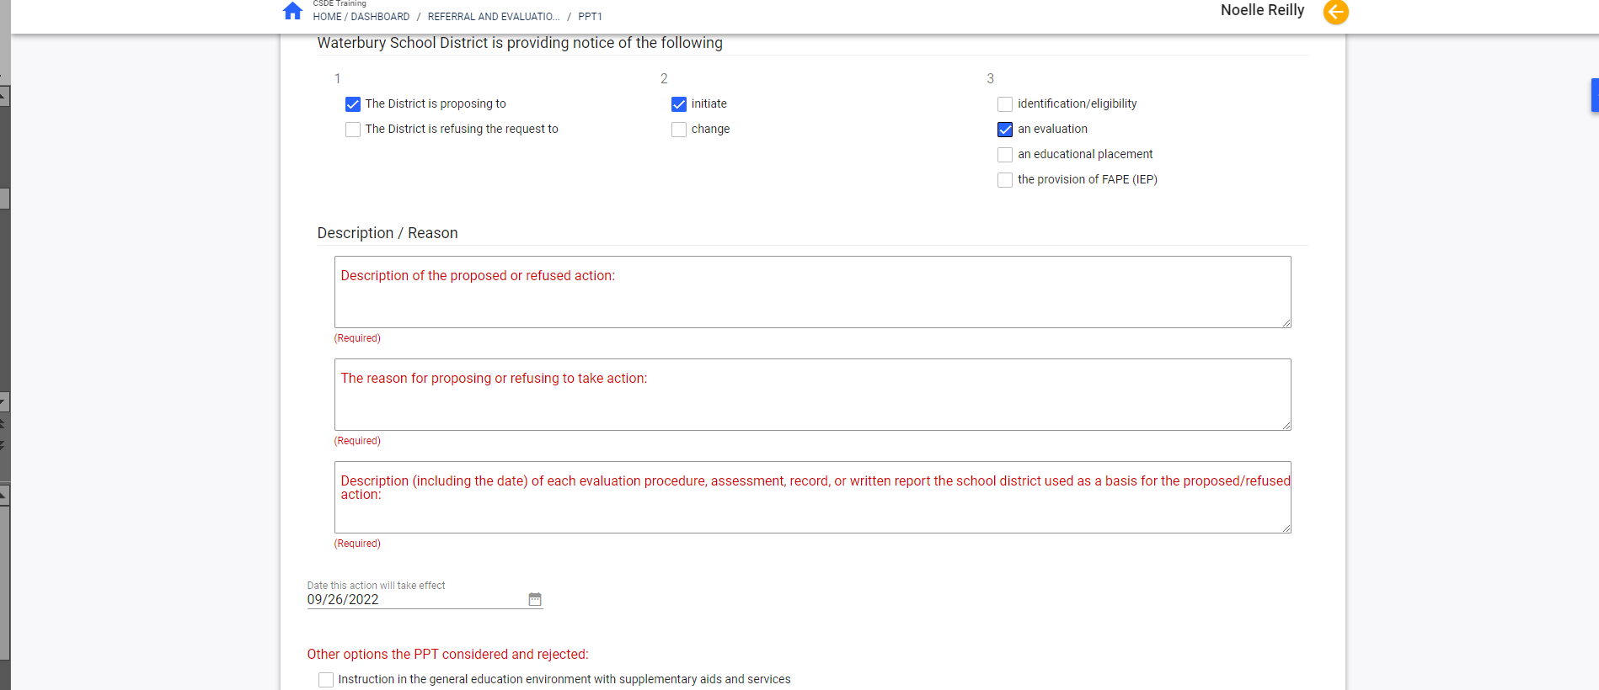
CONNECTICUT STATE DEPARTMENT OF EDUCATION
Notes:
As demonstrated during the IEP quality training sessions there will be open text boxes to fill out the reasons and justifications for the proposed or refused action. There will also be check boxes to reflect other options that may have been considered and rejected and also a way to identify how the parent was notified.
Please Note that the Date this action will take effect defaults to 15 school days after the user’s entered Document Date. If the user enters a date less than 10 school days from the Document Date, a parent waiver will be required as indicated by use of a check box.
There will be additional and more specific guidance on Prior Written Notice in the future. We will share the Prior Written Notice Guidance Grid in the chat. (Share Document)
This is a guidance document developed by the state to help you with decision making processes while completing the Prior Written Notice. This should be made available to anyone in your district responsible for filling and finalizing the prior written notice.
As a reminder the Prior Written Notice will be a formal and finalized document. It will need to be saved, reviewed in draft and then finalized. As with other documents created within this system, the finalized version will be available At the bottom of the screen where finalized documents are listed, it will also now be available in the Parent Portal.

Slide 17

If we have agreed to evaluate, what does the evaluation look like?
CONNECTICUT STATE DEPARTMENT OF EDUCATION
Notes:
At this point we have held the PPT , we've reviewed the referral and determined that it is appropriate to move forward with an initial evaluation.
Since we have decided to evaluate, we will need to receive permission to conduct an initial evaluation.
We will now discuss how to create the Consent for Initial Evaluation form and share with the parent or guardian for permission.
At this point again you can use the green arrow at the top of your screen to move yourself forward in the process, or you can go back up to the top level navigation bar and click on referral and evaluation.

Slide 18
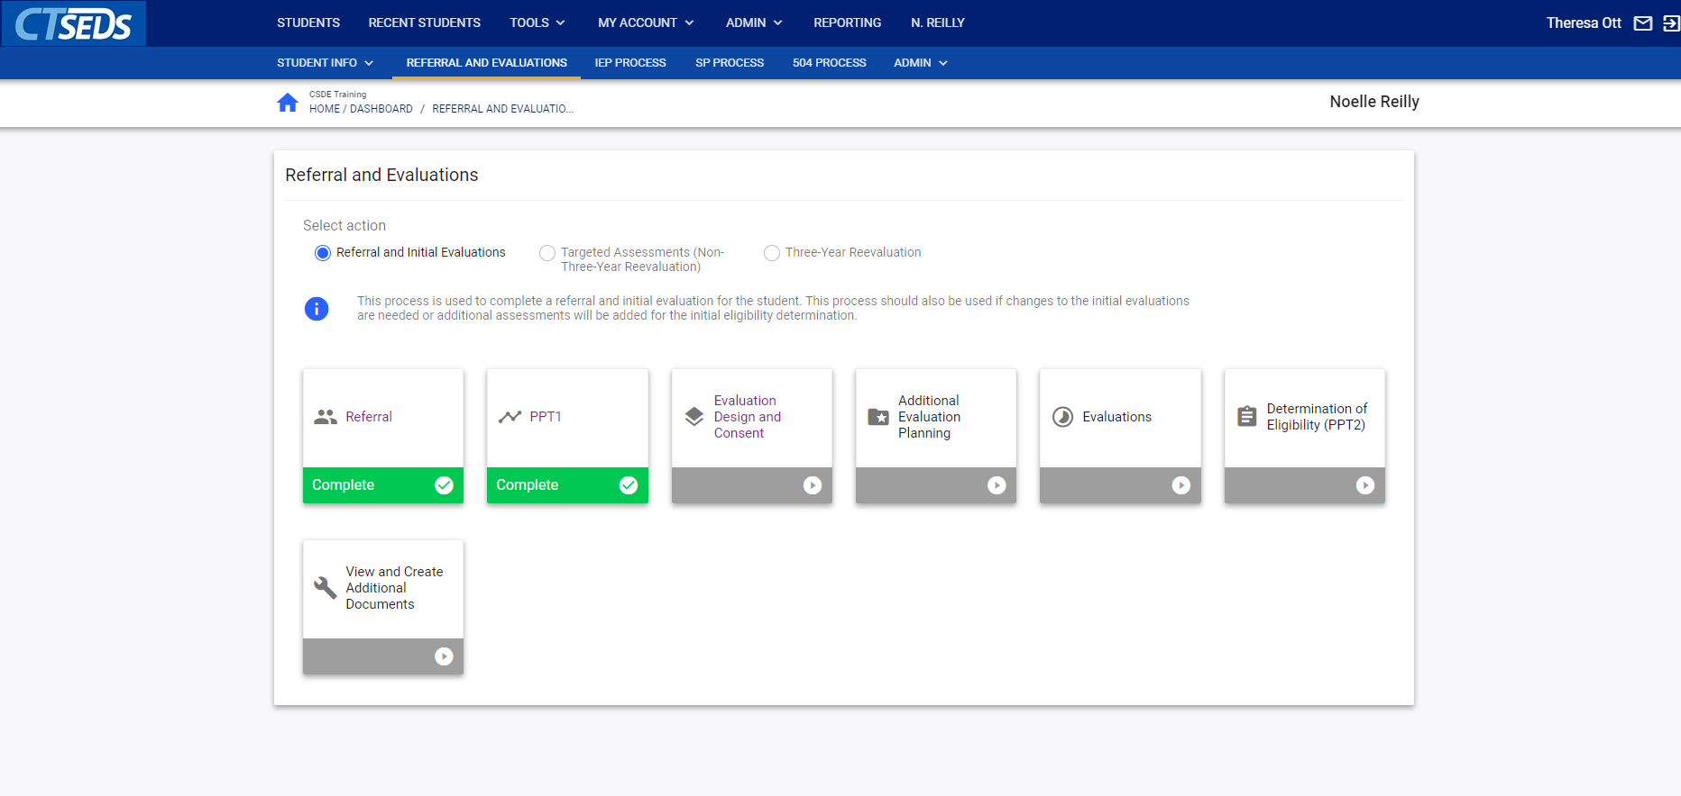
CONNECTICUT STATE DEPARTMENT OF EDUCATION
Notes:
At this point you should see the first tile, referral, highlighted in green and the second tile PPT 1 also highlighted in green. This tells us that we have completed both of these steps within the process.
We are at the stage where we discuss what the assessment and evaluation will be, so we will click on the tile entitled Evaluation Design and Consent.

Slide 19
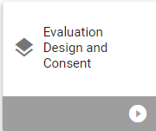
Evaluation Design and Consent
Demographic and Parent
About this Evaluation
Assessment Plan
CONNECTICUT STATE DEPARTMENT OF EDUCATION
Notes:
This will bring you to a landing page with the panels you see here.
Again the first panel indicates which tile you are on, the next allows you to verify demographic information.
The two panels we will discuss in this stage of the process are About this Evaluation and Assessment Plan

Slide 20
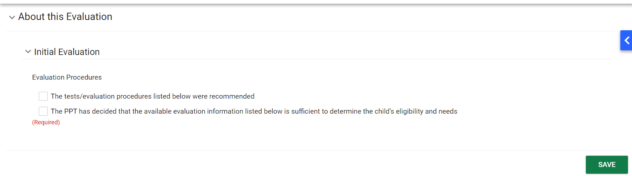
CONNECTICUT STATE DEPARTMENT OF EDUCATION
Notes:
The first step will be to click on About this Evaluation which will give us access to this panel.
This is similar to the evaluation consent form we are used to, in the questions that it asks.
You are asked to identify the evaluation procedures and it gives you two check boxes.
You can choose
test and evaluation procedures listed below are recommended
or you can indicate that the PPT has decided we already have sufficient information to determine eligibility for services.
if the second box is selected a text box will appear so that the user can describe the information that the PPT is using in order to make the eligibility determination.
once you click on that first box test evaluation procedures listed below are recommended -you will then be able to move on to the Assessment Plan Panel

Slide 21
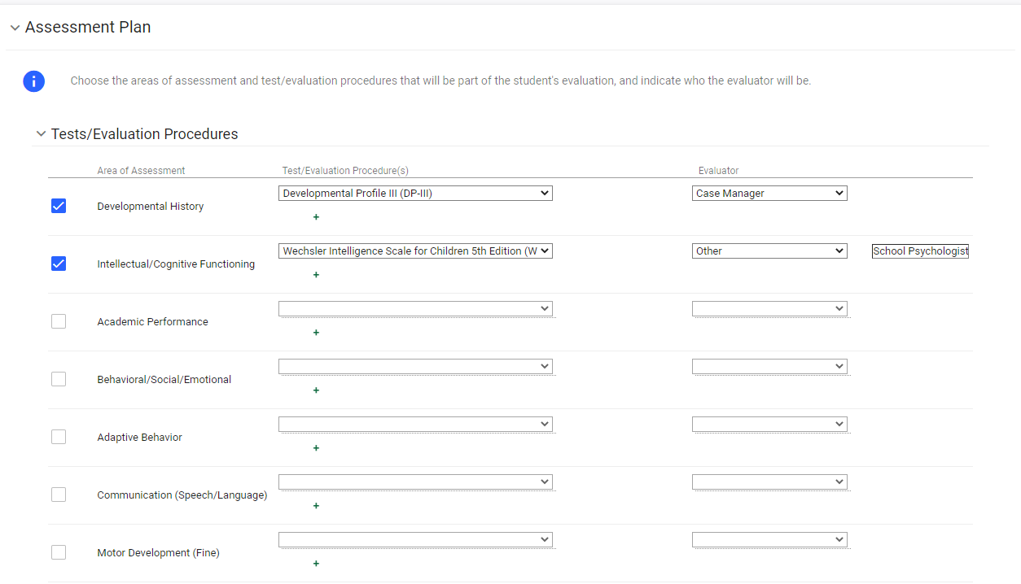
CONNECTICUT STATE DEPARTMENT OF EDUCATION
Notes:
On the assessment plan panel, the user will be able to identify the tests and evaluation procedures being recommended.

Slide 22
CONNECTICUT STATE DEPARTMENT OF EDUCATION
Notes:
Click for animation. Areas of assessment will be listed…

Slide 23
CONNECTICUT STATE DEPARTMENT OF EDUCATION
Notes:
Click for animation. …with drop-downs available containing the most common types of evaluations under each area of assessment.
While there are many specific assessments listed in the drop down, there are options for “individually administered assessments” if you choose not list the specific tests by name.

Slide 24
CONNECTICUT STATE DEPARTMENT OF EDUCATION
Notes:
Click for Animation. You’ll also identify the evaluator by utilizing a drop-down populated with roles of members within the IEP Team. If the role you need is not the title of someone within the IEP team (ex: independent evaluator), it will not appear in the drop-down. Please note we are not indicating evaluators by name- the drop down reflects the role or title of possible evaluators only.
As with most other sections within the system, if the information that you need is not available (either in: area of assessment, test or evaluation procedure, or evaluator), there will be an Other option. Again, once you choose ‘other’, you’ll then be prompted to fill in a text box.

Slide 25
CONNECTICUT STATE DEPARTMENT OF EDUCATION
Notes:
Click for Animation. If you require more than one type of assessment in a specific area, you have the ability to click on the green plus sign which provides another drop down to indicate a test evaluation or procedure. As an example, I may have several academic assessments to conduct (such as the GORT, the KeyMath, and the TOWL) and this feature will allow those assessments to be included under the ‘Academic’ area of assessment, listed separately.
Once you have identified the areas of assessment and related information, you’ll need to scroll to the bottom of the page and hit SAVE. This will bring you to the next step in the process, and the information from this page will be used to create the Consent for Initial Evaluation form.

Slide 26
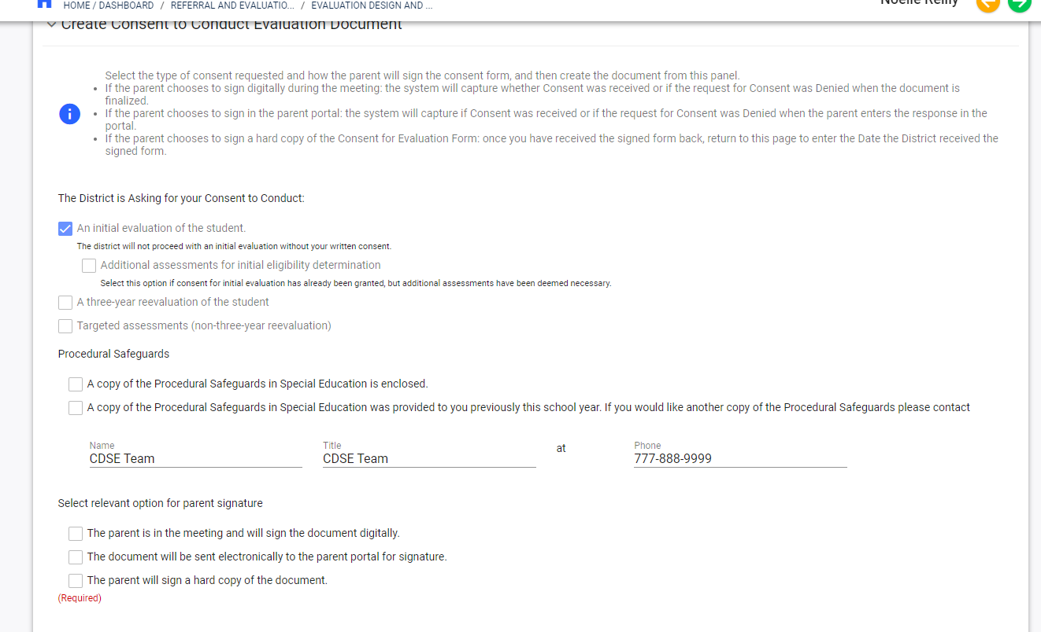
CONNECTICUT STATE DEPARTMENT OF EDUCATION
Notes:
On the Create Consent to Conduct Evaluation document page, you’ll see that an initial evaluation of the student is already pre-checked for you.
You’ll find more checkboxes indicating the sharing of procedural safeguards and would click on the appropriate one. This form is also pre-populated with the name of a contact person, their title, and a phone number that a parent/guardian can call with questions. The Procedural Safeguards Contact can be pre-set in the system. If you do not see any information here or if the information is not up to date, it can be edited by entering the information manually.

Slide 27
CONNECTICUT STATE DEPARTMENT OF EDUCATION
Notes:
Click for Animation. We would like to draw your attention to the choices at the bottom of this page.
Here you will have the ability to indicate how the parent will be providing their signature in order to indicate permission to evaluate.
If a parent is in the meeting and would like to sign a digital copy…you check the appropriate box. Once you click save, a Pop Up will appear on the screen. The parent can use a mouse or stylus to check approval and sign directly on the device. Once saved, the date of consent will automatically be in the system
If a parent is sent a copy electronically (via the parent portal)…They will receive an email indicating there is a document to sign and review. After completing a brief id verification process, they will then be able to sign the document and save. This will automatically mark the document as ‘signed’ within the system and the date of consent will automatically be in the system. The team will be notified via messages that a document has been signed. They can also View Parent Actions through the Parent Information page in order to check on the status of a document.
And finally, if the parent is sent a hard copy to sign…the team will finalize the document as a PDF and print out to share with the family. Once the signed document is returned to the team, we will then need to enter the date of consent manually through the system.

Slide 28
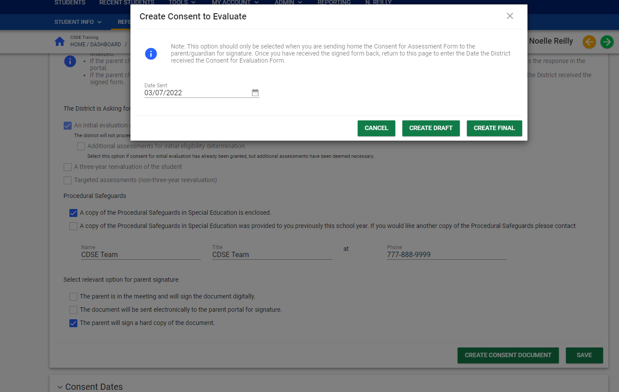
CONNECTICUT STATE DEPARTMENT OF EDUCATION
Notes:
This is the pop up that will appear allowing you to Create the finalized consent document.
Please make sure to review the document in draft form prior to finalizing.

Slide 29
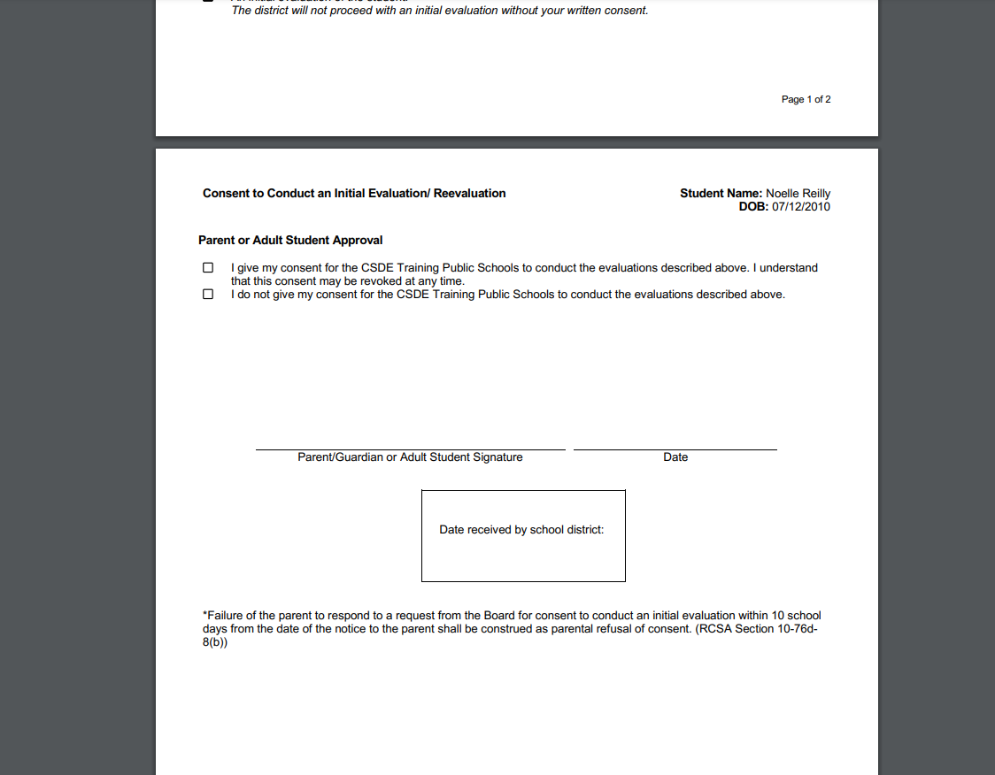
CONNECTICUT STATE DEPARTMENT OF EDUCATION
Notes:
This is the document that will need to be printed If the parent is signing a paper version. You will print it, receive the signature and then remember to upload a scanned version of that document into the system through the View/Create Documents tile.

Slide 30
03/07/22
03/07/22
CONNECTICUT STATE DEPARTMENT OF EDUCATION
Notes:
Click for Animation. Whereas if the parent has chosen to sign electronically or digitally, the ‘signature’ would appear on this line of the finalized document.

Slide 31
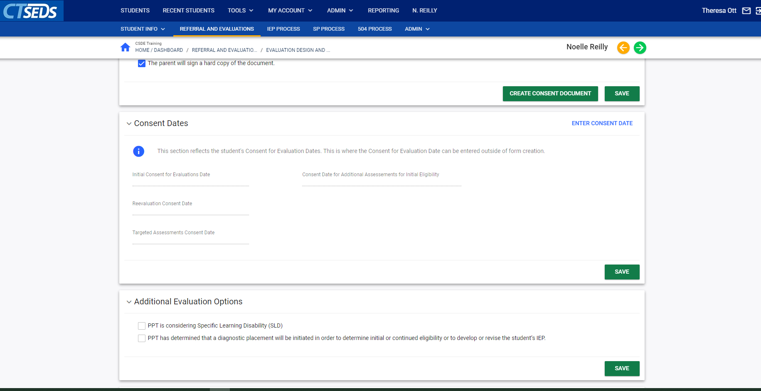
CONNECTICUT STATE DEPARTMENT OF EDUCATION
Notes:
In the panel marked consent dates you will see the system auto-populate the initial consent if the document has been signed digitally or electronically.
If the parent has signed the consent form on a paper copy you need to return to this panel , click on Enter the Consent Date and enter the date that the signed document was received.
As part of the initial referral process there is one additional panel to consider.
Beneath the Consent Dates panel, you will see Additional Evaluation Options. It is only necessary to access this panel in specific situations.

Slide 32
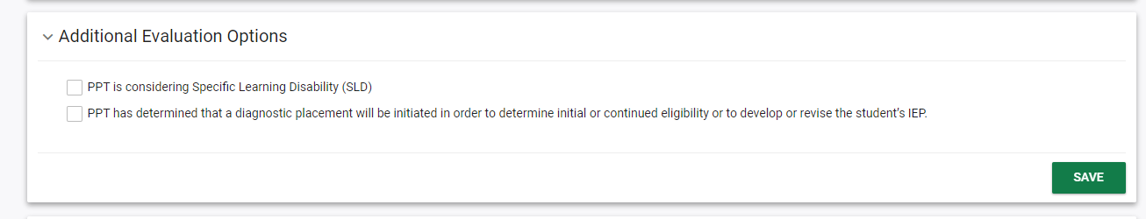
CONNECTICUT STATE DEPARTMENT OF EDUCATION
Notes:
As a reminder, the Additional Evaluation Options panel is NOT necessary for every initial referral. If you do not need to access this panel, CT SEDS will allow you to move on in the process.
We will now discuss the three reasons that you would click on one of these check boxes.
if the PPT is considering specific learning disability,
Specific Learning Disability/Dyslexia
or
if the PPT has determined that a diagnostic placement for purposes of evaluation should be initiated in order to determine initial eligibility
You would click one of the two appropriate boxes only in those situations and then you would hit save.
If you choose that the PPT has determined that a diagnostic placement for purposes of evaluation should be initiated in order to determine initial eligibility, there will be additional pop-up screens and documents to fill out related to the review of progress while in the diagnostic placement. There will be additional guidance available on this process in the future.

Slide 33
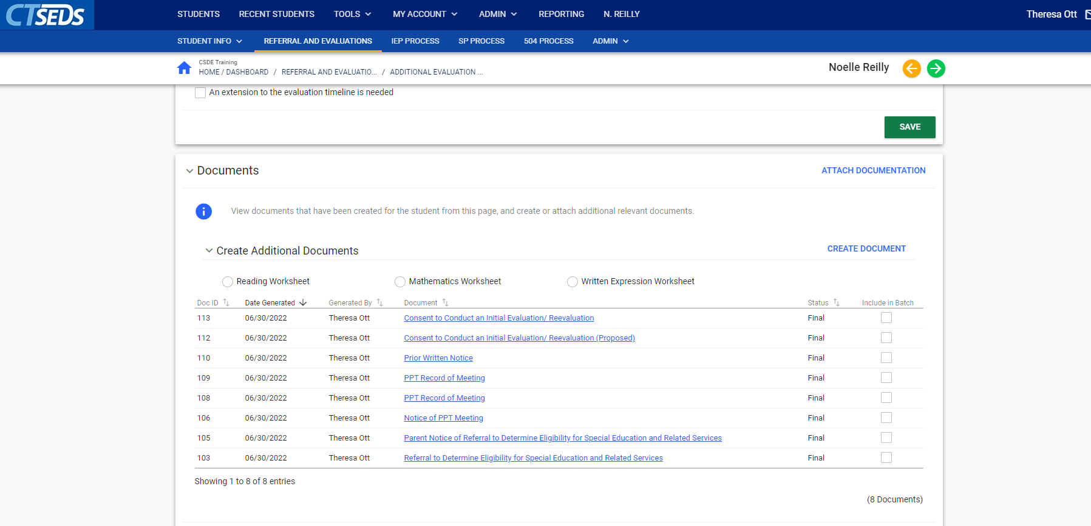
CONNECTICUT STATE DEPARTMENT OF EDUCATION
Notes:
If the team is considering SLD or SLD/Dyslexia, the Reading, Math and Written Expression Worksheets are available as separate documents at the bottom of the landing page. You will find them above the finalized documents in the Documents panel.
You must fill these forms out within the system as a part of the referral process for the identified areas of concern. They are also available in the View/Create documents tab, if needed.

Slide 34

Evaluations have been completed
CONNECTICUT STATE DEPARTMENT OF EDUCATION
Notes:
So, at this point our meeting is complete.
We've done our record of meeting, we've sent the prior written notice home, we've provided the consent for evaluation form to the guardian and it has been signed and returned.
It has been several weeks and we have had the opportunity to evaluate the student and generate reports discussing the results of those evaluations.
We are now ready to begin preparing for our second PPT meeting in order to review the results of the evaluations and discuss possible eligibility determination.

Slide 35
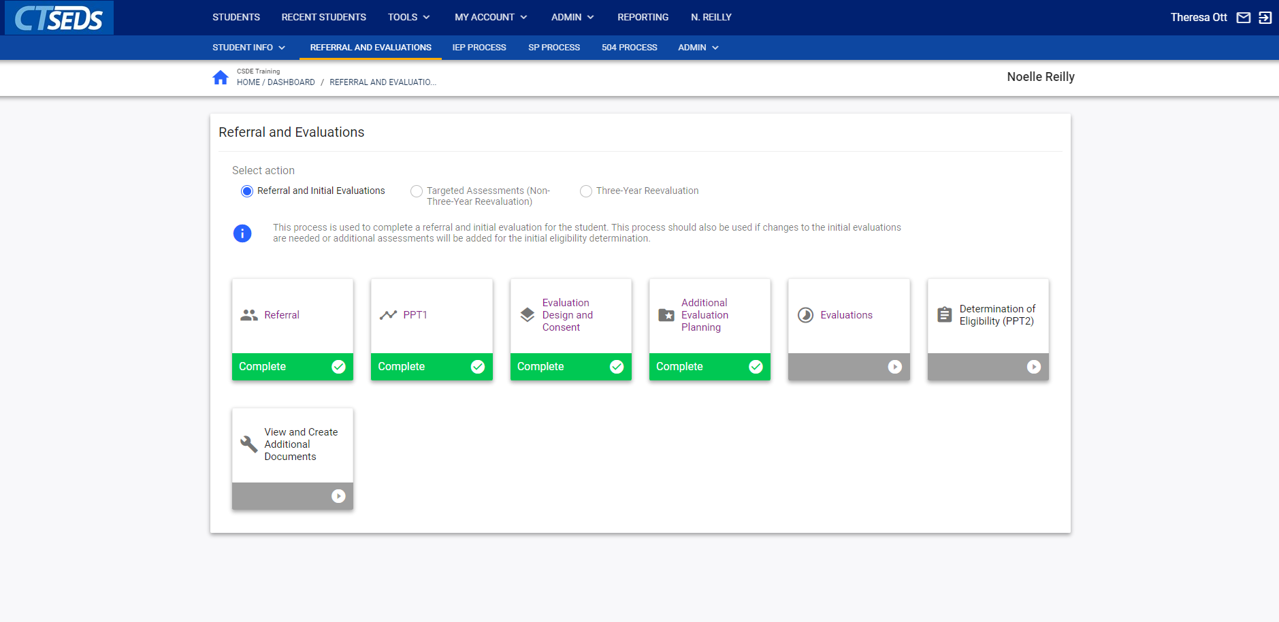
CONNECTICUT STATE DEPARTMENT OF EDUCATION
Notes:
In preparation for this upcoming meeting, the evaluators would log back into CT SEDS, go back to the Referral and Evaluation module and look for the tile entitled Evaluations.
You can see here that the other tiles within the process are now green, indicating completed steps.

Slide 36
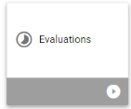
Evaluations
Demographic and Parent
Assessments/Data and Evaluations
CONNECTICUT STATE DEPARTMENT OF EDUCATION
Notes:
On the Evaluations page, you will have a panel entitled Assessments/Data and Evaluations.

Slide 37
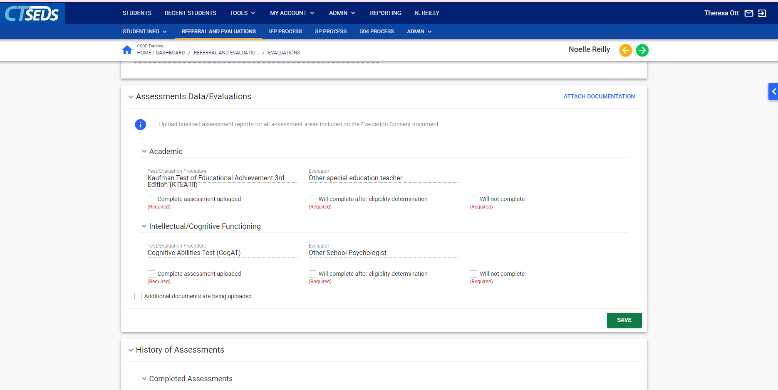
CONNECTICUT STATE DEPARTMENT OF EDUCATION
Notes:
Within this panel, your team will need to navigate to the pre-populated test and evaluation procedures that were identified on the assessment plan. There will be three options to choose from indicating…

Slide 38
CONNECTICUT STATE DEPARTMENT OF EDUCATION
Notes:
Click for Animation. Whether or not the assessment was completed and uploaded…

Slide 39
CONNECTICUT STATE DEPARTMENT OF EDUCATION
Notes:
Click for Animation. Whether assessments will be completed after the eligibility determination is made, or…

Slide 40
CONNECTICUT STATE DEPARTMENT OF EDUCATION
Notes:
Click for Animation. Whether we will not be completing this specific assessment.
For purposes of training, we’ll assume all of our evaluations were completed.
In this case, each evaluator would come to this page, choose Compete assessment uploaded. The system will then prompt you to enter a date for the completion of that evaluation and you can navigate to the link in the top right corner identifying Attach Documentation. You would then upload a PDF version of the completed evaluation report for that particular assessment area.
All team members with access to the CT SEDS system will now be able to view any uploaded reports prior to the PPT meeting. This is similar to the document repository you may be used to.
Please note that uploaded documents are not automatically shared with parents through the parent portal. Only documents that are created within the CT SEDS system can be shared through the Parent Portal, so you would need to send those to the family as an attachment via email.

Slide 41
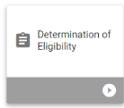
Determination of Eligibility
CREATE A NOTICE OF PLANNING AND PLACEMENT TEAM MEETING
Meeting Attendance Excusal
Record of Meeting
Primary Disability
Determinant Factors
CONNECTICUT STATE DEPARTMENT OF EDUCATION
Notes:
Once the team has gone into the system and updated the evaluations, indicating the date the evaluations were completed, it is time to move on to the next tile in the process, Determination of Eligibility.
Within that page, you will see a document link to Create Notice of PPT. The user will follow the process previously demonstrated while creating the invite for PPT1. The invite for PPT 2 is created and sent to the parents and appropriate team members. Once the meeting invite is created, the team will have access to the IEP Process, allowing them to work on the draft document of the IEP prior to the meeting.
Once the meeting is held or as it is being held, you will again create the Meeting Attendance excusal document, if necessary; which is also available on this page.
Once the PPT has discussed the evaluation results, a decision will be made.

Slide 42
Determination of Eligibility
CREATE A NOTICE OF PLANNING AND PLACEMENT TEAM MEETING
Meeting Attendance Excusal
Record of Meeting Not eligible
Primary Disability
Determinant Factors
CONNECTICUT STATE DEPARTMENT OF EDUCATION
Notes:
Click for Animation. If the student is NOT found eligible, the team would move forward with completing and finalizing the record of meeting (since an IEP has not been developed) and, of course, the PWN as shown earlier in this presentation.

Slide 43
Determination of Eligibility
CREATE A NOTICE OF PLANNING AND PLACEMENT TEAM MEETING
Meeting Attendance Excusal
Record of Meeting
Primary Disability eligible
Determinant Factors
CONNECTICUT STATE DEPARTMENT OF EDUCATION
Notes:
Click for Animation. If the team does find the student eligible, a primary disability will need to be determined and Determinant Factors decided. For purposes of this training, we will find the student eligible and move on.

Slide 44
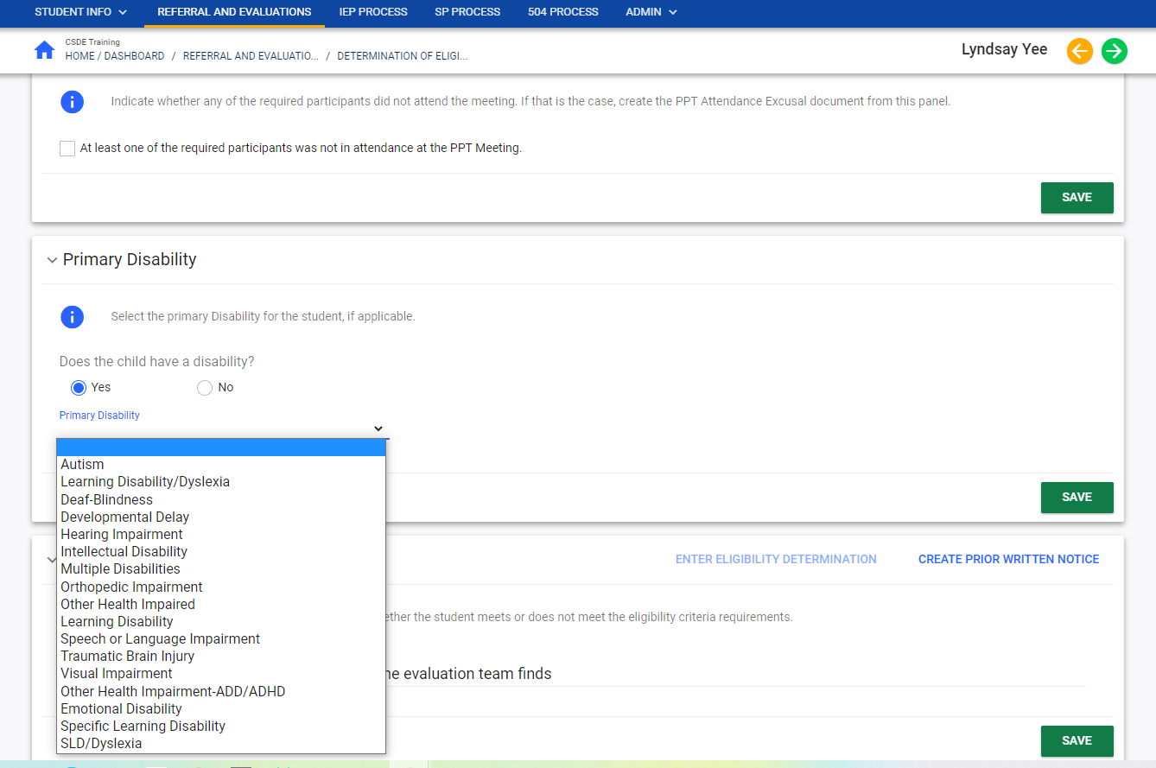
CONNECTICUT STATE DEPARTMENT OF EDUCATION
Notes:
This Primary Disability panel is very straightforward. It asks the question: does the child have a disability?
You would indicate either yes or no. if you have checked yes then you will see a drop down list of Eligibility categories and you would click on the identified disability and hit save.
The process for identification of students based on selected criteria has not changed.
For disabilities with criteria worksheets (such as Emotional Disability or Autism), you will need to access those checklist from the state site, as in the past, and upload them into the system through the View/Create document tab.

Slide 45
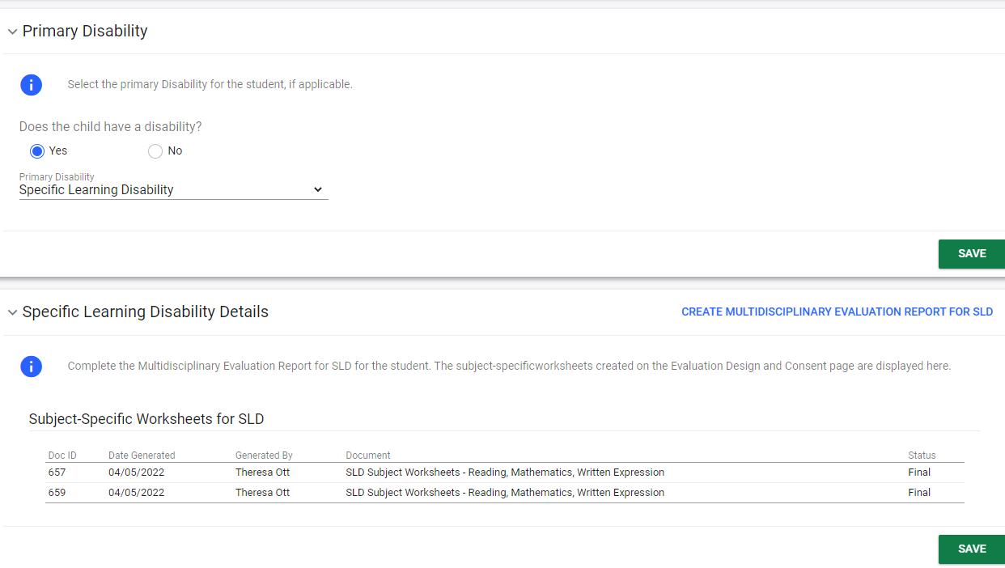
CONNECTICUT STATE DEPARTMENT OF EDUCATION
Notes:
If you click on specific learning disability or specific learning disability/dyslexia as the category of disability it will automatically generate a link to the multidisciplinary evaluation report.
At this point in the process, the report will need to be completed within the system. The team will want to consider having a copy, paper or electronic, to review during the meeting for purposes of identification. The SLD worksheets and Multidisciplinary Reports are the only eligibility criteria documents available through CT SEDS at this time.
Remember that the Reading, Writing and Math Worksheets were access as part of the Evaluation Design process and completed through the View/Create documents tab.

Slide 46
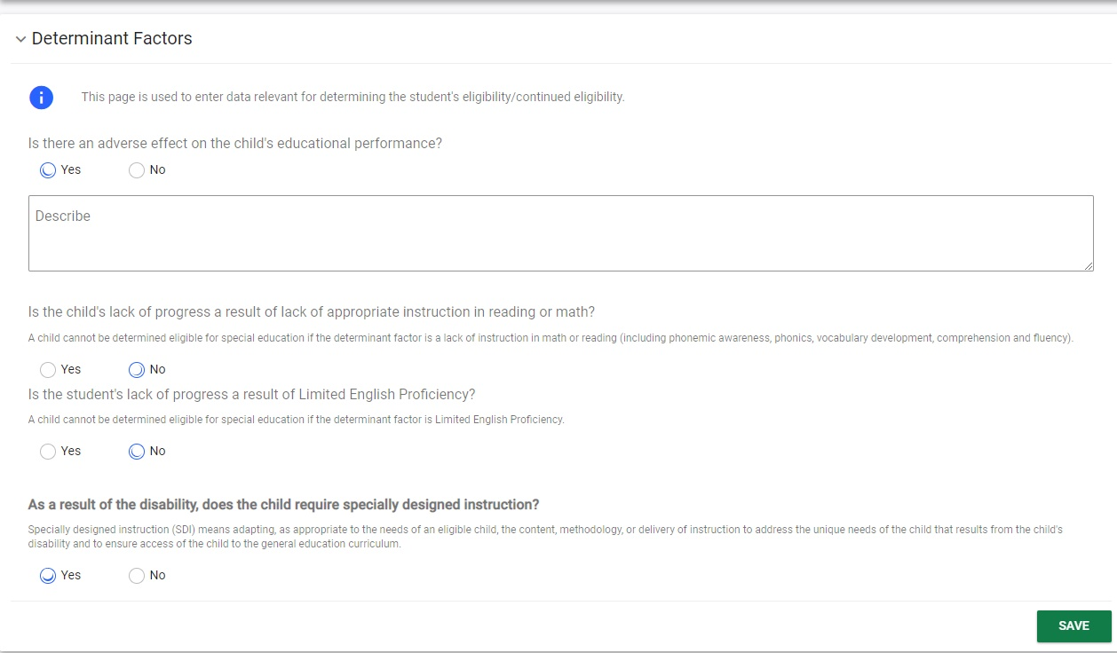
CONNECTICUT STATE DEPARTMENT OF EDUCATION
Notes:
The next panel within the page is DETERMINANT FACTORS. This is similar to our current process, with the same series of questions that are asked regarding whether the identified disability has:
An adverse effect of the child’s educational performance (describe that effect)
Is the lack of progress a result of lack of appropriate instruction in reading or math?
Is the student lack of progress a result of limited English proficiency? And finally,
As a result of the disability, does the child require specially designed instruction?
Remember to Click SAVE prior to continuing

Slide 47
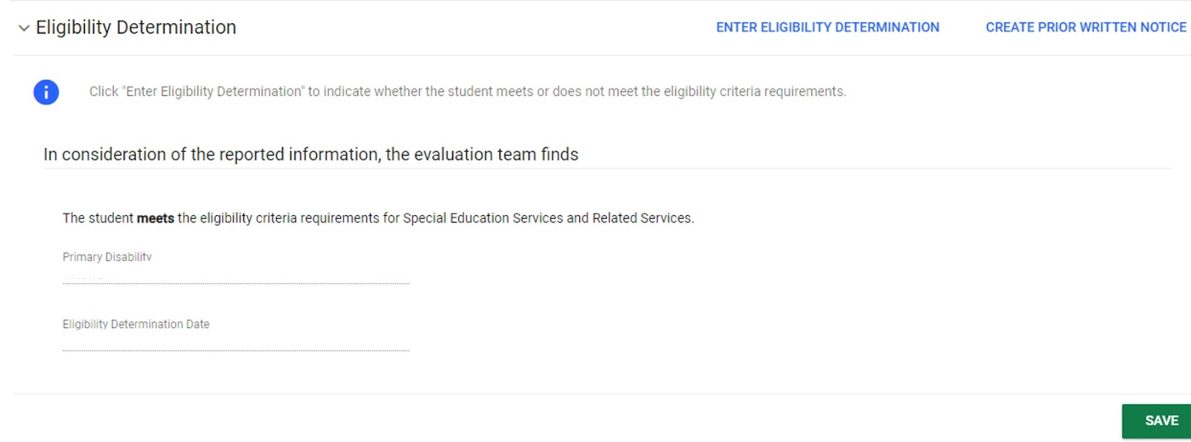
CONNECTICUT STATE DEPARTMENT OF EDUCATION
Notes:
We have indicated the primary disability, attached the appropriate documents, and responded to questions about determinant factors.
You will now need to formally finalize the ELIGIBILITY DETERMINATION within the next panel. You will first click on the link to ENTER ELIGIBILITY DETERMINATION

Slide 48
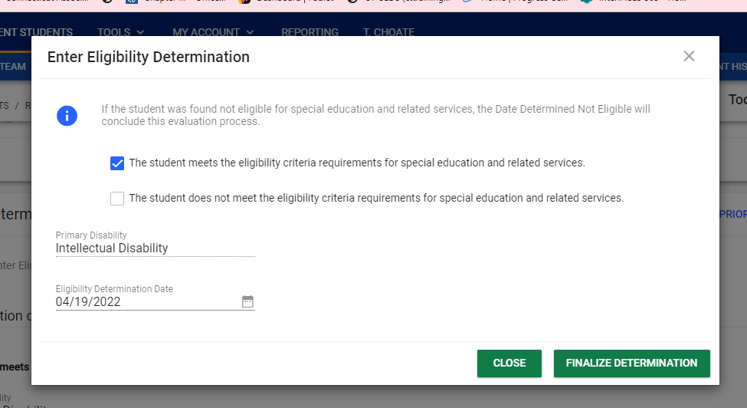
CONNECTICUT STATE DEPARTMENT OF EDUCATION
Notes:
The ELIGIBILITY DETERMINATION LINK will trigger a pop-up screen asking you to check whether the student meets eligibility criteria for special education and related services or does not.
The screen will reflect the primary disability you indicated in the PRIMARY DISABILITY determination pop-up earlier and will auto populate the eligibility determination date.
You will review this information, click finalize determination and then close.
This will create the an event in CT SEDs and in the student’s history, reflecting the date of primary eligibility determination.

Slide 49
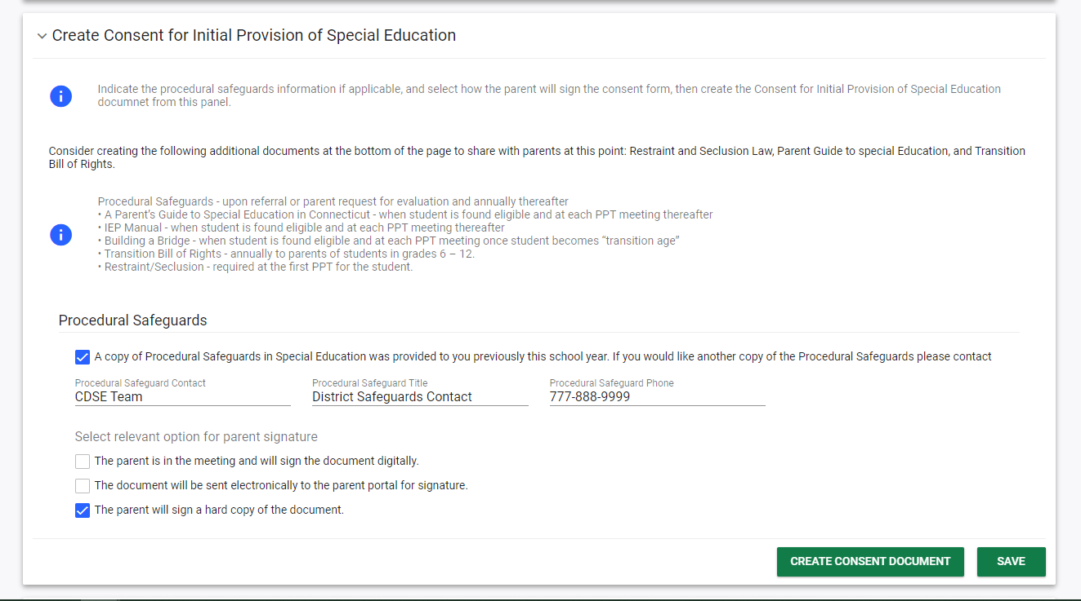
CONNECTICUT STATE DEPARTMENT OF EDUCATION
Notes:
To continue, you will need to create the consent for initial provision of special education services document and the prior written notice document
Within the Consent for Initial Provision of Special Education document, you will, again, indicate how procedural safeguards and other relevant documents will be shared with the parent, and choose the relevant option for parent signature.
As a reminder:
If the parent is getting a hard copy to sign the team will then need to return to CT-SEDS and enter the dates consent was actually received, once the signed document is returned; you will also need to upload the signed consent form using the View/Create Documents tab.
If parent is in the meeting and would like to sign the digital copy, you check the appropriate box and a Pop Up appears. Parent can use mouse or stylus to check approval and sign on device. Once saved it will automatically be in the system
If parent is being sent a copy electronically, they will need to open it up through parent portal and sign. The team will see signed copy via messages and will double check to make sure date of consent is indicated in the system.
This document will need to be saved, reviewed as a draft and finalized.

Slide 50
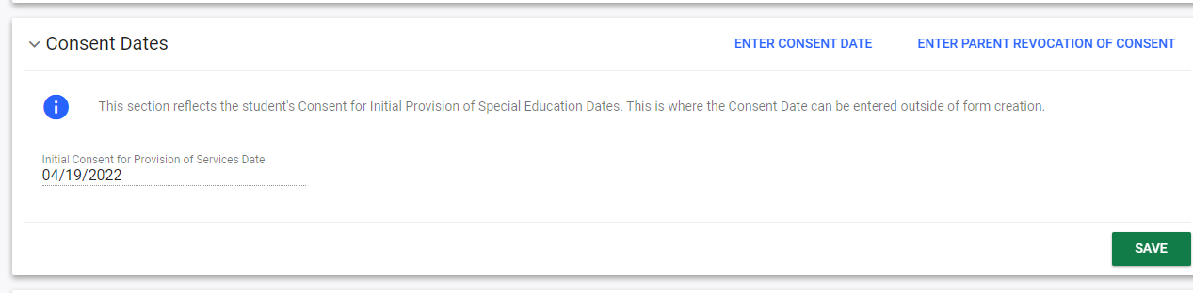
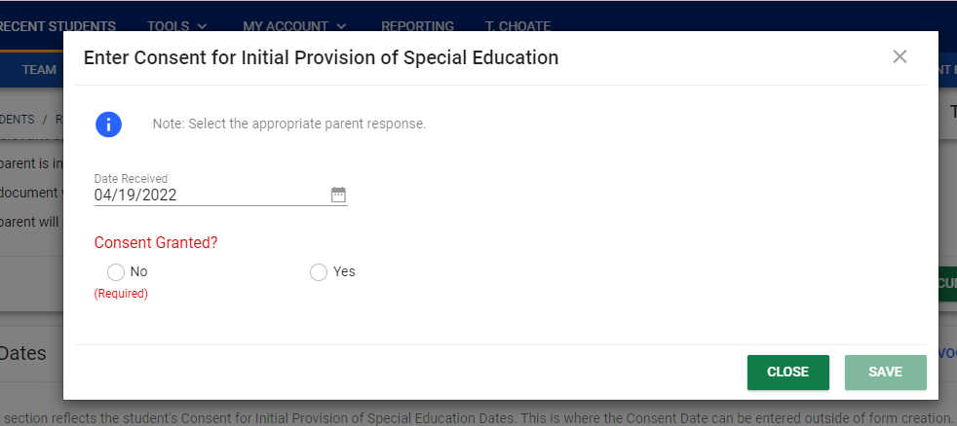
CONNECTICUT STATE DEPARTMENT OF EDUCATION
Notes:
As with other consent documents, there will be a pop-up indicating the initial consent and the date that it was signed, or an option for you to enter the consent date for a handwritten document.

Slide 51
CONNECTICUT STATE DEPARTMENT OF EDUCATION
Notes:
Click for Animation. What we would like to draw your attention to here, is that this is also where we would enter parent revocation of consent should the situation arise. The link to that panel is located in the top right corner.

Slide 52
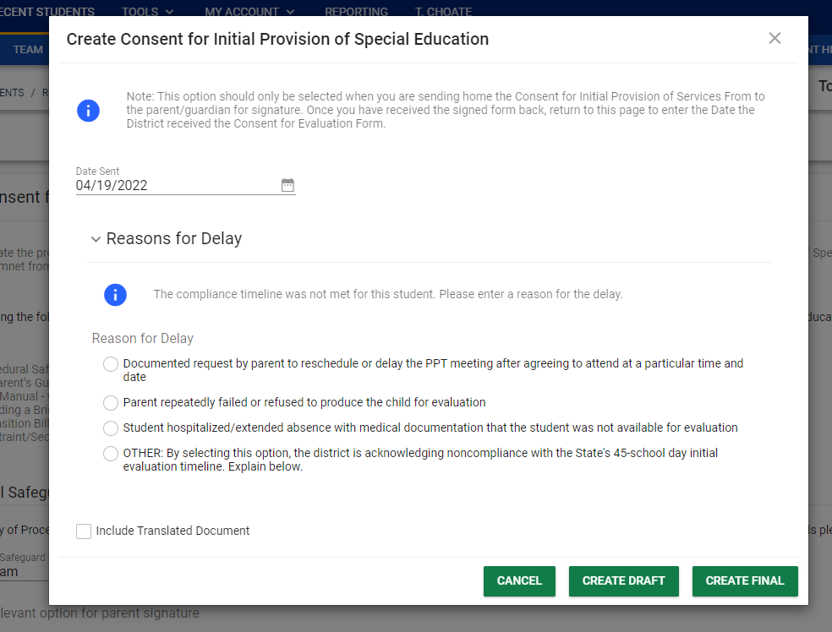
CONNECTICUT STATE DEPARTMENT OF EDUCATION
Notes:
We would also like to point out that there is a screen that will pop-up if the compliance timeline was not met for a student. You will be asked to indicate one of four options for the delay - and, after selecting the appropriate option, you’ll create the document.
As with other documents, you would need to create the draft for review, ensuring the dates and information entered is appropriate. You’ll then close the screen and go back and create the final document that will become part of the student’s record.

Slide 53
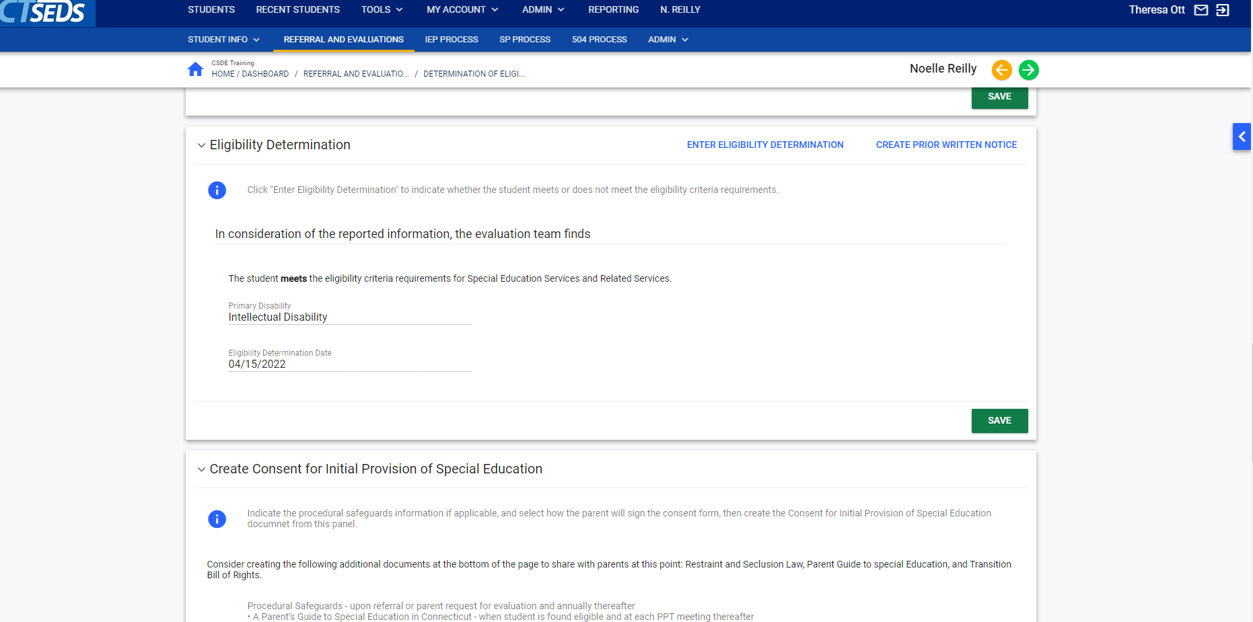
CONNECTICUT STATE DEPARTMENT OF EDUCATION
Notes:
As a reminder, once you've conducted the PPT to determine eligibility, and entered the eligibility determination into CT SEDS; you will also need to remember to go back and create the PRIOR WRITTEN NOTICE by accessing the Eligibility Determination panel
A separate prior written notice will need to be completed for the identification and eligibility, as well as the initiation of FAPE. You will need a separate Prior Written Notice document for each action. We are unable to put multiple actions on one form.
Once your documents are finalized, you can use the green arrow to get to your next step.

Slide 54
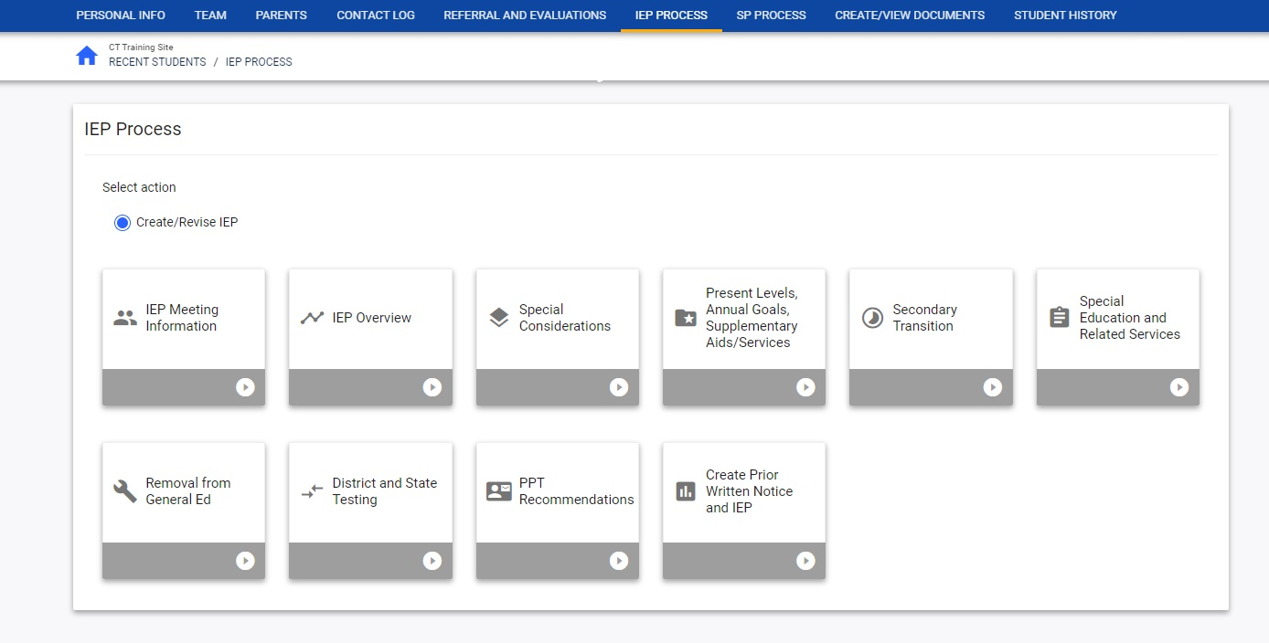
CONNECTICUT STATE DEPARTMENT OF EDUCATION
Notes:
Now that the student is eligible, you are ready to address the IEP process and the development of the IEP.
The tiles for this process are similar, in that they progress from left to right and there are pages and panels that must be completed within each tile.
The IEP process tends to be ore sequential than Referral and Evaluation.
These tiles are similar to what was discussed during the IEP quality training sessions and the screenshots and examples that were shown during that training are similar if not the same as what you encounter within the system.
Please know that your teams will be able to work on the draft version of the IEP prior to finalizing all of the eligibility determination information. More than user is able to access the IEP within the student system
We do not recommend having more than one team member working on the same page of the document, as the information they input may overwrite the other user.
If you do find a need to have more than one person working on the same page for a student, it is recommended that you work together to identify times that each user will be accessing that particular page in order to avoid overlap.
We hope this presentation was helpful. Please know that there are additional resources and supports available to assist you and your teams with navigation of the system in real time. Those will be shared at the end of today’s session.
We want to thank our colleagues at PCG for collaborating with us and allowing us to present this module for you. We appreciate your participation and engagement and will now turn the session back over to PCG.
A note for trainers: it will be very rare instances where two team members would be working on the same page as the present levels are addressed per area of concern (you should not have an SLP and an OT in the same Present Levels page at the same time, because theoretically, they would not ever be in the same page based on area of concern. Not to say it never happens, but it should not be a common occurrence.

