Slide 1
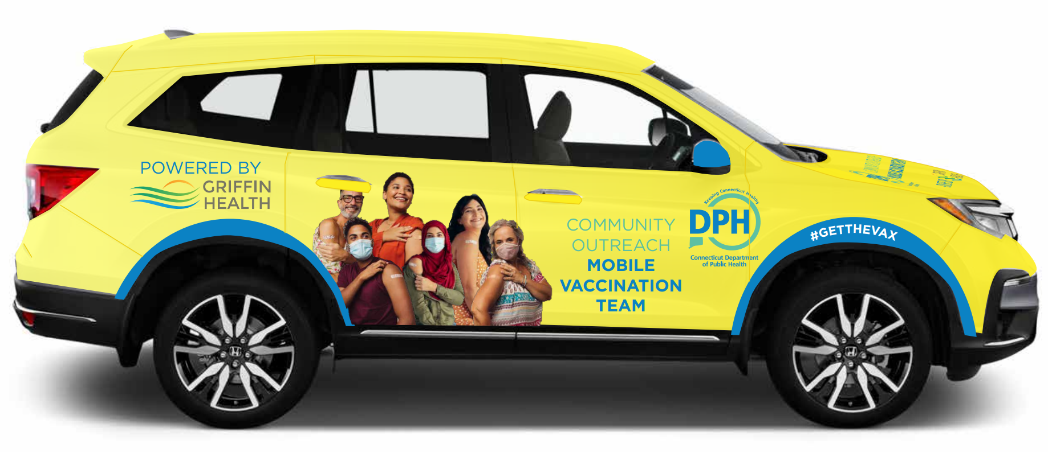

DPH Vans Advertising Playbook for Local Health & Host Sites
COVID-19 Vaccine Roll-out

Slide 2

DRAFT: Subject to change – purely informational purposes
Advertising Checklist:
Resident Outreach
Distribute flyers within 4-5 block radius of pop-up site (with Fire Department or other volunteers), leveraging the templates available in the DPH Vans Marketing Toolkit
Canvass flyers on community bulletins
Request superintendent email parents / students
Request other departments share on their email distribution / social media accounts
Parks & Recreation
Public Works & Water
Chamber of Commerce
Neighborhood Watch associations
Small businesses
Library
Generate robo-calls to residents
Set-up COVIDCT Everbridge notification (how-to details)
Reach out to local NAACP chapter (or other similar organizations)
Loop in Emergency Services managers / staff (where relevant)
Press / Social Media Communications
Submit to local newspapers (using press release template if helpful)
Share / distribute across any other influencer social media platforms
Faith-based network
School district
Library
Parent groups

Slide 3
DRAFT: Subject to change – purely informational purposes
Advertising Checklist:
Incentive partners
Reach out to local businesses who may be willing to provide an incentive to individuals who receive vaccinations at the clinic
Businesses interested in participating should fill out this form
The clinic and the businesses will be advertised on the DPH #CTSummerOnUs campaign website, as well as potentially in the Governor’s briefings and social media posts
On-site
Ensure there are no “building closed” signs on doorways or website
Set-up additional on-site signage (including flyers on doorways, on-site arrows to direct people inside building if needed)
Note: Griffin will provide 1 sandwich board for display close to roadside

Slide 4
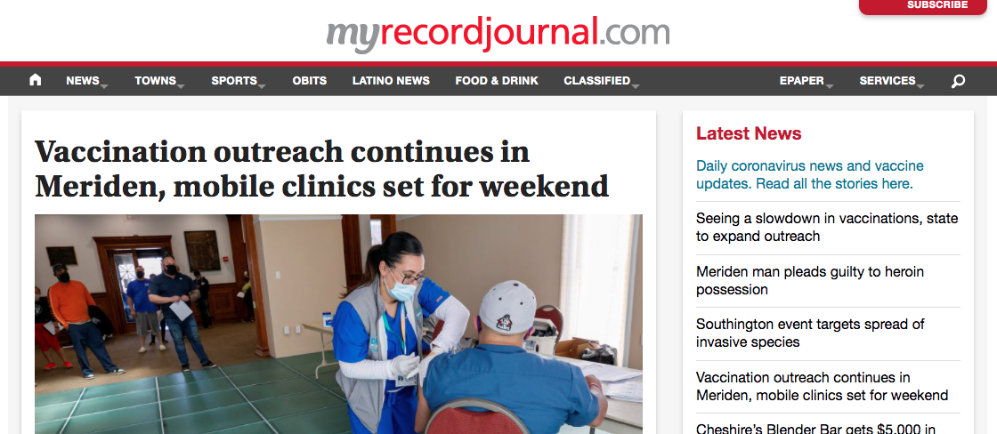
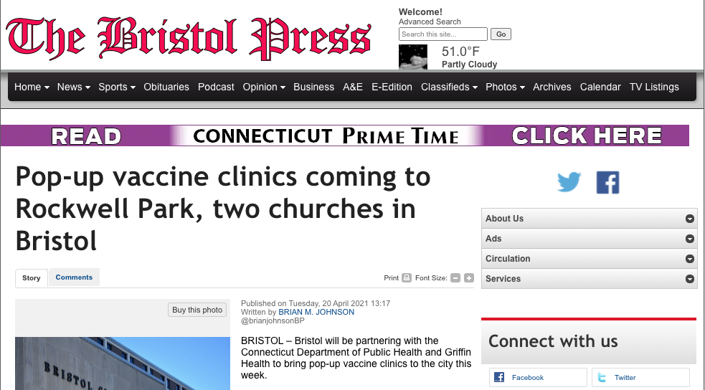
DRAFT: Subject to change – purely informational purposes
Advertising Checklist:
Example Local Press Release
Meriden Record Journal, ”Vaccination outreach continues in Merien, mobile clinics set for weekend”
Bristol Press, “Pop-up vaccine clinics coming to Rockwell Park, two churches in Bristol”

Slide 5
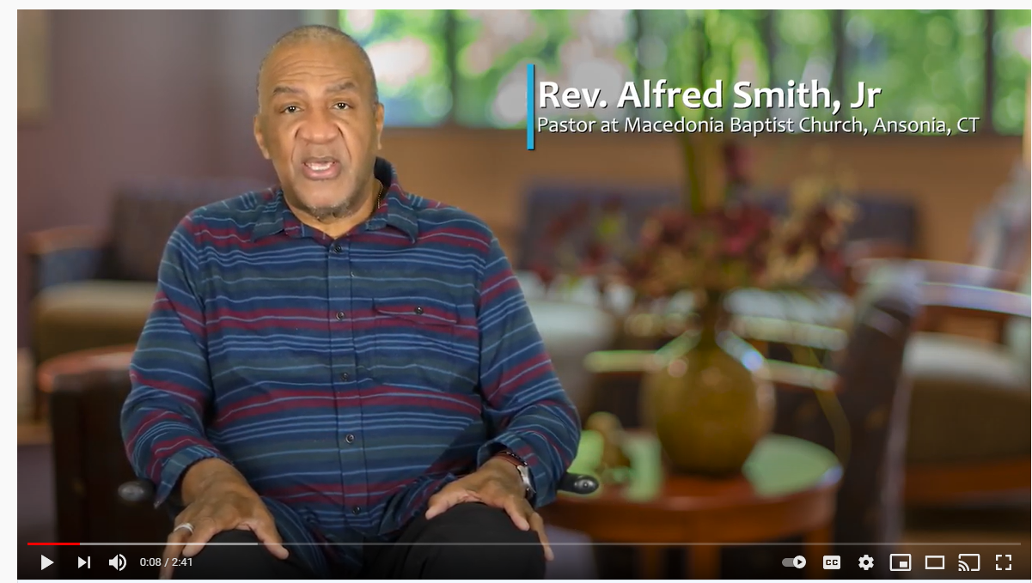
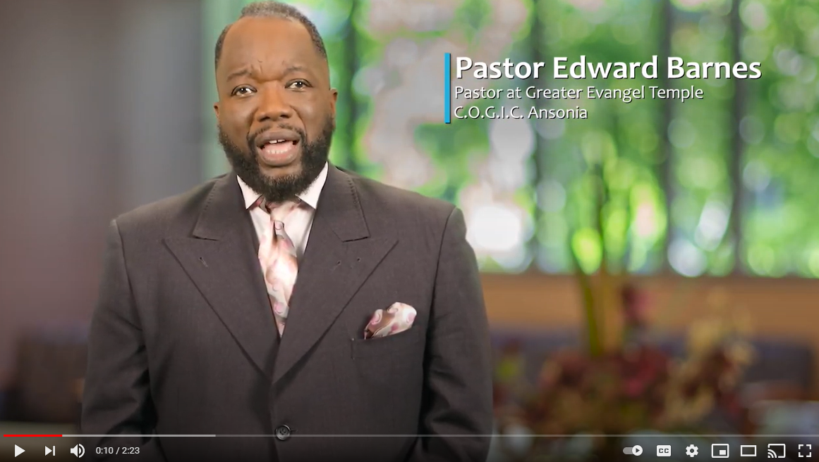
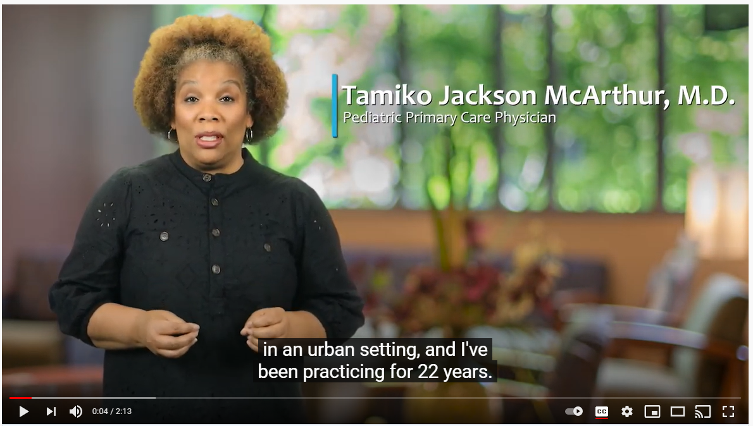
DRAFT: Subject to change – purely informational purposes
Advertising Checklist:
Example PSAs
Intended Audience - Black Community
Dr. McArthur: https://youtu.be/tVNsHBXsnuw
Rev. Smith: https://youtu.be/RnzGzJw1vdA
Pastor Barnes: https://youtu.be/qMD0guXCfMw

