Slide 1
Office of Health Strategy
AHEAD Model
March 26, 2024

Slide 2
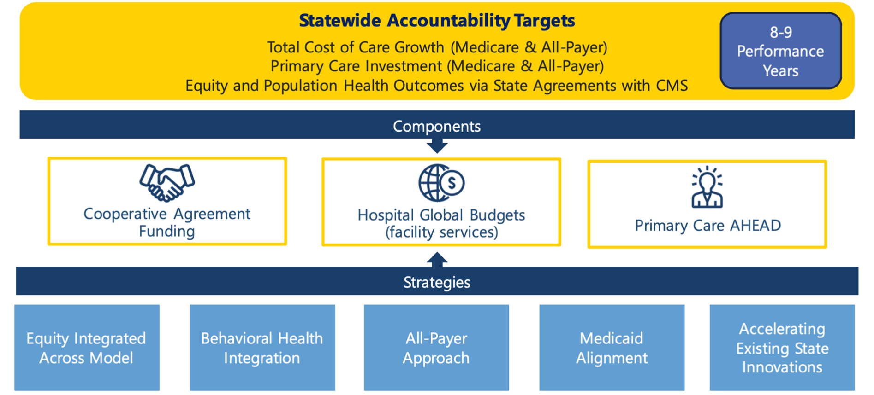
AHEAD Model At-A-Glance
Flexible Framework designed to improve health outcomes
AHEAD At-A-Glance

Slide 3
AHEAD Model Elements

Slide 4
AHEAD Benefits
States will benefit from a variety of tools as part of AHEAD

Slide 5
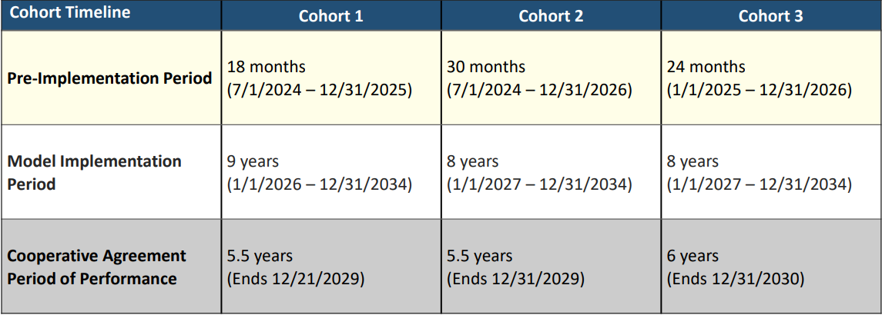
AHEAD Timeline
Connecticut application – Cohort 2
Notice of Award – May 2024
Timeline

Slide 6
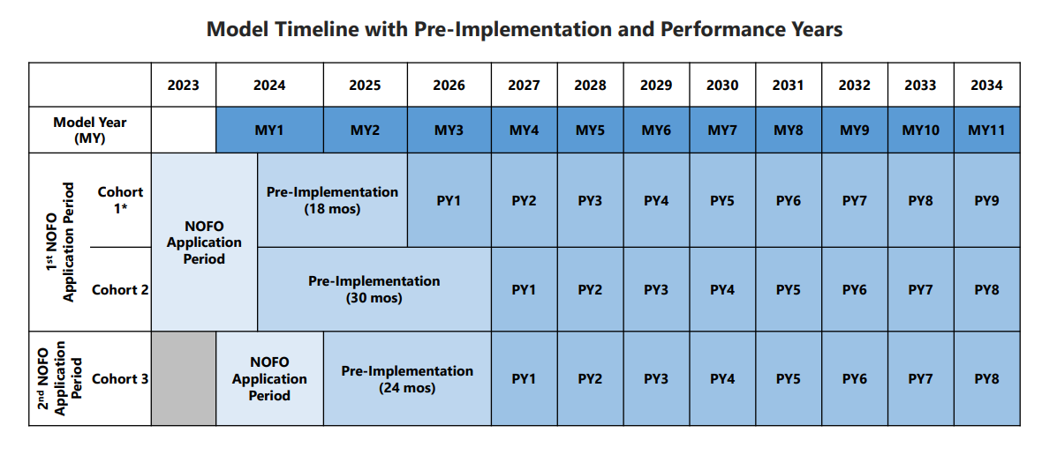
AHEAD Model Timeline
Model Timeline

Slide 7
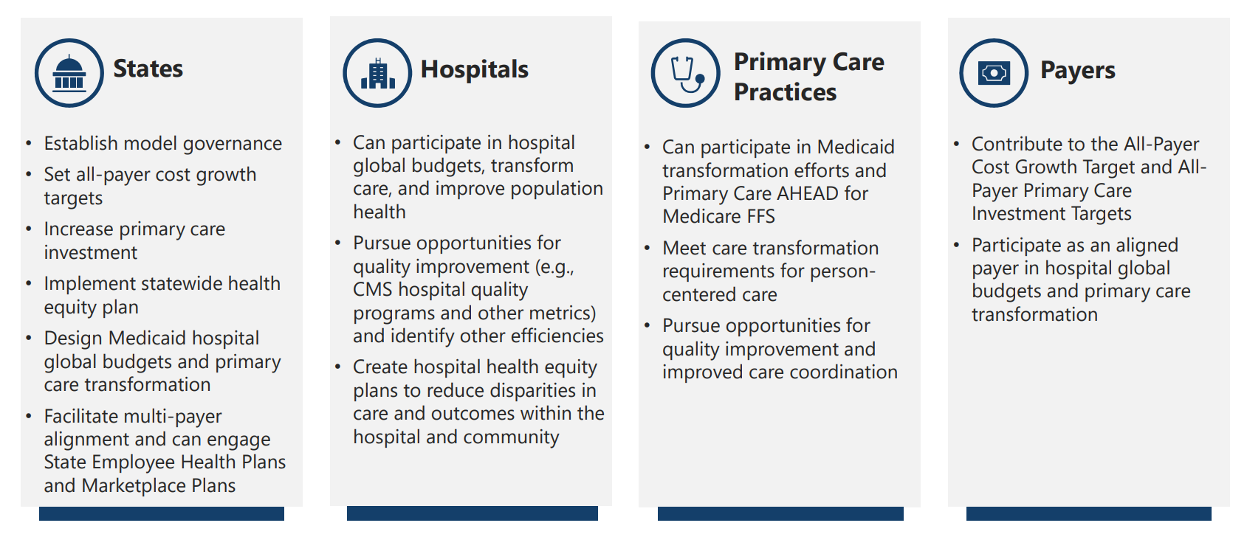
AHEAD Stakeholders
Roles of Stakeholders

Slide 8
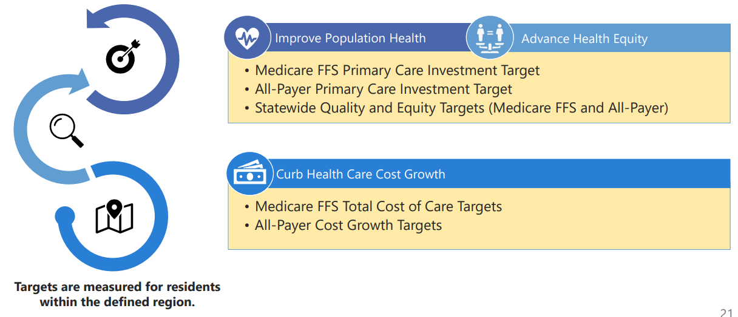
AHEAD Statewide Targets At-A-Glance
Targets are part of the State Agreement with CMS
Targets At-A-Glance

Slide 9
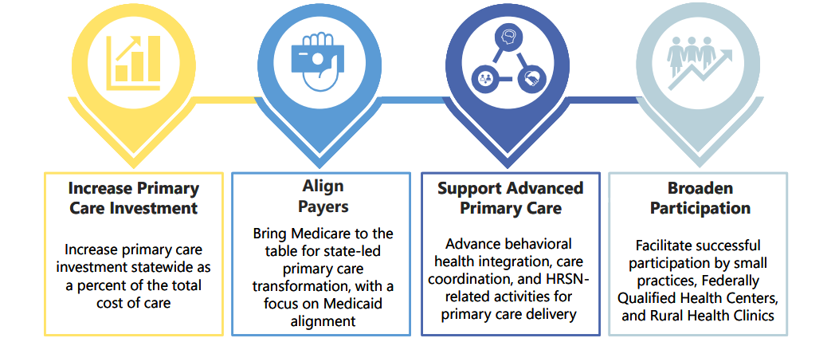
AHEAD Primary Care
Primary Care Goals
Primary Care Goals

Slide 10
AHEAD Global Budgets
Hospital Global Budgets Incentives
Hospital Global Budget

Slide 12
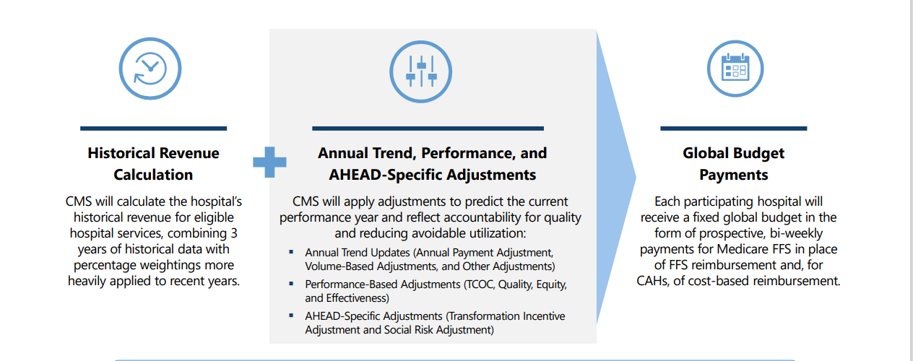
AHEAD Medicare FFS Global Budget Methodology
Medicare FFS Global Budget

Slide 13
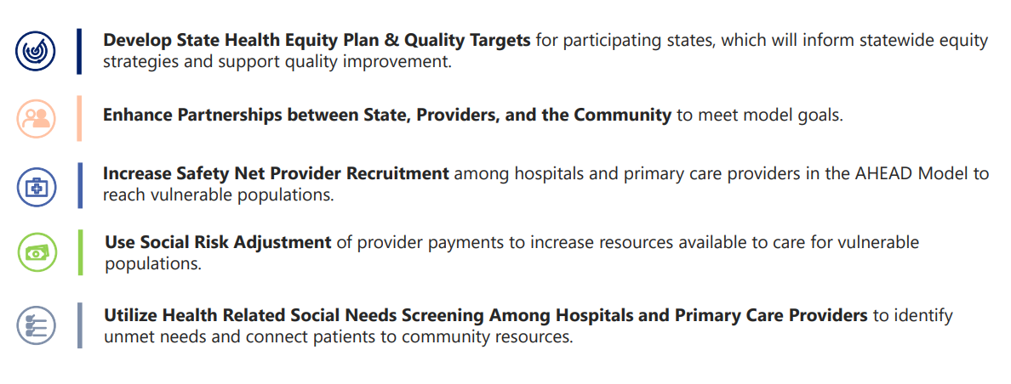
AHEAD Health Equity
Strategy to advance health equity
Health Equity Strategy

Slide 14
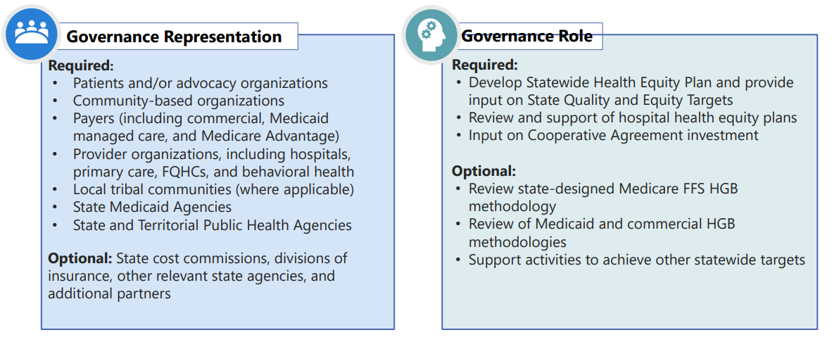
AHEAD Model Governance Structure
AHEAD states will establish multi-sector model governance structure
Model Governance Structure

Slide 15
Questions?

