Slide 1
TODAY’S TOPIC Explanation of Benefits (EOB) brought to you by Ted Doolittle State Healthcare Advocate presented by Jill Hall OHA Nurse Consultant

Slide 2
Important Health Plan Documents Series

Slide 3
August 23, 2022 @noon

Slide 5
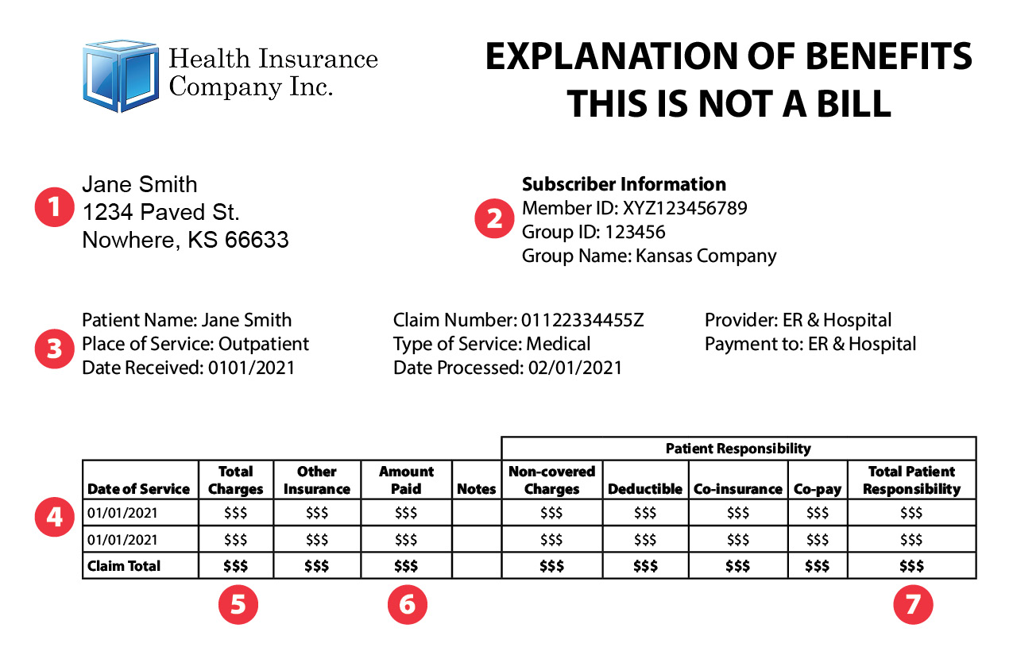

Slide 7
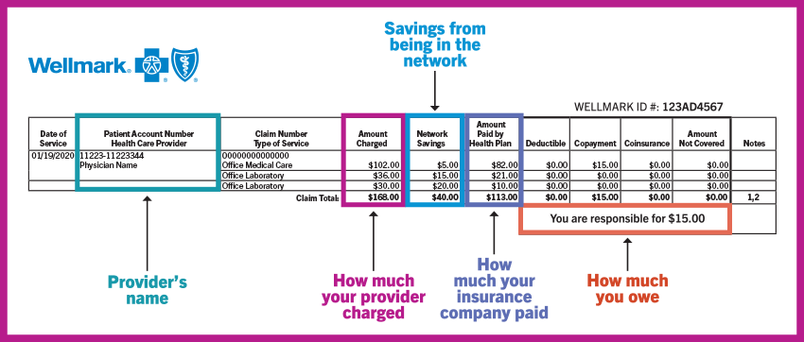

Slide 8
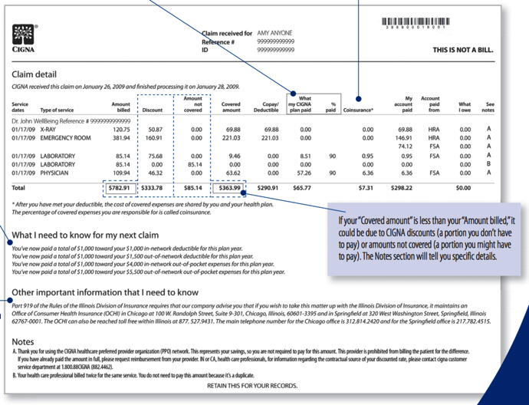

Slide 9
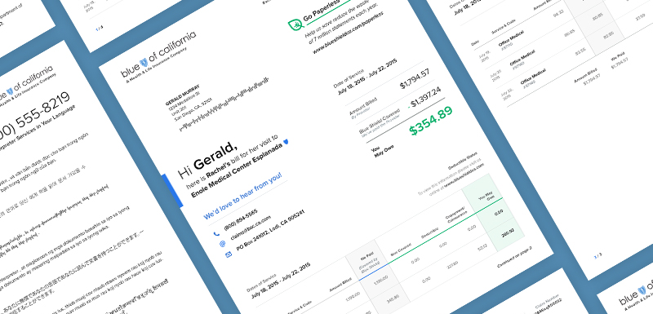
How to Read EOBs?

Slide 10
EOB Terminology
Billed Amount
Maximum Allowed Amount (MAA)
Deductible, Copays and Coinsurance (paid out-of-pocket)
Discount Amount (the difference between the billed and allowed amounts)
Patient Liability (total out-of-pocket costs)
Not Covered Services
Remarks/Notes & Claim Processing Codes

Slide 11
Maximum Allowed Amount (MAA)
The maximum amount that would ever be paid on an insurance claim for each treatment, procedure, service, equipment and supply listed on the claim.
Approved Amount
Contracted Amount
Negotiated Amount
Total Amount Eligible for Benefits

Slide 12
Charges or Billed Amount
The cost of the services as reported on the submitted insurance claim.
Charged Amounts is usually higher than the Maximum Allowed Amount.

Slide 13
About In-Network Cost Savings
There may be more out-of-pocket costs when using out-of-network benefits.
In-network Providers accept the Maximum Allowed Amount as payment in full.
Out-of-network Providers can charge you the difference between the Billed Charges and the Allowed Amount.

Slide 14
Discounts (as seen on EOBs)
The difference between the Charges or Billed Amount and the MAA might be referred to as:
Network Discount
Member Savings
Fee Adjustment

Slide 16
Notes:
.

Slide 17
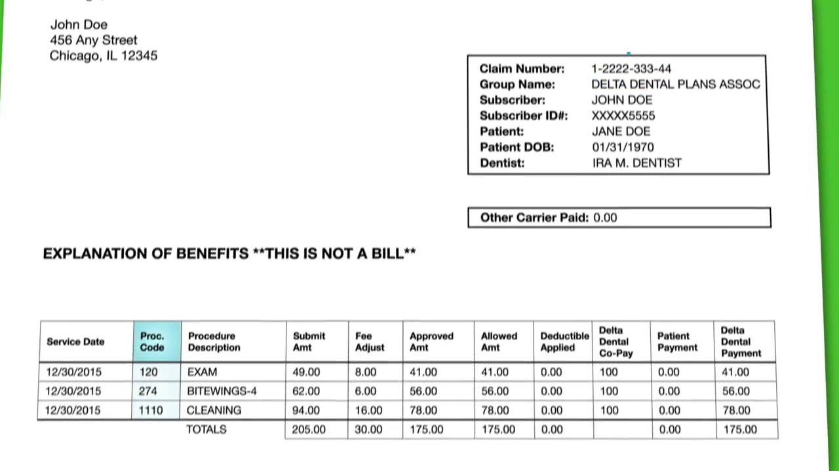
X
X
X
X
X
x

Slide 21
Remarks/Comments/Non-payment Codes on EOBs
Administrative issues:
Coverage not in effect at the time the service was provided.
Denied for duplicate claim or service.
Benefit maximum reached.
Pre-certification was required.
Time limit for filing has expired.
Coding problems:
Procedure code inconsistencies
Diagnosis code inconsistencies
Medical judgement decision:
Not enough clinical information received to approve coverage.
Denied because procedure or treatment has not determined medically necessary.

Slide 22
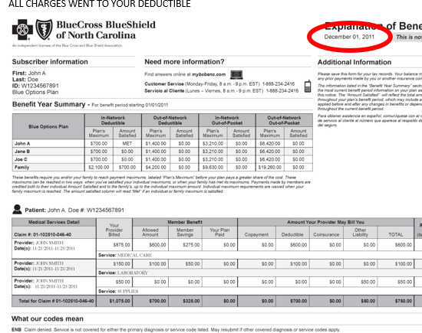
The date of the EOB is extremely important!

Slide 23
There are strict time limits to dispute your EOB and/or appeal non-coverage decision. These time frames are found in your Health Plan Benefits Book.

Slide 25
What Happened When Something Goes Wrong?

Slide 26
Don’t Worry Alone!

Slide 27
Thank you for joining us today. Any Questions? Email: Healthcare.Advocate@ct.gov Phone: 866-466-4446 Web: www.ct.gov/oha

Slide 28
EXAMPLE Schedule of Benefits

