Slide 1
Strengthening Communities, Making A Difference
How Community Action Spurs
Economic Opportunity for Women
Throughout the Lifespan
David Morgan – President & CEO
Emily Pena – Family Child Care Partnership Manager
Lillian McKenzie – Development & Communications Manager
Jillian Ruisi – Director of Community Services
TEAM Inc – www.teaminc.org

Slide 2

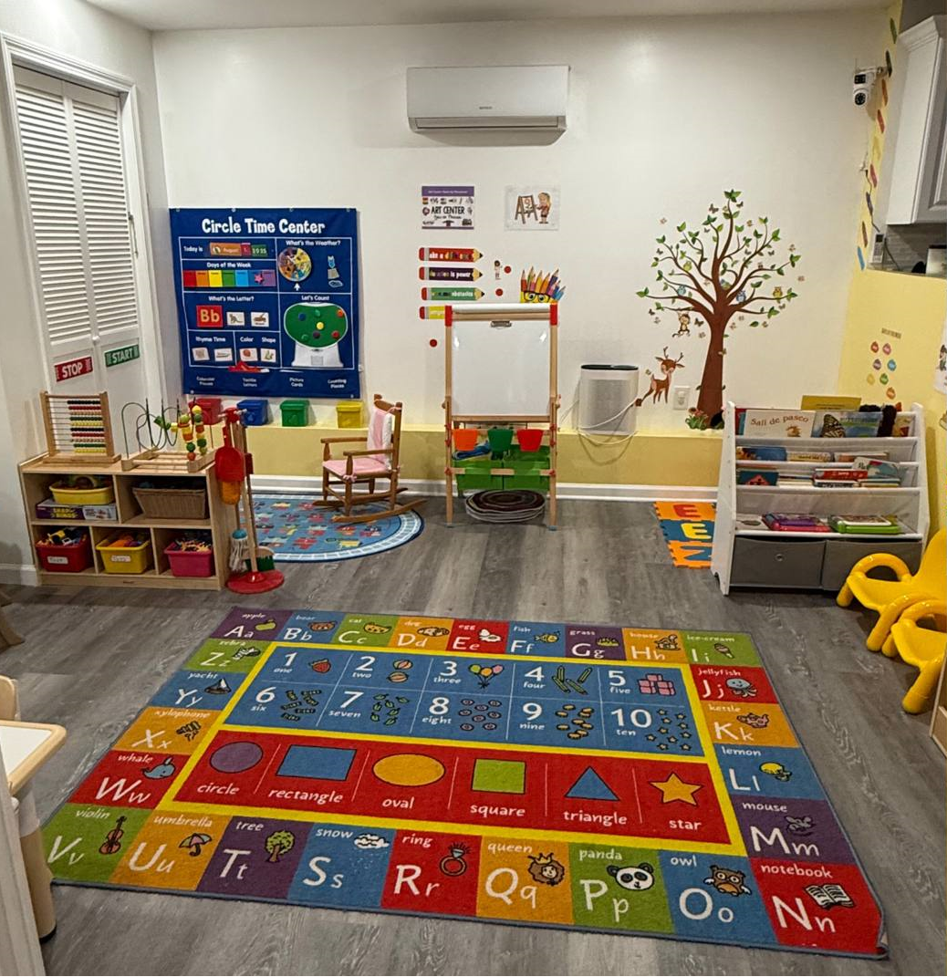
Family Childcare Homes
Program Overview and Regional Impact
Early Head Start Child Care Partnership | 19 contracted partners in Waterbury CT delivering high-quality Head Start services. Each provider has access to coaching, early developmental screenings, and access to tools, training, and resources that enhance care quality
Extensive Regional Network | Our network includes 400 licensed homes, 99.5% women-owned, providing thousands of infant, toddler, and school-age care slots region-wide.
Supporting Providers’ Growth | We empower providers as entrepreneurs by offering tools, training, and resources to grow sustainable home-based businesses.
Community and Economic Impact | Investing in providers fosters economic mobility, community resilience, and expands early childhood education access.

Slide 3




GAINful Employment
Housing Wage in CT is $35.42 or 87 hrs/wk @ minimum wage
Addressing increased cost-of-living AND access to good-paying jobs/career paths
Responsibility of childcare often falls to mothers, and is a primary barrier to economic mobility for women.
Gaining Access to Independence Now (GAIN) | Addresses any and all barriers to qualifying for higher wage opportunities: tuition, materials/uniform, transportation, childcare, etc.
Healthcare
Commercial Transportation (CDL)
Security
Emergency Management & First Responders
Billing & Accounting
Dental Hygienist & More

Slide 4
Strengthening Economic Supports for Older Adult Women
As a Community Action Agency, TEAM plays a critical role in supporting the economic security and well-being of older adult women. Through essential services, TEAM ensures access to care, nutrition, independence, and resources that reduce financial strain and enhance quality of life.

Slide 5
Strengthening Communities, Making A Difference
Thank You!
David Morgan – President & CEO
Emily Pena – Family Child Care Partnership Manager
Lillian McKenzie – Development & Communications Manager
Jillian Ruisi – Director of Community Services
TEAM Inc – www.teaminc.org

