Slide 1
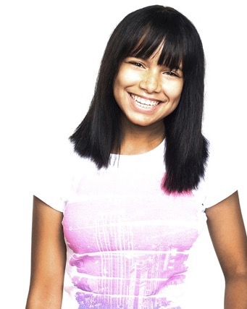
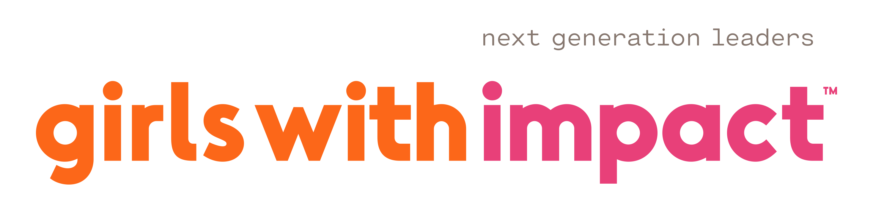
NextGen CT: 10,000
Equipping 10,000 NextGen Women in Business in Connecticut

Slide 2
Why now?
Despite huge potential, young women are an untapped talent pipeline
Compared to white women, just
50%
of black women get a college degree
Only
2%
of the $150B in venture capital is awarded to female founders
Girls face a
30%
confidence drop, impacting their career & earnings trajectory
Driving Entrepreneurship – the skills for the modern-day workforce
# STEEM
Notes:
This was all timely even before Covid – with the lack of women at the top and in entrepreneurship
Covid bright to light the need to provide powerful education from home – but also the digital inequities that many companies now want to help address
In fact, we’ve been filling a huge gap amid Covid, serving 2500 girls in the last 3 months alone
#BLM also highlighted the need to really take action on diversity – something we’ve been committed to since day one with 60% of girls of color
We focus on Entrepreneurship as a key building block to STEM because a) these are the skills of the future and b) we think these leadership skills are essential to being leaders and not just doers
In face, Neha – quoted here – combined her STEM with GWI and made the NYT

Slide 3
Proving the Power of Next Gen Women
Once in business, younger women win…underscoring the need to train earlier
Participation
Ranked Teams
1st Place teams
78%
68%
Male
CEOs
51%
Woman
Founder
49%
Male only
Founder
32%
Woman
CEOs
22%
Five years of data – 1,000 participants – in college venture competitions at Uconn
Notes:
This generation more capable than we ever thought.
We’ve all heard the stats that women contribute to the bottomline in corporate America… but let’s go a generation down, into college.
We wondered: How do they fare in college business competitions?
Here’s what we found
First, that women were just 22% of participants in thse venture competitions – not really a surprise right?
-- When we look at the ranking teams -- first, second and third place winning teams – it’s a diff storty– 51% had a woman founder vs 49% of teams that had male founders
And among the CEOs of first-placed teams, 32% had a woman CEO.
Wow, if we knew that, wouldn’t we invest in training them earlier?

Slide 4
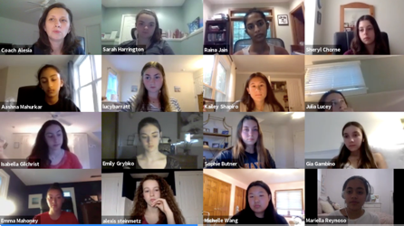
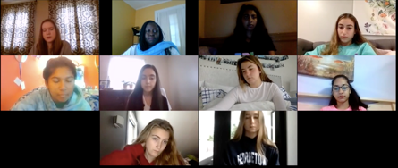
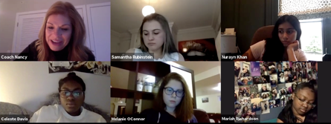
Our Goal….
Equip 1 million NextGen women as tomorrow’s
c-suite leaders, innovators and entrepreneurs

Slide 5
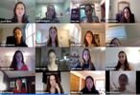

Our solution: Innovative live, online business education
Digital platform to equip girls as tomorrow’s leaders, drive diversity and equality
1. Online Business & Leadership Academy
2. The Boardroom
Girls With Impact is:
The nation’s only live, online mini-MBA
Delivered live, online, by instructors
Equipping girls (ages 14 – 24) to:
  Launch ventures addressing market needs
  Build transferrable work readiness skills
  Impact their college, career success
  Drive confidence, tech, financial, social skills
  Become tomorrow’s CEOs
Post-Graduation
Features:
1. Mentor matching
2. Spotlight series
3. Monthly peer forum
4. Internship placement
10 weeks (1 hour/week live class)
Learn core business skills
Turn passion into an Impact
Create a business
Get certificate

Slide 6
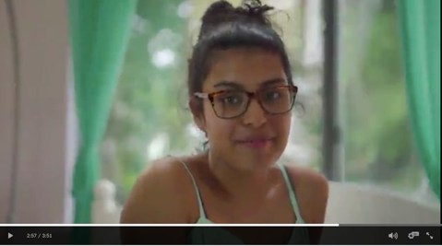
Who we’re impacting to date
“Talent is created equally, opportunity is not”
Geography: United States
Primary focus: Low-to-moderate income ages 14-24
8,000+ girls served to date
75% underwritten – thanks
to our corporate partners
“I am powerful” video – click to play
“” Quote from Thasunda Duckett

Slide 7
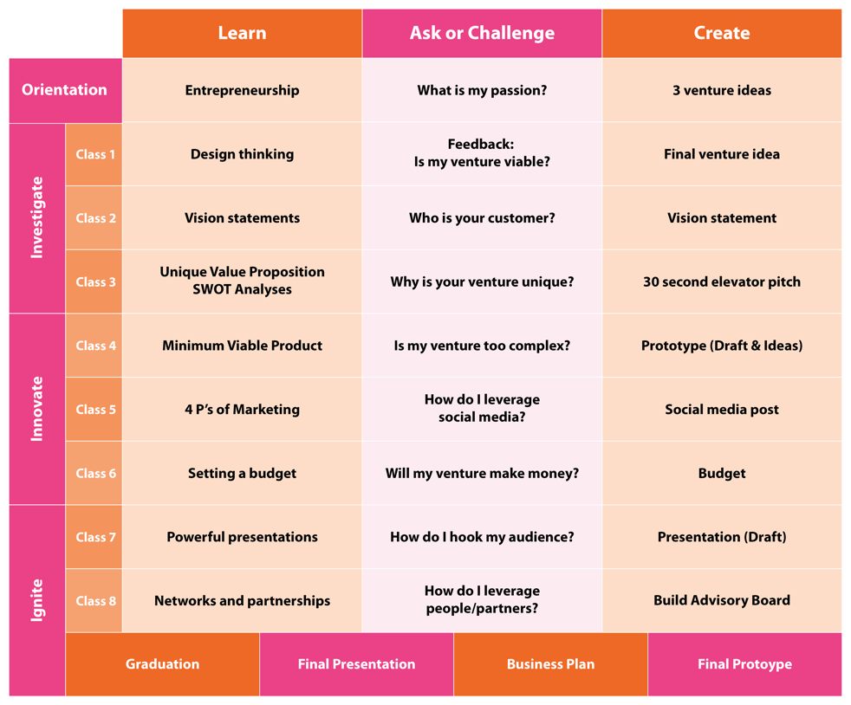
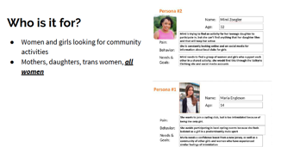
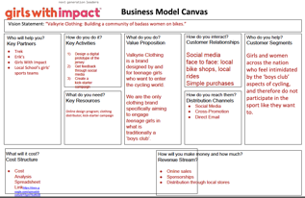
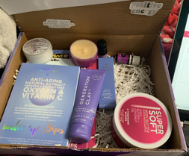
What they’re learning
Over 10 weeks, girls move from ideation to business plan, prototype, venture pitch
3 deliverables to graduate the program
1. Pitch
presentation
2. Business
Model
Canvas
3. Visual prototype

Slide 8
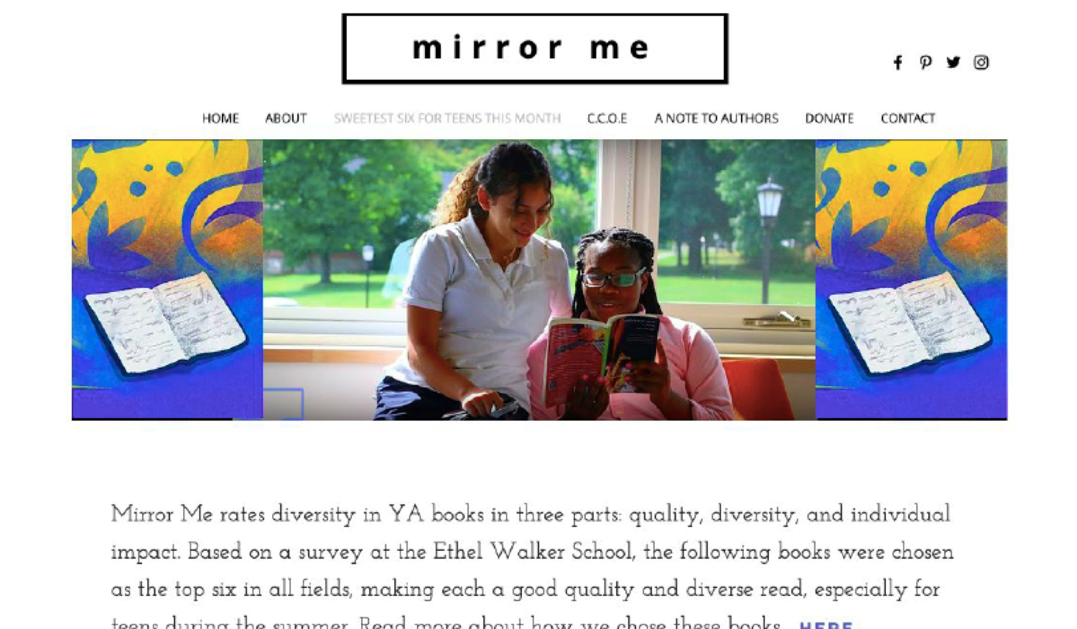
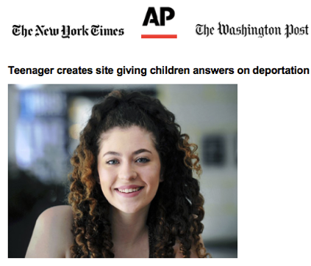
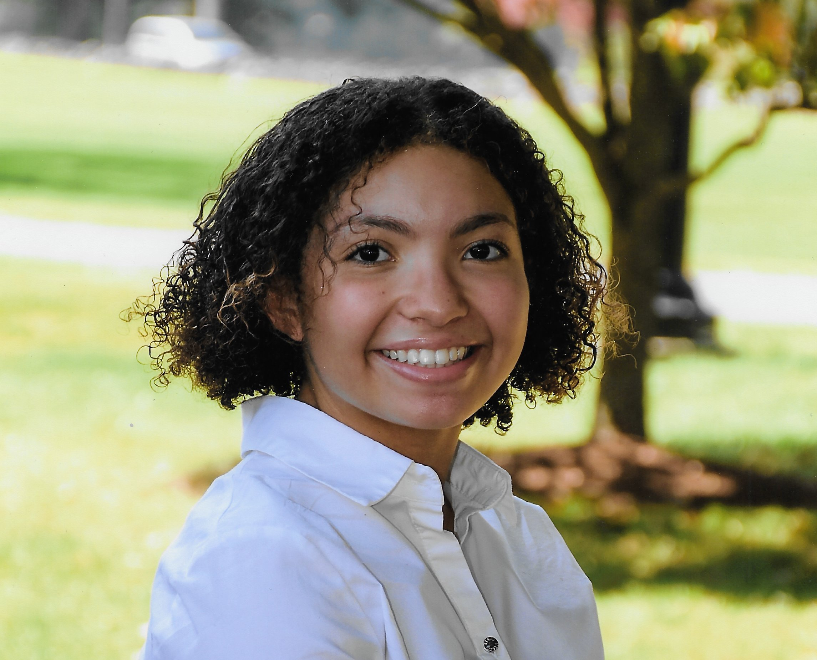
How they’re impacted: From tangible ventures to….
Giving them a leg-up for college and career
Kristen St. Louis, 17
CEO, MirrorMe Diversity
“It enabled me to bring my idea to reality.”
Jody Bell, CEO, In Case of Deportation
$20,000 scholarship, honors seat in business
“I don’t know how to explain it.. I feel powerful.”
Neha Shukla, 15
CEO, Six Feet Apart (wearable sensor, NYT)
“I learned real business skills.”
Notes:
The beauty is that girls not only graduate with a business plan and venture pitch in hand, but we’ve also armed with with confidence and a host of skills
Our pre-and post assessment collects about 30 pieces of data; this is only a smattering but you can see
85% feel more confident they can become a leader
79% feel increased tech skills
93% more college ready
91% more confident speaking
75% better able to manage cash
Girls are also getting full ride scholarships up to $200K – $110K is the average of scholarships reported

Slide 9
To powerful improvements in confidence, leadership, tech
Represents only one-third of data
Layout?
Hard Skills
Math, excel, marketing, tech
Soft Skills
Speaking, organization,
Project mgmt
College
Ready
Business Leader &
Confidence
Economic
Security
Pre- and post assessment reveals:
85%: Increased leadership confidence
91%: Improved public speaking
74%: Increased tech skills
50%: More able to collaborate via tech
65%: More confident pitching investors
75%: More equipped to manage cash
60%: More likely to save money
$110k: Average college scholarships
Reported as directly attributable to program
93%: Increased their college readiness
53%: More likely to major in business or entrepreneurship

Slide 10

Goals and Outcomes
Our 3 Big Goals
Our Outcomes
LEADERSHIP: 85% are more leader confident
TECH SKILLS: 79% feel improvement
SALES: 63% more confident cold-calling
PROJECT MANAGEMENT: 60% more able to create a project plan
COLLABORATION: 50% better at collaborating with others online
DIFFERENTIATE: 65% are better able to pitch investors
1
Job Ready
College ready
COLLEGE/CAREER READINESS: 93% feel more college ready
ADMISSIONS: 63% able to distinguish themselves for admissions
COLLEGE MAJORS: 50%+ major in business/entrepreneurship
2
SAVING MONEY: 60% more likely to save
SETTING GOALS: 63% perform better at goal setting
LEANING IN: 63% more confident raising hand to answer a question
REJECTION: 58% more comfortable being turned down
DELEGATING: 63% more confident asking others to do something
3
Life ready

Slide 11

Sept 17th:
1
What should a post-Recovery plan look like?
What types of training is needed to create paths?
Notes:
Now you can see why we want to create 10K isabells, keillie and melissas… to follow in the footsteps of Jeff, Ian and Schepp…
Laura, Susan… Jen
Please join us...
If your org is looking to build a talent pipeline, or making community or HR investments, join us. H&S example, Becton DIcksonson
Personal philanthropy – Something unique… Philanthropists right here who’ve given $15-20M to entprenreurship… unqiue focus on NextGen women
You can help through your connections – you may know of someone
Each of us in this room can participate in one of these 3 ways…
Finally, remember that there’s triple whammy when you invest in the next generation -- from your brand, community impact and talent pipeline to driving your business forward.
We hope you’ll join us for the journey. Thank you and have a great rest of your day

Slide 12
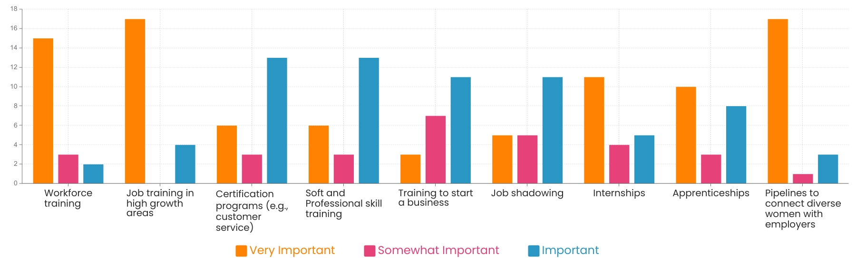
Younger women: How do we help women 18-24 in job placement?
Question: The goal with young women - ages 18-24 - is to help them get placed into their first jobs. On a scale from 1 – 5, please rate the importance of the following in achieving that end (job placement)?
82%
85%
60%
57%
Notes:
Now moving next to Young Women – how do we help them?
The 3 takeaways from this data are:
importance of training and creating a pieline to connect diverse women with employers –
Interesting that internships and job shadow lower in terms of importance – speaks to shift in getting people job ready – less luxury of doing job shadow
Also low on the ist is busiess start-up… now, I can tell you many of them wabt to start a bisuness… in fact, the majority of GEnZ wants to
Q: Would you agree ? Is there anyting missing on this for young women?

Slide 13
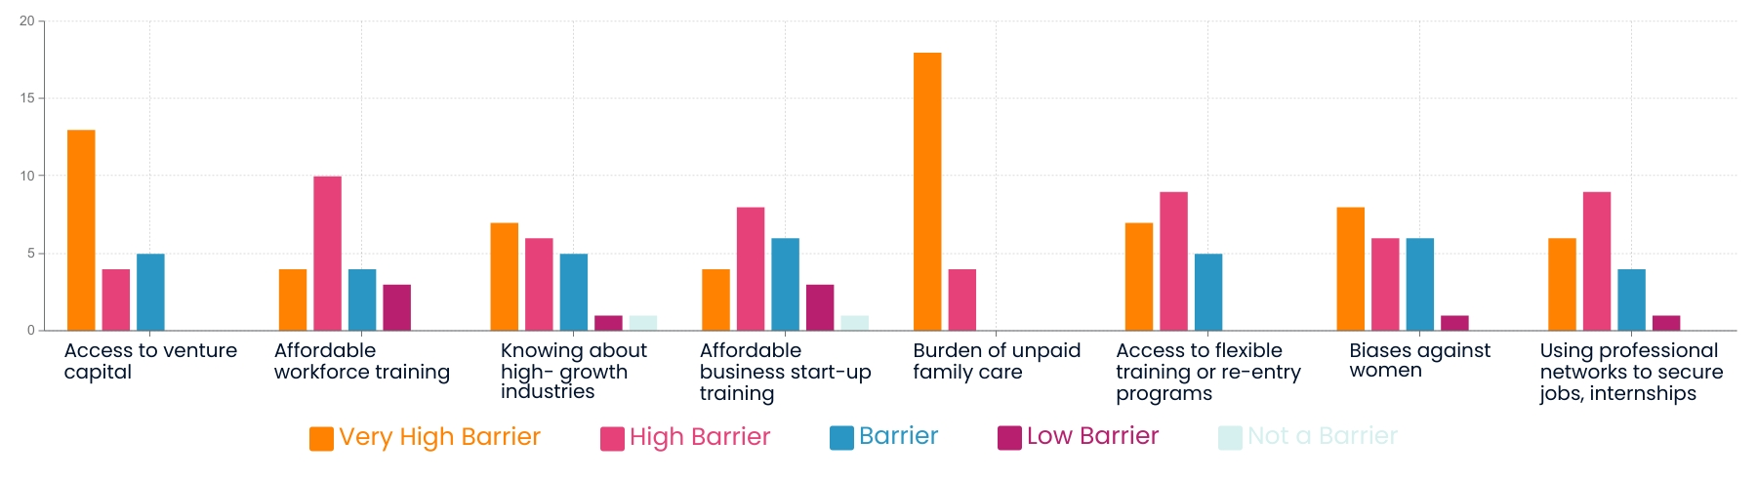
How significant are the barriers?
Question:
Many barriers continue to exist impacting women’s professional and economic success. Of the following, how much of a barrier do you think they are to women’s success?
82%
57%
Notes:
See the unpaid family leave stand out but the other big barriers are:
Access to capital
Q: what do you think about this? What other barriers

Slide 14





How we’re advancing 10,000
Leveraging online learning to advance work readiness
1
Engaging companies
Employee engagement
Internship placement
Workforce agencies
- Business training
Partnering to recruit
Schools, community colleges
Community orgs
2
3
Notes:
Now you can see why we want to create 10K isabells, keillie and melissas… to follow in the footsteps of Jeff, Ian and Schepp…
Laura, Susan… Jen
Please join us...
If your org is looking to build a talent pipeline, or making community or HR investments, join us. H&S example, Becton DIcksonson
Personal philanthropy – Something unique… Philanthropists right here who’ve given $15-20M to entprenreurship… unqiue focus on NextGen women
You can help through your connections – you may know of someone
Each of us in this room can participate in one of these 3 ways…
Finally, remember that there’s triple whammy when you invest in the next generation -- from your brand, community impact and talent pipeline to driving your business forward.
We hope you’ll join us for the journey. Thank you and have a great rest of your day

Slide 15
Addendum

Slide 16
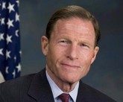
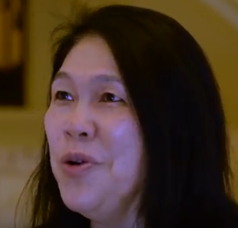
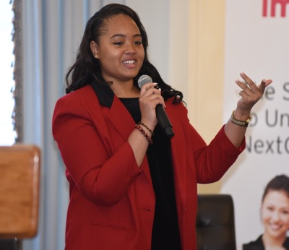
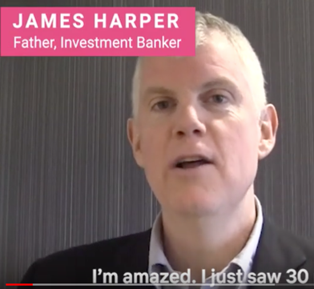
What they’re saying
US Senator Dick Blumenthal
Linna Yuen, Real estate broker and mom of graduate
Kellie Taylor, Graduate, CEO, Cleo
James Harper,
Father and banker
“Girls With Impact is doing such important work. It cultivates success by teaching girls the steps to plan and launch a business.”
“I can’t imagine where these girls will be 15 or 20 years from now. The whole world should know about this program.”
“My school had a business program but it wouldn't help me bring it to life. Girls With Impact helped me stand out to get my job while in college.”
“I just saw 30 girls pitch their ventures with a power point presentation. This is stuff I do at work.”

Slide 17
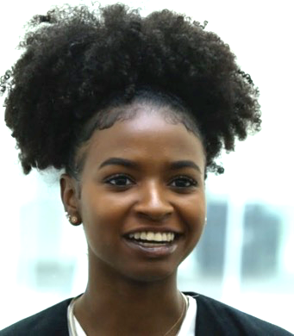
What they’re creating – and how they’re getting ahead
From non-profits, to businesses and high-impact projects
Rachel Motley, 17
Venture: Crown Kits (style kits for black hair)
Outcome: Full rides to Babson & Howard ($200,000+)
“When I interviewed at Babson, they focused on my Girls With Impact project…. I’m much more confident; I know how to go about making things happen. The things they teach are what you really need to know.”
Jody Bell, 16
Venture: In Case of Deportation
Outcome: Global news, $20k scholarship and honors program in business, delegate seat on Mock UN
“I don’t know how to explain it but… I feel kind of powerful.”
- Jody, just three weeks into the program

Slide 18
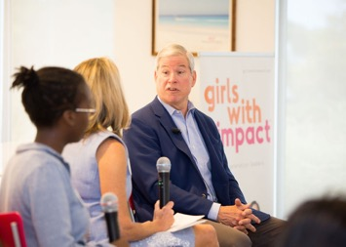
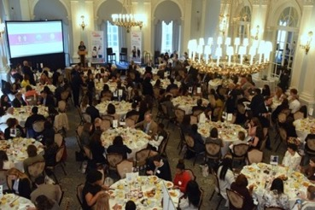
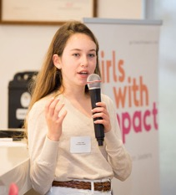
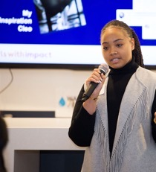
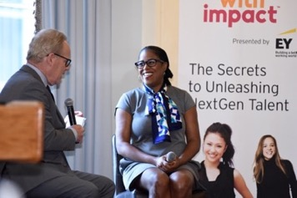
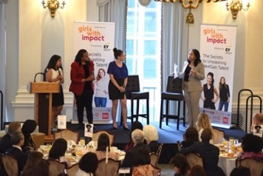
Our Signature Breakfasts
Build brand, client engagement and more at breakfasts in key markets
Benefits:
Govt: Direct engagement w/key city/state/federal leaders on hot topic
Clients: Invite clients for powerful relationship building
Employees: Recognize hi-po’s
Purpose: Align with mission increasing women in the c-suite
Market Leadership: Demonstrate your leadership on NextGen/women talent
Jennifer Openshaw interviews Booking Holdings Chairman Jeff Boyd, talking AI, talent
100% surveyed: “Exceeded expectations”
Gen Z CEOs pitch their ventures and share the impact of entrepreneurship training.
“I feel more capable and have a much better sense of business.” ”It put me into a different league and got me my scholarship”
CNBC’s Tyler Mathisen interviews Thasunda Duckett, CEO, Consumer Banking, JPM Chase
Notes:
Thank you, Jamie. And thank you girls.
Wasn’t that amazing – [applause]
This is what we are going to bring to all girls and it’s starting here in Fairfield County – are you going to be a part of it?
There are many ways to get involved with GWI – this table just lists some options for both individuals and organizations
But please, we are looking for people who are looking for us, so if you are looking to burild the next generation of leaders then let’s connect…[contact info on next slide]

Slide 19
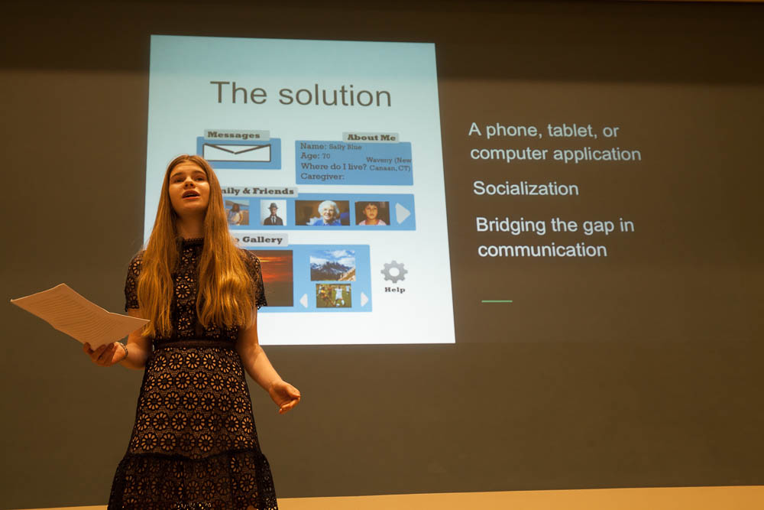
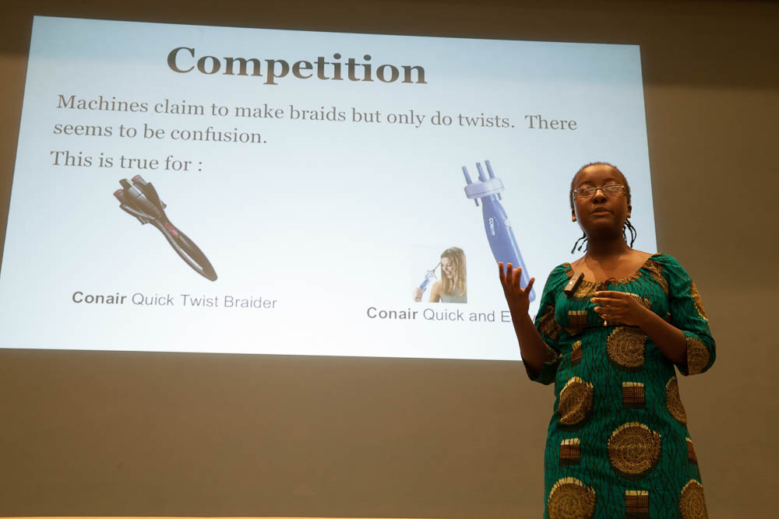
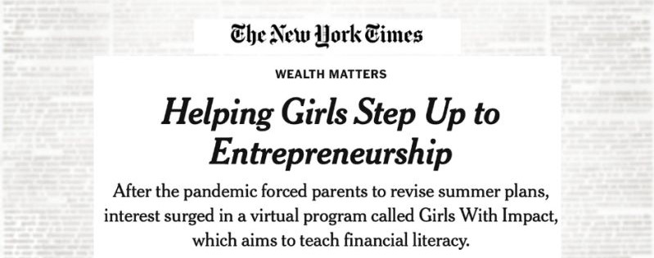
How you’ll benefit… and make real impact
Our economy/communities
Ventures drive innovation and impact
More prepared diverse female workforce
Increase women’s readiness for leadership
Girls/Women
Major college differentiator, work readiness
Increased confidence, leadership, financial skills
“I feel ready to be a CEO” – Natalie, 15
For employee engagement
Recruiting through their networks, local schools
Mentoring > Graduation event
Leader speaker/feature
Sharing expertise – videos
Job shadow/Internships
For employers
D&I leadership
Brand/reputation
Naming opportunities
Employee engagement, talent pipeline
Intern pool
NextGen customers/leaders

Slide 20
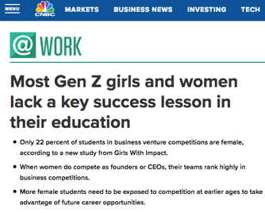




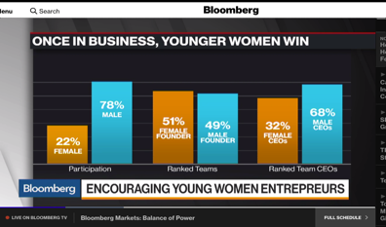
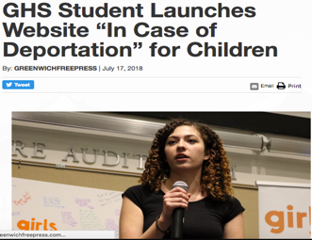

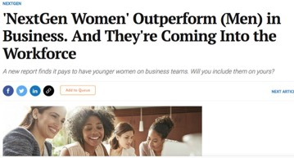
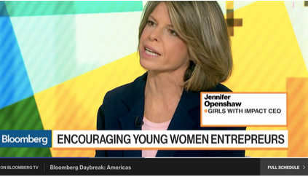

In the news
Creating the next Jeff Bezos

Slide 21







Advisors and partners
Lynda Applegate
Entrepreneurship Professor,
Harvard Business School
Elisabetta Bartoloni
Partner, Heidrick & Struggles
Jessica Cain
VP, Eversource Energy
Stephanie Redish Hofman
Director, Google
Karlyn Carnahan, CPCU
Head of Americas, Celent (an MMC Co.)
Denise Taylor
Administrator, Bridgeport Public Schools
Nicole Enslein
Founder & CEO, Sublime Communications
Bob Ghoorah
Founder, Quarry VC
General Counsel, Ning Interactive Inc.
Nisha Kumar
CFO, Greenbriar (former CFO, AOL)
Petal Modeste
Associate Dean, Columbia School of Law
Fernando Salinas
CHRO-R&D, Johnson & Johnson
Meera Viswanathan
Head of School, Ethel Walker
Gina Warner
CEO, National AfterSchool Association
Judy Nedell
Head of Guidance, Greenwich School District

Slide 22


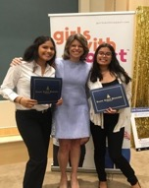

Founder & Chair: Jennifer Openshaw
A national financial leader and entrepreneur
Silicon Valley – financial services
CEO, Women’s Financial Network (acquired by NYSE:SIEB)
California State Treasurer’s Office
Author, Dow Jones, TV expert, Microsoft spokesperson
CMO & Co-Author, Mercer’s When Women Thrive research platform

Slide 23


Join us
Be a part of it
The time is now.
Contact:
Jennifer Openshaw
jen@girlswithimpact.com
310.980.9252
Notes:
Time is now.

