Slide 1
Cribari Bridge Section 106 Consulting Party Meeting
Westport Town Hall
Room 201
December 18, 2025

Slide 2
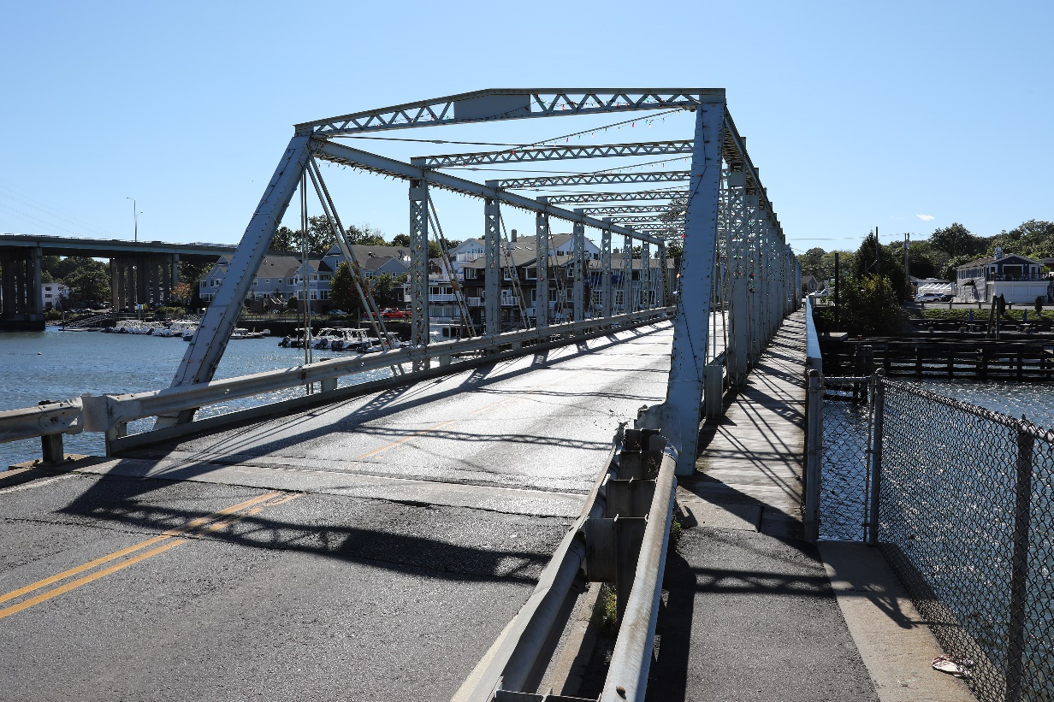
Agenda
Introductions
Purpose & Need of Project
Where we are in the Section 106 Process
Next Steps in Section 106 Process
Mitigation & MOA
Historic Bridge Marketing
Brief Update on EA/EIE Status
Questions/Discussion
Contact Information

Slide 3
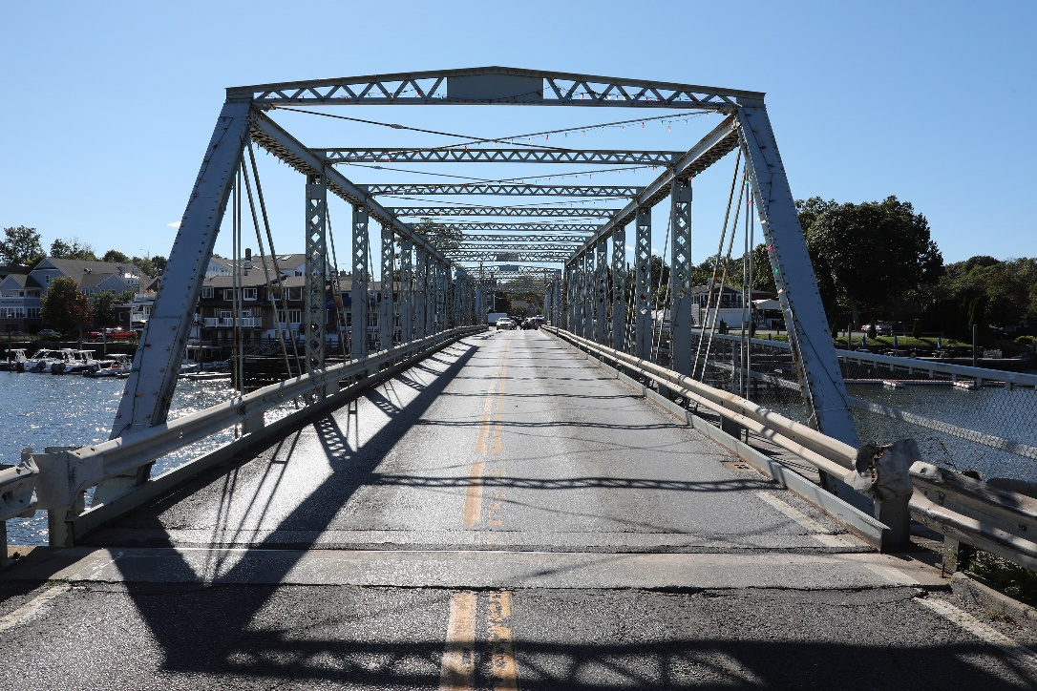
Introductions
CTDOT
State Historic Preservation Office
Town of Westport
Westport Historic District Commission
Coalition for Westport
Westport Preservation Alliance
Preservation Connecticut
Historic Bridges
Historic Bridge Foundation
Additional Stakeholders

Slide 4
Purpose & Need
The purpose of the Proposed Action is to provide a resilient structure that:
Addresses the structural and functional deficiencies of the existing bridge and
Accommodates safe vehicular, bicycle, pedestrian, and marine traffic.

Slide 5
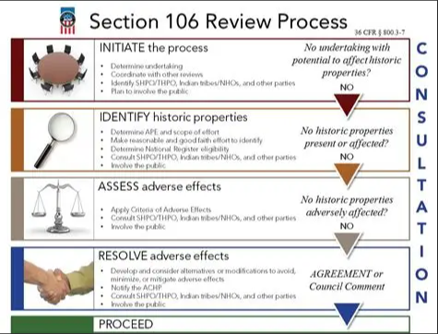
Section 106 Consultation
4-Step Process
  Initiate the Process
  Identify Historic Properties
  Assess Adverse Effects
  Resolve Adverse Effects
FHWA’s Section 106 Tutorial

Slide 6
Next Steps in Section 106 Consultation
Adverse Effect Finding by FHWA
  Historic Property Adversely Effected:
    Cribari Bridge (Saugatuck River Swing Bridge) individually listed and a contributing historic property to the Bridge Street Historic District
  FHWA notification to ACHP
Memorandum of Agreement
  MOA Content
  Signatories & Concurring Parties
  ACHP’s Guidance on Agreement Docs: https://www.achp.gov/initiatives/guidance-agreement-documents
  Example: RT 7/15: MOA_Route7-15_102-358_202305.pdf
Mitigation
  Meaningful/Creative/Alternative
  Represents a reasonable public expenditure after considering the impacts of the action and the benefits of the proposed mitigation measures (23 CFR Part 771.105(e))
    Related to the loss of the historic property
    Public benefit

Slide 7
Meaningful Mitigation
So, what does CTDOT & FHWA need from you before the next consulting party meeting?
Meaningful mitigation ideas in a prioritized list to CTDOT by February 6th 2026
Types of mitigation include but are not limited to following:
  Publications
  Training/workshops
  Websites
  Reuse and/or repurpose salvaged materials (e.g., historic bridge or bridge components)
  Educational materials, programs, or exhibits
  Community engagement programs
  Films/videos
  Design Reviews
  Documentation

Slide 8
Next Steps in Section 106 Consultation
Historic Bridge Marketing (23USC144(n)(4))
Any State which proposes to demolish a historic bridge for a replacement project with funds made available to carry out this section shall first make the bridge available for donation to a State, locality, or responsible private entity if such State, locality, or responsible entity enters into an agreement to-
(A) maintain the bridge and the features that give it its historic significance; and
(B) assume all future legal and financial responsibility for the bridge, which may include an agreement to hold the State transportation department harmless in any liability action.
Costs incurred by the State to preserve the historic bridge, including funds made available to the State, locality, or private entity to enable it to accept the bridge, shall be eligible as reimbursable project costs under this chapter up to an amount not to exceed the cost of demolition. Any bridge preserved pursuant to this paragraph shall thereafter not be eligible for any other funds authorized pursuant to this title.

Slide 9
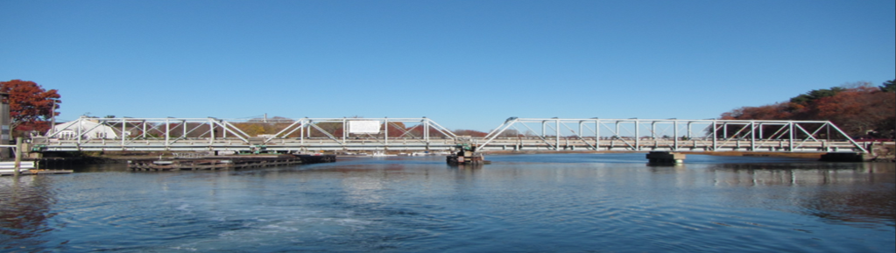
Historic Bridge Marketing
So, what does this mean for consulting parties?
Is there an interest by the Town or private entity in adopting the Bridge?
If so, where will it go? Who will be the owners responsible for preservation of the Bridge’s historic features? Is there a financial plan?
Official marketing will be concurrent with EA/EIE comment period
Follow-up contract meetings with CTDOT, FHWA, SHPO & future bridge owner

Slide 10
EA/EIE Update & Section 106
How does Section 106 fit into the NEPA Timeline?
Draft MOA in EA/EIE
Section 106 Consultation Meeting during 45-day comment period for EA/EIE (late winter/spring 2026)
  CTDOT/FHWA will discuss mitigation proposed for MOA
  Discussion of how consulting parties are involved after Section 106 & NEPA documents finalized
Executed MOA before NEPA is concluded
  Consulting parties invited to sign as Concurring Parties

Slide 11
Questions/Open Discussion
https://portal.ct.gov/dot/projects/cribari-bridge

Slide 12


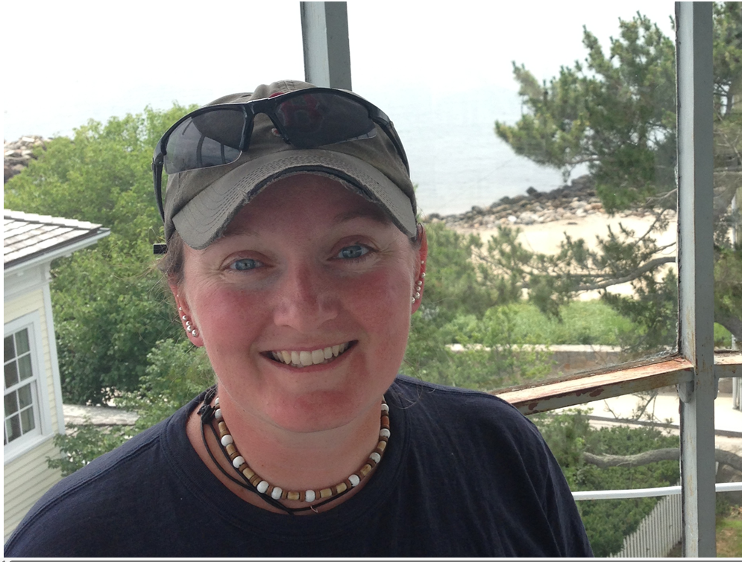
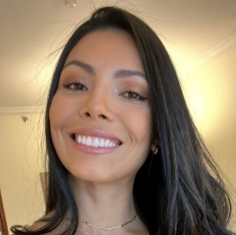
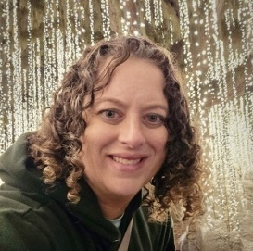
Contact Information
Project Managers
NEPA
Section 106
James R. Barrows
Transportation Supervising Engineer
James.Barrows@ct.gov
Kevin Fleming
Transportation Supervising Planner
Kevin.Fleming@ct.gov
Mandy Ranslow
Cultural Resource Supervisor
mandy.ranslow@ct.gov
Ashley Heredia
Transportation Engineer III
Ashley.Heredia@ct.gov
Heather Carpini-Prescott
Architectural Historian
Heather.Carpini-Prescott@ct.gov
Homework Reminder for Consulting Parties:
List of prioritized mitigation idea from consulting parties to CTDOT by 2/6/2026
Consideration of interest in adopting the Cribari Bridge if the preferred alternative is carried forward

