Slide 1



WEBINAR
Learn How to Use RewardingWork.org/ct
to Find and Hire Support
12-7-2023

Slide 2
DDS INTRODUCTIONS
Elisa Velardo, DDS Deputy Commissioner
Amy Blazawski, Self Determination Director North Region
amy.blazawski@ct.gov
Denise Paladino, Self Determination Director South Region
denise.paladino@ct.gov
Chelsea Houston, Self Determination Director West Region
chelsea.houston@ct.gov

Slide 3
REWARDING WORK INTRODUCTIONS
Theresa Driscoll, Director of Marketing and Communication
tdriscoll@rewardingwork.org
Etinosa Okunbor, Marketing Outreach Specialist
Etinosa.Okunbor@rewardingwork.org

Slide 4
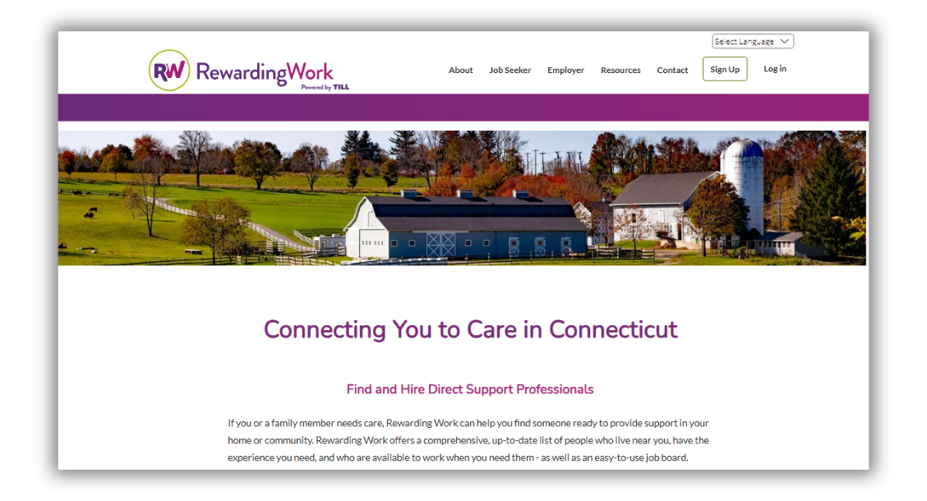
ABOUT REWARDING WORK
  Established in 2004
  Program of TILL, Inc. since 2018
  First directory in U.S. to focus
solely on supporting people
of all ages with disabilities
  Free for anyone with CT DDS eligibility

Slide 5
BENEFITS OF USING REWARDINGWORK.ORG/CT
  FIND AND HIRE THE SUPPORT THAT IS RIGHT FOR YOU
  Free subscription with CT DDS Access Code
  Your subscription begins immediately and allows you to:
    Search applicants who live near you and have the qualifications and experience you need
    Post your support needs on our job board.
    Review applicant responses go directly to you.

Slide 6
FREE, RENEWABLE 12-MONTH SUBSCRIPTION
ENTER ACCESS CODE AT SIGN UP:
CTDDSCONNECT

Slide 7
SUCCESS STORIES
Thirty-year old Stephen leads a busy life between the day program he attends and his involvement in community activities. His dad, Frank, has used Rewarding Work to hire the support that makes this possible.
Laurel used Rewarding Work to hire support for her son Jacob, who loves hiking and getting out in the community. Laurel says this support benefits the entire family.
“Carol is doing a great job, and has really become part of the family.”
-Frank
“The support we have found using Rewarding Work has been a lifesaver.”
-Laurel

Slide 8
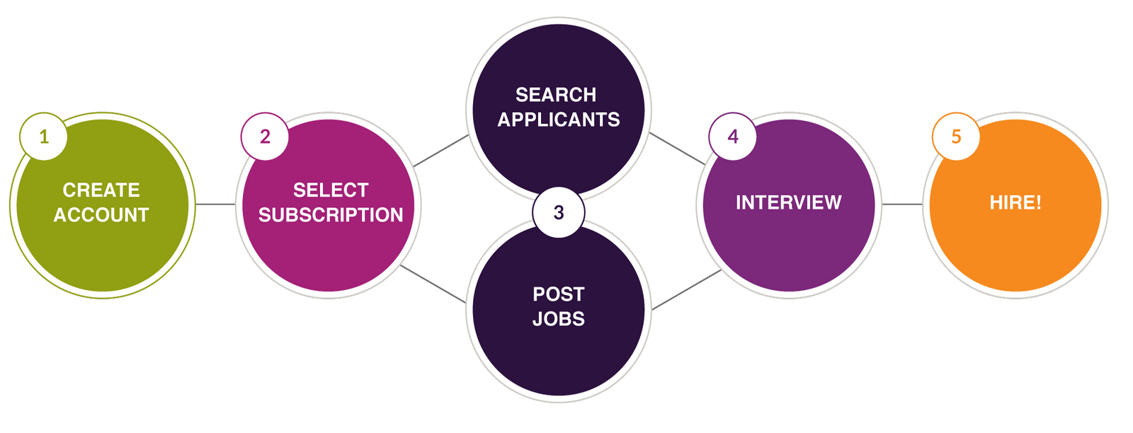
HOW REWARDING WORK WORKS

Slide 9
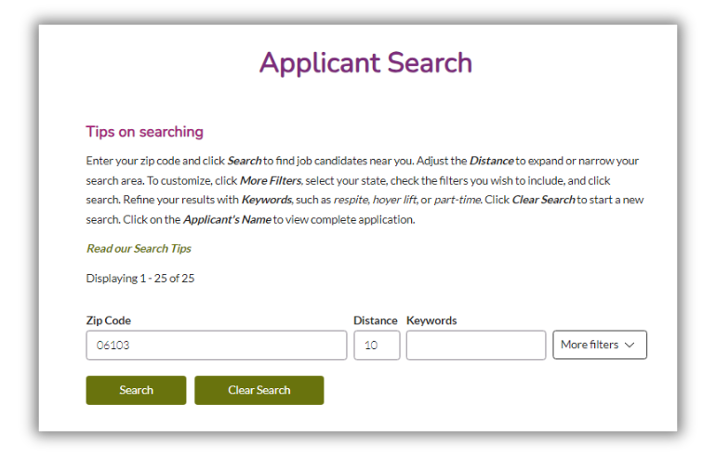
SEARCH APPLICANTS
  Search for applicants who
fit your needs
  Search by zip code
  Filter to customize
your search
  Add keywords
  Contact applicants
of your choice

Slide 10
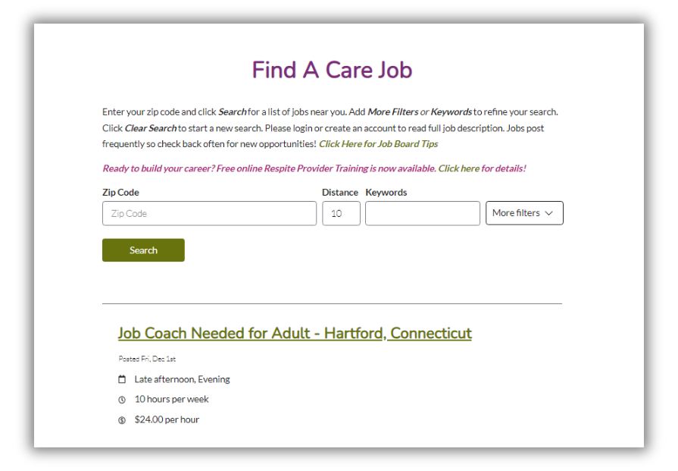
POST A JOB
  Complete online job form
  Job posts immediately
  Job post is active for 30 days
  Applicants search for jobs
that are a fit for them
  Applicant replies go
directly to you
  Contact applicants
of your choice

Slide 11
MODERN & INTUITIVE WEBSITE
  Accessible and responsive
  Mobile friendly and ADA compliant
  Intuitive and appealing
  Powerful search engine to customize and filter searches
  Easy to use Job Board that lets employers save and edit their jobs; and allows job applicants to easily search for job opportunities near them.

Slide 12
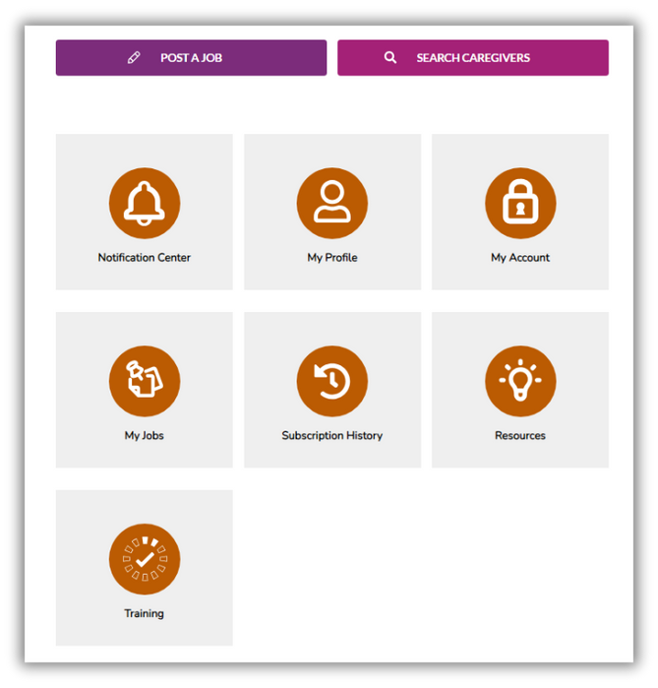
MODERN & INTUITIVE WEBSITE
  Easy to use “Dashboard”
makes it easy to manage
your account

Slide 13
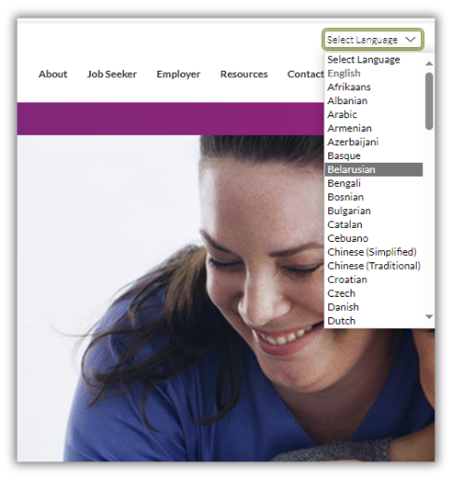

WEBSITE ENHANCEMENTS
  Translate website to any language
  Sign up for automated notifications
  Updated applicant availability feature
  Share this job button on job board
  Training videos
  Chat feature

Slide 14
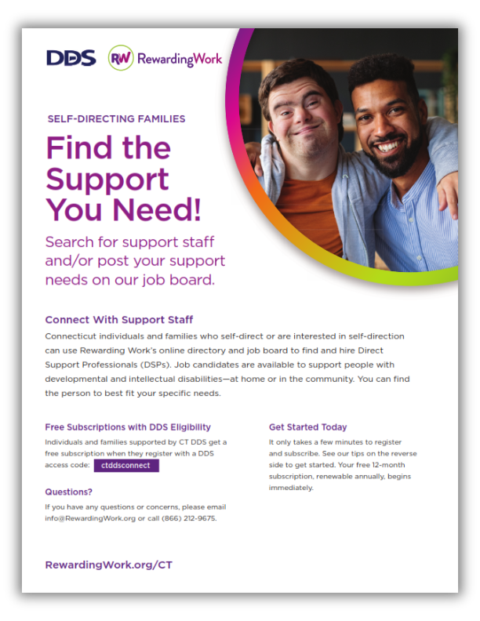
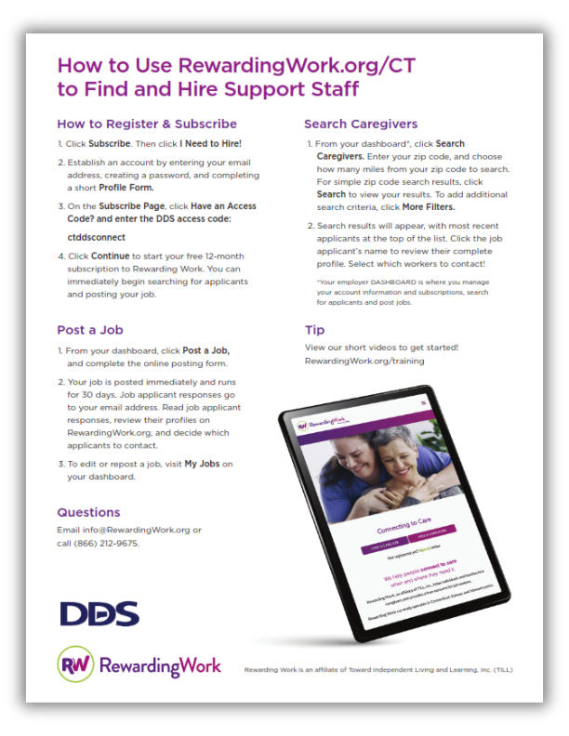
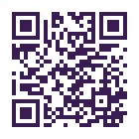
REWARDINGWORK.ORG/CT FLYER
Download Flyer

Slide 15
REWARDINGWORK.ORG USAGE
225 job applicants from 90 cities and towns were active on RewardingWork.org during
November 2023.
180 employers from more than 85 cities and towns throughout Connecticut are using RewardingWork.org/ct to find and hire staff.
Applicant profiles must be renewed every 3 months to stay active.
Free access code subscriptions are 12-months and are renewable.

Slide 16
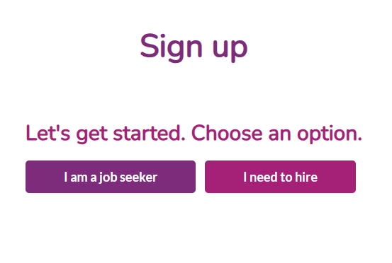
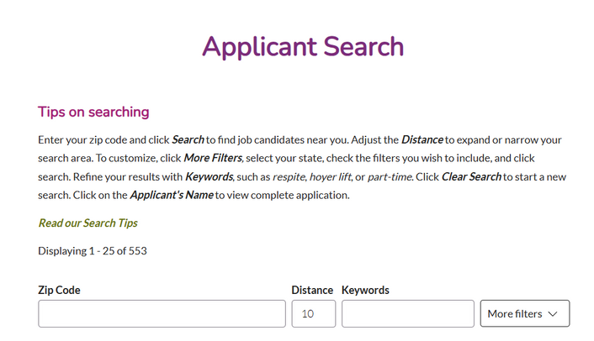
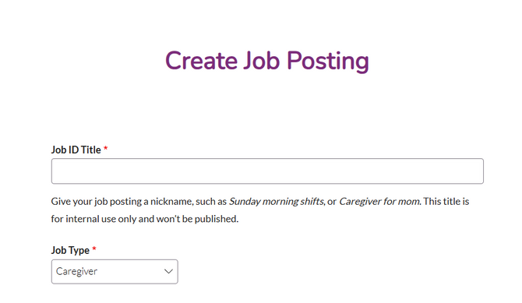
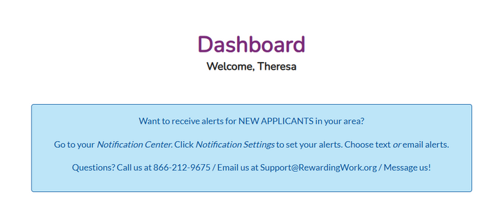
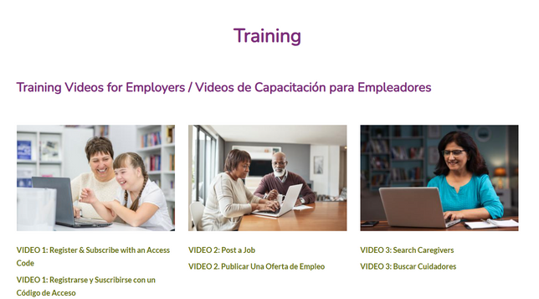
REWARDINGWORK.ORG DEMO

Slide 17
QUESTIONS?

Slide 18




CONTACT US
Live Telephone Support
M-F, 9am-5pm
866-212-9675
Email Support
Support@rewardingwork.org
Training Videos
RewardingWork.org/training
Website Chat/Messaging
Useful Tips
RewardingWork.org/employer/useful-tips-employers
www.RewardingWork.org/ct

