Slide 1
DDS STEP (Supporting Transformation to Empower People)
Provider Training Session 1: Strategic Planning
Connecticut Department of Developmental Services
June 2023

Slide 2
Zoom Tips
Click Show Captions to turn captions on
Click Start Video to turn on your camera
Click Unmute to speak
Click Chat to write to the group or to see what people write

Slide 3
Agenda
Welcome & introduction
How do I get started?
Planning for the future
Collaborating with DDS
Q&A and Closing

Slide 4
Session Objectives
1
Review STEP as a long-term planning opportunity and how to get started.
2
Discuss the resources available to providers and how you can use STEP incentives to advance your agency’s strategy.
3
Understand how DDS is supporting provider creativity.

Slide 5
STEP Introduction

Slide 6
What is STEP?
STEP highlights and promotes the supports DDS offers that provide greater choice, independence, integration, and empowerment.
STEP is at the heart of DDS, representing the DDS mission and paving the way to a better future for individuals with intellectual disabilities (ID) in Connecticut.
Looking Ahead
STEP’s Core Supports:
Self-Direction
Supportive Housing
Individualized Home Support
Assistive Technology
Remote Supports
Employment
Community
Companion Home
You can leverage STEP to continue building a strong foundation as a leader for services and supports for individuals with ID.
We need YOUR participation to promote independence in the lives of the people using ID supports!

Slide 7
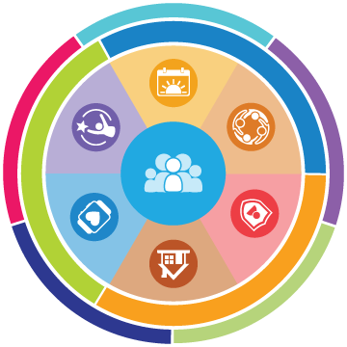
STEP is an incredible opportunity to empower the people we support through strategic investments in the DDS system.
Building on Charting the Life Course priorities, STEP emphasizes a different way of thinking that encourages high expectations, emphasizes life experiences that align with individuals’ goals, and the integration of multiple support types to build independence.
Individuals and their Families
Providers
DDS
Work to develop a vision for their life and build skills and natural supports for lifelong independence according to their goals, interests, and strengths.
Create more support options for individuals that give them opportunities to connect their residential and working lives to their goals and needs.
Develop an organizational approach that prioritizes person-centered processes and supports individuals to be independent and self-determined.

Slide 8
Prepare & Plan for Transformation

Slide 9
Planning for Transformation
Assess Current Services
Identify Transformation Opportunities
Develop Transition Plan
Evaluate what services and supports are currently provided and how those services align with the strategic direction of the agency
Determine how STEP and other funding opportunities can be used to transform your agency
Collaborate with agency leadership and engage stakeholders to create a plan

Slide 10
Planning for Transformation:
Assess Current Services
Review service offerings
Identify candidates
Evaluate infrastructure
Assess barriers and myths
Understand planned direction

Slide 11
Planning for Transformation:
Identify Transformation Opportunities
Review available STEP incentives and other DDS funding opportunities
Consider options to improve community integration
Explore best practices from other providers
Consider staffing needs and additional training
Check in with stakeholders and community partners

Slide 12
Planning for Transformation:
Develop Transition Plan
Bring agency leadership together
Review ideas and make decisions
Confirm with stakeholders
Plot out actions and timelines
Complete Transition Plan template, including budget

Slide 13
STEP Transition Plans

Slide 14
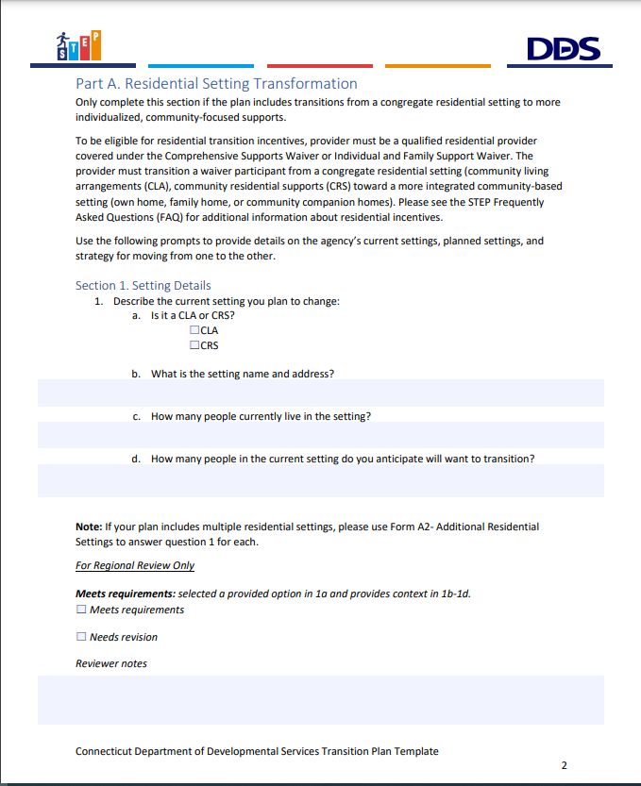
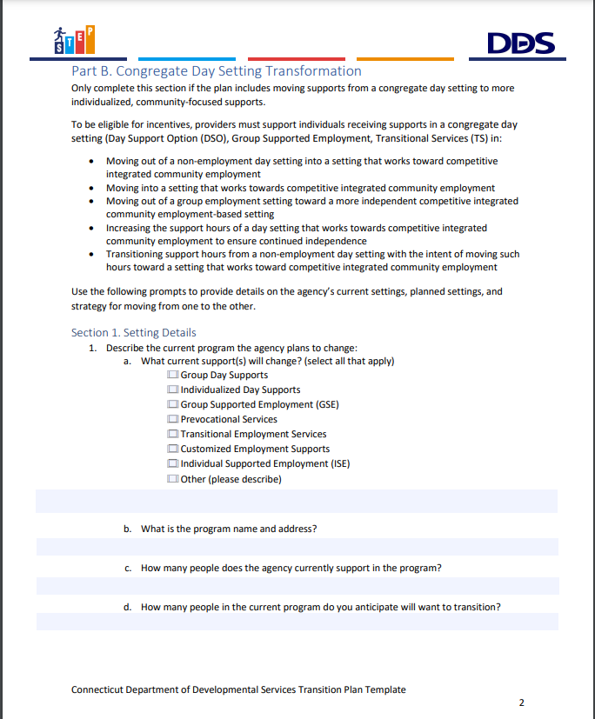
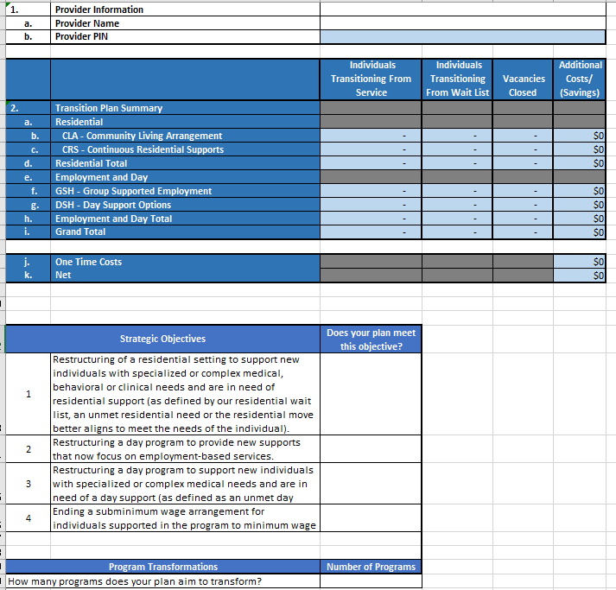
Transition Plan Templates
Template A: Residential
Template B:
Day & Employment
Budget Sheet

Slide 15
Incentivized STEP Transitions
Transitioning from a CLA or CRS to a more integrated community-based setting (own home, family home or CCH)
Transition Plan Instructions
Budget Sheet
Template A: Residential
Transitioning from non-vocational congregate day settings to prevocational and vocational supports
Transition Plan Instructions
Budget Sheet
Template B:
Day & Employment
Transitioning from GSE to ISE or Customized Employment
CLA: Community Living Arrangement
CRS: Continuous Residential Supports
CCH: Community Companion Home
GSE: Group Supported Employment
ISE: Individual Supported Employment

Slide 16
Role of Regions in Transition Plan Process
Provider submits STEP Transition Plan to regional Resource Administrator
Provider develops a STEP Transition Plan
Regional review of the submitted plan
Regional approval of the plan
Provider begins transformation planning and engages Regional Staff for input and support
Review team collaborates with provider for revisions to the plan as needed
Provider begins implementation activities

Slide 17
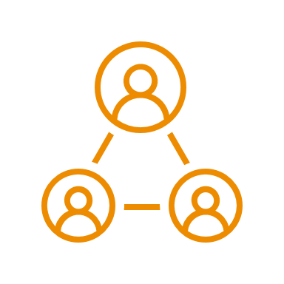
How Does DDS Make Approval Decisions?
Transition Plan Templates each include review criteria for consistency in review across regions. In addition, DDS is prioritizing approval of plans that are truly transformative and innovative. A transformative plan is characterized by the type of transition and meeting at least one of the four criteria listed below:
TYPE OF TRANSITION
Plan for transitioning individuals from a congregate to a non-congregate, community-based setting
Innovative Criteria for STEP Plans
APPENDIX K OBJECTIVES
SCALE OF IMPACT
NEW APPROACH
NEW PROGRAMS
Completes one of the pending Appendix K Objectives related to restructuring settings or ending subminimum wage arrangements
The number of people or settings impacted is significant for the agency and represents real transformation
Tests a new approach for the agency with the potential for growth and capacity to serve more individuals
Creates or expands an agency’s capacity to provide individualized supports through new programs or offerings

Slide 18
Implementation Activities
As providers implement STEP transition plans, they must be sure to communicate proactively and collaboratively with individuals and their families, their support teams, and DDS.
1
PLAN COMMUNICATION
Providers should communicate the details of the transition plan to staff and leadership at all levels of the agency so teams are aligned.
3
INDIVIDUALIZED PLANS
Each person transitioning has different needs and preferences. Case managers will guide individuals and their support teams through individual transition planning.
2
INDIVIDUAL AND FAMILY BUY-IN
Communicate any changes in the plan to individuals and their families and get their approval before moving forward.
4
IMPLEMENTATION
Once plans are approved, providers will work closely with individuals, their teams, and case managers to implement their plan in a way that works for them.

Slide 19
Strategic Planning

Slide 20
Ways to Use STEP Incentives
Change can be challenging, and it requires resources. STEP represents significant financial resources for providers to use to best support their strategic planning for transformation to a more person-centered, community-based approach to supports.
Enabling and accelerating STEP Transitions and growing related programs
Enhancing individual choice and independence in other agency efforts
The following are examples of ways to use funding. Many fit both categories:
Launching new skills classes for individuals
Supportive housing projects*
Assistive technology*
Remodeling CLAs for more accessibility and/or privacy
Customized employment certifications
Setting up community integrated drop-in programs
Recruiting and hiring staff
New trainings for staff
Transportation vans
Staff time to develop relationships with employers
Remote Supports infrastructure
Staff retention bonuses*
* Indicates DDS has other funding available for these areas

Slide 21
Key Questions to Ask
Key Points:
The ID system IS changing. STEP can help you change with it
Technical assistance and regional staff can help you think through answers as you plan
What changes would the individuals we support and their families like to see?
What challenges do existing programs and settings face?
How do we already foster independence and choice?
Where does our agency see our program offerings next year? In five years? Beyond?
How can we accommodate individuals with greater behavioral and medical support needs?
How can STEP help us implement sustainable change?

Slide 22
Collaborating with DDS
Adding a new support? → DDS can support your agency getting qualified/credentialed
Looking for people to fill newly created vacancies? → DDS can connect you with people on the waitlist or other high priority individuals seeking supports
Exploring a new approach? → DDS can help you figure out how it fits into the waiver framework
Really thinking outside of the box? → DDS can coordinate with your agency and DSS to consider potential routes forward
Hitting implementation barriers? → DDS and the technical assistance team are there to help you troubleshoot
DDS is also in progress on and beginning many other activities to support transformation

Slide 23
Q&A and Closing

Slide 24
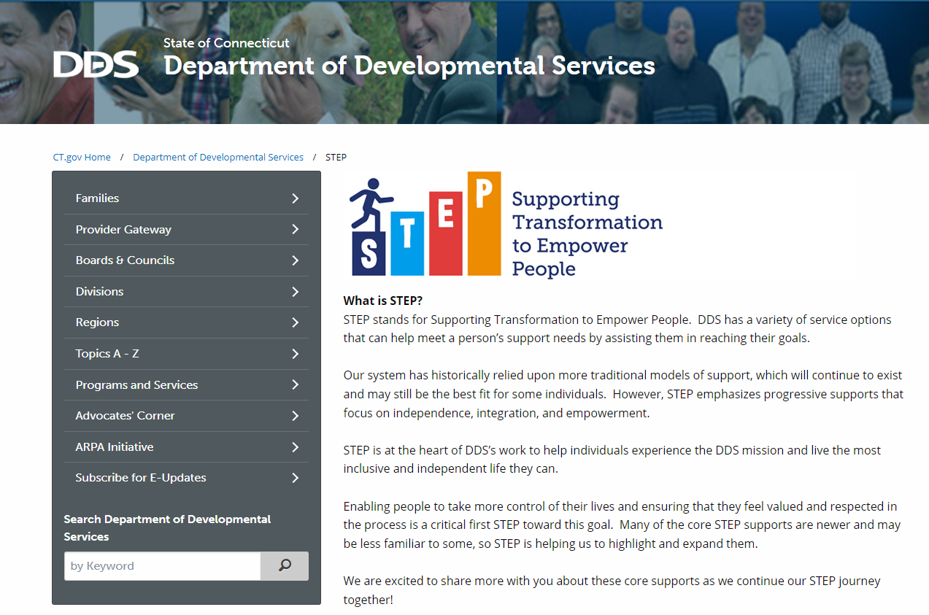
Resources
Looking for more information about STEP? Check out the STEP Resources page on the DDS Provider Gateway
Looking for information about STEP to share with individuals and their families? Check out the new public STEP Page
on DDS Provider Gateway
on www.ct.gov/step

Slide 25
Thank You!

