Slide 1

DDS Specialized Services Provider Billing and Web Claim Submission Workshop
Presented by The Department of Social Services & DXC Technology

Slide 2
DDS Specialized Services Provider Billing Workshop Training Topics
Introduction to DDS Specialized Services Program Changes
Re-Enrollment
Access and Set-up of Secure Web Account
Web Account Capabilities
      Demographic Maintenance
      Clerk Account Set-up/Maintenance
      Switch Provider
      Client Eligibility
      Prior Authorization (PA)
      Claim Submission/Inquiry/Submission Options
      Remittance Advice (RA)
      Components of the RA
    Claim Submission Methods
Claim Submission Guidelines
Common Claim Denials/Resolution
Web Information - Resources @ ww.ctdssmap.com
Important Prior Authorization/Claim Submission Tools
    Fee Schedule

Slide 3
DDS Specialized Services Provider Billing Workshop
Training Topics cont.
Available Publications
Bulletins
Important Messages
Provider Manuals
Banner Messages
Quarterly Newsletters
On-going Communication Tools
E-Messaging
Contacts
Questions

Slide 4
DDS Specialized Services Provider Billing and Web Claim Submission Workshop
www.ctdssmap.com
Program Introduction

Slide 5
DDS Specialized Services Provider Billing Workshop
Introduction to DDS Specialized Services Program Changes
Effective for dates of service, October 1, 2018 and forward, organization and individual providers of DDS Specialized services must enroll as “DDS Specialized Services” providers to be reimbursed directly by the Department of Social Services (DDS) for DDS Specialized services provided to clients in a Nursing Facility.
Client’s must have a HUSKY C or HUSKY D benefit plan and be 21 years of age or older for DDS Specialized services to be reimbursed by DSS.
Prior Authorization from DDS will be required for all DDS Specialized services to be reimbursed by DSS.
Enrolled “DDS Specialized Services” providers must submit claims directly to DXC Technology in order to be reimbursed for the service(s) they provide.
Providers enrolled as “DDS Specialized Services” billing providers will receive payment directly from (DSS).
      Payment will be received via Electronic Fund Transfer, (EFT) after a successful pre-note transaction, directly into the provider’s designated account.
      Until a successful pre-note transaction is received, providers will receive a paper check.

Slide 6
DDS Specialized Services Provider Billing Workshop
Introduction to DDS Specialized Services Program Changes cont.
      DXC Technology runs a financial cycle twice per month to process provider claims received since the last claims processing cycle.
      Providers should refer to the latest financial cycle schedule - PB 18-30 (July – December 2018)
      Schedule published twice per year for the periods of January - June and July - December
This workshop will provide guidance in the determination of client eligibility and service authorization for successful claim submission, reimbursement and reconciliation of claim activity including the timely identification and correction of claims issues for maximum reimbursement of the services provided.

Slide 7
DDS Specialized Services Provider Billing and Web Claim Submission Workshop
www.ctdssmap.com
Re-Enrollment

Slide 8
DDS Specialized Services Provider Billing Workshop
Re-enrollment – Notification and Process
Providers will receive a reminder letter when they are due for re-enrollment 6 months prior to the end of their previous 3 year contract.
  The reminder letter will include an Application Tracking Number (ATN).
  To re-enroll providers should:
    Access the www.ctdssmap.com Web site
    From the Home Page click Provider > Provider Re-enrollment
    Enter the ATN received in the re-enrollment reminder letter
    Enter NPI or Non medical provider identifier (AVRS ID)

Slide 9
DDS Specialized Services Provider Billing Workshop
Re-enrollment – Provider Specific Requirements
Prior to Re-enrolling, DDS Specialized Services Providers:
Must be credentialed/re-credentialed by the Department of Developmental Services (DDS).
For initial enrollment providers enrolling as a DDS Specialized Services provider must submit a copy of their Provider Profile from DDS confirming their credentials to provide DDS Specialized services to clients residing in Nursing Facilities.
For re-enrollment requirements will be communicated to the provider at the time of re-enrollment.
The Application tracking number should be pre-printed in the upper right hand corner of the (FOD) to ensure the association of the FOD to the provider’s re-enrollment application.

Slide 10
DDS Specialized Services Provider Billing Workshop
Re-enrollment – Notification and Process cont.
Providers should successfully complete the re-enrollment application as quickly as possible upon receipt of their notice.
Providers with re-enrollment applications that are not fully completed by the provider’s re-enrollment due date will receive a notice advising they have been dis-enrolled from the Connecticut Medical Assistance Program (CMAP).
      Upon dis-enrollment claims submitted by the provider will deny until the application is in a finalized status
      A Provider Enrollment contract will not be reinstated until the application is finalized.
    Reinstatement of contracts w/out a finalized application violates Affordable Care Act (ACA) policies.

Slide 11
DDS Specialized Services Billing and Web Claim Submission Workshop
www.ctdssmap.com
Secure Web Account Access/Setup

Slide 12
DDS Specialized Services Provider Billing Workshop
Secure Web Account Set-up – Access to Secure Web Portal
Providers who have successfully enrolled as an DDS Specialized Services Provider will receive:
An approval letter with their new AVRS/Medicaid ID
Additional letter under separate mailing containing their Personal Identification Number (PIN)
The AVRS ID and PIN allow the provider initial access to the Connecticut Medical Assistance Program Secure Web Portal for the purpose of creating a secure Web account for the “Primary Account Holder/Local Administrator”.
Set-up of a Secure Web Account enables providers to
  Make changes to their provider file
  Verify Client Eligibility
  Review Service Authorizations (Prior Authorizations)
  Submit and Query Claims

Slide 13
DDS Specialized Services Provider Billing Workshop
Secure Web Account Set-up – Access to Secure Web Portal
To ensure access to the www.ctdssmap.com Web portal to utilize the self-service features of interchange:
If your office/company has security measures blocking your access you will need to contact the individual responsible for your firewall and internet permissions and request access to the Connecticut Medical Assistance Program (CMAP) Web site.
Notes:
Check ability to access, if you can’t get there it limits what you can do, not compatible with MAC

Slide 14
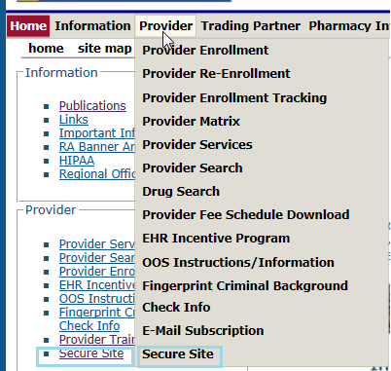
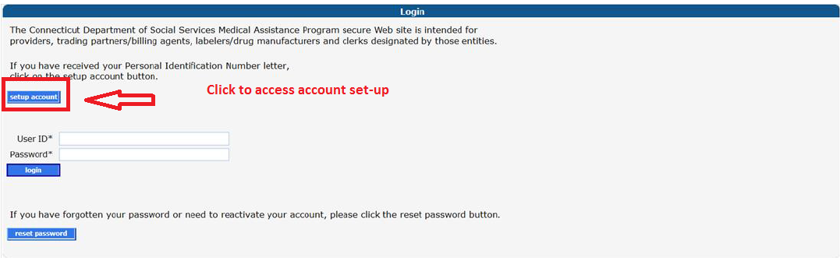
DDS Specialized Services Provider Billing Workshop
Secure Web Account Set-up – Options to Secure Site Access www.ctdssmap.com

Slide 15
DDS Specialized Services Provider Billing Workshop
Secure Web Account Set-up – Options to Secure Site Access cont. www.ctdssmap.com

Slide 16
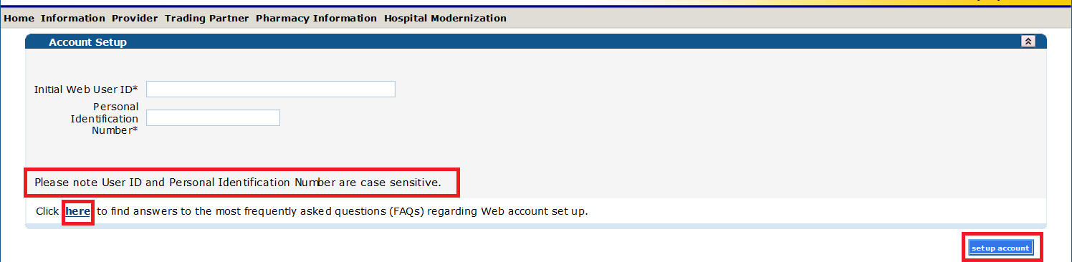
DDS Specialized Services Provider Billing Workshop
Secure Web Account Setup
  The “Web Account Setup” functionality allows providers to set up a “Main Account Administrator/Primary Account Holder” user account.
  Enter the provided Initial Web User ID and PIN (which can be found in the enrollment and PIN letters), in the appropriate fields; click set-up account.

Slide 17
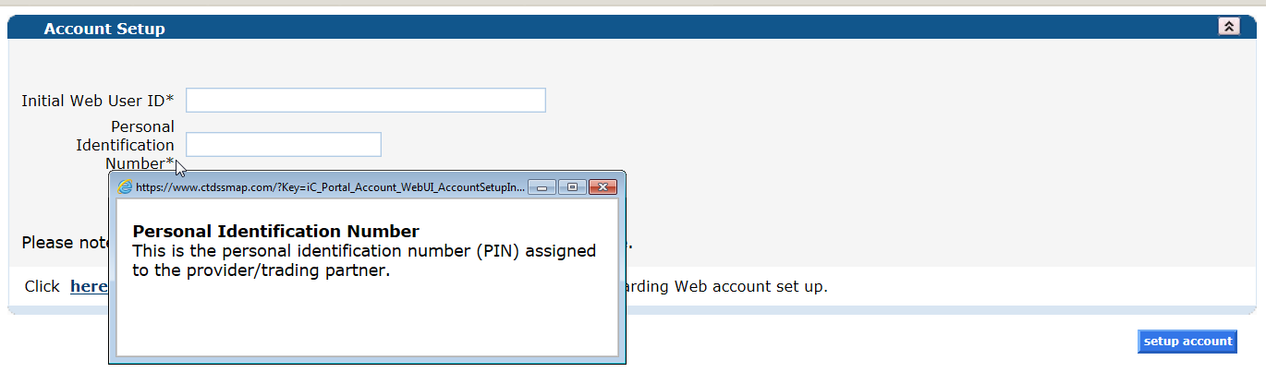
DDS Specialized Services Provider Billing Workshop
Secure Web Account - Online Field Help
The ctdssmap.com Web site features an Online Field Help Window to assist providers with accessing and submitting information.
Placing your mouse over a data field name will create a small question mark beside the cursor. Click the left mouse button when the question mark is displayed to open the Online Field Help window relevant to the selected field.

Slide 18
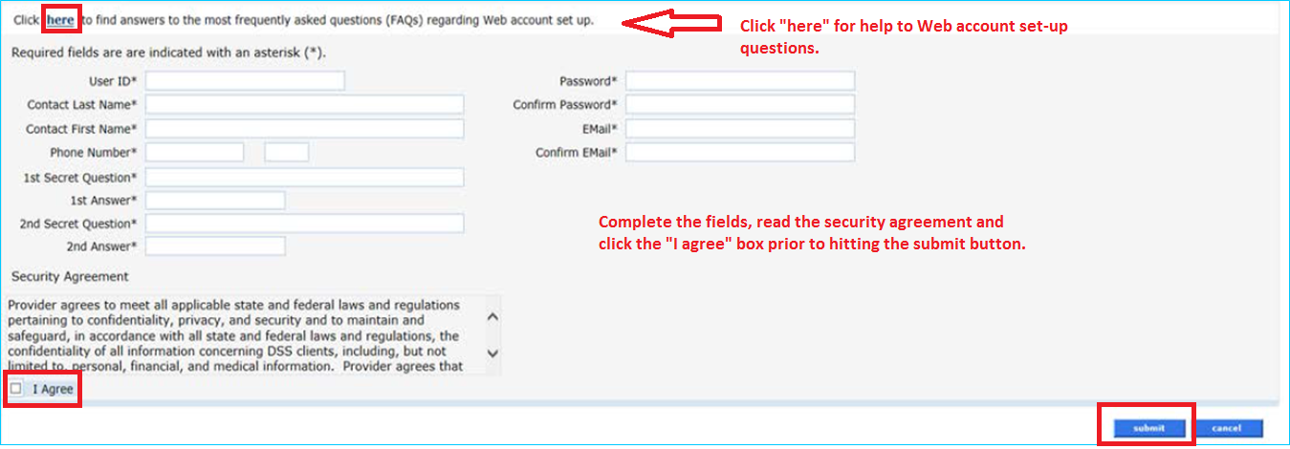
DDS Specialized Services Provider Billing Workshop
Secure Web Account Set-up
Once on the Account Set-up screen, fill in the fields with the appropriate information.
  **Before clicking submit, be sure to write down the chosen User ID, Password, and security question/answer(s) and keep them in a secure location.**

Slide 19
DDS Specialized Services Provider Billing and Web Claim Submission Workshop
Web Account Capabilities
www.ctdssmap.com

Slide 20
DDS Specialized Services Provider Billing Workshop
Web Account Capabilities
Accessing your Secure Site provider account allows you to:
Update your demographic information (primary account holder only)
addresses/phone numbers
bank accounts
Verify re-enrollment due date(s)
Reference – www.ctdssmap.com > Publications > Manuals > Chapter 10 Web Portal/AVRS > Section 10.9 Web Security Administration > “Secure Web Site Enrollment and Maintenance Instructions” link > Section 10.3.5 Demographic Maintenance

Slide 21
DDS Specialized Services Provider Billing Workshop
Web Account Capabilities
Set Up clerk accounts:
Allows Primary Account Holder to assign permission to others to access areas of the secure web portal to perform job tasks
Reference – www.ctdssmap.com > Publications > Manuals > Chapter 10 Web Portal/AVRS > Section 10.9 Web Security Administration >“Secure Web Site Enrollment and Maintenance Instructions” link > Section 10.2 Creating Clerk Accounts.
Switch Provider:
Switch from one provider to another, to allow clerks that have been associated to multiple provider accounts easy access.
Reference – www.ctdssmap.com > Publications > Manuals > Chapter 10 Web Portal/AVRS > Section 10.9 Web Security Administration > “Secure Web Site Enrollment and Maintenance Instructions” link > Section 10.3.7 Switch Provider
  Check client eligibility via the Web:
    Reference – www.ctdssmap.com > Publications > Manuals > Chapter 10 - Web Portal/AVRS > Section 11- Client Eligibility Verification

Slide 22
DDS Specialized Services Provider Billing Workshop
Web Account Capabilities cont.
Access Prior Authorization for services to be provided:
    Prior Authorization Inquiry
    Reference – www.ctdssmap.com > Publications > Manuals > Chapter 10 Web Portal/AVRS > Section 12 Prior Authorization
Create, Submit and Query claims for dates of service 10/1/2018 and forward:
    For services noted on the “DDS Specialized Services for NF Residents” Fee Schedule
    Claim Format – Professional 5010 HIPAA Compliant
    Query Paid, Denied or Suspended claims
    Reference - www.ctdssmap.com > Publications > Manuals > Chapter 10 Web Portal/AVRS > Section 10 Claim Submission, Resubmission, Adjustments and Inquiry

Slide 23
DDS Specialized Services Provider Billing Workshop
Web Account Capabilities
    Obtain Remittance Advice (RA)
    Reports claim activity (Paid, Denied, Adjusted, Suspended) since last financial cycle.
    Reference – www.ctdssmap.com > Publications > Manuals > Chapter 10 > Section 15 – Trade Files

Slide 24
DDS Specialized Services Provider Billing and Web Claim Submission Workshop
Web Account Capabilities –Demographic Maintenance www.ctdssmap.com

Slide 25
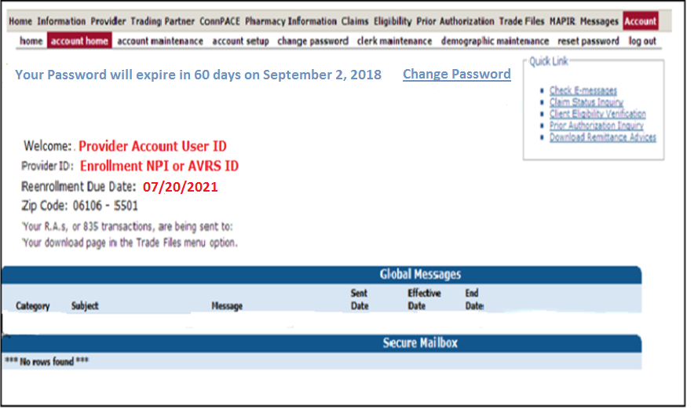
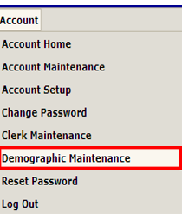
DDS Specialized Services Provider Billing Workshop
Web Account Capabilities - Demographic Maintenance
The Demographic Maintenance section of the Secure Site allows you to alter and maintain demographic information:
Mail to, Pay to, Service Location, and Enrollment addresses
EFT (Electronic Funds Transfer) Account (account that receives all CMAP related reimbursements)
Service Language
Access this section by selecting demographic maintenance from either the Account submenu or the Account drop-down menu

Slide 26
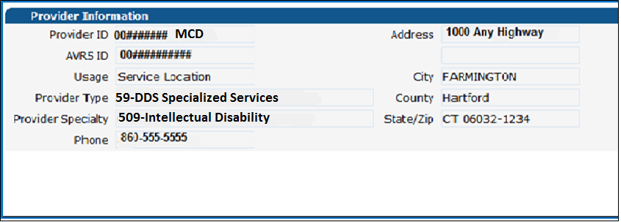
DDS Specialized Services Provider Billing Workshop
Web Account Capabilities Demographic Maintenance cont.
The Demographic Maintenance page displays the provider information panel as well as a submenu
Clicking the submenu options will open a panel with related information:
Service Location
Location Name Address
Electronic Funds Transfer (EFT Account)
Service Language - Language, Effective Date, End Date

Slide 27
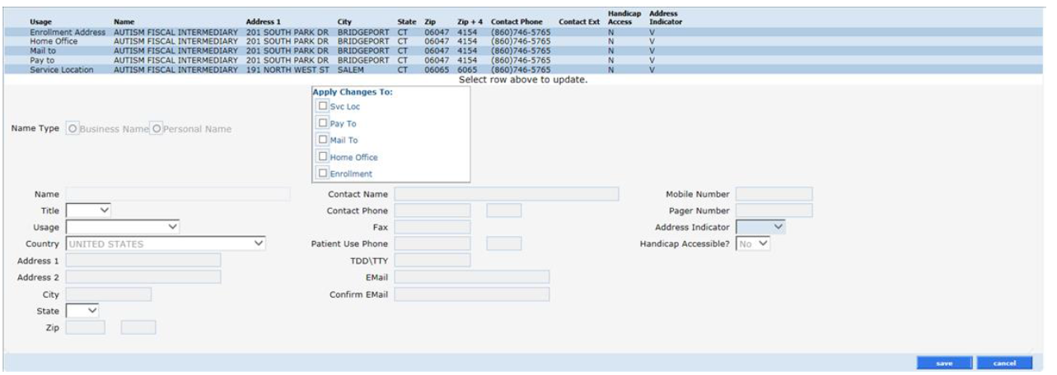
DDS Specialized Services Provider Billing Workshop
Web Account Capabilities - Demographic Maintenance cont.
Specify different mailing, payment, service location and enrollment addresses.

Slide 28


DDS Specialized Services Provider Billing Workshop
Web Account Capabilities-Demographic Maintenance cont.
To alter address information, simply select the applicable row from the provided list (Enrollment Address, Mail to, Pay to, or Service Location); then click maintain address
Select/fill in the appropriate information (address, phone number, etc.); click save

Slide 29
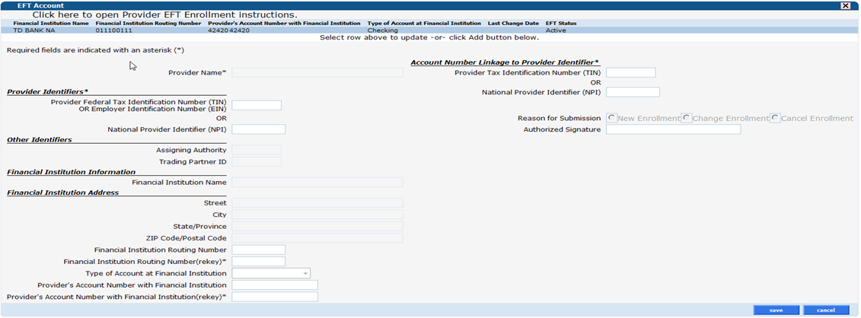
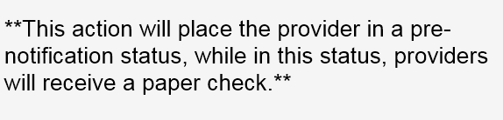
DDS Specialized Services Provider Billing Workshop
Web Account Capabilities - Demographic Maintenance cont.
The EFT Account panel allows you to add and maintain bank accounts into which reimbursements from CMAP will be electronically deposited. Click add; enter the appropriate information; and click save.

Slide 30
DDS Specialized Services Provider Billing and Web Claim Submission Workshop
Web Account Capabilities –Clerk Maintenance
www.ctdssmap.com

Slide 31
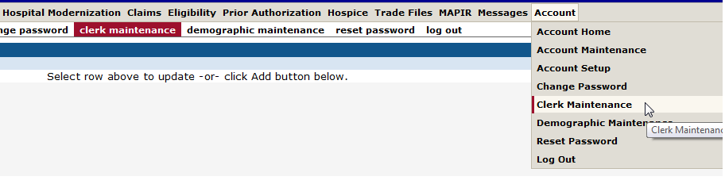
DDS Specialized Services Provider Billing Workshop
Web Account Capabilities - Clerk Maintenance
Set-up of clerk accounts grant Web access to staff members allowing them to perform functions based on their job responsibilities
The “Primary Account Holder/Main Account Administrator” is responsible for maintaining clerk accounts within their organization. This includes adding clerks, changing the role(s) for clerks, removing clerks, and resetting passwords
Access the Clerk Maintenance section of the Secure Site by selecting clerk maintenance from either the Account submenu or the Account drop-down menu

Slide 32
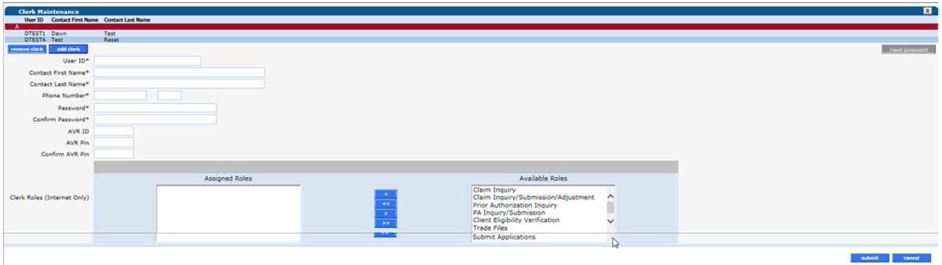
DDS Specialized Services Provider Billing Workshop
Web Account Capabilities - Clerk Maintenance
To create a new clerk account:
Click add clerk
Fill in the required fields
Assign Roles
Click submit
Submit Applications
Notes:
This is a sample Picture with Content slide ideal for including a picture with a brief descriptive statement.
To Replace the Picture on this Sample Slide (this applies to all slides in this template that contain replaceable pictures)
Select the sample picture and press Delete. Click the icon inside the shape to open the Insert Picture dialog box. Navigate to the location where the picture is stored, select desired picture and click on the Insert button to fit the image proportionally within the shape.
Note: Do not right-click the image to change the picture inside the picture placeholder. This will change the frame size of the picture placeholder. Instead, follow the steps outlined above.
Tip: use the Crop tool to reposition a picture within a placeholder. From the Picture Tools Format tab on the ribbon, click the Crop button. Click and drag the picture within the placeholder to reposition. To scale the picture within the placeholder (while Crop is active), grab a round corner handle and drag to resize. Hold Shift key to constrain picture aspect ratio when resizing.

Slide 33
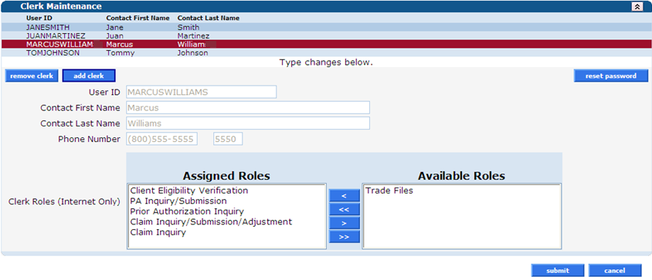
DDS Specialized Services Provider Billing Workshop Web Account Capabilities - Clerk Maintenance
Return to the Clerk Maintenance menu to add additional clerks, reset an existing clerk’s password, or to alter clerks’ Assigned Roles
Notes:
Assignment of Roles or Removal of roles. Remember SAVE

Slide 34
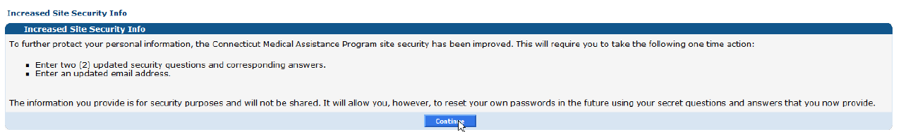
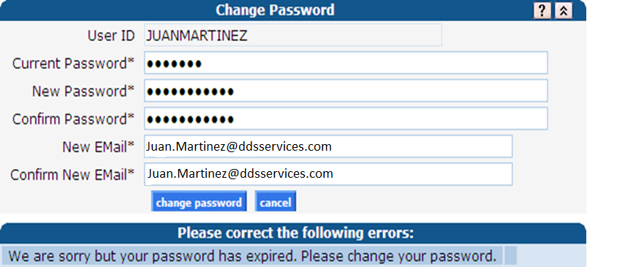
DDS Specialized Services Provider Billing Workshop Web Account Capabilities - Clerk Maintenance
This will be the firs panel that at clerk will see after signing on to their Secure Web Portal Account
When a new clerk logs into the Secure Site for the first time, they will be required to change their password from the one created by the account administrator
Fill in the fields with the appropriate information; click change password
  The clerk is now ready to perform the job duties allowed under the Assigned Roles chosen by the account administrator
Notes:
This is a sample Picture with Content slide ideal for including a picture with a brief descriptive statement.
To Replace the Picture on this Sample Slide (this applies to all slides in this template that contain replaceable pictures)
Select the sample picture and press Delete. Click the icon inside the shape to open the Insert Picture dialog box. Navigate to the location where the picture is stored, select desired picture and click on the Insert button to fit the image proportionally within the shape.
Note: Do not right-click the image to change the picture inside the picture placeholder. This will change the frame size of the picture placeholder. Instead, follow the steps outlined above.
Tip: use the Crop tool to reposition a picture within a placeholder. From the Picture Tools Format tab on the ribbon, click the Crop button. Click and drag the picture within the placeholder to reposition. To scale the picture within the placeholder (while Crop is active), grab a round corner handle and drag to resize. Hold Shift key to constrain picture aspect ratio when resizing.

Slide 35
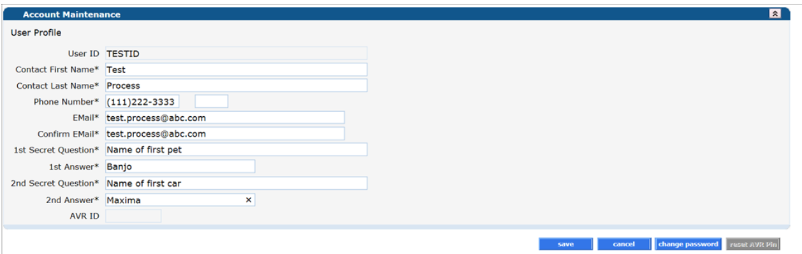
DDS Specialized Services Provider Billing Workshop Web Account Capabilities - Clerk Maintenance
Once a clerk is signed in, they can update their information by selecting account maintenance from either the Account submenu or the Account drop-down menu
Fill in the appropriate information; click save
Notes:
This is a sample Picture with Content slide ideal for including a picture with a brief descriptive statement.
To Replace the Picture on this Sample Slide (this applies to all slides in this template that contain replaceable pictures)
Select the sample picture and press Delete. Click the icon inside the shape to open the Insert Picture dialog box. Navigate to the location where the picture is stored, select desired picture and click on the Insert button to fit the image proportionally within the shape.
Note: Do not right-click the image to change the picture inside the picture placeholder. This will change the frame size of the picture placeholder. Instead, follow the steps outlined above.
Tip: use the Crop tool to reposition a picture within a placeholder. From the Picture Tools Format tab on the ribbon, click the Crop button. Click and drag the picture within the placeholder to reposition. To scale the picture within the placeholder (while Crop is active), grab a round corner handle and drag to resize. Hold Shift key to constrain picture aspect ratio when resizing.

Slide 36
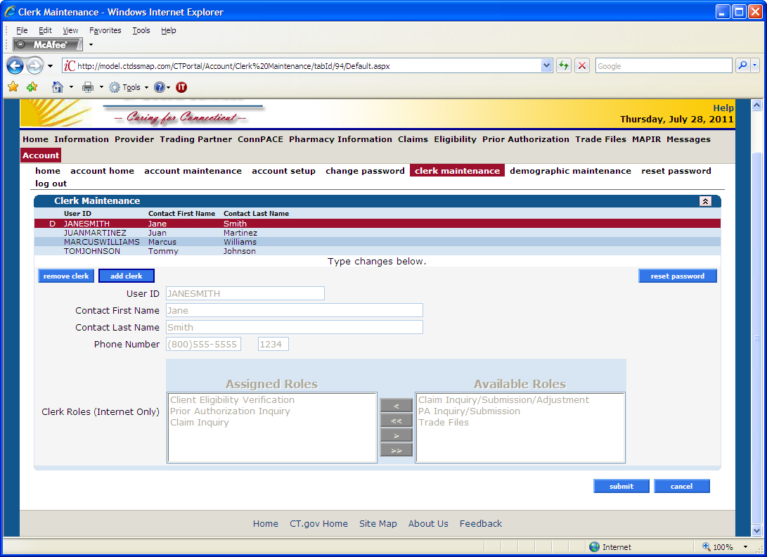
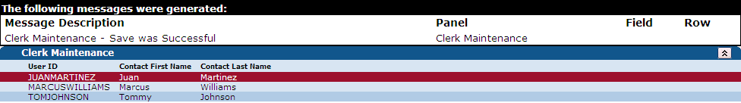
DDS Specialized Services Provider Billing Workshop Web Account Capabilities - Clerk Maintenance
To delete a clerk account – select that account from the list of existing clerks and click on remove clerk
A window will appear asking to you verify that you want to mark that clerk account for deletion; click OK
The D indicates that the clerk has been marked for deletion
Click Submit to finalize the clerk account removal
Notes:
Highlighted clerk “D” for deletion

Slide 37
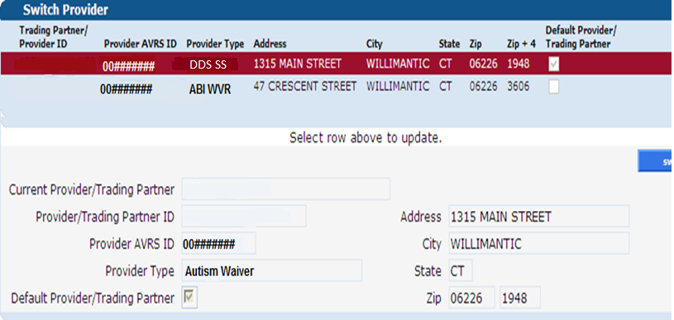
DDS Specialized Services Provider Billing Workshop Web Account Capabilities - Switch User
Once a clerk ID is created by the local administrator, the same clerk ID can be added to more than one main account, this will allow the clerk the ability to switch back and forth between submitting online transactions for those providers
Select switch provider from either the Account submenu or the Account drop-down menu
Select the appropriate provider; click switch to. A window will appear asking you to verify the switch; click OK
Notes:
Should be mentioned to Providers that the Switch to is helpful for employees who work for a different unit- they can easy switch between the two. Highlighted provider is the one you are switching to.

Slide 38
DDS Specialized Services Provider Billing and Web Claim Submission Workshop
Web Account Capabilities - Client Eligibility www.ctdssmap.com

Slide 39
DDS Specialized Services Provider Billing Workshop
Eligibility Verification - Eligibility Verification Methods
Receipt of a service order from the DDS Case Manager confirms the client is DDS Specialized Services eligible, however, the client’s eligibility file may not yet reflect the client’s HUSKY C or HUSKY D eligibility. To avoid unnecessary claim denials such as:
    The client was not eligible on the date of service.
    The service provided was not a covered service under the client’s benefit plan.
Providers should verify client eligibility:
  Verify client eligibility upon receipt of the initial service order.
  Regular Intervals during service
Eligibility verification can be performed in the following ways:
  Internet Web site at www.ctdssmap.com.
  Automated Voice Response System (AVRS).
  Vendor software utilizing the ASC X12N 270/271 Health Care Eligibility/Benefit Inquiry and Information Response transaction.
  Provider Electronic Solutions (PES) software.

Slide 40
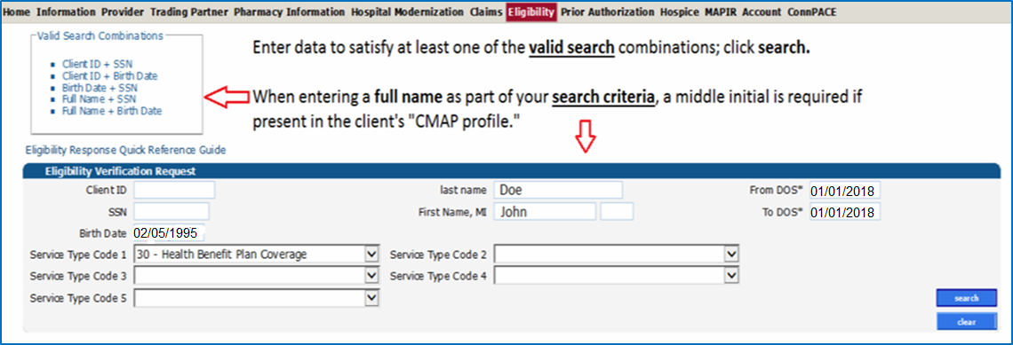
DDS Specialized Services Provider Billing Workshop
Eligibility Verification
To verify a CMAP client’s eligibility through the Secure Site – click on the Eligibility tab on the main menu
Notes:
Service type codes can be searched for specific benefit coverage. (up to 5)

Slide 41
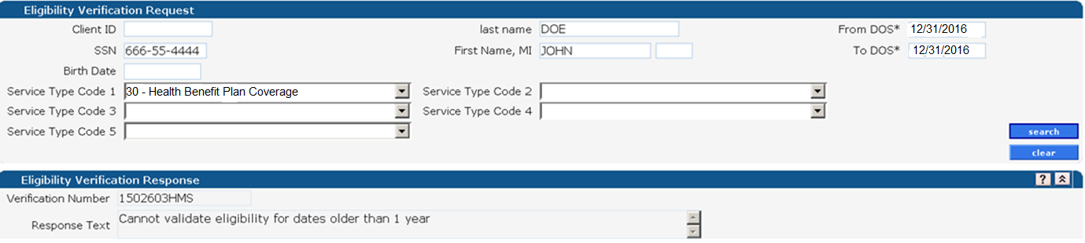
DDS Specialized Services Provider Billing Workshop
Eligibility Verification
The Eligibility Verification Response window provides the search results
In this specific case – the client’s eligibility cannot be verified for the requested date (December 31, 2016) as eligibility verification can only look back one year
Changing the dates of the eligibility request to within the allowable one year window creates a different result.

Slide 42

DDS Specialized Services Provider Billing Workshop
Eligibility Verification
Eligibility searches cannot span multiple months
01/01/2018 – 01/31/2018 is valid, 01/15/2018 – 02/15/2018 is not valid
Submitting a request that spans multiple months will result in an error message.

Slide 43


DDS Specialized Services Provider Billing Workshop
Eligibility Verification
Positive eligibility responses provide greater detail…

Slide 44
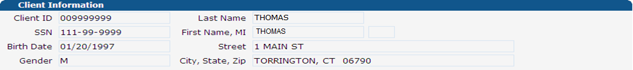
DDS Specialized Services Provider Billing Workshop
Eligibility Verification
What does all this information mean?
Eligibility Verification Response
Provides a verification number that should be kept on record in case the client’s coverage is retroactively changed at a later date
Reports client’s eligibility status for the requested date(s) of service
Client Information

Slide 45
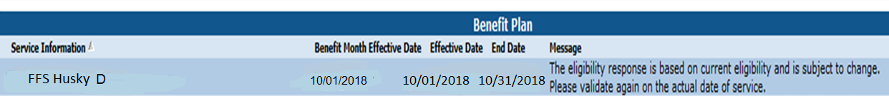
DDS Specialized Services Provider Billing Workshop
Eligibility Verification
Benefit Plan
The benefit plan(s) with which the client was an active member on the date(s) of service requested
The client must have a HUSKY C or HUSKY D benefit plan for the DDS Specialized Services provider to be reimbursed for services provided to a DDS client residing in a nursing facility and billed directly to DXC Technology by the DDS Specialized Services provider.

Slide 46
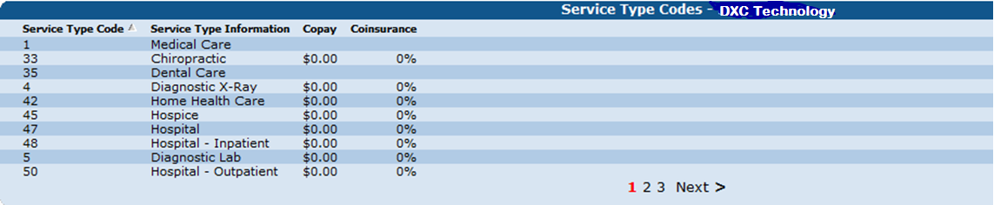
DDS Specialized Services Provider Billing Workshop
Eligibility Verification
Service Type Codes – DXC Technology
A list of services for which the client was eligible that would be submitted for payment to DXC Technology

Slide 47
DDS Specialized Services Provider Billing Workshop
Eligibility Verification
Lockin
Some clients are locked into receiving certain health care services only from specific providers or pharmacies; those providers or pharmacies will be listed here
Medicare
Types of Medicare coverage active for the client on the date(s) of service requested

Slide 48
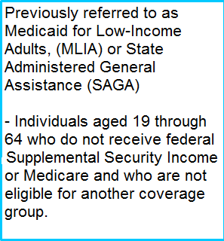
DDS Specialized Services Provider Billing Workshop
Eligibility Verification
Benefit Plans payable for DDS Specialized Services
HUSKY C
HUSKY D
Previously referred to as fee–for–service Medicaid, or Adult Medicaid
Individuals that are aged, blind, or disabled

Slide 49
DDS Specialized Services Provider Billing and Web Claim Submission Workshop
Web Account Capabilities - Prior Authorization (PA) www.ctdssmap.com

Slide 50
DDS Specialized Services Provider Billing Workshop
Prior Authorization
Effective for dates of service October 1, 2018 and forward, all services will be authorized by the Department of Developmental Services (DDS).
All services will be authorized for a period of one year
DDS Specialized Services providers will have access to the service authorizations for the client’s they will service via the provider’s secure Web Portal Home page from the Prior Authorization (PA) menu.
Each service to be provided will have its own unique PA Number beginning with the letter D and be viewable to the servicing provider by selecting PA Search from the PA menu.
NOTE: To prevent unnecessary claim denials providers should determine if service authorization has been received for the service/start date prior to providing service and submitting claims.

Slide 51
DDS Specialized Services Billing Provider Workshop
Billing Guidelines and Restrictions- Billable Services
Procedure Code | Description | Allowed Units | Prior Authorization Required | Diagnosis Restrictions
97537 | Community or Work Reintegration Training, per 15 min. | Confirm units per day allowed | Yes, authorized per year of service | If unknown, use F79
T2020 | Day Habilitation Waiver, per diem | Confirm units per day allowed | Yes, authorized per year of service | If unknown, use F79
T2021 | Day Habilitation Waiver, per 15 min | Confirm units per day allowed | Yes, authorized per year of service | If unknown, use F79
H2019 | Therapeutic Behavioral Services, per 15 min. | Confirm units per day allowed | Yes, authorized per year of service | If unknown, use F79
97802 | Medical nutrition therapy re-assessment and intervention, per 15 min. | Confirm units per day allowed | Yes authorized per year of service | If unknown, use F79

Slide 52
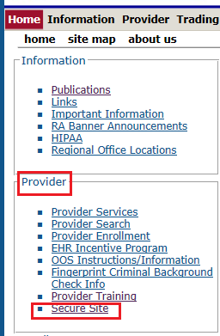
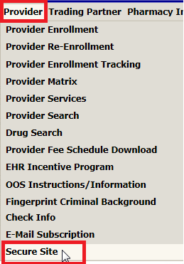
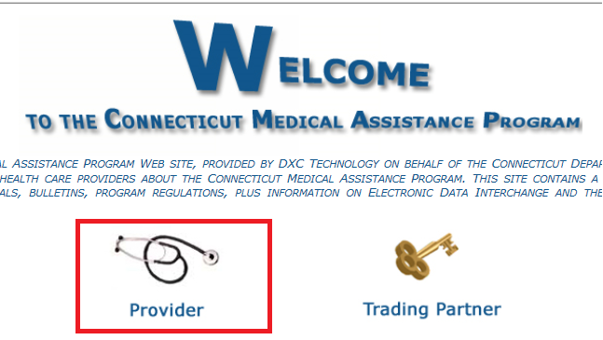
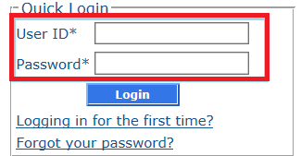
DDS Specialized Services Provider Billing Workshop
Prior Authorization (PA) – Access via Secure Web Portal
Users have multiple ways to log on to their secure Web account from the www.ctdssmap.com Home page.

Slide 53
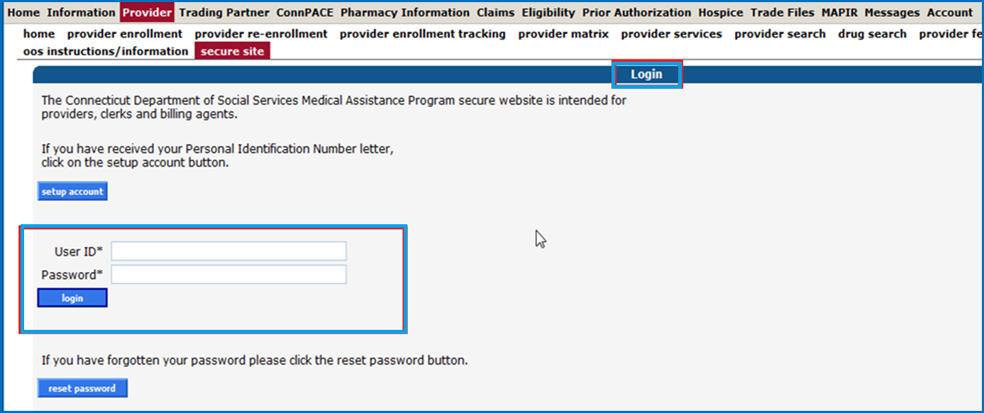
DDS Specialized Services Provider Billing Workshop
Prior Authorization (PA) - Access Via Secure Web Portal cont.

Slide 54
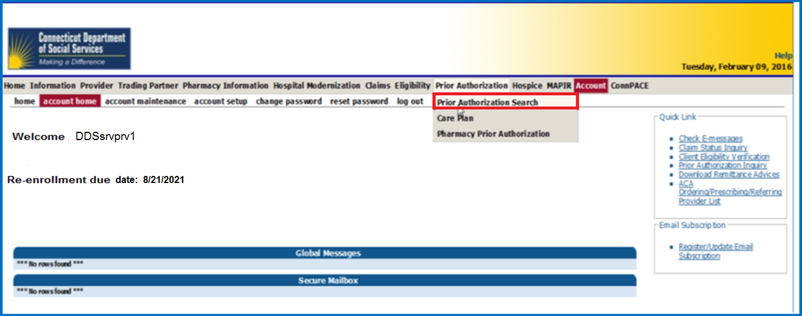
DDS Waiver Services Provider Billing Workshop
Prior Authorization (PA) Search – via Secure Web Account Home Page
Once on the secure site, click Prior Authorization Search from the Prior Authorization Menu.

Slide 55
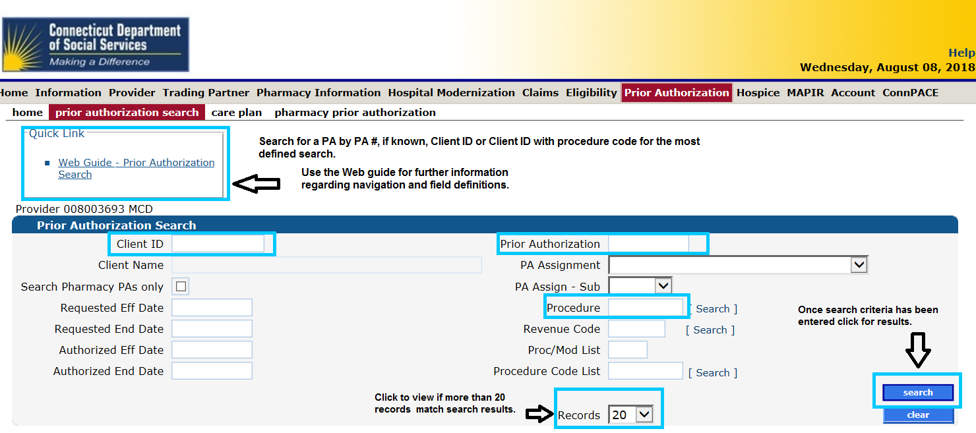
DDS Specialized Services Provider Billing Workshop
Prior Authorization (PA) - Search Criteria
Search by Client ID or PA Number. Further define search by date, procedure or list code.

Slide 56
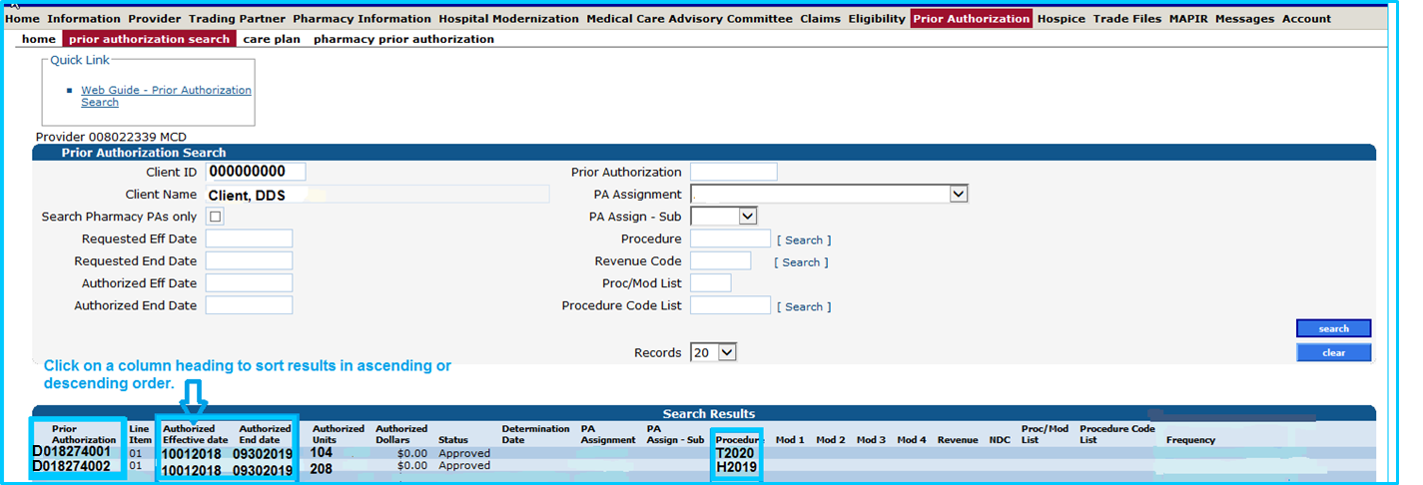
DDS Specialized Services Provider Billing Workshop
Prior Authorization (PA) Search Results – DDS Specialized Services
Search results by client ID provide all PAs authorized for the client under the provider’s care. Results can be more defined by increasing the amount of data used in the search.

Slide 57
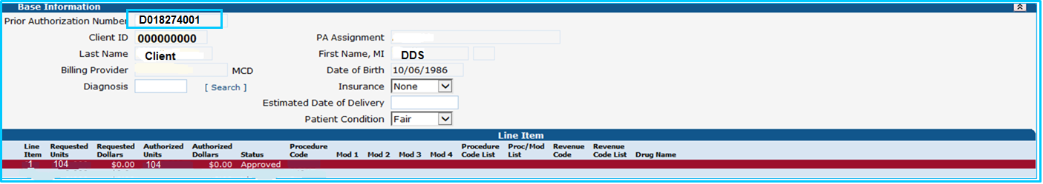
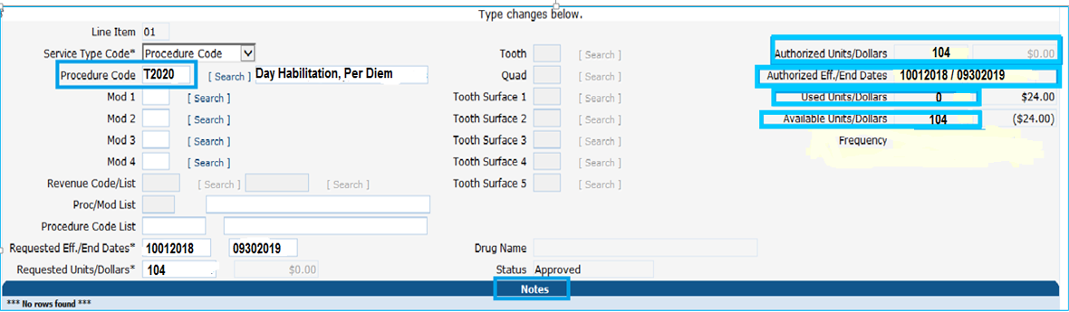
DDS Specialized Services Provider Billing Workshop
PA Access to Additional Service Authorization Information
Additional Care Plan Information can be viewed by opening a PA from the PA Search Results Inquiry. Once a PA line detail is open, providers have access to units available and used, in addition to case manager notes.

Slide 58
DDS Specialized Services Provider Billing Workshop
PA Inquiry - Viewing and Understanding the DDS Specialized Services PA
Points to remember when viewing the client’s Service Order/Prior Authorization on your secure Web Account:
  The procedure code(s) and effective dates of service and units should match:
    the service request or
    the service order noted in the notes section of the PA on your secure Web account (Created by the DSS Case Manager)
  Note: Discrepancies should be reported to the DDS Case Manager

Slide 59
DDS Specialized Services Provider Billing and Web Claim Submission Workshop
Web Account Capabilities - Claim Submission and Inquiry www.ctdssmap.com

Slide 60
DDS Specialized Services Provider Billing Workshop
Web Account Capabilities - Web Claim Submission/Inquiry
    Web Claim Submission allows for:
    Interactive Claim Submission with immediate response of claim payment, denial or suspense.
    Web Claim Inquiry:
    Allows providers to query claims in order to adjust, void, or re-submit within the same claims processing cycle.

Slide 61
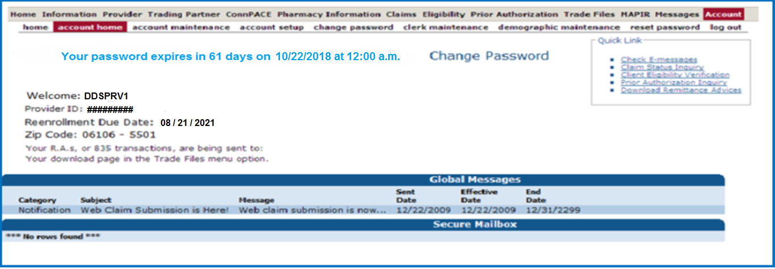
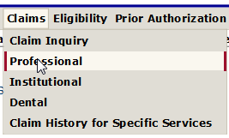
DDS Specialized Services Provider Billing Workshop
Web Claim Submission Access to Claim Format
Click Claims and Select the Professional Format
Notes:
Each menu options has sub-options

Slide 62
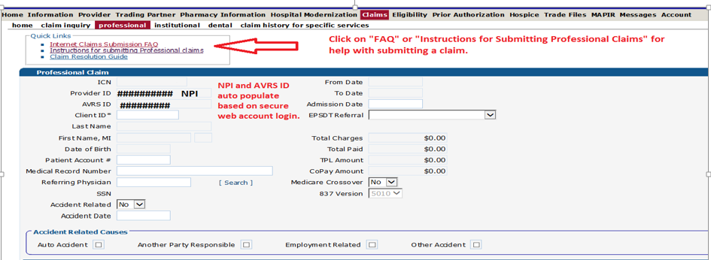
DDS Specialized Services Provider Billing Workshop
Claim Processing/Submission Information/Resources

Slide 63
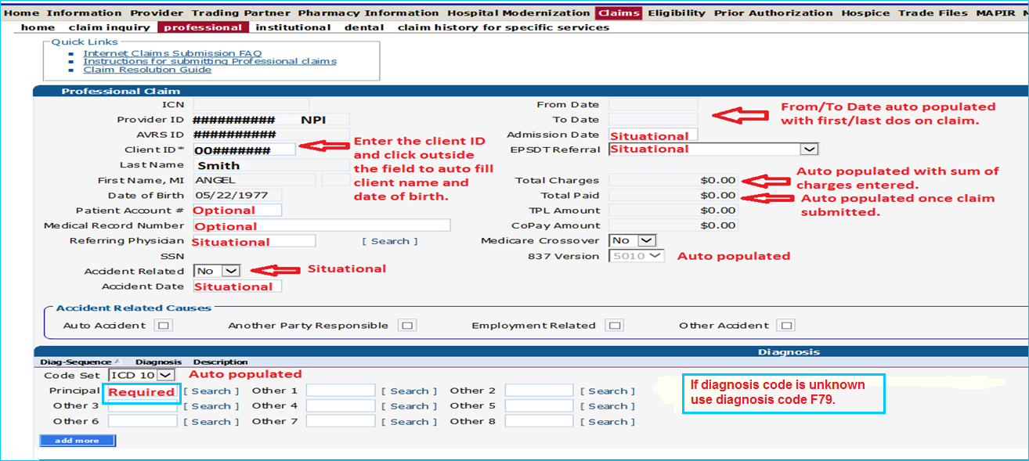
DDS Specialized Services Provider Billing Workshop
Claims Processing/Submission Information – Demographics/Diagnosis.

Slide 64
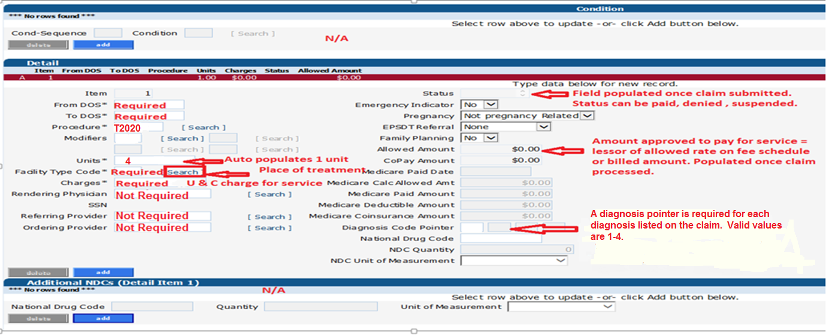
DDS Specialized Services Provider Billing Workshop
Claims Processing/Submission Information – Service Line Detail

Slide 65
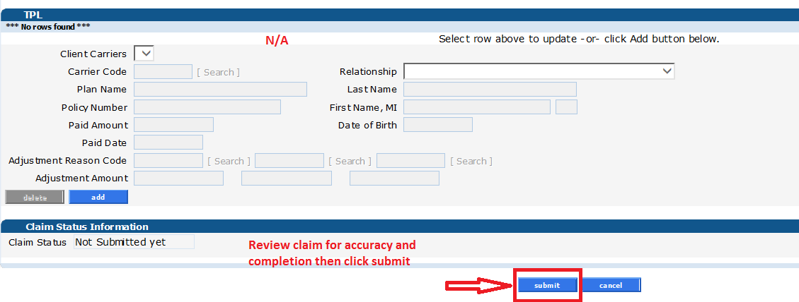
DDS Specialized Services Provider Billing Workshop
Claims Processing/Submission Information – Third Party Liability/Claim Status

Slide 66
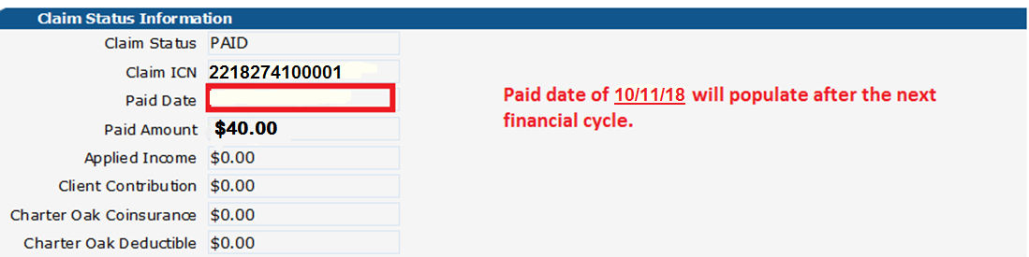
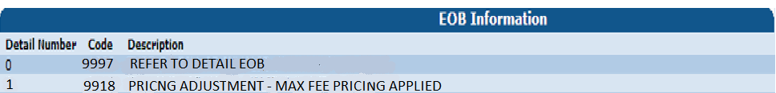
DDS Specialized Services Provider Billing Workshop
Claims Processing/Submission Information – Claim Status cont./EOB Info.

Slide 67

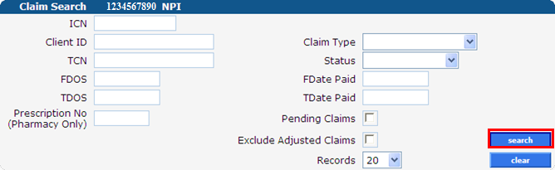
DDS Specialized Services Provider Billing Workshop
Web Claim Inquiry
Once you have submitted a claim to DXC Technology using the ctdssmap.com Secure Site:
  click on the “Claims” tab on the main menu and select “Claim Inquiry”
Enter enough information to satisfy at least one of the following criteria:
  ICN
  Client ID FDOS/TDOS or Fdate Paid/Tdate Paid (spanning 91 days or less)
  check the Pending Claims box

Slide 68
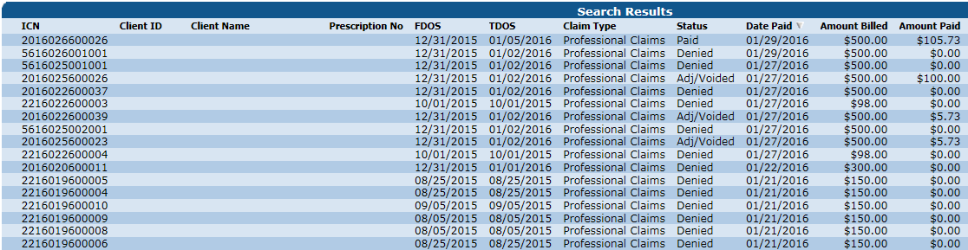
DDS Specialized Services Provider Billing Workshop
Web Claim Inquiry - Search Results
When more than one claim matches the claim inquiry search criteria, a list of claims will appear in the Search Results panel
Search results may be sorted by clicking on the column headings
Click anywhere on a given row to select the claim to view

Slide 69

DDS Specialized Services Provider Billing Workshop
Web Claim Inquiry – Internal Control Number (ICN) Logic
Claims submitted to DXC Technology are each assigned a unique 13-digit Internal Control Number (ICN) that is used for tracking and research.
  1 Claim Region – Identifies the manner in which the claim was submitted. (20 = Electronic Claims
  with No attachments)
  2 Year of Receipt – Indicates the year in which the claim was received by DXC Technology (18 =
  2018)
  3 Julian Date of Receipt – The Julian calendar date of receipt (274 = the two hundred seventy fourth day of the year =
  October 1, 2018).
  4 Batch Number – An internal number assigned by DXC Technology to uniquely identify a batch.
  (123)
  5 Claim Number – A sequential number assigned to uniquely identify claims within a batch. (456)
Notes:
Include ICN region code handout

Slide 70
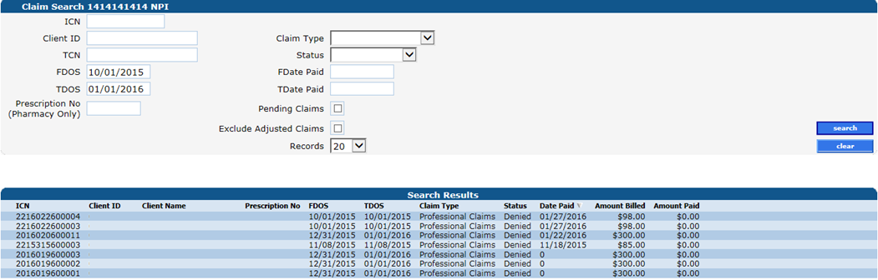
DDS Specialized Services Provider Billing Workshop
Web Claim Inquiry
Search Results by FDOS and TDOS is limited to no more than 93 days

Slide 71
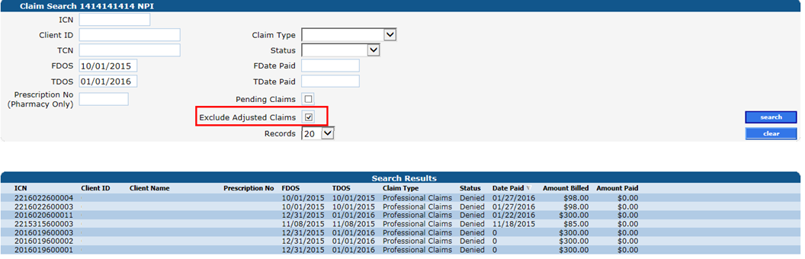
DDS Specialized Services Provider Billing Workshop
Web Claim Inquiry - Exclude Adjusted Claims
Removes claims that have been altered since their initial submission
Results in a more accurate representation of your total reimbursement

Slide 72
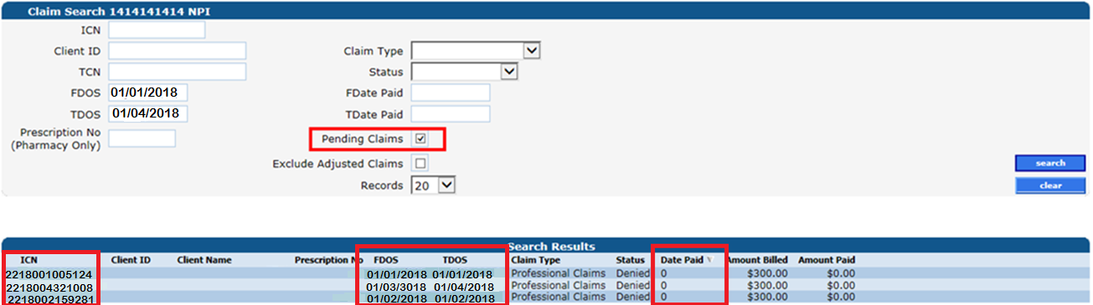
DDS Specialized Services Provider Billing Workshop
Web Claim Inquiry - Pending Claims
Claims submitted since the last Remittance Advice (RA) was issued that have not yet gone through a financial cycle. Note the Paid date for these claims is 0 until the cycle paid date.
Convenient way to see all claims that will impact your reimbursement for the current cycle
Click any line in the Search Results panel to view the corresponding claim
Notes:
Every claim submitted since last financial cycle allows you to fix any denied claims

Slide 73
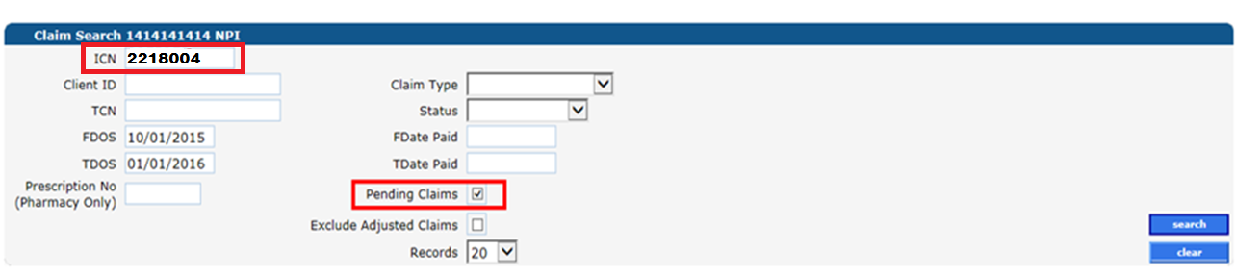
DDS Specialized Services Provider Billing Workshop
Web Claim Inquiry - Pending Claims
To narrow search results for pending claims by region on a given date, enter the first 7 digits of the Claim Internal Control Number (ICN).
This search will provide claims submitted via the Web on January 4, 2018 that have not yet processed through a financial cycle.

Slide 74
DDS Specialized Services Provider Billing and Web Claim Submission Workshop
Web Account Capabilities – Web Claim Submission Options www.ctdssmap.com

Slide 75
DDS Specialized Services Provider Billing Workshop
Web Claim Submission Options
Paid claims allow you to:
  Cancel any alterations you have made
  Adjust the claim
  Void the claim
  Copy the claim and use it as a template to create a new claim
  Create a brand new claim
Denied claims allow you to:
  Resubmit the claim (with or without making changes)
  Cancel any alterations you have made
  Create a brand new claim
Suspended claims allow you to:
  Create a brand new claim

Slide 76
DDS Specialized Services Provider Billing Workshop
Web Claim Submission Options - Adjustments
Perform the following steps to easily adjust a paid claim:
Select Claim Inquiry
Enter the paid claim ICN (found on your RA) in the ICN field
Click the search button
Once the claim is retrieved, make any necessary changes to the claim
Click the adjust button at the bottom of the claim page
The adjustment will process immediately and return a status of Paid, Denied or Suspended

Slide 77
DDS Specialized Services Provider Billing Workshop
Web Claim Submission Options - Adjustment Limitations
Timely Filing
Claims that are over the Timely Filing guidelines cannot be adjusted, unless the adjustment is submitted to pay the same or less than the original claim; otherwise, claim adjustments outside of the timely filing limit will be fully recouped
Special Handled Claims
Claims with an ICN that begins with either “12” or “13” indicate that they have been special handled by DXC Technology and are, therefore, not able to be adjusted via the www.ctdssmap.com Web site

Slide 78
DDS Specialized Services Provider Billing Workshop
Web Claim Submission Options - Void
Perform the following steps to void or completely recoup a paid claim:
Select Claim Inquiry
Enter the paid claim ICN (found on your RA) in the ICN field
Click the search button
Once the claim is retrieved, click the void button at the bottom of the claim page
The void will process immediately and return a message that the claim has been successfully adjusted / voided with a new ICN

Slide 79
DDS Specialized Services Provider Billing Workshop
Web Claim Submission Options - Copy
Paid claims may be copied and submitted as a new claim
This feature is helpful for reoccurring services
Copy - Perform the following steps to easily copy a paid claim for submission as a new claim:
Select Claim Inquiry
Enter the paid claim ICN (found on your RA) in the ICN field
Click the search button
Once the claim is retrieved, click the copy button at the bottom of the claim page
Make the necessary changes to the claim
Click the submit button at the bottom of the claim page
The new claim will process immediately and return a status of Paid, Denied or Suspended

Slide 80
DDS Specialized Services Provider Billing Workshop Web Claim Submission Options - Resubmit
Resubmission - Perform the following steps to easily resubmit a denied claim:
Select Claim Inquiry
Enter the denied claim ICN (found on your RA) in the ICN field
Click the search button
Once the claim is retrieved, make any necessary changes to the claim
Click the re-submit button at the bottom of the claim page
The claim will process immediately and return a status of Paid, Denied or Suspended

Slide 81
DDS Specialized Services Provider Billing and Web Claim Submission Workshop
Claim Submission Methods
www.ctdssmap.com

Slide 82
DDS Specialized Services Provider Billing Workshop
Claim Submission Methods
Claims submitted for DDS Specialized services, directly by DDS Specialized Services providers must be submitted via:
  Internet Web site at www.ctdssmap.com
    Interactive with immediate response of claim payment, denial or suspend.
    Allows providers to query claims in order to adjust, void, or re-submit within the same claims processing cycle.
  Vendor Software utilizing the following HIPAA ASC X12N transactions:
    837P – Health Care Claim Professional
    Requires provider to enroll as a Trading Partner
  Paper (special handling only)
    CMS-1500 Claim Form
  As of October 1, 2016 the Department of Social Services (DSS) will no longer accept paper claims for processing. Paper claims submitted on or after October 1, 2016 will be returned to the provider.
  Ref: PB 2016-31.

Slide 83
DDS Specialized Services Provider Billing and Web Claim Submission Workshop
Claim Submission Guidelines
www.ctdssmap.com

Slide 84
DDS Specialized Services Provider Billing Workshop
Claim Submission Guidelines - Edits and Audits
Regardless of the claim submission method, all claims are processed through the Connecticut interChange system and are subject to a series of edits that check the validity of claim data such as:
    Submitting provider must be actively enrolled on the date of service.
    Client must be eligible on date of service.
    Procedure Code submitted must be valid for the Provider Type.
Claims are then subject to a series of audits such as:
    If the billed procedure code requires prior authorization (PA), has the PA been approved?
    The claim is compared to previously paid claims
      Is the current claim a duplicate of a paid claim?

Slide 85
DDS Specialized Services Provider Billing Workshop
Claim Submission Guidelines - Timely Filing
Timely Filing Guidelines
  The timely filing limit, under the HUSKY C & HUSKY D Benefit plan for the submission of DDS Specialized Services by a DDS Specialized Services Provider:
      One (1) year from the date of service (initial claim).
      One (1) year from date of last payment or denial, if not for timely filing.

Slide 86
DDS Specialized Services Provider Billing Workshop
Claim Submission Guidelines - Spanning Dates of Service
Dates of service can only be spanned for non-medical services submitted in the professional claim format when service is provided on consecutive dates which span the from and through dates of service on the claim detail.
  For example, if Therapeutic Behavioral services (H2019) are to be provided for 3 days per week, the services may be spanned on a single claim detail if the services are performed on consecutive days of service such as Monday – Wednesday.
  Spanned dates of service cannot span multiple PAs or multiple line details on a PA.
  For example, Procedure code H2019 is authorized under PA D018274100 for dates of service 10/1/18-9/30/19 and PA D018274181 for dates of service 10/1/2019-9/30/2020.
  Services performed for H2019 on Monday, 9/30/19 through Wednesday, 10/2/19 cannot be spanned on a single line detail.
    Date of service 9/30/19 must be billed on a separate line detail as the service is authorized under D018274100.
    Services for Tuesday and Wednesday 10/1-10/2/2019 may be spanned as both are authorized under PA D018274181.

Slide 87
DDS Specialized Services Provider Billing and Web Claim Submission Workshop
Claim Denials and Resolution
www.ctdssmap.com

Slide 88
DDS Specialized Services Provider Billing Workshop
  Claim Denials and Resolution
Denial Reasons Due to Eligibility:
  EOB Code 2003 - Client Ineligible for dates of service
  EOB Code 4021 - Procedure Billed is not a Covered Service under the Client’s Benefit Plan. (If this is the only EOB that sets on the claim, the client does not have a HUSKY C or HUSKY D benefit plan. If any other EOB is on the claim, take action on the other EOB and disregard EOB 4021).
    Please Note: The system attempts to process under the HUSKY benefit plan first, if not a covered service it will set 4021 for the HUSKY benefit plan. The system will then attempt to process under any other benefit plan the client may have, which too will set 4021.
    Resolution:
      Client eligibility file needs to be updated with a HUSKY C or HUSKY D benefit plan or a change in the effective dates of eligibility.

Slide 89
DDS Specialized Services Provider Billing Workshop
Claim Denials and Resolution
  Claim Denial Reason due to PA Exhausted:
    EOB Code 3003 – Prior Authorization is required for payment of the service (units for the service are exhausted).
  Resolution 1: Units of service must be added by the DDS Case Manager to an existing PA that is currently exhausted.
  Resolution 2: PA exhausted may be due to provider keying error. Provider should review claim(s) within the span dates of the PA for keying errors or possible over service.

Slide 90
DDS Specialized Services Provider Billing Workshop
Claim Denials and Resolution
Claim Denial Reason due to Provider Not Allowed to Submit Claims for Care Plan:
  EOB Code 3017 – Provider not Allowed to Submit claims for Care Pan
    Cause:
    Provider Submitting a claim for H2019 for an ABI client using their DDS Specialized Services Provider AVRS ID. (H2019 a covered service under both ABI and DDS Specialized Services).
  Resolution : Provider must resubmit claim under their ABI Provider ID.

Slide 91
DDS Specialized Services Provider Billing and Web Claim Submission Workshop
Remittance Advice
www.ctdssmap.com

Slide 92
DDS Specialized Services Provider Billing Workshop
Remittance Advice - Access to Claim and Financial Reporting
All claims activity is reported to providers twice a month on a Remittance Advice (RA)
RAs provide comprehensive information about claims that are paid, denied, in process, and adjusted, and are produced based on a provider’s claim activity
Providers receive RAs electronically via the secure Provider Web site at www.ctdssmap.com
Available in the ASC X12N 835 Payment/Advice standard transaction format, which is a string of raw data that must be configured by the provider/vendor for download into their system, PDF or in the Comma Separated Format (CSV) which provides the paper version of the RA
Only the last 10 RAs are maintained on the DXC Technology Web site; it is highly recommended that providers save a copy of their RAs to their local computer system for future access

Slide 93


DDS Specialized Services Provider Billing Workshop
Remittance Advice (RA) - Access to Claim and Financial Reporting
To access the Remittance Advice in PDF or CSV Format:
Click Download Remittance Advice from the Quick Link box on the account home screen or select Download from the Trade Files drop-down menu
then select “Remit. Advice (RA) - PDF” or “CSV” from the “Transaction Type” on the File Download Search screen.
Note: Files are only retained on the Provider’s Secure Web Account for a period of five (5) months or ten (10) RAs at which time they are removed. Providers should download copies each cycle for future reference.

Slide 94

DDS Specialized Services Provider Billing Workshop
Remittance Advice Comma Separated Value - CSV Format
In addition to the traditional PDF Remittance Advice (RA) format, DDS Specialized Services providers will have access to their (RA) in an excel format. This allows providers to sort the file and search for specific claim approvals and denials. To access the RA, go to our Web site at www.ctdssmap.com and log onto the secure Web portal. Under “Trade Files”, choose “Download” from the drop down menu. Select “CSV” from the “Transaction Type” on the File Download Search screen. This will populate the current files available to download. The following provides an example of the data available in this excel format:

Slide 95
DDS Specialized Services Provider Billing Workshop
Remittance Advice - Components of the RA – 7 Sections
Banner Page
  Important messages from DSS or DXC Technology
Claims Information (Paid, Denied, and Adjustments)
  Sorted by claim type and status; reports up to 20 EOB codes per claim
TPL Information
  The primary insurance that is on file for clients whose services appear on the RA
Financial Transactions Processed
  Payouts, Refunds, Account Receivables
Notes:
7 sections of an RA
RA personal message to provider type or individual provider ID: reprocessed claims; holiday closings
Claims are chronological NOT by client ID, broken up by Paid, Denied, and Adjusted
AR for adjustments that resulted in lower payment or claim recoupment information
EOB description in final section only
* Last Pull is Friday Mornings*

Slide 96
DDS Specialized Services Provider Billing Workshop
Remittance Advice - Components of the RA – 7 Sections cont.
RA Summary
  Month-to-day and year-to-day summaries of financial activities, account receivables
EOB Code Descriptions
  Descriptions of the EOB codes that posted to claims on the RA
Claims in Process
  Lists claims that were in suspense when the financial cycle was run
Notes:
7 sections of an RA
RA personal message to provider type or individual provider ID: reprocessed claims; holiday closings
Claims are chronological NOT by client ID, broken up by Paid, Denied, and Adjusted
AR for adjustments that resulted in lower payment or claim recoupment information
EOB description in final section only
* Last Pull is Friday Mornings*

Slide 97


Remittance Advice – Banner Page

Slide 98


Remittance Advice - Paid Claims

Slide 99


Remittance Advice – Denied Claims

Slide 100


Remittance Advice – Claim Adjustments

Slide 101



Remittance Advice – Final Transactions

Slide 102



Remittance Advice – Summary

Slide 103



Remittance Advice – EOB Code Descriptions

Slide 104
DDS Specialized Services Provider Billing and Web Claim Submission Workshop
Program Reminders for Successful Claim Submission
www.ctdssmap.com

Slide 105
DDS Specialized Services Provider Billing Workshop
Reminders for Successful Claim Submission – Service Authorization
  Check to be sure the services you have been requested to provide have been authorized.
  Use “Prior Authorization Search” under the Prior Authorization menu
  Report discrepancies to the appropriate DSS Case Manager immediately.
  Review Prior Authorizations when you are notified of changes to be sure the services you are being requested to provide have been authorized.

Slide 106
DDS Specialized Services Provider Billing Workshop
Reminders for Successful Claim Submission - Claim Submission Review
    Prior to submitting claims be sure services provided match services authorized and services to be billed.
    Identify discrepancies early to avoid over service or potential billing errors which may cause claims to deny such as:
        Exceeding units on the PA
        Spanning dates of service across PAs or PA line details.

Slide 107
DDS Specialized Services Provider Billing Workshop
Reminders for Successful Claim Submission - Claim Submission Review cont.
    Minimize claim submission time by:
      Submitting claims via 837 batch or interactively via the web. Paper claims will be returned unless the claim needs special handling.
      Copying a prior paid claim, especially when billing for like services, minimizes changes needed for resubmission
      Spanning dates of service on a single line detail when the same service is performed on consecutive dates reduces key strokes and the number of details on a claim.

Slide 108
DDS Specialized Services Provider Billing Workshop
Program Reminders for Successful Claim Submission - Claim Resolution
    Reconcile claims as entered via the web or leave time before claim cycle cutoff to correct and resubmit.
    Reconcile RA for the current cycle before receiving next RA to identify problems early to avoid major reimbursement issues.
        Refer to list of EOB code descriptions at the end of the RA to determine reason(s) for denial.
        Use Claim Resolution Guide (Chapter 12 of Provider Manual) to determine the cause of a denial and its resolution.
        Contact DXC Technology Provider Assistance Center with issues you cannot resolve.

Slide 109
DDS Specialized Services Provider Billing and Web Claim Submission Workshop
Program Information Resources
www.ctdssmap.com

Slide 110

DDS Specialized Services Provider Billing Workshop
Information Resources - www.ctdssmap.com

Slide 111


Fee Schedules
    CMAP fee schedules are available for download from the Web site
    Select Provider Fee Schedule Download from the Provider drop-down menu
    You must read and accept the End User License Agreement prior to downloading the fee schedule; click I Accept
    Provider Fee Schedules are listed by provider type and specialty
    Click the corresponding link to download the appropriate fee schedule
    “Fee Schedule instructions” can be accessed at the top of the page after clicking I Accept

Slide 112
DDS Specialized Services Provider Billing and Web Claim Submission Workshop
Program Information Resources - Publications
www.ctdssmap.com

Slide 113


DDS Specialized Services Provider Billing Workshop
Information Resources - Important Messages (IM)
www.ctdssmap.com contains a wealth of information for providers:
Important Messages
      Available on the Home page. Also available on the Information page
      Contains urgent messages that require immediate communication to the provider community as well as links to important information regarding recent/upcoming system changes

Slide 114

DDS Specialized Services Provider Billing Workshop
Information Resources - Remittance Advice (RA) Banner Announcements
RA Banner Announcements
Available by selecting the Information tab or clicking on RA Banner Announcements in the Information box on the left hand side of the home page
Messages originally published for providers on the first page of their remittance advice. Some banner announcements are provider specific and therefore are only sent to the relevant provider types/specialties
Often published in regards to reprocessed claims; explaining the reasons behind the reprocessing as well as the claim types affected

Slide 115

DDS Specialized Services Provider Billing Workshop
Information Resources - Archive Important Message and RA Banner Announcements
    Important Messages and RA Banner Announcements are available on the Home page of the www.ctdssmap.com Web site.
    Only the most current messages will be posted in the main areas on the Web for a limited time; thereafter, providers will have to retrieve previously published Important Messages and Banner Announcements from messages archive.
    To access the messages archive page, select messages archive from the Information drop-down menu on the home page.
    RA Banner Announcements and Important Messages dated January 1, 2014 and forward are saved on the Web site and are available for review.

Slide 116


DDS Specialized Services Provider Billing Workshop
Information Resources - Publications
Publications
A majority of the information available on the www.ctdssmap.com Web site is located on the Publications page
Access the Publications page by selecting Publications from either the Information box on the left hand side of the home page or from the Information drop-down menu

Slide 117

DDS Specialized Services Provider Billing Workshop
Information Resources - Publications – Provider Bulletins
Provider Bulletins
  Publications posted to relevant provider types / specialties documenting changes or updates to the CT Medical Assistance Program
  Bulletin Search allows you to search for specific bulletins (by year, number, or title) as well as for all bulletins relevant to your provider type. The online database of bulletins goes back to the year 2000

Slide 118


DDS Specialized Services Provider Billing Workshop
Information – Publications - Provider Manual @ www.ctdssmap.com
The Provider Manual is available to assist providers in understanding how to receive prompt reimbursement through complete and accurate claim submission
It is the primary source of information for submitting CMAP claims, prior authorizations, and other related transactions. This manual contains detailed instructions regarding the Program, and should be your first source of information pertaining to policy and procedural questions
The Provider Manual is divided into twelve (12) chapters
    Click on the chapter title to open the document (disable pop-up blockers)
    Chapters 7 and 8 are provider specific – select your provider type from the drop-down menu and click View Chapter to access the chapter
    Chapter 11 is claim-type specific

Slide 119
DDS Specialized Services Provider Billing Workshop
Information – Publications - Provider Manual @ www.ctdssmap.com
Chapter 1 – Introduction
Provides information on the CT Medical Assistance Program, the Department of Social Services’ and DXC Technology’s responsibilities and resources
Chapter 2 – Provider Participation Policy
Details the CMAP regulations for provider participation
Chapter 3 – Provider Enrollment and Re-enrollment
Provides information on provider eligibility in regards to provider enrollment and re-enrollment
Chapter 4 – Client Eligibility
Provides information regarding client eligibility in the Medical Assistance Program, client eligibility verification, and client third party liability
Chapter 5 – Claim Submission Information
Provides information on general claims processing, billing requirements and timely filing guidelines
Chapter 6 – Electronic Data Interchange Options
Provides information on electronic claim submission and electronic RAs

Slide 120
DDS Specialized Services Provider Billing Workshop
Information – Publications - Provider Manual @ www.ctdssmap.com
Chapter 7 – Specific Policy/Regulation
This section contains the Medical Services Policy sections that pertain to the chosen provider type
Chapter 8 – Provider Specific Claims Submission Instructions
Provides information on provider specific billing requirements and instructions
Chapter 9 – Prior Authorization
Provides information on how to obtain Prior Authorization for designated services
Chapter 10 – Web Portal/Automated Voice Response System (AVRS)
Provides information on both the AVRS and the Web Portal functions
Chapter 11 – Other Insurance/Medicare Billing Guides
Provides claim-type specific information on other insurance and Medicare billing
Chapter 12 – Claim Resolution Guide
Provides descriptions of common EOBs and, if applicable, information to resolve the errors

Slide 121


DDS Specialized Services Provider Billing Workshop
Information – Resources Provider Newsletters and Claims Processing Guides
Provider Newsletters
  Quarterly publications to providers on a wide range of topics
    Claims Processing Information
    Guides and FAQs to assist with billing/claims processing

Slide 122



DDS Specialized Services Provider Billing Workshop
Information Resources - Links
    The Links page (accessible by selecting Links from either the Information box on the left hand side of the home page or from the Information drop-down menu) provides Web links to various relevant sites and resources

Slide 123


DDS Specialized Services Provider Billing Workshop
Information – HIPAA
    The HIPAA information page is accessible by selecting HIPAA from either the Information box on the left hand side of the home page or from the Information drop-down menu.
    The HIPAA page provides information regarding:
    HIPAA Mandated Transactions
    Frequently Asked Questions
      DXC Technology and DSS have compiled a list of common HIPAA-related questions and answers
    Glossary of Terms
      General definitions and explanations of HIPAA-related terms and acronyms

Slide 124
DDS Specialized Services Provider Billing and Web Claim Submission Workshop
Program Information On Going Communication Tool
www.ctdssmap.com

Slide 125


DDS Specialized Services Provider Billing Workshop
Information Resources – E-mail Subscriptions
E-mail Subscriptions
Register for E-mail Subscriptions - Providers MUST register to receive information electronically for new provider publications and notifications through the email subscription function on the Connecticut Medical Assistance Program (CMAP) Web site at www.ctdssmap.com
    For complete E-mail subscription information, please see provider bulletin PB 15-23 on the CMAP Web site

Slide 126
Contacts
www.ctdssmap.com
Contacts

Slide 127
DDS Specialized Services Provider Billing Workshop Contacts
Where to go for help:
DXC Technology Provider Provider Assistance Center
  For Enrollment and Claim related issues:
  Monday through Friday, 8:00 a.m. – 5:00 p.m. (EST), excluding holidays
  1-800-842-8440 (toll free)

Slide 128
Questions/Comments
www.ctdssmap.com
Question and Comments

Slide 129
Thank You For Attending
The Connecticut Medical Assistance Program
DDS Specialized Services Provider Billing and Web Claim Submission Training.
All questions and comments regarding this training are welcome.
Please fill out the provided workshop survey:
Your feedback helps us to improve future workshops

