Slide 1
MidState Arc – Living Without Limits
Remote Support
Redefining Independent Living
Using
Assistive Technologies &
Remote Support

Slide 2

Advanced Remote Monitoring System
MidState Arc – Living Without Limits

Slide 3




Remote Supports
Independence
Community Integration
Quality
Of
Life
Safety

Slide 4




“ARMS” Three-way Partnership
Alarm.com – owns the Remote Support System
Mule Security – is the distributer and installer for Alarm.com
MidState Arc Inc. –Living Without Limits – ties it all together and provides the assessment, implementation and ongoing support.
Notes:
Arms is a three way partnership….and has been in effect for over 10 years
Alarm.com provides the Wellness system and Platform
Mule Security works with installation and integration into a Central System to handle Fire, Carbon and Emergency responder needs alerts.
MidState Arc LWL’s works with the team to identify what is needed for equipment, sets up the system dashboard with the providers, conducts all the training and provides ongoing support and assistance
This Model is Specifically designed to Assist and support Provider Agencies and all their staffing challenges and training/retraining needs
This system can be used 3 different ways as a fully functioning remote support system with a command center which is the current model for MASS, the system also allows Agencies and do the monitoring themselves and the third option is for agencies to use this option as a enhancement to their on-call system for supportive housing.

Slide 5

What
Can Remote Support actually monitor?

Slide 6
Door Access and Safety
Cooking Safety
Fall Prevention and Detection
Emergency Response
Medication access
Food access
Decision-Making Support
Temperature Control
Scheduling and Reminders
Movement Pattern Analysis
Bed access monitoring
Behavioral Pattern Recognition
Communication and Social Safety
Activity and Lifestyle Monitoring
Virtual Face to Face mentoring & Job Coaching

Slide 7

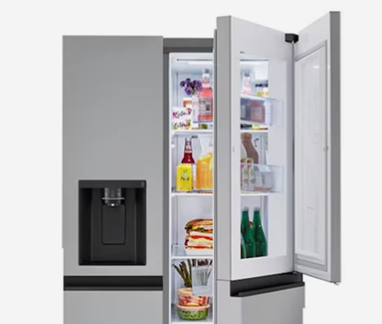
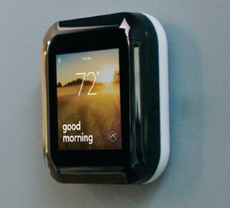
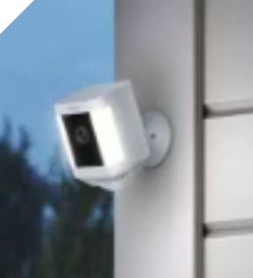



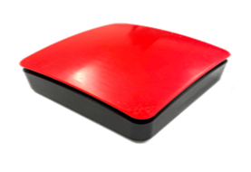
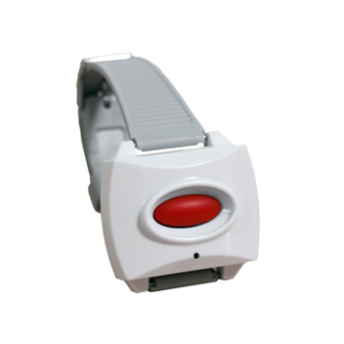
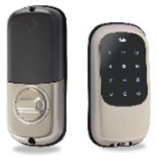

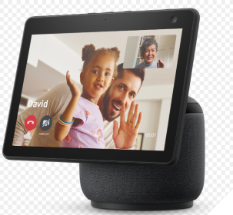


How does ARMS monitor your loved one
MOTION SENSORS
CONTACT SENSORS
SENSOR MATS
BUTTONS & PENDANTS
DOOR ACCESS AND CONTROL (INSIDE & OUTSIDE)

Slide 8

Notes:
And the use of artificial intelligence, the ARMS system learns a person's habits through movement and interaction with the sensors, pads and buttons. After two weeks it knows the routine

Slide 9
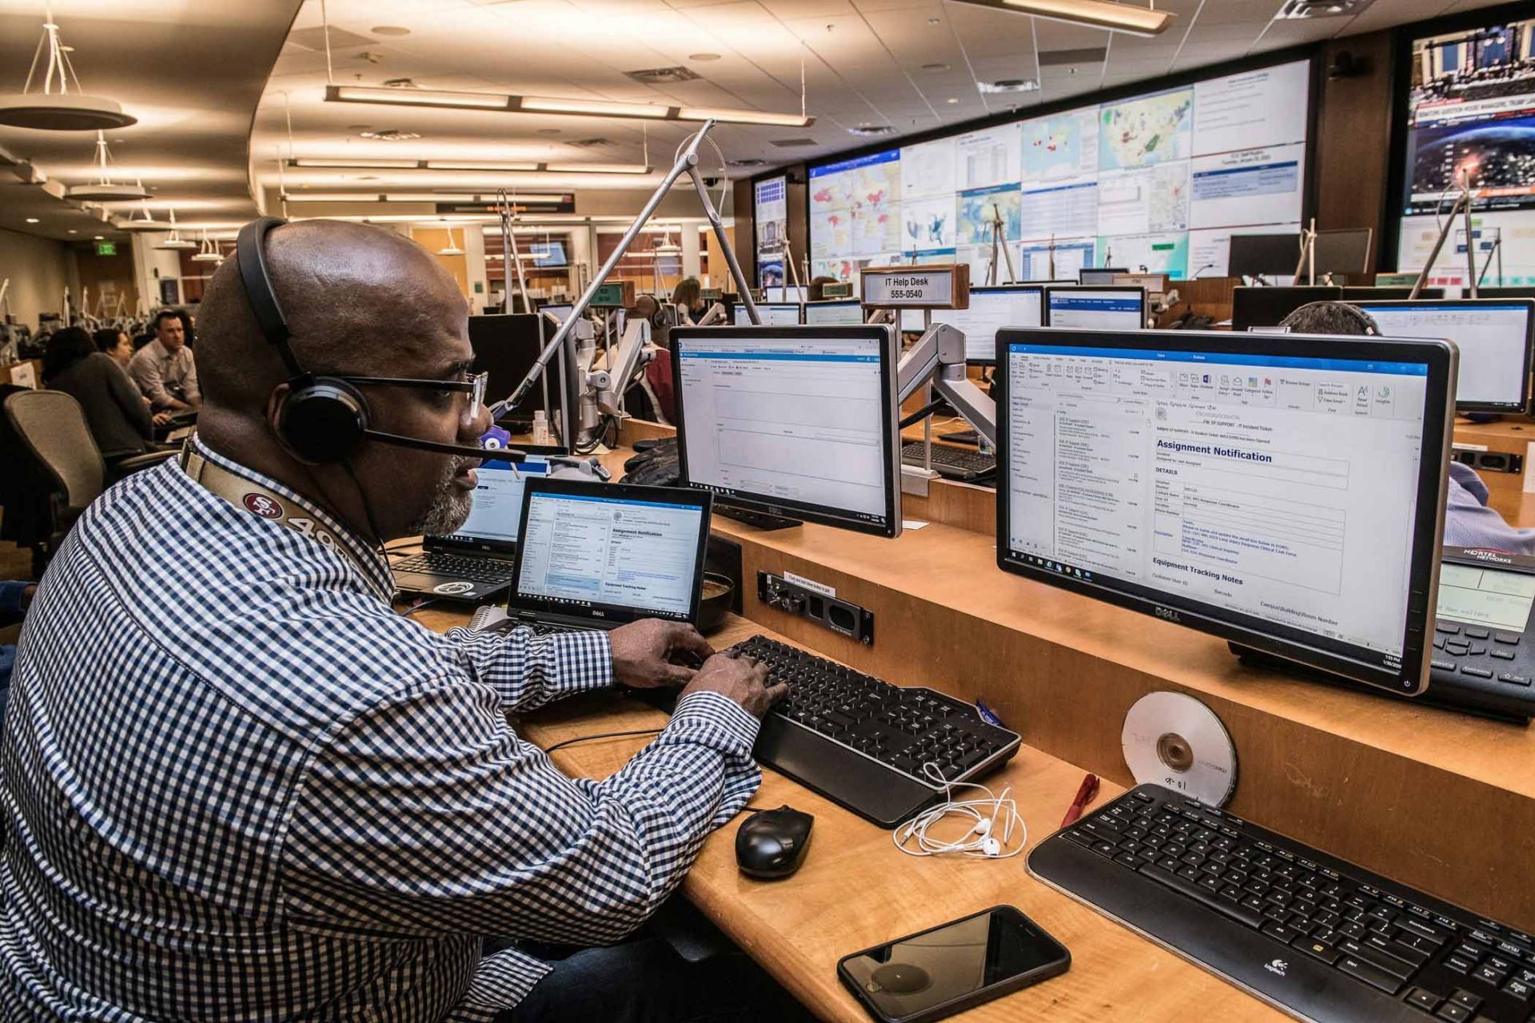
Command Center
Living Without Limits Command Center can monitor/support the person and send agency/family the daily reports
An agency or family can also receive the alerts
The command Center is staffed with employees who have a background in the field of intellectual Disabilities, they are highly trained on procedure, protocol for operations and also on the needs, concerns and the expected responses.
Notes:
The command Center is staffed 24 hours a day 365 days a year with Virtual Support Professionals who have a background in the field of intellectual Disabilities, they are highly trained on procedures & protocols for operations, Department of Developmental Services Policies and on the critical information for the person being monitored including the needs & concerns and the expected responses & actions.
We have staff who monitor the systems each day to ensure they are in good working order; they monitor the data taken each day to make sure all the expectations are being carried out; they retrain the person, staff or other care givers when needed.
These are living systems, and they change and grow with the person.

Slide 10
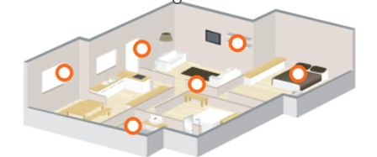
How does it work?
The team/Family decides what needs to be monitored
Specific Assistive are installed to address the needs
Protocols are put in place to guide the VSP’s on what they are monitoring & how they are to respond
Quality monitoring is done daily
Reports are produced as needed
The system is adjusted as needed

Slide 11
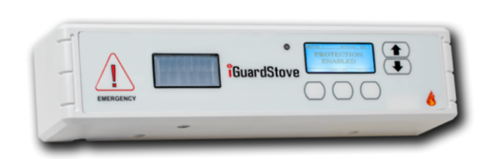
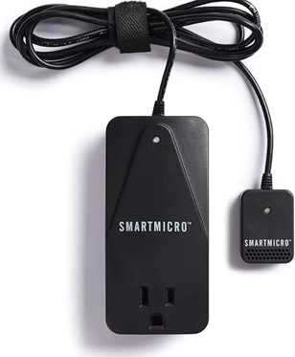
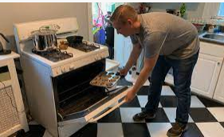
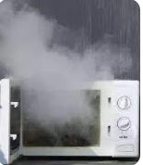

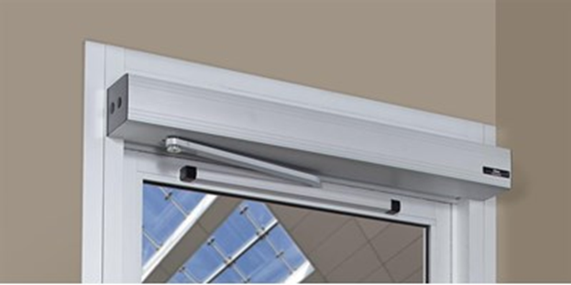
There are many add On's for this system
Notes:
There are many add on assistive technologies that can be added on to the system
Cooking Safety devices– for stove, oven and microwave
Electronic Med management device
Automatic door openers

Slide 12
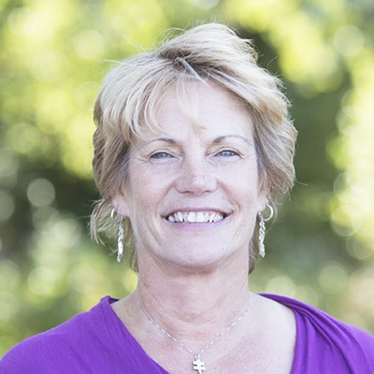
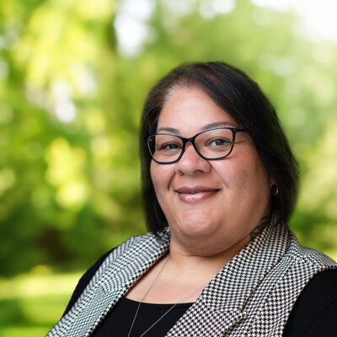
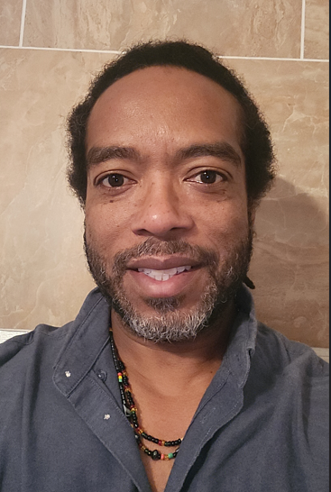
ARMS Team
Director of
Community Integration
Pam Fields
Chief Executive Officer
Nigel Cooper
Manager of Remote Supports

Slide 13

Questions

Slide 14
  Contact Information
Kathryn Wood
Director of Community Integration
kwood@midstatearc.org | (203)-238-8384

