Slide 1
Terrence’s Apartment

Slide 2
New Place!

Slide 3
Living Room

Slide 4
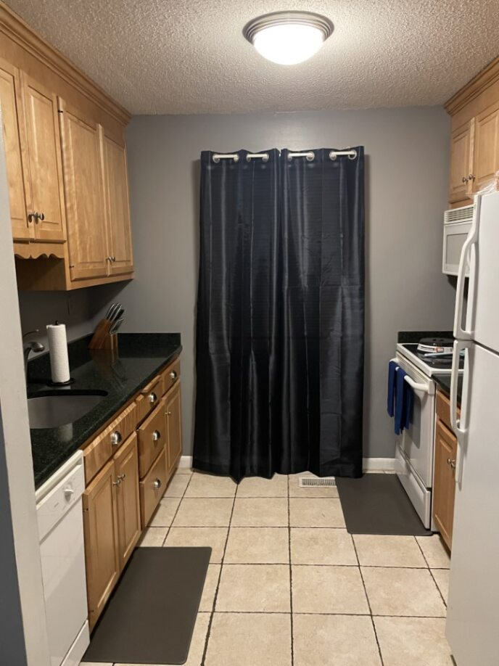
Kitchen/Dining Room

Slide 5
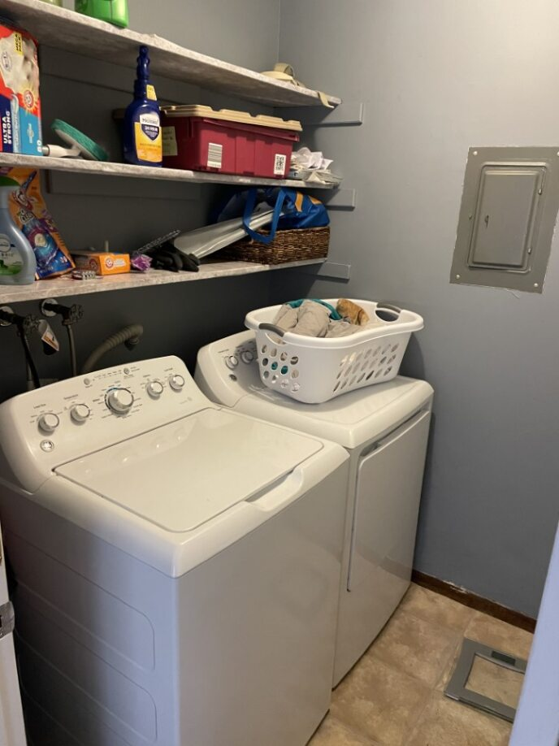
Bathroom & Laundry

Slide 6
Bedroom

