Slide 1

Three Pillars of STEP
  Support transitions to community-based support options
  Highlight progressive supports
  Restructure existing supports to be more person-centered
Three Pillars of STEP
Developmental Services

Slide 2
Expanding Residential Support Options
Progressive Support Options for Residential Settings
366% Increase in open Supportive Housing units
7
Private
providers approved for non-project-based Supportive Housing funding
13
Private providers with approved residential STEP plans
Expanding Residential Support Options
Developmental Services
Notes:
In alignment with our 5-year strategic plan priorities, DDS leveraged the STEP initiative to enhance the range of support options to encourage independence and self-determination for the individuals we support.
The agency substantially increased the available supply of supportive housing since 2021, both inside dedicated developments and more independently through non-project based initiatives. STEP transformation plans have also supported private providers to continue to facilitate transitions towards increased independence and out of congregate settings for interested individuals. The agency has incentivized and supported restructuring congregate settings to support individuals with more complex medical/behavioral needs, to maximize available choices and options for individuals.

Slide 3
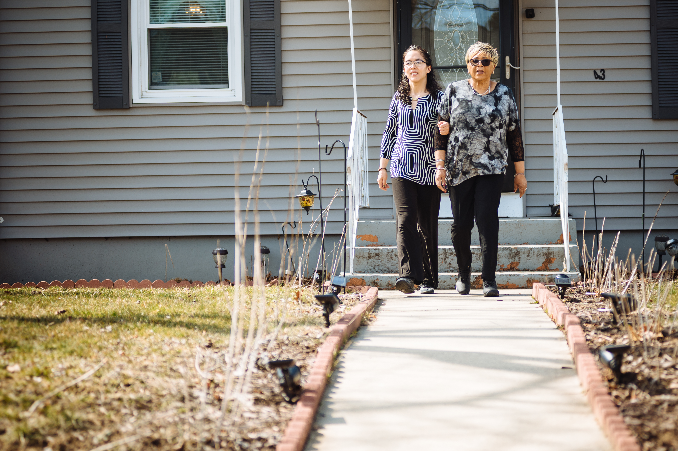
In Focus: Supportive Housing
Supportive Housing, then and now
Barriers
Inter-agency coordination
Communication gaps
Financial barriers to entry
Action Steps
Hired a Supportive Housing director
Coordination
Communication
Deployed funding opportunities for non-project based supportive housing
Results
Over 60 available Supportive Housing units and growing fast!
Expanding Residential Support Options
Developmental Services
Notes:
Starting several years ago, DDS began a coordinated effort to expand the supply of Supportive Housing in Connecticut. The department identified several barriers that kept the available supply of Supportive Housing low for the individuals we serve. Some, like overall housing supply, fell outside the scope of STEP. Others became opportunities for improvement.
A lack of inter-agency coordination made it difficult for providers to identify how to shift funding for individuals or obtain steady sources of funding for rent. Changing guidelines and shifting eligibility standards were difficult for providers to interpret. The Supportive Housing Director has helped unify communication and provider pathways around Supportive Housing. She has also helped oversee the funding opportunities for non-project based supportive housing, an innovative approach to supportive housing that helps circumvent the time and financial constraints of new housing projects by creating supportive housing settings within existing residential developments.

Slide 4

Expanding Day Support Options
Progressive Support Options for Day Settings
100+
Private provider staff trained in Customized Employment
16
Private providers with approved day STEP plans
Expanding Day Support Options
Developmental Services

Slide 5

In Focus: Employment-Focused Options
Enhancing Options to Respond to Unmet Need
Barriers
Lack of a waivered service to teach foundational employment skills
Lack of employment-focused skills support groups
Action Steps
Develop a group day option to support employment exploration
Develop a group day option to support maintaining existing employment
Results
16 providers have already created plans to provide the services.
Expanding Day Support Options
Developmental Services

