Slide 1
Remote Supports Services
Empowering Independent Living
Kyle Corbin
National Director of Business Development
kcorbin@safeinhome.com

Slide 2
Remote Supports
Empowers people with intellectual and developmental disabilities to live independently in their own homes and communities using a remote support staff and assistive technologies.
Notes:
Remote Supports, follows the HCBS guidelines of what’s important to and important for the individual, as well as directed by the individual – we empower people to live more independently on their own terms.
And we allow for, and follow, person-centered planning that adheres to the requirements of HCBS – creating plans that supports what is important to and important for the person.
We share this mutual goal

Slide 3
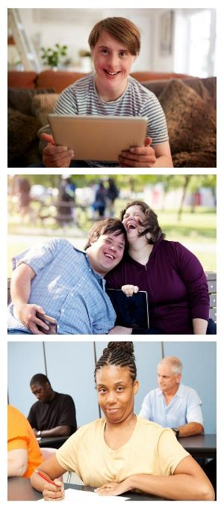
A person-centered support service that offers:
The Person Supported
Individualized Solutions developed by the person and the care circle
A Learning Environment that’s supportive and safe
The Next Step to Independence to support the needs and desires of each individual
Remote Support Staff always available -24/7; always supportive - never directive
Notes:
We take a person-centered approach that focuses on what is important TO the person and FOR the person. Our solutions are devised based on what the individual tells us they want and what they need. They have the power to decide. We want to provide what they want.
We then create environment that’s supportive of building their desired skills and provides the means to support their need for independence, safety, and privacy.

Slide 4
Our Remote Supports is a service, not a thing.
It is not replacing humans with technology but is a trained workforce connecting and supporting people through technology.
Notes:
What’s important to remember that Remote Supports does not replace people coming into the home. It has yet to displace a DSP from a job. It simply integrates technology into the service to provide alerts, privacy and safety. Our RSS are available 24/7 to respond to a call, perform ISP check-ins, or just to talk. We follow the care plan protocols. The human-to-human connection remains. It is a service. Not a thing.

Slide 5
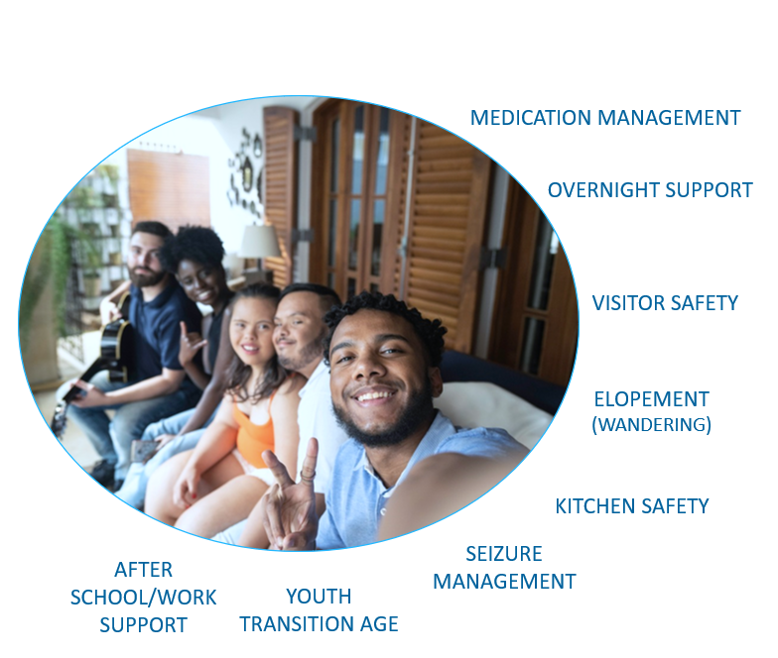
Our Support Solutions
Notes:
Purpose of Slide: Demonstrate what Remote Supports can support. Focus on showing our reach and flexibility
We support people across many risks/needs. We can support people that need help with medication reminders, support in ensuring the wrong people do not enter their home. We even support people who are at risk of having seizures – to those who need help in the kitchen when preparing meals. We provide support in-the home and in the community.
Our services are great for youth transitioning to adults who require or desire to live independently. Or people transitioning from care facilities. This list is not exhaustive. SafeinHome caters to complex needs and we are used to thinking outside of the box to develop support solutions.
<UTILIZE A STORY>
<insert example story of one of more of these topics to demonstrate, risk covered & how SIH provided support>

Slide 6
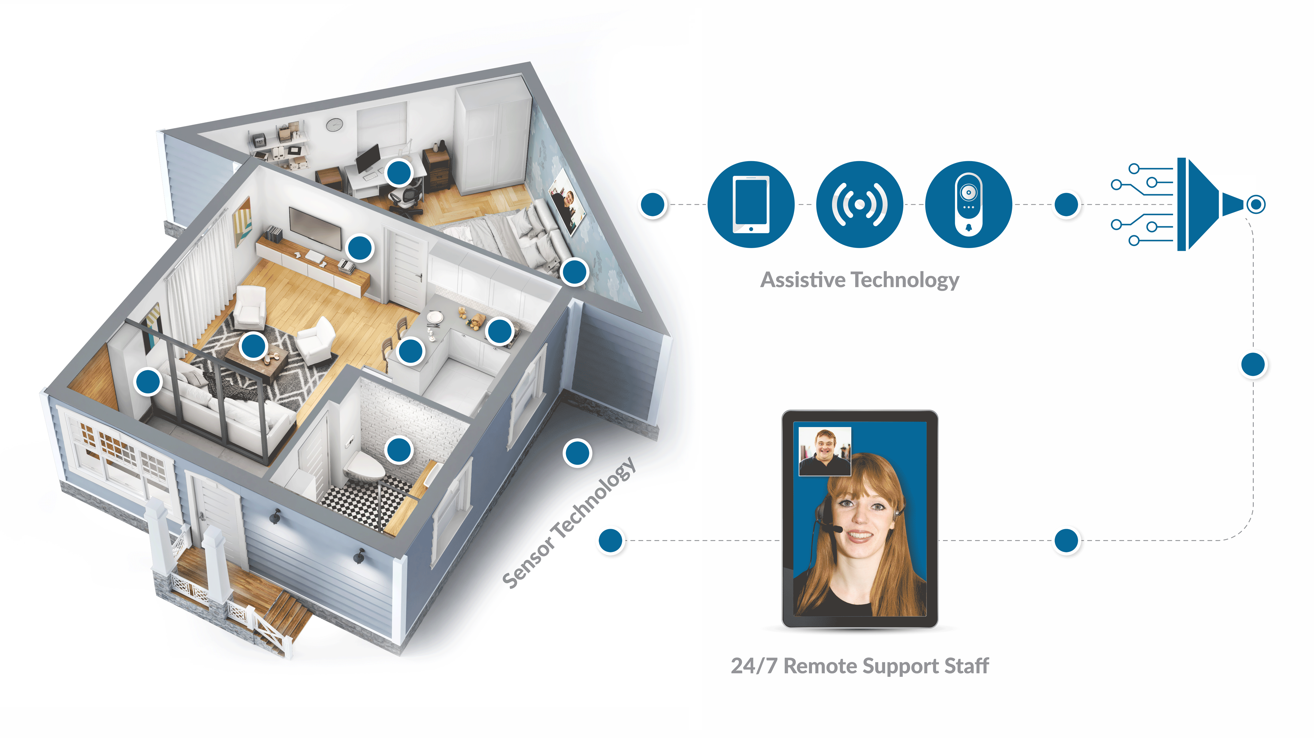
How it Works
How Remote Supports Work
Notes:
So how does it all work together. It is using Remote Support Staff along with sensory and assistive technology devices installed within the home or worn on the body that functions to communicate, send alerts to a Remote Support staff that follows a support plan – directed by the person supported.

Slide 7
Remote Support Staff
Human-to-Human CONNECTION
Acceptance Commitment Therapy
TRAINED IN
ACT
BEHAVIORAL TECHNIQUES
Non-directive
Authentic relationships
Continuity & stability
Develops decision-making skills
State required training
HIPAA compliant workspace
CONNECTED INDEPENDENCE WITHOUT ISOLATION
Notes:
Who are the Remote Support Specialists?
They are specially trained in Acceptance and Commitment Therapy Behavioral Techniques. They are HIPAA compliant and work in a HIPAA compliant workspace. They have all the required state training for the people they served. With respect to the dignity of risk, we do this to ensure better outcomes when engaging with Medication Reminders, Mitigating elopement or helping to elevate decision-making skills as part of daily activities.
Our remote support staff engages with respect and are never directive and develop authentic relationships with the people we serve. We always show-up and we are never late.

Slide 8
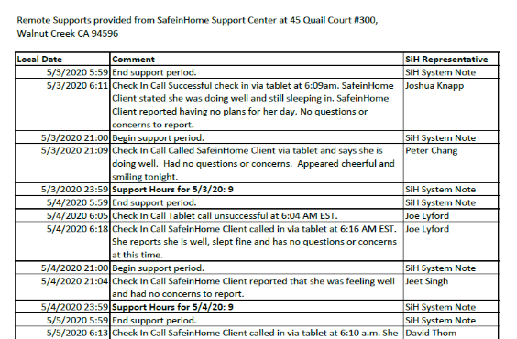
Weekly Reports
AKA: Support Notes:
RSS interactions
HPC/RSS hand-offs
Daily Activities
Kitchen/Bathroom Use
Home Entry/Exit Times
Medication Management
Sleep/Wake Activity
RSS: Remote Supports Staff
HPC:
Notes:
SafeinHome Supports Notes documents these types of activities and also all interactions with the person served. This type of data is useful for team decision making and improving and optimizing the care plan - Sam is up 3x night- why? Does he know? Eating? Over/under use of Bathroom?
Also makes it easier for case manager to keep track of what is happening with the people in their case load. It is a SafeinHome Difference.

Slide 9
Steps to Remote Support
STEP 1
STEP 3
STEP 5
VARIES
Earliest: 48 HRS Standard: 3-5 DAYS
Typically Within 24 HRS
Consultation
Proposal
Approval
Installation
Service Start
As Early As 24 HRS Of Request
Care Plan Finalization
STEP 2
STEP 4
Client Service Team Gets Involved
Notes:
Purpose of the slide: Show case SIH availability, turnaround time and flexibility. (This to be modified from the POV of the individual)
Upon a request our response time is within 24 – 72 hours.
Then you will get a proposal – tells you everything that will take place, goals and the hours of support
After approval from the county – then we can install
Our guys can install within 3-5 business days – typically. Install will vary depending on the type of solution
Service start date 2-3 days after installation.

Slide 10
Get More People on Service
with education…the more they know
Case Managers
Individual & Families
NEED TO KNOW HOW TO EXPLAIN REMOTE SUPPORT SERVICES.
NEED TO KNOW HOW REMOTE SUPPORT SERVICES WORK AND BENEFIT THEM
SafeinHome Educational Resources
VIRTUAL SEMINARS
IN-PERSON SEMINARS
TESTIMONIAL VIDEOS
SELF-PACED CBT TRAINING
No obligation to use our service
Notes:
We can more people on service with education.
Imagine for a moment, trying to explain to others about a service you are not familiar with. Would you do it? Probably not, so imagine how a case manager feels introducing a service that they do not feel confident enough to answer questions about?
Individuals and families also need to understand as well
But, we need your help to reach Case Managers and families. Our goal ultimately, like yours is to get people the support services they need. But we know that this is slowed down, due to a lack of knowledge.
Our company is willing to provide in-person or virtual seminars about what is Remote Supports. For case managers, we have a self-paced computer-based training. We have seen that with increased knowledge, case managers are more willing to talk to individuals and families about Remote Supports.
Our offer has no conditions, or obligations. If a case manager or individual wants to receive RS services elsewhere, they can. We just want to see people get the support services they need, in light of the shortage of DSPs.

Slide 11
Questions?

