Slide 1
DDS Fourth Tuesday Forum Technology for Transition-Age Youth

Slide 2
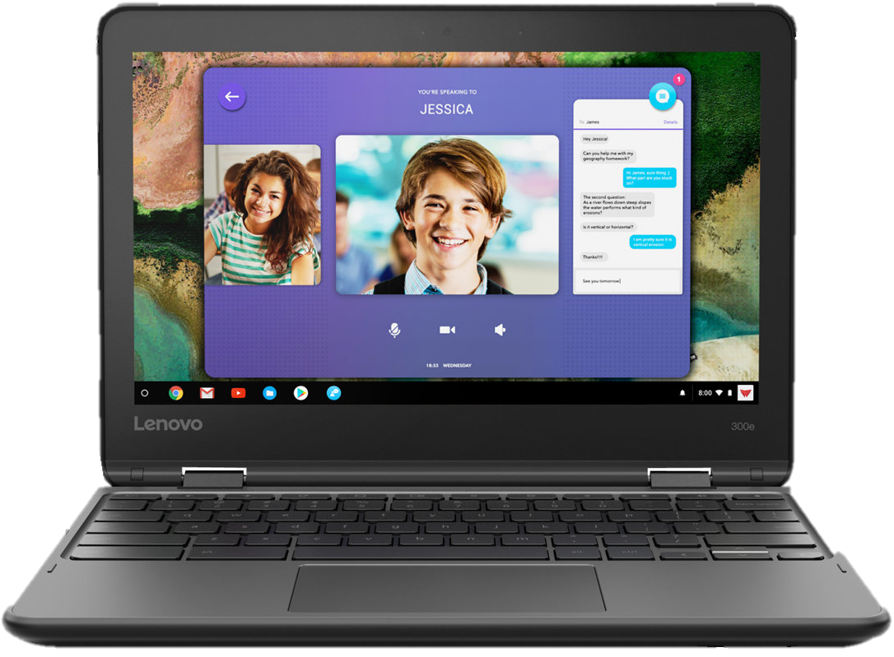
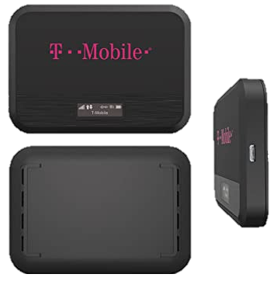
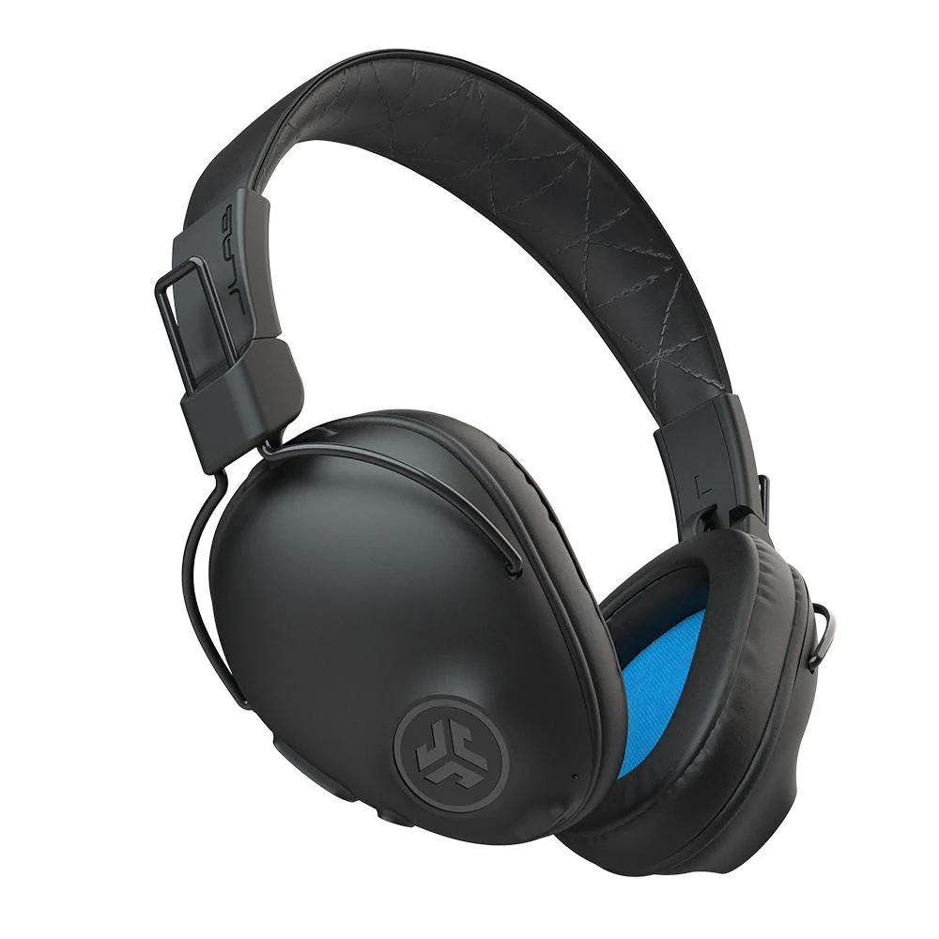
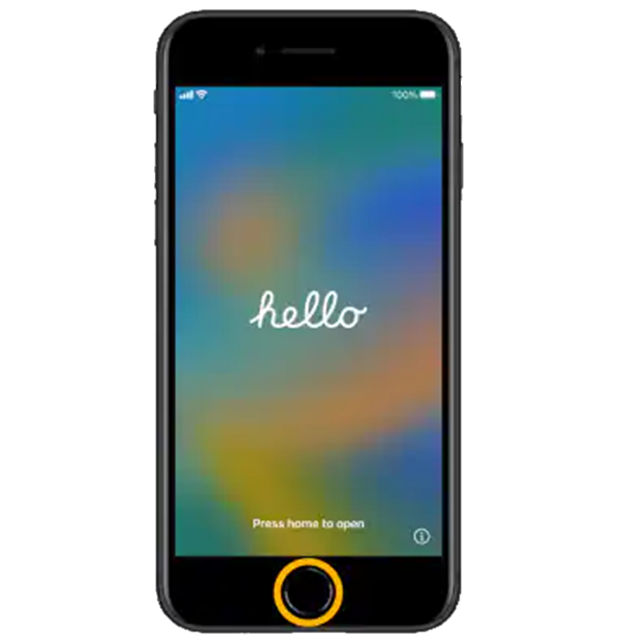
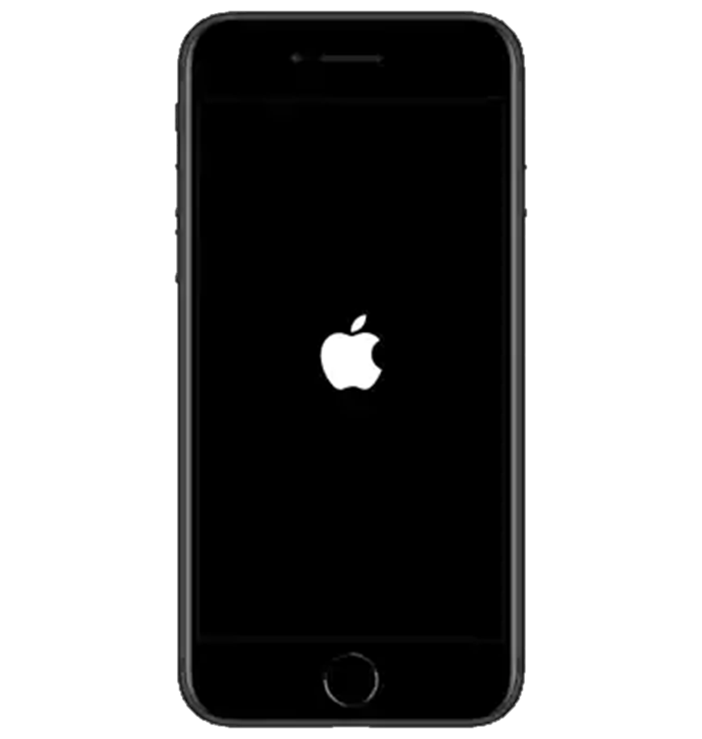
AT & Me
DDS Initiative started summer 2023
Purpose is to provide transition-age individuals with the technology to increase their independence and improve their daily living skills
DDS individuals approved for the program attend a class where they learn how to set up the technology
Technology includes: a backpack with an iPhone SE, Google Chromebook, hotspot, Bluetooth headphones, mouse, Otterbox case, Otterbox fast charger and free service from T-Mobile for six months
Notes:
Technology can be utilized for so many tasks these days, such as placing a grocery order, requesting transportation through a service such as Uber or Lyft, paying bills or scheduling a doctors appointment. With society integrating more and more into the digital age, DDS implemented AT & Me to “provide transition-age individuals with the technology to increase their independence and improve their daily living skills.”

Slide 3
Feedback
Individuals have mentioned many opportunities now available to them with the technology they receive through AT & Me. Some include:
Health monitoring
Employment opportunities
Communication with family
Notes:
Health Monitoring: connection with diabetes sensor
Employment opportunities: looking for jobs, having a means of communication to contact employers & obtain interviews
Communication with family: staying connected with family members, increased independence for individuals

Slide 4
If you have any questions about assistive technology or AT & Me, please email DDS.AssistiveTechnology@ct.gov.
We look forward to hearing from you!

Slide 5
AT & Me Experience
Chelsea Bailey
Experience with AT & Me process
Initial motivation for participating in the AT & Me program
How do you continue to use the technology you received?
What has the technology help you accomplish?
Anything else you would like to share about your experience with AT & Me

