Slide 1
Remote
Supports
Notes:
Good Afternoon I am Pam Fields CEO of MidState Arc. Remote supports has been provided by MidState Arc since 2014.

Slide 2
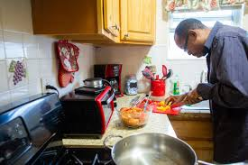

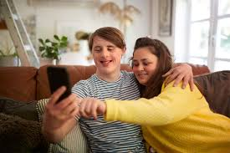
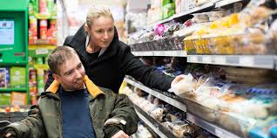
Remote Supports
Independence
Community Integration
Quality
Of
Life
Safety
Notes:
Our remote support monitoring service covers increased independence, safety for the person moving into a less restrictive environment, bring a higher quality of life and promoting full community integration and inclusion

Slide 3
What are Remote Supports
Remote Support is a way to virtually monitor someone
who is alone using a technology system paired with
a live off-site staff or natural support who then
responds to alerts or notifications sent by the system.
Notes:
Remote Support is a way to virtually monitor someone who is alone
And using a technology system paired with
a live off-site staff or natural support to monior alerts and notifications sent by the system.

Slide 4
Process
Assessments for Barriers
Remote
Monitoring
Installation
and Training
Device Identification
Notes:
Our Process includes the following steps

Slide 5

The process starts with the Person’s Support Team
The team explores the possibility of utilizing
remote support options
Notes:
Our First Step is to work with the support team and provide them with the information they need to make an informed decision

Slide 6
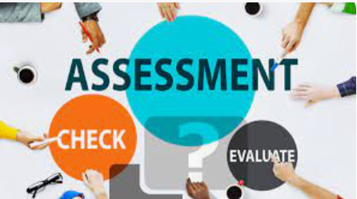
ASSESSMENTS
The person is then referred to have a comprehensive assessment done, during which time the Assistive Technology Professional(s) work with the care team to complete a series of assessments including:
    Independent Living Assessment
    Risk & Safety Assessment
    Assistive Technology Assessment
Notes:
The person is then referred to have a comprehensive assessment done, during which time the Assistive Technology Professional(s) work with the care team to complete a series of assessments including:
Independent Living Assessment
Risk & Safety Assessment
Assistive Technology Assessment

Slide 7

The Assessment also includes :
Paper review of the Person-Centered Plan, LON and any other pertinent documents
Information gathering sessions with the care team and any other person(s) who may be able to share information (such as nurses, therapists and/or staff)
Face to face meetings with the person including visits to all environments they will be using assistive technology
Notes:
The Assessment also includes :
Paper review of the Person-Centered Plan, LON and any other pertinent documents
Information gathering sessions with the care team and any other person(s) who may be able to share information (such as nurses, therapists and/or staff)
Face to face meetings with the person including visits to all environments they will be using assistive technology

Slide 8

The Assessor works with the family to identify Fears and concerns
The unknown – what will happen when they are alone
Vulnerability with technology
Service delivery changes
Change(s) in general
Technology fears around Privacy and Security
Notes:
Prior to implanting any technology …..All these have to be addressed so everyone is comfortable.

Slide 9

Recommendations
.
Notes:
The Assessment Professional(s) then make recommendations including:
What types of assistive technology would help
If Remote Supports is a possibility
Which Remote Support system would work best
Which Components of Remote Supports would be included in the persons remote supports
The team works with the agency to make the decisions throughout the process.
Types of remote support systems to choose from include two general types
Alerts and notifications are sent to a central system to people who are trained to answer the alerts, and address issues remotely; if needed they contact a care giver or 911 to address on site needs
Alerts and notifications are sent to the persons current provider or to a family member if they live at home. That agency or family would then send in the on call staff when needed.
MidState uses the ARMS Remote Supports System which allows MidState to monitor the individuals we support.

Slide 10
Remote Support components
Notes:
Each system is customized for the individuals. Once the team has chosen the kind of system to use next step is for the team to choose the components of the remote support system. They need to identify what they want to know from the system The next several slides will give you an idea of some components that can be used..

Slide 11
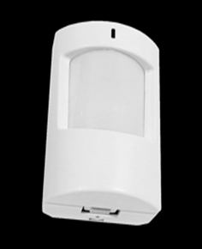
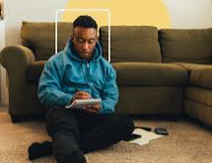


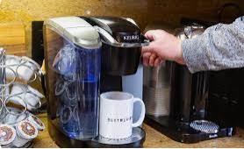
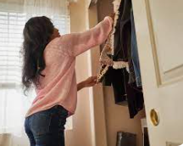
Motion Sensors
Notes:
Motion sensors are used throughout the house to capture general movement

Slide 12
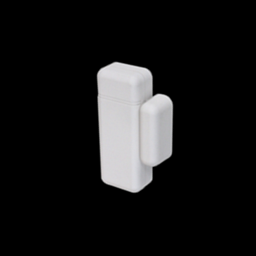
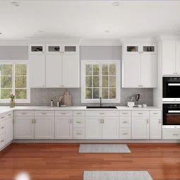
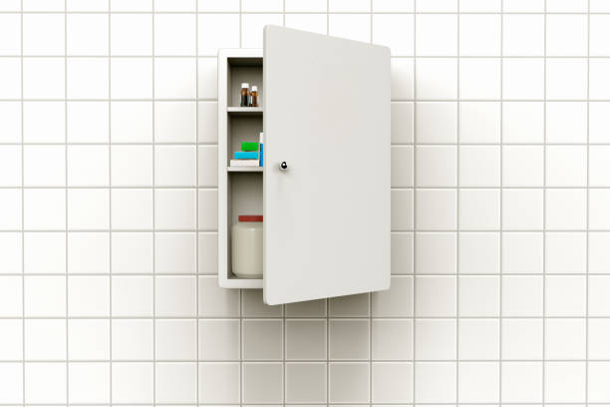

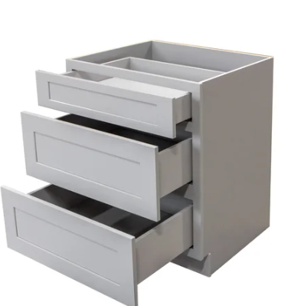
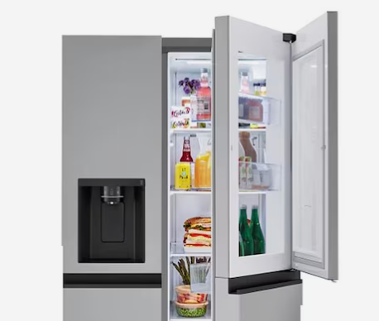
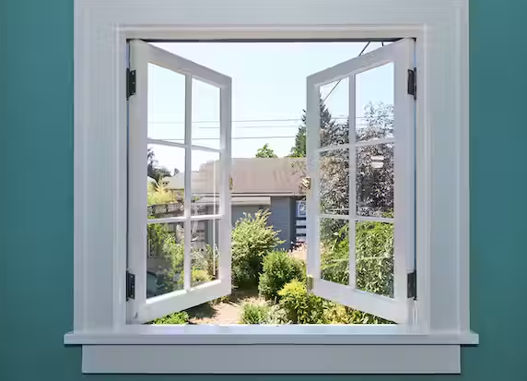
Contact Sensors
Notes:
Contact Sensors track what has opened or closed; this can include any thing that opens and closes including drawers and windows

Slide 13
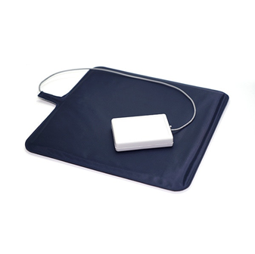
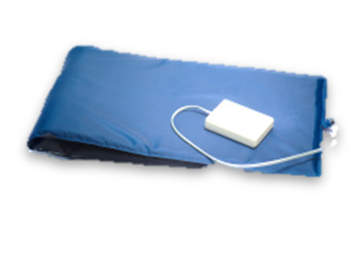



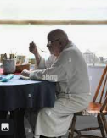

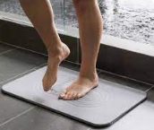
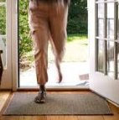
Sensor Mats
Notes:
Sensory mats for Bed, chair and other contact aid with collecting data from where someone sits, stands or lies

Slide 14

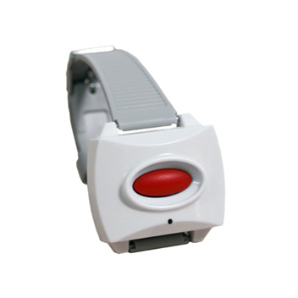
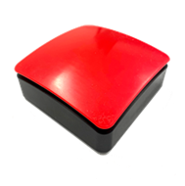
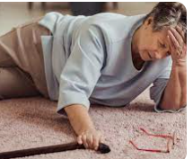
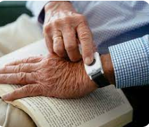
Emergency buttons & Pendants
Notes:
Emergency buttons and Pendants track falls, and allows one to call for help from a care giver or a medical professional

Slide 15
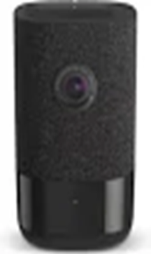
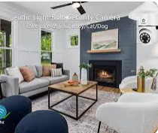
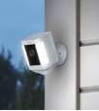

Two-way video option with audio
Notes:
Cameras Allow monitoring of the common areas inside and outside the home with two-way audio; we typically do not use inside cameras except for training and video calls; but it is an option

Slide 16
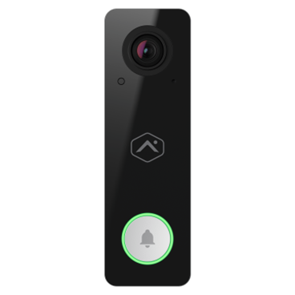
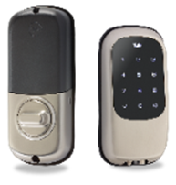
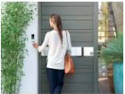
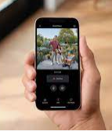
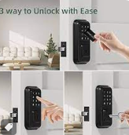
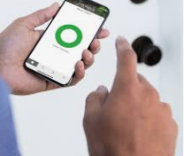
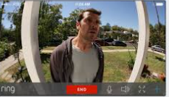
Door Safety from inside or far away
Notes:
Video Doorbells and smart locks ensure the person is safe and gives options for easy entry and safe door answering.
The ADC doorbell can be programed to activate an intelligent light or an intelligent outlet with a strobe device plugged into it to notify a hearing-impaired person someone is at the door.

Slide 17
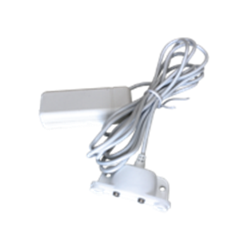
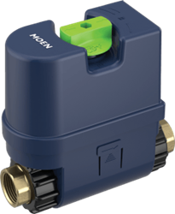
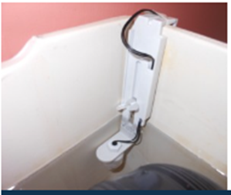
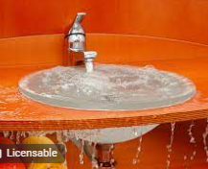
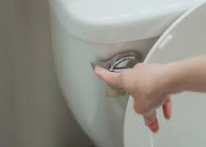
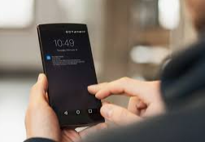

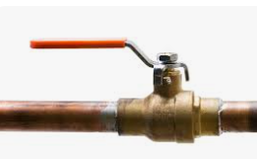

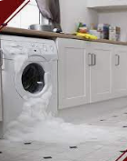
Water Sensors
Notes:
Flush sensors and water overflow sensors track if someone flushes the toilet or if there is a flood, toilet overflow, sink overflow or washing machine;
Once you receive the overflow alert the water sensor valve allows you to shut the water off remotely until someone can get there to assist

Slide 18
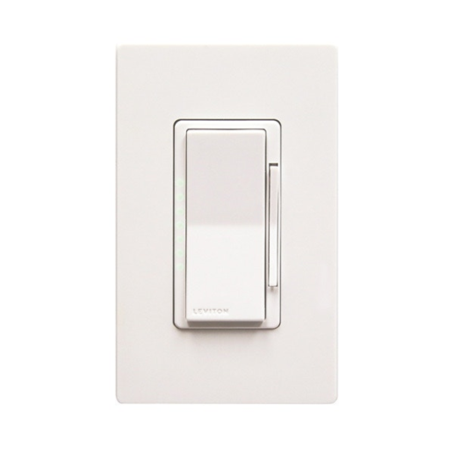

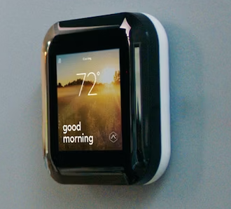
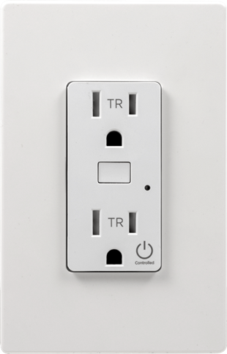
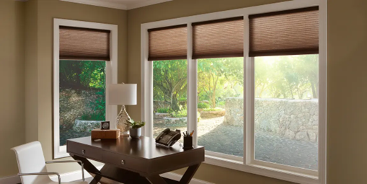
Environmental Controls
Notes:
Environmental Control options including Temperature, Lights, plugs and blinds that allows the person/caregiver to adjust your comfort from a phone or by setting routines .
If someone locks themselves out you can let them in remotely. You can allow Different codes for care givers that are easy to eliminate if they no longer work with the person

Slide 19
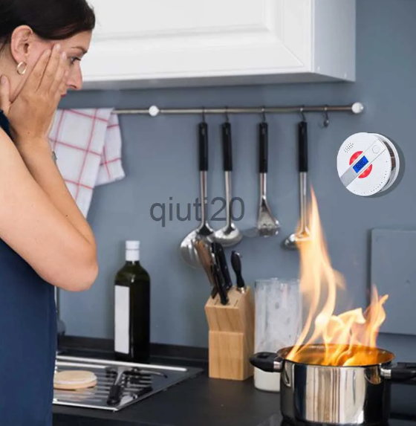

Safety monitoring fire and carbon
Notes:
Not only can you have fire and carbon detection but you can opt in for full alarm monitoring

Slide 20

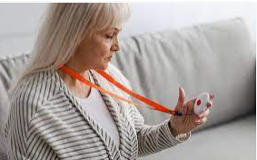

Personal Emergency Response System
Notes:
Pers is available that allows contact with the caregiver when in the community
The system also supports connected car that lets you know where the person is and if their car is ok (gas, accident, etc.…)

Slide 21
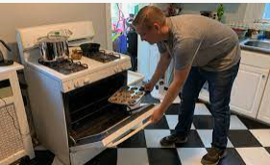
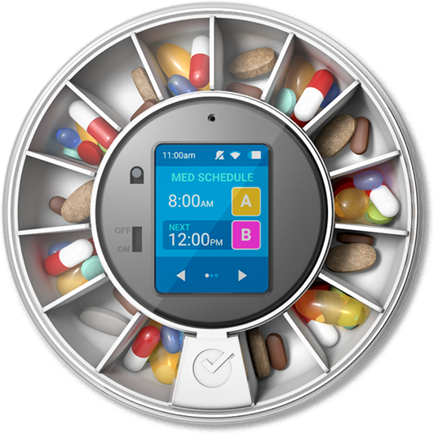
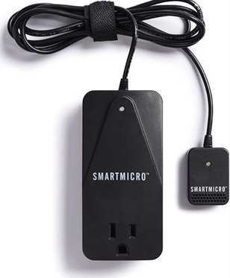




There are many add On's for this system
Notes:
I also wanted to cover add Ons to the system that we use on a regular basis. We use a variety of add on devices such as
Cooking Safety – for stove, oven and microwave –the Iguard is being added to the system
Med management
Automatic door openers
Bed shakers – are being added to the system
And the list goes on and on
Alarm . Com is constantly looking to integrate new devices into their system.

Slide 22
Other add-on resources
Direct support staff
Natural supports
Community resources like visiting nurses
Transportation
Meals on wheels
Money Management
Notes:
There are other resources you can add and that includes
Natural supports
Community resources like visiting nurses
Transportation
Meals on wheels
Money Management

Slide 23
Is A Trial Needed?
Trials can be done in the persons current environment, or it can be done in the new environment.
Trials can address all concerns and fears and answer any unknown questions
It can identify other areas assistance is needed
Notes:
Then the team will decide if trials of a remote support system to see how the person does and to address all the fears identified with the team, during this stage cameras in the common areas will be used to answer the questions what happens when no one is there
Talk about Morris and Annie two different trials

Slide 24
Other Steps to address any fears/concerns and ensure safety
Transparency throughout the process (don’t hide a fear and definitely address all fears)
Safety nets must be considered and used over time to alleviate fears and allow everyone involved to move forward and make the new steps
Education, training and stake holder meetings
Allow time for the change to occur
Build in review updates and revisions
Develop Remote Support plan to address all possibilities.
Develop a Back up plan if something goes down
Notes:
Additional steps to address fears and concerns

Slide 25
What Remote Supports are not
Not a plug and play and walk away
Not a solution for everyone
Not Stagnant (constantly changing and updating based on the persons need).
Does not eliminate all risk factors

Slide 26
Remote Supports
is not
for
Everyone
Notes:
MIdState Arc conducts a thorough triage of all people who are referred to make sure it is a good fit. There are certain diagnosis and behaviors that would prevent someone from reducing their in-person staffing ratios to truly live independently.
These behaviors/diagnoses include actions that would require immediate staff intervention to ensure everyone’s health and safety, and could not be addressed by any other method..

Slide 27
Such diagnosis/behaviors include but are not limited to:
Predatory behavior,
Pyromania,
self-injurious behaviors,
Bolting/AWOL without safety skills,
uncontrolled seizures,
lack of social sexual safety skills,
Prader Willis, uncontrolled pica,
uncontrolled aggression or dangerous behaviors, etc…
Other issues/behaviors could be identified during the safety assessment
Advanced memory diseases
Notes:
Predatory behavior,
Pyromania,
self-injurious behaviors,
Bolting/AWOL without safety skills,
uncontrolled seizures,
lack of social sexual safety skills,
Prader Willis, uncontrolled pica,
uncontrolled aggression or dangerous behaviors, etc…
Other issues/behaviors could be identified during the safety assessment
Advanced memory diseases

Slide 28
MidState Arc is supporting
15 smart homes
Notes:
And have 10 more opening in the next month. Talk about positive steps they have taken and what positive changes we have seen

Slide 29
Benefits of remote supports
Promotes independence by making people feel more comfortable and secure
Gives more opportunity for decision making and control
Helps people live safer in their own home
Enhances daily living
Allows independence with less dependence on direct care staff.
Notes:
Promotes independence by making people feel more comfortable and secure
Gives more opportunity for decision making and control
Helps people live safer in their own home
Enhances daily living
Allows independence with less dependence on direct care staff.

Slide 30


Remote Monitoring and
Assistive Technology can help us stay healthy and safe, all while living the most independent lives possible.
Notes:
MidState Arc fully supports Independent living using remote supports and other assistive technologies
Questions??

