Slide 1


REMOTE SUPPORTS
Getting Started, Team Process, & Creative Solutions
Presented by:
Amy M. Blaze, MSW, LCSW
Director of Services Development & Supports, Self-DeterminATION, NR

Slide 2
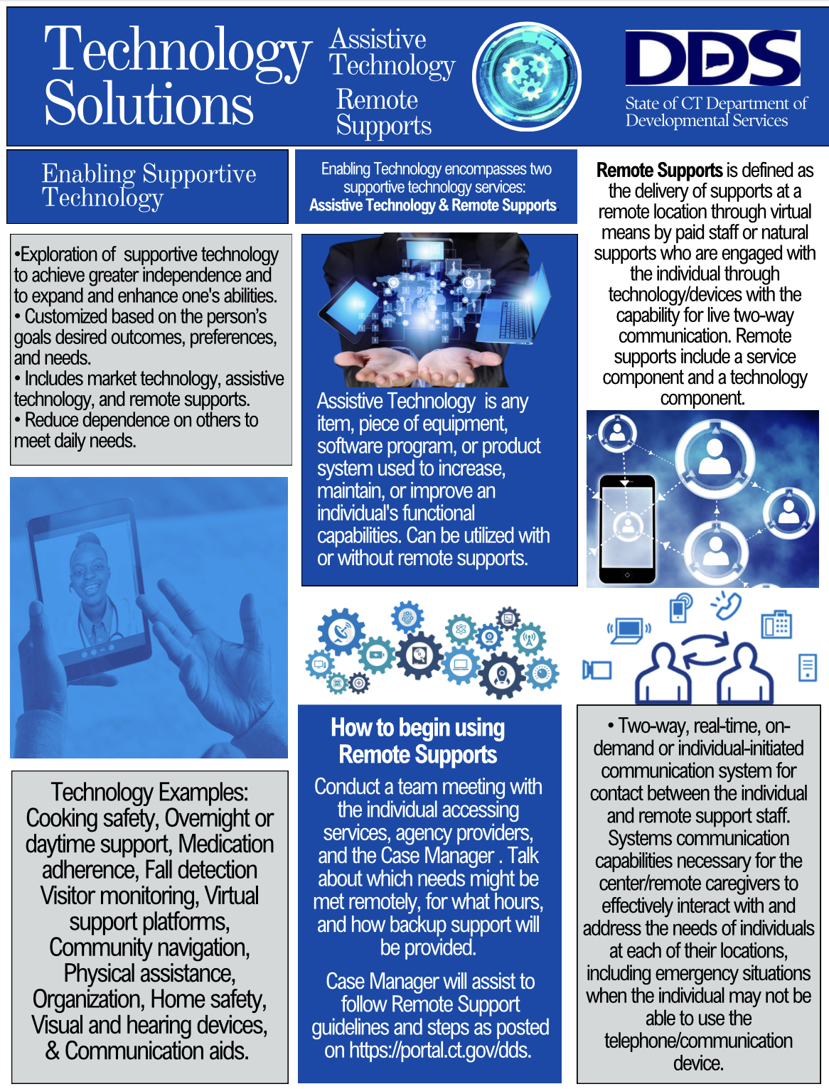

Slide 3
https://youtu.be/ux9sNn4Lxpw

Slide 4


Slide 5


Slide 6

Getting Started, Team Process & Creative Planning
Solution Circles
Joint Learning
Curriculum
Tech Support
Deliverables

Slide 7





Solution Circles
A solution circle is a short and powerful tool to generate ideas toward the goal of problem solving through a collaborative new approaches. The model was developed by Forrest, Pearpoint and colleagues (1996) and it aims to bring together a group of people to generate ideas for solutions to a particular problem.

Slide 8

Joint Learning/Curriculum/Tech Support/Deliverables
Case Management , Providers, Interdisciplinary Staff (OT/AT/PT/Transition Advisors, etc…)
4 Cases from each region (varying in age/goals (ie: Independence/Mobility/Safety/Travel/Vision/ Communication/ Vision/Hearing
Add Individuals, Parents, Caregivers, Guardians, other Stakeholders when/if needed

Slide 9
Joint Learning/Curriculum/Tech Support/Deliverables
General Curriculum & Training = Definitions/Roles of Participants/ Process/Tools & Forms/Closing the Loop/ Participant or Team Responsibilities / Expectations & Marketing
Joint Learning- Vicarious Problem Solving and Motivation for new case referrals simply by being present
Built in Tech Support through the Team Process. (Referrals, Resources, & Ongoing Consultation)
Continued Follow-Along with Core Teams and Facilitators
Deliverables = Successful Implementation & Use of Services & Supports

Slide 10
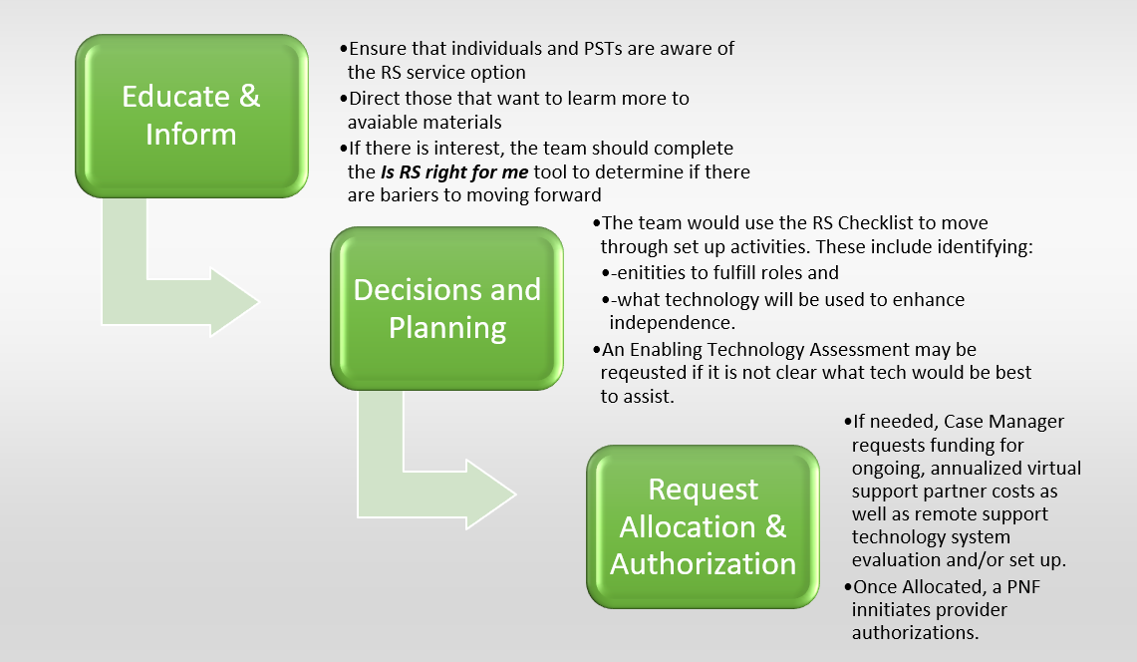

Slide 11
Are Remote Supports Right for Me?
What would the individual like to be able to do more independently by using Remote Support?
The purpose of this assessment is to determine the appropriateness of utilizing remote technology as part of an individual’s service delivery plan. It will assist the person with making informed choices and planning for success. Please note the following information to help guide the process:
The identification of risk does not automatically prevent the person from accessing remote support, as people have the right to choose to take risks—otherwise known as “value-based decision making.” Many risks, encountered by an individual, may be addressed through well-planned use of remote support technology.
Planning and support team members should be reviewing this assessment before the meeting to identify issues and concerns. At the meeting, the discussion should focus on how concerns might be addressed through technology and remote support options.
This assessment must be completed by the case manager, in collaboration with the individual, their family/representative (when appropriate), the provider, and other members of the team.
If any of the following are checked NO, then the team should reconsider the appropriateness of remote supports.

Slide 12
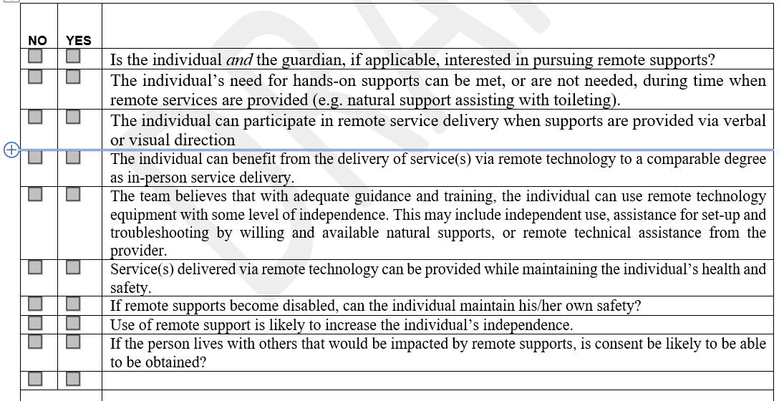

Slide 13
Remote Supports Checklist
This document serves as a guide to the development of a Remote Support set up as well as a final checklist documenting the supports that have been set up. This document should remain in the master record. Additional details of the supports are documented throughout the Person-Centered Plan as would be any supports.
Remote Supports: The delivery of support by staff at to a remote location through virtual means by paid staff or natural supports who are engaged with the individual through technology/devices with the capability for live, two-way communication. Equipment used to meet this requirement must include one or more of the following systems: Motion sensing systems, radio frequency identification, live video feed, live audio feed, GPS tracking, web-based oversight system, or a device that otherwise meets the requirement for two-way communication. Individual interaction with the staff person may be scheduled, on-demand, or in response to an alert from a device in the remote support equipment system.

Slide 14
The following items will be completed to set up Remote Supports:
        ☐ Remote Supports has been explained to the individual and/or guardian.
        ☐The Individual and their and their Planning & Support Team has completed the “Is Remote Supports Right for Me” tool. a Remote Support Assessment.
        ☐ The Individual’s Planning & Support Team has determined that remote support is a recommended service option.
        ☐ The individual has adequate resources or has requested resources from PRAT
        ☐ Individual and Planning & Support Team has identified the combination of technology and/or services to meet the individual’s needs.
        ☐ Individual and planning team has identified the Virtual Support Partner, On-Call Backup Entity and Remote Support Technology Supplier.
        ☐ Remote Supports are documented in the Person-Centered Plan

Slide 15
          Identify Virtual Support Partner:
Virtual Support Partner: A paid support person such as an agency, qualified provider, etc. OR unpaid support person such as a family member, friend, or other natural support that provides virtual support (e.g., prompting, queuing etc.,) from a remote location utilizing the Remote Support System that has been set designed for the individual.
☐ Remote Support Technology Supplier
☐ Qualified provider
☐ Unpaid support person such as a family member, friend, or natural support that provides virtual support
Name:
Address:
Contact person:
Natural Support (Relationship to individual):

Slide 16
Remote Support Technology Supplier:
Remote Support Technology Supplier: The entity with the responsibility to set up the customized Remote Support system necessary for remote supports based upon each individual’s needs. This entity may additionally provide the real-time Virtual Partner Supports.
Name:
Address:
Contact person:
Is the Virtual Support Partner and Remote Support Technology Supplier the same entity? ☐Yes ☐No
Remote Support Technology System (Technology Descriptions):
Remote Support Technology System: Technology that facilitates and provides the remote support service. These systems may use wireless technology, and/or phone lines, to link an individual’s home to a Virtual Support Partner (defined below) off-site. The system may use remote sensor technology to send “real-time” data to the Virtual Support Partner who is immediately available to assess the situation and provide assistance in accordance with the Individual Response Plan.

Slide 17
Identify Assistive Technology (AT) Products:
Assistive Technology (AT) Hardware/Software: Assistive Technology can be any item, piece of equipment, product, service, or system (whether acquired commercially or customized), that will impact or enhance autonomy and the capabilities of a person with a disability.
Name and Type of Assistive Technology: | Quantity | Description of use:
        *The use of Assistive Technology intended to enable independence would not require a Human Rights Committee Review (HRC). If the assistive technology employed is determined to infringe on the rights of the individual or others, an HRC review would be required.

Slide 18
Internet Connectivity:
Internet Connectivity: May include broadband /internet or cellular services provided at fair market value for the purpose of access to activities related to achieving documented person-centered goals and objectives for a period of up to one year.
1. Has Internet Connectivity been secured? ☐Yes ☐No
  2. If needed, is there access to a High-Speed Internet connection with enough bandwidth to support recommended enabling technology devices?
  ☐Yes ☐No

Slide 19
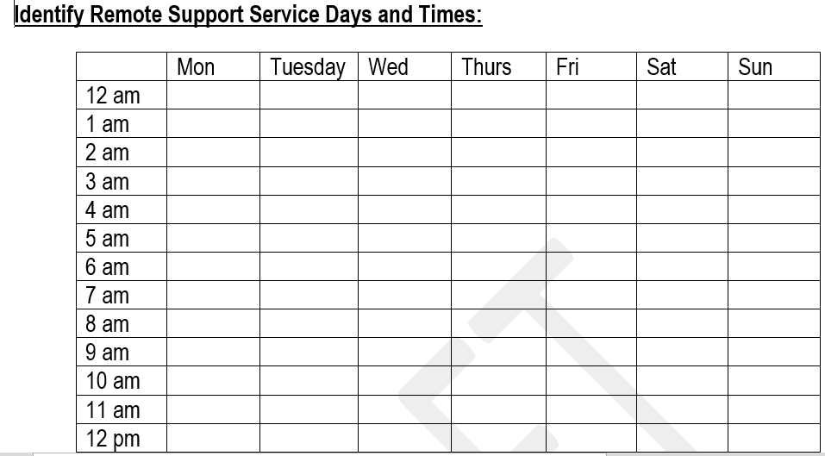

Slide 20
In-Person Response Plan:
In-Person Response Plan: A plan created by an individual’s team and providers that identifies who or what entity will serve as the On-Call Support. This plan must also provide detail on at least one back-up respondent and expectations around the response times (maximum 30 minutes).

Slide 21
Identify On -Call Supports:
On-Call Backup Entity- the entity that is responsible for the on-call service. The on-call service is the backup agency that received a notification from the virtual support partner or from the remote technology directly that an in-person staff intervention is necessary. The on-call back up entity will then contact the corresponding staff to provide the in-person support.
Identify who or what entity will serve as the On-Call Backup Entity to provide on demand, in-person support when needed:
☐ Natural support
☐ Self-Hired Direct Support Professional (DSP)
☐ Remote Direct Support Professional (RDSP)
☐ Paid agency
Name:
Address:
Contact number:
Best method to reach additional On-Call Back

Slide 22
Entity (Phone /Text/ Email/Other):
Provide details on at least one additional On-Call Support respondent:
Name:
Address:
Contact number:
Best method to reach additional On-Call Support (Phone /Text/ Email/Other):
Expectations around response times (maximum 30 minutes).
Provide any additional instructions for a remote support person regarding safety issues:

Slide 23
Provider Qualifications

Slide 24
Qualifications
 | Support Categories | Principal of the Entity (Connecticut Administrator if an out of state corporation) Resume or summary of qualifications must Include the following: 1. Name of employer(s) 2. Dates of employment 3. Detailed supervisory/administrative experience including programs and population served. See specific requirements below | Executive Management Team Resume or summary of qualifications must Include the following: 1. Name of employer(s) 2. Dates of employment 3. Detailed supervisory/direct care experience including programs and population served. See specific requirements below.

Slide 25
REMOTE SUPPORTS | Virtual Support Partner *Unpaid natural supports do not require qualification by DDS | Three years’ experience working with people with Intellectual Disability involving participation in an interdisciplinary team process and the development, review and/or implementation of elements in an individual’s plan of care. One year of the experience must have involved supervision of direct care staff in OR responsibility for developing, implementing and evaluating individualized supports for people with Intellectual Disability in the areas of behavior, education or rehabilitation. AND Medicaid provider status for assistive technology and supplies or agency that obtains Medicaid performing provider status the provision of supports by staff at a remote location who are engaged with the individual through technology/devices with the capability for live two-way communication. Equipment used to meet this requirement must include live video feed and live audio feed. One or more of the following systems may be required based on the needs of the individual(s): motion sensing system, radio frequency identification, GPS tracking, web-based monitoring system, or a device that otherwise meets the needs of the individual(s) | At least one (1) staff member of the Executive Management Team with one (1) year experience supervising staff providing supports to individuals with intellectual disabilities or in a related field.

Slide 26
On-Call Backup Entity | The on-call service is the backup agency that receives a notification from the virtual support partner or from the remote technology directly that an in-person staff intervention is necessary. The on-call back up entity will then contact the corresponding staff to provide the in-person support. Current qualified provider of Individualized Home Support Services or Three years’ experience working with people with Intellectual Disability involving participation in an interdisciplinary team process and the development, review and/or implementation of elements in an individual’s plan of care. One year of the experience must have involved supervision of direct care staff in OR responsibility for developing, implementing and evaluating individualized supports for people with Intellectual Disability in the areas of behavior, education or rehabilitation | At least one (1) staff member of the Executive Management Team with one (1) year experience supervising staff providing supports to individuals with intellectual disabilities or in a related field.

