Slide 1
Welcome to
Community Companion Homes

Slide 2
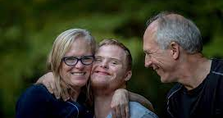
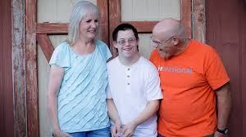
What is a
Community Companion Home? (CCH)

Slide 3
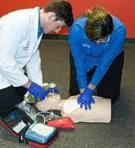
Training to become a
CCH Licensee

Slide 4
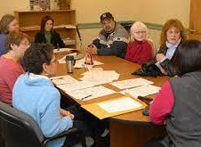
Responsibilities of a CCH
Licensee

Slide 5
Matching
Process

Slide 6
Who comprises the CCH Team?

