Slide 1
How to Play this Presentation
Open the presentation in PowerPoint
Wait for slide show to load up ( it may take a minute or two)
Click on arrows at the bottom of screen to go to the next slide or back a slide or click on the next slide in sequence on the left bar.
To hear recordings, press on the megaphone and press play

Slide 2
AT and Me Technology Training Opportunity

Slide 3
What is the AT & Me program?
AT & Me is an opportunity for people supported by DDS to learn how to use technology to live more independently and to improve their daily living skills. People who participate in AT & Me will learn how to use the equipment provided to them. DDS’ goal is to accept an initial 200 participants who will learn the use and application of technology. After completing the training, each participant will have the responsibility of teaching two more individuals who receive services from DDS how to use the equipment. DDS will provide the names of these individuals to the participant. This training and support will be provided to participants through a program known as peer-to-peer training. An online application needs to be submitted by the individual's case manager.

Slide 4
What is the purpose of the AT & Me program?
The ability to use digital media safely and independently has become an important and necessary skill. Many tasks today can only be completed by using technology, including applying for a job, scheduling a COVID test, paying bills, or ordering a ride from Uber or Lyft. Individuals in the program will benefit from knowing how to use the everyday communication tools provided in the AT & Me program, enabling them to integrate more fully into this digital society.

Slide 5
Who is eligible for the AT & Me program?
Eligibility to participate in the AT & Me program is based on factors including assessment of the individual’s communication challenges, available resources, the anticipated benefit of the technology, and alignment with program goals and priorities. The Assistive Technology backpack includes:
Franklin Wireless JE Xtream WiFi Hot Spot with SIM card and charge cable
Solo Urban Hybrid Briefcase,
iPhone SE with SIM card and wall charger
Lenovo 3003 Yoga Chromebook with charger cable
Gen4 JLabs Studio Pro On Ear Headphones
Otter Box USB-A/ USB-C Wall Charger
It is important to note that the distribution of the Assistive Technology backpack, will be determined based on the number of applicants. Sometimes, prioritization may occur based on urgency or the individual's specific needs, with weight given to the Case Manager’s recommendation of candidates from their caseloads. Individuals will need to participate in a Pre and Post Learning Survey and will be notified by DDS when training will begin.

Slide 6
Online application needs to be submitted, forms must be completed, and participants must bring information to take the class.
Forms to be filled out
Form to collect information prior to and during class
An online application needs to be completed and submitted by the individuals case manager.
Participants must complete and send in the consent form to take the class
Presurvey must be completed before starting class
Post survey hard copy will be placed in the bag with an online link if the individual chooses to fill out the survey online
Participants will bring a form to class with them that will have their email address, username, and password on it.
They will use the same document throughout the class to keep track of their new usernames and passwords (i.e., Apple ID, iCloud address, etc.)

Slide 7
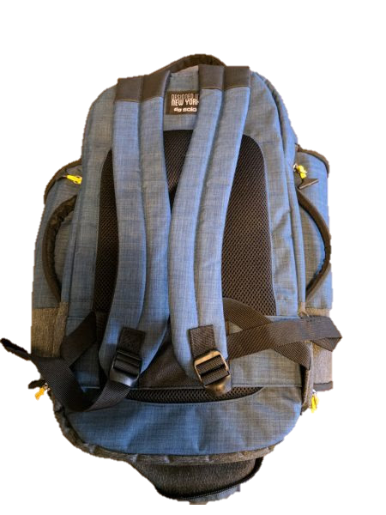
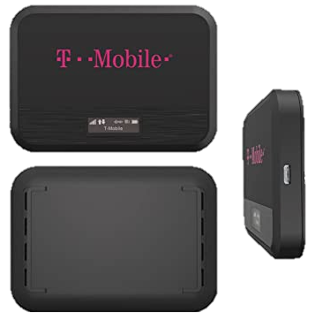
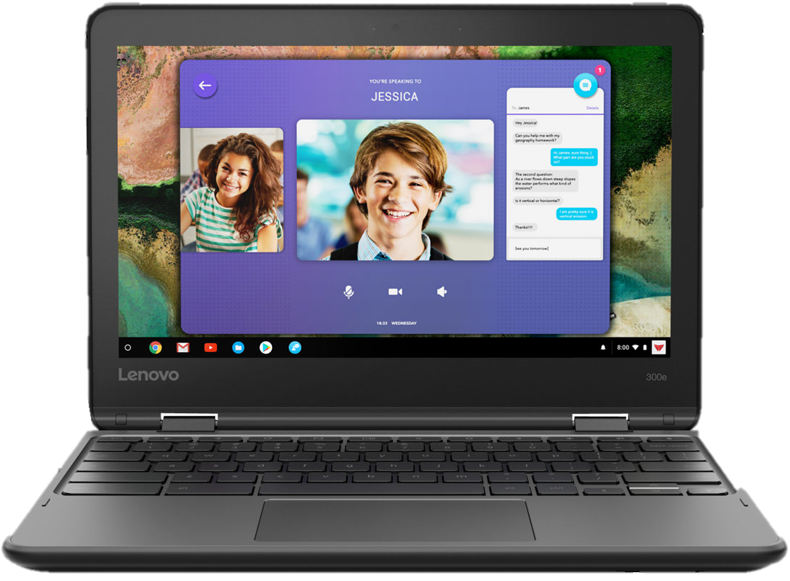
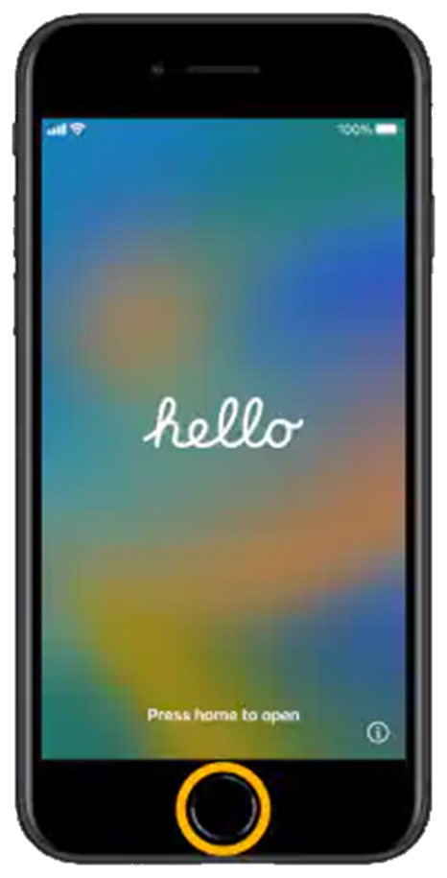
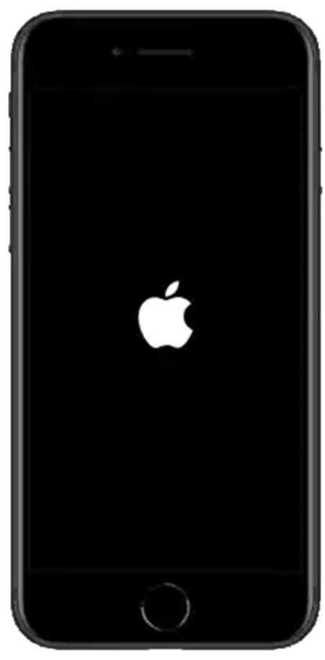
Approved participants will receive free Assistive Technology (AT) equipment such as:
Franklin Wireless JE Xtream WiFi Hotspot with SIM card (w/months of service until July 28, 2024) and charge cable
Lenovo 3003 Yoga Chromebook with charger cable
iPhone SE with SIM card (w/months service of until July 28, 2024) and charge cable
Solo Urban Hybrid Briefcase/ Backpack

Slide 8
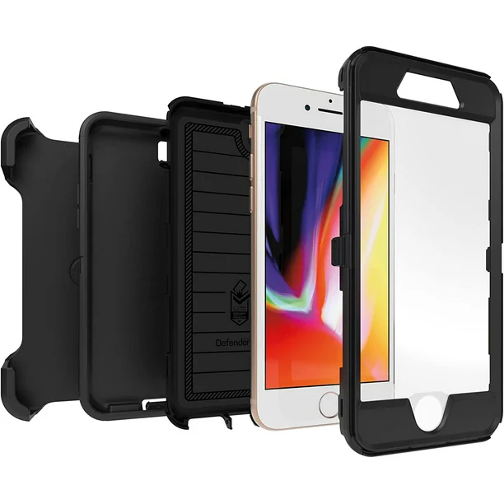
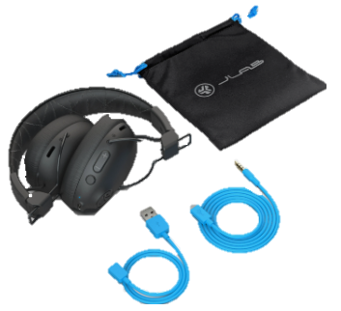
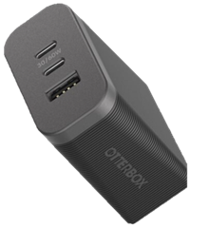
Approved participants will receive free Assistive Technology (AT) equipment such as (Continued):
Gen4 JLabs Studio Pro On Ear Headphones
Extra high-speed Otter Box USB-A/ USB-C Wall Charger
iPhone SE Otter Box Case

Slide 9
JE Xtream Wi-Fi Hotspot
Provides Wi-Fi Internet access for your devices at home and on the go.
On/off button located on top of device.
USB-C charging port located on right side.
Display, power indicator light, and navigation buttons on front of unit.
Review plugging in and charging device.
Turn the device on. The device is already set up.
Note the Wi-Fi name and password that appears on the display screen. We will use this to connect the next device. Write down for your records.

Slide 10
Lenovo Yoga ChromeBook
Provides access to the Internet/ Web, Email, and applications.
Can be used as a laptop or folded and used as a tablet (touch screen).
USB-C data/ charging port, USB-A port, and headphone port on the left side.
Lock receptacle, HDMI port, USB-A port, volume buttons, and power button on right side.
Screen, webcam, keyboard and trackpad visible when opened.
Review plugging in and charging device.
Turn the device on. Set Up Device (steps outlined on next slide).

Slide 11
Lenovo Yoga ChromeBook (Cont.)
Decline
Decline Chrome Vox (voiceover) if offered it can be set up later if wanted)
Verify
Verify language and keyboard
Select
Select any accessibility options desired (can also be set up later)
Connect
Connect to Wi-Fi Hotspot (use the name and password on the display)
Accept
Accept user agreement
Confirm
Confirm that it is you who are using the Chromebook
Create
Create Gmail/ Google account (or use existing if you have one)
Write down
Write down the Gmail/ Google address and password for your records
Accept
Accept terms of service

Slide 12
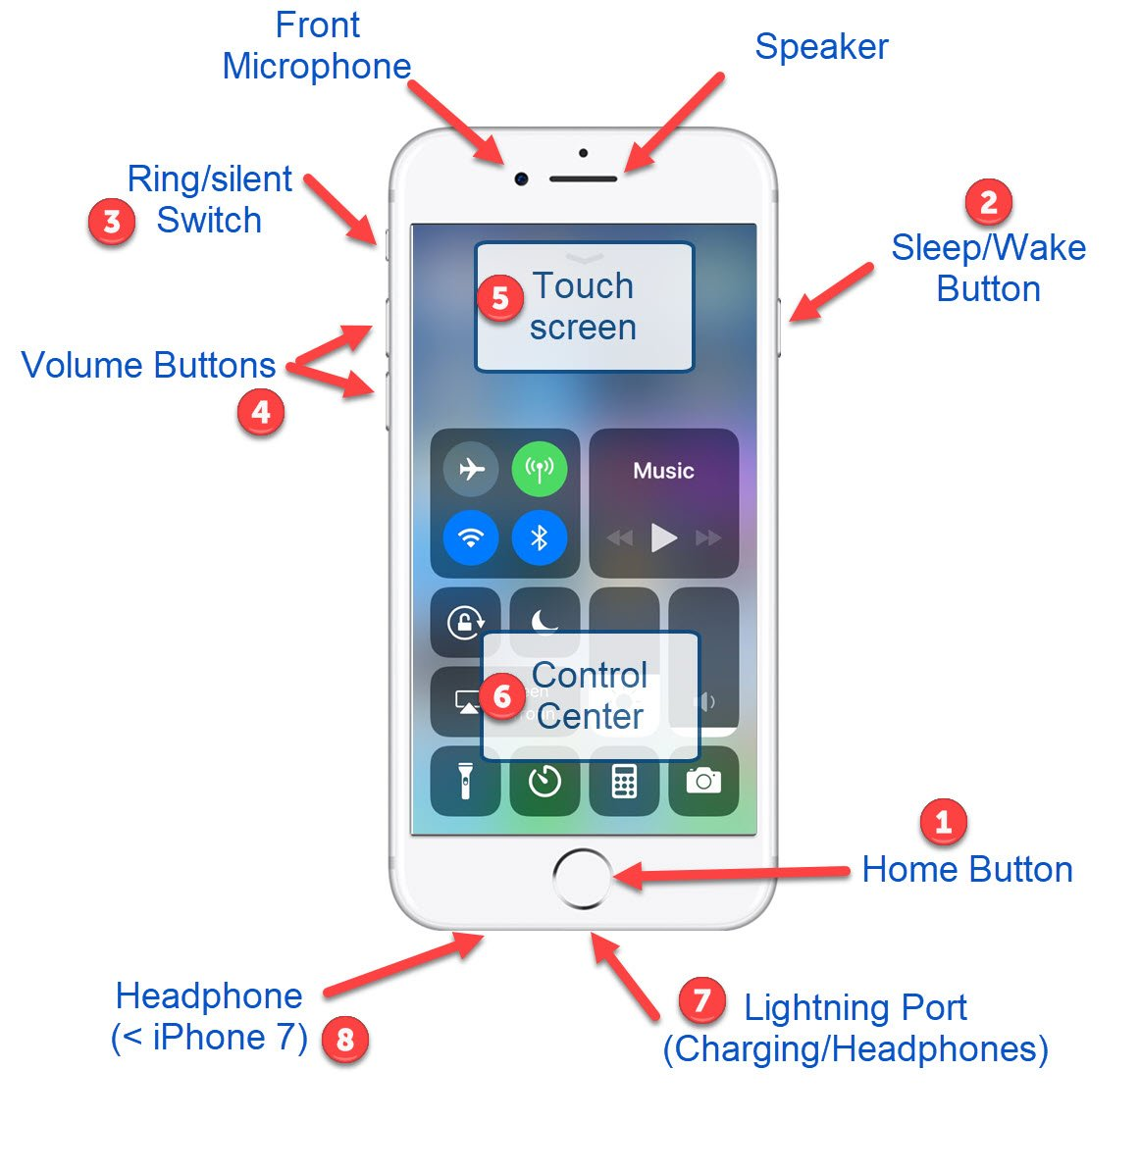
iPhone SE
Provides access to video and audio calls, text messaging.
Provide brief physical description of device:
Volume and mute buttons on left. Power button on right. Charge port on bottom.
Camera on back. Screen, camera, and home button on front.
Review installing protective case and using optional holster/ clip.
Review plugging in and charging device.
Turn the device on. Set Up Device (steps outlined on next slide).

Slide 13
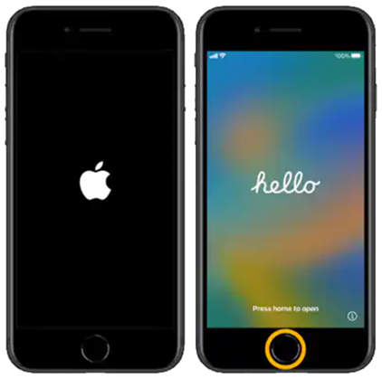
iPhone SE (Cont.)
Select language and country,
Choose set up manually, then connect to your Wi-Fi hotspot.
Set up Touch ID.
Create a passcode (write it down for your records).
Apps and Data option (can transfer information from existing cell).
Create an Apple ID (using Gmail Account you just created).
Write down the Apple ID and password for your records.
Accept terms and conditions (setup continued on next slide).

Slide 14
iPhone SE (Cont.)
Enable iMessage and FaceTime.
1
Enable location services.
2
Enable Siri (choose preferred voice).
3
Choose options, appearance, and regular or zoomed display.
4

Slide 15
Bluetooth Headphones
Provides private listening of Chromebook and iPhone audio.
Review folding and unfolding headphones.
Right ear cup has a charging port (MicroUSB), volume buttons, a large power button (hear two beeps for on/ one beep for off), and a small Bluetooth pairing button (press and hold eight seconds until light near the charging port flashes red then blue).
MicroUSB to USB-A cord is used to charge headphones.
MicroUSB to 1/8” jack is used to plug into Chromebook or other devices with an audio jack.
Turn the device on and pair headphones to ChromeBook and/ or iPhone.

Slide 16
Q&A
Any questions?
Any ideas/ requests for future trainings?
Remember to turn your devices off when not using them to save battery.
Remember to safely place all your new equipment in your backpacks.

Slide 17
Thank You!

