Slide 1
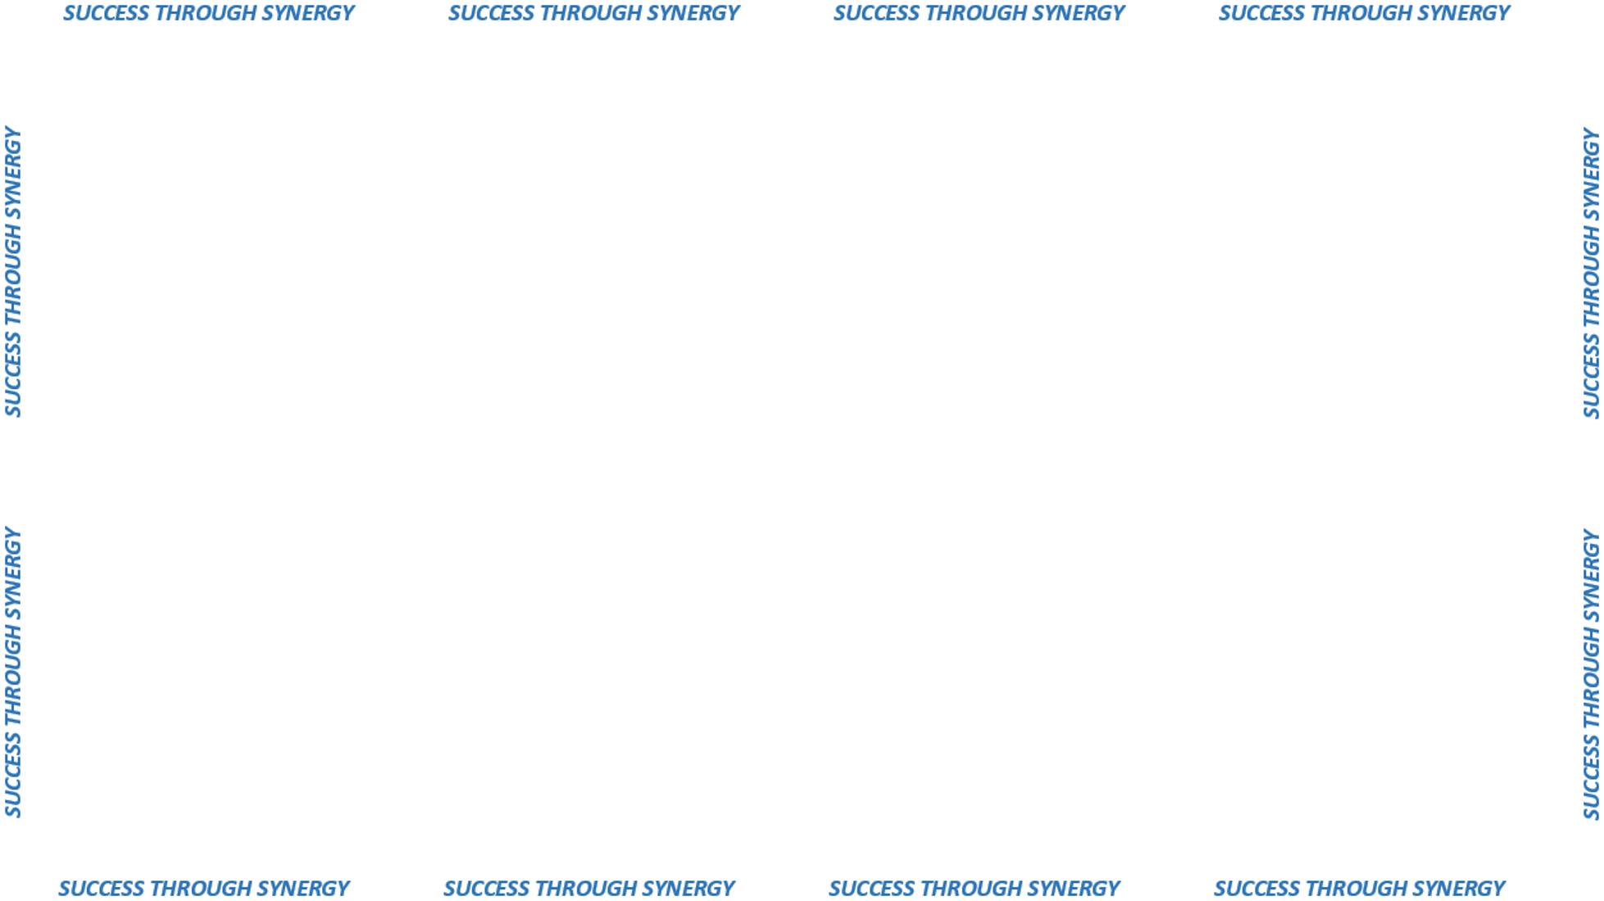

STATE
SURPLUS
PROGRAM

Slide 2



State surplus
“NOW” AND “FUTURE” VISION

Slide 3

”NOW”
”FUTURE”
Asset
Management
Focused
Goal to expand
the focus
Check Public Surplus
Reallocation
BEFORE
Purchasing new
Viewed from
“disposal”
perspective
Consider
“NEW LIFE”
Considered
“END OF LIFE”

Slide 4
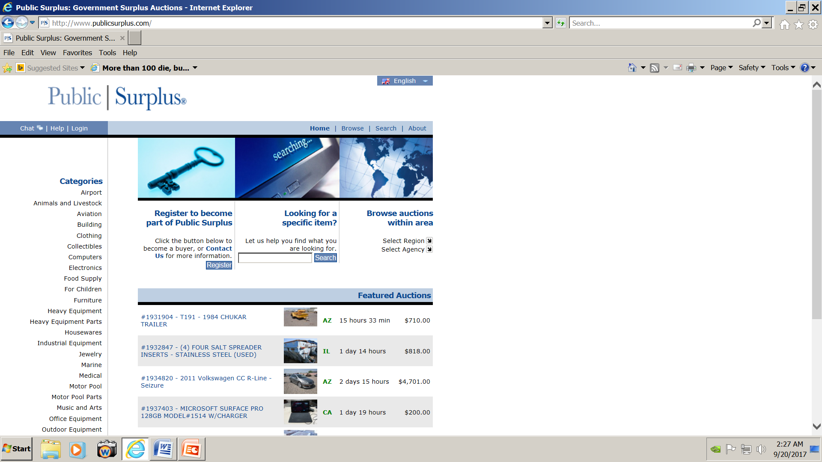
WEBSITE
WWW.PUBLIC SURPLUS.COM
Username: Ctstaff
Password: CTstaff1

Slide 5

Once Logged In
1. Go to “Browse auctions within area”
2. Select Region = Connecticut
3. Select Agency = State of Connecticut
4. Click the hyperlink:
“View all auctions for State of Connecticut”
Veronica.coty@ct.gov

Slide 6


Anything with a gold key is available for reallocation within state agencies
AT NO COST !

Slide 7

2017 STATISTICS
Internal Reallocations
Public Auctions
State Agency Reallocations
1,103 Autions
13,400 Items
1,103 Autions
13,400 Items
Municipality Purchases
60 Autions
927 Items
Non Profit Reallocations
22 Autions
494 Items

