Slide 1
WebProcure
Supplier Management – How To
April 2020

Slide 2
Table of Contents
Accessing Supplier Administration
Edit Pending Suppliers – Approve & Propagate
Edit Suppliers – Update Suppliers
Edit Suppliers – Export Suppliers
Edit Suppliers – Notify Suppliers
Edit Suppliers - Denial of Vendors
Edit Suppliers – Create Audit

Slide 3
Table of Contents, continued
Add New Supplier
Add Existing Supplier
Bulk Propagate Suppliers
Bulk Supplier Import

Slide 4
Accessing Supplier Administration

Slide 5
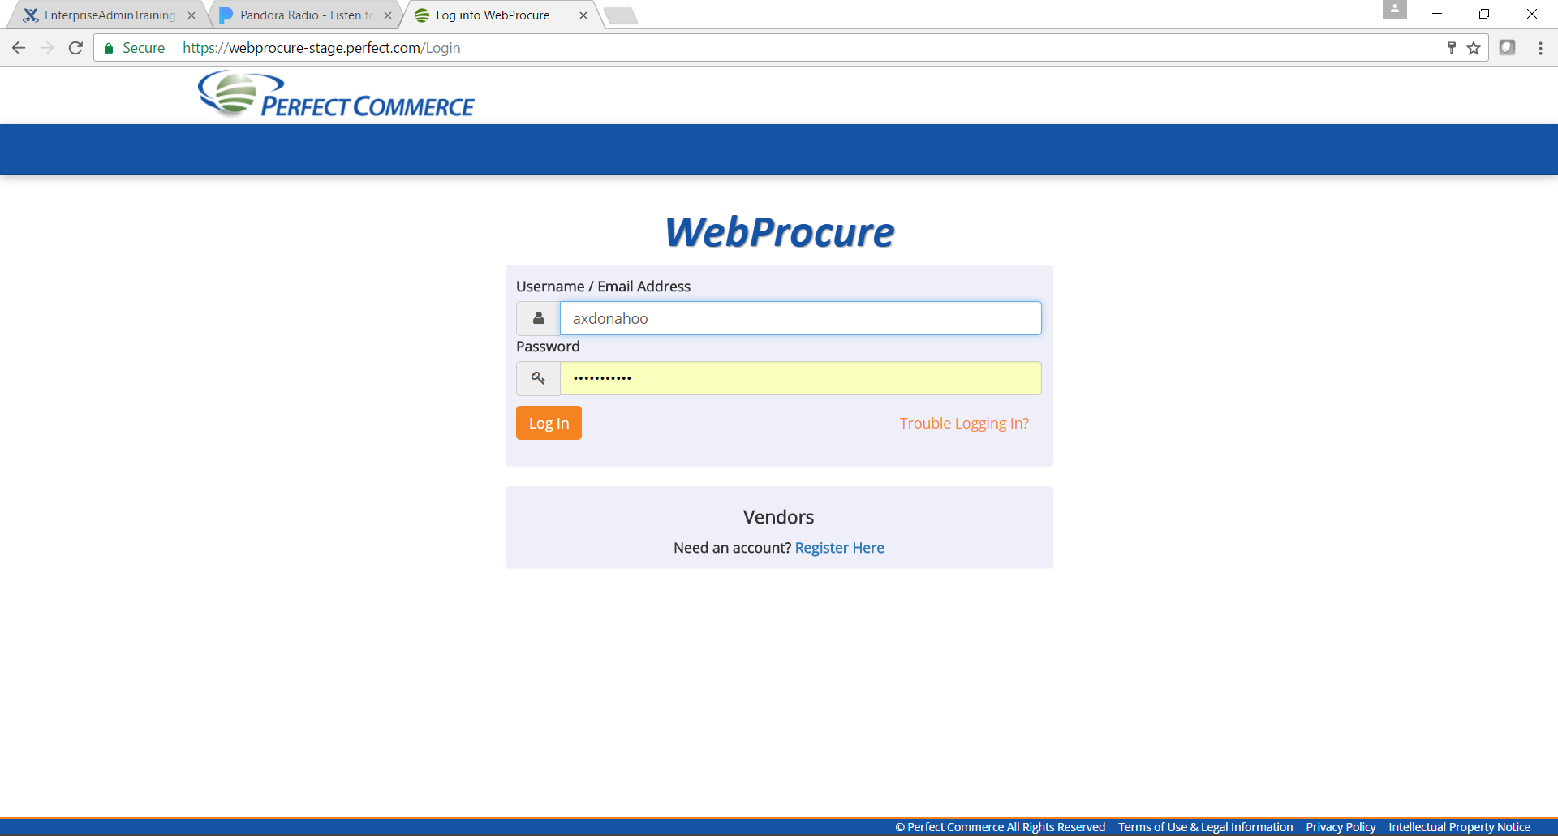
Login to WebProcure
https://webprocure-stage.perfect.com/Login

Slide 6
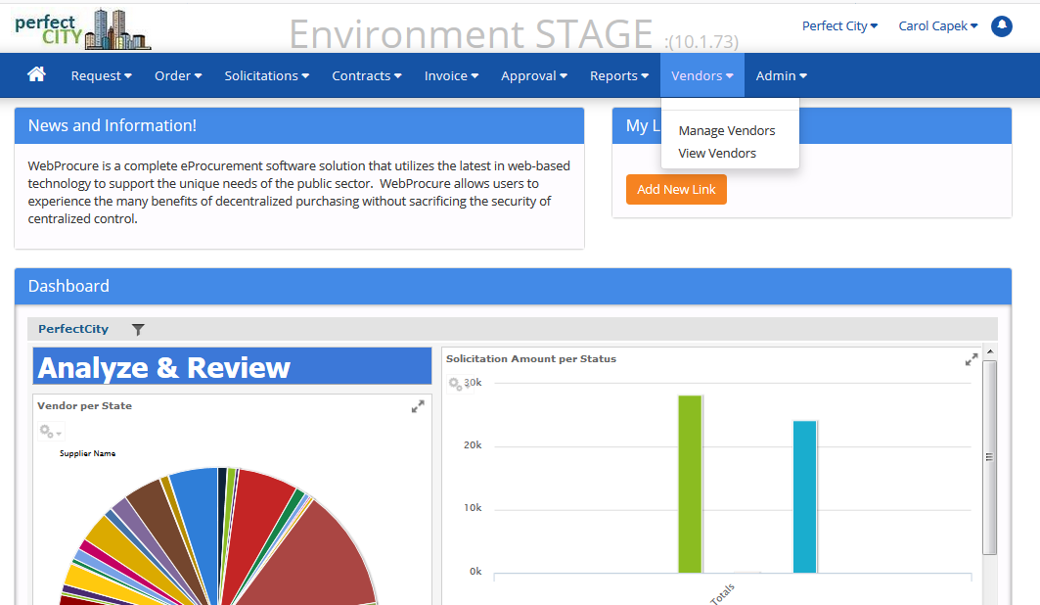

Navigate to Manage Vendors

Slide 7
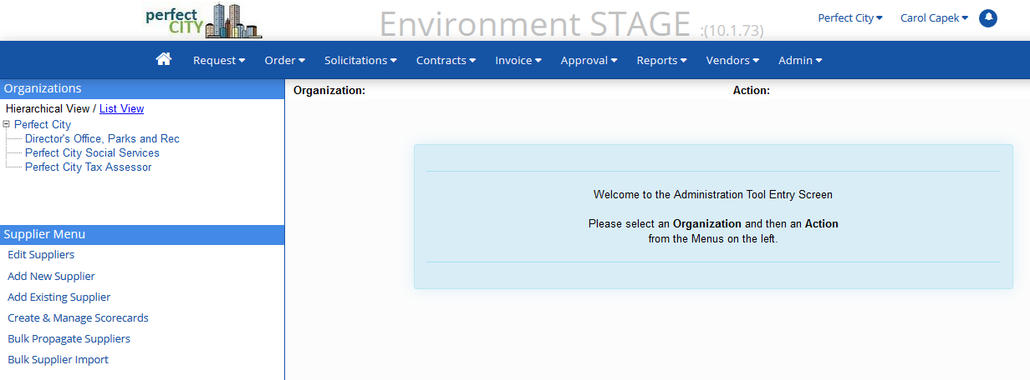
Manage Vendors Home Screen
Note: Supplier Management activities for the Entity Supplier Specific Vendor Database will be performed at the Entity Head Organization level. No Supplier Management action or task should be performed at any sub-organization level for the Entity, unless a review of process is completed and it is determined appropriate to have multi-organizational Supplier Management.

Slide 8
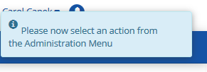
Select the Head Organization
Note the system message pops up, “Please now select an action from the Administration Menu”. Next sections will review the actions available.

Slide 9
Edit Pending Suppliers –
Approve & Propagate

Slide 10
Select Edit Suppliers from Supplier Menu

Slide 11
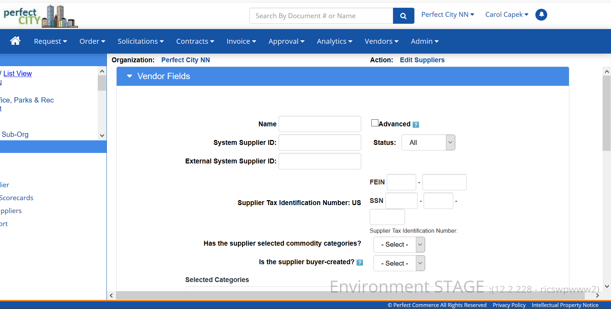
Returns the Supplier Basic Search Screen

Slide 12
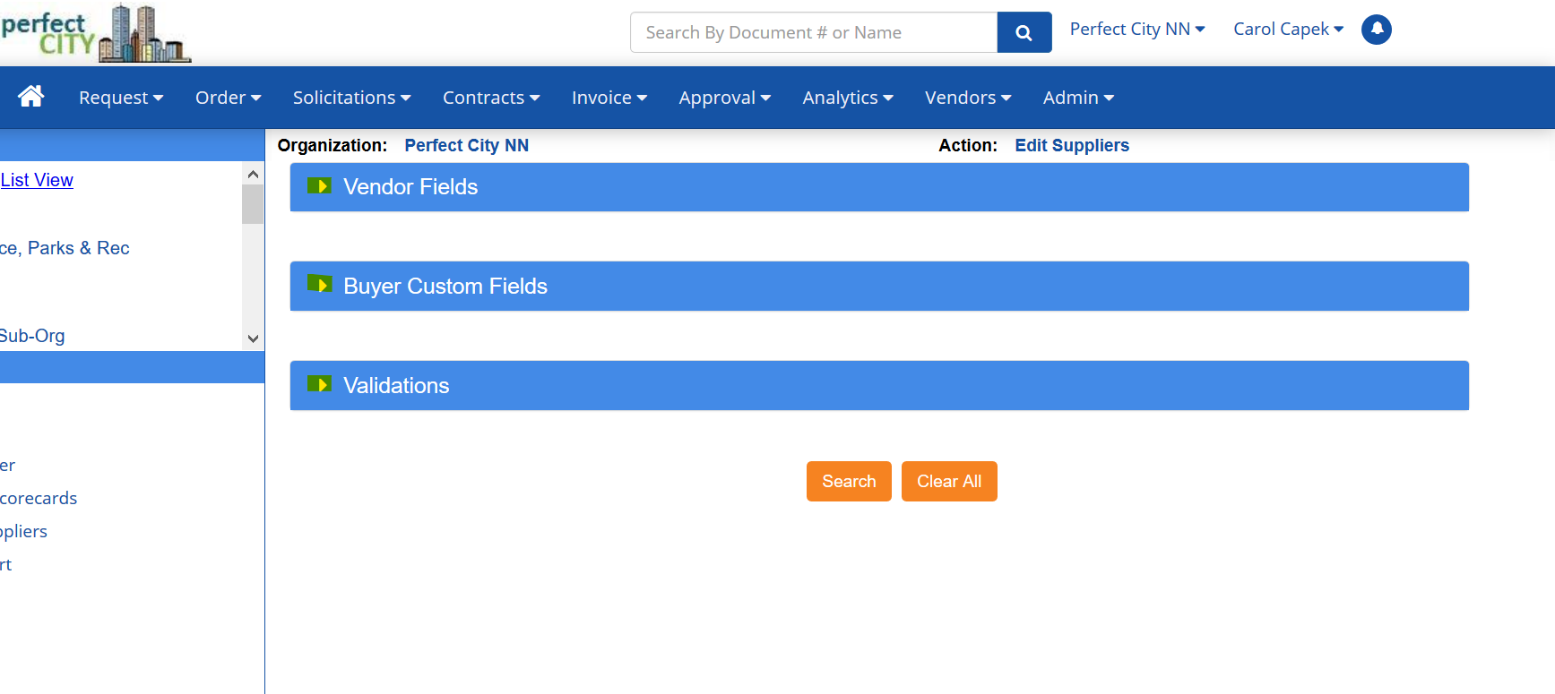
Refined Search Screen Sections
If you use arrows/carets on left – you can expand/compress sections – see next few slides for sections:

Slide 13
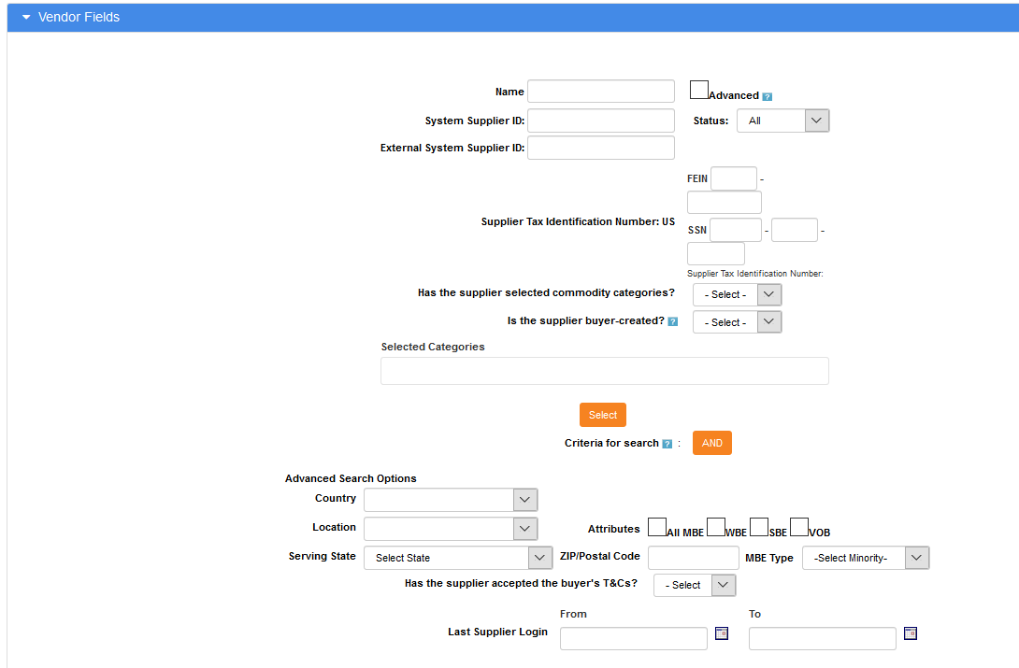
Vendor Fields
Use Vendor Fields for basic Searches – see more details in next slides:

Slide 14
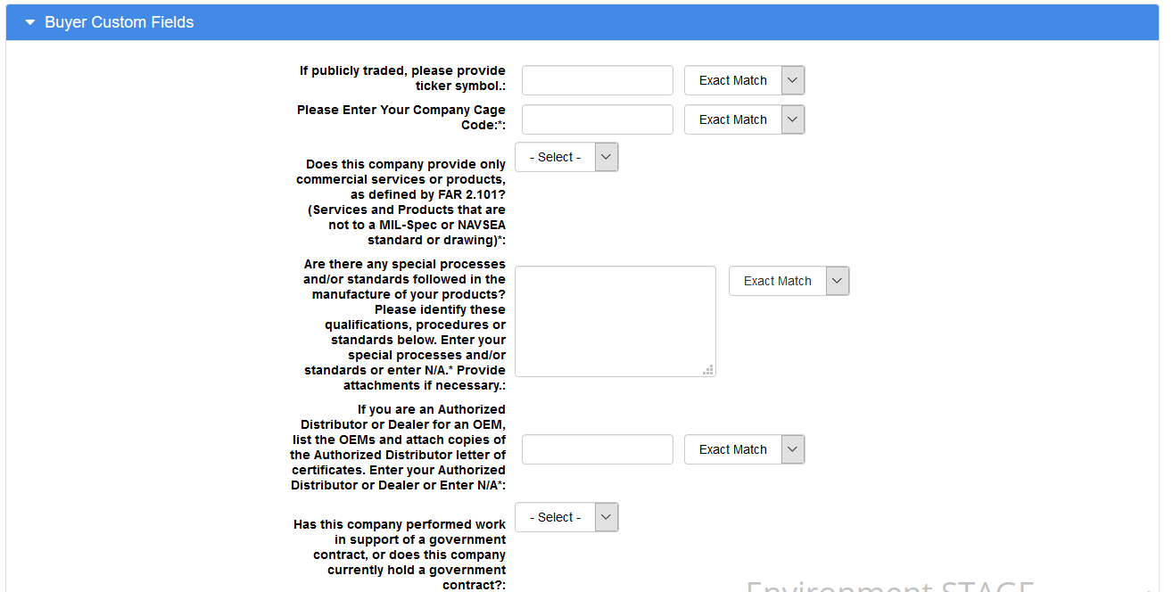
Buyer Custom Fields
These fields are defined for each client as part of Vendor Registration and Vendor Management Design – these are data the vendor enters, or the client does to track and maintain details related to vendors:

Slide 15
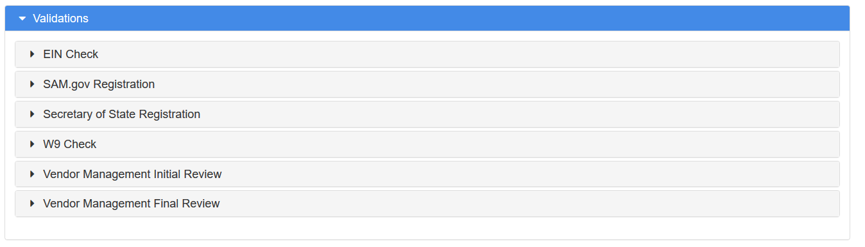
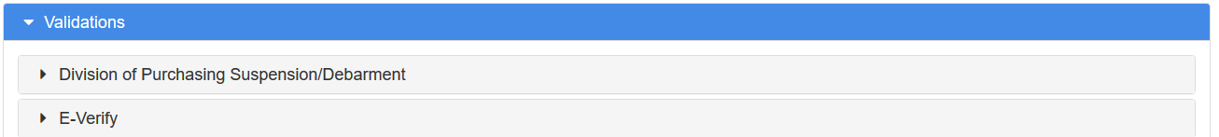
Validations
Validations are tools used to collect information about certifications, debarment statuses, approval processes and a variety of client tracked items – these can be defined by each client – some examples are below:

Slide 16
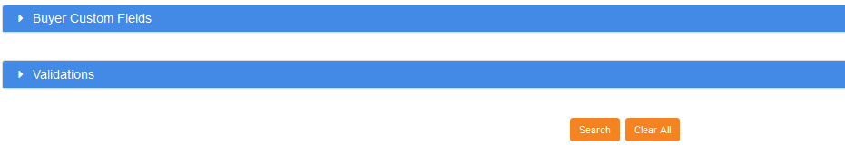
Basic – Enter the Supplier Name & Search
Type the most unique part of the Supplier Organization name into the Name field. This action will help reduce the Search Results. Example: Test Office Supplies—Enter only “Test” into the Name field and Search

Slide 17
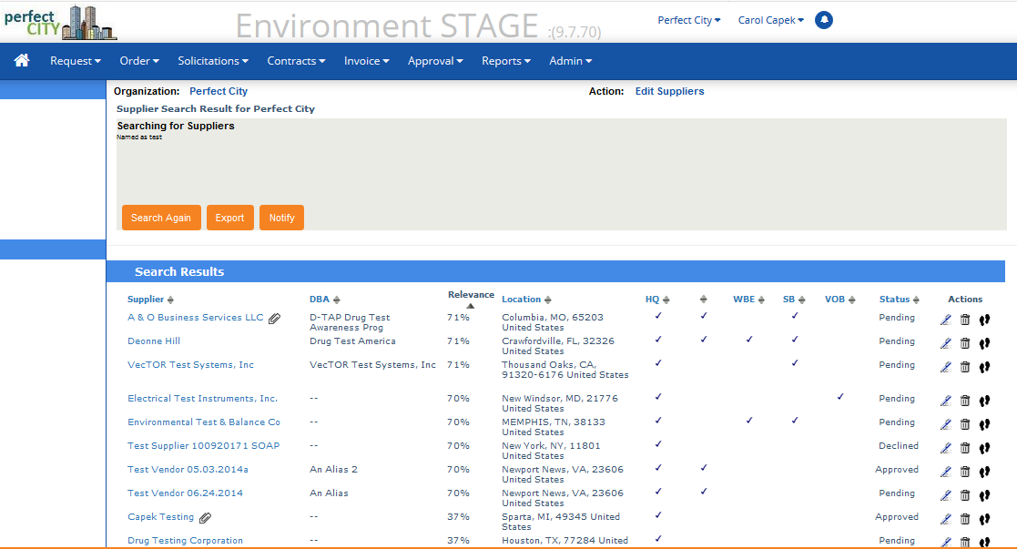
Returns any Supplier with Name or DBA

Slide 18
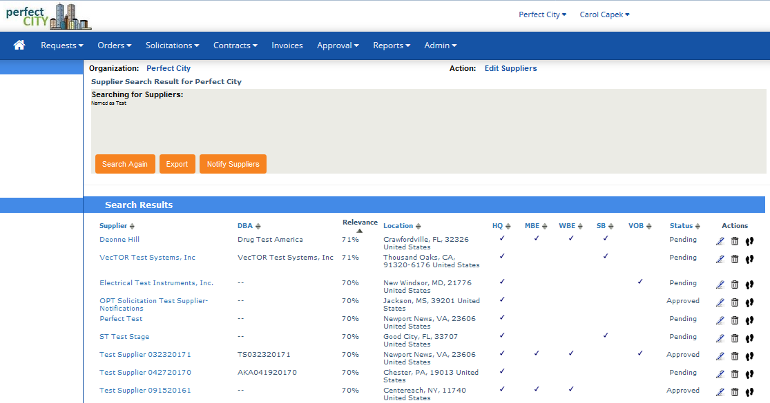
Locate Supplier to Review and Edit
Click the Edit icon
within the
Actions
column

Slide 19

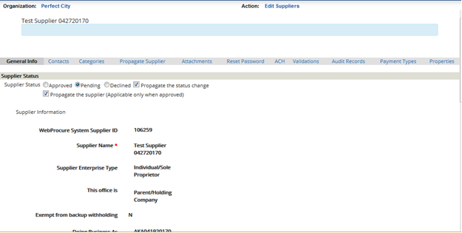
Default Supplier Profile Page is General Info

Slide 20
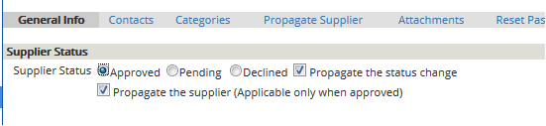
Review Vendor Details, Approve & Propagate
Scroll down pages and tab through vendor information to review
Once reviewed and confirm set for approval – Select the radio button beside Approved in Supplier Status section and Select the checkbox besides Propagate the Suppler (should be defaulted to checked)
Note: The Propagate the Supplier option is the action of copying the supplier record to all sub-organizations within the Enterprise. If the Propagate the supplier option is not selected—even though the supplier profile is approved for the Head organization level it will not be available for any sub-organization for Solicitation association or Purchase Order creation within the WebProcure system.
Additional NOTE: There are new permissions that won’t allow a user to uncheck the “Propagate” checkboxes – these have been enabled for Entity users so all propagation occurs

Slide 21
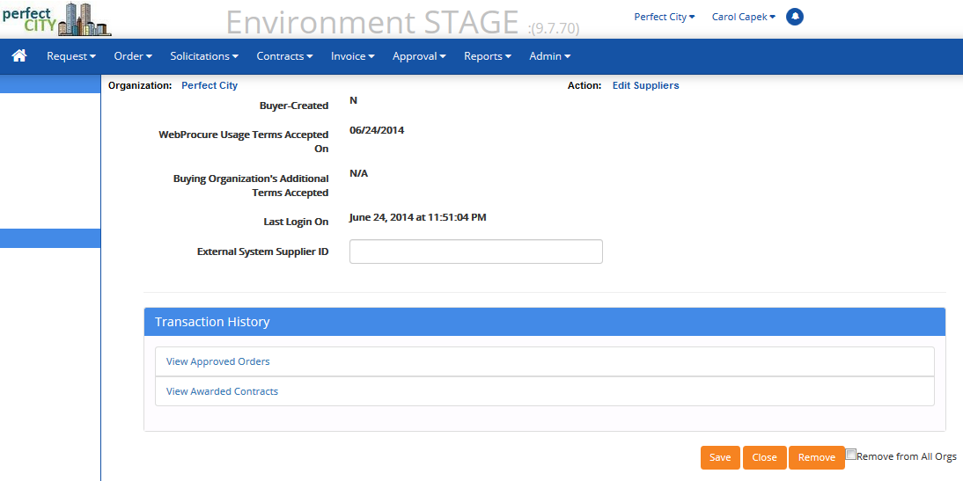
To complete Approval, Select Save
Scroll to the bottom of the General Info Page and Select Save

Slide 22
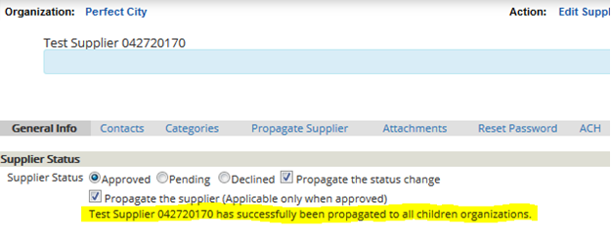
Await Approval and Propagation Completion
The Propagation will perform; this process could take up to 20 to 30 seconds. Do not click any button or navigate away from the page until the page refreshes and you see the verbiage highlighted in the below screen print.
Note: If the page refreshes and the verbiage “[Supplier Organization name] has successfully been propagated to all children organization” does not display—perform the following steps:
1. Change the Supplier Status back to Pending and click Save
2. Select the Approved status option AND
3. Select the Propagate the supplier (Applicable only when approved) option
4. Click Save
5. The page will refresh and display the verbiage “[Supplier Organization name] has successfully been propagated to all children organization”

Slide 23
Edit Suppliers – Update Suppliers

Slide 24
Repeat Slides 9-16 To Find a Vendor
Utilize Steps above to locate and get a list of vendors matching the name or other criteria entered.
Use Vendor Fields for basic Searches
Use Buyer Custom Fields to search those fields defined for your client as part of Vendor Registration and Vendor Management Design – these are data the vendor enters, or the client does to track and maintain details related to vendors
Use Validation Fields to search those fields defined for your client to collect information about certifications, debarment statuses, approval processes and a variety of client tracked items

Slide 25
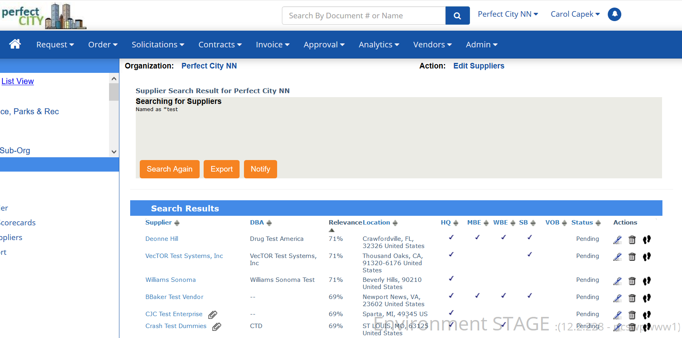
Locate Supplier to Review and Edit
Click the Edit icon
within the
Actions
column

Slide 26
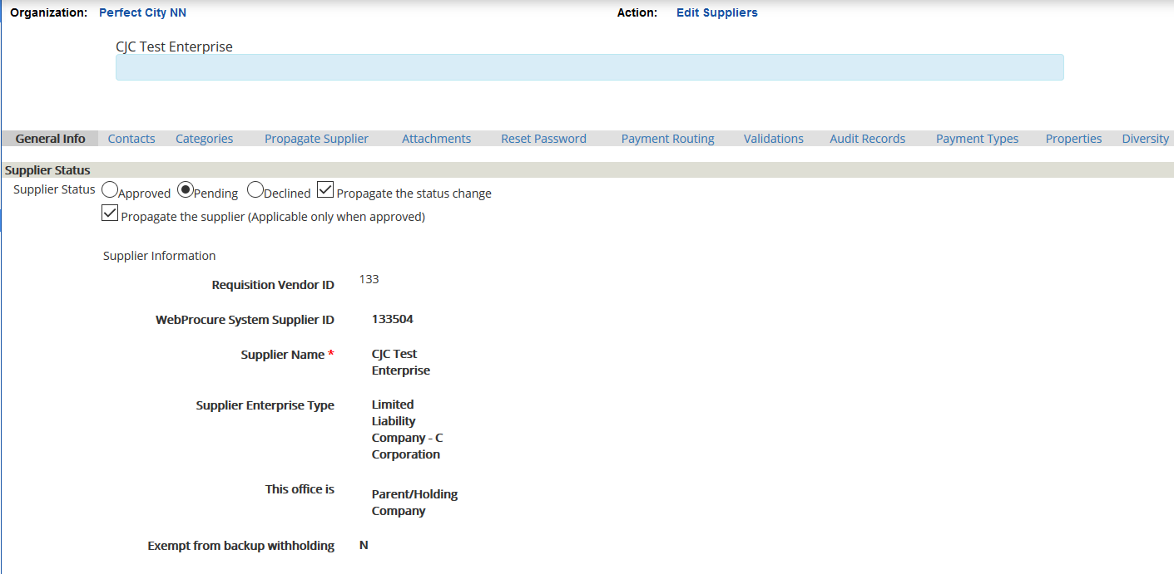
Default Supplier Profile Page is General Info

Slide 27
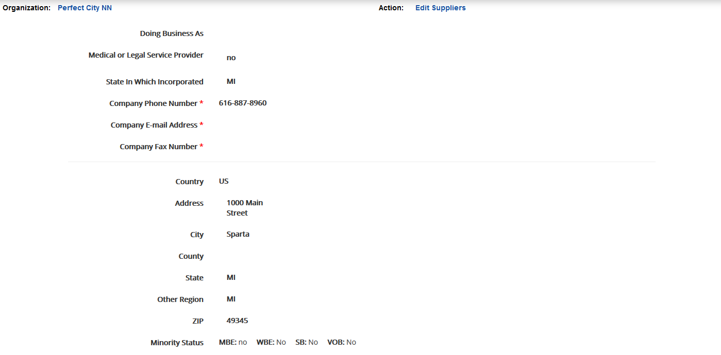
General Info, continues, page down

Slide 28
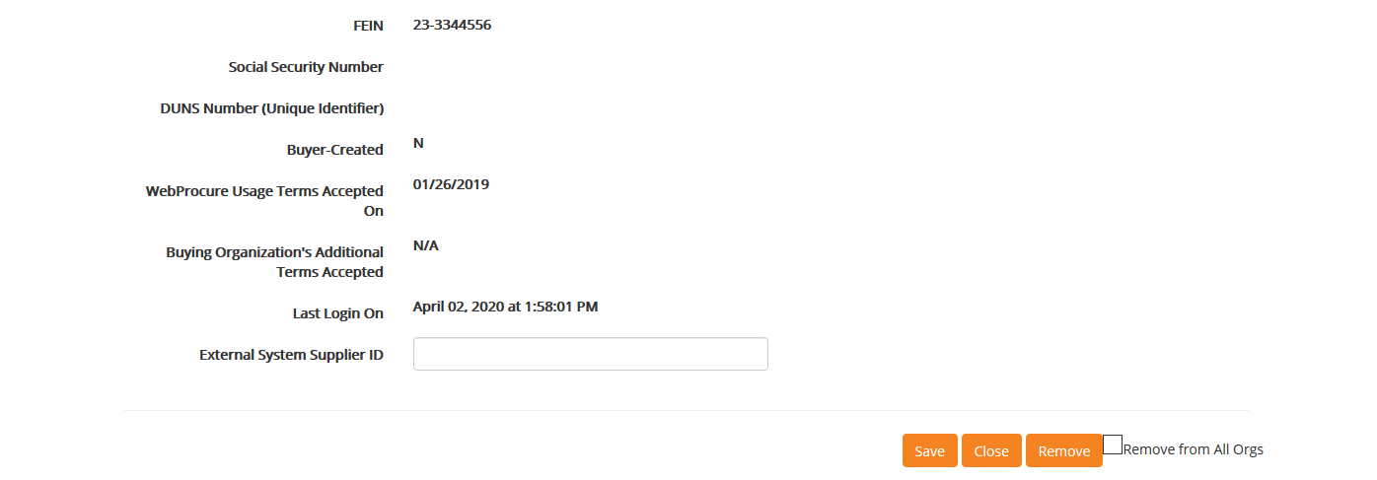
General Info, continues, page down

Slide 29
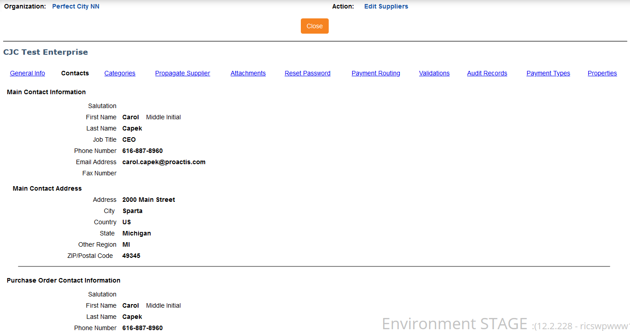
Review Vendor Details to Update
Scroll down General Info pages above, Review Vendor Data and Update relevant Fields and hit Save
Proceed through other tabs across the top (after General Info) needing review and/or updates – Contacts, Categories, Attachments, Payment Routing, Validations, Audit Records, Payment Types, Properties, etc. – Review and update the records as needed. Hit the Save button. See Help for additional details.

Slide 30
Edit Suppliers – Export Suppliers

Slide 31
Repeat Slides 9-16 To Find a Vendor
Utilize Steps above to locate and get a list of vendors matching the name or other criteria entered.
Use Vendor Fields for basic Searches
Use Buyer Custom Fields to search those fields defined for your client as part of Vendor Registration and Vendor Management Design – these are data the vendor enters, or the client does to track and maintain details related to vendors
Use Validation Fields to search those fields defined for your client to collect information about certifications, debarment statuses, approval processes and a variety of client tracked items

Slide 32
List of Suppliers

Slide 33
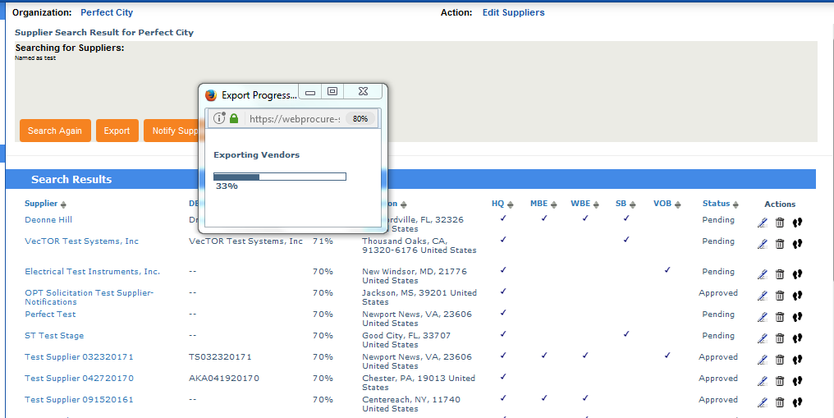
Select Export

Slide 34
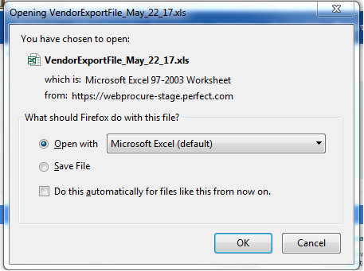
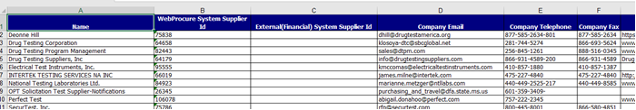
Choose Option
Once the Export completes, a list of choices will appear in the window:
Make your choice to Open or Save the files and hit OK; the Exported Files will open or save – below is a snippet:

Slide 35
Edit Suppliers – Notify Suppliers

Slide 36
Repeat Slides 9-16 To Find a Vendor
Utilize Steps above to locate and get a list of vendors matching the name or other criteria entered.
Use Vendor Fields for basic Searches
Use Buyer Custom Fields to search those fields defined for your client as part of Vendor Registration and Vendor Management Design – these are data the vendor enters, or the client does to track and maintain details related to vendors
Use Validation Fields to search those fields defined for your client to collect information about certifications, debarment statuses, approval processes and a variety of client tracked items

Slide 37
List of Suppliers

Slide 38
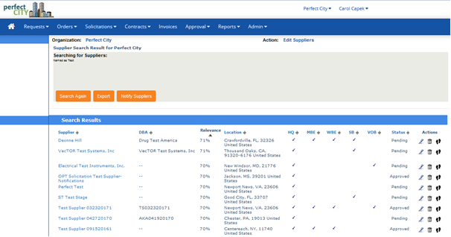
Select Notify Suppliers

Slide 39
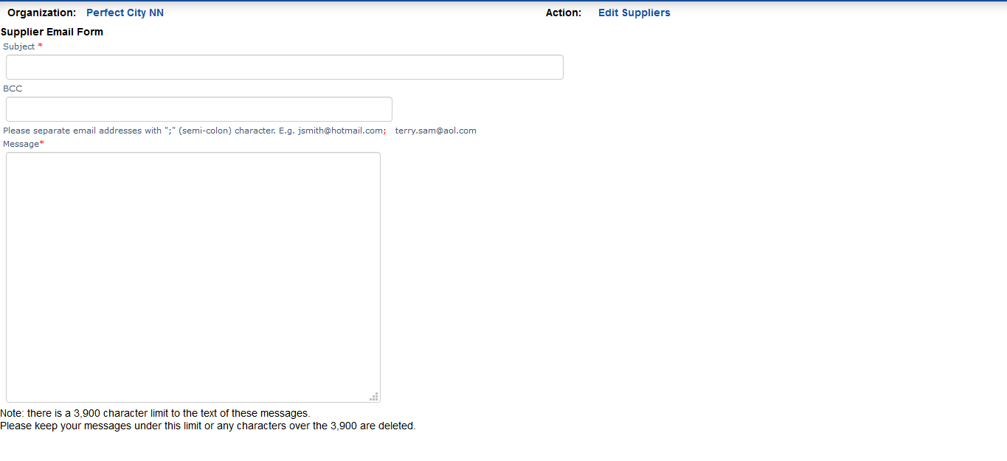

Draft Email
Supplier Email Form Opens. Draft the message in the top section of the screen (Subject and Message are required), attach any files needed. BCC to yourself to retain a copy of the email and recipients:

Slide 40
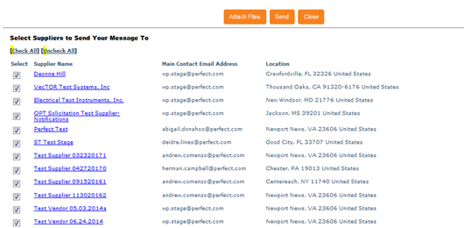
Draft Email
Scroll down the screen and select the vendors (Check All or Uncheck All and select individually) from the initial selection that you want to send the message by clicking Send.

Slide 41
Edit Suppliers – Denial of Vendors

Slide 42
Repeat Slides 9-16 To Find a Vendor
Utilize Steps above to locate and get a list of vendors matching the name or other criteria entered.
Use Vendor Fields for basic Searches
Use Buyer Custom Fields to search those fields defined for your client as part of Vendor Registration and Vendor Management Design – these are data the vendor enters, or the client does to track and maintain details related to vendors
Use Validation Fields to search those fields defined for your client to collect information about certifications, debarment statuses, approval processes and a variety of client tracked items

Slide 43
Locate Supplier to Review and Edit
Click the Edit icon
within the
Actions
column

Slide 44
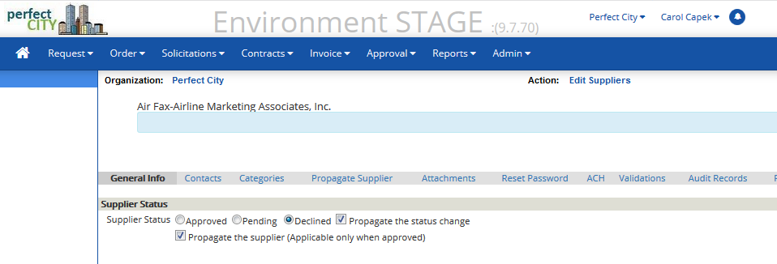
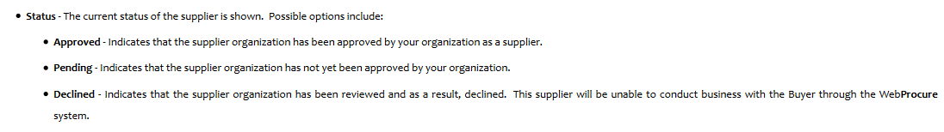
Supplier Status
Change the Status from Approved to Declined by selecting the button in front of declined.

Slide 45
To complete Denial, Select Save
Scroll to the bottom of the General Info Page and Select Save
NOTE: Also – proceed to next section, Create Audit Record to Indicate Reason for Denial

Slide 46
Edit Suppliers – Create Audit

Slide 47
Repeat Slides 9-16 To Find a Vendor
Utilize Steps above to locate and get a list of vendors matching the name or other criteria entered.
Use Vendor Fields for basic Searches
Use Buyer Custom Fields to search those fields defined for your client as part of Vendor Registration and Vendor Management Design – these are data the vendor enters, or the client does to track and maintain details related to vendors
Use Validation Fields to search those fields defined for your client to collect information about certifications, debarment statuses, approval processes and a variety of client tracked items

Slide 48
Locate Supplier to Review and Edit
Click the Edit icon
within the
Actions
column

Slide 49
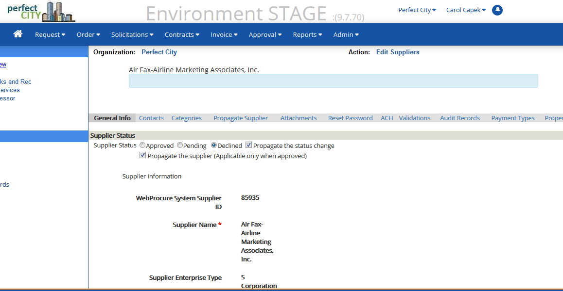
Audit Records
Select Audit Records to create a manual audit for this vendor

Slide 50
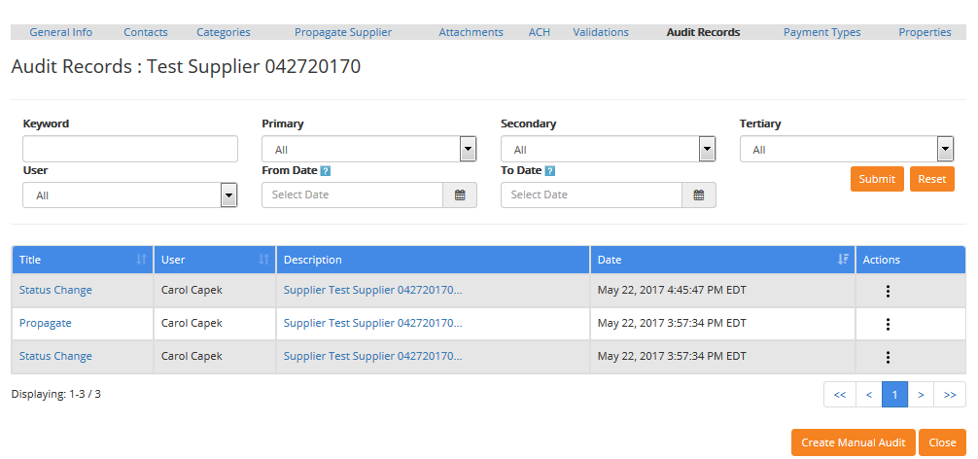
Audit Records – Create Manual Audit
Select Create Manual Audit to create a manual audit record indicating the Reason for Denial/Decline for tracking purposes, or for other purposes for this vendor

Slide 51
Audit Records – Create Manual Audit
Type the Title and Description noting reason for declining the vendor. The system will log the date and time and user id of the creator. Attach any relative documents (if needed). Select Save

Slide 52
Audit Records – End Result

Slide 53
Add New Supplier

Slide 54
Add New Supplier
Note: The preferred and effective process for Supplier Profile creation within the WebProcure system is to have a representative from the supplier organization to complete the Entity Customized on-line WebProcure Supplier Registration process. The Supplier completing the on-line Registration process will ensure that the Supplier Profile is complete and accurate whereas the Supplier Profile created by a buyer user via the Add New Supplier process will result in a less complete supplier profile and often times result in the unwanted duplication of supplier profiles.
Please search your vendor file for FEIN/SSN first before adding a new supplier (note: this will not ensure the supplier doesn’t exist in the global pool, only in your pool, however, it will prevent you from adding a duplicate to your own vendor file pool).

Slide 55
Select the Head Organization
Note the system message pops up, “Please now select an action from the Administration Menu”

Slide 56
Select Add New Supplier from Supplier Menu

Slide 57
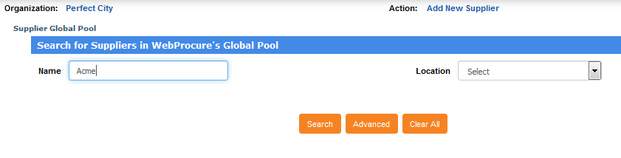
Enter Supplier Name
Enter “Supplier Organization Name” in the Name field and Select Search

Slide 58
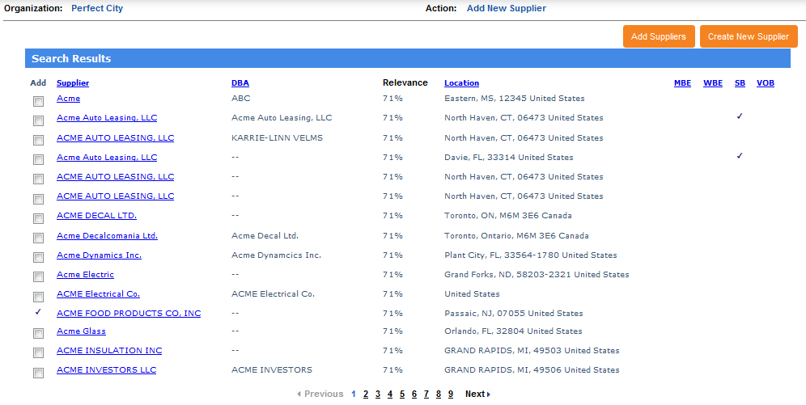
Search Results
Supplier Organization(s) with a name match or partial name match will display within the Search Results section

Slide 59
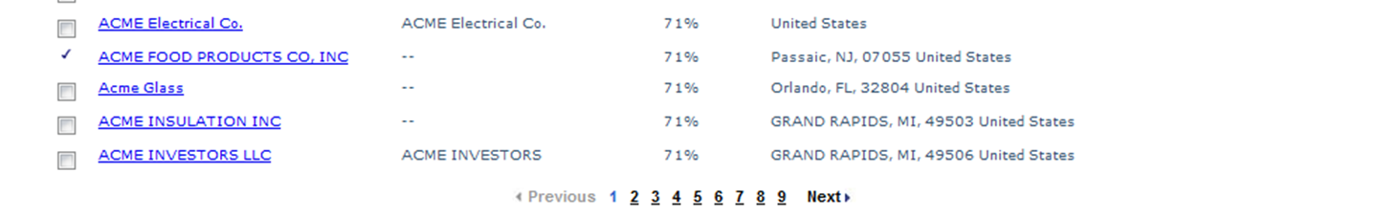
Review Supplier Results - Edit Supplier
A supplier organization listed within the Search Results section represent one of the below criteria
a. A checkmark to the left of the Supplier name represents that the supplier profile already exists within the Entity’s WebProcure Specific Supplier database.
i. The Add Supplier process should be abandoned since the Supplier is already an existing profile within the Entity’s WebProcure Specific Supplier Database
ii. The supplier organization’s profile can be accessed via the Edit Supplier option

Slide 60
Review Supplier Results - Add Supplier
b. A select box to the left of the Supplier name represent that the supplier organization exists within the WebProcure Global Supplier database, but is not associated or a part of the Entity’s WebProcure Specific Supplier database.
i. Add the existing supplier profile to the Entity’s Specific Supplier Database
ii. Click the select box to the left of the supplier name and click Add Suppliers
iii. Once a Supplier has been added to the Entity’s specific Supplier database, the supplier organization’s profile can be accessed via the Edit Supplier option

Slide 61
Review Supplier Results – Create New Supplier
If the Supplier Organization is not listed within the Search Results section matching your Supplier name. You can also select supplier details (underlined vendor name) to verify FEIN/SSN and other details

Slide 62
Create New Supplier - Caution
Enter the supplier information for the Supplier Organization being created via the Add New Supplier option. CAUTION: There are no checks for duplicates in this process of adding suppliers
Fill in all the available fields as completely as possible for the Supplier Profile
Minimal Required fields are listed below:
Supplier name
Parent Holding Company or Branch
Contact first name
Last name
Phone number
Fax and/or email

Slide 63
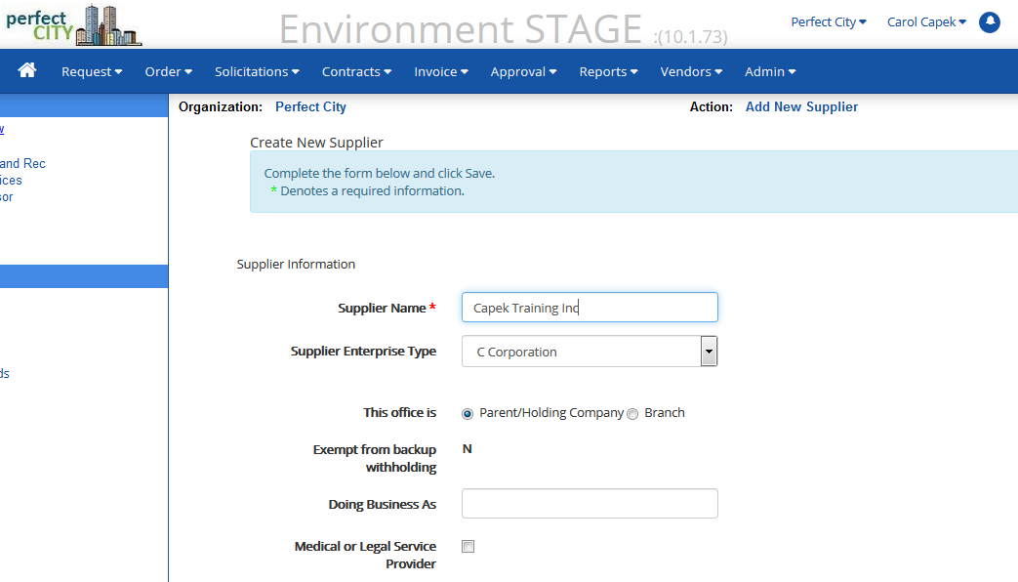
Create New Supplier - complete form
If the Supplier Organization is not listed within the Search Results section matching your Supplier name

Slide 64
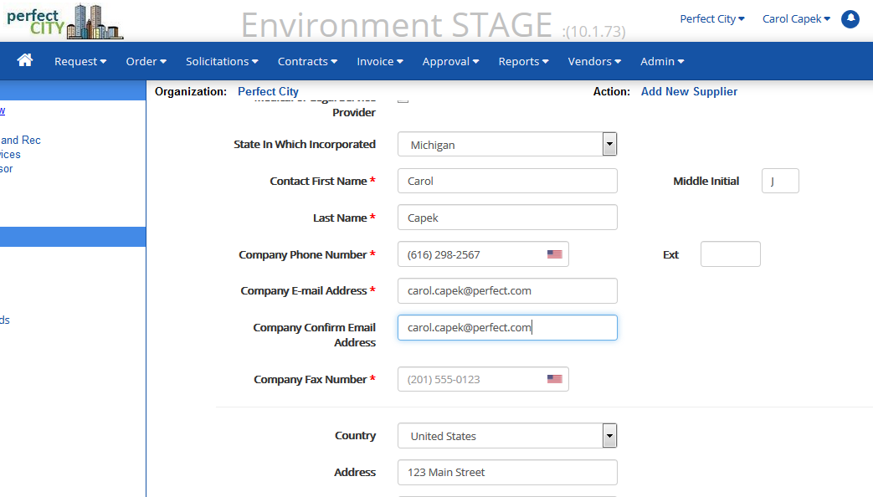
Create New Supplier - complete form
If the Supplier Organization is not listed within the Search Results section matching your Supplier name

Slide 65
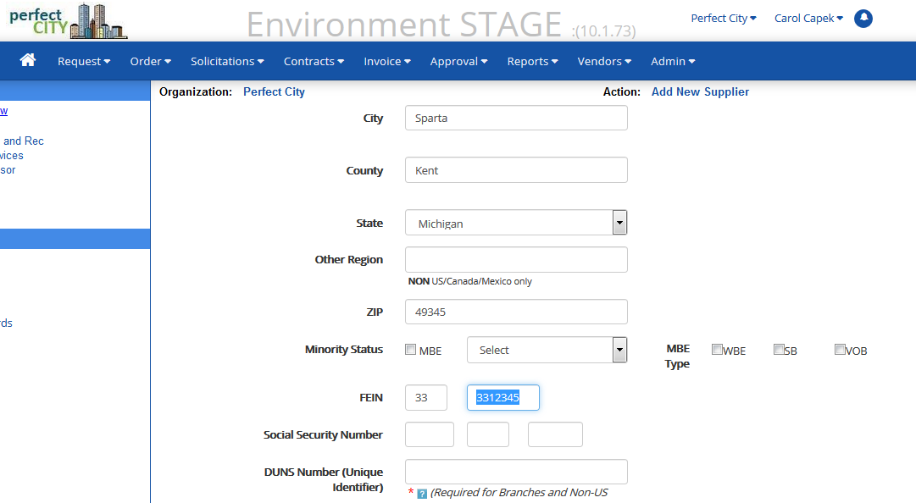
Create New Supplier – complete form
If the Supplier Organization is not listed within the Search Results section matching your Supplier name

Slide 66
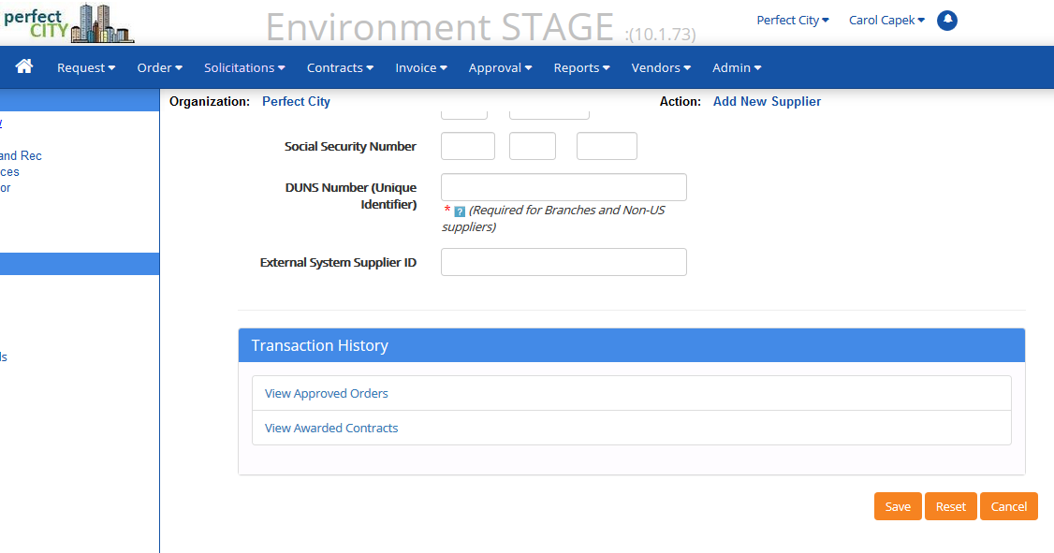
Create New Supplier - Save
Select Save to add supplier

Slide 67
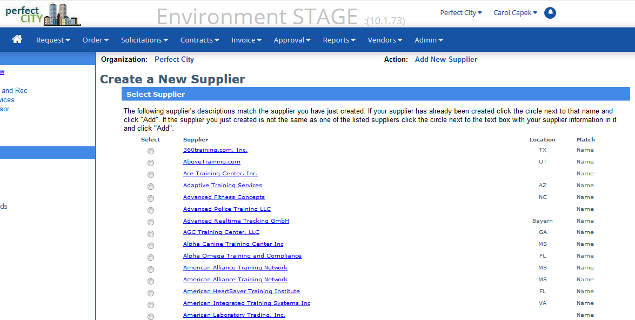
Create New Supplier – Review List
Review the list of suppliers on the Select Supplier page. Verify again that the supplier profile created via the Add New Supplier option does not already exist within the WebProcure Global Supplier database. If you aren’t sure, Cancel and search again, or use the Supplier Names listed here to review details such as FEIN/SSN, etc.

Slide 68
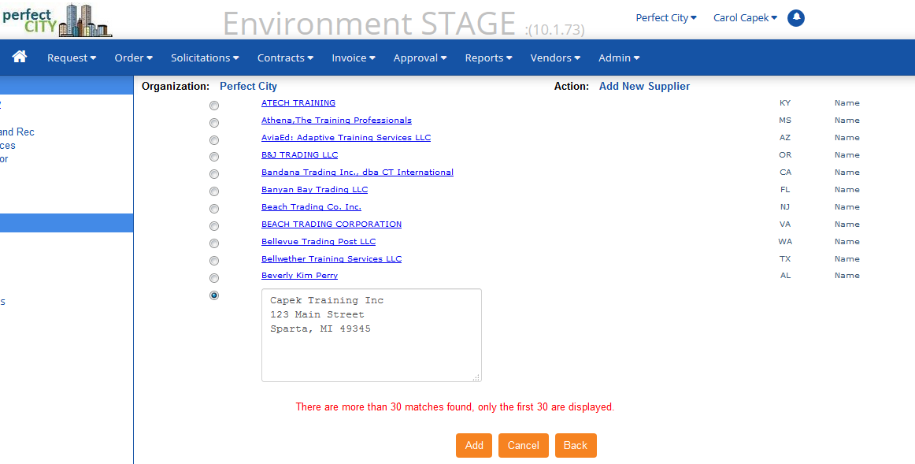
Create New Supplier – Review List, Add
If you are sure of no duplication (FEIN, Name, Etc.) select Add at the bottom of the page to add the selected Supplier to the WebProcure Global Supplier Database and the Entity Specific Supplier Database.

Slide 69
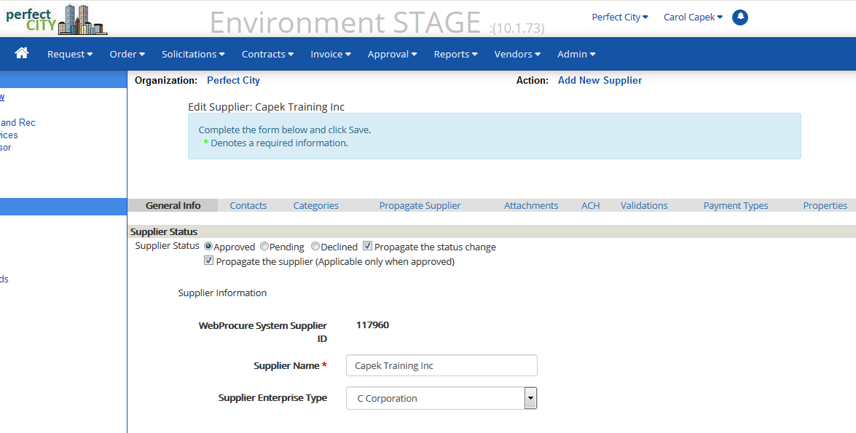
Update Status to Pending
Note: A Supplier Profile that is added by a buyer user via the Add New Supplier process will default to an Approved Supplier status. An Approved supplier profile will not propagate successfully without first reverting the Supplier status back to Pending and performing the save action. The new supplier profile can then be set back to an Approved Supplier Status and Propagate the supplier (Applicable only when approved option selected), when the full review of the vendor is completed.

Slide 70
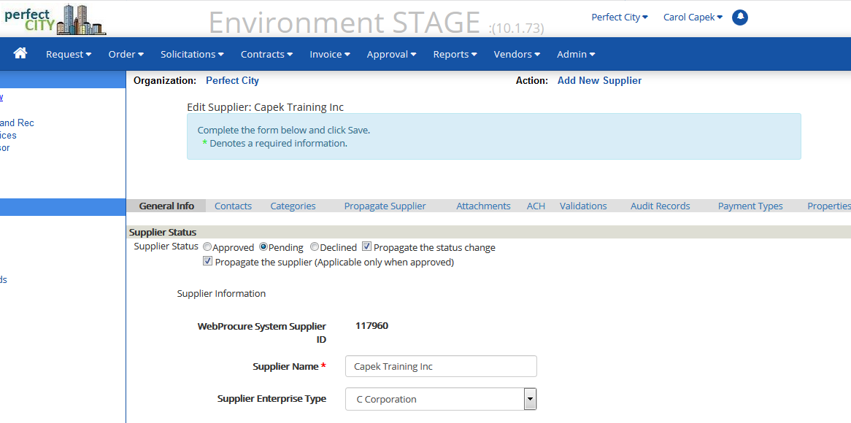
Update Status to Pending - Result
Newly added supplier is now pending for review and approval:

Slide 71
Add Existing Supplier

Slide 72
Add Existing Supplier
Note: Adding Existing Suppliers from Global Pool can be accomplished on the Add New Supplier function; rarely you may need to add a supplier to another org via this mechanism

Slide 73
Select the Organization
Note the system message pops up, “Please now select an action from the Administration Menu”

Slide 74
Select Add Existing Supplier from Supplier Menu

Slide 75
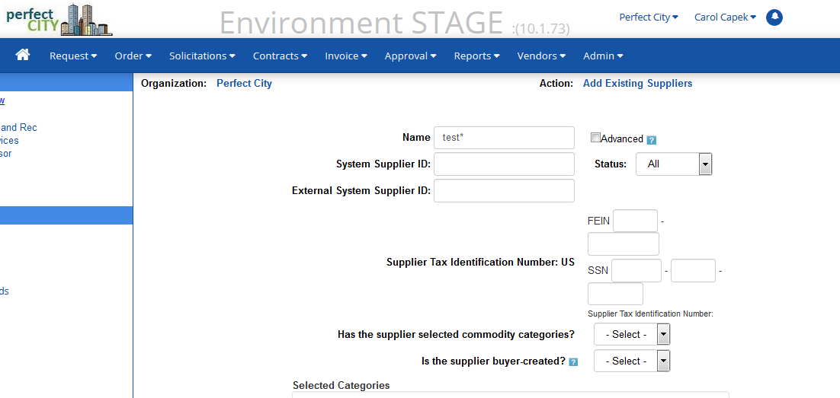
Enter Supplier Name
Enter “Supplier Organization Name” in the Name field and Select Search

Slide 76
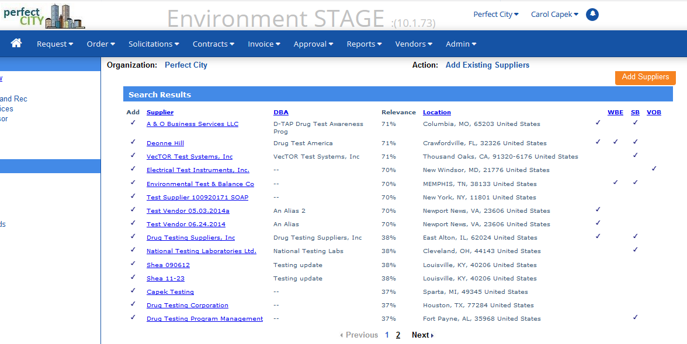
Search Results
Results show those that are similar or match so they can be added - vendors with a checkmark are already added in your organization:

Slide 77
Review Supplier Results – Edit Supplier
A supplier organization listed within the Search Results section represent one of the below criteria
a. A checkmark to the left of the Supplier name represents that the supplier profile already exists within the Entity’s WebProcure Specific Supplier database.
i. The Add Existing Supplier process should be abandoned since the Supplier is already an existing profile within the Entity’s WebProcure Specific Supplier Database
ii. The supplier organization’s profile can be accessed via the Edit Supplier option

Slide 78
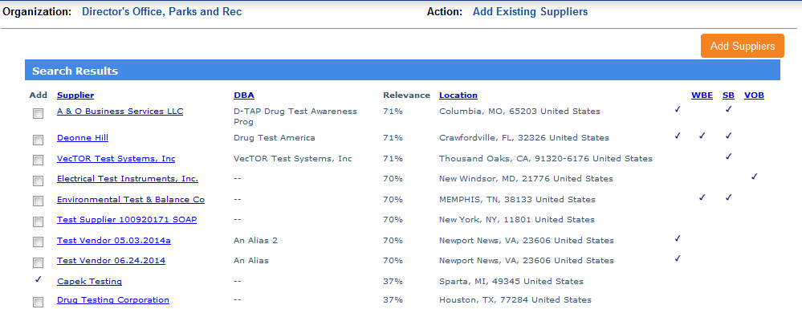
Review Supplier Results – Add Supplier
b. A select box to the left of the Supplier name represent that the supplier organization exists within the Entity’s WebProcure Specific Supplier database, but not within the indicated organization.
i. Add the existing supplier profile to the Entity’s indicated organization
ii. Click the select box to the left of the supplier name and click Add Suppliers
iii. Once a Supplier has been added to the Entity’s specific Supplier database, the supplier organization’s profile can be accessed via the Edit Supplier option

Slide 79
Bulk Propagate Suppliers

Slide 80
Select the Head Organization
Note the system message pops up, “Please now select an action from the Administration Menu”. Next sections will review the actions available.

Slide 81
Select Bulk Propagate Suppliers

Slide 82
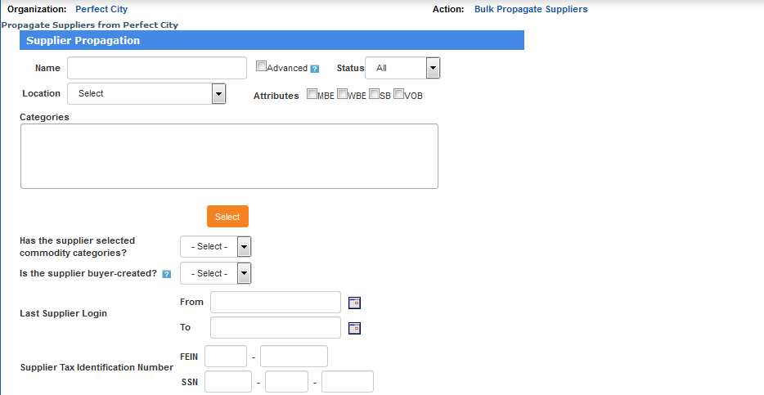
Bulk Propagate Supplier
Note: Use this tool to propagate suppliers from one organization to others. Only suppliers that are Approved can be propagated. Any supplier profile propagated via the Bulk Propagated process will result in an Approved profile status. See screens next two slides - steps follow:

Slide 83
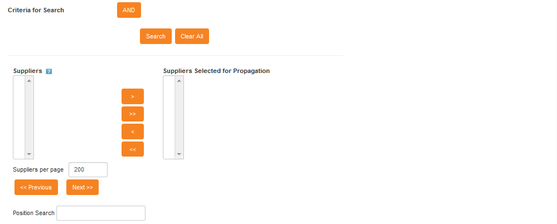
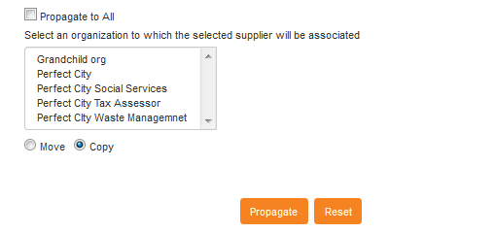
Bulk Propagate Supplier, screen
Note:

Slide 84
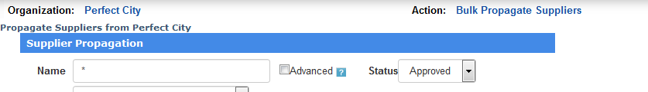

Bulk Propagate Supplier, Steps
Steps to complete in order to Bulk Propagate Suppliers to a New Agency
Name—Type an Asterisk (*)
Status—Select the Approved option from the Status drop down box:
Click the Search button

Slide 85


Bulk Propagate Supplier, Steps continued
4. When the result come back (this could take several seconds), click the double arrow button located between the Supplier section and the Suppliers Selected for Propagation section (to move all (or first 200) suppliers to right side to be propagated):
After:

Slide 86

Bulk Propagate Supplier, Steps Continued
Scroll to the bottom of the page and select the Agency(s) name from the Select an organization to which the selected suppliers will be associated section:
Leave the Radio button selected for the Copy option
Click the Propagate button at the bottom of the page

Slide 87

Bulk Propagate Supplier, Steps continued
A Script window will appear in the top left corner of the page while the propagation process is being complete for the selected suppliers as shown below:
Click the Close Button
The system will return you to the Bulk Propagate page.
Scroll back to the Suppliers section of the page
Click the Next button to display the next 200 supplier search results of the Approved Suppliers that need to be propagated to the New Agency.
Repeat steps 4 through 12 until all Suppliers produced in the search results in the Supplier section are propagated to the New Agency.

Slide 88

Bulk Propagate Supplier, Steps Continued
14. When you have reached the last page of Approved Suppliers for propagation to the New Agency the following system message will appear
Once you have received the above system message—you will have completed the Bulk Propagation of Suppliers to the new agency.
This process can be repeated for many agencies.

Slide 89
Bulk Supplier Import

Slide 90
Select the Head Organization
Note the system message pops up, “Please now select an action from the Administration Menu”. Next sections will review the actions available.

Slide 91
Select Bulk Supplier Import

Slide 92

Bulk Supplier Import
Note: Use this tool to bulk import suppliers
Use the following screen to process Supplier’s to the system.
Coordination with Proactis COM or Prof Services Project Manager is suggested.

Slide 93

Bulk Supplier Import
Use the Help Button to pull up the following screen with instructions and sample spreadsheet and related information to proceed with the vendor load steps

