Slide 1
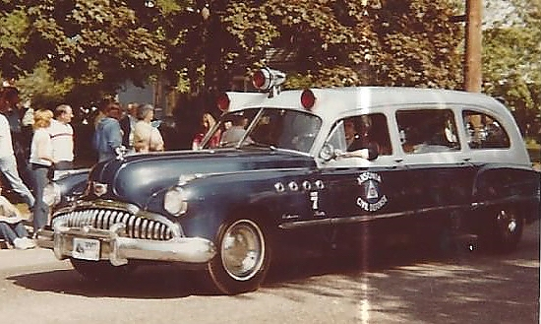
Ansonia Rescue Medical Service and the Ansonia Civil Defense Rescue Association
DOCUMENT SHREDDING FUNDRAISER
When: Saturday, June 18, 2016
Where: Entrance to the Ansonia Public Works Complex on North Division Street
Time: 9 am – Noon
Cost: Suggested donations start at $5
Who: ProShred Company assisted by EMS Volunteers
The purpose of this event is to raise funds for the continued restoration and preservation of Ansonia’s first ambulance, a 1949 Buick (pictured).
For more information call Ansonia Rescue Medical Service headquarters at:
203-735-3668.

