Slide 1
Capital Prep Harbor
Leveraging Student Voice to Change the World PRESENTED BY: Capital Prep Harbor
April, 2022

Slide 2
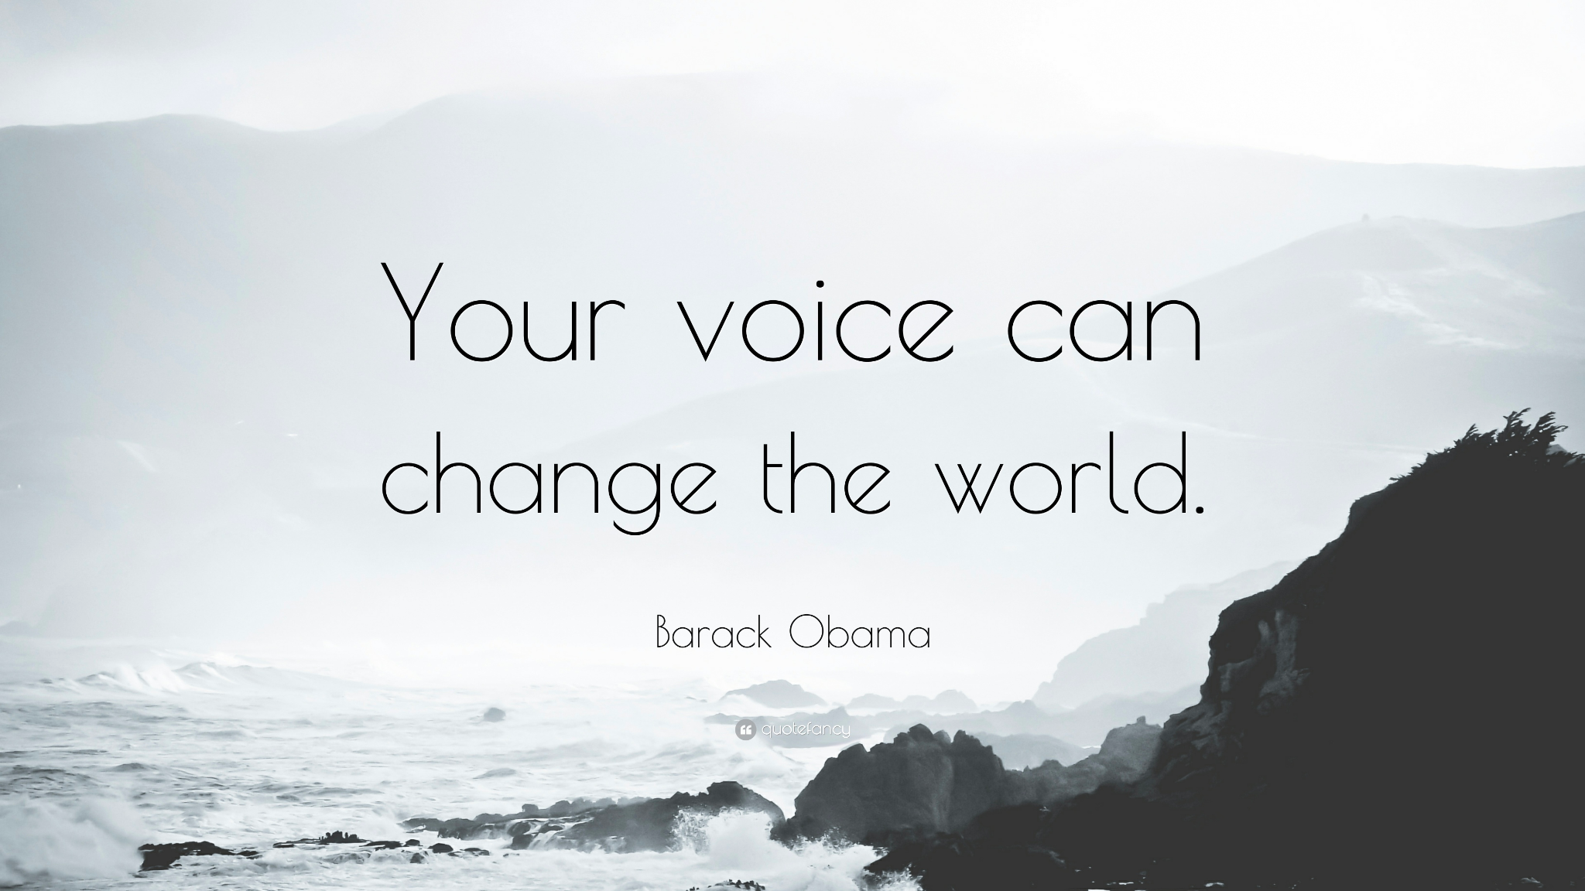
Notes:
Borders
34

Slide 3
Mission & Vision
Notes:
Borders

Slide 4
Capital Prep School Mission
Mission
The mission of Capital Preparatory Schools, the network designed to change the world through social justice and affective supports, is to ensure that all historically disadvantaged students graduate with the college and career readiness skills needed to become responsible and engaged citizens for social justice. Capital Prep will do so by offering a rigorous college preparatory curriculum, project-based learning, and multi-pronged affective and social justice activities.
Vision
We know attaining a college degree is a trajectory-changing milestone. Less than half of children who grow up in the bottom 20% of the income distribution do not attain a college degree and will not escape poverty as adults; however, 9 out of 10 children who attain a college degree will move up the economic ladder out of poverty. Our school will transform our students into scholars by being relentlessly focused on our mission every minute of every day. Capital Prep will ensure that 100% of our scholars are accepted to and prepared for college by the end of their tenure.
Notes:
Borders
34

Slide 5
Learner Expectations
(C) ollaborator
(P) roblem Solver
(R) esearcher
(E) mpathetic Citizen
(P) illar of Knowledge
Notes:
Borders
There are five learner expectations that make up the acronym “CPREP.” The represent Collaborator, Problem Solver, Researchers, Empathetic Citizen and Pillar of Knowledge. Capital Preparatory School community members should always act in accordance with our Learner Expectations, not only in the academic sense, but also in their behavior, language, and attitudes.

Slide 6
Student Voice
Student Voice is student input or leadership in instruction, school structures, or education policies that can promote meaningful school wide change.
Student Voice can impact education systems, practice, and/or policy by empowering students as change agents, often working in partnership with adult educators.
​
​
Notes:
Aiden
Sentence Starter:
“Good Morning, My name is Aiden Henry and I’d like to explain a concept the concept of Student Voice”

Slide 7
Why We Need Student Voice
Produces collaborative learning environments
Often decreases behaviour and classroom management issues
…. Inquiry based learning!
…. Increased the depth and breadth of knowledge
Student Voice allows students to…
Gain knowledge that allows them to help themselves and their peers
Engage in school improvement and take ownership in school successes
Help sustain school improvement efforts
Helps students apply what they learn in the classroom to their own lives and to their communities
Notes:
Aiden

Slide 8
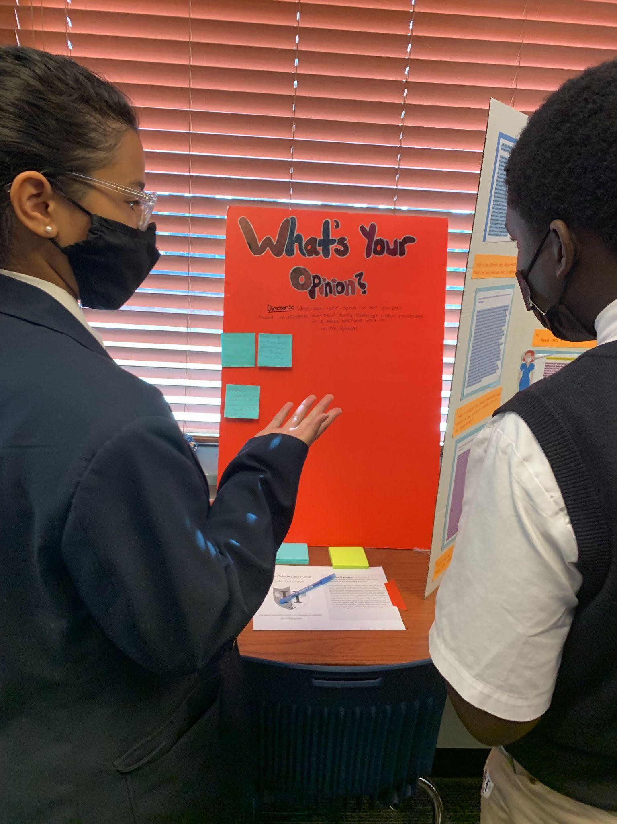
Student Voice:
Senior Social Justice Project
“We will… change the world…
Because… WE ARE CAPITAL PREP"
Notes:
Tran
What is the first step in changing the world? At CPREP, scholars begin by looking at their immediate community and the people that surround them
SJ starts from kindergarten to 12th grade
To build a path to senior year and into college
To instill a sense of social awareness, activism, and student voice
Have the sj matrix ready
https://docs.google.com/document/d/1LgUy0AEcOrMU20pJP-PTFaR57nvxAWrjDpIB240Q6-M/edit
Challenges and lesson learned from a classroom perspective
Time/timing: 1 hour

Slide 9
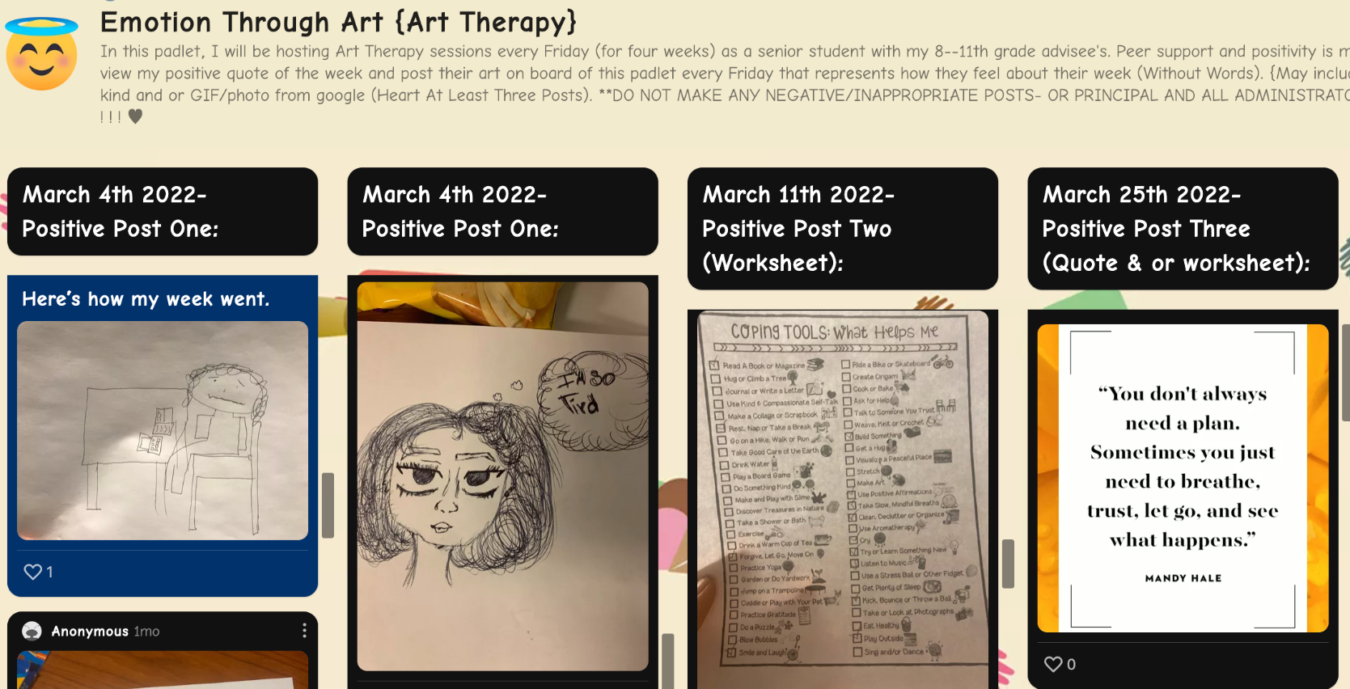
C-PREP Social Justice Definition
Capital Prep’s Definition of Social Justice
Capital Prep Harbor School defines Social justice as the equitable distribution of access to information, political and economic resources. A Capital Preparatory School scholar identifies, analyzes, and addresses disparities in access to resources and opportunities.
Capital Prep Harbor School defines Social Injustice as the unequal access to information, or distribution of political or economic resources based on social identification of a marginalized group such as race, religion, sexual orientation, gender identity or expression, sex, ethnicity, ability, class.
Notes:
Tran
scholars start with equitable vs. equal -> identify the needs in Bridgeport community
scholars identify gaps in knowledge, resources, and opportunities based on social identifications
scholars research the gap, analyze the needs, and focus on a population (marginalized group)

Slide 10
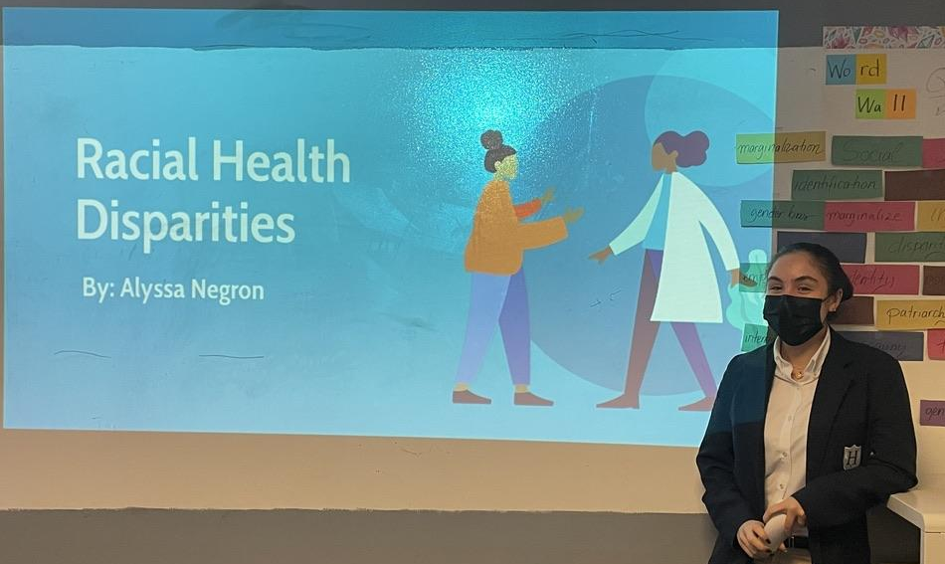
What is the “Social Justice Project”?
The Social Justice Project or SJP is a performance based task where Seniors (12th) will demonstrate their ability to question, research, lead, act, present, and reflect in order to confront a social injustice in their community.
The Social Justice Project will be evidence of a scholar’s ability to fulfill the mission of Capital Preparatory Harbor School and is a graduation requirement.
Identify a social justice problem in the community.
Create an informed “Social Justice Action Plan.”
Conduct activities that will attempt to solve the problem.
Raise awareness in the school community.
Analyze data/results throughout the project.
Notes:
Tran

Slide 11
What are the components of the “Social Justice Project”?
Research Paper
Chapter 1: Background information, Problem of Statement, Research Questions
Chapter 2: Literature Review
Chapter 3: Methodology and Action Plan Proposal
Chapter 4: Findings from Action Plan
Chapter 5: Conclusions
Action Plan
A - Activities to Solve the Problem
ex. Pre/Post-Tests, work with Dean to orchestrate restorative circles, interviews with scholars to find out their knowledge gap, guest speakers to discuss the School to Prison Pipeline & Restorative Justice
B - Raising Awareness in the Broader Community
ex. social media page, lead a workshop in the local library
C - Raising Awareness Event
ex. school assembly, virtual panel discussion - open to the community
Panel Presentation
Notes:
Tran

Slide 12
Roles in the Senior Social Justice Project
Scholars:
Identify a social justice problem in the community.
Create an informed “Social Justice Action Plan.”
Conduct activities that will attempt to solve the problem.
Raise awareness in the school community.
Analyze data/results throughout your project.
Present Findings to school community and stakeholders.
Illuminators/Advisors:
Regular progress monitoring check-ins and advisement
Collaborate with scholars to conduct activities that will attempt to solve the identified problem
Participate and provide feedback for final panel presentation
Administrative/Deans:
Regular progress monitoring check-ins with Illuminators
Collaborate with scholars, Illuminators, and facilities in order to organize Social Justice Action Plan
Schedule, participate, and provide feedback for final panel presentation
Notes:
Tran
Consultant & community members: mentor, provide work/research experience/ academic resources/ field expertise -> consult the seniors on the Action Plans
My role: beside assisting scholars with the research and various stages of the Action Plan, I also document scholars’ progress, communicate with illuminators, advisors, admins, families
Let’s hear from the Seniors themselves - who are at the final stages of the SJP
external process. not just internal within CPREP
Add a visual of community members

Slide 13
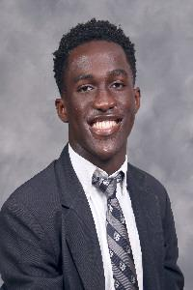
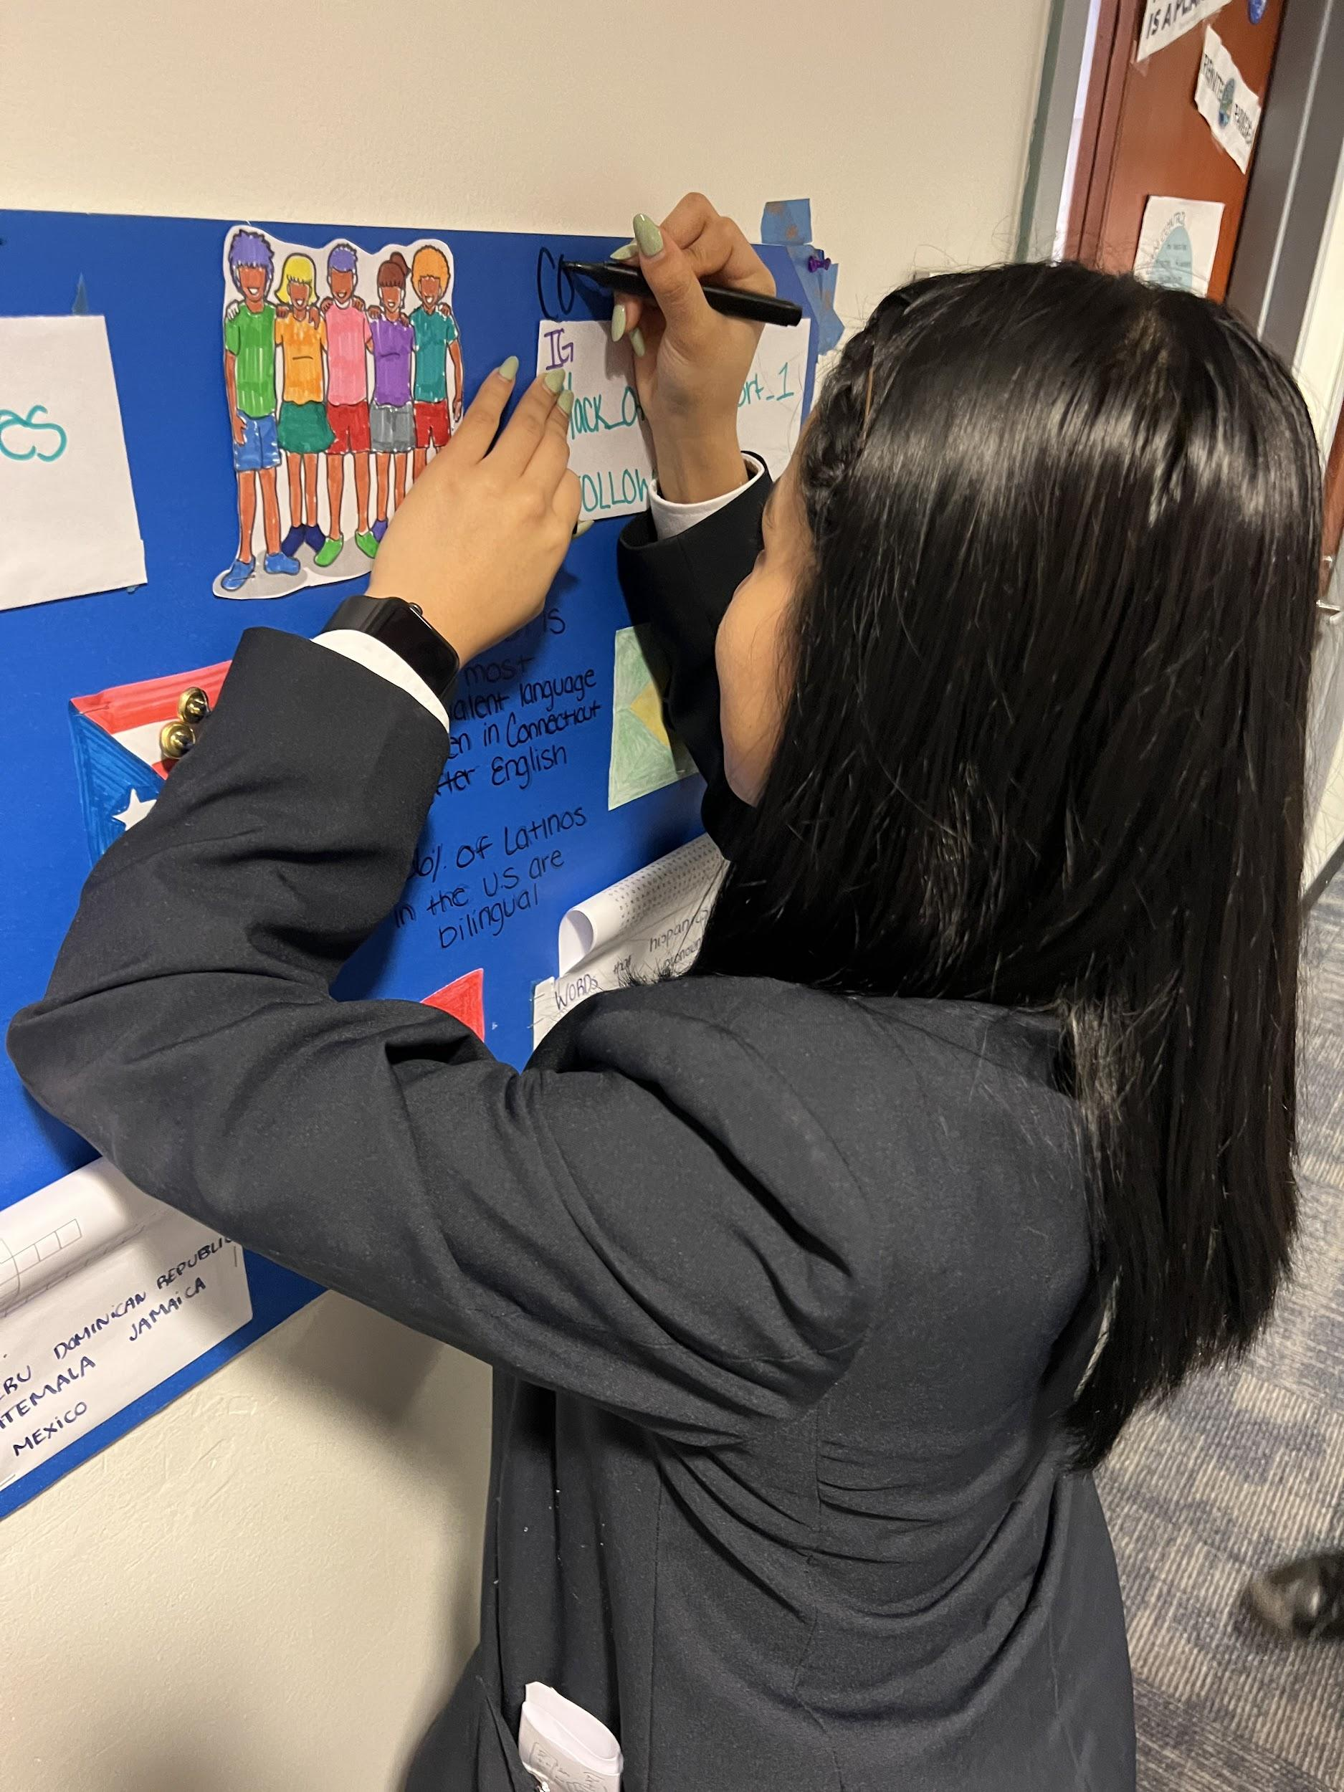
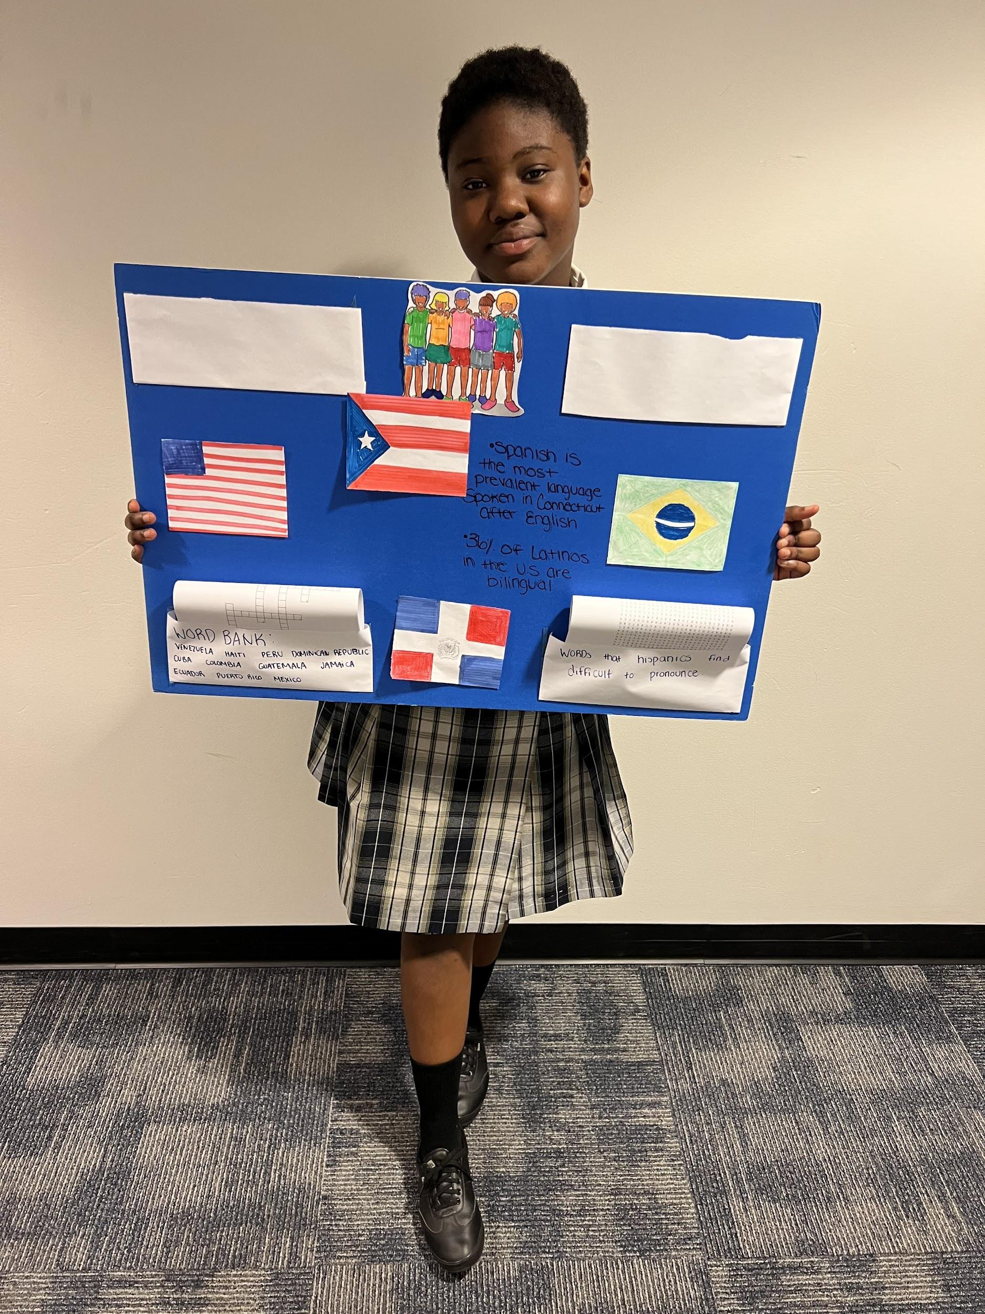
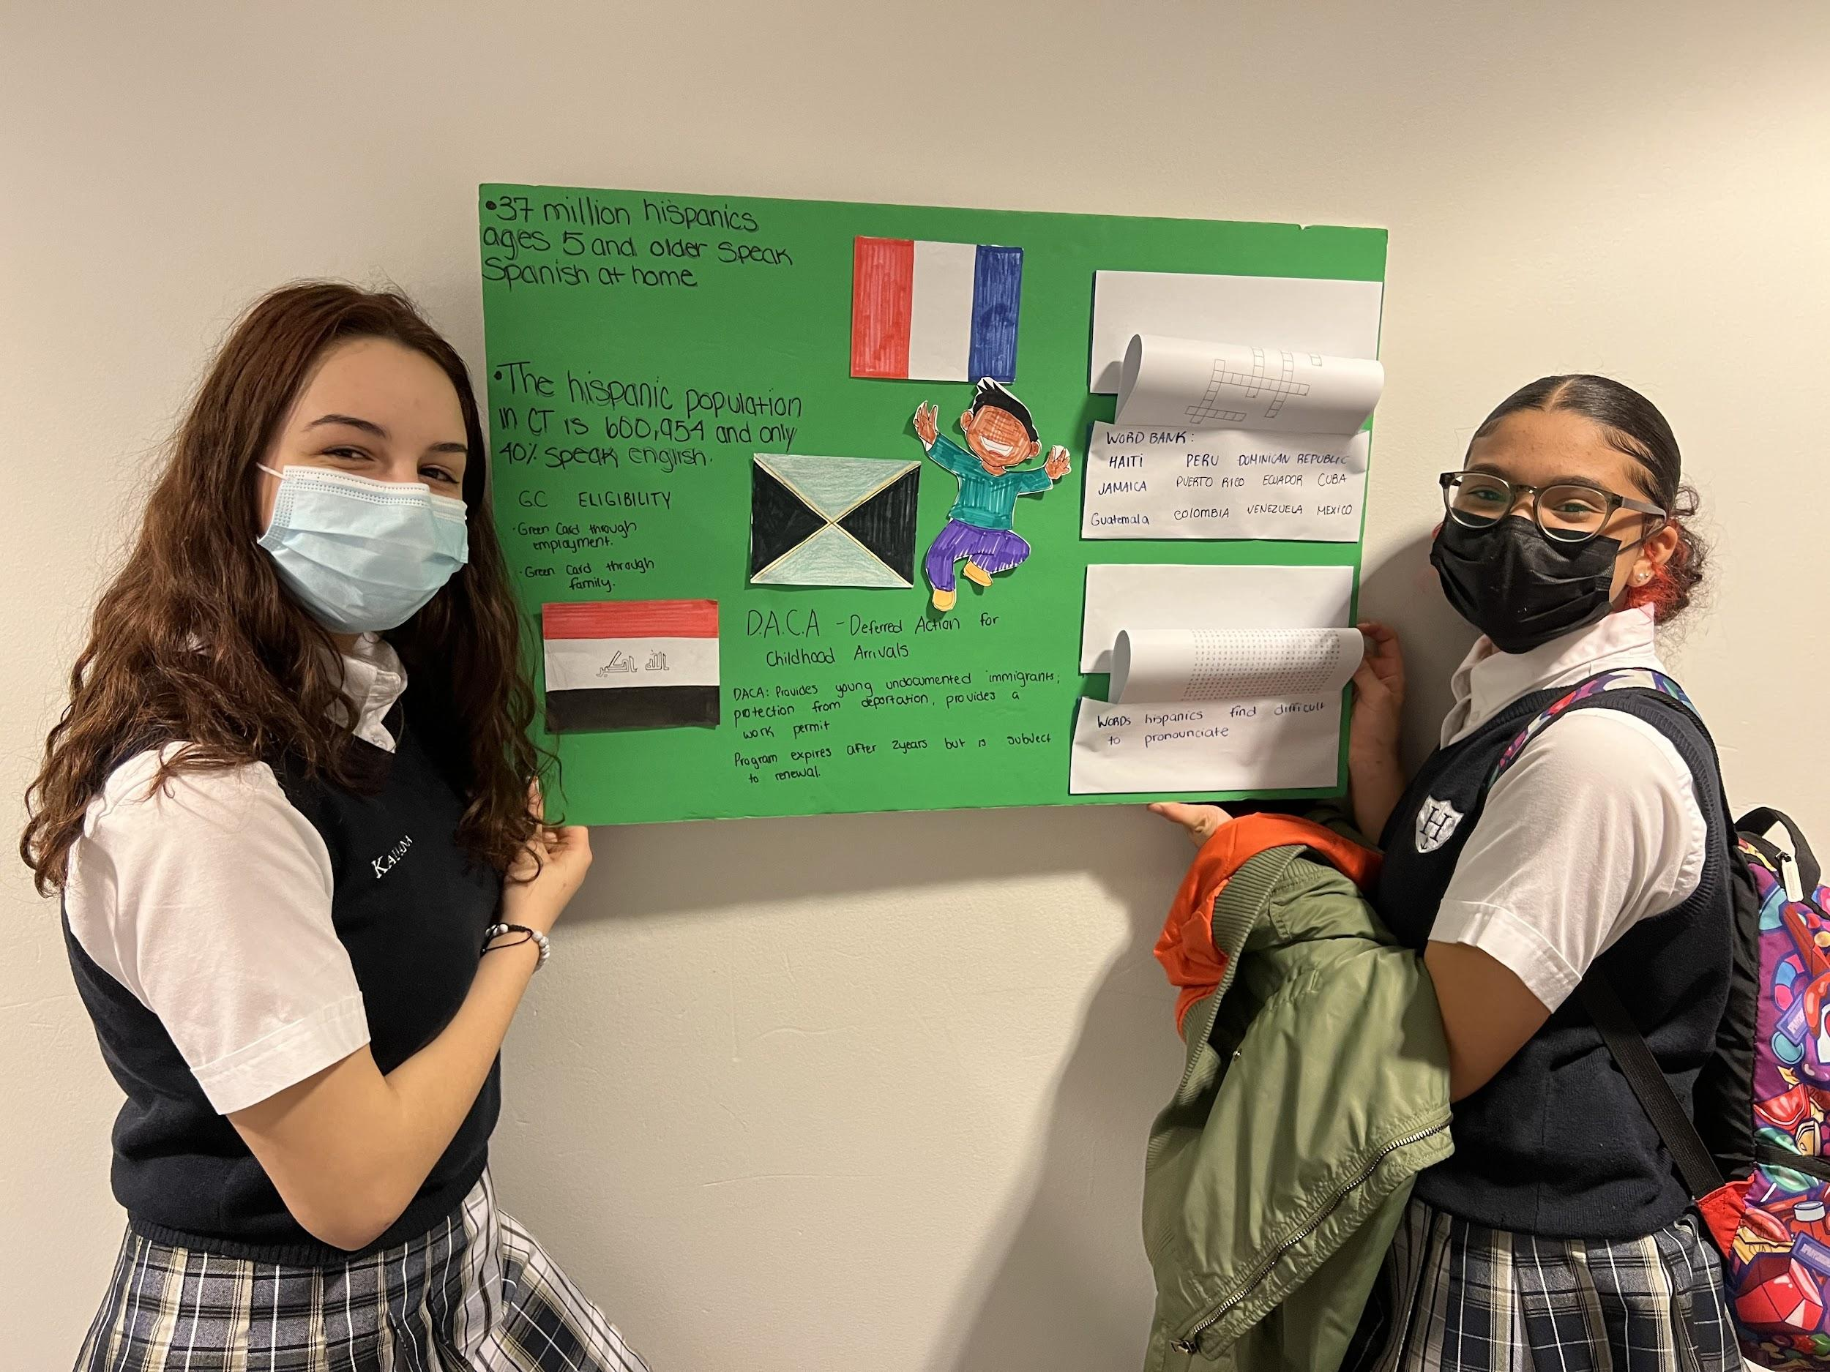
Student Experience: Senior Social Justice Project
Lack of Knowledge Regarding the Immigration Process
(Kemsly Gelin c/o 22’)Essential Question: How can an advocacy group improve the lack of knowledge on the issues that immigrants face regarding access to resources?
Why did I choose this topic?
How will my project impact my community?
Action Plan?
Notes:
Kemsly
Decision behind this topic
Action plan
I also created an interactive game …

Slide 14
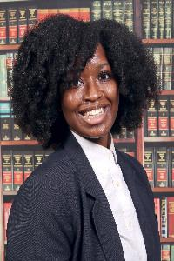
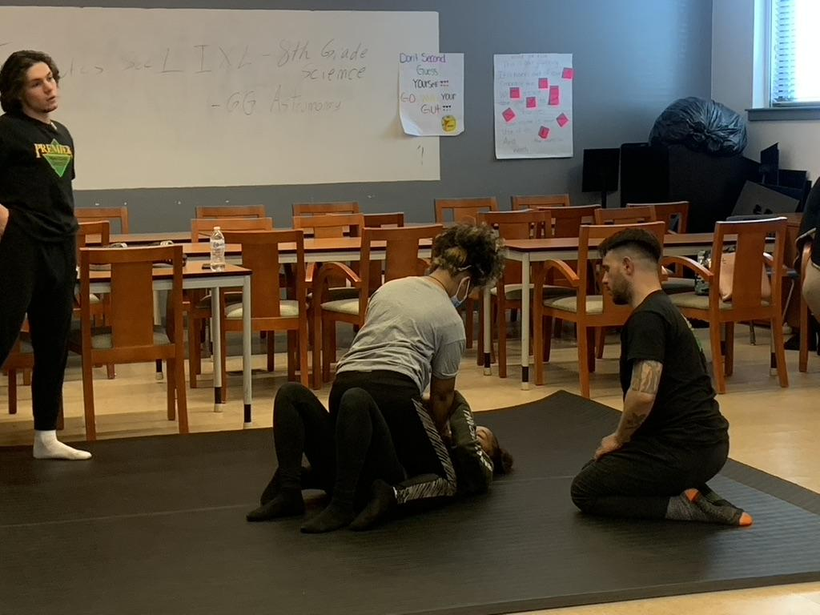
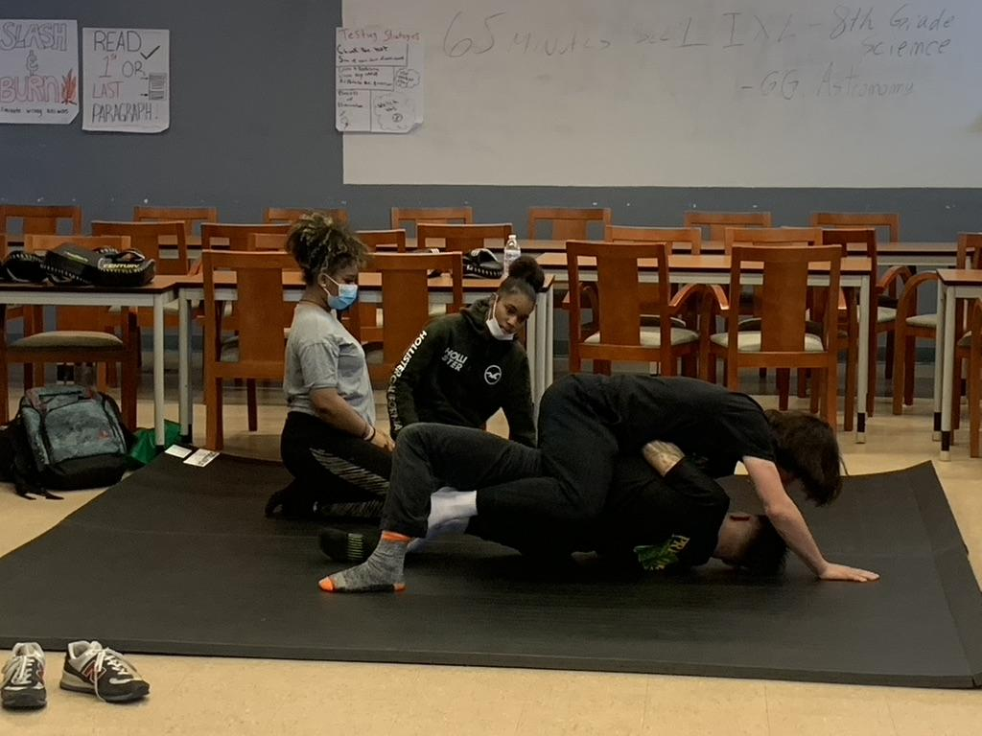
Student Experience: Senior Social Justice Project
The Sexual Harassment and Trafficking of Minority Women and Children
(Brianna Walker c/o 22’) Essential Question: How can a sexual harassment awareness seminar improve the lack of knowledge on sexual harassment and defense techniques among minority women and teens?
Why did I choose this topic?
How will my project impact my community?
Action Plan?
Notes:
Brianna
Why I chose this topic?
Action Plan…
Influence on other kids and interaction with other kids. How my projects perhaps inspires students.
Notes:
How will this process make me a better scholar?

Slide 15
Preparing for the Senior Social Justice Project
Notes:
Borders

Slide 16
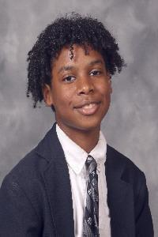
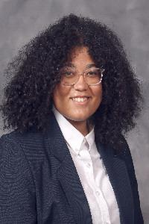
Student Experience: Before the Senior Social Justice Project
Aiden Henry 11th Grade
Autum Candito 11th Grade
Notes:
Autum & Aiden
aiden goes first - then autum
experience in SJP - starting from last year - what you are currently doing - ideas for next year

Slide 17
Limitations & Challenges
Assignment Completion
Family contact and involvement
Advisory support
Saturday Office Hours
Winter Panels (Mid-Point)
Motivation & Time Management
Town Halls
Assemblies
Stakeholder Engagement
Community organizations
Community fair

Slide 18
Contact Information
777 Main Street
Bridgeport, CT 06604
475-422-5900
Ayanna Carter (Principal)
Ayanna.Carter@CapitalPrepHarbor.org
Wynton Borders (Dean Academics)
Wynton.Borders@CapitalPrepHarbor.org
Khai Tran (Illuminator)
Khai.Tran@CapitalPrepHarbor.org

Slide 19
Thank you!!!
Notes:
Borders

