Slide 1




INTRODUCTION to the Teacher Education and Mentoring (TEAM) Program
Bridging the journey from preparation to professional practice

Slide 2


CONTENTS
2-7 Overview
8-10 Support Plan and Survey
11-12 Modules
13-14 Key Players
15-18 Common Core of Teaching
19-35 Cycle of Continuous Professional Learning
36 TEAM Completion
37-42 TEAM Dashboard
43-47 TEAM, Educator Evaluation, and CCS
48 Contact
Page 1

Slide 3

INTRODUCTION
Before we begin, remember that you are NOT expected to know everything
  Learning to teach is a developmental process that begins in pre-service and develops throughout one’s career
  In your first years, you are translating the theory from teacher preparation programs into practice
  Research finds it takes 3-5 years for teachers to become proficient and maximize student achievement
The most important characteristic for success is a commitment to continuous professional learning
Page 2

Slide 4

WHAT IS TEAM?
The Teacher Education and Mentoring (TEAM) Program bridges the journey from preparation to professional practice
  Collaborative reflection helps you assess your practice and its effects on student outcomes
  Mentor experience and expertise enriches professional development
  Mentor support helps you manage day-to-day challenges both instructionally and personally
“The most valuable resource that all teachers have is each other.
Without collaboration, our growth is limited to our own perspectives.”
ROBERT JOHN MEEHAN
Page 3

Slide 5
RARE OPPORTUNITY
TEAM is nationally recognized as a leader in high-quality induction programs for educators
New Teacher Center’s Review of State Policies on New Educator Induction
  Connecticut, Delaware, and Iowa are the only states that dedicate funding to new teacher induction, offer multi-year supports for new teachers, and require completion of the induction program for advancement to a professional license
Supporting you and your career in education is our priority
  Up to a third of teachers will leave the profession within three years
  Research from a Regional Education Laboratory found that teachers who completed TEAM were more likely to remain in the classroom
Page 4

Slide 6

FEEDBACK
“When I started this module, my classroom was almost 100% teacher driven.
By the end of the module, there was a noticeable sharing of classroom responsibilities and a greater participation by the students in the learning process.”
FORMER TEAM PARTICIPANT
93%
Positively influenced my practice
94%
Made me a more reflective educator
Reviewing the CCT Performance Profile was extremely helpful in examining and identifying my teaching practices prior to this process.
FORMER TEAM PARTICIPANT
90%
Improved my students’ achievement
96%
Helped me design more effective lessons that engage students deeper in the content
Page 5

Slide 7

MISSION
“To promote excellence,
equity and high achievement for Connecticut students by engaging teachers in purposeful exploration of professional practice through guided support and personal reflection.”
Page 6

Slide 8

TEAM OVERVIEW
Legislatively mandated multi-year induction program for all beginning teachers
  Paired with an experienced, trained mentor
  Collaborate with mentor to create Professional Growth Action Plans
  Complete five modules of professional learning
  Engage in mentoring activities as a part of each module
Including observations, co-planning, student work analysis, data review, and reflection conversations
Completion of the TEAM program is required for teachers to advance to a professional teacher license
Page 7

Slide 9

SUPPORT PLAN
Before starting TEAM, all participants must complete the Two-Year* Beginning Teacher Support Plan to submit to DF and TCC
  Develop timeline by planning out module completion
Modules completed Year 1 and Year 2
  Factor in any circumstances that may require use of a third year, such as a planned leave of absence
This changes how mentor stipends are dispersed
  Use district timeline or requirements, as applicable
  Category II teachers have a one-year support plan
  Support Timeline Plan: 2 Modules
  Support Timeline Plan: 5 Modules
By planning your workload, you become more likely to complete all TEAM requirements on time!
Page 8

Slide 10

SURVEY
Each module will begin with a survey asking you to reflect on your educator preparation program and how prepared you feel for your first teaching assignment
  For each survey, consider your coursework and clinical experiences
  Use this reflection to identify areas of strength and needs for growth with your mentor to inform your focus area for each module
  All submissions will be kept confidential
Data will be used in the aggregate to improve educator preparation programs!
Page 9

Slide 11
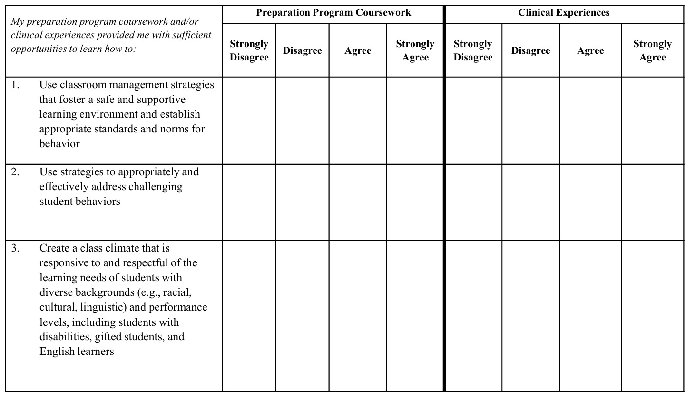
SURVEY EXAMPLE
Example of Module 1 survey, aligned to CCT Domain 2 Classroom Environment, Student Engagement, and Commitment to Learning
Page 10

Slide 12
MODULES
Legislatively mandated multi-year induction program for all beginning teachers
MODULES 1-4
Require a reflection paper or project to be submitted for review at the end of the 8-10-week professional learning experience
2026-2027 is a Transition Year to Prepare for Launch of TEAM 2.0 in Fall 2027.
Please see the next page for an update.
MODULE 5
Is a facilitated conversation using scenarios that prompt honest discussions
about possible ethical dilemmas regarding:
Relationships with students, professional ethics, cultural responsiveness, community and family, and/or bullying
Upon completion of the facilitated conversation, teachers complete a questionnaire.
Page 11

Slide 13
A
TRANSITION YEAR
B
REFLECTION PAPERS/PROJECTS
MENTORSHIP
ENGAGEMENT LOGS
Starting September 1, 2026, you have the option to choose which pathway you use to complete TEAM modules.
You and your mentor will decide which pathway you use for each module, in consultation with your district.
The CSDE recommends using Pathway B because it more closely resembles TEAM 2.0 and will serve as a better transition into next year.
Both pathways will satisfy TEAM requirements.
CURRENT TEAM PROCESS
FLEXIBLE TEAM PROCESS
Mentor continues to submit mentor meeting log notes in TEAM dashboard
BT drafts reflection paper/project
and submits to mentor for sign-off
Mentor selects “Paper/Project Submission” and signs off
(one sign-off required)
Paper/Project is submitted to the district’s selected review queue
(Regional, Private, or In-District)
Successful → module marked complete
Unsuccessful → revise and resubmit
Mentor and BT collaboratively document a minimum of 10 hours of mentoring per module in Mentorship Engagement Logs
Mentor selects “Log Submission” and signs off (one sign-off required)
Mentor submits Mentorship Engagement Logs in the TEAM dashboard
Module marked complete
Page 12

Slide 14
TEAM ROLES - 1
Mentors
Administrators
Accomplished teacher selected by the school district who completed the TEAM Program Initial Support Teacher Training
Serves as your first and primary contact throughout the TEAM program, provides guidance and support on developing your teaching practice, as well as your progress through the TEAM Program requirements, including completing mentor logs
An instructional leader who can provide guidance and support to help teachers grow professionally
The individual who will review and sign-off on the Profession Growth Action Plan (PGAP), indicating that he or she can support the agreed upon activities and/or resources
Can help the teacher make connections between TEAM, teacher evaluation, and professional learning
Page 13

Slide 15

TEAM ROLES - 2
District Facilitators
Individuals appointed to serve as a liaison between CSDE, district, beginning teachers, and mentors regarding requirements of the TEAM program
Coordinating Committees
TEAM Coordinating Committees (TCCs)
plan, implement and monitor the district’s TEAM Program
Reviewers
Educators selected by district and trained to read and review reflection papers or projects
* Reviewers are not used for Pathway B in the Transition Year.
Page 14

Slide 16
COMMON CORE OF TEACHING
TEAM is aligned with the domains of Connecticut’s Common Core of Teaching (CCT)
with each domain embedded in the TEAM modules
1
Content and Essential Skills
Embedded
2
Module 1
Classroom Environment, Student Engagement and Commitment to Learning
3
Planning for Active Learning
Module 2
4
Instruction for Active Learning
Module 3
5
Assessment for Learning
Module 4
6
Professional Responsibilities and Teacher Leadership
Module 5
Page 15

Slide 17
COMMON CORE of TEACHING (CCT) AS THE FOUNDATION
The CCT is linked by state law and regulations to requirements across a
teacher’s career including preparation, induction and teacher evaluation
edTPA Student Teacher Evaluation
CCT Rubric for Effective Teaching
Connecticut Common Core of Teaching (CCT)
CCT Performance Profiles TEAM
CCT Rubric for Effective Service Delivery
Page 16

Slide 18
ALIGNING TEAM TO CCT
Legislatively mandated multi-year induction program for all beginning teachers
MODULES 1-4
Require a reflection paper or project to be submitted for review at the end of the 8-10 week professional learning experience
2026-2027 is a Transition Year to Prepare for Launch of TEAM 2.0 in Fall 2027.
Please see slide 35 for details.
MODULE 5
is a facilitated conversation using scenarios that prompt honest discussions
about possible ethical dilemmas regarding:
Relationships with students, professional ethics, cultural responsiveness, community and family, and/or bullying
Upon completion of the facilitated conversation, teachers complete a questionnaire in the dashboard.
Page 17

Slide 19

KEY THEMES
High Student Achievement
Including success for all students
Differentiation
Of instruction to support all students
Collaboration
With colleagues and families to meet the diverse needs of all students
Continuous professional growth and learning
Along with a commitment to the analysis of teaching
Page 18

Slide 20
OVERVIEW OF THE PROCESS OF CONTINUOUS PROFESSIONAL GROWTH
PHASE 4
PHASE 1
Implement new learning in practice and monitor impact
Reflect on practice and analyze data
Throughout, mentor provides coaching and supports application of learning to improve teaching practice and student outcomes
PHASE 3
PHASE 2
Engage in professional learning
Set goals for professional learning
Page 19

Slide 21
TEAM MODULE PROCESS – PHASE 1
1
Reflect on Practice and Analyze Data
  Analyze data on teaching and student learning to identify a module focus
Beginning Teacher Survey for the module, observation feedback from mentor or administrator, student work samples, student assessment results, assignments, lesson plans, district rubric, student learning data like SLOs
  Explore CCT Performance Profile using your data to reflect on strengths and areas for growth
  Select one indicator for professional growth and development
  Record specific examples and/or evidence of practice
  Create an Initial Summary using specific examples to describe what the teacher and students are doing in the focus area at the start of the module
Page 20

Slide 22
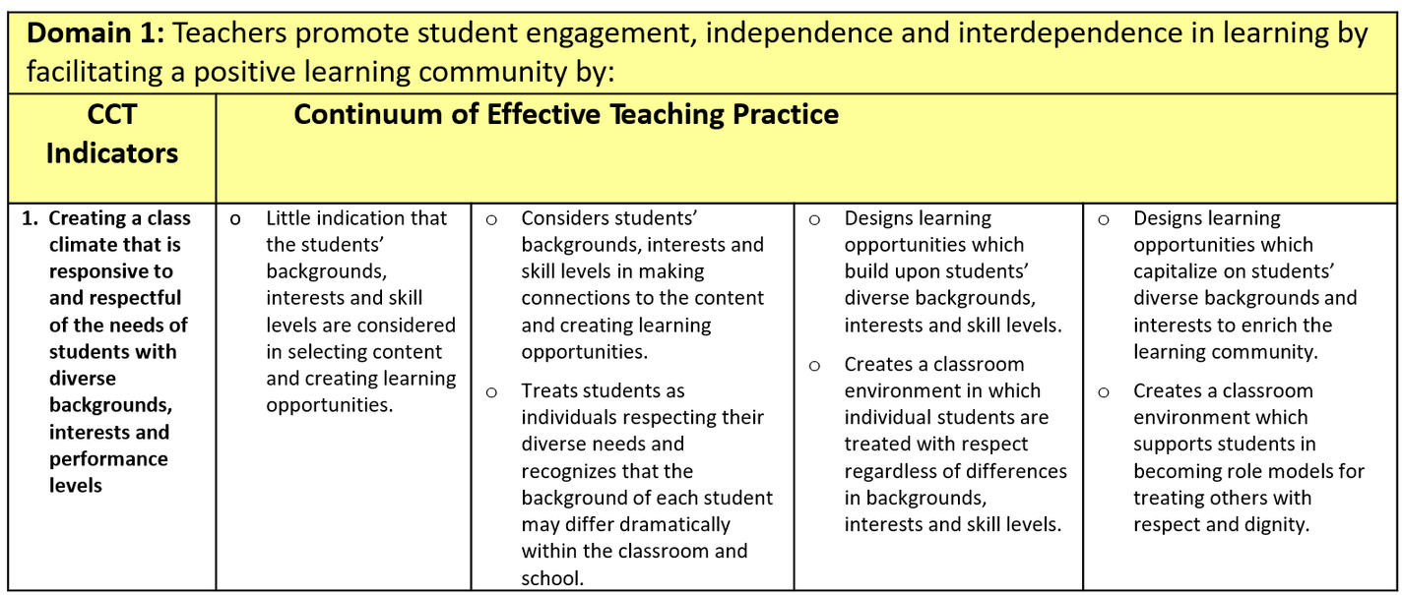
CCT PERFORMANCE PROFILE
1
Reflect on Practice and Analyze Data
  Read the Performance Profile (one for Modules 1-4) from left to right and note how the performance descriptors change across the continuum
Each indicator starts here and is completed below
An excerpt showing one indicator of several for Module 1
Page 21

Slide 23

INITIAL SUMMARY
1
Reflect on Practice and Analyze Data
  Once you have identified the focus area for the module, write an Initial Summary
  Identify what you as the teacher are doing right now, as well as what students are doing right now (will help to compare your practice at the end of the module)
  This sets the stage for reviewers, so be sure to include any unique situations that contextualize the unique needs of your students
Page 22

Slide 24
TEAM MODULE PROCESS – PHASE 2
2
Set Goals for Professional Learning
SAMPLE
Replicate this formula
  Set a Professional Growth Goal for the module
Must be achievable with 8-10 week time frame
Connect to selected CCT Performance Profile Indicator
Indicates what you the teacher want to learn to improve practice
and the anticipated positive impact on students
  Create a Professional Growth Action Plan (PGAP)
Details on the next page
  Submit it to the administrator
The administrator signing off indicates they will support the plan
This does not guarantee requested resources will be provided
Only one PGAP can be submitted at a time
I will learn...
new strategies for fostering appropriate student behavior
As a result, students will...
interrupt less and be more actively engaged during reading instruction
Page 23

Slide 25
PROFESSIONAL GROWTH ACTION PLANS
2
Set Goals for Professional Learning
  GOAL designed using the indicators on the previous page
  TEACHER LEARNING ACTIVITIES to be discussed with mentor
Could include:
Sanford Inspire or Harmony Academy professional learning modules (aligned to specific CCT indicators within each module)
Colleague observations
Data conversations with mentor/colleagues/specialists
Workshops/podcasts/online or in-person courses
Grade-level or subject-area team meetings
Professional articles or a relevant section/chapter of a book
Instructional video
  RESOURCES needed to support activities, to be discussed with administrator
  ANTICIPATED TIMELINE for Module completion (Recommended 8-10-week period)
Page 24

Slide 26


PROFESSIONAL LEARNING RESOURCES
2
Set Goals for Professional Learning
Pull out your computers and register to get access to all online professional learning resources, including Sanford Inspire and Harmony Academy
STEP 1 - Go to the URL
mylearningportal.org
STEP 2 - Click the registration button
STEP 3 - Access and use any of the following
Page 25

Slide 27
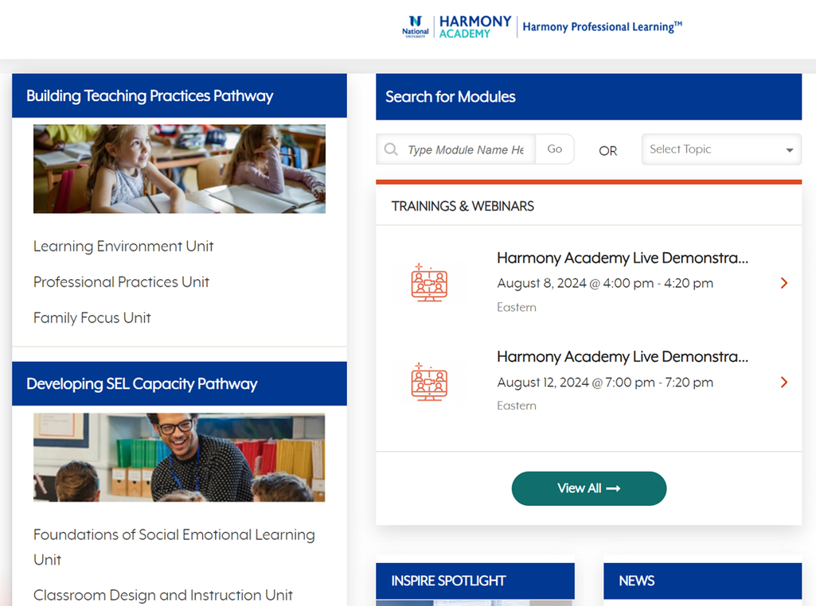
PROFESSIONAL LEARNING CROSSWALK
2
Set Goals for Professional Learning
Consult Crosswalk of TEAM Modules, High Leverage Practices, and Harmony Modules to support your goal making
High leverage practices are research based practices most likely to improve student outcomes
Crosswalk of TEAM, HLPs, and Harmony Modules
Use Harmony’s on-demand modules (left column of the image at right) to learn about classroom management strategies (top) and healthy relationships (bottom)
Page 26

Slide 28

TEAM MODULE PROCESS – PHASE 3
3
Engage in Professional Learning
  Engage in professional learning activities
Develop new practices, or refine/expand existing practice to build on content and pedagogical skills
  Record specific examples of what you learned and how you was learned
The more detailed the better
Consider both new knowledge and new skills learned
  Think deeper about your own practice and how the new learning relates to it
Take your time to engage in the activities and reflect to build your new learning
Page 27

Slide 29

TEAM MODULE PROCESS – PHASE 4
4
Implement New Learning in Practice and Monitor Impact
  IMPLEMENT new learning in daily practice
  DISCUSS with mentor how implementation is impacting practice and student learning
  ADJUST as needed or identify and develop additional new learning
  ANALYZE impact on teaching practice, instruction, and student learning
  RECORD specific example/evidence of changes in practice and student outcomes
Page 28

Slide 30
REFLECTION EXAMPLE
Sample Beginning Teacher Journal
Module 3: Instruction for Active Learning
4
Implement New Learning in Practice and Monitor Impact
At the suggestion of Nora, I took a look at some of the sample module documents on the website. In both samples, the teachers picked a specific teaching goal. After reviewing these, I made some important observations. First, I noticed that when articulating a goal, both teachers picked a specific goal, such as increasing student engagement or differentiating instruction. They also picked a very specific skill or area of instruction, such as reading comprehension. Secondly, I noticed in both samples that the teachers discussed a text source that they consulted to inform their decisions and actions. Using research-based strategies seems to be equally important as having classroom data to support this process.
I also looked at the CCT Performance Profile and thought about my placement on the continuum for each indicator. Indicators that stood out to me dealt with the differentiation and varying student/teacher roles to develop independence. Both of these are issues that I have been struggling with this year. I have been trying to differentiate based on readiness, but struggling to figure out how to manage students working on different work. Specific struggles include how to grade different work, how to have students working on different things, how to have students accept different work, and how to replace assignments instead of having the students needing a challenge just do MORE work. I spend most of my time focusing on the whole class developing a skill and use a lot of whole class or individual instruction. This leaves me feeling spread thin because students are off-task during the whole class time and very needy during the individual time. I could probably structure this time better and get students to do some of their own thinking.
After some more thought on which to choose and continuing to talk to Nora, I think differentiation is the most important focus for me. One of the reasons that I have been struggling so much with differentiation is that when I give students that need a challenge harder material, they are very needy and ask so many questions that I can’t manage all the groups doing different work. I think I need to look at strategies for managing differentiation and I need to be sure I’m using the right strategies with the right students.
  IMPLEMENT new learning in daily practice
  DISCUSS with mentor how implementation is impacting practice and student learning
  ADJUST as needed or identify and develop additional new learning
  ANALYZE impact on teaching practice, instruction, and student learning
  RECORD specific example/evidence of changes in practice and student outcomes
Page 29

Slide 31
DOCUMENTATION
4
Implement New Learning in Practice and Monitor Impact
Reflection Paper/Project Requirements:
  Specific learning activities and resources used to develop new learning
  What you learned and specific examples of how you applied it to your practice
  Specific examples of how changes improved teaching practice
  Specific examples of how these changes have or will impact students
  A comparison of the changes in teaching practice and positive outcomes for students to what was described in the Initial Summary
As a reminder, these requirements only apply to Pathway A in the Transition Year
Page 30

Slide 32
MODULE SUBMISSION
A
4
Implement New Learning in Practice and Monitor Impact
REFLECTION PAPERS/PROJECTS
  Share reflection paper/project with mentor for feedback and sign-off
  Mentor sign-off indicates that the reflection paper/project is consistent with on-going work between the mentor and the teacher
  Teachers submit each module when the mentor has signed-off
  Do not wait to submit modules, no more than one reflection paper/project should be submitted within a four-week period
CURRENT TEAM PROCESS
Mentor continues to submit mentor meeting log notes in TEAM dashboard
BT drafts reflection paper/project
and submits to mentor for sign-off
Mentor selects “Paper/Project Submission” and signs off
(one sign-off required)
Paper/Project is submitted to the district’s selected review queue
(Regional, Private, or In-District)
Successful → module marked complete
Unsuccessful → revise and resubmit
Reminder of Pathway A
Page 31

Slide 33
CRITERIA FOR SUCCESS
4
Implement New Learning in Practice and Monitor Impact
Development of New Learning
Impact on Practice
Impact on Students
Teachers engage in professional learning to develop new knowledge and skills to improve their practice so they can help students achieve.
Teachers apply new knowledge and skills learned to improve teaching
Student learning and achievement improve as a result of teachers applying the new knowledge and skills learned
  Explains using specific examples how they used new learning to improve teaching or planning practice
This is where using your beginning teacher journal well pays off
  Explains using specific examples how student performance/learning has improved as a result of changes in the teacher’s practice or will improve as a result of planning
  It's acceptable to include strategies that you tried but didn’t work as well
  Describes how the teacher developed new learning
  Explains what the teacher learned from the selected activities and resources and/or their thinking deeply about their teaching practice
Page 32

Slide 34

MODULE RESULTS
4
Implement New Learning in Practice and Monitor Impact
If your reflection paper/project is unsuccessful:
  You can revise and resubmit it
  Talk to your mentor about the feedback you received
  Consider doing the following as you revise:
Add specificity (this is the key reason for unsuccessful submission) by gathering additional evidence from your journal, collect additional data, engage in more professional growth activities, read sample papers for reference, continue to engage with your mentor
  DO NOT WAIT until your TEAM deadline date to submit reflection papers/projects, you cannot revise or resubmit any unsuccessful papers/projects after that date, instead submit them as soon as you revise
Module Specific Resources from TEAM Website
Page 33

Slide 35
ALTERNATIVE MODULE SUBMISSION
4
B
Implement New Learning in Practice and Monitor Impact
MENTORSHIP
ENGAGEMENT LOGS
Reminder of Pathway B
FLEXIBLE TEAM PROCESS
  During the 2026-2027 Transition Year in preparation for the Fall 2027 launch of TEAM 2.0 teachers can complete modules using Pathway A (what was just covered) or Pathway B (at right)
  Rather than submit a reflection paper/project, Pathway B emphasizes engagement with your mentor, and more closely resembles TEAM 2.0
  Both pathways are accepted in 2026-2027
Mentor and BT collaboratively document a minimum of 10 hours of mentoring per module in Mentorship Engagement Logs
Mentor selects “Log Submission” and signs off (one sign-off required)
Mentor submits Mentorship Engagement Logs in the TEAM dashboard
Module marked complete
Page 34

Slide 36
PROCESS OF CONTINUOUS PROFESSIONAL GROWTH
PHASE 4
PHASE 1
Implement new learning in practice and monitor impact
Reflect on practice and analyze data
Throughout, mentor provides coaching and supports application of learning to improve teaching practice and student outcomes
PHASE 3
PHASE 2
Engage in professional learning
Set goals for professional learning
This process continues for each TEAM module
Page 35

Slide 37
TEAM COMPLETION
Once you complete all your modules...
  Your district facilitator (DF) will notify your superintendent, and your completion will be recorded in the state Educator Data System (EDS)
Your certification file will update upon receipt, and you will have completed ONE of the requirements to be eligible to apply for a professional teacher license
Failure to complete all your modules by your TEAM deadline date...
  You will be automatically enrolled in the Intervening Study and Experience (IS/E) Program and will be required to complete the following:
Take a course in Ethics offered through NASDTEC, continue to work within one of the following four categories (Initial Educator Certificate, Durational Shortage Area Permit, Long-Term Substitute, or Volunteering), write a reflection paper and complete an interview with the Talent Office at CSDE
Once these requirements are complete, you will be required to finish the TEAM program.
Your TEAM Deadline Date is typically three years from the TEAM Entry Date
Page 36

Slide 38
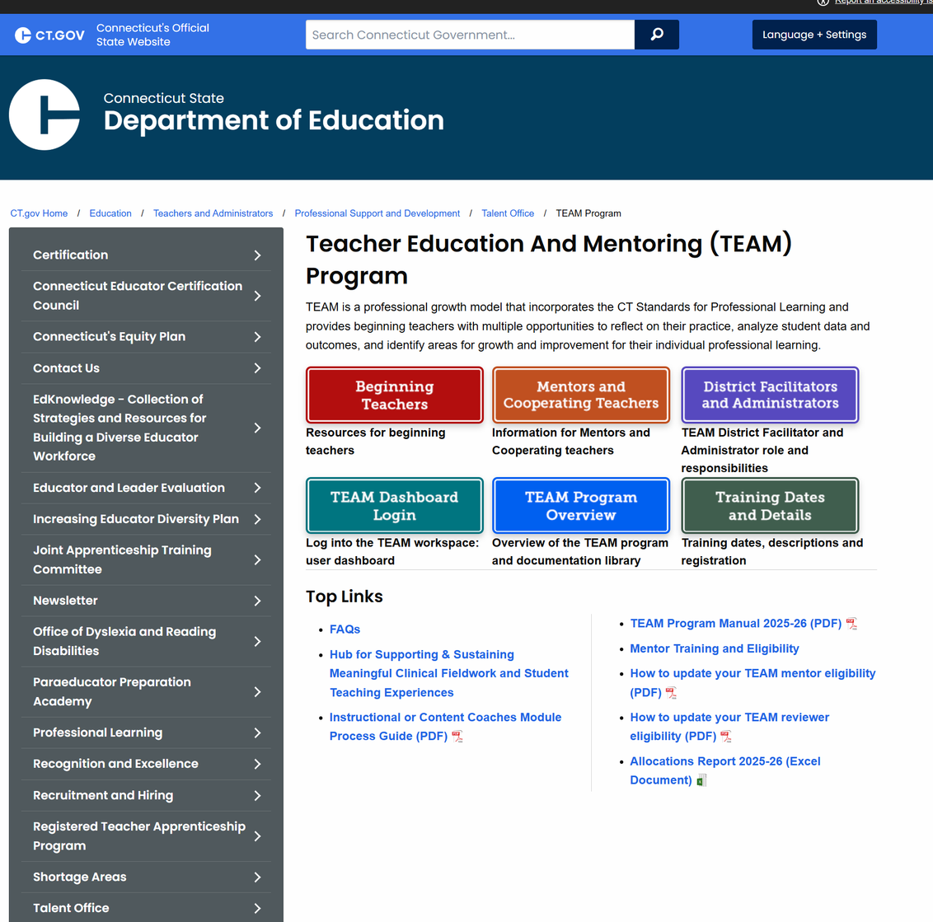
TEAM DASHBOARD
Central location for documenting process and accessing tools related to TEAM
VISIT THIS SITE:
https://modules.ctteam.org/
  CCT Performance Profiles
  Professional Growth Action Plans (PGAPs)
  Meeting Logs
  Journals
  Reflection Paper/Projects
https://portal.ct.gov/SDE/Talent_Office/Talent-Office-home-page/TEAM-Program
Also, VISIT:
Shown at right
  Find resources
Sample module documents, sample reflection papers/projects, reflection paper criteria and feedback, recommended resources, online orientations and more
Page 37

Slide 39
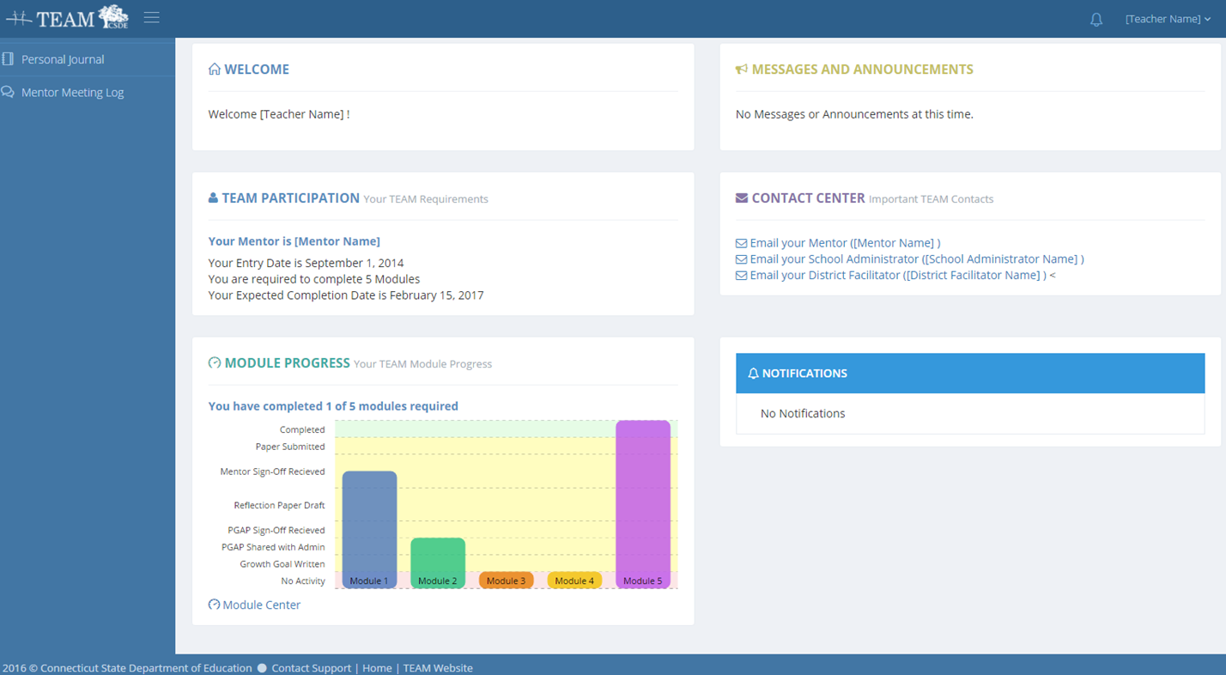
TEAM Dashboard Homepage
Page 38

Slide 40
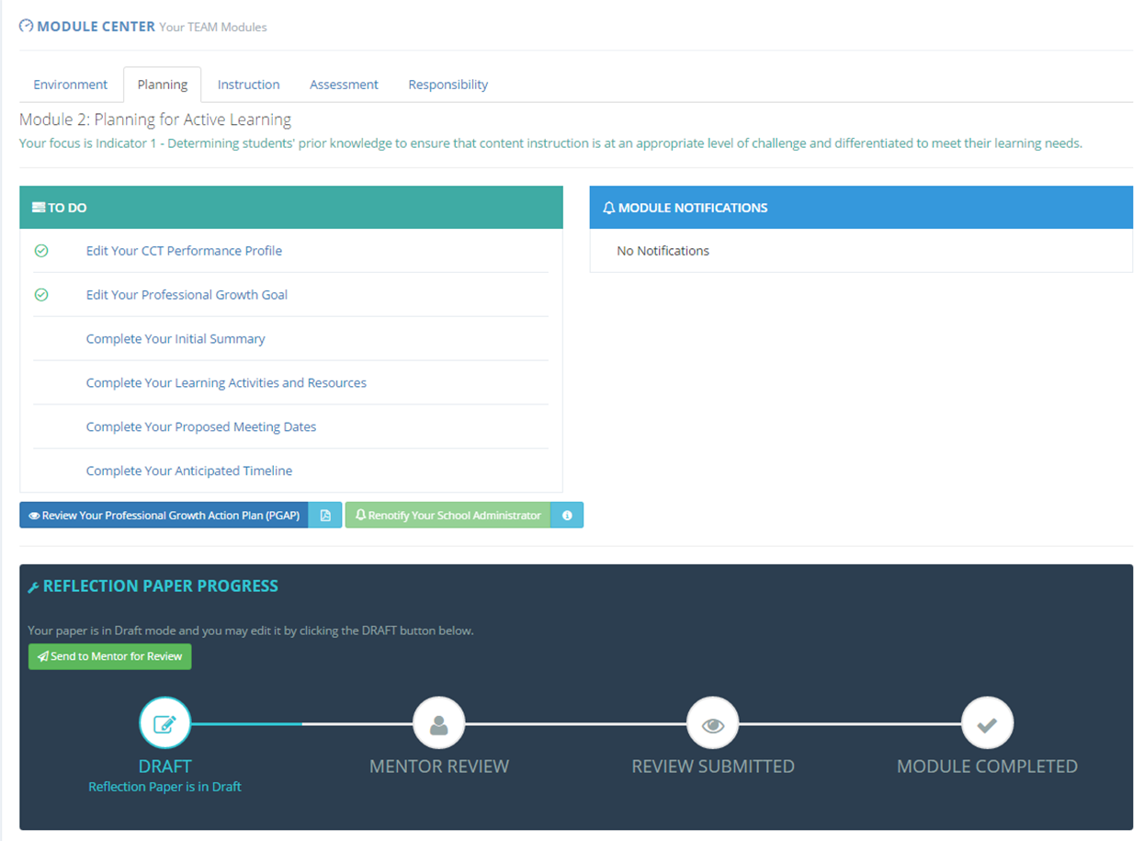
MODULE CENTER
Page 39

Slide 41
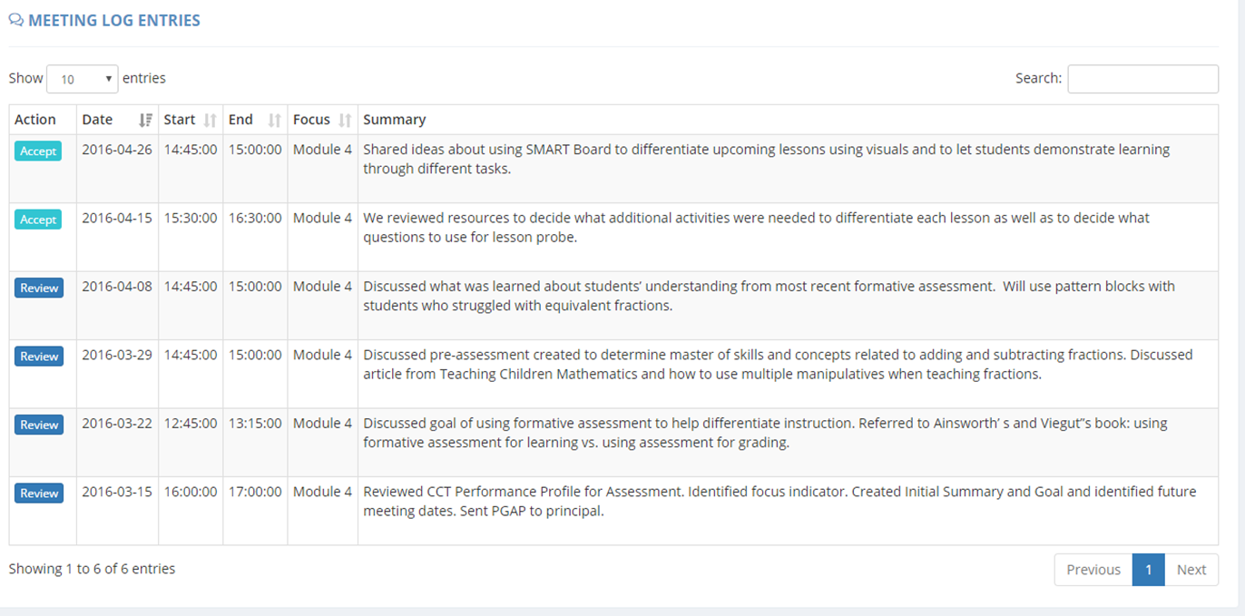
MEETING LOGS
Mentors are responsible for documenting meetings with their beginning teacher in the meeting log, beginning teachers verify the accuracy of the meetings
Page 40

Slide 42
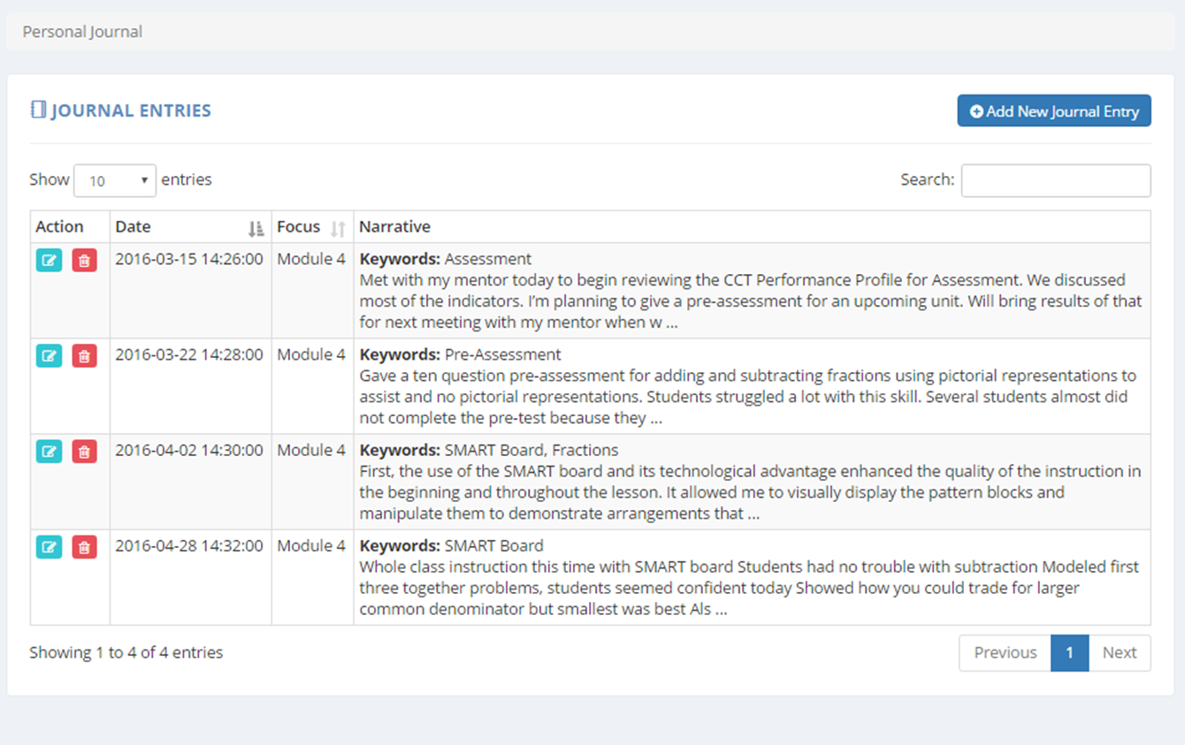
JOURNAL ENTRIES
Beginning Teachers are responsible for documenting meetings with their mentors and any professional learning experiences related to the TEAM program in their journals.
Page 41

Slide 43
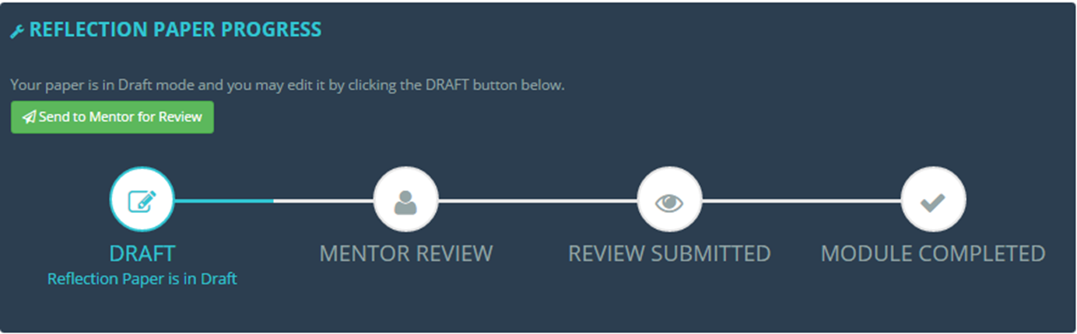
REFLECTION PAPER TRACKER
Changes During Transition Year
For those who choose to pursue Pathway B, you will not need to submit a reflection paper. Instead, your mentor will select “Log Submission” and sign off.
Page 42

Slide 44
TEAM & EVALUATION
Educator evaluation and support pairs with your TEAM program
TEAM
Both
Educator Evaluation & Support
Teacher outcomes
  Collaboration
  High-quality feedback
  Standards-based professional learning
  Data-based decisions
Student outcomes
  Data-based decisions
  Improved student learning
  Early career teachers
  Mentor support
  8-10-week learning modules
  Success Determined by:
New learning, impact on practice, impact on students
  All Educators
  Year-long process
  Evaluated through analysis of:
Performance and practice, student growth and development, whole-school learning
Page 43

Slide 45

CONNECTING THE DOTS
TEAM, Teacher Evaluation, and Common Core Standards Work Together
As I worked with my mentor, I realized that if I wanted my students to think more deeply about content and be more independent learners, I needed to think differently about my practice.
As a result, I drafted possible goals for my TEAM Modules that supported my student learning goal that I developed as part of my teacher evaluation and support plan.
Grade 8 History Teacher
FORMER TEAM PARTICIPANT
Page 44

Slide 46
INTERSECTING GOALS
Example of TEAM, Teacher Evaluation, and Common Core Standards Working Together
TEACHER EVALUATION STUDENT LEARNING GOAL (SLO):
Students will improve their competence in reading comprehension of informational texts using the concepts, themes and information presented in history.
TEAM MODULE GOALS:
Module 1: Classroom Environment
I will learn and apply a variety of strategies to create a learning environment where students feel invited to share their views without fear of judgment.
Module 2: Planning
I will learn about and incorporate a variety of strategies into my planning to teach academic vocabulary in history. I anticipate that my students will be able to proficiently use historical terms in their writing.
Module 3: Instruction
I will learn about and apply research-based instructional strategies in my history lessons so that my students will be able to demonstrate a deeper understanding of the unit on slavery.
Module 4: Assessment
I will learn about, create and communicate assessment criteria so that students can self-assess a practice performance task that combines literacy and history.
COMMON CORE STANDARDS APPLICATION:
Students will logically and objectively prove their views with authentic evidence and supporting facts.
Students will use academic vocabulary to build students’ ability to access more complex texts for reading and writing.
Students will read carefully and grasp information, arguments, ideas and details based on text evidence.
Students will base their writing on evidence from texts using established criteria.
Page 45

Slide 47
Questions?
Contact your District Facilitator
Your District Facilitator is your first line of contact and can answer most programmatic questions.
If there is a question they cannot answer, they will contact the appropriate parties to find the answer to your question.
If you are unsure who your District Facilitator is, ask your mentor or school administrator.

Slide 48
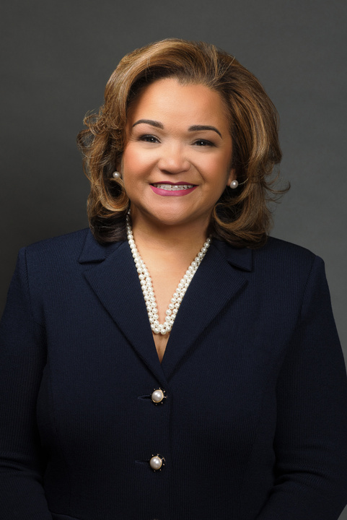
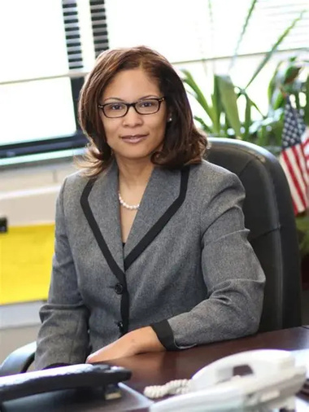
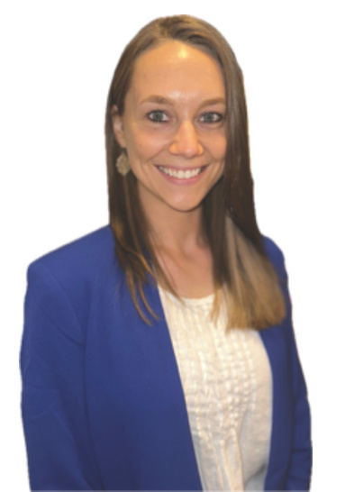

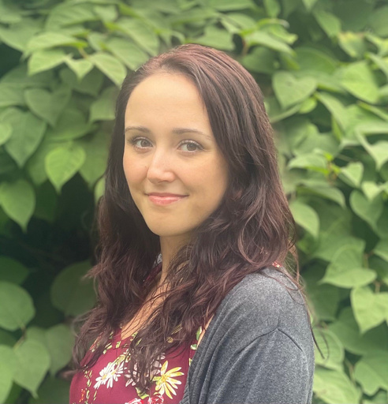
TEAM Program Leadership
Meet the CSDE Team Behind TEAM
Dr. Shuana Tucker
Dr. Jade Gopie
Ashley Wright
Gady Weiner
Victoria Malvey
Chief Talent Officer
Talent Office Bureau Chief
Education Consultant
TEAM Program Manager
Education Consultant
TEAM Data Manager
Educational Services Specialist
TEAM Program Support
Stay up to date on developments within TEAM, including the transition to TEAM 2.0, by reading the quarterly TEAM Newsletters.

Slide 49


"The roots of education are bitter, but the fruit is sweet."
ARISTOTLE

