Slide 1
Teacher Education and Mentoring (TEAM) Program
District Facilitator Meeting
September 10, 2026

Slide 2





Every Student Prepared for Learning, Life, and Work Beyond School: State Board of Education Comprehensive Plan (2023-2028)
Every Student Prepared for Learning, Life, and Work Beyond School:
State Board of Education Comprehensive Plan (2023-2028)
Ensure Equitable Access to Education
All learners are supported, including those with high needs, and have equitable access to education regardless of background or advantage, including access to great teachers and leaders, and a diverse educational workforce.
Ensure Safe and Healthy
Learning Environments
Learning spaces are safe, compassionate, and culturally responsive. They are designed to support the academic, physical, and social-emotional well-being of all learners, including learners of color, multilingual learners, those with a disability, learners experiencing food and housing insecurities, learners coming from low-income families, and those who identify as LGBTQ.
Elevate Curriculum Frameworks
Elevate Connecticut’s curriculum frameworks to provide support for the development of rigorous, engaging instruction and the reliable assessment of universally required skills for life beyond school and a lifelong love of learning.
Create Multiple Career Pathways
Create opportunities for all students to explore multiple career pathways through coordinated and rigorous programs that are developed in partnership with institutions of higher education and local/regional employers, and that align to economic opportunity and advance students in careers of their choice.

Slide 3
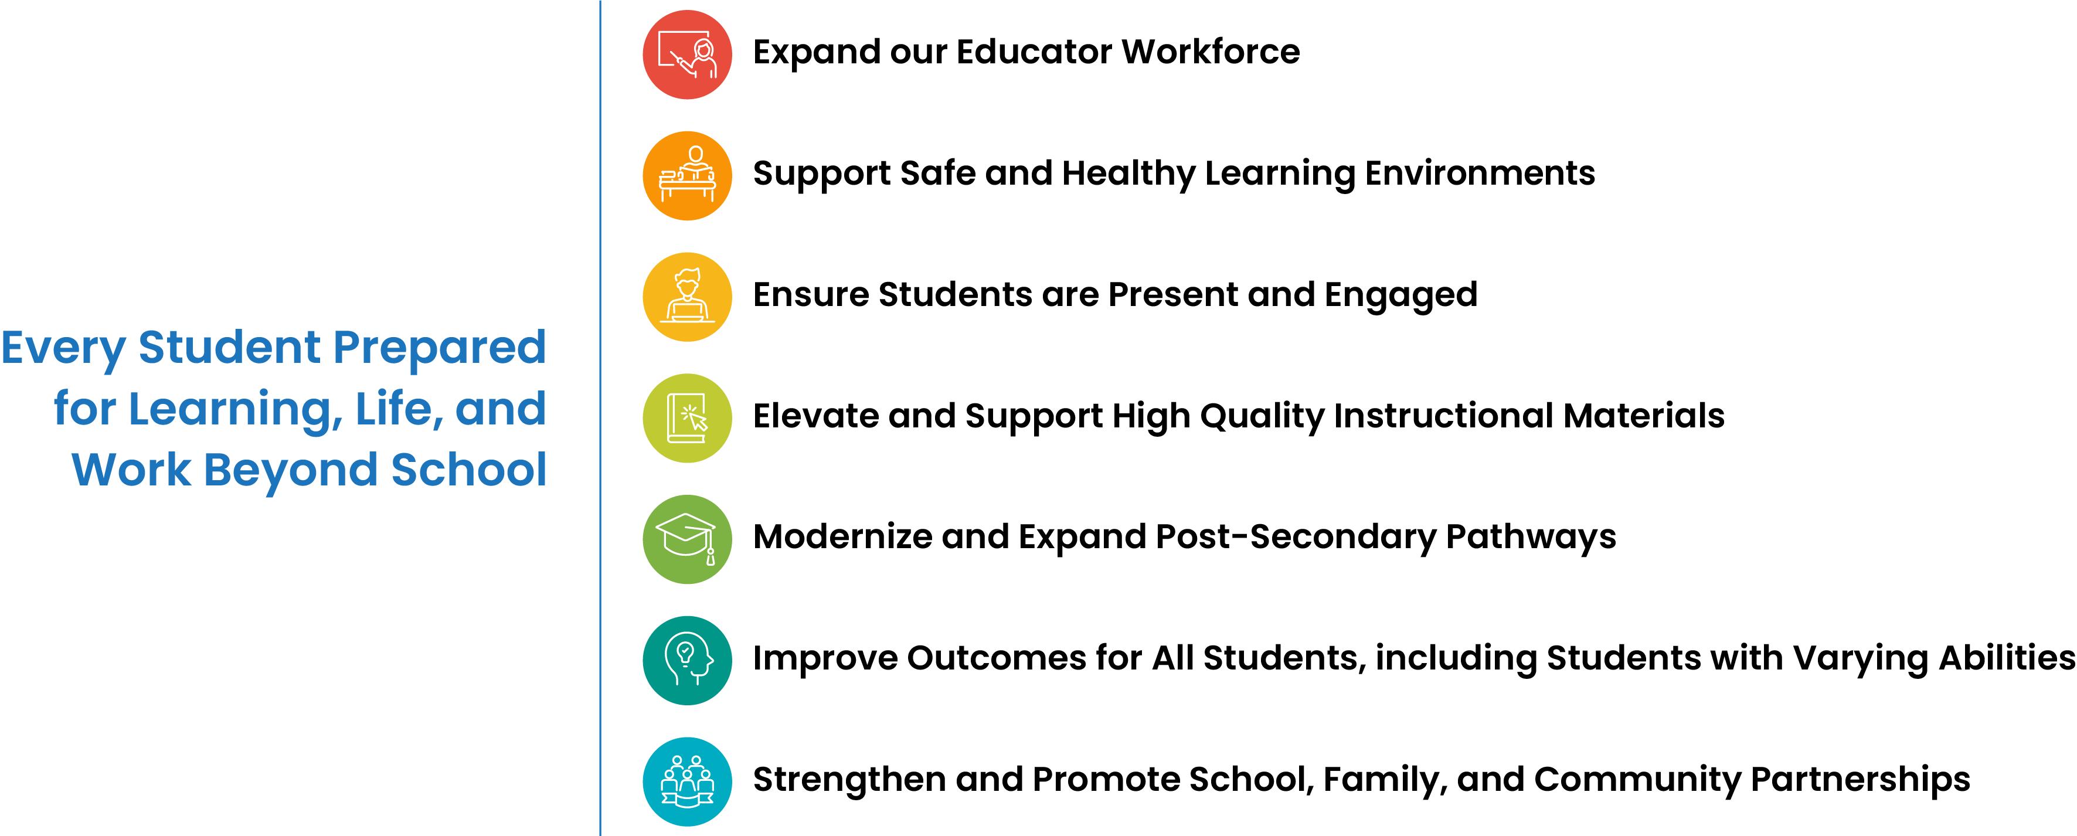
CSDE Strategic Focus Areas
CSDE Strategic Focus Areas

Slide 4

Agenda
Welcome and introductions
A message from the 2026 CT Teacher of the Year
Meeting Goals and 2025-2026 Year in Review
District and Mentor Spotlights
TEAM 2.0 - What is Changing and Why
2026-2027 Transition Year
Beginning of Year Reminders
Small Group Discussion
Q & A and Resources

Slide 5
Meeting Norms
Be Present & Engaged
Listen for Understanding
Keep It Focused & Forward-Looking

Slide 6
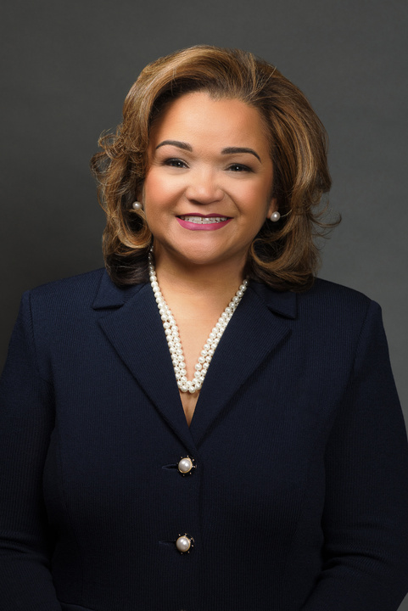
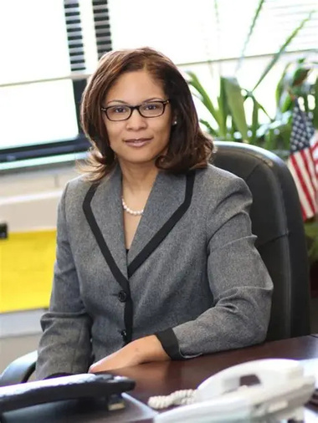
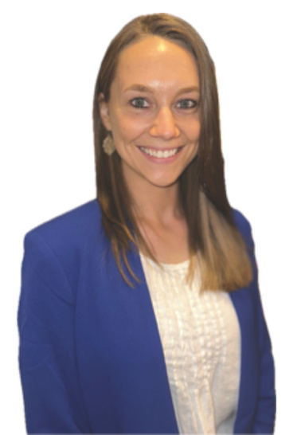
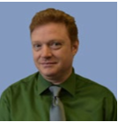
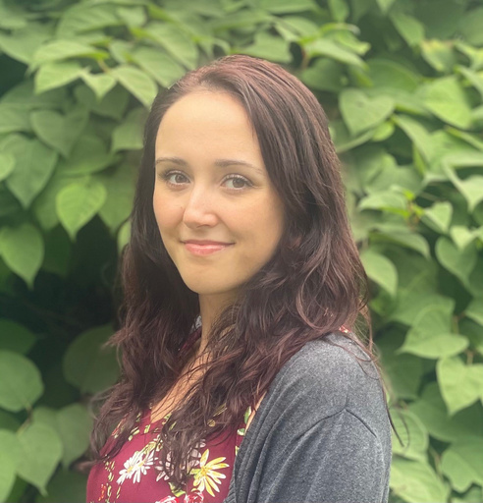
Welcome! Meet the CSDE Team Behind TEAM
WELCOME!
Meet the CSDE Team Behind TEAM
Dr. Shuana Tucker
Dr. Jade Gopie
Ashley Wright
Gady Weiner
Victoria Malvey
Chief Talent Officer
Talent Office Bureau Chief
Education Consultant
TEAM Program Manager
Education Consultant
TEAM Data Manager
Educational Services Specialist
TEAM Program Support
Who else is here with us today?
Let us know in the chat!

Slide 7
Meeting Goals
By the end of today's session, you should...
  Understand key TEAM updates and priorities.
  Know what to expect for the year ahead.
  Be prepared to support TEAM implementation in your districts.

Slide 8
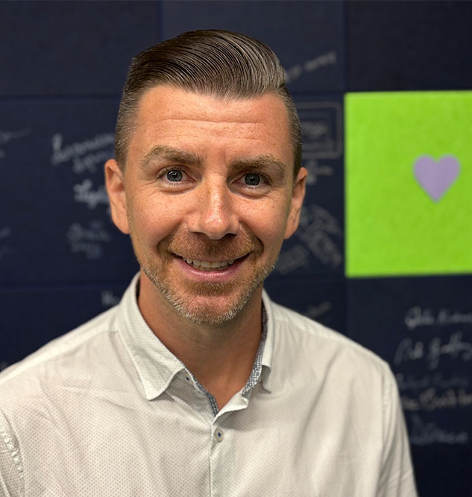
A Message from Brian Betesh, the 2026 CT Teacher of the Year

Slide 9
The 2025-2026 Year in Review
Beginning Teachers Completed TEAM
26,500
Mentors Trained/Updated
3,100
Reflection Papers Successfully Completed
4,316
Attrition Rate
75.7% of teachers still in CT after completing TEAM
1 year: 93.7%
2 years: 86.6%
3 years: 82.7%
2025-2026 TEAM Completers
1,149
Beginning Teachers
3,139
BTs that completed in 2025-26 still in EDS
98.8%
Total # of Completed Modules
123,551

Slide 10
District Spotlight: Achievement First
Building Connection & Accountability Through TEAM Cohorts
Achievement First organizes beginning teachers into cohorts and prioritizes pairing them with mentors within the same school to foster meaningful, in-person collaboration.
Twice each year, the District Facilitator hosts a Module Kickoff to bring mentors and beginning teachers together to review expectations, establish timelines, address questions, and share ideas for developing meaningful PGAPs and selecting learning activities aligned with their goals.
A strong example of how intentional structures can cultivate connection, consistency, and accountability while keeping TEAM focused on authentic professional growth.
To learn more, email DJ at djvandrilla@achievementfirst.org (Principal, District Facilitator)
We invite you to complete the form highlighting the exceptional work being done by all participants in TEAM.

Slide 11
Mentor Spotlight: Jumoke Academy
Kara McDonald has been especially supportive of teachers who needed help in the middle of the TEAM process. She has stepped in when a teacher’s original mentor left the school and has also supported teachers who transferred to Jumoke while already engaged in the TEAM process. She helps teachers understand where they are in the process, what still needs to be completed, and provides ongoing support along the way. Her support also extends beyond TEAM. Kara regularly helps new teachers with instructional best practices, classroom questions, and the day-to-day challenges that come with being new to the profession. Her consistency and willingness to step in when needed have made her a valuable support for beginning teachers.
Mentoring is an important part of supporting beginning teachers in our district. Mrs. McDonald has shown the value of having a mentor who is knowledgeable, available, and willing to step in when additional support is needed. Her work with new teachers has supported both their completion of TEAM requirements and their growth as educators.
TEAM mentors are recognized through district communication and opportunities to highlight their work with beginning teachers. Mentors may be acknowledged through TEAM newsletters, staff communications, and during TEAM meetings as teachers complete modules or reach milestones in the process. As a district, we are also looking for more intentional ways to recognize mentors for the time and support they provide to beginning teachers. This could include mentor spotlights, certificates of appreciation, recognition at district meetings, and highlighting mentors in future TEAM newsletters.
In an effort to celebrate the amazing dedication of our mentors across Connecticut, we invite you to complete the form that recognizes mentors and shares your appreciation!

Slide 12

To Our TEAM District Facilitators…
A strong start keeps teachers in Connecticut classrooms, and that start begins with you.
Thank you for the dedication, commitment, and professionalism you bring to this role each day.

Slide 13
A Message from Dr. Shuana Tucker
CSDE Chief Talent Officer

Slide 14
What TEAM Data and Feedback Have Told Us
Time is regarded as the most valuable resource
Time spent on documentation can reduce the time available for coaching and support
Administrative burden was found to be crowding out time for coaching
Documentation requirements have grown to outweigh the relationship they were meant to support
Significant amount of redundancy with educator preparation program (EPP) requirements
Beginning teachers report duplication of paper and project requirements between educator preparation programs (EPP) and TEAM
One size does not fit all
Flexible, differentiated pathways provide stronger support for the range of experience that beginning teachers bring to their varied assignments.

Slide 15
From TEAM to TEAM 2.0: A Renewed Approach to Teacher Induction
Meaningful Mentorship | Professional Growth | Educator Well-Being
Central Focus
Reflection papers/projects
Applied practice and authentic mentorship
Mentors
Modules
Standard and linear
Flexible and responsive
Mechanics
Guided feedback, job-embedded support
Guides toward paper/project completion
Burdensome and time-consuming
Simplified and coherent
The goal: Improve early-career teacher retention.
Simplified. Connected. Flexible. Practice-based.

Slide 16
Purpose of the Transition Year
Provide teachers and schools with a gradual on-ramp to full roll-out of TEAM 2.0 in 2027-28
Collect information about what works and what needs adjustment
  WEPC will survey mentors & beginning teachers in spring 2027 using the same set of questions asked in fall 2025 and spring 2026
  Questions ask about satisfaction with TEAM overall and with mentorship specifically, how they use their mentorship time, workload, burnout, and job satisfaction
  Comparing responses from the transition year to prior years will allow us to see how satisfaction, engagement, and time use are shifting and identify areas for refinement

Slide 17
2026-27 Transition Year
Pathway A | Pathway B
Reflection Paper/Project | Mentor Engagement Log
  Both pathways will remain valid during the 2026–27 school year.

Slide 18
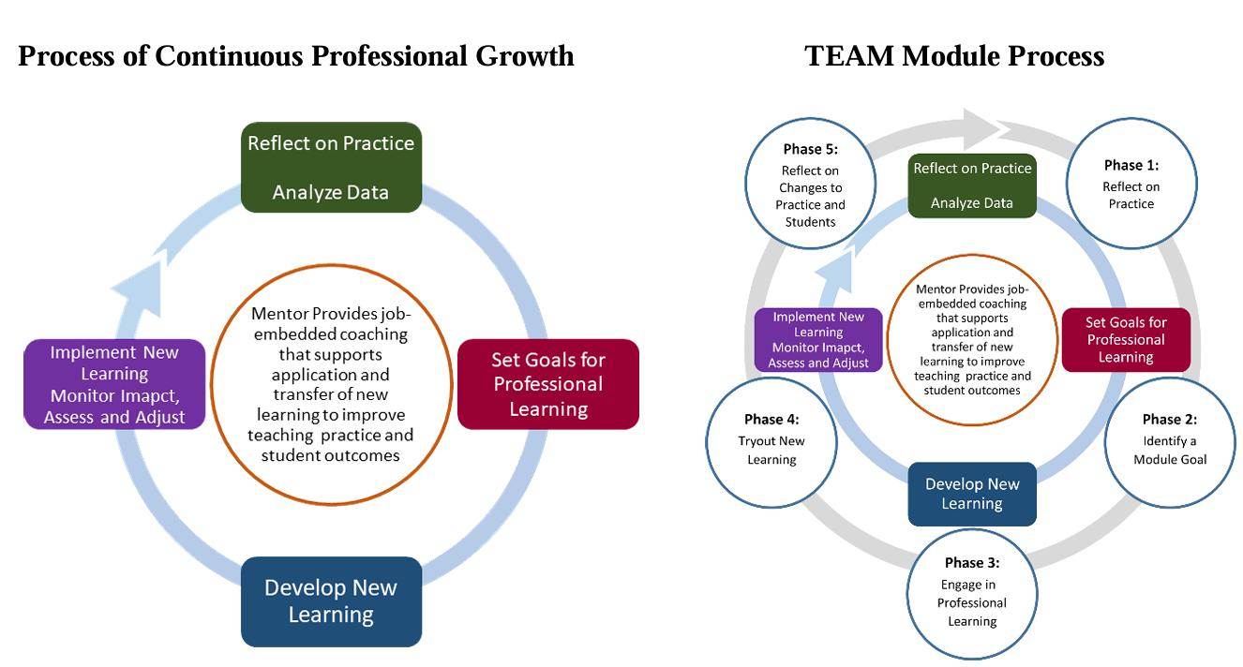
Cycle of Professional Learning

Slide 19
Transition Year: Pathway B
Component | Who completes it? | Purpose
Date/time/type of engagement | Mentor | Establishes the required engagement hours
Focus/need | BT | Identifies the authentic professional need
Mentor support | Mentor | Documents the coaching/support provided
BT action/learning | BT | Demonstrates the beginning teacher’s key takeaways and the next steps to be undertaken.
Follow-up | BT + Mentor | Ensures the continued progression of the mentoring cycle.
  The purpose of the log is to document meaningful mentoring, not to shift and recreate the reflection paper in a different format.

Slide 20
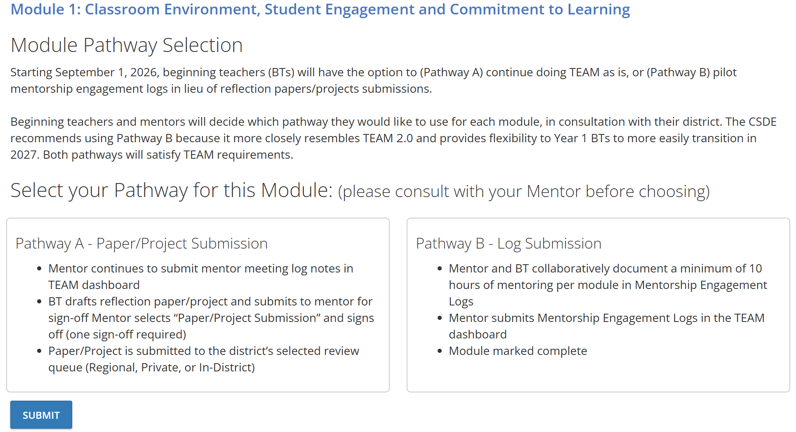
Module Pathway Selection – TEAM Dashboard

Slide 21
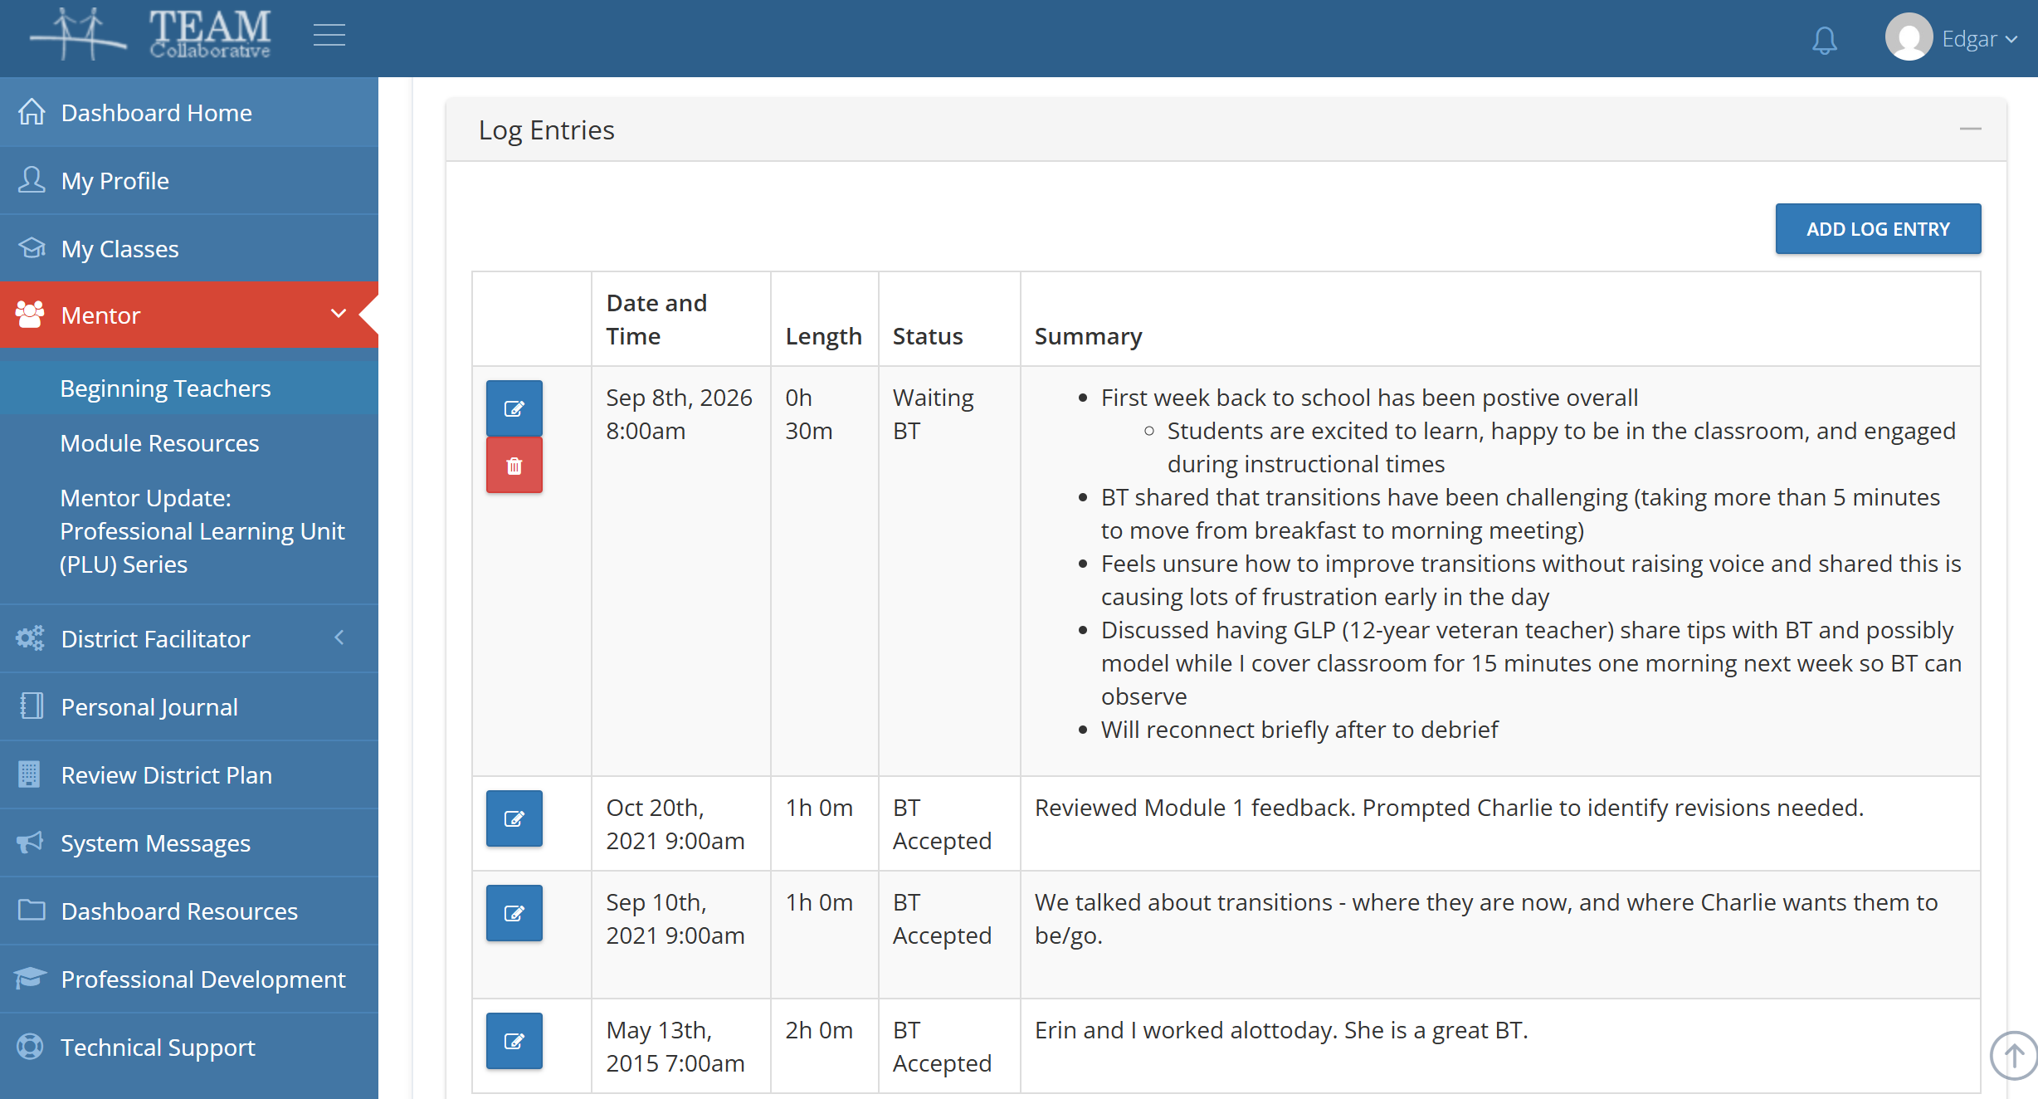
Mentor Logs Engagement Log Entry
Entries can be submitted in 5-minute increments.
Bulleted lists are acceptable.
Aligned to CCT. Domain and PGAP
Next steps identified.
Be specific.

Slide 22
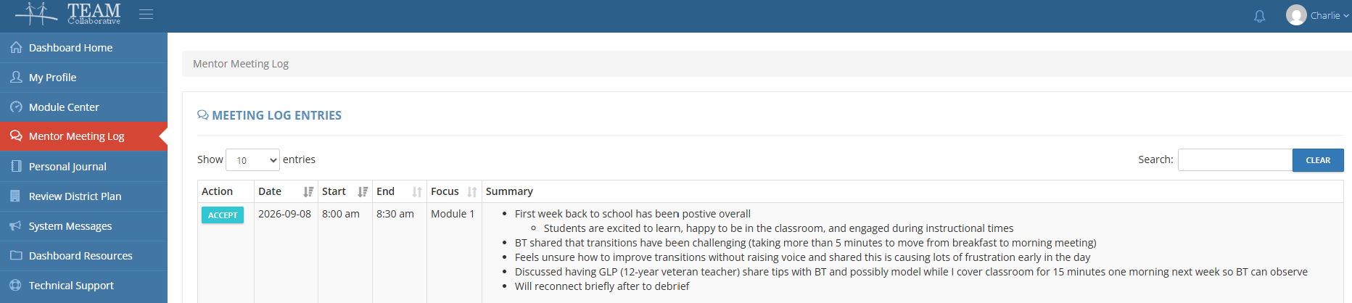
Beginning Teacher Accepts Log Entry

Slide 23

A Mentor's Checklist
Colleagues from CEA generously designed this checklist for TEAM mentors to use as a reference during this transition year.

Slide 24
Transition Year: What We’re Learning
Mentor documentation: Mentors are capturing and submitting evidence of mentoring interactions.
BT engagement: Beginning teachers remain active participants in the mentoring process, even when their contributions are less visible in the dashboard.
A different kind of evidence: We’re learning what documentation is most useful for showing professional growth without returning to a compliance-heavy model.
Looking ahead: This year is helping us identify opportunities to better reflect the shared nature of mentoring and professional growth in TEAM 2.0.

Slide 25
Maintaining High Standards
"If we don't have papers or projects, how will we know the BTs are growing professionally?"
Evaluation and Support System
Professional growth is assessed through the district’s evaluation and support process, not TEAM
Mentor Training and Support
Trained mentors remain the primary drivers of quality.
Equipped with guided conversation tools and engagement logs
District Oversight
TEAM Coordinating Committees (TCCs) and DFs keep local implementation accountable and aligned
Consistent check-ins with mentors and BTs
PDECs coordinate and differentiate local professional learning

Slide 26
Beginning of Year Reminders

Slide 27
The Role of a TEAM District Facilitator
The DF must...
  be appointed by the superintendent;
  be a certified teacher or administrator in the district;
  lead the TEAM Coordinating Committee; and,
  function as the liaison between the CSDE, the district, beginning teachers, mentors and administrators regarding requirements of the TEAM program.
Early in each school year, the superintendent will be asked to appoint the individual who will be responsible for the facilitation of TEAM in the district.
A fact sheet containing an overview of DF responsibilities is included in Appendix E of the TEAM Program Manual.

Slide 28
Beginning of the Year Reminders – Page 1
Review the annual timeline on the website and make sure you are aware of all the TEAM activities and deadlines.
Data updates to the dashboard occur on Tuesdays and Thursdays. Any updates to EDS/CECS will be reflected in the subsequent data transfer.
Verify that all BTs and Mentors have created user accounts on the dashboard, recommending that they use a personal email address.
Confirm with your central office staff that any new hires are entered into EDS at the earliest opportunity to ensure their assignments populate on the dashboard.

Slide 29
Beginning of the Year Reminders – Page 2
2 BTs per mentor, 3 w/ CSDE permission
$500 per BT – paid for by district, support from CSDE
Stipend is tied to hours, not modules
Share this video with building principals, especially those new to their role and supporting BTs
When contacting the CSDE (email or helpdesk ticket) please be as specific as possible and include the teacher's EIN or at least full name.
Review the monitoring list on the dashboard to ensure that all beginning teachers are included.

Slide 30
Payment Report
Timeline
  Report becomes available on 1/20/2027
  Edits/corrections must be submitted before the 2/15/2027 deadline
  The allocations are distributed via the grants system in late April
The amount per BT is calculated based on the available funding and number of active BTs. The amount last year was $230.
To meet the required $500 per mentor, districts are required to provide the remaining portion of the stipend.
District Facilitators should be monitoring mentor meeting logs and module hours.

Slide 31
Mentor Eligibility
To maintain eligibility, mentors must complete a minimum of three online Professional Learning Units (PLUs) prior to their eligibility end date.
Training Year Year 1 Year 2 Year 3 School Year 4 and Beyond
Mentor Criteria Checklist
Experienced and accomplished teachers who have been carefully selected
Completed Initial Support Teacher (IST) training
Hold provisional educator certificate or higher
Have three years of teaching experience, one of which is in the current district
Must complete IST
Eligibility expires
Cannot serve as mentor/cooperating teacher
District Facilitator Alert about eligibility expiration
IST or Mentor Update
Complete a minimum of 3 PLUs
Effective 1/1/2024, mentors will be eligible to take one PLU per training year. Upon completing the Initial Support Training (IST) or completing the Mentor Update Professional Learning Series, they will be eligible to take a PLU toward their next eligibility renewal deadline of 9/30 of their training year and an additional PLU for every subsequent year during their eligibility period.

Slide 32
Exemption Requests
Exemption Requests
Your district recently hired an educator with experience in another state, but they are populating in the TEAM dashboard. Do they have to participate in TEAM?
Possibly. The prior experience must be evaluated by the Certification Office.
Former employer sends ED 126 to the Certification Office
District Facilitator notifies TEAM Office
TEAM Office and Certification Office review ED 126 and determine exemption eligibility
TEAM Office notifies District Facilitator

Slide 33
Extension Requests
Extension Requests
What is the process for applying for an extension of the TEAM deadline?
The flowchart below illustrates the required steps. Note: These may only be accepted within six months of a deadline date.
BT submits initial request to mentor/DF
District Facilitator coordinates all local reviews and signatures
TEAM Office and Certification Office review and determine extension eligibility
TEAM Office notifies District Facilitator
District Facilitator submits request to CTteam@ct.gov

Slide 34

Conversations with Colleagues
We encourage DFs to discuss...
  what teacher education and mentoring looks like in your district;
  what conditions are in place that support or constrain these practices;
  as a veteran DF, tips you would give to new DFs;
  how your TCC will communicate these shifts locally over the next year; and/or,
  the ways that the RESCs can best support your work.
  We will monitor the clock and send a 2-minute and 1-minute reminder.

Slide 35
Resources for Your District
TEAM Newsletter
Optional Harmony Professional Learning Modules for BTs
TEAM DF Annual Timeline and BT Orientation PPT
Cooperating Teacher Handbook
CSDE/TEAM Webpages

Slide 36
Frequently Asked Questions – Page 1
Frequently Asked Questions – Page 1
A teacher was called to active duty. Do we need to request an extension?
Since BTs won’t be required to submit papers/projects, what will they submit instead?
BTs will submit their PGAP and ongoing comments in their engagement log. (More details to come with TEAM 2.0.)
No, if a teacher is not listed in EDS with an assignment, the TEAM clock is paused until they reappear in EDS. Once they are back in EDS, the teacher will get the balance of time added to the deadline.

Slide 37
Frequently Asked Questions – Page 2
Frequently Asked Questions – Page 2
A new educator joined the district. How will their user account reflect this change?
A beginning teacher has been on medical leave (or active duty) and TEAM has been interrupted. Can their deadline be extended to prevent the IS/E?
When a teacher is no longer listed in EDS with an active assignment, their TEAM clock is stopped. Once the teacher returns to the classroom, an extension is granted based on the remaining balance of time.
The assignment of a teacher to a district is determined by the assignment data in EDS. If a teacher needs to update their email address, please have them submit a tech support ticket that includes the new email address

Slide 38
Frequently Asked Questions – Page 3
Frequently Asked Questions – Page 3
Can a district have more than one district facilitator?
Can the role of district facilitator be assigned to a district’s support staff?
No, only a certified educator may serve as the district facilitator.
Yes, but only one primary user may edit the support plan and approve mentor stipends.

Slide 39
Frequently Asked Questions – Page 4
Frequently Asked Questions – Page 4
Does the beginning teacher still have to complete a PGAP?
Does the mentor have to review/approve every engagement log?
The mentor and beginning teacher will document their engagement collaboratively.
Yes. In both the transition year and the implementation of TEAM 2.0, beginning teachers will continue to formulate a PGAP that serves as the foundation for their professional learning and mentored support.

Slide 40
Frequently Asked Questions – Page 5
Frequently Asked Questions – Page 5
Does the district facilitator score the quality of the mentoring conversation?
Can a district facilitator reject an engagement log?
No. However, if the district facilitator has concerns about the engagement between the mentor and the beginning teacher, the district facilitator may arrange a conversation to address those concerns.
No. TEAM 2.0 is designed to be authentic and built upon trust between mentors and beginning teachers. It is a non-evaluative process.

Slide 41
Frequently Asked Questions – Page 6
Frequently Asked Questions – Page 6
What happens if a beginning teacher doesn’t demonstrate growth?
Do mentors still need 10 hours per module?
Most beginning teachers are required to complete 50 total contact hours, including a minimum of 10 hours per module. Time should be allocated to areas where support will be most impactful.
TEAM is non-evaluative. Professional growth is evaluated through the evaluation and support process.

Slide 42

District Facilitators are Key
District Facilitators are Key
    Support mentors, beginning teachers, administrators, and the HR team
    Answer programmatic questions and clarify expectations
    Connect with CSDE when additional guidance is needed
    Help create a consistent, supportive TEAM experience across your district
    For any other questions, please email CTteam@ct.gov and be sure to include as much information as possible (EIN, Name, district, etc.)
As the district’s primary point of contact for TEAM, you are responsible for being able to:

