Slide 1
Welcome District Facilitators
TEAM
Bridging the journey from preparation through professional practice
Spring 2022
Claudine Primack, CSDE, TEAM Program Manager
Gady Weiner, TEAM Data Manager
Notes:
Welcome DFs

Slide 2
Agenda
Welcome
Mindful Minute
TEAM Allocations
District Mentoring Plans
Training Schedule
Feedback from Reviewer Update, IST, IRT, and DF Open Forums
TEAM Update

Slide 3
What are some of the ways you are incorporating or providing emotional support for teachers.
How have you navigated the challenges in your districts?
What are you leaving behind and what are you taking with you as we move out of the pandemic?
What does it look like moving forward?
Rekindling the Passion

Slide 4
Imagine Vacation
Look closely at each of the images.
If you could close your eyes and be instantly transported, where would you go?
Put the number of your choice in the chat.
Now let’s spend 5 minutes on your Imagine Vacation.
1
2
3
4
5
6
Notes:
Imagine Vacation
Look closely at each of the images.
If you could close your eyes and be instantly transported, where would you go?
Put the number of your choice in the chat.
Now let’s spend 5 minutes on your Imagine Vacation:(example script)
Close or soften your eyes
Give yourself a moment to arrive at your destination
Is there anyone that you would like to bring with you on this vacation? If, so visualize them now with you.
Take some time to explore and be curious about this destination
What do you notice? (temperature, scents, colors, emotions, breath, body)
Give yourself a few moments to experience these
Notice how you are feeling
Beginning to complete this journey knowing that this experience is here for you to return to at another time
Thank those that were there with you or if you were alone thank yourself for embarking on this journey alone
As you feel ready, slowly begin to open your eyes and take notice to how your body and mind are feeling after this experience.

Slide 5
TEAM Allocations

Slide 6
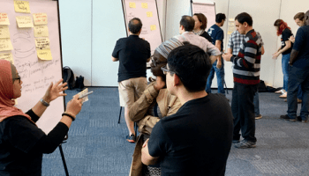
TEAM Funding/Allocations
Funding may be used to off-set the cost of the following:
State funded
TEAM Dashboard
Professional development for beginning teachers and mentors (including purchasing resources)
State funded
Mentor Training
Mentor Stipends

Slide 7
Beginning Teachers
4368
4200
3535
2021-2022
2020-2021
2019-2020

Slide 8
TEAM
Updates

Slide 9
Mentor Support Plans

Slide 10
Training Schedule
All trainings have been posted for the year.
SDE TEAM Site

Slide 11
Training Feedback
Paced my own learning
Able to dissect the material slowly and thoughtfully
Appreciated the respect for my professional and personal time
Allowed for a deeper understanding
Made me self-reflect about my own practices
Pre-work laid down a nice foundation for the work we reviewed in our sessions
Allowed time to read documents carefully and reflect
Gave me time to dive deeper and learn more
Allowed me to get a greater understanding than could be gained in just two hours once per week

Slide 12
IST TOT Dates
June 28th (9:00 -11:00)
September 19th (3:00 -5:00) TOT
Training of New Trainers
Must hold a provisional or higher certification
Must have 5 or more years as a mentor
Must have demonstrated leader capabilities
Must complete online training modules
Must participate in TOT

Slide 13
Dashboard Updates - Reviews
Papers will be returned to the queue if review is not completed within:
6 days for initial Reviewers
Will receive notice on day 4
Currently only for regional review option, but will be applied to private in-district review as well
16 days for Chief Reviewers
Will receive notice on day 14
In-District Review Option
Districts with this review option will not be able to enter TEAM outcomes or set modules as completed unless they have an active TEAM trained reviewer in their district.

Slide 14
Dashboard Updates – Regional Review Process Change
Current Process
Increase in Chief Reviewer queue
Can take 8-10 weeks for papers that go to Chief Review to be returned
New Process (effective date TBD)
Paper will be returned to BT after first review
Paper will go to Chief Review if second review is unsuccessful
Current Process
First Reviewer | Second Reviewer | Final Result
Unsuccessful | Unsuccessful (same criteria) | Unsuccessful Paper returned to BT with feedback for revision and resubmission
Unsuccessful | Unsuccessful (different criteria) | Requires Adjudication by Regional Chief Reviewer
Unsuccessful | Successful | Requires Adjudication by Regional Chief Reviewer

Slide 15
Dashboard Updates – District Facilitators
There is now a combined Admin/Mentor Match page on your dashboard! Depending on district, may have two tabs (district/school – listed as 2 tables on current admin and mentor match pages).

Slide 16
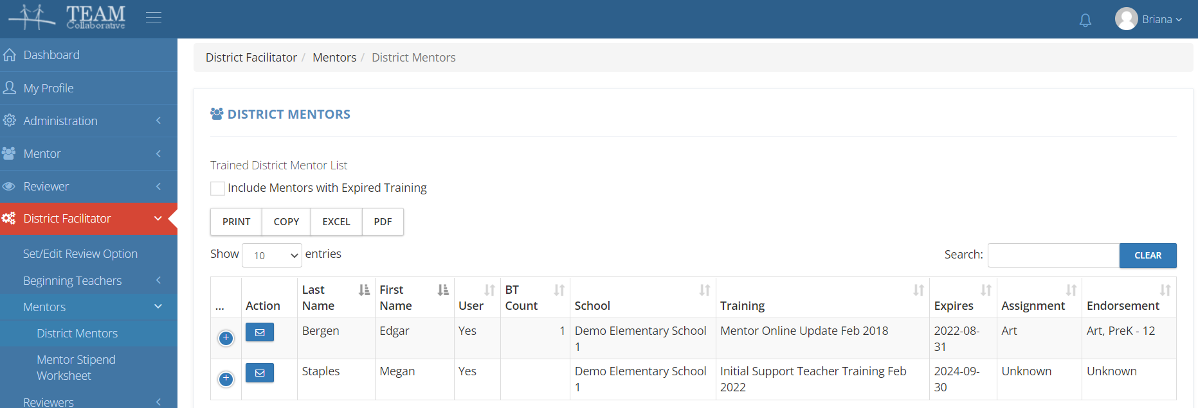
Dashboard Updates – District Facilitators
Assignment and endorsement information is now listed on the District Mentors page.

Slide 17
Dashboard Updates – District Facilitators
Teachers with a TEAM deadline in 6 months are now listed on your District Facilitator Dashboard.

Slide 18
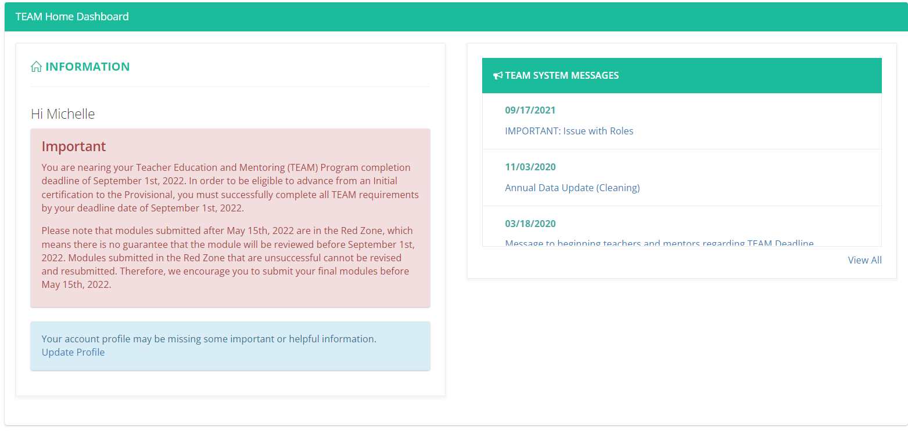
Dashboard Updates – Beginning Teachers
A red warning with upcoming deadline information will appear 6 months prior to TEAM completion deadline on their TEAM Home dashboard.

Slide 19
Dashboard Updates – Red Zone
9/1 – submit modules by 5/15
2/15 – submit all modules by 12/15
Timeframe for paper returns is dependent on if school is in session, queue size, and if it goes to chief review (regional review option only).
This varies throughout the year, but can take up to 8 weeks.

Slide 20
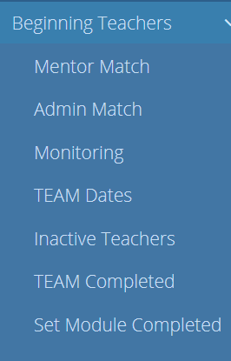
TEAM Completions
Module completion is recorded automatically in the dashboard
In-District Reviews are entered by the DF and should include all reviews including unsuccessful reviews
TEAM Completion is when all modules have been successfully completed.
Completions need to be entered in EDS using
the date of completion
The dashboard gives the date of completion

Slide 21
Contacts
For questions about TEAM, please contact the CSDE
TEAM Program Phone Number: 860-713-6820 Email : ctteam@ct.gov
For technical questions about TEAM workspaces, please submit a TEAM technical support ticket or email Briana Patriarca at bpatriarca@eastconn.org
For questions about certification, please call the certification office at 860-713-6969

Slide 22
Thank you!

