Slide 1


Welcome District Facilitators
TEAM
Bridging the journey from preparation through professional practice
Fall 2021
Ellen Dalton, LEARN
Claudine Primack, CSDE, TEAM Program Manager
Gady Weiner, TEAM Data Manager
Christopher Todd, Bureau Chief, Talent Office
Notes:
Welcome DFs

Slide 2

Agenda
Welcome
A decade of TEAM
  Stats and Achievements
  Michael Mahony Retirement
Module 5 – New Scenarios
Training Schedule
Beginning Teacher Survey
Instructional/Content Coaches
New PLUs
TEAM and EDS Update

Slide 3
A decade of TEAM

Slide 4

20,700
Mentors Trained

Slide 5
18,000+
TEAM Completions

Slide 6
81,000
Papers Reviewed

Slide 7
80%
Percentage of teachers who remain teaching in CT.
TEAM makes a difference in teacher retention.

Slide 8
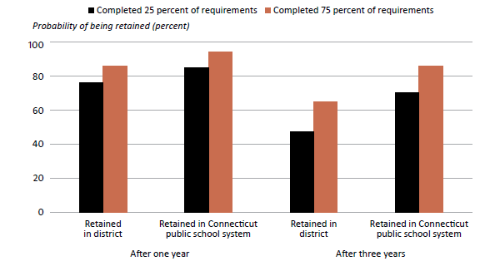
Teachers who completed more TEAM requirements were more likely to stay in the same district and in the CT public school system after 1 and 3 years of teaching
(2012/13–2017/18)
Notes:
In 2019-20, SDE engaged the services of the Regional Educational Laboratory to conduct a study of TEAM. The report released in 2021 showed a strong correlation between completing TEAM and retaining teachers.

Slide 9
Michael Mahony - Retirement
Michael, our life guard! Always willing to throw a line of good information when needed. I was saved many times. Eternal thanks and happy retirement. ~BG Brown
Mike was always a pleasure to work with! Prompt, professional, and a veritable life saver! Wishing him nothing less than the best of luck in a well-deserved retirement! ~Barbara Stoliark
Michael, Happy retirement. Thank you for always being at the other end of the mail and solving all my problems. You won't be retired but refired! ~Marie Iannazzi

Slide 10
Michael Mahony - Retirement
Michael has been the epitome of tech help: effective, responsive, and gracious! His support made such a difference as we transitioned to various changes over the years. Thank you Michael! We will miss you. Lenore Schneider
I would like to thank Mike for all his years of creativity, intelligence, and specially his patience and prompt response time! Rena Cadro
Congratulations on your retirement. You will be sorely missed. Thank you for all the time and support you gave me during my first few years in my new HR role. You were fantastic. Thanks again. Dr. Lisa Armstrong

Slide 11

Module 5 – New Scenarios
Supplemental Scenarios
Culturally Responsive Teaching

Slide 12

Module 5
Being culturally responsive encourages students to feel a sense of belonging and helps to create safe spaces where all children feel seen, valued, respected, and heard by teachers with high regard and expectations for them.

Slide 13

Scenario 1
Read the context for the scenario
Read the scenario
Scenario 1
Consider the discussion questions provided.

Slide 14
Scenario 2
Read the context for the scenario
Read the scenario
Scenario 2
Consider the discussion questions provided.

Slide 15
Scenario 3
Read the context for the scenario
Read the scenario
Scenario 3
Consider the discussion questions provided.

Slide 16

Training Schedule
All trainings have been posted for the year.
SDE TEAM Site

Slide 17

New Resources for DFs
DF Manual
Annual Timeline

Slide 18
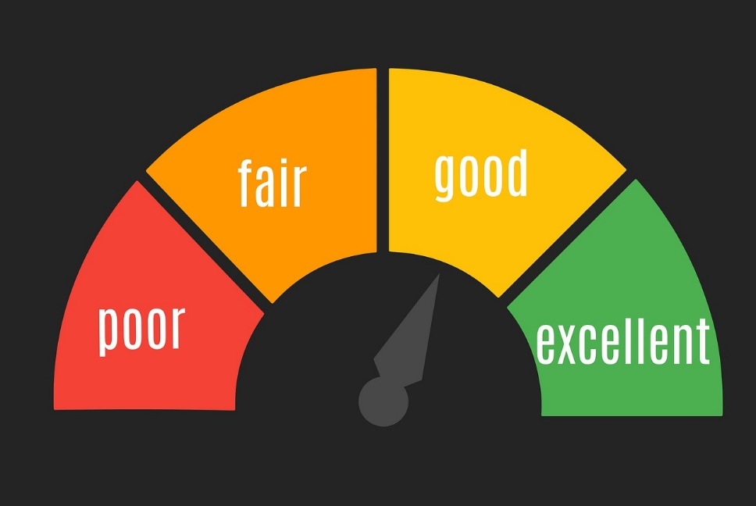
Beginning Teacher Questionnaire
Reflect on educator preparation
Aligned to CCT and Performance Profiles
Coursework and clinical experiences, including student teaching
Consider your strengths and areas for growth
Inform TEAM module goal setting and work.

Slide 19

Instructional/Content Coaches
Complete 2 modules selected from Modules 1-4 and Module 5.
Reflect on the work they do with classroom teachers and the impact of their coaching on the teacher and students.
How is the IC‘s work with the classroom teacher(s) improving both teacher(s) and students?
Same Criteria for Success

Slide 20

New PLUs
TEAM Reflection Papers: Guiding Your Beginning Teacher to Success
Coaching Conversations

Slide 21
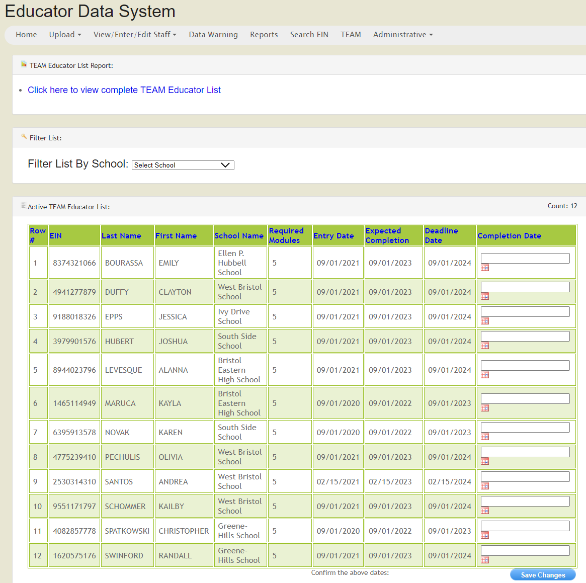
EDS Update
EDS opened on the third week of September
15,000 educators are in EDS as of 9/22, expected number is 53,000
Reminder: TEAM list requires assignment information

Slide 22
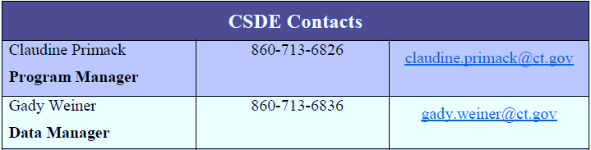
Contacts
For questions about TEAM, please contact the CSDE
TEAM Program Phone Number: 860-713-6820 Email : ctteam@ct.gov
For technical questions about TEAM workspaces, please call Briana Patriarca at 860-455-1521 or email at BPatriarca@eastconn.org
For questions about certification, please call the certification office at 860-713-6969

Slide 23

Thank you!

