Slide 1


CONNECTICUT STATE DEPARTMENT OF EDUCATION
Welcome District Facilitators
Bridging the journey from preparation through professional practice
October 2017
www.ctteam.org
Notes:
Welcome DFs
Let me introduce myself- brief intro to my role
Introduce Gady- give a brief intro to your role
Thank you for your ongoing commitment to TEAM. Your role is critical to the success of the beginning teachers in your district.
Who do we have with us today- Please introduce yourselves.
We are offering this webinar today to help get you ready for this very important role that you have.

Slide 2

Agenda
TEAM Overview
TEAM Participants/Roles and Responsibilities
District Program Oversight and Accountability
Best Practices
Notes:
Some of you are new to this role and we have a few experienced DFs with us as well.
We will do a quick overview of the TEAM program and requirements. Gady will share information with you about how teachers are entered into TEAM and we will review TEAM entry dates, expected completion dates, and deadlines.
The roles and responsibilities of the various TEAM participants is important to fully understand as the DF. The DF is always the first line of communication with all of the various participants.
To help prepare you for all of your responsibilities as the DF, we will first review what you need to be attentive to and we will walk you through some of the tools and resources available to assist you in managing all of it.
Finally, we want to share some best practices that DFs are using to support their teachers and mentors.
Then we will open it up to questions.
As we are presenting, if you need us to provide any additional information, let us know. We want this webinar to be interactive, so please feel free to ask questions as we go along- you don’t necessarily need to wait to the end.

Slide 3
The Purpose of TEAM
Provide all beginning teachers with the support they need to develop as effective educators;
Ease the beginning teacher’s transition into the teaching profession in order to retain effective teachers;
Develop teachers who are reflective practitioners, able to critically assess their practice against CT’s teaching standards, and are committed to continuous professional learning;
Cultivate an understanding of the professional responsibilities of an educator;
Foster collaborative learning communities for all educators; and
Provide excellent teachers the opportunity to develop as educational leaders.
TPM p. 2
Notes:
Although many of you have been involved in TEAM even prior to taking on this new role, we want to take a few moments to remind everyone about the real purpose behind TEAM.
Research tells us that teachers, new to the profession, need guided support to help ease their transition from preparation to professional practice. While we want teachers who are classroom ready when they begin their first year, we know that they have a great deal to learn.
The most important role TEAM plays is helping our newest teachers to develop as professional educators who embrace a mind-set that learning is a life-long skill that leads to improved practice and student growth. I want to emphasize the importance of professional learning as the basis of TEAM.
The entire TEAM module process is designed to support professional learning and growth. Long before CT adopted our professional learning standards, TEAM was built on the belief that professional learning must be personal, relevant, sustained, part of a learning community of practice, data driven, and provide a learning structure that enhances educator growth.
TEAM has a broad impact on more than just beginning teachers- it promotes leadership in mentors.

Slide 4
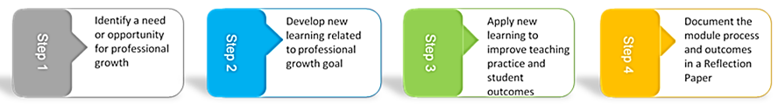
The TEAM Program Module Process
TPM p. 3
Notes:
Effective professional learning is the leverage point with the greatest potential for strengthening and refining the day-to-day performance of teachers. The purpose of professional learning is for educators to develop the knowledge, skills, practices, and dispositions they need to help students perform at higher levels.
The TEAM module process is designed to help teachers take an active role in their continuous development and places emphasis on their learning. Teacher and mentors are active partners in determining the content of the BTs learning, how that learning occurs, and how BT will evaluate and communicate its effectiveness.
For most educators, professional learning is the singular most accessible means they have to develop the new knowledge, skills, and practices necessary to better meet students' learning needs.
It is important to help BTs understand that the TEAM process is about their own professional learning, and not merely an act of compliance.

Slide 5
The TEAM Modules
The TEAM Program is designed around five professional growth modules that provide a framework of support for new teachers.
The five modules focus on five of the six domains of Connecticut’s Common Core of Teaching, which can also be accessed online at www.ctteam.org under module resources.
Module 1: Classroom Environment, Student Engagement and Commitment to Learning aligns with the CCT Domain 2
Module 2: Planning for Active Learning aligns with the CCT Domain 3
Module 3: Instruction for Active Learning aligns with the CCT Domain 4
Module 4: Assessment for Learning aligns with the CCT Domain 5
Module 5: Professional Responsibilities aligns with the CCT Domain 6
Notes:
Depending on the BT’s endorsement and assignment (Gady will address that in a few minutes) he or she will complete 5 or 2 modules.
The modules align with the CCT which sets the standards and articulates the knowledge, skills, and dispositions CT teachers must have. It is the foundation of effective teaching. Teacher prep programs are based on those standards, educator evaluation is based on those standards and TEAM is based on those standards.
Modules 1-4 require a reflection paper

Slide 6
Module 5:
Professional Responsibility
By design, this module will serve to educate new teachers about their professional responsibility in regard to:
    1) expectations for ethical and moral integrity and
    2) making connections beyond the classroom to the larger school/district educational community and to the community of student and families.
To fulfill Module 5 requirements, teachers must engage in district-facilitated conversations that focus on ethical and professional dilemmas for teachers, and complete an online questionnaire, available on their dashboard.
A reflection paper is not required for Module 5.
Notes:
Module 5 is different
It does not require a reflection paper
Mod 5 is designed to be a facilitated discussion around ethical dilemmas that teachers might face
Teachers must complete a short online survey and submit it from their workspace in order for it to be complete

Slide 7
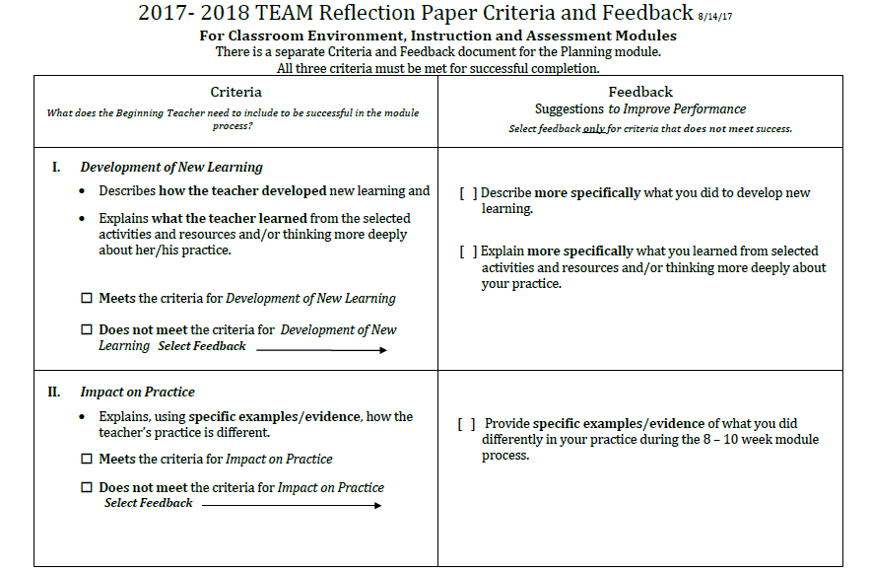

Slide 8
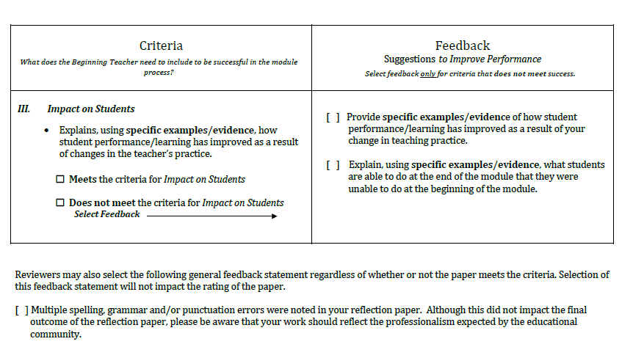

Slide 9
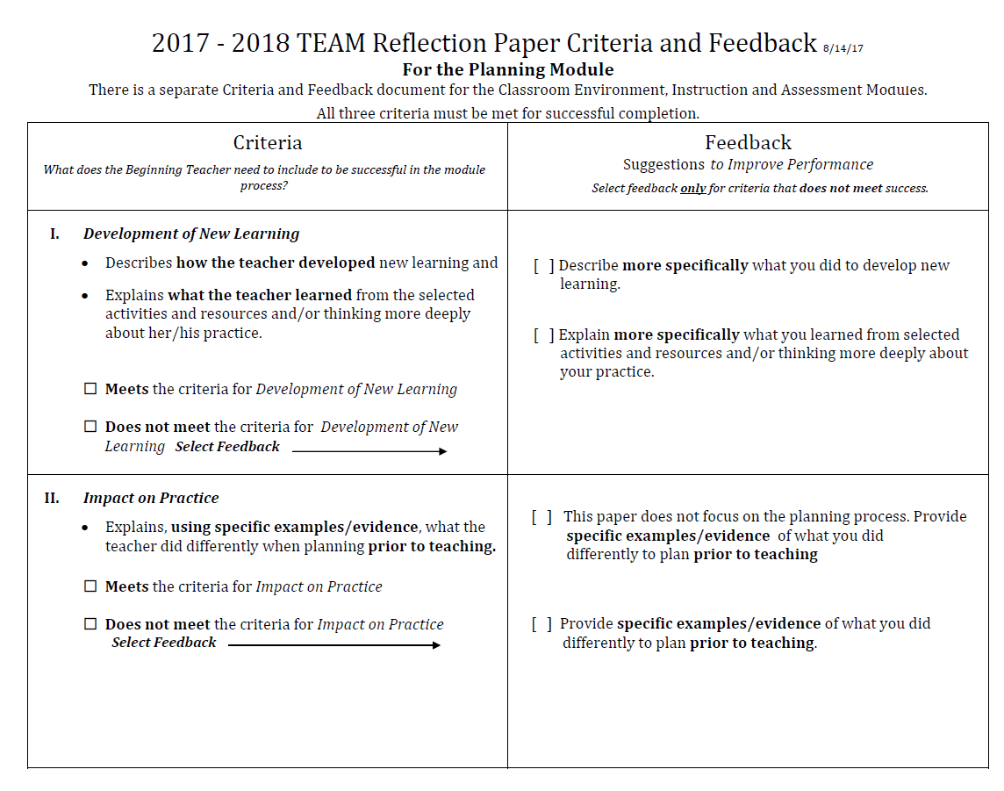

Slide 10
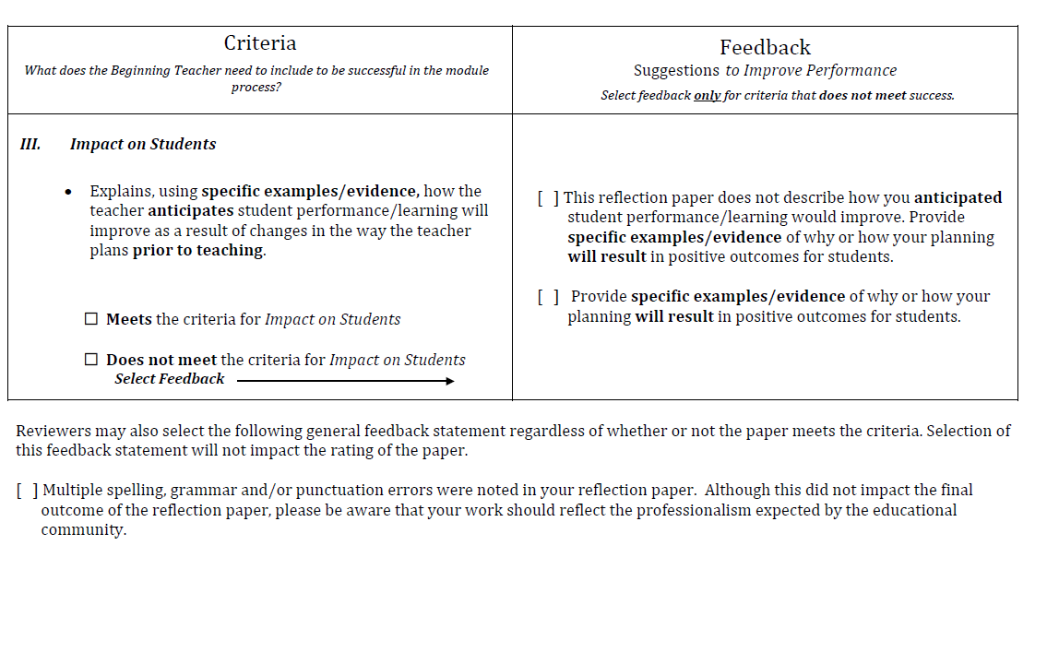

Slide 11

Roles and Responsibilities
Superintendent
District Facilitator
TEAM Coordinating Committee
Administrator
Mentor
Beginning Teachers
Reviewer
TPM- Section 2 p. 12-14
Notes:
TEAM was designed to be a district based program. In order for the program to run effectively, the roles and responsibilities of everyone involved in TEAM must be clearly defined. Let’s review each of these roles.

Slide 12
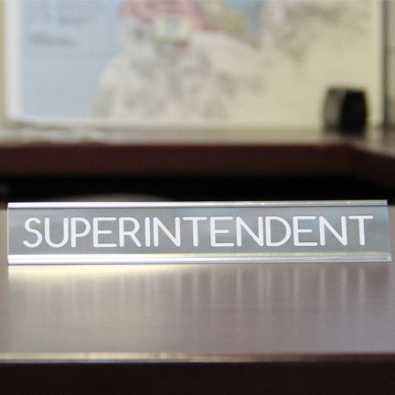
Superintendent
Appoints the DF Annually
Verifies TEAM Completions
  without signing off, the BT’s completion is not transferred to the Certification Bureau
  Notification is sent to the superintendent via email, DF is copied,
  DF sees a pending sign-off message on the dashboard
Ensures TCC, DF and Admins Support TEAM
Notes:
Ultimately, the superintendent has the responsibility to ensure that TEAM is being implemented with fidelity to the requirements. Therefore, the superintendent is required to appoint or reappoint a DF who acts as the liaison between the superintendent and everyone else. When teachers have completed all of their TEAM requirements, the super must verify the completion. In some districts, the super relies on the DF to provide this information.

Slide 13
District Facilitator (DF)
Leads the TEAM Coordinating Committee
Functions as liaison between the CSDE, the district, the beginning teachers, and the mentors regarding requirements of the TEAM program.
Notes:
Legislation calls for districts to establish a committee to oversee TEAM implementation. The DF is the lead facilitator of the TCC. The TCC is responsible to oversee, plan, implement, and monitor the district’s TEAM Program under the direction of the DF.
It is your responsibility to ensure that the TCC meets regularly, knows your district TEAM plan, revises it as required, monitors BTs participation, identifies prospective mentors, ensures training is updated, matches BT and mentors as soon as possible, selects reviewers, monitors mentoring hours, approves stipends and coordinates training and support as needed.

Slide 14
TEAM Coordinating Committee
Legislation requires districts to form a local or regional TEAM coordinating committee or committees (TCC) to oversee, plan, implement, and monitor the district’s TEAM Program under the direction of the DF.
Must include a minimum of four certified professional employees including representation from, but not limited to, a trained mentor teacher, an administrator, and representatives of the exclusive bargaining representative for certified employees, based on district size.
TPM p. 13 - 14
Notes:
The TCC is responsible to oversee, plan, implement, and monitor the district’s TEAM Program under the direction of the DF. Consider how the TCC can assist you with all of the responsibilities you have. Are there individuals on the TCC who can take on one of the tasks that needs to be accomplished.

Slide 15

Administrator
Instructional leader
  Can help the teacher make connections between TEAM, teacher evaluation, and professional learning.
Signs off on the PGAP
  Determines if the district and the school can support the identified professional learning activities in the PGAP or helps the teacher to find alternative activities or resources for those that cannot be supported.
Notes:
The administrator also plays a crucial role in the implementation of TEAM. The adm is an instructional leader who can support a BTs professional learning by sharing resources, providing feedback, helping the BT leverage TEAM to support yearly goals.
Adm is required to sign-off on a teacher’s professional learning growth plan (PGAP). The purpose is not to approve the PGAP, but to determine if she or he can support the teacher’s plan and requested resources. This is a good opportunity for the adm to engage the BT in a learning focused conversation, The adm can suggest additional resources and guide the teacher in his or her professional growth

Slide 16

Mentors
Teachers selected by the district to support beginning teachers through the induction phase of their careers
Provide guidance to the beginning teacher throughout the year by helping her or him manage routine tasks, problems or challenges, and complete the TEAM program requirements.
TPM p.24-25
Notes:
Mentors are the key support for BTs - not only in completing TEAM, but in coaching and guiding the BT throughout the first years of induction into the profession? BTs needs change throughout the year and need someone they trust to provide an ear to listen or someone to collaborate with, or bounce ideas off.
As the DF, you want to try to make good matches that will results in trusting and supportive relationships. You may also need to intervene in matches that do not seem to be working. It is important that you check in with BTs and mentors frequently to gauge how things are going. BTs are often reluctant to speak up, so it is important that you are aware of what is happening at all times. When DFs don’t do this, we find teachers who are at the end of their time in TEAM, have not had the benefit of a good mentor relationship and may be facing a loss of their certification.
In some instances, it may be a BT who is not willing to work with a mentor. These situations need to be addressed as soon as possible. Extensions cannot be granted to teachers who simply didn’t participate in TEAM.
As the DF you should have a plan in place for these kinds of situations. You should talk with your superintendent or HR director about the protocol for addressing these types of circumstance.
Mentors need to build trusting relationships, so often there is a fine line that needs to be carefully navigated. Having a plan in place before you encounter one of these situations can help make handling it much easier.

Slide 17
Mentors
TCC must have a process for the recruitment and selection of prospective mentors/cooperating teachers.
  Mentors/cooperating teachers must possess a provisional or professional educator certificate and have a minimum of three years of teaching experience, including at least one year of experience in the district in which they are presently employed.
  All mentors/cooperating teachers must be TEAM-trained and updated every three years.
The district must assign a TEAM trained mentor to all beginning teachers required to participate in TEAM.
  The CSDE strongly encourages districts to assign a mentor within the first 30 days of hire.
Mentors may be assigned 2 BTs, 3 with special approval from CSDE.
  Mentor must provide a minimum of 50 hours of mentor support with the expectation of approximately 10 hours of support for each professional growth module completed.
Notes:
Do you have enough mentors in your district? Do you have the right mentors to meet the needs of your teachers? How are you recruiting new mentors? Consider not only demonstrated experience, but also race, culture, ethnicity when selecting new mentors. You want to have a pool of mentors who will meet the needs of your beginning teachers.
2 BTs can be assigned to a mentor. If a 3rd needs to be assigned, you must contact us (Claudine Primack) to get special approval.

Slide 18
Mentors
Possess the following characteristics:
  Effective teaching practice as defined in the Connecticut CCT;
  The ability to work cooperatively as a team member to aid the professional growth of a beginning teacher;
  A professional commitment to improving the induction of beginning teachers into the teaching profession;
  The ability to listen and communicate effectively with others;
  The ability to relate effectively to adult learners;
  The ability to be reflective and articulate about the craft of teaching; and
  Other criteria defined by the district.
Notes:
Your district may have a plan that includes criteria, you should be familiar with it. The slide lists some of the criteria that may be considered.
Mentors must accurately record their mentoring hours in order for the SDE to approve the mentor stipend.

Slide 19
Beginning Teachers Who Participate in TEAM
Certification Requirements | Assignment | Duration
Nonrenewable Interim Initial Educator Initial Educator Interim Initial Educator AND Endorsement from Category 1 or 2 | Working with students in an assignment that is in compliance with their endorsement | 10 months in the same assignment
TPM p. 4
Notes:
In order to be eligible to participate in TEAM, teachers must meet specific requirements. First, they must have the appropriate certification. Column 1 lists those certifications that teachers must possess in one of the endorsement areas that TEAM is required (see next slide for endorsements). Column 2 speaks to the position the teacher holds or is assigned in their school, which must be in alignment with the certification. Teachers who are teaching in a grade that is outside of their certification, for example, would not be in compliance. A teacher who is teaching in a content area that is different from the endorsement on their certification, would be out of compliance.
In order for the system to pick up a teacher who is eligible and required to complete TEAM, both of the requirements in the first two columns must be met. The duration refers to the length of the time in a specific position. Any teacher, with an initial certification, working under that certification either full or part-time, will be required to do TEAM. However, a teacher who is working in a substitute position under an initial certification must be in the same position for the full year- 10 months.

Slide 20
Category I | Category II | TEAM Program NOT required
Teachers certified and teaching under the endorsements below will participate in the Five-Module Program | Teachers certified and teaching under the endorsements below will participate in the Two-Module Program | Endorsement areas NOT participating in the TEAM program
> English (#015) > Mathematics (#029) > Biology (#030) > Chemistry (#031) > Physics (#032) > Earth Science (#033) > General Science (#034) > Health (#043) > Special Education (#065,165, 265) > Elementary (#001, 002, 003, 004 005, 006, 008, 013, 112, 113 excludes birth to age 3, 305) > Middle School 4-8 (#006, 215, 226, 229, 230, 231, 232, 233, 234, 235) > History/Social Studies (#025, 026) > Art (#042) > Music (#049) > Physical Education (#044) > Bilingual Education (#009, 902, 915, 926, 929, 930, 931, 932, 933, 934, 966, 967, 968, 969, 970, 971, 972, 973, 974) > World Languages (#018, 019, 020, 021, 022, 023, 024, 101) > Teaching English to Speakers of Other Languages [TESOL] (#111) > Remedial Reading/Remedial Language Arts (#102) | > Business Education (#010) > Vocational Agriculture (#041) > Agriculture (#040) > Home Economics (#045) > Technology Education (#047) > Partially Sighted (#055) > Hearing Impaired (#057) > Blind (#059) > Teacher-Coordinator Marketing Educator (#089) > Occupational Subj. in Technical High Schools (#090) > Trade and Industrial Occupations in Comprehensive H.S. (#098) > Health Occupations — Comp. High School (#103) > Health Occupations in a Technical High School (#109) > Unique endorsements in dance, theater, and Montessori > School Library Media Specialist (#062) | > Driver Education (#035) > Speech and Language Pathologist (#061) > School Counselor (#068) > School Psychologist (#070) > School Social Worker (#071) > School Nurse-Teacher (#072) > School Dental Hygienist-Teacher (#073) > Vocational Technical Administrator (#082) > School Business Administrator (#085) > English to Non-English Speaking Adults (#088) > Intermediate Administrator/ Supervisor (#092) > Superintendent of Schools (#093) > Teacher Coordinator Co-op Work Edu/Diversified Occup. (#104) > Department Chairperson (#105) > H.S Credit Diploma Program (#106) > Ext. Diploma Prog. Non-credit Mandated Prog. (#107) > Practical Nurse Education Instruction (#108)
TPM - Appendix B
Notes:
These are the endorsement areas for certification. Category I and II are required to participate in TEAM. Teachers in category I will complete 5 modules, teachers in category II will complete 2 modules from modules 1, 2, 3, and 4. Module 5 will not count as one of their two modules. We strongly encourage districts to have all teachers participate in Module 5. However, it won’t count as one of the two module requirement.

Slide 21
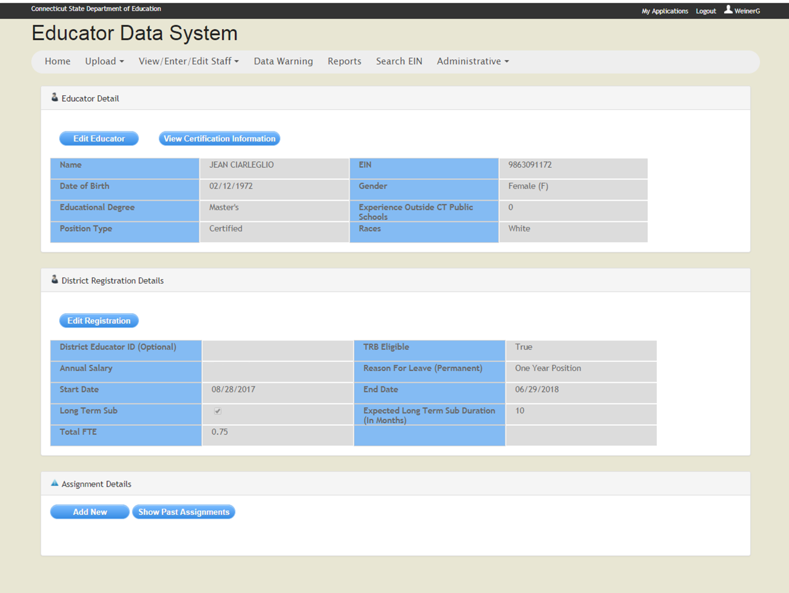
Notes:
A common data entry issue that causes teachers to be excluded from TEAM is missing assignment information or incorrect info that will cause a compliance error.

Slide 22
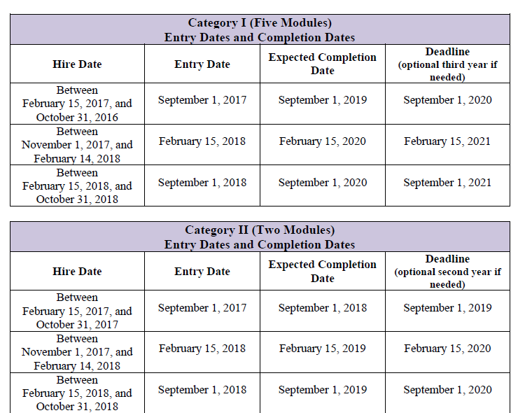
Timelines – Beginning Teacher Entry Dates and Completion Dates
Category I
TPM p.8
Notes:
Entry Dates: When teachers are entered into the state Educator Data System (EDS) and they meet the requirements to be participate in TEAM, they are assigned an entry date. All teachers hired and entered into EDS prior to October 31, are given a September 1 entry date, Teachers who are hired and entered into EDS beginning on November 1 until February 14 are given a February 15 entry date. Any teacher hired and entered into EDS on February 15 and after will be given a September 1 entry date in the following year.
Expected Completion Dates: Category I teachers are expected to complete TEAM in 2 years. They have a third year built in that allows extra time if needed for situations such as a maternity or sick leave, or personal family crisis that may have prevented them from completing TEAM in the two years. DFs do not need to check with the state or request the extra year, you can grant that time as needed. On word of caution, there is no extra stipends in the third year if the full stipend was paid out over the two years. If a teachers has been out or has not worked on TEAM, you may want to reduce the stipend to half or 0 for that year and reserve the money for the extra year that will be needed.
Deadline: The deadline is the end of the 3 years that is provided. If a teacher has not completed TEAM requirements by the end date, he or she will no longer be able to renew his or her certification. If there were extenuating circumstances that prevented the teacher from completing TEAM in the 3 years, the DF can initiate a request for an extension of a deadline. There must be third party documentation to support the request. More information can be found in the TEAM program manual.

Slide 23
Timelines – Beginning Teacher Entry Dates and Completion Dates
Category II
TPM p.8
Notes:
Category II entry dates reflect 1 year to complete TEAM with the option of a second year if needed.

Slide 24

Review of Reflection Papers
Regional/In-district Option
Reflection Paper Reviewers
  educators selected by the district to review beginning teacher reflection papers
  must attend Initial Review Training and complete annual Update Training (online) to maintain eligibility to review reflection papers
A ratio of at least 1 reviewer per 5 papers (regional review option)
TPM p. 18-19
Notes:
Regardless of the option a district chooses, all reviewers must participate in an Initial Reviewer Training and be updated annually,
For district participating in the regional review- A number of district educators trained to review reflection papers (the number of reviewers in a district that need to be trained will be proportionate to the number of beginning teachers in the district who are participating in the program
Those who selected the in-district option need to be sure that there are enough reviewers available to ensure confidentiality of the BT. If not, you may consider changing to the regional review.

Slide 25
Regional Chief Reviewers
New Role
Different than “Chief Reviewers”
Provides Professional Learning Opportunity to Enhance Reviewer Skills
Resource to District – Reviewers, Beginning Teachers, Mentors
Notes:
We have trained 5 cohorts of Regional The training builds on a reviewer’s skills and provides a deeper understanding of the review process. Participants feel confident about their ability to reconcile papers. We would like to train more Regional Chief Reviewers. If you have reviewers who would make a good Regional Chief Reviewer, please send Claudine their names.

Slide 26
District Program Oversight and Accountability
Registration of teachers in the state EDS system so that eligible teachers are properly identified to participate in TEAM;
Assignment of mentors to beginning teachers within 30 days of hire;
Completion of mentor /beginning teacher meeting logs, to confirm that beginning teachers and their mentors are meeting as required; and
Adherence to established timelines for module completion.
TPM p. 14
Notes:
DFs must coordinate the oversight of the TEAM program to ensure that it is fully implemented with fidelity to the requirements. There are several tools available to assist the DF and TCC in this process.
Registration- all teachers need to be registered in EDS. Know who is responsible in your district for entering the data into EDS. Problems with teachers not appearing in your list of beginning teachers often is due to not being entered into EDS or being entered incorrectly. Contact Gady Weiner if you need assistance.
Assignment of mentors; you may not be the person who is responsible for determining which mentor will work with which BT, but you are responsible for ensuring that all BTs are assigned a mentor as soon as possible. You must also electronically match the BT and mentor so they can work together online.
Log- you have the ability to monitor the logs that show how much time teachers and their mentors are working together. You should monitor this frequently. If you notice that no time has been logged, it might be an indication that something is not working in the mentor/BTT relationship. Check in reqularly with BT and mentors to gauge how things are going and be proactive in helping resolve problems before it is too late.
Timelines, the expected completion date and deadline must be adhered to, but the district can set timelines for each module. Districts who are doing this ensure that their teachers all meet the state required deadlines and complete TEAM on time.

Slide 27
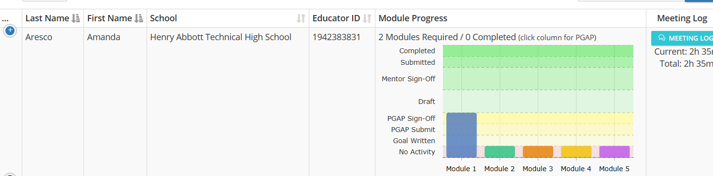
Mentors
Each mentor is required to provide a minimum of 50 contact hours to each beginning teacher over the course of the five-module program or 20 contact hours for the two-module program.
With an expectation of providing approximately 10 hours of support per module.
It is the mentor’s responsibility to document all mentoring hours in the mentor/beginning teacher mentor log.
The DF will monitor the mentor/beginning teacher log.

Slide 28
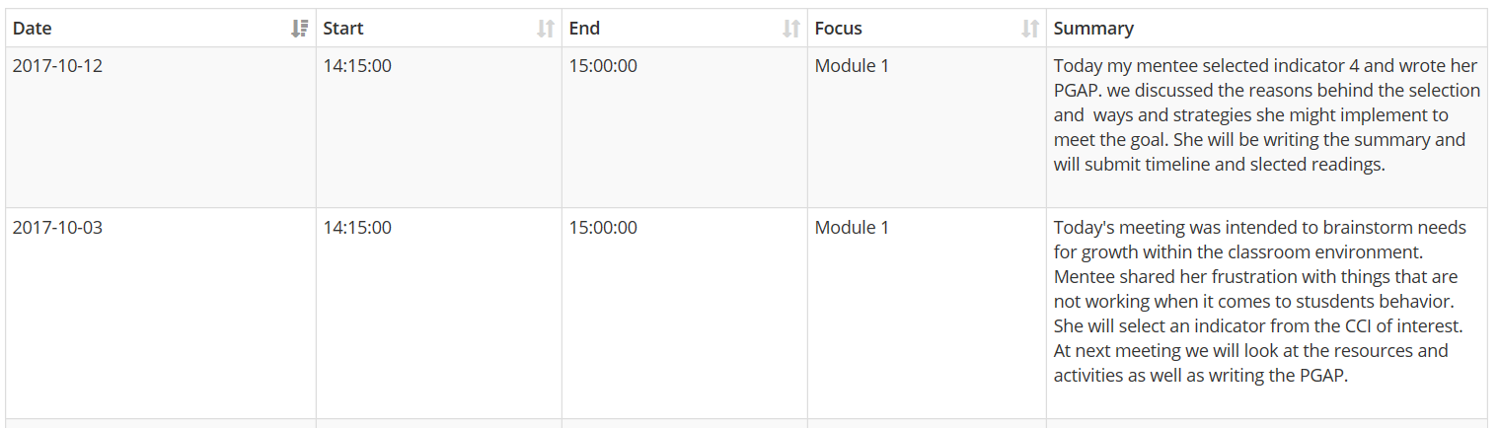
Sample Mentor Meeting Log
Notes:
This is a sample of a log, Mentors should log all of the work they engage in with the BT including helping the BT set up the classroom for the beginning of school, assisting in planning parent conferences, and other general mentoring tasks. Mentorship in not only about TEAM. It is about inducting early career teachers into the profession.

Slide 29
The TEAM Module Workspace, Dashboard, and Tools
The TEAM Program website, www.ctteam.org, has been established for multiple purposes:
Information/Communication – Provides program participants with program documents and prompt and timely communications from the CSDE.
Training – The website provides beginning teachers and their mentors with a link to a list of professional learning opportunities (PD Registration) and the ability to register for a selected course.
Professional Growth Module Workspace – Provides access to the web-based tools and resources that allow for the completion of the professional growth module process and communication with mentors, DFs, and administrators.
Notes:
Review the DF dashboard to locate where each of these tools/resources can be found.

Slide 30
New Professional Learning Resources
Educators will have access to professional learning resources, aligned directly to the CCT Performance Profiles, and collaborative discussion rooms where participants can connect with their mentors and other program participants as they work through each module:
  • Classroom Environment, Student Engagement, and Commitment to Learning
  • Planning for Active Learning
  • Instruction for Active Learning
  • Assessment for Learning
  • Professional Responsibilities and Teacher Leadership
The goal is to support and bridge the learning of the knowledge and skills that can directly be implemented in the classroom.

Slide 31
Best Practices
Match mentors and Beginning Teachers within 30 days of hiring
Check in with Mentor/BT to make sure that the match is working
Establish Individual Building TEAM Facilitators
Monthly TEAM Professional Learning Events
  Establish a calendar of topics
  Partner with another district
  Mentor support sessions
Establish district timelines with specific due dates
  These are monitored by the building TEAM facilitator
All teachers new to the district participate in Module 5
  Or, all staff on a yearly basis
Notes:
Review these best practices. Districts who have developed processes to ensure TEAM is fully implemented and that all BTs are given full support in their first few years in the profession, are seeing success with their teachers.

Slide 32


Slide 33
CSDE TEAM Program Contacts
You can find answers to most of your questions in the FAQs at www.ctteam.org.
Claudine Primack: TEAM Program Manager
claudine.primack@ct.gov 860-713-6826
Gady Weiner: Data Manager
gady.weiner@ct.gov 860-713-6836
Notes:
Show them where the FAQs are located. Encourage them to check for answers before calling. Tell beginning teachers and mentors where they can find answers to their questions as well.

Slide 34

Notes:
Thank you for all that you do for CT teachers. Without your support, TEAM would not function as well as it does.

