Slide 1

Introduction to TEAM
Bridging the journey from preparation through professional practice
2017-2018
Notes:
This introduction to the TEAM program is intended to provide an overview that can be used during an orientation to TEAM. The faciliator may want to have the following materials for this session: copies of the CCT, the TEAM Program Manual or a link to it. You may want to ask participants to bring a computer device with them to be able to access various resources throughout the session.
1. Welcome participants:
ask them to introduce themselves and share something about themselves- why they chose teaching, what they are feeling at the moment, etc.
2. You may want to ask them what they know about TEAM. If there are mentors in the group, you may want to ask them to share something about a positive experience they’ve had working with BTs.
3. Explain: TEAM is a collaborative endeavor focused on student achievement that brings together beginning teachers and trained mentors. The framework for TEAM is embedded in Connecticut’s Common Core of Teaching, which provides the opportunity to examine teacher practice across a continuum. By lending their experience and expertise, mentors assist in bringing beginning teachers along the continuum at a quicker pace than would be accomplished.

Slide 2

Learning Targets
1. Participants will know:
The mission and goals of the TEAM Program;
The expectations of the TEAM Program and their district; and
What supports are available from the district.
2. Participants will be able to:
Locate TEAM web-based tools and online resources;
Discuss the Module Process with their mentor;
Create a user account on www.ctteam.org; and
Develop a two-year plan mentoring plan.
Notes:
Share with participants that these learning targets frame the orientation.
There is a lot of information in this session, but the most important thing for them to know at the end of the session are the expectations of both the TEAM program and the district (refer to your district three-year support plan) and tell them where to find support. Their mentor will be their number one resource and will be providing assistance. The DF is also another good resource. Provide DF’s contact information for them.

Slide 3

What is the TEAM Program?
Legislation passed in October 2009 has established a Teacher Education and Mentoring (TEAM) Program for the purpose of providing support and professional growth for beginning teachers.
Notes:
Establish why CT has an induction program:
Induction is critical to retaining teachers. Nearly half of all teachers who enter the profession leave within the first five years, citing lack of support as one of the primary reasons.
The Teacher Education and Mentoring Program (TEAM) is an induction program that includes mentorship and professional development. CT is one of only 3 states across the nation who has a high-quality induction program.
Beginning teachers who are eligible to participate in the program are assigned a trained mentor to guide them through developing individualized growth plans, uniquely based on their own needs as educators. While most beginning teachers successfully complete TEAM in two years, there are a few beginning teachers every year that for various reasons do not fulfill their obligation to TEAM at the end of three years. Refer to TEAM Program Manual pages 3-6 for more details on eligibility. Appendix B lists all of the endorsements by category of participation.
Successful completion of the TEAM Program is required for eligibility to move from an Initial Educator Certificate to a Provisional Educator Certificate.

Slide 4

What is the Mission of the TEAM Program?
The mission of the TEAM Program is:
to promote excellence, equity and high achievement for Connecticut students by engaging teachers in purposeful exploration of professional practice through guided support and personal reflection.
Notes:
Share the following:
The CT Department of Education is committed to ensuring that all students have an effective teacher in every classroom.
Learning to teach is a developmental process that begins during preservice and continues throughout a teacher’s career. Research shows that it can take three to five years for a teacher to become fully proficient and be able to maximize student achievement. It is critical that teachers receive support in those early years to help them deal with the day to day tasks, routines, and challenges both instructionally and personally. Teaching is hard work.
Therefore, the TEAM program is intended to help beginning teachers to become reflective practitioners, who can critically assess their practice and identify their professional growth needs. Becoming a highly effective teacher requires a lifelong commitment to continuous professional learning.
Emphasize that TEAM is intended to help teachers develop as professionals and to develop a mindset that professional learning is continuous throughout their career. Acknowledge that it is acceptable to ask questions. They are not expected to know everything.

Slide 5

Why is TEAM so Important?
On-Going Support
Formative Process
Professional Growth and Development
Notes:
Teachers who participate in induction programs develop into more effective teachers earlier in their careers. Critical to a quality induction program is the support beginning teachers receive.
Mentors are assigned to beginning teachers to provide support and guide them along a path of professional growth. The mentor-beginning teacher relationship is a collaborative one leading to mutual learning for both the teacher and the mentor.
TEAM is a professional growth program and it is formative in nature. It provides novice teachers with ongoing opportunities to reflect on current practice, identify a need or opportunity for growth, engage in new learning to improve practice and realize positive outcomes for students.
Beginning teachers will create and submit a paper of up to 3000 words in which they reflect on and document this process.

Slide 6
Who are the TEAM Program Players?
Beginning teachers who hold an initial or interim initial certificate.
District Facilitator
TEAM Coordinating Committees
Administrators
Trained Mentors
Trained Reflection Paper Reviewers
CT Department of Education (CSDE)
Regional Education Service Centers (RESCs)
Notes:
The next few slides will provide details on each of these groups and how they will support beginning teachers. You can refer to Section 2 of the TEAM Program Manual (TPM), roles and responsibilities pp. 12-19

Slide 7
How will my District Support the TEAM Program?
District Facilitator
An individual appointed to serve as a liaison between CSDE, district, beginning teachers, and mentors regarding requirements of the TEAM program.
TEAM Coordinating Committee
A district committee that plans, implements and monitors the district’s TEAM Program.
District Support Plan
A plan outlining how your district will support beginning teachers and mentors.
Notes:
Take some time with this slide to explain your district process and who is on the TCC and how they can contact the DF and TCC if needed. You might want to provide either a link to your district plan, or a contact sheet for the TCC members.
Explain that TEAM is a district based program, which means that the district is responsible for their own plan and the specific details can be customized by the district. Each district is required by law to develop their district plan which includes: timelines, processes for module completion, mentor recruitment and assignment, etc.

Slide 8
How will my District Support the TEAM Program?
TEAM Mentors
An accomplished teacher who has been selected by the school district and has completed the TEAM Program Initial Support Training.
This person is responsible for providing guidance to the beginning teacher as he or she progresses through the year and the TEAM Program requirements.
Reflection Paper Reviewers
Educators selected by districts and trained to read and review reflection papers
Notes:
Explain how mentors will be assigned in your district and what the expectation is for mentorship. See TPM pp. 13-15
Reviewers may or may not be necessarily in your district- we will provide more details on this later.

Slide 9
How will my District Support the TEAM Program?
Administrator
Is an instructional leader who can provide guidance and support to help teachers grow professionally.
The individual who will review and sign-off on the Profession Growth Action Plan (PGAP), which is an agreement that he or she can support the activities or resources requested.
Can help the teacher make connections between TEAM, teacher evaluation, and professional learning.
Notes:
It is important to remind teachers that their administrators are a valuable resources. Administrators are required to be instructional leaders of their buildings. They have deeper insights into a teacher’s practice through goal setting conferences and classroom observations. Their insights offer additional information to inform the module process.

Slide 10

What is the Design of the TEAM Program?
TEAM is a professional growth model aligned with five domains of Connecticut’s Common Core of Teaching (CCT)
Classroom Environment, Student Engagement and Commitment to Learning
Planning for Active Learning
Instruction for Active Learning
Assessment for Learning
Professional Responsibilities and Teacher Leadership
Notes:
This slide provides a general overview- 5 modules are aligned with the CCT-
The next few slide provide more detail.

Slide 11
The Common Core of Teaching Emphasizes:
High Student Achievement and success for all students
Differentiation of instruction to support students
Collaboration with colleagues and families to meet the diverse needs of all students
Commitment to the analysis of teaching and continuous professional growth and learning
Notes:
1. Ask how many of the participants are familiar with the CT Common Core of Teaching. Have they seen it? What do know about it?
You may want to provide a copy of the CCT as a reference.
2. Ask participants read the CCT starting with page one to the top of page 2 and page 4. Ask, what is the CCT Emphasizing on pages 1 thru top of page 2? After that discussion, ask, what do you notice about the alignment with the CCT and the TEAM Modules? (then show slide 12)
Answers may include:
The CCT (CCT) articulates the knowledge, skills and qualities that Connecticut teachers need in order to prepare students to meet the challenges of the 21st century.
The effectiveness of Connecticut schools depends upon skillful teaching. Teacher quality is one of the most significant contributors to student learning and achievement; what teachers know and do directly influences what students learn.
The philosophy behind the CCT is that teaching requires more than simply demonstrating a certain set of technical skills. It requires command of subject matter and pedagogical skills combined with caring deeply about students and their successes, a willingness to work in collaboration with colleagues and families to meet the diverse learning needs of all students, and a commitment to analysis of one’s teaching and continuous professional development.

Slide 12
Aligning TEAM to CT Common Core of Teaching
CT Common Core of Teaching | TEAM Program Modules
Domain 1 Content and Essential Skills | EMBEDDED
Domain 2 Classroom Environment, Student Engagement and Commitment to Learning | MODULE 1
Domain 3 Planning for Active Learning | MODULE 2
Domain 4 Instruction for Active Learning | MODULE 3
Domain 5 Assessment for Learning | MODULE 4
Domain 6 Professional Responsibilities and Teacher Leadership | MODULE 5
Notes:
1. Explain how the Modules are aligned to the CCT. Notice that the module numbers do not reflect the Domain numbers.
The CCT contains teaching standards which describe effective knowledge, skills, and qualities and the foundational skills and competencies that pertain to all teachers, regardless of the subject matter, field or age group they teach. The CCT is linked by state law and regulations to requirements across a teacher’s career including preparation, induction, and teacher evaluation. You can mention that all teacher evaluation rubrics are required to be aligned to these same standards. In other words, teachers will be evaluated on the same standards. Their TEAM work can help them to improve their practice and positively impact their evaluation.

Slide 13
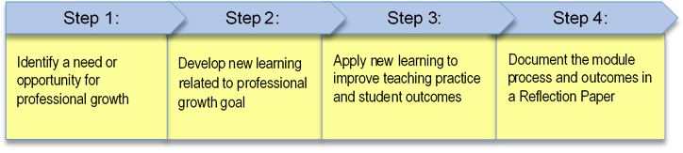
The TEAM Module Process
Notes:
Now that participants have a general overview of the mission and goals, the focus is now on the module process. Through each of the steps of the module process, teachers use a personal journals to reflect on and record specific examples/evidence of their new learning, the impact on their practice, and positive outcomes for students. At the culmination of the module process, teachers draw on these reflections and use examples/evidence to create a reflection paper that documents each of these four steps.
The 2016-17 TEAM Module Guidelines provide a detailed overview of each step. The TEAM Module Guidelines can be found in Appendix C of the TPM and are also available on the TEAM website. You may want copy it and distribute as a handout.

Slide 14



Module Five is Different
Modules 1-4 require a reflection paper to be submitted for review at the end of the 8-10 week guided professional learning experience.
Module 5 is a facilitated conversation using scenarios that prompt honest discussions about possible ethical dilemmas regarding:
Relationships with students
Professional ethics
Community and family
Bullying
Upon completion of the facilitated conversation, teachers complete an online questionnaire accessed through the TEAM online dashboard.
Notes:
Explain that this module is different than the other four:
The Code of Professional Responsibility for Educators is a set of principles which the education profession expects its members to honor and follow. These principles set forth, on behalf of the education profession and the public it serves, standards to guide conduct and the judicious appraisal of conduct in situations that have professional and ethical implications.
The Code adheres to the fundamental belief that the student is the foremost reason for the existence of the profession. The education profession is vested by the public with a trust and responsibility requiring the highest ideals of professionalism. Therefore, the educator accepts both the public trust and the responsibilities to practice the profession according to the highest possible degree of ethical conduct and standards. Such responsibilities include the commitment to the students, the profession, the community and the family.

Slide 15
The TEAM Module Process
Analyze teaching and learning and identify a module focus using the CCT Performance Profile
Create an Initial Summary using specific examples to describe what the teacher and students are doing in the focus area at the start of the module.
Write a Professional Growth Goal and Action Plan (PGAP) describing what the teacher wants to learn, how s/he will learn it, and how it should improve teaching practice and student performance.
Using the learning activities/resources identified in the PGAP, develop new learning that will be used to improve teaching practice.
Document specific examples of what the teacher did to develop new learning.
Record specific examples of what the teacher learned.
Implement new learning.
Record and analyze specific examples of how changes in teaching practice result in better outcomes for students.
Monitor impact of plan to determine readiness to draft reflection paper.
Reflect on and describe: what you learned and how you learned it; how you used new learning to improve teaching; the positive impact the improvements in teaching practice had on students.
Document the positive impact of the module by comparing the changes in teaching practice and outcomes for student to what was escribed in the Initial Summary.
Notes:
Each step is broken down here. You can use the Guidelines to review the steps of the process. The next several slides will provide more details on each step.

Slide 16
TEAM Module Process
Step 1
Plan for Professional Growth
Explore CCT Performance Profile
Select one indicator for professional growth and development
Record specific examples/evidence of practice
Create an Initial Summary describing current practice
Develop a Goal
Record meetings in Log (mentor records, mentee verifies)
Document work in Journal
Notes:
Briefly review the process of this step. You may want to have a copy of one CCT Performance Profile as a handout to share with participants. Or, if they have access to computers during the orientation, they can pull one up from the TEAM website.
Explain that the Journal is different from the meeting log. The journal provides teachers and mentors a place to record their own notes and reflections. It is a useful tool to record specific examples that can later be used in the reflection paper.
The next few slides explain how to read a profile.

Slide 17
CCT Performance Profile
Profiles available on ctteam.org
Read the Performance Profile going across from left to
right.
Note language changes as you move across the continuum
Domain 1: Teachers promote student engagement, independence and interdependence in learning by facilitating a positive learning community by:
CCT Indicators | Continuum of Effective Teaching Practice
1. Creating a class climate that is responsive to and respectful of the needs of students with diverse backgrounds, interests and performance levels | o Little indication that the students’ backgrounds, interests and skill levels are considered in selecting content and creating learning opportunities. | Considers students’ backgrounds, interests and skill levels in making connections to the content and creating learning opportunities. Treats students as individuals respecting their diverse needs and recognizes that the background of each student may differ dramatically within the classroom and school. | Designs learning opportunities which build upon students’ diverse backgrounds, interests and skill levels. Creates a classroom environment in which individual students are treated with respect regardless of differences in backgrounds, interests and skill levels. | Designs learning opportunities which capitalize on students’ diverse backgrounds and interests to enrich the learning community. Creates a classroom environment which supports students in becoming role models for treating others with respect and dignity.
Notes:
Use the next 4 slides to review the Performance Profile. It is especially important to point out that the stem of the Domain is a part of the indicator. The next slides are animated, you can click each one and it will point to the specific part of the profile.

Slide 18
CCT Performance Profile
Profiles available on ctteam.org
Read the Performance Profile going across from left to
right.
Note language changes as you move across the continuum
Domain 1: Teachers promote student engagement, independence, and interdependence in learning by facilitating a positive learning community by:
CCT Indicators | Continuum of Effective Teaching Practice
1. Creating a class climate that is responsive to and respectful of the needs of students with diverse backgrounds, interests and performance levels | o Little indication that the students’ backgrounds, interests and skill levels are considered in selecting content and creating learning opportunities. | Considers students’ backgrounds, interests and skill levels in making connections to the content and creating learning opportunities. Treats students as individuals respecting their diverse needs and recognizes that the background of each student may differ dramatically within the classroom and school. | Designs learning opportunities which build upon students’ diverse backgrounds, interests and skill levels. Creates a classroom environment in which individual students are treated with respect regardless of differences in backgrounds, interests and skill levels. | Designs learning opportunities which capitalize on students’ diverse backgrounds and interests to enrich the learning community. Creates a classroom environment which supports students in becoming role models for treating others with respect and dignity.
The indicator begins with the Domain stem statement
Notes:
The stem of the Domain is where you begin to read the indicator.

Slide 19
CCT Performance Profile
Profiles available on ctteam.org
Read the Performance Profile going across from left to
right.
Note language changes as you move across the continuum
and the includes indicator
Domain 1: Teachers promote student engagement, independence and interdependence in learning by facilitating a positive learning community by:
CCT Indicators | Continuum of Effective Teaching Practice
1. Creating a class climate that is responsive to and respectful of the needs of students with diverse backgrounds, interests and performance levels | o Little indication that the students’ backgrounds, interests and skill levels are considered in selecting content and creating learning opportunities. | Considers students’ backgrounds, interests and skill levels in making connections to the content and creating learning opportunities. Treats students as individuals respecting their diverse needs and recognizes that the background of each student may differ dramatically within the classroom and school. | Designs learning opportunities which build upon students’ diverse backgrounds, interests and skill levels. Creates a classroom environment in which individual students are treated with respect regardless of differences in backgrounds, interests and skill levels. | Designs learning opportunities which capitalize on students’ diverse backgrounds and interests to enrich the learning community. Creates a classroom environment which supports students in becoming role models for treating others with respect and dignity.
Notes:
The language in the indicator goes with the Domain stem statement

Slide 20
CCT Performance Profile
Profiles available on ctteam.org
Read the Performance Profile going across from left to
right.
Note language changes as you move across the continuum
Domain 1: Teachers promote student engagement, independence and interdependence in learning by facilitating a positive learning community by:
CCT Indicators | Continuum of Effective Teaching Practice
1. Creating a class climate that is responsive to and respectful of the needs of students with diverse backgrounds, interests and performance levels | o Little indication that the students’ backgrounds, interests and skill levels are considered in selecting content and creating learning opportunities. | Considers students’ backgrounds, interests and skill levels in making connections to the content and creating learning opportunities. Treats students as individuals respecting their diverse needs and recognizes that the background of each student may differ dramatically within the classroom and school. | Designs learning opportunities which build upon students’ diverse backgrounds, interests and skill levels. Creates a classroom environment in which individual students are treated with respect regardless of differences in backgrounds, interests and skill levels. | Designs learning opportunities which capitalize on students’ diverse backgrounds and interests to enrich the learning community. Creates a classroom environment which supports students in becoming role models for treating others with respect and dignity.
And the performance descriptors across the continuum
Notes:
The continuum of performance demonstrates the indicator as a teacher grows professionally in their skill.
At this point you may want to ask the BT to look across one indicator and place him or herself on the continuum. Emphasize that it is important to be honest with themselves and it is acceptable to admit they are still learning. No one is going to criticize them. In fact, even experienced teachers may find themselves on the left side of the continuum if they are teaching a new grade or new content. As professionals, we are always growing. Teachers may feel they are more on the left at the beginning of the year and move toward the right as the year progresses.
For each Domain, they should place themselves on the continuum. It is recommended that this activity be completed with their mentor. The mentor and the BT can engage in conversation about the reasons why the teacher places her/himself in a specific cell. BT’s may also consider feedback they have received from their classroom observations and their SLG/Os for the year. Together the BT and the mentor can discuss how to connect TEAM with the teacher’s evaluation.

Slide 21

Initial Summary
The Initial Summary should include specific examples/evidence of:
What the teacher is doing at the start of the module.
What the students are doing at the start of the module.
Notes:
Once the teacher has identified the focus area for the module and the new learning that her or she wants to develop, the BT will write an Initial Summary.
Explain: The Initial Summary sets the stage for the module. Teachers should be sure to include details about what is currently happening as these will be useful places to contrast how their practice has changed by the end of the module. Teachers who have unique situations may want to include some context for their classroom or their students’ specific learning needs. This may assist the reviewer in developing a clearer understanding of the teacher’s module work.
You may want to consider pulling up an example from the TEAM website module resources to illustrate what an initial summary looks like and what it includes.

Slide 22
TEAM Module Goal
The Professional Growth Goal should :
Connect to the selected CCT Performance Profile Indicator.
Describe what the teacher wants to learn.
Explain what impact the teacher anticipates the application of new learning will have on the students:
I want to learn .
As a result, students will _____________________________.
Be achievable in 8 –10 weeks.
how to improve transitions from whole class to group work
be more actively engaged in group work.
Notes:
Teachers are expected to set SLG/Os for their evaluation. Those goals are focused on student learning. A TEAM goal is different from a student learning goal because it focuses on what the teacher wants to learn and how that learning connects to student outcomes.
You may wish to share some of the examples from the TEAM Module resources on the TEAM website.

Slide 23
TEAM Module Process
Step 2
Develop a Professional Growth Action Plan (PGAP)
Identify specific activities to develop new learning.
Select resources to support professional growth activities.
Record the teacher learning activities and resources online.
Create and record a schedule for future meetings.
Communicate with the building administrator to share Professional Growth Action Plan.
Notes:
Step 2 focus on the PGAP- Review the process outlined here. Explain that the administrator will sign-off on the PGAP and may want to have a conversation with the teacher about the resources. The administrator may want to suggest other resources as well that support the teacher’s goal.
Teachers should not submit more than one PGAP at a time to the administrator. The module process is intended to be an 8-10 week process. Once the PGAP has been sent to the administrator, the BT can begin developing new learning. Administrators have been cautioned NOT to sign-off on multiple PGAPs at one time.

Slide 24
Professional Growth Action Plan (PGAP)
created online by entering of the following components: Goal, Activities/Resources, Anticipated Timeline, and Proposed Meeting Dates
Goal (Related to CCT, addresses a relevant and achievable teacher learning need and includes outcomes for students)
Teacher Learning Activities/Resources To be discussed with administrator
Activities | Resources Needed
Anticipated Timeline for Module Completion (Recommend 8-10 week period)
Proposed Meeting Dates
Notes:
Review the parts of the PGAP-
Spend some time talking about what resources and activities a BT might engage in, such as observing another colleague, attending a district workshop, sharing related TEAM data in a data team and getting feedback from colleagues, reading journal articles, etc.
If there are mentors present, have them share some of the activities and resources prior mentees have engaged in to develop new learning.

Slide 25
TEAM Module Process
Step 3
Develop, Implement, and Apply New Learning
Engage in activities to develop new learning.
Try out new learning in the classroom.
Document changes in practice and impact on students.
Compare examples/evidence to the Initial Summary.
Record reflections, evidence and decisions.
Notes:
Step 3- emphasize the importance of taking time to actually engage in the activities to build new learning. Explain to BTs that the module process is not about writing a college term paper, but it is about professional growth. If they have chosen resources that are not helpful, they should find something else. The goal is to grow professionally. The new learning should be helping them to improve their current practices. As they develop the new learning, they should be applying it to see how it works and document what they see regarding their own practice and student outcomes.
The better they document the outcomes in their journals, the easier the reflection paper will be to write. They will be able to draw from their journal to write their reflection papers.
In reviewing reflection papers, one reason that paper are most frequently unsuccessful is the lack of specific details. Carefully documenting the process as they proceed, will help teacher capture those specifics as they occur. It is often difficult to remember later what specifically happened.

Slide 26
TEAM Module Process
Step 4
Write Reflection Paper
Create a reflection paper (no more than 3000 words) that includes:
a description of what the teacher did to develop new learning;
an explanation of what the teacher learned from the learning activities and resources;
specific examples/evidence of how the teacher used new learning to improve teaching practice;
specific examples/evidence of how student performance/ learning improved as a result of changes in teaching practice; and
specific examples of positive outcomes for students.
Notes:
Explain that these are the specific requirements for a reflection paper. If the teacher includes all of this information and provides specific examples, their paper should be successful.

Slide 27
Module Submission
Teachers should submit each module when the mentor has signed-off.
The module process is expected to take between 8-10 weeks to complete.
Please Note: No more than one reflection paper should be submitted within a four week period.
Notes:
Teachers should not wait to submit modules. The intent of the program is to develop professionally through an 8-10 week process. As the teacher engages in the professional growth module, each step should be completed and submitted appropriately.

Slide 28
The TEAM Module Process
Notes:
After you have finished reviewing the full module process, teachers may be wondering- How will I (the bt) submit my paper?) Who do I send it to or email? This will lead you to the next set of slides about the workspace.

Slide 29


A Web-Based Program
Beginning teachers and mentors will have an online dashboard and workspace to access tools to assist in completing TEAM requirements:
CCT Performance Profiles (self-analysis)
Professional Growth Action Plan (PGAP)
Beginning Teacher and Mentor Meeting Log
Journal for Beginning Teacher
Journal for Mentor
Reflection Paper
Notes:
Explain the online tools that the teacher will use to complete TEAM.

Slide 30
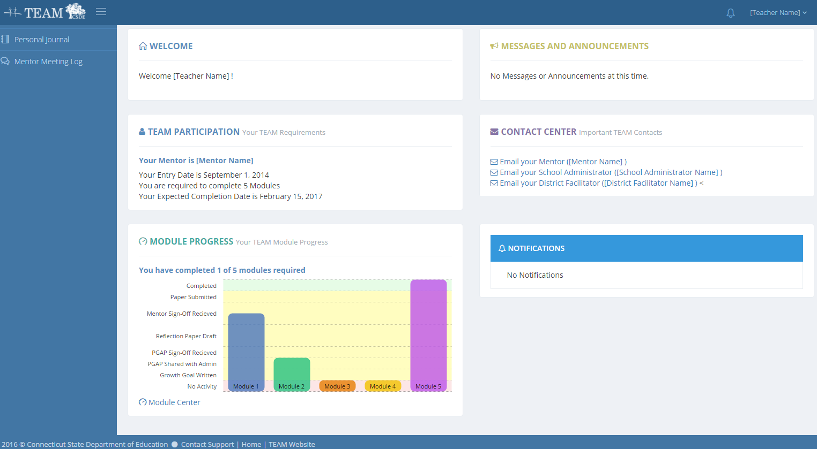
Beginning Teacher Dashboard

Slide 31
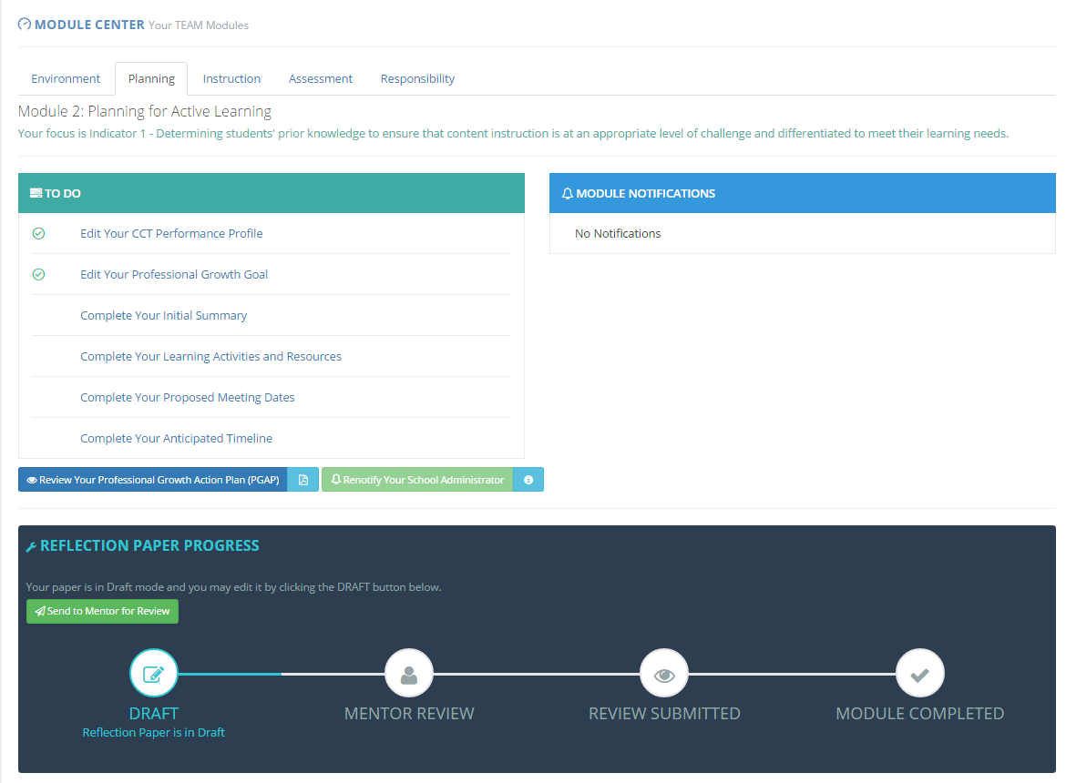
Beginning Teacher Module Center

Slide 32
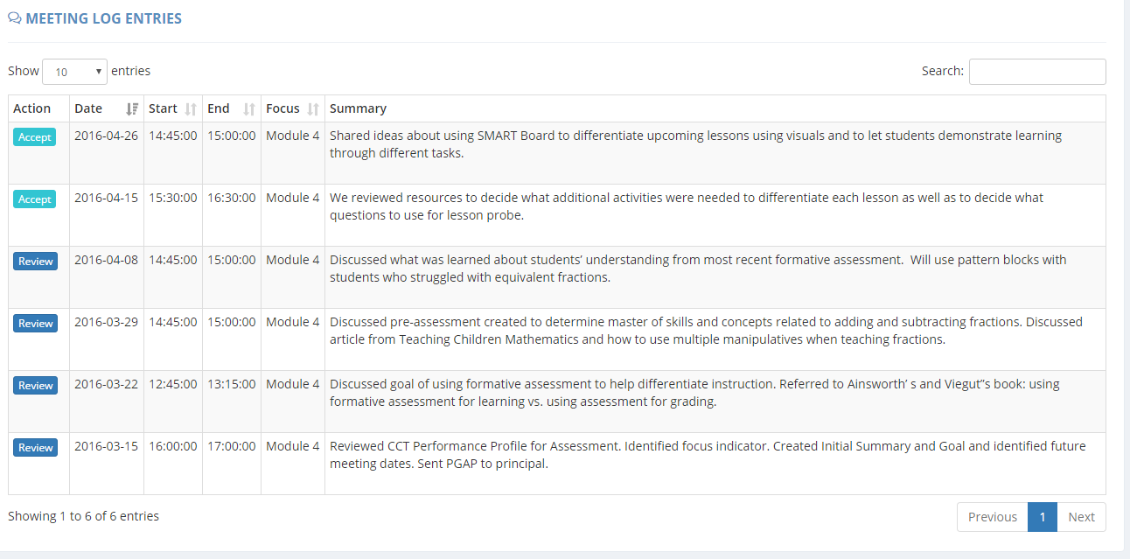
BT/Mentor Meeting Log
Note: Mentors are responsible for documenting meetings with their beginning teacher in the meeting log. Beginning teachers verify the accuracy of the meetings.

Slide 33
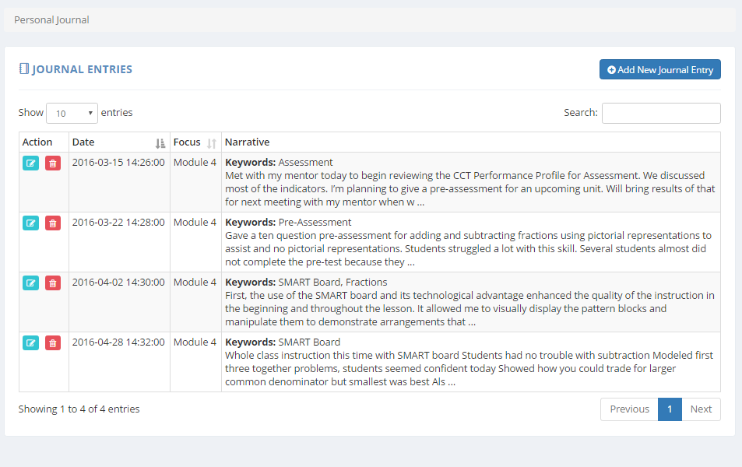
My Personal Journal

Slide 34
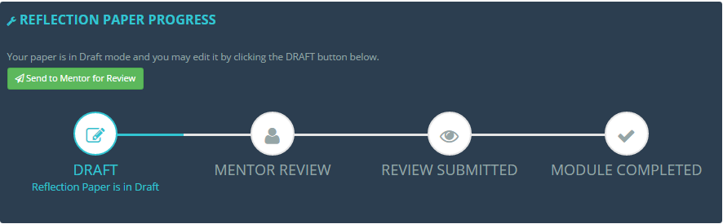
Reflection Paper Tracker

Slide 35
What Happens after I Complete my Reflection Paper?
Share the reflection paper with mentor for feedback and sign-off
Note: Mentor sign-off indicates that reflection paper is
consistent with on-going work during module.
Submit reflection paper electronically via
www.ctteam.org for review.
Teachers will be notified via ctteam whether their reflection paper has met the completion standard.
30
Notes:
Remind teachers that their mentor must review their papers twice before they can submit it.

Slide 36
Who will review my Reflection Papers?
Options for the Review of Reflection Papers
Districts have two options:
In-District Review
Trained reviewers from the district will review Reflection Papers.
Regional Review Committee
Trained reviewers representing all Connecticut districts will review the reflection paper.
Notes:
Explain the process that applies to your district.

Slide 37

Three Criteria for Success
Development of New Learning
Impact on Practice
Impact on Students
Notes:
The next few slides will review the criteria for review of a reflection paper.

Slide 38

Criteria I
Development of New Learning
Describes how the teacher developed new learning; and
Explains what the teacher learned from the selected activities and resources and/or thinking more deeply about her/his practice.
Notes:
Teachers should discuss how they developed their new learning. Did they observe a colleague, attend a data team meeting to review student data, participate in an online workshop, read a journal. Then they should explain what they learned and how it relates to their own teaching.
For example, a teacher might have participated in an online workshop about differentiated instruction and learned that students needs should determine the way the teacher designs instruction. As a result of that new learning, the teacher realizes that he has not been considering the varying needs of his students and has been designing instruction geared to the whole class. OR- you can provide examples of your own here.
The key is that the teacher needs to reflect on and think more deeply about his/her own practice in relationship to the new learning.

Slide 39

Criteria II
Impact on Practice
Explains, using specific examples/evidence how the teacher’s practice is different.
Notes:
Reviewers are looking to see how the teacher is doing something different as a result of the new learning. The BT should use their journal to document daily what is happening as a result of the new learning. This will help them to recall the specific examples when they write their reflection papers. The mentor and the BT can also focus their conversations around the daily reflections the BT records.
You may want to share an example of what this looks like.

Slide 40

Criteria III
Impact on Students
Explains, using specific examples/evidence, how student performance/learning has improved as a result of changes in the teacher’s practice.
Notes:
Reviewers are looking for positive outcomes on student performance. If a strategy that a teacher tried did not work, it is ok to include that in the reflection paper, but what is very important to include is what else did the teacher do to improve his/her practice that then resulted in improved student outcomes.

Slide 41
Reflection Paper Results
What happens if my Reflection Paper does not meet the criteria for successful completion?
C onsider doing t he fol lo wing
Read sample PD Papers found on www.ctteam.org under “Module Resources.”
Go back to the journal for additional data.
Engage in additional professional growth activities.
Collect additional data.
Continue to engage in discussions with mentor.
Submit revised Reflection Paper.
Notes:
If the BT is careful to address each of the criteria, she/he should be successful. However, if there is any criteria that is not successful, the BT can revise the paper.
Let the participants explore the site using their device and find the links for what is listed.

Slide 42

TEAM Completion
What happens when a I successfully complete all the required modules?
Your superintendent will verify that the you have completed the TEAM Program Requirements.
You are now eligible to apply for provisional certification.
Notes:
Once the TEAM modules have been successfully completed, the superintendent is notified and asked to verify the completion. That verification is sent to CSDE certification. Keep in mind that certification can take some time to be processed.
Please remind teachers that the superintendent verification may take some time. Once the superintendent verifies the completion, it also takes some time for the certification office to receive the results and process the application for certification. Tell teachers they even though they may receive notification that they have completed all of their modules, they are not done with TEAM until the superintendent verifies the completion and certification receives that notice.

Slide 43
TEAM Completion
What happens if I do not successfully complete all the required modules by the completion date?
Failure to successfully complete TEAM will result in the inability to advance your initial certificate to a provisional certificate.
You will not be able to renew your initial certificate and upon expiration, will no longer be able to teach in a CT public school.
*Please see the TEAM Program Manual for additional details.
Notes:
There have been relatively few individuals who have not successfully completed TEAM requirement by their deadline. Those individuals were not successful because they did not complete all for the TEAM program requirements within their allotted timeframe. Teachers who have extenuating circumstances that prevent them from completing TEAM within the full time allotted, can ask the DF to request an extension of time. However, if there are no documented extenuating circumstances, an extension will not be possible. Therefore, it is critical that teachers pay attention to their due dates.
See Section 3 of the TPM for a detailed explanation of the consequences.

Slide 44
Additional Tools/Resources
Sample Module Documents
Sample Reflection Papers
Reflection Paper Criteria and Feedback
Recommended Resources
Sample District Support Plans
Online Orientations
Monthly Electronic Communications
Notes:
You may want to display the ctteam.org website and show them where to find these resources.

Slide 45
TEAM TWO-YEAR BEGINNING TEACHER SUPPORT PLAN
Anticipated timeline of participation
Module(s) that will be completed during the 2016-17 school year
Module(s) that will be completed during the 2017-18 school year
Anticipated circumstances, such as a planned leave of absence (i.e., maternity leave, planned medical leave, etc.). that may require a third year
Notes:
Now that teachers have a general understanding of the TEAM program and the module process, you will want to spend a little time reviewing the Support Plan that they will need to submit to the DF and the TCC. The forms can be found in Appendix K of the TPM. You may want to provide the forms at this orientation, where they may begin to fill it in.
Purpose of the Support Plan: The support plan serves two purposes: first it informs the DF and the TCC of the BTs plan and possible need for a third year. Second, it helps the beginning teacher think about how to structure her or his own schedule in order to meet the requirements of TEAM. By planning how what they need to accomplish over the next two years, teachers are more likely to complete all of the TEAM requirements within their allotted time.
If you have teachers in Category II (two modules) explain that their support plan will be for one year only. Appendix B of the TPM lists all of the endorsements by category of participation.
Your district may have specific requirements for module completion and due dates. Remind BTs to use the district timeline to complete the plan. The plan also asks BTs if there are circumstance that may require them to use the third year. This is important to know. so that the mentor stipend can be distributed over the 3 years.

Slide 46
Connecting the Dots
TEAM
Educator Evaluation and Support
Team and
Evaluation
All Educators
Year-long Process
Evaluated through Analysis of:
Performance and Practice
Student Growth and Development
Whole-school Learning
Parent or Peer Feedback
Early Career Teachers
Mentor Support
8-10 Week Modules (incremental learning)
Success Determined by:
Teacher Learning
Impact on Practice
Outcomes for Students
High-Quality Professional Learning
High-Quality Professional Learning
Teacher Outcomes
Collaboration
High-quality Feedback
Standards-Based Professional Learning
Data-based Decisions
Student Outcomes
Data-based Decisions
Improved student learning
Local and regional boards of education shall coordinate the teacher education and mentoring program and the teacher evaluation and support program, provided they are kept separate.
Notes:
Explain to teachers that they will also be required to participate in the district’s evaluation and support plan. It might feel overwhelming when you think about these as separate requirements. However, if you can see how each can support the other, it makes it less overwhelming. This slide is intended to show the relationship between TEAM, evaluation and professional learning.
TEAM is a professional growth model. TEAM should not be a stand-alone task. The more teachers understand how their day to day work is connected, the more successful they will be. Teachers who approach TEAM as an act of compliance, fail to see how TEAM can help them grow professionally and how it supports student achievement and growth. Evaluation goals can be broken down into smaller goals for TEAM, classroom observation feedback from an administrator can inform the focus of professional learning, TEAM is about professional growth.
Ask: What connections does TEAM have to their work (TEVAL, PLC, Data Teams, Formative/Summative Process, etc.)? For example, how are the goals for TEAM similar and different to the goals written for TEVAL? This will help them to process the TEAM content that was presented.
Refer to TPM pp. 19.
The CSDE and RESC Alliance are providing new resources in the fall that can extend this discussion and help teachers and mentors to see the connections between TEAM, evaluation, and professional learning.

Slide 47

Connecting TEAM, Evaluation and Support and CCS
One teacher’s thinking…
Grade 8: History
Teacher Reflections: As I worked with my mentor I realized that if I wanted my students to think more deeply about content and be more independent learners, I needed to think differently about my practice.
As a result, I drafted possible goals for my TEAM Modules that supported my student learning goal that I developed as part of my teacher evaluation and support plan.
Notes:
This is an actual quote from a TEAM participant.

Slide 48
Connecting TEAM, Evaluation and Support and CCS
.
Evaluation- Student Learning Goal (Broad): Students will improve their competence in reading comprehension of informational texts using the concepts, themes and information presented in history.
Possible TEAM Module Goals
Module One: Classroom Environment | Module Two: Planning | Module Three: Instruction | Module Four: Assessment
I will learn and apply a variety of strategies to create a learning environment where students feel invited to share their views without fear of judgment. CCS Application: Students will logically and objectively prove their views with authentic evidence and supporting facts. | I will learn about and incorporate a variety of strategies into my planning to teach academic vocabulary in history. I anticipate that my students will be able to proficiently use historical terms in their writing. CCS Application: Students will use academic vocabulary to build students’ ability to access more complex texts for reading and writing. | I will learn about and apply research-based instructional strategies in my history lessons so that my students will be able to demonstrate a deeper understanding of the unit on slavery. CCS Application: Students will read carefully and grasp information, arguments, ideas and details based on text evidence. | I will learn about, create and communicate assessment criteria so that students can self-assess a practice performance task that combines literacy and history. CCS Application: Students will base their writing on evidence from texts using established criteria.
Notes:
The teachers SLG/Os can be broken down into smaller parts for TEAM goals. Review the ways in which these goals have been broken down. You might want to suggest that the BT share his or her SLG/O with the mentor at the start of the year, so they can think about ways that TEAM modules can support the SLG/O.

Slide 49

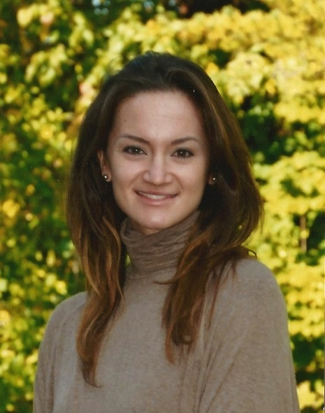

I believe that reaching out to my coworkers for assistance, researching strategies in publications, and keeping a willingness to learn from others will contribute to my professional growth and a long, successful career in teaching.
Reviewing the CCT Performance Profile was extremely helpful in examining and identifying my teaching practices prior to this process.
When I started this module, my classroom was almost 100 percent teacher driven. By the end of the module, there was a noticeable sharing of classroom responsibilities and a greater participation by the students in the learning process.
40
Notes:
These are actual comments from CT teachers who completed TEAM.

Slide 50
Contact Information
For questions, please contact: the TEAM Program Office at 860-713-6820 or email
For questions regarding technical issues, please contact Michael Mahoney at 860-455-1537
For questions regarding training, please contact your local RESC.
CSDE Contacts
Claudine Primack Program Manager | 860-713-6841 claudine.primack@ct.gov
Gady Weiner Data Manager | 860-713-6836 gady.weiner@ct.gov
41

Slide 51
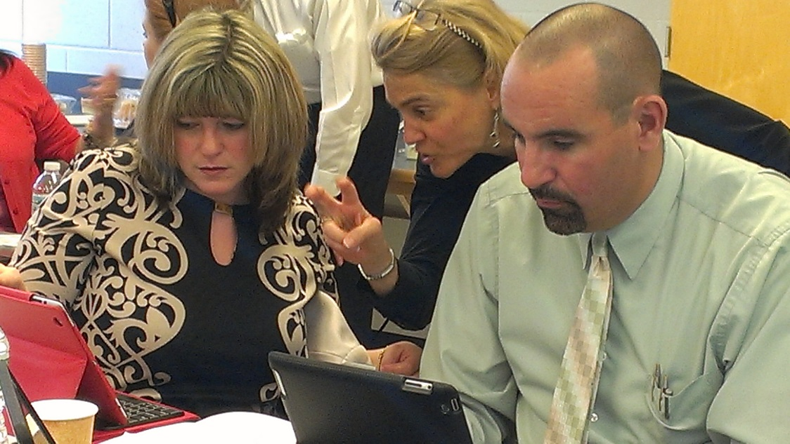
The most valuable resource that all teachers have is each other. Without collaboration, our growth is limited to our own perspectives.”
Robert John Meehan
rockmyclass.com

Slide 52
Thank you!
Notes:
Mary- Closing/Wrap-up
Check on what worked well/what could have been done differently with this meeting; if they generally support this format, what are some of the other presentations they may want to see?

