Slide 1
The Connecticut Alternate Assessment System: Monitoring and Assessment Supports Updates​
November 7, 2025
Notes:
Deirdre
Welcome to this presentation on Monitoring and Assessment Supports Updates.​

Slide 2
Presenters
Deirdre Ducharme, Performance Office​
​
Ashley DiGangi, Bureau of Special Education​
Notes:
Deirdre
Presenters
Today’s presenters include Deirdre Ducharme from the Performance Office and Ashley DiGangi from the Bureau of Special Education.

Slide 3
Overview of Today’s Presentation
Inclusive Education
Monitoring the Participation on Alternate Assessments
Review of Alternate Assessment System: The Design, Purpose, and Eligibility Criteria
Additional Alternate Eligibility Considerations
Resources
Notes:
Deirdre
Overview of Today’s Presentation
In this presentation, we are going to review federal and state legislation that supports inclusive education, providing a free and appropriate education to students with disabilities, and those that support annual testing for students registered in the Connecticut Public School System.
We will also review the state and local monitoring of student participation on alternate assessments. We will show you the different data systems available to support this work.
We will then walk you through the review of eligibility criteria on alternate assessments in addition to exploring the design and purpose of alternate assessments.
Finally, we will explore best practices for teachers and school administrators supporting students with the most significant cognitive needs. We will offer suggestions for supporting students who don’t qualify for alternates.

Slide 4
Inclusive Education
Notes:
Deirdre
Inclusive Education

Slide 5
Promoting Inclusive Education​
Two Federal laws that address the education for children with disabilities are the Elementary and Secondary Education Act of 1965 (ESEA) and the Individuals with Disabilities Education Act (IDEA), signed into law in 1965 and 1975, respectively. ​
Notes:
Deirdre
Promoting Inclusive Education​
Welcome to today’s session on Monitoring and Assessment Supports Updates.
We will explore this presentation through the lens of promoting inclusive education. As educators, our ultimate goal is to foster a safe, supportive, and nurturing learning environment where every student has the opportunity to learn, grow, and reach their full potential.
The work you and your school teams do each day is essential to advancing inclusive education. Assessments play a key role in this effort by measuring learning outcomes aligned with grade-level standards. The Performance Office is here to support you by ensuring you have the tools and resources needed to provide all students with access to high-quality learning experiences.
EdSight and the Centralized Reporting System offer valuable data, including results from statewide assessments and optional interim assessments. These tools can help inform instruction and support the individualized needs of every student in your classroom.

Slide 6
Part B of the Individuals with Disabilities Education Act (IDEA)​
Regulations for Part B of the IDEA require states to make available to eligible students with significant cognitive disabilities an alternate assessment designed to measure their knowledge and skills (34 CFR §§ 200.1(d) and 300.160 (c)).​
Notes:
Deirdre
Part B of the Individuals with Disabilities Education Act (IDEA)​
We will take a moment to review the federal legislation that guides our work at both the state and local levels.​
​
Part B of the Individuals with Disabilities of Education Act (IDEA) requires states to make available an alternate assessment aligned with alternate academic achievement standards (AA-AAAS) for eligible students with the most significant cognitive disabilities. Moreover, IDEA requires that if a Planning and Placement Team determines that a student must take an alternate assessment, the team must include a statement in the student’s IEP of why the student cannot participate in the regular assessment; and why the alternate assessment selected is appropriate for the student (34 CFR § 300.320(a)(6)(ii)).​

Slide 7
Participation - Connecticut General Statutes 10-14n ​​Act (IDEA)​
(b) (1) For the school year commencing July 1, 2015, and each school year thereafter, each student enrolled in grades three to eight, inclusive, and grade eleven in any public school shall, annually, take a mastery examination in reading, writing and mathematics during the regular school day.​
​(3) For the school year commencing July 1, 2018, and each school year thereafter, each student enrolled in grades five, eight, and eleven in any public school shall annually take a state-wide mastery examination in science during the regular school day.​
Notes:
Deirdre
Participation - Connecticut General Statutes 10-14n ​​Act (IDEA)​

Slide 8
General Principles of Inclusive Education​
Every student is an integral part of the general education community.​
Students thrive and succeed when they are valued and actively engaged in their classroom and school communities.​
Use high-quality, evidence-based Multi-Tiered System of Supports (MTSS) that are developmentally appropriate, are culturally and linguistically responsive, and foster students’ acquisition and use of knowledge and skills; use of appropriate behaviors to meet their needs; positive social emotional skills, including friendships with peers; and sense of belonging.​
Notes:
Ashley
General Principles of Inclusive Education​
Here are just a few ways to ensure that we are promoting inclusive education in our classrooms and learning communities:​
​
Each and every student is valued and fully supported​
All students are actively engaged and participate ​
All students are supported to succeed in making academic progress (including those students who need the greatest extensive supports)​
All students are supported to build friendships and experience belonging not only in the classroom but in other aspects of their school program and community​
​
In additional to these assurances, IDEA and ESEA have the same goal of improving academic achievement through high expectations and high quality programs aligned to state standards and resources for being a part of a well round education.​
​
TIES Belonging Resources | Creating communities of belonging for students with significant cognitive disabilities | Institute on Community Integration Publications​
​

Slide 9

General Principles of Inclusive Educational Practices​
Integrate evidence-based Universal Design for Learning (UDL), Multi-Tiered System of Supports (MTSS), and Positive Behavioral Interventions and Supports. ​
Implement educator training, preparation, and professional development for all personnel working with students​.
Provide systematic supports/technical assistance to promote inclusive educational practices​.
Recognize families as critical collaborative partners​.
Notes:
Ashley
General Principles of Inclusive Educational Practices​
Use high-quality, evidence-based Multi-Tiered System of Supports (MTSS) that are developmentally appropriate, culturally and linguistically responsive​
foster students’—acquisition and use of knowledge and skills; use of appropriate behaviors to meet their needs; positive social emotional skills, including friendships with peers; and sense of belonging.​
Recognize families as collaborative partners, experts, and engaged decision-makers in their students’ lives and value and treat students with disabilities and their families with respect​.
The purpose of this document is to describe how school leadership standards align with the core tenets of MTSS, providing context for the value and relevance of the framework.

Slide 10

The Individualized Education Program (IEP)
The IEP is not the student’s sole educational program, nor is it a curriculum. For each student eligible under IDEA, their educational program consists of:
  The general education curriculum
  The school’s routines & activities
  The Individualized Education Program
The IEP should honor the student and family voice and intentionally align supports to the general education setting, curriculum, routines, activities and social opportunities throughout the school day.
Notes:
Ashley
The Individualized Education Program (IEP)
Comprehensive inclusive education should be grounded in each of these key principles.
Will the student experience belonging as a member in their school and general education classroom(s)?
Will the student be actively participating at school across the school day?
Will the student be learning the grade-level general education curriculum?
The answer to each of these questions needs to be yes.
Comprehensive inclusive education should be grounded in each of these key principles:
The IEP is not the student’s sole educational program, nor is it a curriculum. For each student eligible under IDEA, their educational program consists of :
The general education curriculum
The school’s routines & activities
The Individualized Education Program
A strong and well-designed IEP allows any educator or specialist to have a detailed understanding of the student’s identified disability, barriers, and measurable goals to support instruction and learning and facilitate those important social and communicative interactions that promote the whole child.

Slide 11
IEP State Assessment Section
This section of the IEP requires a clear individualized justification for each standard assessment the student is taking, and the rationale for why the selected alternate assessment is appropriate.
Why the student CAN'T participate – references the disability related needs (cognitive functioning, instructional level, access needs) demonstrate the level that the student meets state eligibility criteria.
Why the Alternative Assessment is appropriate – show that the CTAA aligns with the students` instructional goals and mode of access. Align with the Present Levels of Performance (PLOP).
Notes:
Ashley
The IEP must list any designated supports or accommodations the student needs for each content area (ELA, Math, Science). These supports must already be used during classroom instruction and testing.

Slide 12

Start with the End in Mind
The Connecticut Alternate Assessment System is designed for a very small number of children with the most significant cognitive disabilities. When planning for the alternate assessment, and the subsequent programming that aligns to that profile, we need to be cognizant of possible implications to the student's future. We should always strive for the highest degree of competencies and opportunities for all students.
Notes:
Ashley
Start with the End in Mind
When planning for any programming for a student, we should always keep the end goal in mind for that unique individual along with the short term one-year goals that we plan within the IEP. Yet, we also want to look ahead at the needs of the students during critical transitional years, such as pre-school to elementary, elementary to middle school, middle school to secondary education, and finally post secondary and beyond. We need to ensure we work with the entire team, including the parents/guardian and student, by keeping the educational benefit in mind while maintaining high expectations and advocacy for our students. For some this may mean providing resources and services along the educational continuum to prepare for high school graduation, job planning or placement, or further education and training. For others, this may mean planning for transitional services and programming beyond age 22. When planning for the alternate assessment, and the subsequent programming that aligns to that profile, we need to be cognizant of possible implications to the student's future.

Slide 13
Five Things to Consider When Making Decisions About Student Participation on State Alternate Assessments
1. Disability
Only children with the most significant cognitive disabilities can take the alternate assessment.
2. Yearly
4. Agreement
Each PPT member is aware of implications and should agree that the student meets all of the eligibility criteria for taking the alternate assessment.
5. Instruction
All children are taught academic content for their enrolled grade level. Students who take the alternate assessment may need content presented in reduced depth, breadth, or complexity.
3. Guidelines
Every year the PPT should make the determination of which assessment is most appropriate based on the students dynamic learning profile.
PPT members use the Connecticut Alternate Assessment System Eligibility Form to determine if there is current evidence to support the student taking the alternate assessment.
Notes:
Ashley
Five Things to Consider When Making Decisions About Student Participation on State Alternate Assessments
There are considerations to make when determining if a student should participate on an alternate assessment.
First, we need to consider the student’s disability and documented need. Only children with the most significant cognitive disabilities can take an alternate assessment.
Second, the Planning and Placement Team must determine yearly at the annual which assessment is most appropriate for that student (standard or alternate) based on the student’s learning profile- as evidenced throughout the IEP.
Third, if the PPT is considering an alternate assessment, they must complete the Connecticut Alternate Assessment Eligibility Form, which is embedded within the IEP, to determine if there are current cognitive and functional adaptive assessment scores and other evidence to support participation.
Fourth, each member of the PPT, including the parent/guardian, must agree that the student meets eligibility criteria for taking the alternate assessment, and understand the short and long-term implications.
Fifth, all educators and support specialists should collaborate to ensure that all students are taught academic content aligned to their grade, being mindful that students with the most significant cognitive disabilities may need content presented in reduced depth, breadth, and complexity. These students may need access to assistive materials, software, technology and communication or language plans to ensure access. Again, we need to think and plan with the end in mind.

Slide 14
Monitoring the Participation on Alternate Assessments
Notes:
Deirdre
Monitoring the Participation on Alternate Assessments
To orient you with the alternate assessment system, we will take a quick look at prevalence data from the 2024-25 school year.

Slide 15
ESSA Requirements
ESSA placed a 1.0% cap on the state participation rate for each subject, based on the total number of all students in the state assessed in the subject (34 CFR 200.6(c)(2)). This is to ensure that students with the most significant cognitive disabilities have access to the grade level, general education standards.
The CSDE is here to provide guidance and support to districts in making appropriate alternate eligibility determinations.
Notes:
Deirdre
ESSA Requirements
The Every Student Succeeds Act (ESSA) ensures that educators, families, students, and communities receive essential information through annual statewide assessments. These assessments measure student progress toward high academic standards.
Under the Elementary and Secondary Education Act (ESEA), states receive federal education funding to support local education agencies, with the expectation that they meet specific requirements—including the participation of all public school students in state summative assessments.
One such requirement under ESSA is the 1.0% cap at the state level on the percentage of students who may participate in the Connecticut Alternate Assessment System in any tested subject area. This percentage is calculated by dividing the number of students taking the Connecticut Alternate Assessments in a subject (math, ELA, or science) by the total number of students tested in that subject statewide.
While it is important for Connecticut to monitor and comply with guidance from the U.S. Department of Education, the Connecticut State Department of Education (CSDE) remains committed to supporting districts. This includes providing guidance on critical areas such as making appropriate eligibility determinations for alternate assessments.
Please view this presentation as an opportunity for the CSDE to offer clarification and support to help guide your important work.

Slide 16
Connecticut’s Approach to Supporting Districts
PPT Screening for Eligibility using the Connecticut Alternate Assessment System Eligibility Form
Annual and Required Training for Teachers Administering the Alternate Assessment System Training
Professional Development Trainings for District Administrators
Planning and Placement Team Participation Guidance Resources (FAQs, Flowcharts, Accessibility Considerations, CSDE Assessment Guidelines)
Notes:
Deirdre
Connecticut’s Approach to Supporting Districts
The Connecticut State Department of Education (CSDE) continually reviews the Planning and Placement Team (PPT) screening process for determining eligibility for the Connecticut Alternate Assessment System. The Eligibility Form, embedded within CT-SEDS, has remained a consistent tool that requires teams to review cognitive and adaptive behavior assessment data within the triennial evaluation period to ensure students meet the established criteria. Eligibility must be reviewed annually in CT-SEDS, and teams must plan for participation in state assessments for all grades covered by the duration of the student’s IEP.
Additionally, educators who administer alternate assessments are required to complete annual training. This year, training will be available in early November and will be offered in a self-paced format. Each session focuses on a specific component of the system, including eligibility determination, test design for the Connecticut Alternate Assessment (CTAA) in Math and ELA, the Connecticut Alternate Science (CTAS) Assessment, and strategies for supporting students with complex communication and behavioral needs.
A variety of recorded training sessions are available on the CSDE portal, covering topics related to alternate assessments, accessibility features, and accommodations.
You’ll also find a wide range of resources on the Alternate Assessment System webpages to support teams in understanding eligibility requirements, assessment procedures, and frequently asked questions. Links to many of these resources are included at the end of this presentation.

Slide 17
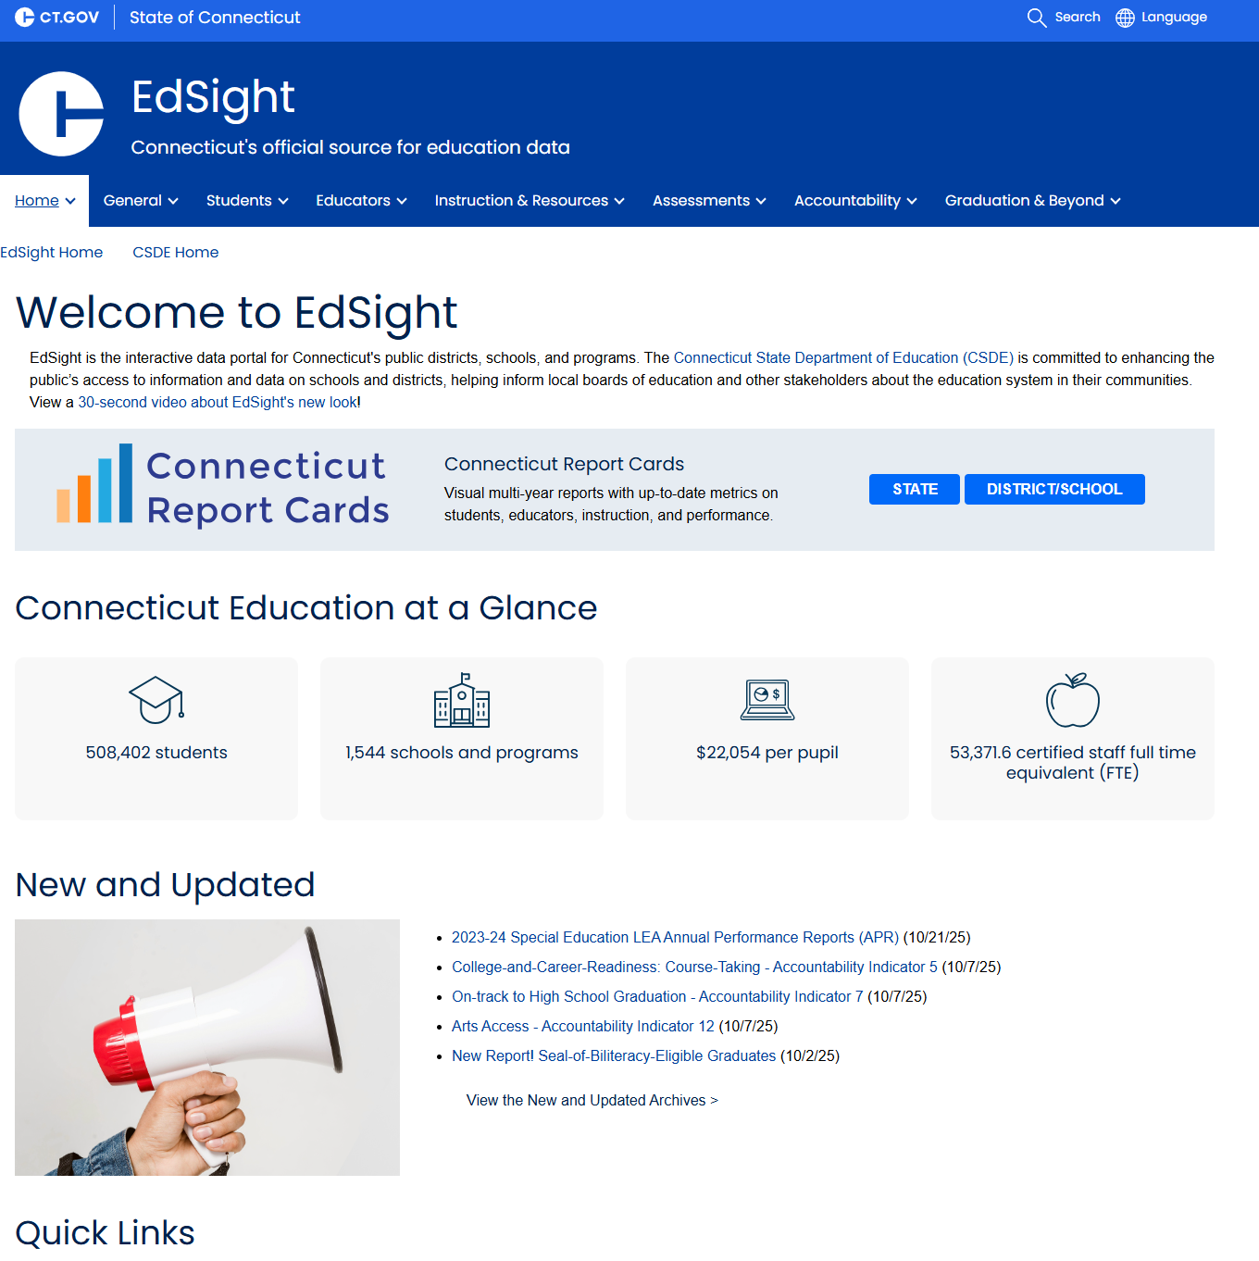
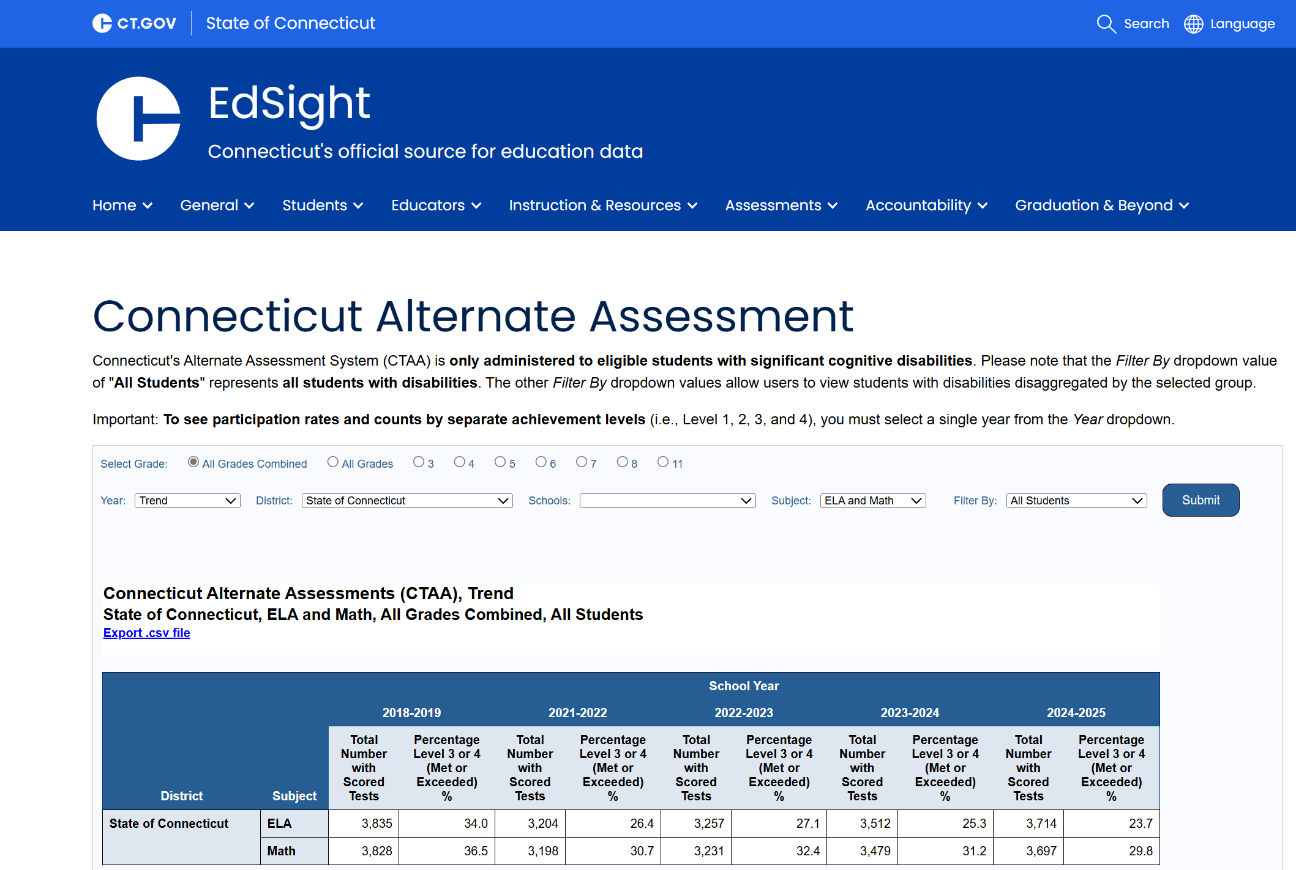
Public EdSight
Notes:
Deirdre
Public EdSight
Use EdSight to track participation and trend performance data for all your students.
Non-confidential assessment results are publicly reported through EdSight. This is an interactive web site that integrates important school and district information collected by the Connecticut State Department of Education (CSDE) that serves as a single source for all data-driven analysis and reporting. The CTAA results, along with the results for the Connecticut Alternate Science Assessment (CTAS), can be accessed via these paths:
• On the EdSight home page, select the Assessment tab from the top header, then choose Alternate Assessment from the drop-down menu.
The Alternate Assessment main page includes an interactive report for viewing ELA and Math data. Users can filter by grade, year, district/school, subject, and student demographics.
Users can also view year specific CTAS data by school and district via an Excel file. Due to the small number of students taking these assessments, small groups are suppressed. Individual data is available on the Centralized Reporting System, which we will view in a few moments.

Slide 18
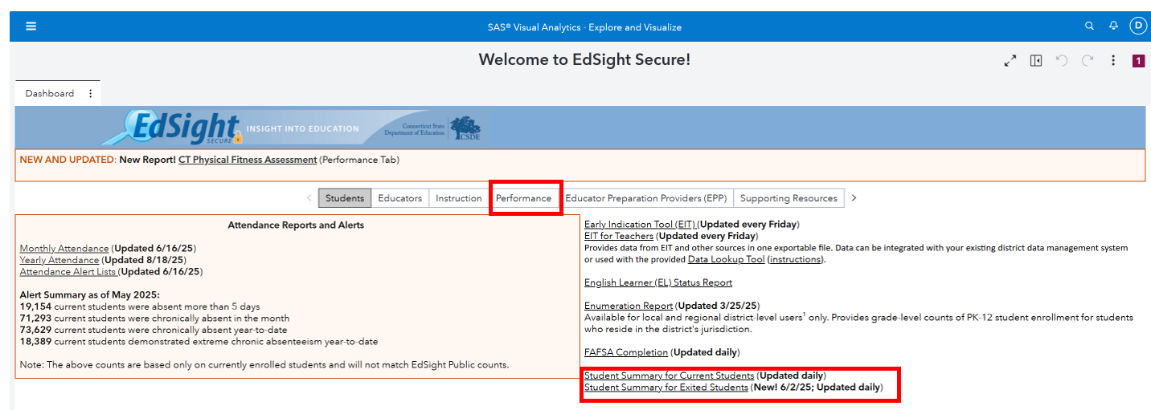
EdSight Secure
Notes:
Deirdre
EdSight Secure
https://secure-edsight.ct.gov/
Available to authorized district-level users
When viewing the CTAA on EdSight, the reports that can be utilized to review ELA and math results are interactive.
Data available for individual LEA Districts and their associated schools; not available at the ASEP level.

Slide 19
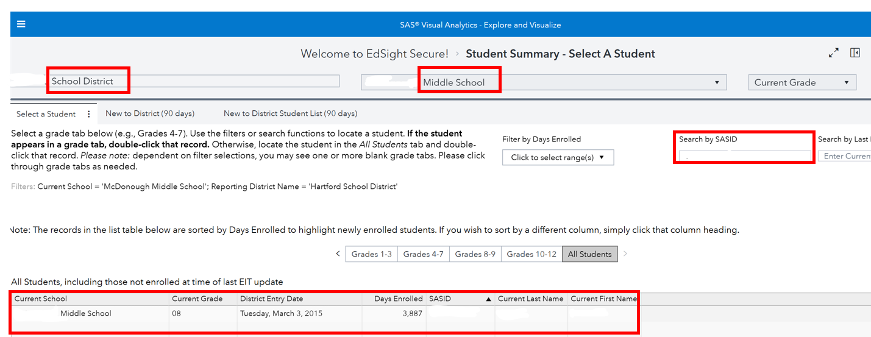
EdSight Secure: Searching by Group or Individual
Notes:
Deirdre
EdSight Secure: Searching by Group or Individual
On this page of EdSight Secure, high-level district users can search for schools within their district. Authorized users can also search by SASID, as shown on this slide. When searching by SASID, the student’s current school of enrollment will appear at the bottom of the dashboard, as shown on this slide.

Slide 20
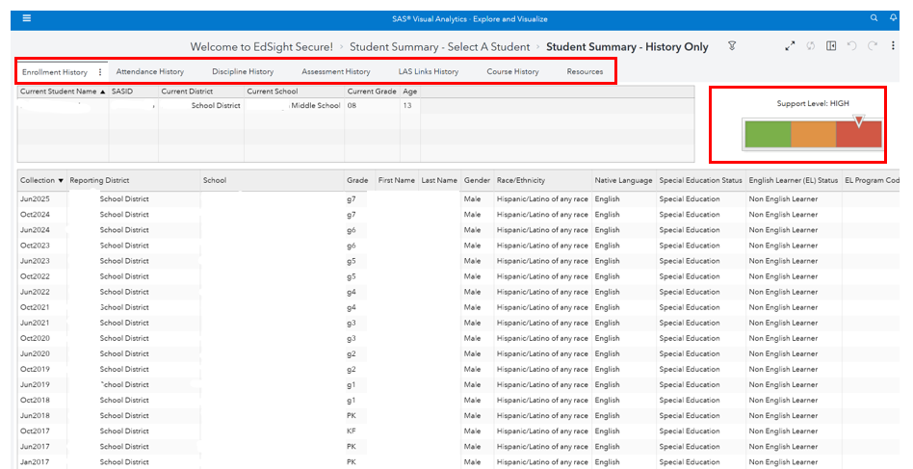
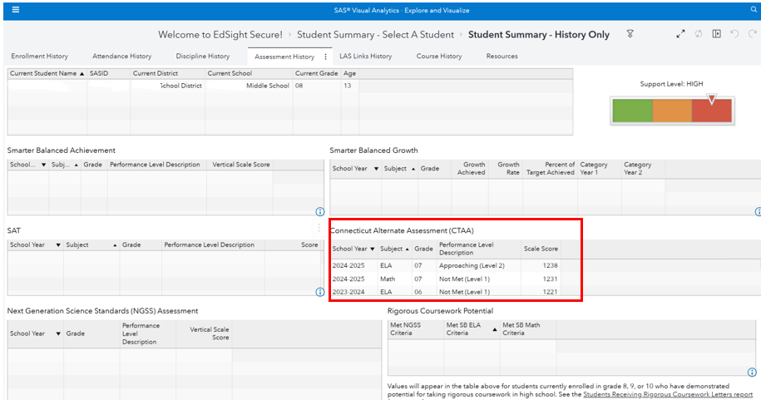
EdSight Secure: Student Search
Notes:
Deirdre
EdSight Secure: Student Search
When looking at this individual dashboard, you will see that the Early Indicator, shown on the upper right of the dashboard, has three categories: green (or on target), orange (needs support), and red (high need). This student requires a high level of need. Select from any of the tabs on the top header to view specific data associated with Enrollment History, Attendance History, Discipline History, Assessment History, LAS Links History, Course History and Resources.
To view the student’s historical assessment data, choose Assessment History from the top header. Data results span from when the student first took the state assessment as a third grader in 2020-21 to the most recent data results from the 2024-25 school year: This information is useful to teachers and educators as one indicator for tracking growth and determining student performance across years.

Slide 21
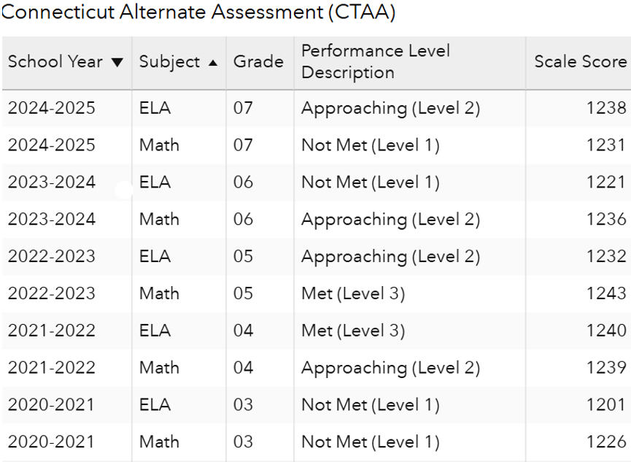
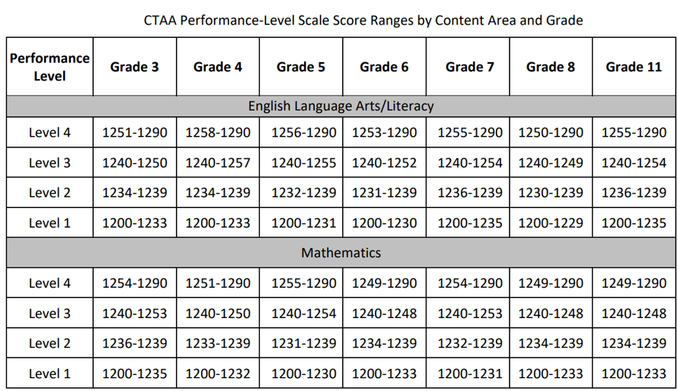
EdSight Secure: Student Longitudinal Performance
Notes:
Deirdre
EdSight Secure: Student Longitudinal Performance
This is an example of the longitudinal performance data available for this student on the CTAA.
Refer to the CTAA Performance-Level Scale Score Ranges by Content Area and Grade to map the range the student’s scale score falls within.
CTAA-Guide-for-Score-Report-Interpretation.pdf
The CTAA tests student performance in English language arts (ELA) and mathematics based on alternate achievement standards. The student’s performance on the CTAA is reported by a scale score for each content area, as well as by performance level. Scale scores are reported for each student on the Individual Student Report (ISR).
The CTAA scores may be used in conjunction with the Individualized Education Program (IEP) progress reports and with report cards to evaluate the student’s performance on academic content and skills. The scores can inform planning for instruction that is aligned with the Connecticut Core Standards. The Connecticut Core Standards can be used to assist the teacher in interpreting the student’s scores in relation to the standards and in planning standards-based instruction. Student CTAA scores should not be used in isolation when making program or placement decisions about students.
CTAS Performance-Level Scale Scores are available on the portal: Guide for CTAS Score Report Interpretation

Slide 22
A Historical Trajectory of Student Participation on Alternate Assessments
Assessment Category | 2024-25 | 2023-24 | 2022-23 | 2021-22 | 2020-21 | 2018-19 | 2017-18 | 2016-17
# All Students -ELA | 250,735 | 250,738 | 254,594 | 252,817 | 249,127 | 272,371 | 275,497 | 269,875
# Alternate -ELA | 3,407 | 3,275 | 3,047 | 2,850 | 2,507 | 3,838 | 4,173 | 4,318
% Alternate -ELA | 1.36% | 1.31% | 1.21% | 1.13% | 1.01% | 1.41% | 1.51% | 1.60%
# All Students -Math | 250,069 | 249,913 | 253,677 | 251,832 | 249,604 | 271,769 | 274,975 | 285,400
# Alternate - Math | 3,386 | 3,235 | 3,011 | 2,818 | 2,498 | 3,828 | 4,140 | 4,281
% Alternate –Math | 1.35% | 1.29% | 1.20% | 1.12% | 1.00% | 1.41% | 1.51% | 1.50%
# All Students – Science | 108,574 | 109,150 | 109,933 | 109,121 | 102,146 | 117,094 | -- | 121,123
# Alternate - Science | 1,332 | 1,280 | 1,228 | 1,131 | 984 | 1,647 | -- | 1,859
% Alternate - Science | 1.23% | 1.17% | 1.13% | 1.04% | 0.96% | 1.41% | -- | 1.53%
Notes:
Deirdre
A Historical Trajectory of Student Participation on Alternate Assessments
To orient you with the alternate assessment system, we will take a quick look at prevalence data from the 2024-25 school year. This report was generated in EdSight and shows a small increase in student participation on the 2024-25 alternate assessments.
The 2024-25 data shows an increase in student participation on alternates closer to the 2018-19 rates…
Participation rates from 2016-17 are much higher, but at that point in time, teachers used the Learner Characteristics Inventory to determine eligibility for participation on alternate assessments.

Slide 23
2024-25 Student Participation by Disability Category
Student Group | All Grades | Grade 3 | Grade 4 | Grade 5 | Grade 6 | Grade 7 | Grade 8 | Grade 11
ADD / ADHD | 0.80 | 1.15 | 1.09 | 1.10 | * | 1.27 | 0.00 | 0.00
Autism | 47.12 | 59.93 | 58.51 | 48.44 | 43.03 | 42.13 | 37.82 | 36.10
Deaf-Blindness | * | * | 0.00 | * | 0.00 | 0.00 | 0.00 | 0.00
Emotional Disability | 0.29 | * | * | * | * | * | 0.00 | *
Hearing Impairments | 0.19 | 0.00 | * | 0.00 | * | 0.00 | * | *
Intellectually Disabled | 24.23 | 12.15 | 14.67 | 24.59 | 24.90 | 31.46 | 31.88 | 32.99
Learning Disabilities | 1.63 | 2.79 | 1.09 | 1.65 | 2.59 | 1.08 | 0.79 | 1.24
Multiple disabilities | 19.48 | 14.61 | 17.21 | 18.35 | 21.12 | 18.99 | 22.57 | 25.10
Other Health Impairments | 3.42 | 4.43 | 3.44 | 3.30 | 3.19 | 1.81 | 4.55 | 3.11
Specific Learning Disabilities/Dyslexia | * | 0.00 | 0.00 | 0.00 | 0.00 | 0.00 | 0.00 | *
Speech / Language Impairments | 0.99 | 1.81 | 1.99 | 1.28 | * | * | * | *
TBI | 0.21 | * | 0.00 | * | 0.00 | * | * | *
Visual Impairments | * | 0.00 | 0.00 | 0.00 | * | 0.00 | 0.00 | 0.00
Notes:
Deirdre
2024-25 Student Participation by Disability Category
Here is the percent of students by disability category taking the Connecticut Alternate Assessments. Highlighted in yellow are those categories that are questionable for eligibility since they do not fall within the expected criteria to meet criteria for the most significant cognitive disability. Districts should conduct their own analysis of participation data by disability category to identify any questionable determinations or need to review an individual IEP for more information.
Students identified as ADD/ADHD, Emotional Disability, Learning Disability, and Speech/Language Impairments should participate on standard assessments with the provision of accommodations and assistive technology, if appropriate.

Slide 24
2024-25 Participation by Demographic Categories
Student Group | All Grades | Grade 3 | Grade 4 | Grade 5 | Grade 6 | Grade 7 | Grade 8 | Grade 11
EL/ML | 14.83 | 19.21 | 16.85 | 14.31 | 16.73 | 12.66 | 12.67 | 10.37
Not EL/ML | 85.17 | 80.79 | 83.15 | 85.69 | 83.27 | 87.34 | 87.33 | 89.63
FRL | 61.74 | 63.38 | 67.57 | 63.12 | 60.36 | 62.57 | 59.80 | 53.94
Not FRL | 38.26 | 36.62 | 32.43 | 36.88 | 39.64 | 37.43 | 40.20 | 46.06
American Indian or Alaska Native | 0.21 | * | * | 0.00 | * | * | 0.00 | *
Asian | 6.48 | 6.24 | 7.25 | 7.34 | 5.58 | 7.59 | 6.53 | 4.56
Black or African American | 20.12 | 19.54 | 20.47 | 18.53 | 18.73 | 20.61 | 21.39 | 21.78
Hispanic/Latino of any race | 38.05 | 40.56 | 41.30 | 37.25 | 39.84 | 36.35 | 36.24 | 34.02
Native Hawaiian or Other Pacific Islander | * | * | 0.00 | 0.00 | 0.00 | 0.00 | 0.00 | 0.00
Two or More Races | 4.70 | 4.60 | 4.89 | 4.95 | 4.78 | 5.24 | 4.55 | 3.73
White | 30.42 | 28.57 | 25.91 | 31.93 | 30.88 | 30.02 | 31.29 | 35.27
Notes:
Deirdre
2024-25 Participation by Demographic Categories
Here is the 2024-25 statewide participation calculations on alternate assessments by student demographics. What stands out? How might this demographic data look for your district?

Slide 25
2024-25 Performance by Subject, Grade, and Performance Category
Subject | Total Number of Students | Total Number Tested | CTAA Participation Rate | Total Number with Scored Tests | Level 1 Not Met Count | Level 1 Not Met % | Level 2 Approaching Count | Level 2 Approaching % | Level 3 Met Count | Level 3 Met % | Level 4 Exceeded Count | Level 4 Exceeded % | Level 3 & 4 Met or Exceeded Count | Level 3 & 4 Met or Exceeded % | Average VSS
Gr 3. ELA | 667 | 608 | 91.2 | 607 | 340 | 56.0 | 95 | 15.7 | 120 | 19.8 | 52 | 8.6 | 172 | 28.3 | 1232
Gr 3. Math | 667 | 605 | 90.7 | 603 | 262 | 43.4 | 154 | 25.5 | 159 | 26.4 | 28 | 4.6 | 187 | 31.0 | 1234
Gr. 4 ELA | 604 | 552 | 91.4 | 550 | 346 | 62.9 | 77 | 14.0 | 105 | 19.1 | 22 | 4.0 | 127 | 23.1 | 1230
Gr. 4 Math | 604 | 550 | 91.1 | 549 | 308 | 56.1 | 109 | 19.9 | 101 | 18.4 | 31 | 5.6 | 132 | 24.0 | 1228
Gr. 5 ELA | 596 | 545 | 91.4 | 544 | 249 | 45.8 | 170 | 31.3 | 103 | 18.9 | 22 | 4.0 | 125 | 23.0 | 1231
Gr. 5 Math | 596 | 543 | 91.1 | 543 | 147 | 27.1 | 204 | 37.6 | 158 | 29.1 | 34 | 6.3 | 192 | 35.4 | 1234
Gr. 6 ELA | 559 | 502 | 89.8 | 498 | 266 | 53.4 | 157 | 31.5 | 52 | 10.4 | 23 | 4.6 | 75 | 15.1 | 1229
Gr. 6 Math | 559 | 497 | 88.9 | 494 | 252 | 51.0 | 132 | 26.7 | 75 | 15.2 | 35 | 7.1 | 110 | 22.3 | 1232
Gr. 7 ELA | 610 | 550 | 90.2 | 550 | 329 | 59.8 | 76 | 13.8 | 105 | 19.1 | 40 | 7.3 | 145 | 26.4 | 1234
Gr. 7 Math | 610 | 550 | 90.2 | 549 | 189 | 34.4 | 232 | 42.3 | 101 | 18.4 | 27 | 4.9 | 128 | 23.3 | 1234
Gr. 8 ELA | 560 | 501 | 89.5 | 500 | 254 | 50.8 | 149 | 29.8 | 57 | 11.4 | 40 | 8.0 | 97 | 19.4 | 1229
Gr. 8 Math | 560 | 498 | 88.9 | 497 | 170 | 34.2 | 105 | 21.1 | 144 | 29.0 | 78 | 15.7 | 222 | 44.7 | 1234
Gr. 11 ELA | 546 | 471 | 86.3 | 465 | 222 | 47.7 | 104 | 22.4 | 108 | 23.2 | 31 | 6.7 | 139 | 29.9 | 1235
Gr. 11 Math | 546 | 467 | 85.5 | 462 | 168 | 36.4 | 162 | 35.1 | 104 | 22.5 | 28 | 6.1 | 132 | 28.6 | 1233
Notes:
Deirdre
2024-25 Performance on CTAA ELA & Math by Grade and Performance Category
This report can be generated from EdSight. Again, districts are encouraged to generate these reports for their local schools to monitor student cohort performance on assessments. The last column in the table shows the average scale score. Refer to the CTAA Interpretative Guide to determine the range and description that aligns to the scale score.
Based on the data, less than 95% students eligible for alternate assessments take the assessments. Participation rates are as low as 85% in Grade 11. What does this data look like locally in your district?
Also look at the percent of students performing in each grade across performance categories. Notice the percent of students reaching Level 4. When reviewing data locally, it might be worth determining if the student should be reconsidered to participate on the standard assessments. Performance levels should help teams align instructional goals and present levels of performance in the IEP to further identify a students specific goals and objectives.

Slide 26
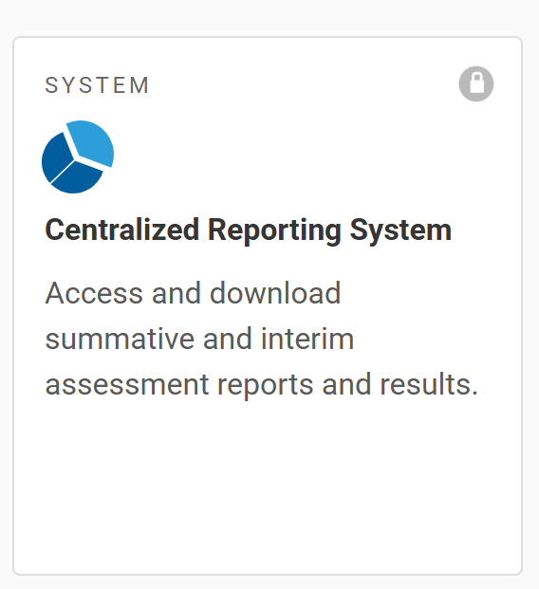
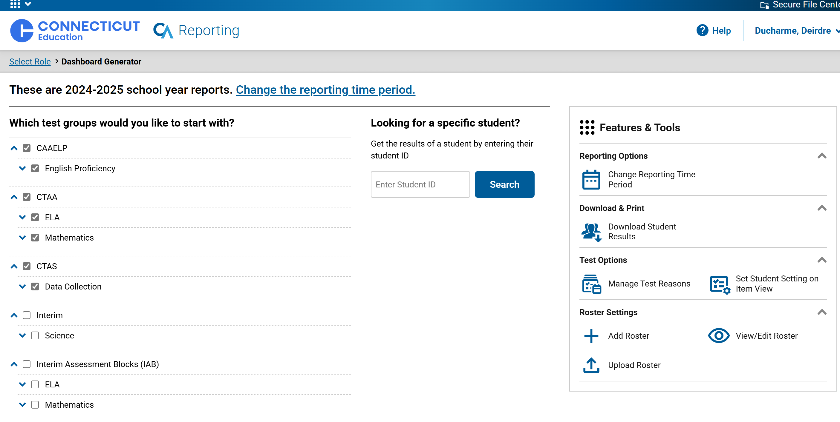
Centralized Reporting System
Notes:
Deirdre
Centralized Reporting System User Guide
Located on the Connecticut Comprehensive Assessment Program Portal, the Centralized Reporting System is available to district and school administrators that have a TIDE user account with associated permissions. This system allows administrators to view individual and aggregate school/district results for Smarter Balanced and NGSS summative and interim assessments, and alternate assessment data including the summative CAAELP, CTAA, and CTAS.

Slide 27
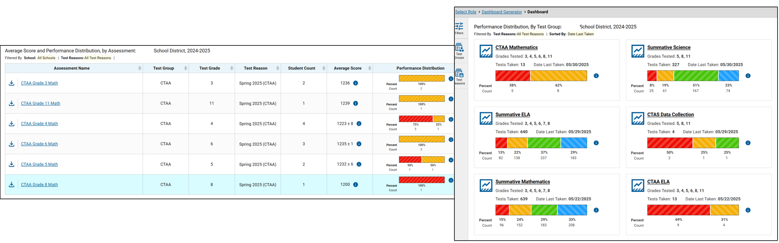
Centralized Reporting System: Assessment Dashboard
Notes:
Deirdre
Centralized Reporting System: Assessment Dashboard
Here we see the CRS dashboard for students that took the alternate assessments during the 2024-25 school year. The image shows that the user can drill-down and look at high-level performance data by tested area. As a first glance, the data tells me which grades students in my district took the alternate assessments: Grades 3-6, 8, and 11. It also tells me the count and percent of students for applicable performance categories for math and ELA. CTAS is not shown here, but it would be available on the user’s dashboard for those students that took the alternate science in Grades 5, 8, and 11.

Slide 28
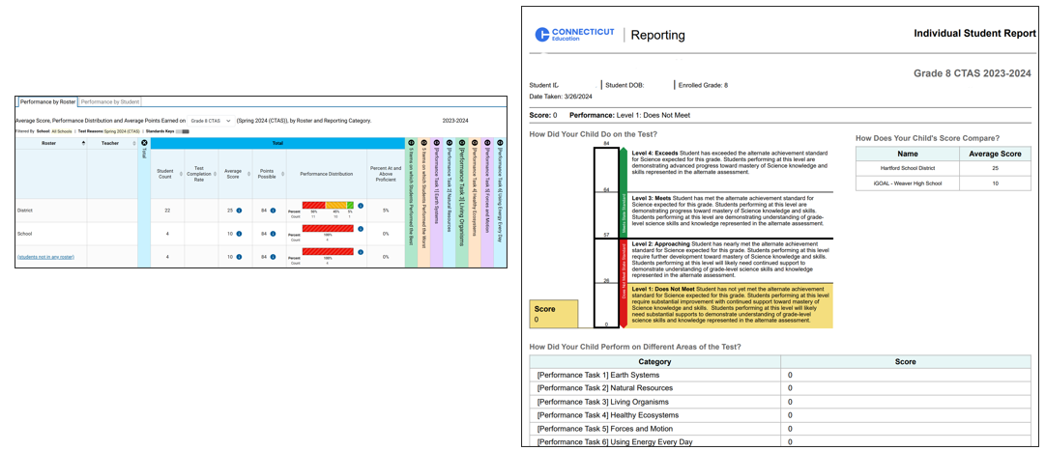
Centralized Reporting System: Group and Individual Performance
Notes:
Deirdre
Centralized Reporting System: Group and Individual Performance (CTAS displayed)
The CRS allows users to search aggregate data at the district or individual school or roster-level (if applicable), or drill down to the individual level.
Shown on this slide, the alternate science data is available by district, school, and roster. It provides the student count, average score, points possible, performance distribution, and specific performance for each science performance task. The image also shows a student's Individual Report for science. All ISRs can be downloaded and printed from CRS. Data can also be downloaded into an Excel file for further data analysis. Are your classroom teachers and TEAs using this data to help identify strengths and weaknesses in the area of science? Are teams using this data to determine alignment with curriculum and instructional expectations? If not, the possibilities are quite powerful. For example, educators can look at district, school, roster level data for each item across the 6 Performance Tasks. Which items or tasks did students struggle? Which items or areas of science were students most successful? How can this information be used to inform instruction?

Slide 29
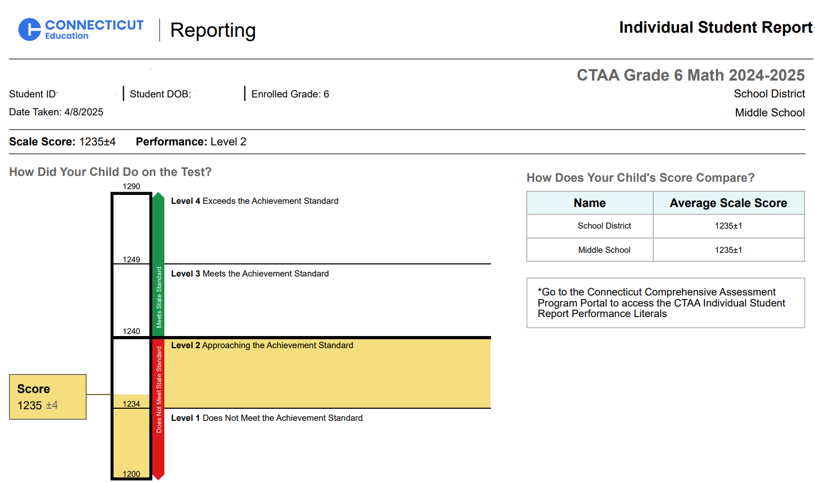
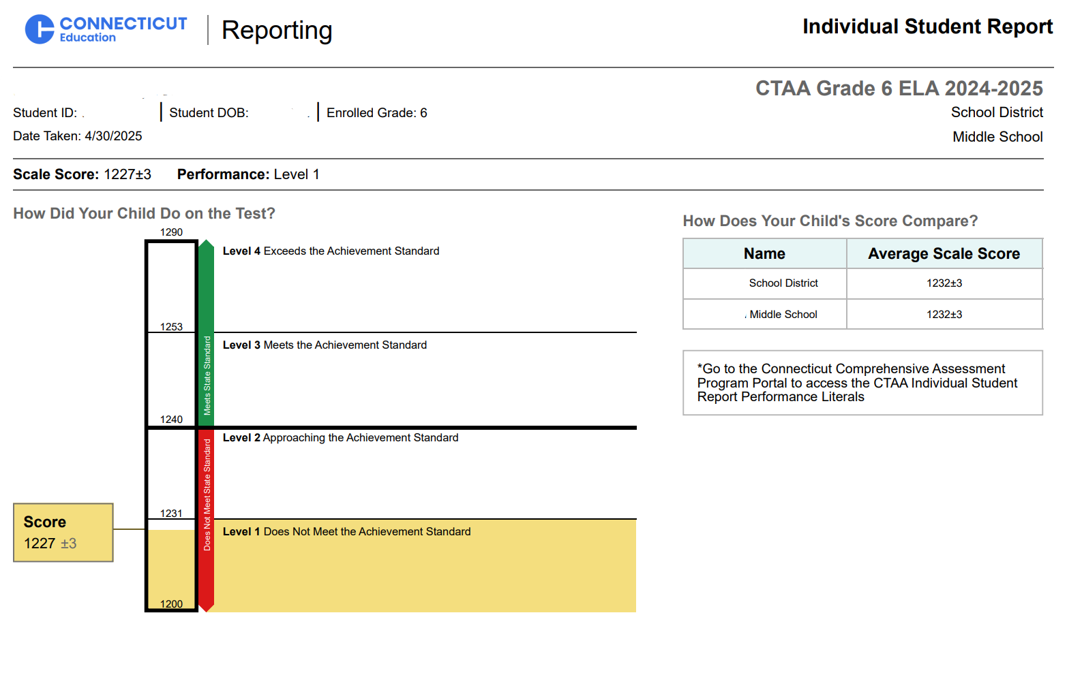
Centralized Reporting System: CTAA Math and ELA ISR
Notes:
Deirdre
Centralized Reporting System: CTAA Math and ELA ISR
Here is an image of a student's Individual Report for the CTAA. It shows the student's scale score and performance category for math and ELA as compared to the student's school.

Slide 30
Review of the Connecticut Alternate Assessment System: The Design, Purpose, and Eligibility Criteria
Notes:
Deirdre
Review of Alternate Assessment System: The Design, Purpose, and Eligibility Criteria
To orient you with the alternate assessment system, we will take a quick look at prevalence data from the 2024-25 school year.

Slide 31
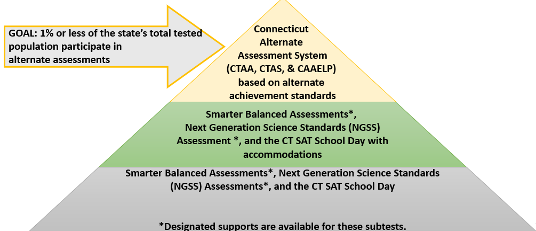
Pyramid of Connecticut’s Statewide Assessment
Notes:
Deirdre
Pyramid of Connecticut’s Statewide Assessment
We are now going to briefly discuss the purpose for alternate assessments.
Most students enrolled in the Connecticut Public Schools will participate on standard assessments. As indicated by the bottom tier of this pyramid, a variety of accessibility supports are available to all students on statewide assessments.
For those students with IEPs/Section 504 Plans, a variety of embedded and non-embedded accommodations are available on statewide assessments, as indicated by the middle tier. At the top tier, the smallest percent of students, one-percent or less, will participate on alternate assessments.
Image of the Pyramid of Connecticut's Statewide Assessment System. The bottom tier shows the state's standard assessments. The middle tier shows that students can access the standard assessments with accommodations. The top tier shows the Connecticut Alternate Assessment System with a goal that 1% or less of the state's total tested population will participate on alternate assessments.

Slide 32
Design of the Alternate Assessment
Based on grade-level learning standards developed for students with the most significant cognitive disabilities, the Connecticut Alternate Assessment System adjusts for:
Depth (the level of cognitive complexity of the knowledge, skills, and abilities within the standard),
Breadth (how many standards are measured), and
Complexity (describes the difficulty of content with built-in scaffolding to support accessibility needs).
Notes:
Ashley
Design of the Alternate Assessment
The Connecticut Alternate Assessment System is designed to measure the knowledge and skills of students with the most significant cognitive disabilities as required by the IDEA and ESSA. They support student independence to the greatest extent possible by making academic and language content accessible and the expected achievement levels appropriate. These assessments adjust for the depth, or cognitive complexity of skills and abilities, within the grade level standards. The assessments measure fewer standards, and the content adjusts for difficulty and is scaffolded to support the diverse range of accessibility needs within this student population.
Additional Information:
Depth- refers to how much of a single skill is measured by an item; for example, a deeper level item may address both description and dialogue narrative techniques whereas an item of less depth may only address description.
Breadth- refers to the scope or range of the content standards covered by the items in the AA-AAAS. In some cases, the AA-AAAS may cover the same content standards as the general assessment (perhaps, the essence of those standards).
Complexity-refers specifically to the format of the passages, items, tasks with built in scaffolding (documented in the secure Directions for Test Administration- applicable to the CTAA Math and ELA; and the CTAS Performance Task script read by the teacher).

Slide 33
The Alternate Assessment Incorporates…
Optimal testing conditions that must be provided to all students who take the test
Accessibility features that must be provided to students as needed
Accommodations and assistive technology that students should receive per their Individualized Education Program (IEP) (if applicable) in conjunction with CSDE testing policies and procedures
Notes:
Ashley
The Alternate Assessment Incorporates
The combination of accessibility features, optimal testing conditions, and accommodations are incorporated within the alternate assessment design and are intended to maximize students’ test access and performance.
Additional Information:
Connecticut Alternate Assessments are designed to include:
optimal testing conditions that must be provided to all students who take the test; ​
accessibility features that must be provided to students as needed; and ​
accommodations that students must receive as specified in their IEPs.​
​

Slide 34
The Alternate Assessment is Comprised of Three Assessments
The Connecticut Alternate Assessment (CTAA) for English language arts and mathematics (Grades 3-8 and 11),
The Connecticut Alternate Science (CTAS) Assessment (Grades 5, 8, and 11), and
The Connecticut Alternate Assessment of English Language Proficiency (CAAELP) (Grades K-12).
Notes:
Ashley
The Alternate Assessment is Comprised of Three Assessments
Nearly all students with disabilities should be expected to make academic progress measured against grade-level achievement standards.
All Connecticut public school students are expected to be provided instruction aligned to the Connecticut Core Standards and the Next Generation Science Standards. The subtests within the Connecticut Alternate Assessment System are derived from the CCS, NGSS, or CELP standards.
Additional Information:
The CTAA assesses grade-level content linked to and derived from the CCS, which are the academic standards for English language arts and mathematics expected for all Connecticut students. The IEP goals and objectives should be based on the general education curriculum defined in the CCS for all Connecticut students. The CTAA has been developed to ensure that all eligible students with significant cognitive disabilities are able to participate in an assessment that is a measure of what they know and can do in relation to the grade-level CCS.
Similarly, eligible students with significant cognitive disabilities in Grades 5, 8, and 11 are assessed in science using the CTAS, which is aligned to the grade-level NGSS allowing students to access the content and demonstrate what they know and can do related to grade-level science standards.
Finally, eligible students who are identified as EL/ML in the public school system are expected to demonstrate their English language proficiency skills annually. The CELP standards describe the language necessary for students to complete grade-appropriate tasks, while continually developing English proficiency. Content aligned to and derived from the CELP standards define the tested domains of listening, speaking, reading, and writing. The IEP goals and objectives include supports for English language development for these eligible students. The CAAELP assessment provides eligible students identified as EL/ML with significant cognitive disabilities the ability to participate in an assessment that measures what they know and can do in relation to the CELP standards.

Slide 35
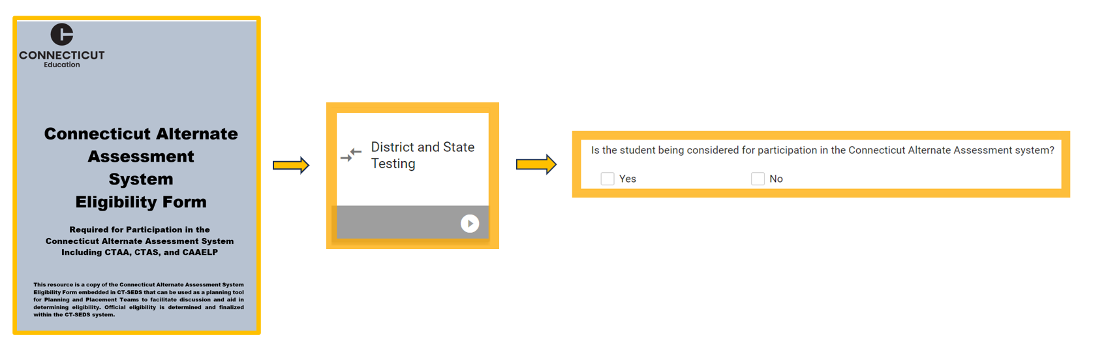
Eligibility in CT-SEDS
Notes:
Ashley
Eligibility in CT-SEDS
To determine eligibility, PPTs will complete the Connecticut Alternate Assessment System Eligibility Form located within CT-SEDS.
Teams will select the District and State testing tile to locate this form. Once on this tile, in the state testing portion, they will see this question “Is the student being considered for participation in the Connecticut Alternate Assessment System?”
Teams can print out a hard copy Connecticut Alternate Assessment System Eligibility Form from the portal to use as a planning tool to facilitate discussions and aid in determining eligibility.
Connecticut Alternate Assessment Eligibility Form

Slide 36
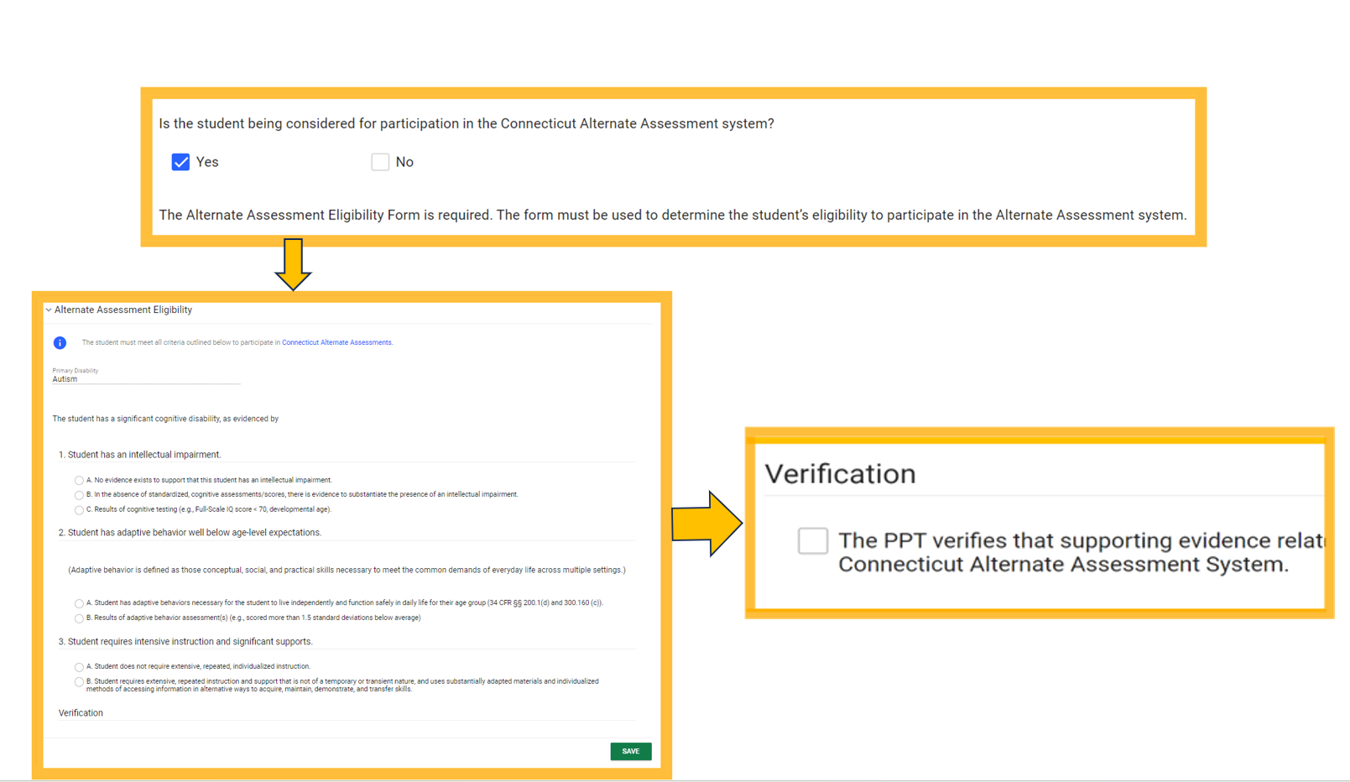
Eligibility in CT-SEDS, Continued
Notes:
Ashley
Eligibility in CT-SEDS
If the student is being considered for participation in the alternate assessment, the team will select “yes” and save the record. Then, the Connecticut Alternate Assessment System Eligibility Form will populate on the page (as shown on this slide).
The PPT must review and complete the eligibility form as part of the annual PPT process. If based on substantiated evidence, the student qualifies for the assessment, the team will select the Verification box and save. When the IEP is finalized and implemented, the alternate assessment data will sync to TIDE by populating the Alternate Assessment Indicator on the student’s TIDE dashboard.

Slide 37
Characteristics of Students with the Most Significant Cognitive Disabilities
Notes:
Ashley

Slide 38
The Alternate Assessment Criteria
For participation in the Connecticut Alternate Assessment System, the identification of a significant cognitive disability is not based on IDEA disability category or English learner/multilingual learner status; nor is it based on previous low academic achievement or need for accommodations to participate in general state assessments.
Notes:
Ashley
The Alternate Assessment Criteria
As stated by federal law and regulations, only those students who have the "most significant cognitive disabilities" should participate in the Connecticut Alternate Assessment System. But, what does "the most significant cognitive disabilities" really mean? We need to explore this in more depth because there is no special education category of "most significant cognitive disability.“
Teams need to ensure that eligibility is not based on a student’s IDEA disability category, EL/ML status, previous low achievement, or the need for accessibility features to access general summative assessments.
Because not all students who have an intellectual disability meet the criteria for a significant cognitive disability, teams need to be aware of accessibility features that may provide them access to general state summative assessments. If teams have questions regarding this, please reach out to the CSDE.
Additional Information:
One of the things that we know is that most of the students who do appropriately participate in the Connecticut Alternate Assessment System have the IDEA categorical labels of intellectual disabilities, autism, and multiple disabilities BUT it is critical to remember that not all of the students with these labels should be assigned to the Connecticut Alternate Assessment System.

Slide 39
What are the characteristics of a student with the most significant cognitive disabilities?
Students in this group are heterogeneous in their characteristics and current skill levels.
Many, but not all, are identified prior to entering kindergarten.
A small percentage of these students do not yet have a communication system.
Students may often use augmentative communication devices or assistive technology for access to their environment, daily living, and instruction.
Notes:
Ashley
What are the characteristics of a student with the most significant cognitive disabilities?
Another thing that we know is that many of the students who do appropriately participate in the Connecticut Alternate Assessment System come to kindergarten already having been identified for special education services to support their intellectual and functional adaptive behavior dynamic needs. Of course, not all of these students should take the Connecticut Alternate Assessments. Once again, we need to consider the continuum of services and the student’s unique learning profile.
Students may often use augmentative communication devices or assistive technology for access to their environment, daily living, and instruction. Communication and assistive technology should be considered from Pre-K and beyond, even if communication is at the “cause and effect” or low-tech levels.
These characteristics should be documented and evident in the student’s programming and throughout the IEP.
Additional Information:
Students with significant cognitive disabilities are a relatively small population who: (1) are identified with one or more of the existing categories of disability under the IDEA (for example: intellectually disabled, autism, multiple disabilities, and traumatic brain injury, which are the most common); and (2) have cognitive impairments that may prevent them from attaining grade-level achievement standards, even with systematic instruction and accommodations. Additionally, student records indicate a pervasive disability or multiple disabilities that significantly impact intellectual functioning and functional adaptive behavior defined as essential for someone to live independently and to function safely in daily life.

Slide 40
What are the characteristics of a student with the most significant cognitive disabilities, continued?
Students are identified with one or more of the existing categories of disability under the IDEA.
Significant Intellectual Impairment
Functional adaptive skills are well below age level expectations.
Student requires intensive instruction and significant supports.
For students with the most complex characteristics who do not have an established mode of communication, refer to the Early Stopping Rule guidelines.
Notes:
Ashley
What are the characteristics of a student with the most significant cognitive disabilities?
Additionally, the following characteristics of a student with the most significant cognitive disabilities will need to be reviewed and documented as part of the Connecticut Alternate Assessment Eligibility Form.
Students that are identified with one or more of the existing categories of disability under the IDEA
Student has a significant Intellectual Impairment
Student has functional adaptive skills are well below age level expectations
Student requires intensive instruction and significant supports
As you can tell from what we know, the decision about which students should participate in the Connecticut Alternate Assessment System is often a very difficult decision.

Slide 41
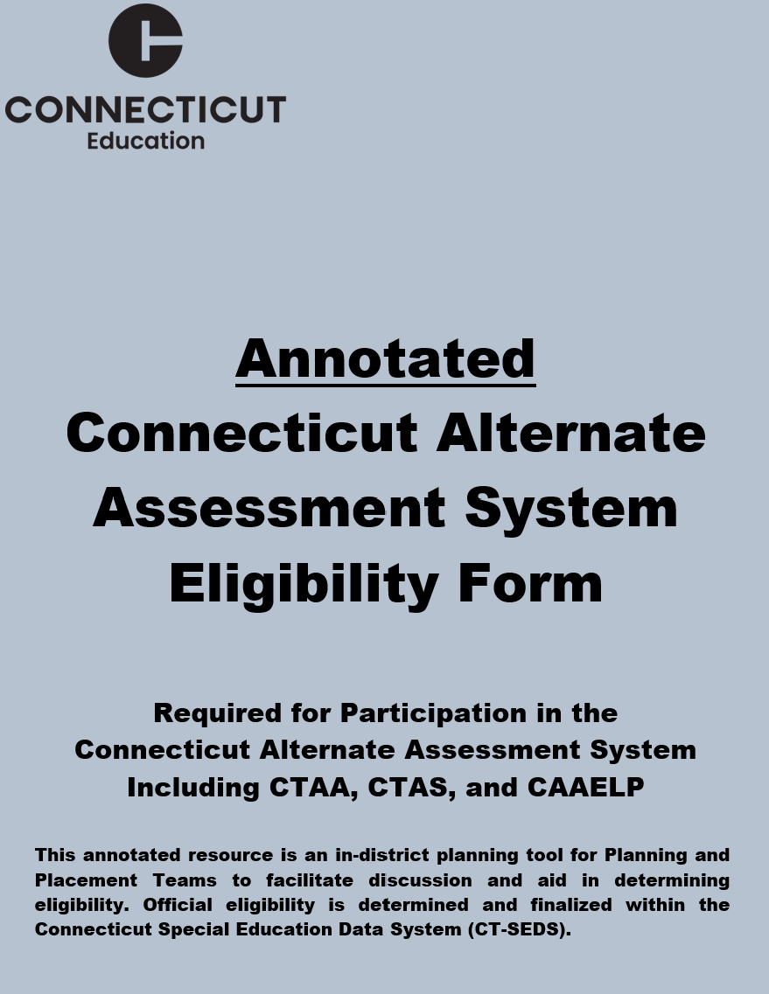
An In-Depth Look at Eligibility Criteria
Notes:
Deirdre
An In-Depth Look at Eligibility Criteria
Annotated Connecticut Alternate Assessment Eligibility Form

Slide 42
Eligibility Criteria #1 Identification Under IDEA
While a student may not be determined to have a significant cognitive disability based solely on an IDEA classification, individuals with an intellectual disability, multiple disabilities, autism, or traumatic brain injury are more likely to be eligible for an alternate assessment.
For more information, refer to Sections 34 CFR 300.309 (3)(a)(1) and (2) and 300.8(c)(4)(i) of IDEA.
Notes:
Deirdre
Although, there is no federal restriction on the primary disability category for participation in an alternate assessment, students with certain disability categories (for example intellectual disability, multiple disabilities, autism, or traumatic brain injury) are more likely to meet eligibility criteria.

Slide 43
Eligibility Criteria #1 Student has an Intellectual Impairment
    Common Cognitive Assessments Used:
  Cognitive Assessment System (CAS)
  Comprehensive Test of Nonverbal Intelligence (CTONI)
  Differential Ability Scales (DAS)
  Kaufman Assessment Battery for Children (KABC)
  Naglieri Nonverbal Ability Test (NNAT)
  Pictorial Test of Intelligence (PTI)
  Reynolds Intellectual Assessment Scales (RIAS)
  Stanford-Binet Intelligence Scale (SB)
  Test of Nonverbal Intelligence (TONI)
  Universal Nonverbal Intelligence Test (UNIT)
  Wechsler Adult Intelligence Scale (WAIS)
  Wechsler Intelligence Scale for Children (WISC)
  Wechsler Intelligence Scale for Children Spanish
  Wechsler Nonverbal Scale of Ability (WNV)
  Wechsler Preschool & Primary Scale of Intelligence (WPPSI)
  Woodcock-Johnson Test of Cognitive Abilities (WJ)
To qualify, the PPT must determine that the student has an intellectual impairment.
This determination is documented through an assessment of cognitive functioning, that places the individual significantly below age/grade-level expectations.
Results of cognitive testing (e.g., Full-Scale IQ score<70).
Assessment results should be within 3 years of the triennial IEP.
In the absence of cognitive assessments, the PPT must determine there is evidence throughout other areas of the plan that substantiates a significant cognitive disability.
Notes:
Deirdre
Eligibility Criteria #1 Student has an Intellectual Impairment
First, the team must establish that the student has an intellectual impairment.
This determination is documented through an assessment of cognitive functioning, that places the individual significantly below age/grade-level expectations.
Results of cognitive testing (e.g., Full-Scale IQ score<70).
Assessment results should be within 3 years of the triennial IEP.
In the absence of cognitive assessments, the PPT must determine there is evidence throughout other areas of the plan that substantiates a significant cognitive disability.
Also shown on this slide is a list of Cognitive Assessments commonly used. Refer to the Connecticut Alternate Assessment Eligibility Form for details.

Slide 44
Eligibility Criteria #2 Student has functional adaptive behavior skills well below age-level expectations.
Functional adaptive behavior is defined as those conceptual, social, and practical skills necessary to meet the common demands of everyday life across multiple settings.
Functional adaptive scores should be more than 1.5 standard deviations below the mean score.
Assessment results should be within 3 years of the triennial IEP.
Functional Adaptive Behavior Assessments Used
Adaptive Behavior Assessment System (ABAS)
Scales of Independent Behavior-Revised (SIB-R)
Vineland Adaptive Behavior Scales (VABS)
Other
Notes:
Deirdre
Eligibility Criteria #2 Student has functional adaptive behavior skills well below age-level expectations.
Next, the PPT must determine that the student has functional adaptive behavior skills well below age-level expectations. What does this mean?
Functional adaptive behavior is defined as those conceptual, social, and practical skills necessary to meet the common demands of everyday life across multiple settings.
Functional adaptive scores should be more than 1.5 standard deviations below the mean score.
Assessment results should be within 3 years of the triennial IEP.
The most common functional adaptive behavior assessments include:
Adaptive Behavior Assessment System (ABAS)
Scales of Independent Behavior-Revised (SIB-R)
Vineland Adaptive Behavior Scales (VABS)
As referenced in the American Psychological Association’s Ethical Principles of Psychologists and Code of Conduct, Section 9: Assessments, these assessments should be the most current edition available.
If “Other” is selected, DO NOT use assessments or associated composite scores that do not measure broad functional adaptive behavior skills for the purpose of this alternate assessment eligibility criteria (e.g., Assessment of Basic Language and Learning, Autism Behavior Rating Scale, Autistic Diagnostic Observation Schedule, Behavior Assessment System for Children, file review, or observations would not be appropriate for this purpose).
When “Other” is selected, the team should specify the full name of the functional adaptive behavior skill assessment, recognizing these will be identified for additional CSDE monitoring. Additionally, teams must ensure that the evaluations address the degree for which a student’s second language acquisition or sensory disability affects the validity and reliability of test findings for a student who is EL/ML, Deaf/Blind, Hearing or Visually Impaired.

Slide 45
Eligibility Criteria #3 Student requires intensive instruction and significant supports.
  Student requires extensive, repeated instruction and support that is not of a temporary or transient nature and uses substantially adapted materials and individualized methods of accessing information in alternative ways to acquire, maintain, demonstrate, and transfer skills.
Examples of Documentation in the IEP
Goals and objectives are linked to (and derived from) the Connecticut Core Standards and Next Generation Science Standards.
If the student is dually identified as EL/ML, the goals and objectives are linked to (and derived from) the Connecticut English Language Proficiency Standards.
Documentation of evidence in the Present Levels of Performance across multiple settings and subject areas.
Documentation of accommodations and supports in the Supplemental Aids and Services.
Notes:
Deirdre
Eligibility Criteria #3 Student requires intensive instruction and significant supports.
Finally, the team must determine that the student requires extensive, repeated instruction and support that is not of a temporary or transient nature and uses substantially adapted materials and individualized methods of accessing information in alternative ways to acquire, maintain, demonstrate, and transfer skills.
The PPT can provide evidence that the student has IEP goals and objectives linked to (and derived from) the Connecticut Core Standards (CCS) and Next Generation Science Standards (NGSS), which are the academic standards for English language arts, mathematics, and science in Connecticut. For students identified as EL/ML the PPT can provide evidence that the student has IEP goals that support English language development linked to (and derived from) the Connecticut English Language Proficiency (CELP) Standards. To access these standards, students are typically provided repeated access to content in a systematic manner, across multiple settings and subject areas, allowing these students greater opportunity to demonstrate what they know and can do. Supports are individualized and evidenced throughout the student’s IEP, particularly in the student’s present levels of performance, goals and objectives, accommodations, and related service needs. Students who do not require extensive, repeated, and individualized instruction, and do not use substantial supports to achieve measurable gains in the grade- and age-appropriate curricula, are expected to take Connecticut’s standard assessments with designated supports, accommodations, and assistive technology (if applicable) as indicated in the student’s IEP.

Slide 46
Additional Alternate Eligibility Considerations
Notes:
Deirdre
Additional Alternate Eligibility Considerations

Slide 47
When There is Insufficient Evidence to Meet Eligibility Criteria
Review and determine the access points used for the students to access their instruction within the learning environment.
Understand accessibility supports that may be available for that student to access the learning environment, including curriculum and social emotional learning.
Based on accessibility supports utilized throughout instruction, review designated supports and accommodations associated with each applicable standard assessment.
Trial practice and training tests with appropriate supports and accommodations to gather information and evaluate student need.
Document the accessibility supports needed for the summative assessment and the student will take the grade applicable standard assessments in the IEP.
Notes:
Deirdre
When There is Insufficient Evidence to Meet Eligibility Criteria
For students with cognitive disabilities that have average or slightly below average functional adaptive skills, or those that do not meet the cognitive eligibility criteria, plan to administer the standard assessment.
What are the access points used for the student to access their instruction within the learning environment?
Trial Practice Tests with appropriate supports and accommodations to:
Explicitly familiarize the student with the test format, platform, and available embedded tools, designated supports and accommodations.
Show the student how to use them.
Work with the student to determine which supports are helpful versus those that are not.
Trial assistive technology or communication devices with the test to check functionality and student access needs.

Slide 48
When to Reconsider Eligibility for the Alternate Assessment
Revisit the student’s alternate eligibility status if you find the following:
The student participated in standard state assessments (e.g., Smarter Balanced) in the past.
The primary disability category is a learning disability, learning disability/dyslexia, or emotional disability.
The reason provided as to why the student qualified is that:
  “they are in a life skills class” or
  “they are in the self-contained class” or
  “they are in the alternate assessment class” or
  anything having to do with “behaviors” as the primary issue.
Notes:
Deirdre
When to Reconsider Eligibility for the Alternate Assessment
As teams, when revisiting the student's eligibility status reconsider the following:
Has the student participated in standard assessments in the past?
Is the disability category SLD, SLD/Dyslexia, or ED?
If the reason provided is or is similar to statements such as…
“they are in a life skills class” or
“they are in the self-contained class” or
“they are in the alternate assessment class” or
Or anything having to do with “behaviors” as the primary issue
Then teams will need to return to the annotated eligibility form to ensure appropriateness .
If you are a PPT Chair, a member of the PPT, or an Administrator, and you are hearing these comments, these should act as a red flag for you. Consider reviewing the decisions to assess certain students with alternate assessments.

Slide 49
When to Reconsider Eligibility for the Alternate Assessment, Continued
Revisit the student’s alternate eligibility status if you find the following:
The student takes a content-area class in a general education setting with their typical peers without significant supports and modifications.
The student is slightly below, or even at, grade level in one content area.
The student demonstrates functional adaptive behaviors necessary for the student to live independently and function safely in daily life for their age group.
The student never took the alternate assessment and then, in middle or high school, they do.
Notes:
Deirdre
When to Reconsider Eligibility for the Alternate Assessment, Continued
Revisit the student’s alternate eligibility status if you find the following:
The student takes a content-area class in a general education setting with their typical peers without significant supports and modifications.
The student is slightly below, or even at, grade level in one content area.
The student demonstrates functional adaptive behaviors necessary for the student to live independently and function safely in daily life for their age group.
The student never took the alternate assessment and then, in middle or high school, they do.

Slide 50
Best Practices for Administrators
Review participation rates and identify possible trends by disability categories or other demographics that might be disproportionate to students taking standard assessments.
Ensure that teams are accurately completing the Alternate Assessment Eligibility Form as designed. Use the annotated form as reference.
Provide continuous professional development opportunities for staff, so that they can maximize differentiated learning and inclusion teaching practices.
Hold office hours, team meetings, or mini trainings for PPT staff including building administration, on alternate eligibility criteria.
Provide opportunities to engage families in discussions regarding appropriate identification and eligibility for the alternate assessment.
Communicate and share resources for teachers and administration on preparing students to participate on standard assessments if they do not meet alternate eligibility criteria.
Notes:
Ashley
Best Practices for Administrators
We have compiled a list of some best practices for districts to consider that can support the process of accurate identification for the Alternate Assessment. Many of these recommendations are drawn from a survey of several districts in which they were asked to share their best practices for special education teachers and PPTs.
When a district is given notice of exceeding the 1% threshold, administrators or IEP file reviewers should consider:
Conducting file reviews of individuals identified for the Alternate Assessment
Reviewing for accurate completion of the eligibility form as designed
Using the Annotated Connecticut Alternate Assessment System Eligibility Form as reference
Training of PPT Chairs
Continually training to adjust for staff turnover rates
Engaging families through communication regarding the process where appropriate, sharing the forms, and considering parent training

Slide 51
Best Practices for Special Education Teachers and PPTs
Communicate with parents/guardians on summative assessments and eligibility.
Carefully consider the impact of placing a student on an alternate assessment.
Thoroughly review and verify student alternate eligibility data in IEP.
Review evidence and eligibility criteria at annual PPT; do not automatically accept decision from previous year.
Review justification for student eligibility; ensure evaluations are current and within the triennial.
Accurate completion of the Alternate Assessment Eligibility Form with all current and applicable data in CT-SEDS.
Attend trainings, office hours, and have team meetings on eligibility criteria for alternate assessments.
Notes:
Ashley
Best Practices for Special Education Teachers and PPTs
Communicate with parents/guardians on summative assessments and eligibility.
Carefully consider the impact of placing a student on an alternate assessment.
Thoroughly review and verify student alternate eligibility data in IEP.
Review evidence and eligibility criteria at annual PPT; do not automatically accept decision from previous year.
Review justification for student eligibility; ensure evaluations are current and within the triennial.
Accurate completion of the Alternate Assessment Eligibility Form with all current and applicable data in CT-SEDS.
Attend trainings, office hours, and have team meetings on eligibility criteria for alternate assessments.

Slide 52
Best Practices for Creating Inclusive Education
Create and communicate a vision for inclusive educational practices.
Build professional knowledge and capacity and collaborative partnerships across educator specialties (e.g., general and special education, English Learner/Multilingual Learner educators, school counselors, related service specialists) – we all have an accountability to create inclusive communities!
Create a master schedule that supports implementation of inclusive educational practices.
Engage in data-driven improvement strategies.
Prioritize collaborative communication, visibility, transparency with families.
Notes:
Ashley
Best Practices for Creating Inclusive Education
Create and communicate a vision for inclusive educational practices.
Build professional knowledge and capacity and collaborative partnerships across educator specialties (e.g., general and special education, English Learner/Multilingual Learner educators, school counselors, related service specialists) – we all have an accountability to create inclusive communities!
Create a master schedule that supports implementation of inclusive educational practices.
Engage in data-driven improvement strategies.
Prioritize collaborative communication, visibility, transparency with families.

Slide 53
Tips for Identifying Participation on Alternate Assessments
Understand Participation Criteria.
Gather evidence on each criteria based on evaluations and using documentation in the IEP across
  Multiple sources,
  Multiple years, and
  Multiple settings.
Document evidence using the embedded CT Alternate Assessment System Eligibility Form.
Notes:
Ashley
Tips for Identifying Participation on Alternate Assessments
Understand Participation Criteria.
Gather evidence on each criteria based on evaluations and using documentation in the IEP across
Multiple sources,
Multiple years, and
Multiple settings.
Document evidence using the embedded CT Alternate Assessment System Eligibility Form.

Slide 54
Data Monitoring
Carefully review your local participation data (See EdSight) at each grade, subject per school.
Review local practices for identifying assessments appropriate for students with disabilities.
If your district exceeds 1% participation, identify and address the possible root causes for high participation in the alternate assessments.
Require assurances with PPT members to ensure their adherence to the Connecticut Alternate Assessment System eligibility guidance.
Provide assurances to communicate with parents/guardians about implications for their child’s participation on alternate assessments.
Identify actionable items “Do now/Do tomorrow” and set goals to accurately identify students for the most appropriate assessments based on current assessment and evidence.
Notes:
Ashley
Data Monitoring
Carefully review your local participation data (See EdSight) at each grade, subject per school.
Review local practices for identifying assessments appropriate for students with disabilities.
If your district exceeds 1% participation, identify and address the possible root causes for high participation in the alternate assessments.
Require assurances with PPT members to ensure their adherence to the Connecticut Alternate Assessment System eligibility guidance.
Provide assurances to communicate with parents/guardians about implications for their child’s participation on alternate assessments.
Identify actionable items “Do now/Do tomorrow” and set goals to accurately identify students for the most appropriate assessments based on current assessment and evidence.

Slide 55
SERC Training
Universal Design for Learning, Assistive Technology,
and Accessible Educational Materials In-district Training and Technical Assistance
The CT State Education Resource Center, in collaboration with the CT State Department of Education, is pleased to offer free in-district training and technical assistance in Universal Design for Learning, Assistive Technology, and Accessible Educational Materials. Within these categories, we also offer training on ethical integration and use of AI and AI tools for educators and students, Google Suite Tools and iOS devices and apps.
For more information, please contact:
Smita Worah, worah@ctserc.org
Claire Conroy, conroy@ctserc.org
Notes:
Ashley
SERC Training
Universal Design for Learning, Assistive Technology, and Accessible Educational Materials In-district Training and Technical Assistance
The CT State Education Resource Center, in collaboration with the CT State Department of Education, is pleased to offer free in-district training and technical assistance in Universal Design for Learning, Assistive Technology, and Accessible Educational Materials. Within these categories, we also offer training on ethical integration and use of AI and AI tools for educators and students, Google Suite Tools and iOS devices and apps.
For more information, please contact:
Smita Worah, worah@ctserc.org
Claire Conroy, conroy@ctserc.org

Slide 56
Resources
Notes:
Resources

Slide 57
Resources from National Organizations
TIES Lessons for All: 5-15-45 | TIES Lessons for All: The 5-15-45 Tool | Institute on Community Integration Publications
TIES helps educators, parents, and administrators create and support inclusive school communities | TIES Center
Leveraging Multi-Tiered Systems of Support (MTSS) To Enhance Educational Leadership
AA-AAS: Standards That Are the “Same but Different” (NCSC Brief #1) (archive-it.org)
NCSC Partners - Welcome to the National Center and State Collaborative!
NCSC Wiki
Notes:
Resources

Slide 58
Resources for Determining Eligibility
Developing an Assessment Participation Action Plan: A Tool for District Leaders
IEP Team Resource: Making Decisions about Participation in the Alternate Assessment
Parent Overview of the Connecticut Alternate Assessment System
Determining Student Participation on Connecticut Statewide Summative Assessments
FAQ About the Connecticut Alternate Assessment System
Connecticut Alternate Assessment Participation Guidance for Planning and Placement Teams
Notes:
Resources

Slide 59
Resources for Teams to Support Eligibility and Accessibility for State Assessments
State Assessment Decision-making Processes for ELLs with Disabilities
Improving Instruction for English Learners Through Accessibility Decision Making (Improving Instruction): Training Module
Connecticut Alternate Assessment Eligibility Form
Annotated Connecticut Alternate Assessment Eligibility Form
FAQ About the Connecticut Alternate Assessment System Eligibility Form
Accessibility Considerations
CSDE Assessment Guidelines
Special Documented Accommodations
Resources for Planning and Placement Team/Section 504 webpage
Assessment Resources Quick Guide for Planning and Placement/Section 504 Teams
Notes:
Resources

Slide 60
Alternate Assessment Score Reports and Interpretative Guides
Guide for CTAA Score Report Interpretation
Guide for CTAS Score Report Interpretation
CTAA English Language Arts Performance Level Descriptors
CTAA Mathematics Performance Level Descriptors
CTAA Individual Student Report Performance Literals – Mathematics
CTAA Individual Student Report Performance Literals – English Language Arts
Parent Overview of Connecticut's Alternate Assessment System (English)
CAAELP Parent Guide to Individual Student Reports ISR (English)
Notes:
Resources

Slide 61
Resources that Support Access to Participation and Performance Data
How to Access the CAAELP Scores in the Centralized Reporting System (CRS)
EdSight Alternate Assessment data page (includes CTAA Interactive Report and CTAS data [Excel])
Centralized Reporting System User Guide
Notes:
Resources

Slide 62
ESSA Resources
Every Student Succeeds Act. 2015. 20 USC § 1001. https://www.congress.gov/114/plaws/publ95/PLAW-114publ95.pdf
US Department of Education. 2017. Every Student Succeeds Act: Assessments under Title 1, Part A & Title 1, Part B: Summary of Final Regulations.
Every Student Succeeds Act: Assessments under Title 1, Part A & Title 1, Part B: Summary of Final Regulations (2017): https://www2.ed.gov/policy/elsec/leg/essa/essaassessmentfactsheet1207.pdf
Notes:
Resources

Slide 63
CSDE Contacts
Performance Office | Bureau of Special Education
Abe Krisst, Bureau Chief Phone: 860-713-6894 Mobile Phone: 860-690-0650 Email: Abe.Krisst@ct.gov | Bryan Klimkiewicz, Special Education Division Director Phone: 860-713-6910 Bryan.Klimkiewicz@ct.gov
Deirdre Ducharme, Education Consultant Special Populations Direct line: 860-713-6859 Email: Deirdre.Ducharme@ct.gov | Ashley DiGangi, Associate Education Specialist Phone: 860-713-6501 Email: Ashley.Digangi@ct.gov
Katie Seifert, Associate Education Consultant Special Populations Direct line: 860-713-6722 Email: Katherine.Seifert@ct.gov | Nicole Deal, Education Consultant Bureau of Special Education Phone: 860-713-6943 Email: Nicole.Deal@ct.gov
Notes:
Ashley
CSDE Contacts
Here are CSDE contacts from the Performance Office and Bureau of Special Education. Please reach out with any questions.
We are here to support you and your teams.

Slide 64
Thank You for Your Participation!
Notes:
Resources

