Slide 1
Smarter Balanced Assessment: Determining the Interim Assessment Block (IAB) Performance Categories
SY 2026–27
Notes:
Welcome to this presentation on the Smarter Balanced Assessment: Determining the Interim Assessment Block Performance Categories.
While students who take a Smarter Balanced Summative Assessment in either English Language Arts or Mathematics receive an overall vertical scale score in that subject, students who take a Smarter Balanced Interim Assessment Block receive one of three performance categories on that block: Above Standard, At/Near Standard, or Below Standard. But how are those performance categories determined? This PowerPoint presentation will answer that question.

Slide 2
Interim Assessment Blocks (F/IAB)
The Smarter Balanced Interim Assessment Overview
Interim Assessment Blocks (IABs): Measure 3–8 Targets
Focused Interim Assessment Blocks (FIABs): Measure no more than 3 Targets
Notes:
Smarter Balanced offers Interim Assessment Blocks (IABs) and Focused Interim Assessment Blocks (FIABs) in both Mathematics and ELA for Grades 3–11, with the main difference between the two types of blocks being the number of Targets assessed. An IAB assesses between 3–8 Targets, while an FIAB measures no more than three. A list of all Interims available in each content area can be found in the hyperlinked Interim Assessment Overview. It is important to remember that unlike the Smarter Balanced Summative Assessments, the Interim Blocks are not computer adaptive.
Math IABs assess specific concepts, which are directly related to the domains at each grade level. Students are expected to make connections between content and practice, model a mathematical situation, and explain their reasoning when solving problems.
In ELA, blocks are designed to measure reading comprehension of literary and informational text, writing, listening, and research. Writing skills in these blocks are divided into writing brief texts, revision of writing, using appropriate language and vocabulary, and editing skills.
Each grade has one performance task in either opinion/argumentative writing, informational/explanatory writing, or narrative.

Slide 3
Important Topics
The Smarter Balanced Vertical Scale
The Standard Error of Measurement (SEM)
Notes:
To understand how Interim Assessment Block Performance Categories are determined, we first need to become familiar with the Smarter Balanced Vertical Scale and the standard error of measurement.

Slide 4
Smarter Balanced Overall Scale Scores for ELA
ELA | Grade 3 | Grade 4 | Grade 5 | Grade 6 | Grade 7 | Grade 8
Level 4: Exceeded | 2490–2623 | 2533–2663 | 2582–2701 | 2618–2724 | 2649–2745 | 2668–2769
Level 3: Met | 2432–2489 | 2473–2532 | 2502–2581 | 2531–2617 | 2552–2648 | 2567–2667
Level 2: Approaching | 2367–2431 | 2416–2472 | 2442–2501 | 2457–2530 | 2479–2551 | 2487–2566
Level 1: Not Met | 2114–2366 | 2131–2415 | 2201–2441 | 2210–2456 | 2258–2478 | 2288–2486
Notes:
For ELA, this table presents the precise vertical scale score ranges for each achievement level in each grade.
The threshold vertical scale scores that separate one level from the next are the lower numbers in each range for Levels 2, 3, and 4. For example, the threshold score for Level 3 in Grade 3 ELA is 2432.
These threshold, or cut scores, were developed based on feedback from thousands of K–12 educators, higher education faculty, psychometric experts, parents, and other stakeholders through a process called standard setting. All Smarter Balanced states, including Connecticut, have adopted these achievement levels and their corresponding threshold scores.

Slide 5
Smarter Balanced Overall Scale Scores for Math
Mathematics | Grade 3 | Grade 4 | Grade 5 | Grade 6 | Grade 7 | Grade 8
Level 4: Exceeded | 2501–2621 | 2549–2659 | 2579–2700 | 2610–2748 | 2635–2778 | 2653–2802
Level 3: Met | 2436–2500 | 2485–2548 | 2528–2578 | 2552–2609 | 2567–2634 | 2586–2652
Level 2: Approaching | 2381–2435 | 2411–2484 | 2455–2527 | 2473–2551 | 2484–2566 | 2504–2585
Level 1: Not Met | 2189–2380 | 2204–2410 | 2219–2454 | 2235–2472 | 2250–2483 | 2265–2503
Notes:
For Math, this table presents the precise vertical scale score ranges for each achievement level in each grade.
The threshold vertical scale scores that separate one level from the next are the lower numbers in each range for Levels 2, 3, and 4. For example, the threshold score for Level 3 in Grade 3 Math is 2436.

Slide 6
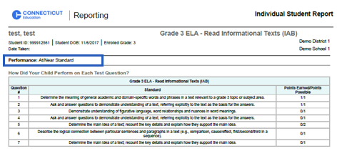
Interim Assessment Block
Performance Categories
Notes:
For each Interim Assessment Block, students are assigned to one of three performance categories: Below Standard, At/Near Standard, or Above Standard. Results for IABs are reported in the same manner as Claim results on summative tests and Interim Comprehensive Assessments (ICAs). That is, the results are given as “Below Standard,” “At or Near Standard,” or “Above Standard.”
To determine this performance category, the first step in the psychometric process is to use the items on the IAB to calculate a scale score and standard error of measurement. Psychometric theory tells us that a test score is an estimate of a student’s achievement and comes with a certain amount of measurement error. This is why we indicate that a student’s test score can vary if the student were to take the test multiple times. Each time a student takes a Smarter Balanced Interim Assessment Block, psychometric procedures are used to calculate not only the vertical scale score, but also the standard error of measurement (SEM) for each student. These psychometric calculation procedures are identical to those used to calculate the overall vertical scale score, except in this instance, the calculation is based on the subset of items in the block. For Interims, the standard error of measure is 1.5.

Slide 7
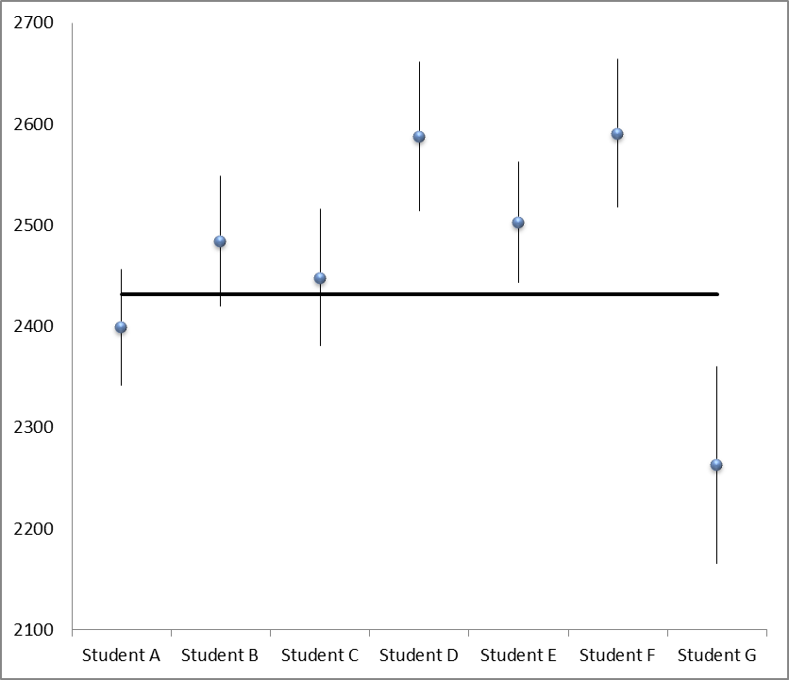
Grade 3 ELA IAB Example
Notes:
Now that the IAB scale score and standard error of measurement for each student has been determined in the system, we can visit an example to see how those scale scores and SEM are used to determine the IAB performance category.
This figure represents the IAB scale scores for seven students in Grade 3 English Language Arts.
The scale scores are represented by the blue dots.
The vertical lines above and below the blue dots represent the confidence interval for the IAB scale score for each student. Because the standard error of measurement represents the extent of uncertainty in a student’s scale score, this confidence interval is established as 1.5 times the standard error of measurement for each student, both above and below the IAB scale score for that student.
The black horizontal line represents the Grade 3 English Language Arts overall threshold score that divides Performance Level 2 from Level 3. For this example, the score is 2432; it is the minimum overall vertical scale score needed on the Grade 3 ELA Assessment for a student to be classified in Performance Level 3.
In short, the IAB reporting categories (below standard, at/near standard, above standard) result from comparing the student’s IAB scale score to the cut score that divides Achievement Level 2 from Level 3 (referred to as the “standard”), incorporating the standard error of measurement on the test.
If a student’s IAB scale score and confidence interval are entirely below the horizontal line, then that student is said to be performing “Below Standard” on the IAB. See Student G.
If a student’s IAB scale score and confidence interval touch the horizontal line, then that student is said to be performing “At/Near Standard” on that IAB. See Students A, B and C.
If a student’s IAB scale score and confidence interval are entirely above the horizontal line, then that student is said to be performing “Above Standard” on that IAB. See Students D, E, and F.
This explanation also applies to the Claim reporting categories for the summative assessment and Interim Comprehensive Assessment.

Slide 8
Important to Note
Fewer items used for IAB scale scores; therefore, the SEM for an IAB scale score will be greater than that of the overall vertical scale score.
Using 1.5 times the SEM for an IAB, instead of just 1, to establish the confidence interval gives greater confidence in the IAB performance category.
Use of a wider confidence interval (1.5 SEM) will result in more students in the “Approaching Standard” category.
Notes:
Please note the following:
IAB scale scores are derived using fewer items than the overall vertical scale scores; therefore, the standard error of measurement for an IAB scale score will be greater than that of the overall vertical scale score.
Using 1.5 times the standard error of measurement, instead of just 1, to establish the confidence interval gives us greater confidence in the IAB performance category that is assigned to the student. However, use of this wider confidence interval will result in more students being assigned to the middle category of “Approaching Standard.”

Slide 9
Thank you!
Contact
Email: ctstudentassessment@ct.gov
Phone: 860-713-6894
Notes:
I hope this presentation has provided you with an understanding of how the Interim Assessment Block Performance Categories are determined. For additional information, please refer to the Smarter Balanced Interpretive Guide or contact our office. Thank you!

