Slide 1
Administering Interim Assessments Remotely
Dr. Cristi Alberino and Deirdre Ducharme
CSDE Performance Office
Notes:
Hello.
We hope that everyone is doing well.
Welcome to this presentation in which we will be discussing Administering Interim Assessments Remotely.

Slide 2
Agenda
Using Interims Remotely
Administration of Interims
Accessibility
What to Do and What Not to Do
Resources
Student/Proctor Simulation
Notes:
The Agenda is as follows:
Using Interims Remotely
Administration of Interims
Accessibility
What to Do and What Not to Do
Resources
Student/Proctor Simulation

Slide 3
Purpose
This training will provide recommendations on procedures, proper uses, and tips for administering Smarter Balanced and Next Generation Science Standards (NGSS) Interim Assessments remotely.
Notes:
This training will provide recommendations on procedures, proper uses, and tips for administering Smarter Balanced and Next Generation Science Standards (NGSS) Interim Assessments remotely.

Slide 4
What are the Interim Assessments?
Interim Assessments
provide teachers with an additional resource that measures students’ mastery of specific content and skills.
are administered on a computer using the same test delivery system as the summative assessments.
are accessed using the Cambium Assessment, Inc. Secure Browser or Supporting Browsers (if remote).
Notes:
The interim assessments provide teachers with an additional resource that measures students’ mastery of specific content and skills.
Interim assessments are administered on a computer using the same test delivery system that the Smarter Balanced and NGSS summative Assessments use.
Typically, students use the Cambium Assessment, Inc. (CAI; formerly the American Institutes for Research Assessment) Secure Browser to take interim assessments at school. The CAI non-secure supporting browsers are available for remote testing.

Slide 5
Non-Disclosure Agreement
Interim items are classified as non-secure/non-public
Materials cannot be posted publicly, reproduced for commercial purposes, or sold
Materials contain copyrighted information
Notes:
Although the interim assessment items are non-secure items, the interim assessments are non-public.
They should not be emailed or posted on sites such as Google classroom.
Remember there are a finite number of items in each interim assessment block, and we will not be replacing current items.
Just to be clear, interim items are different than sample items.

Slide 6
Requirements for Using Interims Remotely. The TA …
administers the test consistent with policies for in-person administration.
monitors the test activity such that these interim tests are open only for the minimum amount of time necessary for students to complete their responses.
uses established test administration practices to support students getting access to the interim assessments.
Notes:
In general, the requirements are as follows:
The TA administers the test consistent with policies for in-person administration.
The TA monitors the test activity such that these interim tests are open only for the minimum amount of time necessary for students to complete their responses. The time necessary to complete an interim assessment will depend on the students taking the test, so times may vary. The same pause rules are in effect so tests can be paused when necessary.
The TA uses established test administration practices to support students getting access to the interim assessments.

Slide 7
Requirements for Using Interims Remotely. The TA …
reports any irregularities or security breaches immediately to the CSDE Assessment Office.
communicates with students to provide a session ID and SASIDs during student login using a secure method.
provides assistance and communicates with students during testing using a secure method
actively monitors the session to ensure students successfully complete the test.
Notes:
The TA reports any irregularities or security breaches such as interim items posted on social media, students sharing items, taking pictures of items, or items being emailed. These should be immediately reported to the CSDE Assessment Office at 860 713 6860 or ctstudentassessment@ct.gov. This information is also available at the end of the presentation.
The TA must communicate with students to provide a session ID and support students through the login process. This includes helping them securely locate their State Assigned Student ID (SASID).
It is important that the SASID is communicated using a secure method, such as a classroom management system, as opposed to non-secure methods such as private text messages and emails.
The TA actively monitors the test to ensure students successfully complete the test and that the session is not open longer than is necessary.

Slide 8
What Does the Test Administrator (TA) Do?

Slide 9
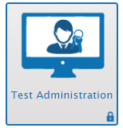
Test Administrator Duties
Using any web browser, navigate to Connecticut’s Test Administration Login page in the Comprehensive Assessment Portal, and log in using the same credentials used at school. Contact the district test administrator if login information is needed.
Notes:
Using any web browser, navigate to Connecticut’s Test Administration Login page in the Comprehensive Assessment Portal and log in using the same credentials used at school. Contact the district test administrator if login information is needed.
If the district test administrator needs assistance with access, please contact the CSDE at 860-713-6860 or ctstudentassessment@ct.gov.

Slide 10
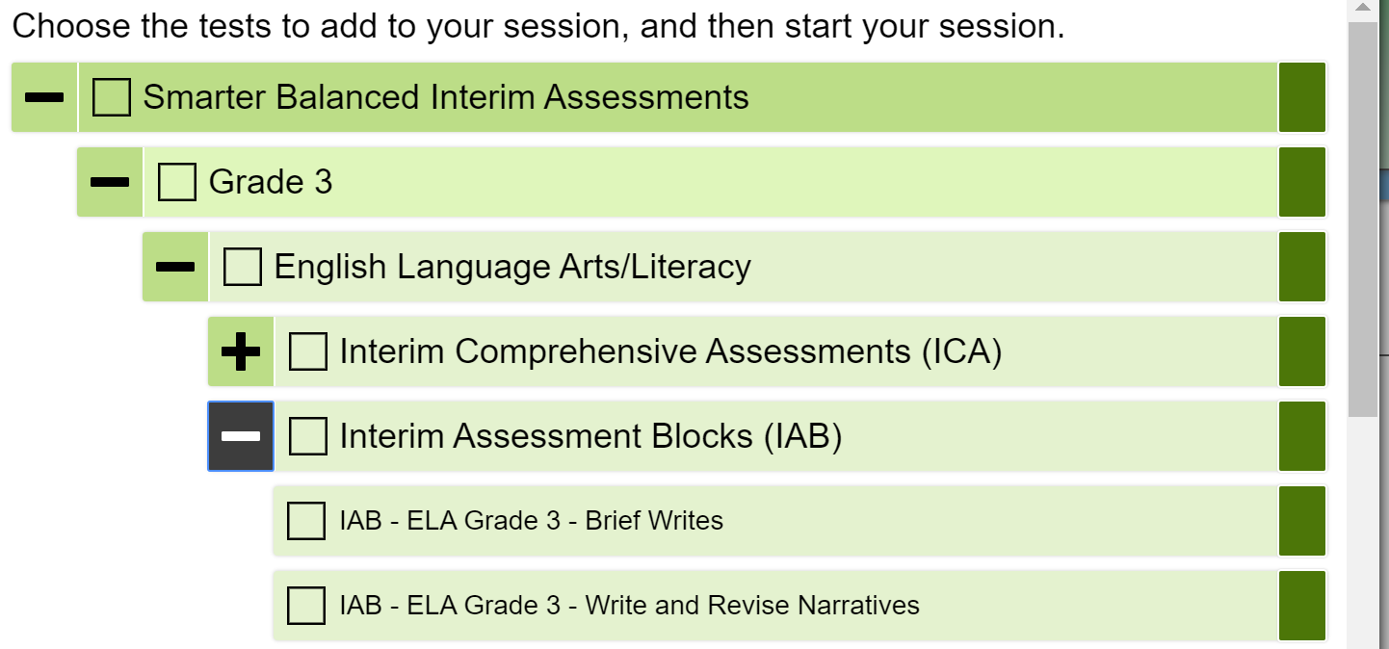
Test Administrator Duties
Once logged into the TA Interface:
Select the test grade and subject to be administered
Start the test session
Provide students with the session ID
After students sign in, they select the test assigned
Approve students to start testing
Actively monitor testing
After all students complete the test, stop the test session and log out
Notes:
Once logged into the TA Station:
Select the test grade and subject to be administered. All IABs across all grades are available for easy access if out-of-grade testing is needed (e.g., one grade above or below grade of enrollment).
Start the test session and securely provide students with the session ID that is generated. All students may use this session ID for the session.
After students sign in and select the test they are going to take, approve them so that they may start testing.
After all students complete the test, stop the test session and log out.

Slide 11
What Does the Student Do?

Slide 12
How Students Take the Test Remotely
The required software for student devices is listed in the following table.
If the student’s device is a . . . | . . . then the student’s device requires the following software:
loaner device from the school district with the CAI Secure Browser already installed | CAI Secure Browser (If the CAI Secure Browser is already installed, the devices require no further setup.)
personal device running Windows, Mac, or Linux | Chrome or Firefox web browser
personal device running Chrome OS | Chrome web browser
personal iPad | CAISecureTest app (You need to download this app from your iPad’s App Store.)
Notes:
Now we turn to the student. These are the browser restrictions.
More information is available on the CT Portal.

Slide 13
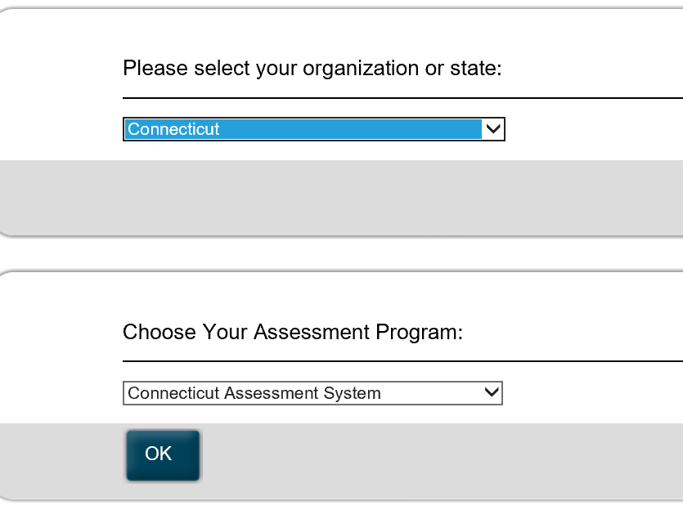
How Students Take the Test Remotely
In the URL bar, enter http://mobile.tds.airast.org/Launchpad and hit “Enter” on the keyboard. The Mobile Launchpad page appears.
From the drop-down lists, select “Connecticut” and then “Connecticut Assessment System.”
Select “OK.” The Student Sign-In page will appear.
Notes:
We will only be covering the administration using the standard browser since we believe most will be using that.
Enter the URL listed on the screen and hit “Enter” on the keyboard. The Mobile Launchpad page appears.
From the drop-down lists, select “Connecticut” and then “Connecticut Assessment System.”
Select “OK.” The Student Sign-In page will appear.

Slide 14
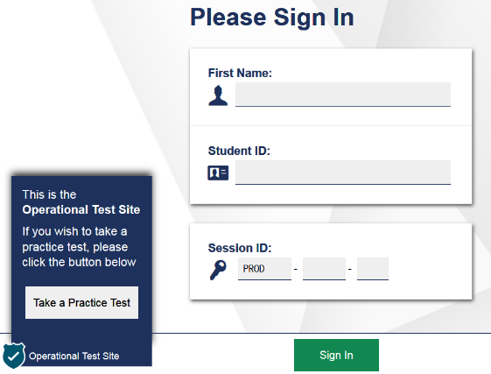
How Students Take the Test Remotely
Enter the following information:
In the First Name and Student ID fields, students enter their first names and SASIDs. The student’s first name should match the name indicated in PSIS. Students should not use nicknames.
In the Session ID field, students enter the session ID provided by the TA. This ID is created by TA’s when they activate a test session.
Notes:
In the First Name and Student ID fields, students enter their first names and SASIDs. The student first name should match the name indicated in PSIS. Students should not use nicknames.
In the Session ID field, students enter the session ID provided by their test administrator. This ID is created by TA’s when they activate a test session.
Remember that the SASID should be communicated using a secure method, such as a classroom management system, as opposed to non-secure methods such as private text messages and emails.

Slide 15
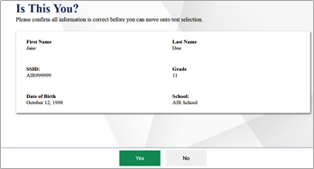
How Students Take the Test Remotely
Students select “Sign In.” The Is This You? page appears.
If all the information on that page is correct, select “Yes” to proceed. The Your Tests page appears.
Notes:
Students select “Sign In.” The Is This You? page appears.
If all the information on the Is This You? page is correct, select “Yes” to proceed. The Your Tests page appears.

Slide 16
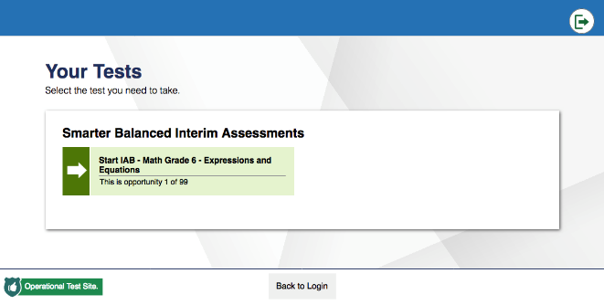
How Students Take the Test Remotely
From the Your Tests page, the student selects the interim assessment they will be taking.
Notes:
From the Your Tests page, the student selects the interim assessment they will be taking.

Slide 17
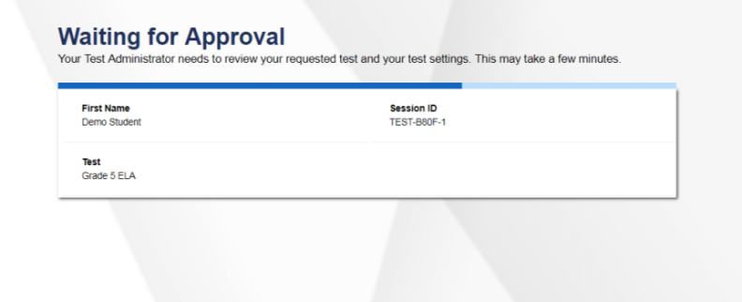
How Students Take the Test Remotely
The student’s request is sent to the TA, and the student is taken to the Waiting for Approval page. The TA must approve the student for testing. Once approved, the Instructions and Help page appears.
Notes:
The student’s request is sent to the test administrator, and the student is taken to the Waiting for Approval page. The test administrator must approve the student for testing before he or she can proceed. Once the test administrator approves, the Instructions and Help page appears.

Slide 18
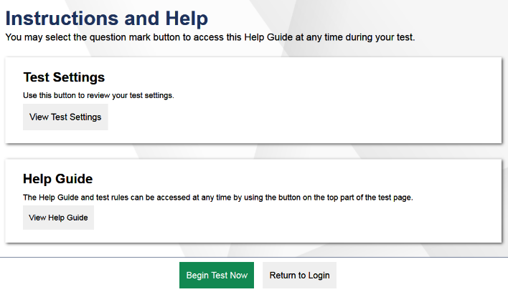
How Students Take the Test Remotely
To start the test, select “Begin Test Now.”
Notes:
To start the test, select “Begin Test Now.”

Slide 19
Let’s Not Forget Accessibility!
Check to be sure students have access to their accommodations or designated support by looking in TIDE.
Before approving interim assessments, teachers should verify supports and accommodations in Test Administration Interface.
Notes:
Embedded designated supports and accommodations are available for eligible students using interim assessments remotely assuming the supports are identified in the student’s TIDE profile. Prior to the administration of the test, teachers should verify the activation of supports (and accommodations for eligible students) in TIDE Test Settings. Refer to the Test Information Distribution Engine User Guide for details about setting supports and accommodations in TIDE and the Manually Entering Designated Supports and Accommodations brochure if entering these supports using the Test Administration Interface.
As a reminder, designated supports are available to all students with an identified need based on educator decision, while accommodations are only available to students with an active IEP or 504 Plan. Refer to the Assessment Guidelines and the Embedded and Non-Embedded Designated Supports for English Learners brochure for more information.
Some non-embedded designated supports are only available with a paper copy test (large print or braille or translation glossary for math or illustration glossary). The teacher should carefully consider what is needed for a student to access the interims. If they can't be provided as an embedded support, the teacher should consider the materials and tools available to the student in the home environment to assist with this process. These should already be in place because the student would most likely need the same tools to access distance learning.
Prior to testing, teachers should make sure students have access to scrap paper. For students in Grades 5-8 and 11, certain math IABs permit the use of an embedded DESMOS calculator. For these specific blocks, students may use a non-embedded calculator if one is available at home. The use of the following calculators are permitted: Grade 5- basic calculator, Grade 8 and 11- scientific or graphing calculator. Non-embedded calculators can also be used on the NGSS Interim Assessments.
The school (or district) should have a specific process in place for how these non-embedded designated supports and accommodations would be provided to ensure access while also maintaining the validity of the assessment.

Slide 20
Support for Administering Interim Assessments Remotely
Technical questions can be directed to the Connecticut Help Desk at 844.202.7583 or cthelpdesk@cambiumassessment.com.
General questions can be directed to the Performance Office Team at ctstudentassessment@ct.gov or 860.713.6860.
Notes:
While anyone can contact the CSDE, only educators can contact the Help Desk for technical support.

Slide 21
When Administering Remotely…
  DO
  Know the purpose for administering the interim assessment (or test items).
  Choose which interim assessment will provide the best information or determine whether presenting an interim item during instruction will best meet your needs.
Notes:
Before we present information on the various supporting tools and resources, we should go over the Do’s and Don’t’s of remote interim assessment administration.
- Know the purpose for administering the interim assessment (or test items).
- Choose which interim assessment will provide the best information or determine what new information you need about your students’ skills.

Slide 22
When Administering Remotely…
  DON’T
  Do not post the test items on the internet or a public page.
  Do not email interim test items.
  Do not email or text students’ personal or confidential information—even to parents. Use a secure method provided by your district.
Notes:
Remember the security issues already presented:
Do not post the test items on the internet or a public page.
Do not email interim test items.
Do not email or text students’ personal or confidential information, SASIDS,—even to parents. Use a secure method provided by your district.

Slide 23
Available Resources
Tools for Teachers: Remote Teaching and Learning
CSDE Comprehensive Assessment Program Portal
Quick Guide to Administer Interim Assessments Remotely
How to Activate an Interim Assessment Test Session
Next Generation Science Standards Test Administration Quick Guide
Notes:
We have three slides of linked resources that may help you in using any of these tools remotely. Some of these are new, such as the Tools for Teachers, Remote Teaching and Learning link. Also the Quick Guide to Administering Interim Assessments Remotely.

Slide 24
Available Resources
Embedded and Non-Embedded Designated Supports for English Learners
Manually Entering Designated Supports and Accommodations
Assistive Technology Manual
How to Activate a Test Session Smarter Balanced Interim Assessments
2020-21 Smarter Balanced Interim Assessment Overview
Notes:
The Assistive Technology Manual is new this spring 2020 and addresses the use of assistive technology for students with significant physical disabilities who rely on that.

Slide 25
Available Resources
CSDE Interim Assessment Web Page
Assessment Guidelines
Test Delivery System Test Administrator User Guide
Centralized Reporting System User Guide
Smarter Balanced Interim Assessment Test Administration Manual
Notes:
We encourage you to contact us with questions or concerns that might arise as you use these resources in very different ways than we have in the past.

Slide 26
Contact Information
Dr. Cristi Alberino, ELA
Education Consultant, Performance Office
Cristi.Alberino@ct.gov
860-713-6862
Deirdre Ducharme, Special Populations, ELA
Education Consultant, Performance Office
Deirdre.Ducharme@ct.gov
860-713-6859
CSDE, Performance Office
860-713-6860 ctstudentassessment@ct.gov
Notes:
Here you can find the email and phone numbers to reach out with questions. We have also listed the Help Line number and email for educators to use when they encounter technical issues.
Please stay safe and healthy.
Thank you for joining us!

