Slide 1


CONNECTICUT STATE DEPARTMENT OF EDUCATION
District Test Coordinator
Test Administration Workshop
Smarter Balanced, NGSS Standard, CTAA, and CTAS
January 23, 24 and 25, 2019

Slide 2
CSDE Assessment Staff
Performance Office
Abe Krisst
Bureau Chief, Student Assessment
Abe.Krisst@ct.gov
(860) 713-6894
Special Populations (CTAA, CTAS, and Accommodations/Supports)
Deirdre Ducharme
Deirdre.Ducharme@ct.gov
(860) 713-6859
Janet Stuck
Janet.Stuck@ct.gov
(860) 713-6837
NGSS Standard and CTAS
Jeff Greig
Jeff.Greig@ct.gov
(860) 713-6854

Slide 3
CSDE Assessment Staff
Performance Office
Smarter Balanced
  Cristi Alberino, Ph.D.
  Cristi.Alberino@ct.gov
  (860) 713-6862
Connecticut SAT School Day
Michelle Rosado
Michelle.Rosado@ct.gov
(860) 713-6748
All Assessments Support
Marlene Chameroy
Marlene.Chameroy@ct.gov
(860) 713-6860

Slide 4
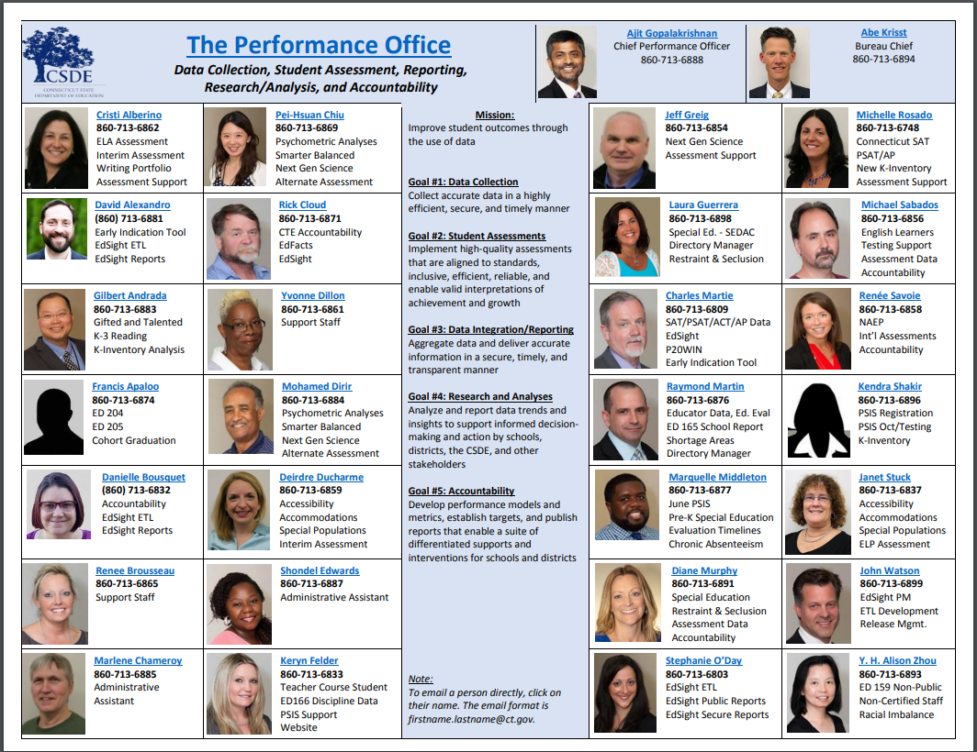

Slide 5
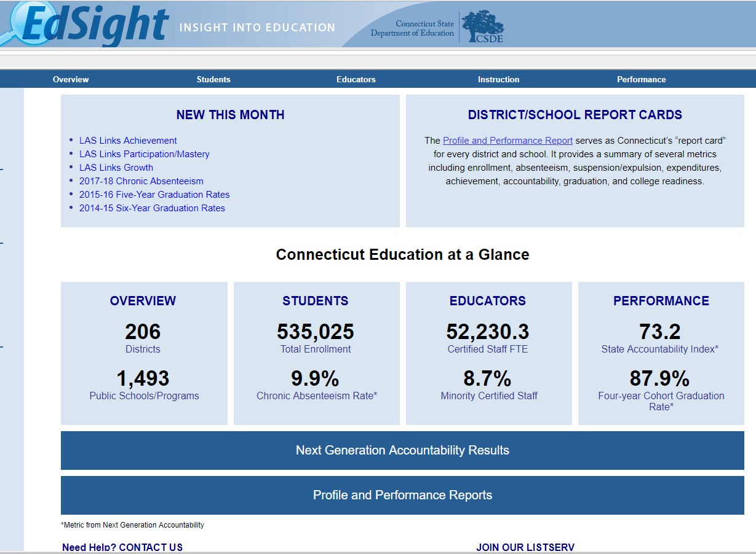
CSDE Assessment Reporting
http://edsight.ct.gov

Slide 6
Contact Information
Purpose | Who | Phone | E-mail
Test Administration Procedures Questions Technology Questions | Connecticut Help Desk (AIR) | 844-202-7583 | CTHelpDesk@air.org
Smarter Balanced and NGSS Science State Policy Test Administration Questions Reporting of Security Breaches Only | CSDE Performance Office | 860-713-6860 | ctstudentassessment@ct.gov
Designated Supports and Accommodations Questions CTAA and CTAS | Deirdre Ducharme Janet Stuck | 860-713-6859 860-713-6837 | Deirdre.Ducharme@ct.gov Janet.Stuck@ct.gov
Notes:
Note: Irregularities and Improprieties do not need to be reported directly to CSDE via phone or e-mail.

Slide 7
American Institutes for Research
  Connecticut Help Desk
  844-202-7583
  CTHelpDesk@air.org
  The Help Desk is open Monday – Friday 7:00 a.m. to 7:00 p.m.
  during summative testing.
  AIR Project Team
  Jen Chou, Program Director Amber Benlian, Program Manager
  Alicja Kania, Program Coordinator

Slide 8
Presentation Overview
Overview of Assessments for Spring 2019
  Updates for Connecticut Summative Assessments
  TIDE/PSIS Data Sync
  Policies - Test Completion, Security, Participation
  Improprieties, Irregularities, and Breaches
  Appeals Types
NGSS Assessment
AIR Systems Overview
Special Populations Update

Slide 9
Overview of Assessments for
Spring 2019

Slide 10
What has Remained the Same in 2019?
Smarter Balanced and CTAA
TIDE
Manuals
  DTC manual
  Science, CTAA, and Smarter manuals
Delivery of results for Smarter Balanced in June
Who needs to be tested – Private Approved Facilities/Out of State/Special Education/English learner
Office Hours
Notes:
Smarter Balanced and CTAA – These tests are the same.
TIDE – Some minor changes but not many. These will be covered in the AIR portion of the presentation.
Manuals – DTC Manual, Science, CTAA, Smarter and CTAS manuals are being distributed.
Delivery of results for Smarter Balanced in June.
Who needs to be tested – Private Approved Facilities/Out of State/Special Education/English learner
Regardless of the amount of time spent in a U.S. school, English learners must be assessed in ELA, mathematics and science.
Connecticut public school districts are responsible to test students enrolled in the Public School Information System (PSIS) who have been placed in out-of-state facilities or in-state, non-approved schools. This includes the Connecticut Next Generation Science Standards (NGSS) Test, Connecticut Alternate Science Test (CTAS), the Smarter Balanced Assessments, and the Connecticut Alternate Assessment (CTAA).
Office Hours – These will be hosted again this year. Registration information is forthcoming.

Slide 11

What is New in 2019?
New Secure Browser
Science Assessments – Standard and Alternate
Major New Support for NGSS Only
  Spanish Presentation/Translation for Science
No Testing of 12th Graders
Sign-On Confirmation for all Test Administrators in the TA interface
Training for the TEA Role
Errata for Grade 5 CTAS
Notes:
Science Assessments – Standard and Alternate: Both of these were field tested last year. This year, they are live.
Major New Accommodations
Spanish Presentation/Translation for Science: This is an embedded designated support that will allow Spanish Speaking students to toggle between a full Spanish translation of the test and the English version.
Testing of 12th Graders: Testing of 12th graders in CTAA or Science is not required.
Sign-On Confirmation for all Test Administrators in TIDE: All Test Administrators in TIDE will be asked to confirm training via a pop-up box when logging in.
Training for the TEA Role: The required online Alternate Assessment System Training is available on the Alternate Assessment card located on the CSDE Comprehensive Assessment Program Portal and can be accessed with TIDE user credentials. Teachers administering the Alternate Assessments will be required to take a quiz and receive a score of 80% or greater. Once the quiz is passed, this will activate the “Trained TEA” status in the TEA user account and provide permissions to access the online supporting systems. All TEAs will need this trained status to access the Data Entry Interface, which allows for the submission of the Learner Characteristics Inventory (LCI) to register a student for the Alternate Assessments. Only trained TEAs have user permissions to submit an LCI through the Data Entry Interface.
New Secure Browser: The new browser for 2018-19 should be loaded on all devices.
Errata for Grade 5 CTAS: A printing error occurred in the Resource Packet for the Grade 5 Connecticut Alternate Science Assessment (CTAS). This issue involves the graphic for Storyline 4 - Activity 6 - Resource 1 in Grade 5. The printed table has two rows of data when it should have three rows. The graphic has been updated and is available at the following link: Pond Organisms Data Table Poster. Districts should remove the resource from the CTAS Resource Packet and replace it with the updated graphic from the portal.

Slide 12
Connecticut Summative Assessments
School Year 2018 - 2019
State Assessment | Grade(s) | Testing Window | Delivery Method
Smarter Balanced ELA & Math | 3 – 8 | March 25 – June 7 | Online
Connecticut Alternate Assessment (CTAA) | 3 – 8 and 11 | March 25 – June 7 | Online
NGSS Assessment | 11 | February 4 – June 7 | Online
 | 5 and 8 | March 25 – June 7 | Online
Connecticut Alternate Science Assessment (CTAS) | 5, 8, and 11 | Test can administered all year. Student ratings entered into the DEI: March 25 – June 7 | Online Upload March 25 – June 7
Connecticut SAT School Day | 11 | March 27 or April 9 Makeup Dates: April 23 and 24 | Paper

Slide 13
Connecticut SAT School Day
Primary Test Date:
March 27, 2019 or April 9, 2019
Make-up Dates:
April 23 and 24, 2019
Test Coordinator Workshops
February 26 or 27, 2019
Contact Michelle Rosado at michelle.rosado@ct.gov with any questions.

Slide 14
Communication
CSDE Student Assessment Newsletter (SAN)
    Sent to
    The DA listed in TIDE
    SAT Test Center Supervisors and English Learner Assessment Coordinators
    Anyone can subscribe
    Posted on CSDE Web site and Connecticut Comprehensive Assessment Portal
CSDE Comprehensive Assessment Program Portal
    Sign up for e-mail updates (http://ct.portal.airast.org)

Slide 15
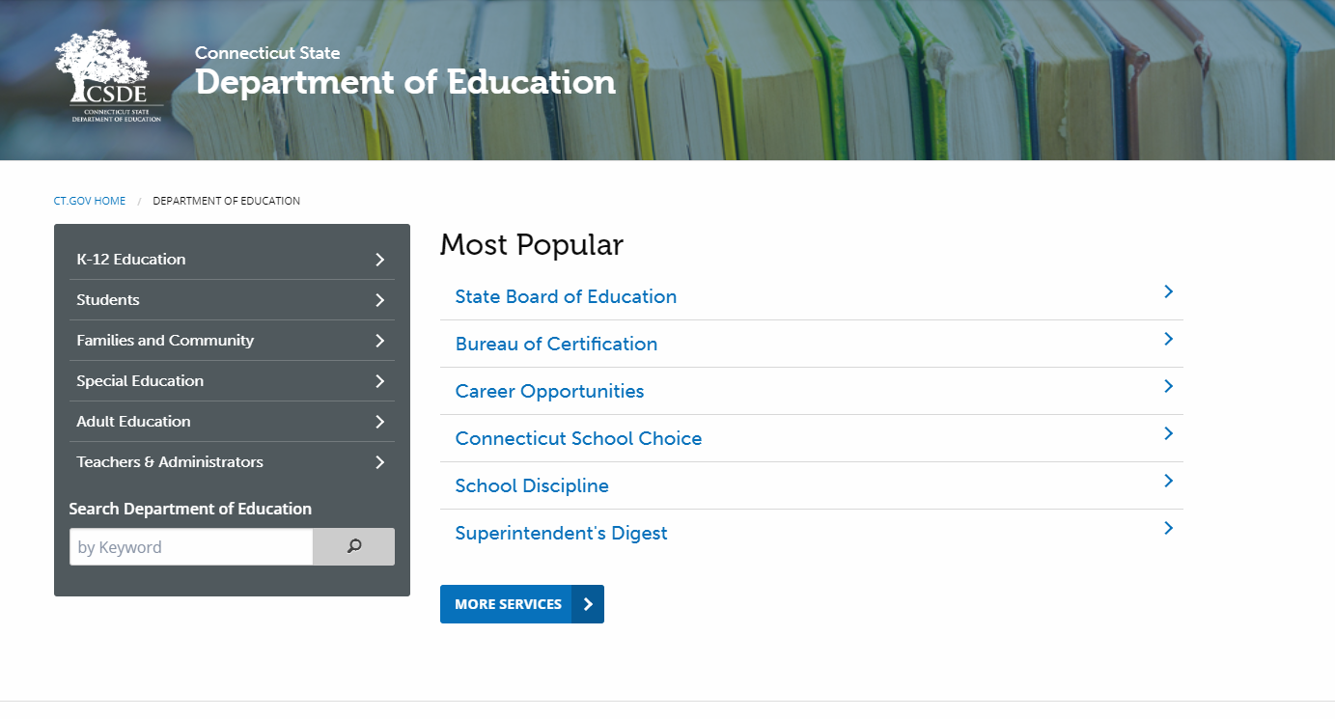
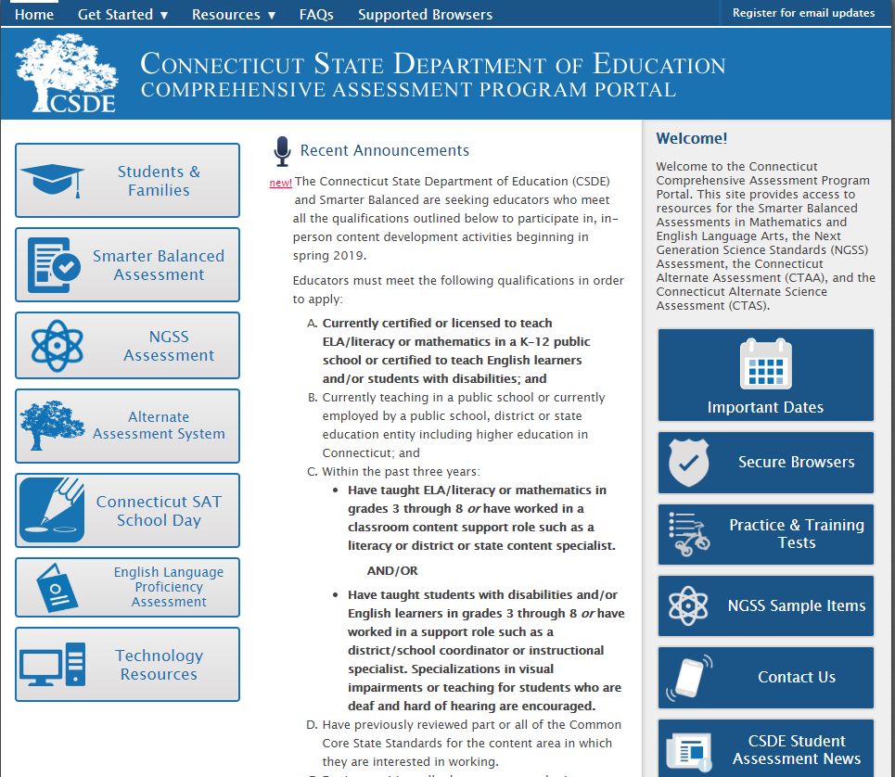
Communication – Web Sites

Slide 16

TIDE/PSIS Data Sync

Slide 17
TIDE/PSIS Data Sync
District Test Coordinators need to work with District PSIS Coordinators to ensure accurate student information is reported in the PSIS Registration Module and TIDE.
During the summative test window, changes made in PSIS Registration will automatically be updated in TIDE by the following day.
Notes:
District Test Coordinators need to work with District PSIS Coordinators to ensure accurate student information is reported in the PSIS Registration Module and TIDE.
The PSIS Coordinators should make all changes to student enrollment and demographic information directly in the PSIS Registration Module.
This information is the only way to ensure accurate reporting of the annual statewide test results.
Students need to be appropriately identified in the PSIS Registration Module to receive alternate assessment or indicate designated supports and accommodators in TIDE test settings
During the summative test window, changes in TIDE will be updated the day after those changes are made in the PSIS.

Slide 18
TIDE/PSIS Data Sync
SPED, FRL, EL, Military Family, and Homeless values have been loaded.
The values for Recently Arrived EL and Section 504 were not pulled from Freeze Zero. These must be set.
Student demographic values will be saved and the fields locked in PSIS on June 7, 2019. All changes to a student’s status at the time of testing must be made by then.
Notes:
SPED, FRL, EL, Military Family, and Homeless values have been loaded with the values reported in the October PSIS Collection Freeze Zero file (i.e., freeze file from the collection generated on November 2, 2018).
The values for Recently Arrived EL and Section 504 were not pulled from Freeze Zero. These values have been set to “No” in the Registration Module and must be updated in the PSIS Registration Module for testing and reporting purposes.

Slide 19
TIDE/PSIS Data Sync
Student Status Change
If Sped/EL/Lunch = Yes originally and then changed
  If student has already taken any state academic summative test
  o Leave as Yes for all tests
  If student has not already taken any state academic summative test
  o Change to No
If Sped/EL/Lunch = No originally and then changed
  If student has already taken any state academic summative test
  o Change to Yes for all subsequent tests and we will apply status for all tests
  If student has not already taken any state academic summative test
  o Change it to Yes
Notes:
If Sped/EL/Lunch = Yes
If Student has already taken any state academic summative test,
o Leave as Yes for all tests
If student has not already taken any state academic summative test
o Change to No
If Sped/EL/Lunch = No
If student has already taken any state academic summative test,
o Change it to Yes for all subsequent tests and we will apply status for all tests
If student has not already taken any state academic summative test
o Change it to Yes

Slide 20
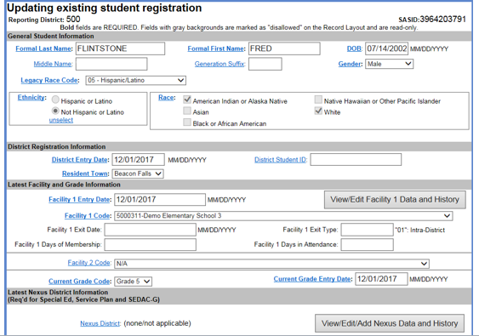
TIDE/PSIS Data Sync

Slide 21
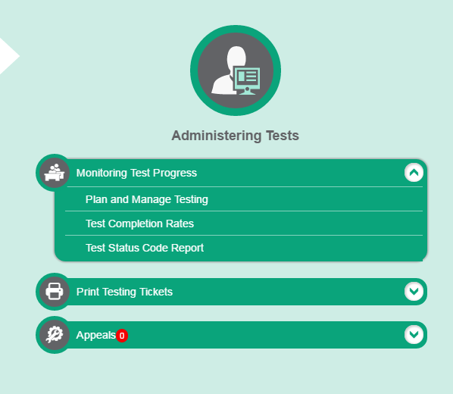
Test Completion
All students must complete testing by the end of the test window.
Extensions are generally not granted.
Some districts have not completed testing in years past.
How can districts track completion? By using tools on TIDE.

Slide 22

Test Security

Slide 23
Test Security
Breaches of test security include, but are not limited to:
  analyzing/copying test items
  coaching students
  giving students answers, and/or changing students’ answers
  allowing students access to digital, electronic, or manual devices (except approved accommodations)
  unauthorized log-in to the Test Delivery System
Cell phone use by students is prohibited in testing rooms!

Slide 24
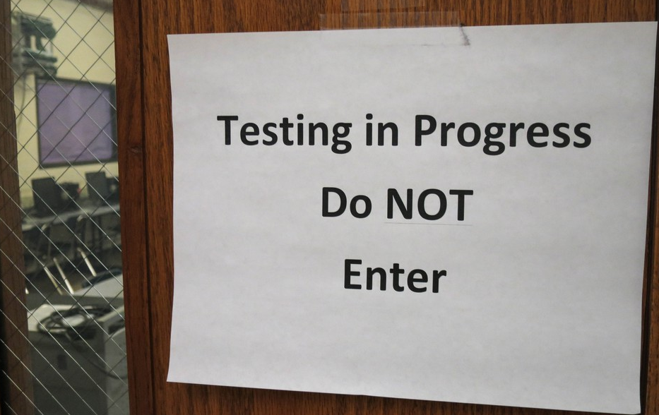
State Policy Regarding Participation

Slide 25
Participation - Connecticut General Statutes 10-14n
    (b) (1) For the school year commencing July 1, 2015, and each school year thereafter, each student enrolled in grades three to eight, inclusive, and grade eleven in any public school shall, annually, take a mastery examination in reading, writing and mathematics during the regular school day.
    (2) For the school year commencing July 1, 2013, to July 1, 2017, inclusive, each student enrolled in grades five, eight and ten in any public school shall, annually, in March or April, take a state-wide mastery examination in science during the regular school day.
    (3) For the school year commencing July 1, 2018, and each school year thereafter, each student enrolled in grades five eight and eleven in any public school shall annually take a state-wide mastery examination in science during the regular school day.

Slide 26
Participation
Federal law expects full participation of all students.
The minimum standard for participation is at least 95 percent of all students for each subject.
At the district and school level, the CSDE evaluates the participation rate for all students, as well as students in the "high needs" subgroup for all content areas.
Notes:
Federal law continues to expect full participation of all students on the state summative assessments. The minimum standard for the participation rate is at least 95 percent of all students and all student groups for each subject. For accountability purposes at the district and school level, the CSDE evaluates the participation rate for all students, as well as students in the "high needs" subgroup for all content areas.

Slide 27
Participation
A student is a “Participant” if…
A student is a “Non-Participant” if…
For Smarter Balanced
      The student logs into both the CAT and PT for Math and the CAT for ELA.
For Science
      The student logs into the assessment.
For Smarter Balanced
      The student does not log into any test session, or the student logs into only one of the two sessions for the Math test.
For Science
      The student does not log into the assessment.

Slide 28
Improprieties Irregularities and
Breaches

Slide 29
Test Security Levels
Type | Action
Impropriety | Incident corrected and contained at the district/school or entered in the Appeals module of TIDE (if appropriate).
Irregularity | Incident submitted in the Appeals module of TIDE (if appropriate) by end of the day of the incident.
Breach | The District Test Coordinator must immediately notify the CSDE at 860-713-6860.
Note: The Test Security Levels are fully described in Appendix G of the Test Coordinator’s Manual.
Notes:
Level of Severity and Potential Effect on Test Security
Types of Issues
LOW
Impropriety
Student(s) making distracting gestures/sounds or talking during the test session that creates a disruption in the test session for other students.
Student(s) leave the test room without authorization.
Testing staff leaving related instructional materials on the walls in the testing room.
MEDIUM
Irregularity
Student(s) cheating or providing answers to each other, including passing notes, giving help to other students during testing, or using hand-held electronic devices to exchange information.
Student(s) accessing the Internet or any unauthorized software or applications during a testing event.
Student(s) accessing or using unauthorized electronic equipment (e.g., cell phones, iPods, or electronic translators) during testing.
Disruptions to a test session such as a fire drill, school-wide power outage, earthquake, or other acts.
Testing staff failing to ensure administration and supervision of the assessments by qualified, trained personnel.
Testing staff giving incorrect instructions that are not corrected prior to testing.
Testing staff giving out their username/password (via email or otherwise) to anyone, including to other authorized users.
Testing staff coaching or providing any other type of assistance to students that may affect their responses. This includes both verbal cues (e.g., interpreting, explaining, or paraphrasing the test items or prompts) and nonverbal cues (e.g., voice inflection, pointing, or nodding head) to the correct answer. This also includes leading students through instructional strategies such as think-aloud, asking students to point to the correct answer or otherwise identifying the source of their answer, or requiring students to show their work.
Testing staff providing students with non-allowable materials or devices during test administration or allowing inappropriate designated supports and/or accommodations during test administration.
Testing staff allowing anyone other than a student to log in to the test unless prescribed as an allowable accommodation in the student’s IEP. This includes TAs or other staff using student information to log in or allowing a student to log in using another student’s information.
Testing staff providing a student access to another student’s work/responses.
HIGH
Breach
Testing staff modifying student responses.
The live Student Interface or Test Administration Interface being used for practice instead of a live test administration. Live interfaces should only be accessed via the secure browser for live Summative Assessments. Any practice or training tests should be taken on the Practice Test and Training Test sites, available on the Connecticut Comprehensive Assessment Program Portal.
Adult or student posting items or test materials on social media (Twitter, Facebook, etc.).
Testing staff allowing students to take home printed test items, reading passages, writing prompts, or scratch paper that was used during the test or failing to otherwise securely store test materials.
Adult or student copying, discussing, or otherwise retaining test items, reading passages, writing prompts, or answers for any reason. This includes the use of photocopiers or digital, electronic, or manual devices to record or communicate a test item. This also includes using secure test items, modified secure test items, reading passages, writing prompts, or answer keys for instructional purposes. This includes reviewing secure test items beyond active proctoring of students.
Secure test materials (e.g., writing prompts, test items, or reading passages) being shared with the media, or allowing media to observe a secure test administration.
Adult or student improperly removing secure testing materials, such as test items, stimuli, reading passages, writing prompts, or scratch paper from the testing environment.

Slide 30
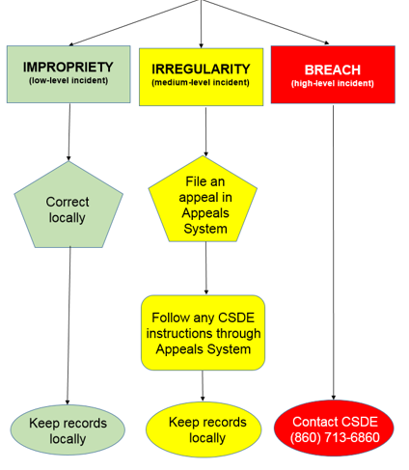
Testing Incident

Slide 31
Appeal Types
Appeal Type | Description
Reset a Test | Removes the test and scores from the system Enables student to start a new test
Re-open a Test | Allows for a test that has already been submitted in error or has expired to be re-opened
Re-open a Test Segment | Re-opening a test segment allows a student to access the first segment of a test that was submitted in error
Grace Period Extension | Granted if a test session is unexpectedly interrupted Allows access to all previous responses
Restore a Test That Has Been Reset | Returns a test from the Reset status to its prior status Only allowed on tests that have been reset A test can be restored if it was reset in error
Invalidate a Test | Rarely Used Eliminates the test Student does not receive a score
Notes:
Description
Invalidate a Test
Invalidations are extremely rare. Invalidating a student’s test eliminates the test opportunity, and the student will have no further opportunities to complete the test. Invalidated tests will not be scored. You can submit these appeals until the end of the test window.
The CSDE may approve an appeal to invalidate a test if a student was administered the wrong grade-level test because of an error in the Public School Information System (PSIS)—this type of event should be logged as a testing irregularity.
Reset a Test
Resetting a student’s test allows the student to restart a test opportunity (removing all responses on the test), or allows the data entry operator to restart the data entry process. You can submit these appeals until the end of the test window.
The CSDE may approve an appeal to reset a test in the event that certain test settings need to be changed because they were incorrectly set while the student is testing. Some embedded test settings will not appear until after the test has been reset.
Re-open a Test
Re-opens a test that was completed, invalidated, or expired.
This appeal is useful when a student is unable to complete a test due to a technological difficulty that results in the expiration of the test or a student is unable to complete the test before it expires due to an unanticipated excused absence or unanticipated school closure.
When you submit an appeal to re-open a test, a GPE appeal will automatically be submitted.
Grace Period Extension (GPE)
Allows a student to review previously answered questions upon resuming a test or test segment after expiration of the pause timer. For example, a student pauses a test, and a 20-minute pause timer starts running. The following scenarios are possible:
If resuming the test within 20 minutes, a student can review previously answered questions.
Without a GPE, a student resuming the test after 20 minutes cannot review previously answered questions—a student can only work on unanswered questions.
Upon receiving a GPE, a student can review previously answered questions upon resuming the test. The normal pause rules apply to this opportunity.
Restore a Test that was Reset
Reverses a reset, restoring the student’s responses to what they were before the reset was processed.
The CSDE will only approve an appeal to restore a test if a test was inadvertently or inappropriately reset.
Re-open Test Segment
Re-opens a test segment. Students can answer unanswered items and modify responses to answered items in the re-opened segment.
This appeal is useful when a student inadvertently or accidentally leaves a test segment incomplete and starts a new test segment. Students can answer unanswered items, and can modify responses to answered items in the reopened test.
New change this year:
If a testing irregularity occurs that is tracked through a TIDE appeal, and a student with an IEP or 504 Plan is not given the correct assessment or is not provided the mandated accommodations, the DTC must provide a letter to the CSDE on their district/school letterhead. Letters must be on district/school letterhead, signed by the DTC, and faxed to Performance Office Irregularities at 860-713-7033 or 860-326- 0540. The letter must include:
a. The student’s grade, SASID, and the name of the test on which the irregularity occurred;
b. The date and a detailed explanation of the irregularity;
c. The name of the teacher involved;
d. A description of the discussion that occurred with parents/guardians of the student explaining the irregularity, options offered, and impact on the student’s time;
e. A brief list of procedures in place to ensure the irregularity is not repeated.

Slide 32
District Volunteers
Please see information in recent Student Assessment News for Smarter Balanced test development opportunities.
CSDE is recruiting volunteer districts to visit during testing. Please see the CSDE staff for more information.

Slide 33
NGSS Assessment

Slide 34
2019 NGSS Assessment
First live test administrations. All students in Grades 5, 8 and 11 must participate.
Assessment | Grades | Testing Window
NGSS Standard Assessment | 11 | February 4 – June 7, 2019
NGSS Standard Assessment | 5 and 8 | March 25 – June 7, 2019

Slide 35
2019 NGSS Assessment
Standards for the four performance levels will be set next summer by a committee of Connecticut educators and community leaders.
Results will be available for students, schools, and districts in early Fall 2019. Participation (target = 95%) and performance results will be included in school and district accountability.
Reporting: Overall Science plus three claim scores: Using the science and engineering practices to demonstrate understanding of the disciplinary core ideas and crosscutting concepts in: 1) Life Science; 2) Physical Science; and 3) Earth/Space Science. School and district results will also be reported for DCI areas (e.g., Ecosystems, Earth’s Systems).
Notes:
Additional target-level reporting will likely be available for schools and districts for the various disciplinary core ideas (e.g., Ecosystem, Energy, Earth’s System, etc.).

Slide 36

Administered online using same AIR systems as Smarter Balanced, in a single day (with a break) or across multiple days. Students are not allowed to return to completed items after a break of more than 20 minutes.
Assessments will use matrix sample design – students will be assigned different items from a large item pool.
Live tests include 12 stand-alone items and 6 item clusters. Additional field tested items added.
Variety of item types including simulations and animations.
90 minutes (plus 10 minutes for directions) is the minimum administration time. Students have as much time as needed.
Notes:
Live tests include 12 stand-alone items and 6 item clusters. Additional field tested items added (1 cluster or 6 stand-alone items) variety of item types including innovative items such as interactions and simulations.
90 minutes (plus 10 minutes for directions) is the minimum administration time. Students have as much time as needed. Time is monitored by test examiner (not by TDS).

Slide 37
Design of NGSS Assessments
(at Grades 5, 8, and 11)
Content Area | DCI Area | Stand-Alone Items | Item Clusters
Life Science | From Molecules to Organisms | 4 | 2
 | Ecosystems
 | Heredity
 | Biological Evolution
Physical Science | Matter and Its Interactions | 4 | 2
 | Forces and Motion
 | Energy
 | Waves and their Applications
Earth/Space Science | Earth’s Place in the Universe | 4 | 2
 | Earth’s Systems
 | Earth and Human Activity
 | Total | 12 | 6

Slide 38

NGSS Assessment
Variety of Universal Tools, Designated Supports, and Accommodations available for students including:
Text-to-Speech available to all students (headphones only needed for TTS)
Spanish translation for ELs (using new “toggle” feature)
Desmos calculators available at each grade.
Periodic Table available online for students in Grades 8 and 11. Districts are responsible for printing copies from PDF available on web portal.

Slide 39
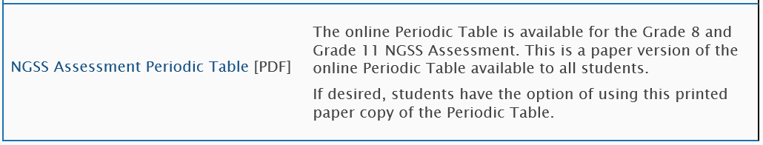
NGSS Assessment

Slide 40
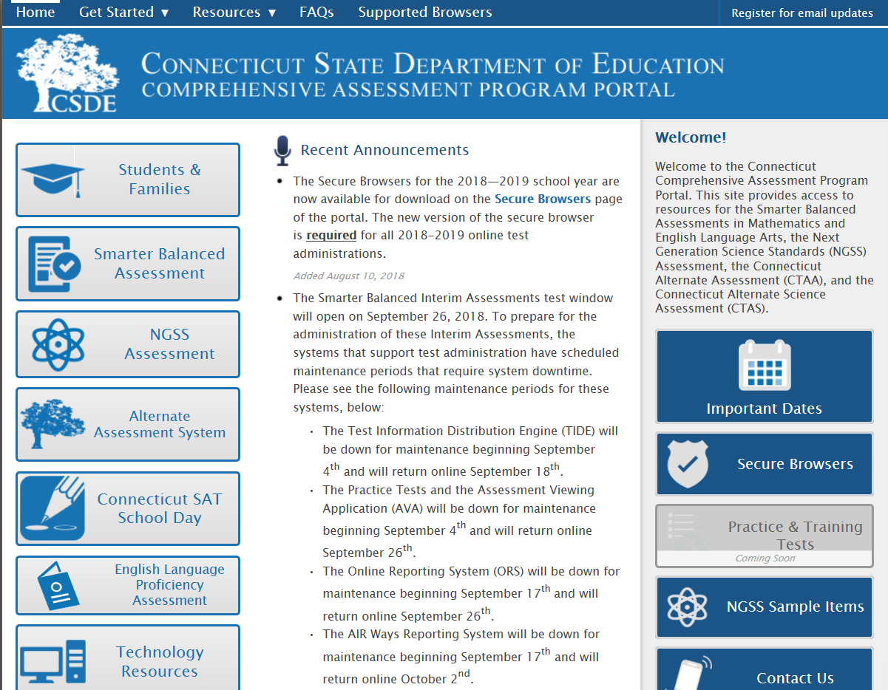
NGSS Sample Items and Practice Tests
http://ct.portal.airast.org
Five NGSS sample item clusters at each grade band.
Updated NGSS Practice Tests are now available. Includes item clusters and stand-alone items with all item interaction types.

Slide 41
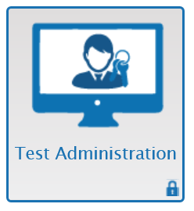
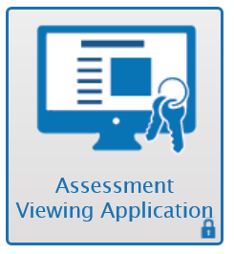
NGSS Interim Assessments
Optional
Administered through AIR’s online Test Delivery System (TDS)
Educators can view and score the items using the Assessment Viewing Application (AVA)
Include “testlets” with two item clusters aligned to two different NGSS performance expectations from various topic areas (e.g., Forces and Motion, Ecosystems, Earth Systems). Should take students 15-20 minutes each.

Slide 42
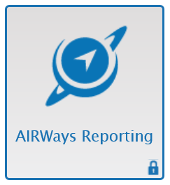
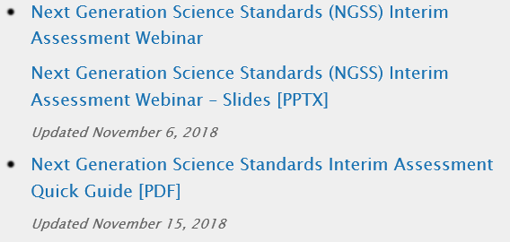
NGSS Interim Assessments
All items are machine-scored (no constructed response)
Results available immediately at various levels (i.e., student, class, school, district) through AIRWays reporting system
Recorded training webinar with slides and Quick Guide are available on web portal

Slide 43
AIR Systems Overview
Notes:
This presentation is designed to introduce you to testing systems administered by the American Institutes for Research.

Slide 44
Overview
Portal
Secure Browser
Test Information Distribution Engine (TIDE)
Test Delivery System (TDS)
Data Entry Interface (DEI)
Notes:
Over the course of this presentation we’ll talk about:
the portal, your gateway to the AIR systems;
the Secure Browser which allows the students to access the tests;
the Test Information Distribution Engine (TIDE), which contains student and user data;
the Test Delivery System (TDS);
the Online Reporting System (ORS); and
the Teacher Hand Scoring System (THSS).

Slide 45
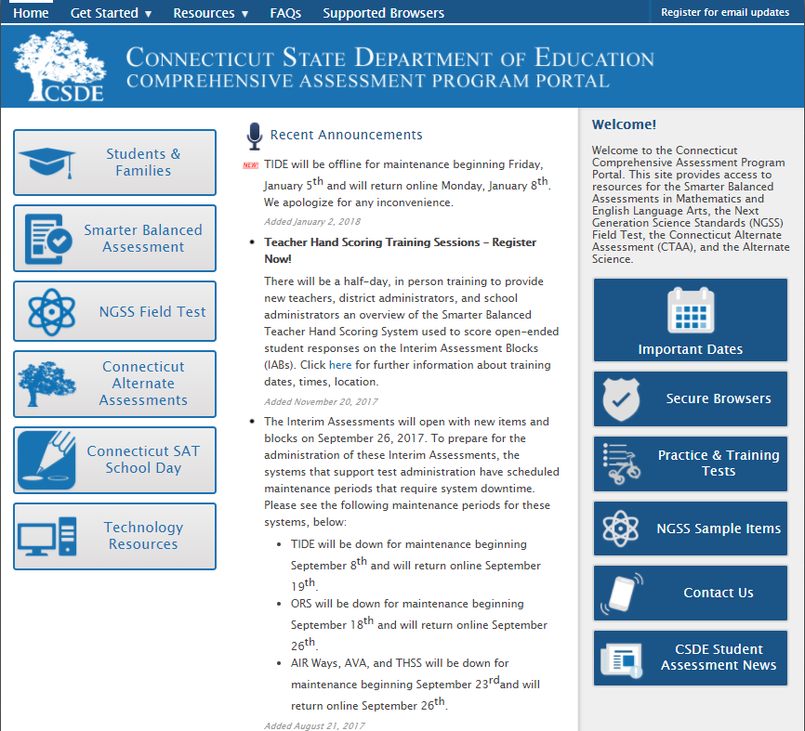
Connecticut Portal: Home Page
Notes:
The Connecticut Smarter Balanced Portal is your access point to all of the systems provided by AIR. It is also where you can find testing resources, help desk information, timely testing announcements, and Frequently Asked Questions (FAQ).
The portal is organized by user role. On the left side of the screen are cards showing each possible user role.
The center of the screen shows the announcements relevant to all user roles. On the right side are quick links to important sections of the portal.
At the top of the screen is a menu bar. This menu bar appears on all portal pages and allows you to easily navigate the website.
Also on the menu bar is a link where you can sign up to receive updates and messages about the portal.

Slide 46
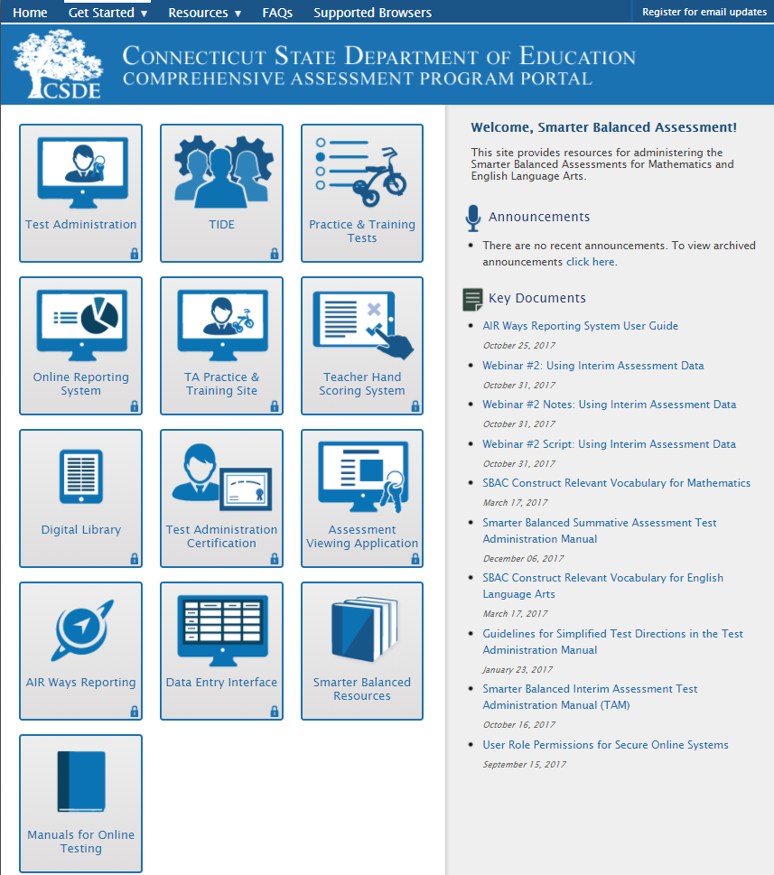
CT Portal: Assessment Program Pages
Notes:
The program pages consist of two sections, one section on the right, containing announcements specific to each type of assessment program. Any announcements specific to only one assessment program will be posted here.
On the left side of the page are more cards. These cards link to the systems and resources specific to the user type.
Cards with the small lock icon on them are links to systems which require a login and password to access. If a card is gray with the coming soon banner the system to which it links is not yet live.

Slide 47
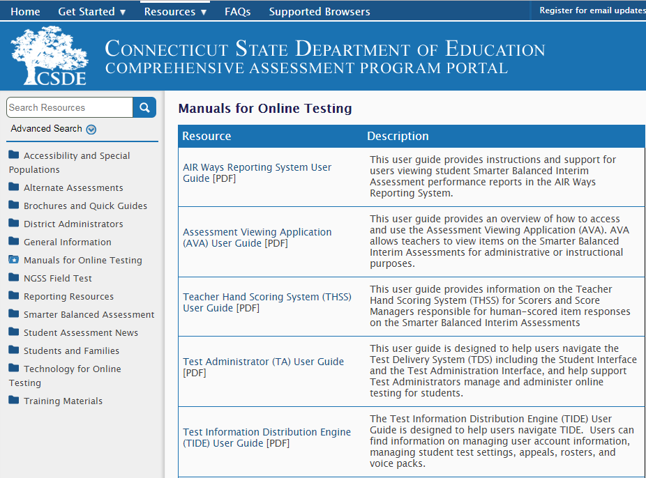
CT Portal: Resources
Notes:
One of the sections of the portal is a resource page. This page contains folders and subfolders with appropriate resources.
These resources are organized in a tree structure with subfolders inside folders, and resources inside the folders. You may click on each folder to access the applicable resources.

Slide 48

What is the Secure Browser?
The browser is designed to ensure test security by prohibiting students from accessing any other programs or websites during testing.
Notes:
The secure browser is designed to ensure test security by prohibiting students from accessing any other programs or websites during testing.
This is the only piece of specialized software that needs to be downloaded. It needs to be installed on each computer that students will use to test.
The secure browser is available on Windows, Mac, Linux, Chromebooks, and supported tablets so you will need to make sure to download the appropriate Secure Browser.
Students must use the secure browser to log in to the Student Interface. The secure browser is designed to ensure test security by prohibiting students from accessing any other programs or websites during testing. Your school’s Technology Coordinator is responsible for ensuring that the secure browser has been correctly installed on all testing devices. If you have questions about the secure browser, contact your Technology Coordinator.

Slide 49
Secure Browser Information
Download the latest secure browser from the portal. The browser from 2017–2018 will no longer work.
Before taking a test, all applications must be closed.
Students will use the secure browser to take the Smarter Balanced assessments, NGSS, and the CTAA.
Notes:
Make sure you download the latest secure browser from the portal.
Make sure students have closed all applications on their computer before trying to log in. The Secure Browser will throw an error message if any application is open.

Slide 50
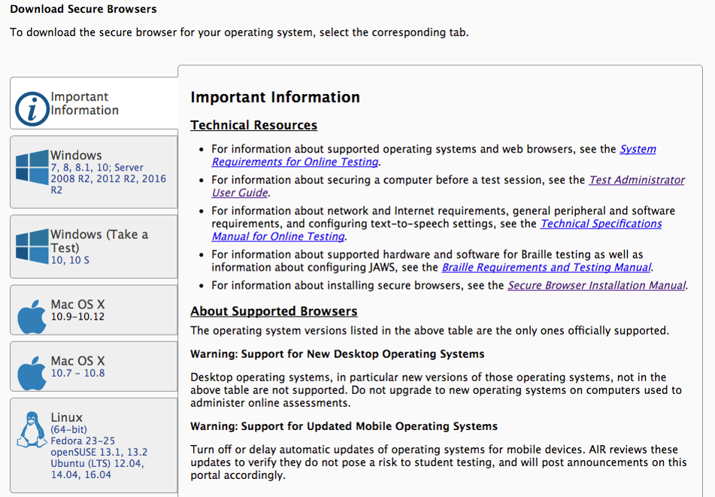
Secure Browser Download
Notes:
On the download page of the portal you’ll find links to browsers for each operating system.
Supported systems are found either in the System Requirements document available on the portal or in the table at the top of the download page.
Additionally, the secure browser app may be found in the app store for each tablet.
The Secure Browser may be installed individually with your usual network tools. More information can be found in the Secure Browser Installation Manual available on the portal.
Are there any questions regarding the Secure Browser?

Slide 51
Chrome Update
AIR currently supports Chrome versions 67 to 71.
  AIR provides presumptive support for new versions of Chrome as they are released, which means students are not prevented from taking tests on the newest versions. However, although AIR and Google work collaboratively on new versions, with each new release, AIR does need to perform internal testing to make sure there are no issues. If issues are discovered at this stage, AIR and Google will resolve them as quickly as possible. It is our recommendation that all devices are locked down before the test administration window begins. This will reduce the risk of any issues occurring during testing should a new version be released with problems that were not anticipated.
AIR can no longer support a device once Google stops supporting it. Please continue to monitor Google’s end-of-life policy (https://support.google.com/chrome/a/answer/6220366?hl=en).

Slide 52
Mac OS Support
AIR released a new secure browser on November 30th in order to support 10.14 and address new security issues with the other Mac OS versions.
All macOS devices (10.9 to 10.14) are required to have the new secure browser installed in order to take one of the Connecticut Comprehensive Assessments.
The previous secure browser will not work after December 31, 2018.

Slide 53
Accessing AIR Systems
All user accounts were rolled over and passwords reset on September 18, 2018.
Starting this year, setting up a security question is no longer required.
If you log in on a new device or browser (or clear the cache on a previously-used browser) you must enter an emailed code after passing the initial login screen. This step does not occur when you activate your account.

Slide 54
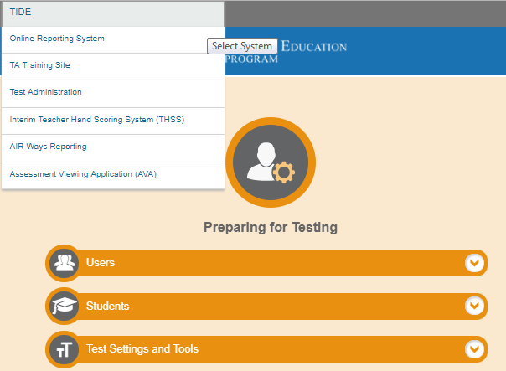
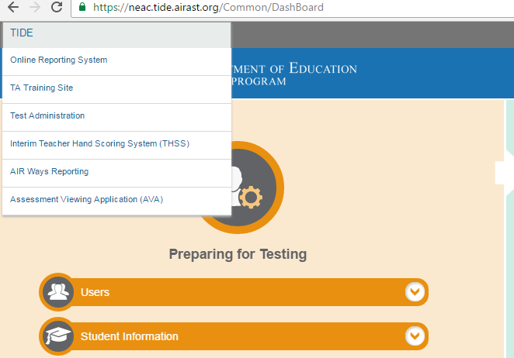
Accessing AIR Systems from TIDE
Notes:
Now that we have discussed the Portal and the Secure Browser, let’s move on to the systems.
AIR uses a Single Sign On System. This means that your user name and password for TIDE will also be used for all other systems (TDS, ORS, User Interface, and THSS). Also, once a user has logged into one online system, he or she can go into other online systems without having to log in again until the user logs out of the system.
After logging in, the user is free to navigate between systems. In the top left of any secure application you’ll see a dropdown menu. This menu will initially show you the application you are in. You can click on the dropdown and select the system you wish to navigate to.
The Digital library is provided by Smarter Balanced, not AIR, and needs a separate login. AIR is looking to federate the two systems so that in the future, the same login will also work with the Digital Library.

Slide 55
TIDE: User Roles
Task | DA | DC | SC | SA | TE | TEA | TA
Viewing and Editing Student Settings | ✓ | ✓ | ✓
Manage Rosters | ✓ | ✓ | ✓ | ✓ | ✓ | ✓
Adding User Accounts | ✓ | ✓ | ✓
Create Appeals | ✓ | ✓ | ✓
Downloading and Installing Voice Packs | ✓ | ✓ | ✓ | ✓ | ✓ | ✓ | ✓
Notes:
Your TIDE account has a role, and that role has certain permissions. This table is the user roles table for Connecticut. For instance, the District Administrator role has permission to perform all the tasks in TIDE. The Test Administrator role can only view student information and download voice packs.
In addition to limiting tasks, permissions limit scope. A district-level user can work with data pertaining to that district, and a school-level user can work with data pertaining to that school.
For a detailed list of user roles and associated permissions, see your TIDE User Guide.

Slide 56
TIDE: User Roles
A new user role has been created for 2018 – 2019: District Reporting (DR) Administrator
The DR role allows users to access all the results for a district in ORS
DR role will also have view-only role in TIDE. However, DR role will not allow the user to add other users, approve appeals, order materials, etc.

Slide 57
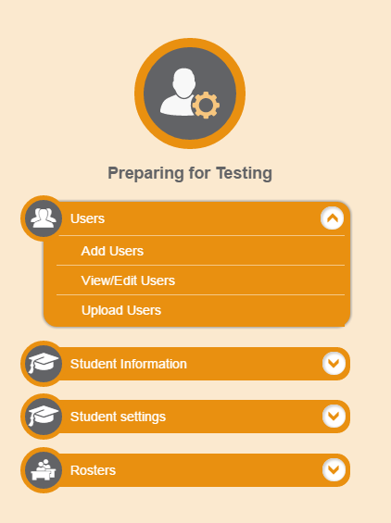
TIDE: Manage Users
Notes:
The first TIDE feature we will look at is Manage Users. Here you see the Users tab. If you want to add users this is the tab you will go to.

Slide 58
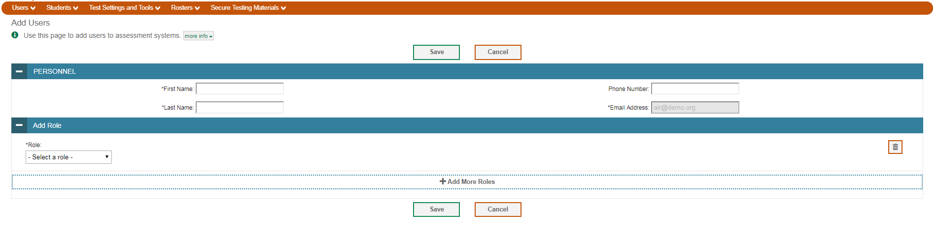
TIDE: Add Users
Notes:
If a user does not exist in TIDE you may add them. There are two ways to add user accounts. The first way is to manually add them with the [Add User] button. Fill out the information in the form, and click [Add User]. The fields marked with an asterisk are mandatory. The e-mail address will be the user’s username for all AIR applications.
The second way to add users is to create an upload file in Excel or CSV format, and then upload that file to TIDE. If you have many new users to add, this method is easier than adding each one individually with the Add users. To create an upload file, download the correct template from TIDE and fill it out with your users. More information on this process is available in the TIDE User Guide on the portal.

Slide 59
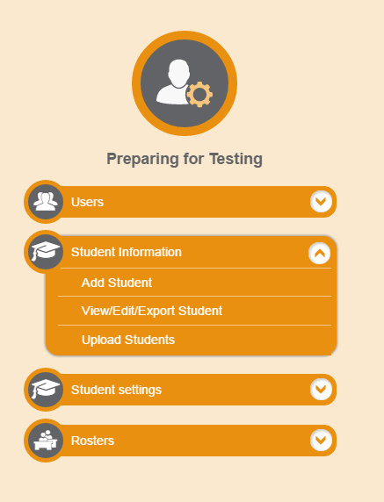
TIDE: Student Information
Notes:
The next TIDE tab we will discuss is the [Student Information] tab. This tab contains sub-tabs for viewing students, and uploading students test settings. Only the state is will be adding, deleting and updating student records
Accommodations and designated supports will be set at the school or district levels. TAs and teachers cannot assign accommodations and designated supports in TIDE.

Slide 60
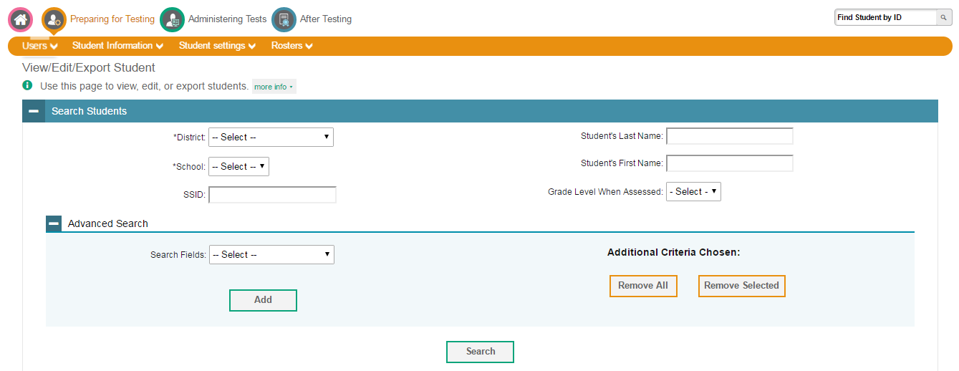
TIDE: Retrieve Students
Notes:
The View Students page includes a form for setting selection criteria to search for students. Some criteria are required, such as the state, district, and school. Other criteria are optional, such as the SSID and student’s first or last name.
You can further refine your criteria by clicking [Add Additional Search Criteria]. Using this feature, you can retrieve students matching required demographics, test settings, or other criteria.

Slide 61
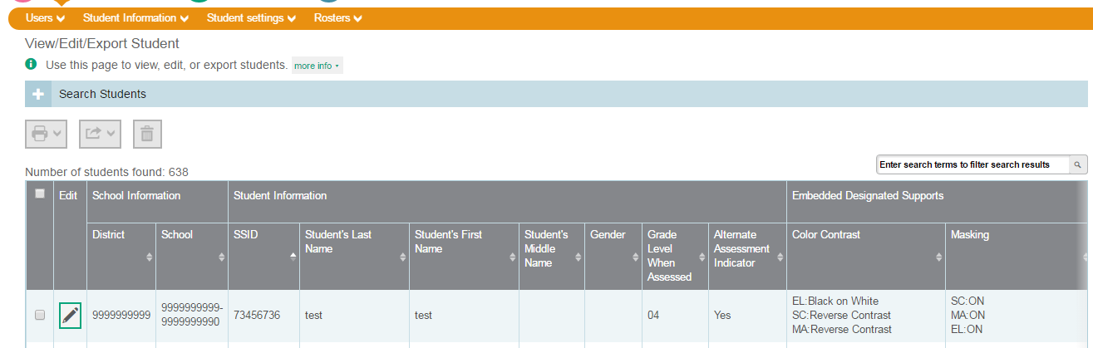
TIDE: View Retrieved Students
Notes:
TIDE will display all the students satisfying the search criteria. You can sort the listing by clicking a column heading in the table. From here you can:
You can modify a student’s test settings and accommodations, by clicking [View].
You can export student information into an Excel file
For more detailed information about each of these activities, see the TIDE User Guide.

Slide 62
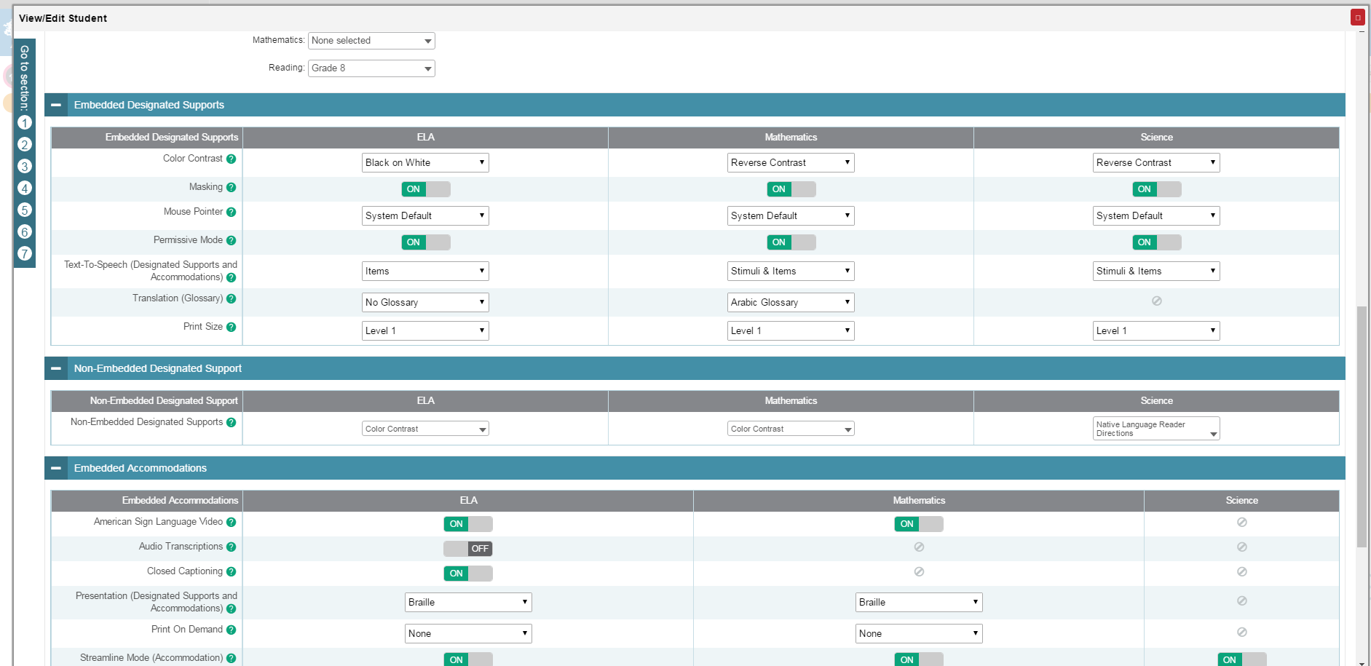
TIDE: Student Settings
Notes:
In TIDE, there are two ways to apply student’s test settings. The first way is to manually set them under the student information tab. The second way to set accommodations is to compose an upload file in Excel or CSV format, and then upload that file to TIDE. This method is easiest if you have many new students and you don’t want to add them one at a time under the Upload Student Information tab. To upload students settings select the Upload Student Settings tab.

Slide 63
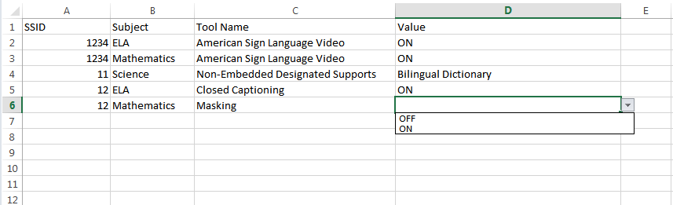
TIDE: Upload Student Settings

Slide 64
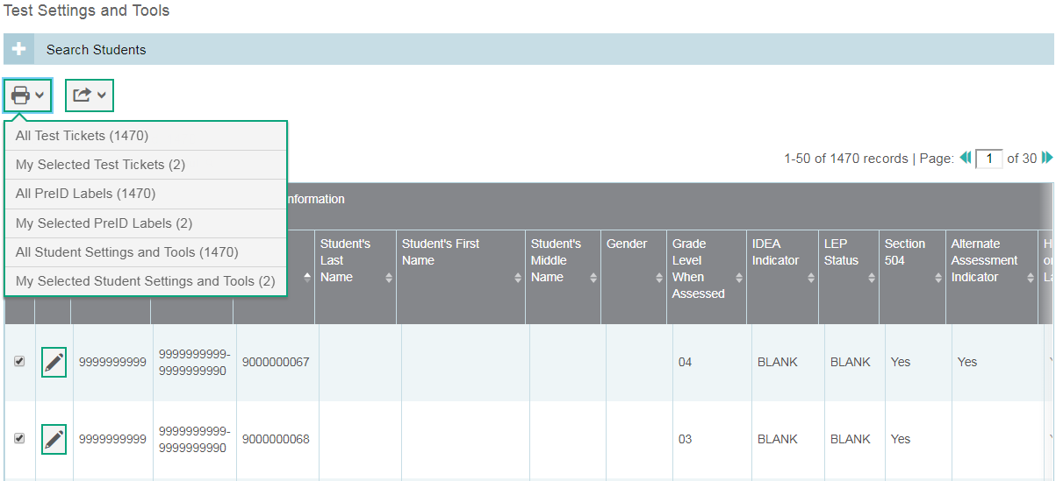
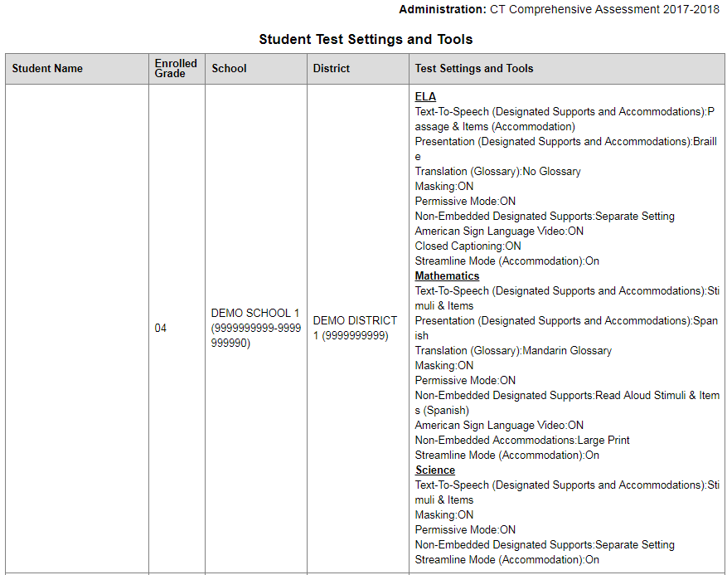
TIDE: Student Settings and Tools

Slide 65


TIDE: Accommodation Eligibility
In order to be eligible for any embedded or non-embedded accommodation, the IDEA Indicator or 504 Plan field must be set to Yes.

Slide 66
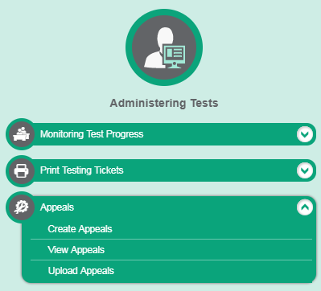
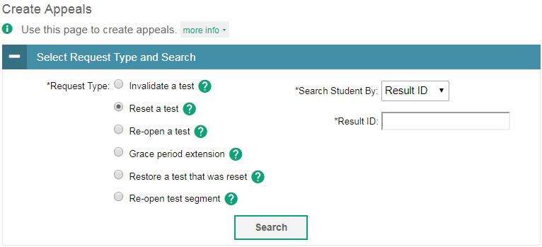
TIDE: Appeals
Notes:
The Create Appeals page is where the user can create an appeal for a test.
The first step to create an appeal is to select the type of appeal you want to create.
The second and third steps set search criteria for a given test result. When you click [Search], TIDE displays all the test results satisfying the criteria.

Slide 67
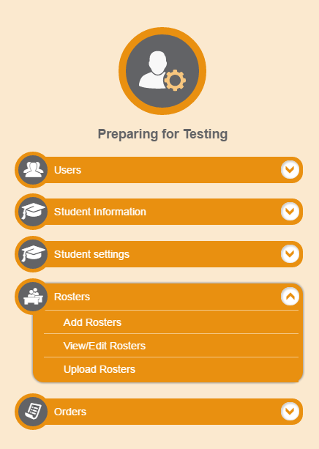
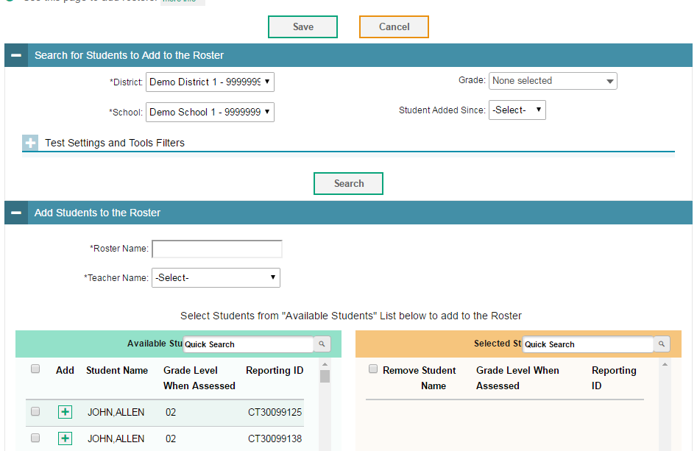
TIDE: Rosters
Notes:
There is also a Rosters feature available in TIDE. Rosters are groups of students associated with a teacher in a particular school. Rosters typically represent entire classrooms in lower grades, or individual classroom periods in upper grades. Users can also create customs lists for example, a list of students receiving special instructions or who below to an extracurricular program to view information as a group.
Due to time constraints we don’t have time to discuss Rosters more in depth but you can find more information regarding Rosters in the TIDE User Guide, which will be posted to the portal and we will also hold more trainings in the future.

Slide 68
TIDE: Ordering Paper Materials
Only Braille and Large Print kits for Smarter Balanced and NGSS.
Confirm that the student has the non-embedded accommodation set properly in TIDE.
Districts can start to order paper materials starting January 24, 2019.
Districts can track shipments in TIDE.

Slide 69
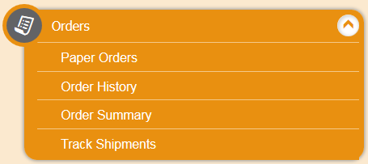
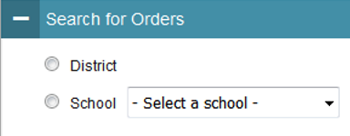
TIDE: Ordering Paper Materials
Step 1: From the Orders task menu on the TIDE dashboard, select Paper Orders.
Step 2: Search for orders by District or School.
Step 3: Enter the quantity needed for each of the materials needed.

Slide 70
TIDE: Participation Reports
Plan and Manage Testing
Test Status Code Report
Test Completion Rates

Slide 71
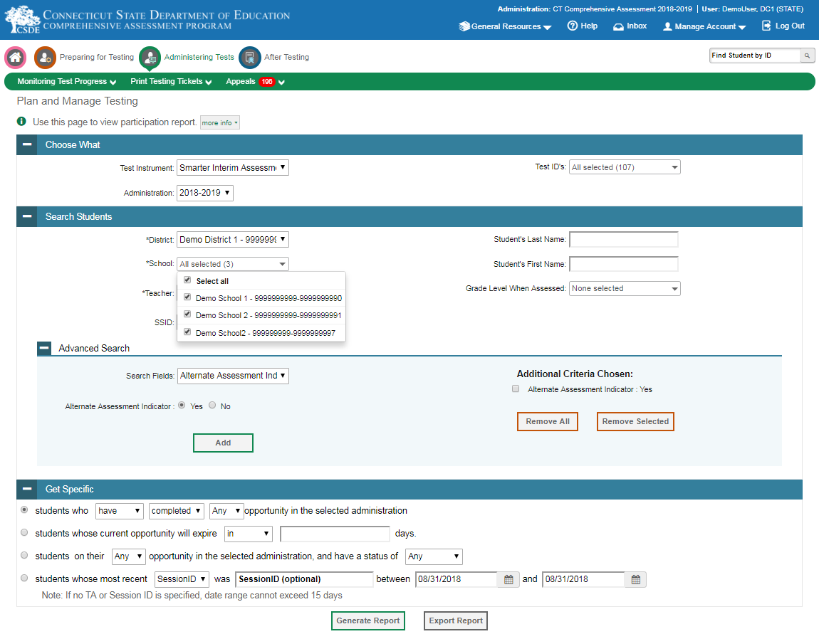
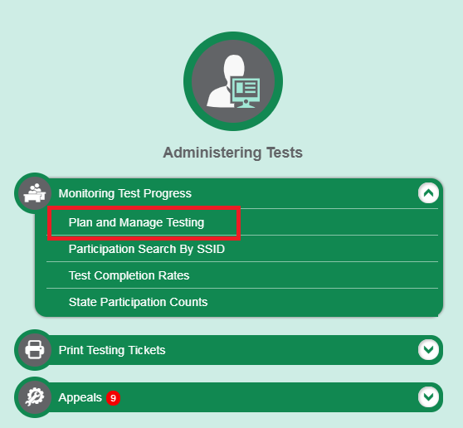
TIDE: Participation Reports (Plan and Manage Testing)

Slide 72
TIDE: Participation Reports (Plan and Manage Testing)
Select multiple schools from a drop down

Slide 73
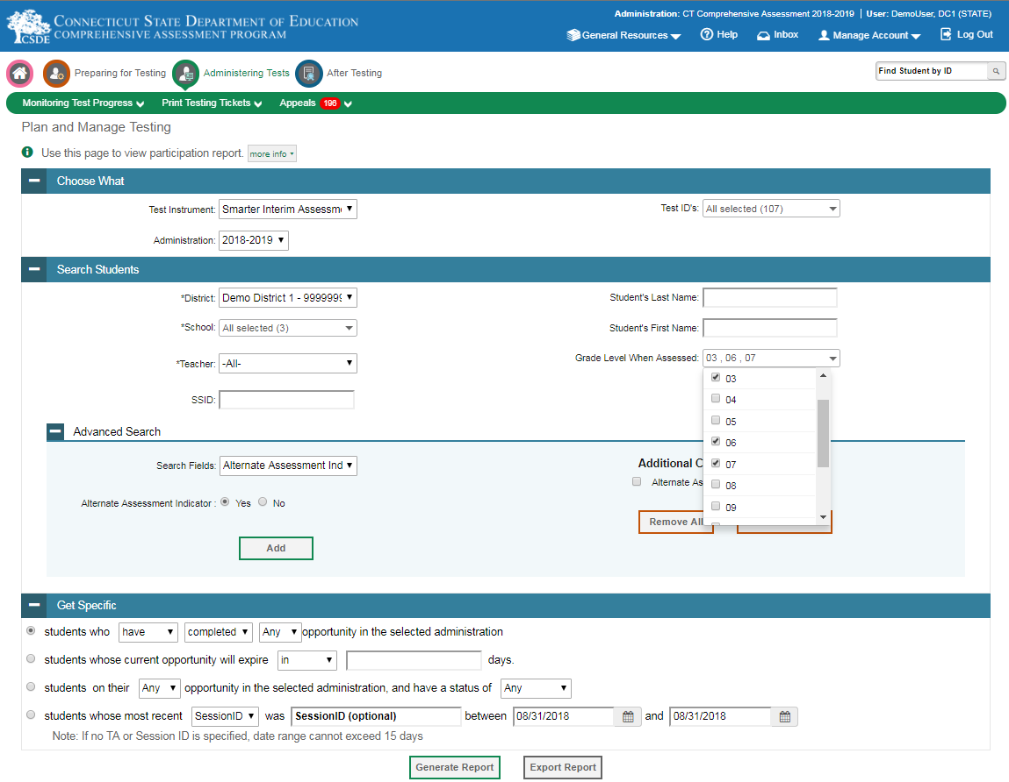
TIDE: Participation Reports (Plan and Manage Testing)
Select multiple grades from a drop down

Slide 74
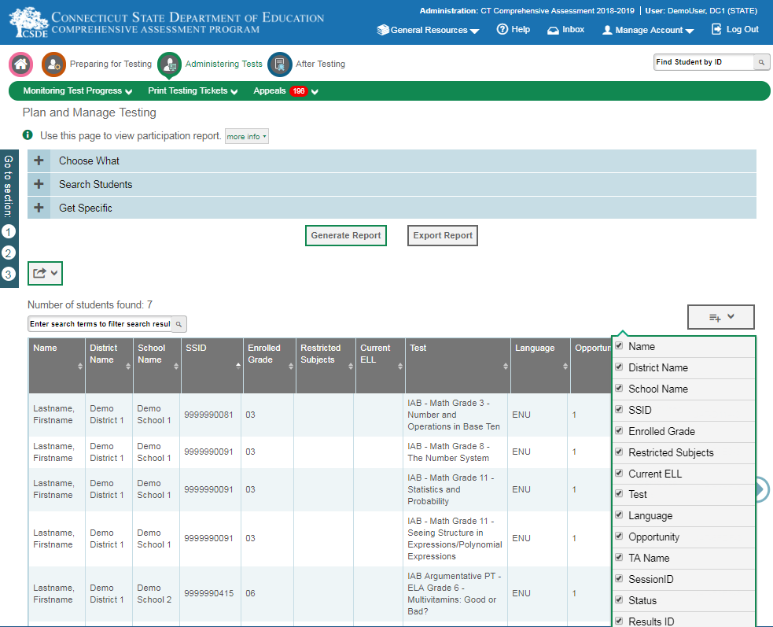
TIDE: Participation Reports (Plan and Manage Testing)
Test Duration will be included in Plan and Manage Testing results.
Show and hide result columns.
Only columns visible in the TIDE user interface will be exported.

Slide 75
TIDE: Participation Reports (Test Status Code Report)
Specific report used to view each student’s test status and all special codes to explain a student’s non-participation in a test
Displays all test statuses for each test for which each student in a district/school is eligible
May be generated at the district level or at the school level, depending on your user role
Report should be generated for each test to obtain an accurate picture reflecting the testing status of all students for all tests in the school or district
Particularly useful for Summative Assessments

Slide 76
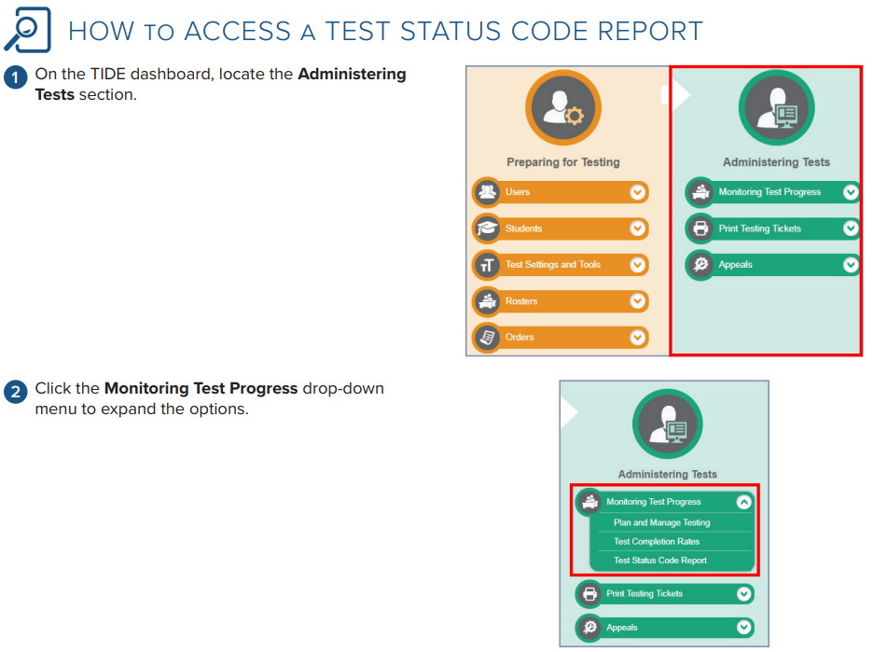
TIDE: Participation Reports (Test Status Code Report)

Slide 77
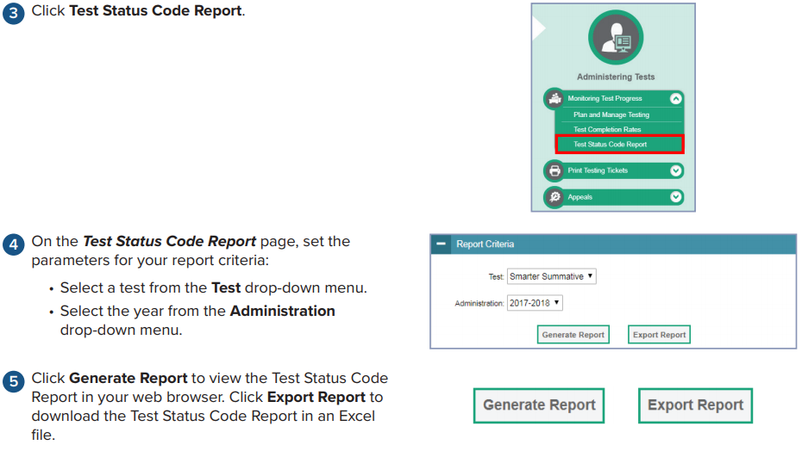
TIDE: Participation Reports (Test Status Code Report)

Slide 78
TIDE: Participation Reports (Test Completion Rates)
High-level reports used to summarize the number and percentage of students who have started or completed a test
May be generated at the district or school level, depending on your user role
All students in the specified school or district will be included in this report
Report should be generated for each test to obtain an accurate picture that reflects the testing status of all students for all tests in the school or district

Slide 79

TIDE: Participation Reports (Test Completion Rates)

Slide 80
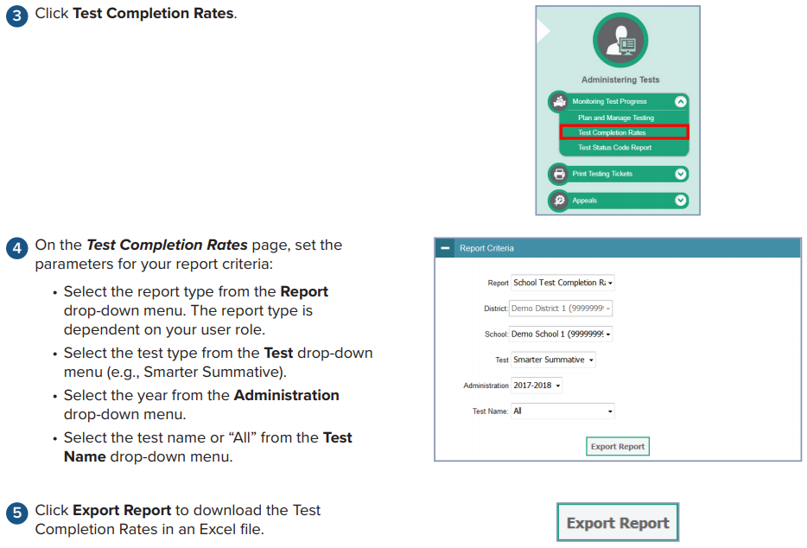
TIDE: Participation Reports (Test Completion Rates)

Slide 81
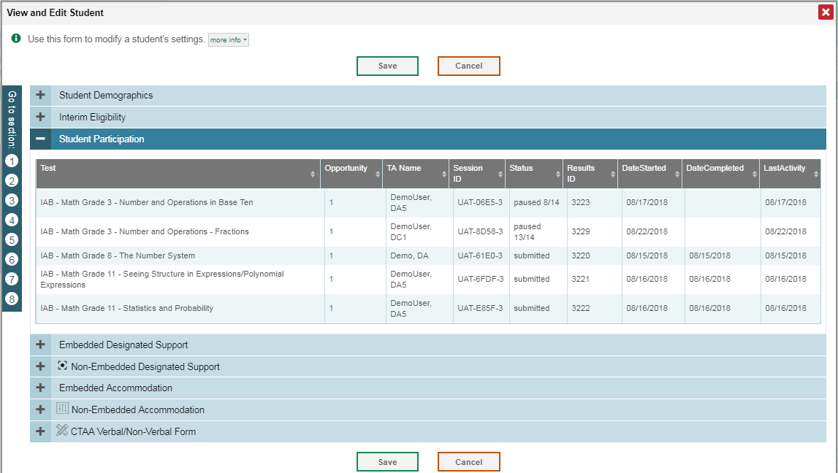
TIDE: Participation Reports (Student Level)
Student Participation data tied to student profile.

Slide 82
Online Testing System
Two interfaces:
  Student
  Test Administrator
Two sites:
  Operational Assessments
    Smarter Balanced Interim
    Smarter Balanced Summative
    NGSS Interims
    NGSS Summative
    Connecticut Alternate Assessment (CTAA)
  Practice/Training Tests
    Smarter Balanced
    NGSS
    CTAA
Notes:
The second system we will talk about is the Test Delivery System. Throughout the rest of this presentation this system will be referred to as TDS.
TIDE provides all the information that TDS needs to test a student and a Test Administrator needs to proctor a test.
There are two interfaces, the student interface where the students access the test, and the Test administrator interface where test administrators are able to proctor student tests.
Additionally, the test delivery system is used to provide access to practice and training tests where students can explore testing tools, check test settings, and practice testing. Test Administrators can practice administering tests, or administer tests for students who need to practice in a proctors setting, such as those who require print on demand.

Slide 83
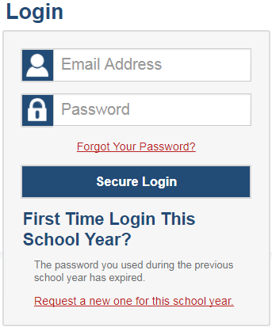
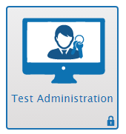
Test Administration (TA) Interface
Notes:
As a Test Administrator, you will use the Test Administrator Interface to create and manage test sessions. To access the TA Interface, visit your portal page.
This is the login screen. You must have an authorized username and password in order to log in to the TA Interface. Once your user account has been created, you can use the same username and password to access other online systems to which you have access. Your login information is private and should not be shared with anyone else.
To login, enter your username and password, and click [Secure Login].

Slide 84
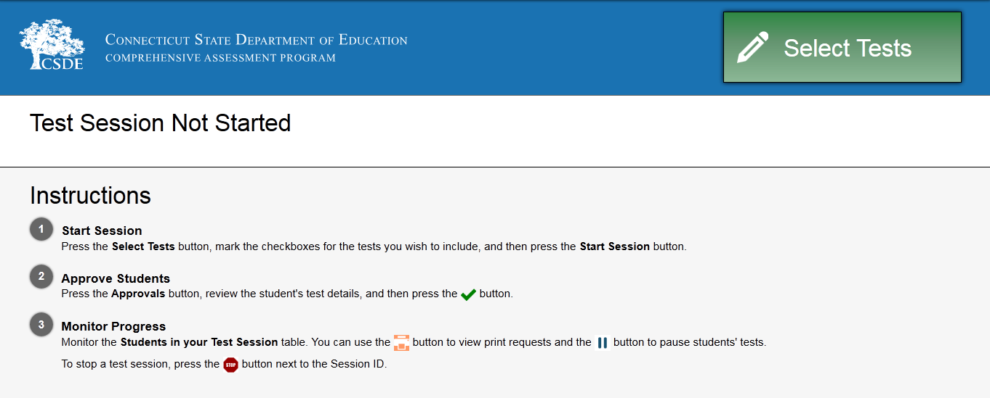
TA Interface: Overview
Notes:
Once you have logged in, you will see the TA Interface. From here, you can access the features you need to create and manage test sessions, look up students, and access help information. We will begin with an overview of the interface, followed by a more detailed review of each feature.
In the header row, you will see your username, a help link, and the logout button. You can click on the [Help] link to access additional information about the TA Interface. Click on [Log Out] when you want to exit the TA Interface.
The first button on the left of the screen is the [Start/Stop Session] button. Before sessions are created, this button will be labeled [Start Session] and will be grayed out. When a session is in progress, the button label will change to [Stop Session], and it will be red. The session ID field will be blank when you first log in. The session ID will be generated and will populate automatically when a test session is created.
There are three panels on the Start/Stop Session screen. In the first panel, you will see a list of available tests. The second panel is an instructions area containing helpful information. Click on it to expand or collapse the text. The third panel shows a list of the students in the selected session and indicators of their progress. If you have not yet created a session, this list will be empty. The list of students refreshes every 60 seconds, but you can also manually refresh the page by clicking the [Refresh Now] button.

Slide 85
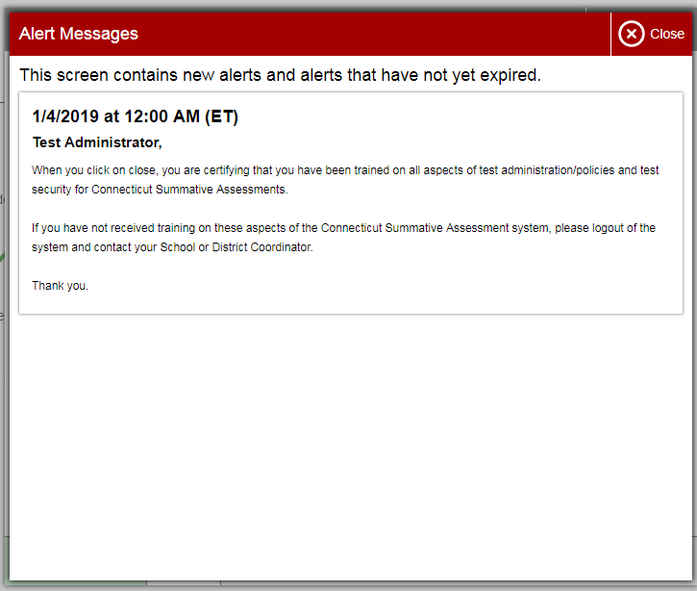
TA Interface: Overview
A pop-up screen will appear reminding the teacher that he/she must be trained before administering the test.
Closing out the screen is an affirmation that the teacher has been trained.
Notes:
Once you have logged in, you will see the TA Interface. From here, you can access the features you need to create and manage test sessions, look up students, and access help information. We will begin with an overview of the interface, followed by a more detailed review of each feature.
In the header row, you will see your username, a help link, and the logout button. You can click on the [Help] link to access additional information about the TA Interface. Click on [Log Out] when you want to exit the TA Interface.
The first button on the left of the screen is the [Start/Stop Session] button. Before sessions are created, this button will be labeled [Start Session] and will be grayed out. When a session is in progress, the button label will change to [Stop Session], and it will be red. The session ID field will be blank when you first log in. The session ID will be generated and will populate automatically when a test session is created.
There are three panels on the Start/Stop Session screen. In the first panel, you will see a list of available tests. The second panel is an instructions area containing helpful information. Click on it to expand or collapse the text. The third panel shows a list of the students in the selected session and indicators of their progress. If you have not yet created a session, this list will be empty. The list of students refreshes every 60 seconds, but you can also manually refresh the page by clicking the [Refresh Now] button.

Slide 86
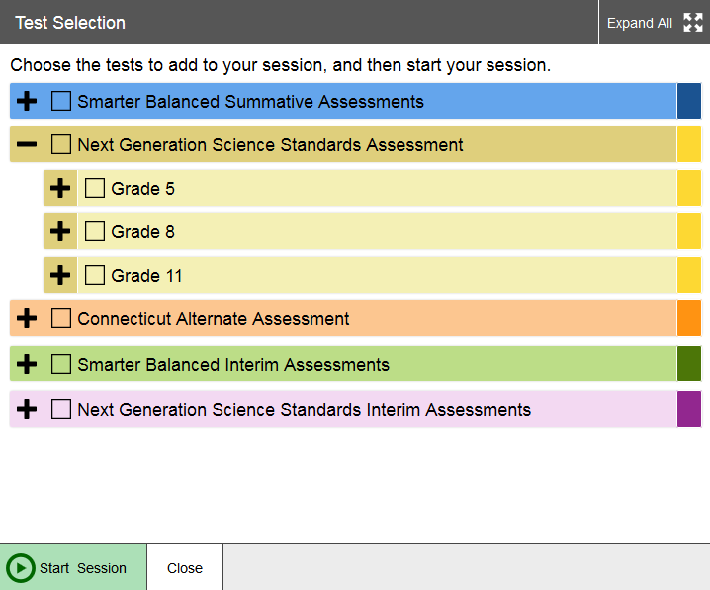
TA Interface: Test Tree
Notes:
Once you have logged in, you will see the TA Interface. From here, you can access the features you need to create and manage test sessions, look up students, and access help information. We will begin with an overview of the interface, followed by a more detailed review of each feature.
In the header row, you will see your username, a help link, and the logout button. You can click on the [Help] link to access additional information about the TA Interface. Click on [Log Out] when you want to exit the TA Interface.
The first button on the left of the screen is the [Start/Stop Session] button. Before sessions are created, this button will be labeled [Start Session] and will be grayed out. When a session is in progress, the button label will change to [Stop Session], and it will be red. The session ID field will be blank when you first log in. The session ID will be generated and will populate automatically when a test session is created.
There are three panels on the Start/Stop Session screen. In the first panel, you will see a list of available tests. The second panel is an instructions area containing helpful information. Click on it to expand or collapse the text. The third panel shows a list of the students in the selected session and indicators of their progress. If you have not yet created a session, this list will be empty. The list of students refreshes every 60 seconds, but you can also manually refresh the page by clicking the [Refresh Now] button.

Slide 87
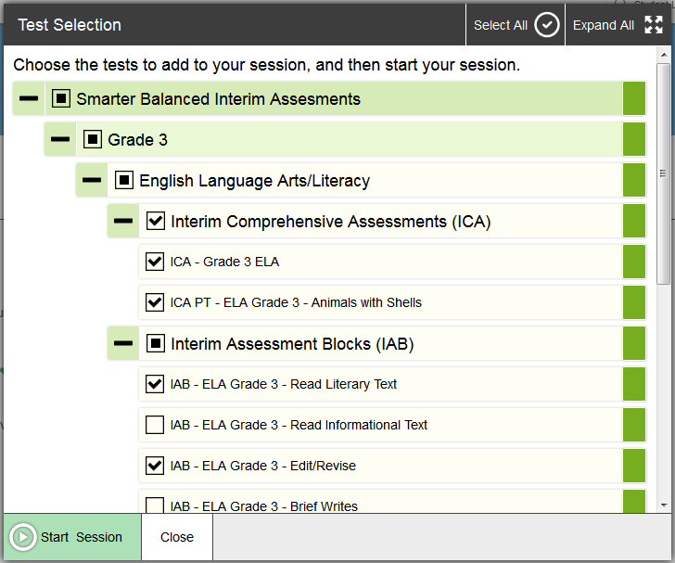
TA Interface: Start a Test Session
Notes:
The first step in administering a test is to create a test session. This should be done less than twenty minutes prior to starting the test in order to prevent the system from timing out. The list of students in the session will be generated automatically when the students log in to the session. To create a testing session, click the test(s) you wish to administer. You may select all available tests listed, for all grade levels and all content areas. Be assured that students will only have access to the tests you have selected for them.
Once you have selected your tests, the [Start Session] button will turn green. Click on the [Start Session] button. The system will automatically generate a session ID. This ID must be provided to students in order for them to log in. You may write it on the board or provide it to students using a printed card or similar method. Be sure to remind students that the session ID is case sensitive and must be entered exactly as it is written – without extra spaces or characters. If you do provide students with the information on paper, be sure to collect and destroy it when the session is complete.

Slide 88
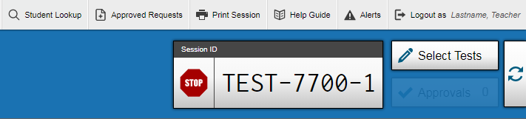

TA Interface: Approve Students
Notes:
If no changes are needed, select [Approve All Students] to admit all students to the session. If a student has selected an incorrect test, you must [Deny] that student entry to the test session.

Slide 89

TA Interface: Monitoring a Test Session
Notes:
Once you have started the test session and students have logged in, you must approve their test settings before they can access their tests. It is very important that you pay close attention to the test name prior to approving to be sure that students have selected the appropriate test. You can do this by clicking the [Approve] button. A list of students will display, organized by test name. You should review the list to make sure that all students have chosen the correct content area and test. You should also ensure that all of the settings that a student should have are correct. This is done using the [See/Edit Details] button. We will talk more about that in a few moments.
If no changes are needed, select [Approve All Students] to admit all students to the session. If a student has selected an incorrect test, you must [Deny] that student entry to the test session.

Slide 90
Student Interface
Student Interface Login System Revamp
Help prevent incorrect login attempts and help students understand what is wrong when they do happen
Make it easier for people to recognize whether they are in the Practice Test Site or Operational Test Site
WCAG 2.1 Compliance

Slide 91

Student Interface - Please Sign-In Page
Notes:
First, let’s talk about the Student Interface. The Student Interface is where the student will sign in to and take their assessment. To sign in to the online testing system, students must enter three pieces of identifying information: their first name, their state-assigned student identifier (SSID), and the current session ID.
When entries are complete, students will click the [Sign In] button to log in to the test. You may assist students with logging in, if necessary. The session ID is generated when the Test Administrator creates the test session and will be given to students by the TA when it is time for them to log in to the test. Session IDs should not be generated more than 20 minutes before students are ready to log in.

Slide 92

Student Interface - Is This You? Page
Notes:
First, let’s talk about the Student Interface. The Student Interface is where the student will sign in to and take their assessment. To sign in to the online testing system, students must enter three pieces of identifying information: their first name, their state-assigned student identifier (SSID), and the current session ID.
When entries are complete, students will click the [Sign In] button to log in to the test. You may assist students with logging in, if necessary. The session ID is generated when the Test Administrator creates the test session and will be given to students by the TA when it is time for them to log in to the test. Session IDs should not be generated more than 20 minutes before students are ready to log in.

Slide 93

Student Interface - Your Tests Page
Notes:
First, let’s talk about the Student Interface. The Student Interface is where the student will sign in to and take their assessment. To sign in to the online testing system, students must enter three pieces of identifying information: their first name, their state-assigned student identifier (SSID), and the current session ID.
When entries are complete, students will click the [Sign In] button to log in to the test. You may assist students with logging in, if necessary. The session ID is generated when the Test Administrator creates the test session and will be given to students by the TA when it is time for them to log in to the test. Session IDs should not be generated more than 20 minutes before students are ready to log in.

Slide 94

Student Interface - Waiting for Approval Page
Notes:
First, let’s talk about the Student Interface. The Student Interface is where the student will sign in to and take their assessment. To sign in to the online testing system, students must enter three pieces of identifying information: their first name, their state-assigned student identifier (SSID), and the current session ID.
When entries are complete, students will click the [Sign In] button to log in to the test. You may assist students with logging in, if necessary. The session ID is generated when the Test Administrator creates the test session and will be given to students by the TA when it is time for them to log in to the test. Session IDs should not be generated more than 20 minutes before students are ready to log in.

Slide 95

Student Interface - Audio/Video Checks Page
Notes:
First, let’s talk about the Student Interface. The Student Interface is where the student will sign in to and take their assessment. To sign in to the online testing system, students must enter three pieces of identifying information: their first name, their state-assigned student identifier (SSID), and the current session ID.
When entries are complete, students will click the [Sign In] button to log in to the test. You may assist students with logging in, if necessary. The session ID is generated when the Test Administrator creates the test session and will be given to students by the TA when it is time for them to log in to the test. Session IDs should not be generated more than 20 minutes before students are ready to log in.

Slide 96

Student Interface - Instructions and Help Page
Notes:
First, let’s talk about the Student Interface. The Student Interface is where the student will sign in to and take their assessment. To sign in to the online testing system, students must enter three pieces of identifying information: their first name, their state-assigned student identifier (SSID), and the current session ID.
When entries are complete, students will click the [Sign In] button to log in to the test. You may assist students with logging in, if necessary. The session ID is generated when the Test Administrator creates the test session and will be given to students by the TA when it is time for them to log in to the test. Session IDs should not be generated more than 20 minutes before students are ready to log in.

Slide 97

Student Interface - Review Test Settings Page
Notes:
First, let’s talk about the Student Interface. The Student Interface is where the student will sign in to and take their assessment. To sign in to the online testing system, students must enter three pieces of identifying information: their first name, their state-assigned student identifier (SSID), and the current session ID.
When entries are complete, students will click the [Sign In] button to log in to the test. You may assist students with logging in, if necessary. The session ID is generated when the Test Administrator creates the test session and will be given to students by the TA when it is time for them to log in to the test. Session IDs should not be generated more than 20 minutes before students are ready to log in.

Slide 98
Student Interface – Spanish Toggle
Spanish Toggle will be available for the NGSS Summatives.
The item will be displayed in Spanish with a button to allow the student to toggle to the English version.
Student can submit their response to either the Spanish or English version.
Text to Speech in Spanish will be offered for the NGSS Summative
Notes:
First, let’s talk about the Student Interface. The Student Interface is where the student will sign in to and take their assessment. To sign in to the online testing system, students must enter three pieces of identifying information: their first name, their state-assigned student identifier (SSID), and the current session ID.
When entries are complete, students will click the [Sign In] button to log in to the test. You may assist students with logging in, if necessary. The session ID is generated when the Test Administrator creates the test session and will be given to students by the TA when it is time for them to log in to the test. Session IDs should not be generated more than 20 minutes before students are ready to log in.

Slide 99


Student Interface – Spanish Toggle
Notes:
First, let’s talk about the Student Interface. The Student Interface is where the student will sign in to and take their assessment. To sign in to the online testing system, students must enter three pieces of identifying information: their first name, their state-assigned student identifier (SSID), and the current session ID.
When entries are complete, students will click the [Sign In] button to log in to the test. You may assist students with logging in, if necessary. The session ID is generated when the Test Administrator creates the test session and will be given to students by the TA when it is time for them to log in to the test. Session IDs should not be generated more than 20 minutes before students are ready to log in.

Slide 100
Data Entry Interface (DEI)
The Data Entry Interface is used for the following assessments:
  Learner Characteristics Inventory (LCI)
  CTAS
  Smarter Balanced paper tests (Large Print and braille)
  NGSS paper tests (Large Print and braille)

Slide 101
Data Entry Interface (DEI)
The DEI can be accessed via the portal under the Smarter Balanced, NGSS or Alternate Assessment program cards.
Teachers must use the DEI to complete the LCI and CTAS.
For students who take the paper Braille and Large Print Smarter Balanced and NGSS, the teacher must enter the student responses into the DEI.
The DEI does not require the secure browser. Users can access the DEI using most internet browsers (Chrome, Firefox, etc.)

Slide 102

DEI: Log In
Step 1: Log in to the DEI using your TIDE credentials.
Step 2: Enter the student’s first name and SASID in the appropriate fields. Click Sign In.

Slide 103

DEI: Navigation
Step 3: Confirm the information is correct for the student.
Step 4: Select the appropriate
task for data entry.

Slide 104


DEI: Navigation
Step 5: Select the task and click Next button to proceed to the next page.
Step 6: Review the instructions as needed and click Begin Task Now
to begin entering data.

Slide 105



DEI: Navigation
Step 7: Once all items are complete, click Finished.
Step 8: To review or edit data, select the item that you wish to review. Once you have verified that the data you have entered is accurate, click I am finished with this task.
Step 9: Click Yes to submit the task.

Slide 106
Thank you!
Further Information
Connecticut Assessment Program Portal
  http://ct.portal.airast.org/
Connecticut Help Desk
  American Institutes for Research
  1.844.202.7583
  CTHelpDesk@air.org

Slide 107




Student Assessment for Special Populations
Connecticut Alternate Assessment System
CTAS
Notes:
For assessment purposes, special populations include students who potentially require additional considerations as participants in Connecticut’s assessments. These student groups include:
general education students identified for designated supports;
students with disabilities with an Individualized Education Program (IEP) or a Section 504 Plan;
students identified as English learners (ELs);
dually identified students (EL and special education or EL and Section 504); and
students with significant cognitive disabilities who meet the eligibility criteria for the Connecticut Alternate Assessment System.
The Public School information System (PSIS) registration must reflect current and accurate demographic information that identifies students as English learners, or those students identified as special education or section 504 in order to access many of the embedded supports and accommodations available during testing.

Slide 108



Universal Tools:
Available to ALL students
Embedded
Breaks
Calculator (Math Grades 6-8; Science Grades 5, 8, & 11)
Digital Notepad
English Glossary^
Expanded Passages/Stimuli
Highlighter
Keyboard Navigation
Math Tools
Strikethrough
Writing Tools
Zoom
Line Reader
Mark for Review
Designated Supports:
Available to ANY student with a need determined by educators
Embedded
Color Contrast
Masking
Text-to-Speech- Science, Math & ELA Non-Reading Passages
*Translations-Math (Stacked Spanish)
Turn off any universal accessibility tool
*Translation Test Directions Spanish (Math, Science) Updated
Print Size Online
Mouse Pointer
Streamline New
*Translations-Math (Glossary)
*Text-to-Speech-Spanish (Science) New
*Spanish Translation (Science) New
Available to students with an IEP or 504 Plan
Accommodations:
Embedded
American Sign Language (Video)^
Closed Captioning (ELA Listening)
Refreshable Braille (ELA: Contracted, Uncontracted) ^
Braille Transcript (ELA Listening)
Braille Embosser (Math & ELA: Contracted, Uncontracted)^
Text-to-Speech ELA Reading Passages (Grades 3-8)
Non-Embedded
Abacus
Alternate Response Options
Speech-to-Text
Braille Booklet
100s Number Table (Grades 4-8)
Braille supplemental math booklet for online fixed form test
Human Signer for Science items
# Print on Demand
~ # Read Aloud ELA Reading Passages (Grades 3-8)
~ # Human Signer for ELA or Math Items
~ # Human Signer for ELA Reading Passages (Grades 3-8)
Specialized Calculator (Math Grades 6-8; Science Grades 5, 8, & 11)
Large Print Booklet
~# Scribe
Multiplication Table (Grades 4-8)
Non-Embedded
*Bilingual Dictionary (Science)
Color Contrast
Color Overlay
Magnification Device
Noise Buffering
Read Aloud
Separate Setting
*Translation Glossary (Math)
*Translation Test Directions^
*Read Aloud in Spanish (Math, Science) Updated
Simplified Test Directions^
*Native Language Reader Directions (Science)
Amplification
Non-Embedded
Breaks
Scratch Paper/ whiteboard with marker
^ NOT available for Science
~ Requires Trained Educator
^ NOT available for Science
# Requires Petition for Approval of Special Documented Accommodations
*Intended for English Learners (EL)
^ NOT available for Science
1/18/2019
Notes:
This Accessibility Chart was updated in January 2019 to include new supports for the 2018-19 test administration.
First, it’s important to preface that most student testers will participate in the standard Smarter Balanced Math and ELA assessments and the NGSS Science assessments (if enrolled in grades 5, 8, and 11). With these students in mind, there are a variety of tools and supports available to all students taking the Smarter Balanced and NGSS summative assessments and optional interim assessments. We recommend having your students practice these tools and supports well in advance of testing through the use of the Smarter Balanced and/or NGSS Practice and Training Tests. Students can use these experiences to better understand the formatting and mechanics of the online supports, which will build confidence and familiarity prior to summative testing. It will also allow teachers to determine how useful and effective the supports work for their individual students and provide information about the effectiveness of the given supports prior to summative testing. These supports should only be provided if they are consistent with the types of supports and accommodations accessed by the student during instruction. While the options may appear to be useful for certain students, unless they are needed and familiar to students, the provision of them could in fact hinder a student’s performance. Careful thought and consideration should be made when determining the appropriateness of these supports.
This accessibility chart is organized and color-coded by the type of support available to specific subgroups of students based on need and eligibility. Supports and accommodations are provided in two ways: embedded and non-embedded. Embedded tools and supports are provided by the online Test Delivery System, while non-embedded supports are provided at the local level by the teacher/test examiner. The provision of these supports require a careful and consistent communication between teachers and their school/district test coordinators to ensure that they are entered in the TIDE system, tested on the Practice Tests, and available to students at the time of summative testing.
Throughout this chart, note the caret symbol signifies supports that are unavailable on the Standard Science Assessment and the asterisk identifies supports intended for English Learners.
First, let's take a look at Universal Tools (indicated by the blue background). Universal tools are access features of the assessments that are available to ALL students. They include tools such as the embedded Desmos calculator for students taking NGSS Science or Smarter Balanced Math (in Grades 6-8).
Next, let's focus on Designated Supports, which are grouped in the grey section. These embedded and non-embedded designated supports are available to any student, including a general education students, for whom the need has been indicated by the students primary teacher or team of teachers, including the student. You will notice that many of these supports indicate that they are new or updated. For example, the Streamline support (which presents the test without a split screen) was categorized as an embedded accommodation in previous years, but is now available to any student based on need. You will also notice a variety of designated supports available to our English learners taking the NGSS. Let’s take a moment to present these new embedded supports:
Spanish Translation Science
Text-to-Speech Spanish Science
Translation Test Directions Spanish Science
The new non-embedded Designated Support for Spanish includes a read aloud of the test directions and items in Spanish.
Now, let's review the Accommodations (grouped in the green section) that are ONLY available to students with an IEP or Section 504 plan. As indicated by the Accessibility Chart, some options have special requirements. For example, the Text-to-Speech and Read Aloud of the Smarter Balanced ELA Reading Passages requires the submission of the Decision Guidelines prior to testing. Another example of special requirements, the read aloud and scribe (non-embedded) accommodations requires that teachers sign off and follow additional protocols.
Also, certain accommodations under non-embedded (those with a pound sign) require approval through the Petition for Approval of Special Documented Accommodations. This will be covered in more detail later.

Slide 109
Special Accommodation Procedures
Required for:
*Read Aloud of Reading Passages
Scribe
Print on Demand
Human Signer Accommodation
Human Signer Passages Accommodation
Any accommodation not listed that is unique to the student
Process:
1. The DA in TIDE should contact Deirdre Ducharme or Janet Stuck to report any student who may qualify. DAs must provide:
SASID
Assessment Name; Subtests
Requested Accommodation and Rationale
2. Based on initial eligibility, the CSDE will provide the DA with the Special Documented Accommodations Petition for completion.
3. Fax the completed petition along with active IEP and additional evidence (if applicable) to 860-326-0540.
4. CSDE will review petition and provide a letter of approval or guidance to district.
*Students may not be tested with requested accommodations until the district receives an approval letter from CSDE.
*Read Aloud Grades 3-8 ONLY also requires the submission of the Text-to-Speech and Read Aloud Decision Guidelines
Notes:
For a small number of students, the universal tools, designated supports, and accommodations provided on the Accessibility Chart may not be enough to meet their accessibility needs of the student. In this case, the District Administrator in TIDE may submit a petition for these students to the Connecticut State Department of Education Performance Office to discuss and develop a plan for the assessment. To facilitate this process, the DA must contact Deirdre or Janet and provide information about the student’s specific needs per their primary disability and needs identified in their IEP. If appropriate, we will provide a petition to be completed by the student’s primary teacher and returned via fax with the teacher, DA, and Special Education Director’s signature, along with a complete copy of the student’s active IEP. All Special Documented Accommodations must be submitted by January 28.
No special accommodations can be provided unless they are approved by the CSDE.
As identified on this slide, some examples of Special Accommodations include, but are not limited to:
Read aloud ELA passages Grades 3-8;
Print on Demand;
Scribe and Human Signer/Human Signer of ELA Reading Passages;
Any alternative response option/ assistive technology device that the student typically uses that is not compatible with the Assessment platform; and
Other
The Special Documented Accommodations Procedure is described in the Assessment Guidelines, Appendix B.

Slide 110




Medical Exemption Procedure
In Connecticut, the exemption determination for a medical emergency rests primarily on the following criteria:
The student is unable to attend school and is medically/emotionally unavailable for homebound/hospitalized instruction.
See Appendix A of the Assessment Guidelines.
Notes:
Students who are hospitalized or homebound due to illness should be tested unless there are medical constraints. These students can have the test administered at home or in the hospital provided the test is administered by a certified school staff member who is fully trained in the proper test administration and security procedures for the specific assessment system (Smarter Balanced Assessments, NGSS Science, Connecticut SAT, CTAA, and CTAS).
In rare cases, there may be a student who experiences a medical emergency just prior to (or during) the testing window. There is a process whereby, the student may receive an exemption from testing due to the emergency nature of the medical condition, if the criteria for exemption are met. A medical exemption can be given to a student depending on the availability of the student during the statewide testing window.
Contact Deirdre or Janet if you think you have a student who is eligible for a medical exemption. Based on eligibility, DAs will be provided with a Medical Exemption form for completion, signature, and submission to the CSDE. Please keep in mind that there are two deadlines for receiving these forms:
Medical Exemption forms for the Connecticut SAT School Day are due by May 1, 2019; and
Medical Exemption forms for Smarter Balanced, the NGSS Science, and the Connecticut Alternate Assessments (CTAA/CTAS) are due no later than June 14, 2019.

Slide 111
Alternate Assessment System Training Requirements
The required Alternate Assessment System Training is accessible online via the CSDE Comprehensive Assessment Program Portal.
All certified educators administering the alternate assessments, regardless of previous training status, must participate in the 2018-19 Alternate Assessment System Training and for each subsequent year.
TEAs must complete and pass the end-of-training quiz with a score of at least 80 percent or better.
Resources:
Overview for District Administrators
Overview for Teachers Administering the Alternate
CTAA Assessment System User Guide (will be posted soon)
CTAA Test Administration Manual (will be posted soon)
Notes:
Teachers Administering the Alternate (TEAs) are intricately involved in all aspects of the selection and supervision of the Connecticut Alternate Assessment and the Alternate Science. The Connecticut Alternate Assessment System Training requirements provide for high-quality standardized administration ensuring appropriate interpretations for results about what students with significant cognitive disabilities know and can do.
All teachers who will be administering the alternate assessments must be trained via the online course regardless of previous training status. This training is required each school year. Once training and the embedded quiz is passed the TEA will have permission to;
Submit the Learner Characteristics Inventory (LCI) into the DEI;
Access the required secure test materials for the CTAA
Administer any alternate assessment.
District Administrators are responsible for the following tasks:
Determine who will be administering an Alternate Assessment during the 2018-19 school year.
Verify that the teacher has a TEA User Role in TIDE. Update, add, and delete accounts as appropriate.
Communicate details regarding the required online training with your TEAs. Share the Overview for Teachers Administering the Alternate resource referenced on this slide.
Verify that all TEAs complete and pass the quiz. Those with passing scores will have their Trained Status activated to Y (Yes) in TIDE.
Review the resources included on this slide for more information.

Slide 112



Confirming Trained Teacher Status
Only the DA has access to add/change/delete a TEA User Role
1
2
3
Notes:
DAs can create a roster in TIDE to confirm those TEAs who have been trained. We have highlighted the steps in this slide. If a teacher indicates that they completed the training and passed the quiz, but do not have access to the LCI or other Alternate Assessment Systems, verify their TIDE User Role. Only TEA user roles will provide teachers access to the Alternate Assessment systems.

Slide 113
Accommodations for Alternate Assessments
Resource and Location | Description
IEP page 8 | Accommodations needed for instruction and assessment should be defined
CTAA and CTAS Eligibility and Learner Characteristics Inventory | Specific accommodations questions are collected
Types of Allowable Accommodations:
  Technology for Presentation and/or Response
  Braille
  Paper Version of Item
  Sign Language
  Scribe
  Read Aloud (should be provided on all versions of the assessment)
Notes:
The accommodations indicated on page 8 of the student's IEP are to be provided for alternate assessment testing. This includes environmental supports or accommodations and assistive technology or Augmentative and Alternative Communication (AAC) supports. The design of the CTAA includes reading of the entire test to the student via a human reader or Text-to-Speech.

Slide 114


Eligibility and the Learner Characteristics Inventory (LCI)
Notes:
The Learner Characteristics Inventory (LCI) document has been developed to determine eligibility for the Alternate Assessment System through discussion at the Planning and Placement Team (PPT) meeting. In addition to teacher provided evidence, the LCI describes the range of the characteristics of learners who participate in alternate assessments. This document is required to register students for the CTAA and the CTAS. The document may be accessed on the CSDE Comprehensive Assessment Program Portal.
The LCI must be submitted in the Data Entry interface (DEI) on the CSDE Comprehensive Assessment Program Portal.
Only teachers with the user role of TEA and confirmed training status may register a student to participate in the Alternate Assessment System by submitting the LCI into the Data Entry Interface. You may click on this image to download the LCI.
Special Education students eligible for Alternate Assessments must meet all of these criteria as covered in training:
The student has a significant cognitive disability
The student is learning content linked to (derived from) the Connecticut Core State Standards (CCSS) and the Next Generation Science Standards
The student requires extensive direct individualized instruction and substantial supports to achieve measurable gains in the grade and age appropriate curricula.
These students should represent 1% or less of the total tested population.
CSDE has provided resources to support these decisions and are monitoring the LCI characteristics to ensure students are participating into the most appropriate assessments.

Slide 115

Criteria for Student Participation Alternate Assessments
Notes:
Special education students with an active IEP are considered eligible to participate in the CTAA and CTAS if at the Planning and Placement Team (PPT) evidence supports meeting each of the 3 required criteria. If one or more required criteria is not indicated as yes then the student is expected to participate in the standard assessments.
Evidence includes support of the students significant cognitive disability and its pervasive nature. Therefore, student with primary disability categories of intellectually disability, autism, and multiple disabilities are more likely to be eligible. For example, students with the primary disability category identified as Specific Learning Disability, Specific Learning Disability/Dyslexia, Emotional Disturbance, or Speech Language Impairment generally do not qualify to participate in alternate assessments.

Slide 116
Learner Characteristics Inventory Monitoring
The CSDE continues to meet with stakeholders, attend national meetings, and develop resources to clarify the intended purpose for the Alternate Assessments and eligibility criteria for student participants.
The CSDE will be monitoring LCI submissions and contacting districts with concerns, including, but not limited to primary disability categories that do not support a significant cognitive disability, academic functioning, and other student characteristics reported in the LCI.
Districts may be asked to review IEPs and other supporting evidence to ensure the appropriate assessment selection for identified students.
Notes:
To support this ongoing initiative, education consultants from the Performance Office will be monitoring the 2018-19 LCI submissions. Data reported by the LCI will be reviewed to determine if the student meets the evidence-based criteria for participation in the alternate assessments by examining the Primary Disability Categories for consistency with a significant cognitive disability.
For example students identified with primary disability of a Specific Learning Disability or Specific Learning Disability/Dyslexia are not eligible for the Alternate Assessments based upon the criteria to be identified as LD- which ensures ruling out a significant cognitive disability.
Academic functioning and other student characteristics will also be reviewed to determine if additional clarification of evidence is needed to support eligibility.
The District Administrator (DA in TIDE) and the Director of Special Education will be contacted with concerns identified during the monitoring process. Careful attention should be made to review and determine the most appropriate assessment for students based on understanding the eligibility process for the Alternate Assessments and the types of supports and accommodations that are available to students on the standard assessments when they do not qualify for an alternate assessment.

Slide 117
Resources to Support the Eligibility of the Alternate Assessment System
CSDE Assessment Guidelines
Learner Characteristics Inventory
The Connecticut Alternate Assessment System Participation
Guidance for Planning and Placement Teams
Frequently asked Questions and Answers About The Connecticut Alternate Assessment System
For more information, visit the CSDE Website and the Connecticut Comprehensive Assessment Program Portal.
Notes:
Included on this slide are resources to help support the purpose and eligibility for the Connecticut Alternate Assessment System.

Slide 118



Monitoring LCI Submissions
https://ct.portal.airast.org/core/fileparse.php/51/urlt/CT_Monitoring-Test-Progress_Brochure.pdf
Notes:
District Administrators may monitor the Completion of LCIs through the Plan and Manage testing drop down menu in the Administering Test portion of TIDE.

Slide 119
Connecticut Alternate Assessment System
 | CT Alternate Science (CTAS) | Connecticut Alternate Assessment (CTAA)
Grades | 5, 8, 11 | 3-8 and 11
Test Subject Areas | Science Earth Life Physical | English language arts Reading Writing Mathematics
Test Delivery Method | Trained TEA assesses eligible student with performance tasks based upon CT Alternate Science Assessment Essence statements | Trained TEA administers the grade specific Math and ELA items via the online testing system.
Test Window | Designed to be administered through the school year: student ratings will be entered in the DEI. Upload window: March 25-June 7 , 2019 | Administered with required secure Directions for Test Administration (DTAs). March 25– June 7, 2019
Security | Non-secure | Secure
Notes:
This is a comparison between the CTAA for Math and ELA and the Connecticut Alternate Science (CTAS).

Slide 120
CTAA Assessment Documents
Documents | Purpose | User
CTAA Test Administration Manual (TAM) | Provides policies and procedures for TEAs and DCs/SCs to prepare for the administration of the Test. | TEAs and DC/SCs
Directions for Test Administration (DTA) Note: The DTAs are secure documents and can be found in TIDE | Each test form has a specific DTA that provides directions and a script to administer each item of the test. TEAs must follow these directions and script exactly. DTAs include the allowable manipulatives and reference materials for specific items, scoring rubrics for constructed-response mathematics items and the open-response foundational reading items in Grades 3 and 4. | TEAs
CTAA System User Guide | Provides information to access and navigate the Online Test Delivery System for purposes related to assessing students. | TEAs and DCs/SCs
CTAA Assessing Students Who Are Blind, Deaf, or Deaf-Blind: Additional Guidance for Test Administration | Includes tasks to complete before, during, and after the assessment; strategies to enhance access to the CTAA; appendices with information for accessing the Open-Response (OR) Foundational Reading Items in Grades 3 and 4; and additional resources for TEAs working with students who are Blind, Deaf, or Deaf-Blind. | TEAs assessing a student who is Blind, Deaf, or Deaf-Blind.
Notes:
To complete the CTAA, TEAs and DAs should review these critical documents referenced on this slide. They are available on the Connecticut Comprehensive Assessment Program Portal using the Alternate Assessment System card.
CTAA Test Administration Manual (TAM) guides Teachers Administering Alternate Assessments (TEAs) Test Administrators and Test Coordinators as they prepare for and administer the CTAA. The TAM provides an overview of the test, activities, descriptions of roles and responsibilities for individuals involved in the administration, guidelines for student involvement, and requirements to ensure appropriate testing practices.
The Directions for Test Administration (DTA) is a secure document required to administer the test. It provides Teachers Administering Alternate Assessments (TEAs) a script, directions, required manipulatives and reference materials to administer each item of the CTAA. The CTAA for Math and ELA should not be administered without this manual!
The CTAA System User Guide provides information on how to access and navigate the online CTAA Test Delivery System.
The Assessing Students who are Blind, Deaf or Deaf-Blind: Additional Directions for Test Administration provides additional guidance for assessing students who are Blind, Deaf or Deaf-Blind.

Slide 121


Secure Alternate Assessment Materials
Notes:
The required Connecticut Alternate Assessment (CTAA) Directions for Test Administration (DTAs) are secure testing materials and may be accessed ONLY by users with a TEA or DA role in the Test Information Distribution Engine (TIDE).
These grade-specific DTAs are required for test administration.
Additional secure PDFs of each grade and subject CTAA is available as an accommodation particularly for students who require the use of an eye gaze board or other communication supports.

Slide 122

Connecticut Alternate Science (CTAS)
Hardcopy materials were sent to District Administrators in TIDE in November 2018.
District Administrators should determine a plan for sharing, organizing, and storing these materials with Teachers Administering the Alternate Assessment (TEAs) and plan to preserve and redistribute the Resource Packets and Performance Tasks in subsequent school years.
CTAS materials are also available for preview and/or download on the Connecticut Comprehensive Assessment Program Portal.
Notes:
Hardcopy materials were sent in November 2018 to District Administrators in TIDE. These materials should be shared and/or reproduced according to customized print settings for test administration.
CTAS materials are also available for preview and/or download from the Connecticut Comprehensive Assessment Program Portal. These are available to use as needed on assistive technology or communication devices. If you print materials from the Connecticut Portal, use the following print settings:
• Performance Tasks: print on both sides of the paper–portrait orientation; use black ink
• Student Score Worksheets: print on both sides of the paper–landscape orientation; use black ink
• Resource Packets: print on both sides of the paper–landscape orientation; flip on short edge; you must use color ink
CTAS materials can be paper punched and stored in a three-ring binder by grade and content area and shared by teachers year after year.
Student Score Worksheets are needed for each individual student tested.
TEAs must maintain and safely store Student Score Worksheets in between test administrations. After submitting the Student Score Worksheets through the DEI, TEAs must maintain hard copies for record keeping.
As a reminder, the materials used during the 2018 CTAS field test are outdated and should not be used. If you have any remaining field test materials in your classroom, please discard them. Please note the live CTAS materials used for administration beginning in 2018–2019 will contain a publish date of 2018. These 2018–2019 materials are intended to be reused each year.

Slide 123


CTAS Overview
The CTAS has Performance Tasks consisting of a Storyline capturing the NGSS Performance Expectations, Essence Statements, and Core Extensions within a specific content area (Earth Science, Life Science, and Physical Science).
Each Connecticut Alternate Science Essence Statement is associated with 2–4 Core Extensions.
Core Extensions describe specific student performances and are aligned to provided activities administered by TEA.
Notes:
The Connecticut Alternate Science Assessment is organized into six Storylines in each assessed grade level – Grades 5, 8, and 11. There are two Storylines per content area. Content areas include Earth Science, Life Science, and Physical Science. Each Storyline supports the assessment of the NGSS performance expectations, the derived Essence Statements, and the corresponding Core Extensions. Each Storyline includes a Guiding Question that frames the Performance Task and embedded activities. Each activity provides a coherent sequence of instruction for the TEA on how to assess student performance associated with each Core Extension. These activities provide students with significant cognitive disabilities the opportunity to make sense of real-world phenomena and/or engage with an engineering design problem.

Slide 124


CTAS Description
Each grade-specific CTAS set contains:
Performance Tasks, which include:
  a guiding question and a general overview of the task
  a list of materials needed
  instructions for preparing materials
  step-by-step activities with built-in script and scaffolding for TEAs
  scoring guidance
Resource Packets, which are specific to each Performance Task, and include materials such as posters, graphs, sentence strips
Student Score Worksheet, which is to be completed in hardcopy and then submitted through the Data Entry Interface (DEI) during the testing window of March 25, 2019 –June 7, 2019
Notes:
Each Storyline includes a Performance Task at each assessed grade level with a series of assessment activities. Each activity provides a coherent sequence of instruction for the TEA on how to assess student performance associated with each Core Extension. The TEA assesses the eligible students on provided Performance Tasks using provided Resource Packet materials. The TEA rates the student’s performance on each activity using a 0–2 scale and provided scoring guidance. Supports include the use of communication devices and assistive technology or accommodations as described in the student’s Individualized Education Program (IEP).
The Resource Packets are to be used in conjunction with the Performance Tasks. They include materials that will be presented to the student when referenced by the teacher script in the Performance Task.
As TEAs administer each Performance Task, a paper copy of the Student Score Worksheet should be completed to record student ratings. After the CTAS is fully administered, TEAs will enter the ratings recorded on the Student Score Worksheet in the Data Entry Interface (DEI) during the testing window of March 25–June 7, 2019.

Slide 125

CTAS TEA Responsibility Checklist
Notes:
TEAs should review the Connecticut Alternate Science Assessment TEA Responsibility Checklist to assist with pre-planning and administration activities related to CTAS.

Slide 126
Early Stopping Rule
Students who are typically eligible for the Early Stopping Rule (ESR) have characteristics indicated by the Learner Characteristics Inventory (LCI) that represent the most complex support needs compared to their peers with significant cognitive disabilities.
Students who are typically eligible for the ESR have
  an uncertain response to stimuli
  the most significant adaptive behavioral needs
  not yet established a mode of communication
Students who generally have a pervasive need for adult support throughout their lives are generally eligible for the ESR.
For more information, see the Early Stopping Rule Flowchart.
Notes:
Typically, the students who are eligible for the Early Stopping Rule (ESR) are those students who have the most complex needs as compared to their peers with significant cognitive disabilities. Often, these students do not use oral speech, nor do they have an established communication system. They may be learning about cause and effect in order to utilize Augmentative or Alternative Communication supports. These students are not able to use objects/textures, regularized gestures, pictures, signs, etc., to communicate with consistency. Furthermore, they may have an uncertain response to sensory stimuli. The IEPs of these students often focus on medical and functional needs.
If you think your student may be eligible for the ESR, consider testing early in the assessment window and follow the ESR process as described in this training. This will ensure that there will be sufficient testing time within the window in case your student is not eligible for the ESR. Refer to the Early Stopping Rule Flowchart (hyperlinked on this slide) for more details about eligibility.

Slide 127
ESR Eligibility
Prior to qualifying for an ESR, the TEA must:
Attempt to administer the first 4 items on the Connecticut Alternate Assessment (CTAA) English language arts (ELA).
  If the student does not demonstrate a response after the fourth item, pause the test. Attempt to administer the CTAA Mathematics.
  If the student responds to one or more of the first four items, continue testing.
Attempt to administer the first 4 items on the CTAA Mathematics.
  If the student does not demonstrate a response after the fourth item, pause the test. If the student responds to one or more of the first four items, continue testing.
If your student is in grades 5, 8, or 11, attempt to administer the first activity in the first CTAS Performance Task of your choice. If the student does not demonstrate a response, pause the test and bubble in NR on the paper Student Score Worksheet and contact the CSDE.
Notes:
In order to qualify for the ESR, TEAs must attempt to administer each alternate assessment. For example, if your student is in Grade 5, you will schedule a minimum of three test sessions: one test session for the CTAA ELA; a second session for the CTAA mathematics; and a third session to administer the first activity in the first Storyline of the first Performance Task of your choice.
When initiating administration of each CTAA subtest, administer the first four test questions and attempt to elicit a student response using the types of strategies incorporated in everyday activities. If your student does not provide a response to all four items of the CTAA ELA and mathematics, pause the student’s tests. If your student does not provide a response to the first CTAS activity, mark NR on the Student Score Worksheet and follow the steps outlined in the next few topics.
Prior to contacting the Office of Student Assessment:
locate your student’s most recent Planning and Placement Team (PPT)-approved Learner Characteristics Inventory (LCI); and
contact Janet Stuck: 860-713-6837 or Deirdre Ducharme: 860-713-6859.
If your student is determined eligible for the ESR, the CSDE will provide additional guidance to ensure accurate documentation and reporting for accountability purposes.
If your student is not determined eligible for the ESR, the Trained TEA will continue testing the student.

Slide 128


Special Populations Resources
Resources |  | Description
 |  | CSDE Comprehensive Assessment Program Portal Smarter Balanced Assessments NGSS Connecticut Alternate Assessments CTAA CTAS Connecticut SAT School Day English Language Proficiency Assessment Resources for administrators, teachers and families
 |  | All educators administering the Connecticut Alternate Assessments (CTAA and CTAS) must participate in online training each year regardless of previous training status. Training includes four modules and a mandatory quiz, in which a score of 80% or better is required to administer the alternate assessments.
Notes:
Take a moment to review some of the most commonly referenced resources related to accessibility features on the Connecticut statewide assessments, including the CT Alternate Assessment System.

Slide 129



Special Populations Resources
Resources | Description
 | This document is intended to provide guidance for Connecticut school district personnel who must make decisions about testing special student populations on Smarter Balanced, Connecticut NGSS (Standard) Science, and Connecticut Alternate Assessments (CTAA and CTAS).
 | This collection form is intended for Special Education, 504, and EL students taking the Smarter Balanced Assessments and NGSS to indicate designated supports and accommodations. All designated supports and accommodations must be submitted in TIDE.
 | The Decision Guidelines for Text-to-Speech of the Smarter Balanced Reading Passages 2018-2019 form must be completed for any student in Grades 3-8 who will receive the accommodation of Text-to-Speech or Read Aloud of English language arts/literacy (ELA) reading passages on the Smarter Balanced assessments. This form can be completed online by selecting the “submit this form electronically” hyperlink embedded in the form.

Slide 130

Special Populations Resources
Notes:
A variety of forms, brochures, manuals and supports related to accessibility and accommodations are available under the Resources tab on the Connecticut Portal.

Slide 131




Special Populations Resources
Resources | Description
 | This portal provides access to the alternate assessment card which provides testing applications and resources. Entering the Learner Characteristics Inventory Uploading the Connecicut Alternate Science ratings into the Data Entry interface. Accessing the Connecticut Alternate Assessment Ancillary testing documents Instructional supports Performance Level Descriptors Accounts are created for trained teachers as the Teacher Administering the Alternate role (TEA).
 | This website provides information and resources about the National Center and State Collaborative (NCSC). The NCSC is the consortium Connecticut worked with to develop the Connecticut Alternate Assessment for English language arts and math for our students with significant cognitive disabilities.
 | The NCSC shared goal was to ensure that students with the most significant cognitive disabilities achieve increasingly higher academic outcomes and leave high school ready for post-secondary options. This wiki and the materials hosted here help educators meet goals by supporting instruction aligned to the Connecticut Core State Standards (CCSS).
Notes:
Here are just a few resources related to the Connecticut Alternate Assessment System.

Slide 132
Thank You
Good Luck With Testing!
Notes:
Thank you.

