Slide 1
Spring 2024 Digital SAT® School Day Digital Readiness Check
Date: Time: Room:

Slide 2
Student Digital Readiness Check
Purpose of the Digital Readiness Check:
Ensure testing devices meet technical requirements
Ensure Bluebook is installed correctly
Complete Exam Set-Up process
Review of test taker rules
Participation in BigFuture School and opt-in to Connections
Add Free Score Sends for SAT
Answer sample questions in the Test Preview or complete a Full-Length Practice Test
Explore universal tools
The digital readiness check will take approximately 30 minutes.

Slide 3
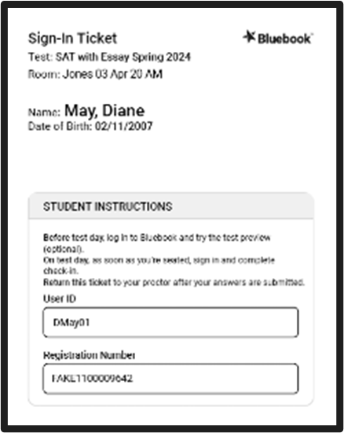
Take Your Seat and Receive Your Sign-In Ticket
Take your assigned seat.
The proctor will give you a sign-in ticket.

Slide 4
Power On Your Device & locate Bluebook™
Bluebook will either be an icon on your desktop
Or in your app menu
If you don’t see Bluebook on your desktop or in the app menu, restart your device.

Slide 5
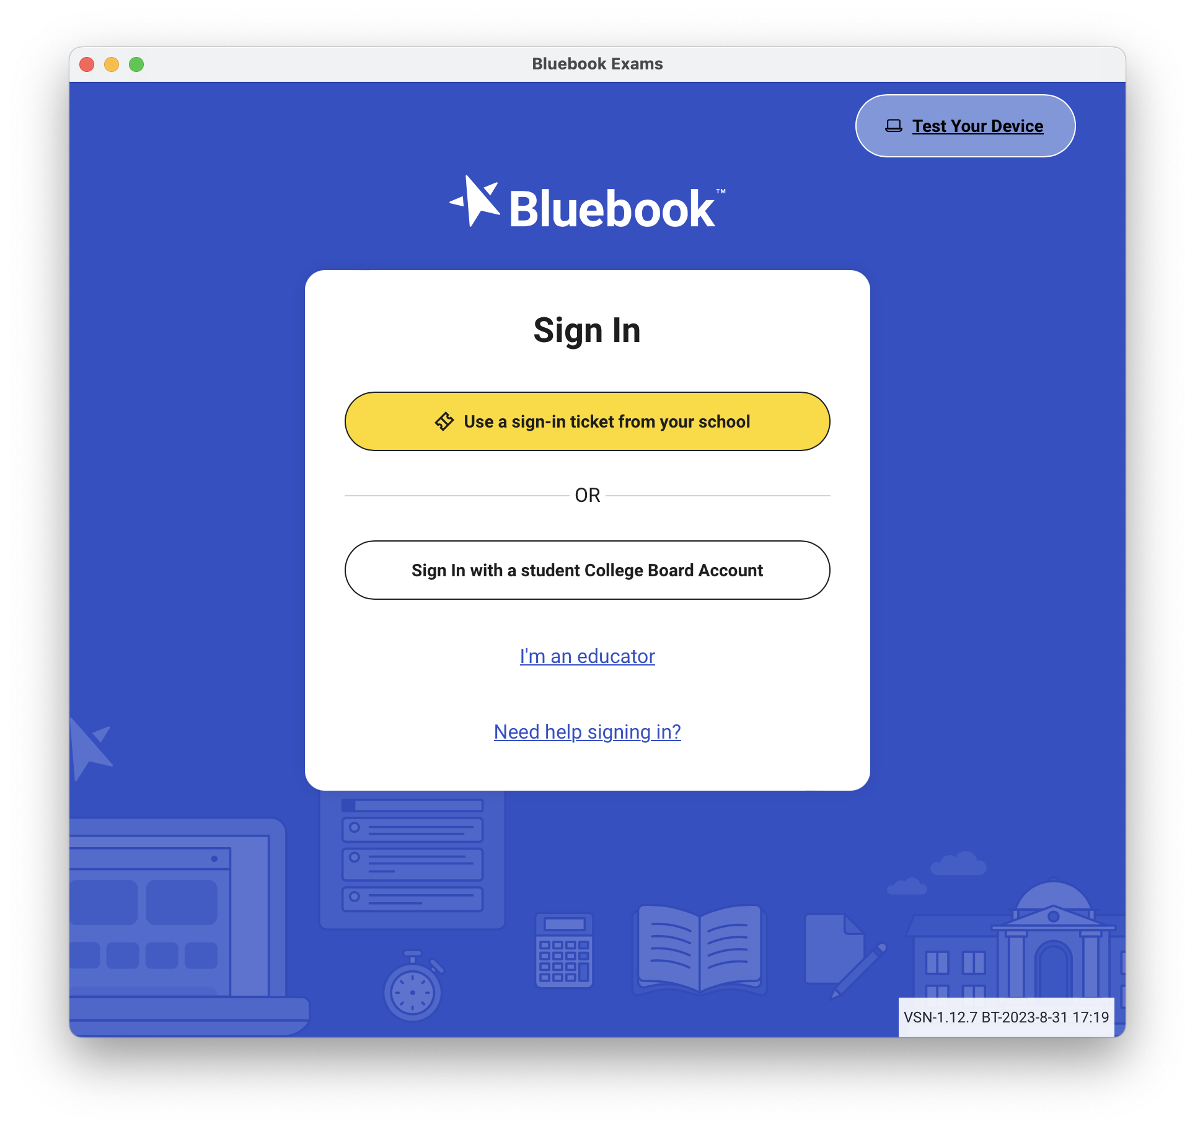
Test Your Device
Test your device before you sign in by selecting the Test Your Device button

Slide 6
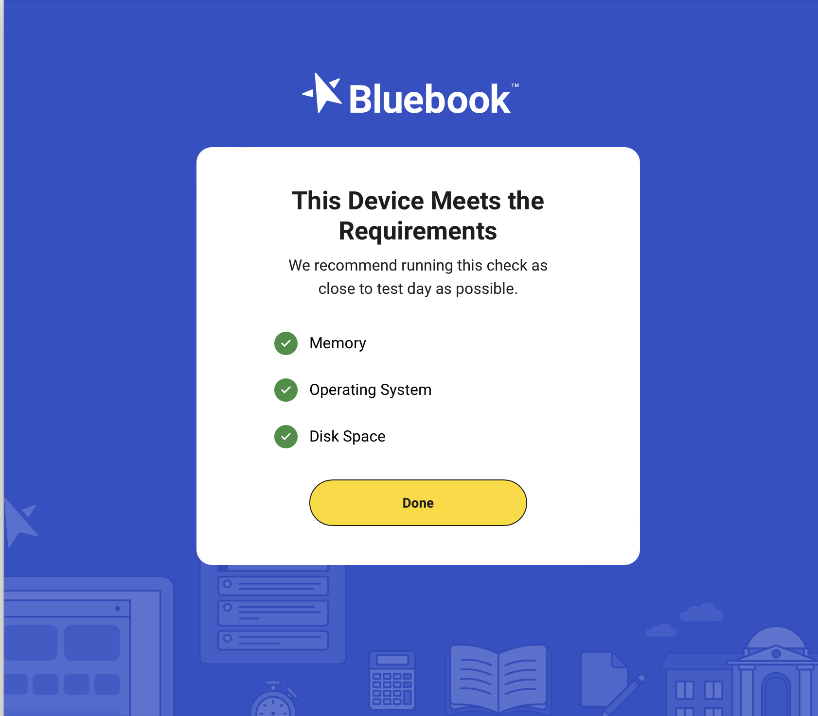
Test Your Device
If the device meets the requirements, select Done.
If the device does not meet the requirements, let your proctor know.

Slide 7
Sign into Bluebook
Click on the yellow button and enter the user ID and registration number provided on your sign-in ticket.

Slide 8
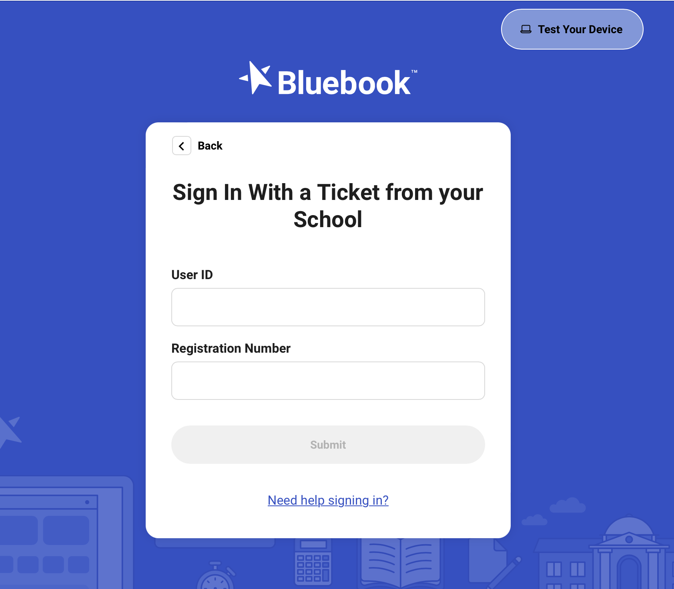
Sign into Bluebook
Your sign in ticket will have:
Your user ID
Your Registration Number

Slide 9
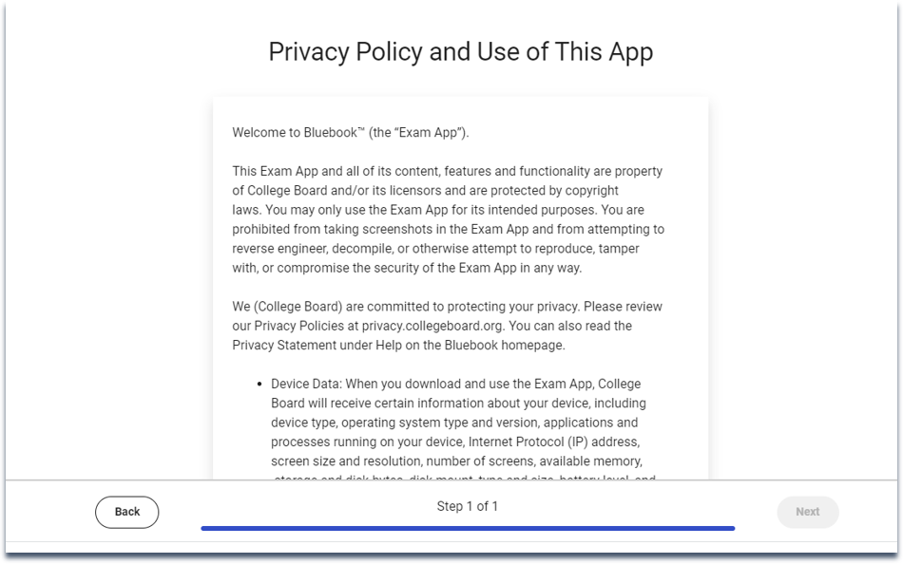
Sign into Bluebook
Scroll down and review the entire privacy policy. Then click Next.

Slide 10
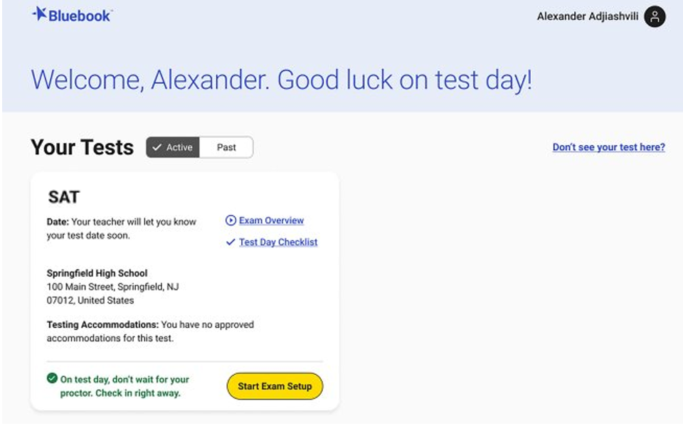
Compare Your Test Ticket and Bluebook
You will see a test card for the assessment you will be taking. Make sure that the “Active” tab is checked.

Slide 11
Compare Your Test Ticket and Bluebook
Confirm that:
1. The correct test is displayed.
2. The correct school name is displayed.
3. (If applicable) The correct accommodations are displayed

Slide 12
Start Exam Setup
Click on the yellow Start Exam Setup button.

Slide 13
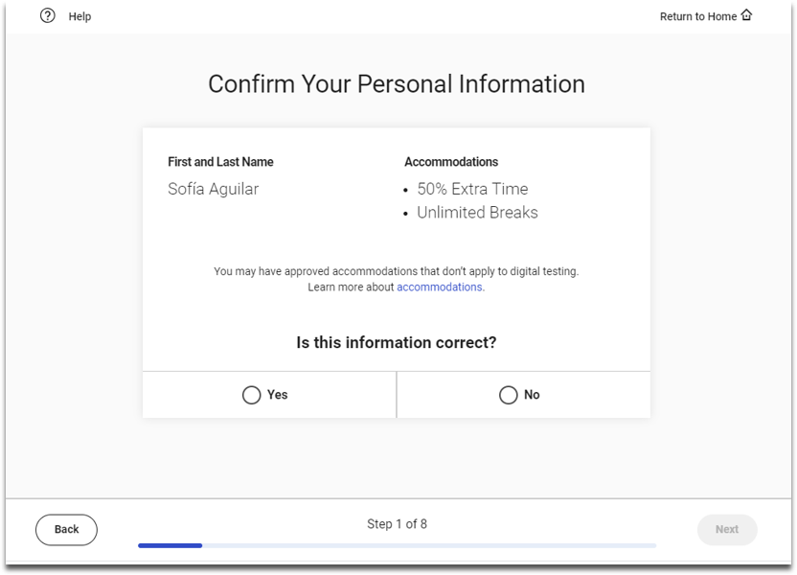
Students Confirm Personal Information
Make sure that your name and testing accommodations (if applicable) are correct. Click “yes” or “no” and then click Next.
NOTE: If your accommodations look inaccurate, let your proctor know.
Time and One-half (+50%)
Breaks as Needed

Slide 14
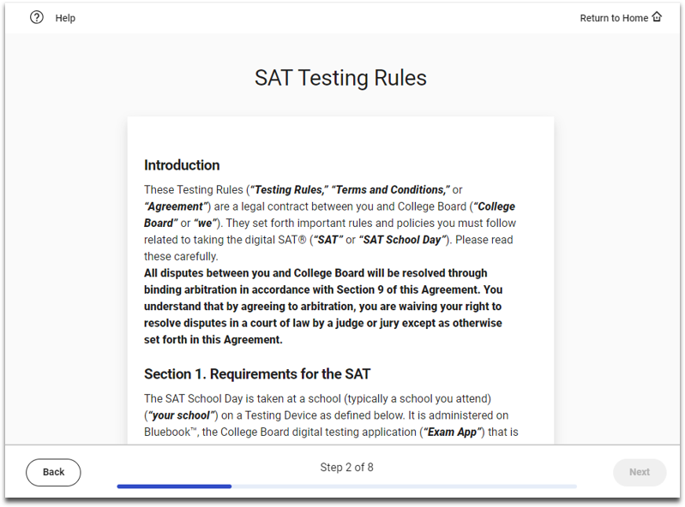
Review & Agree to Test Taker Rules
Scroll down to read the testing rules. Then click Next.

Slide 15
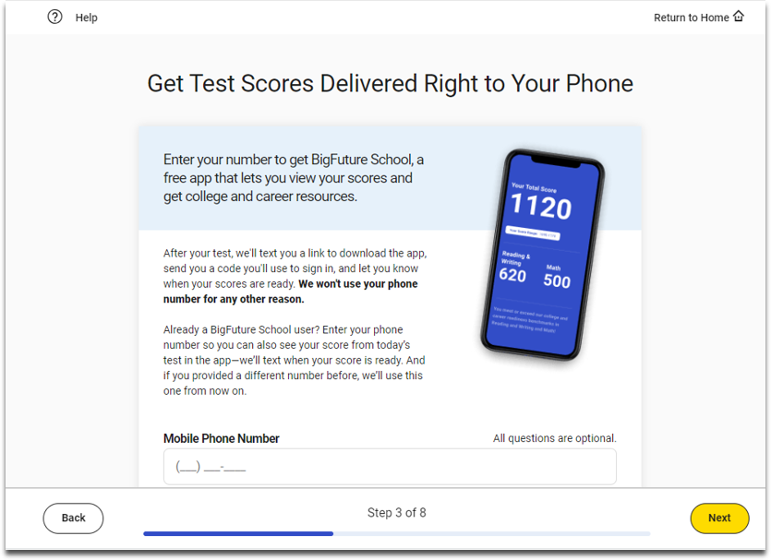
BigFuture School Participation (Optional)
You can provide your mobile phone number if you would like to access your scores via the free BigFuture School mobile app.
If you would like to participate, enter your phone number and click Next.
If you do not want to participate, do not enter you phone number and click Next.

Slide 16
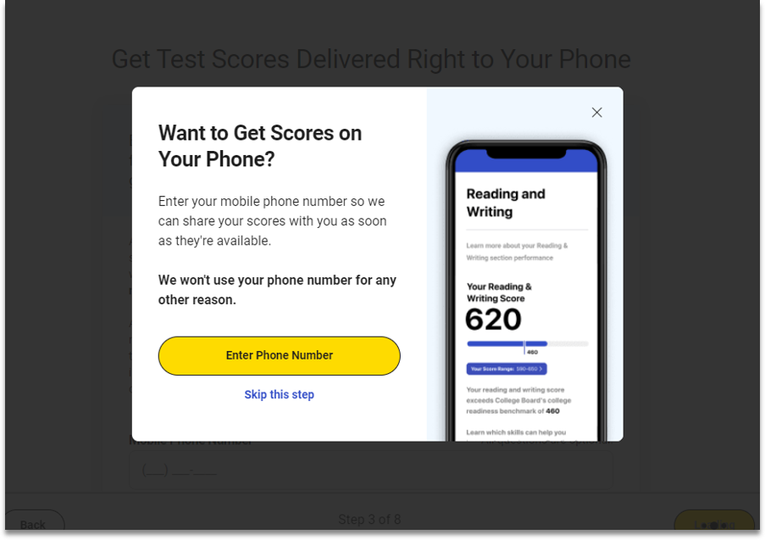
BigFuture School Participation (Optional)
If you didn’t provide your mobile number, you will be given another opportunity to provide it or you can skip this step.

Slide 17
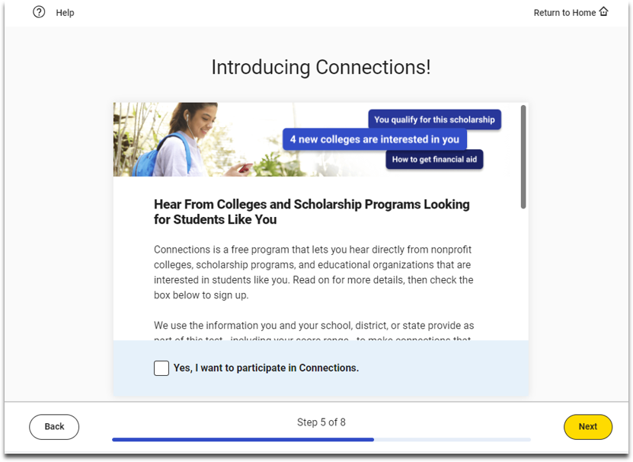
Connections Opt-In (Optional)
You may opt into participating in Connections.
To participate, select the box that says “Yes, I want to participate in Connections” and click Next.
If you do not want to opt-in, do not select the box, and click Next.

Slide 18
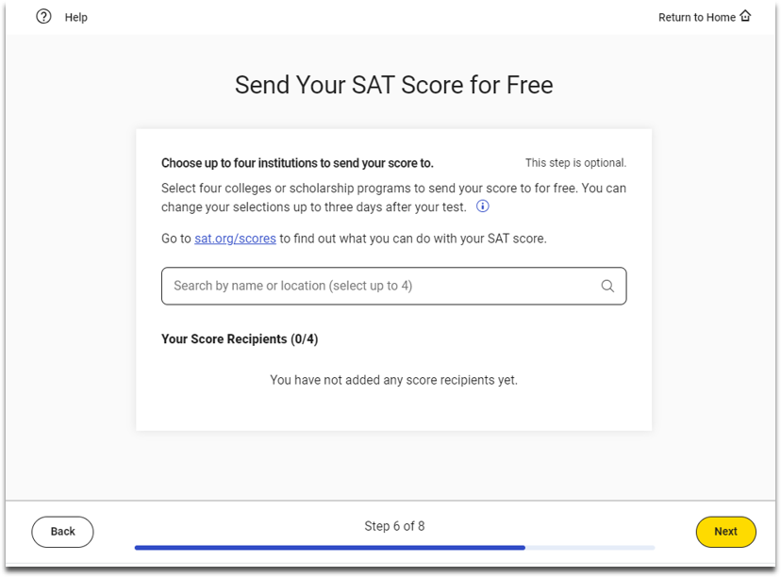
SAT Free Score Sends (Optional)
On this step, you have the option to send your SAT scores to up to 4 colleges or scholarship programs for free.
Enter the name of the college or scholarship program and then select the correct one from the list.
If you do not want to send your scores, leave this blank.
Click Next.

Slide 19
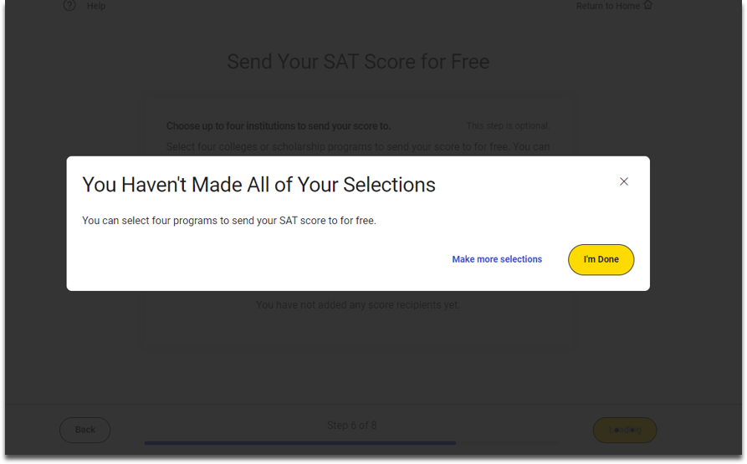
SAT Free Score Sends (Optional)
If you haven’t’ selected four programs, you will see a message that says, “You Haven’t Made All of Your Selections” and be provided with an opportunity to add more. Click Make more selections to add more programs.
If you have made all your intended selections, click I’m Done.

Slide 20
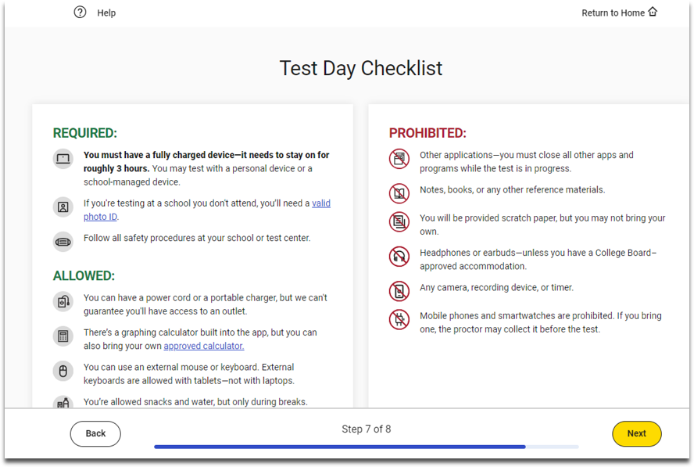
Test Day Checklist
Review the items that are required, allowed, and prohibited during testing.
Click next.

Slide 21
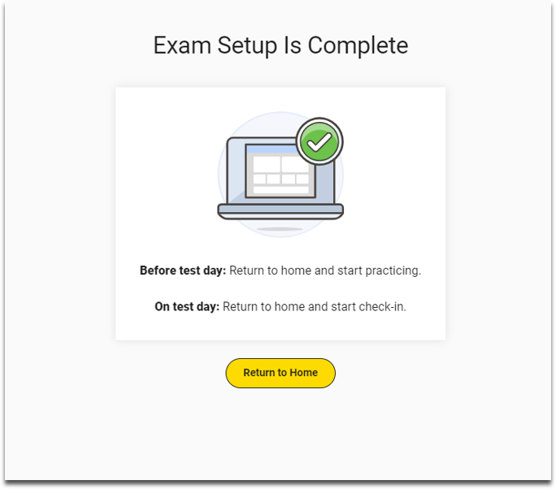
Exam Set-Up Complete
Exam Setup is now complete. Click Return to Home.

Slide 22
Optional: Test Preview and Full-Length Practice Tests
Test preview is a short set of questions that you can go through to see how Bluebook works.
You can also take a full-length practice test to prepare for test day.

Slide 23
Digital Test Preview Scavenger Hunt
Try some questions:
Answer at least 3 Reading and Writing questions
Answer at least 3 Math questions
Find these items to make sure you’re prepared for test day:
Hide/Unhide Test Timer
Calculator
Annotation Tool
Question Navigator
Reference Sheet
Mark for Review
Option Eliminator
Line Reader

Slide 24
Your Digital Readiness Check is Complete

