Slide 1
Test Administrator/Teacher Training
SY 2025-26
Notes:
Welcome to the 2025-26 Test Administrator/Teacher Training for Connecticut’s Statewide Assessment Program.
This training is optional and covers a variety of topics related to state assessments, test administration, and test policies and procedures.

Slide 2
Presentation Overview
Welcome from the Staff
Connecticut’s Sensible Assessment System
Student Participation
Assessment Calendar
Overview of the Connecticut Statewide Assessments
Getting to Know the Online Test Systems
Starting a Test Session
Test Monitoring and Security
Accessibility & Accommodations
Practice and Training
Additional Teacher Trainings
Resources
Notes:
Today’s agenda includes an overview of summative assessments for spring 2026. We will also provide updates on the Cambium System and accessibility and accommodations for eligible students.

Slide 3


Welcome from the Performance Office Staff
Bureau Chief
Abe Krisst
Abe.Krisst@ct.gov; (860) 713-6894
Education Support Technician
Kimberly Johnson
Kimberly.Johnson@ct.gov; (860) 713-6885
Notes:
Before we get started, we’d like to take the opportunity to welcome and introduce you to the small but mighty assessment team at the CSDE.
Abe Krisst is the Bureau Chief in the Performance Office.
Kim Johnson supports the Performance Office and school administrators across a multitude of data collections and assessment related activities.

Slide 4
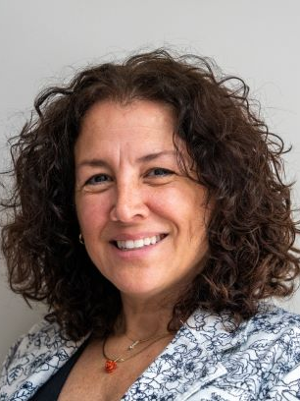

Meet the Assessment Team
Smarter Balanced/Interims
State Policy Test Administration Questions
Appeals/Reporting of Security Breaches
Cristi Alberino, Ph.D.
Cristi.Alberino@ct.gov; (860) 713-6862​
NGSS​
State Policy Test Administration Questions​
Jeff Greig​
Jeff.greig@ct.gov; (860) 713-6748
Notes:
Cristi Alberino, ELA Consultant, oversees the Smarter Balanced and NGSS Interim Assessments and English Language Proficiency Assessment (LAS Links), testing appeals/security breaches, student alerts, and other state policy test administrations processes.
Jeff Greig, Science Consultant, oversees all aspects of the Next Generation Science Standards and the Connecticut Alternate Science Assessments (CTAS). He also oversees state policy test administration processes.

Slide 5



Meet the Assessment Team - Continued
Connecticut SAT School Day, PSAT, AP​
ED159 Collection
Michelle Rosado​​
Michelle.Rosado@ct.gov; (860) 713-6748
Psychometrics​
Pei-Hsuan Chiu​, Ph.D.
pei-hsuan.chiu@ct.gov; (860) 713-6869​
English Learners Testing Supports; Assessment
Data/Accountability​
Michael Sabados​, Ph.D.
Michael.Sabados@ct.gov; (860) 713-6856​
Notes:
Michelle Rosado oversees the Connecticut SAT School Day and PSAT/AP Assessments among other projects.
Pei-Hsuan Chiu is our psychometrician that oversees all things related to data analysis and reporting.
Michael Sabados also supports the analysis and reporting of student and accountability data and advises on English learners testing supports. He also works closely on Connecticut’s English Language Proficiency Assessment (LAS Links) for English learners/multilingual learners in Grades K-12.

Slide 6


Meet the Accessibility Team
Accessibility Supports and Accommodations for
Smarter Balanced, NGSS, LAS Links, CT SAT School Day, and the
Connecticut Alternate Assessment System (CTAA, CTAS, & CAAELP)​​
Deirdre Ducharme​
Deirdre.Ducharme@ct.gov; (860) 713-6859​
Katie Seifert​​
Katherine.Seifert@ct.gov; (860) 713-6722
Notes:
Deirdre Ducharme and Katie Seifert are available to answer questions related to test administration processes in addition to questions about accessibility supports for all students, including language supports for multilingual learners and accommodations for students with disabilities.
They also oversee the Connecticut Alternate Assessment System for math, ELA, science, and the CAAELP, Connecticut’s alternate language proficiency assessment, and support the accommodations process for the Connecticut SAT School Day.

Slide 7
Know your Contacts
Contact​ | Name ​ | Phone/Email​
District Test Coordinator​ | ​ | ​
School Test Coordinator​ | ​ | ​
Special Education Contact
English Language Assessment Coordinator
Technology Coordinator​ | ​ | ​
CSDE Assessment Office​ | ​ | (860) 713- 6860; ctstudentassessment@ct.gov​
Connecticut Help Desk (Cambium Assessment )​ | ​ | (844) 202-7583; ​ cthelpdesk@cambiumassessment.com​ ​ The Help Desk is open Monday – Friday 7:00 a.m. to 7:00 p.m. during testing.​
Notes:
Prior to testing, make sure you know who your school test coordinator is as well as your primary District Administrator for Testing (there is one DA per district). These individuals will provide training and guidance along the way and will answer questions related to your individual school’s testing schedule. Your District Administrator for Testing and School Coordinator should be the first line of contact when questions arise.

Slide 8
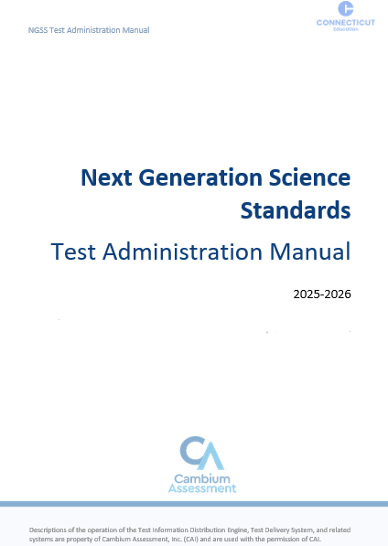
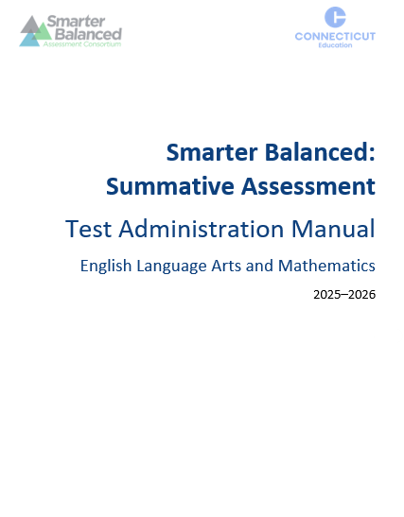
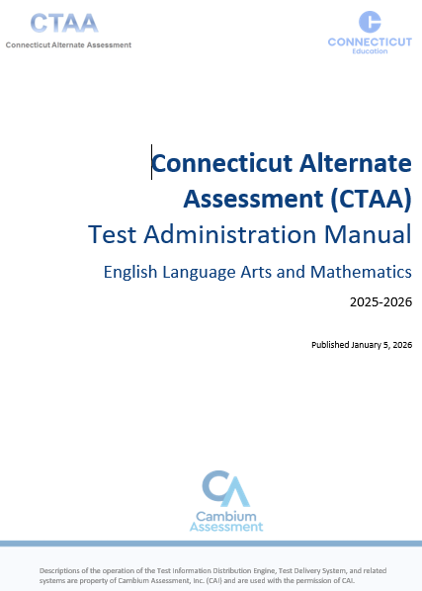
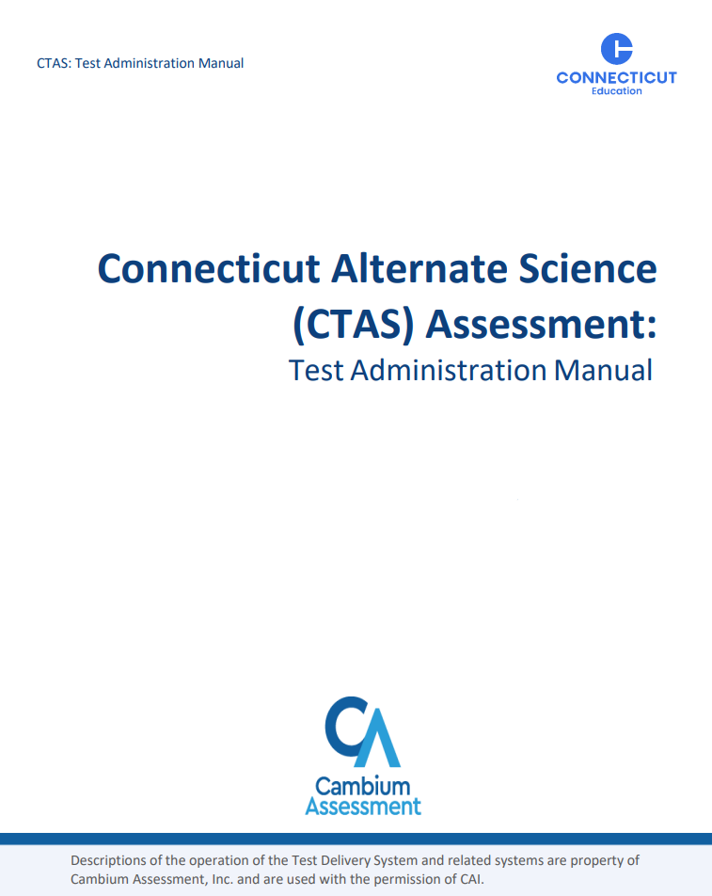
Test Administration Manuals
Smarter Balanced Test Administration Manual
Next Generation Science Standards Test Administration Manual
Connecticut Alternate Assessment (CTAA) for Math and English Language Arts
Connecticut Alternate Science (CTAS) Assessment Test Administration Manual
Notes:
Teachers administering the summative assessments should review the Test Administration Manuals (TAMs) prior to administration. These are provided to the district as hard copies and can also be printed down from the Connecticut Comprehensive Assessment Program Portal Page.
Smarter Balanced Test Administration Manual
Next Generation Science Standards Test Administration Manual
Connecticut Alternate Assessment (CTAA) for Math and English Language Arts
Connecticut Alternate Science (CTAS) Assessment Test Administration Manual

Slide 9
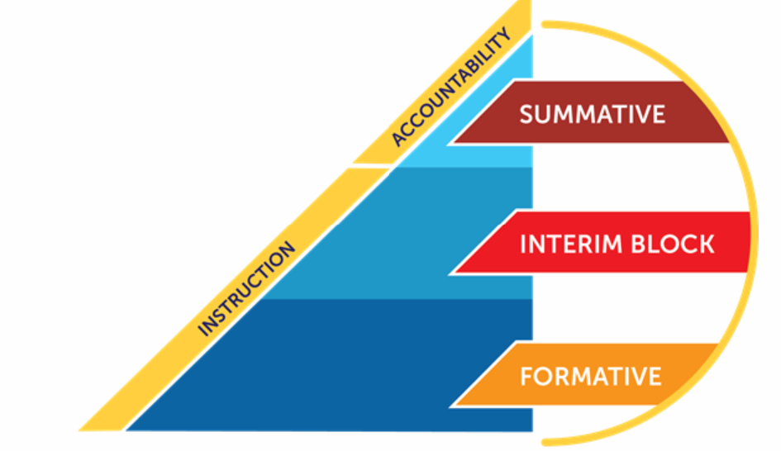
Overview of Connecticut’s Assessment Program
Connecticut’s assessment system is designed to support student learning of the Connecticut Core Standards and the Next Generation Science Standards.
This assessment system provides accurate measures of achievement and growth toward college and career readiness benchmarks while challenging students to think critically and solve real-world problems.
Notes:
Before we provide an overview of assessments, let’s start with why assessments are important.
Connecticut’s assessment system is designed to support student learning of the Connecticut Core Standards and the Next Generation Science Standards. These standards set learning expectations for what students should learn and be able to do at each grade level so that by the time they graduate from high school, they are ready to succeed in college and the workplace. These standards help set clear and consistent expectations for rigorous, high-quality instruction and learning for all students.
As shown on this slide, Connecticut’s Sensible Assessment System is balanced and comprehensive. It offers different tools for various purposes. We offer resources and training that go beyond the summative assessments and have a variety of formative and interim resources to help support our teachers and students!
Let’s take a deeper dive and review each type of assessment.

Slide 10
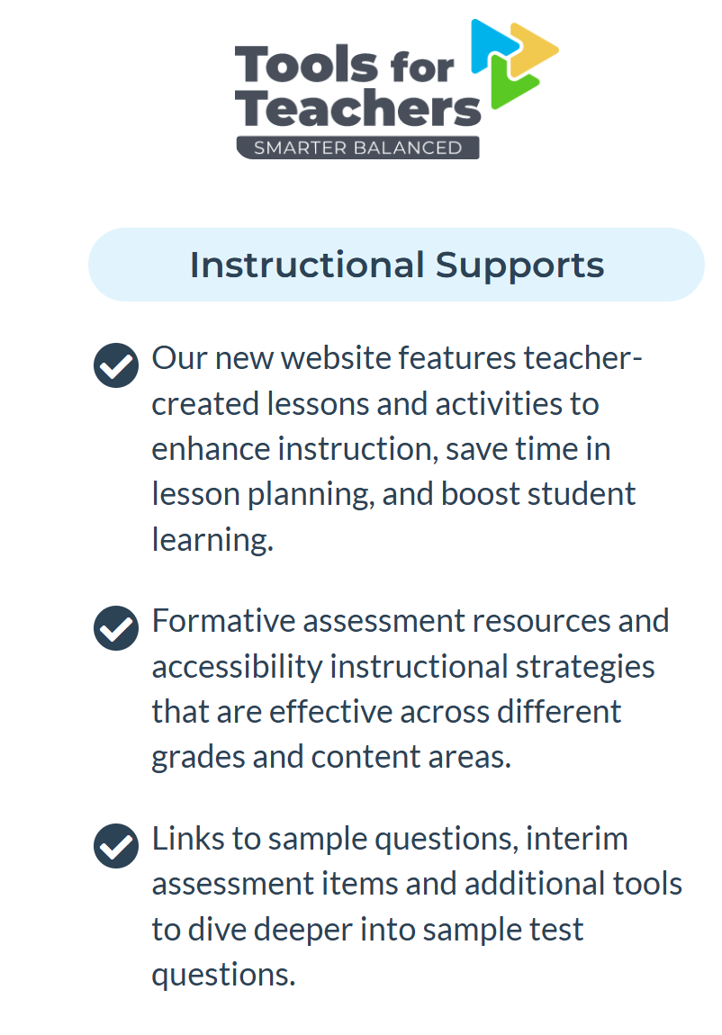
Overview of Connecticut’s Assessment Program – Formative Assessments
Formative assessment is a process used by teachers and students during instruction throughout the year. It is aligned to the standards and provides feedback to teachers so they can adjust ongoing teaching and learning. It also provides feedback to students to help them know where they are, where they need to be, and what they need to do to reach mastery.
Notes:
As we noted on the previous slide, there are three components to a balanced and sensible assessment system. Let’s review each aspect. First, what are formative assessments?
Unlike a summative assessment, which is an “event” that measures a student’s overall performance, formative assessment is a process used by teachers and students during instruction throughout the year. It is aligned to the standards and provides feedback to teachers so that they may adjust ongoing teaching and learning to improve students’ achievement of intended instructional outcomes. It also provides feedback to students to help them know where they are, where they need to be, and what they need to do to reach mastery.
To access Tools for Teachers, you must have a TIDE user name and password.
Link to Tools for Teachers: https://login.smarterbalanced.org/sso/idps/0oa1l0mrfklcVhxYy358?fromURI=https%3A%2F%2Flogin.smarterbalanced.org%2Fhome%2Foidc_client%2F0oa2ot1pcqJNDfCSZ357%2Faln177a159h7Zf52X0g8

Slide 11
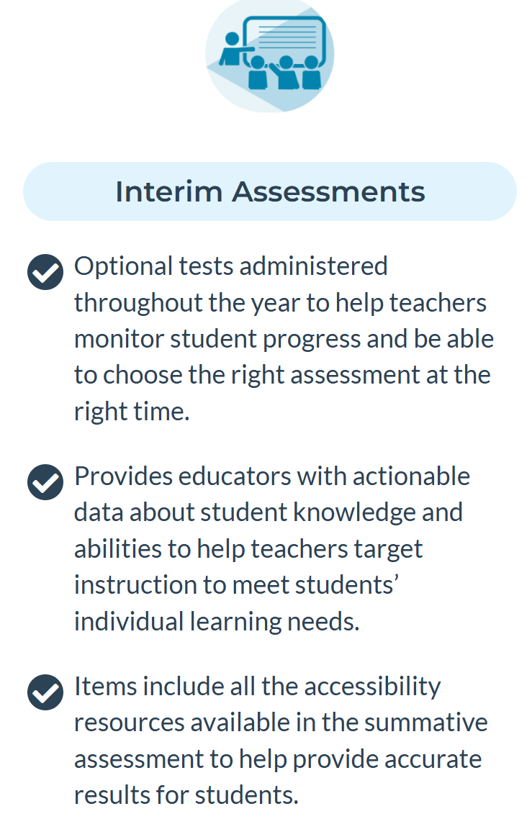
Overview of Connecticut’s Assessment Program – Interim Assessments
Interim assessments are optional, short, fixed-form assessments that are aligned to the standards and allow teachers to check student progress throughout the year, providing actionable results to inform instruction in ELA, math, and science.
Notes:
Smarter Balanced Interim Assessments are optional assessments in mathematics and ELA and are available to students in Grades 3-8 and high school. The interim assessments are aligned to the CCS in both content areas, and they use the same testing platform as the summative assessments. Interims are one of the three components of the Smarter Balanced Assessment System—along with the end-of-year summative assessments in ELA/literacy and mathematics, and a library of formative assessment tools and practices that support classroom instruction. More information can be found on the Interim Assessment Page: https://portal.ct.gov/SDE/StudentAssessment/Smarter-Balanced/Smarter-Balanced-Interim-Assessments.
The NGSS Interim assessments are also an optional resource available to Connecticut school districts. These Interim assessments consist of item clusters and shorter stand-alone items that are each aligned to an NGSS performance expectation. Each item includes a stimulus based on real-world science phenomena and includes one or more item interactions to elicit student understanding. There are a variety of NGSS interim items available for Elementary School (Grades 3-5), Middle School (Grades 6-8), and High School (Grades 9-11), all of which can be taken on the same platform used in the summative NGSS Assessments.
Connecticut Sensible Assessment System--Interim Block Assessments
2025-26 Interim Assessments Overview

Slide 12
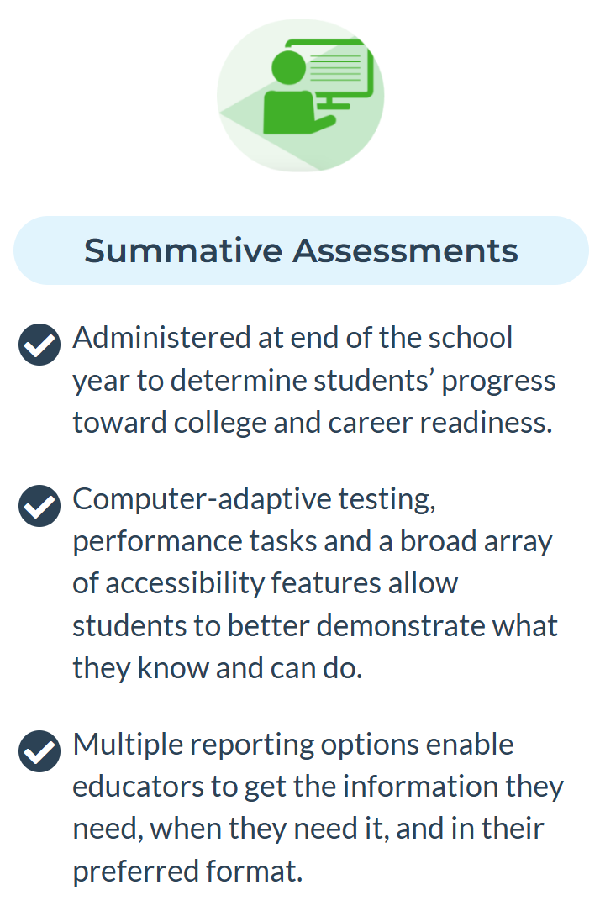
Overview of Connecticut’s Assessment Program – Summative Assessments
Summative assessments, administered in Grades 3-8 and 11, measure academic standards, performance, and growth in math, ELA, and science.
Notes:
As we noted on the previous slide, there are three components to a balanced and sensible assessment system. Let’s review each aspect. First, what are summative assessments?
Summative assessments are the culminating evaluation of student performance against a set of grade-appropriate standards. The primary purpose of the state’s summative assessments is to provide an efficient and reliable estimate of a student’s overall performance in a subject area relative to grade-appropriate standards that enable valid interpretations of student achievement (in all tested grades and subjects) and progress.
Then we have the Smarter Balanced Interim Assessments, which are optional assessments in mathematics and ELA and are available to students in Grades 3-8 and high school. The interim assessments are aligned to the CCS in both content areas, and they use the same testing platform as the summative assessments. Interims are one of the three components of the Smarter Balanced Assessment System—along with the end-of-year summative assessments in ELA/literacy and mathematics, and a library of formative assessment tools and practices that support classroom instruction. More information can be found on the Interim Assessment Page: https://portal.ct.gov/SDE/StudentAssessment/Smarter-Balanced/Smarter-Balanced-Interim-Assessments.
The NGSS Interim assessments are also an optional resource available to Connecticut school districts. These Interim assessments consist of item clusters and shorter stand-alone items that are each aligned to an NGSS performance expectation. Each item includes a stimulus based on real-world science phenomena and includes one or more item interactions to elicit student understanding. There are a variety of NGSS interim items available for Elementary School (Grades 3-5), Middle School (Grades 6-8), and High School (Grades 9-11), all of which can be taken on the same platform used in the summative NGSS Assessments.
And lastly, the formative assessment process.
Unlike a summative assessment, which is an “event” that measures a student’s overall performance, formative assessment is a process used by teachers and students during instruction throughout the year. It is aligned to the standards and provides feedback to teachers so that they may adjust ongoing teaching and learning to improve students’ achievement of intended instructional outcomes. It also provides feedback to students to help them know where they are, where they need to be, and what they need to do to reach mastery.

Slide 13
Who Participates in Testing?

Slide 14
Connecticut General Statutes 10-14n
    (b) (1) For the school year commencing July 1, 2015, and each school year thereafter, each student enrolled in grades three to eight, inclusive, and grade eleven in any public school shall, annually, take a mastery examination in reading, writing and mathematics during the regular school day.
    (3) For the school year commencing July 1, 2018, and each school year thereafter, each student enrolled in grades five, eight, and eleven in any public school shall annually take a state-wide mastery examination in science during the regular school day.
Notes:
Federal legislation, the Every Student Succeeds Act signed in 2015 reauthorized the Elementary and Secondary Education Act (ESEA). This act reaffirms and requires that each state institute challenging content and performance standards for its public school students. These performance standards establish the level at which students are expected to master the material included in the state’s content standards. The ESEA requires that all states have quality assessments established in reading, mathematics, and science to determine the extent to which students have mastered the material outlined in the state’s content standards. This requirement addresses a key element of the Title I program, i.e., a high-quality assessment system that is aligned with a state’s content and performance standards to ensure that all students are held to the same high academic standards.
This slide identifies the legislation that mandates state summative assessments. This legislation requires that students be assessed in Grades 3-8, and 11 in mathematics, reading, and writing, as well as science in Grades 5, 8, and 11.
Federal law requires full participation of all students on the state summative assessments. The minimum standard for the participation rate is at least 95 percent of all students and all student groups for each subject. For accountability purposes at the district and school level, the CSDE evaluates the participation rate for all students, as well as students in the "High Needs” group, for all content areas.
What are the legislatively mandated state summative assessments?
The Smarter Balanced Assessments are aligned to the Connecticut Core Standards (CCS) in English language arts (ELA) and mathematics and measure student progress toward college and career readiness. These assessments are administered to students in Grades 3-8. The ELA assessment consists of a Computer Adaptive Test (CAT) while the mathematics assessment consists of a CAT and a performance task (PT).
The Next Generation Science Standards (NGSS) Assessments are aligned to the NGSS. The assessments are also computer adaptive and are administered in Grades 5, 8, and 11.
The Connecticut SAT School Day is administered to all students in Grade 11 in Connecticut public schools. The Connecticut SAT School Day is aligned to the CCS in ELA and mathematics. Scores for the Connecticut SAT School Day can also be used for the college admissions process. The Connecticut SAT School Day is multi-stage adaptive and has two sections: reading/writing and mathematics.
The Connecticut Alternate Assessments (CTAA) support student independence to the greatest extent possible by making academic content accessible and the expected achievement levels appropriate. The CTAA for math and English language arts was developed to ensure that all students with significant cognitive disabilities that meet eligibility requirements for alternate assessments are able to participate in an assessment that measures what they know and can do in relation to grade-level standards. The CTAA is only administered to eligible students in Grades 3-8 and 11. It is a secure test, accessed online (or paper-pencil) with the support of a trained teacher.
The Connecticut Alternate Science (CTAS) Assessments was developed to ensure that all eligible students with significant cognitive disabilities are able to participate in an assessment that is a measure of what they know and can do in relation to the NGSS. The CTAS includes six Performance Tasks that are intended to be administered throughout the year as teachers work with eligible students to rate student performance on the CTAS Core Extensions. This alternate science assessment is only administered to eligible students in Grades 5, 8, and 11.
Other statewide assessments include the following:
English Language Proficiency (ELP) Assessment is required to be administered to eligible students under the Connecticut Consolidated State Plan for the ESSA. Results of this assessment are included in Indicator 11 of the Next Generation Accountability System reports. Both Titles I and III of the ESEA require States and LEAs to annually assess the English proficiency of all ELs/MLs in the State enrolled in public schools in grades kindergarten through twelve in the domains of speaking, listening, reading, and writing (sections 1111(b)(7) and 1123(b)(3)(D) of the ESEA). Accordingly, as part of a general state assessment program, all Els/MLs with disabilities must participate in the annual State ELP assessment with or without appropriate accommodations or by taking an alternate assessment, if necessary, consistent with their IEPs. The IDEA, Titles I and III of the ESEA, and Federal civil rights laws require that all children, including children with disabilities, take statewide assessments that are valid and reliable for the purpose for which they are being used, and this includes the annual ELP assessment.
The Connecticut Alternate Assessment of English Language Proficiency (CAAELP) The CAAELP is designed for students with the most significant cognitive disabilities in Grades K-12 who are dually identified as EL/ML and receive services under the IDEA. Eligible students, determined at each annual Planning and Placement Team (PPT) meeting, may be considered for participation in the appropriate assessments associated with their grade and EL/ML identification.
Connecticut Physical Fitness Assessment
The Connecticut Physical Fitness Assessment (CPFA) is Connecticut’s annual assessment of public school students’ physical well-being. Students in Grades 4, 6, and 8 are assessed annually. At the high school level, schools have the flexibility to assess students at any grade, but must assess each student at some point between Grades 9 and 12.
The goals of the assessment program are to:
inform schools, districts and the public about programs focusing on fitness and physical activity in our schools and evaluate their success
Is there an Opt-Out Policy for academic statewide assessments?
There is no opt out for CT students taking the Smarter Balanced, NGSS, Connecticut's Alternate Assessment System, or Connecticut SAT School Day Assessments. If students do not test, they will be considered a non-participant and will impact school accountability.

Slide 15
Who Participates on the Connecticut Summative (End-of-Year) Assessments?
All students enrolled in the Public School Information System (PSIS) in Grades 3–8 and 11 (these students include those identified as English learners/multilingual learners and/or students with disabilities who have an active IEP or Section 504 Plan)
Students enrolled in PSIS attending Approved Private Special Education Programs (APSEPs)
Students enrolled in PSIS who are being educated in out-of-state facilities, in-state facilities, and non-approved facilities
  Refer to the Students in PSIS Who Attend Out-of-State and In-State Non-Approved Facilities brochure.
Notes:
The participation Expectations for Smarter Balanced, NGSS, and Connecticut SAT School Day include:
All students enrolled in the Public School Information System (PSIS) in Grades 3-8 and 11 (these students include those identified as English learners/multilingual learners and/or students with disabilities who have an IEP or Section 504 Plan)
Students enrolled in PSIS attending Approved Private Special Education Programs (APSEPs)
Students enrolled in PSIS who are being educated in out-of-state facilities, in-state facilities, and non–approved facilities
Refer to Testing Students In PSIS Who Attend Out-of-State and Non-Approved Facilities for more information about testing students placed out of state or at non-approved facilities.

Slide 16
2026 Assessment Calendar
Notes:
To assist districts with planning their calendars, the CSDE is providing the State Summative Assessment Calendar for Connecticut public schools for the 2025-26 school year.
This is the link to the spring 2026 assessment calendar: Connecticut Sensible Assessment System--Summative Assessment - End-of-Year

Slide 17
2026 Summative Assessment Calendar
State Assessment | Grade(s) | Testing Window
LAS Links (English Language Proficiency: Speaking, Listening, Reading, and Writing) | K–12 | January 5–March 6, 2026
Connecticut Alternate Assessment of English Language Proficiency Assessment (CAAELP) | K–12 | January 12–March 6, 2026
Connecticut SAT School Day Math & ELA | 11 | March 2–April 30, 2026
Smarter Balanced Math & ELA | 3–8 | March 23–May 29, 2026
NGSS Assessments | 5, 8, and 11 | February 2–May 29, 2026, Grade 11; March 23–May 29, 2026, Grades 5 and 8.
Connecticut Alternate Assessment (CTAA) Math & ELA | 3–8, 11 | March 23–May 29, 2026
Connecticut Alternate Science (CTAS) Assessment | 5, 8, and 11 | Test administered throughout the school year. Student ratings entered in the DEI: March 23–May 29, 2026

Slide 18
Getting to Know the Online Assessment System

Slide 19

How are students tested?
Online using a computer/tablet
Varied question types (multiple choice, constructed response, grid-in)
Built-in accessibility tools (highlighter, mark for review, digital notepad)
Adjusts item difficulty (Smarter Balanced and NGSS Assessments are computer adaptive; the CT SAT School Day is multi-stage adaptive)
Notes:
The Smarter Balanced summative assessment for English language arts and mathematics requires students to
Participate in an online assessment comprised of two components: a computer adaptive test (CAT) for both ELA and math; and a performance task (PT) for math. The tests are not timed, however, recommended test session lengths of 40 to 120 minutes, depending on content area and grade level, are provided in the Smarter Balanced Test Administration Manual;
Demonstrate critical-thinking and problem-solving skills; and
Accurately respond to various item response types using a keyboard and mouse or touchpad.
The Next Generation Science Standards (NGSS) Assessments, which is a computer adaptive assessment, consists of a variety of item types and interactions, many of which students will have experienced before on the NGSS Assessment and Smarter Balanced Assessments. Some items will be organized in item clusters that are designed to engage the student in a grade appropriate, meaningful scientific activity aligned to a specific NGSS performance expectation. Each item cluster begins with a real-world phenomenon and includes two or more item interactions that require students to demonstrate the ability to use the science and engineering practices, disciplinary core ideas, and cross-cutting concepts described by the performance expectation. In addition to item clusters, there are stand-alone items that most often contain a single interaction framed around a single task demand. Each student will receive six item clusters and 12 stand-alone items that will be scored. The suggested testing time of at least 90 minutes is a recommendation of how much time students will need to complete the NGSS Assessments. Students should be given additional time if needed. For details, refer to the NGSS Test Administration Manual.
The online Connecticut SAT School Day is shorter and multistage adaptive. This assessment is produced and delivered by the College Board using their own online platform. Teachers/test administrators use Test Day Toolkit to administer the tests, while students use the Bluebook App to take the tests. More information is available at Home – SAT Suite of Assessments | College Board. Reading and Writing tests have an allotted time of 64 minutes for 54 questions. The math session has 44 questions with access to embedded Demos Calculator and students have 70 minutes to complete the session.
Most students will test in one day, even with up to 50% or 100% extended time per documented need in IEP or Section 504 Plan.

Slide 20
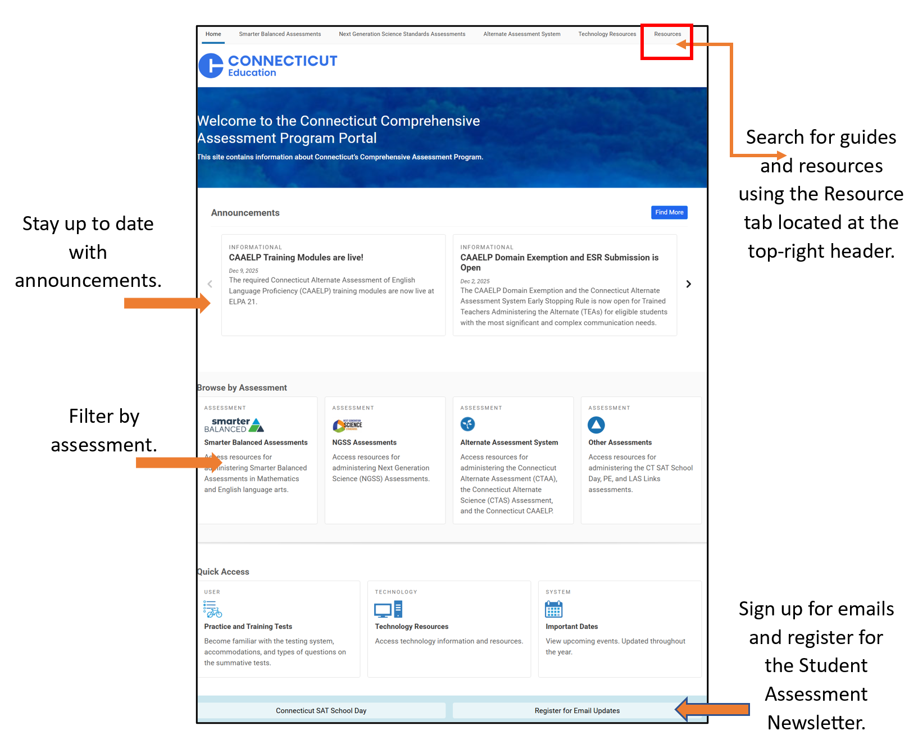
The Connecticut Comprehensive Assessment Program Portal
Notes:
Everything you need for test administration, such as accessing test manuals/user guides and the test administration interface, is located on the Connecticut Portal. As shown on this slide, you can browse by assessments, search for resources, view announcements. Each assessment has its own page (Smarter Balanced, NGSS, or other assessments such as the Connecticut Alternate Assessment System) that can be accessed when you select the assessment card. By selecting the test of your choice, you can drill down based on the phase of testing. Systems are grouped by the following categories: Preparing for Testing, Administering Tests, and After Testing.
You can also use the Resource look-up, as referenced by the red box in the upper right corner of the portal.

Slide 21
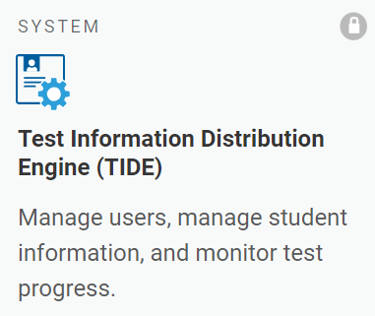
TIDE
School administrators use TIDE to
manage user accounts, manage rosters, file and/or view appeals, monitor testing progress, and manage test settings for students who participate in online assessments.
School personnel use TIDE account credentials to
access TIDE, the Assessment Viewing Application (AVA), Test Administration (TA) Interface, TA Practice & Training Site, the Centralized Reporting System (CRS), and the Data Entry Interface (DEI).
view students rostered to them and review test settings for students with designated supports and accommodations.
For information about using TIDE, refer to the TIDE User Guide, the User Role Permissions for Online Testing brochure for details about user access, and the Documenting Designated Supports and Accommodations brochure for details about test settings.
Notes:
TIDE, located on the Connecticut Portal, includes all the school and district users and is populated by the District Administrator for Testing and/or the School Test Coordinator. Depending on your user role in TIDE, you will have access to the test delivery system for test administration and the Centralized Reporting System, where you can find student test results from interim and summative assessments. While there are a variety of user roles available to teachers, most test administrators only need a TE or TA user role. If you have teacher access, you will use TIDE to create student rosters, view student test settings, such as designated supports and accommodations, and you can print test tickets.
If you are a new administrator, you will need TIDE user access from your school or district test coordinator. Refer to the TIDE User Guide for information on user roles and permissions, along with more information about this important data repository.
For information about using TIDE, refer to the Test Information Distribution Engine (TIDE) User Guide (https://ct.portal.cambiumast.com/resource-item/en/test-information-distribution-engine-tide-user-guide).
The User Role Permissions for Secure Online Systems; (https://ct.portal.cambiumast.com/resource-item/en/user-role-permissions-for-secure-online-systems) provides details about the various user roles and associated permissions within the system.
Refer to Accessing TIDE brochure (https://ct.portal.cambiumast.com/resource-item/en/accessing-tide) for information about resetting accounts and managing user accounts.

Slide 22
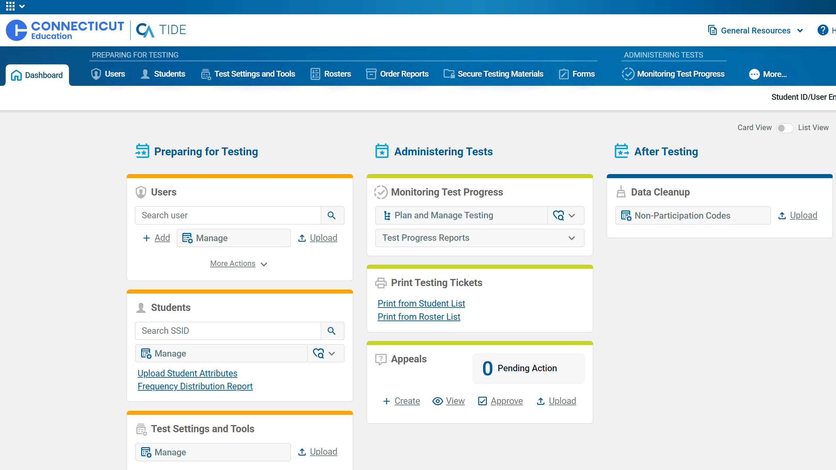
Accessing TIDE
Existing user accounts were rolled over and passwords reset in September 2025.
If you log in on a new device or browser (or clear the cache) you must enter an emailed code after passing the login screen. This step does not occur when you activate your account.
See your District or School Test Administrator if you are a new user and don’t have a TIDE user account, or if your contact information needs to be updated (e.g., name, phone number).
Notes:
A single sign-on password gives users access to all applicable testing systems, including Tools for Teachers). Keep the following criteria in mind when setting up your password for SY 2024-25.
One (1) uppercase letter
One (1) lowercase letter
One (1) number
One (1) special character
Min 12 characters (increase from min 8 characters)
Different from last 24 passwords (increase from last 2 passwords)
If you see a lock in the upper corner of the assessment cards, you will be required to sign-in using your TIDE password.

Slide 23
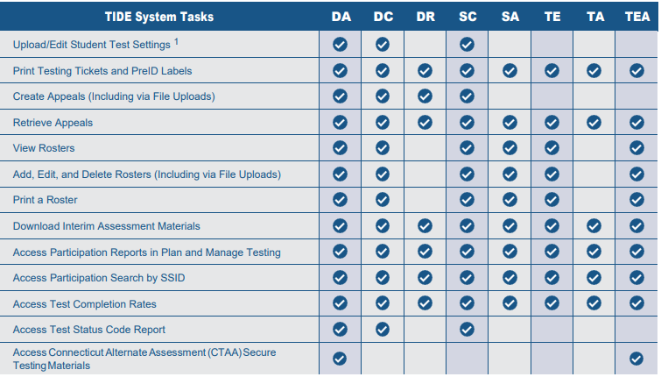
TIDE User Roles and Functions
To use TIDE, you need a recent version of a web browser, such as Chrome.
Each user in TIDE has a role, such as a district-level user or a test administrator-level user. Each role has an associated list of permissions to access certain features within TIDE.
Notes:
User Role Permissions for Secure Online Systems; https://ct.portal.cambiumast.com/resource-item/en/user-role-permissions-for-secure-online-systems
Teachers will need a TE role in TIDE to administer the Smarter Balanced and NGSS Assessments. With this level of access, teachers can view, create, modify, and print student rosters. They can also view student test settings and accommodations in TIDE. They will also be able to set up an interim and summative test session using the Test Administration Interface and access student results for rostered students using the Centralized Reporting System.

Slide 24
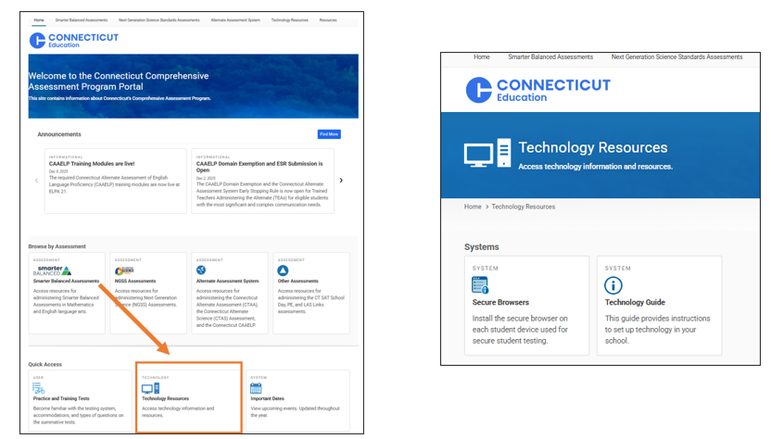
The Secure Browser
Students are required to use the Secure Browser to take the interim and summative Smarter Balanced, NGSS, the CTAA Math and ELA Assessments, and the CAAELP.
The Secure Browser prohibits access to other programs or websites during testing.
The 2025-26 Secure Browser was released in September 2025. Download the latest secure browser from the portal. The secure browser from 2024-25 no longer works
Notes:
The Secure Browser is designed to ensure test security by prohibiting students from accessing any other programs or websites during testing.
The 2025-26 Secure Browser was released in September 2025. Download the latest secure browser from the portal. The secure browser from 2025-26 will no longer work.
Students will be required to use the Secure Browser on their device to take the summative Smarter Balanced, NGSS, the CTAA math and ELA assessments, and the CAAELP.
Where is the secure browser located?
Technology Resources; https://ct.portal.cambiumast.com/technology-resources.html is located on the Connecticut Portal.
The 2025-26 Secure Browser must be downloaded to the student’s testing device. It is through this browser that students will access the online Smarter Balanced and NGSS Assessments.
The box displayed on the slide indicates where to access information on the secure browser. From the main page of the portal, select Technology Resources. Your school or district technology department may already have a process in place to download the secure browser on to each of the testing devices used by students. Without a secure browser, students will not have access to statewide assessments. A technology guide is also available for reference if information is needed regarding the configuration of student workstations and networks, and information regarding use of assistive technology.
Resource:
Recommended for Technology Coordinators, the Technology Guide provides information about setting up test stations for staff and students, configuring networks for online testing, and managing test sessions from any secure browser: https://ct.portal.cambiumast.com/tech-guide.html.

Slide 25
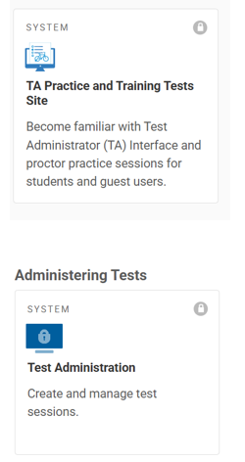
The Test Administration Interface: Practice Site
Practice Sites
  TA Practice & Training Site: Allows TAs to practice administering the Smarter Balanced, CTAA, CAAELP, and NGSS Practice tests.
  Practice & Training Tests: Allows students to practice taking tests online and using test tools.
    Students can log in to the practice test with their name and SAID or as guests.
    Students can either take proctored tests in sessions created by TAs in the TA Practice & Training Site or they can take non-proctored tests.
Notes:
Located on the Connecticut Portal, the TA Practice and Training Site is used to start the practice and training tests for Smarter Balanced, CTAA, CAAELP, and NGSS Practice Tests.
Student responses on practices tests are not scored, however, Answer Keys are available on the Connecticut Portal:
NGSS Practice Test Answer Keys
Smarter Balanced Practice Test Scoring Guides

Slide 26
The Test Administration Interface: Operational Testing Sites
Operational Testing Sites
  Test Administrator Interface: Allows TAs to administer interim and summative operational tests (Smarter Balanced, NGSS, Alternate Assessments).
  Student Interface (Secure Browser): Allows students to take operational test.
Notes:
Located on the Connecticut Portal, the Test Administration Interface is used to start the online interim and summative assessments. More information about this will be covered in the next slides.

Slide 27
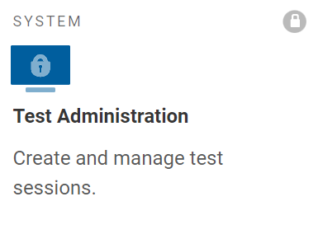
Starting a Test Session
Notes:
Cambium Assessments has a variety of systems that are linked to the test interface that ensure efficiency during test administration.
Two computer devices are used to administer the online Smarter Balanced, NGSS, and Alternate Assessments:
One computer device is used by the student to access the secure browser, which gives students access to their tests (populated based on the grade in which the student is enrolled in PSIS).
The second device is used by the test examiner to access the Test Administration Interface, which is located on the Connecticut Comprehensive Assessment Program Portal and used to set up a test administration and monitor testing from start to finish.
Moving forward in this presentation, we will only focus on test administration for Smarter Balanced and NGSS.

Slide 28
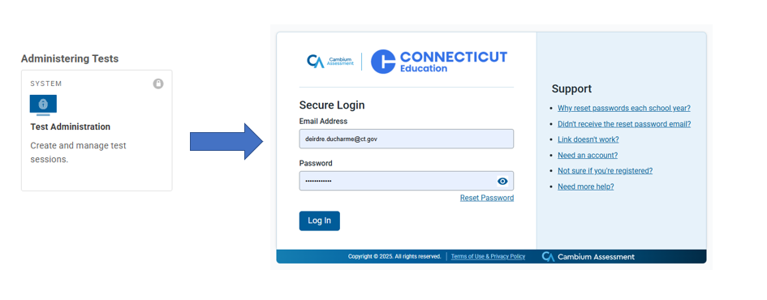
1. Log onto the Test Administration Site
Test administrators will log onto the Test Administration Interface using their secure TIDE username and password.
Notes:
The test examiner must create a test session before students can log in to the Test Delivery System (but no more than 30 minutes prior or the system will time out unless the test session was scheduled in advance). When a test examiner creates a test session, a unique Session ID is randomly generated. This Session ID must be provided to the students before they log in and should be written down.
To set up a test session in real time, select the Active Sessions tab (as shown on slide) and follow the prompts. To set up a test session in advance, choose the Upcoming Sessions tab and follow the prompts.
Key Resource: All test administrators should use the Test Administration Manuals for Summative Testing specific to the assessment (e.g., Smarter Balanced, NGSS, CTAA, CTAS, CAAELP). Manuals should be reviewed prior to, during, and after testing to ensure that all steps are followed. The manuals include standardized scripts read to students at the time of testing. All TAMs are available for viewing, downloading/printing on the Connecticut Comprehensive Assessment Program Portal. Home Page; https://ct.portal.cambiumast.com/index.html

Slide 29
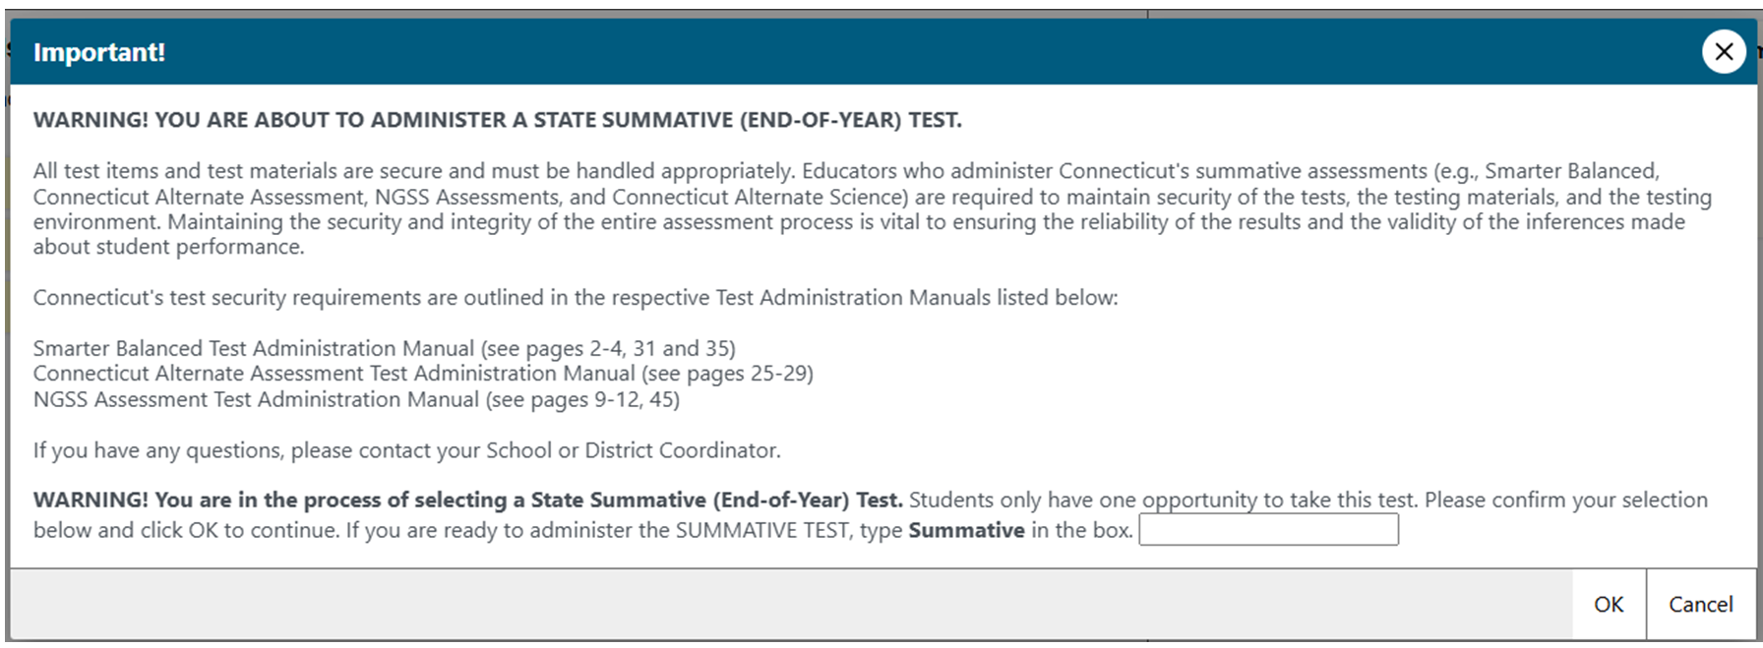
2. Verify Teacher Training and Qualifications
Notes:
This is the Test Administrator (TA) confirmation screen. It will appear again this year, and TA will be prompted to type in the word summative, and then select OK to proceed and begin creating test sessions.
This process is not new -we have followed this protocol for several years. It is essential that all school proctors and test administrators receive local training and carefully use the Test Administration Manuals when planning and administering tests.

Slide 30
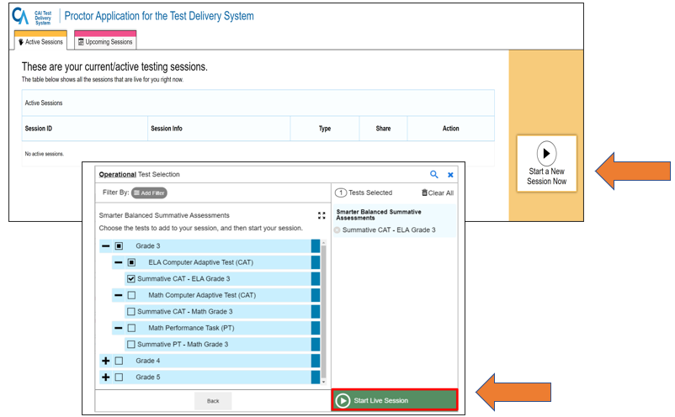
3. Choose Session
Choose Active Sessions to start a test in real time.
Select “Start a New Session Now,” choose the grade and assessment(s) from the drop-down menu, and then select “Start Live Session.”
To schedule a test session for a later date, select the Upcoming Sessions tab.
Notes:
Choosing a Session for Immediate Administration:
When a test examiner logs in to the Test Administration Interface and chooses Active Sessions, the Test Selection window opens automatically. To create a test session, select the test(s), grade(s), content area(s), and CAT(s) or PT(s) to be administered in the test session.
The Test Selection window color codes tests (summative assessments are blue). Assessments are also categorized by test, grade, content area, and type (CAT or PT). All tests appear collapsed by default. To expand a category, click (+). To collapse an expanded a category, click (−).
After selecting the assessment(s) to be administered during the test session, the test examiner clicks the [Start Live Session] button to begin the test session and generate the Session ID that students use to join that test session. The example on this slide displays all Grade 3 summative tests and shows that the test examiner has selected the Grade 3 ELA CAT to include in the test session.
To schedule a test session for a future date, select the Upcoming Sessions option.

Slide 31
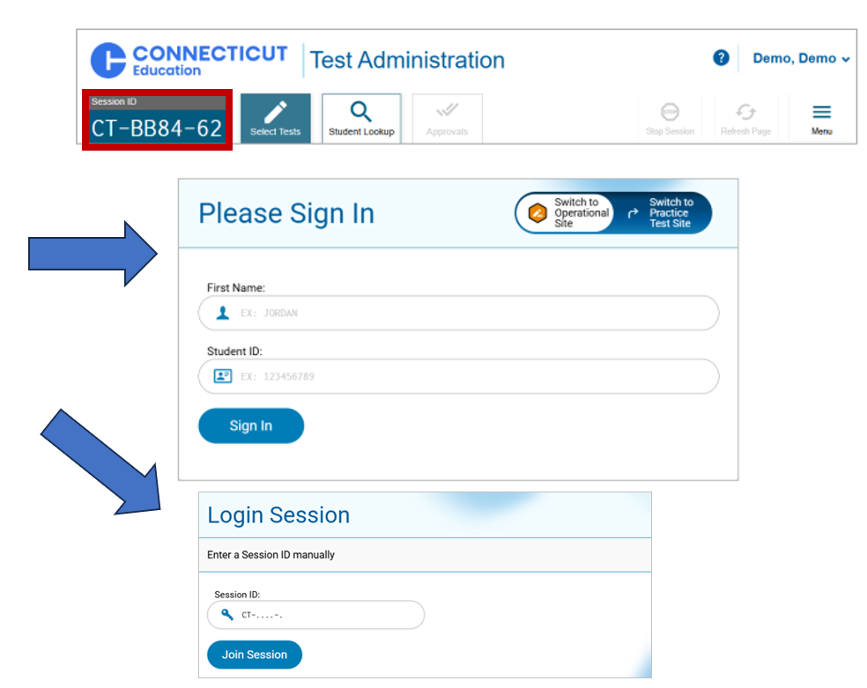
4. Provide Students with the Test Session ID and Direct them to Sign onto the Secure Browser
Inform the students of the Session ID.
Using the Secure Browser, the student will enter their full first name, and their ten-digit SASID (as indicated in PSIS).
A Login Session will pop-up and the student will enter the Session ID to join the session.
Notes:
Provide the students with the Session ID. This ID should also be written on the chalk board for easy reference.
Students will enter this information into the Secure Browser, along with their fully first name (as indicated in the PSIS registration system) and their SASID.
Ensure that all students have successfully entered their information before they sign-in.

Slide 32
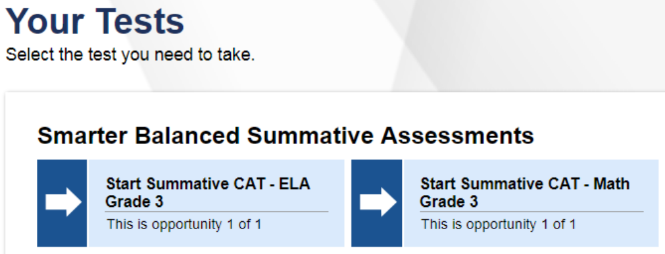
5. Inform Students of Which Test to Take
Inform students of the test session in which they will be participating.
Notes:
Once students sign into the Secure Browser, all assessments associated with their grade of enrollment will appear. Therefore, be sure to clearly communicate which assessment the student should choose. Tests are generated based on the student's grade in TIDE.
If you find an error with the student’s grade listed in TIDE or if the test form is not for the correct grade, do not test the student. Contact your DA immediately so that the student’s grade can be updated in PSIS.
Test administrators should look closely to the test name listed on the Test Administrator Interface prior to approving to be sure it is the correct summative test to be administered at that time.

Slide 33
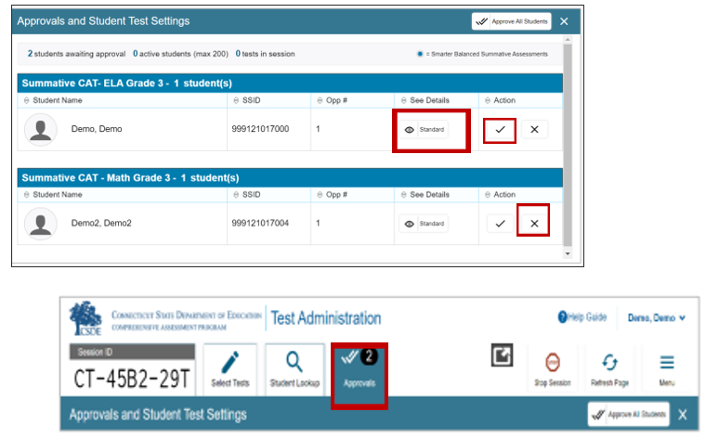
Reviewing, Approving, and Denying Tests
Using the Test Administration Interface, view students and their test settings (designated supports and accommodations) by selecting the “eye” icon.
If everything is accurate, select the check mark.
If there is an error with the test selected, or with the student’s demographics/test settings, choose the X.
Choose the Approve All Students option located on the top menu bar.
Notes:
On the Test Administration Interface, the test examiner will select the [Approvals] button as indicated on the slide. The Test Administrator can approve students individually by selecting the green check-mark associated with their student name/record. (Note: If a student selects a test other than the one the test examiner plans to administer to that student that day (for example, a student selected a PT instead of a CAT or selected mathematics instead of ELA), the test examiner must deny the test session by selecting the red x. The student may then log in again and select the correct test.)
Then, a new window opens that shows a list of students. The test examiner should review the list to ensure that students are taking the correct content area (mathematics or ELA) and type of test (CAT or PT). All tests should say “Summative” in the title.
Check the “eye” icon to see if the student has any embedded or non-embedded designated supports or accommodations. If non-embedded supports are listed, make sure that the student has the appropriate material prior to test administration (e.g., Bilingual Word-to-Word Glossary for NGSS).
If you notice that a student’s settings are incorrect, do not approve that student to begin testing. The test examiner will need to work directly with a School or District Coordinator to correct the test settings in TIDE for students without IEP/504 Plans. If the student has an IEP/Section 504 Plan, reach out to the student’s Case Manager to conduct an amendment or review/revise of the plan to ensure appropriate accommodations. Please note: designated supports and accommodations should never be manually entered for students with an IEP or Section 504 plan.
Again, please do not approve a student’s test or have the student participate in testing until all test supports and/or accommodations are accurately reflected in TIDE. Ensuring the test settings are correct before the student begins testing is critical to avoid the need for a test reset that may result in additional testing for the student later.

Slide 34
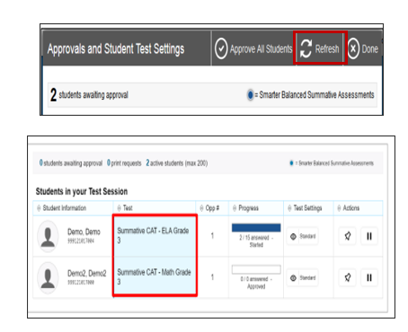
Monitoring Test Progress
Once students have started their tests, circulate through the room to ensure that all conditions of test security are maintained.
If you witness or suspect the possibility of a test security incident, pause the test and contact the District Administrator for Testing immediately.
The TA Interface refreshes every 20 seconds or select the refresh button at the top right of the screen.
Notes:
Once students have started their tests, circulate through the room to ensure that all conditions of test security are maintained.
If you witness or suspect the possibility of a test security incident, pause the student’s test and contact the District Administrator for Testing immediately in accordance with the security guidance provided in this manual.
Refer to the Test Administration Interface to view the testing progress of any student. This site will not show test items or scores, but it will show how many items have been delivered to each student (e.g., question 24/40). The Test Administration Interface is designed to automatically refresh every 20 seconds, but you can refresh it manually at any time by clicking the [refresh] button at the top right of the screen (as indicated by red text box on your screen).
As a security measure, test examiners are automatically logged out of the Test Administration Interface after 30 minutes of test examiner inactivity and student inactivity in the test session, which will result in closing the test session. If this occurs, create a new session, and the students will have to log in to the new session to resume testing. When starting a new session, give the students the new Session ID so that they can log in and resume testing.

Slide 35
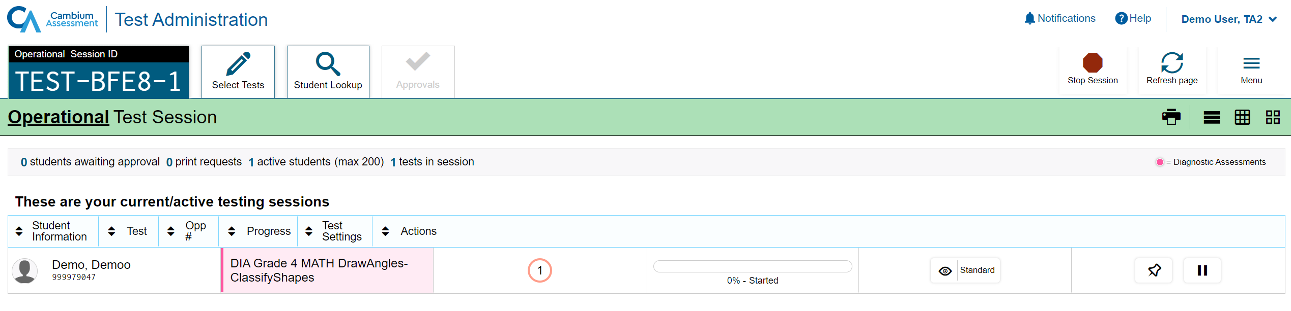
Things to Know
Proctors can pin students of interest to the top, so they are easy to monitor.
Notes:
Proctors have the ability to pin select students of interest to the top, so they are easy to monitor.

Slide 36
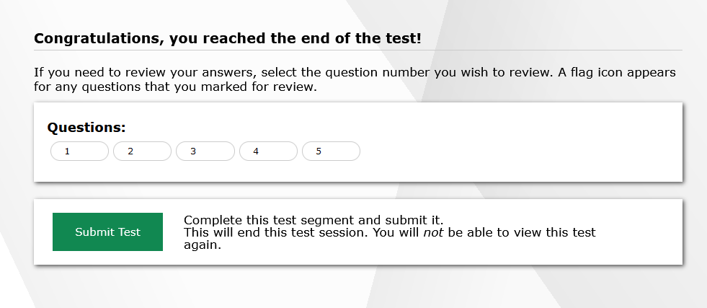
Finishing a Test
Notes:
After answering the last item in the test session, each student is presented with a screen prompting the student to review answers (marked and unmarked) for all items available to the student or prior to submitting the test.
After answering the last question, students must submit their tests. If students would like to review their answers before submitting their test, they should click the number of the question they wish to review and, only after they finish reviewing, should they click [SUBMIT TEST].
Once a student clicks [SUBMIT TEST], the student will not be able to review answers.

Slide 37
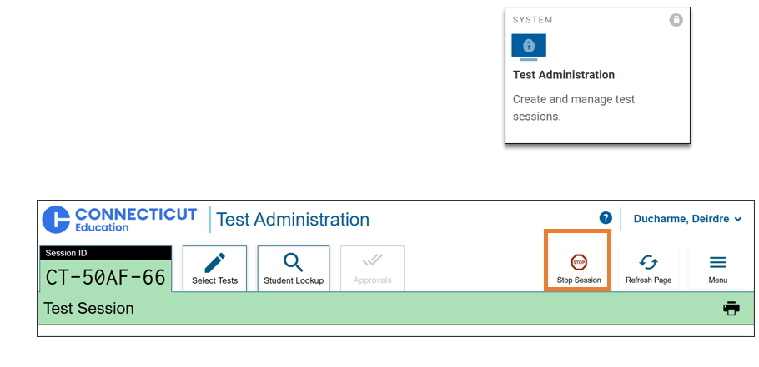
How does a test administrator end a session?
Test administrators click [STOP] in the Test Administration Interface to end a session and pause any student test still in progress.
Log out of the Test Administration Interface by clicking the [Logout] button at the top right.
Notes:
The test administrator will click [STOP] in the Test Administration Interface to end the test session and pause any student test in the session that is still in progress. Log out of the Test Administration Interface by clicking the [Logout] button at the top right.

Slide 38
Test Time Reminders

Slide 39
Recommended Test Times
Content Area | Grades | Computer Adaptive Test (CAT) Hours: Minutes | Performance Task (PT) Hours: Minutes | Total Time Hours: Minutes
English Language Arts | 3-5 | 1:30 | N/A | 1:30
Math | 3-5 | 1:30 | 1:00 | 2:30
English Language Arts | 6-8 | 1:30 | N/A | 1:30
Math | 6-8 | 2:00 | 1:00 | 3:00
Both English Language Arts and Math | 3-5 | 3:00 | 1:00 | 4:00
Both English Language Arts and Math | 6-8 | 3:30 | 1:00 | 4:30
Some districts are testing much more than the suggested time.
Please monitor this closely. Extra time does not necessarily correlate with achievement and very low/high times may represent lack of effort, motivation, or active proctoring.
Notes:
These are the suggested times for ELA and Math.
Some districts/schools are testing much more than the suggested time for each test. While this is not a timed test, and students may need more than the suggested time, please monitor this closely. Extra time does not necessarily correlate with achievement and very low/high times may represent lack of effort, motivation, or active proctoring.

Slide 40
Test Monitoring and Security

Slide 41
Test Security
Breaches of test security include, but are not limited to:
  Analyzing/copying test items
  Coaching students
  Giving students answers and/or changing students’ answers
  Allowing students access to digital, electronic, or manual devices (except approved accommodations)
  Unauthorized log-in to the Test Delivery System
  Cell phones (including Smart Watches) used by students are strictly prohibited!
Notes:
Breaches of test security include analyzing or copying test items, coaching students or giving students answers and changing students’ answers. We do not allow students to access to digital, electronic, or manual devices (except for approved accommodations). Any unauthorized log-in to the Test Delivery System may also be a breach of test security. This list is not comprehensive, but this represents most issues we see when it comes to issues in test security.
Please note that the use of cell phones (including Smart Watches) by students is strictly prohibited!

Slide 42
Test Security and Proctoring
Violation of test security is a serious matter with far-reaching consequences. Breaches of test security include, but are not limited to, copying or photographing of test materials, failing to return test materials, coaching students, giving students answers, and/or changing students’ answers. Such acts may lead to the invalidation of an entire school district’s student test scores, disruption of the test system statewide, and legal action against the individual(s) committing the breach. A breach of test security may be dealt with as a violation of the Code of Professional Responsibility for Teachers, as well as a violation of other pertinent state and federal law and regulation. The Connecticut State Department of Education will investigate all such matters and pursue appropriate follow-up action. Any person found to have intentionally breached the security of the test system may be subject to sanctions including, but not limited to, disciplinary action by a local board of education, the revocation of Connecticut teaching certification by the State Board of Education,* and civil liability pursuant to federal copyright law.
*See Section 10-145b(i) (2) (E) of the Connecticut General Statutes, which reads in relevant part as follows: The State Board of Education may revoke any certificate, permit, or authorization issued pursuant to said sections if the holder is found to have intentionally disclosed specific questions or answers to students, or otherwise improperly breached the security of any administration of a mastery examination, pursuant to section 10-14n.
Notes:
Please be aware of the state statutes concerning test security. The State Board of Education may revoke any certificate, permit, or authorization issued pursuant to said sections if the holder is found to have intentionally disclosed specific questions or answers to students, or otherwise improperly breached the security of any administration of a mastery examination, pursuant to section 10-14n.

Slide 43
Test Security Definitions
Type | Definition
Impropriety | An incident that has a low impact on the individual or group of students testing and has a low risk of affecting student performance on the test, test security, or test validity. It can be corrected and contained at the local level.
Irregularity | An incident that impacts an individual or group of students and may potentially affect student performance on the test, test security, or test validity.
Breach | An incident that poses a threat to the validity of the test. Examples include the release of secure materials or a security/system risk. These circumstances have external implications and may result in a decision to remove the test item(s) from the available, secure item bank.
Notes:
Contact your School Coordinator/District Administrator immediately to report a test security.

Slide 44
Issues that Might Arise During Testing
Problem | Response
The test examiner notices that a student is off task. | Encourage the student to do their best. If appropriate, have the student pause the test (for less than 20 minutes) and allow the student to take a break.
A student requests assistance with answering a test item or manipulating an item type. | Teachers may assist students in navigating the online test environment, but they should not assist students with any content needed to answer questions.
The Test Administration Interface is accidentally closed while students are still testing. | Direct students to reopen the secure browser. The test examiner can navigate back to the Test Administration Interface. Re-enter the test session by entering the active Session ID.
The test examiner is automatically logged out of the Test Administration Interface. | The test examiner can create a new test session with a new Session ID. The students will need to use this to log back into the system and resume testing. Students who paused the test or were inactive for more than 20 minutes cannot go back to previously responded items.
Notes:
The table on this slide shows appropriate responses to specific problems that may come up during testing.
Follow these suggestions:
If the student is off task, encourage the student to do their best. In some cases, have the student pause the test (for less than 20 minutes) and allow the student to take a break.
If a student requests assistance with answering a test item or manipulating an item type, the teacher may assist students in navigating the online test environment and responding to different item types (e.g., using the available global tools, such as the Mark for Review features and the Next button), but they should not assist students with any content needed to answer questions.
If the Test Administration Interface is accidentally closed while students are still testing, direct students to reopen the secure browser. The test examiner can navigate back to the Test Administration Interface. Re-enter the test session by entering the active Session ID.
If the test examiner is automatically logged out of the Test Administration Interface after 30 minutes of inactivity by both the test examiner and the students, this will result in closing the test session entirely. To troubleshoot, the test examiner can create a new test session with a new Session ID. The students will need to use this to log back into the system and resume testing. Students who paused the test or were inactive for more than 20 minutes cannot go back to previously responded items

Slide 45
Reminders
Remove or cover instructional materials.
Ensure sufficient spacing between student seating.
Place a “TESTING—DO NOT DISTURB” sign on the door, or in halls.
Prepare the test setting (e.g., small group, lighting, testing devices, assistive technology etc.).
Set up a practice test experience for all students and model how to use universal tools, designated supports, and accommodations (e.g., text-to-speech, speech-to-text) with those students using them.
Ensure student’s have scrap paper and any non-embedded designated support/accommodation identified in TIDE. Headsets are also required on the Smarter Balanced ELA Listening Assessments.
Notes:
To ensure that all students are tested under the same conditions, the test examiner should adhere strictly to the script for administering the test as published in the Test Administration Manual. These instructions are provided in the boxes on the following pages. When asked, the test examiner should answer questions raised by students but should never help the class or individual students with specific test items. No test items or passages can be read to any student for any content area, unless the student requires a designated support or accommodation as described in the Assessment Guidelines.
Test Administrators should distribute
scratch paper to students for all test sessions (scratch paper can include plain paper, lined paper, paddy paper, or graph paper) for ELA, math, or science.
graph paper to students in Grades 6, 7, and 8 for the mathematics assessments; and
headphones to students for the listening portion of the English language arts assessments, to students who require Audio Glossaries on the mathematics assessments, and students who require text-to-speech on either assessment.
Be sure to provide students with any non-embedded designated supports or accommodations that they are approved for.
Other reminders:
Instructional materials must be removed or covered, including but not limited to, information that might assist students in answering questions. This includes materials that may be displayed on bulletin boards, chalkboards or dry-erase boards, or on charts (e.g., wall charts that contain literary definitions, maps, mathematics formulas, etc.).
Students must be seated so there is enough space between them to minimize opportunities to look at each other’s work, or they should be provided with tabletop partitions. Students may also be tested on an individual basis as appropriate
If helpful, place a “TESTING—DO NOT DISTURB” sign on the door or post signs in halls and entrances rerouting hallway traffic in order to promote optimum testing conditions.

Slide 46
Appeals
Tips:
Actively monitor. Provide technical assistance when necessary.
If a test irregularity occurs, contact your School Coordinator or District Administrator as soon as possible.
When unsure of what to do, reach out for help by contacting your school or district test administrator.
Notes:
Test administrators should actively monitor and proctor the testing sessions. If a test irregularity occurs, contact your School Coordinator or District Administrator as soon as possible.
And remember, when unsure of what to do, reach out for help by contacting your school or district test administrator.

Slide 47
Accessibility Supports and Accommodations

Slide 48
Who is Eligible for Supports and Accommodations?
Designated supports and accommodations are determined based on student need.
The IEP is determined per the Planning and Placement Team (PPT).
The Section 504 Plan is determined by the Section 504 Team.
The EL/ML Language Plan is determined by an educator team.
Educator(s) recommendations are determined by an educator team.
Notes:
There are a variety of features that are built into the test delivery interface as supports to assist students in navigating and completing their assessments. For example, students can use annotation features such as note taking, highlighting, and marking items for review. These are examples of universal tools that can be accessed by any student as needed.
Other accessibility supports are available to students with a higher need but should be determined by an educator team, including but not limited to Planning and Placement Teams and Section 504 Teams. When considering eligibility for accessibility supports, determine if the student:
Is in the general education curriculum, and based on their current learning profile, they need and utilize a designated support for access.
Is an EL/ML and, based on their current learning profile, they need and utilize a designated support for access to language.
Has a Section 504 Plan or an IEP that has determined they require either a designated support or an accommodation for access.
Note: Only students with an IEP/Section 504 Plan are eligible to participate on statewide assessments with accommodations.

Slide 49
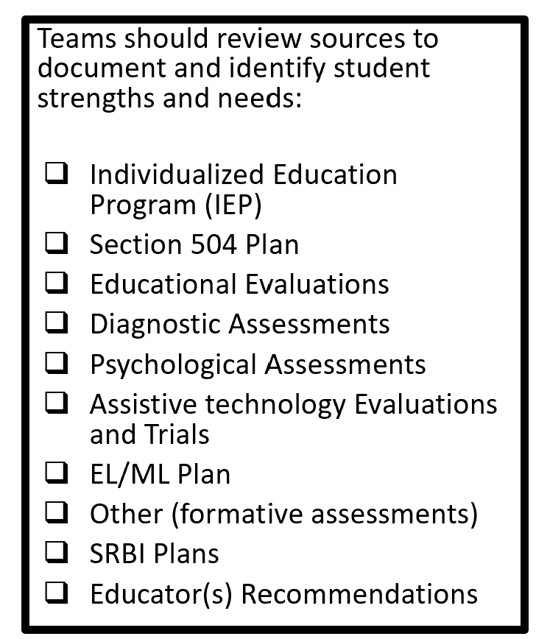
How are accessibility supports determined?
Based on a preponderance of evidence, educational teams should establish
The learning or access strengths
The learning or access barriers
The points of access needed by the student
Supplemental aids and services needed throughout the academic and non-academic school day
Accommodations needed for the student with an IEP or Section 504 Plan to access district and statewide assessments
Notes:
Educators should document each student’s strengths and barriers within their SRBI Plan, English Learner/Multilingual Learner (EL/ML) Plan, Individualized Education Program (IEP), or Section 504 Plan. By identifying and leveraging a student’s strengths, teams can better support areas where barriers to learning exist.
When reviewing a student’s profile, teams should consider critical data that demonstrate both the need for support and the effectiveness of strategies in helping the student meet specific goals and objectives.
Key components to consider when developing or reviewing a plan include:
What are the student's learning or access strengths?
What are the student’s instructional needs and barriers?
How can the student’s strengths be used to support access to learning?
What access points are needed during instruction, and what strategies are currently working well?
Has an evaluation been conducted to determine the need for assistive technology?
What cognitive and psychological evaluations have been completed?
What are the findings from these assessments?
These evaluations provide valuable insights into the student’s unique learning profile, which can serve as foundational elements for designing effective supports.
Who determines the need and provision of accessibility supports?
When considering the provision of accessibility supports for a student, the educator team should include, but not be limited to, the following staff members listed on this slide as applicable:
Classroom teacher
Special Education Teacher
English learner/multilingual learner instructor
Special service providers (e.g., speech/language specialist, reading/math coach)
Student
Parent/Guardian
Planning and Placement Team
Section 504 Team

Slide 50
Considerations for Educator Teams Including PPT and Section 504 Teams
What are the student’s learning profile strengths and how can we leverage them to support any access needs?
What considerations have been reviewed for student accessibility and independence along the continuum of services for access?
What are the specific universal tools, designated supports, language supports, or accommodations being used within the learning environment with success that are providing the student with access?
What is the student’s experience and perception of how well the universal tools, designated supports, language supports, or accommodations worked?
  CCSSO Questions to Ask When Selecting Accessibility Supports (various tools that elicit discussion with educator teams, student, parent/guardian, and classroom teacher)
Notes:
When considering accessibility supports, educators, including those on the PPT and Section 504 Teams should consider the following:
What are the student’s strengths that can be built upon to increase access?
What are the barriers the student is currently facing in accessing the learning environment?
What tools are they currently using with success (automaticity, accuracy, independence, positive reporting by student)?
Has the team reviewed accessibility through the continuum of supports? (Low to High)?
Trialing supports is key in determining if the accessibility tool is the right fit for the student in effort to reduce barriers. Educators can use practice tests and interim assessments to ensure the student is able to and wants to use the support. Take time to talk with the student to discuss if the student sees benefit to the tool, and uses it with accuracy, automaticity, and with independence. By doing this you will gain information to ensure appropriate accessibility supports. Consider the following:
Has the student practiced with these tools before?
Has the student used these tools within the instructional setting?
How does the student report they feel about the tool, does it help or is it confusing to use?
Is there evidence to support that this tool reduces the barrier?
How well do students who receive universal tools, designated supports, language supports, and accommodations perform on assessments (e.g., Smarter Balanced, NGSS, summative and interim)?
If students are not meeting the expected level of performance, is it due to:
Students not having access to the necessary instruction?
Students not receiving the appropriate universal tools, designated supports, language supports or accommodations?
Students using universal tools, designated supports, or accommodations that were not effective?
Students unfamiliar with how to use and/or access the universal tools, designated supports, or accommodations?
What combinations of universal tools, designated supports, language supports, and accommodations seem to be effective? What data do you have to support this?

Slide 51
Reminders for Educator Teams
Accessibility supports are not a one size fits all.
Understand the purpose and functionality for each accessibility support in the context of online testing in conjunction with the students’ current specific strengths and learning barriers before making a determination.
“More” [accessibility supports] are not equated to a better test experience.
Refer to the CSDE Assessment Guidelines for detailed information about accessibility supports and accommodations.
Notes:
Educator Teams, including IEP and 504 Teams, and those planning designated supports for students without formal plans (such as Els/MLs) should have a clear understanding of both the purpose and functionality of each accessibility within the online testing environment. This understanding should be grounded in the student’s documented plan before making any determinations.​
Key considerations include: ​
Accessibility supports are not a one size fits all. ​
More supports do not necessarily lead to a better test experience. ​
Conflicting supports can cause confusion during the test set up and administration and may result in test irregularities. ​
​
Below are key resources:​
Accessibility Considerations​
CSDE Assessment Guidelines ​
Description of Designated Supports and Accommodations for Smarter Balanced and Next Generation Science Standards Assessment (abridged description of accessibility supports)​
Accessibility Chart ​
Assessment Resources for Planning and Placement and Section 504 Teams Quick Guide

Slide 52
Reminders for Educator Teams – Conflicting Accessibility Supports
Selecting conflicting supports leads to confusion during the test set-up and student test experience and may lead to test irregularities. Common conflicting accessibility supports include:
    Embedded Text-to-Speech and Non-Embedded Read Aloud
    Embedded Speech-to-Text and Scribe
    Embedded Color Contrast and Non-Embedded Color Contrast or Color Overlay
    Print Size and Large Print (Note: Large Print= Large Print Test Booklet)
Notes:
Common examples of conflicting accommodations include: ​
Embedded Text-to-Speech vs. Non-Embedded Read Aloud ​
Embedded Speech-to-Text vs. Scribe ​
Embedded Color Contrast vs. Non-Embedded Color Contrast or Color Overlay ​
Print Size vs. Large Print (Note: Large Print refers to a separate Large Print Test Booklet. Students using Large Print do not take an online assessment.)​

Slide 53
Classifying Accessibility Supports
Universal Tools, Designated Supports, and Accommodations can be classified into two categories:
Embedded: Tools available through the online computer platform
Non-Embedded: Tools provided to the student by the school/test administrator
High-Level Overviews:
Description of Designated Supports and Accommodations for Smarter Balanced and Next Generation Science Standards Assessments
Accessibility Chart
Notes:
Technology empowers educators to implement computer-based instruction and assessment accessibility supports that promote individualized learning experiences. These supports are designed to reduce or eliminate barriers that may prevent students from demonstrating their knowledge and skills.​ More importantly, accessibility supports used in the classroom do not lower learning expectations.​
Across the three tiers of the accessibility, supports fall into two main categories: ​
Embedded supports are integrated into the digital testing platform. ​
Non-embedded supports are external tools provided by the test administrator to the student.
The Accessibility Chart, shown here, was developed specifically for the Smarter Balanced and the Next Generation Science Standards Assessments. It provides 3 tiers of support ranging from Universal Tools (shown to the far left in blue), designated supports (shown in orange and located in the center of the chart), and accommodations shown in red to the far right. You will notice that within each section, embedded and non-embedded tools are listed along with hyperlinks to additional information if applicable. Please note the user Key, located at the far right, includes symbols noting tools that are not available on science versions, those accommodations that are non-standard and require additional teacher training, along with other tools that might be appropriate for ELs/MLs.
These accessibility features can help support students with various barriers such as:
There are many ways to support students who experience barriers to learning—particularly those related to reading—by applying the principles of Universal Design for Learning (UDL) and adapting instructional and communication strategies to promote meaningful access to content.
Below are some common barriers that can be supported through the use of universal tools, designated supports, and accommodations (if eligible):
Executive Functioning Challenges (e.g., attention, cognitive control, processing difficulties)
Persistent Calculation Disability / Dyscalculia
Reading Disability / Print Disability / Struggling Reader
Language Disability
Language Acquisition Needs
Significant Motor Difficulties or Recent Injury
Visual Impairments / Blindness
Hard of Hearing / Deafness
While the Accessibility Chart is a great reference, details about each of these accessibility features are documented in the CSDE Assessment Guidelines.

Slide 54
Understanding Universal Tools
Universal Tools (embedded and non-embedded): available to all students based on student preference and selection (e.g., highlighter, notepad).
What to Know
Universal Tools
are automatically available to all students through the test delivery system.
can be turned off by the test administrator/proctor prior to testing.
include non-embedded tools if needed by the student (Refer to Accessibility Chart).
Resource: Five Built-in Test Tools Students Should Know (and Use!)
Notes:
Here we provide the definition of universal tools and considerations the team can use. Remember universal tools are available to ALL students. However, just because they are available doesn’t mean that they are appropriate for all students.
Therefore, universal tools can be turned off by the test administrator/proctor prior to testing. Also remember, that in the context of statewide assessments, different assessments use different platforms and offer different tools. Take time to learn about the unique accessibility features provided for each assessment.
Resource:
Familiarize Students with Smarter Balanced Universal Test Tools
Accessibility Chart

Slide 55
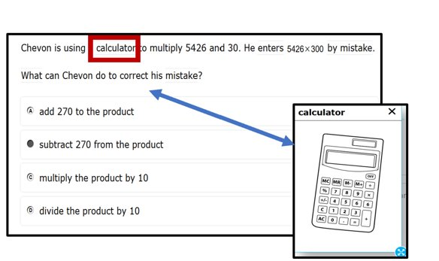
Understanding Designated Supports
Designated Supports (embedded and non-embedded): accessibility features available for use by any student (determined by educator team with input from the parent/guardian and student).
Examples: color contrast, text-to-speech of items, illustration glossary (math) as shown to the right.
Notes:
Designated supports are accessibility features available for any student whom the need has been indicated by an educator team with input from the parent/guardian and student.
This should be based off the students specific and unique learning profile.
When teams make this recommendation, it should also be consistently utilized across educational settings as applicable. If a student has an IEP or Section 504 Plan these supports should be documented in these plans. They will then sync from CT-SEDS to TIDE.

Slide 56
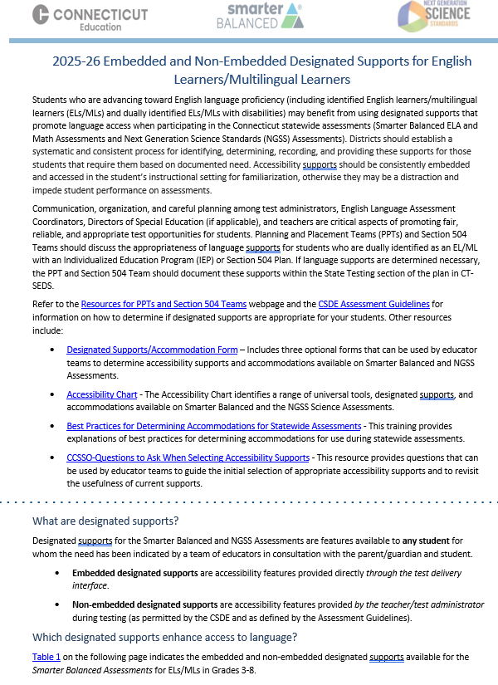
Language Supports for ELs/MLs
Eligibility is based on student identification as EL/ML in the Connecticut Public School Information System (PSIS)
Available for any EL/ML including those dually identified under the Individuals with Disabilities Education Act and/or Section 504 for whom the need has been indicated by a team of educators with input from the parent/guardian and student
Should be used regularly during learning and instruction across all content areas
May require some adult-dependence for support
Additional test time may be necessary
Embedded and Non-Embedded Designated Supports for English Learners/Multilingual Learners
Notes:
Students progressing toward English language proficiency—including English learners/multilingual learners (ELs/MLs) and dually identified ELs/MLs with disabilities—may benefit from designated supports that promote language access during Connecticut’s statewide assessments. These supports are not one-size-fits-all and may not address every language need, but they can help reduce barriers and improve access.
Simplified Test Directions, On-the-Fly Translations, and printed directions. Language supports also include tools to support navigation of the Test Delivery System for math and ELA; and include specific supports for Spanish-speaking students on math and science assessments.
It’s important to remind students that assessments are just one snapshot of their learning. For students with significant language barriers, testing time should be reasonable and appropriate to their needs.
Designated supports are selected by informed educators—ideally a team familiar with the student’s English proficiency, instructional supports, and assessment history. Input from families and students is essential in this decision-making process.
For a full list of available supports, refer to the Embedded and Non-Embedded Designated Supports for English Learners/Multilingual Learners brochure.
Embedded and Non-Embedded Designated Supports for English Learners/Multilingual Learners

Slide 57
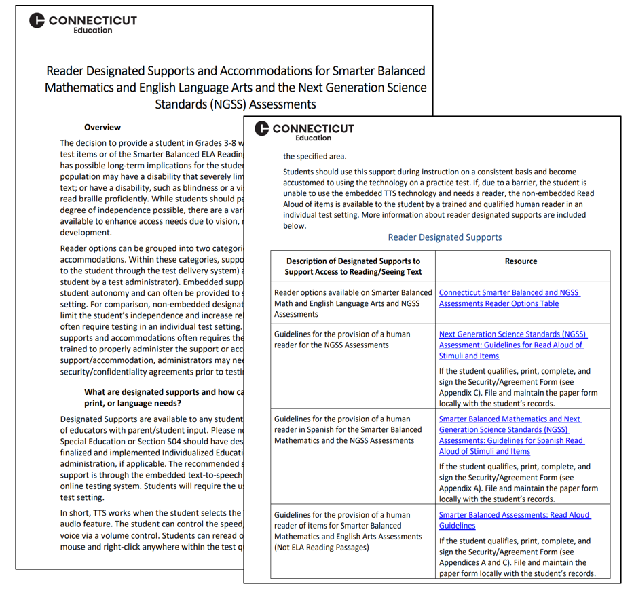
Reader Options Resources for Smarter Balanced/NGSS
Reader Designated Supports and Accommodations for Smarter Balanced Mathematics and English Language Arts and the Next Generation Science Standards (NGSS) Assessments
This resource provides information about designated supports and accommodations that provide access to print/text.
Notes:
Many students benefit from reader supports especially those students who have a reading or print disability, such as dyslexia. Other students with visual disabilities may need accessibility to information on the computer because they can’t see the text. The resource shown on this slide provides a range of reader supports available based on documented need. This guide provides educators with a review of reader options and the required documentation needed to administer a human reader. Reader supports are available on Smarter Balanced and NGSS assessments and the corresponding documents and resources associates with each accessibility feature.
The Reader Designated Supports and Accommodations for Smarter Balanced Mathematics and English Language Arts and the Next Generation Science Standards (NGSS) Assessments provides an explanation of reader designated supports and accommodations with corresponding screeners and guidelines to support student eligibility and administration on statewide assessments.

Slide 58
Understanding Accommodations
Accommodations (embedded and non-embedded) are changes in procedures or materials that increase equitable access during assessment. They:
generate valid assessment results for students who need them;
allow students to show what they know and can do.
Examples: Assistive technology, American Sign Language, braille, closed captioning
Accommodations:
must be documented for the student’s current grade in a finalized and implemented plan in CT-SEDS.
sync directly from CT-SEDS to TIDE.
should be integrated into all district, school, and/or classroom processes which prioritize student access needs.
Notes:
Accommodations are for students with an IEP or 504 plan. These are changes in materials or procedures that increase equitable access during assessments. They allow students to show what they know and can do. Like designated supports they should be consistently accessed and incorporated into the students instructional setting. Students should have familiarity and independence with both accommodations and designated supports that are assigned.

Slide 59
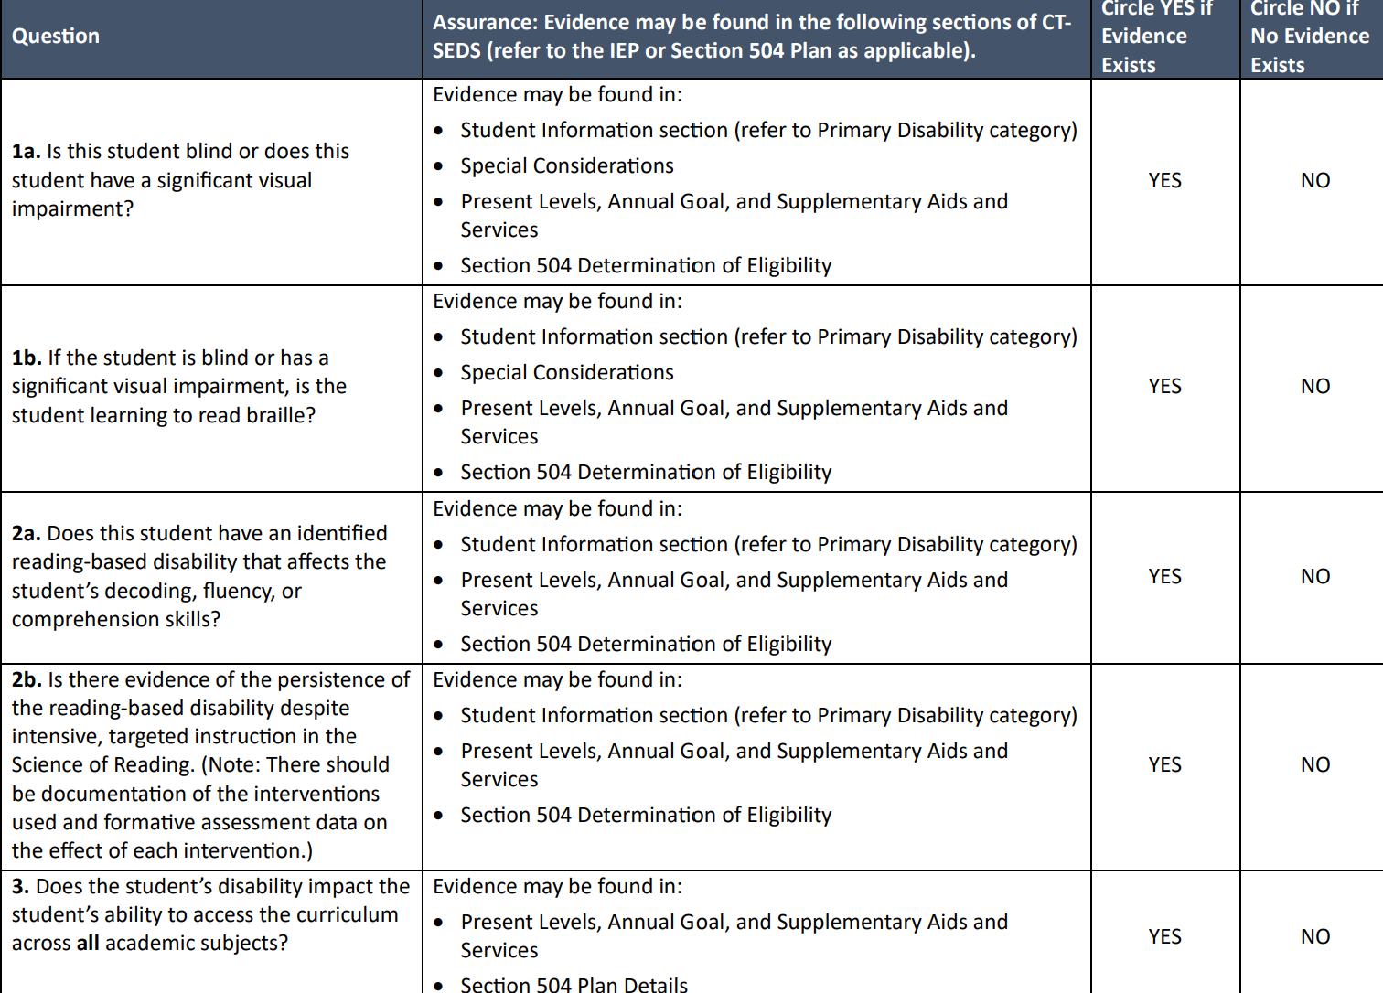
Decision Guidelines for TTS of the Smarter Balanced ELA Reading Passages
When considering TTS of the ELA Reading Passages, PPTs/Section 504 Teams should complete the Decision Guidelines for Text-to-Speech of the Smarter Balanced ELA Reading Passages during the annual convening to establish the extent of need based on the student’s access barriers due to a print or visual disability.
This accommodation is intended for students
  with a documented print disability,
  with significant visual disabilities, or,
  who are blind with inadequate braille skills.
Maintain this form locally with the student’s record.
Notes:
The questions provided in this document can assist IEP/Section 504 decision-making teams in determining the preponderance of evidence that demonstrates whether if a student qualifies to have the ELA reading assessment read via a text-to-speech accommodation.
PPTs should use this form to help document the need for the embedded text-to-speech of the Smarter Balanced reading passages. This accommodation is only for students with an IEP or Section 504 Plan in Grades 3-8 with a documented print disability, or for students who are blind with inadequate braille skills. Additionally, if the student has a print/reading-based disability (dyslexia), there must be strong evidence of the persistence of the disability despite intensive, extensive, and targeted instruction that is based on the Science of Reading and that the student needs extensive supports to access print. There should be documentation of the interventions used and formative assessment data on the effects of each intervention. The student should be familiar with this accommodation and use it regularly during instruction, and typically, the student would most likely be using alternate educational materials (AEM) during instruction.
If your student qualifies, select the Text-to-Speech of ELA Passages (Embedded Accommodation) in CT-SEDS, along with Text-to-Speech (Embedded Designated Support) for math and science stimuli and items, if appropriate. Please complete and maintain this form locally with the student’s record.
Decision Guidelines for Text-to-Speech of the Smarter Balanced ELA Reading Passages

Slide 60
Determining Eligibility for a Read Aloud Special Documented Accommodation
PPTs/Section 504 Teams should provide documentation of need within the plan (e.g., present levels of performance, reading/communication goals and objectives, and supplementary aids and services/program accommodations sections.)
Psychological assessments and/or academic performance assessments referenced showing processing disabilities related to visual, print, or reading disabilities and understanding/use of language.
Teams must complete the Documented Evidence for a Read Aloud of the Smarter Balanced ELA Reading Passages as a screener for eligibility and maintain locally with the student’s record.
Notes:
In alignment with the eligibility criteria for TTS of ELA Reading Passages, students who qualify for the special documented Read Aloud accommodation are those who, despite receiving intensive and targeted instruction or intervention—such as in the science of reading or braille acquisition—are still unable to access print materials without the use of extensive accommodations including embedded text-to-speech.
These students consistently rely on having text read aloud to them during instruction and other environments. They may also use tools such as audiobooks, screen readers, Bookshare, or other forms of alternate educational materials to access print content.
Eligibility is not limited by a student’s primary disability category. If there is documented evidence of a specific word reading disability—such as challenges with decoding, encoding, or phonological processing, and text-to-speech does not meet the complexity of the student’s needs, a read aloud may be appropriate. Characteristics of a word reading disability or dyslexia must be clearly reflected in the student’s current evaluation results and educational programming.
To determine eligibility for the Read Aloud accommodation of Smarter Balanced ELA Reading Passages, teams should begin by completing the Documented Evidence for Read Aloud of the Smarter Balanced ELA Reading Passages form. This serves as a screening tool to establish a preponderance of evidence that the student requires this accommodation due to a documented disability.
In the context of the Smarter Balanced Reading assessment, the Read Aloud of ELA passages should be used only as an access tool to support the student’s interaction with the text. If used beyond this purpose, it may alter the construct being measured—shifting the focus from reading comprehension to listening comprehension.
To support this determination, teams should review:
The student’s present levels of performance in the IEP
Reading and communication goals and objectives
The Supplementary Aids and Services/Program Accommodations section of the plan
Teams should also examine documentation from psychological and academic performance assessments included in the IEP or 504 Plan. These should show evidence of processing disabilities related to visual, print, or reading challenges, as well as difficulties with language comprehension and use. Skills in listening, thinking, speaking, reading, writing, or spelling may also be reflected and should be considered in the decision-making process.

Slide 61
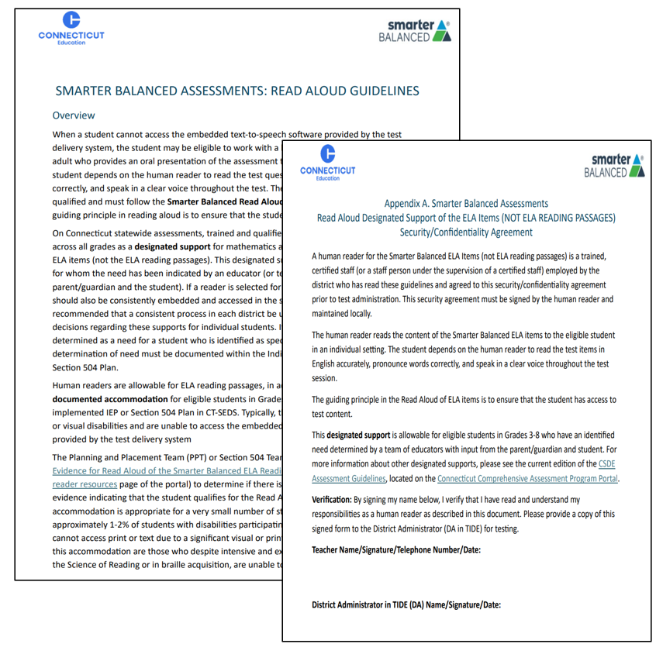
Determining Eligibility for a Read Aloud Special Documented Accommodation- Continued
If eligible for a Read Aloud, document in CT-SEDS for associated tests and grades covered by the duration of the plan.
The qualified individual acting as the reader should review the Smarter Balanced Assessments Read Aloud Guidelines and sign the Test Security/Confidentiality Agreement Form (Appendix B of document). The signed security/attestation form should be maintained locally.
Notes:
A human reader is a trained and certified teacher who provides an oral presentation of the assessment text to an eligible student. The student depends on the human reader to read the test questions accurately, pronounce words correctly, and speak in a clear voice throughout the test. The human reader must be trained and qualified and must follow the Smarter Balanced Read Aloud Guidelines. The guiding principle in reading aloud is to ensure that the student has access to test content. ​
The teacher and administrators must also complete and sign the Security/Confidentiality Form (within the Read Aloud Guidelines) to verify their understanding of responsibilities as human reader for state testing. Forms should be maintained locally with the student’s record per district procedures.

Slide 62
Special Documented Accommodations
Non-standard accommodations
Must be determined at the PPT/Section 504 convening
The educator team rules out that the standard embedded and non-embedded accommodations and accessibility features do not provide adequate access given the students documented disability.
Require the greatest extent of adult-dependence/support and are aligned to accommodations used by student to access instruction across content areas.
Require that teachers must review the Special Documented Accommodations for Smarter Balanced and Next Generation Science Standards (NGSS) Assessments Overview corresponding guidelines and protocols. Test Security Agreement Forms must be signed and returned to their SC/DA for signature and record keeping.
Notes:
In exceptional circumstances, there may be a student whose disabilities are such that the allowable embedded and non-embedded accommodations described in the CSDE Assessment Guidelines provide insufficient access to the Smarter Balanced and/or NGSS Assessments.
Special Documented Accommodations are determined by Planning and Placement Teams (PPT) and Section 504 Teams based on a preponderance of evidence found throughout the student’s plan. These accommodations must align with the student’s documented disability or disabilities.
The team should clearly identify:
The student’s learning and access barriers.
The specific access points required.
The supplemental aids and services needed across both academic and non-academic settings.
The accommodations necessary for the student to access district and statewide assessments.
Special Documented Accommodations:
Non-standard accommodations
Must be determined at the PPT/Section 504 convening
The educator team rules out that the standard embedded and non-embedded accommodations and accessibility features do not provide adequate access given the students documented disability.
These accommodations require the greatest extent of adult-dependence/support and are aligned to accommodations used by student to access instruction across content areas.
Resource: Special Documented Accommodations

Slide 63
What are Special Documented Accommodations?
Scribe
Read Aloud of ELA Reading Passages
Human Signer/Visual Support for Smarter Balanced ELA or Math and/or NGSS (includes directions, math and science items and stimuli, and ELA items [Not Reading Passages])
Human Signer/Visual Support for ELA Reading Passages
Math Manipulatives (Grades 3-8)
Non-Embedded Calculator (Math Grades 6-8, calculator-allowed items only)
Print on Demand
Customized Accommodation
Notes:
Special Documented Accommodations may include:
• Scribe
• Read Aloud of ELA Reading Passages
• Human Signer/Visual Support for Smarter Balanced ELA or Math and/or NGSS (includes directions, math and science items and stimuli, and ELA items [Not Reading Passages])
• Human Signer/Visual Support for ELA Reading Passages
• Math Manipulatives (Grades 3-8)
• Non-Embedded Calculator (Math Grades 6-8, calculator-allowed items only)
• Print on Demand
• Customized Accommodation
Teachers providing a special documented accommodation must review the Special Documented Accommodations for Smarter Balanced and Next Generation Science Standards (NGSS) Assessments Overview for a listing of corresponding guidelines and protocols. Test Security Agreement Forms must be signed and returned to their SC/DA for signature and record keeping.

Slide 64
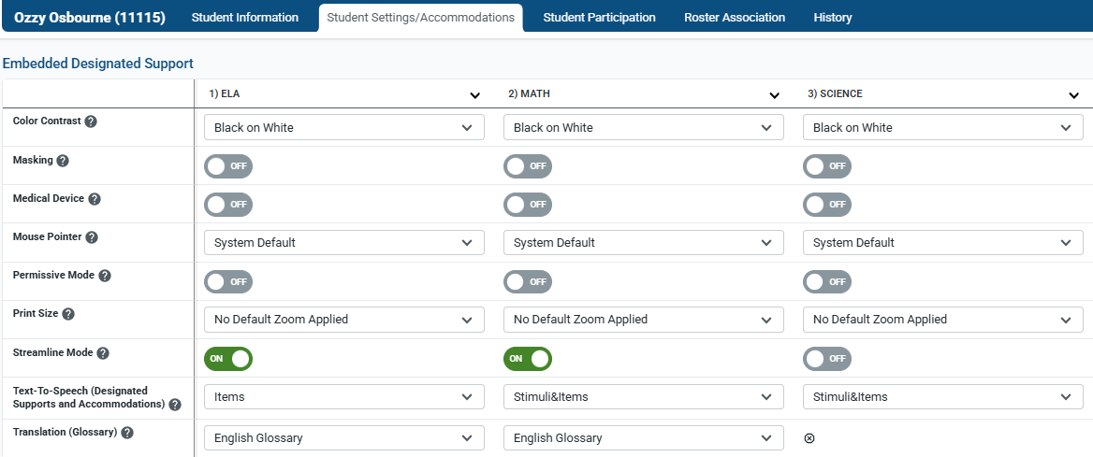
Documenting Designated Supports in TIDE for Students without IEPs/Section 504 Plans
Your DA/SC has a process for setting designated supports in TIDE for eligible students who do not have an IEP or Section 504 Plan.
Test supports must be set prior to the start of the student’s test session. Supports added to TIDE after testing has started are not retroactive.
Contact your DA/SC if designated supports are missing or incorrect in TIDE. Do not test your student until issues are resolved.
Notes:
Designated supports and accommodations should not be manually entered or batch uploaded for students with an IEP or Section 504 Plan. All updates must be processed through a PPT/Section 504 convening and documentation in CT-SEDS.
Your School Coordinator or District Administrator if you have questions about a student’s test setting in TIDE.
Additional Resources:
Documenting Designated Supports and Accommodations in TIDE for more information about this process.
TIDE User Guide: Test Information Distribution Engine (TIDE) User Guide
Accessing TIDE: Accessing-TIDE-Brochure.pdf
User Role Permissions for Secure Online Systems: User Role Permissions for Secure Online Systems

Slide 65
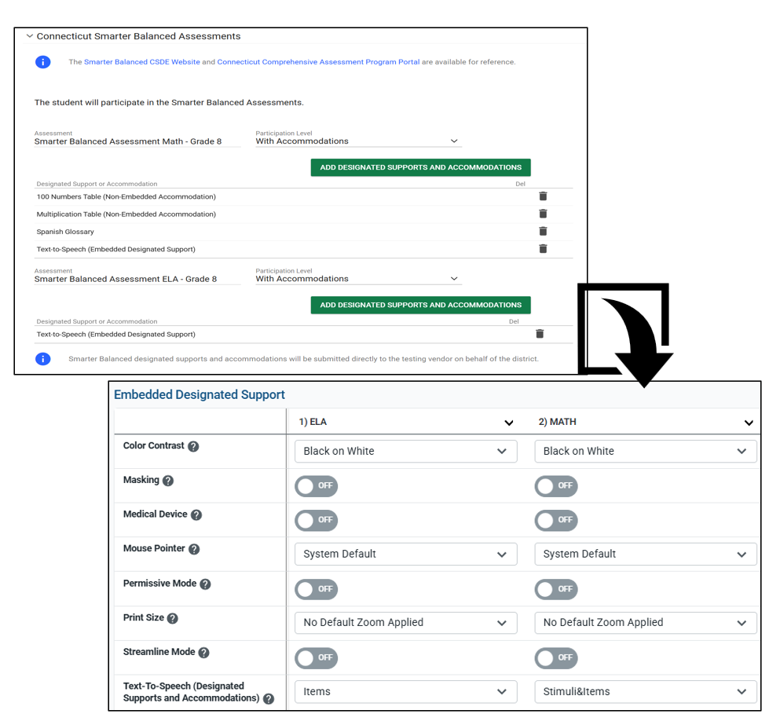
CT-SEDS Sync with TIDE for Students with Implemented IEPs/Section 504 Plans
Supports/accommodations planned for the current grade of enrollment in a finalized and implemented IEP/Section 504 Plan sync to TIDE. (Note: IDEA/Section 504 must be activated in PSIS/TIDE.)
Supports/accommodations should never be manually entered (or batch uploaded) to TIDE.
Contact the Case Manager if accommodations are missing or incorrect. All edits must be made through the amendment or reconvening process in CT- SEDS.
Notes:
For students with an IEP or Section 504 Plan, the team will document designated supports and accommodations within CT-SEDS under the District and Statewide Assessment Tile. Teams should plan for the grades that span the duration of the plan to ensure supports are available for interim and summative testing. Keep in mind the following:
Each assessment has its own menu for designated supports and accommodations as applicable to the assessment and test design.
Supports/accommodations planned for the student’s current grade of enrollment in a finalized and implemented IEP/Section 504 Plan sync to TIDE. (Note: IDEA/Section 504 must be activated in PSIS/TIDE.)
Supports/accommodations should never be manually entered (or batch uploaded) to TIDE.
Contact the student’s Case Manager if accommodations are missing or incorrect. All edits must be made through the amendment or reconvening process in CT- SEDS.
Resources:
CT-SEDS to TIDE Designated Supports/Accommodations Sync Frequently Asked Questions
Cross-Checking Student TIDE Test Settings and CT-SEDS
Documenting Designated Supports and Accommodations in TIDE

Slide 66
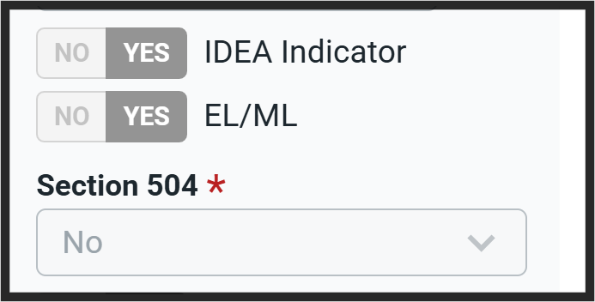
Designated Support/Accommodation Eligibility in PSIS/TIDE
The IDEA or Section 504 indicator (based on the PSIS registration fields) must indicate Yes for accommodations to sync from CT-SEDS.
The EL/ML designation must indicate Yes in PSIS if the student is identified as EL/ML.
Contact your DA/SC if you find any data is not accurate on your student’s TIDE dashboard.
Accommodations for students with IEPs/Section 504 Plans should NEVER be manually entered in TIDE unless authorized by the CSDE.
Notes:
When reviewing accommodations in the student dashboard in TIDE you will want to be aware of the following indicators and how they are set. ​These demographic fields must be updated in PSIS as applicable to students.
Eligibility for any embedded or non-embedded accommodation requires the IDEA or Section 504 indicator (based on the PSIS registration fields) set to Yes. Without this indication, accommodations cannot sync to TIDE from CT-SEDS.​
The student’s EL/ML designation must be set to Yes in PSIS if the student is identified as EL/ML.​
Accommodations should NEVER be manually entered or batch uploaded in TIDE. The IEP/Section 504 is the source of truth! If corrections are necessary, contact the Case Manager and an amendment of edit/revise can be conducted.
Reminder: Work with your PSIS Coordinator to ensure that IDEA, Section 504, and EL/ML indicators are accurately reflected in PSIS.

Slide 67
Practice Test Overview

Slide 68
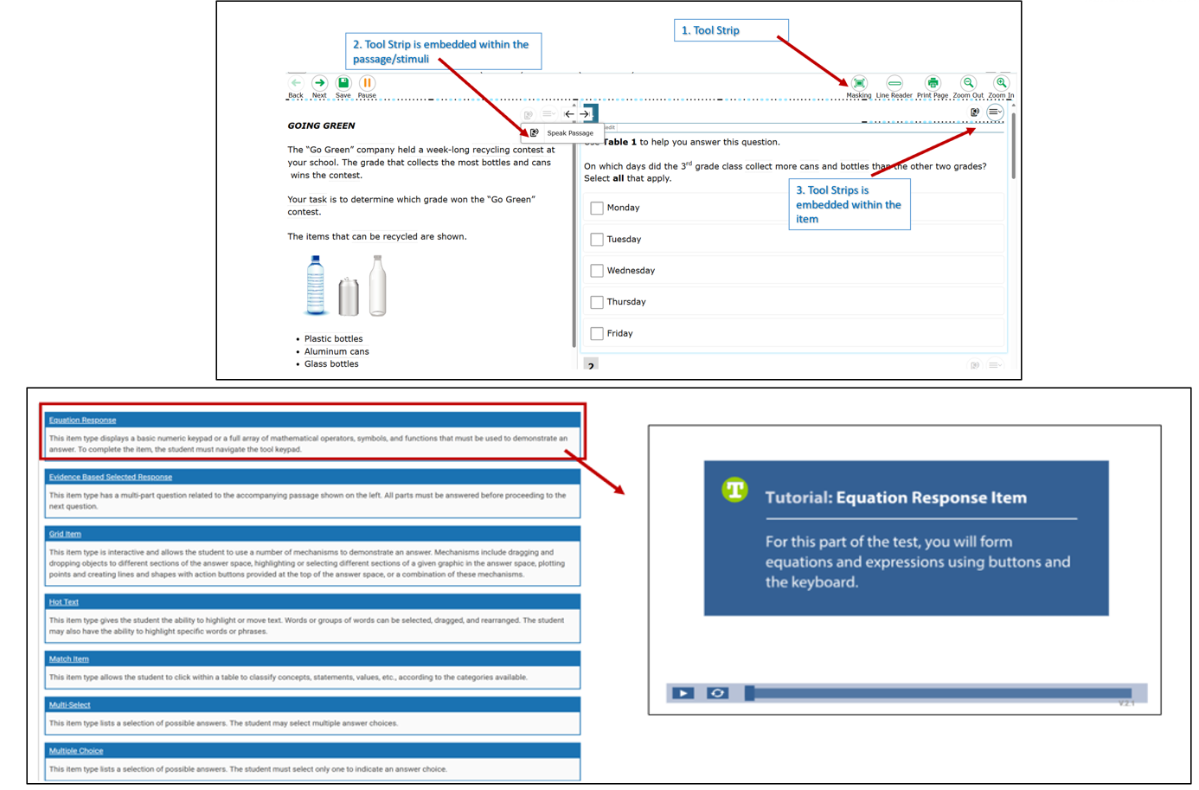
Practice Tests
Use the Practice Test to explicitly demonstrate to students how to navigate the test interface, use tools, and practice using accessibility features.
Item Type Tutorials and the Five Built-in Test Tools Students Should Know (and Use!) can be used and modeled to students.
Notes:
Practice Tests are available for Smarter Balanced Math and ELA in Grades 3-8 and high school. They are similar in format and structure to the actual test and include about 30 questions. Practice Tests area also available for NGSS and the Connecticut Alternate Assessment System.
Use the Practice Tests to model how to use specific features such as the Desmos Calculator (available for certain math items in Grades 6-8), text-to-speech, math translation glossary, and speech-to-text. Students need to know in advance how to activate these features if applicable.
It is important that teachers review and ensure students have the applicable accessibility supports documented in TIDE prior to testing. During the Practice Test, show students how to use the tool strip (indicated by image on the top of this slide) to access applicable tools available to students based on the test, grade, and supports available in TIDE. For illustration purposes, the tool strip on the slide includes icons for masking, line reader, print page and zoom.
For example:
If a student is taking the Grade 8 NGSS assessment, the embedded Periodic Table icon will appear in the tool strip.
An English Learner/Multilingual Learner (EL/ML) with a documented Spanish toggle for math in TIDE will see the toggle icon.
A student in grades 6–8 taking the calculator section of the Smarter Balanced math assessment will have access to the Desmos calculator in the tool strip.
Accommodation tools—such as text-to-speech and American Sign Language—can be activated directly from the tool strip. Other accessibility features can be enabled through the context menu (hamburger menu).
It is essential that teachers explicitly demonstrate and model these features for students using a Practice Test.

Slide 69
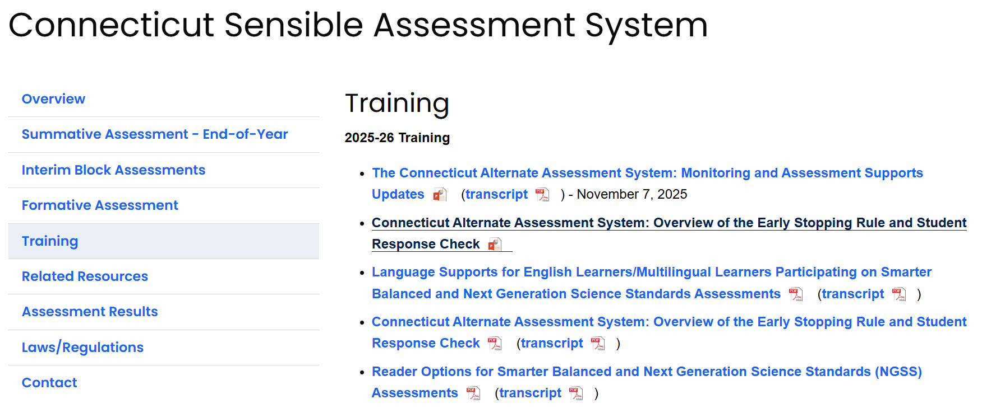
Online Training Resources
Notes:
Refer to the Training tab on the Sensible Assessment System webpage for access to training and webinars.

Slide 70
CSDE Performance Office Contacts
Abe Krisst Bureau Chief Connecticut Education – Performance Office Phone: (860) 713-6894; Mobile: (860) 690-0650 Email: Abe.Krisst@ct.gov
Deirdre Ducharme Education Consultant Performance Office- Special Populations Direct line: (860) 713-6859 Email: Deirdre.Ducharme@ct.gov
Katie Seifert Associate Education Consultant Performance Office- Special Populations Direct line: (860) 713-6722 Email: Katherine.Seifert@ct.gov
Kimberly Johnson Education Support Technician Performance Office Phone: (860) 713-6885 Email: Kimberly.Johnson@ct.gov
Cristi Alberino Education Consultant Performance Office –Interim & Summative Assessments Email: Cristi.Alberino@ct.gov
Jeff Greig Education Consultant Performance Office – NGSS Interim & Summative Assessments Email: Jeff.Greig@ct.gov
Notes:
Here are CSDE contacts from the Performance Office. Please reach out with any questions.
We are here to support you and your teams.

Slide 71
Thank You for Your Participation!

