Slide 1
CSDE Learning Series for Planning and Placement Teams
Connecticut Alternate Assessment System: Overview of the Early Stopping Rule and Student Response Check
2025-26
Notes:
Welcome to the CSDE Learning Series for Planning and Placement and Section 504 Teams.
In this training, we will focus on the Eary Stopping Rule and the Student Response Check.

Slide 2
Part B: Individuals with Disabilities
Education Act (IDEA)
Regulations for Part B of the IDEA require states to make available to eligible students with significant cognitive disabilities an alternate assessment designed to measure their knowledge and skills (34 CFR §§ 200.1(d) and 300.160 (c)).
Notes:
We will take a moment to review the federal legislation that guides our work at both the state and local levels.
Part B of the Individuals with Disabilities of Education Act (IDEA) requires states to make available an alternate assessment aligned with alternate academic achievement standards (AA-AAAS) for eligible students with the most significant cognitive disabilities. Moreover, IDEA requires that if a Planning and Placement Team determines that a student must take an alternate assessment, the team must include a statement in the student’s IEP of why the student cannot participate in the regular assessment; and why the alternate assessment selected is appropriate for the student (34 CFR § 300.320(a)(6)(ii)).

Slide 3
Participation - Connecticut General Statutes 10-14n​
    (b) (1) For the school year commencing July 1, 2015, and each school year thereafter, each student enrolled in grades three to eight, inclusive, and grade eleven in any public school shall, annually, take a mastery examination in reading, writing and mathematics during the regular school day.
    (3) For the school year commencing July 1, 2018, and each school year thereafter, each student enrolled in grades five, eight, and eleven in any public school shall annually take a state-wide mastery examination in science during the regular school day.
Notes:
Together, the ESEA and the IDEA provide the system and structure to ensure that children with disabilities have access to learning environment that meet their individual needs.

Slide 4
The Design of Alternate Assessments
The Connecticut Alternate Assessment System adjusts for:
Depth (the level of cognitive complexity of the knowledge, skills, and abilities within the standard),
Breadth (how many standards are measured), and
Complexity (describes the difficulty of content with built-in scaffolding to support accessibility needs).
Notes:
The Connecticut Alternate Assessment System is designed to measure the knowledge and skills of students with the most significant cognitive disabilities as required by the IDEA and ESSA. They support student independence to the greatest extent possible by making academic and language content accessible and the expected achievement levels appropriate. These assessments adjust for the depth, or cognitive complexity of skills and abilities, within the grade level standards. The assessments measure fewer standards, and the content adjusts for difficulty and is scaffolded to support the diverse range of accessibility needs within this student population.
Additional Information:
Depth- refers to how much of a single skill is measured by an item; for example, a deeper level item may address both description and dialogue narrative techniques whereas an item of less depth may only address description.
Breadth- refers to the scope or range of the content standards covered by the items in the AA-AAAS. In some cases, the AA-AAAS may cover the same content standards as the general assessment (perhaps, the essence of those standards).
Complexity-refers specifically to the format of the passages, items, tasks with built in scaffolding (documented in the secure Directions for Test Administration- applicable to the CTAA Math and ELA; and the CTAS Performance Task script read by the teacher).

Slide 5
The Design of Alternate Assessments: Administering Test Items
Accommodations include, but are not limited to:
American Sign Language
Assistive Technology
Augmentative and Alternative Communication
Read Aloud
Scribe
OPTIMAL
TESTING
CONDITIONS
FOR ALL
ACCESSIBILITY
FEATURES
FOR ALL
as needed
Access
to the CTAA
Accommodations
Identified in IEP and allowable on CTAA
Notes:
Alternate Assessments incorporate optimal testing conditions that must be provided to all students who take the test, accessibility features that must be provided to students as needed, and ​accommodations that students must receive as specified in their Individualized Education Program (IEP).​
​
This combination of accessibility features, optimal testing conditions, and accommodations is incorporated within the assessment design and is intended to maximize students’ test access and performance.
The CTAA and CAAELP are online, while the CTAS is a paper, performance task-based assessment. Each assessment may be accessed in a variety of formats based on the diverse needs of the student.
The content of the CTAA for both English language arts and mathematics is designed to be read aloud to all participating students. The TEA reads the item, response options, and passages as often as is reasonable to obtain a student’s response to an item. All text must be read to students exactly as written. The TEA may not paraphrase or vary speed to emphasize words in ways that hint at correct or incorrect responses.​
​
Generally, students may access the test items by:
• Listening to the trained teacher read the test;
• Reading the test question independently if the trained teacher determines this is appropriate;
• Having the test question signed by a qualified trained educator; or
• Listening to a recorded voice read the test question (applicable to the online CTAA and CAAELP only)
Review the CTAA System User Guide and the Test Administration Manuals (available for the CTAA, CTAS, and CAAELP) (available on the Connecticut Comprehensive Assessment Program Portal) to determine how to activate/use accessibility features if needed. ​

Slide 6
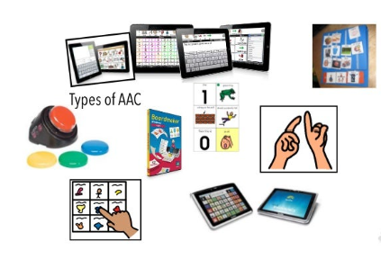
The Design of Alternate Assessments: How Students Respond
Students may respond to test items using their modes of communication while the trained teacher records the responses. Communication might include:
Verbalizing the answer;
Gesturing, signing, or pointing to the answer;
Using an eye gaze system to select the answer;
Using assistive technology (AT) to indicate the answer;
Circling or marking the answers on a paper copy of the test for educator transcription (CTAA only); or
Using the mouse to select the answer online (applicable on the online CTAA and CAAELP only)
Physical prompting such as hand-over-hand is not permitted during the administration of the CTAA.
Notes:
Accommodations are changes in the materials or procedures of the assessment that do not alter the construct being measured. A student may use the accommodations that are in their IEP that are consistent with the policies associated with the CTAA, CTAS, and CAAELP. TEAs should refer to the Supplementary Aids and Services section in the plan for more information on the student’s accessibility supports throughout instruction to determine accommodations that may be needed by the student.
There are a variety of ways a TEA can administer the alternate assessments so that they are accessible using the mode of communication used by the student.​
​
For example, assistive technology can be used in conjunction with the test delivery interface when administering the CTAA and CAAELP. Permissive mode must be activated in the student’s TIDE account and the functionality should be tested using a practice test before the student participates in summative testing. ​
​
A paper version of the CTAA may be downloaded and printed from TIDE and made available to the student if it is a more appropriate format than the online test platform. As a reminder, the TEA will transcribe the student responses from the paper test into the test delivery interface in order to submit and process the student’s test.​
​
The TEA typically reads and scribes all portions of the test as needed by the student as defined by the associated testing materials applicable to each test. For example, teachers will follow the script in the Directions for Test Administration for CTAA and CAAELP and follow the script as documented in the required CTAS test materials.​
​
The TEA may also administer the assessment using sign language if that is an appropriate accommodation in the student’s IEP.​
​

Slide 7

What is the
Early Stopping Rule (ESR)?
Notes:
What is the Early Stopping Rule?

Slide 8
What is the Early Stopping Rule?
The ESR process is for a relatively small number of students participating in the Alternate Assessment System who do not demonstrate an observable mode of communication and, therefore, are not able to participate fully on the alternate assessments.
Notes:
Generally, students with the most significant cognitive disabilities will be able to participate in the CTAA for English language arts (ELA) and mathematics in Grades 3–8 and 11, and science if the student is enrolled in Grades 5, 8, or 11, and the Connecticut Alternate English Language Proficiency Assessment (CAAELP) if the student is designated as an English learner/multilingual learner (EL/ML). These alternate assessments are designed specifically for these students. ​
​
However, the CSDE developed a process called the Early Stopping Rule (ESR) for a very small subset of students that have not yet established a mode of communication. The guidance in this training applies to the Connecticut Alternate Assessment System only for the purpose of determining if a student has the necessary observable communication skills to participate fully on alternate assessments.​

Slide 9
General Characteristics of Eligible Students
Students who are typically eligible for the ESR have​
  An uncertain response to stimuli.​
  The most significant functional adaptive behavioral needs.​
  Not yet established a mode of communication.​
  A pervasive need for adult support throughout their lives.​
  IEPs with focus on medical and functional needs.​
  IEPs that document goals that support the development of the student’s communication.​
  IEPs that documents the use of assistive technology or augmentative and alternate communication devices.
Notes:
We are now going to review general characteristics of students that typically meet the qualifications for an ESR.
Typically, the students who are eligible for the ESR are those students who require the most complex support for their needs even when compared to their peers with significant cognitive disabilities also participating in the alternate assessments. ​
​
Often, these students do not use oral speech, nor do they have an established communication system even through the use of assistive technology (low or high tech). Goals may include learning cause and effect to utilize augmentative or alternative communication supports. These students do not currently use objects or textures, regularized gestures, pictures, signs, etc., to communicate with consistency. They may demonstrate uncertain response to sensory stimuli and their IEPs often focus on medical and functional academic needs. Additionally, the IEP should also document goals that support the development of the student’s communication.

Slide 10
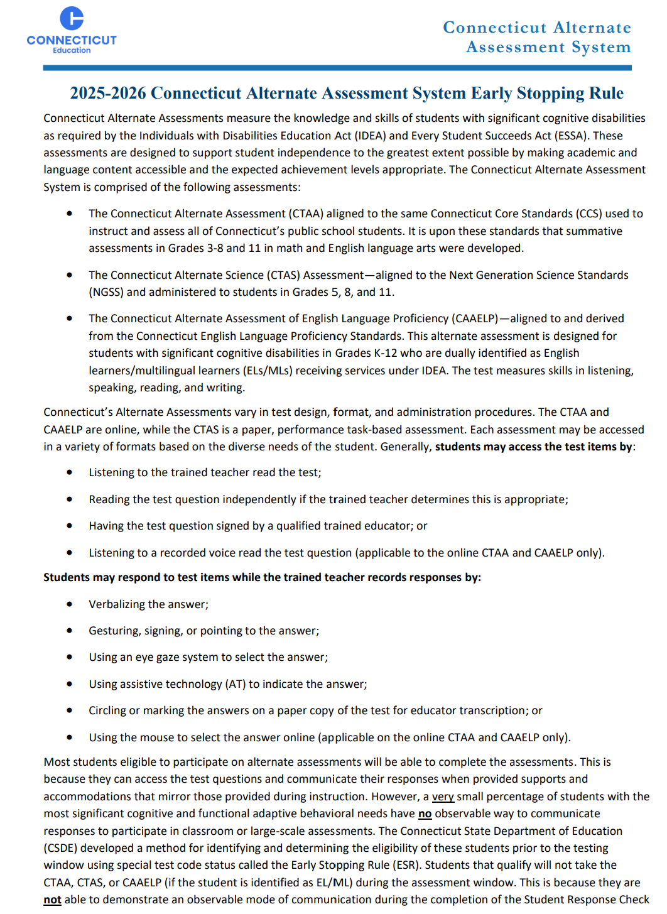
The ESR Guidelines
The purpose of the ESR is for teachers to identify students that may qualify before the onset of the testing window as students approved will not take the alternate assessments since they meet the ESR criteria. TEAs should:​
Review the Connecticut Alternate Assessment System Early Stopping Rule and Student Response Check guidelines as early in the school year as possible.​
Note timelines for screening eligible students.​
Ensure that all paperwork is completed, signed, and submitted to District Administrators by published deadlines. ​Incomplete or incorrect forms will be denied approval.​
Notes:
Before we begin, here are a few important considerations. If a TEA believes that their student may qualify for an ESR, they should carefully review the ESR guidelines and administer the SRC in December and early January. The SRC must be completed prior to the opening of the applicable testing windows. For those students that qualify per the outcome of the three trials, the corresponding SRC Administration Behavioral Notes and ESR Request and Attestation Form should be completed with accuracy, signed, and returned to their District Administrator by the deadline specified in this training.​
​
Incomplete or incorrect forms will be denied approval.

Slide 11
SRC and ESR Submission Deadlines
Important:
TEAs, Special Education Directors and DAs need to be aware of the SRC and ESR submission deadlines.
Submission and deadlines for each year can be found on the Connecticut Alternate Assessment System Early Stopping Rule and Student Response Check website.
Notes:
TEAs, Special Education Directors and DAs need to be aware of the SRC and ESR submission deadlines.
Submission and deadlines for each year can be found on the Connecticut Alternate Assessment System Early Stopping Rule and Student Response Check website.
As stated in the previous slide, incomplete and late submissions will be denied.

Slide 12
What is the ESR process?
Administer the Student Response Check. (One trial per day for a total of 3 trials.)
Take notes of each trial using the SRC Administration Behavioral Notes.
If student does not indicate a mode of communication to all three trials, complete the Early Stopping Rule Request and Attestation Form in its entirety.
Submit a copy of the SRC Administration, Behavioral Notes, Observational Notes, and ESR Request and Attestation Form to your District Administrator by the stated deadlines.
Notes:
Specifically designed for the Connecticut Alternate Assessments, trained TEAs will follow the guidance outlined on the Early Stopping Rule document, they will administer a three-item Student Response Check (SRC) (included in Appendix A) to the student who do not have an observable mode of communication to respond to instruction. ​ This must be completed in an individual setting.
​
The SRC is a content-neutral screener that applies to all alternate assessments including the CTAA, CTAS, and the CAAELP.
The administration of the SRC confirms the observation of the student’s mode of communication. The purpose is to determine if the student can indicate a response using their preferred method of communication. It is NOT necessary that the student respond correctly to any of the items.​
​
The SRC should be administered individually to the student a total of three times, on three different days, and at various times of the day, between December 1, 2025, and January 5, 2026 (CAAELP) and December 1, 2025, and February 2, 2026 (CTAA and/or CTAS).

Slide 13
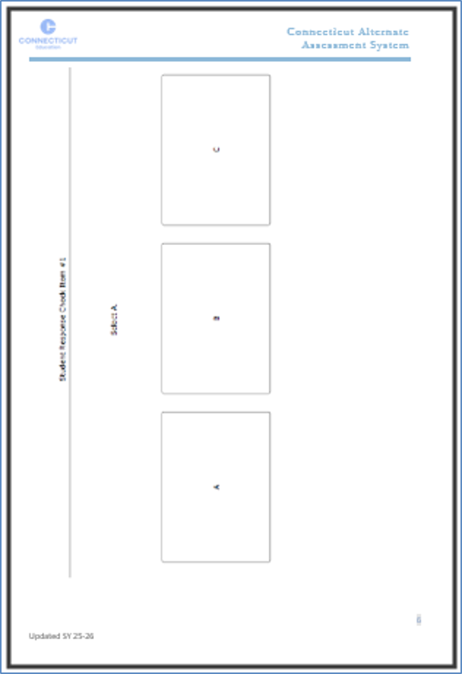
Excerpt of the SRC Eligibility Process
Example of the first step for administering the SRC (see Appendix A)​
Present Student Response Check Card Item #1 to the student in paper form or on a device.
Using the following potential communication modes, ask the student to “Select A”. The student should respond using one or more of the following communication modes:
Verbalizing, gesturing, signing, or pointing to the answer
Using the mouse/touchscreen to select the answer on a device
Using assistive technology (AT) to indicate the answer
Using an eye gaze system to select the answer
Circling or marking the answer on the Student Response Check Card Item #1
Use Appendix B to note the communication behaviors of the student.
Repeat Steps for Items 2 and 3.
Notes:
As the trained teacher administers the SRC, they will work with their student using a variety of communication modes, such as verbalizing, gesturing, signing, or pointing – which are acceptable ways students can answer the three questions on the form. TEAs should also program any assistive technology to support the response to these questions for students that use a communication device or other technologies.​
​
With a variety of communication modes available, the TEA will observe if the student is able to respond. If the student uses a communication response during any of the three SRC administrations, the trained TEA will discontinue the SRC because the student does not qualify for the ESR. The student is expected to participate in the alternate assessments applicable to the grade of enrollment.
For illustrative purposes, this is an example of the first item of the SRC. The TEA will follow steps shown on the left-side section of this slide, and present Student Response Check Card Item #1 to the student in paper form or on a device (as shown on the right). ​
​
The TEA will follow the entire process as indicated in the Connecticut Alternate Assessment System Early Stopping Rule document available on the Alternate Assessment page of the Connecticut Comprehensive Assessment Program Portal.​
​
Using a variety of communication modes (listed), ask the student to “Select A”.

Slide 14
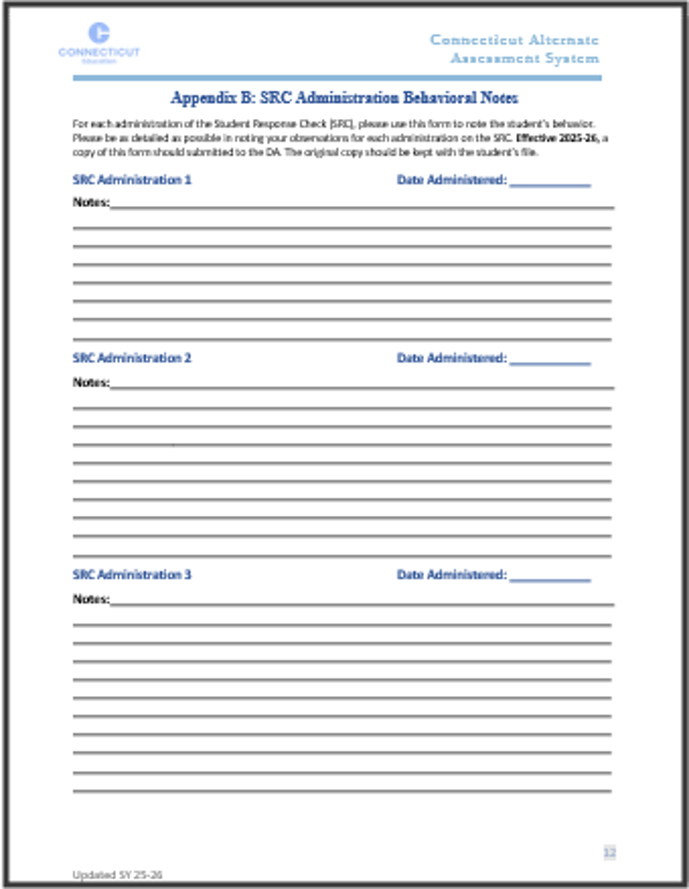
SRC Administration Behavioral Notes
Present Student Response Check Card Item #1 to the student in paper form or on a device.
Using the following potential communication modes, ask the student to “Select A”. The student should respond using one or more of the following communication modes:
Verbalizing, gesturing, signing, or pointing to the answer
Using the mouse/touchscreen to select the answer on a device
Using assistive technology (AT) to indicate the answer
Using an eye gaze system to select the answer
Circling or marking the answer on the Student Response Check Card Item #1
Use Appendix B to note the communication behaviors of the student.
Repeat Steps for Items 2 and 3.
Notes:
Using Appendix B of the Early Stopping rule guidelines, the TEA will note the communication behaviors of the student for each SRC card indicating that the student does or does not demonstrate an observable communication response necessary to participate on the alternate assessment. As a reminder, the student’s response does not need to be correct.​
​
The TEA will repeat these steps on the second and third administrations of the SRC scheduled at an earlier or later time on different days.​
​
Effective 2025-26, a copy of this form should be submitted to the DA along with a copy of the completed and signed ESR Request and Attestation Form. The original copy of the SRC Administration Behavioral Notes should be kept with the student’s file​
​
If the student is able to provide a mode of communication to any of the three items, discontinue administration. The student does not qualify for the ESR.

Slide 15
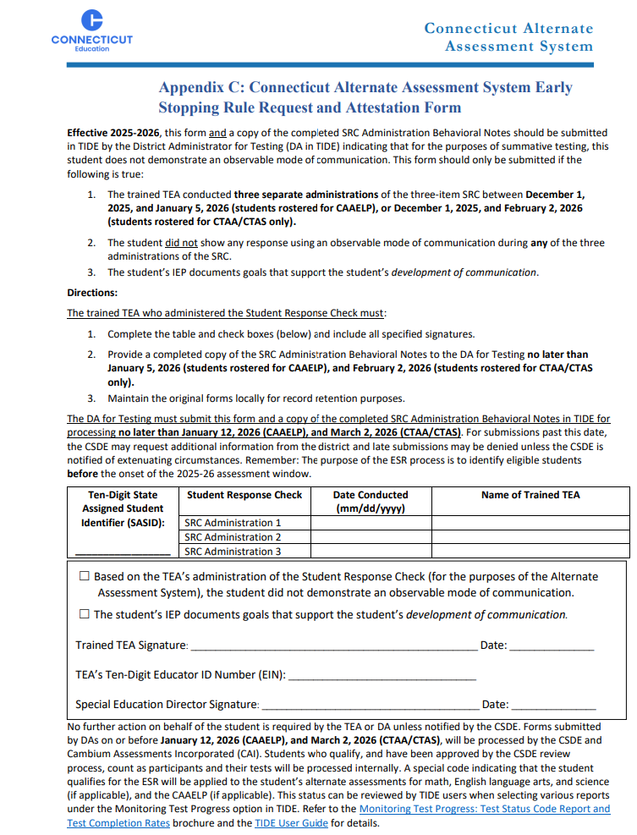
Early Stopping Rule Request and
Attestation Form
If the student does not demonstrate an observable communication response, the TEA will complete the ESR Request and Attestation Form (Appendix C).
All portions of the student's form should be accurate and complete.
NEW! Submit a copy of the SRC Behavioral Notes and completed Request and Attestation Form to the DA by these dates:
  January 5, 2026 – CAAELP
  February 2, 2026 – CTAA/CTAS
Notes:
The trained TEA who administered the SRC will complete the request and attestation form shown here. They will complete the table and check boxes and include all specified signatures. ​
​
New for 2025-2026, a copy of the SCR Administration Behavioral Notes and a copy of the attestation form should be submitted to the DA for Testing before January 5, 2026, for CAAEP and February 2, 2026, for CTAA and/or CTAS.​
The DA will be required to submit both of these completed forms and the to the CSDE by January 12, 2026, for CAAELP and March 2, 2026, for CTAA/CTAS to confirm eligibility for ESR.
It is important that the TEA do not proceed with testing or open any tests for their student if they received ESR approval by the CSDE.​
​
TEAs should locally maintain a copy of their notes documented from Appendix B and a copy of the request and attestation form with their student’s records.

Slide 16
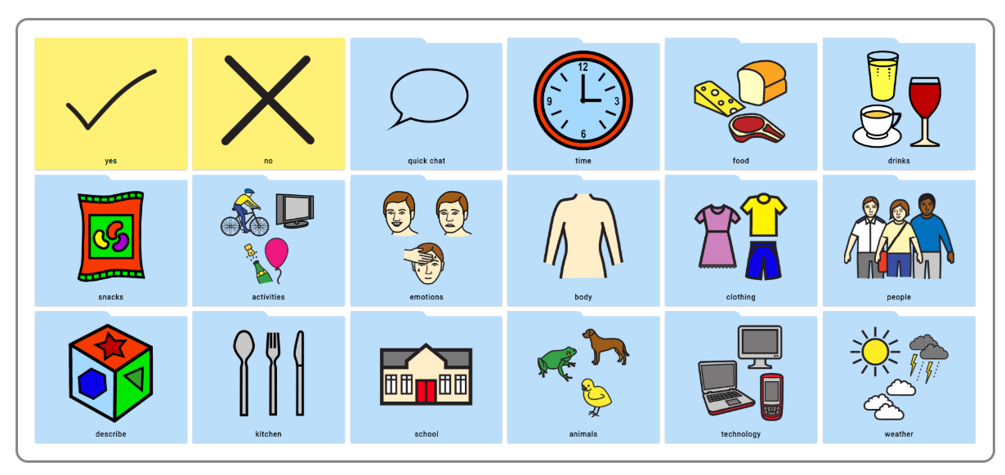
SRC Eligibility Process
The student is ineligible for the ESR if they communicate a response to any of the three items during any of the three SRC administrations.​ (Responses do not have to be correct.)
The trained TEA will discontinue the SRC administration. ​
The student will participate in the
  CTAA (Grades 3-8, 11) and
  CTAS (Grades 5, 8, or 11), and
  CAAELP (K-12) if they are EL/ML.
Refer to CTAA Assessing Students who are Blind, Deaf, or Deaf-Blind Additional Guidance, the CTAS Assessing Students who are Blind, Deaf, or Deaf-Blind Additional Guidance, and the CAAELP Accessibility and Accommodations Manual for information on accessibility.
Notes:
If the student does not show any response using an observable mode of communication for each of the three items across three separate administrations, then the student meets eligibility for the ESR.​
Reminder: The purpose of the ESR process is to identify eligible students before the onset of the assessment window. Therefore, late submissions may be denied unless the CSDE is notified by the District Administrator of extenuating circumstances.​
​
TEAs must save a copy of the completed form locally with student’s records.​
​

Slide 17

If the Student Doesn’t Qualify
Review and determine the access points used for the students to access their instruction within the learning environment. ​
Understand accessibility supports including assistive technology that may be available for that student to access the learning environment, including curriculum and social emotional learning.​
Based on accessibility supports utilized throughout instruction, review designated supports and accommodations associated with each applicable standard assessment. ​
Trial practice and training tests with appropriate supports and accommodations to gather information and evaluate student need.
Photo Credit from the AAC Photo Library; Deed - Attribution 4.0 International - Creative Commons
Notes:
For students who have limited and inconsistent mode of communication and don’t meet the criteria per the Student Response Check:
Review and determine the access points used for the students to access their instruction within the learning environment. ​
Understand accessibility supports including assistive technology that may be available for that student to access the learning environment, including curriculum and social emotional learning.​
Based on accessibility supports utilized throughout instruction, review designated supports and accommodations associated with each applicable standard assessment. ​
Trial practice and training tests with appropriate supports and accommodations to gather information and evaluate student need.
​

Slide 18
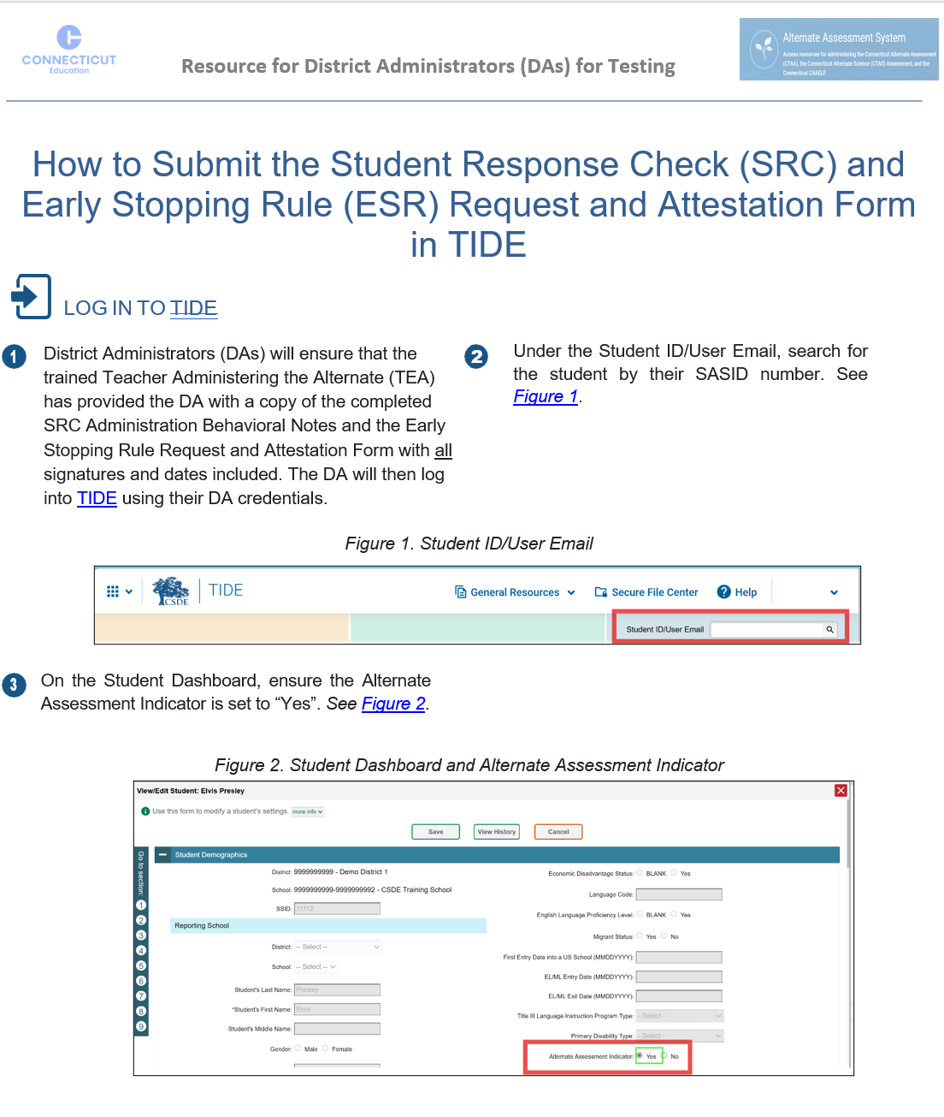
Guidance for District Administrators
  First, verify that the student’s Alternate Assessment Indicator is activated to Yes in TIDE.
  Review the ESR Request and Attestation Form for accuracy and completion (e.g., SASID, dates, signatures).
  Follow the steps outlined in the How to Submit the Student Response Check and Early Stopping Rule (ESR) Request and Attestation Form in TIDE.
Submit the SRC Observational Notes and ESR Request and Attestation Form using the upload feature in the TIDE Form by the following dates:
  CAAELP - No later than January 12, 2026
  CTAA/CTAS - No later than March 2, 2026
Notes:
District Administrators (DA in TIDE) should first verify that the student’s Alternate Assessment Indicator is set to Yes in TIDE. This is automatically activated when the PPT completes the Connecticut Alternate Assessment System Eligibility Form and Verification Section for all grades covered by the duration of the IEP including the student’s current grade of enrollment AND the plan is finalized and implemented. If the indicator is set to No, contact the student’s Case Manager as the plan may not be implemented or may require an amendment. Do not submit the ESR request until the issue is resolved and the alternate indicator is set to Yes in TIDE.
When submitting the information in TIDE, ensure the student SASID is entered correctly and that all portions of the digital form including the TEA’s EIN, dates of the SRC administration, and teacher/administrator signatures.
DA’s should submit a copy of the completed SRC Administration Behavioral Notes and the ESR Request and Attestation Form via TIDE Forms by the following deadlines:
CAAELP - No later than January 12, 2026
CTAA/CTAS - No later than March 2, 2026
Resource for DAs: How to Submit the Student Response Check and Early Stopping Rule (ESR) Request and Attestation Form in TIDE.

Slide 19
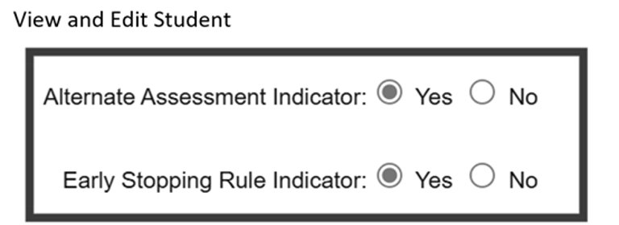
Checking ESR Status in TIDE
DAs in TIDE will receive an email notification from Cambium Assessment on the reviewed status of the ESR.
All educators with access to TIDE can check the student’s ESR status by searching the student and viewing the student dashboard. If the student has been approved for an ESR, “Yes” will be indicated in TIDE.
If the student has been approved for an ESR, no further action is required by the TEA. TEAs should not open or attempt any tests with the student during the assessment window. The student will count as a test participation through the approved ESR, and their tests will be closed out by Cambium Assessment.​
Notes:
It may take up to a week for ESRs to be reviewed and approved. DAs will receive an email from Cambium Assessments indicating the ESR status as approved, denied, or needs more information. All educators with access to TIDE can check the student’s ESR status by searching the student and viewing the student dashboard.​
​
If the student has been approved for an ESR, “Yes” will be indicated for the Early Stopping Rule Indicator. If your ESR was approved, no further action or testing is required by the TEA or DA on behalf of the student. TEAs should not open or attempt any tests with the student. ​
​
Once the ESR is approved, the student is assigned the ESR test code status and will count as a participant. Once the test window is opened, a Cambium team member will close the tests within the system. ​

Slide 20
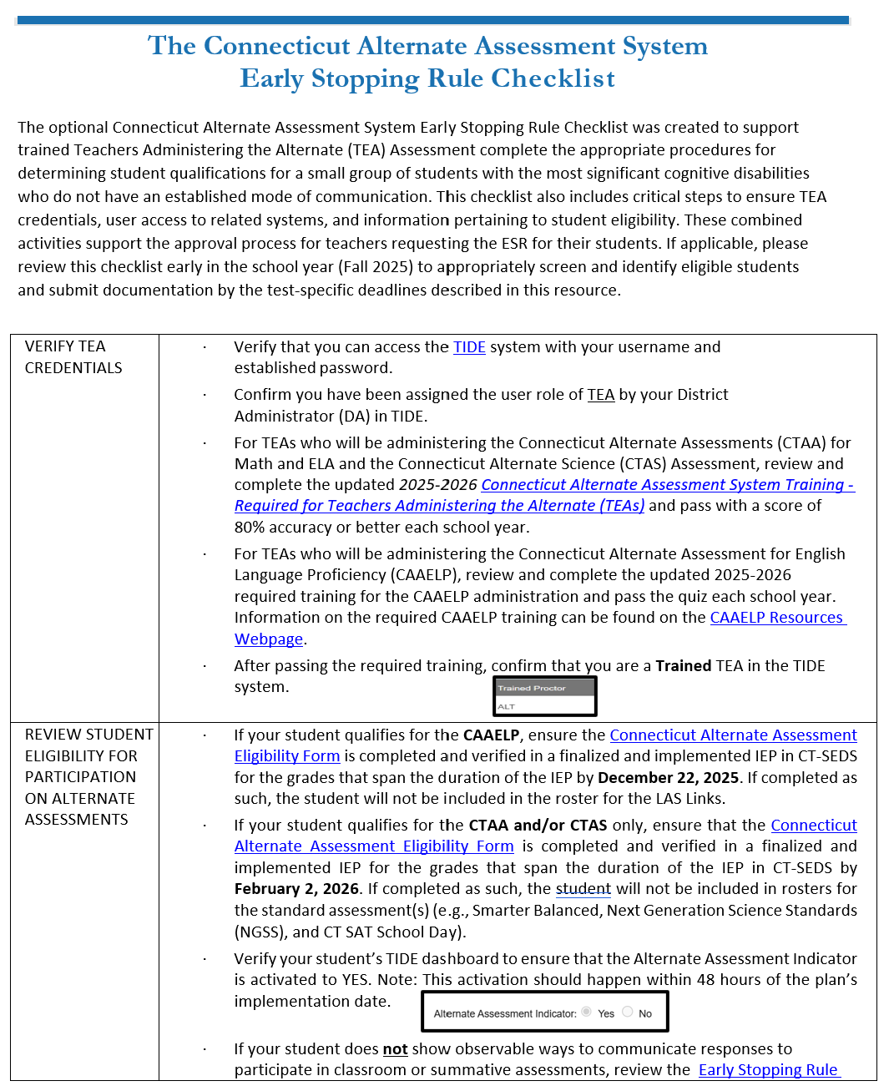
New Resource for TEAs: ESR Checklist Tool
Notes:
The optional ESR Checklist was created to support trained Teachers Administering the Alternate (TEA) Assessment complete the appropriate procedures for determining student qualifications. The checklist also includes critical steps to ensure TEA credentials, user access to related systems, and information pertaining to student eligibility. These combined activities support the approval process for teachers requesting the ESR for their students. If applicable, please review this checklist early in the school year to appropriately screen and identify eligible students and submit documentation by the test-specific deadlines described in this resource.​
​
​
​
​

Slide 21
CSDE Performance Office
Special Populations Contact Information
Abe Krisst Bureau Chief Connecticut Education – Performance Office Direct Line: 860-713-6894 Mobile Phone: 860-690-0650 Email: Abe.Krisst@ct.gov
Deirdre Ducharme Education Consultant Performance Office - Special Populations Direct Line: 860-713-6859 Email: Deirdre.Ducharme@ct.gov
Katie Seifert Associate Education Consultant Performance Office - Special Populations Direct Line: 860-713-6722 Email: Katherine.Seifert@ct.gov
Notes:
Here is our contact information. Please reach out with any questions as we are here to support you and your teams.

Slide 22
Thank you!!!!
Thank you for attending and for all you do for your students.
Connecticut State Department of Education
Notes:
Thank you for attending and for all you do for your students.

