Slide 1
CSDE Learning Series for Planning and Placement Teams and Section 504 Teams
Language Supports for English Learners/Multilingual Learners Participating on Smarter Balanced and Next Generation Science Standards Assessments
2025-26
Notes:
CSDE Learning Series for Planning and Placement Teams and Section 504 Teams
Language Supports for English Learners/Multilingual Learners Participating on Smarter Balanced and Next Generation Science Standards Assessments
Welcome to this training!

Slide 2

What are language supports and who qualifies?
Notes:
What are language supports and who qualifies?
As educators, we have a vital opportunity to support all students—especially English learners and multilingual learners (ELs/MLs)—by meeting them at their current stage of language development. Through targeted scaffolding, tools, and instructional strategies, we can reduce barriers and promote equitable access to learning.
While we can’t control how each student learns, we can influence outcomes by aligning supports with individual goals. Bilingual and ESL programs help ELs/MLs develop essential receptive, productive, and interactive language skills. Bilingual programs, as defined in Section 10-17e of the Connecticut General Statutes, use both the student’s native language and English to deliver content instruction, fostering deeper understanding and academic growth.
When language supports are aligned with principles of equity and access, they create inclusive environments where all learners can thrive. Many of these supports are also reflected in the designated supports available on statewide assessments such as Smarter Balanced and NGSS, ensuring ELs/MLs can effectively demonstrate their knowledge.
This presentation highlights key language supports that enhance both instruction and assessment outcomes for multilingual learners.

Slide 3

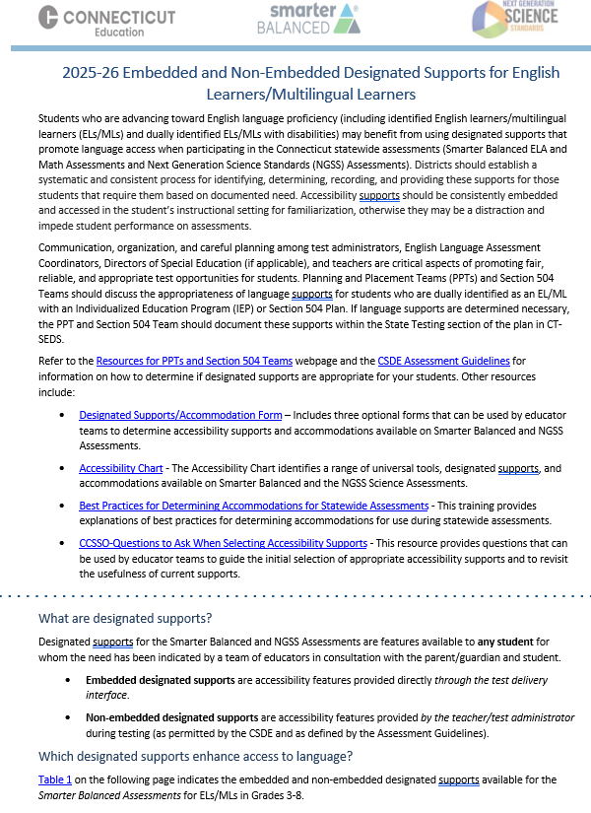
Language Supports
Language supports are designated supports available for ELs/MLs including those dually identified under the Individuals with Disabilities Education Act and/or Section 504 for whom the need has been indicated by a team of educators with input from the parent/guardian and student
Should be used regularly during learning and instruction across all content areas
May require some adult-dependence for support
Additional test time may be necessary
Embedded and Non-Embedded Designated Supports for English Learners/Multilingual Learners
Notes:
Language Supports
Students progressing toward English language proficiency—including English learners/multilingual learners (ELs/MLs) and dually identified ELs/MLs with disabilities—may benefit from designated supports that promote language access during Connecticut’s statewide assessments. These supports are not one-size-fits-all and may not address every language need, but they can help reduce barriers and improve access.
This presentation outlines a range of supports, including:
Simplified Test Directions, On-the-Fly Translations, and printed directions read by the test administrator;
Tools to support navigation of the Test Delivery System for math and ELA; and
Specific supports for Spanish-speaking students on math and science assessments.
It’s important to remind students that assessments are just one snapshot of their learning. For students with significant language barriers, testing time should be reasonable and appropriate to their needs.
Designated supports are selected by informed educators—ideally a team familiar with the student’s English proficiency, instructional supports, and assessment history. Input from families and students is essential in this decision-making process.
There are two types of designated supports:
Embedded supports: Built into the test platform.
Non-embedded supports: Provided by educators during testing, as permitted by the CSDE Assessment Guidelines.
For a full list of available supports, refer to the Embedded and Non-Embedded Designated Supports for English Learners/Multilingual Learners brochure.
Embedded and Non-Embedded Designated Supports for English Learners/Multilingual Learners

Slide 4
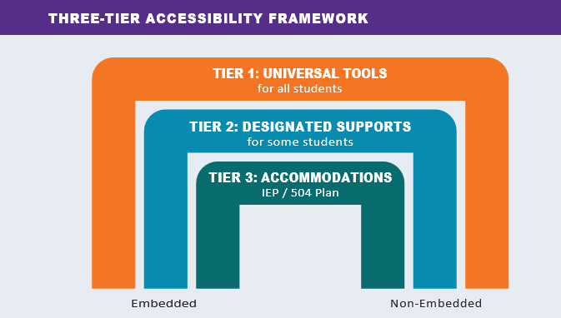
Three-Tier Accessibility Approach
Language Supports for ELs/MLS
This document is an adaptation of the following National Center on Educational Outcomes report commissioned and published by CCSSO: Lazarus, S., Goldstone, L., Wheeler, T., Paul, J., Prestridge, S., Sharp, T., Hochstetter, A., and Warren, S. (2021). CCSSO Accessibility Manual: How to Select, Administer, and Evaluate Use of Accessibility Supports for Instruction and Assessment of All Students. The Council of Chief State School Officers (CCSSO).
Notes:
Three-Tier Accessibility Approach
The Three-Tier Accessibility Approach is a tool to illustrate how accessibility supports aid students specific to need and purpose.
In looking at the largest bridge, Tier 1, Universal Tools are available to ALL students. Universal Tools are those that every student should have access to if they will benefit the student, such as scratch paper or a highlighter. These tools can be used by any student that needs them at any time, regardless of the activity or the content area.
The bridge below, Tier 2, is for a smaller group of students. Here, the educator team reviews strengths and barriers to determine if designated supports are needed. An example of a Tier 2 support might include those that promote language access. Designated supports such as the bilingual word-to-word glossary on the science test may be beneficial for some students who already use this tool during instruction.
Tier 3, is for an even more specialized subset of students who have an IEP or Section 504 Plan. Accommodations might include the provision of closed captioning of the ELA Listening assessment for students with hearing impairments.
Resource:
From the Council of Chief State School Officers (CCSO) Accessibility Manual: 753a0706.flowpaper.com/CCSSOAccessibilityManual/
The Three-Tier Accessibility Framework is an adaptation of the following National Center on Educational Outcomes report commissioned and published by CCSSO: Lazarus, S., Goldstone, L., Wheeler, T., Paul, J., Prestridge, S., Sharp, T., Hochstetter, A., and Warren, S. (2021). CCSSO Accessibility Manual: How to Select, Administer, and Evaluate Use of Accessibility Supports for Instruction and Assessment of All Students. The Council of Chief State School Officers (CCSSO).

Slide 5
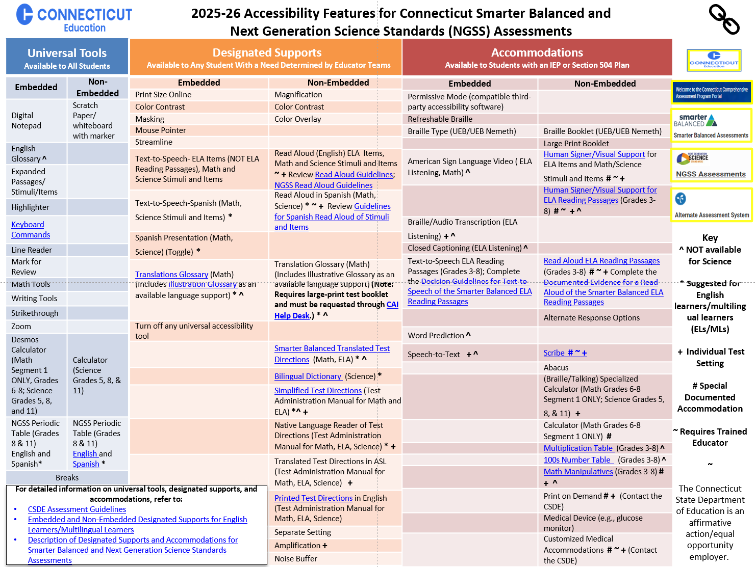
Smarter Balanced/NGSS Accessibility Chart
Notes:
Smarter Balanced/NGSS Accessibility Chart
Let’s review these different levels of supports and accommodations using the Accessibility Chart, shown here. It was developed specifically for the Smarter Balanced and the Next Generation Science Standards Assessments. It provides 3 tiers of support ranging from Universal Tools, shown to the far left in blue, designated supports, shown in orange and located in the center of the chart, and accommodations, shown in red to the far right. You will notice that within each section, embedded and non-embedded tools are listed, along with hyperlinks to additional information, if applicable.
Please note the User Key, located on the far right, that includes symbols representing tools that are not available on the science assessments, those accommodations that are non-standard and require additional teacher training, and tools that might be appropriate for English learners/multilingual learners.
While the Accessibility Chart is a great reference, to learn the details about each of these accessibility features reference the CSDE Assessment Guidelines.
Accessibility Charts for the LAS Links Assessment and the Connecticut SAT School Day are posted to the CSDE web page.
Other Accessibility Charts are available for the CT SAT School Day and LAS Links –available on the CSDE webpage. Connecticut Sensible Assessment System--Summative Assessment - End-of-Year; https://portal.ct.gov/sde/student-assessment/main-assessment/student-assessment/summative-assessment---end-of-year
CT SAT School Day: PowerPoint Presentation; https://portal.ct.gov/-/media/sde/student-assessment/sat/2024_25-ct-sat-school-day-accessibility-chart-fall-version.pdf?rev=61abb70fb53f435bbfad65eea3d32460&hash=CBDFA77A9EA595794CEB46B27F8BEA52
LAS Links: las-links-accessibility-chart-final.pdf; https://portal.ct.gov/-/media/sde/student-assessment/special-populations/las-links-accessibility-chart-final.pdf?rev=a9cb927b69fd4717911a7271fd568dc3&hash=A16B453E1EA2739002CCAD62A422E6E1

Slide 6
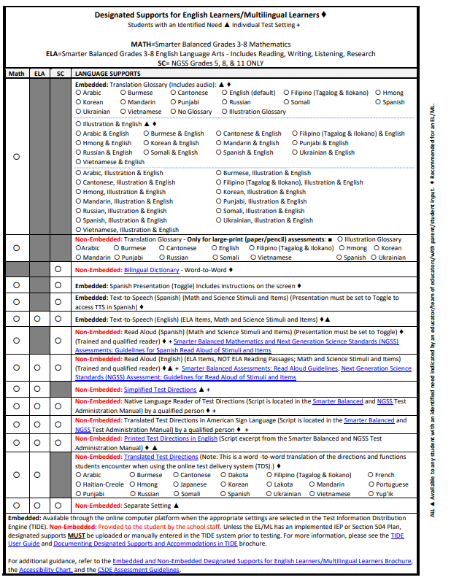
Optional Form to Plan Language Supports for EL/MLs
The Designated Supports/Accommodations Form provides educator teams with a template for reviewing and choosing embedded and non-embedded accessibility features on Smarter Balanced and NGSS Assessments by subject area (math, ELA, and science).
This resource also includes a listing of:
Accommodations for ELs/MLs dually identified under IDEA or Section 504;
Language supports for ELs/MLs; and
Other Designated supports available to all students based on need and educator team determination with parent/student input.
Notes:
Optional Form to Plan Language Supports for EL/MLs
This optional form is available to the educator team for determining language supports for English learners/multilingual learners participating in the Smarter Balanced mathematics and English language arts assessments and the NGSS assessment. These decisions should be determined prior to testing to ensure optimal test conditions and to minimize test irregularities.
https://ct.portal.cambiumast.com/resource-item/en/designated-supports-accommodations-form

Slide 7
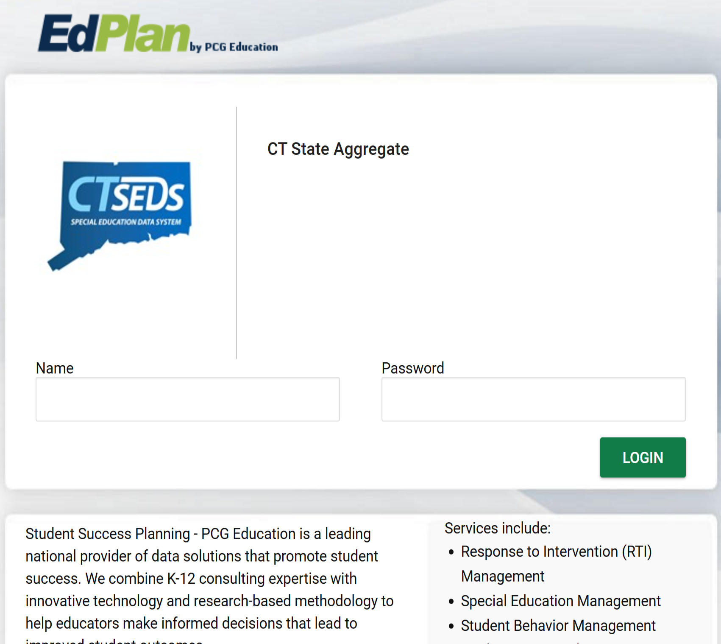
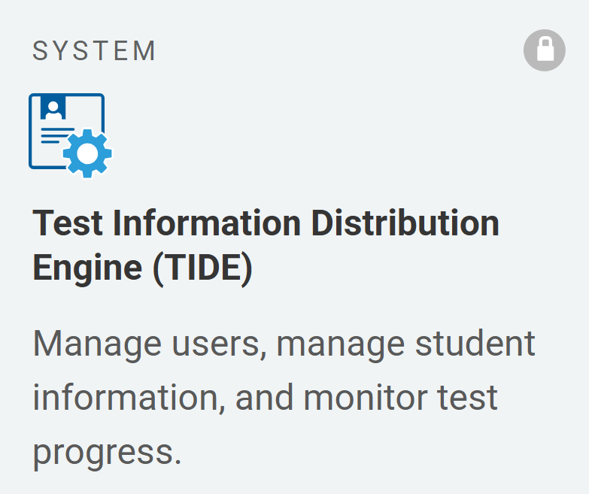
How to Document Language Supports for EL/MLs
If the student has an IEP or Section 504 Plan, the team should document applicable designated supports and accommodations in CT-SEDS. Accommodations from finalized and implemented plans will sync to TIDE.
Designated supports for students without IEPs/Section504 Plans can be manually entered in TIDE or uploaded as a batch file (remove records for students with documented plans).
Refer to the Documenting Designated Supports and Accommodations in TIDE brochure for details.
Notes:
How to Document Language Supports for EL/MLs
As with all designated supports and accommodations, test settings must be documented in TIDE prior to testing.
Designated supports for students who are not identified as Special Education or Section 504 can be entered directly into TIDE by the District Administrator (DA) or School Test Coordinator (SC) either manually or via the upload process prior to testing. However, if conducting a batch upload, please remember to remove records for students who have documented IEP/Section 504 Plans.
Designated supports and accommodations for students with finalized and implemented plans will sync to TIDE from CT-SEDS.
As with all designated supports and accommodations, test settings must be documented in TIDE prior to testing. If the student does not have an Individualized Education Program (IEP) or Section 504 Plan, the supports can be manually entered in TIDE or uploaded. Refer to the Documenting Designated Supports and Accommodations in TIDE brochure for details.

Slide 8

What type of language supports are available for Smarter Balanced and NGSS Assessments?
Notes:
What type of language supports are available for Smarter Balanced and NGSS Assessments?
Now that we know how to distinguish between the levels of supports, let’s review those types of language supports that are available on the state summative tests.

Slide 9
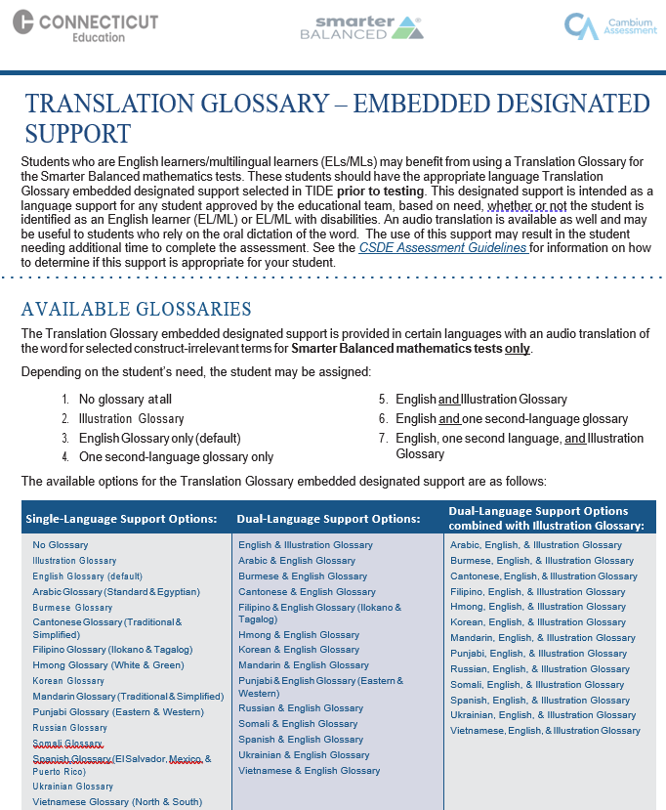
1. Translation Glossary Options for
Smarter Balanced Math
A language support provided for selected construct irrelevant math terms. Terms include, but are not limited to, Arabic, Filipino, Korean, Russian, Spanish and Ukrainian.
Depending on the student’s need, the following combinations can be documented in TIDE:
  English Glossary only (default)
  One second- language glossary
  English and Illustration glossary
  English and one-second-language glossary
  English, one second language, and Illustration Glossary
Translation (Glossary) – Embedded Designated Support
Notes:
1. Translation Glossary Options for Smarter Balanced Math
This designated support is intended as a language support for any student approved by the educational team, based on need. An audio translation is available as well and may be useful to students who rely on the oral dictation of the word. The use of this support may result in the student needing additional time to complete the assessment.
Based on differences in complexity across languages, different language glossaries may provide support for different construct irrelevant English language terms. Therefore, if a student has access to the English and one second-language glossary, some terms may have both glossaries present while other terms may have only one of the two glossaries present. Please note that not all math items contain glossary options.
Refer to Translation (Glossary) – Embedded Designated Support for more information.

Slide 10
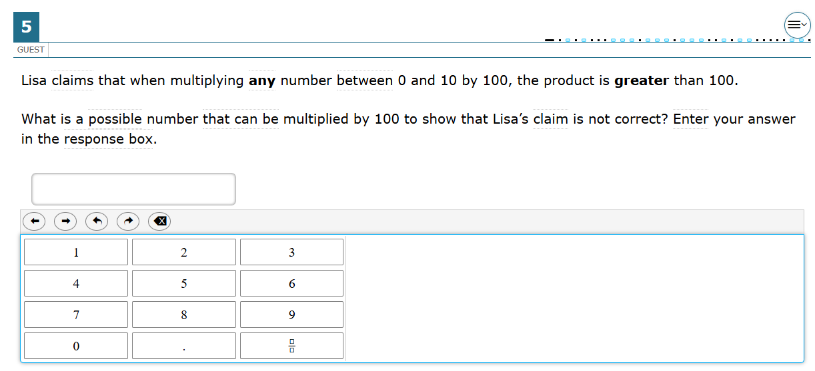

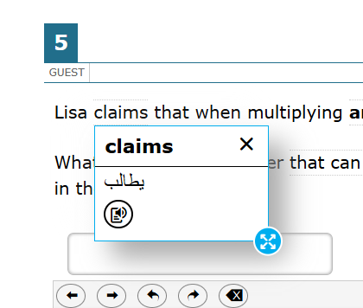
Embedded Translation Glossary for Math
A dotted line above or below a word or phrase indicates an available translation as shown inside the red box to the right.
When the student hovers the mouse over the term, a pop-up box will appear with the translation, audio, and/ or illustration of the term.
The student can select the audio icon next to the glossary term and listen to the audio recording of the glossary.
The student can click the X at the top right-hand corner of the pop-up window to close the glossary.
Notes:
Embedded Translation Glossary for Math
To use the embedded Translation Glossary for Math, the student should look for a dotted line above or below a word or phrase. This indicates an available translation as shown inside the red rectangular box on your slide.
When the student hovers the mouse over the term, a pop-up box will appear with the translation, audio, and/ or illustration of the term.
The student can select the audio icon next to the glossary term and listen to the audio recording of the glossary.
The student can click the X at the top right-hand corner of the pop-up window to close the glossary.
The use of this support may result in the student needing additional time to complete the assessment.
Translation Glossary must be documented in TIDE prior to testing. It will be visible in the Test Administration Interface and immediately available to the student for use while taking an interim or summative assessment. Once set in TIDE, this setting will persist until the end of the school year unless otherwise adjusted. Also note that many designated supports are not retroactive (e.g., Translation Glossary), meaning that if the support is not reflected in TIDE prior to testing, it will not be available on the test form. Instead, an appeal may need to be submitted through TIDE to generate a new test form with the updated test setting.
Image of math question with a red rectangular box around the word "Calculator" as this word is flagged with a translation option.

Slide 11
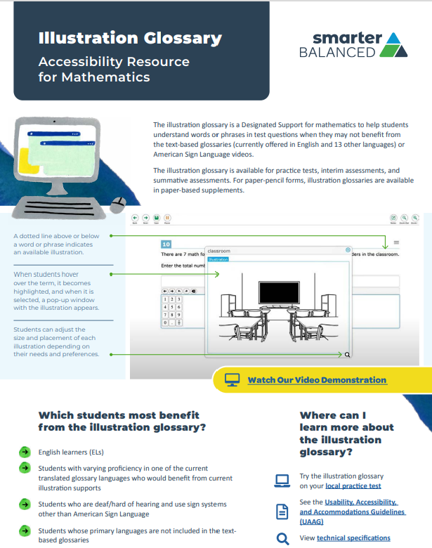
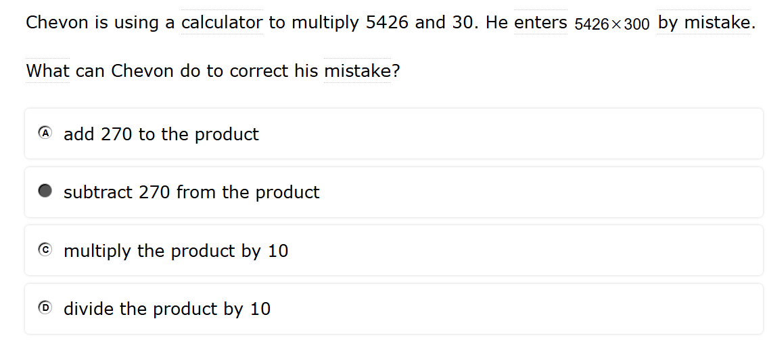

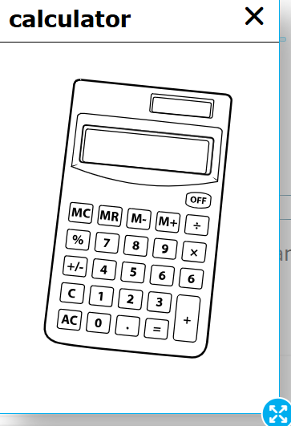
Embedded Illustration Translation Glossary for Math
The Illustration Glossary is designed to help students understand words or phrases in test questions when their primary native language is not available
This translation option can be configured in TIDE with English and the student’s native language if it is an available option.
A dotted line above or below a word or phrase indicates an available illustration.
Students who are deaf/hard of hearing and use sign systems other than American Sign Language may benefit from this support.
Notes:
Embedded Illustration Translation Glossary for Math
The illustration glossary is designed to help students understand words or phrases in test questions when their primary native language is not available.
A dotted line above or below a word or phrase indicates an available illustration. Refer to the red rectangular box on the slide that shows a translation option for the word “Calculator.”
When students hover over the term, it becomes highlighted, and when it is selected, a pop-up window with the illustration appears (as shown on the slide).
Students can adjust the size and placement of each illustration depending on their needs and preferences.
Students who are deaf/hard of hearing and use sign systems other than American Sign Language may benefit from this support.

Slide 12

Non-Embedded Translation Glossary for Math (Includes Illustration Glossary)
Available for eligible students with an IEP or Section 504 Plan taking the test using a Large Print Test Booklet.
Available single translations include: Illustration, Arabic, Burmese, Cantonese, English, Filipino (Tagalog & Ilokano), Hmong, Korean, Mandarin, Punjabi, Russian, Somali, Vietnamese, Spanish, and Ukrainian.
Must be documented in CT-SEDS.
Must be requested to Cambium Help Desk by the District Administrator (DA for Testing) when ordering materials in TIDE. (Contact Deirdre Ducharme or Katie Seifert at the CSDE for assistance.)
Classroom materials MAY NOT be used.
Notes:
Non-Embedded Translation Glossary for Math (Includes Illustration Glossary)
The non-embedded Translated Glossary is only available for students with an IEP or Section 504 Plan who qualify to take the Smarter Balanced Assessments using Large Print Test Booklets. The District Administrator (DA for Testing) must request the non-embedded Translated Glossary when ordering materials in TIDE.
This support must be documented by the Team in the student’s IEP/Section 504 Plan in CT-SEDS.

Slide 13
2. Non-Embedded Simplified Test Directions for Smarter Balanced Assessments
Notes:
2. Non-Embedded Simplified Test Directions for Smarter Balanced Assessments

Slide 14
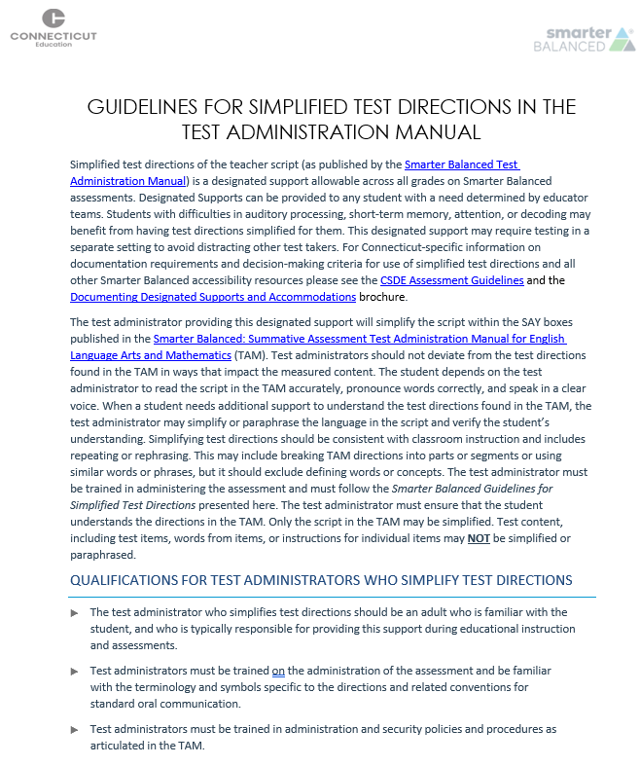
Non-Embedded Simplified Test Directions for Smarter Balanced Math and ELA
A language support to simplify the teacher script as published by the Smarter Balanced Test Administration Manual (e.g., paraphrasing/clarifying script, adjusting reader speed).
May also support students with difficulties in auditory processing, short-term memory, attention, or decoding.
Must test in an individual test setting unless a small group is configured based on similar accessibility needs.
Test Administrators must review the Guidelines for Simplified Test Directions in the Test Administration Manual. There are associated test administrator tasks to support activities prior to and during test administration.
Not available for NGSS.
Notes:
Non-Embedded Simplified Test Directions for Smarter Balanced Math and ELA
This designated support allows the test administrator to simplify the script within the SAY boxes published in the Smarter Balanced: Summative Assessment Test Administration Manual for English Language Arts and Mathematics (TAM). This can be done through the use of paraphrasing and clarifying the script while also adjusting reader speed and volume.
Simplified Test Directions are intended to support students with difficulties in auditory processing, short-term memory, attention, or decoding.
No other part of the test may be simplified. The test administrator must not prompt the student in any way that would result in a different response to a test item or influence the student’s response in any way.
Test administrators should not deviate from the test directions found in the TAM in ways that impact the measured content.
The student depends on the test administrator to read the script in the TAM accurately, pronounce words correctly, and speak in a clear voice. When a student needs additional support to understand the test directions found in the TAM, the test administrator may simplify or paraphrase the language in the script and verify the student’s understanding. Simplifying test directions should be consistent with classroom instruction and includes repeating or rephrasing. This may include breaking TAM directions into parts or segments or using similar words or phrases, but it should exclude defining words or concepts.
The test administrator must be trained in administering the assessment and must follow the Smarter Balanced Guidelines for Simplified Test Directions (Guidelines for Simplified Test Directions in the Test Administration Manual).
This support is only available for the teacher directions published in the Smarter Balanced Test Administration Manual.

Slide 15
3. Non-Embedded Translated Test Directions for Smarter Balanced
ELA and Math
Notes:
3. Non-Embedded Translated Test Directions for Smarter Balanced ELA and Math

Slide 16
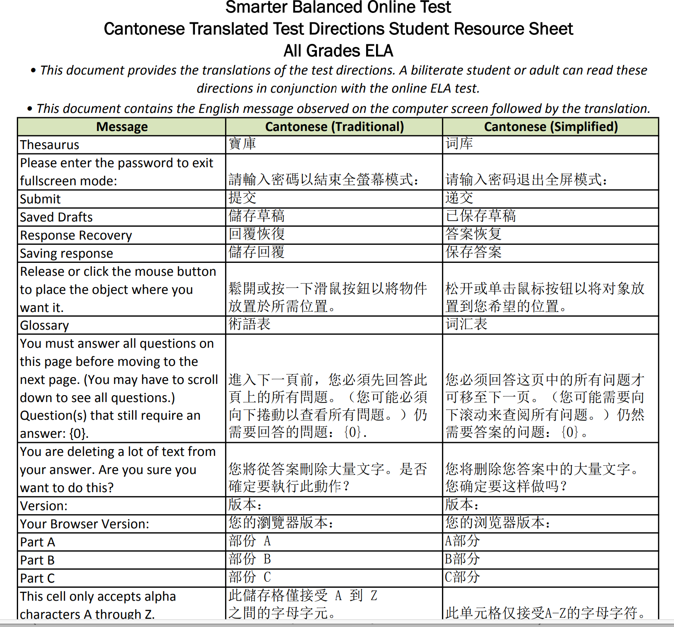
Non-Embedded Translated Test Directions for Smarter Balanced ELA and Math
PDFs of word-to-word translations of the directions and functions encountered when using the online test delivery system (TDS). (Available on the portal.)
Terms are available for Smarter Balanced ELA and math only.
Download & print prior to test day.
If available, a certified bilingual test administrator may read terms to the student or, if the student is literate in the selected language, they may read the terms independently.
Additional test time may be needed.
Languages include: Arabic; Burmese; Cantonese; Dakota; Filipino (Tagalog & Ilokano); French; Haitian-Creole; Hmong; Japanese; Korean; Lakota; Mandarin; Portuguese; Punjabi; Russian; Somali; Spanish; Ukrainian; Vietnamese; and Yup’ik.
Notes:
Non-Embedded Translated Test Directions for Smarter Balanced ELA and Math
This is a word-to-word translation of the directions and functions students encounter when using the online test delivery system (TDS).
PDFs of the terms are available for Smarter Balanced ELA and math only.
If available, a certified bilingual test administrator trained and employed at the school can read to the student or, if the student is literate in the selected language, they may read the terms independently. Students who are developing English language skills can use this translation resource.
The use of this support may result in the student needing additional overall time to complete the assessment, as well as a separate setting.
Languages currently supported for the Non-Embedded Translated Test Directions include: Arabic; Burmese; Cantonese; Dakota; Filipino (Tagalog & Ilokano); French; Haitian-Creole; Hmong; Japanese; Korean; Lakota; Mandarin; Portuguese; Punjabi; Russian; Somali; Spanish; Ukrainian; Vietnamese; and Yup’ik.
If applicable to the student, PDFs should be downloaded and printed by the test administrator prior to testing and distributed to the student at the time of testing. Materials are available on the portal using this link Translated Test Directions.

Slide 17
4. Non-Embedded Native Language Reader of Test Directions for Smarter Balanced and NGSS Assessments
Notes:
4. Non-Embedded Native Language Reader of Test Directions for Smarter Balanced and NGSS Assessments

Slide 18
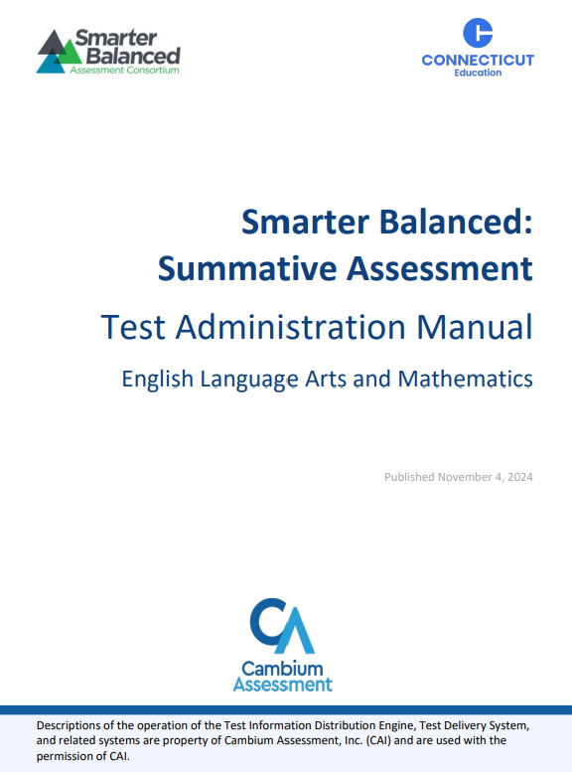
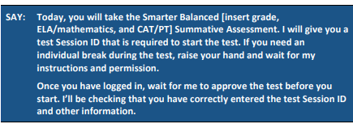
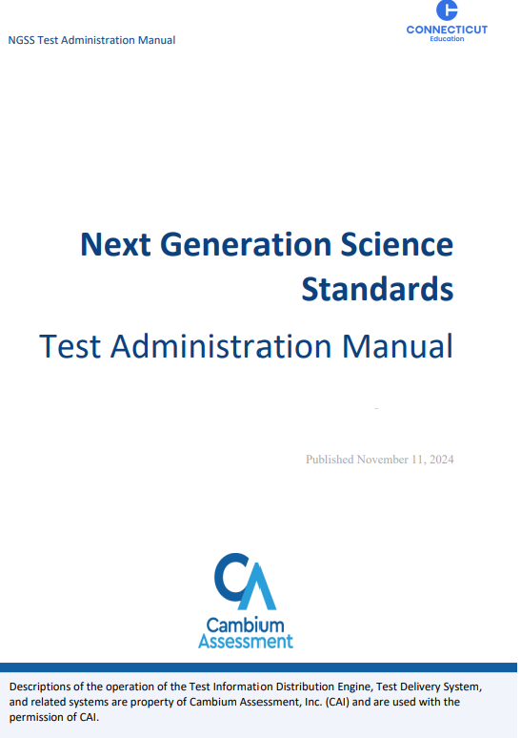
Non-Embedded Native Language Reader of Test Directions for Smarter Balanced and NGSS Assessments
A native language reader of the script from the Smarter Balanced or NGSS Test Administration Manuals can be provided if certified teacher is literate and fluent in the student’s native language and is trained in test administration.
Student must test in a 1:1 setting or in a small group of students that speak the same language.
Notes:
Non-Embedded Native Language Reader of Test Directions for Smarter Balanced and NGSS Assessments
An on-the-fly native language reader of the script from the Smarter Balanced Test Administration Manual can be provided to the student if a certified and trained teacher employed by the school is available who speaks that language.
Located in the interim/summative Test Administration Manual, all teacher test directions/scripts (indicated by SAY) may be read and clarified in English or using the student’s native language for EL/MLs who have been identified as needing this support.
A certified staff person trained in test administration and security who proficiently speaks the student’s native language may administer this designated support. If the teacher is non-certified, they must be trained and under the supervision of a certified educator.
Links to the Test Administration Manuals are included here:
NGSS Test Administration Manual (TAM); https://ct.portal.cambiumast.com/resource-item/en/ngss-test-administration-manual-tam
Smarter Balanced Summative Test Administration Manual (TAM); https://ct.portal.cambiumast.com/resource-item/en/smarter-balanced-summative-test-administration-manual-tam

Slide 19
5. Non-Embedded Printed Test Directions in English (Student Version) from the Smarter Balanced and NGSS Test Administration Manuals
Notes:
5. Non-Embedded Printed Test Directions in English (Student Version) from the Smarter Balanced and NGSS Test Administration Manuals

Slide 20

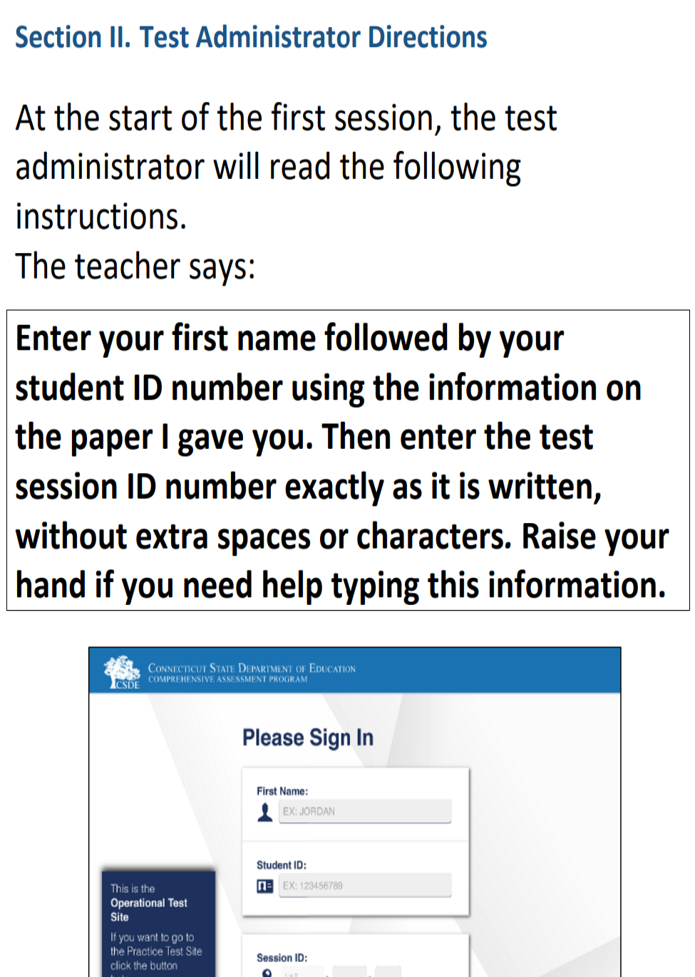
Non-Embedded Printed Test Directions in English (Student Version) from the Test Administration Manuals
This designated/language support provides the student with a visual reference in English for test directions/script within the SAY boxes in the Summative Test Administration Manuals (TAMs) for Smarter Balanced and NGSS Assessments.
The test administrator must download, print, and distribute the printed test directions to the student at the time of testing. Options include:
  NGSS TAM Printed Test Directions Student Version for One-Day Testing
  NGSS TAM Printed Test Directions Student Version for Testing Two-or-More Days
  Smarter Balanced TAM Printed Test Directions Student Version Grades 3-5
  Smarter Balanced TAM Printed Test Directions Student Version Grades 6-8
Notes:
Non-Embedded Printed Test Directions in English (Student Version) from the Test Administration Manuals
This designated/language support provides the student with a visual reference in English for test directions/script within the SAY boxes in the Summative Test Administration Manuals (TAMs) for Smarter Balanced and NGSS Assessments. The test administrator must download, print, and distribute the printed test directions to the student at the time of testing. Options include:
NGSS TAM Printed Test Directions Student Version for One-Day Testing
NGSS TAM Printed Test Directions Student Version for Testing Two-or-More Days
Smarter Balanced TAM Printed Test Directions Student Version Grades 3-5
Smarter Balanced TAM Printed Test Directions Student Version Grades 6-8

Slide 21
6. Non-Embedded Bilingual Word-to-Word Glossary for NGSS
Notes:
6. Non-Embedded Bilingual Word-to-Word Glossary for NGSS
A bilingual/dual language word-to-word glossary may be an appropriate language support for students whose primary language is not English and who use dual language supports in the classroom. Although word-to-word glossaries are not permitted on the Smarter Balanced Math and ELA Assessments, they are available as non-embedded designated support on the Next Generation Science Standards Assessments (NGSS) for students who use them regularly during instruction. Two word-to-word glossary options are available for ELs/MLs participating on the NGSS.
If applicable to the student, PDFs should be downloaded and printed by the test administrator prior to testing and distributed to the student at the time of testing. Materials are available on the portal using this link Bilingual Dictionaries and Glossaries Authorized for Use by English Language Learners.
Also, this support should be documented in TIDE prior to testing. If the student does not have an Individualized Education Program (IEP) or Section 504 Plan, the support can be manually entered in TIDE or uploaded. If the student is dually identified, this support should be documented by the Team in the student’s IEP/Section 504 Plan. Refer to the Documenting Designated Supports and Accommodations in TIDE brochure for details.

Slide 22
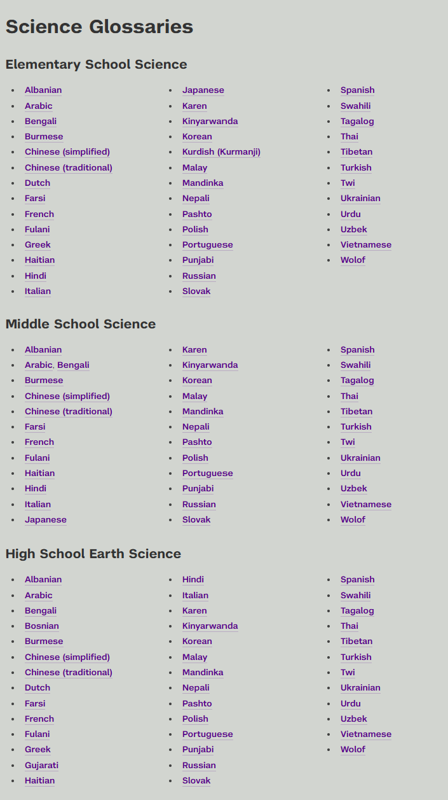
Non-Embedded Bilingual Word-to-Word Glossary for NGSS
Two types of word-to-word glossaries are permitted on the NGSS for students that use them regularly during instruction. Refer to the Bilingual Dictionaries and Glossaries Authorized for Use by English Language Learners for details.
1) NYS Statewide Language Regional Bilingual Education Resource Network: Bilingual Glossaries and Cognates
Test administrator must download & print paper copies prior to testing.
Materials are not secure, but they should be safely stored by the teacher if testing over multiple days.
Student may need additional test time.
Digital word-to-word glossaries are not permitted during testing.
For the purposes of statewide testing, this resource can only be used on the NGSS.
Notes:
Non-Embedded Bilingual Word-to-Word Glossary for NGSS
Two types of word-to-word glossaries are permitted on the NGSS for students that use them regularly during instruction.
1. NYS Statewide Language Regional Bilingual Education Resource Network: Bilingual Glossaries and Cognates (https://steinhardt.nyu.edu/metrocenter/language-rbern/resources/bilingual-glossaries-and-cognates)
This optional resource offers word-to-word translations in a variety of languages in the subject areas of math, ELA, history, and science- which is beneficial for classroom instruction. The science translations may be used on the NGSS.
In preparation for administering the NGSS, the teacher should use this resource to locate the word-to-word glossaries in the science section applicable to the student’s native language (if available).
Materials should be downloaded, printed, and distributed to the student at the time of testing.
Note the following:
• Students are not permitted to use digital word-to-word glossaries within the secure test platform or secure testing environment. Only paper copies are allowed.
• These materials are not secure, but they should be safely stored by the teacher if the student is testing over multiple days.
• The use of this support may result in the student needing additional overall time to complete the assessment.
• These word-to-word glossaries are publicly available but may not be included in any publication to be sold without explicit permission from Steinhardt New York University. Inclusion does not constitute endorsement or any other commercial publication.
• For the purposes of statewide testing, this resource can only be used on the NGSS. It is not permitted for use on Smarter Balanced Assessments.

Slide 23
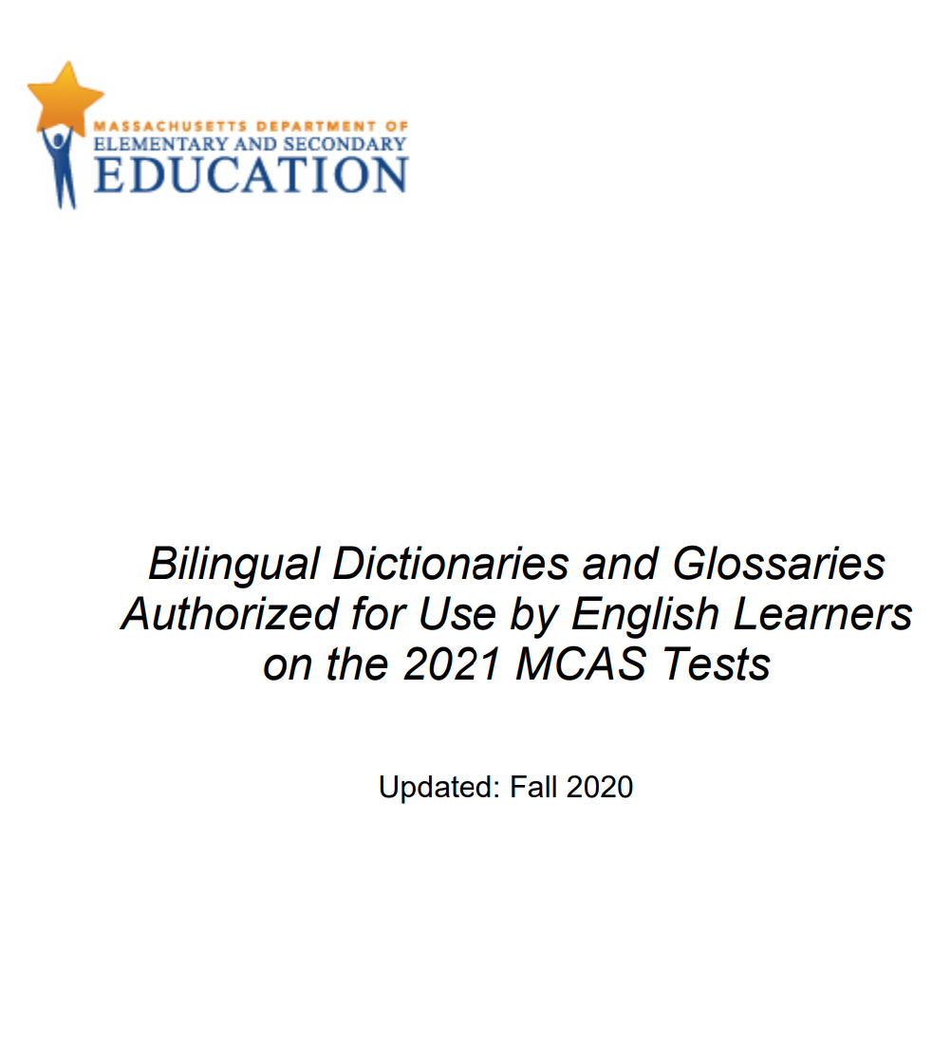
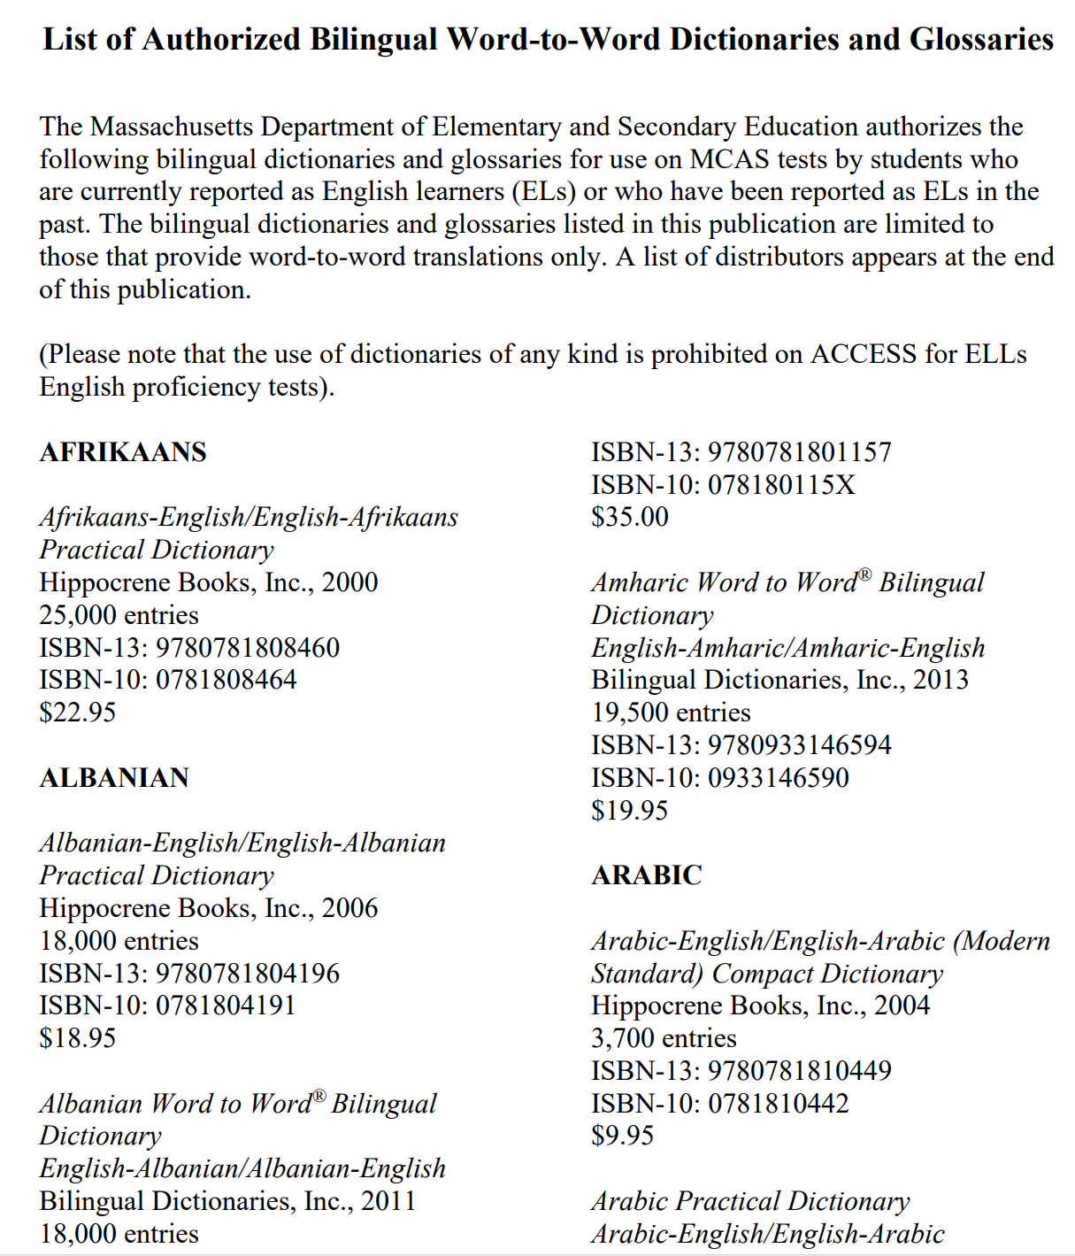
Bilingual Word-to-Word Glossary for NGSS
2) Bilingual Dictionaries and Glossaries Authorized for Use by English Learners on the 2021 MCAS Tests
This resource provides examples of word-to-word glossaries allowed on the NGSS.
Dictionaries are not permitted.
Test administrator should locate language appropriate glossary prior to testing.
Materials are not secure, but they should be safely stored by the teacher if testing over multiple days.
Student may need additional test time.
For the purposes of statewide testing, this resource can only be used on the NGSS.
Notes:
Bilingual Word-to-Word Glossary for NGSS
The second resource permitted for use on the NGSS is the Bilingual Dictionaries and Glossaries Authorized for Use by English Language Learners. This resource provides examples of word-to-word glossaries allowed on the NGSS. If your student’s native language is not represented on this list, refer to the NYS Statewide Language Regional Bilingual Education Resource Network: Bilingual Glossaries and Cognates (https://steinhardt.nyu.edu/metrocenter/language-rbern/resources/bilingual-glossaries-and-cognates) for availability.
Please note the following reminders:
Dictionaries are not permitted on Connecticut’s standardized tests. Only word-to-word translations are available to ELs/MLs on the NGSS Assessment.
• These materials are not secure, but they should be safely stored by the teacher if the student is testing over multiple days.
• The use of this support may result in the student needing additional overall time to complete the assessment.
• This resource is used with permission of the Massachusetts Department of Elementary and Secondary Education. Inclusion does not constitute endorsement of this paper or any other commercial publication.
• For the purposes of statewide testing, this resource can only be used on the NGSS. It is not permitted for use on Smarter Balanced Assessments.

Slide 24
7. Embedded Spanish Presentation for Math and Science
Notes:
7. Embedded Spanish Presentation for Math and Science
Spanish presentation will allow the literate Spanish-speaking student to toggle between a full Spanish translation of the math and science passages and item and the English version of them.
By default, all test directions, navigation buttons, and test content will be presented to the student in the Spanish language.
For students whose primary language is not English and who use dual language supports in the classroom, the use of this designated support (dual language) translation may be appropriate.
This support should only be used for students who are proficient readers in Spanish and who are not proficient in English.
The use of this support may result in the student needing additional overall time to complete the assessment and may increase reading and cognitive load.
Unless the student also has an IEP or Section 504 Plan, this designated support must be batch uploaded or manually entered in the Embedded Accommodation section of the student’s test settings in TIDE within the Presentation (Designated Supports and Accommodations) tab for Math and/or Science. Select Spanish toggle. Districts may also select this support in TIDE using a batch upload. Refer to your DA for Testing for details related to local procedures.

Slide 25
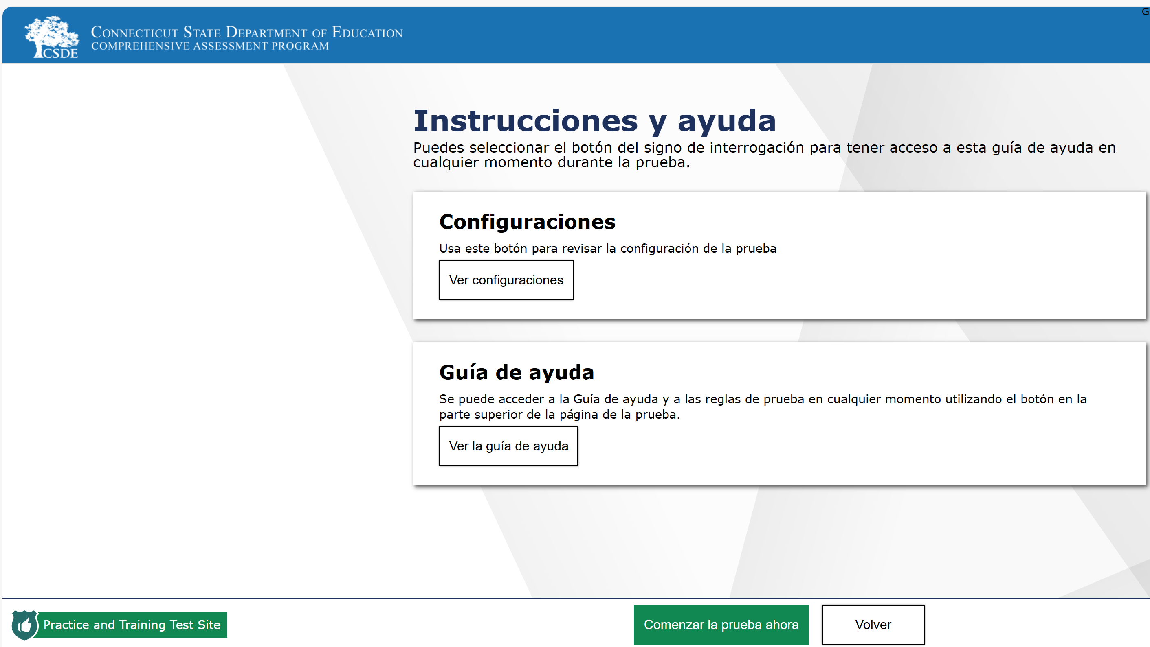
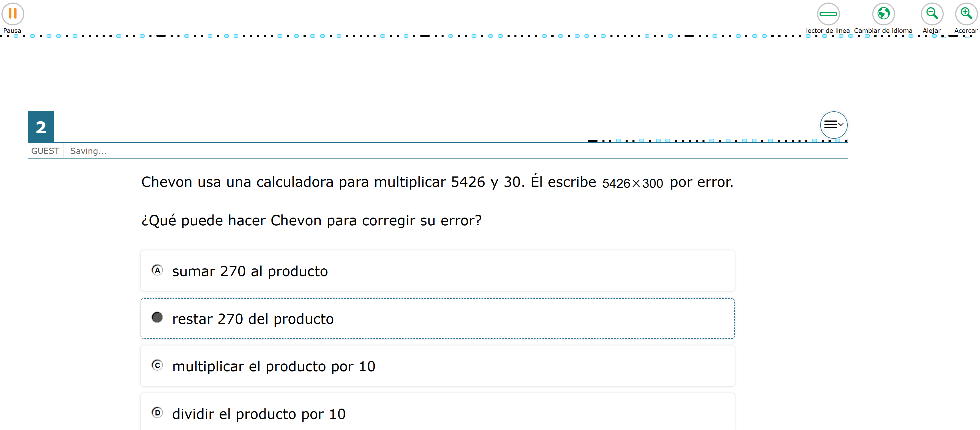

Embedded Spanish Presentation for Math and Science
Spanish presentation will allow the literate Spanish-speaking student to toggle between a full Spanish translation of the math and science stimuli and items and the English presentation.
All test directions, navigation buttons, and test content will be presented to the student in the Spanish language (shown to the right).
To toggle from Spanish to English presentation, students will select the globe icon
located at the top of their test screen.
Notes:
Embedded Spanish Presentation for Math and Science
This Spanish presentation will allow the literate Spanish-speaking student to toggle between a full Spanish translation of the item and the English version of the passages and items.
By default, all test directions, navigation buttons, and test content will be presented to the student in the Spanish language.
For students whose primary language is not English and who use dual Spanish language supports in the classroom, the use of this designated support (dual language) translation may be appropriate.
This support should only be used for students who are proficient readers in Spanish and who are not proficient in English.
The use of this support may result in the student needing additional overall time to complete the assessment and may increase reading and cognitive load.

Slide 26
8. Embedded Text-to-Speech Options for ELA, Math, and Science
Notes:
8. Embedded Text-to-Speech Options for ELA, Math, and Science

Slide 27

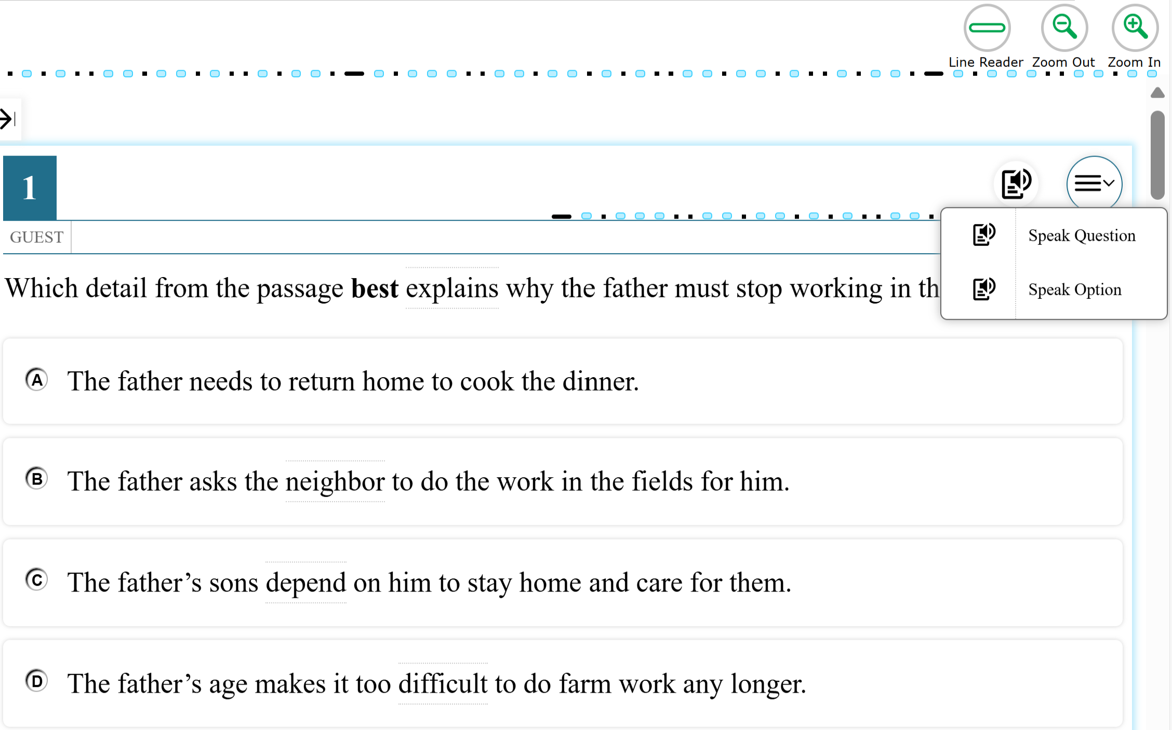
Embedded Text-to Speech Options for ELA, Math, and Science
TTS reads questions, responses, and certain places in the stimuli/item by placing the mouse​ in front of the text and right-clicking. Choose “Start Speaking from Here.”
Text-to-speech (TTS) in English is available for ELA items (not reading passages) and math/science stimuli and items by selecting the speaker icon .
  Verify that TTS for items is documented for ELA in TIDE.
  Verify that TTS of stimuli & items is documented for math and science in TIDE.
These supports must be documented in TIDE prior to testing. They will not work if they are activated after a student begins their test.
Notes:
Embedded Text-to Speech Options for ELA, Math, and Science
Text-to-speech (TTS) is available in English for students who benefit and use it during instruction. TTS is available for ELA items (not reading passages) and math/science stimuli and items.
Verify that TTS for items is documented for ELA.
Verify that TTS of stimuli & items is documented for math and science.
These supports must be documented in TIDE prior to testing. They will not work if they are activated after a student begins their test.

Slide 28
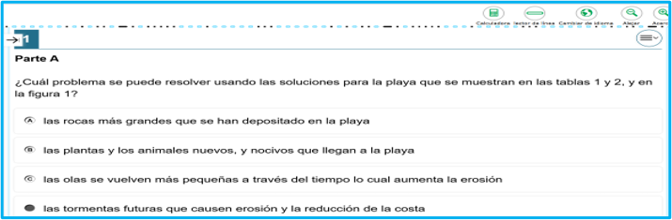
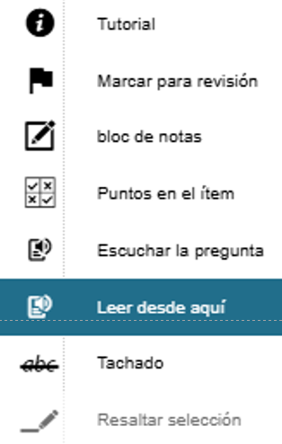
Text-to Speech in Spanish for Math and Science
TTS reads questions, responses, and certain places in the stimuli/item by placing the mouse​ in front of the text and right-clicking. Choose “Start Speaking from Here.”
TTS is available in Spanish for the math and science stimuli and items by selecting .
  Work with your technology department to download the applicable Spanish voice pack to the student's testing device.
  Verify that TTS of stimuli & items is documented for math and science in TIDE.
  Verify that Spanish Toggle is documented for math and science in TIDE.
These supports must be documented in TIDE prior to testing. They will not work if they are activated after a student begins their test.
Notes:
Text-to Speech in Spanish for Math and Science
TTS is available in Spanish on the math and science assessments for students who are fluent in Spanish who also use and benefit from text-to-speech during instruction.
Work with your tech department to download the applicable Spanish voice pack to the student's testing device.
Verify that TTS of stimuli & items is documented for math and science.
Verify that Spanish Toggle is documented for math and science.
TTS reads questions, responses, and certain places in the stimuli/item by placing the mouse​ in front of the text and right-clicking. Choose “Start Speaking from Here.”
TTS and Spanish presentation (Spanish Toggle) must be documented in TIDE prior to testing. These supports will not work if they are activated after a student begins their test.

Slide 29
9. Non-Embedded Read Aloud Options for ELA, Math, and Science
Notes:
9. Non-Embedded Read Aloud Options for ELA, Math, and Science

Slide 30
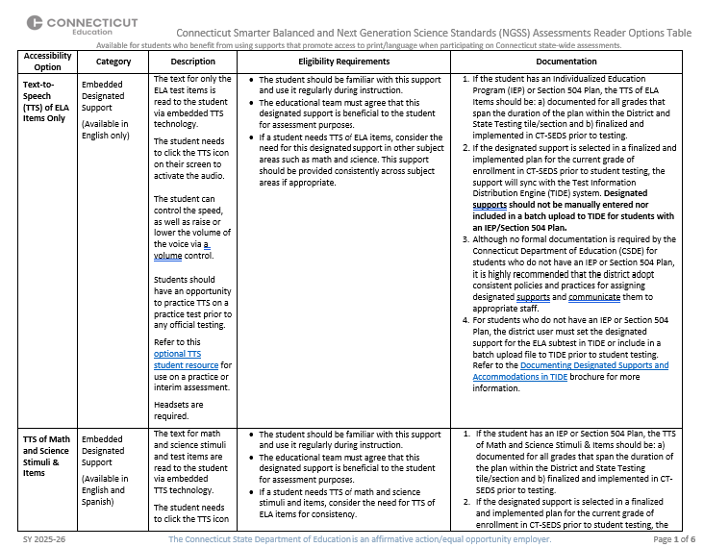
Non-Embedded Read Aloud Options for ELA, Math, and Science
A read aloud in English is available for ELA items (not reading passages) and math/science stimuli and items.
  The reader must review the Smarter Balanced Read Aloud Guidelines, and complete the Security/Confidentiality Agreement (Appendixes B and C).
A read aloud is available in Spanish for the math and science stimuli and items if the school can provide a certified teacher who is literate and fluent in Spanish and is trained in test administration.
  The reader must review the Smarter Balanced Mathematics and Next Generation Science Standards (NGSS) Assessments: Guidelines for Spanish Read Aloud of Stimuli and Items.
Notes:
Non-Embedded Read Aloud Options for ELA, Math, and Science
A read aloud in English is available for ELA items (not reading passages) and math/science stimuli and items.
The reader must review the Smarter Balanced Read Aloud Guidelines, and complete the Security/Confidentiality Agreement (Appendixes B and C).
A read aloud is available in Spanish for the math and science stimuli and items if the school can provide a certified teacher who is literate and fluent in Spanish and is trained in test administration.
The reader must review the Smarter Balanced Mathematics and Next Generation Science Standards (NGSS) Assessments: Guidelines for Spanish Read Aloud of Stimuli and Items.
This is the link to the Smarter Balanced and NGSS Reader Options Table:
Connecticut Smarter Balanced and NGSS Assessments Reader Options Table

Slide 31
10. Separate Setting
Notes:
10. Separate Setting

Slide 32
Separate Setting
Students may test in flexible groupings based on need. For example, students who are easily distracted, or who may distract others in environments .
The separate setting may be in a different room that allows students to work individually or among a smaller group, or in the same room, but in a specific location (for example, away from windows, doors, or pencil sharpeners, in a study carrel, with a whisper phone, near the teacher’s desk, or in the front of a classroom).
Some language supports require students to be assessed individually. These students would also require a separate setting. Examples include students accessing the Read Aloud designated support or Simplified Test Directions.
If Separate Setting is documented in an IEP/Section 504 Plan, refer to details in the plan that specify the type of setting needed.
Notes:
Separate Setting
Students who are easily distracted, or who may distract others in environments such as group testing, may need an alternate location to be able to take the assessment. The separate setting may be in a different room that allows them to work individually or among a smaller group, or in the same room, but in a specific location (for example, away from windows, doors, or pencil sharpeners, in a study carrel, with a whisper phone, near the teacher’s desk, or in the front of a classroom). Some students may benefit from being in an environment that allows for movement, such as being able to walk around. In some instances, students may need to interact with instructional or test content outside of school, such as in a hospital or their home. A specific adult, employed by the school and trained in a manner consistent with the interim/summative Test Administration Manual, including security procedures, may act as test proctor (test administrator) for the student. Some designated supports or accommodations require students to be assessed individually. These students would also require a separate setting. Examples include students accessing the Read Aloud designated support or accommodation, talking calculator, or scribe/speech-to-text.
If Separate Setting is documented in an IEP/Section 504 Plan, refer to details in the plan that specify the type of setting needed.

Slide 33
Resources
Notes:
Resources

Slide 34
Resources
Resource | URL | Description
Best Practices for Determining Accommodations for Statewide Assessments | https://portal.ct.gov/-/media/sde/student-assessment/special-populations/ct-seds_dec12_office-hours-masterpptx.pdf Recorded Training: https://www.youtube.com/watch?v=NKJrZ-oNquY | Using a strength-based approach and through the implementation of the principles of universal design, this training identifies how accessibility features can promote access to instruction and assessments for all students based on their unique learning profiles.
CSDE Assessment Guidelines | https://ct.portal.cambiumast.com/resource-item/en/csde-assessment-guidelines | This document is intended to provide guidance for Connecticut school district personnel who must make decisions about testing special student populations for Connecticut Summative Assessments.
Notes:
Resources
Best Practices for Determining Accommodations for Statewide Assessments - Using a strength-based approach and through the implementation of the principles of universal design, this training identifies how accessibility features can promote access to instruction and assessments for all students based on their unique learning profiles.
CSDE Assessment Guidelines - This document is intended to provide guidance for Connecticut school district personnel who must make decisions about testing special student populations for Connecticut Summative Assessments.

Slide 35
Resources-Continued
Resource | URL | Description
Accessibility Considerations | https://ct.portal.cambiumast.com/resource-item/en/accessibility-considerations | This resource addresses accessibility needs for statewide assessments, including accessibility tools that can be incorporated in the instructional setting to promote student access and independence in the classroom, when completing assignments, and for school assessments.
CCSSO Questions to Ask When Selecting Accessibility Supports | https://portal.ct.gov/-/media/sde/student-assessment/special-populations/ccsso_educator-team-accessibility-supports-implementation-and-followup-questionnaires_master.pdf?rev=9c69a7534709410c9b40ed411e8090c4&hash=84026AD06AF4C13E5994BDA2984940A3 | This resource provides questions that can be used by local educator teams to guide the initial selection of appropriate accessibility supports and to revisit the usefulness of current supports.
Notes:
Resources
Accessibility Considerations - This resource addresses accessibility needs for statewide assessments, including accessibility tools that can be incorporated in the instructional setting to promote student access and independence in the classroom, when completing assignments, and for school assessments.
CCSSO Questions to Ask When Selecting Accessibility Supports - This resource provides questions that can be used by local educator teams to guide the initial selection of appropriate accessibility supports and to revisit the usefulness of current supports.

Slide 36
CSDE Performance Office
Special Populations Contact Information
Abe Krisst Bureau Chief Connecticut Education – Performance Office Direct Line: 860-713-6894 Mobile Phone: 860-690-0650 Email: Abe.Krisst@ct.gov
Deirdre Ducharme Education Consultant Performance Office - Special Populations Direct Line: 860-713-6859 Email: Deirdre.Ducharme@ct.gov
Katie Seifert Associate Education Consultant Performance Office - Special Populations Direct Line: 860-713-6722 Email: Katherine.Seifert@ct.gov
Notes:
CSDE Performance Office Special Populations Contact Information:
Here is our contact information. Please reach out with any questions as we are here to support you and your teams.
Abe Krisst, Bureau Chief, Connecticut Education – Performance Office; Direct Line: 860-713-6894; Mobile Phone: 860-690-0650; Email: Abe.Krisst@ct.gov
Deirdre Ducharme Education Consultant, Performance Office - Special Populations, Direct Line: 860-713-6859, Email: Deirdre.Ducharme@ct.gov
Katie Seifert, Associate Education Consultant, Performance Office - Special Populations, Direct Line: 860-713-6722, Email: Katherine.Seifert@ct.gov

Slide 37
Thank you!!!!
Connecticut State Department of Education
Notes:
Thank you for attending and for all you do for your students.

