Slide 1

District Administrator’s
2023 Test Administration Workshop
Smarter Balanced, NGSS, CTAA,CTAS, and the Collaborative for the Alternate Assessment of English Language Proficiency (CAAELP)
January 18 and 20, 2023
Notes:
Welcome to the 2023 DA Administrator’s Workshops.

Slide 2

Notes:
How does all this work happen?
This is our Performance Office Team. Our office mission is to improve student outcomes through the use of data and technology.

Slide 3
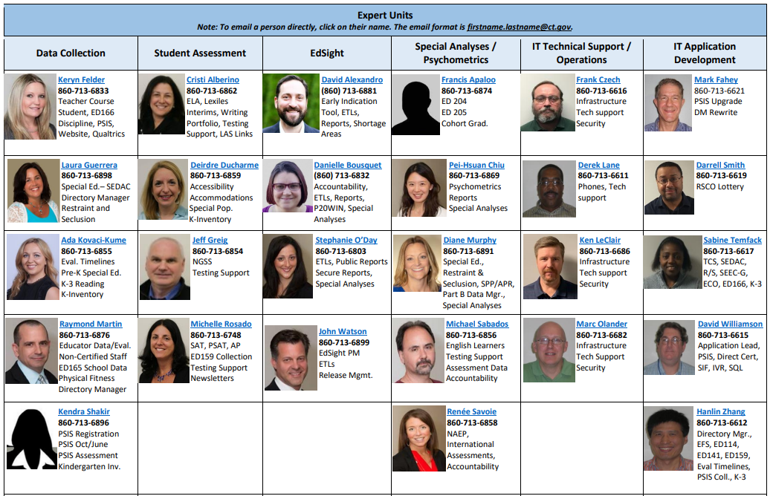
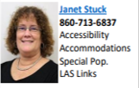
Notes:
This slide includes our Assessment Team, but also our EdSight team, Data Collections team, Psychometrics team, IT Operations, and IT Development.

Slide 4
Connecticut State Department of Education-
Performance Office
  Cambium Project Team
  Jen Chou, Program Director
Marie Musumeci, Program Coordinator

Slide 5

Presentation Overview
Overview of Summative Assessments for Spring 2023
Cambium System Overview
Special Populations Update

Slide 6
Connecticut State Department of Education-
Performance Office
Who | When | How
CSDE Performance Office | State Policy Test Administration Questions Reporting of Security Breaches Only | 860-713-6860 ctstudentassessment@ct.gov
Connecticut Help Desk - Cambium Assessment | Test Administration Procedures Questions Technology Questions | 844-202-7583 cthelpdesk@cambiumassessment.com

Slide 7

What remains the same in 2023?
TIDE System
Office Hours
Importance of maintaining data in PSIS Registration
Ordering of paper materials in TIDE (Braille and Large Print)
Rolling Results
Test Delivery System
Test Administration Procedures
The Tests
Notes:
What remains the same this year?
TIDE is still being provisioned as the student management system. Uploads will come from PSIS every night like in the past.
We will be doing Office Hours again. We will be doing them every Thursday at 3pm beginning on March 30 and running through the end of testing. Links are in the Student Assessment News. We will be sending out a calendar invite to all DAs so they will appear on your calendars sometime in March.
We will be taking data nightly from PSIS registration. It is very important that this is maintained locally and updated by your PSIS Coordinator as appropriate. If you are a coordinator and have not connected with your PSIS district person, we recommend to do that ASAP.
You will be ordering paper materials in TIDE still for Braille and Large Print. Users can begin to order on January 27.
Rolling release of results are back. Generally, 10 days after testing has been completed, you will have access to results in the CRS. This will hopefully begin a little earlier this year relative to last year when we did not open things until Mid May.
The Test Delivery System remains the same. The components that have been successfully implemented over the last few years are back.
The tests remain the same except for one detail in the next slide. Smarter and the Alternate Assessments are the same.

Slide 8
What remains the same in 2023?
Who needs to be tested? All students including:
    Students in Private Approved Facilities
    Students in PSIS who attend Out-of-State Facilities or In-State Non-Approved Facilities
    Students with disabilities and/or English learners
Notes:
Who needs to be tested? All students including:
Students in Private Approved Facilities
Students in PSIS who attend Out-of-State Facilities or In-State Non-Approved Facilities
Students with disabilities and/or English learners

Slide 9

What’s new in 2023?
Integration of CT-SEDS
Collaborative for the Alternate Assessment of English Language Proficiency (CAAELP) Assessment
Accountability Calculations are Back
New Early Stopping Rule (ESR) Process
Teacher Training Slide Deck
New Manuals
Science Computer Adaptive Test (CAT) Test
Secure Brower
Notes:
What is new this year?
The integration of CT SEDS with the TIDE System is a big advance this year. More information on this transition is in forthcoming slides. The plan is that in the future, all data from CT SEDS is pushed over to TIDE but for this year, there is somewhat of a segmented approach only allowing for transfer of finalized IEP and 504 plans.
We have a new assessment, the CAAELP. This is an ELP ALT test that is administered in the Cambium environment. More information on this transition is also coming in forthcoming slides. This testing window is from February 1 to March 31. Normally, we have not intermingled ELP testing with this workshop but since we are using the Cambium systems to deliver this, it is why we are looping you also into this. You will be working with your ELAC, English Language Assessment Coordinator, to administer this.
Accountability reporting is back 100 percent.
The ESR is a new streamlined and more efficient process. There has been information distributed in the student assessment news as well as previous communication. More information on the effort is in this slide deck.
We have a new Teacher Training Slide Deck. This has been requested for many years. This will be sent to you in the next week or so.
We have new Test Administrator manuals for Smarter, Science and CTAA and Test Coordinator Manuals. Hard copies will be delivered by the end of this month.
The Science test is now a full CAT and not a Linear on the Fly (LOFT) test design anymore. The new CAT will improve the efficiency of testing. The tests will still be equivalent across years, but the testing will now just be a CAT.
There is a new secure browser as has always been the case every school year. Cambium will address the details of the browser in their forthcoming section.

Slide 10

State Policy Regarding Participation

Slide 11
Participation - Connecticut General Statutes 10-14n
    (b) (1) For the school year commencing July 1, 2015, and each school year thereafter, each student enrolled in grades three to eight, inclusive, and grade eleven in any public school shall, annually, take a mastery examination in reading, writing and mathematics during the regular school day.
    (3) For the school year commencing July 1, 2018, and each school year thereafter, each student enrolled in grades five, eight, and eleven in any public school shall annually take a state-wide mastery examination in science during the regular school day.
Notes:
This is the language that drives our summative testing for reading, writing, mathematics, and science.
These are the statutes if needed when communicating with parents/guardians or other educators; this may be helpful to use in the district.

Slide 12
2022-23 Assessment Office Hours*
Date | Topics
Every Thursday from March 30 to June 1 at 3 p.m. | Smarter, NGSS, CTAS and CTAA Topics
*NOTE: There are additional Office Hours for LAS Links and Connecticut SAT School Day. Visit the Student Assessment Training webpage to view recorded sessions and PowerPoints.

Slide 13
2023 Testing Calendar
State Assessment | Grade(s) | Testing Window | Delivery Method
CAAELP | K - 12 | February 1 – March 31, 2023 | Online
Smarter Balanced ELA & Math | 3 – 8 | March 27 – June 2, 2023 | Online
Connecticut Alternate Assessment (CTAA) | 3 – 8 and 11 | March 27 – June 2, 2023 | Online
NGSS Assessments | 11 | February 6 – June 2, 2023 | Online
 | 5 and 8 | March 27 – June 2, 2023 | Online
Connecticut Alternate Science Assessment (CTAS) | 5, 8, and 11 | Test should be administered throughout the school year. Student ratings entered in the DEI: March 27 – June 2, 2023 | Online Upload March 27 – June 2, 2023
Connecticut SAT School Day | 11 | March 22-24 and March 28-29, 2023 Makeup Dates: April 25-27, 2023 | Online
Notes:
This is a snapshot of the spring 2023 test window for all statewide assessments.
Note that the CAAELP assessment runs also from February 1 to March 31.
The 2024 calendar was released in December for those of you that maybe planning for future years already.

Slide 14

TIDE/PSIS Data Sync

Slide 15
TIDE/PSIS Data Sync
District Administrators need to work with District PSIS Coordinators to ensure accurate student information is reported in the PSIS Registration Module and TIDE.
During the summative test window, changes made in PSIS Registration will automatically be updated in TIDE by the following day.
Notes:
District Administrators need to work with District PSIS Coordinators to ensure accurate student information is reported in the PSIS Registration Module and TIDE.
During the summative test window, changes made in PSIS Registration will automatically be updated in TIDE by the following day.
Please note that SAT TIDE is different.
Note that the IEP status is coming from PSIS Registration.

Slide 16
TIDE/PSIS Data Sync Facts
Testing Demographics SPED, FRL, EL, Military Family, and Homeless values were loaded in November 2022.
The values for Recently Arrived EL and Section 504 were not pulled from Freeze Zero. These must be set in the PSIS Registration Module.
Student demographic values will be saved, and the fields locked in PSIS on June 2, 2023. All changes to a student’s status at the time of testing must be made by June 2, 2023.
Students who are repeaters should be tested.
Student’s grade in PSIS is that grade in which the test is given.
Grade 11 "skippers" are not tested.
Notes:
Here are some critical facts for the TIDE/PSIS Sync.

Slide 17
TIDE/PSIS Data Sync
Student Status Change*
Status | If student has already taken any state assessment | If student has not already taken any state assessment
If SPED/EL/FRL was YES originally and then changed | Leave status as YES for all tests | Change status to NO for all tests
If SPED/EL/FRL was NO originally and then changed | Change to YES for all subsequent tests and the CSDE will apply this status for all tests | Change status to YES
*Making these changes may impact the student eligibility for designated supports and accommodations.
Notes:
This will address the way students need to be changed in PSIS if there are status changes during the test window.

Slide 18
TIDE
Designated Supports and Accommodations
Prior to testing, ensure that all embedded (and non-embedded) designated supports and accommodations are entered/uploaded into TIDE. Refer to the Accessibility Chart for the list.
If applicable, work with school staff and eligible students to practice using the embedded accommodations, such as speech-to-text, text-to-speech, or math translation glossaries.
Contact the CSDE if you have a student that requires the use of a special documented accommodation (i.e., use of a scribe or human reader). Petitions are due by March 1.
Refer to the Assessment Guidelines and the Connecticut Comprehensive Assessment Program Portal for additional resources.
Notes:
Prior to testing, ensure that all embedded (and non-embedded) designated supports and accommodations are entered/uploaded into TIDE. Refer to the Accessibility Chart for the list.
If applicable, work with school staff and eligible students to practice using the embedded accommodations, such as speech-to-text, text-to-speech, or math translation glossaries.
Contact the CSDE if you have a student that requires the use of a special documented accommodation (i.e., use of a scribe or human reader). Petitions are due by March 1.
Refer to the Assessment Guidelines and the Connecticut Comprehensive Assessment Program Portal for additional resources.

Slide 19
Uploading Student Supports to TIDE Using TIDE’s Excel or CSV Files
The 2022-23 TIDE test setting templates are available in Excel and Comma-Separated Value formats.
Refer to the TIDE User Guide for information on how to upload or manually enter designated supports and accommodations.
The “IDEA” or “504” indicator must be set to “Yes” in the PSIS Registration Module before accommodations can be uploaded, saved, or accepted in TIDE.
Notes:
The 2022-23 TIDE test-setting templates are available in Excel and Comma-Separated Value formats. You can use the template to populate designated supports for students, including multilingual learners, and accommodations for students per their Individualized Education Programs (IEPs) and 504 Plans.
Refer to the TIDE User Guide for information on how to upload or manually enter designated supports and accommodations.
A super critical piece of info is that the “IDEA” or “504” indicator must be set to “Yes” in the PSIS Registration Module before accommodations can be uploaded, saved, or accepted in TIDE.

Slide 20
CT-SEDS
&
TIDE
Designated supports and accommodations listed in a finalized IEP/504 in CT-SEDS will sync with TIDE prior to the March testing window.
Any changes made to a student’s accommodation in CT-SEDS will be reflected in TIDE during the nightly sync.
Manual adjustments should not be made in TIDE for students with finalized IEPs/504 Plans in CT-SEDS. Instead, PPTs must make the edit(s) directly in CT-SEDS.
Notes:
Designated supports and accommodations listed in a finalized IEP/504 in CT-SEDS will sync with TIDE prior to the March testing window. CSDE will communicate with districts when this sync occurs. This sync will NOT be the case for College Board TIDE.
Any changes made to a student’s accommodation in CT-SEDS will be reflected in TIDE during the nightly sync.
Manual adjustments should not be made in TIDE for students with finalized IEPs/504 Plans in CT-SEDS. Instead, PPTs must make the edit(s) directly in CT-SEDS.

Slide 21
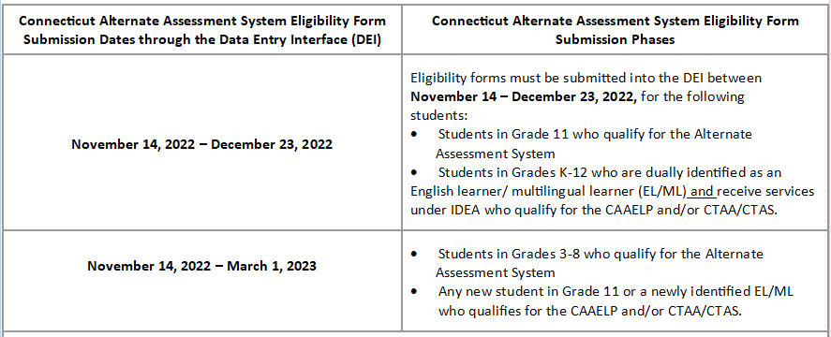
Connecticut Alternate Assessment System Eligibility Form Submission Deadlines

Slide 22
Activation of the Alternate Flag Indicator for Alternate Assessments
Alt Flag Indicators are activated weekly by Cambium as forms are submitted using the Data Entry Interface through March 1.
If forms are submitted after this date, TEAs will need to notify their District Administrator, who will contact the Connecticut Help Desk to request the activation of the Alt Flag Indicator.
1.844.202.7583
cthelpdesk@cambiumassessment.com

Slide 23

Questions

Slide 24

Test Security
Notes:
These protocols remain essentially the same. However, we would like to repeat them to reemphasize test security policies, especially for new District Administrators and/or staff.

Slide 25
Test Security
Breaches of test security include, but are not limited to:
  analyzing/copying test items
  coaching students
  giving students answers, and/or changing students’ answers
  allowing students access to digital, electronic, or manual devices (except approved accommodations)
  unauthorized log-in to the Test Delivery System
  Cell phone (including Smart Watches) use by students is prohibited!
Notes:
Breaches of test security include, but are not limited to:
analyzing/copying test items
coaching students
giving students answers, and/or changing students’ answers
allowing students access to digital, electronic, or manual devices (except approved accommodations)
unauthorized log-in to the Test Delivery System
This list is not comprehensive, but this represents most issues when it comes to issues in test security.
Please note that cell phone (including Smart Watches) use by students is prohibited!

Slide 26
Test Security and Proctoring
Violation of test security is a serious matter with far-reaching consequences. Breaches of test security include, but are not limited to, copying or photographing of test materials, failing to return test materials, coaching students, giving students answers, and/or changing students’ answers. Such acts may lead to the invalidation of an entire school district’s student test scores, disruption of the test system statewide, and legal action against the individual(s) committing the breach. A breach of test security may be dealt with as a violation of the Code of Professional Responsibility for Teachers, as well as a violation of other pertinent state and federal law and regulation. The Connecticut State Department of Education will investigate all such matters and pursue appropriate follow-up action. Any person found to have intentionally breached the security of the test system may be subject to sanctions including, but not limited to, disciplinary action by a local board of education, the revocation of Connecticut teaching certification by the State Board of Education,* and civil liability pursuant to federal copyright law.
*See Section 10-145b(i) (2) (E) of the Connecticut General Statutes, which reads in relevant part as follows: The State Board of Education may revoke any certificate, permit, or authorization issued pursuant to said sections if the holder is found to have intentionally disclosed specific questions or answers to students, or otherwise improperly breached the security of any administration of a mastery examination, pursuant to section 10-14n.
Notes:
We include this language that is in the TAM, and it outlines the seriousness of testing and test security.
This is a reminder of the importance of test security and proctoring.
Please pass this important message onto your colleagues in district.

Slide 27
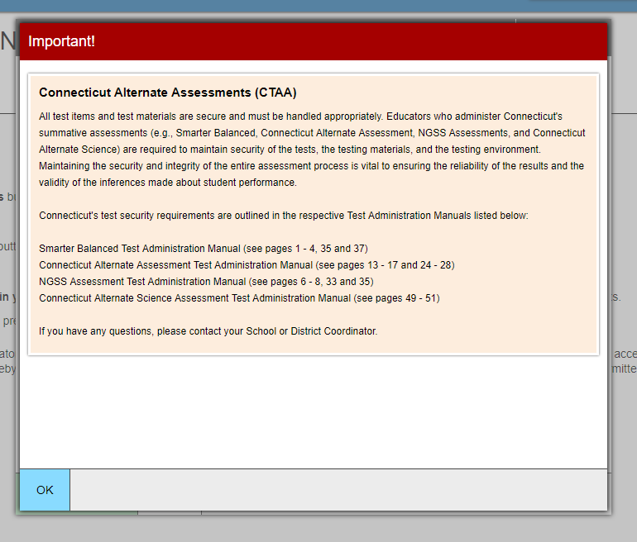
TA Security Confirmation Page
Notes:
We have this is a confirmation screen at the beginning of each TA login that assures that TAs have been made aware of the security measures in the TAM. This will again appear this year and TAs will have to select OK to advance and begin creating test sessions. This protocol is not new as we have been doing it for several years. It is critical that all school proctors/test administrators are trained locally and use the Test Administration Manuals carefully when planning and administering tests.

Slide 28

Improprieties, Irregularities, and
Breaches
Notes:
Now we will cover briefly the three levels of security issues. The three levels of issues that may occur during testing.
Improprieties
Irregularities
Breaches

Slide 29
Test Security Definitions
Type | Definition
Breach | A test security incident that poses a threat to the validity of the test. Examples may include the release of secure materials or a security/system risk. These circumstances have external implications and may result in a decision to remove the test item(s) from the available, secure item bank.
Irregularity | A test security incident that impacts an individual or group of students who are testing and may potentially affect student performance on the test, test security, or test validity.
Impropriety | A test security incident that has a low impact on the individual or group of students who are testing and has a low risk of potentially affecting student performance on the test, test security, or test validity. These circumstances can be corrected and contained at the local level.

Slide 30
Test Security Actions
Impropriety (low-level incident)
Corrected at the local level and/or entered in Appeals system if appropriate
Keep records locally
Breach (high-level incident)
Contact CSDE at 860-713-6860 or ctstudentassessment@ct.gov immediately.
Irregularity (medium-level incident)
File an appeal in the Appeals system by the end of the day of incident
Follow instructions in Appeals system
Keep records locally
Note: The Test Security Levels are described in Appendix G of the Test Coordinator’s Manual.

Slide 31
Appeal Types
Appeal Type | Description
Reset a Test | Removes the test and scores from the system Enables student to start a new test
Re-open a Test | Allows for a test that has already been submitted in error or has expired to be re-opened
Re-open a Test Segment | Re-opening a test segment allows a student to access the first segment of a test that was submitted in error
Grace Period Extension | Granted if a test session is unexpectedly interrupted Allows access to all previous responses
Restore a Test That Has Been Reset | Returns a test from the Reset status to its prior status Only allowed on tests that have been reset A test can be restored if it was reset in error
Invalidate a Test | Rarely Used Eliminates the test Student does not receive a score
Notes:
Appeal types are the same as last year.

Slide 32
Tips on Entering Appeals
Tip | What does that mean?
Enter Appeals Judiciously | Staff entering appeals should be trained. CSDE is reviewing every appeal closely and does not approve everything. Provide info if necessary, in the entry box.
Re-open or Grace Period Extension Should Only be Used When Needed | Students should not be allowed back into the test just to double check work if they already submitted their test. Students are encouraged to review items prior to ending their test.
When Unsure of What to do, Reach Out for Help | Contact the CSDE with any questions. ctstudentassessment@ct.gov; 860-713-6860; or email Cristi.Alberino@ct.gov

Slide 33
Appeals Process for an
Accommodation Issue
The DA must fax a signed letter to the CSDE on letterhead to Performance Office Irregularities at 860-713-7033.
The letter must include:
  The student’s grade, SASID, and the name of the test on which the irregularity occurred;
  The date and a detailed explanation of the irregularity;
  The name of the proctor;
  A description of the discussion with parents/guardians explaining the irregularity, and options offered; and
  Procedures to ensure the irregularity is not repeated.
Notes:
If you have an appeal for an accommodation issue, you will be asked to fax a signed letter to the CSDE on letterhead to Performance Office Irregularities at 860-713-7033.
Please help us and provide this back to us quickly.

Slide 34
Questions

Slide 35
CAI System

Slide 36
CT Comprehensive Assessment Program Portal
All CAI systems and resource materials can be accessed via the Connecticut Comprehensive Assessment Program Portal (https://ct.portal.cambiumast.com/).

Slide 37
Secure Browser Updates
The Secure Browser is designed to ensure test security by prohibiting students from accessing any other programs or websites during testing.
The 2022-23 Secure Browser was released in August 2022. Download the latest secure browser from the portal. The secure browser from 2021-22 will no longer work.
Students will be required to use the Secure Browser on their device to take the summative Smarter Balanced, NGSS, and all the CTAA assessments.

Slide 38
Chrome Update
CAI currently supports Chrome versions 102-108.
CAI provides presumptive support for new versions of Chrome as they are released, which means students are not prevented from taking tests on the newest versions. However, although CAI and Google work collaboratively on new versions, CAI does need to perform internal testing to make sure there are no issues. If issues are discovered we will resolve them, as quickly as possible.
Recommended: Lock down devices before the test administration window begins. This reduces the risk of any issues occurring during testing should a new version be released with unanticipated problems.
CAI no longer supports a device if Google stops supporting it. Monitor Google’s end-of-life policy here: https://support.google.com/chrome/a/answer/6220366?hl=en.

Slide 39
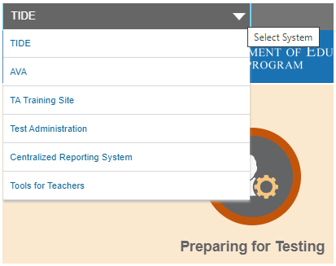
Accessing Systems
All user accounts were rolled over and passwords reset in August 2022.
If you log in on a new device or browser (or clear the cache on a previously-used browser) you must enter an emailed code after passing the initial login screen. This step does not occur when you activate your account.

Slide 40
Test Information Distribution Engine (TIDE) Updates
TIDE supports state, district, and school test coordinators throughout the testing process, from test preparation, to test administration, to post-administration.
Features include the following:
  Add/Manage User Accounts
  Review Student Demographic Information
  Review/Edit Student Settings
  Create/Submit Appeals
  Create Rosters
  Order Paper Materials
  Run Participation Reports

Slide 41
TIDE Updates
All students taking a summative assessment (Smarter Balanced, NGSS, CTAA, CTAS, and/or CAAELP) need to be in TIDE.
All users who are proctoring a summative assessment or need access to the DEI need to have an account in TIDE.

Slide 42
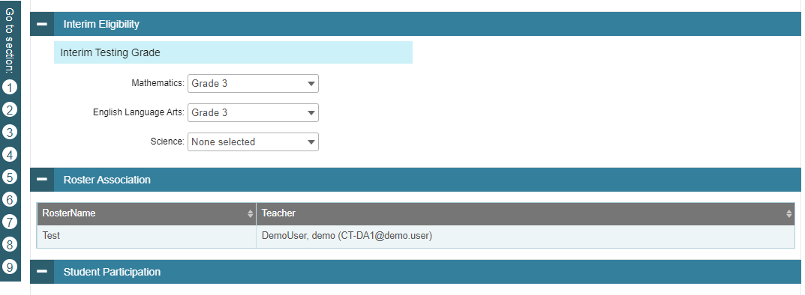
TIDE Updates: Student Roster Management
Student Roster Membership
New section on View Student Details page displays the rosters to which a student belongs. This will allow a teacher to easily verify a student is rostered correctly.

Slide 43
TIDE Participation Reports
Plan and Manage Testing
Test Status Code Report
Test Completion Rates
Test Session Status Report

Slide 44
TIDE: Participation Reports
(Test Status Code Report)
Specific report used to view each student’s test status and all special codes to explain a student’s non-participation in a test
Displays all test statuses for each test for which each student in a district/school is eligible
May be generated at the district level or at the school level, depending on your user role
Report should be generated for each test to obtain an accurate picture reflecting the testing status of all students for all tests in the school or district
Particularly useful for Summative Assessments

Slide 45
TIDE: Participation Reports
(Test Completion Rates)
High-level reports used to summarize the number and percentage of students who have started or completed a test
May be generated at the district or school level, depending on your user role
All students in the specified school or district will be included in this report
Report should be generated for each test to obtain an accurate picture that reflects the testing status of all students for all tests in the school or district
Users will be able to view test completion data by combo tests (example: completion of both the Math CAT and Math PT).

Slide 46
TIDE: TIDE Forms
TIDE forms:
  Supports securely collecting form/survey information from district and school users in support of test administration activities.
  Provides users an easy, intuitive interface to search and view form submissions

Slide 47
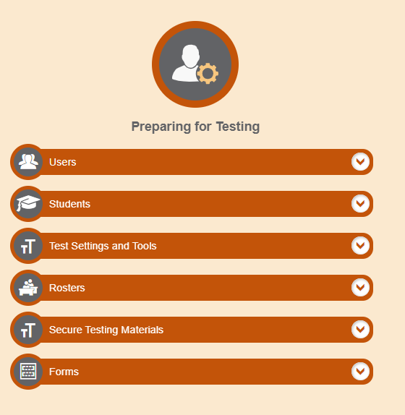
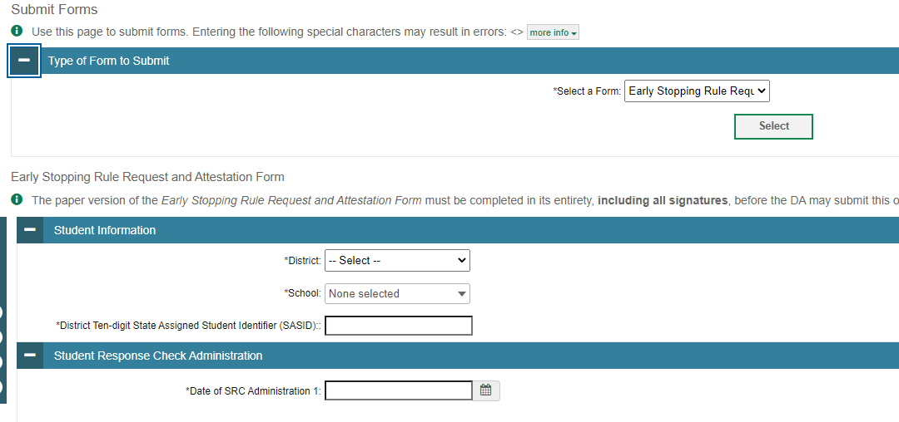
TIDE: TIDE Forms
TIDE forms are currently being used to collect information on the ESR and Domain Exemptions for CAAELP.

Slide 48
TDS Updates: Color Contrast Options
Three more color contrast options are now available:
  White on Red
  Red on White
  Yellow on Black

Slide 49
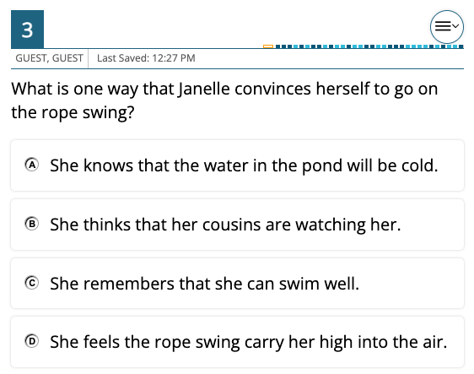
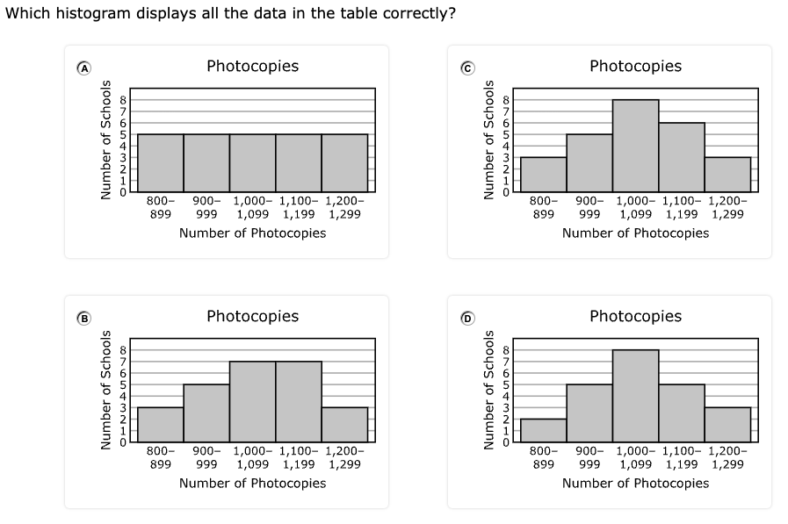
TDS Updates: Bounding Boxes
Bounding boxes around MC and MS response options were created to enhance content presentation for better readability and usability.

Slide 50
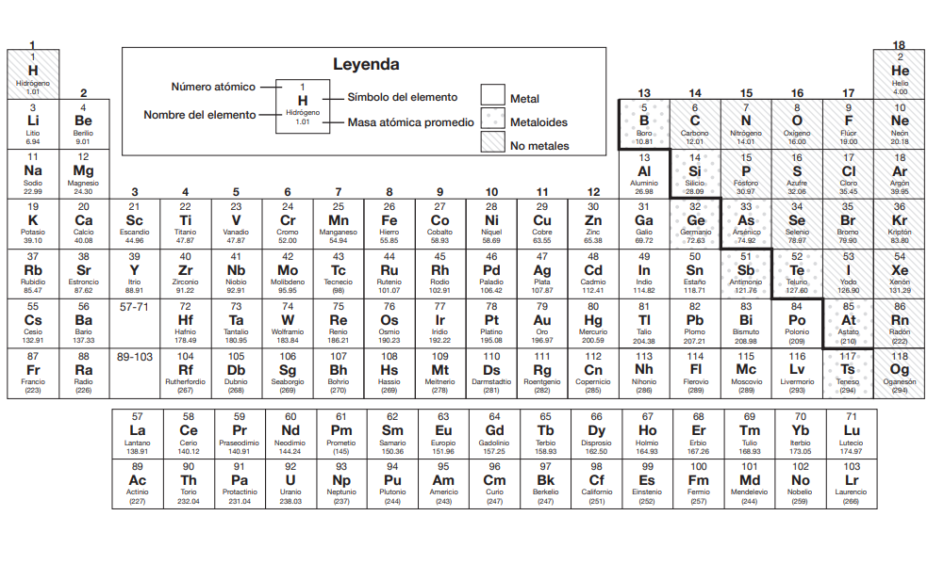
TDS Updates:
The periodic table for Science assessments will now also be available in Spanish.

Slide 51
Questions

Slide 52
Accessibility and Special Populations

Slide 53

Accessibility and Special Populations Overview
2023 Calendar for Special Considerations
Who is Eligible for Supports and Accommodations?
Accommodation Reminders
What’s New for 2022-23?
  CT-SEDS
  New Early Stopping Rule Process
  CAAELP
The Connecticut Alternate Assessment System (CTAA, CTAS, and CAAELP)
Questions

Slide 54
2023 Calendar for Special Considerations
 | Deadline | Delivery Method
Submission Deadline Alternate Assessment Eligibility Forms | March 1, 2023 | DEI
Designated Supports/Accommodations | November 14–June 3, 2023 *must be entered in TIDE prior to testing | TIDE
Early Stopping Rule | Student Response Check (SRC) by February 1, 2023, then DA in TIDE submits Connecticut Alternate Assessment System Early Stopping Rule Request and Attestation Form by March 1. | TIDE
Special Documented Accommodations | March 1, 2023 | DA Requests Petition from CSDE
Medical Exemptions | May 5, 2023 - Connecticut SAT School Day June 9, 2023 - Smarter Balanced, NGSS, Connecticut Alternate Assessments | DA Requests Application from CSDE
Notes:
Refer to the Assessment Guidelines for procedural and policy guidance.
https://ct.portal.cambiumast.com/-/media/project/client-portals/connecticut/pdf/2019/csde-assessment-guidelines.pdf

Slide 55

Who is Eligible for Supports and Accommodations?

Slide 56

Who is Eligible for
Universal Tools?
Universal Tools
accessibility features available to ALL students (e.g., digital notepad, line reader, highlighter)
provided digitally (embedded) through the Test Delivery System or provided by the test examiner as a non-embedded tool
to learn more, refer to the Smarter Balanced Blog Post: Five Built In Test Tools Students Should Know (and Use!)
Notes:
Who is eligible for universal tools?
Universal tools are
accessibility features available to ALL students (e.g., digital notepad, line reader, highlighter)
provided digitally (embedded) through the Test Delivery System or provided by the test examiner as a non-embedded tool
to learn more, refer to the Smarter Balanced Blog Post: Five Built In Test Tools Students Should Know (and Use!)
Familiarizing Students with Universal Test Tools Can Yield Confidence Boost
Smarter Balanced digitally-delivered assessments (interims, the summative test, and practice tests) include a wide array of embedded universal test tools. These are available to students as part of the technology platform. Students gain confidence with the testing software when they understand how to use these test tools and when they can be most useful. Using practice tests and/or administering interims, and coaching students on the built-in test tools are a great way to help them gain familiarity. Here’s the link to tips on using five of these universal test tools: https://smarterbalanced.org/five-built-in-test-tools-students-should-know-and-use/.

Slide 57

Who is Eligible for
Designated Supports?
Designated Supports
embedded accessibility features available to ANY student for whom the need has been indicated by an educator (or team of educators with parent/guardian and student) (e.g., streamline, text-to-speech of items, print size)
selected supports should be consistently used in the student’s instructional setting
non-embedded designated supports can be provided by the test examiner (e.g., read aloud of test items, simplified test directions)
must be activated in TIDE
provide opportunities for students to practice using tools and designated supports using Practice Tests
Notes:
Who is eligible for designated supports?
Designated Supports are
embedded accessibility features available to ANY student for whom the need has been indicated by an educator (or team of educators with parent/guardian and student) (e.g., streamline, text-to-speech of items, print size)
selected supports should be consistently used in the student’s instructional setting
non-embedded designated supports can be provided by the test examiner (e.g., read aloud of test items, simplified test directions)
must be activated in TIDE
provide opportunities for students to practice using tools and designated supports using Practice Tests

Slide 58

Who is Eligible for Test Accommodations?
Accommodations
available for students with an active Individualized Education Program (IEP) or a Section 504 Plan
IEP/504 Plan must specify which accommodations will be used during testing (refer to the IEP), and should generally reflect similar accommodations required for instruction
embedded accommodations are provided through the Test Delivery System (e.g., text-to-speech of ELA Reading Passages, closed captioning)
non-embedded allowable accommodations are provided by the test examiner (e.g., 100 Numbers Table, Large Print Test booklet)
must be activated in TIDE
Notes:
Who is eligible for test accommodations?

Slide 59


Accommodation Eligibility
Eligibility for any embedded or non-embedded accommodation requires the IDEA Indicator or Section 504 Plan field (based on the PSIS registration fields) set to Yes. Without this indication, accommodations cannot be set in TIDE.

Slide 60
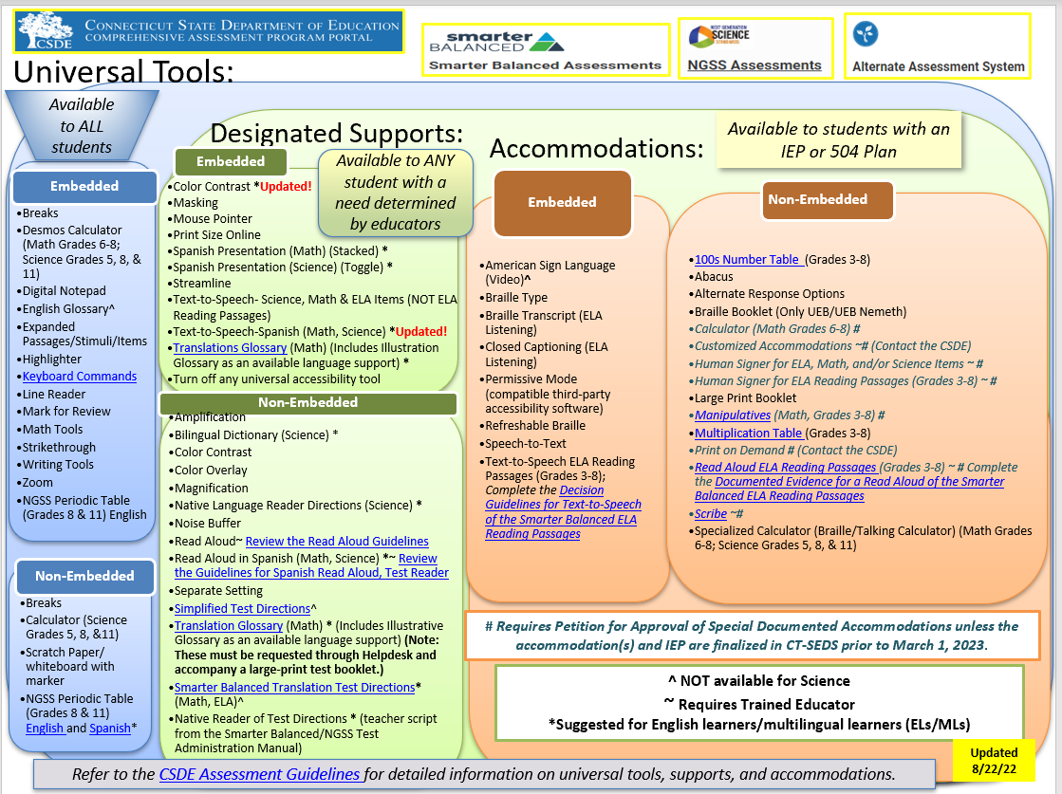

Notes:
The Accessibility Chart identifies the range of universal tools, designated supports, and accommodations available students when accessing the Smarter Balanced and the NGSS Science Assessments.
Accessibility Chart (cambiumast.com)

Slide 61
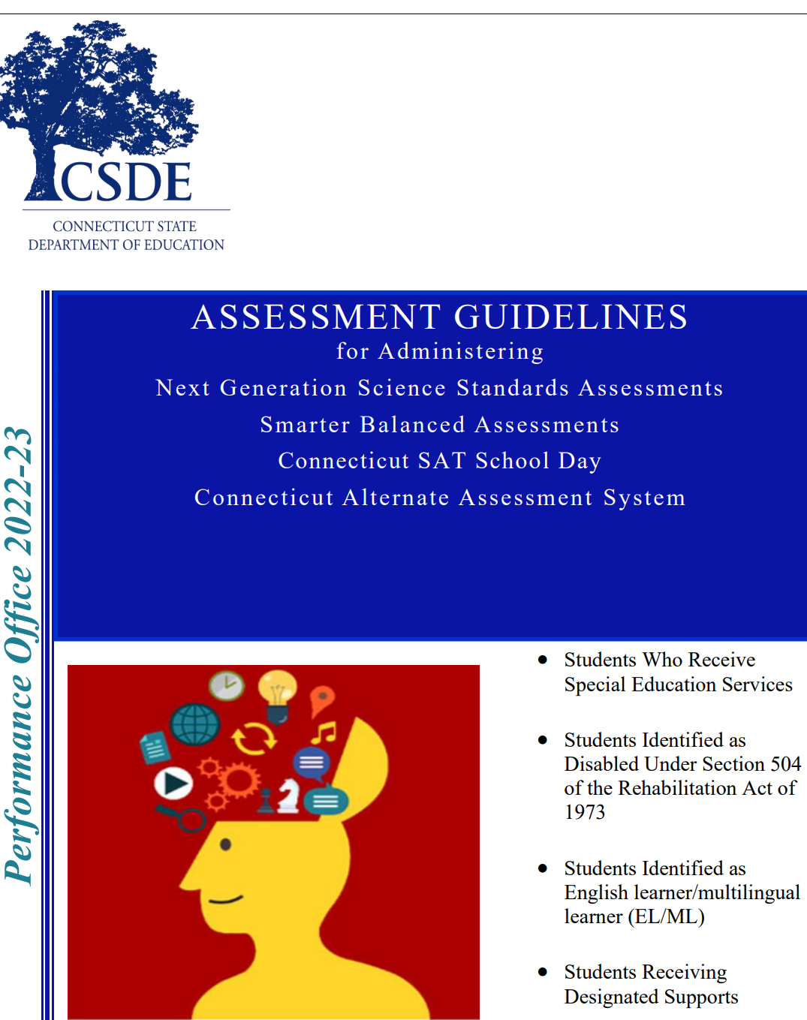
CSDE Assessment Guidelines
The CSDE Assessment Guidelines include detailed information related to accessibility supports and accommodations on statewide assessments.
They provide guidance related to special circumstances such as medical exemptions and requests for non-standard special documented accommodations.

Slide 62
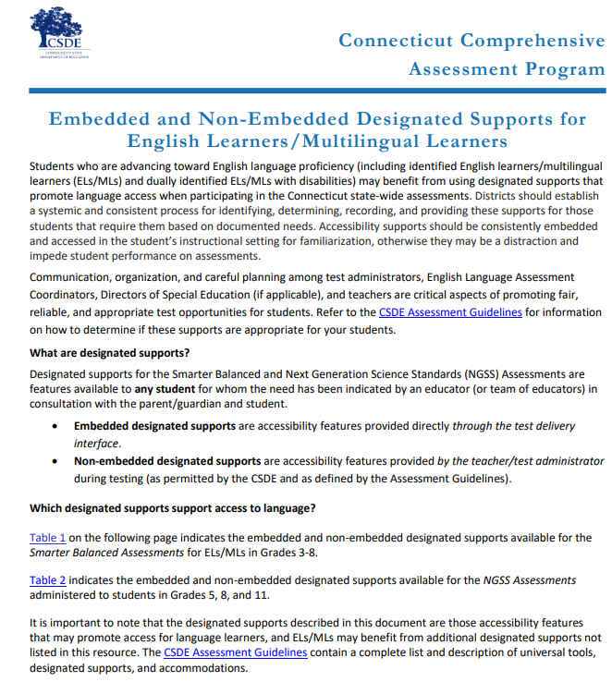
EL/ML Language Supports
Examples of English Language Supports
Simplified Test Directions (Math and ELA)
Smarter Balanced Translated Test Directions (Math and ELA)
Bilingual Word-to-Word Dictionary (NGSS only)
Translated Glossary (Math)
Read Aloud (Spanish) for Math and Science
For more information, refer to the Assessment Guidelines and the Embedded and Non-Embedded Designated Supports for English Learners/Multilingual Learners (shown here).
Notes:
Students who are advancing toward English language proficiency (including identified English learners/multilingual learners (ELs/MLs) and dually identified ELs/MLs with disabilities) may benefit from using designated supports that promote language access when participating in the Connecticut state-wide assessments. Districts should establish a systemic and consistent process for identifying, determining, recording, and providing these supports for those students that require them based on documented needs. Accessibility supports should be consistently embedded and accessed in the student’s instructional setting for familiarization, otherwise they may be a distraction and impede student performance on assessments. Communication, organization, and careful planning among test administrators, English Language Assessment Coordinators, Directors of Special Education (if applicable), and teachers are critical aspects of promoting fair, reliable, and appropriate test opportunities for students. Refer to the CSDE Assessment Guidelines for information on how to determine if these supports are appropriate for your students.

Slide 63
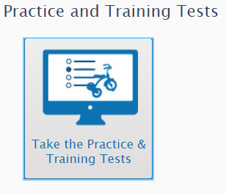
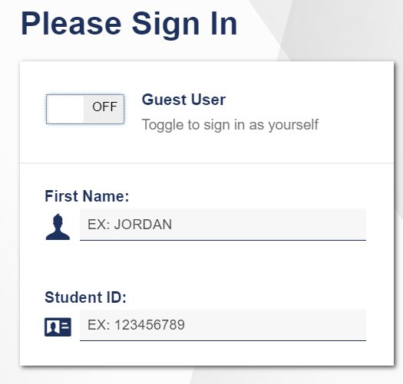
Provide Students with Opportunities to Practice
Administer Practice Tests to allow students to become familiar with online test platform, item format, universal tools, and practice with designated supports and accommodations (if applicable).
Notes:
Become familiar with the testing system, accommodations, and types of questions on the summative tests.
https://ctpt.tds.cambiumast.com/student
Use the Practice Tests to model how to use specific features such as the Desmos Calculator (available for certain math items in Grades 6-8), text-to-speech, math translation glossary, and speech-to-text. Students need to know in advance how to activate these features if applicable.
Practice Tests are available for all summative assessments including the CTAA and the CAAELP.

Slide 64
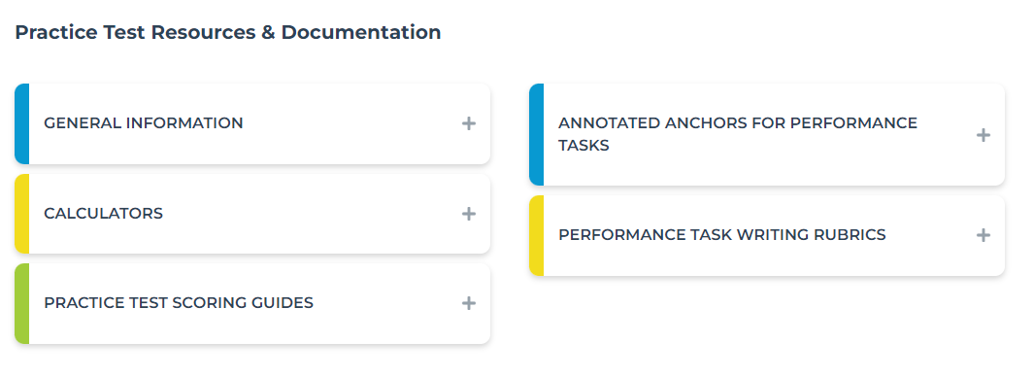
Provide Students with Opportunities to Practice
Additional resources are available on the Smarter Balanced website.
https://smarterbalanced.org/our-system/students-and-families/samples/
Notes:
Practice Tests and Sample Questions – SmarterBalanced; https://smarterbalanced.org/our-system/students-and-families/samples/

Slide 65

Accommodation Reminders

Slide 66
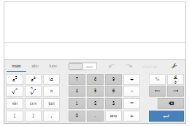
Desmos Reminders: Math Segment 1 and Performance Tasks (Grades 6-8) & NGSS
On the Assessments:
Practice sample assessment items with the Desmos Calculators on the Smarter Balanced Sample Items Website.
To help students and teachers prepare for assessments—and to support delivery of tests and quizzes in classrooms—Desmos developed a suite of "Test Mode" apps that match the configuration that students will encounter on test day.
In the Classroom:
Teach, learn, and explore mathematical concepts.
Learn how the calculator supports students on the assessment with the Tools for Teachers’ Accessibility Strategy: Calculator
Create graphs to download, print, emboss in braille, or share electronically.
Desmos has assembled a collection of unique and engaging digital activities teachers can use with students.
Notes:
Built with universal design in mind, Desmos calculators provide features and resources for students with a variety of accessibility needs. Learn more about Desmos Accessibility.
https://calculators.smarterbalanced.org/#about
Visit the Smarter Balanced Desmos page for more details!
Accessibility Features
Support for braille: Students who are blind can read and write equations using the two mathematical braille codes used in the United States: Nemeth and Unified English Braille (UEB).
Accessible graphs: Students who are blind can create their own graphs in real time and determine the shape of a graph through audio trace. The pitch of the tone increases or decreases depending on the shape of the wave or graph. Students can then emboss their graphs and share print or braille versions with classmates and teachers.
Support for screen readers: Fully supporting keyboard navigation, the calculators communicate with screen readers, which voice additional cues to indicate a student’s location within an expression or within a graph (numerator or denominator, superscript or subscript, baseline, points on the graph, etc.). Paired with a refreshable braille display, these features offer students who use braille the same opportunity as their peers to access an online calculator.
Colors that have sufficient contrast: The calculators provide support for students who have low vision or students who have difficulty with visual perceptual skills.
Adjustable font-size settings: The calculators allow students to adjust font size if they prefer larger print.
The Smarter Balanced Desmos calculators is also compliant with the latest web accessibility standards.

Slide 67
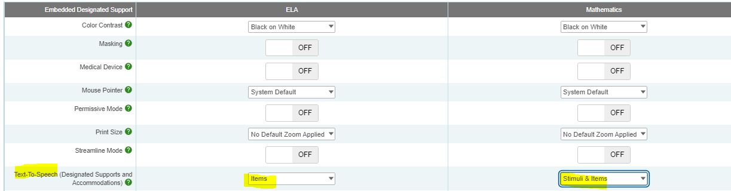

Text-to-Speech of Items
Text-to-Speech of items is considered a designated support. It is available in ELA, Math, and Science.
Notes:
Allows text to be read aloud to the student via embedded text-to-speech (TTS) technology. The student is able to control the speed, as well as raise or lower the volume of the voice via a volume control. Text-to-speech is available as an embedded designated support for science, math, and ELA items.

Slide 68
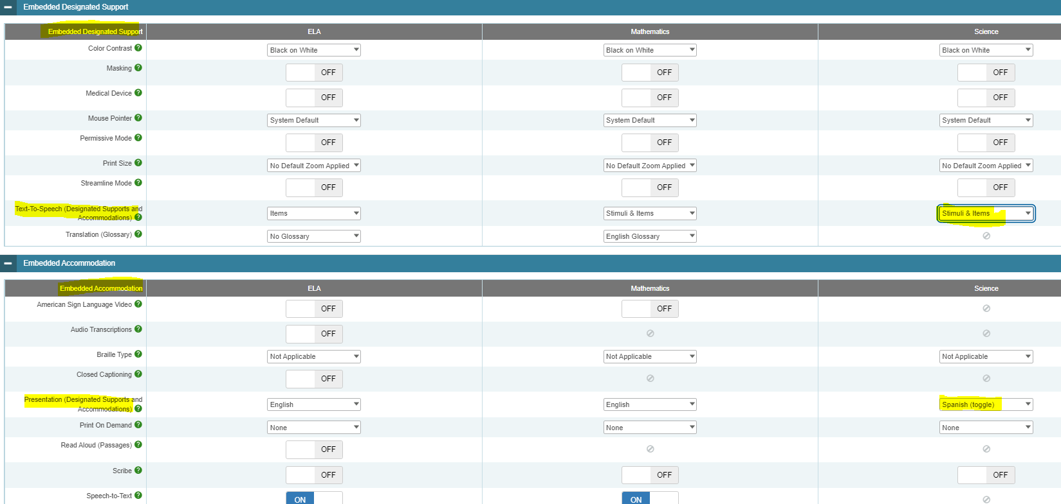
Text-to-Speech in Spanish with Math Stacked and/or Science Spanish Toggle
Text-to-Speech in Spanish is available on the NGSS assessment. For eligible students, set Text-to-Speech to Stimuli & Items for Science and set presentation to Spanish Toggle.
Notes:
Spanish presentation will allow the literate Spanish-speaking student to toggle between a full Spanish translation of the item and the English version of the item. By default, all test directions, navigation buttons, and test content will be presented to the student in the Spanish language. This designated support must be entered in the Embedded Accommodation section of the student’s test settings in TIDE within the Presentation (Designated Supports and Accommodations) tab for Science. Select Spanish toggle.

Slide 69
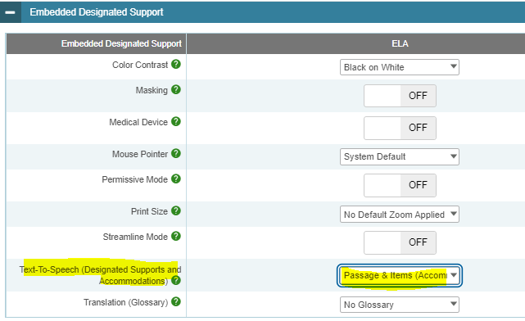
Text-to-Speech of Reading Passages
Text-to-Speech of ELA Reading Passages is considered an accommodation for students who are visually impaired or have a print disability. Refer to the Decision Guidelines for Text-to-Speech to determine eligibility.
To activate, set Text-to-Speech to Passages & Items for ELA.
Notes:
There are a variety of reader options for students with various access needs. Begin by reviewing the Connecticut Smarter Balanced and NGSS Reader Options Table to learn more about available designated supports and accommodations. https://ct.portal.cambiumast.com/resources/accessibility-and-special-populations/connecticut-smarter-balanced-and-ngss-assessment-reader-options-table
One such accommodation is text-to-speech of the ELA Reading Passages. This accommodation allows the reading passages to be read aloud to the student via embedded text-to-speech technology. This accommodation is only for students in Grades 3-8 with a documented print disability, or for blind students who do not yet have adequate braille skills. Information on selecting this accommodation for appropriate students is found in Guidelines for Choosing Text-to-Speech or Read Aloud for Smarter Balanced.
https://ct.portal.cambiumast.com/resources/accessibility-and-special-populations/guidelines-for-choosing-text-to-speech-or-read-aloud-for-smarter-balanced-ela-summative-and-interim-assessment-reading-passages-for-students-with-disabilities-in-grades-3-8
Text-to-speech for ELA reading passages is not available for English learners (unless the EL student has an IEP or 504 Plan documenting this needed accommodation). The text-to- speech for ELA reading passages accommodation is intended for a small group of students. The PPT or 504 Team should complete (and maintain locally) the 2021-22 Decision Guidelines for Text-to-Speech of the Smarter Balanced ELA Reading Passages to confirm eligibility. https://ct.portal.cambiumast.com/-/media/project/client-portals/connecticut/pdf/2021/text-to-speech-decision-guidelines.pdf
When text-to-speech is used, appropriate headphones must be available to the student, unless the student is tested individually in a separate setting.

Slide 70
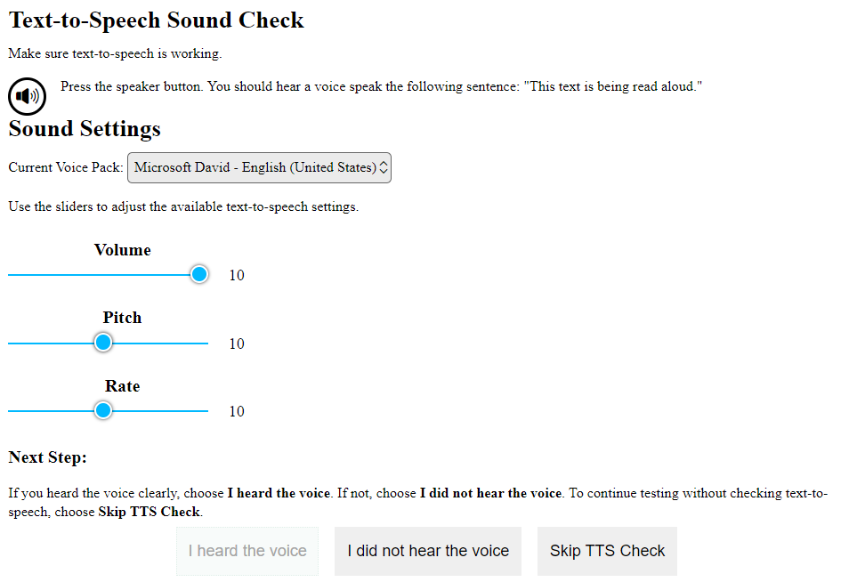

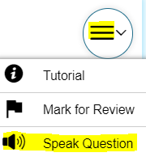
Text-to-Speech Reminders
Set up a practice opportunity for students using Text-to-Speech.
Students will need headsets unless testing in a 1:1 setting.
Ensure that students know how to control the speed, as well as raise or lower the volume of the voice via a volume control. Students can also adjust using the System Settings icon.
Show students how to activate the audio.
This audio check appears when students sign onto the test. Students can make adjustments here, or by selecting the System Settings icon (shown on the left).

Slide 71
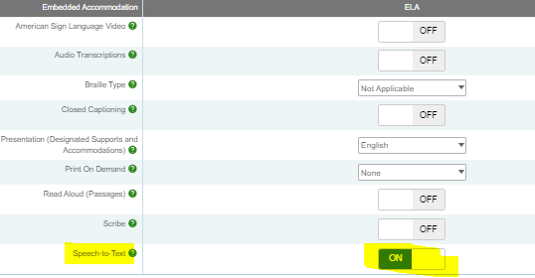
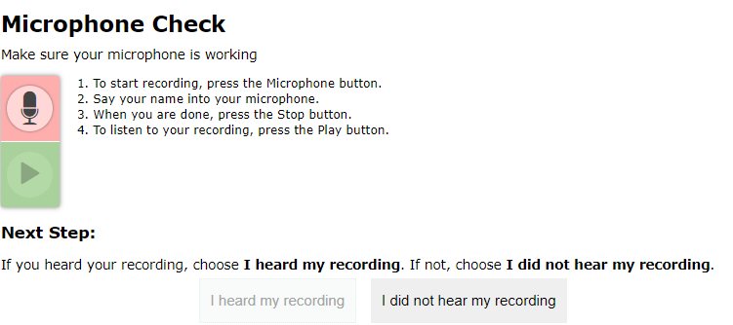

Speech-to-Text Reminders
For students that qualify for speech-to-text, activate this accommodation in TIDE.
When students access the Secure Browser, they will receive a prompt to test the functionality of their audio and microphone.
Notes:
Often used with students who have motor or processing disabilities (such as dyslexia), this accommodation allows students to orally dictate their responses to Smarter Balanced open-ended items using Cambium Assessment’s internal speech-to-text software. Any open-ended item (often associated with the Math Performance Task and the ELA reading and writing assessments) will have a speech-to-text icon that can be activated by the student and used to generate a dictated response.
Accommodation check: When applicable, ask your student to practice this accommodation on a Practice Test. When they do, be sure to look for the microphone icon. If it doesn’t appear under the open-ended item response text box, then the accommodation may not have been set in TIDE.

Slide 72
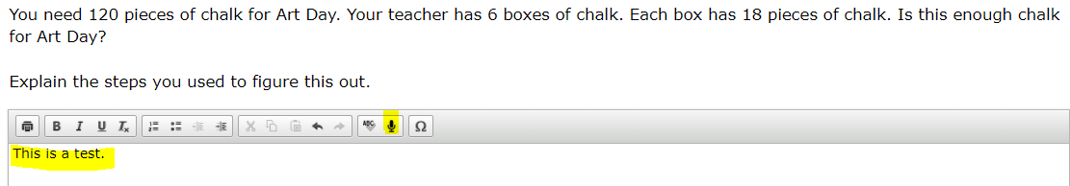
Speech-to-Text Reminders
A microphone icon will appear below any item text box that requires a written response.
When the student selects the microphone, they will dictate their verbal response as the system transcribes the voiced message in the text box.
Notes:
Students can delete or revise their response as appropriate.
Students should try this accommodation using a Practice or Interim Assessment in advance of summative testing to ensure that the student knows how to operate this function.
This feature auto punctuates and capitalizes as it transcribes a student’s dictation. Students should proofread and edit responses before moving onto the next item.
Must test in a separate 1:1 setting.

Slide 73
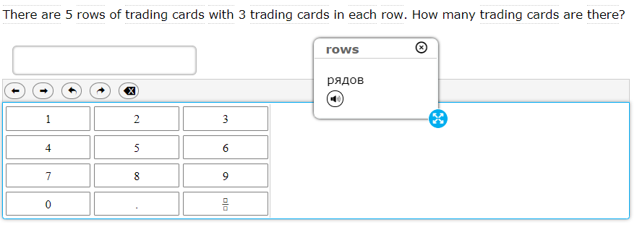

Translation Glossary: Math
Selections include
  Single native-language support (i.e., Russian Glossary, Illustration Glossary)
  Dual language supports (native language paired with English); (i.e., Russian & English Glossary); or
  Dual language supports combined with Illustration Glossary (i.e., Russian, English, & Illustration Glossary)
  The icon enables an audio translation of the word.
  Refer to the Translation Glossary Embedded Designated Support brochure for details.
A dotted line above or below a word or phrase indicates an available translation.
When students hover over the term, it becomes highlighted, and when it is selected, a pop-up window with the word translation appears.
Notes:
Notes about this designated support:
Based on differences in complexity across languages, different language Glossaries may provide support for different construct irrelevant English language terms. Therefore, if a student has access to the English and one second-language Glossary, some terms may have both Glossaries present while other terms may have only one of the two Glossaries present. Please note that not all math items contain glossary options.
The Illustration Glossary may be a useful language support for those students who are not fluent in their native language and benefit from a pictorial symbol OR if the student’s native language is not represented by the list of available language options . The provision of these dual supports may be distracting or inappropriate without careful consideration of the student’s language needs.
Also note that if the student has a dual language mode or triple language mode (i.e., Russian, English, & Illustration Glossary) enabled, the Glossary will appear with the corresponding tabs, one for each language, when appropriate.
Refer to the Translation Glossary Embedded Designated Support brochure for more details. https://ct.portal.cambiumast.com/resources/accessibility-and-special-populations/translation-(glossary)-%E2%80%93-embedded-designated-support

Slide 74
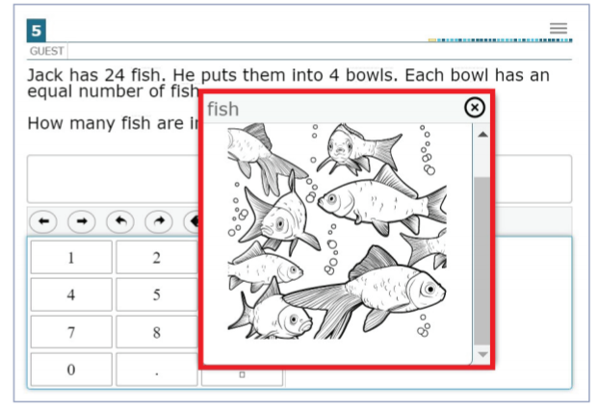
Illustration Glossary
Which students most benefit from the illustration glossary?
English learners/multilingual learners
Students with varying proficiency in one of the current translated glossary languages who would benefit from current illustration supports
Students who are deaf/hard of hearing and use sign systems other than American Sign Language
Students whose primary languages are not included in the text-based glossaries
Refer to the Illustration Glossary Accessibility Resource for Mathematics for details.
A dotted line above or below a word or phrase indicates an available illustration.
When students hover over the term, it becomes highlighted, and when it is selected, a pop-up window with the illustration appears.
Students can adjust the size and placement of each illustration depending on their needs and preferences.
Notes:
The illustration glossary is a Designated Support for mathematics to help students understand words or phrases in test questions when they may not benefit from the text-based glossaries (currently offered in English and 13 other languages) or American Sign Language videos. The illustration glossary is available for practice tests, interim assessments, and summative assessments. For paper-pencil forms, illustration glossaries are available in paper-based supplements. This must be requested when ordering the test material.
Refer to the Illustration Glossary Accessibility Resource for Mathematics for more information: https://portal.smarterbalanced.org/library/en/illustration-glossary.pdf.

Slide 75
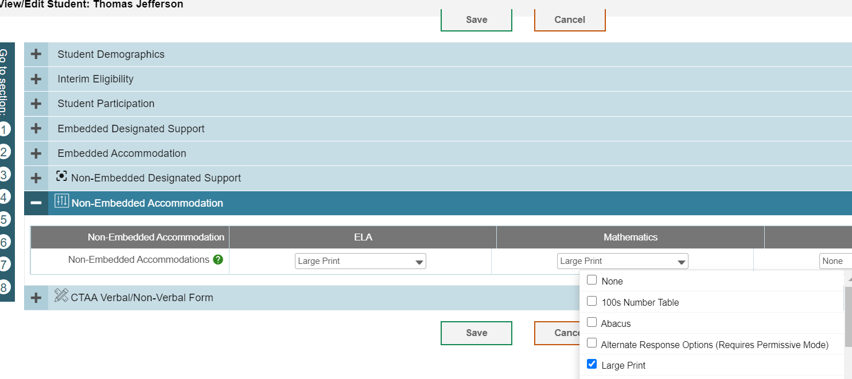
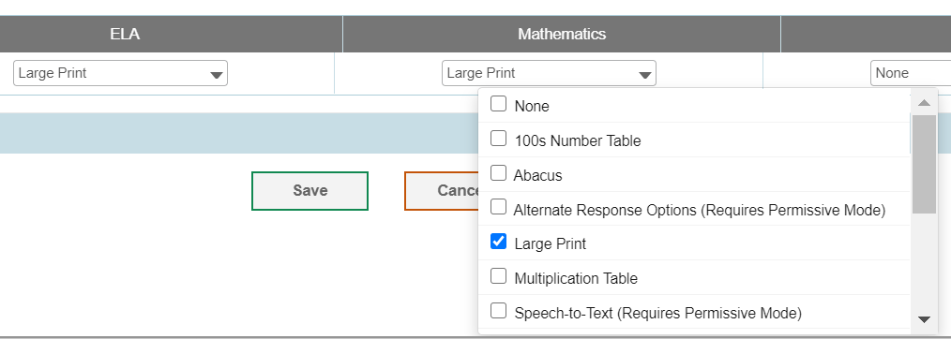
Large Print or Braille Test Materials
District Administrators can order braille and large-print kits for Smarter Balanced and NGSS in TIDE any time after January 26, 2023.
Confirm that the student has the non-embedded accommodation set properly in TIDE.
Notes:
Remember to transcribe student responses into scannable test booklets for scoring.
The following braille presentations are available:
Math ELA Science
UEB Contracted + Nemeth Math
UEB Contracted (No Math Content)
UEB Contracted + Nemeth
UEB Uncontracted + Nemeth Math
UEB Uncontracted (No Math Content)
UEB Contracted + UEB Math
UEB Uncontracted + UEB Math

Slide 76
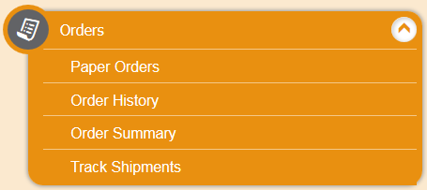
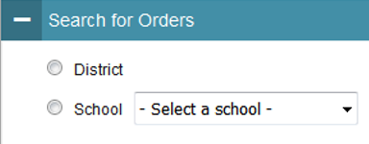
Ordering Paper Materials in TIDE
Step 1: From the Orders task menu on the TIDE dashboard, the DA selects Paper Orders.
Step 2: Search for orders by District or School.
Step 3: Enter the quantity needed for each of the materials needed.
Districts can track shipments in TIDE.

Slide 77

What are Special
Documented Accommodations?
When universal tools, designated supports, and accommodations do not meet a student’s accessibility needs as described in their IEP/504 Plan, DAs can apply for a special documented accommodation for additional supports through a petition process prior to March 1, 2023.
Read Aloud of Reading Passages*
Human Signer/Visual Support (Items and/or passages)
Scribe
Print on Demand
Manipulatives (Math, Grades 3-8)
Hand-held calculator (Math, Grades 6-8) for calculator-allowed items
Customized
*Requires the submission of the Documented Evidence for a Read Aloud of the Smarter Balanced ELA Reading Passages with the submission of the petition.
Notes:
For a small number of students, the universal tools, designated supports, and accommodations on the Accessibility Chart and described in the Assessment Guidelines may not be enough to meet the accessibility needs of the student. In this case, the District Administrator in TIDE may submit a petition for these students to the Connecticut State Department of Education Performance Office to discuss and develop a plan for the assessment.

Slide 78

What is the Process for Submitting a Special Documented Accommodation?
Do |  | Do Not
 | DA’s should contact Deirdre or Janet regarding any student who may qualify. See Assessment Guidelines Appendix C page 60. |  | Never provide student names or confidential information if requesting information via email.
 | Based on initial eligibility, DAs will receive a Special Documented Accommodation Petition and access to the Cambium Secure FTP site for submitting completed paperwork documenting the need for special accommodation(s). |  | Do not email petitions, IEPs, 504s, or any confidential information. All petitions must be submitted by the DA using Cambium’s secure FTP site.
 | CSDE will review petitions and provide a letter of approval or guidance to district via the secure FTP site. Letters of approval may also include the completion/submission of security/confidentiality agreements. |  | Don’t test students with requested accommodations without prior approval from the CSDE.
Notes:
To facilitate this process, the DA must contact Deirdre Ducharme or Janet Stuck and provide information about the student’s specific needs per their disability and supports identified in their IEP. If appropriate, we will provide a petition to be completed by the student’s primary teacher and returned with the teacher, DA, and Special Education Director’s signature, along with a complete copy of the student’s active IEP. All Special Documented Accommodations must be submitted by March 1, 2023.
No special accommodations can be provided unless they are approved by the CSDE.
If students are approved to receive a human reader, human signer, or scribe, the teacher will need to sign the Smarter Balanced/NGSS Confidentiality/Security Agreement form and return to the District Administrator.
The DA will upload the signed form to the secure FTP site for documentation.
The Special Documented Accommodations Procedure is described in the Assessment Guidelines, Appendix C.

Slide 79
In Connecticut, the exemption determination for a medical emergency rests primarily on the following criteria:
The student is unable to attend school and is medically/emotionally unavailable for homebound/hospitalized instruction for the entire testing window.
Medical Exemption forms due dates:
LAS Links - March 10, 2023
CAAELP - April 7, 2023
Connecticut SAT School Day- May 5, 2023; and
Smarter Balanced, the NGSS, and the Connecticut Alternate Assessments (CTAA/CTAS) - June 9, 2023
See Appendix B of the Assessment Guidelines.
Medical Exemption Procedure
Notes:
Students who are hospitalized or homebound due to illness should be tested unless there are medical constraints. These students can have the test administered at home or in the hospital provided the test is administered by a certified school staff member who is fully trained in the proper test administration and security procedures for the specific assessment system (LAS Links, CAAELP, Smarter Balanced Assessments, NGSS Science, Connecticut SAT, CTAA, and CTAS).
In rare cases, there may be a student who experiences a medical emergency just prior to (or during) the testing window. There is a process whereby, the student may receive an exemption from testing due to the emergency nature of the medical condition, if the criteria for exemption are met. A medical exemption can be given to a student depending on the availability of the student during the statewide testing window. This process is described in Appendix B of the Assessment Guidelines on page 58.
Contact Deirdre or Janet if you think you have a student who is eligible for a medical exemption. Based on eligibility, DAs will be provided with a Medical Exemption form for completion, signature by the student’s physician, and submission to the CSDE. Please keep in mind that there are assessment specific deadlines for receiving these forms:
Medical Exemption forms due dates:
LAS Links - March 10, 2023
CAAELP - April 7, 2023
Connecticut SAT School Day- May 5, 2023; and
Smarter Balanced, the NGSS, and the Connecticut Alternate Assessments (CTAA/CTAS) - June 9, 2023.

Slide 80
What’s New for 2023?
Early Stopping Rule Process
CT-SEDS
CAAELP

Slide 81

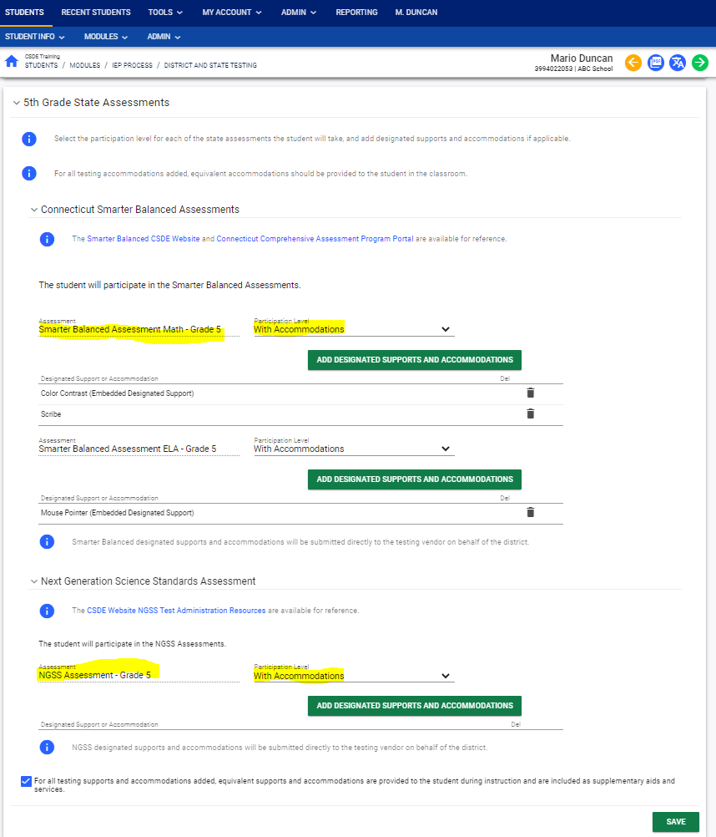
CT-SEDS: Individual Education Program (IEP) District and Statewide Testing Page
This page includes:
each specific state assessment (associated with the student’s tested grade)
a drop-down menu to select appropriate designated supports and accommodations
prior to spring testing, designated supports and accommodations in a finalized IEP/504 in CT-SEDS will sync with TIDE
Math
ELA
Science
Notes:
This is the district and statewide testing page in CT-SEDS in which PPTs will indicate if accommodations are needed on statewide assessments (Smarter Balanced and NGSS). As indicated by the blue arrow, PPTs can select the green box to add designated supports and accommodations specific to the Smarter Balanced Math and ELA, and NGSS if in Grades 5, 8, and 11. The 504 Module operates in the same manner. Once an IEP/504 is finalized by the IEP, designated supports and accommodations will sync with TIDE.

Slide 82
2022-23 Populating Designated Support/Accommodations in TIDE
2022-23 Populating Designated Support/Accommodations in TIDE
Student’s Status | Populating Designated Supports and/or Accommodations in TIDE | Special Documented Accommodations
Finalized IEP/504 Plan in CT-SEDS | Designated supports and accommodations selected for the 2022-23 test administration will sync with TIDE nightly. The first sync is expected prior to the March testing window. | If the following non-standard accommodations are selected in CT-SEDS, they will sync with TIDE. Human Signer/Visual Support Read Aloud of ELA Reading Passages Scribe Calculator (6-8) Math Manipulatives (3-8)
Most Current IEP/504 Plan in Previous Vendor System without 2022-23 Designated Supports and Accommodations | The PPT should reconvene to review/revise the IEP or create an amendment to outline designated supports and accommodations for the 2022-23 school year. Then the district may upload a test accommodation file to TIDE (e.g., Frontline or locally generated TIDE Test Setting Excel or Comma-Separated Value (CSV) file layouts), or manually enter designated supports/accommodations in TIDE prior to testing. | If the following non-standard accommodations are needed, please refer to the Appendix C of the Assessment Guidelines for information on requesting a petition for Special Documented Accommodations: Human Signer/Visual Support Read Aloud of ELA Reading Passages Scribe Calculator (6-8) Math Manipulatives (3-8)
IEP/504 Plans in Previous Vendor System with 2022-23 Designated Supports and Accommodations | If the district is working with the IEP vendor, districts can upload their file to TIDE prior to testing.
English Learner/Multilingual Learner Plans | Districts will upload or manually enter designated supports in TIDE prior to testing. Refer to the TIDE Test Setting Excel or Comma-Separated Value (CSV) file layouts.
General Education | Districts will upload or manually enter designated supports in TIDE prior to testing. Refer to the TIDE Test Setting Excel or Comma-Separated Value (CSV) file layouts.

Slide 83


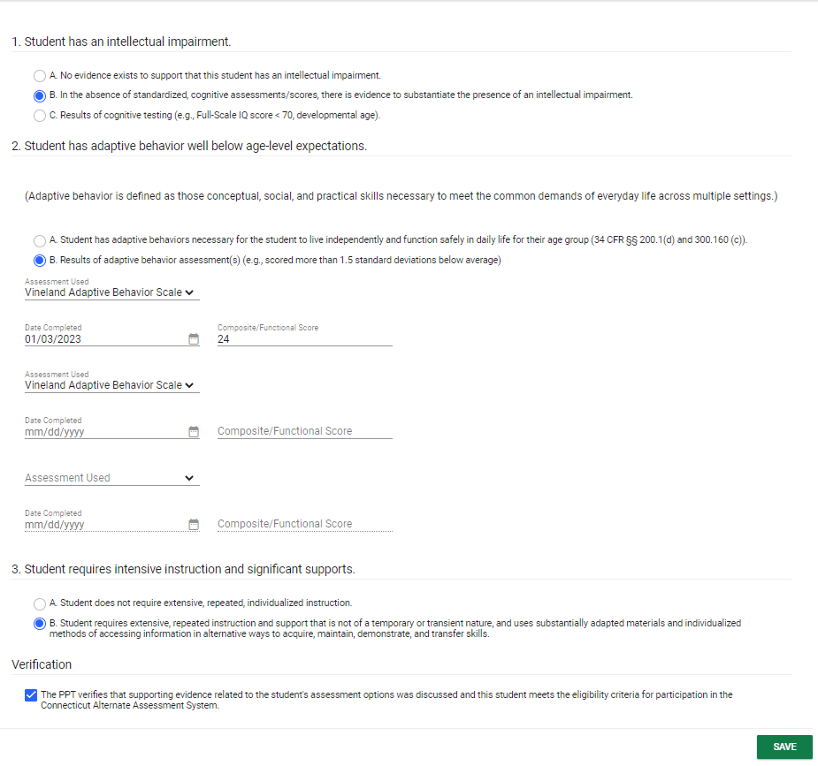
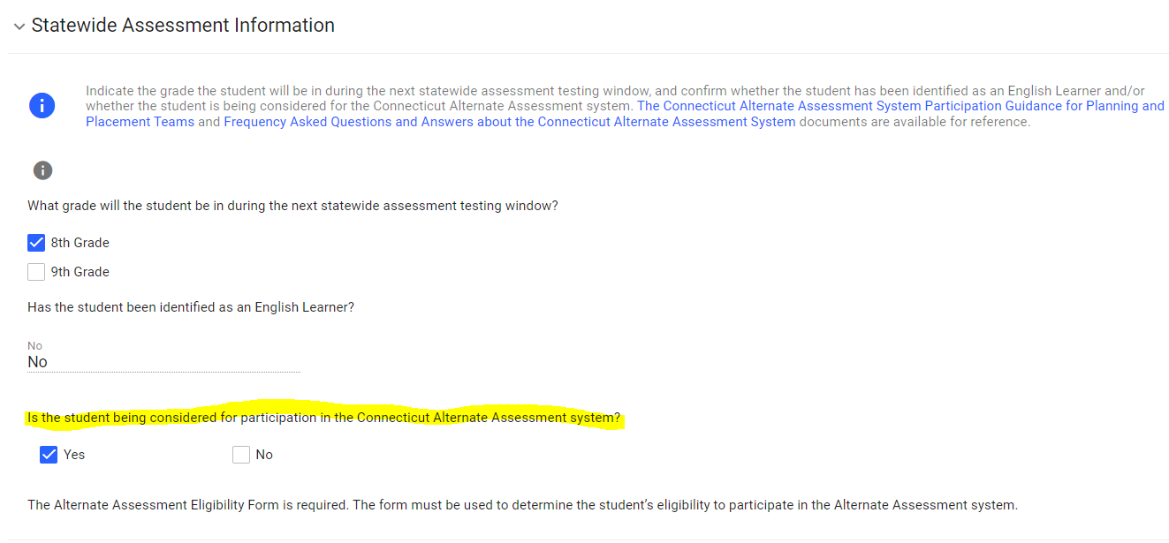
CT-SEDS: Alternate Assessment Eligibility
PPTs can indicate that a student is being considered for the Connecticut Alternate Assessment System.
The Connecticut Alternate Assessment System Eligibility Form is built into CT-SEDS.
Alternate Assessment Eligibility
Notes:
PPTs can select the Connecticut Alternate Assessment System from the CT-SEDS State-wide Testing Module. (See #1)
If YES is selected for the item “Is the student being considered to participate in the Connecticut Alternate Assessment System,” the Connecticut Alternate Assessment System Eligibility Form will pop up on the screen for completion. (See #2)
This year, regardless of IEP status in CT-SEDS, all eligibility forms must be submitted in the DEI.
In the future, CSDE will pull Alt-Eligibility forms from CT-SEDS to populate TIDE. As a reminder, the Connecticut Alternate Assessment System Eligibility Form is used to determine CAAELP eligibility as well for dually identified ELs/MLs with cognitive disabilities in Grades K-12.

Slide 84
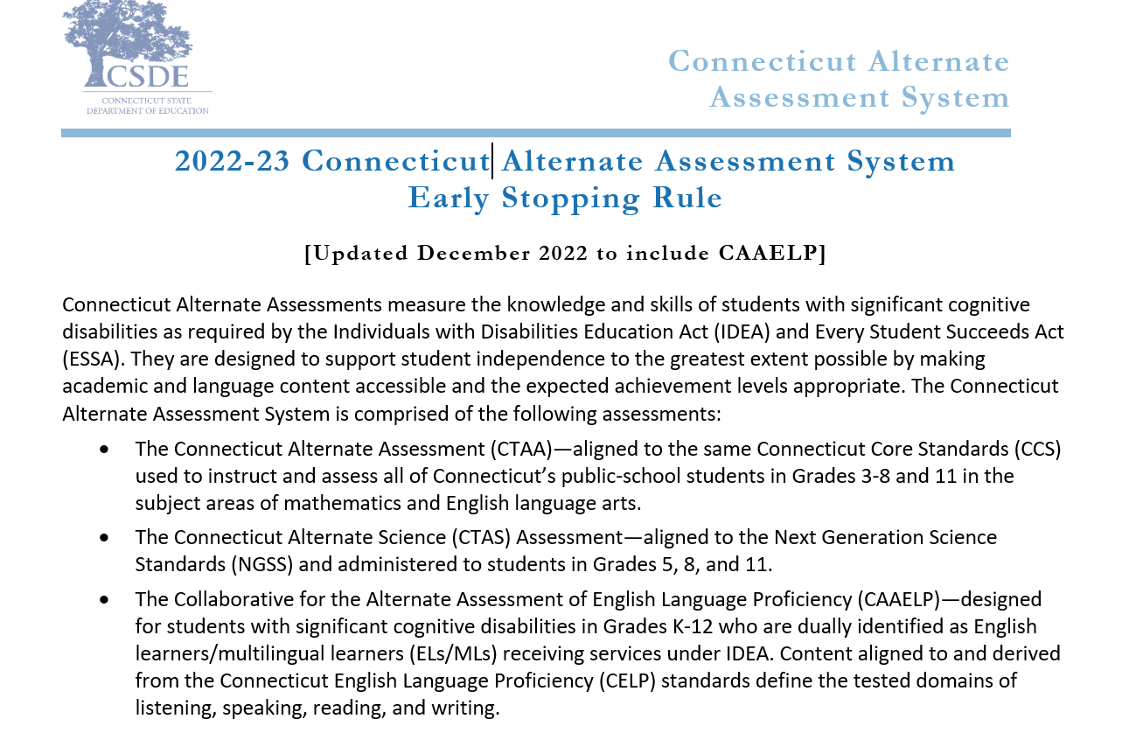
Early Stopping Rule for
CTAA, CTAS, & CAAELP
This document includes:
the Student Response Check (Appendix A)
The SRC Administration Behavioral Notes (Appendix B)
The Early Stopping Rule Request and Attestation Form (Appendix C)
Notes:
The Alternate Assessment System Early Stopping Rule (ESR) has been revised for the 2022-23 testing year and was just updated this December to include the CAAELP assessment.
The Early Stopping Rule is a process used by the CSDE to support students who are non-verbal and do not have an established observable mode of communication.
For this small group of students with these characteristics, their teachers will follow the instructions in the Early Stopping Rule document to determine eligibility. Eligibility will be determined before the start of the testing window.
In short, teachers will refer to the instructions published in the 2022-23 Connecticut Alternate Assessment System Early Stopping Rule guidelines. They will administer three trials of the Student Response Check (SRC), included in the guidelines, by February 1, 2023. If the student qualifies, the teacher will complete the 2022-23 Connecticut Alternate Assessment System Early Stopping Rule Request and Attestation Form (also included in the guidelines) and return it to their District Administrator for Testing (DA in TIDE). The DA will submit the form to the CSDE by March 1, 2023, for review and approval.
If approved, the District Administrator will receive an email with approval. Teachers will not need to administer any portion of the alternate assessments (CTAA, CTAS, or CAAELP). Cambium Assessments will assign an ESR code to any test that applies to them (CTAA, CTAS, and CAAELP).
Typically, the students who are eligible for the Early Stopping Rule (ESR) are those students who have the most complex needs as compared to their peers with significant cognitive disabilities. Often, these students do not use oral speech, nor do they have an established communication system. They may be learning about cause and effect in order to utilize Augmentative and Alternative Communication supports. These students are not able to use objects/textures, regularized gestures, pictures, signs, etc., to communicate with consistency. Furthermore, they may have an uncertain response to sensory stimuli. The IEPs of these students often focus on medical and adaptive needs including the development of communication.

Slide 85

New Proficiency Assessment
Eligibility
Students must:
    Be identified as EL/ML in Grades K-12 in PSIS registration
    Have an active IEP reflecting significant cognitive disabilities (students with a Section 504 Plan are NOT eligible)
    Have the PPT confirm eligibility for the Alternate Assessment System using the Alternate Assessment System Eligibility Form
    Refer to the Collaborative for the Alternate Assessment for English Language Proficiency (CAAELP) Participation Guidelines for more details.
Notes:
This new alternate assessment for English Language Proficiency is for students who must
Be identified as EL/ML in Grades K-12 in PSIS
Have an active IEP reflecting significant cognitive disabilities
Have the PPT confirm eligibility for the Alternate Assessment System using the Alternate Assessment System Eligibility Form
Refer to the Collaborative for the Alternate Assessment for English Language Proficiency (CAAELP) Participation Guidelines for more details.

Slide 86
CAAELP
 | Collaborative for the Alternate Assessment of English Language Proficiency (CAAELP)
Test Window | February 1-March 31, 2023
TIDE User Role Required | Teacher Administering the Alternate (TEA)
Student Eligibility | Students identified as EL/ML and special education with significant cognitive disabilities per PPT decision using Alternate Assessment System Eligibility Form
Grades | K-12
Test Subject Areas | Reading, Listening, Speaking, Writing
Test Delivery Method | Trained educator (with TEA User Role) administers CAAELP assessment items individually to eligible Els/MLs using the Cambium Test Delivery System.
Required Administration Materials | Administered using Grade and domain specific Test Administrator Directions and Scoring Rubrics Booklets
Security | Secure
Training | CAAELP Test Administration Training
Certificate | Trained status certificate should be maintained locally
Submissions into DEI | Submit the Alternate Assessment System Eligibility Form
Notes:
This table describes some of the important features of the new Alternate Assessment.
Please note that anyone with the responsibility for administering the CAAELP must access the CAAELP training which is a separate training from the CTAA and CTAS training. These individuals must also be provided a TEA user role in the TIDE system by the DA.

Slide 87
CAAELP Resources
Information is located on the CSDE Student Assessment main webpage/CAAELP Resources, or on the Alternate Assessment page of the Connecticut Comprehensive Assessment Program Portal (CT Portal).
Collaborative for the Alternate Assessment of English language Proficiency (CAAELP) December 2022
LAS Links and CAAELP Office Hours PowerPoint (1/4/23)
Additional information on the Collaborative that is not CT specific can be viewed can be viewed at altelpa.org.
Notes:
Communication, training, and resources have been provided to ELACs to share with staff. It is important to ensure the Planning and Placement Teams have information to determine eligibility for the most appropriate English language proficiency assessment for your K-12 ELs/MLs with significant cognitive disabilities.

Slide 88
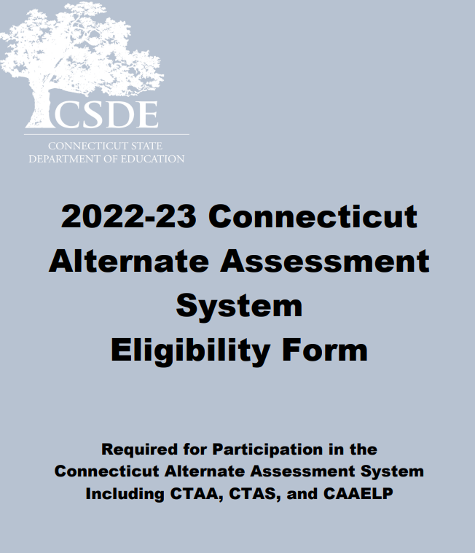
The Connecticut Alternate Assessment System for Eligible Students with Significant Cognitive Disabilities
Notes:
The Connecticut Alternate Assessment System Eligibility Form is used to determine eligibility for the Alternate Assessment System through discussion at the Planning and Placement Team (PPT) meeting. This document is required to register students for the CTAA, the CTAS and the new CAAELP. The document may be accessed on the CSDE Comprehensive Assessment Program Portal.
The eligibility form must be submitted in the Data Entry interface (DEI) on the CSDE Comprehensive Assessment Program Portal. It has been updated to include the CAAELP. Remember that only educators with a TEA user role in TIDE who have passes the required Alternate Assessment System training to administer CTAA and CTAS may submit his form into the DEI.

Slide 89
Resources to Support the Eligibility of the Alternate Assessment System
Frequently Asked Questions and Answers about the Connecticut Alternate Assessment System
Annotated Connecticut Alternate Assessment System Eligibility Form
Frequently asked Questions and Answers About the Connecticut Alternate Assessment System Eligibility Form
Connecticut Alternate Assessment System Participation Guidance for Planning and Placement Teams Flowchart
For more information, visit the CSDE Website and the Connecticut Comprehensive Assessment Program Portal.
Notes:
Included on this slide are resources to help support your understanding of the purpose and eligibility for the Connecticut Alternate Assessment System.

Slide 90
Connecticut Alternate Assessment System
 | Connecticut Alternate Assessment (CTAA) for Math and ELA | Connecticut Alternate Science (CTAS) | Collaborative for the Alternate Assessment of English Language Proficiency (CAAELP) also known as Alt ELPA
Test Window | March 27-June 2, 2023 | March 27-June 2, 2023 (upload score worksheets) | February 1-March 31, 2023
Eligible Students | Students identified as special education with significant cognitive disabilities per PPT decision using Alternate Assessment System Eligibility Form | Students identified as special education with significant cognitive disabilities per PPT decision using Alternate Assessment System Eligibility Form | Students identified as EL/ML and special education with significant cognitive disabilities per PPT decision using Alternate Assessment System Eligibility Form
Grades | 3-8 and 11 | 5, 8, 11 | K-12
Test Subject Areas | English Language Arts • Reading • Writing Mathematics | Science •Earth •Life •Physical | • Reading • Listening • Speaking • Writing
Test Delivery Method | Trained TEA administers the grade-specific math and ELA items via the online testing system individually to eligible students | Trained TEA assesses eligible student with performance tasks based on Connecticut Alternate Science Assessment Essence statements | Trained educator (with TEA User Role) administers CAAELP assessment items individually to eligible Els/MLs using the Cambium Test Delivery System.
Required Administration Materials | Administered with required secure Directions for Test Administration (DTAs) | Designed to be administered through the school year using CTAS Required Materials student ratings will be entered in the DEI https://ct.portal.cambiumast.com/resources/alternate-assessment-system/ctas-required-materials | Administered using Grade and domain specific Test Administrator Directions and Scoring Rubrics Booklets
Security | Secure | Non-Secure | Secure
Notes:
This is a comparison between the CTAA for Math and ELA and the Connecticut Alternate Science (CTAS).
The CTAA is aligned to the Connecticut Core Standards for math and English language arts for eligible students with significant cognitive disabilities in Grades 3-8 and 11.
It is a secure test accessed via an online platform during March 28-June 3, 2022.
It is designed to promote maximum student access while maintaining the integrity of the constructs being assessed
It incorporates optimal testing conditions that must be provided to all students who take the test (i.e., 1:1 test setting)
accessibility features that must be provided to students as needed (i.e., human reader, scribe).
CTAS: Each Storyline includes a Performance Task at each assessed grade level with a series of assessment activities. Each activity provides a coherent sequence of instruction for the TEA on how to assess student performance associated with each Core Extension. The TEA assesses the eligible students on provided Performance Tasks using provided Resource Packet materials. The TEA rates the student’s performance on each activity using a 0–2 scale and provided scoring guidance. Supports include the use of communication devices and assistive technology or accommodations as described in the student’s Individualized Education Program (IEP).
The Resource Packets are to be used in conjunction with the Performance Tasks. They include materials that will be presented to the student when referenced by the teacher script in the Performance Task.
As TEAs administer each Performance Task, a paper copy of the Student Score Worksheet should be completed to record student ratings. After the CTAS is fully administered, TEAs will enter the ratings recorded on the Student Score Worksheet in the Data Entry Interface (DEI) during the testing window of March 28–June 3, 2022.

Slide 91
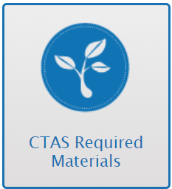
CTAS Description
District Administrations received paper copies of CTAS test materials in the fall of 2018. These materials are to be shared among schools and teachers and used from year to year. Materials can also be downloaded and printed from the Connecticut Comprehensive Assessment Program Portal.
Notes:
Each grade-specific CTAS set contains:
Performance Tasks, which include:
a guiding question and a general overview of the task
a list of materials needed
instructions for preparing materials
step-by-step activities with built-in script and scaffolding for TEAs
scoring guidance
Resource Packets, which are specific to each Performance Task, and include required materials such as posters, graphs, sentence strips
Student Score Worksheet, which is to be completed in hardcopy and then submitted through the Data Entry Interface (DEI) during the testing window of March 27-June 2, 2023
Each Storyline includes a Performance Task at each assessed grade level with a series of assessment activities. Each activity provides a coherent sequence of instruction for the TEA on how to assess student performance associated with each Core Extension. The TEA assesses the eligible students on provided Performance Tasks using provided Resource Packet materials. The TEA rates the student’s performance on each activity using a 0–2 scale and provided scoring guidance. Supports include the use of communication devices and assistive technology or accommodations as described in the student’s Individualized Education Program (IEP).
The Resource Packets are to be used in conjunction with the Performance Tasks. They include materials that will be presented to the student when referenced by the teacher script in the Performance Task.
As TEAs administer each Performance Task, a paper copy of the Student Score Worksheet should be completed to record student ratings. After the CTAS is fully administered, TEAs will enter the ratings recorded on the Student Score Worksheet in the Data Entry Interface (DEI) during the testing window of March 27- June 2, 2023.

Slide 92
Data Entry Interface (DEI)
There are certain instructions for the submission of tests using the Data Entry Interface. Refer to the How to Access the Data Entry Interface brochure for details.
This system is used for the following assessments:
  Submitting the Connecticut Alternate Assessment System Eligibility Form
  Submitting the CTAS Student Score Worksheet
  Smarter Balanced paper tests (large print and braille)
  NGSS paper tests (large print and braille)

Slide 93
Data Entry Interface (DEI)
The DEI can be accessed via the portal under the Smarter Balanced, NGSS or Alternate Assessment program cards.
Trained teachers must use the DEI to submit the Alternate Assessment System Eligibility Form and CTAS Student Score Worksheet.
For students who take the paper Braille and Large Print Smarter Balanced and NGSS, teacher must transcribe students' responses from these booklets into the DEI.
The DEI does not require the secure browser. Users can access the DEI using most internet browsers (Chrome, Firefox, etc.).
All secure paper materials must be returned to Measurement Incorporated (MI) by the end of the window.

Slide 94
Alternate Assessment System Training Requirements
Connecticut Alternate Assessment System Training must be completed annually by certified educators administering the alternate (TEAs).
Training is online and available on the Alternate Assessment web page on the portal.
TEAs must complete and pass the end-of-training quiz with a score of at least 80 percent or better.
Resources:
Overview for District Administrators
Overview for Teachers Administering the Alternate
CTAA System User Guide
CTAA Test Administration Manual
CTAS Test Administration Manual
CTAA Assessing Students who are Blind, Deaf, or Deaf-Blind Additional Guidance
CTAS Assessing Students who are Blind, Deaf, or Deaf-Blind Additional Guidance
Notes:
Teachers Administering the Alternate (TEAs) are intricately involved in all aspects of the selection and supervision of the Connecticut Alternate Assessment and the Alternate Science. The Connecticut Alternate Assessment System Training requirements provide for high-quality standardized administration ensuring appropriate interpretations for results about what students with significant cognitive disabilities know and can do.
All teachers who will be administering the alternate assessments (CTAA and CTAS) must be trained via the online course regardless of previous training status. This training is required each school year. Once training and the embedded quiz is passed the TEA will have permission to;
Submit the Connecticut Alternate Assessment System Eligibility Form into the DEI;
Submit the CTAS Student Score Worksheet for students in Grades 5, 8, or 11;
Access the required secure test materials for the CTAA;
Administer the CTAA and CTAS assessments.
District Administrators are responsible for the following tasks:
Determine who will be administering an Alternate Assessment during the 2022-23 school year.
Verify that the teacher has a TEA User Role in TIDE. Update, add, and delete accounts as appropriate.
Communicate details regarding the required online training with your TEAs. Share the Overview for Teachers Administering the Alternate resource referenced on this slide.
Verify that all TEAs complete and pass the quiz. Those with passing scores will have their Trained Status activated to Y (Yes) in TIDE. Note: the CAAELP training is separate and does not sync with TIDE.
Review the resources included on this slide for more information.

Slide 95
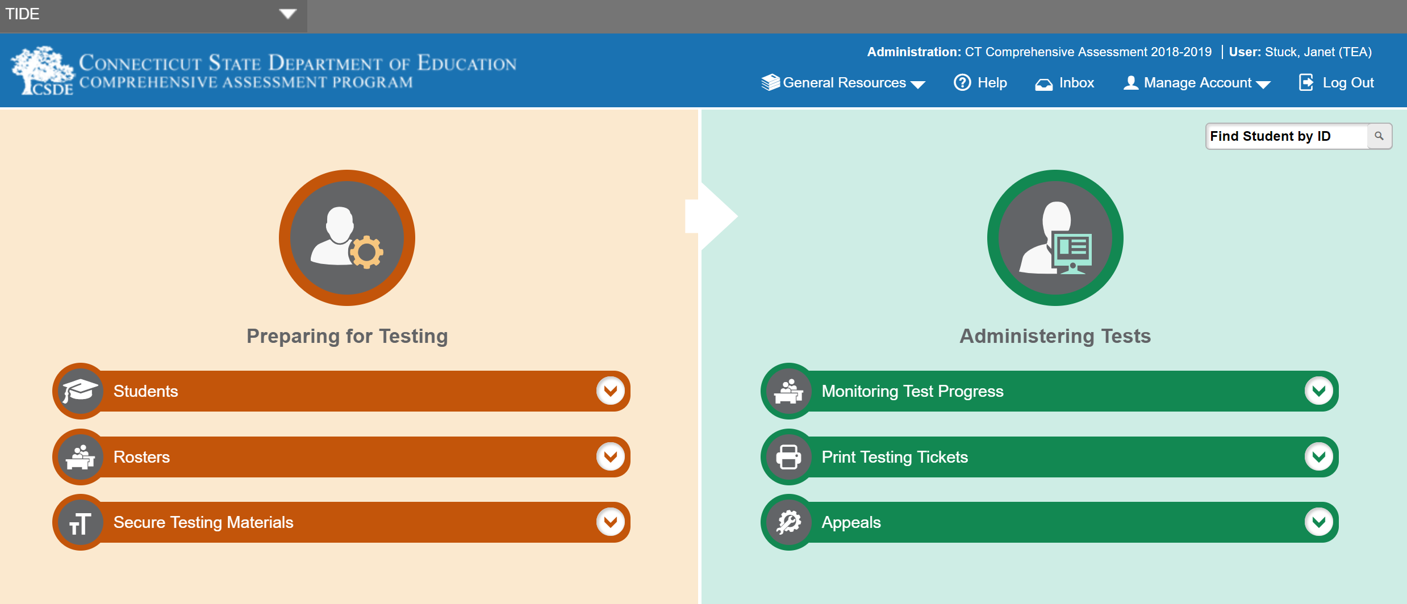
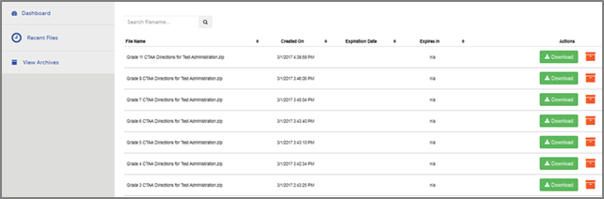
Secure Alternate Assessment Materials
Notes:
The required Connecticut Alternate Assessment (CTAA) Directions for Test Administration (DTAs) are secure testing materials and may be accessed ONLY by users with a TEA or DA role in the Test Information Distribution Engine (TIDE).
These grade-specific DTAs are required for test administration. Teachers should also use the Connecticut Alternate Assessment Test Administration Manual: CTAA Test Administration Manual (TAM) (cambiumast.com) prior to and during testing.
Additionally, secure PDFs of each grade and subject CTAA is available as an accommodation particularly for students who require the use of an eye gaze board or other communication supports.

Slide 96
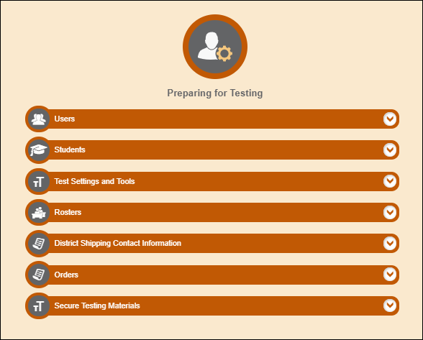
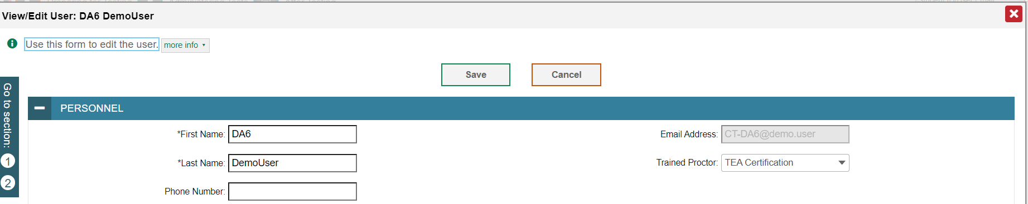
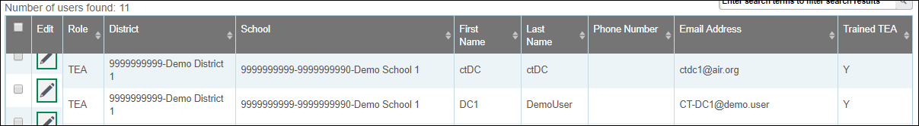
Only the DA has access to add/change/delete a TEA User Role
Confirming Trained Teacher Status
1
2
3
Notes:
DAs can create a roster in TIDE to confirm those TEAs who have been trained. We have highlighted the steps in this slide. If a teacher indicates that they completed the training and passed the quiz, but do not have access to the Connecticut Alternate Assessment System Eligibility Form or other Alternate Assessment Systems, verify their TIDE User Role. Only TEA user roles will provide teachers access to the Alternate Assessment systems.

Slide 97
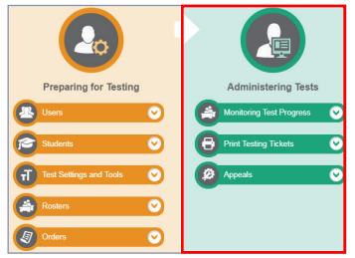
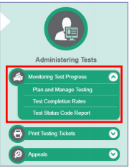
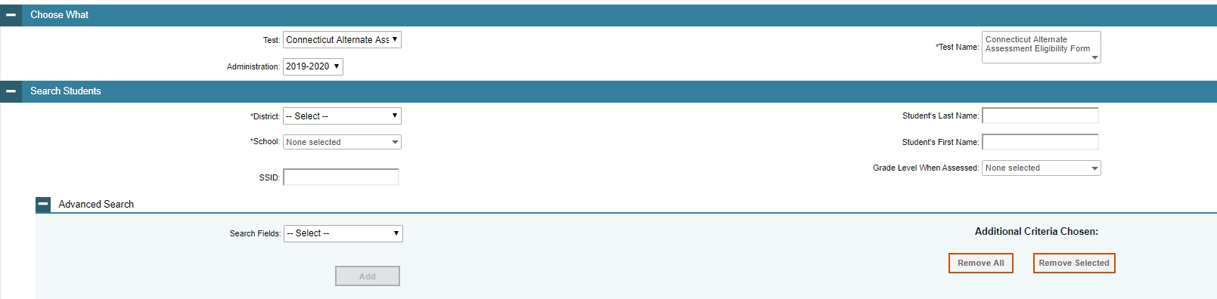
Monitoring Submissions
https://ct.portal.cambiumast.com/-/media/project/client-portals/connecticut/pdf/2019/monitoring-test-progress-brochure.pdf
Notes:
District Administrators may monitor the completion of CT Alternate Assessment Eligibility Form through the Plan and Manage Testing drop-down menu in the Administering Test portion of TIDE.

Slide 98
Questions

