Slide 1
District Administrator Training
January 2026
Notes:
Welcome to the spring 2026 District Administrator Training for Statewide Assessments. Administrators are welcome to use this material when conducting local training sessions for school coordinators and teachers. PDF copies of this presentation and transcript will be available on the CSDE Sensible Assessments Training webpage.

Slide 2
Webinar Reminders
The slide deck is linked in the chat.
This webinar will be recorded and posted.
There will be several points during the webinar to answer audio questions via the “raise hand” feature.
Chat questions will be answered, time permitting, via the chat. If your question is not addressed, please email ctstudentassessment@ct.gov for an answer.
No breaks are scheduled.
Thank you for attending and enjoy the webinar!
Notes:
The slide deck is available via the link in the chat.
This webinar is being recorded and will be posted for future reference.
Throughout the session, there will be several opportunities to ask questions using the “Raise Hand” feature.
Chat questions will be addressed as time permits. If your question is not answered during the webinar, please email ctstudentassessment@ct.gov for assistance.
Please note that no breaks are scheduled.
Thank you for joining us and enjoy the webinar!

Slide 3
The Performance Office
Data Collection, Assessment, Information Technology, Reporting, Research, and Accountability
Mission: Improve student outcomes through the use of data and technology.
  Goal #1: Data Collection
  Goal #2: Student Assessments
  Goal #3: Data Integration/Reporting
  Goal #4: Research and Analyses
  Goal #5: Accountability
Notes:
Welcome to the Performance Office. Our mission is to improve student outcomes through the use of data and technology. As shown on this slide, our goals include:
Goal 1. Data Collection
Goal 2. Student Assessments
Goal 3. Data Integration/Reporting
Goal 4. Research and Analyses
Goal 5. Accountability
There are a several ways to stay informed. First, visit the Performance Office website for the latest updates. You can also join the Performance Office Newsletter Listserv. To subscribe, send an email from the address you wish to receive notifications to listserv@list.ct.gov.
Finally, visit our webpage.

Slide 4
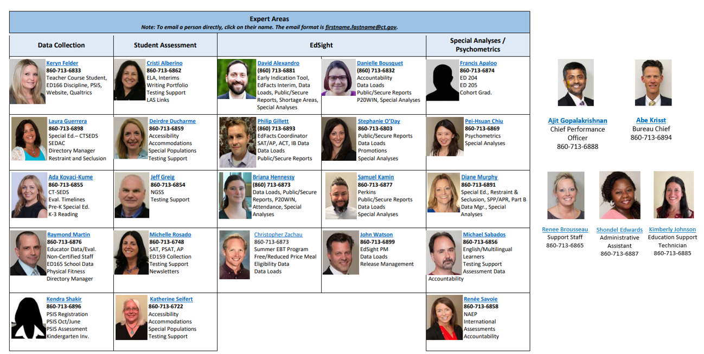
Performance Office Team
Notes:
Meet the staff from the Performance Office.

Slide 5
Cambium Project Team
  Jen Chou, Senior Program Director
  jennifer.chou@cambiumassessment.com
Marie Musumeci, Program Manager
marie.musumeci@cambiumassessment.com
Christine Jung, Program Coordinator
christine.jung@cambiumassessment.com
Notes:
Here is the contact information for the Cambium Team:
Jen Chou, Program Director; jennifer.chou@cambiumassessment.com
Marie Musumeci, Senior Program Coordinator; marie.musumeci@cambiumassessment.com
Christine Jung, Program Coordinator; christine.jung@cambiumassessment.com

Slide 6
Who and When Do I Contact?
Performance Office
860-713-6860
ctstudentassessment@ct.gov
If you have questions pertaining to:
State policy test administration questions
Accommodations, designated supports, customized accommodations, special circumstances
Reporting of security breaches
CT-SEDS/TIDE syncing issues
Notes:
Contact the Performance Office at 860-713-6860 or ctstudentassessment@ct.gov if you have questions pertaining to:
State policy test administration questions
Accommodations, designated supports, customized accommodations, special circumstances
Reporting of security breaches
CT-SEDS/TIDE syncing issues

Slide 7
Who and When Do I Contact? - Continued
Connecticut Help Desk-Cambium Assessment
844-202-7583
cthelpdesk@cambiumassessment.com
If you have questions pertaining to:
Test administration procedure questions
Secure browser
Technology questions
Notes:
Contact the Connecticut Help Desk-Cambium Assessment at 844-202-7583 or cthelpdesk@cambiumassessment.com if you have questions pertaining to:
Test administration procedure questions
Secure browser
Technology questions

Slide 8
Presentation Overview
Overview of Summative Assessments
Cambium System Overview
Special Populations Update
Connecticut Alternate Assessments
Notes:
In this presentation we will cover the following topics:
Overview of Summative Assessments
Cambium System Overview
Special Populations Update
Connecticut Alternate Assessments

Slide 9
2026 Assessment Calendar
State Assessment | Grade(s) | Testing Window | Delivery Method
Connecticut Alternate Assessment of English Language Proficiency (CAAELP) | K–12 | January 12–March 6, 2026 | Online
Smarter Balanced ELA & Math | 3–8 | March 23 –May 29, 2026 | Online
Connecticut Alternate Assessments (CTAA) | 3–8 and 11 | March 23–May 29, 2026 | Online
NGSS Assessments | 11 | February 2–May 29, 2026 | Online
NGSS Assessments | 5 and 8 | March 23–May 29, 2026 | Online
Connecticut Alternate Science Assessment (CTAS) | 5, 8, and 11 | Test administered throughout the school year. Student ratings entered in the DEI: March 23–May 29, 2026 | Online Upload March 23–May 29, 2026
Notes:
To assist districts with planning their calendars, the CSDE is providing the State Summative Assessment Calendar for Connecticut public schools for the 2025-26 school year.
Connecticut Sensible Assessment System--Summative Assessment - End-of-Year

Slide 10
SAT Bonus Info
CT SAT School Day Requirement for Grade 11 Students
Students registered in PSIS as Grade 11 are required to take the CT SAT.​
  The testing window is March 2–April 30, 2026.​
  Schools can choose whichever dates to test students. All students do NOT need to be tested on the same day. ​
  CT SAT School Test Coordinator Training
    In-Person Training February 3, 2026, 9:30-12:00 and 12:30-3:00. Register through the Connecticut State Department of Education (SDE) Events Calendar.
    Virtual Training is February 4, 2026, 11:00-1:00. Register for the webinar.​
  Resources and recorded webinars are posted to the CT SAT School Day webpage.
  Contact michelle.rosado@ct.gov with questions.
Notes:
The Connecticut SAT School Day is administered to all students in Grade 11 in Connecticut public schools. The Connecticut SAT School Day is strongly aligned to the CCS in ELA and mathematics. Scores for the Connecticut SAT School Day can also be used for the college admissions process. The Connecticut SAT School Day has two sections: reading and writing, and mathematics. Note the following:
The testing window is March 2–April 30, 2026.​
Schools can choose whichever dates to test students. All students do NOT need to be tested on the same day. ​
There are two options to attend the CT SAT School Test Coordinator Training:
In-Person Training February 3, 2026, 9:30-12:00 and 12:30-3:00. Register through the Connecticut State Department of Education (SDE) Events Calendar.
Virtual Training is February 4, 2026, 11:00-1:00. Register for the webinar.​
Resources and recorded webinars are posted to the CT SAT School Day webpage.
Contact michelle.rosado@ct.gov with questions.

Slide 11
What’s new? What’s the same?
New
TIDE has a new look!
Updated Secure Browser
2026- 27 Assessment Calendar
Change in Alert Notification – Hotline Direct
Clarifications for the Connecticut Alternate Assessment System Early Stopping Rule Process
One copy of Individual Student Reports (ISR’s)
Test Administration Review
Student-Centered Assessment for Learning (SCALE) Initiative
Same
Designated supports and accommodations
Data sync between PSIS and CT-SEDS
Cambium Systems
Office Hours
Teacher Training Slide Deck
Testing students out-of-state and in non-approved facilities
Rolling release of results
Shipping paper manuals to districts
Timing and distribution of ISR’s
Affirmation/attestation page (Write in the word summative.)
Notes:
To ease any worries, let start with what remains the same this year?
There are no changes to designated supports and accommodations.
Student data is still syncing to TIDE from PSIS and CT-SEDS.
While the TIDE system has a new look, there are no changes to the Test Administration Interface and the Centralized Reporting System.
We will continue to offer Office Hours during the months of April and May.
The processes for CAAELP Domain Exemptions and the Early Stopping Rule (ESR) for the Alternate Assessment System remain the same, although we will provide clarifications on the ESR process later in this presentation.
We will be producing a Teacher Training Slide Deck and publishing it to the Training page of the Sensible Assessments webpage.

Slide 12
What’s New?
Test Administration Review (TAR)
What is TAR?
TAR is an effort to review and improve test administration practices among CSDE, districts, educators, and students through observations, interviews, and data analysis.
Why TAR?
Required by USED Peer Review Criteria: Critical Element 2.4 – Monitoring Test Administration – states “The State adequately monitors the administration of its State assessments to ensure that standardized test administration procedures are implemented with fidelity across districts and schools. Monitoring of test administration should be demonstrated for all assessments in the State system.”
Standards for Educational and Psychological Testing - Standard 6.1: “Test administrators should follow carefully the standardized procedures for administration and scoring specified by the test developer and any instructions from the test user. Those responsible for testing programs should provide appropriate training, documentation, and oversight…”
CSDE is committed to highest quality and continuous improvement.

Slide 13
What’s New?
Test Administration Review (TAR) - Continued
Who?
Through the CSDE’s Center for Educational Research Collaboration (CCERC), a team of researchers from the University of Hartford and the University of Connecticut have been identified to jointly conduct this work.
In collaboration with CSDE, they will develop observation protocols, conduct site visits, analyze data, and create reports to support systemic improvement of test administration protocols and practices.
When?
This effort will start during the Spring 2026 testing window with Smarter Balanced and NGSS assessments.
The research team and CSDE will be in contact with sampled districts over the next month.

Slide 14
What’s New? Student Centered Assessment for Learning (SCALE)
What is SCALE?
A statewide professional learning, coaching, and technical assistance program to strengthen Connecticut’s capacity to design, implement, and sustain balanced assessment systems (aka sensible assessment systems) that accelerate student learning.
SCALE will align with CSDE’s broader vision for teaching, learning, and assessment coherence, especially the important role of assessment for learning.
SCALE is optional for districts.
Why SCALE?
Section 1 of Public Act No. 24-93 requires CSDE to develop and implement a program of professional learning for educators on assessment literacy.
SCALE builds on the assessment audit conducted last year. The law requires the CSDE to evaluate the audit with the goals of eliminating redundant assessments, discouraging classroom test-prep activities, reducing testing time, and maximizing assessments that provide actionable information for teachers.

Slide 15
What’s new? SCALE Initiative - Continued
Who?
CSDE is partnering with the Center for Assessment and the RESCs to develop and implement SCALE.
When?
Beginning in the Spring of 2026 through school year 2027-28.
More information on the program will be distributed to districts in the next month.

Slide 16
State Policy Regarding Assessment Participation

Slide 17
Participation - Connecticut General Statutes 10-14n
    (b) (1) For the school year commencing July 1, 2015, and each school year thereafter, each student enrolled in grades three to eight, inclusive, and grade eleven in any public school shall, annually, take a mastery examination in reading, writing and mathematics during the regular school day.
    (3) For the school year commencing July 1, 2018, and each school year thereafter, each student enrolled in grades five, eight, and eleven in any public school shall annually take a state-wide mastery examination in science during the regular school day.
Notes:
This is the language that drives our summative testing for reading, writing, mathematics, and science.
Reference these statutes if needed when communicating with parents/guardians or other educators.

Slide 18
ESSA Requirements for Alternate Assessments
ESSA placed a 1.0% cap on the state participation rate for each subject, based on the total number of all students in the state assessed in the subject (34 CFR 200.6(c)(2)). This is to ensure that students with the most significant cognitive disabilities have access to the grade level, general education standards.
The CSDE has provided guidance and support to districts in making appropriate alternate eligibility determinations.
Notes:
The Every Student Succeeds Act (ESSA) ensures that educators, families, and communities receive essential information through annual statewide assessments.
One key requirement under ESSA is the state-level cap of 1.0% on the percentage of tested students in a subject area who participate in the Connecticut Alternate Assessment System. This percentage is calculated by dividing the number of students taking the Connecticut Alternate Assessments in a subject area by the total number of all students tested in that subject area.
While it is important for Connecticut to monitor and comply with the U.S. Department of Education guidance, the CSDE remains committed to supporting districts by providing resources and guidance on essential topics such as making appropriate eligibility determinations for alternate assessments.

Slide 19
PSIS/TIDE/CT-SEDS Data Sync

Slide 20
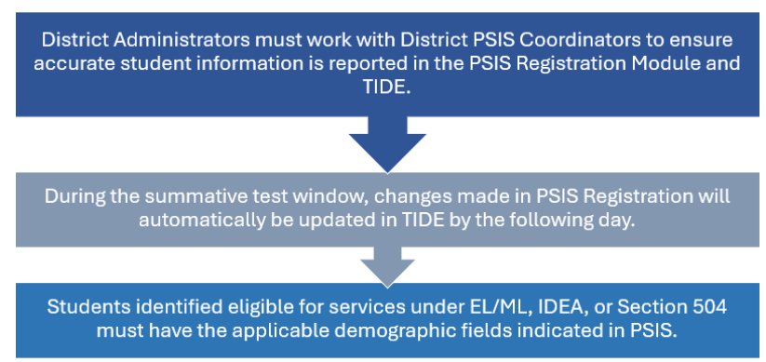
PSIS/TIDE Data Sync
Notes:
The Public School Information System (PSIS) provides data to test delivery systems for state summative assessments administered to Connecticut public school students. District PSIS Coordinators must work closely with Testing Coordinators, English Language Assessment Coordinators (ELACs), and SAT Test Coordinators to ensure that student information is being reported accurately, including these reporting categories:
Special Education (SPED) Status,
Free and Reduced Lunch (FRL) Status,
English Learner/Multilingual Learner (EL/ML) Status,
Military Family,
Homeless,
Recently Arrived EL/ML, and
Section 504 Status.

Slide 21
PSIS/TIDE Data Sync Reminders
Same process as last year…..
Testing Demographics SPED, FRL, EL/ML, Military Family, and Homeless values were loaded to TIDE in November 2025.
The values for Recently Arrived EL/ML and Section 504 were not pulled from Freeze Zero. These must be set in the PSIS Registration Module by the PSIS Coordinator. (Important: If Section 504 is not set in PSIS, accommodations cannot sync from CT-SEDS to TIDE.)
Student demographic values will be saved, and the fields locked in PSIS on May 29, 2026. All changes to a student’s status at the time of testing must be made by following dates:
  March 6, 2026, for LAS Links and CAAELP
  April 30, 2026, for the Connecticut SAT School Day
  May 29, 2026, for Smarter Balanced Assessments, NGSS, CTAS, and CTAA
Students who are repeaters should be retested.
Student grade in PSIS is the grade in which the test is given.
Grade 11 “skippers” are not tested.
Notes:
Here are some critical facts for the PSIS/TIDE Sync.
The SPED, FRL, EL/ML, Military Family, and Homeless have been loaded to TIDE with the values reported in the October PSIS Collection Freeze Zero file (i.e., freeze file from the collection generated on October 30, 2025). However, the values for Recently Arrived EL and Section 504 were not pulled from Freeze Zero because these data are not reported in the PSIS October collection. These values have been set to “No” in the Registration Module and must be updated in the PSIS Registration Module for testing and reporting purposes. Once updated in PSIS, allow up to 24 hours for the updated demographics to upload to TIDE. Once the Section 504 indicator is set to YES in TIDE, designated supports and accommodations will sync with CT-SEDS.

Slide 22
PSIS/TIDE Data Sync
Student Status Change
Status | If student has already taken any state assessment | If student has not already taken any state assessment
If SPED/EL/FRL was YES originally and then changed | Leave status as YES for all tests | Change status to NO for all tests
If SPED/EL/FRL was NO originally and then changed | Change to YES for all subsequent tests and the CSDE will apply this status for all tests | Change status to YES
*Making these changes may impact the student eligibility for designated supports and accommodations.
Refer to the November 2025 edition of the Student Assessment Newsletter for details on PSIS and state assessments.

Slide 23
CT-SEDS/TIDE Data Sync
Designated supports and accommodations must be identified for the student’s current grade (and all grades covered by the duration of the plan) in finalized and implemented plans in CT-SEDS.
The Alternate Assessment Indicator in TIDE will activate for students who qualify for the Alternate Assessment per the completion of the Connecticut Alternate Assessment System Eligibility Form for the student's current grade.
Designated supports and accommodations are updated daily in TIDE to reflect changes made to students’ plans in CT-SEDS within 48 hours of finalization and the implementation date. Educators should never manually update accommodations in TIDE for students with an IEP or Section 504 Plan.
Refer to the CT-SEDS to TIDE Designated Supports and Accommodations FAQ and the Documenting Designated Supports and Accommodations in TIDE for additional guidance.
Notes:
Designated supports and accommodations must be identified for the student’s current grade in CT-SEDS on the District/Statewide Assessment Tile. Plans must be finalized and implemented before accommodations can sync to TIDE. Also, teams should plan and document accommodations for all grades covered by the duration of the plan. This enables students to have access to accommodations if taking interim assessments earlier in the school year.
The Alternate Assessment Indicator in TIDE will activate for students who qualify for the Connecticut Alternate Assessment System per the completion of the Connecticut Alternate Assessment System Eligibility Form embedded within CT-SEDS. This form must be completed annually and align to the student’s current grade of enrollment. The plan must be finalized and implemented for the alternate assessment data to sync to TIDE.

Slide 24
Test Security Overview
Notes:
In this next section, we will review test security protocols.

Slide 25
Test Security
Breaches of test security include, but are not limited to:
  Analyzing/copying test items
  Coaching students
  Giving students answers and/or changing students’ answers
  Allowing students access to digital, electronic, or manual devices (except approved accommodations)
  Unauthorized log-in to the Test Delivery System
  Cell phone (including Smart Watches) use by students is prohibited!
Notes:
Breaches of test security include analyzing or copying test items, coaching students or giving students answers and changing students’ answers. We do not allow students to access to digital, electronic, or manual devices (except for approved accommodations). Any unauthorized log-in to the Test Delivery System may also be a breach of test security. This list is not comprehensive, but this represents most issues we see when it comes to issues in test security.
Please note that the use of cell phones (including Smart Watches) by students is strictly prohibited!

Slide 26
Test Security and Proctoring
Violation of test security is a serious matter with far-reaching consequences. Breaches of test security include, but are not limited to, copying or photographing of test materials, failing to return test materials, coaching students, giving students answers, and/or changing students’ answers. Such acts may lead to the invalidation of an entire school district’s student test scores, disruption of the test system statewide, and legal action against the individual(s) committing the breach. A breach of test security may be dealt with as a violation of the Code of Professional Responsibility for Teachers, as well as a violation of other pertinent state and federal law and regulation. The Connecticut State Department of Education will investigate all such matters and pursue appropriate follow-up action. Any person found to have intentionally breached the security of the test system may be subject to sanctions including, but not limited to, disciplinary action by a local board of education, the revocation of Connecticut teaching certification by the State Board of Education,* and civil liability pursuant to federal copyright law.
*See Section 10-145b(i) (2) (E) of the Connecticut General Statutes, which reads in relevant part as follows: The State Board of Education may revoke any certificate, permit, or authorization issued pursuant to said sections if the holder is found to have intentionally disclosed specific questions or answers to students, or otherwise improperly breached the security of any administration of a mastery examination, pursuant to section 10-14n.
Notes:
Please review this with your staff to be aware of the state statutes concerning test security.

Slide 27
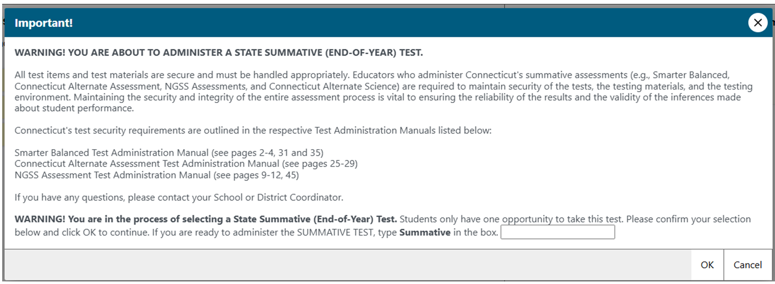
Test Administrator Security Confirmation/Attestation Page
Test Administrator (TA) Confirmation Screen
Notes:
This is the Test Administrator (TA) confirmation screen. It will appear again this year, and TAs will have to select OK to proceed and begin creating test sessions.
This process is not new -we have followed this protocol for several years. It is essential that all school proctors and test administrators receive local training and carefully use the Test Administration Manuals when planning and administering tests.
Additionally, when selecting a summative assessment, users will be prompted to type in the word summative.

Slide 28
Improprieties, Irregularities, and Breaches

Slide 29
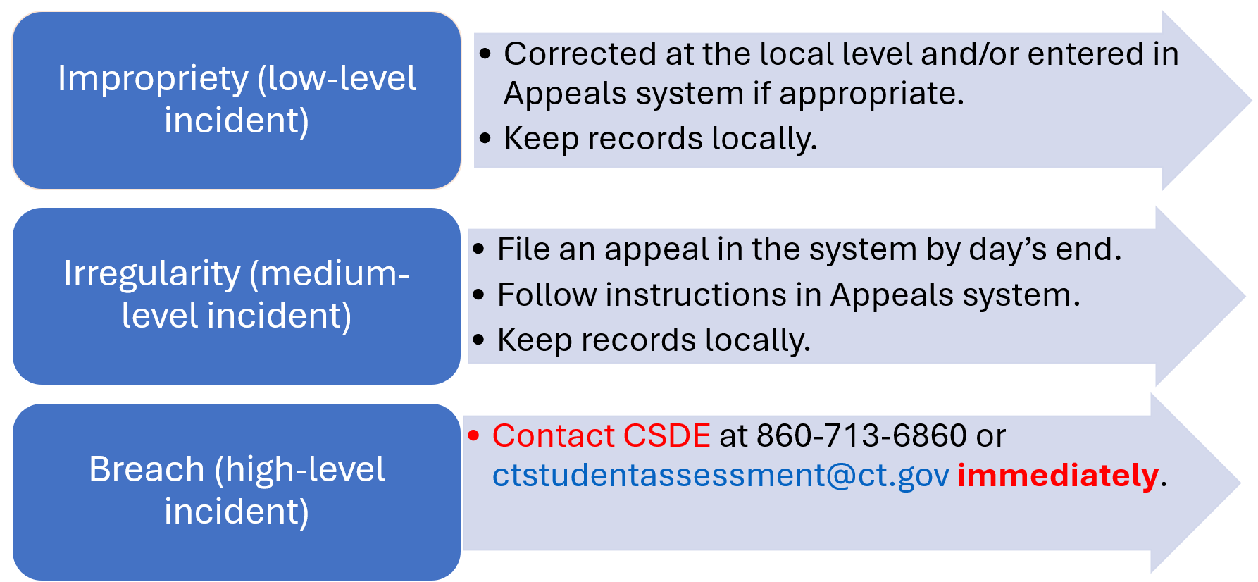
Test Security Actions
Note: The Test Security Levels are described in Appendix G of the Test Coordinator’s Manual.
Notes:
Let’s review the three levels of Test Security Actions:
Impropriety (low-level incident): Corrected at the local level and/or entered in Appeals system if appropriate. Keep records locally.
Irregularity (medium-level incident): File an appeal in the system by end of day. Follow instructions in the Appeals system. Keep records locally.
Breach (high-level incident): Contact the CSDE at 860-713-6860 or ctstudentassessment@ct.gov immediately.
Note: The Test Security Levels are described in Appendix G of the Test Coordinator’s Manual.

Slide 30
Appeal Types
Appeal | Description
Re-open a Test | Allows for a test that has already been submitted in error or has expired to be re-opened.
Re-open a Test Segment | Re-opening a test segment allows a student to access the first segment of a test that was submitted in error.
Grace Period Extension | Granted if a test session is unexpectedly interrupted. Allows access to all previous responses.
Reset a Test | Removes the test and scores from the system. Enables student to start a new test.
Invalidate a Test | Rarely used. Eliminates the test. Student does not receive a score.
Notes:
There are three classifications for test security incidents: Breach, Irregularity, and Impropriety. Definitions for each are as follows:
Breach: A test security incident that poses a threat to the validity of the test. Examples may include such situations as a release of secure materials or a security/system risk. These circumstances have external implications and may result in a decision to remove the test item(s) from the available, secure item bank. A breach incident must be reported to the District Administrator immediately and entered in TIDE (should an appeal be required). Breaches require immediate attention and escalation to the CSDE. The District Administrator must immediately notify the CSDE by telephone at 860-713-6860.
Irregularity: A test security incident that impacts an individual or group of students who are testing and may potentially affect student performance on the test, test security, or test validity. These circumstances can be corrected by the district/school and submitted in the online Appeals system for resolution, if necessary. An irregularity must be reported to the District Administrator immediately and entered into the Appeals module in TIDE (should an appeal be required).
Impropriety: A test security incident that has a low impact on the individual or group of students who are testing and has a low risk of potentially affecting student performance on the test, test security, or test validity. These circumstances can be corrected and contained at the local level. An impropriety should be reported to the District Administrator and/or School Test Coordinator immediately and entered into the Appeals module in TIDE (should an appeal be required).
It is important for test examiners to ensure that the physical conditions in the testing room meet the criteria for a secure test environment. See section Security of the Test Environment in the Test Administration Manual for more detail.

Slide 31
Tips for Entering Appeals
Enter Appeals Judiciously | Staff entering appeals should be trained. CSDE is reviewing every appeal closely. Provide necessary information in the entry box.
Re-open or Grace Period Extension should only be used when needed | Students should not be allowed back into the test just to double check work if they already submitted their test. Students are encouraged to review items prior to ending their test.
Unsure of what to do, reach out for help | Contact the CSDE with any questions. ctstudentassessment@ct.gov; 860-713-6860; 860-713-6862 or email Cristi.Alberino@ct.gov
Notes:
For security incidents that result in a need to reset, reopen, allow a grace period extension, restore, or invalidate individual student tests, the CSDE must first approve the request. The CSDE works diligently to address appeals within 24 hours. In most instances, an appeal will be submitted to address a test security breach or irregularity. In some cases, an appeal may be submitted to address incidents that are not security related, such as reopening an assessment for a student who becomes ill and is unable to resume testing because the test has expired. If an appeal needs to be submitted and approved quickly, please call the CSDE Performance Office using the contact information provided in Appendix A. Because the appeals system is for action only, all appeals should also be reported to the District Administrator. Note that appeals should be submitted cautiously. Reopening tests, for example, can lead to security issues and should be used sparingly. Contact the CSDE for guidance on potential test irregularities and next steps.

Slide 32
Appeals Process for an Accommodation Issue
The DA must send a signed letter to the CSDE on letterhead that must include:
  The student’s grade, SASID, and the name of the test on which the irregularity occurred;
  The date and a detailed explanation of the irregularity;
  The name of the proctor;
  A description of the discussion with parents/guardians explaining the irregularity, and options offered; and
  Procedures to ensure the irregularity is not repeated.
  Can be emailed with SASID only (no student name) or posted to TIDE Secure File Center.
Notes:
If a testing irregularity occurs, or if a student with an IEP or Section 504 Plan is not given the correct assessment or is not provided the mandated accommodations, in most cases the DA will be asked to provide a letter to the CSDE on their district/school letterhead. Letters submitted must be on district/school letterhead, signed by the DA, and emailed to Cristi.Alberino@ct.gov or sent via the TIDE Secure File Center. Please do not email student information. Documentation may also be faxed to Performance Office Irregularities at 860-713-7033. The letter must include:
The student’s grade, SASID, and the name of the test on which the irregularity occurred.
The date and a detailed explanation of the irregularity.
The name of the teacher involved.
A description of the discussion that occurred with parents/guardians of the student explaining the irregularity, options offered, and impact on the student’s time; and
A brief list of procedures in place to ensure that this type of irregularity is not repeated.
The online appeals process, and conditions for use, are described in the TIDE User Guide with specific instructions on submitting appeal requests.
Can be emailed with SASID only (no student name) or posted to TIDE Secure File Center.

Slide 33
Testing Time Reminders

Slide 34
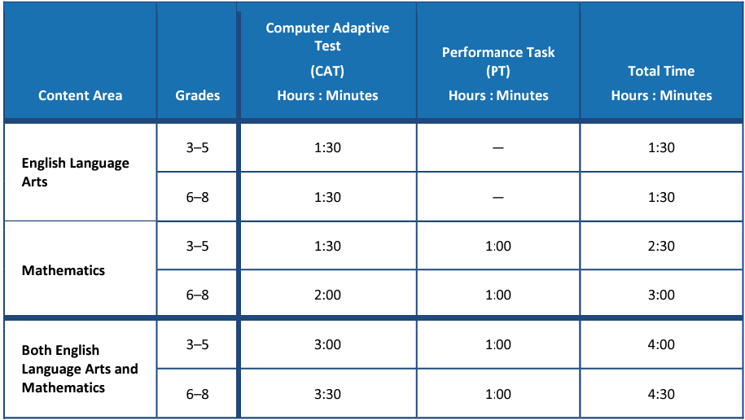
Recommended Test Times
Some districts are testing much more than the suggested time.
Please monitor this closely. Extra time does not necessarily correlate with achievement and very low/high times may represent lack of effort, motivation, or active proctoring.
Notes:
These are the suggested times for ELA and Math.
Some districts are testing much more than the suggested time for each test. While this is not a timed test, and students may need more than the suggested time, please monitor this closely. Extra time does not necessarily correlate with achievement and very low/high times may represent lack of effort, motivation, or active proctoring.

Slide 35
Recommended Test Times - Continued
NGSS can be administered in one day or two consecutive days.
The recommended testing time is at least 90 minutes for testing with an additional 10 minutes for directions.
Pause rules: If a student pauses a test, a 20-minute pause timer starts running.
    If a student resumes the test within 20 minutes, they can review previously answered questions.
    If a student resumes the test after 20 minutes, they cannot access previously answered questions, only unanswered questions.
Notes:
The NGSS can be administered in one day or over two consecutive days.
The recommended testing time is at least 90 minutes for testing with an additional 10 minutes provided to read the directions to the students.
Remember the pause rules: If a student pauses a test, a 20-minute pause timer starts running.
If a student resumes the test within 20 minutes, they can review previously answered questions.
If a student resumes the test after 20 minutes, they cannot review previously answered questions. They can only work on unanswered questions.

Slide 36
Testing Administration Reminders

Slide 37
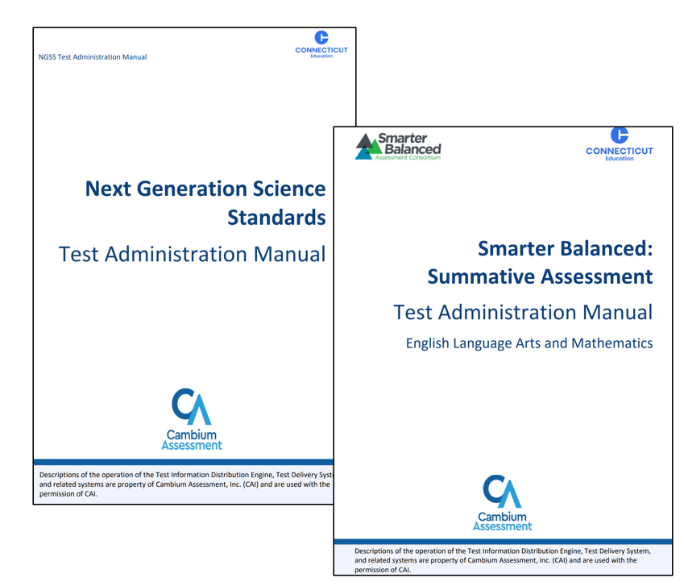
Test Administration Reminders
Remove or cover instructional materials.
Ensure sufficient spacing between student seating.
Prepare the test setting (e.g., small group, lighting, testing devices, assistive technology etc.).
Set up a practice test experience for all students and model how to use universal tools, designated supports, and accommodations (e.g., text-to-speech, speech-to-text) with those students using them.
Ensure student’s have scrap paper and any non-embedded designated support/accommodation identified in TIDE.
Headsets are also required on the Smarter Balanced ELA Listening Assessments.
Notes:
Test Administrators should distribute:
scratch paper to students for all test sessions (scratch paper can include plain paper, lined paper, paddy paper, or graph paper) for ELA, math, or science.
graph paper to students in Grades 6, 7, and 8 for the mathematics assessments; and
headphones to students for the listening portion of the English language arts assessments, to students who require Audio Glossaries on the mathematics assessments, and students who require text-to-speech on either assessment.
Be sure to provide students with any non-embedded designated supports or accommodations that they are approved for.
Other reminders:
Instructional materials must be removed or covered, including but not limited to, information that might assist students in answering questions. This includes materials that may be displayed on bulletin boards, chalkboards or dry-erase boards, or on charts (e.g., wall charts that contain literary definitions, maps, mathematics formulas, etc.).
Students must be seated so there is enough space between them to minimize opportunities to look at each other’s work, or they should be provided with tabletop partitions. Students may also be tested on an individual basis as appropriate.
If helpful, place a “TESTING—DO NOT DISTURB” sign on the door or post signs in halls and entrances rerouting hallway traffic in order to promote optimum testing conditions.

Slide 38

Questions
Use “Raise Hand” Tool

Slide 39
CAI System

Slide 40
Connecticut (CT) Comprehensive Assessment Program Portal
All CAI systems and resource materials can be accessed on the Connecticut Comprehensive Assessment Program Portal
(https://ct.portal.cambiumast.com/).
Notes:
This is the link to the CT Comprehensive Assessment Portal. All systems and resources for the summative tests are available on this site.

Slide 41
Secure Browser Updates
The Secure Browser prohibits access to other programs or websites during testing.
The 2025-26 Secure Browser was released in September 2025. Download the latest secure browser from the portal. The secure browser from 2024-25 no longer works.
Students are required to use the Secure Browser to take the summative Smarter Balanced, NGSS, the CTAA Math and ELA Assessments, and the CAAELP.
Notes:
The Secure Browser is designed to ensure test security by prohibiting students from accessing any other programs or websites during testing.
The 2025-26 Secure Browser was released in September 2025. Download the latest secure browser from the portal. The secure browser from 2025-26 will no longer work.
Students will be required to use the Secure Browser on their device to take the summative Smarter Balanced, NGSS, the CTAA math and ELA assessments, and the CAAELP.

Slide 42
Chrome Update
New SecureTest PWA app
In past school years, secure testing on ChromeOS (Chromebook) was conducted using Cambium Assessment’s (CAI) SecureTestBrowser Chrome App running in Kiosk mode. However, Google has deprecated Chrome Apps. As a result, we have transitioned to the SecureTest Progressive Web App (PWA) secure browser.
Setting up the SecureTest PWA browser requires multiple configuration steps to ensure that it is configured properly in the Google Admin Console (GAC). CAI has created a SecureTest PWA Browser Troubleshooting Guide that has been posted to the Portal. If you encounter any problems, please consult the guide or contact the Help Desk.

Slide 43
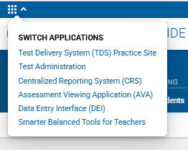
Accessing Systems
All user accounts were rolled over and passwords reset in September 2025.
If you log in on a new device or browser (or clear the cache) you must enter an emailed code after passing the login screen. This step does not occur when you activate your account.

Slide 44
Single Sign-On Password Policy
Password policy
One (1) uppercase letter
One (1) lowercase letter
One (1) number
One (1) special character
Min 12 characters (increase from min 8 characters)
Different from last 24 passwords (increase from last 2 passwords)
Notes:
All user accounts were rolled over and passwords reset in September 2025
If you log in on a new device or browser (or clear the cache on a previously-used browser) you must enter an emailed code after passing the initial login screen. This step does not occur when you activate your account for the first time.

Slide 45
Test Information Distribution Engine (TIDE)
Refer to the TIDE User Guide for details.
Features include the following:
  Add/Manage User Accounts
  Review Student Demographic Information
  Review/Edit Student Settings and Tools (Note: Accommodations should not be changed directly in TIDE. All accommodations are imported from CT-SEDS.)
  Create/Submit Appeals
  Create and Submit TIDE forms
  Create Rosters (Understanding and Creating Rosters)
  Order Paper Materials (i.e., large print and braille test booklets)
  Run Participation Reports (Accessing Participation Reports)
Notes:
TIDE supports state, district, and school test coordinators throughout the testing process, from test preparation, to test administration, to post-administration. Refer to the TIDE User Guide for details. Features include the following:
Add/Manage User Accounts
Review Student Demographic Information
Review/Edit Student Settings (Note: Accommodations should not be changed directly in TIDE. All accommodations are imported from CT-SEDS.)
Create/Submit Appeals
Create Rosters (Understanding and Creating Rosters)
Order Paper Materials (i.e., large print and braille test booklets)
Run Participation Reports (Accessing Participation Reports)

Slide 46
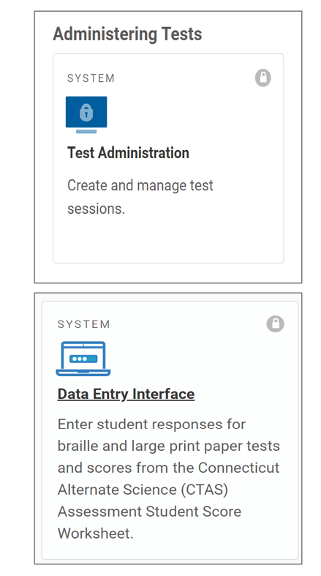
TIDE Reminders
All students taking a summative assessment need to be in TIDE. Work with your PSIS Coordinator if there are concerns about missing students or incorrect student demographics.
All users who are proctoring a summative assessment or need access to the Data Entry Interface (DEI) need to have an account in TIDE.
Notes:
All students taking a summative assessment need to be in TIDE. Work with your PSIS Coordinator if there are concerns about missing students or incorrect student demographics.
All users who are proctoring a summative assessment or need access to the Data Entry Interface (DEI) need to have an account in TIDE. Refer to the User Role Permissions brochure for details about various user roles and corresponding access to different systems for secure online testing.

Slide 47
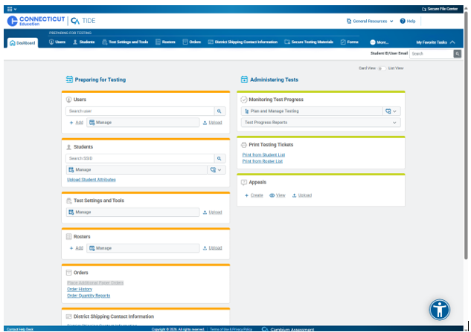
TIDE’s New Look
"Card-based" Layout

Slide 48
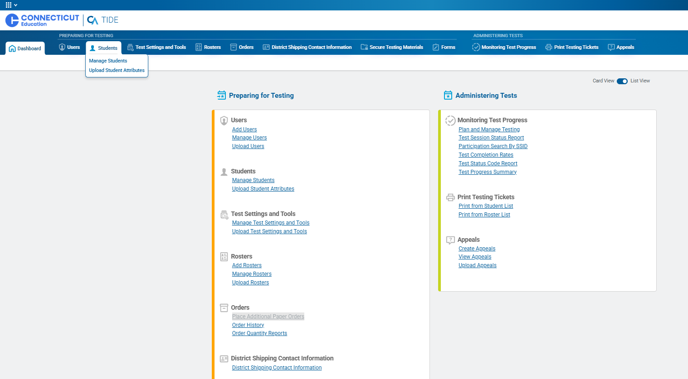
TIDE’s List-Based Layout
"List-based" Layout

Slide 49
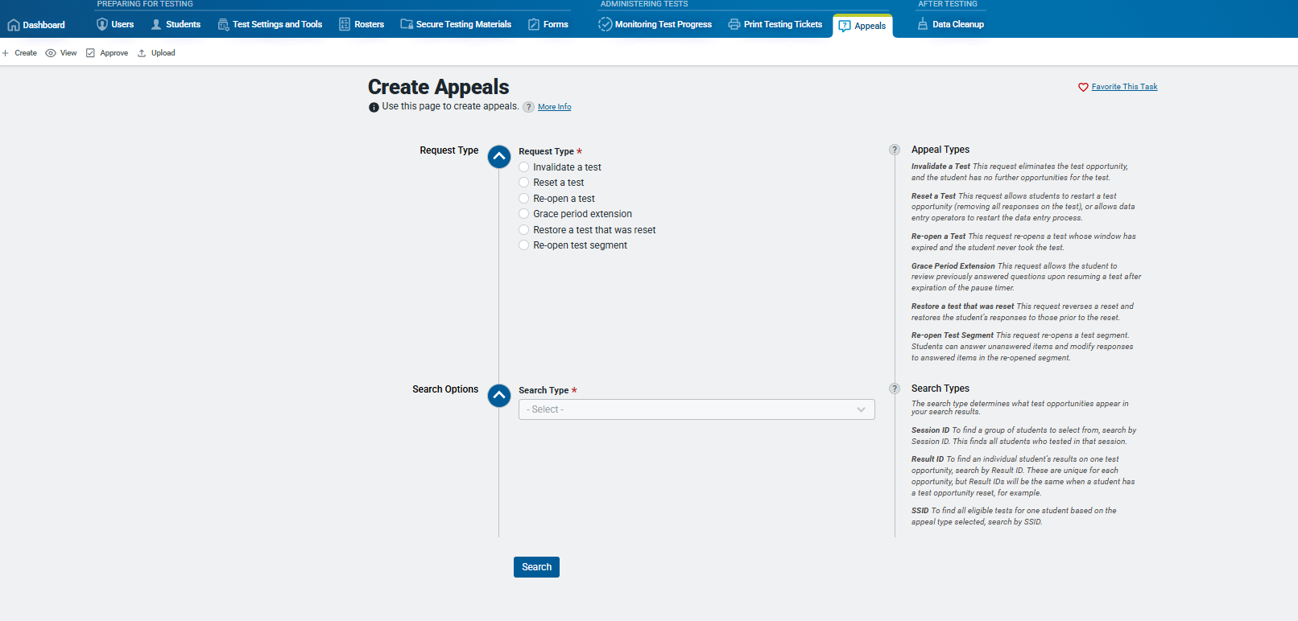
TIDE’s List-Based Layout- Continued
Tasks are featured in the center to help shift user focus.
Descriptions have been added to the right rather than buried within a tool tip.

Slide 50
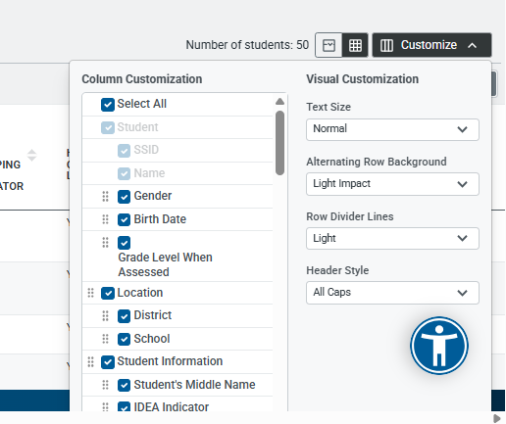
TIDE’s Customize View

Slide 51
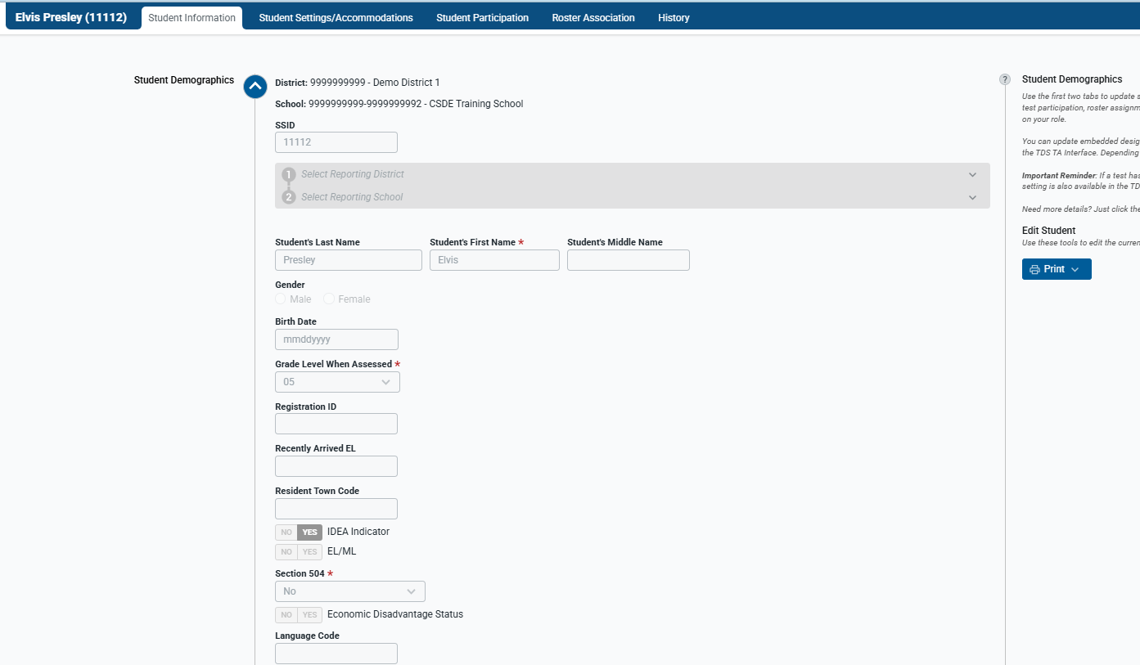
TIDE Student Dashboard

Slide 52
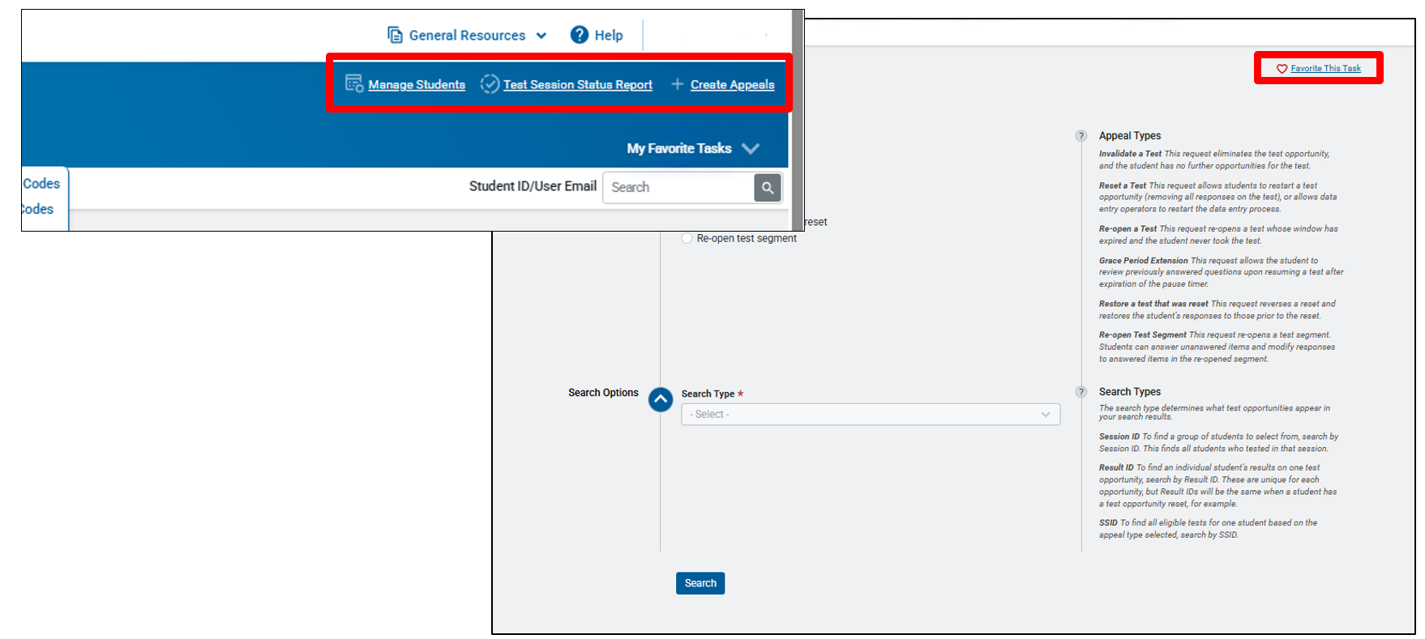
TIDE: Customize Favorites

Slide 53
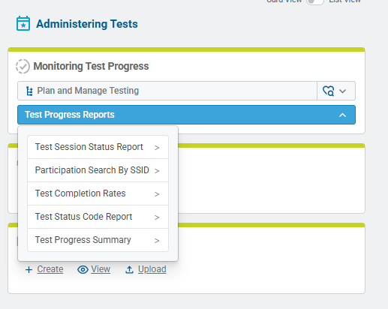
TIDE Participation Reports
Plan and Manage Testing
Test Session Status Report
Participation Search by SSID
Test Completion Rates
Test Status Code Report
Test Progress Summary
Notes:
It is very important that districts and schools track test completion for students taking summative assessments. A variety of reports are available in TIDE and can be used as tools to track test completion.
Refer to the Monitoring Test Progress brochure for information on generating Test Status Code Reports and Test Completion Rates in TIDE.

Slide 54
TIDE Participation Reports
(Test Session Status Report)
Used to view each student’s test status and all special codes to explain a student’s non-participation in a test.
Displays all test statuses for each test for which each student in a district/school is eligible.
Generated at the district level or at the school level, depending on your user role.
Generated for each test to obtain an accurate picture reflecting the testing status of all students for all tests by school or district.
Useful for summative assessments.
Notes:
The test completion rate report is a high-level report used to summarize the number and percentage of students who have started or completed a test.
May be generated at the district or school level, depending on your user role.
All students in the specified school or district will be included in this report.
Report should be generated for each test to obtain an accurate picture that reflects the testing status of all students for all tests in the school or district.
Users will be able to view test completion data by combo tests (e.g., completion of both the Math CAT and Math PT).

Slide 55
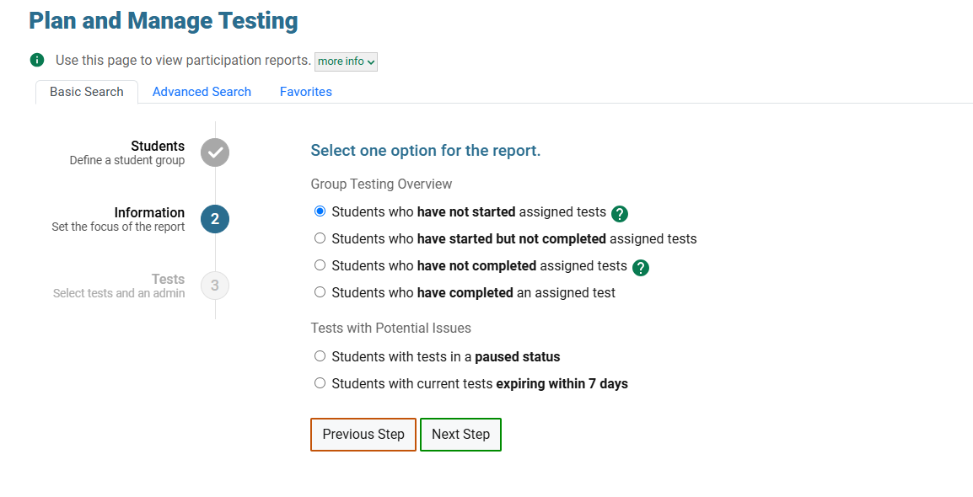

TIDE Participation Reports
(Plan and Manage Testing)
The Plan and Manage Testing Report includes quick-access reports and smart defaults.
This means fewer mouse clicks and fewer decisions required of users to answer questions such as, “Who still needs to test?”
Provides a list of general reports that can be generated.
Notes:
This report provides a detailed view of each student’s test status along with any special coding explain non-participation (e.g., ESR, CAAELP Domain Exemption).
It displays all test statuses for every assessment for which each student in a district or school is eligible.
The participation report can be generated at either the district or school level, depending on your user role. To ensure accuracy, the report should be generated for each test, giving a complete picture of all students’ testing status across all assessments in the school, district, or in specialized programs (e.g., ASEPS).

Slide 56
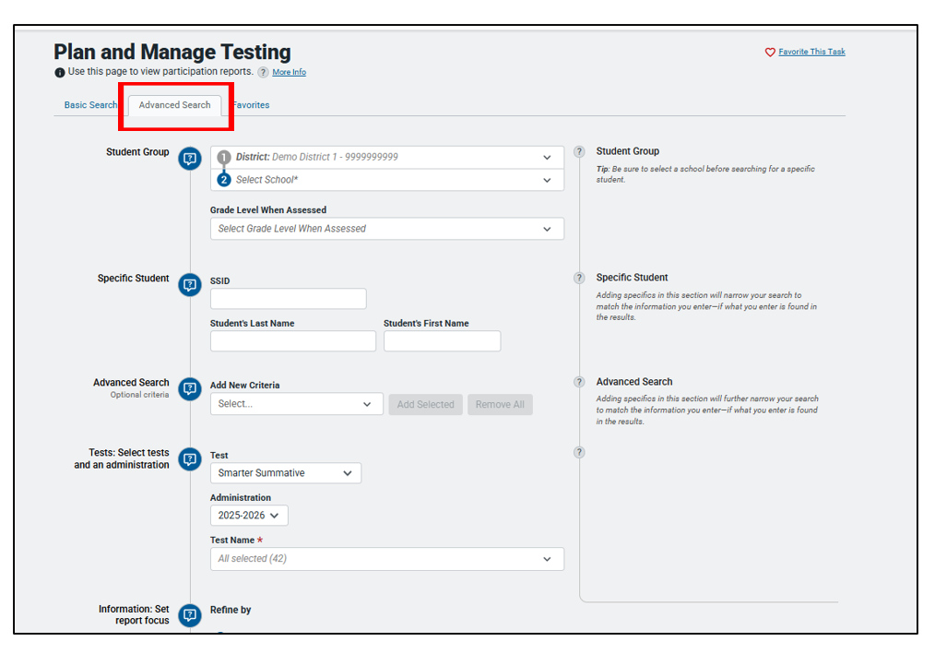
TIDE Participation Reports
(Plan and Manage Testing): Advanced Search
If you need something more than the quick-access report, an advanced view of the Plan and Manage Testing report can be found under advanced search. This will allow you to create more detailed participation searches.

Slide 57
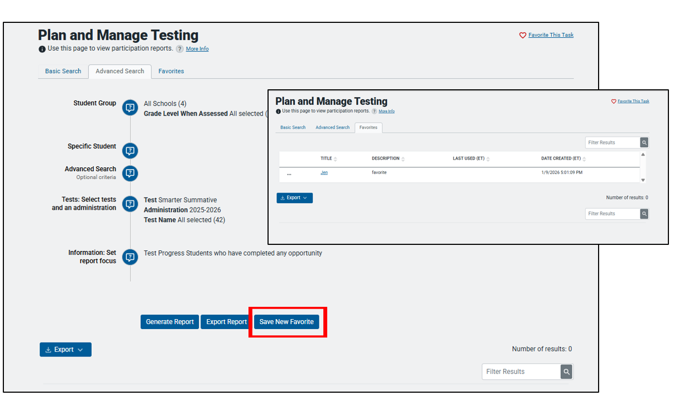
TIDE Participation Reports
(Plan and Manage Testing): Save New Favorite
You can also create your own personal report and save it which will allow you to return to and rerun the report.

Slide 58
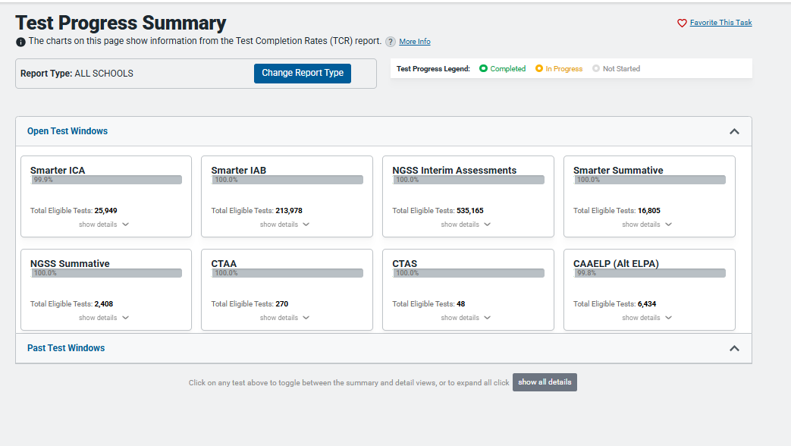
TIDE Participation Reports
(Test Progress Summary Dashboard)
The Test Progress Summary Dashboard provides charts of the information available in Test Completion Report to provide a quick visual reference.

Slide 59
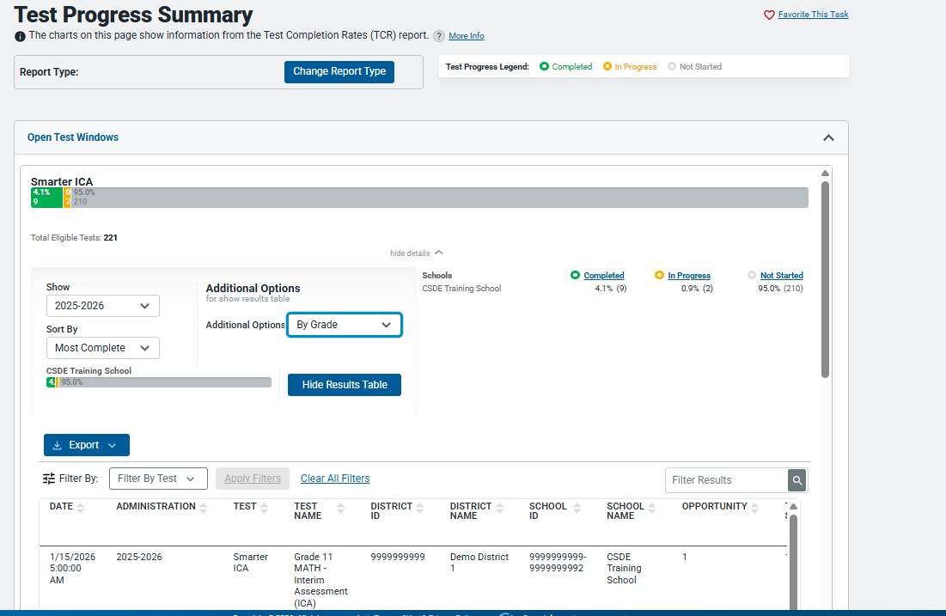
TIDE Participation Reports
(Test Progress Summary) - Continued

Slide 60
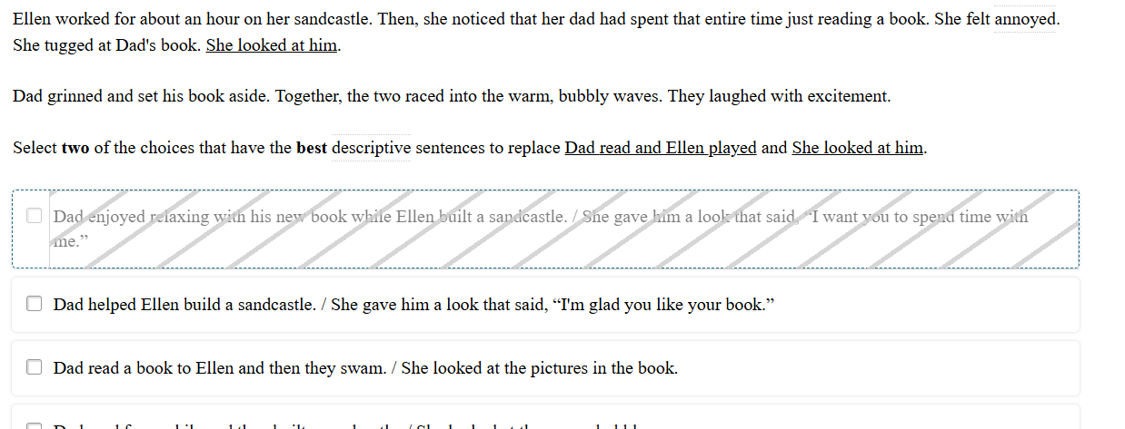
Test Delivery Interface (TDS): Dense Strikethrough
New version of strikethrough uses several diagonal lines to cover the selected option.

Slide 61
Questions
Use “Raise Hand” Tool

Slide 62

Accessibility and Special Populations
Notes:
Now we will discuss a variety of accessibility features that are available on statewide assessments, including language supports for ELs/MLs, and accommodations for eligible students with IEPs and Section 504 Plans.

Slide 63
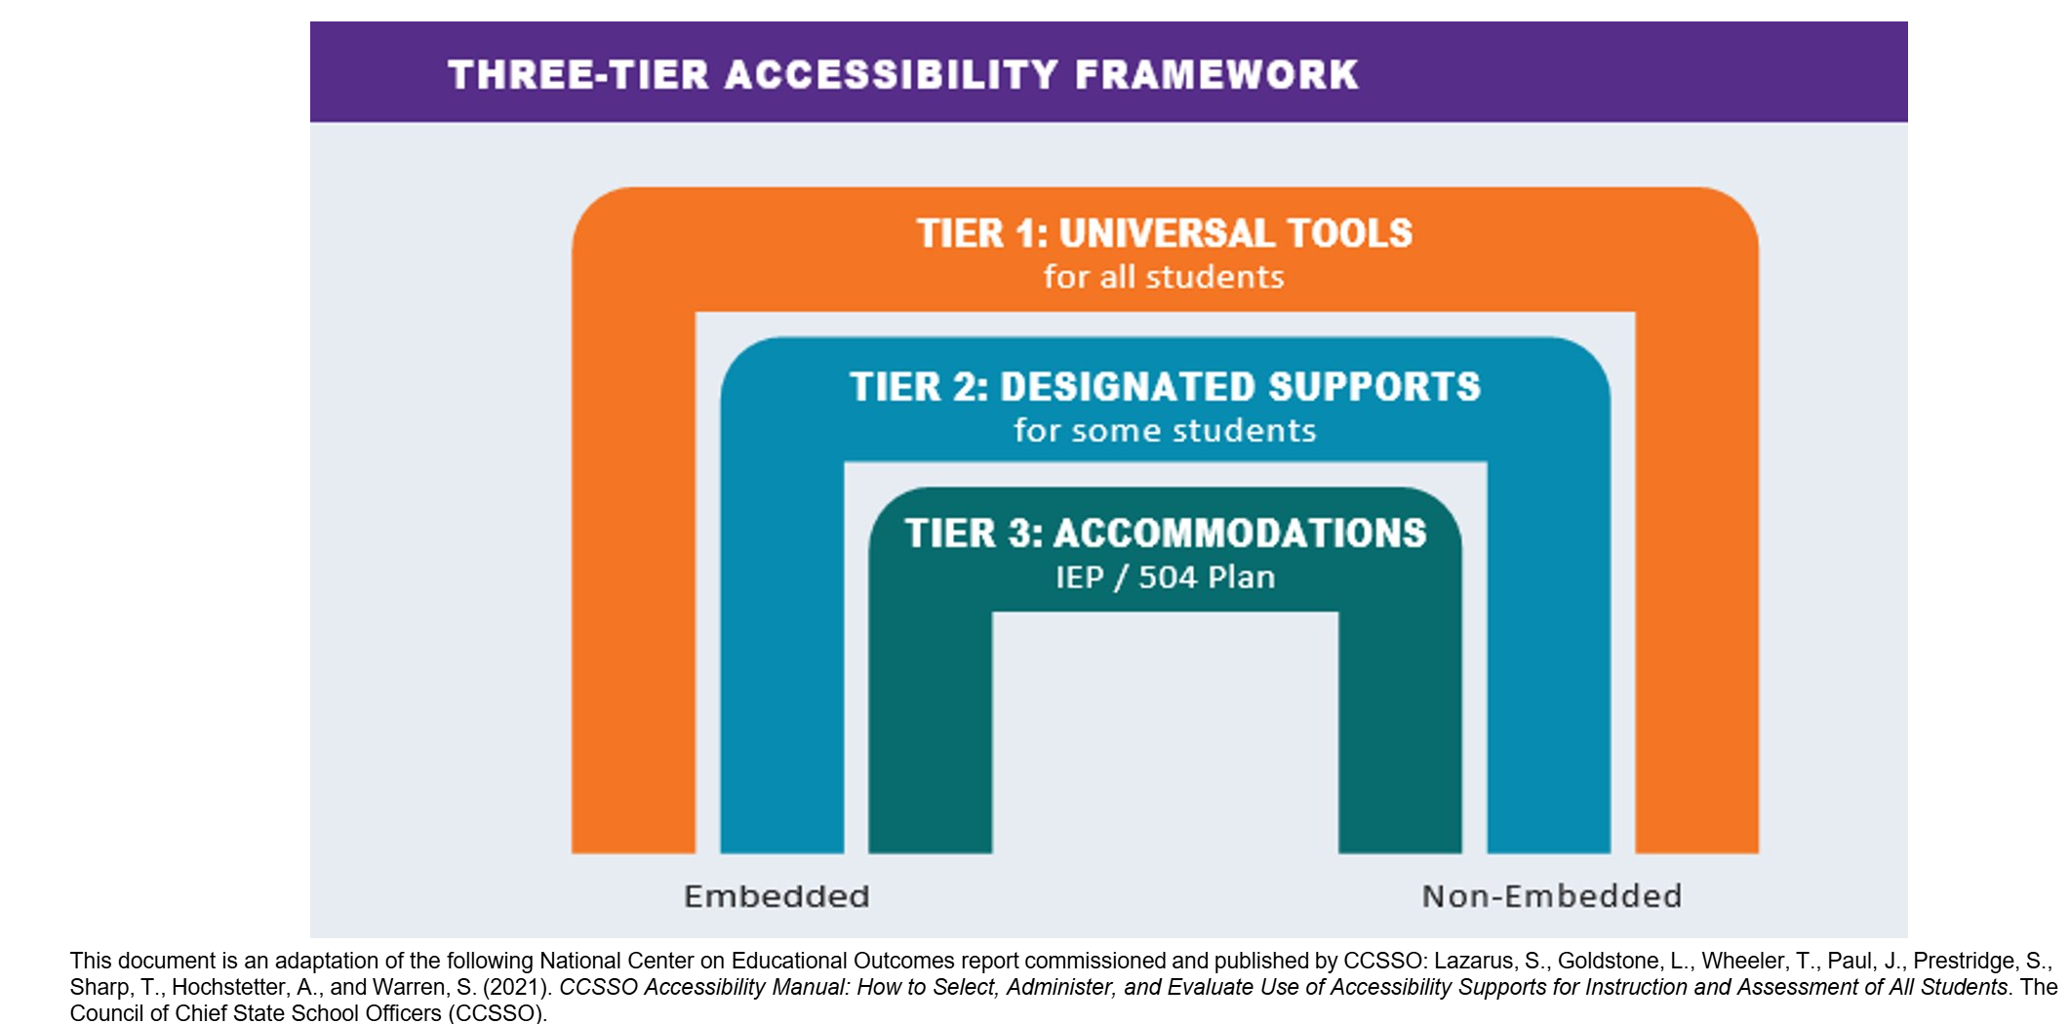
Three-Tier Accessibility Approach
Notes:
The Three-Tier Accessibility Approach is a tool to illustrate how accessibility supports aid students specific to need and purpose.
In looking at the largest bridge, Tier 1, Universal Tools are available to ALL students. Universal Tools are those that every student should have access to if they will benefit the student, such as scratch paper or a highlighter. These tools can be used by any student that needs them at any time, regardless of the activity or the content area.
The bridge below, Tier 2, is for a smaller group of students. Here, the educator team reviews strengths and barriers to determine if designated supports are needed. An example of a Tier 2 support might include those that promote language access. Designated supports such as the bilingual word-to-word glossary on the science test may be beneficial for some students who already use this tool during instruction.
Tier 3, is for an even more specialized subset of students who have an IEP or Section 504 Plan. Accommodations might include the provision of closed captioning of the ELA Listening assessment for students with hearing impairments.
Resource: From the Council of Chief State School Officers (CCSO) Accessibility Manual: 753a0706.flowpaper.com/CCSSOAccessibilityManual/
The Three-Tier Accessibility Framework is an adaptation of the following National Center on Educational Outcomes report commissioned and published by CCSSO: Lazarus, S., Goldstone, L., Wheeler, T., Paul, J., Prestridge, S., Sharp, T., Hochstetter, A., and Warren, S. (2021). CCSSO Accessibility Manual: How to Select, Administer, and Evaluate Use of Accessibility Supports for Instruction and Assessment of All Students. The Council of Chief State School Officers (CCSSO).

Slide 64
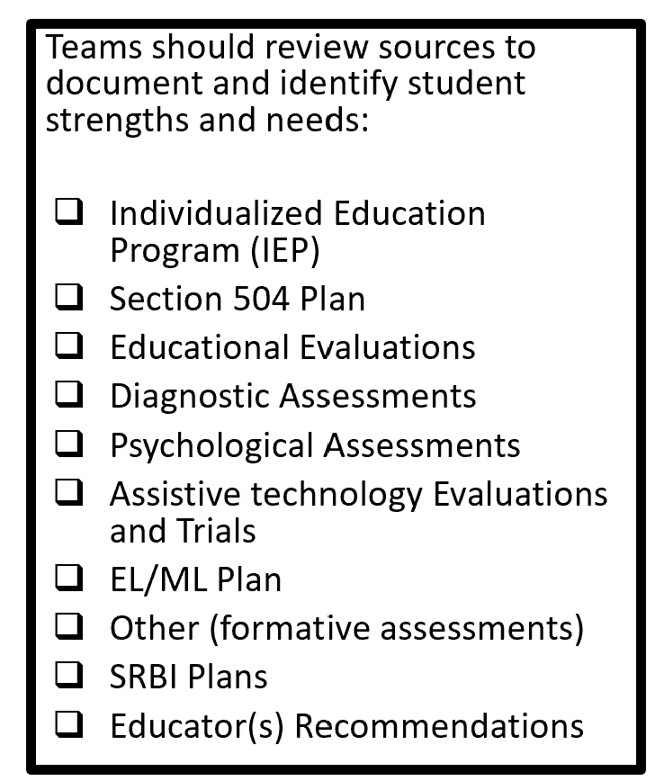
How are accessibility supports determined?
Based on a preponderance of evidence, educational teams should establish
The learning or access strengths
The learning or access barriers
The points of access needed by the student
Supplemental aids and services needed throughout the academic and non-academic school day
Accommodations needed for the student with an IEP or Section 504 Plan to access district and statewide assessments
Notes:
Educators should document each student’s strengths and barriers within their SRBI Plan, English Learner/Multilingual Learner (EL/ML) Plan, Individualized Education Program (IEP), or Section 504 Plan. By identifying and leveraging a student’s strengths, teams can better support areas where barriers to learning exist.
When reviewing a student’s profile, teams should consider critical data that demonstrate both the need for support and the effectiveness of strategies in helping the student meet specific goals and objectives.
Key components to consider when developing or reviewing a plan include:
What are the student's learning or access strengths?
What are the student’s instructional needs and barriers?
How can the student’s strengths be used to support access to learning?
What access points are needed during instruction, and what strategies are currently working well?
Has an evaluation been conducted to determine the need for assistive technology?
What cognitive and psychological evaluations have been completed?
What are the findings from these assessments?
These evaluations provide valuable insights into the student’s unique learning profile, which can serve as foundational elements for designing effective supports.
Who determines the need and provision of accessibility supports?
When considering the provision of accessibility supports for a student, the educator team should include, but not be limited to, the following staff members listed on this slide as applicable:
Classroom teacher
Special Education Teacher
English learner/multilingual learner instructor
Special service providers (e.g., speech/language specialist, reading/math coach)
Student
Parent/Guardian
Planning and Placement Team
Section 504 Team

Slide 65
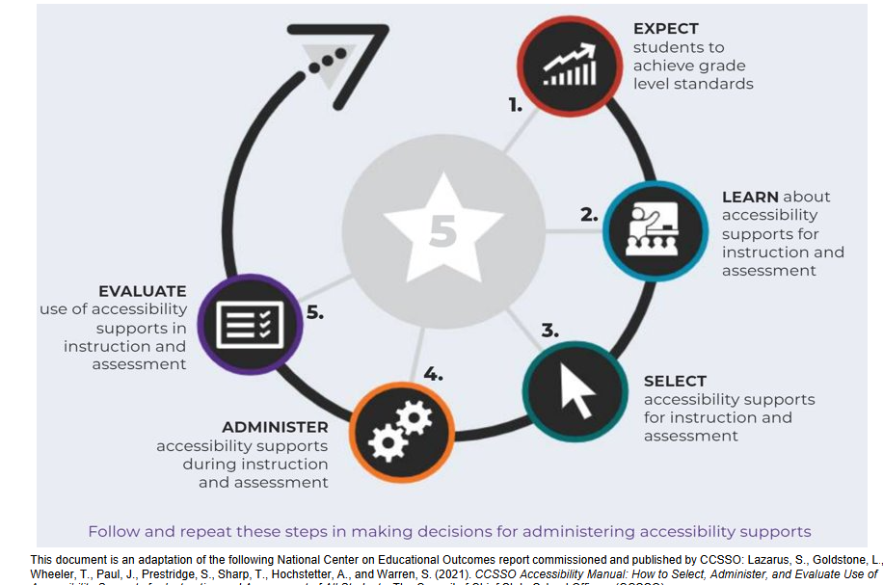
Five-Step Decision Making
Notes:
STEP 1: EXPECT students to achieve grade-level standards.​
​
STEP 2: LEARN about accessibility supports for instruction and assessment.​
​
STEP 3: SELECT accessibility supports for instruction and assessment.​
​
STEP 4: ADMINISTER accessibility supports during instruction and assessment.​
​STEP 5: EVALUATE use of accessibility supports in instruction and assessment

Slide 66
Considerations for Educator Teams Including PPT and Section 504 Teams
What are the student’s learning profile strengths and how can we leverage them to support any access needs?
What considerations have been reviewed for student accessibility and independence along the continuum of services for access?
What are the specific universal tools, designated supports, language supports, or accommodations being used within the learning environment with success that are providing the student with access?
What is the student’s experience and perception of how well the universal tools, designated supports, language supports, or accommodations worked?
  CCSSO Questions to Ask When Selecting Accessibility Supports (various tools that elicit discussion with educator teams, student, parent/guardian, and classroom teacher)
Notes:
When considering accessibility supports, educators, including those on the PPT and Section 504 Teams should consider the following:
What are the student’s strengths that can be built upon to increase access?
What are the barriers the student is currently facing in accessing the learning environment?
What tools are they currently using with success (automaticity, accuracy, independence, positive reporting by student)?
Has the team reviewed accessibility through the continuum of supports? (Low to High)?
Trialing supports is key in determining if the accessibility tool is the right fit for the student in effort to reduce barriers. Educators can use practice tests and interim assessments to ensure the student is able to and wants to use the support. Take time to talk with the student to discuss if the student sees benefit to the tool, and uses it with accuracy, automaticity, and with independence. By doing this you will gain information to ensure appropriate accessibility supports. Consider the following:
Has the student practiced with these tools before?
Has the student used these tools within the instructional setting?
How does the student report they feel about the tool, does it help or is it confusing to use?
Is there evidence to support that this tool reduces the barrier?
How well do students who receive universal tools, designated supports, language supports, and accommodations perform on assessments (e.g., Smarter Balanced, NGSS, summative and interim)?
If students are not meeting the expected level of performance, is it due to:
Students not having access to the necessary instruction?
Students not receiving the appropriate universal tools, designated supports, language supports or accommodations?
Students using universal tools, designated supports, or accommodations that were not effective?
Students unfamiliar with how to use and/or access the universal tools, designated supports, or accommodations?
What combinations of universal tools, designated supports, language supports, and accommodations seem to be effective? What data do you have to support this?

Slide 67
Reminders for Educator Teams
Accessibility supports are not a one size fits all.
Understand the purpose and functionality for each accessibility support in the context of online testing in conjunction with the students’ current specific strengths and learning barriers before making a determination.
“More” [accessibility supports] are not equated to a better test experience.
Selecting conflicting supports may lead to confusion during the test set-up and student test experience and may lead to test irregularities. Common conflicting accommodations include:
  Embedded Text-to-Speech and Non-Embedded Read Aloud
  Embedded Speech-to-Text and Scribe
  Embedded Color Contrast and Non-Embedded Color Contrast or Color Overlay
  Print Size and Large Print (Note: Large Print= Large Print Test Booklet)
Notes:
Educator Teams, including IEP and 504 Teams, and those planning designated supports for students without formal plans (such as Els/MLs) should have a clear understanding of both the purpose and functionality of each accessibility within the online testing environment. This understanding should be grounded in the student’s documented plan before making any determinations.​
Key considerations include: ​
Accessibility supports are not a one size fits all. ​
More supports do not necessarily lead to a better test experience. ​
Conflicting supports can cause confusion during the test set up and administration and may result in test irregularities. ​
Common examples of conflicting accommodations include: ​
Embedded Text-to-Speech vs. Non-Embedded Read Aloud ​
Embedded Speech-to-Text vs. Scribe ​
Embedded Color Contrast vs. Non-Embedded Color Contrast or Color Overlay ​
Print Size vs. Large Print (Note: Large Print refers to a separate fixed form Large Print Test Booklet. Students using Large Print do not take an online assessment.)​

Slide 68
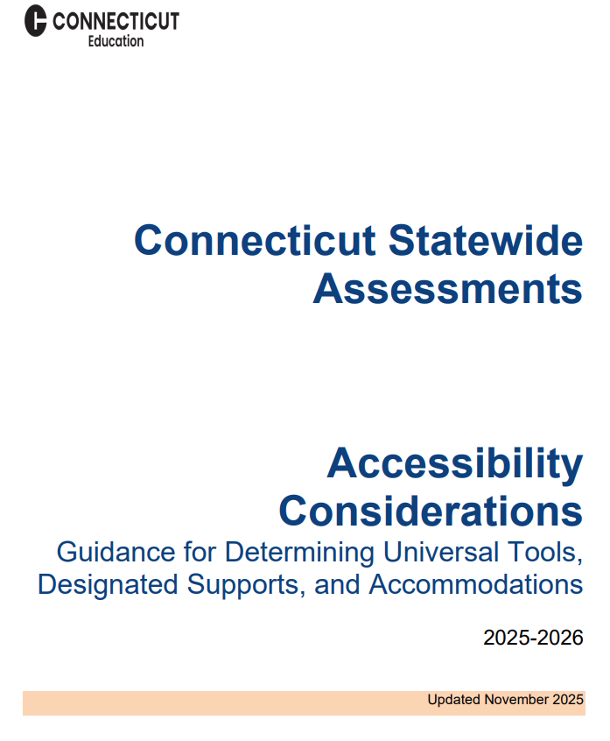
Implementation
Develop a systematic process across the district.
Provide training to educators on available accessibility tools and supports.
Communicate expectations and responsibilities to ensure effective implementation and fair/valid test experience for all students.
CT-Assessments-Accessibility-Considerations.pdf
Notes:
The CSDE recommends a consistent and systematic process be communicated and implemented by districts to determine the need and appropriateness for accommodations and supports provided to individual students with accessibility considerations.
The CT-Assessments-Accessibility-Considerations.pdf resource provides more information about implementing a clear and consistent process for determining accessibility features.

Slide 69
Which Types of Accessibility Supports are Available?
Notes:
We are now going to take a few moments to review who is eligible for the different accessibility supports available.

Slide 70
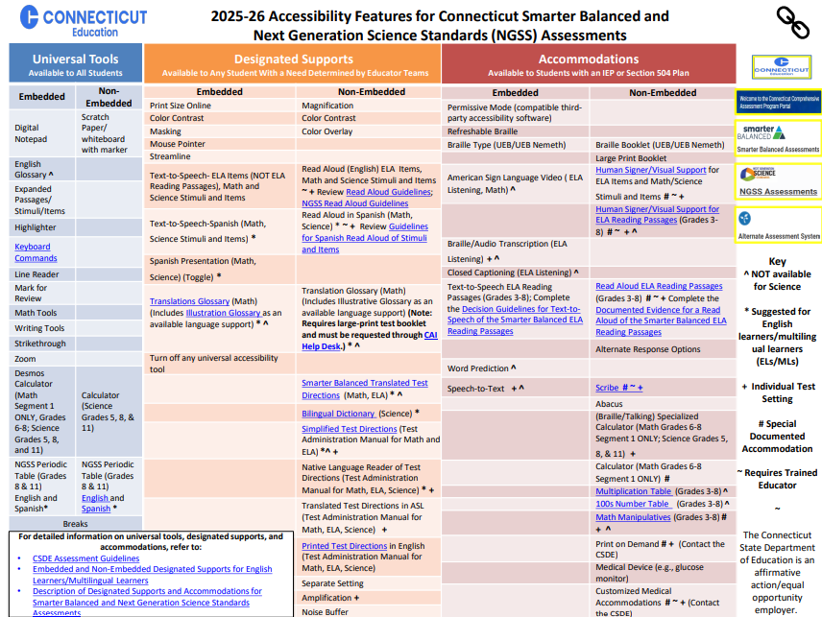
Classifying Accessibility Supports
Universal Tools, Designated Supports, and Accommodations can be classified into two categories:
Embedded: Tools available through the online computer platform
Non-Embedded: Tools provided to the student by the school/test administrator
Resources:
Description of Designated Supports and Accommodations for Smarter Balanced and Next Generation Science Standards Assessments
Accessibility Chart
CSDE Assessment Guidelines
Notes:
Technology empowers educators to implement computer-based instruction and assessment accessibility supports that promote individualized learning experiences. These supports are designed to reduce or eliminate barriers that may prevent students from demonstrating their knowledge and skills.​
Importantly, accessibility supports used in the classroom do not lower learning expectations.​
Across the three tiers of the accessibility, supports fall into two main categories: ​
Embedded supports are integrated into the digital testing platform. ​
Non-embedded supports are external tools provided by the test administrator to the student.
The Accessibility Chart, shown here, was developed specifically for the Smarter Balanced and the Next Generation Science Standards Assessments. It provides 3 tiers of support ranging from Universal Tools (shown to the far left in blue), designated supports (shown in orange and located in the center of the chart), and accommodations shown in red to the far right. You will notice that within each section, embedded and non-embedded tools are listed along with hyperlinks to additional information if applicable. Please note the user Key, located at the far right, includes symbols noting tools that are not available on science versions, those accommodations that are non-standard and require additional teacher training, along with other tools that might be appropriate for ELs/MLs.
These accessibility features can help support students with various barriers such as:
There are many ways to support students who experience barriers to learning—particularly those related to reading—by applying the principles of Universal Design for Learning (UDL) and adapting instructional and communication strategies to promote meaningful access to content.
Below are some common barriers that can be supported through the use of universal tools, designated supports, and accommodations (if eligible):
Executive Functioning Challenges (e.g., attention, cognitive control, processing difficulties)
Persistent Calculation Disability / Dyscalculia
Reading Disability / Print Disability / Struggling Reader
Language Disability
Language Acquisition Needs
Significant Motor Difficulties or Recent Injury
Visual Impairments / Blindness
Hard of Hearing / Deafness
While the Accessibility Chart is a great reference, details about each of these accessibility features are documented in the CSDE Assessment Guidelines.

Slide 71
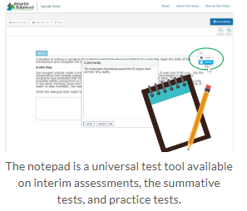
Understanding Universal Tools
Universal Tools (embedded and non-embedded): available to all students based on student preference and selection (e.g., highlighter, notepad).
What to Know
Universal Tools
are automatically available to all students through the test delivery system.
can be turned off by the test administrator/proctor prior to testing.
include non-embedded tools if needed by the student (Refer to Accessibility Chart).
Resource: Five Built-in Test Tools Students Should Know (and Use!)
Notes:
Here we provide the definition of universal tools and considerations the team can use. Remember universal tools are available to ALL students. However, just because they are available doesn’t mean that they are appropriate for all students.
Therefore, universal tools can be turned off by the test administrator/proctor prior to testing. Also remember, that in the context of statewide assessments, different assessments use different platforms and offer different tools. Take time to learn about the unique accessibility features provided for each assessment.
Resource:
Familiarize Students with Smarter Balanced Universal Test Tools
Accessibility Chart

Slide 72
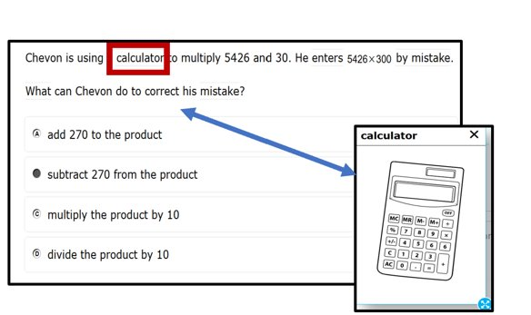
Understanding Designated Supports
Designated Supports (embedded and non-embedded): accessibility features available for use by any student (determined by educator team with input from the parent/guardian and student).
Examples: color contrast, text-to-speech of items, illustration glossary (math) as shown to the right.
Notes:
Designated supports are accessibility features available for any student whom the need has been indicated by an educator team with input from the parent/guardian and student.
This should be based off the students specific and unique learning profile.
When teams make this recommendation, it should also be consistently utilized across educational settings as applicable. If a student has an IEP or Section 504 Plan these supports should be documented in these plans. They will then sync from CT-SEDS to TIDE.

Slide 73
Understanding Accommodations
Accommodations (embedded and non-embedded) are changes in procedures or materials that increase equitable access during assessment. They:
generate valid assessment results for students who need them;
allow students to show what they know and can do.
Examples: Assistive technology, American Sign Language, braille, closed captioning
Accommodations:
must be documented for the student’s current grade in a finalized and implemented plan in CT-SEDS.
sync directly from CT-SEDS to TIDE.
should be integrated into all district, school, and/or classroom processes which prioritize student access needs.
Notes:
Accommodations are for students with an IEP or 504 plan. These are changes in materials or procedures that increase equitable access during assessments. They allow students to show what they know and can do. Like designated supports they should be consistently accessed and incorporated into the students instructional setting. Students should have familiarity and independence with both accommodations and designated supports that are assigned.

Slide 74
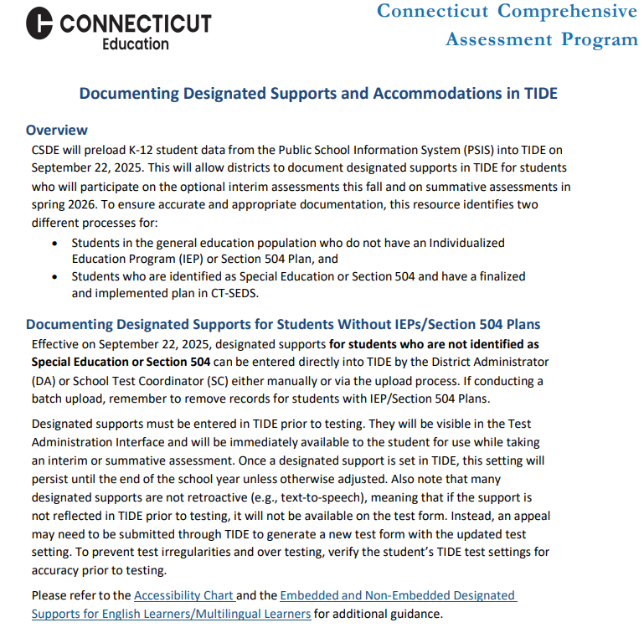
Documenting Designated Supports for Students without IEPs/Section 504 Plans in TIDE
Establish a process for setting designated supports in TIDE for eligible students who do not have an IEP or Section 504 Plan.
Test supports must be set prior to the start of the student’s test session.
If using a batch file to upload accessibility supports to TIDE, be sure to remove any records of students that have IEP/Section 504 Plans.
Resources:
  Documenting Designated Supports and Accommodations in TIDE
  TIDE User Guide for more information.
Notes:
When entering designated supports for students who do not have an IEP or Section 504 plan the DA should establish a process for setting designated supports in TIDE. Any test support needs to be assigned in advance of testing. Students with a finalized and implemented plan will have designated supports and accommodations sync from CT-SEDS to TIDE.
Designated supports and accommodations should not be manually entered or batch uploaded for students with an IEP or Section 504 Plan.
Refer to Documenting Designated Supports and Accommodations in TIDE for more information about this process.
Additional Resources:
TIDE User Guide: Test Information Distribution Engine (TIDE) User Guide
Accessing TIDE: Accessing-TIDE-Brochure.pdf
User Role Permissions for Secure Online Systems: User Role Permissions for Secure Online Systems

Slide 75
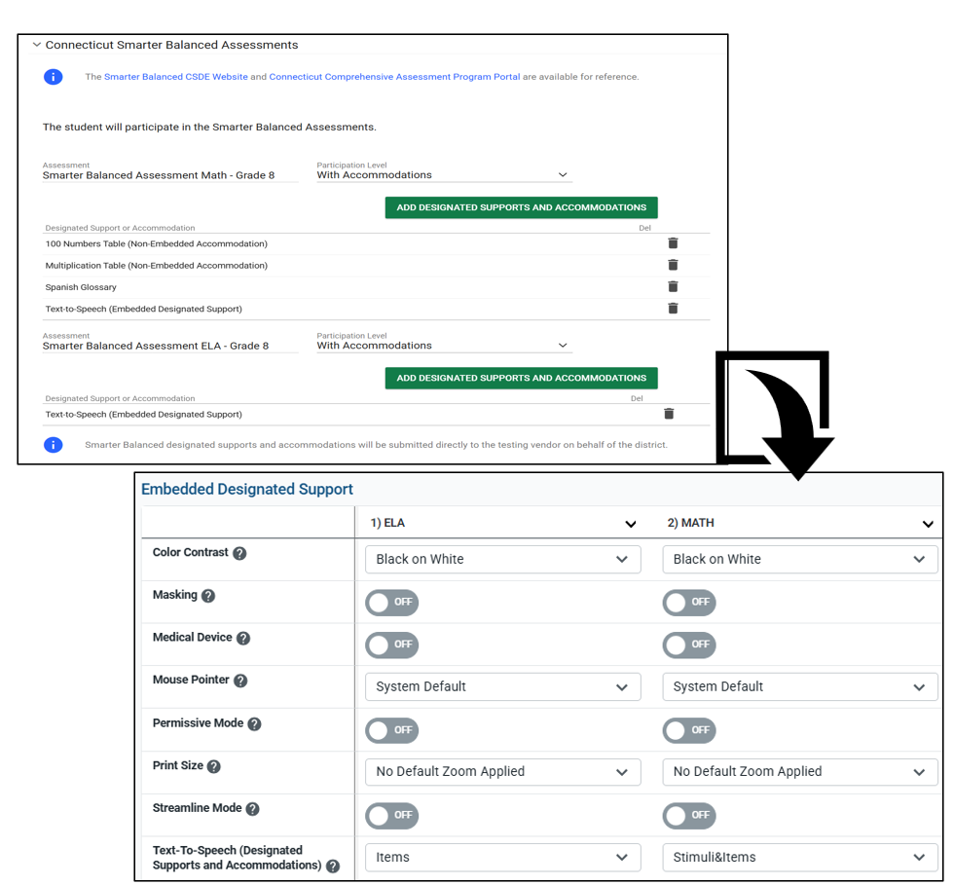
CT-SEDS Sync with TIDE for Students with Implemented IEPs/Section 504 Plans
Supports/accommodations planned for the student’s current grade of enrollment in a finalized and implemented IEP/Section 504 Plan sync to TIDE. (Note: IDEA/Section 504 must be activated in PSIS/TIDE.)
Supports/accommodations should never be manually entered (or batch uploaded) to TIDE.
Contact the student’s Case Manager if accommodations are missing or incorrect. All edits must be made through the amendment or reconvening process in CT- SEDS.
Resources:
CT-SEDS to TIDE Designated Supports/Accommodations Sync Frequently Asked Questions
Cross-Checking Student TIDE Test Settings and CT-SEDS
Documenting Designated Supports and Accommodations in TIDE
Notes:
For students with an IEP or Section 504 Plan, the team will document designated supports and accommodations within CT-SEDS under Statewide Assessment Tile. Teams should plan for the grades that span the duration of the plan to ensure supports are available for interim and summative testing. Keep in mind the following:
Each assessment has its own menu for designated supports and accommodations as applicable to the assessment and test design.
Supports/accommodations planned for the student’s current grade of enrollment in a finalized and implemented IEP/Section 504 Plan sync to TIDE. (Note: IDEA/Section 504 must be activated in PSIS/TIDE.)
Supports/accommodations should never be manually entered (or batch uploaded) to TIDE.
Contact the student’s Case Manager if accommodations are missing or incorrect. All edits must be made through the amendment or reconvening process in CT- SEDS.
Resources:
CT-SEDS to TIDE Designated Supports/Accommodations Sync Frequently Asked Questions
Cross-Checking Student TIDE Test Settings and CT-SEDS

Slide 76
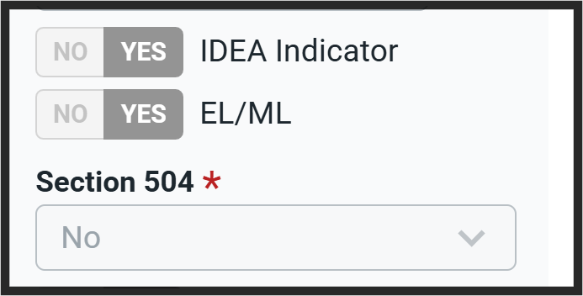
Designated Support/Accommodation Eligibility in PSIS/TIDE
The IDEA or Section 504 indicator (based on the PSIS registration fields) must be set to Yes for accommodations to sync from CT-SEDS.
The EL/ML designation must be set to Yes in PSIS if the student is identified as EL/ML.
Accommodations for students with IEPs/Section 504 Plans should NEVER be manually entered in TIDE unless authorized by the CSDE.
Reminder: Work with your PSIS Coordinator to ensure that IDEA, Section 504, and EL/ML indicators are accurately reflected in PSIS.
Notes:
When reviewing accommodations in the student dashboard in TIDE you will want to be aware of the following indicators and how they are set. ​These demographic fields must be updated in PSIS as applicable to students.
Eligibility for any embedded or non-embedded accommodation requires the IDEA or Section 504 indicator (based on the PSIS registration fields) set to Yes. Without this indication, accommodations cannot sync to TIDE from CT-SEDS.​
The student’s EL/ML designation must be set to Yes in PSIS if the student is identified as EL/ML.​
Accommodations should NEVER be manually entered or batch uploaded in TIDE. The IEP/Section 504 is the source of truth! If corrections are necessary, contact the Case Manager and an amendment of edit/revise can be conducted.
Reminder: Work with your PSIS Coordinator to ensure that IDEA, Section 504, and EL/ML indicators are accurately reflected in PSIS.

Slide 77
Language Supports/Designated Supports for English Learners/Multilingual Learners

Slide 78
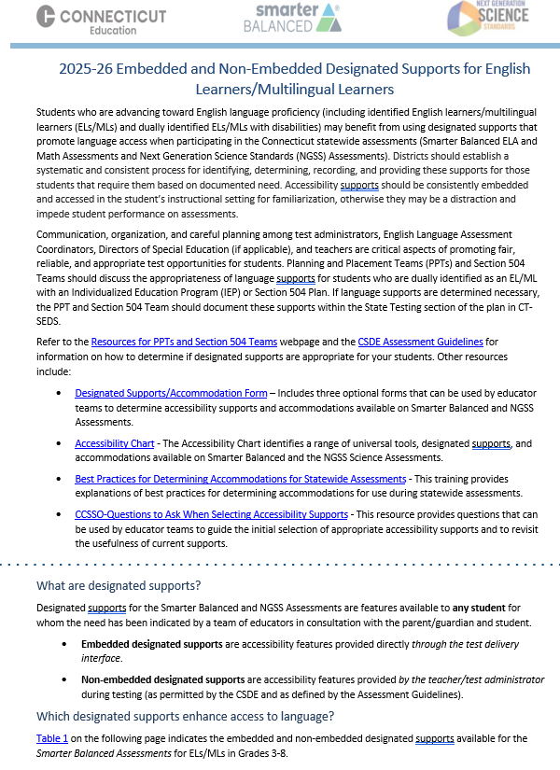
Language Supports for ELs/MLs
Eligibility is based on student identification as EL/ML in the Connecticut Public School Information System (PSIS)
Available for any EL/ML including those dually identified under the Individuals with Disabilities Education Act and/or Section 504 for whom the need has been indicated by a team of educators with input from the parent/guardian and student
Should be used regularly during learning and instruction across all content areas
May require some adult-dependence for support
Additional test time may be necessary
Embedded and Non-Embedded Designated Supports for English Learners/Multilingual Learners
Notes:
Students progressing toward English language proficiency—including English learners/multilingual learners (ELs/MLs) and dually identified ELs/MLs with disabilities—may benefit from designated supports that promote language access during Connecticut’s statewide assessments. These supports are not one-size-fits-all and may not address every language need, but they can help reduce barriers and improve access.
Simplified Test Directions, On-the-Fly Translations, and printed directions. Language supports also include tools to support navigation of the Test Delivery System for math and ELA; and include specific supports for Spanish-speaking students on math and science assessments.
It’s important to remind students that assessments are just one snapshot of their learning. For students with significant language barriers, testing time should be reasonable and appropriate to their needs.
Designated supports are selected by informed educators—ideally a team familiar with the student’s English proficiency, instructional supports, and assessment history. Input from families and students is essential in this decision-making process.
For a full list of available supports, refer to the Embedded and Non-Embedded Designated Supports for English Learners/Multilingual Learners brochure.
Embedded and Non-Embedded Designated Supports for English Learners/Multilingual Learners

Slide 79
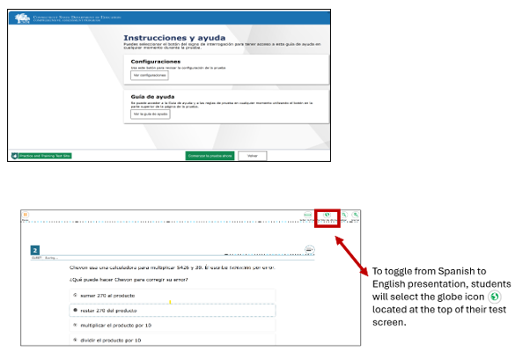
Embedded Spanish Presentation for Math and Science
Spanish presentation will allow the literate Spanish-speaking student to toggle between a full Spanish translation of the math and science stimuli and items and the English presentation.
All test directions, navigation buttons, and test content will be presented to the student in the Spanish language.
Notes:
Spanish presentation will allow the literate Spanish-speaking student to toggle between a full Spanish translation of the item and the English version of the passages and items.
By default, all test directions, navigation buttons, and test content will be presented to the student in the Spanish language.
For students whose primary language is not English and who use dual Spanish language supports in the classroom, the use of this designated support (dual language) translation may be appropriate.
This support should only be used for students who are proficient readers in Spanish and who are not proficient in English.
The use of this support may result in the student needing additional overall time to complete the assessment and may increase reading and cognitive load.
Please note, Spanish Voice Pack needs to be installed prior to the student testing.

Slide 80
Reader Supports for ELs/MLs, Struggling Readers, and Students with Related Reading, Print, and Visual Disabilities

Slide 81
To determine appropriate reader supports, review the following:
Does the student have a documented print or visual disability?
In the case of significant visual impairments, does the student have adequate braille skills?
Does the student have an identified reading-based disability that affects decoding, fluency, or comprehension skills?
Is there evidence of the persistence of the disability despite intensive, targeted instruction in the Science of Reading? (Note: Documentation of interventions data on each intervention is required.)
Are interventions used to improve decoding, fluency, or comprehension skills?
Does the student use assistive technology software, audio books, Bookshare, Accessible Educational Materials, or a read-aloud accommodation (human reader) during instruction?
Notes:
Does the student have a visual or print disability? To illustrate what is meant by “print disability,” teams should consider the following:
Does the student have an identified reading-based disability that affects their decoding, fluency, or comprehension skills?
Is there evidence of the persistence of the reading-based disability despite intensive, targeted instruction in the Science of Reading? (Note: There should be documentation of the interventions used and formative assessment data on the effect of each intervention within the student’s plan.)
Are interventions and instructional programing that is based in the Science of Reading being utilized to improve the student’s decoding, fluency, or comprehension skills?
Does the student use assistive technology software, audio books, Bookshare, Accessible Educational Materials, or receive a read-aloud accommodation (human reader) during instruction?

Slide 82
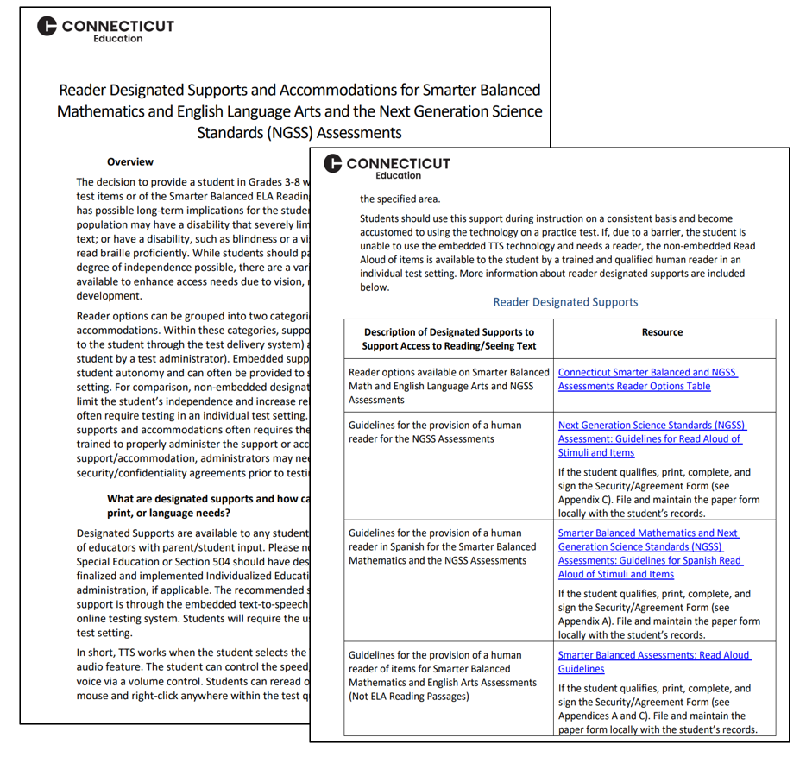
Reader Options Resources for Smarter Balanced/NGSS
Reader Designated Supports and Accommodations for Smarter Balanced Mathematics and English Language Arts and the Next Generation Science Standards (NGSS) Assessments
This resource provides information about designated supports and accommodations that provide access to print/text.
Notes:
Many students benefit from reader supports especially those students who have a reading or print disability, such as dyslexia. Other students with visual disabilities may need accessibility to information on the computer because they can’t see the text. The resource shown on this slide provides a range of reader supports available based on documented need. This guide provides educators with a review of reader options and the required documentation needed to administer a human reader. Reader supports are available on Smarter Balanced and NGSS assessments and the corresponding documents and resources associates with each accessibility feature.
The Reader Designated Supports and Accommodations for Smarter Balanced Mathematics and English Language Arts and the Next Generation Science Standards (NGSS) Assessments provides an explanation of reader designated supports and accommodations with corresponding screeners and guidelines to support student eligibility and administration on statewide assessments.

Slide 83
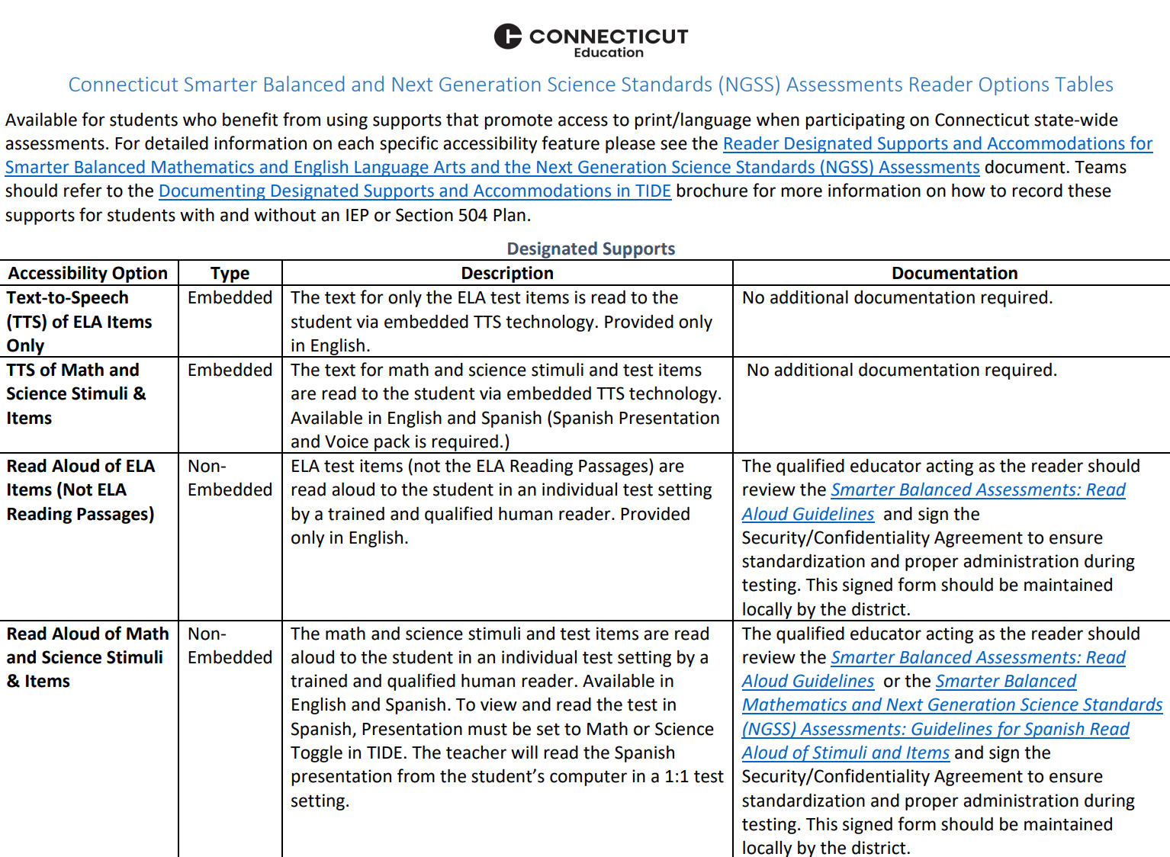
Reader Options Table for Smarter Balanced & NGSS
Connecticut Smarter Balanced and NGSS Assessments Reader Options Table
This resource provides a quick glance at reader supports by accessibility type and assessment. PPTs and Section 504 Teams should review this resource to determine if and which designated supports and accommodations are most appropriate for the student.
Notes:
Educator teams, especially Planning and Placement Teams and Section 504 Teams, should be familiar with available resources to better understand which supports are appropriate for students based on their identified needs. Adhering to specific policies and procedures is essential to ensure both the accurate measurement of student learning and the valid reporting of student performance.
The Connecticut Smarter Balanced and NGSS Assessments Reader Options Table offers a detailed overview of the various reader supports and accommodations available for Smarter Balanced and NGSS assessments. It outlines:
The purpose of each support
Test requirements
Required documentation, if applicable
Differences between embedded and non-embedded reader options
This tool helps educators make informed decisions about the most appropriate accessibility features to support student access to print and text during assessments.

Slide 84
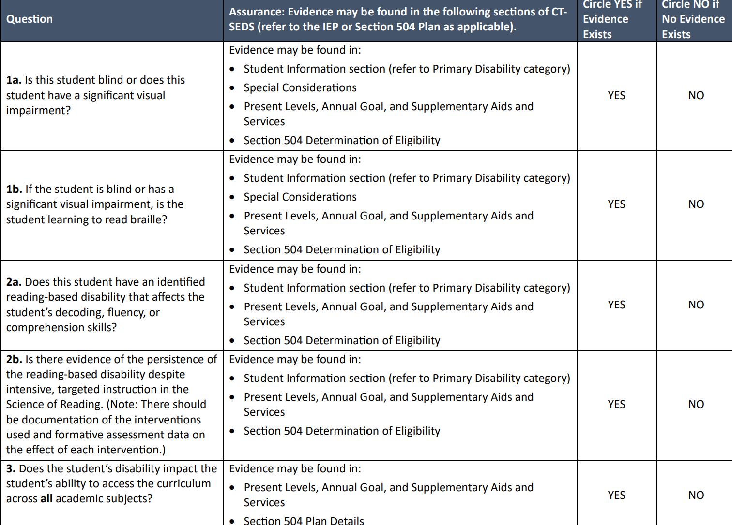
Decision Guidelines for TTS of the Smarter Balanced ELA Reading Passages
When TTS of the ELA Reading Passages are being considered, PPTs/Section 504 Teams should complete the Decision Guidelines for Text-to-Speech of the Smarter Balanced ELA Reading Passages during the annual convening to establish the extent of need based on the student’s access barriers due to a print or visual disability.
This accommodations is intended for students
  with a documented print disability,
  with significant visual disabilities, or for those
  who are blind with inadequate braille skills.
Complete and maintain this form locally with the student’s record.
Notes:
The questions provided in this document can assist IEP/Section 504 decision-making teams in determining the preponderance of evidence that demonstrates whether if a student qualifies to have the ELA reading assessment read via a text-to-speech accommodation.
PPTs should use this form to help document the need for the embedded text-to-speech of the Smarter Balanced reading passages. This accommodation is only for students with an IEP or Section 504 Plan in Grades 3-8 with a documented print disability, or for students who are blind with inadequate braille skills. Additionally, if the student has a print/reading-based disability (dyslexia), there must be strong evidence of the persistence of the disability despite intensive, extensive, and targeted instruction that is based on the Science of Reading and that the student needs extensive supports to access print. There should be documentation of the interventions used and formative assessment data on the effects of each intervention. The student should be familiar with this accommodation and use it regularly during instruction, and typically, the student would most likely be using alternate educational materials (AEM) during instruction.
If your student qualifies, select the Text-to-Speech of ELA Passages (Embedded Accommodation) in CT-SEDS, along with Text-to-Speech (Embedded Designated Support) for math and science stimuli and items, if appropriate. Please complete and maintain this form locally with the student’s record.
Decision Guidelines for Text-to-Speech of the Smarter Balanced ELA Reading Passages

Slide 85
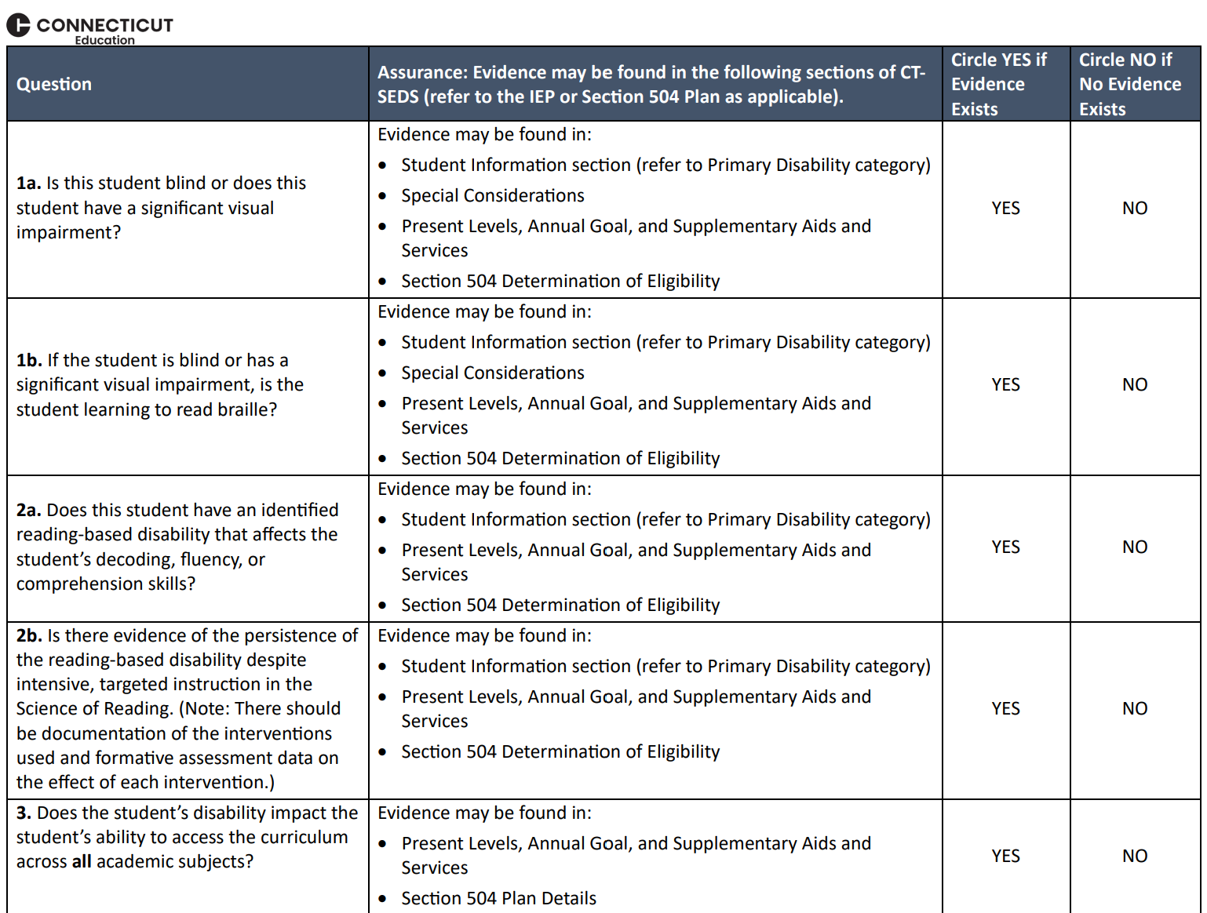
Determining Eligibility for a Read Aloud Special Documented Accommodation
PPTs/Section 504 Teams should provide documentation of need in present levels of performance, reading/communication goals and objectives, and in supplementary aids and services/program accommodations sections.
Psychological assessments and/or academic performance assessments referenced showing processing disabilities related to visual, print, or reading disabilities and understanding/use of language. Skills related to listening, thinking, speaking, reading, writing, or spelling may also be reflected.
Teams must complete the Documented Evidence for a Read Aloud of the Smarter Balanced ELA Reading Passages as a screener for eligibility and maintain locally with the student’s record.
Notes:
In alignment with the eligibility criteria for TTS of ELA Reading Passages, students who qualify for the special documented Read Aloud accommodation are those who, despite receiving intensive and targeted instruction or intervention—such as in the science of reading or braille acquisition—are still unable to access print materials without the use of extensive accommodations including embedded text-to-speech.
These students consistently rely on having text read aloud to them during instruction and other environments. They may also use tools such as audiobooks, screen readers, Bookshare, or other forms of alternate educational materials to access print content.
Eligibility is not limited by a student’s primary disability category. If there is documented evidence of a specific word reading disability—such as challenges with decoding, encoding, or phonological processing, and text-to-speech does not meet the complexity of the student’s needs, a read aloud may be appropriate. Characteristics of a word reading disability or dyslexia must be clearly reflected in the student’s current evaluation results and educational programming.
To determine eligibility for the Read Aloud accommodation of Smarter Balanced ELA Reading Passages, teams should begin by completing the Documented Evidence for Read Aloud of the Smarter Balanced ELA Reading Passages form. This serves as a screening tool to establish a preponderance of evidence that the student requires this accommodation due to a documented disability.
In the context of the Smarter Balanced Reading assessment, the Read Aloud of ELA passages should be used only as an access tool to support the student’s interaction with the text. If used beyond this purpose, it may alter the construct being measured—shifting the focus from reading comprehension to listening comprehension.
To support this determination, teams should review:
The student’s present levels of performance in the IEP
Reading and communication goals and objectives
The Supplementary Aids and Services/Program Accommodations section of the plan
Teams should also examine documentation from psychological and academic performance assessments included in the IEP or 504 Plan. These should show evidence of processing disabilities related to visual, print, or reading challenges, as well as difficulties with language comprehension and use. Skills in listening, thinking, speaking, reading, writing, or spelling may also be reflected and should be considered in the decision-making process.

Slide 86
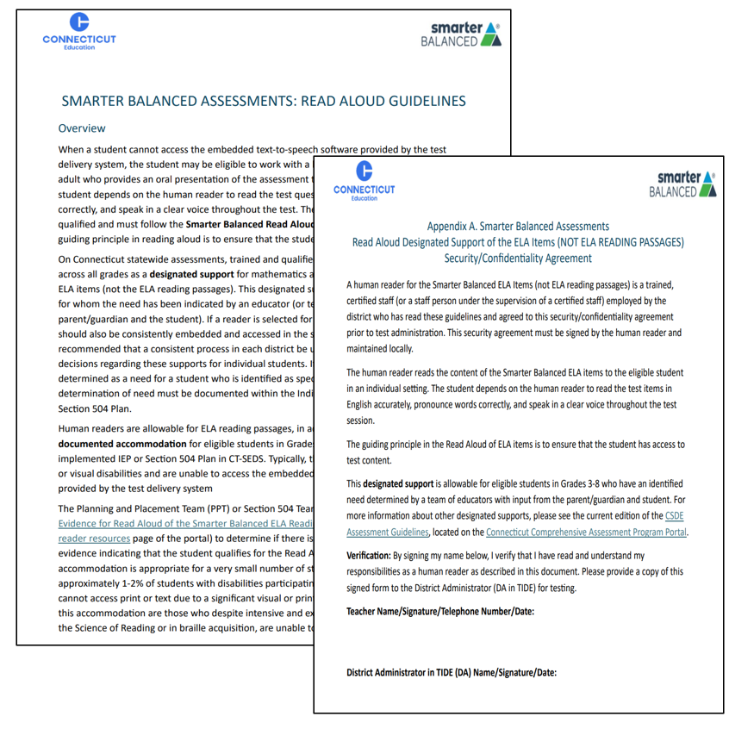
Determining Eligibility for a Read Aloud Special Documented Accommodation- Continued
If eligible for a Read Aloud, document in CT-SEDS for associated tests and grades covered by the duration of the plan.
The qualified individual acting as the reader should review the Smarter Balanced Assessments Read Aloud Guidelines and sign the Test Security/Confidentiality Agreement Form (Appendix B of document). The signed security/attestation form should be maintained locally.
Notes:
A human reader is a trained and certified teacher who provides an oral presentation of the assessment text to an eligible student. The student depends on the human reader to read the test questions accurately, pronounce words correctly, and speak in a clear voice throughout the test. The human reader must be trained and qualified and must follow the Smarter Balanced Read Aloud Guidelines. The guiding principle in reading aloud is to ensure that the student has access to test content. ​
The teacher and administrators must also complete and sign the Security/Confidentiality Form (within the Read Aloud Guidelines) to verify their understanding of responsibilities as human reader for state testing. Forms should be maintained locally with the student’s record per district procedures.

Slide 87
Special Documented Accommodations

Slide 88
What are Special Documented Accommodations?
Special Documented Accommodations may include:
• Scribe
• Read Aloud of ELA Reading Passages
• Human Signer/Visual Support for Smarter Balanced ELA or Math and/or NGSS (includes directions, math and science items and stimuli, and ELA items [Not Reading Passages])
• Human Signer/Visual Support for ELA Reading Passages
• Math Manipulatives (Grades 3-8)
• Non-Embedded Calculator (Math Grades 6-8, calculator-allowed items only)
• Print on Demand
• Customized Accommodation
Special Documented Accommodations are:
non-standard accommodations.
align to those used by the student during instruction and in other learning environments.
must be administered in an individual test setting.
Notes:
In exceptional circumstances, there may be a student whose disabilities are such that the allowable embedded and non-embedded accommodations described in the CSDE Assessment Guidelines provide insufficient access to the Smarter Balanced and/or NGSS Assessments.
Special Documented Accommodations are determined by Planning and Placement Teams (PPT) and Section 504 Teams based on a preponderance of evidence found throughout the student’s plan. These accommodations must align with the student’s documented disability or disabilities.
The team should clearly identify:
The student’s learning and access barriers.
The specific access points required.
The supplemental aids and services needed across both academic and non-academic settings.
The accommodations necessary for the student to access district and statewide assessments.
Special Documented Accommodations

Slide 89
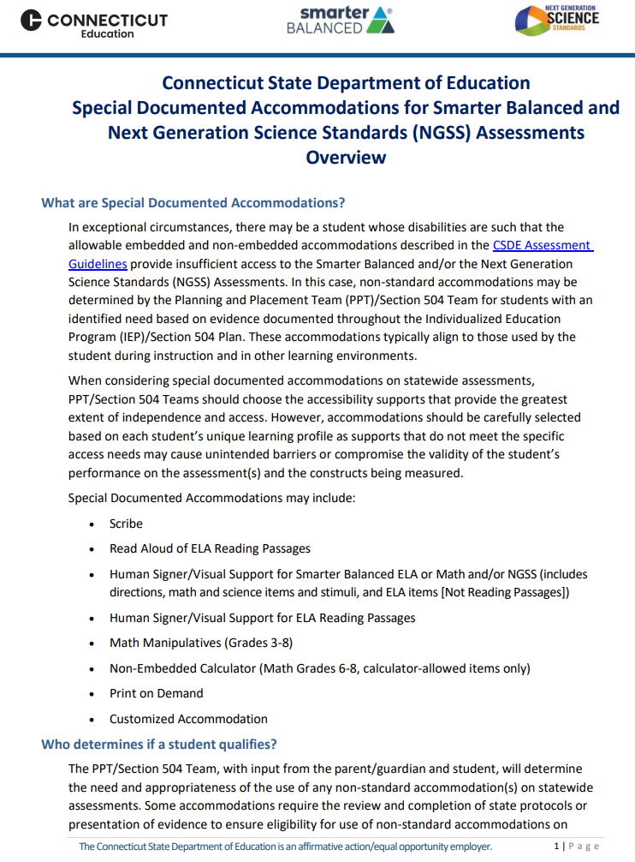
Special Documented Accommodations Overview Document
Teams and DAs should:
review the Special Documented Accommodations for Smarter Balanced and Next Generation Science Standards (NGSS) Assessments Overview for a listing of corresponding guidelines and protocols.
work with teachers/test administrators to access and review applicable guidelines for those that qualify well in advance of testing.
ensure completion/signoff of a security/confidentiality form (collect and maintain locally).
Notes:
DA's need to develop a plan for reviewing:
Accommodations and Special Documented Accommodations (DA's need to work with their Data Manager in CT-SEDS and TIDE to verify the accommodation reports for student's who have accommodations assigned either through a 504 plan or IEP.)​
Provide staff with specific guidelines and test security protocols associated with a Read Aloud, Scribe, Human Signer/Visual Support, and Math Manipulatives. DAs should develop a plan for reviewing and maintaining these documents within their district.
Provide local training .
Prepare for accommodations implementation for summative assessment​.
Schedule assessments- both practice and summative and room assignments for separate setting​.
Create and oversee staff assignment​s.
Prepare materials needed for example math manipulative if selected, headphones, ​and any other applicable approved materials.

Slide 90
Large Print and Braille Test Booklets

Slide 91
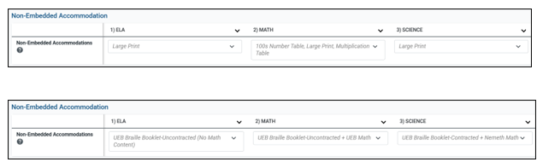
Large Print and Braille Test Booklets Ordering Information
District Administrators can order large-print and braille kits for Smarter Balanced and NGSS in TIDE any time after January 26, 2026.
Confirm that the student has the non-embedded accommodation set properly in TIDE. If the accommodation is missing or is incorrectly reported, contact the student’s Case Manager in CT-SEDS.
Notes:
Students that are unable to access the online assessment with embedded and non-embedded accommodations may be eligible to take the test using a large print or braille test booklet.
Even if this accommodation is selected in CT-SEDS, the DA still needs to place this order within TIDE.
These test materials must be ordered by the DA for Testing in TIDE on or after January 26, 2026.
The PPT or Section 504 Team must select these accommodations in CT-SEDS. Once the plan is implemented, the accommodations will sync to TIDE. Look for the Large Print selection in TIDE (refer to image on slide).
The DA will want to review the student dashboard and for this year collaborate with the special education teacher to ensure the correct Braille presentation is ordered in TIDE.
The following braille presentations are available. Refer to your student’s IEP for details on braille type:
UEB Contracted + Nemeth Math
UEB Contracted (No Math Content)
UEB Contracted + Nemeth
UEB Uncontracted + Nemeth Math
UEB Uncontracted (No Math Content)
UEB Contracted + UEB Math
UEB Uncontracted + UEB Math

Slide 92
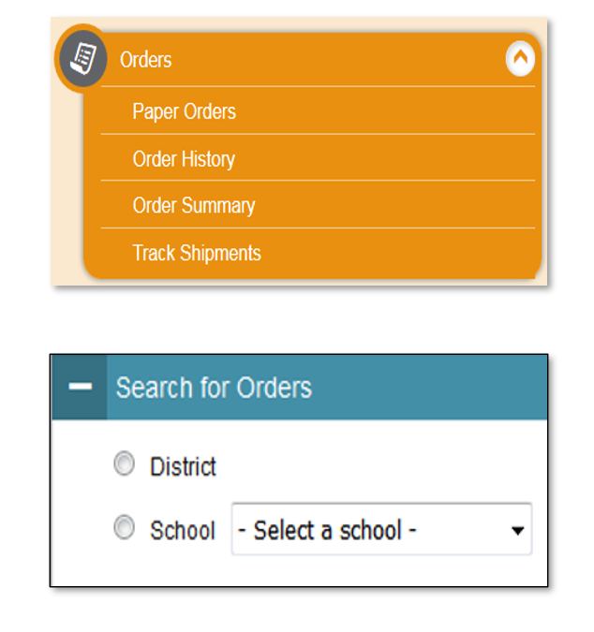
How to Order Large Print and Braille Test Booklets
Step 1: From the Orders task menu on the TIDE dashboard, the DA selects Paper Orders.
Step 2: Search for orders by District or School.
Step 3: Enter the quantity needed for each of the materials needed.
Districts can track shipments in TIDE.
Notes:
The DA will receive instructions with the test materials. As a reminder, tests are secure and should be securely maintained before, during, and after testing.
Once the student has completed testing, the teacher will use the Data Entry Interface to transcribe student responses to all subtests. This is how the tests are scored, and scores are reported. All transcriptions must be made by May 29, 2026. All test systems will close at the end of business on the last day of testing.

Slide 93
Practice Tests Overview

Slide 94
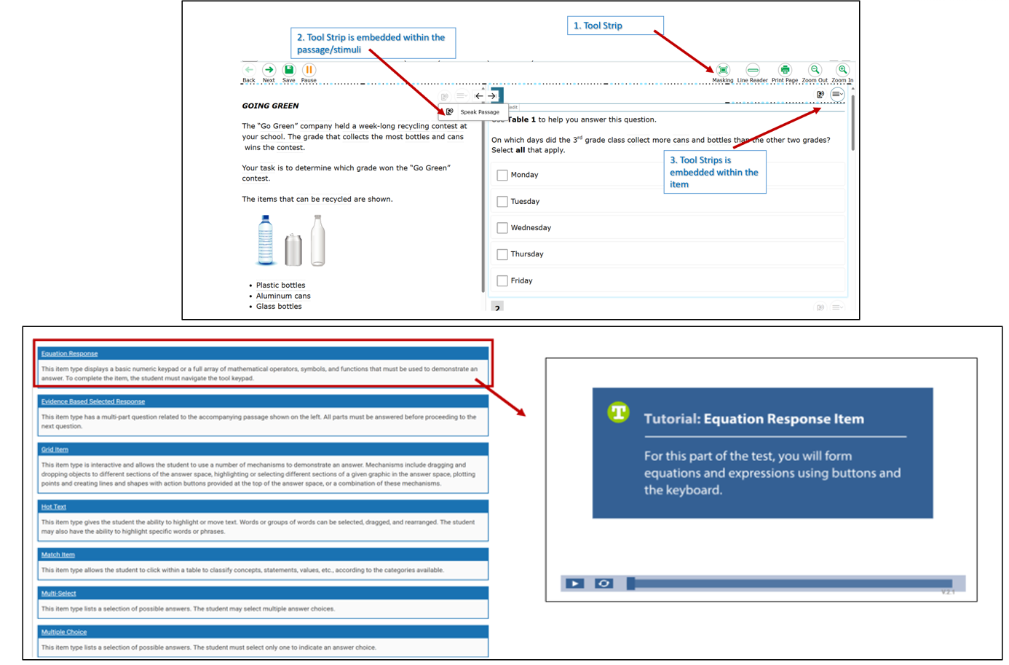
Practice Tests
Teachers can use the Practice Test to explicitly demonstrate to students how to navigate the test interface, use tools, and practice using accessibility features. Item Type Tutorials can also be used and modeled to students.
Notes:
Practice Tests are available for Smarter Balanced Math and ELA in Grades 3-8 and high school. They are similar in format and structure to the actual test and include about 30 questions. Practice Tests area also available for NGSS and the Connecticut Alternate Assessment System.
Use the Practice Tests to model how to use specific features such as the Desmos Calculator (available for certain math items in Grades 6-8), text-to-speech, math translation glossary, and speech-to-text. Students need to know in advance how to activate these features if applicable.
It is important that teachers review and ensure students have the applicable accessibility supports documented in TIDE prior to testing. During the Practice Test, show students how to use the tool strip (indicated by image on the top of this slide) to access applicable tools available to students based on the test, grade, and supports available in TIDE. For illustration purposes, the tool strip on the slide includes icons for masking, line reader, print page and zoom. For example:
If a student is taking the Grade 8 NGSS assessment, the embedded Periodic Table icon will appear in the tool strip.
An English Learner/Multilingual Learner (EL/ML) with a documented Spanish toggle for math in TIDE will see the toggle icon.
A student in grades 6–8 taking the calculator section of the Smarter Balanced math assessment will have access to the Desmos calculator in the tool strip.
Accommodation tools—such as text-to-speech and American Sign Language—can be activated directly from the tool strip. Other accessibility features can be enabled through the context menu (hamburger menu).
It is essential that teachers explicitly demonstrate and model these features for students using a Practice Test.

Slide 95
Important Dates

Slide 96
Important Dates to Remember
Activity | Deadline
Connecticut Alternate Assessment Eligibility Form | CAAELP (Grades K-12 EL/ML students) and CTAA and CTAS (Grade 11)- Due December 22, 2025 CTAA (Grades 3-8, and newly identified students in Grade 11) and CTAS (Grades 5, 8, and newly identified students in Grade 11) – Due February 2, 2026
Emergency Medical Exemptions | Smarter Balanced, NGSS, and CTAA/CTAS - due by June 5, 2026
Customized or Temporary Accommodations | DAs must request well in advance of testing.
Early Stopping Rule CTAA/CTAS | Student Response Check (SRC) completed by TEA no later than February 2, 2026 The DA in TIDE submits Connecticut Alternate Assessment System Early Stopping Rule Request and Attestation Form via TIDE Forms by March 2, 2026
Notes:
When planning for the upcoming assessment window, keep in mind these deadlines related to students that qualify for alternate assessments, or those that may need an emergency medical exemption or temporary accommodation due to an injury.

Slide 97
Questions
Use “Raise Hand” Tool

Slide 98
The Connecticut Alternate Assessment System
(CTAA, CTAS, and CAAELP)
Notes:
We are now going to briefly discuss the purpose for alternate assessments.
The Connecticut Alternate Assessment System is designed to measure the knowledge and skills of students with the most significant cognitive disabilities as required by the IDEA and ESSA. They support student independence to the greatest extent possible by making academic and language content accessible and the expected achievement levels appropriate. These assessments adjust for the depth, or cognitive complexity of skills and abilities, within the grade level standards. The assessments measure fewer standards, and the content adjusts for difficulty and is scaffolded to support the diverse range of accessibility needs within this student population.

Slide 99
Characteristics of a Student with the Most Significant Cognitive Disabilities
The Connecticut Alternate Assessment System is designed for a very small number of children with the most significant cognitive disabilities. Characteristics include:
The identification of one or more of the existing categories of disability under the IDEA
Significant Intellectual Impairment
Functional adaptive skills are well below age level expectations
Need for intensive instruction and significant supports
Notes:
The following characteristics describe a student with the most significant cognitive disabilities. The Planning and Placement Team will need to review and document certain criteria using the Connecticut Alternate Assessment Eligibility Form, which is embedded within CT-SEDS. To qualify the student must:
be identified with one or more of the existing categories of disability under the IDEA;
have a significant Intellectual Impairment;
have functional adaptive skills that are well below age level expectations; and
require intensive instruction and significant supports.
Additional Resources:
Frequently Asked Questions and Answers about the Connecticut Alternate Assessment System;
FAQ About the Connecticut Alternate Assessment System Eligibility Form;
Connecticut Alternate Assessment Eligibility Form

Slide 100
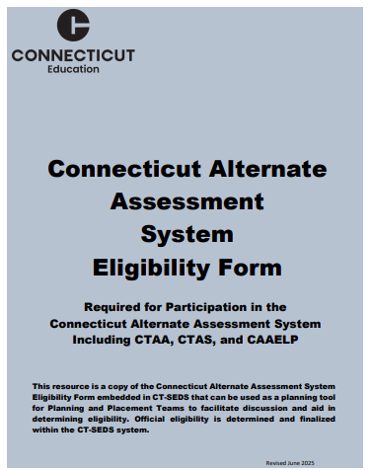
How to Determine Eligibility for Participation on Alternate Assessments
PPTs determine eligibility by completing the Connecticut Alternate Assessment System Eligibility Form in CT-SEDS.
If the student doesn’t meet eligibility, plan for standard testing with accommodations and assistive technology (if applicable).
Once IEP is finalized and implemented, CT-SEDS will sync with TIDE to turn on the Alternate Assessment Indicator.
Refer to the Annotated Connecticut Alternate Assessment System Eligibility Form for additional considerations and guidance.
Notes:
The Connecticut Alternate Assessment System Eligibility Form is used to determine eligibility for the Alternate Assessment System through discussion at the Planning and Placement Team (PPT) meeting. This document is required to register students for the CTAA, the CTAS and the CAAELP. PPT teams complete this form via the PPT process within CT-SEDS using the embedded form in the District and State Testing Tile. Once the form is completed and verified within the tile, and the IEP is finalized and implemented within CT-SEDS, there will be a sync with TIDE to turn the Alt Indicator on.
An important reminder: This assessment is designed for a small, specialized subgroup of students (approximately one-percent) with the most complex and significant needs. Districts should review local eligibility processes and screenings to ensure that there is not an overrepresentation of students selected for the alternate assessments.
The Annotated Connecticut Alternate Assessment Eligibility Form may be accessed on the CSDE Comprehensive Assessment Program Portal to guide IEP teams in the correct determination and evidence for documenting within the IEP a significant cognitive disability.

Slide 101
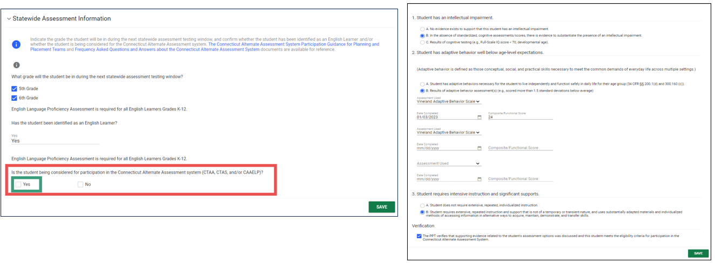
CT-SEDS: Alternate Assessment Eligibility
PPTs can indicate that a student is being considered for the Connecticut Alternate Assessment System.
The Connecticut Alternate Assessment System Eligibility Form is built into CT-SEDS.
Notes:
This is an example of what PPTs complete in CT-SEDS. The PPTs can select the Connecticut Alternate Assessment System from the CT-SEDS State-wide Testing Module. (See image shown on left)
If “YES” is selected for the item “Is the student being considered to participate in the Connecticut Alternate Assessment System (CTAA, CTAS, CAAELP)?,” the Connecticut Alternate Assessment System Eligibility Form will populate on the screen for completion. (See image shown on right) The PPT will complete and provide evidence of an intellectual impairment, adaptive functional skills well below age/grade level expectations, and confirmation that the student requires intensive and extensive instruction. Finally, they will verify this information and click save.
Please note, teams should be completing this form with current evaluation information and information should include numerical composite score and not ranges or descriptors.
For students that have a completed Alternate Assessment System Eligibility Form, for their grade of enrollment, in a finalized and implemented plan, their alternate data will sync from CT-SEDS to TIDE and populate the Alternate Assessment Indicator to “YES”. This activation registers the student for the alternate assessments that they are eligible for (CTAA, CTAS, and/or CAAELP). As a reminder, the Connecticut Alternate Assessment System Eligibility Form is also used to determine CAAELP eligibility for dually identified ELs/MLs with cognitive disabilities in Grades K-12. Therefore, PPTs will need to consider this for EL/ML students dually identified whose IEP covers Grades K-12.

Slide 102
Connecticut Alternate Assessment System Crosswalk
Assessment Detail | CTAA for Math and ELA Grades 3-8, and 11 | CTAS Grades 5, 8, and 11 | CAAELP Grades K-12
Required Administration Materials | Administered online with secure Directions for Test Administration (DTAs) and CTAA TAM. | Administered throughout the school year using CTAS Required Materials and CTAS TAM. Student ratings recorded on the CTAS Student Score Worksheet and entered in the DEI. | Administered online using grade- and domain-specific Test Administrator Directions and Scoring Rubrics Booklets and CAAELP TAM.
Security | Secure | Non-Secure | Secure
Training | Connecticut Alternate Assessment System Training Course | Connecticut Alternate Assessment System Training Course | CAAELP Test Administration Training
Certificate | "Trained status" indicated in TIDE profile. TEA can print/download certificate after passing the required quiz.​ | "Trained status" indicated in TIDE profile. TEA can print/download certificate after passing the required quiz.​ | Trained status certificate is not linked to TIDE and should be printed/downloaded from ELPA21.
Submissions into DEI | Does not apply. | TEA must submit the CTAS Student Score Worksheet in the DEI between March 23 and May 29, 2026. | Does not apply.
Notes:
We have included a high-level comparison of the three alternate assessments.
The CAAELP and CTAA are secure assessments. These secure testing materials are accessed through TIDE in the Secure Testing Materials. Please refer to each tests specific Test administration Manuals (TAMs).
The CTAS is a non-secure assessment. Each Storyline includes a Performance Task at each assessed grade level with a series of assessment activities. Each activity provides a coherent sequence of instruction for the TEA on how to assess student performance associated with each Core Extension. The TEA assesses the eligible students on provided Performance Tasks using provided Resource Packet materials and rates the student’s performance on each activity using a 0–2 scale and provided scoring guidance. Supports include the use of communication devices and assistive technology or accommodations as described in the student’s Individualized Education Program (IEP). After the CTAS is fully administered, TEAs will enter the ratings recorded on the Student Score Worksheet in the Data Entry Interface (DEI) during the testing window of March 23-May 29, 2026.
Additional Information:
Connecticut Alternate Assessment System Training Course
ELPA21 Online

Slide 103
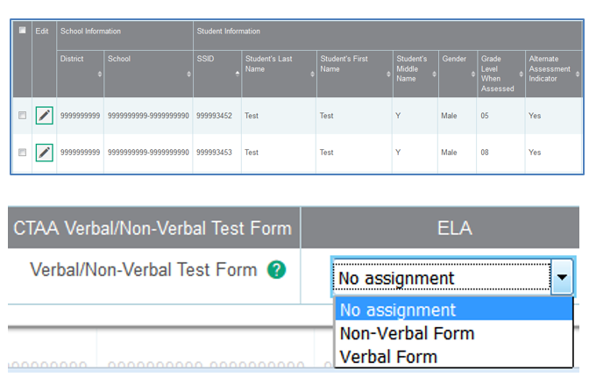
CTAA Verbal and Non-Verbal ELA Test Forms Grades 3 and 4 Only
The Non-Verbal Form presents the Open Response items in a Selected-Response format for students who do not respond:
    with oral speech;
    are blind, deaf, or deaf-blind; or
    use augmentative and alternative communication (AAC).
The forms differ in the presentation of the foundational word identification items or Open-Response (OR) items.
The form assignment must be made in TIDE prior to test administration.
The default setting is the Verbal form. Procedures for selecting the form are located in the CTAA Test Administration Manual.
Notes:
For students in Grades 3 and 4 taking the CTAA ELA reading assessment, select either a Verbal or Non-Verbal test form in the TIDE test settings. The forms differ in the presentation of the foundational word identification items or Open-Response (OR) items. Based on the student’s mode of communication, the Verbal or Non-Verbal form should be selected in TIDE prior to test administration.
As you can see in this image, the appropriate test form must be selected in the student’s test settings in TIDE for the CTAA ELA reading assessment, which includes the open-response items for students in Grades 3 or 4.
The Verbal Form is the default form presented to the student if no form is assigned in TIDE.
CTAA Test Administration Manual (TAM)

Slide 104
The Early Stopping Rule (ESR)
The ESR is a tool developed by the CSDE to identify students with the most significant cognitive disabilities who are unable to demonstrate an observable and consistent mode of communication during instruction and on assessments.
Trained TEAs who are familiar with the student complete the Student Response Check (SRC) and complete the SRC Behavioral notes.
Refer to the Connecticut Alternate Assessment System Early Stopping Rule and Student Response Check to observe procedures, timelines and due dates for ESR identification and approval from the CSDE.
Notes:
Most students eligible to participate on alternate assessments will be able to complete the assessments. This is because they can access the test questions and communicate their responses when provided supports and accommodations that mirror those provided during instruction. However, a small percentage of students with the most significant cognitive and functional adaptive behavioral needs have no observable way to communicate responses to participate in classroom or large-scale assessments.
The CSDE developed a method for identifying and determining the eligibility of these students prior to the testing window using a special test code status called the Early Stopping Rule (ESR). Students that qualify will not take the CTAA, CTAS, or CAAELP (if the student is identified as EL/ML) during the assessment window. This is because they are not able to demonstrate an observable mode of communication during the completion of the Student Response Check (SRC). Instead, the ESR special code status counts these students as test participants with the understanding that they meet specific eligibility criteria through the ESR identification processes.
What process is used to identify students?
For this small group of students with these characteristics, trained TEAS will follow the instructions in the Early Stopping Rule document to determine eligibility. Refer to the Connecticut Alternate Assessment System Early Stopping Rule and Student Response Check for more information.

Slide 105
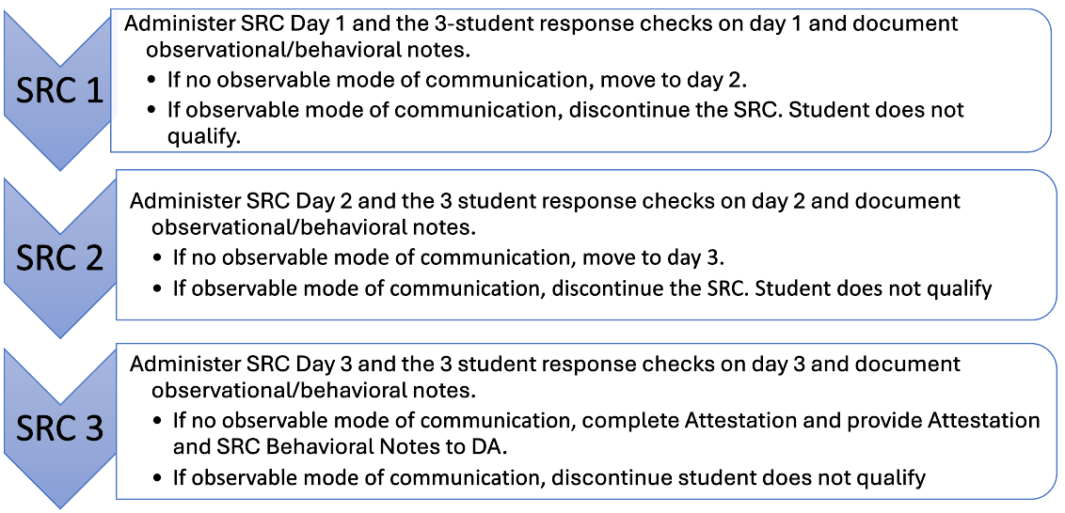
Early Stopping Rule (ESR) and Student Response Check Administration
Notes:
Trained TEAs familiar with the student complete the Student Response Check (SRC) and complete the SRC Behavioral notes.
Administer SRC Day 1 and the 3 student response checks on day 1 and document observational/behavioral notes.
If no observable mode of communication proceed to SRC Day 2.
If there is an observable mode of communication (even if incorrect) discontinue SRC and ESR.

Slide 106
ESR Submission Tips
Things to double check before and during the ESR submission in TIDE.
Verify the Alt Assessment Indicator is set to “Yes” in TIDE.
SRC Behavioral Notes clearly specify the 3 separate dates and a total of 9 trials with detailed information.
Review the Attestation Form and SRC Behavioral Notes prior to upload for the following information
  SASID matches ESR submission in TIDE.
  All SRC sessions are dated and signed by TEA.
  All signatures are completed and dated by TEA, Special Education Director, and DA.
  TEA EIN is provided.
  SRC Behavioral Notes indicate no observable mode of communication for all 3 SRC dates and the 3 trials per day.
Notes:
Refer to these submission tips before completing and uploading the ESR requests and SRC to TIDE.
Verify the Alt Assessment Indicator is set to “Yes” in TIDE.
SRC Behavioral Notes clearly specify the 3 separate dates and a total of 9 trials with detailed information.
Review the Attestation Form and SRC Behavioral Notes prior to upload for the following information.
SASID matches ESR submission in TIDE.
All SRC sessions are dated and signed by TEA.
All signatures are completed and dated by TEA, Special Education Director, and DA.
TEA EIN is provided.
SRC Behavioral Notes indicate no observable mode of communication for all 3 SRC dates and the 3 trials per day.

Slide 107
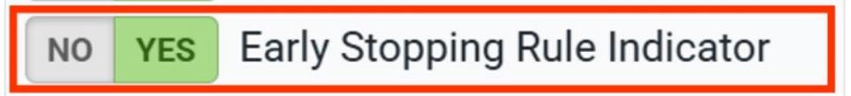
ESR in TIDE - Approval
If approved, you will receive an automatic email from DoNotReply@cambiumassessment.com.
A nightly upload will mark approved ESR students in TIDE.
Once approved, no further action is necessary!
Do NOT begin any tests for approved ESR students.
Cambium will close all tests for ESR approved students.
Once closed, the test(s) will appear as completed in the student's TIDE profile.
Notes:
You will know if, and when, your ESR form is approved, as the DA in TIDE will receive an email letting them know that the form has been approved. The DA will also receive an email if your form is rejected or needs additional information.
All ESR students will be marked as such in TIDE via a nightly upload during the test windows. This means that once approved, all users can see the ESR flag for approved students on their student profiles in TIDE. We recommend using this indicator to help you to remember which students' ESR forms have been approved.
Once approved, you do not need to take any further action. TEAs should not log into the student interface and administer, or even open, any tests for this student. If you do so, you will have to file an appeal in TIDE to have the form reset. Cambium staff are responsible for closing out all eligible tests for approved ESR students.

Slide 108
Training Requirements for the CTAA/CTAS
Resources
Overview for District Administrators
Overview for Teachers Administering the Alternate
CTAA Test Administration Manual
CTAS Test Administration Manual
Connecticut Alternate Assessment System Training Course
Connecticut Alternate Assessment System Training Resources
Connecticut Alternate Assessment System Training must be completed annually by certified educators administering the alternate (TEAs).
Training is online and available on the Alternate Assessment web page on the portal.
TEAs must complete and pass the end-of-training quiz with a score of at least 80 percent or better.
Notes:
Teachers Administering the Alternate (TEAs) are intricately involved in all aspects of the selection and supervision of the Connecticut Alternate Assessment and the Alternate Science. The Connecticut Alternate Assessment System Training requirements provide for high-quality standardized administration ensuring appropriate interpretations for results about what students with significant cognitive disabilities know and can do.
All teachers who will be administering the alternate assessments (CTAA and CTAS) must be trained annually via the online course regardless of previous training status. This training is required each school year. Once training and the embedded quiz is passed the TEA will have permission to:
Submit the CTAS Student Score Worksheet for students in Grades 5, 8, or 11;
Access the required secure test materials for the CTAA using TIDE; and
Administer the CTAA and CTAS assessments.
District Administrators are responsible for the following tasks:
Determine who will be administering an Alternate Assessment during the 2025-26 school year.
Verify that the teacher has a TEA User Role in TIDE. Update, add, and delete accounts as appropriate.
Communicate details regarding the required online training with your TEAs. Share the Overview for Teachers Administering the Alternate resource referenced on this slide.
Verify that all TEAs complete and pass the quiz. Those with passing scores will have their Trained Proctor Status as ALT in TIDE. Note: the CAAELP training is separate and does not sync with TIDE.
These are the links to the Resources:
Connecticut Alternate Assessment System Training – Overview for District Administrators
Connecticut Alternate Assessment System Training – Overview for Teachers Administering the Alternate
CTAA Test Administration Manual (TAM)
Connecticut Alternate Science (CTAS) Assessment: Test Administration Manual
Connecticut Alternate Assessment System Training Course
Connecticut Alternate Assessment System Training Resources

Slide 109
Resources to Support Alternate Assessment Eligibility
Frequently Asked Questions and Answers about the Connecticut Alternate Assessment System
Annotated Connecticut Alternate Assessment System Eligibility Form
Frequently asked Questions and Answers About the Connecticut Alternate Assessment System Eligibility Form
Connecticut Alternate Assessment System Participation Guidance for Planning and Placement Teams Flowchart
Comparison of Connecticut Alternate Assessments
For more information, visit the CSDE Website and the Connecticut Comprehensive Assessment Program Portal.
Notes:
Frequently Asked Questions and Answers about the Connecticut Alternate Assessment System;
Annotated Connecticut Alternate Assessment Eligibility Form;
FAQ About the Connecticut Alternate Assessment System Eligibility Form;
Connecticut Alternate Assessment System Participation Guidance for Planning and Placement Teams
Comparison of Connecticut Alternate Assessments

Slide 110
Training Requirements for the CAAELP (Grades K-12)
Resources
CAAELP Training Announcement
Directions for Accessing CAAELP Online Training for New Users
Directions for Accessing CAAELP Online Training for Returning Users
CAAELP Accessibility and Accommodations Manual
Connecticut Alternate Assessment of English Language Proficiency (CAAELP)Test Administration Manual
Connecticut Alternate Assessment System Early Stopping Rule
CAAELP/Alt ELPA Training must be completed annually by certified educators administering the CAAELP (TEAs).
Training is online at ELPA 21.
District Verification code is elpa21.
Certificate is maintained locally through a process determined by the district.
Additional training available: CAAELP Office Hours
Notes:
The CAAELP/Alt ELPA Training is accessed through ELPA21. This training is required for any educator who is designated as a TEA in TIDE and will be administering the CAAELP Assessment this year. This training must be completed annually (each testing school year), and the certificate of training completion should be saved and shared with administrators as needed. There are separate training modules available for ELACs and TEAs. Please be aware that first time users will need to enter a district verification code, which is elpa21 (all lowercase).
Training guides:
Directions for Accessing CAAELP Online Training for New Users
Directions for Accessing CAAELP Online Training for Returning Users
CAAELP Accessibility and Accommodations Manual
Connecticut Alternate Assessment System Early Stopping Rule
TEAs and ELACs taking this training need to be aware that this training has been developed by ELPA 21, and that some policies and procedures may not mirror those of Connecticut. Teams should participate in a thorough review of the Connecticut specific CAAELP resources available to them as part of this training process. These resources are located on the CAAELP Resource page on the Connecticut Comprehensive Program Portal.
Additional training available: CAAELP Office Hours
Links to Resources:
ELPA21: ELPA21 Online
CAAELP Office Hours: Connecticut Sensible Assessment System—Training
CAAELP Training Modules are live!
Directions for Accessing Training For New Users
Directions for Accessing Training For Returning Users
CAAELP Accessibility and Accommodations Manual
CAAELP Test Administration Manual
Connecticut Alternate Assessment System Early Stopping Rule and Student Response Check

Slide 111
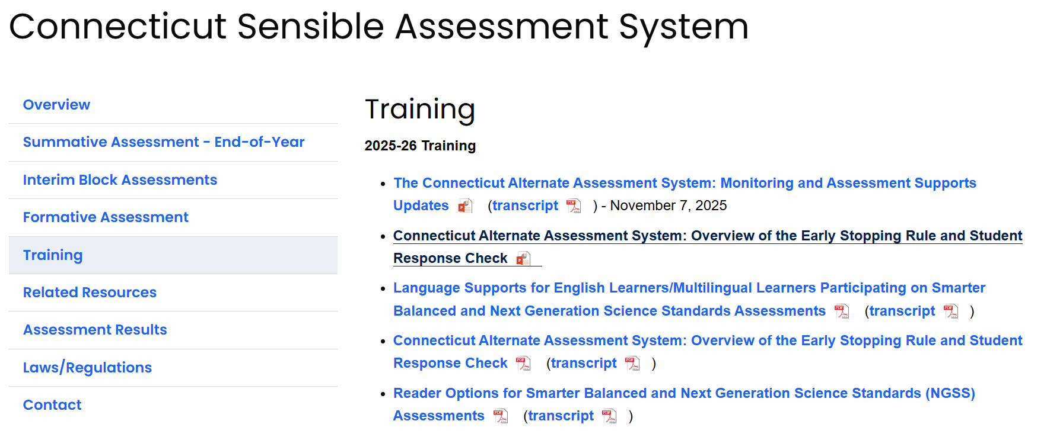
Online Training Resources
Notes:
Refer to the Training tab on the Sensible Assessment System webpage for access to training and webinars.

Slide 112
CSDE Performance Office Contacts
Abe Krisst Bureau Chief Connecticut Education – Performance Office Phone: 860-713-6894; Mobile Phone: 860-690-0650 Email: Abe.Krisst@ct.gov
Deirdre Ducharme Education Consultant Performance Office- Special Populations Direct line: 860-713-6859 Email: Deirdre.Ducharme@ct.gov
Katie Seifert Associate Education Consultant Performance Office- Special Populations Direct line: 860-713-6722 Email: Katherine.Seifert@ct.gov
Kimberly Johnson Education Support Technician Performance Office Phone: 860-713-6885 Email: Kimberly.Johnson@ct.gov
Cristi Alberino Education Consultant Performance Office –Interim & Summative Assessments Email: Cristi.Alberino@ct.gov
Jeff Greig Education Consultant Performance Office – NGSS Interim & Summative Assessments Email: Jeff.Greig@ct.gov
Notes:
Here are CSDE contacts from the Performance Office. Please reach out with any questions.
We are here to support you and your teams.

Slide 113
Thank you!
Thank you for attending and for all you do for your students!

