Slide 1
2024 District Administrator’s Test Administration Workshop
Smarter Balanced Assessments
Next Generation Science Standards (NGSS)
Connecticut Alternate Assessment System
January 17, 18, and 19, 2024

Slide 2
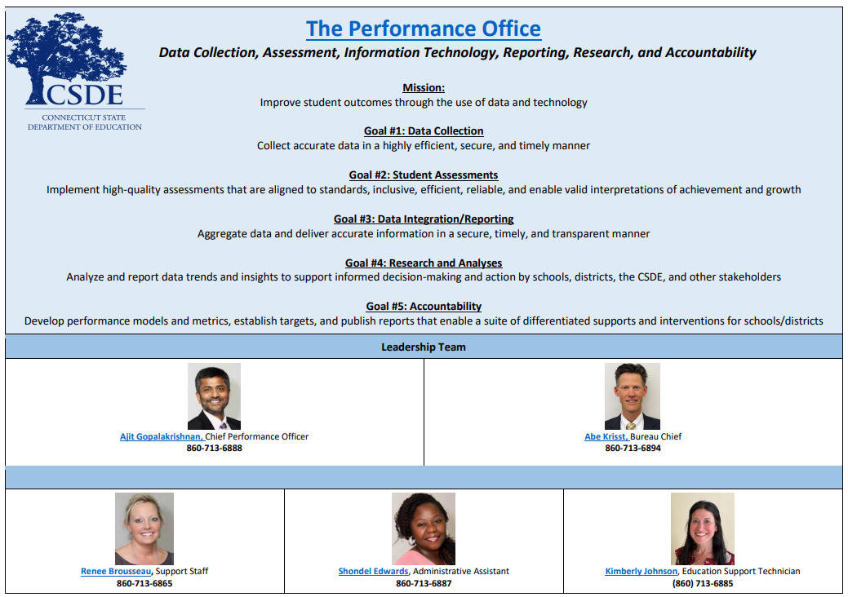
Performance Office
Notes:
How does all this work happen?
This is our Performance Office Team.

Slide 3
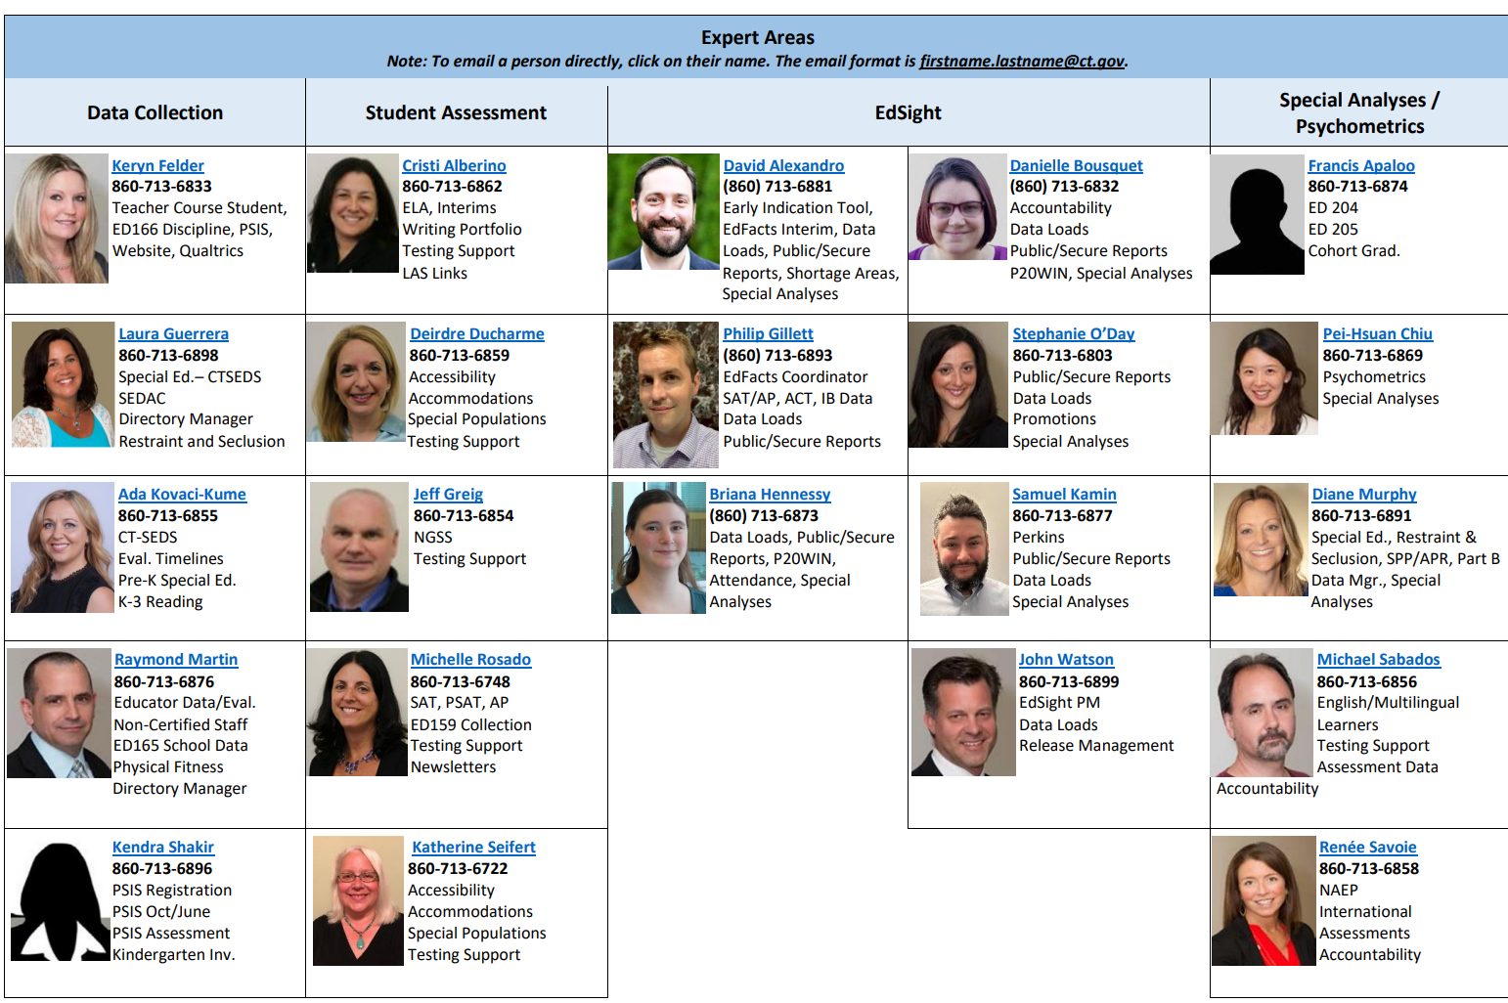
Performance Office
Notes:
Meet the Performance Office!
Additional information can be found on our website: Performance Office (ct.gov)

Slide 4
Cambium Assessment Project Team
Jen Chou, Program Director
jennifer.chou@cambiumassessment.com
Marie Musumeci, Program Coordinator
marie.musumeci@cambiumassessment.com
Christine Jung, Project Assistant
christine.jung@cambiumassessment.com
Notes:
Here is the Cambium Assessment Project Team.

Slide 5
Presentation Overview
Overview of Summative Assessments for Spring 2024
Cambium System Overview
Special Populations Update
Notes:
Today’s agenda includes an overview of summative assessments for spring 2024. We will also provide updates on the Cambium System and accessibility and accommodations for eligible students.

Slide 6
Who Do I Contact?
Who | When | How
CSDE Performance Office | State Policy Test Administration Questions Reporting of Security Breaches Only | 860-713-6860 ctstudentassessment@ct.gov
Connecticut Help Desk- Cambium Assessment | Test Administration Procedure Questions Technology Questions | 844-202-7583 cthelpdesk@cambiumassessment.com
Notes:
This is our contact information.

Slide 7
2023-24 Assessment Office Hours
Date | Topics
Virtual Teams Meeting every Thursday from April 4th to May 30 at 3 p.m. | Smarter, NGSS, CTAS, and CTAA Topics
*NOTE: There are additional Office Hours via TEAMS for LAS Links, CAAELP, and Connecticut SAT School Day. Visit the Student Assessment Training webpage to view recorded sessions and PowerPoints.
Notes:
Here are details for the SY 2023-24 Assessment Office Hours.

Slide 8
2024 Testing Calendar
State Assessment | Grade(s) | Testing Window | Delivery Method
CAAELP | K - 12 | February 1 - March 29, 2024 | Online
Smarter Balanced ELA & Math | 3 – 8 | March 25 - May 31, 2024 | Online
Connecticut Alternate Assessment (CTAA) | 3 – 8 and 11 | March 25 - May 31, 2024 | Online
NGSS Assessments | 11 | February 5 - May 31, 2024 | Online
 | 5 and 8 | March 25 - May 31, 2024 | Online
Connecticut Alternate Science Assessment (CTAS) | 5, 8, and 11 | Test should be administered throughout the school year. Student ratings entered in the DEI: March 25 - May 31, 2024 | Online Upload March 25 - May 31, 2024
Connecticut SAT School Day | 11 | March 4 - April 19, 2024 (Within the test window, schools can choose primary and make-up test dates.) | Online
Notes:
To assist districts with planning their calendars, the CSDE is providing the State Summative Assessment Calendar for Connecticut public schools for the 2024-25 school year. (https://portal.ct.gov/-/media/SDE/Student-Assessment/Main-Assessment/StateSummativeAssessmentCalendar2024-25.pdf)

Slide 9
What Remains the Same in 2024?
TIDE System
Office Hours
Importance of maintaining data in PSIS Registration
Rolling results
Test Delivery System
Test Administration Procedures
The tests
Process for testing students in Private Approved, or students in PSIS who attend Out-of-State Facilities or In-State-Non-Approved Facilities
Testing students with disabilities and/or English learners/multilingual learners
Teacher Training Slide Deck (Updated for 2024)
Early Stopping Rule (ESR) Process
Notes:
What remains the same this year?
TIDE is still being provisioned as the student management system. Uploads will come from PSIS every night like in the past.
We will be holding Office Hours again.
Please maintain your data once again in PSIS registration.
Rolling release of results are back. Generally, 10 days after testing has been completed, you will have access to results in the CRS. This should begin in mid May.
The Test Delivery System remains the same. The components that have been successfully implemented over the last few years are back.
The tests remain the same.
Policies and procedures for testing students enrolled at private approved and PSIS registered out-of-state or in-state, non-approved facilities remains the same. Refer to the hyperlinked resource for details.
All students registered in PSIS in a tested grade (Grades 3-8 and 11) will participate in academic summative assessments.
The Performance Office updated the Teacher Training Slide Deck, which is an optional tool that DAs can use to train staff.
Procedures remain the same for identifying student eligibility for the Early Stopping Rule. Please refer to the hyperlinked resource for more information and details on deadlines.

Slide 10
What’s New in 2024?
Integration of CT-SEDS Alternate Assessment System Eligibility Data from Implemented IEPs to TIDE (this activates the Alt Flag Indicator for eligible students)
Updated Test Administration Manuals
Secure Brower
Earlier Delivery of ISR PDFs to Secure File Center in TIDE
Sensible Assessment Webinars (Refer to the December edition of the Student Assessment News for details on registration.)
Attestation Message
Notes:
What is new this year?
The integration of CT SEDS Alternate Assessment Eligibility Data for implemented IEPs. More information on this to follow in the presentation.
We have updated Test Administrator manuals for Smarter, Science, and CAAELP, CTAA, CTAS, and Test Coordinator Manual. Hard copies will be delivered by the end of this month. All manuals are available on the Connecticut Comprehensive Assessment Program Portal:Home Page (cambiumast.com)
There is a new secure browser as has always been the case every school year.
We will be delivering PDFs to the Secure File Center in early August. Paper reports will also be delivered earlier. These will also arrive in early August.
We will be doing Sensible Assessment webinars highlighting some of the tools from our formative and interim assessments.
Attestation page. We will be asking districts to “attest” to taking a summative assessment this year to eliminate the confusion of taking an interim assessment. More information on this to follow in the presentation.

Slide 11
State Policy Regarding Participation

Slide 12
Participation - Connecticut General Statutes 10-14n
(b) (1) For the school year commencing July 1, 2015, and each school year thereafter, each student enrolled in grades three to eight, inclusive, and grade eleven in any public school shall, annually, take a mastery examination in reading, writing and mathematics during the regular school day.
(3) For the school year commencing July 1, 2018, and each school year thereafter, each student enrolled in grades five, eight, and eleven in any public school shall annually take a state-wide mastery examination in science during the regular school day.
Notes:
This is the language that drives our summative testing for reading, writing, mathematics, and science.
These are the statutes if needed when communicating with parents/guardians or other educators; this may be helpful to use in the district.

Slide 13
TIDE/PSIS Data Sync

Slide 14
TIDE/PSIS Data Sync
District Administrators need to work with District PSIS Coordinators to ensure accurate student information is reported in the PSIS Registration Module and TIDE.
During the summative test window, changes made in PSIS Registration will automatically be updated in TIDE by the following day.
Student identified eligible for services under EL/ML, IDEA, or Section 504 must have the applicable demographic fields indicated in PSIS.

Slide 15
TIDE/PSIS Data Sync Facts
Testing Demographics SPED, FRL, EL, Military Family, and Homeless values were loaded in November 2023.
The values for Recently Arrived EL/ML and Section 504 were not pulled from Freeze Zero. These must be set in the PSIS Registration Module.
Student demographic values will be saved, and the fields locked in PSIS on May 31, 2024*. All changes to a student’s status at the time of testing must be made by May 31, 2024.
Students who are repeaters should be tested.
Student’s grade in PSIS is that grade in which the test is given.
Grade 11 "skippers" are not tested.
In addition, student demographic values will be locked in PSIS for the following assessments: March 1, 2024, for LAS Links; March 28, 2024, for the CAAELP; April 19, 2024, for the Connecticut SAT School Day; and May 31, 2024, for Smarter Balanced Assessments, NGSS, CTAA, and CTAS.
Notes:
Here are some critical facts for the TIDE/PSIS Sync.
District PSIS Coordinators must make all changes to student enrollment and demographic information directly into the PSIS Registration Module. Student demographic values will be saved and the fields will be locked in PSIS on the following dates for accountability calculations:
• March 1, 2024, for LAS Links;
• March 29, 2024, for the Connecticut Alternate Assessment of English Language Proficiency (CAAELP);
• April 19, 2024, for the Connecticut SAT School Day; and
• May 31, 2024, for Smarter Balanced Assessments, the Next Generation Science Standards Assessments, and the Connecticut Alternate Assessment System Assessments (CTAS and CTAA).

Slide 16
TIDE/PSIS Data Sync Student Status Change
Status | If student has already taken any state assessment | If student has not already taken any state assessment
If SPED/EL/FRL was YES originally and then changed | Leave status as YES for all tests | Change status to NO for all tests
If SPED/EL/FRL was NO originally and then changed | Change to YES for all subsequent tests and the CSDE will apply this status for all tests | Change status to YES
*Making these changes may impact the student eligibility for designated supports and accommodations.
Refer to the November edition of the Student Assessment Newsletter for details on PSIS and state assessments.
Notes:
This will address the way students need to be changed in PSIS if there are status changes during the test window.

Slide 17
Questions

Slide 18
Test Security
Notes:
These protocols remain essentially the same. However, we would like to repeat them to emphasize test security policies, especially for new District Administrators and/or staff.

Slide 19
Test Security
Breaches of test security include, but are not limited to:
Analyzing/copying test items
Coaching students
Giving students answers and/or changing students’ answers
Allowing students access to digital, electronic, or manual devices (except approved accommodations)
Unauthorized log-in to the Test Delivery System
Cell phone (including Smart Watches) use by students is prohibited!
Notes:
Breaches of test security include, but are not limited to:
analyzing/copying test items
coaching students
giving students answers, and/or changing students’ answers
allowing students access to digital, electronic, or manual devices (except approved accommodations)
unauthorized log-in to the Test Delivery System
This list is not comprehensive, but this represents most issues when it comes to issues in test security.
Please note that cell phone (including Smart Watches) use by students is prohibited!

Slide 20
Test Security and Proctoring
Violation of test security is a serious matter with far-reaching consequences. Breaches of test security include, but are not limited to, copying or photographing of test materials, failing to return test materials, coaching students, giving students answers, and/or changing students’ answers. Such acts may lead to the invalidation of an entire school district’s student test scores, disruption of the test system statewide, and legal action against the individual(s) committing the breach. A breach of test security may be dealt with as a violation of the Code of Professional Responsibility for Teachers, as well as a violation of other pertinent state and federal law and regulation. The Connecticut State Department of Education will investigate all such matters and pursue appropriate follow-up action. Any person found to have intentionally breached the security of the test system may be subject to sanctions including, but not limited to, disciplinary action by a local board of education, the revocation of Connecticut teaching certification by the State Board of Education,* and civil liability pursuant to federal copyright law.
*See Section 10-145b(i) (2) (E) of the Connecticut General Statutes, which reads in relevant part as follows: The State Board of Education may revoke any certificate, permit, or authorization issued pursuant to said sections if the holder is found to have intentionally disclosed specific questions or answers to students, or otherwise improperly breached the security of any administration of a mastery examination, pursuant to section 10-14n.
Notes:
We include this language that is in the TAM, and it outlines the seriousness of testing and test security.
This is a reminder of the importance of test security and proctoring.
Please pass this important message on to your colleagues in district.

Slide 21
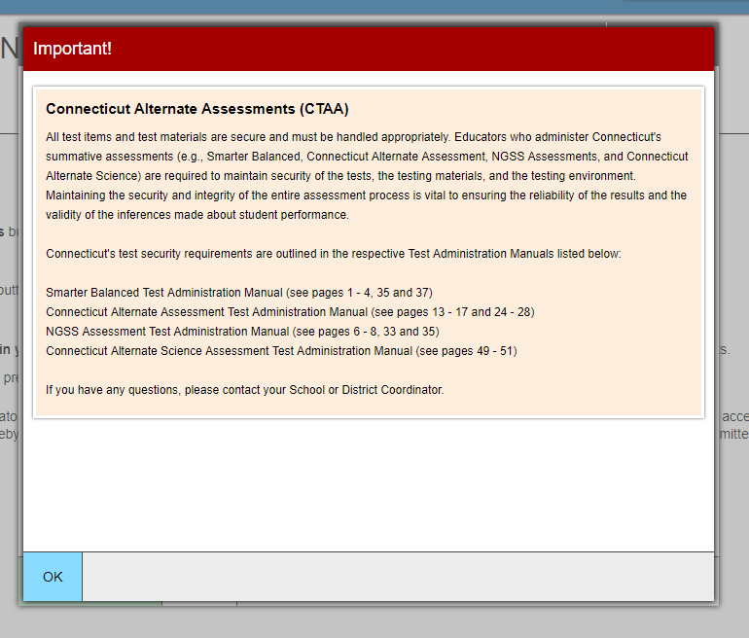
TA Security Confirmation/Attestation Page
Attestation for summative testing will be added below this language.
Notes:
This is the usual confirmation screen. This will again appear this year and TAs will have to select OK to advance and begin creating test sessions.
This protocol is not new as we have been doing it for several years. It is critical that all school proctors/test administrators are trained locally and use the Test Administration Manuals carefully when planning and administering tests.
Also, this year, when selecting a summative assessment, users will be asked to type in the word summative. Note that this is not the exact screen, but we should have a sample out soon to districts.

Slide 22
Improprieties, Irregularities, and Breaches
Notes:
Now we will cover briefly the three levels of security issues. The three levels of issues that may occur during testing.
Improprieties
Irregularities
Breaches

Slide 23
Test Security Definitions
Type | Definition
Impropriety | An incident that has a low impact on the individual or group of students testing and has a low risk of affecting student performance on the test, test security, or test validity. It can be corrected and contained at the local level.
Irregularity | An incident that impacts an individual or group of students and may potentially affect student performance on the test, test security, or test validity.
Breach | An incident that poses a threat to the validity of the test. Examples include the release of secure materials or a security/system risk. These circumstances have external implications and may result in a decision to remove the test item(s) from the available, secure item bank.

Slide 24
Test Security Actions
Impropriety (low-level incident)
Keep records locally.
Breach (high-level incident)
Irregularity (medium-level incident)
File an appeal in the system by day’s end.
Follow instructions in Appeals system.
Keep records locally.
Corrected at the local level and/or entered in Appeals system if appropriate.
Contact CSDE at 860-713-6860 or ctstudentassessment@ct.gov immediately.
Note: The Test Security Levels are described in Appendix G of the Test Coordinator’s Manual.

Slide 25
Appeal Types
Reset a Test | Removes the test and scores from the system. Enables student to start a new test.
Re-open a Test | Allows for a test that has already been submitted in error or has expired to be re-opened.
Re-open a Test Segment | Re-opening a test segment allows a student to access the first segment of a test that was submitted in error.
Grace Period Extension | Granted if a test session is unexpectedly interrupted. Allows access to all previous responses.
Restore a Test That Has Been Reset | Returns a test from the Reset status to its prior status. Only allowed on tests that have been reset. A test can be restored if it was reset in error.
Invalidate a Test | Rarely Used. Eliminates the test. Student does not receive a score.
Notes:
Appeal types are the same as last year.

Slide 26
Tips on Entering Appeals
Enter Appeals Judiciously | Staff entering appeals should be trained. CSDE is reviewing every appeal closely and does not approve everything. Provide information, if necessary, in the entry box.
Re-open or Grace Period Extension Should Only be Used When Needed | Students should not be allowed back into the test just to double check work if they already submitted their test. Students are encouraged to review items prior to ending their test.
When Unsure of What to do, Reach Out for Help | Contact the CSDE with any questions. ctstudentassessment@ct.gov; 860-713-6860; or email Cristi.Alberino@ct.gov

Slide 27
Appeals Process for an Accommodation Issue
The DA must send a signed letter to the CSDE on letterhead to Performance Office Irregularities:
The letter must include:
The student’s grade, SASID, and the name of the test on which the irregularity occurred;
The date and a detailed explanation of the irregularity;
The name of the proctor;
A description of the discussion with parents/guardians explaining the irregularity, and options offered; and
Procedures to ensure the irregularity is not repeated.
Can be emailed with only SASID, posted to TIDE Secure File Center, or faxed to 860-713-7033.
Notes:
If you have an appeal for an accommodation issue, you will be asked send a signed letter to the CSDE on letterhead to Performance Office Irregularities. This letter can be emailed with only SASID, posted to TIDE Secure File Center, or faxed to 860-713-7033
Please help us and provide this to us quickly.

Slide 28
Testing Time Reminders

Slide 29
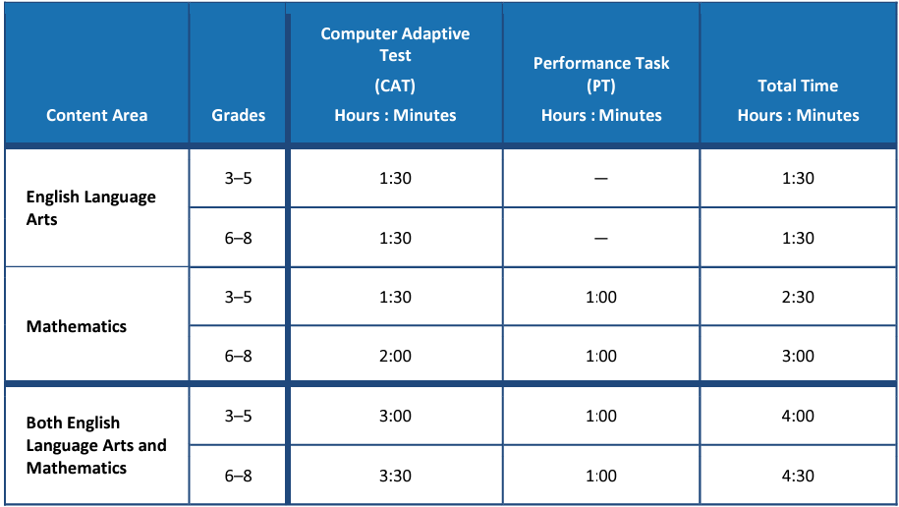
Testing Time Reminder
Many districts are testing much less than the suggested time.
Some districts are testing much more than the suggested time.
Please monitor this closely.
Extra time does not necessarily correlate with achievement and very low/high times may represent lack of effort/motivation/proctoring.

Slide 30
Testing Time Reminder
 | Grade | Mean Testing Time – SY 2022-23
ELA | 3 | 1:45
 | 4 | 1:50
 | 5 | 1:48
 | 6 | 1:51
 | 7 | 1:43
 | 8 | 1:37
 | Grade | Mean Testing Time – SY 2022-23
Math | 3 | 2:00
 | 4 | 2:09
 | 5 | 2:17
 | 6 | 2:07
 | 7 | 1:53
 | 8 | 1:54

Slide 31
Testing Time Reminder
NGSS can be administered in either one day or over two consecutive days.
The recommended testing time is at least 90 minutes for testing with an additional 10 minutes for reading the directions to the students.
Note Pause rules: If a student pauses a test, a 20-minute pause timer starts running.
If a student resumes the test within 20 minutes, they can review previously answered questions.
If a student resumes the test after 20 minutes, they cannot review previously answered questions. They can only work on unanswered questions.

Slide 32
Questions

Slide 33
CAI System

Slide 34
CT Comprehensive Assessment Program Portal
All CAI systems and resource materials can be accessed via the Connecticut Comprehensive Assessment Program Portal
(https://ct.portal.cambiumast.com/).

Slide 35
Secure Browser Updates
The Secure Browser is designed to ensure test security by prohibiting students from accessing any other programs or websites during testing.
The 2023-24 Secure Browser was released in August 2024. Download the latest secure browser from the portal. The secure browser from 2022-23 will no longer work.
Students will be required to use the Secure Browser on their device to take the summative Smarter Balanced, NGSS, the CTAA math and ELA assessments, and the CAAELP.

Slide 36
Chrome Update
CAI currently supports Chrome versions 113-118.
CAI provides presumptive support for new versions of Chrome as they are released, which means students are not prevented from taking tests on the newest versions. However, although CAI and Google work collaboratively on new versions, CAI does need to perform internal testing to make sure there are no issues. If issues are discovered we will resolve them, as quickly as possible.
Recommended: Lock down devices before the test administration window begins. This reduces the risk of any issues occurring during testing should a new version be released with unanticipated problems.
CAI no longer supports a device if Google stops supporting it. Monitor Google’s end-of-life policy here: https://support.google.com/chrome/a/answer/6220366?hl=en.

Slide 37
Chrome Update – Spanish TTS
Due to a recent change in ChromeOS, Chromebooks running version 119 or later will no longer have Spanish voice packs for text-to-speech installed by default. The consequence of this change is that students will not be able to activate text-to-speech on Spanish text in the Secure Browser on those Chromebooks. There are two recommendations for students who need Spanish text-to-speech during the upcoming test administrations:
Arrange for students to use another device for testing or a Chromebook that is still running a version of ChromeOS before 119.
(2) Install the Spanish voice pack manually using the following steps:
Enable the option for the ‘floating accessibility toolbar’ in the ChromeOS Management Console. This must be done by the system administrator.
Open the Secure Browser on the device(s) that need a Spanish voice pack
Click on the new floating toolbar in the right-hand corner of the screen and choose settings
Install the Spanish voice pack
Disable the option for the floating accessibility menu in the ChromeOS Management Console again. This is required.

Slide 38
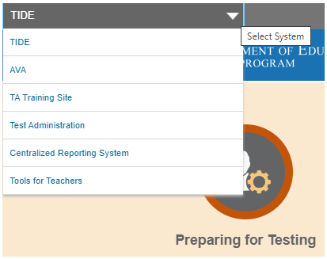
Accessing Systems
All user accounts were rolled over and passwords reset in August 2023.
If you log in on a new device or browser (or clear the cache on a previously-used browser) you must enter an emailed code after passing the initial login screen. This step does not occur when you activate your account.

Slide 39
Test Information Distribution Engine (TIDE) Updates
TIDE supports state, district, and school test coordinators throughout the testing process, from test preparation, to test administration, to post-administration. Refer to the TIDE User Guide for details.
Features include the following:
Add/Manage User Accounts
Review Student Demographic Information
Review/Edit Student Settings (Note: Accommodations should not be changed directly in TIDE. All accommodations are imported from CT-SEDS.)
Create/Submit Appeals
Create Rosters
Order Paper Materials
Run Participation Reports

Slide 40
TIDE Updates
All students taking a summative assessment (Smarter Balanced, NGSS, CTAA, CTAS, and/or CAAELP) need to be in TIDE. Work with your PSIS Coordinator if there are concerns about missing students or incorrect student demographics.
All users who are proctoring a summative assessment or need access to the Data Entry Interface (DEI) need to have an account in TIDE.

Slide 41
TIDE Updates – Uploads
The TIDE upload process has been re-designed to modernize the file upload process.
Applies to any file uploads configured in TIDE (student settings, rosters, user roles, appeals)
New, modern "drag and drop" interaction for easy file selection
Makes file upload templates and file upload history more readily accessible

Slide 42
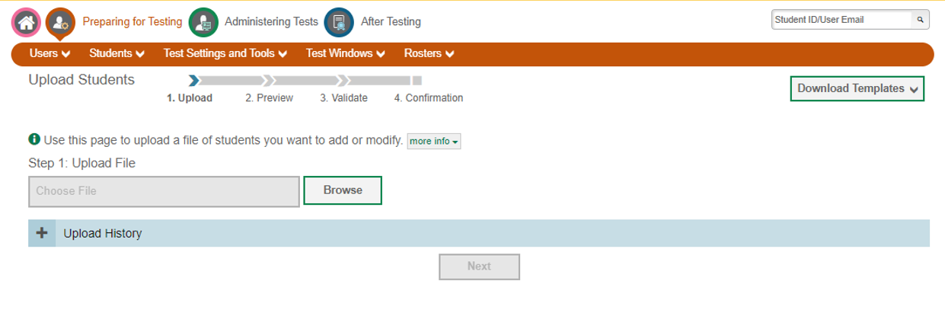
TIDE Updates – Uploads
Old Upload Page

Slide 43
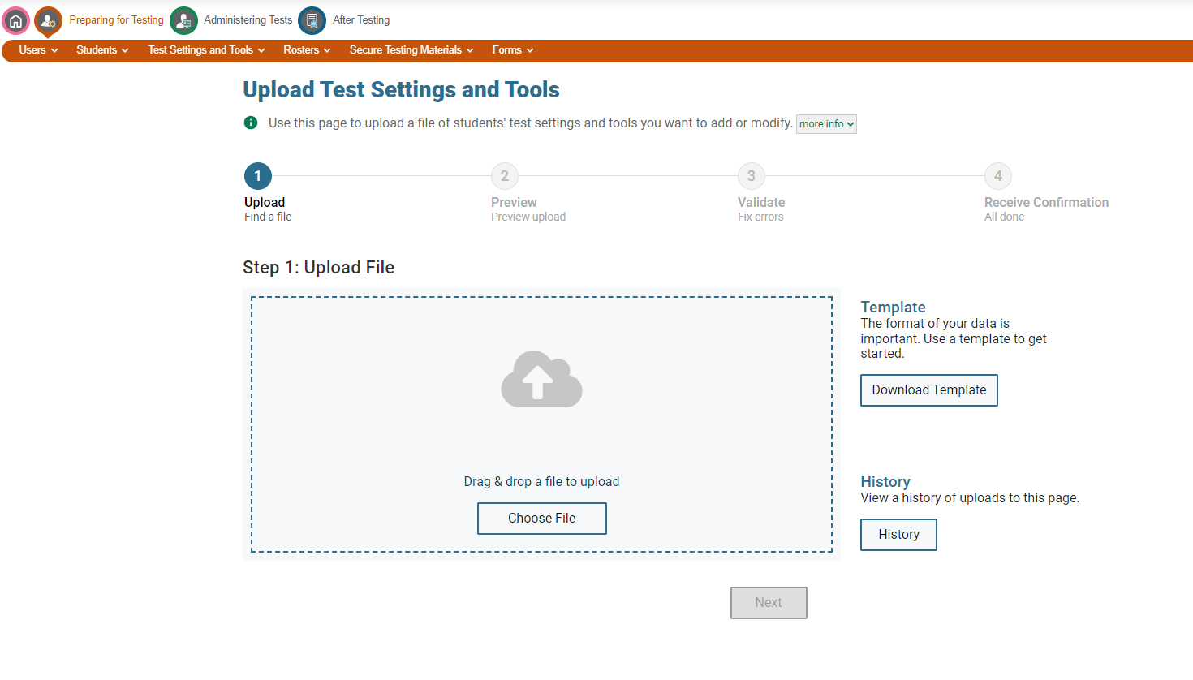
TIDE Updates – Uploads
New Upload Page
Progress wizard is more visually appealing and centered. This wizard is key for informing the user where h/she is at with the upload.
Template and History sections are moved right up front so users can see them right away.
Drag and drop … modernized, touchscreen-friendly instead of having to use a mouse and clicking and browsing for a file.

Slide 44
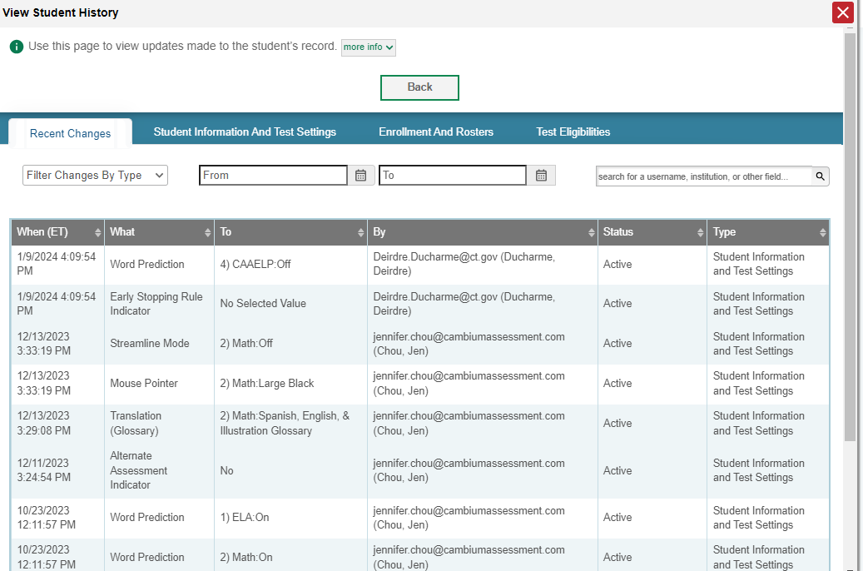
TIDE Inbox – Student Record Update History
Provides a detailed history of what updates were made to a student's record in TIDE, when, and by whom
Helps resolve questions about which user made an update to a student's records
Distinguish updates made by users in the TIDE interface (edits or file uploads) as opposed to through an automated data import process (if applicable for state/district)

Slide 45
TIDE Participation Reports
Plan and Manage Testing
Test Status Code Report
Test Completion Rates
Test Session Status Report

Slide 46
TIDE: Participation Reports (Test Status Code Report)
Specific report used to view each student’s test status and all special codes to explain a student’s non-participation in a test.
Displays all test statuses for each test for which each student in a district/school is eligible.
May be generated at the district level or at the school level, depending on your user role.
Report should be generated for each test to obtain an accurate picture reflecting the testing status of all students for all tests in the school or district.
Particularly useful for summative assessments.

Slide 47
TIDE: Participation Reports (Test Completion Rates)
High-level reports used to summarize the number and percentage of students who have started or completed a test.
May be generated at the district or school level, depending on your user role.
All students in the specified school or district will be included in this report.
Report should be generated for each test to obtain an accurate picture that reflects the testing status of all students for all tests in the school or district.
Users will be able to view test completion data by combo tests (e.g., completion of both the Math CAT and Math PT).

Slide 48
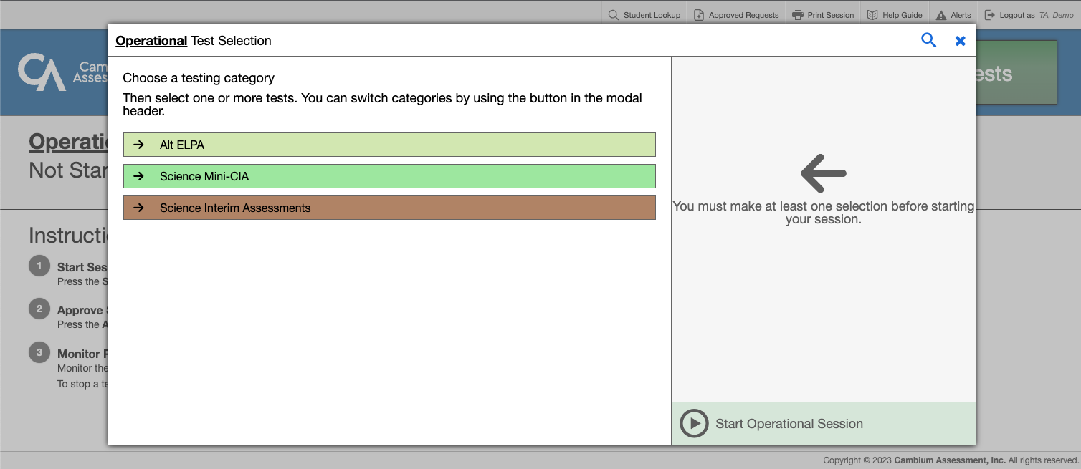
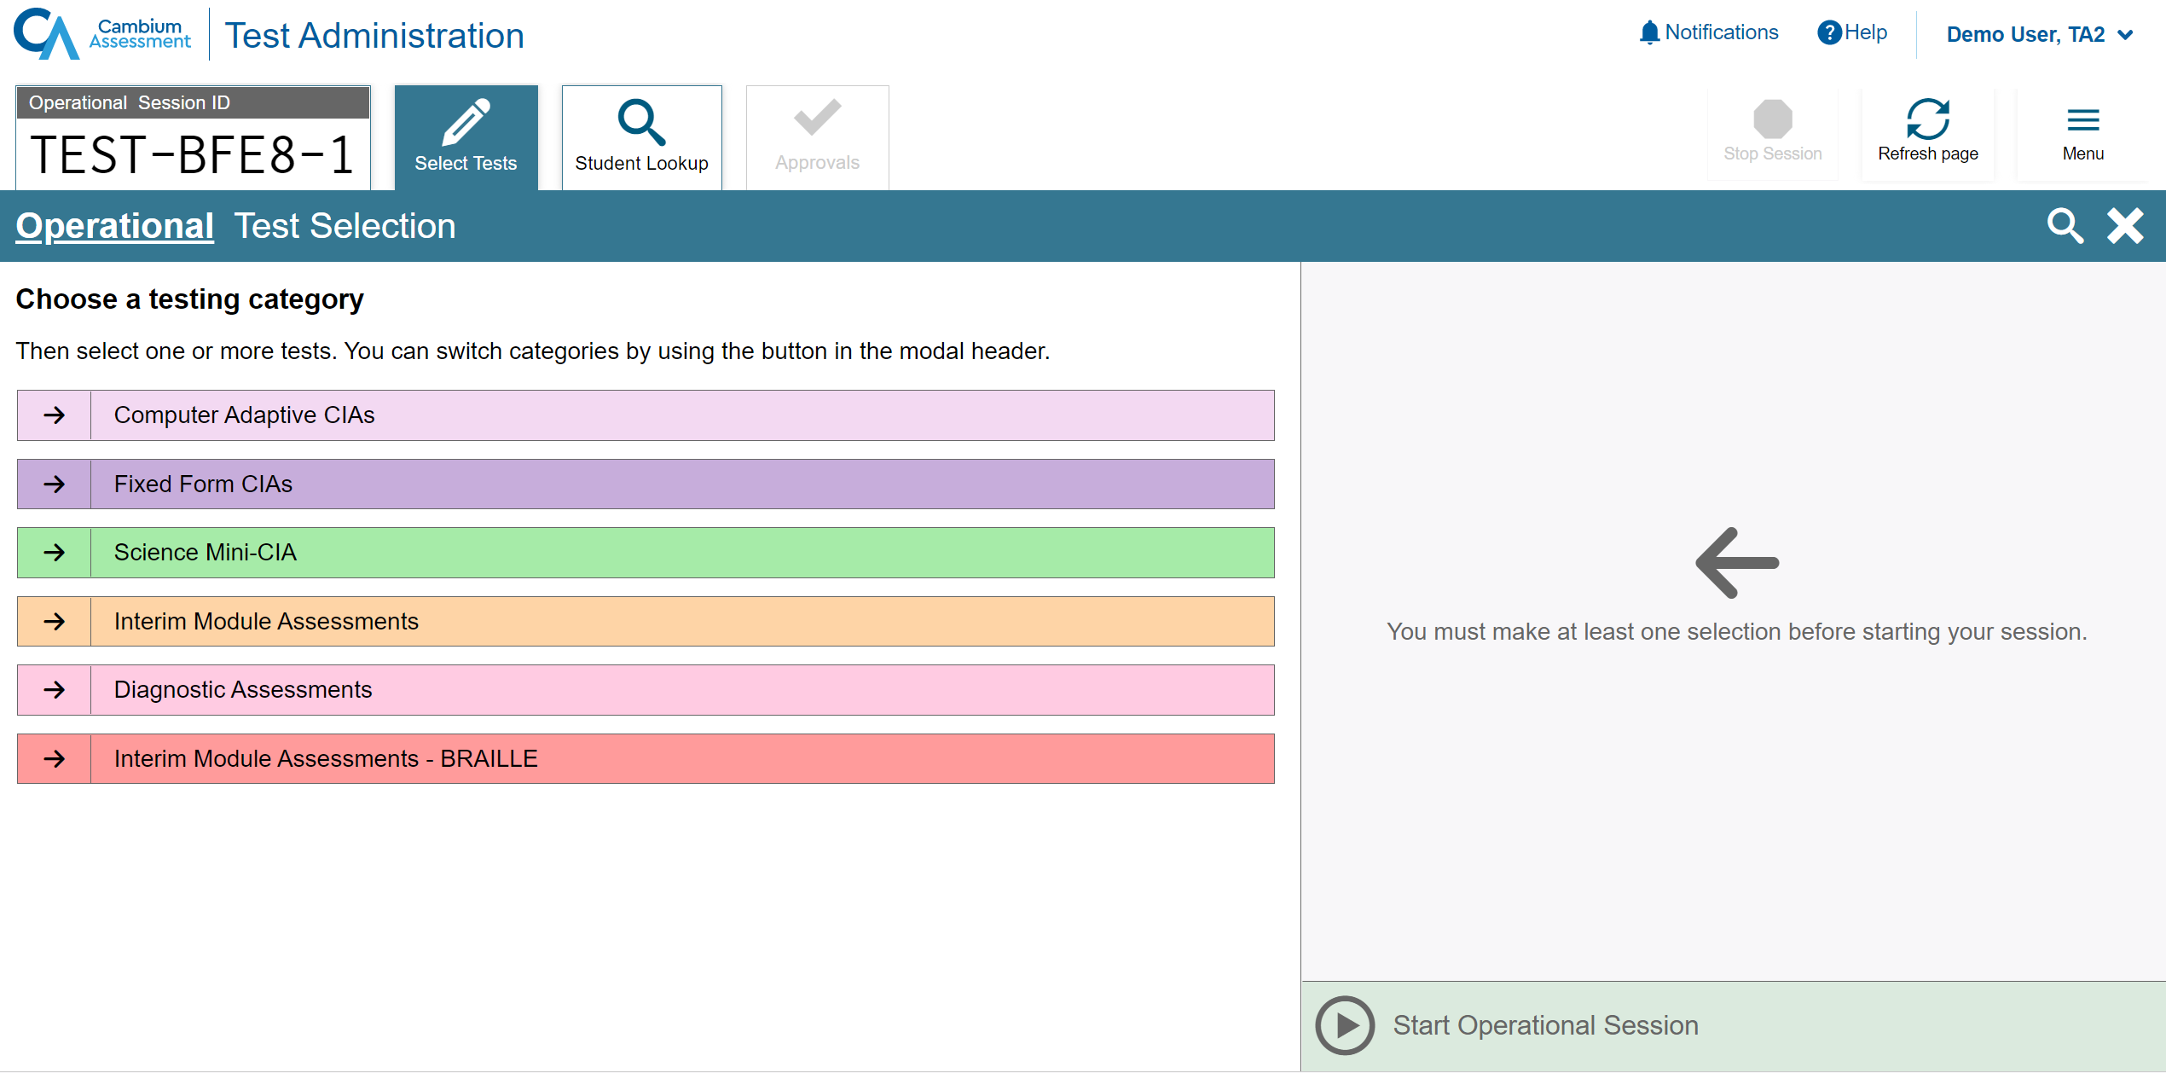
Test Delivery System (TDS) Updates
User Interface Refresh
The TA interface has been modernized without changing the functionality.
The selection of tests are no longer in a dialog box. We are using the full screen real-estate to accommodate longer test labels and lists of selected tests.
Old
New

Slide 49
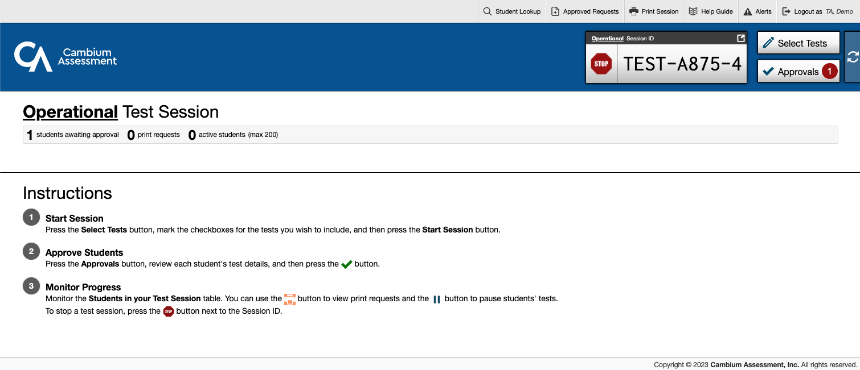
TDS Updates
User Interface Refresh
The Test Session ID, Select Tests and Approvals buttons are now in a tab.
Old
New

Slide 50
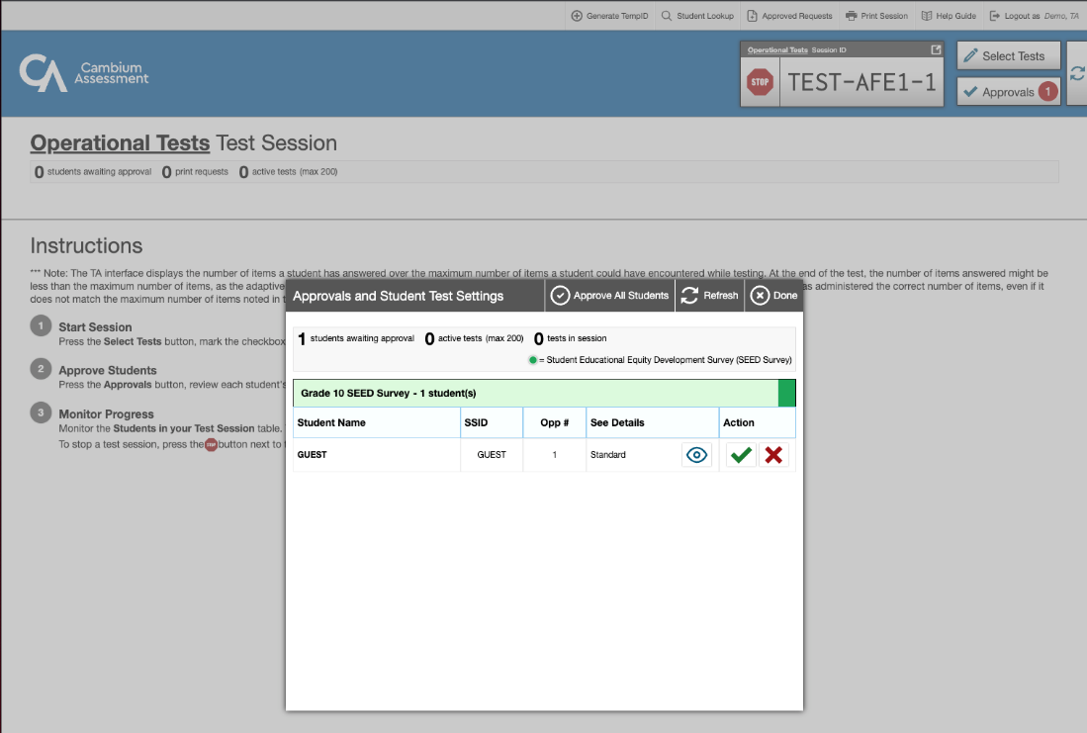
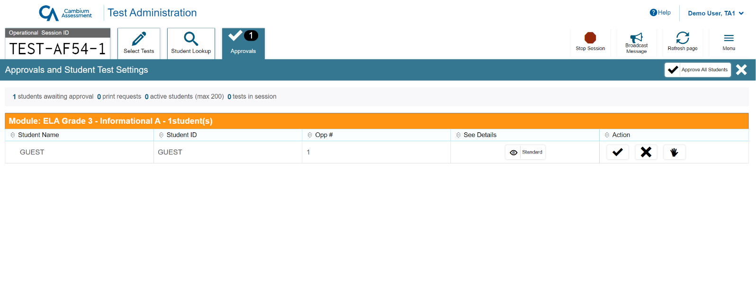
TDS Updates
User Interface Refresh
The entire screen is now used to display the list of students. This allows more students to show on the screen
Old
New

Slide 51
TDS Updates
User Interface Refresh
Proctors will now have the ability to pin select students of interest to the top, so they are easy to monitor.

Slide 52
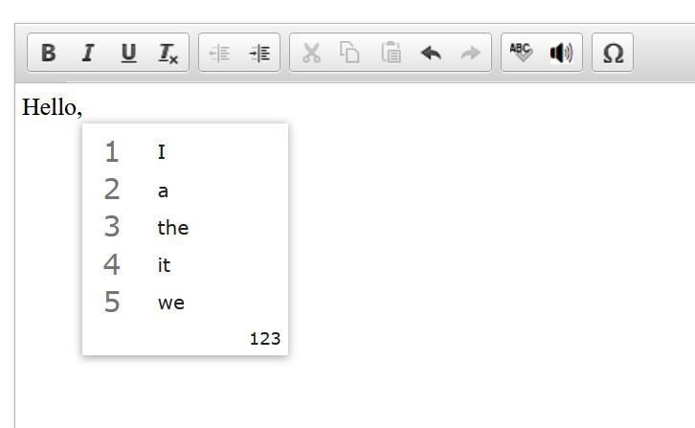
TDS Update: Word Prediction
New configurable accommodation via TIDE
Built directly into TDS now. No pre-install or pre-setup necessary
Available on open-ended items (ELA CAT and Math PT)
Available on Practice, Interims, and Summative Assessments

Slide 53
TDS Update: End Test
There is a new workflow to submit a test.
When the student reaches the last item of the test, they will no longer see an [End Test] button. They will click the [Next] button as if they are simply going to the next page in a traditional, linear workflow.
Instead of seeing an error message saying “There are no more items” they will be taken to a new overall test review screen.
The student can either go back into the test, pause or submit their test for scoring.

Slide 54
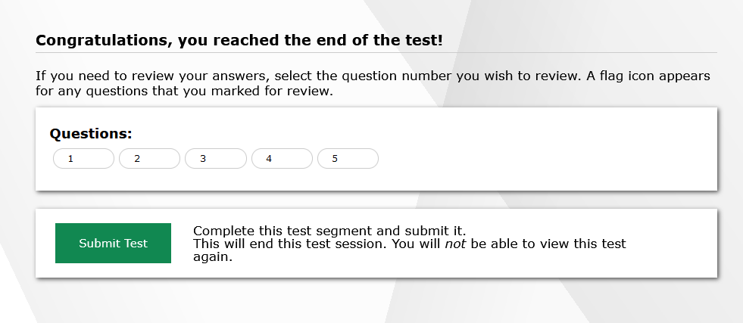
TDS: End Test
Old
New

Slide 55
Questions

Slide 56
Accessibility and Special Populations

Slide 57
Accessibility and Special Populations Overview
2024 Calendar for Special Considerations
Who is Eligible for Supports and Accommodations?
What’s New for 2023-24 Designated Supports and Accommodations?
Accommodation Reminders
CT-SEDS and TIDE
The Connecticut Alternate Assessment System (CTAA, CTAS, and CAAELP)
Questions

Slide 58
2024 Calendar for Special Considerations
 | Deadline | Delivery Method
Connecticut Alternate Assessment Eligibility Form: Fully Implemented IEP in CT-SEDS | December 29, 2023 CAAELP (students identified as EL/ML in Grades K-12); and CTAA and CTAS (Grade 11) | Through implemented IEP in CT-SEDs sync to TIDE through May 31, 2024
 | February 1, 2024 CTAA (Grades 3-8, and newly identified students in Grade 11); and CTAS (Grades 5, 8, and newly identified students in Grade 11)
Early Stopping Rule | Student Response Check (SRC) completed by TEA no later than February 1, 2024; then DA in TIDE submits Connecticut Alternate Assessment System Early Stopping Rule Request and Attestation Form via TIDE Forms by March 1, 2024. | TIDE Forms
Notes:
Here are some deadlines you will want to keep in mind.
The Connecticut Alternate Assessment Eligibility Form. Eligibility forms must be approved, verified, and implemented within the IEP in CT-SEDS. The dates shown here will ensure the correct rostering of students into the specific assessments designated per their IEPs.
Here are the dates for the ESR. TEAs should be completing this and submitting this to their DA for students that would qualify for the ESR. DA's should have this information by February 1st and the submission of the ESR needs to be done no later than March 1st. We will cover the ESR in more detail in future slides.
Refer to the Assessment Guidelines for procedural and policy guidance.
https://ct.portal.cambiumast.com/-/media/project/client-portals/connecticut/pdf/2019/csde-assessment-guidelines.pdf

Slide 59
2024 Calendar for Special Considerations
 | Deadline | Delivery Method
CAAELP Domain Exemption | November 15, 2023, through March 22, 2024 | TIDE Forms
Designated Supports | *Must be entered or submitted via batch upload in TIDE prior to testing (This is for students who do not have IEPs/Section 504 plans) | TIDE Test Settings and Tools
Medical Exemptions | March 8, 2024 - LAS Links April 5, 2024 – CAAELP April 26, 2024 - Connecticut SAT School Day June 7, 2024 - Smarter Balanced, NGSS, Connecticut Alternate Assessments | DA Requests Application from CSDE
Notes:
Domain exemptions for the CAAELP are now open until March 22nd. We will review this in greater detail in future slides and more information can be found on the CAAELP resources page on the Connecticut Comprehensive Portal.
We will review medical exemptions later in this presentation, please keep these dates in mind for each specific assessment.
Refer to the Assessment Guidelines for procedural and policy guidance.
https://ct.portal.cambiumast.com/-/media/project/client-portals/connecticut/pdf/2019/csde-assessment-guidelines.pdf

Slide 60
Who is Eligible for Supports and Accommodations?
Notes:
We are now going to take a few moments to review who is eligible for the different accessibility supports available.

Slide 61
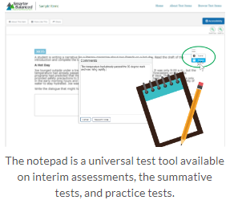
Understanding Universal Tools
Universal Tools (embedded and non-embedded): available to all students based on student preference and selection (e.g., highlighter, notepad).
Making Decisions about Universal Tools:
Universal tools are automatically available to all students through the test delivery system.
Educators may need to determine if certain universal features are distracting for certain students.
Universal tools can be turned off by the test administrator/proctor prior to testing.
Educators also need to ensure that appropriate, non-embedded universal features are available to meet individual students’ needs.
Resource: Five Built-in Test Tools Students Should Know (and Use!)
Notes:
Here we provide the definition of universal tools and considerations the team can use. Remember universal tools are available to ALL students. However, just because they are available doesn’t mean that they all should be used. Some tools may not be appropriate for students and can be a distractor. Therefore, universal tools can be turned off by the test administrator/proctor prior to testing. Also remember, that in the context of statewide assessments, different assessments use different platforms and offer different tools. Take time to learn about the unique accessibility features provided for each assessment.
Resource: Five Built-in Test Tools Students Should Know (and Use!)

Slide 62
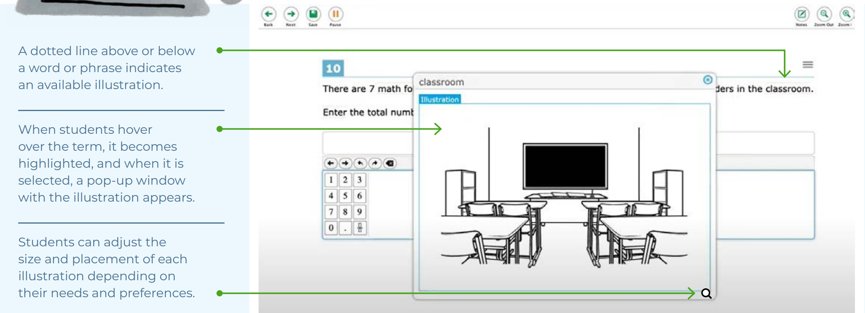
Understanding Designated Supports
Designated Supports (embedded and non-embedded): accessibility features available for use by any student for whom the need has been indicated by an educator team with input from the parent/guardian and student. If these supports are selected for use on statewide assessments, they should also be consistently embedded and accessed in the student’s instructional setting.
Examples: color contrast, text-to-speech of items, illustration glossary (math) as shown to the right.
Making Decisions about Designated Supports:
Educator teams making these decisions should be familiar with the child’s characteristics and needs.
Notes:
Here we provide the definition of designated supports and considerations the team can use. Designated supports are accessibility features available for any student whom the need has been indicated by an educator team with input from the parent/guardian and student. This should be based off the students specific and unique learning profile.
When teams make this recommendation, it should also be consistently utilized across educational settings as applicable.

Slide 63
Selecting Designated Supports for Students Without an IEP/504 Plan
District Administrators should establish a process for setting designated supports in TIDE for eligible students who do not have an IEP or Section 504 Plan. Test supports must be set prior to the start of the student’s test session.
For details, refer to the TIDE User Guide (See pages 39-40.)
Per the example above, the student is eligible to have a medical device, a mouse pointer, streamline mode, text-to-speech of math and science stimuli and items, and the Translation Glossary for Math.
Notes:
When entering designated supports for students who do not have an IEP or Section 504 plan the DA should establish a process for setting designated supports in TIDE. Any test support needs to be assigned prior to the start of a test session.
Refer to these resources to learn more about student settings in TIDE:
TIDE User Guide: Test Information Distribution Engine (TIDE) User Guide (cambiumast.com)
Accessing TIDE: Accessing TIDE (cambiumast.com)
User Role Permissions for Secure Online Systems: User Role Permissions for Secure Online Systems (cambiumast.com)

Slide 64
Understanding Accessibility Supports
Accommodations (embedded and non-embedded): are changes in procedures or materials that increase equitable access during assessment. They generate valid assessment results for students who need them; they allow students to show what they know and can do. These accommodations should be consistently embedded and accessed in the student's instructional setting.
Examples: Assistive technology, American Sign Language, braille, closed captioning
Making Decisions About Accommodations:
Educator teams (PPT/Section 504/EL/ML team), along with the student’s parents/guardians and the student (if appropriate) make decisions regarding needed accommodations.
Decisions about tools, supports, and accommodations should be integrated into all district, school, and/or classroom processes which prioritize student needs and ensure equity of accessibility for all students.
Notes:
Accommodations are for students with an IEP or 504 plan. These are changes in materials or procedures that increase equitable access during assessments. They allow students to show what they know and can do. Like designated supports they should be consistently accessed and incorporated into the students instructional setting. Students should have familiarity and independence with both accommodations and designated supports that are assigned. They prioritize student needs and ensure equitable access.
Accommodations are determined and documented within the IEP or section 504 by the PPT or Section 504 team.
Refer to the CSDE Assessment Guidelines for details about accommodations available for each assessment: CSDE Assessment Guidelines (cambiumast.com)

Slide 65
Understanding Accessibility Supports
Special Documented Accommodations (non-embedded): non-standard accommodations (e.g., human reader or signer, or a scribe to support written communication when the embedded accommodation, or standard accommodations, are not appropriate given the complexity of student need.) These accommodations require testing in an individual test setting and may require additional training for the test administrator. Refer to the Special Documented Accommodations resource available on the portal.
Making Decisions about Special Documented Accommodations
Must be determined at the PPT/Section 504 Convening.
The educator team rules out that the standard embedded and non-embedded accommodations and accessibility features do not provide adequate access given the students documented disability.
These accommodations require the greatest extent of adult-dependence/support.
Notes:
Finally, Special Documents Accommodations are non-standard accommodations (available to students with an IEP or Section 504 Plan)for those who are unable to access standard designated supports and accommodations. Special Documented Accommodations require the greatest extent of adult-dependence and support. Teams should refer to the Special Documented Accommodations resource available on the portal.
Special Documented Accommodations require the greatest extent of adult dependence. The provision of these accommodations require additional training and the review of specific test procedures and test administration protocols. Students must test in a 1:1 test setting. Refer to the CSDE Assessment Guidelines for additional information. CSDE Assessment Guidelines (cambiumast.com)

Slide 66
Designated Support/Accommodation Eligibility
Eligibility for any embedded or non-embedded accommodation requires the IDEA or Section 504 indicator (based on the PSIS registration fields) set to Yes. Without this indication, accommodations cannot sync to TIDE from CT-SEDS.
The student’s EL/ML designation must be set to Yes in PSIS if the student is identified as EL/ML.
Accommodations should NEVER be manually entered in TIDE unless authorized by the CSDE. The IEP/Section 504 is the source of truth. If corrections are necessary, contact the Case Manager and an amendment of edit/revise can be conducted.
Notes:
When reviewing accommodations in the student dashboard in TIDE you will want to be aware of the following indicators and how they are set.
Eligibility for any embedded or non-embedded accommodation requires the IDEA or Section 504 indicator (based on the PSIS registration fields) set to Yes. Without this indication, accommodations cannot sync to TIDE from CT-SEDS.
The student’s EL/ML designation must be set to Yes in PSIS if the student is identified as EL/ML.
Accommodations should NEVER be manually entered in TIDE unless authorized by the CSDE. The IEP/Section 504 is the source of truth! If corrections are necessary, contact the Case Manager and an amendment of edit/revise can be conducted.

Slide 67
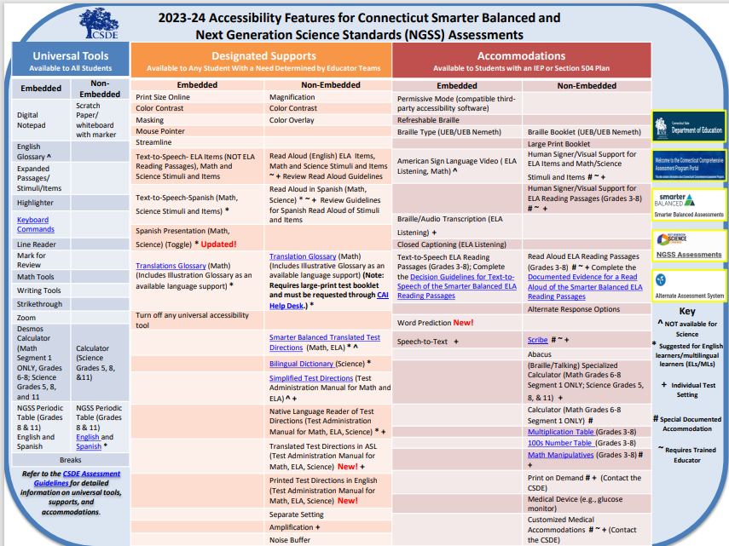
Notes:
This Accessibility Chart, for Smarter Balanced, NGSS, and the Connecticut Alternate Assessment System, is organized by the three levels of supports. These supports are both embedded and non-embedded.
Teams should understand the purpose and functionality of these tools and accommodations before selecting them.
Extra care should be used to ensure that selected supports do not conflict, such as the selection of the embedded text-to-speech of items AND the non-embedded Read Aloud of items.
We have conducted an office hours to help teams in understanding best practices in selecting accessibility features and that session can be found on the Student Assessment training page.
Accessibility Chart: Accessibility Chart (cambiumast.com)

Slide 68
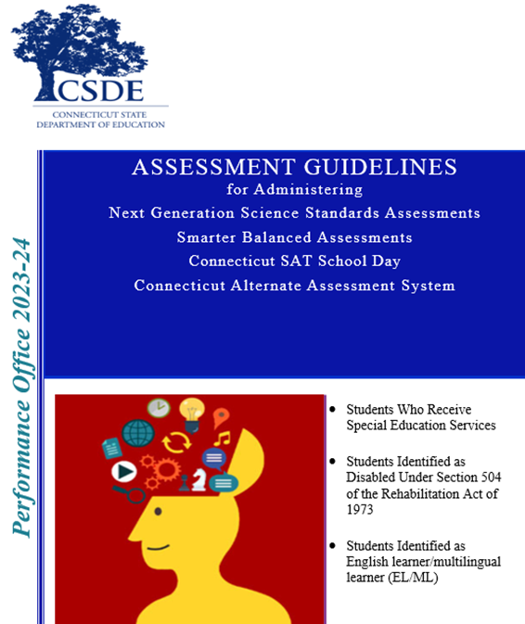
CSDE Assessment Guidelines
The CSDE Assessment Guidelines include detailed information related to accessibility supports and accommodations on statewide assessments.
They provide guidance related to special circumstances such as medical exemptions and requests for non-standard special documented accommodations.
Notes:
CSDE Assessment Guidelines (cambiumast.com)

Slide 69
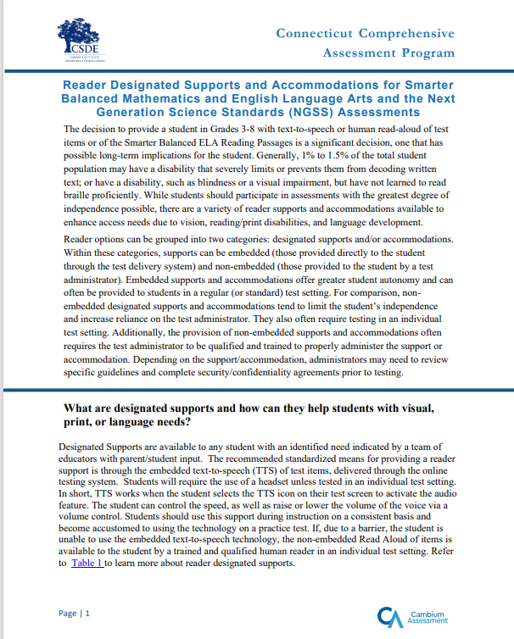
Reader Options Resource for Smarter Balanced/NGSS
Reader Designated Supports and Accommodations for Smarter Balanced Mathematics and English Language Arts and the Next Generation Science Standards (NGSS) Assessments
This document provides guidance, resources, and required documentation on:
Designated Supports that provide greater access to print/text; and
Accommodations that provide the greatest extent of access to print/text (available to students with visual and print disabilities per an IEP/Section 504 Plan)
Notes:
This guide provides educators with a review of reader options available on Smarter Balanced and NGSS assessments and the corresponding documents and resources associates with each accessibility feature. These reader options can be grouped into two categories: designated supports and/or accommodations. Within these categories, supports can be embedded (those provided directly to the student through the test delivery system) and non-embedded (those provided to the student by a test administrator).
Reader Designated Supports and Accommodations for Smarter Balanced Mathematics and English Language Arts and the Next Generation Science Standards (NGSS) Assessments (cambiumast.com)

Slide 70
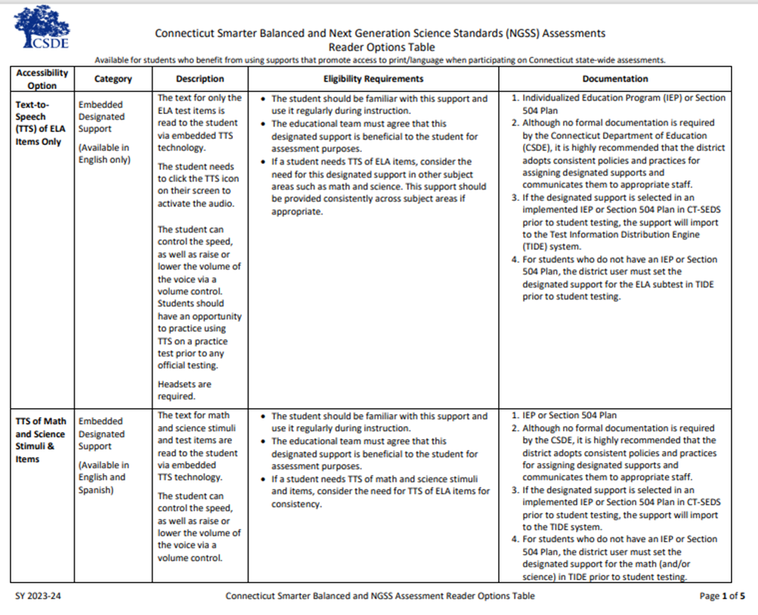
Reader Options Resource for Smarter Balanced/NGSS
Connecticut Smarter Balanced and NGSS Assessments Reader Options Table
This resource provides information on various embedded and non-embedded Smarter Balanced and NGSS reader supports and accommodations. This document:
defines the purpose
test requirement, and;
necessary documentation (if applicable)
Notes:
Connecticut Smarter Balanced and NGSS Assessments Reader Options Table
This resource provides an in-depth look at the different reader options available for SB/NGSS. It defines the purpose, test requirements, and necessary documentation (if applicable) for various embedded and non-embedded Smarter Balanced and NGSS reader supports and accommodations. This tool can help educators determine the most appropriate accessibility features that support access to print/text.
Connecticut Smarter Balanced and NGSS Assessments Reader Options Table (cambiumast.com)

Slide 71
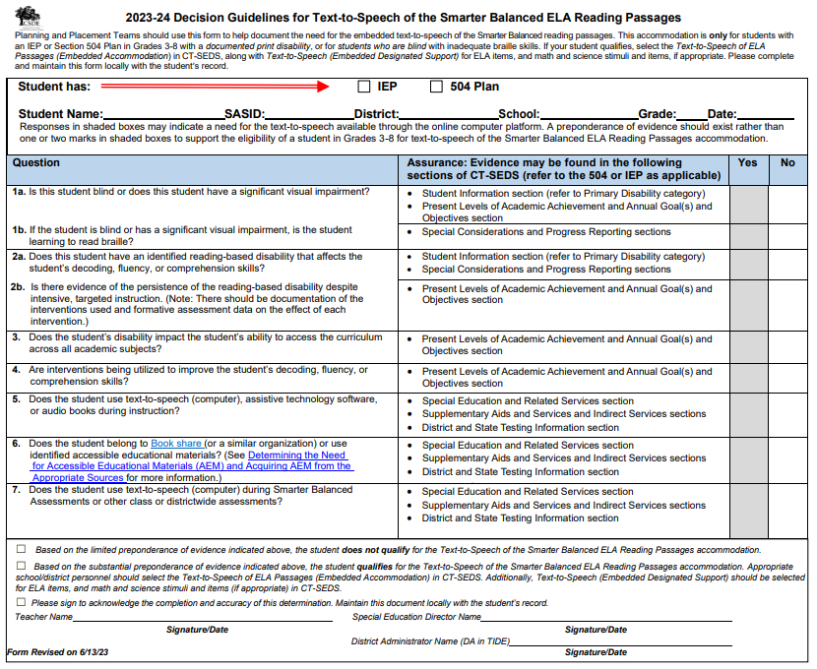
Decision Guidelines for Text-to-Speech of the ELA Reading Passages
Some reader supports require documented evidence for a reader, either embedded TTS of ELA Reading Passages or non-embedded Read Aloud of ELA Reading Passages.
Embedded - TTS of ELA Reading Passages
PPT/Section 504 Team should complete the Decision Guidelines for Text-to-Speech of the Smarter Balanced ELA Reading Passages and it should be maintained with the student’s record.
Accommodation must be documented in CT-SEDS for Smarter Balanced ELA and other subtests as appropriate (i.e., Math, Science).
Notes:
Some reader supports require documented evidence. These supports are for the reading, either embedded or non-embedded of reading passages.
Typically, these students have significant print or visual disabilities and are unable to access the embedded text-to-speech accommodation provided by the test delivery system.
The Planning and Placement Team (PPT) or Section 504 Team should complete either the Decision Guidelines for Text-to-Speech of the Smarter Balance ELA Reading Passages or the Documented Evidence for Read Aloud of the Smarter Balanced ELA Reading Passages form (located on the reader resources page of the portal) to determine if there is a substantial preponderance of evidence indicating that the student qualifies for either the TTS or the Read Aloud accommodation.
Note that this accommodation is appropriate for a very small number of students (estimated to be approximately 1-2% of students with disabilities participating in a general assessment).
If the student meets eligibility requirements for this accommodation, the PPT should select this accommodation in CT-SEDS and file either Decision Guidelines for Text-to-Speech of the Smarter Balance ELA Reading Passages or the Documented Evidence for Read Aloud of the Smarter Balanced ELA Reading Passages locally with the student’s record.
For information on available designated supports and accommodations, please refer to the CSDE Assessment Guidelines.
Embedded - TTS of ELA Reading Passages: The ELA reading passages are read to the student via embedded TTS technology. The student can control the speed, as well as raise or lower the volume of the voice via a volume control. Headsets are required unless the student is testing in an individual test setting.
Decision Guidelines for Text-to-Speech of the Smarter Balanced ELA Reading Passages (cambiumast.com)

Slide 72
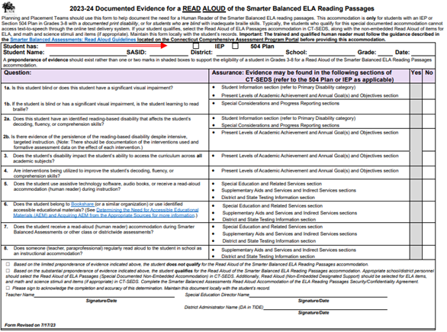
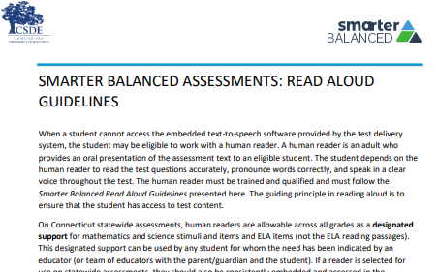
Documented Evidence for Reader Supports
Non-Embedded –Read Aloud of ELA Reading Passages
(1) PPT/Section 504 Team should complete the Documented Evidence for a Read Aloud of the Smarter Balanced ELA Reading Passages and it should be maintained in the student’s record.
(2) The qualified individual acting as the reader should review the Smarter Balanced Assessments: Read Aloud Guidelines and sign the Test Security/Confidentiality Agreement Form (Appendix B of document).
Special Documented Accommodation must be indicated with attestation in CT-SEDS. The team should also select a read aloud accommodation for other applicable subtests (i.e., Math, Science).
Notes:
Non-Embedded –Special Documented Read Aloud of ELA Reading Passages (Human Reader):
When a student cannot access the embedded text-to-speech software provided by the test delivery system, the student may be eligible to work with a human reader.
Guidance for Read Aloud Accommodation:
Human readers are allowable for ELA reading passages, in addition to items, as a special documented accommodation for eligible students in Grades 3-8 who have an implemented IEP or 504 Plan in CT-SEDS. A human reader is an adult who provides an oral presentation of the assessment text to an eligible student. The student depends on the human reader to read the test questions accurately, pronounce words correctly, and speak in a clear voice throughout the test. The human reader must be trained and qualified and must follow the Smarter Balanced Read Aloud Guidelines presented here. The guiding principle in reading aloud is to ensure that the student has access to test content.
If a reader is selected for use on statewide assessments, they should also be consistently embedded and accessed in the student’s instructional setting. It is recommended that a consistent process in each district be used to determine and communicate decisions regarding these supports for individual students.
If the accommodation or special documented accommodation is selected in an implemented IEP or Section 504 Plan in CT-SEDS prior to student testing, the accommodation will import to the TIDE system. Please note students should not have both as they are conflicting accommodations.
Before serving as a human reader, the teacher/proctor must review the Read Aloud Guidelines and sign the Test Security/Confidentiality Agreement Form (Appendix B of the Read Aloud Guidelines). Once signed, the form should be returned to the District Administrator for signature and filed with student record.
Documented Evidence for a Read Aloud of the Smarter Balanced ELA Reading Passages (cambiumast.com)
Smarter Balanced Assessments: Read Aloud Guidelines (cambiumast.com)

Slide 73
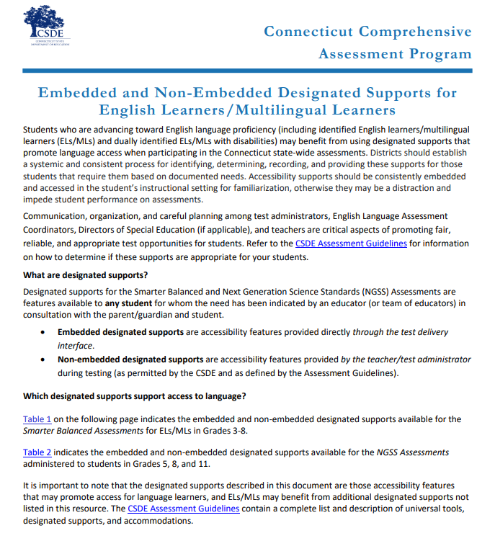
EL/ML Language Supports SB/NGSS
Examples of English Language Supports
Simplified Test Directions (Math and ELA)
Smarter Balanced Translated Test Directions (Math and ELA) *New 2023/24 Portuguese
Bilingual Word-to-Word Dictionary (NGSS only)
Translation Glossary (Math)
Read Aloud (Spanish) for Math and Science
For more information, refer to the Assessment Guidelines and the Embedded and Non-Embedded Designated Supports for English Learners/Multilingual Learners (shown here).
Notes:
Students who are advancing toward English language proficiency (including identified English learners/multilingual learners (ELs/MLs) and dually identified ELs/MLs with disabilities) may benefit from using designated supports that promote language access when participating in the Connecticut state-wide assessments.
Districts should establish a systemic and consistent process for identifying, determining, recording, and providing these supports for those students that require them based on documented needs. Accessibility supports should be consistently embedded and accessed in the student’s instructional setting for familiarization, otherwise they may be a distraction and impede student performance on assessments. Communication, organization, and careful planning among test administrators, English Language Assessment Coordinators, Directors of Special Education (if applicable), and teachers are critical aspects of promoting fair, reliable, and appropriate test opportunities for students.
Refer to the CSDE Assessment Guidelines for information on how to determine if these supports are appropriate for your students.
Embedded and Non-Embedded Designated Supports for English Learners (cambiumast.com)

Slide 74
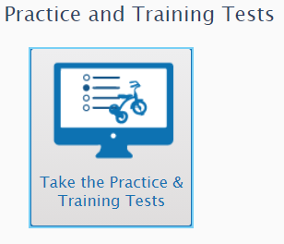
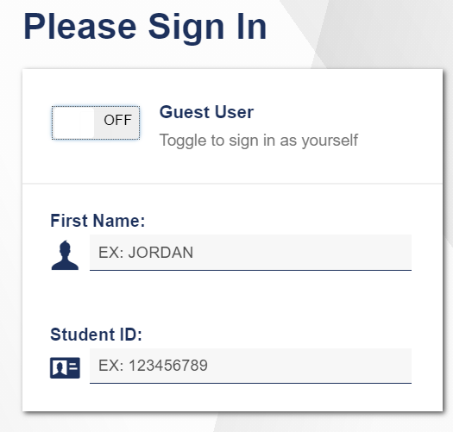
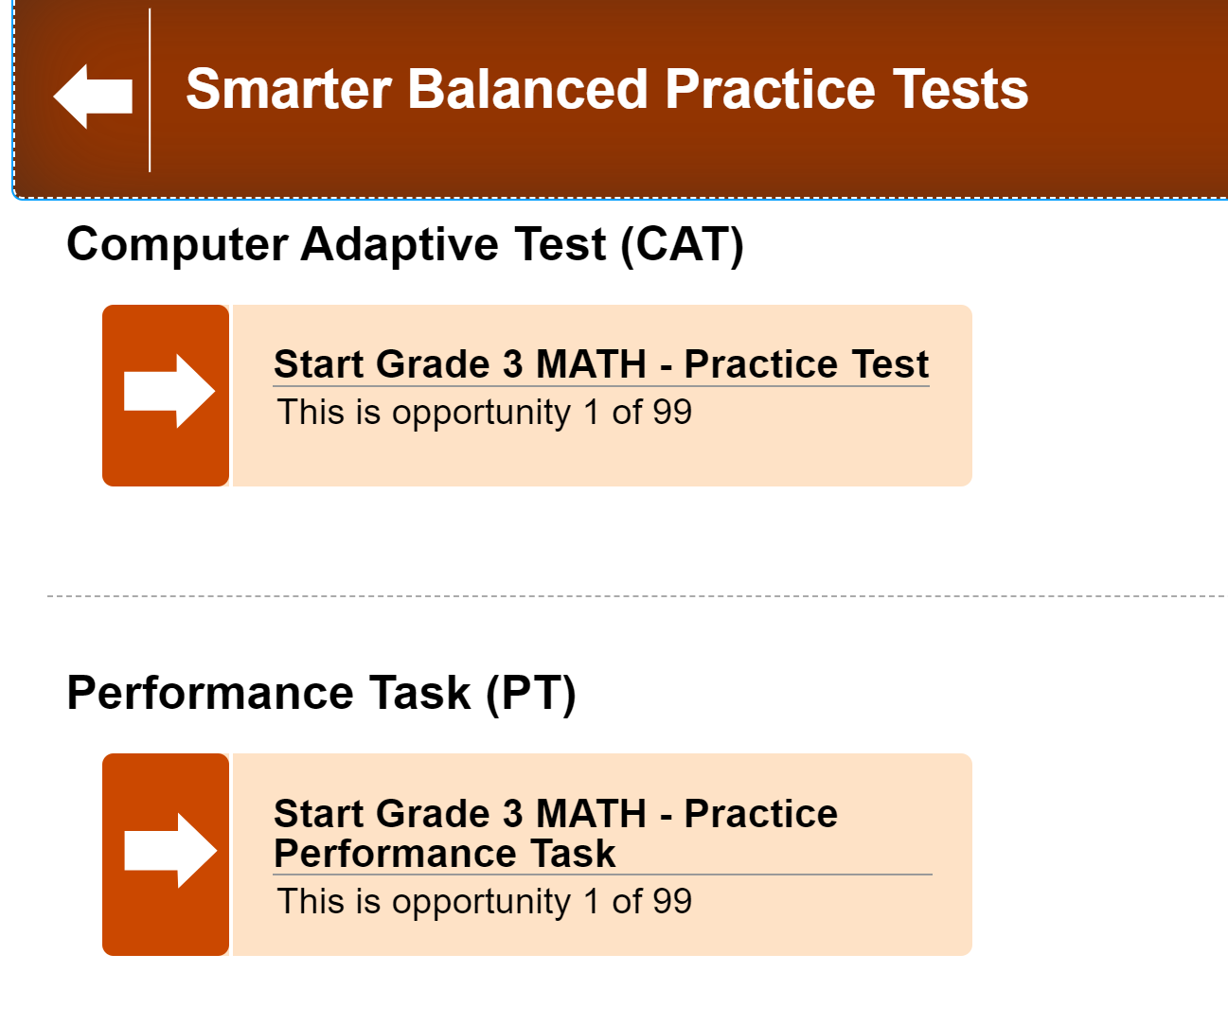
Provide Students with Opportunities to Practice
Administer Practice Tests to allow students to become familiar with the online test platform, item format, universal tools, and practice with designated supports and accommodations (if applicable).
For optimal practice with certain accommodations that support language access and written communication, administer a Math Performance Task Practice Test.
Notes:
Practice Tests are available for Smarter Balanced Math and ELA in grades 3-8 and high school. They are similar in format and structure to the actual test and include about 30 questions. Practice Tests area also available for NGSS and the Connecticut Alternate Assessment System.
https://ctpt.tds.cambiumast.com/student
Use the Practice Tests to model how to use specific features such as the Desmos Calculator (available for certain math items in Grades 6-8), text-to-speech, math translation glossary, and speech-to-text. Students need to know in advance how to activate these features if applicable.
Practice Tests are available for all summative assessments including the CTAA and the CAAELP.

Slide 75
New Designated Supports and Accommodations

Slide 76
New Designated Supports & Accommodations
New designated supports:
Translated Test Directions in ASL (Test Administration Manual for Math, ELA, Science)
Printed Test Directions in English (Test Administration Manual for Math, ELA, Science) (will be posted to the portal prior to testing)
Translation Test Directions for Smarter Balanced Math and ELA- Portuguese was added.
Updated! Toggle for Spanish Presentation for Math (was formerly Spanish stacked)
New embedded accommodation:
Word Prediction (accompanies open-ended items) for Smarter Balanced Math and ELA items.
Notes:
This year we have a few new accessibility supports offered for Smarter Balanced and NGSS. New designated supports include Translated Test Directions in ASL (Test Administration Manual for Math, ELA, Science) and Printed Test Directions in English (Test Administration Manual for Math, ELA, Science).
Translated Test Directions in American Sign Language (Non-Embedded Designated Support) available for the Smarter Balanced and NGSS Test Administration Manual (TAM). This designated support is intended for a student who is deaf or hard of hearing, this language support allows a qualified test administrator to sign or provide visual language support of the test directions script within the SAY boxes in the Summative Test Administration Manual (TAM).
Printed Test Directions in English (Non-Embedded Designated Support) available for Smarter Balanced Math and Smarter Balanced ELA Assessments in grades 3-8 only, and NGSS grades 5, 8, and 11. This language support provides the student with a visual reference in English for test directions/script within the SAY boxes in the Summative Test Administration Manual (TAM). The test administrator must download the directions from the Connecticut Comprehensive Assessment Program portal in advance of testing, and print, and distribute to the student at the time of testing.
Translation Test Directions for Smarter Balanced Math and ELA (not available for Science): Portuguese New for 2024!
This is a word-to-word translation of the directions and functions students encounter when using the online test delivery system (TDS). PDFs of the terms are available for Smarter Balanced ELA and math only. A bilingual adult reads to the student or, if the student is literate in the selected language, they may read the terms independently.
The use of this support may result in the student needing additional overall time to complete the assessment, as well as a separate setting. Use this link to access translation test directions: Translated Test Directions (cambiumast.com)
Spanish Presentation (Math, Science Toggle) embedded
This Spanish presentation will allow the literate Spanish-speaking students to toggle between a full Spanish translation of the item and the English version of the item. By default, all test directions, navigation buttons, and test content will be presented to the student in the Spanish language.
This support should only be used for students who are proficient readers in Spanish and who are not proficient in English. The use of this support may result in the student needing additional overall time to complete the assessment and may increase reading and cognitive load.
A new embedded accommodation this year in the system is Word Prediction (accompanies open-ended items). Word prediction can be a stand alone or used in conjunction with speech to text. It allows students to begin writing a word or saying a word, in a box that appears, the student can choose from a list of single words that have been predicted from word frequency and syntax rules. Word prediction is delivered via CAI’s embedded software program. The program only uses single word prediction. The Word Prediction (Embedded Accommodation) is available for Smarter Balanced Math and Smarter Balanced ELA Assessments open ended items in grades 3-8 only, not science. To trial this accommodation with students, administer a Math Performance Task, as not all practice tests include open-ended items.

Slide 77
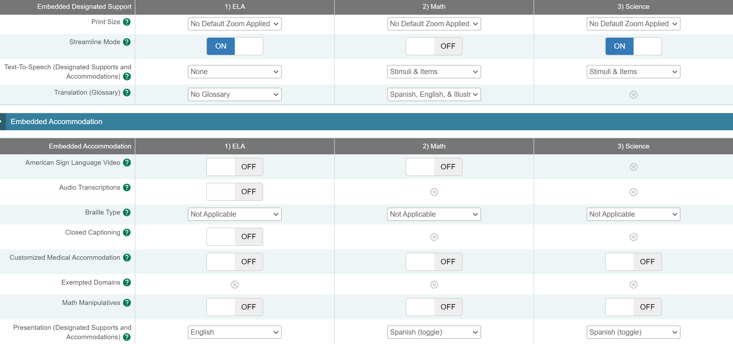
TTS in Spanish with Math and/or Science Spanish Toggle
Text-to-Speech in Spanish is available on the math and NGSS assessment. For eligible students, set Text-to-Speech to Stimuli & Items for math and Science and set presentation to Spanish Toggle.
Notes:
This is what the student dashboard will look like for adding Spanish presentation and TTS in Spanish for students who are not Special Education or Section 504.

Slide 78
Accommodation Reminders
Notes:
Just a reminder all accommodations are populated through CT-SEDS and TIDE from active and implemented IEPs/504 plans that cover the grade level tested.
When teams assign an accommodation, they will also need to ensure they are not selecting conflicting accommodations. For example, the embedded Text-to-Speech and the non-embedded Read Aloud. When reviewing accommodations, DAs will want to check to ensure conflicting accommodations are not present. Please contact the student’s case manager if any issues or errors are identified. The team can then amend or review/revise based on the complexity of the correction.

Slide 79
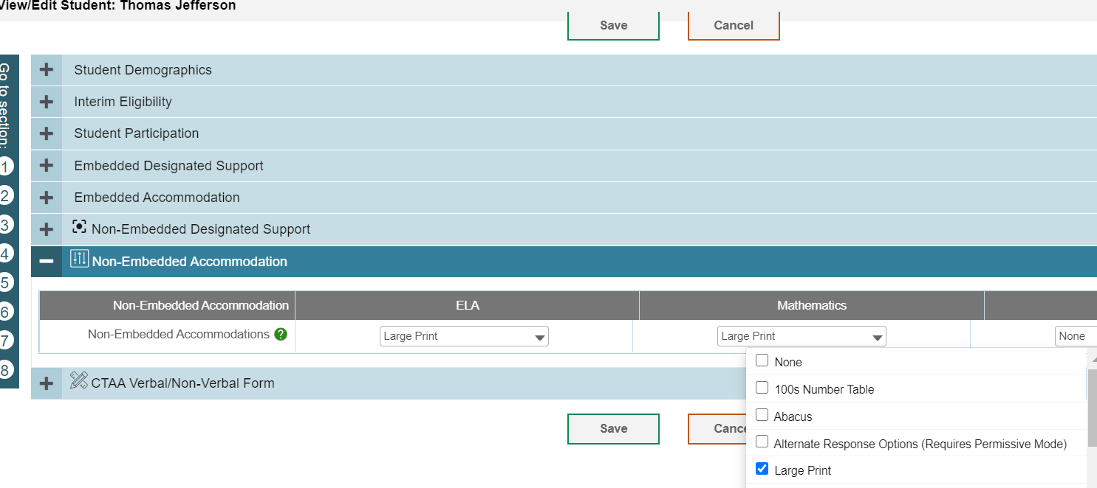
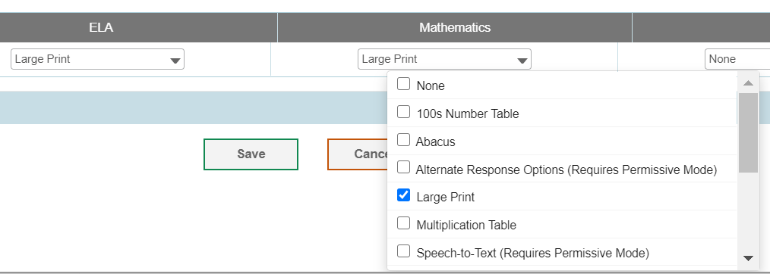
Large Print or Braille Test Materials
District Administrators can order large-print and braille kits for Smarter Balanced and NGSS in TIDE any time after January 26, 2024.
Confirm that the student has the non-embedded accommodation set properly in TIDE. If the accommodation is missing or is incorrectly reported, contact the student’s Case Manager in CT-SEDS.
Notes:
Students that are unable to access the online assessment with embedded and non-embedded accommodations may be eligible to take the test using a large print or braille test booklet.
Even if this accommodation is selected in CT-SEDS, the DA still needs to place this order within TIDE.
These test materials must be ordered by the DA for Testing in TIDE on or after January 26, 2024.
The PPT or Section 504 Team must select these accommodations in CT-SEDS. Once the plan is implemented, the accommodations will sync to TIDE. Look for the Large Print selection in TIDE (refer to image on slide).
The DA will want to review the student dashboard and for this year collaborate with the special education teacher to ensure the correct Braille presentation is ordered in TIDE.
The following braille presentations are available. Refer to your student’s IEP for details on braille type:
UEB Contracted + Nemeth Math
UEB Contracted (No Math Content)
UEB Contracted + Nemeth
UEB Uncontracted + Nemeth Math
UEB Uncontracted (No Math Content)
UEB Contracted + UEB Math
UEB Uncontracted + UEB Math

Slide 80
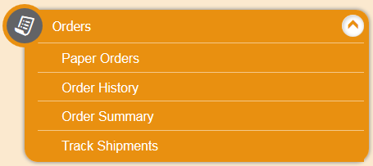
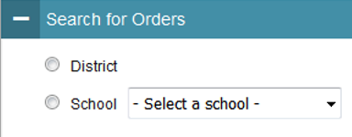
Ordering Paper Materials in TIDE
Step 1: From the Orders task menu on the TIDE dashboard, the DA selects Paper Orders.
Step 2: Search for orders by District or School.
Step 3: Enter the quantity needed for each of the materials needed.
Districts can track shipments in TIDE.
Notes:
The DA will receive instructions with the test materials. As a reminder, tests are secure and should be securely maintained before, during, and after testing.
Once the student has completed testing, the teacher will use the Data Entry Interface to transcribe student responses to all subtests. This is how the tests are scored and scores are reported. All transcriptions must be made by May 31, 2024. All test systems will close at the end of business on the last day of testing.

Slide 81
Special Documented Accommodations
What are Special Documented Accommodations?
When universal tools, designated supports, and standard accommodations do not meet a student’s accessibility needs as described in their IEP/504 Plan, special, non-standard accommodations may be discussed by the PPT/Section 504 Team to determine appropriateness. These accommodations are completed and verified through the PPT/Section 504 process in CT-SEDS. They include:
Scribe
Read Aloud of ELA Reading Passages*
Human Signer/Visual Support for ELA or Math
Human Signer/Visual Support for ELA Reading Passages
Math Manipulatives (Grades 3-8)
Non-Embedded Calculator (Math Grades 6-8, calculator-allowed items only)
Print on Demand
Customized Accommodation
*Requires the completion of Documented Evidence for a Read Aloud of the Smarter Balanced ELA Reading Passages by the PPT or Section 504.
Notes:
In exceptional circumstances, there may be a student whose disabilities are such that the allowable embedded and non-embedded accommodations described in the CSDE Assessment Guidelines provide insufficient access to the Smarter Balanced and/or the Next Generation Science Standards (NGSS) Assessments, special, non-standard accommodations may be appropriate.
These must be determined by the Planning and Placement Team (PPT)/Section 504 Team for students with an identified need based on evidence documented throughout the IEP/Section 504 Plan. These accommodations typically align to those used by the student during instruction and in other learning environments. The team should determinate that the standard embedded and non-embedded universal tools, designated supports, and accommodations do not meet the student’s access needs and that barriers still exist and prevent access to the assessment.
Based on PPT/Section 504 Team determination, special documented accommodations should be selected in the student’s IEP/504 Plan in CT-SEDS. The team will select the verification box within the Special Documented Accommodations section of the accommodation’s menu as attestation that the accommodation is appropriate. Once the plan is implemented, the student’s accommodations will sync with the TIDE.
Scribe and Read Aloud of ELA Reading Passages require the test administrator to review the specific guidelines and complete the security and confidentiality agreements for each specific accommodation.
For Read Aloud of ELA Reading Passages the team should complete the Documented Evidence for a Read Aloud of the Smarter Balanced ELA Reading Passages and submit this completed for to the DA.
Refer to the Math Manipulatives brochure for details about this special accommodation and considerations for use on standardized assessments. Math Manipulatives Brochure (cambiumast.com)
For Print on Demand and Customized accommodations please contact the CSDE.

Slide 82
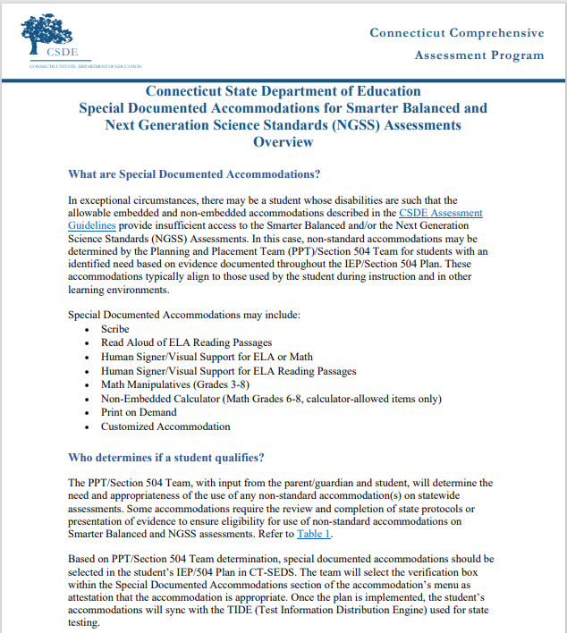
Preparing to Administer Special Documented Accommodation
DA’s should develop a plan for:
Reviewing all designated supports and accommodations and Special Documented Accommodations in IEPs/Section 504 Plans via Accommodation Report in CT-SEDS Everyday (see Data Manager or student Case Manager for details)
Verifying Documented Evidence for a Read Aloud of the Smarter Balanced ELA Reading Passages & Decision Guidelines for Text-to-Speech of the Smarter Balanced ELA Reading Passages
Preparing for accommodation implementation
Training Staff
Collecting and Providing guidelines, test security forms, non-embedded test materials
Scheduling
Staffing
Contact the CSDE to request a customized accommodation or Print on Demand if applicable.
Notes:
DA's need to follow guidance for special documented accommodations. Also customized accommodations need to be cleared through CSDE.
DA's need to develop a plan for reviewing
Accommodations and Special Documented Accommodations (DA's need to work with their Data Manager in CT-SEDS and TIDE to verify the accommodation reports for student's who have accommodations assigned either through a 504 or IEP.)
TTS of ELA Passages guidelines and Read Aloud of Passages guidelines (DA’s should develop a plan for reviewing and maintaining these documents within their district)
Training
Prepare for accommodations implementation for summative assessment
Scheduling of assessment both practice and summative and room assignments for separate setting
Staff assignment
Materials needed for example math manipulative if selected, headphones,
Refer to this resource on the portal: Process for Requesting Special Documented Accommodations (cambiumast.com); https://ct.portal.cambiumast.com/resources/accessibility-and-special-populations/process-for-requesting-special-documented-accommodations

Slide 83
Medical Exemption Procedure
In Connecticut, the exemption determination for a medical emergency rests primarily on the following criteria: The student is unable to attend school and is medically/emotionally unavailable for homebound/hospitalized instruction for the entire testing window.
Medical Exemption Form due dates (must be signed by presiding physical and returned to the CSDE):
LAS Links – March 8, 2024
CAAELP - April 5, 2024
Connecticut SAT School Day- April 26, 2024; and
Smarter Balanced, the NGSS, and the Connecticut Alternate Assessments (CTAA/CTAS) - June 7, 2024
See Appendix for Medical Exemption of the Assessment Guidelines.
Notes:
Students who are hospitalized or homebound due to illness should be tested unless there are medical constraints. These students can have the test administered at home or in the hospital provided the test is administered by a certified school staff member who is fully trained in the proper test administration and security procedures for the specific assessment system (LAS Links, CAAELP, Smarter Balanced Assessments, NGSS Science, Connecticut SAT, CTAA, and CTAS).
In rare cases, there may be a student who experiences a medical emergency just prior to (or during) the testing window. There is a process whereby, the student may receive an exemption from testing due to the emergency nature of the medical condition, if the criteria for exemption are met. A medical exemption can be given to a student depending on the availability of the student during the statewide testing window. This process is described in the Assessment Guidelines.
Contact Deirdre or Katie if you think you have a student who is eligible for a medical exemption. Based on eligibility, DAs will be provided with a Medical Exemption form for completion, signature by the student’s physician, and submission to the CSDE. Please keep in mind that there are assessment specific deadlines for receiving these forms:
Medical Exemption forms due dates:
LAS Links – March 8, 2024
CAAELP - April 5, 2024
Connecticut SAT School Day- April 26, 2024; and
Smarter Balanced, the NGSS, and the Connecticut Alternate Assessments (CTAA/CTAS) - June 7, 2024

Slide 84
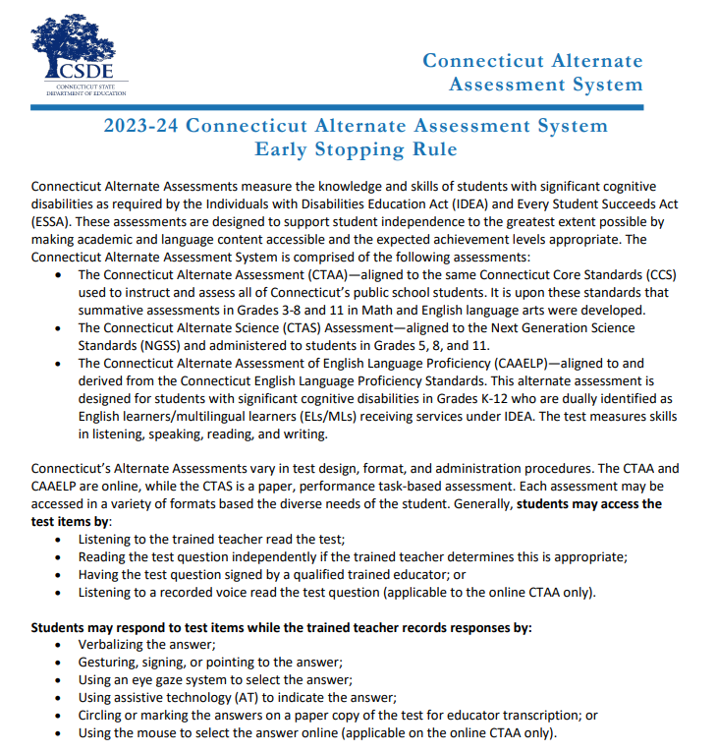
Early Stopping Rule for
CTAA, CTAS, & CAAELP
The 2023-24 Connecticut Alternate Assessment System Early Stopping Rule document includes:
The Student Response Check (Appendix A)
The SRC Administration Behavioral Notes (Appendix B)
The Early Stopping Rule Request and Attestation Form (Appendix C)
Notes:
The Alternate Assessment System Early Stopping Rule (ESR) is for all of Connecticut's Alternate Assessments.
The Early Stopping Rule is a process used by the CSDE to support students who are non-verbal and do not have an established observable mode of communication. Typically, the students who are eligible for the Early Stopping Rule (ESR) are those students who have the most complex needs as compared to their peers with significant cognitive disabilities. Often, these students do not use oral speech, nor do they have an established communication system.
For this small group of students with these characteristics, their teachers will follow the instructions in the Early Stopping Rule document to determine eligibility. Eligibility will be determined before the start of the testing window.
In short, teachers will refer to the instructions published in the 2023-24 Connecticut Alternate Assessment System Early Stopping Rule guidelines. They will administer three trials of the Student Response Check (SRC) on three separate days and times, included in the guidelines, by February 1, 2024. If the student qualifies, the teacher will complete the 2023-24 Connecticut Alternate Assessment System Early Stopping Rule Request and Attestation Form (also included in the guidelines in appendix C) and return it to their District Administrator for Testing (DA in TIDE). The DA will submit the form to the CSDE by March 1, 2024, for review and approval.
If approved, the District Administrator will receive an email with approval. Teachers will not need to administer any portion of the alternate assessments (CTAA, CTAS, or CAAELP). Cambium Assessments will assign an ESR code to any test that applies to them (CTAA, CTAS, and CAAELP). The ESR will count as their participation.

Slide 85
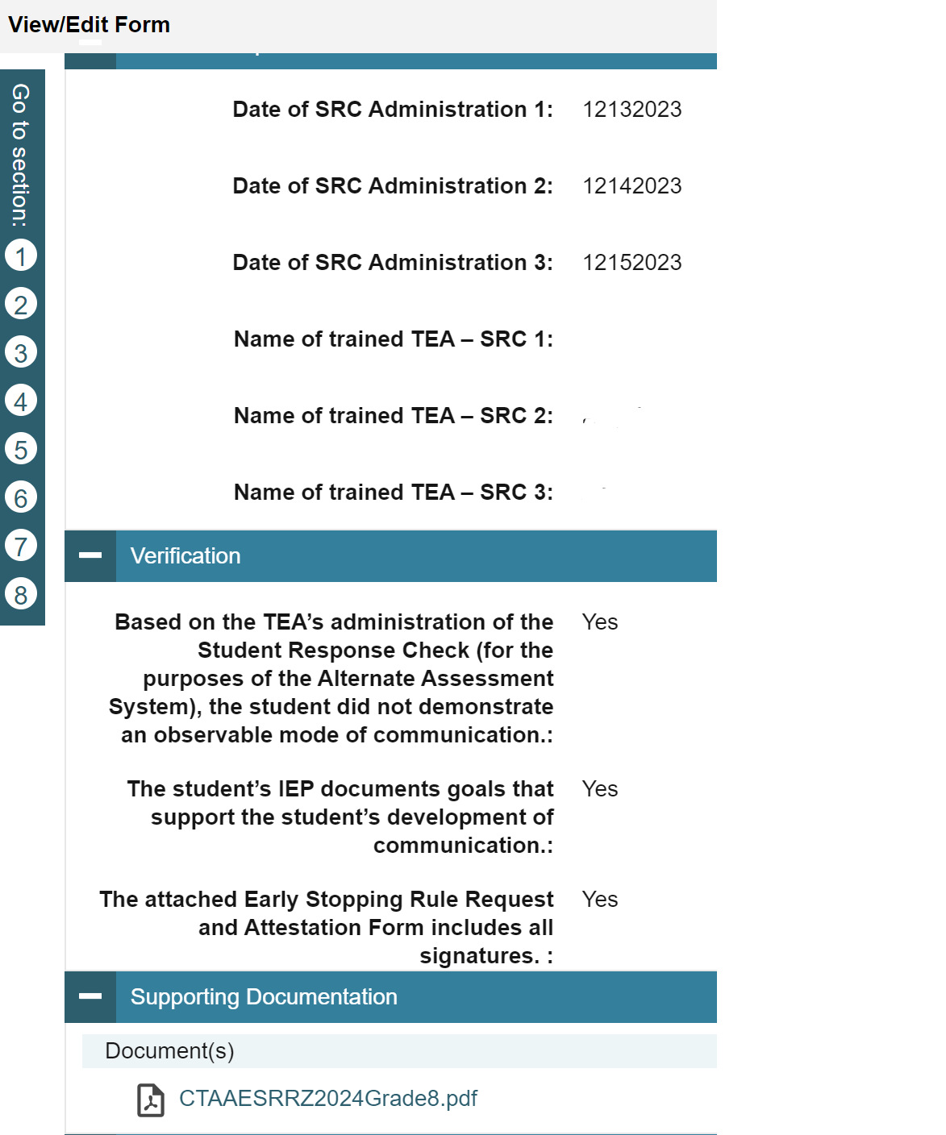
Update to ESR
New this year! The ESR Code is included on student dashboard in TIDE.
From the TIDE menu, select Forms and choose the “Submit Forms” option.
Select the “Early Stopping Rule” from the drop-down menu.
Complete and submit form.
After the form is submitted in TIDE and is approved by the CSDE, the ESR Indicator will be activated on the student dashboard.
Notes:
New this year!!
ESR Code is on Student Dashboard in TIDE.
From the TIDE menu, select Forms and choose the “Submit Forms” option.
Select the “Early Stopping Rule” from the drop-down menu.
Complete and submit form.
After the form is submitted in TIDE and is approved by the CSDE, the ESR Indicator will be activated on the student dashboard.
It is important to communicate this to the TEAs to check this prior to testing.

Slide 86
Questions

Slide 87
CT-SEDS and TIDE

Slide 88
Update to CT-SEDS
Currently CSDE is providing a one-way import of accommodations from CT-SEDS into TIDE.
Allow up to 48 hours for accommodations to appear in TIDE following the IEP/Section 504 implementation date.
Currently CSDE is providing a weekly one-way import of Alt Eligibility data from implemented IEPs in CT-SEDS to TIDE. This data will turn the Alt flag indicator either on or off within TIDE based on status in IEP. If the Alt Flag is NOT populated in TIDE, confirm that the PPT completed the Connecticut Alternate Assessment Eligibility form within CT-SEDS and that the student meets eligibility criteria. Also verify that the IEP is implemented (refer to the IEP Start Date).
Notes:
Currently CSDE is providing a one-way import of accommodations from CT-SEDS into TIDE.
Please allow up to 48 hours for accommodations to appear in TIDE following the IEP/Section 504 implementation date.
Additionally, the CSDE is providing a weekly one-way import of Alt Eligibility data from implemented IEPs in CT-SEDS to TIDE. This data will turn the Alt flag indicator either on or off within TIDE based on status in IEP.
If the Alt flag is not populating in TIDE please check CT-SEDS to verify the student has an Alternate Assessment Eligibility form implemented in CT-SEDS.

Slide 89
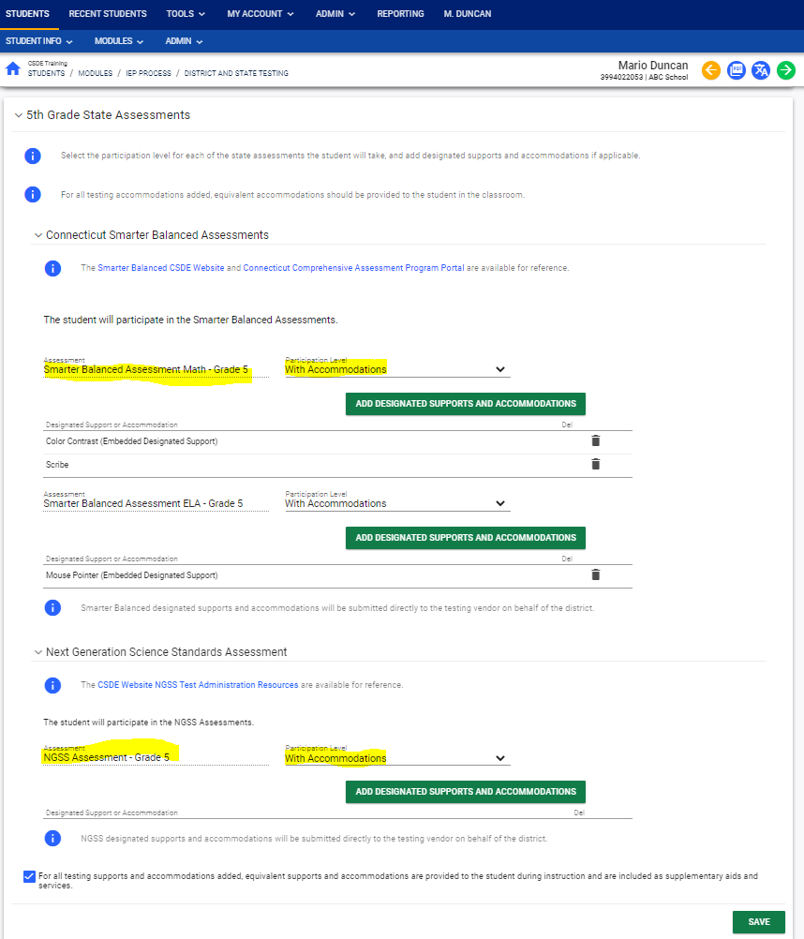
CT-SEDS: IEP District and Statewide Testing Page
This page includes:
Each specific state assessment (associated with the student’s tested grade)
A drop-down menu to select appropriate designated supports and accommodations
Prior to spring testing, designated supports and accommodations in a finalized IEP/504 in CT-SEDS will sync with TIDE
Math
ELA
Science
Notes:
This is the district and statewide testing page in CT-SEDS in which PPTs will indicate if accommodations are needed on statewide assessments (Smarter Balanced and NGSS).
PPT/Section 504 teams need to ensure that they are selecting the grades the IEP/section 504 will cover. For example the plan is in place from February 2024 to February of 2025. That would cover 2 grade levels. Therefore, both grades need to be selected so that designated supports and accommodations can be selected for each assessment within that grade level.
As indicated by the blue arrow, PPTs can select the green box to add designated supports and accommodations specific to the Smarter Balanced Math and ELA, and NGSS if in Grades 5, 8, and 11. The 504 Module operates in the same manner. Once an IEP/504 is finalized by the PPT, designated supports and accommodations will sync with TIDE.
Reminder – select grades that cover the IEP year.
Work with your Special Education Team or student’s Case Manager if you have any questions about student accommodations.

Slide 90
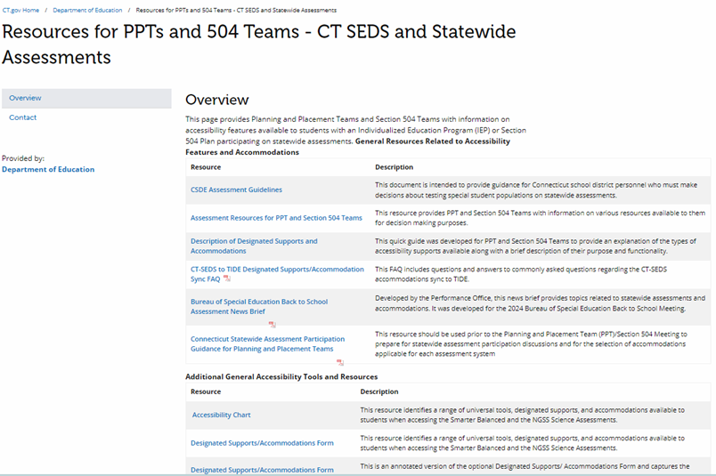
CT-SED FAQ and Resources
To support districts and schools, the CSDE developed resources available in CT-SEDS and on the Student Assessment webpage.
CT-SEDS to TIDE Designated Supports/Accommodation
Frequently Asked Questions
Resources for PPTs and 504 Teams - CT SEDS and Statewide Assessments
Notes:
The CSDE has developed resources to support PPT and Section 504 Teams and related educators. These materials are similar to those available on the portal, but are formatted as quick guides and simplify the content to make it more manageable. Resources are posted directly on the CT-SEDS dashboard and on a customized PPT/Section 504 webpage located on the Student Assessment website.
CT-SEDS FAQ
This resource provides teams with updates to CT-SEDS and TIDE. Additionally, it provides resources and answers to the most common questions relating to CT-SEDS and TIDE. For example these are some of the questions we address:
How do districts know if a student’s IEP/Section 504 plan is finalized/implemented?
How do districts locate which designated supports/accommodations documented in CT-SEDS are imported to TIDE for individual students?
A student’s designated supports/accommodations are not importing even though there is an IEP/Section 504 plan in CT-SEDS. What may be causing this?
Does CT-SEDS provide accommodation reports for state-wide testing for districts to review?
Resources for PPTs and 504 Teams - CT SEDS and Statewide Assessments
This page provides Planning and Placement Teams and Section 504 Teams with information on accessibility features available to students with an Individualized Education Program (IEP) or Section 504 Plan participating on all statewide assessments.

Slide 91
Connecticut Alternate Assessment System (CTAA, CTAS, & CAAELP)

Slide 92
Connecticut Alternate Assessment System
 | Connecticut Alternate Assessment (CTAA) for Math and ELA | Connecticut Alternate Science (CTAS) | Connecticut Alternate Assessment of English Language Proficiency (CAAELP)
Test Window | March 25-May 31, 2024 | Administered throughout the year. Upload student score worksheets via the Data Entry Interface March 25-May 31, 2024 | February 1-March 29, 2024
TIDE User Role Required | Teacher Administering the Alternate (TEA)
Student Eligibility | Students identified as special education with significant cognitive disabilities per PPT decision using Alternate Assessment System Eligibility Form. This form must be submitted in CT-SEDS and IEP must be fully implemented |  | Students identified as EL/ML and special education with significant cognitive disabilities must have the Alternate Assessment System Eligibility Form submitted in CT-SEDS at the PPT and IEP must be fully implemented.
Notes:
In the next several slides we will be sharing the comparison of the Connecticut Alternate Assessment System Assessments. This is a comparison between the CTAA for Math and ELA, the Connecticut Alternate Science (CTAS), and the CAAELP.
In the first section you will find the specific testing window for each assessment.
All three of the Connecticut Alternate Assessment System Assessments require that the educator administering the Alt assessments be assigned the TEA user role in TIDE.
Additionally, eligibility for the Connecticut Alternate Assessment System Assessments require that the students are identified as special education with significant cognitive disabilities per PPT decision using Alternate Assessment System Eligibility Form. This form must be submitted in CT-SEDS and IEP must be fully implemented. For CAAELP the student must also be a dually identified EL/ML in Grades K-12. Please note PPT teams should be planning for all EL/ML students regardless of Alt Eligibility status in Grades K-12.

Slide 93
Connecticut Alternate Assessment System
 | Connecticut Alternate Assessment (CTAA) for Math and ELA | Connecticut Alternate Science (CTAS) | Connecticut Alternate Assessment of English Language Proficiency (CAAELP)
Grades | 3-8 and 11 | 5, 8, and 11 | K-12
Test Subject Areas | English Language Arts Reading Writing Mathematics | Science Earth Life Physical | Reading Listening Speaking Writing
Test Delivery Method | Trained TEA (with TEA User Role) administers the grade-specific math and ELA items using Cambium’s online testing system individually to eligible students in a one-to-one test setting. | Trained TEA assesses eligible student with performance tasks based on Connecticut Alternate Science Assessment Essence statements in a one-to-one test setting. | Trained educator (with TEA User Role) administers CAAELP assessment items to eligible EL/ML using the Cambium Test Delivery System in a one-to-one test setting.
Notes:
The CAAELP is for eligible students in Grades K-12 and it measure Listening, Reading, Speaking, and Writing.
The CTAA is aligned to the Connecticut Core Standards for math and English language arts for eligible students with significant cognitive disabilities in Grades 3-8 and 11.
For both the CTAA and the CAAELP, the TEA administers these grade level specific tests via the online Test Delivery System individually to students in a 1 to 1 setting.
The CTAS is for students in Grades 5, 8, and 11. This assessment measures Earth, Life, and Physical science. The trained TEA assesses eligible student with performance tasks based on Connecticut Alternate Science Assessment Essence statements in a one-to-one test setting.

Slide 94
Connecticut Alternate Assessment System
 | Connecticut Alternate Assessment (CTAA) for Math and ELA | Connecticut Alternate Science (CTAS) | Connecticut Alternate Assessment of English Language Proficiency (CAAELP)
Required Administration Materials | Administered with required secure Directions for Test Administration (DTAs) and CTAA Test Administration Manual. | Designed to be administered throughout the school year using CTAS Required Materials and CTAS Test Administration Manual. Student ratings recorded on the CTAS Student Score Worksheet and entered in the DEI. | Administered using grade- and domain-specific Test Administrator Directions and Scoring Rubrics Booklets and CAAELP Test Administration Manual.
Security | Secure | Non-Secure | Secure
Training | Connecticut Alternate Assessment System Training Course (cambiumast.com) |  | CAAELP Test Administration Training
Certificate | "Trained status" indicated in TIDE profile. TEA can print/download Certificate after passing the required quiz. |  | Trained status certificate is not linked to TIDE and should be maintained locally.
Submissions into DEI | None | CTAS Score Worksheet for scoring between March 25 and May 31, 2024. | None
Notes:
The CAAELP and CTAA are secure assessments. These secure testing materials are accessed through TIDE in the Secure Testing Materials. Please refer to each tests specific TAMS.
CTAS: Is a Non-Secure assessment that the TEA administers throughout the school year.
We have included some training information here on this slide and crosswalk. We will go into more depth about training in upcoming slides.
CTAS: Each Storyline includes a Performance Task at each assessed grade level with a series of assessment activities. Each activity provides a coherent sequence of instruction for the TEA on how to assess student performance associated with each Core Extension. The TEA assesses the eligible students on provided Performance Tasks using provided Resource Packet materials. The TEA rates the student’s performance on each activity using a 0–2 scale and provided scoring guidance. Supports include the use of communication devices and assistive technology or accommodations as described in the student’s Individualized Education Program (IEP).
The Resource Packets are to be used in conjunction with the Performance Tasks. They include materials that will be presented to the student when referenced by the teacher script in the Performance Task.
As TEAs administer each Performance Task, a paper copy of the Student Score Worksheet should be completed to record student ratings. After the CTAS is fully administered, TEAs will enter the ratings recorded on the Student Score Worksheet in the Data Entry Interface (DEI) during the testing window of March 25-May 31, 2024.

Slide 95
CTAA Verbal and Non-Verbal ELA Test Forms Grades 3 and 4 Only
The forms differ in the presentation of the foundational word identification items or Open-Response (OR) items.
The selection of either the Verbal or Non-Verbal form is based upon the student’s communication mode.
The form assignment must be made in TIDE prior to test administration.
The Non-Verbal Form presents the Open Response items in a Selected-Response format for students who do not respond
with oral speech;
are blind, deaf, or deaf-blind; or
use augmentative and alternative communication (AAC).
Notes:
For students in Grades 3 and 4 taking the CTAA ELA reading assessment, select either a Verbal or Non-Verbal test form in the TIDE test settings. The forms differ in the presentation of the foundational word identification items or Open-Response (OR) items. Based on the student’s mode of communication, the Verbal or Non-Verbal form should be selected in TIDE prior to test administration.

Slide 96
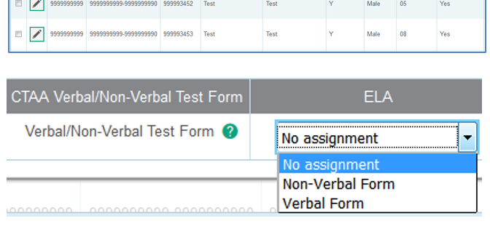
CTAA Verbal and Non-Verbal ELA Test Forms Grades 3 and 4 Only
The default setting is the Verbal form. Procedures for selecting the form are located on the CSDE Comprehensive Assessment Program Portal under Alternate Assessment Resources or in the CTAA Test Administration Manual.
Notes:
As you can see in this image, the appropriate test form must be selected in the student’s test settings in TIDE for the CTAA ELA reading assessment, which includes the open-response items for students in Grades 3 or 4.
The Verbal Form is the default form presented to the student if no form is assigned in TIDE.

Slide 97
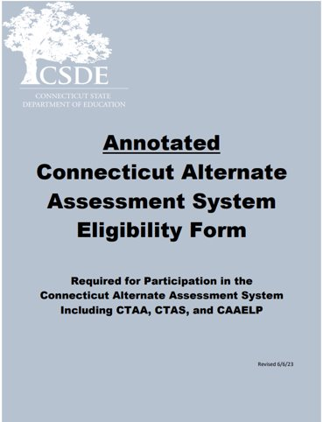
Connecticut Alternate Assessment System for Eligible Students
PPTs complete this eligibility form when considering/determining eligibility for CAAELP, CTAA, or CTAS.
Connecticut Alternate Assessment Eligibility Form is completed as part of the PPT process in CT-SEDS.
Once IEP is implemented CT-SEDS will sync with TIDE to turn on the ALT Flag.
Reminder: This assessment is designed for a small, specialized subgroup of students (approximately one-percent) with the most complex and significant needs. Districts should review local eligibility processes and screenings to ensure that they understand the eligibility process for alternate assessments.
Notes:
The Connecticut Alternate Assessment System Eligibility Form is used to determine eligibility for the Alternate Assessment System through discussion at the Planning and Placement Team (PPT) meeting. This document is required to register students for the CTAA, the CTAS and the CAAELP. PPT teams complete this form via the PPT process within CT-SEDS. Once the form is completed and implemented within the IEP in CT-SEDS, there will be a sync with TIDE to turn the Alt Flag on.
An important reminder: This assessment is designed for a small, specialized subgroup of students (approximately one-percent) with the most complex and significant needs. Districts should review local eligibility processes and screenings to ensure that there is not an overrepresentation of students selected for the alternate assessments.
The Annotated document may be accessed on the CSDE Comprehensive Assessment Program Portal. This tools helps guide IEP teams in the correct determination and evidence for documenting within the IEP a significant cognitive disability.

Slide 98
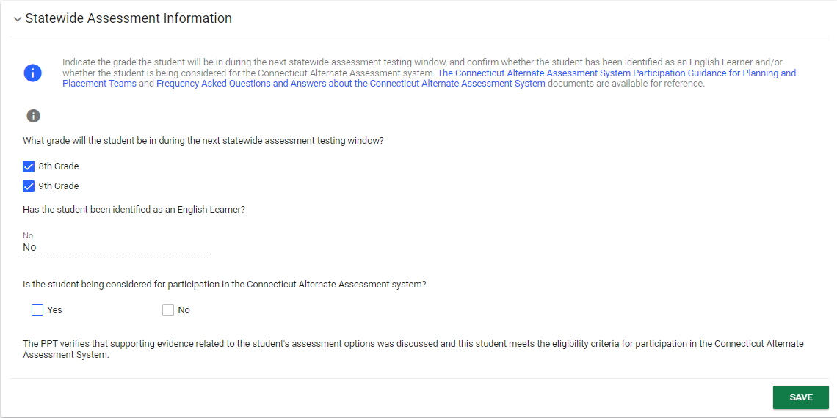
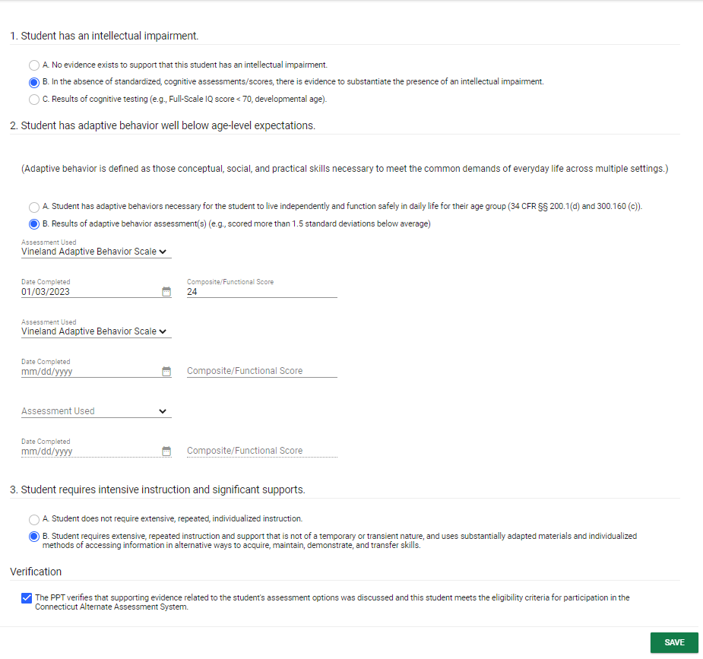
CT-SEDS: Alternate Assessment Eligibility
PPTs can indicate that a student is being considered for the Connecticut Alternate Assessment System.
The Connecticut Alternate Assessment System Eligibility Form is built into CT-SEDS.
Alternate Assessment Eligibility
Notes:
This is an example of what PPTs complete in CT-SEDS. The PPTs can select the Connecticut Alternate Assessment System from the CT-SEDS State-wide Testing Module. (See #1)
If YES is selected for the item “Is the student being considered to participate in the Connecticut Alternate Assessment System,” the Connecticut Alternate Assessment System Eligibility Form will pop up on the screen for completion. (See #2) The PPT will complete and provide evidence of an intellectual impairment, adaptive functional skills well below age/grade level expectations, and confirmation that the student requires intensive and extensive instruction. Finally, they will verify this information and click save.
This year, the CSDE will pull Alt-Eligibility data from CT-SEDS to populate the Alt Assessment Indicator in TIDE of implemented IEP that have completed Alt Eligibility Forms for the grades designated. As a reminder, the Connecticut Alternate Assessment System Eligibility Form is used to determine CAAELP eligibility as well for dually identified ELs/MLs with cognitive disabilities in Grades K-12. Therefore, PPTs will need to consider this for EL/ML students dually identified whose IEP covers Grades K-12.

Slide 99
Resources to Support Alternate Assessment System Eligibility
Frequently Asked Questions and Answers about the Connecticut Alternate Assessment System
Annotated Connecticut Alternate Assessment System Eligibility Form
Frequently asked Questions and Answers About the Connecticut Alternate Assessment System Eligibility Form
Connecticut Alternate Assessment System Participation Guidance for Planning and Placement Teams Flowchart
Comparison of Connecticut Alternate Assessments
For more information, visit the CSDE Website and the Connecticut Comprehensive Assessment Program Portal.
Notes:
Included on this slide are resources to help support your understanding of the purpose and eligibility for the Connecticut Alternate Assessment System.

Slide 100
Alternate Assessment System Training Requirements CTAA/CTAS
Resources:
Overview for District Administrators
Overview for Teachers Administering the Alternate
CTAA Test Administration Manual
CTAS Test Administration Manual
Connecticut Alternate Assessment System Training Course
Connecticut Alternate Assessment System Training Resources
Connecticut Alternate Assessment System Training must be completed annually by certified educators administering the alternate (TEAs).
Training is online and available on the Alternate Assessment web page on the portal.
TEAs must complete and pass the end-of-training quiz with a score of at least 80 percent or better.
Notes:
Teachers Administering the Alternate (TEAs) are intricately involved in all aspects of the selection and supervision of the Connecticut Alternate Assessment and the Alternate Science. The Connecticut Alternate Assessment System Training requirements provide for high-quality standardized administration ensuring appropriate interpretations for results about what students with significant cognitive disabilities know and can do.
All teachers who will be administering the alternate assessments (CTAA and CTAS) must be trained annually via the online course regardless of previous training status. This training is required each school year. Once training and the embedded quiz is passed the TEA will have permission to:
Submit the CTAS Student Score Worksheet for students in Grades 5, 8, or 11;
Access the required secure test materials for the CTAA using TIDE; and
Administer the CTAA and CTAS assessments.
District Administrators are responsible for the following tasks:
Determine who will be administering an Alternate Assessment during the 2023-24 school year.
Verify that the teacher has a TEA User Role in TIDE. Update, add, and delete accounts as appropriate.
Communicate details regarding the required online training with your TEAs. Share the Overview for Teachers Administering the Alternate resource referenced on this slide.
Verify that all TEAs complete and pass the quiz. Those with passing scores will have their Trained Status activated in TIDE. Note: the CAAELP training is separate and does not sync with TIDE.

Slide 101
Alternate Assessment System Training Requirements CAAELP (Grades K-12)
CAAELP/Alt ELPA Training must be completed annually by certified educators administering the CAAELP (TEAs).
Training is online at ELPA 21.
District Verification code is elpa21.
Certificate is maintained locally through a process determined by the district.
Resources:
CAAELP Training Announcement
Directions for Accessing CAAELP Online Training for New Users
Directions for Accessing CAAELP Online Training for Returning Users
CAAELP Accessibility and Accommodations Manual
Connecticut Alternate Assessment of English Language Proficiency (CAAELP)Test Administration Manual
2023-24 Connecticut Alternate Assessment System Early Stopping Rule
Additional training available:
CAAELP Office Hours
Notes:
The CAAELP/Alt ELPA Training is accessed through ELPA21. This training is required for any educator who is designated as a TEA in TIDE and will be administering the CAAELP Assessment this year. This training must be completed annually (each testing school year), and the certificate of training completion should be saved and shared with administrators as needed. There are separate training modules available for ELACs and TEAs. Please be aware that first time users will need to enter a district verification code, which is elpa21 (all lowercase).
Training guides:
•Directions for Accessing CAAELP Online Training for New Users
•Directions for Accessing CAAELP Online Training for Returning Users
•CAAELP Accessibility and Accommodations Manual
•2023-24 Connecticut Alternate Assessment System Early Stopping Rule
TEAs and ELACs taking this training need to be aware that this training has been developed by ELPA 21, and that some policies and procedures may not mirror those of Connecticut. Teams should participate in a thorough review of the Connecticut specific CAAELP resources available to them as part of this training process. These resources are located on the CAAELP Resource page on the Connecticut Comprehensive Program Portal.
Additional training available: CAAELP Office Hours

Slide 102
Connecticut Alternate English Language Proficiency Assessment (CAAELP)
Who should be designated to administer the CAAELP?
Educators or test administrators are:
Determined by the district;
Those who support ELs/MLs;
Those who support special education; or
Both special education and EL/ML educators/ administrators supporting EL/ML.
CAAELP Domain Exemptions
Domain Exemptions are available on the Listening and/or Speaking subtests for the following students:
• If a student is identified as Deaf or hard of hearing, they may not be able to participate in the Listening subtest due to this disability.
• Students who are non-verbal and, even when provided assistive technology or augmentative and alternate communication supports, may not be able to participate in the Speaking subtest.
Domain Exemptions are submitted by the District Administrator (DA) in TIDE between November 15, 2023, through March 22, 2024.
Notes:
Who should be designated to administer the CAAELP?
Educators or test administrators are:
• determined by the district;
Educators who are familiar with the student and are
• those who support ELs/MLs;
• those who support special education; or
• both special education and EL/ML educators/ administrators supporting EL/ML.
CAAELP Domain Exemptions
A small number of students with significant cognitive disabilities may be unable to participate in the Listening or Speaking domain of the Connecticut Alternate Assessment of English Language Proficiency (CAAELP) because of the complexities of their disability. Domain Exemptions are available on the Listening and/or Speaking subtests for the following students:
• If a student is identified as Deaf or hard of hearing, they may not be able to participate in the Listening subtest due to this disability.
• Students who are non-verbal and, even when provided assistive technology or augmentative and alternate communication supports, may not be able to participate in the Speaking subtest.
Domain Exemptions are submitted by the District Administrator (DA) in TIDE between November 15, 2023, through March 22, 2024. Please ensure that the student has the Alt flag turned on in TIDE before submitting a domain exemption. Also ensure that this form is submitted prior to testing the student and communicate this information and expectations clearly to all test administrators. For more information on CAAELP Domain Exemptions and how to submit please visit the CAAELP Resources page.

Slide 103
Reprint of CTAS Materials
In October, CAI mailed DAs for Testing a new supply of CTAS materials.
Reminders:
The 2023-24 CTAS Student Score Worksheets are available for downloading and printing on portal.
Districts should create a system to share materials across schools and store them for future use.
Districts should continue to reuse their CTAS materials as they are shared by teachers for test administration throughout the school year.
TEAs can also continue using their old sets if replacements are not needed.
Notes:
In recognition that district copies of the Connecticut Alternate Science (CTAS) Assessments may be worn from shared use or occasionally misplaced over the past several years, Cambium Assessment, Incorporated recently reprinted them and shipped a new set to the District Administrator (DAs in TIDE).
Materials were also sent to DAs at Approved Private Special Education Programs.
These materials include printed storylines and color resources and do not differ from the original CTAS materials, other than the reprint date.
Remind your teachers administering the alternate (TEA) that the 2023-24 CTAS Student Score Worksheets are available for downloading and printing on portal. These should be maintained securely and upon completion uploaded into the DEI.
It is important that upon receipt of these materials, districts create a system to share materials across the district and store them for future use. Districts should continue to reuse their CTAS materials as they are shared by teachers for test administration throughout the school year. TEAs can also continue using their old sets if replacements are not needed.
If you have any questions, please contact Deirdre Ducharme or Katie Seifert in the Performance Office.

Slide 104
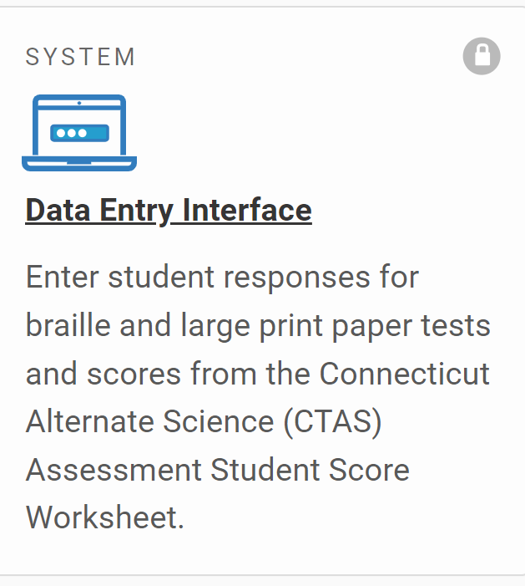
Data Entry Interface (DEI)
The DEI can be accessed via the portal under the Smarter Balanced, NGSS, or Alternate Assessment program cards.
For students who take the paper Braille and Large Print Smarter Balanced and NGSS, teacher must transcribe students' responses from these booklets into the DEI no later than May 31, 2024.
All secure braille/large-print paper materials must be returned to Measurement Incorporated (MI) by the end of the test window. Instructions are included with shipment of materials. Non-secure testing materials can be shredded (i.e. Smarter Balanced/NGSS Test Administration Manuals).
TEA submits CTAS into the DEI no later than May 31, 2024.
There are certain instructions for the submission of tests using the Data Entry Interface. Refer to the How to Access the Data Entry Interface brochure for details.

Slide 105
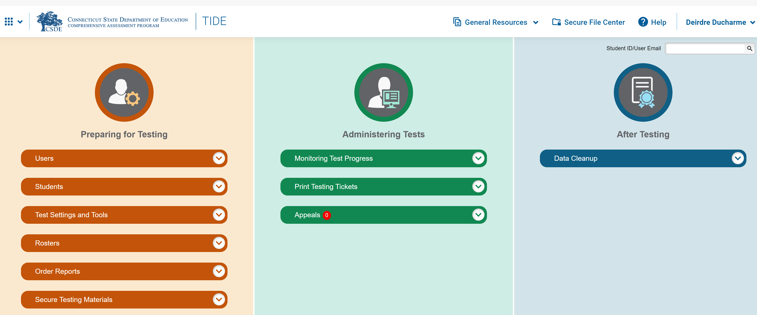
Required Secure Alternate Assessment Materials for CTAA and CAAELP
Notes:
The required Connecticut Alternate Assessment (CTAA) Directions for Test Administration (DTAs) and CAAELP Directions for test Administration (DFA) are secure testing materials and may be accessed ONLY by users with a TEA or DA role in the Test Information Distribution Engine (TIDE). These are secure materials and DA’s/ TEA’s need to ensure test security at all times.
These grade-and content-specific DTAs are required for test administration. For example, if the TEA is administering the Grade 3 CTAA, they will download and print the Grade 3 Math AND ELA DTA from TIDE. Additionally, in conjunction with the DTAs, teachers should also use the Connecticut Alternate Assessment Test Administration Manual: CTAA Test Administration Manual (TAM) (cambiumast.com) and the CAAELP Assessment Test Administration Manual (DFA) (if applicable) prior to and during testing. For the CAAELP DFA the TEA needs to ensure they download the correct assigned form of the DFA (Either Form A, B, C, or D) Please see the CAAELP TAM for more information of test forms.
Upon completion of testing the TEA needs to follow CSDE policies for the secure shredding or removal from devices of downloaded materials.

Slide 106
Confirming Trained Teacher Status
1
Only the DA has access to add, change, or delete a TEA User Role.
2
3
Notes:
DAs can create a roster in TIDE to confirm those TEAs who have been trained. We have highlighted the steps in this slide. TEA user roles will provide teachers access to the Alternate Assessment systems.

Slide 107
Questions

Slide 108
Special Populations Contact Information

Slide 109
Thank you for your participation!

