Slide 1


CONNECTICUT STATE DEPARTMENT OF EDUCATION
District Administrator’s
Test Administration Workshop
Smarter Balanced, NGSS Standard, CTAA, and CTAS
January 20, 21, and 22

Slide 2
CSDE Assessment Staff -
Performance Office
Bureau Chief Abe Krisst Abe.Krisst@ct.gov (860) 713-6894 | Special Populations and Accommodations (Smarter, NGSS, Connecticut SAT School Day, Alternate Assessments) Deirdre Ducharme Deirdre.Ducharme@ct.gov (860) 713-6859 Janet Stuck Janet.Stuck@ct.gov (860) 713-6837 | NGSS Standard and CTAS Jeff Greig Jeff.Greig@ct.gov (860) 713-6854

Slide 3
CSDE Assessment Staff -
Performance Office
Smarter Balanced/Interims All Appeals Cristi Alberino, Ph.D. Cristi.Alberino@ct.gov (860) 713-6862
Connecticut SAT School Day Michelle Rosado Michelle.Rosado@ct.gov (860) 713-6748
Support for ALL Assessments Marlene Chameroy Marlene.Chameroy@ct.gov (860) 713-6860

Slide 4

CSDE Assessment Staff
Performance Office

Slide 5
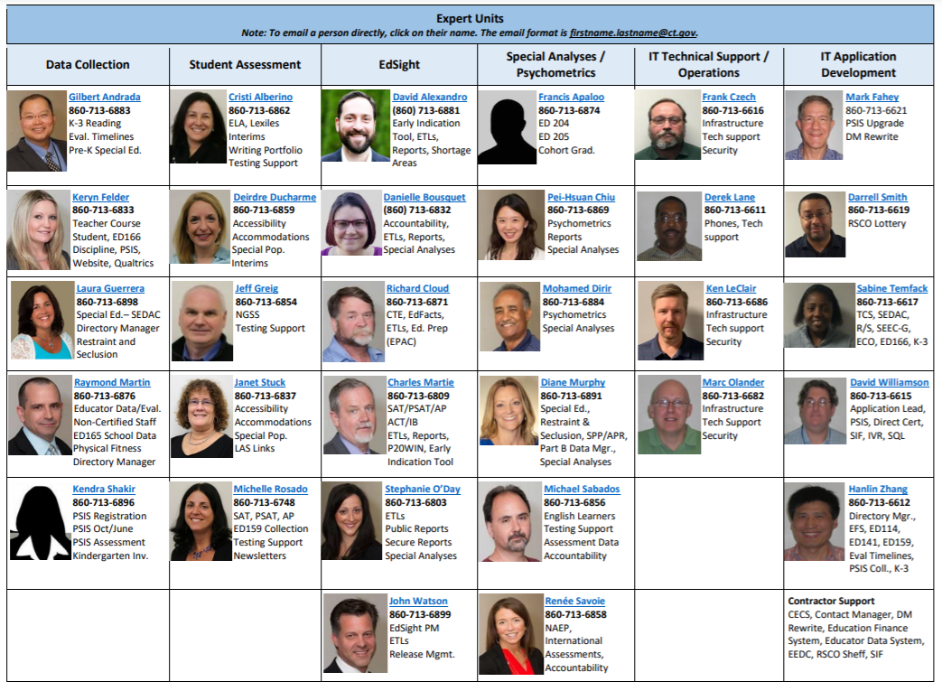

Slide 6
Contact Information
Purpose | Who | Phone | E-mail (PREFERRED)
Test Administration Procedures Questions Technology Questions | Connecticut Help Desk - Cambium Assessment, Inc. | 844-202-7583 | cthelpdesk@cambiumassessment.com
Smarter Balanced and NGSS Assessments State Policy Test Administration Questions Reporting of Security Breaches Only | CSDE Performance Office | 860-713-6860 | ctstudentassessment@ct.gov Cristi.Alberino@ct.gov Abe.Krisst@ct.gov
Designated Supports and Accommodations Questions CTAA and CTAS | Deirdre Ducharme Janet Stuck | 860-713-6859 | Deirdre.Ducharme@ct.gov Janet.Stuck@ct.gov

Slide 7
Cambium Assessment, Inc. (CAI)
  Connecticut Help Desk
  844-202-7583
  cthelpdesk@cambiumassessment.com
  The Help Desk is open Monday – Friday 7:00 a.m. to 7:00 p.m.
  during testing.
  CAI Project Team
  Jen Chou, Program Director
  Amber Benlian, Program Manager
  Marie Musumeci, Program Coordinator

Slide 8
Presentation Overview
Overview of Assessments for Spring 2021
    Assessment and Accountability for 2020–21
    What’s the Same and What’s New?
    Office Hours/Calendar
    TIDE/PSIS Data Sync
    Policies – Security and Participation
    Improprieties, Irregularities, and Breaches
    Appeals
Remote Proctoring System
Cambium Systems Overview

Slide 9
Assessment and Accountability for
2020-21

Slide 10
Current Status on Assessment
Health and safety is priority number one.
CSDE remains committed to administering the state academic assessments to the fullest extent possible in 2020-21.
Having results in 2020-21 will allow CSDE:
  to monitor long-term trends;
  evaluate the full impact of the pandemic on student achievement and growth; and
  target support and resources where they are needed the most.
Having a measure in 2020-21 will also allow CSDE to restart the academic growth measure with the 2021-22 school year.

Slide 11
Current Status on Accountability
State assessments do not have to be synonymous with school and district accountability.
CSDE will seek federal approval to waive formal school and district accountability in 2020-21.
Connecticut is asking for federal approval to waive:
  summative ratings (i.e., the Accountability Index);
  sorting schools into categories 1-5; and
  identifying new Turnaround or Focus schools (categories 4 and 5) in fall 2021 based on 2020-21 data.
What about changes at federal level?

Slide 12
Current Status on Accountability
What about Participation?
To ensure that we get the most complete measure of student performance, CSDE expects universal participation of students when the state assessments can be delivered safely.
Pressure release valve of waiver.

Slide 13
What Remains the Same in 2021?
TIDE System
Provision of Testing Manuals
    2021 Test Coordinator Manual
    2021 NGSS, CTAA, CTAS, and Smarter Balanced Administration Manuals
Who Needs to be Tested? All students including:
    Students in Private Approved Facilities
    Students in PSIS who attend Out-of-State Facilities or In-State Non-Approved Facilities
    Students with Disabilities and/or English learners
    Full-time remote learners
Office Hours
Importance of Maintaining Data in PSIS Registration
Ordering of Paper Materials in TIDE (Braille and Large Print)

Slide 14

What’s New in 2021?
Focused training for Special Populations (Thursday and Friday of this week)
TCM and TAM’s for in-person testing
Scheduling test sessions in advance
Remote testing and remote testing manuals
Embedded Speech-to-Text Accommodation and Math Translation Glossary
Secure Browser
Results Delivery for Assessments – Smarter/CTAA and NGSS/CTAS

Slide 15
2020 - 21 Assessment Office Hours*
Date | Topics
February 16 3:00-4:00 | Connecticut Alternate Assessments/Accessibility and Accommodations
March 15 3:30-4:30 | Connecticut Alternate Assessments/Accessibility and Accommodations
April 1 and every Thursday (3 p.m.) | Smarter, NGSS, CTAS and CTAA Topics (April 8 – Remote Proctoring Tool)
*NOTE: There are additional Office Hours for LAS Links and Connecticut SAT School Day.

Slide 16
2020–21 Assessment Calendar
State Assessment | Grade(s) | Testing Window | Delivery Method
Smarter Balanced ELA & Math* | 3 – 8 | March 29 – June 4 | Online
Connecticut Alternate Assessment (CTAA) | 3 – 8 and 11 | March 29 – June 4 | Online
NGSS Assessments* | 11 | February 1 – June 4 | Online
 | 5 and 8 | March 29 – June 4 | Online
Connecticut Alternate Science Assessment (CTAS) | 5, 8, and 11 | Test should be administered throughout the school year. Student ratings entered in the DEI: March 29 – June 4 | Online Upload March 29 – June 4
Connecticut SAT School Day | 11 | March 24 or April 13 Makeup Dates: April 27 and 28, and May 18 | Paper
*Remote Proctoring Window Opens April 19 for Smarter Balanced and NGSS.

Slide 17

TIDE/PSIS Data Sync
This Photo by Unknown author is licensed under CC BY-SA.

Slide 18
TIDE/PSIS Data Sync
District Administrators need to work with District PSIS Coordinators to ensure accurate student information is reported in the PSIS Registration Module and TIDE.
During the summative test window, changes made in PSIS Registration will automatically be updated in TIDE by the following day.

Slide 19
TIDE/PSIS Data Sync
Testing Demographics SPED, FRL, EL, Military Family, and Homeless values were loaded in November 2020.
The values for Recently Arrived EL and Section 504 were not pulled from Freeze Zero. These must be set in the PSIS Registration Module.
Student demographic values will be saved and the fields locked in PSIS on June 4, 2021. All changes to a student’s status at the time of testing must be made by June 4, 2021.
Students who are repeaters should be tested.
Student’s grade in PSIS is that grade in which the test is given.
Grade 11 "skippers" are not tested.

Slide 20
TIDE/PSIS Data Sync
Student Status Change*
Status | If student has already taken any state assessment | If student has not already taken any state assessment
If SPED/EL/FRL was YES originally and then changed. | Leave status as YES for all tests. | Change status to NO for all tests.
If SPED/EL/FRL was NO originally and then changed. | Change to YES for all subsequent tests and the CSDE will apply this status for all tests. | Change status to YES.
*Making these changes may impact the student eligibility for designated supports and accommodations.

Slide 21
TIDE Designated Supports and Accommodations
Prior to testing, ensure that all embedded (and non-embedded) designated supports and accommodations are entered/uploaded into TIDE. Refer to the Accessibility Chart for the list.
If applicable, work with school staff and eligible students to practice using the new embedded speech-to-text accommodation, which should eliminate the need for third-party software for Speech-to-Text. Remember students will need to test in a separate setting.
Contact the CSDE if you have a student that requires the use of a special documented accommodation (i.e., use of a scribe or human reader). Petitions are due by January 22.
Refer to the Assessment Guidelines and the Guidelines and Documentation tab located on the Connecticut Portal for additional resources.

Slide 22
Activation of the Alternate Flag Indicator for Alternate Assessments
Alt Flag Indicators are activated weekly by Cambium as forms are submitted using the Data Entry Interface through February 15.
If forms are submitted after this date, TEAs will need to notify their District Administrator, who will contact the Connecticut Helpdesk to request the activation of the Alt Flag Indicator.

Slide 23
Activation of the Alternate Flag Indicator for Alternate Assessments
Connecticut Alternate Assessment Eligibility Form Submission Deadlines through the Data Entry Interface (DEI) | Connecticut Alternate Assessment Eligibility Form Student Subgroup
November 12, 2020-January 15, 2021 | Eligible students in Grade 11; and Eligible dually-identified (English learner and Special Education) students in Grades 3-8 and 11
November 12, 2020-February 15, 2021 | Eligible students in Grades 3-8; and Newly eligible Grade 11 students (extended deadline)

Slide 24

Test Security

Slide 25
Test Security
Breaches of test security include, but are not limited to:
  analyzing/copying test items
  coaching students
  giving students answers, and/or changing students’ answers
  allowing students access to digital, electronic, or manual devices (except approved accommodations)
  unauthorized log-in to the Test Delivery System
    Cell phone use by students is prohibited!
    Additional guidance about remote testing will be forthcoming.

Slide 26
Test Security and Proctoring
Violation of test security is a serious matter with far-reaching consequences. Breaches of test security include, but are not limited to, copying or photographing of test materials, failing to return test materials, coaching students, giving students answers, and/or changing students’ answers. Such acts may lead to the invalidation of an entire school district’s student test scores, disruption of the test system statewide, and legal action against the individual(s) committing the breach. A breach of test security may be dealt with as a violation of the Code of Professional Responsibility for Teachers, as well as a violation of other pertinent state and federal law and regulation. The Connecticut State Department of Education will investigate all such matters and pursue appropriate follow-up action. Any person found to have intentionally breached the security of the test system may be subject to sanctions including, but not limited to, disciplinary action by a local board of education, the revocation of Connecticut teaching certification by the State Board of Education,* and civil liability pursuant to federal copyright law.
*See Section 10-145b(i) (2) (E) of the Connecticut General Statutes, which reads in relevant part as follows: The State Board of Education may revoke any certificate, permit, or authorization issued pursuant to said sections if the holder is found to have intentionally disclosed specific questions or answers to students, or otherwise improperly breached the security of any administration of a mastery examination, pursuant to section 10-14n.

Slide 27
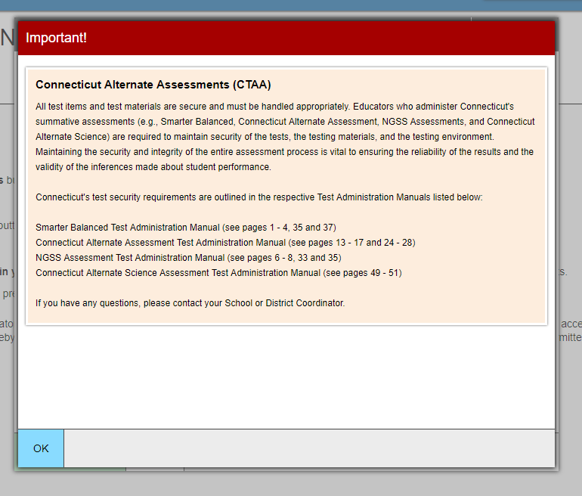
TA Security Confirmation Page

Slide 28

State Policy Regarding Participation
This Photo by Unknown author is licensed under CC BY-SA-NC.

Slide 29
Participation - Connecticut General Statutes 10-14n
    (b) (1) For the school year commencing July 1, 2015, and each school year thereafter, each student enrolled in grades three to eight, inclusive, and grade eleven in any public school shall, annually, take a mastery examination in reading, writing and mathematics during the regular school day.
    (3) For the school year commencing July 1, 2018, and each school year thereafter, each student enrolled in grades five, eight, and eleven in any public school shall annually take a state-wide mastery examination in science during the regular school day.

Slide 30
Improprieties, Irregularities, and
Breaches

Slide 31
Test Security Definitions
Type | Definition
Breach | A test security incident that poses a threat to the validity of the test. Examples may include the release of secure materials or a security/system risk. These circumstances have external implications and may result in a decision to remove the test item(s) from the available, secure item bank.
Irregularity | A test security incident that impacts an individual or group of students who are testing and may potentially affect student performance on the test, test security, or test validity.
Impropriety | A test security incident that has a low impact on the individual or group of students who are testing and has a low risk of potentially affecting student performance on the test, test security, or test validity. These circumstances can be corrected and contained at the local level.

Slide 32
Test Security Actions
Type | Action
Breach | The District Administrator must immediately notify the CSDE at 860-713-6860 of ctstudentassessment@ct.gov.
Irregularity | Incident submitted in the Appeals module of TIDE (if appropriate) by end of the day of the incident
Impropriety | Incident corrected and contained at the district/school or entered in the Appeals module of TIDE (if appropriate)
Note: The Test Security Levels are described in Appendix G of the Test Coordinator’s Manual.

Slide 33
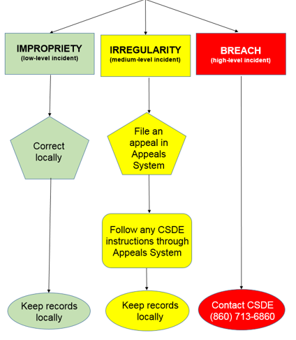
Testing Incident

Slide 34
Appeal Types
Appeal Type | Description
Reset a Test | Removes the test and scores from the system Enables student to start a new test
Re-open a Test | Allows for a test that has already been submitted in error or has expired to be re-opened
Re-open a Test Segment | Re-opening a test segment allows a student to access the first segment of a test that was submitted in error
Grace Period Extension | Granted if a test session is unexpectedly interrupted Allows access to all previous responses
Restore a Test That Has Been Reset | Returns a test from the Reset status to its prior status Only allowed on tests that have been reset A test can be restored if it was reset in error
Invalidate a Test | Rarely Used Eliminates the test Student does not receive a score

Slide 35
Tips on Entering Appeals
Tip | What does that mean?
Enter Appeals Judiciously | Staff entering appeals should be trained. CSDE is reviewing every appeal closely and does not approve everything.
Re-open or Grace Period Extension Should Only be Used When Needed | Students should not be allowed back into the test just to double check work if they already submitted their test. Students are encouraged to review items prior to ending their test.
When Unsure of What to do, Reach Out for Help | Contact the CSDE with any questions. ctstudentassessment@ct.gov 860-713-6860 or email Cristi.Alberino@ct.gov

Slide 36
Appeals Process for an
Accommodation Issue
If a testing irregularity occurs, and a student with an IEP or 504 Plan is not given the correct assessment, is not provided their mandated accommodations, or if any student is given an accommodation they are not entitled to, the DA must provide a letter to the CSDE on district/school letterhead. Letters must be signed by the DA and faxed to Performance Office Irregularities at 860-713-7033.
The letter must include:
  The student’s grade, SASID, and the name of the test on which the irregularity occurred;
  The date and a detailed explanation of the irregularity;
  The name of the teacher involved;
  A description of the discussion that occurred with parents/guardians of the student explaining the irregularity, options offered, and impact on the student’s time; and
  A brief list of procedures in place to ensure the irregularity is not repeated.

Slide 37
Remote Proctoring

Slide 38
What is Remote Proctoring?
Remote proctoring is a process in which a student participates in a Smarter Balanced or NGSS Assessment in the home environment and the test administrator is not physically present.
CAI has developed remote proctoring tools that are paired with their standard Test Delivery System to administer tests at home.
The Remote Proctoring Tools will be made available for Smarter Balanced and NGSS Summative Assessments on April 19, 2021.
Remote Proctoring is currently being used for LAS Links test administration using the DRC InSight system.

Slide 39
When to Use Remote Proctoring for Summative Assessments
Administration Hierarchy (Smarter Balanced and NGSS):
Students attending school fully in-person or in hybrid mode must be tested in-person.
Students who are fully remote and can be tested in-person or in an alternate secure district location (i.e., in a suitable room in a school or district-operated building), should be tested in this manner.
Remote administration is available only to those students who are fully remote and cannot test in person or in an alternate secure district location.

Slide 40
Testing Hierarchy*
In-Person Testing
For all in-person and hybrid students
For remote learners who can come to school safely
Remote Testing
Remote learners who are not able to come to school
*In general, remote testing should be utilized later in the window.

Slide 41
Is There a Remote Proctoring Option for CTAS and CTAA?
  There is no remote proctoring tool for the CTAS and CTAA due to the complexities of the test design and test administration.
  The CSDE recommends that the CTAS and CTAA be administered in a school environment.
  If a student is a fully-remote student, it would be possible to administer the tests only if a trained teacher is available in person to administer the alternate assessments in a one-to-one situation in the remote environment over as many sessions as the student requires.

Slide 42
Can my District use the Remote Proctoring Tool Now?
Beginning in February, all districts will have access to the Remote Proctoring Tool via the NGSS and Smarter Balanced Interim Assessments.
In the next few weeks, more resources will be released to support the administration of these assessments.

Slide 43
Cambium System Updates

Slide 44
Portal
All CAI systems and resource materials can be accessed via the Connecticut Comprehensive Assessment Portal (https://ct.portal.cambiumast.com/).
The portal is undergoing a redesign. The new portal redesign will be released in June 2021. The URL will remain the same.

Slide 45
Secure Browser Updates
The Secure Browser is designed to ensure test security by prohibiting students from accessing any other programs or websites during testing.
The 2020-21 Secure Browser was released on August 14, 2020. Download the latest secure browser from the portal. The browser from 2019-20 will no longer work.
Students will be required to use the Secure Browser to take the summative Smarter Balanced, NGSS, and the CTAA assessments regardless if they are taking the test in class or remote.

Slide 46
iOS Update
Video conferencing for remote administration will now be supported on the Mobile Secure Browser app for iPads running iOS 14.3 and up.
If you are planning to use video conferencing for remote administration via iPad, please make sure to update your operating system, as well as to update to the latest version of the Mobile Secure Browser app.
If you are not planning to use iPad video conferencing for remote administration, no action is required.

Slide 47
Chrome Update
CAI currently supports Chrome versions 83 to 86.
CAI provides presumptive support for new versions of Chrome as they are released, which means students are not prevented from taking tests on the newest versions. However, although CAI and Google work collaboratively on new versions, CAI does need to perform internal testing to make sure there are no issues. If issues are discovered we will resolve them, as quickly as possible.
Recommended: Lock down devices before the test administration window begins. This reduces the risk of any issues occurring during testing should a new version be released with unanticipated problems.
CAI no longer supports a device if Google stops supporting it. Monitor Google’s end-of-life policy https://support.google.com/chrome/a/answer/6220366?hl=en.

Slide 48
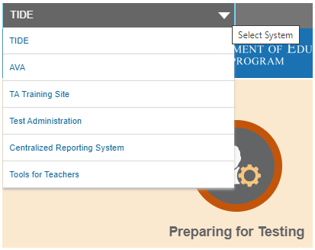
Accessing Systems
All user accounts were rolled over and passwords reset on August 27, 2020.
If you log in on a new device or browser (or clear the cache on a previously-used browser) you must enter an emailed code after passing the initial login screen. This step does not occur when you activate your account.

Slide 49
Test Information Distribution Engine (TIDE) Updates
TIDE supports state, district, and school test coordinators throughout the testing process, from test preparation, to test administration, to post-administration.
Features include the following:
  Add/Manage User Accounts
  Review Student Demographic Information
  Review/Edit Student Settings
  Create/Submit Appeals
  Create Rosters
  Order Paper Materials
  Run Participation Reports

Slide 50
TIDE Updates
All students taking a summative assessment (Smarter Balanced, NGSS, CTAA and CTAS) need to be in TIDE.
All users who are proctoring a summative assessment or need access to the DEI need to have an account in TIDE.
Starting in Fall 2019, CAI is no longer offering the Julie Voice Pack.
  Students testing on the Windows platform can use the voice pack built into the platform or other voice packs but should not use the Julie voice pack unless districts have purchased the license directly from NeoSpeech.

Slide 51
TIDE: Participation Reports
Plan and Manage Testing
Test Status Code Report
Test Completion Rates
Test Session Status Report

Slide 52
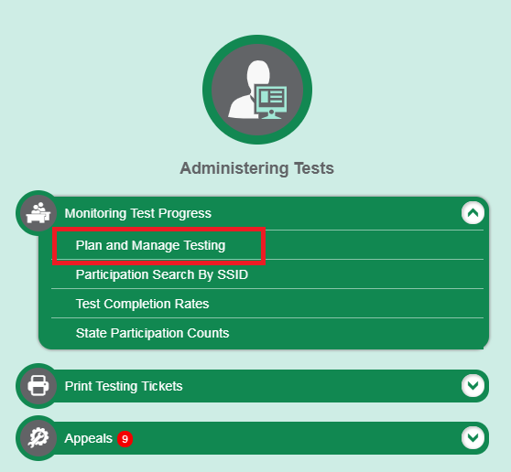
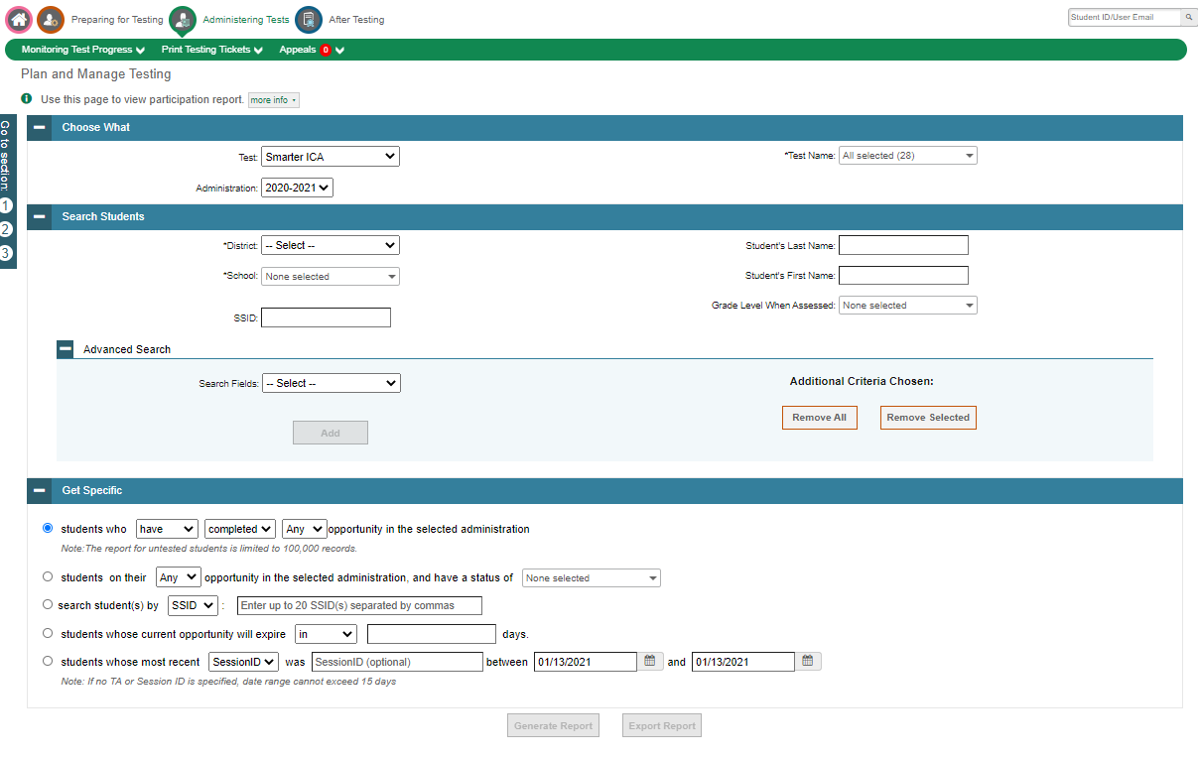
TIDE: Participation Reports
(Plan and Manage Testing)

Slide 53
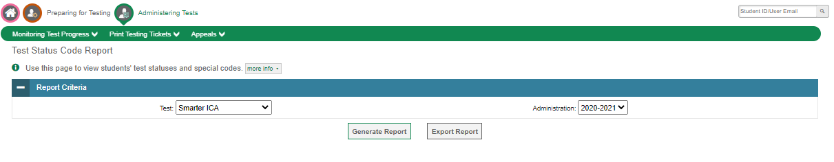
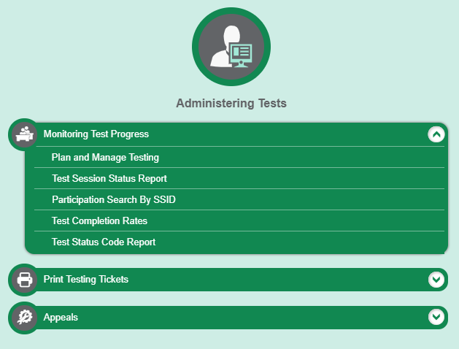
TIDE: Participation Reports
(Test Status Code Report)

Slide 54
TIDE: Participation Reports
(Test Status Code Report)
Specific report used to view each student’s test status and all special codes to explain a student’s non-participation in a test
Displays all test statuses for each test for which each student in a district/school is eligible
May be generated at the district level or at the school level, depending on your user role
Report should be generated for each test to obtain an accurate picture reflecting the testing status of all students for all tests in the school or district
Particularly useful for Summative Assessments

Slide 55
TIDE: Participation Reports
(Test Completion Rates)
High-level reports used to summarize the number and percentage of students who have started or completed a test
May be generated at the district or school level, depending on your user role
All students in the specified school or district will be included in this report
Report should be generated for each test to obtain an accurate picture that reflects the testing status of all students for all tests in the school or district

Slide 56
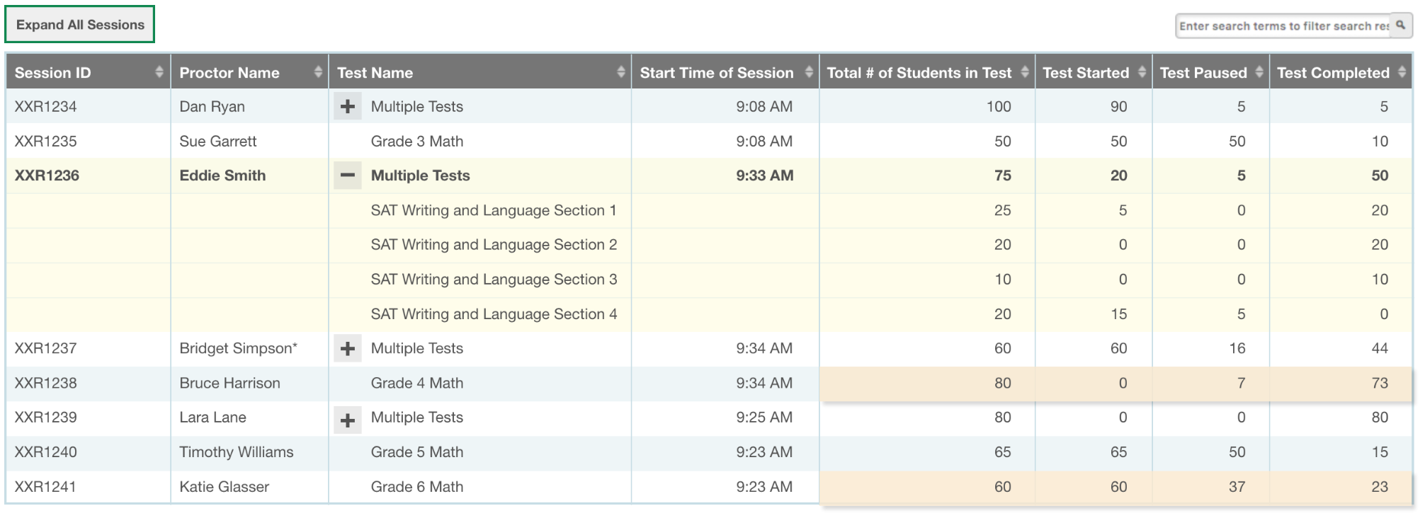
TIDE: Participation Reports
(Test Session Status Report)

Slide 57
TIDE: Participation Reports
(Test Session Status Report)
Support for Session-level reports for District and School Users
  Dashboard type report of current testing activity
  Includes cumulative counts of the number of tests started, paused, and completed in a session/school
  Information updated every couple of minutes

Slide 58
Test Delivery: Student Interface Updates
(Embedded Speech-to-Text)
CAI’s Embedded Speech-to-Text Tool
  Is embedded in the Test Delivery System, which means it can be configured and governed like any other embedded accessibility resource.
  Does not require any software to be installed on the device, or prior setup.
  Must be selected in TIDE.
  Is cross-platform compatible, and has consistent presentation and functionality (i.e.; desktop, chrome, iOS, etc.)
  Only appears on the item interactions that should have it. This tool is only on the short answer items that are on the ELA (CAT) and Math (PT) tests.

Slide 59
Test Delivery: Student Interface Updates
(Embedded Speech-to-Text)
How it works:
  When the accessibility resource is enabled, a microphone icon will appear in or near the response space for constructed-response items.
  The student will click on the microphone icon and begin speaking.
  As the student speaks, the transcribed text will appear in the provided response area.
  The student is permitted to dictate up to 5 minutes of speech at a time.

Slide 60
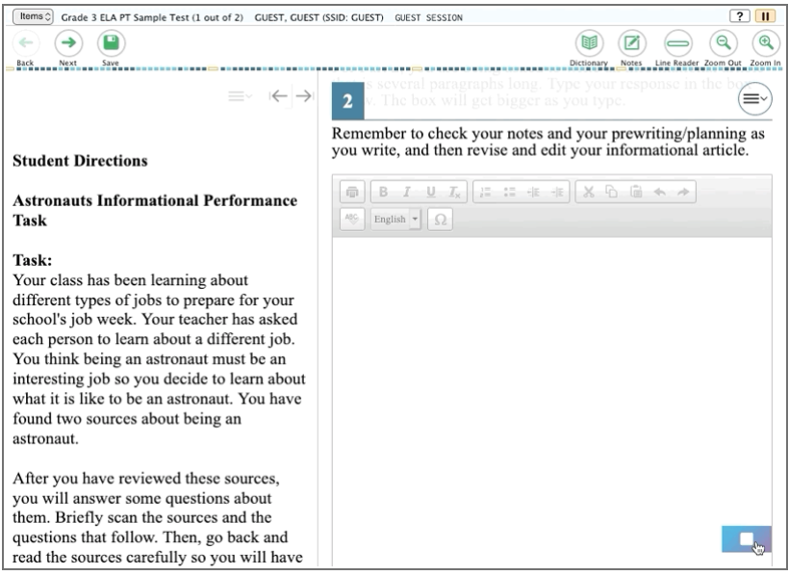
Test Delivery: Student Interface Updates
(Embedded Speech-to-Text)

Slide 61
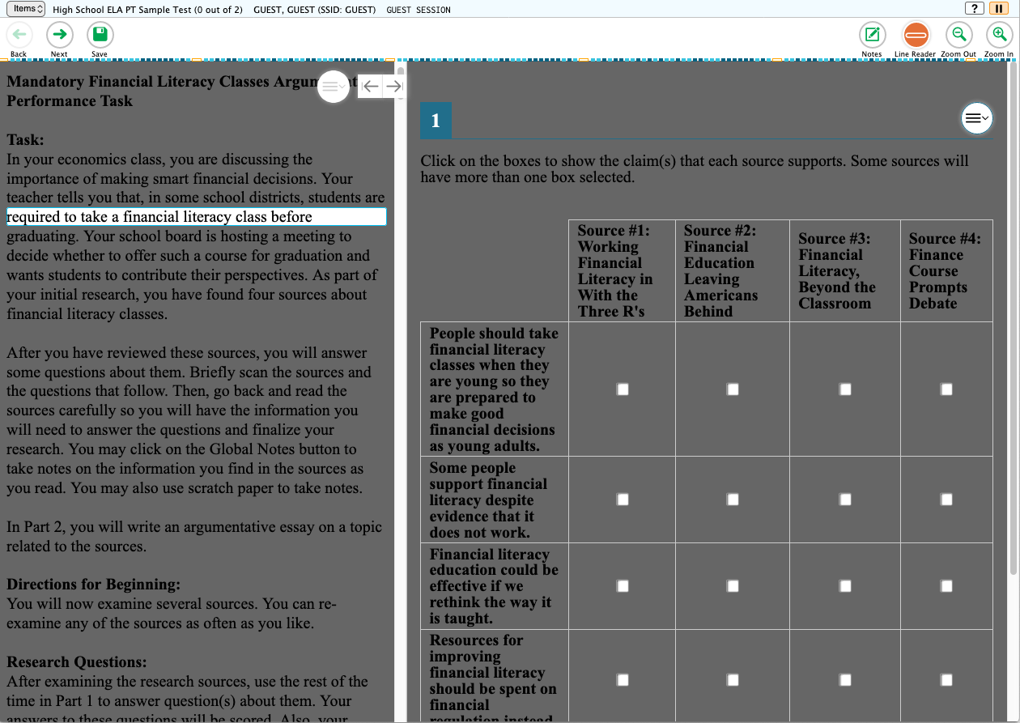
Test Delivery: Student Interface Updates
(Enhanced Line Reader/Masking Hybrid )
A new Line Reader mode is available, which adds a dark gray background to test content, except for the line that being highlighted. Provides the straightforward functionality of the Line Reader, with the distraction-removing benefits of the Masking tool.

Slide 62
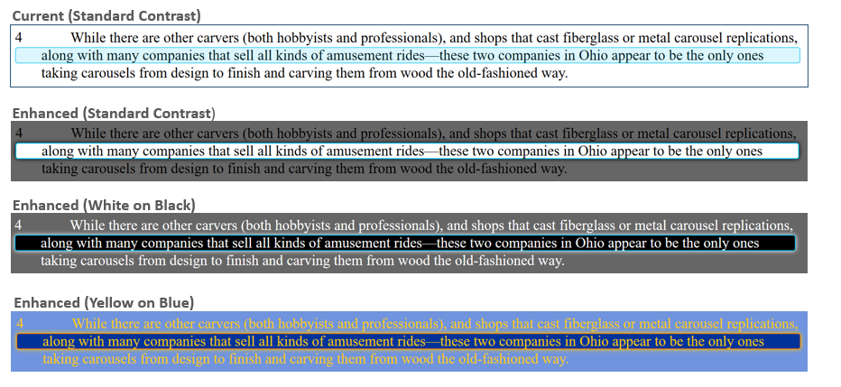
Test Delivery: Student Interface Updates
(Enhanced Line Reader/Masking Hybrid )

Slide 63
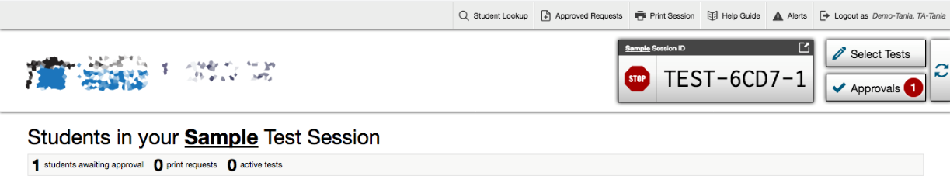
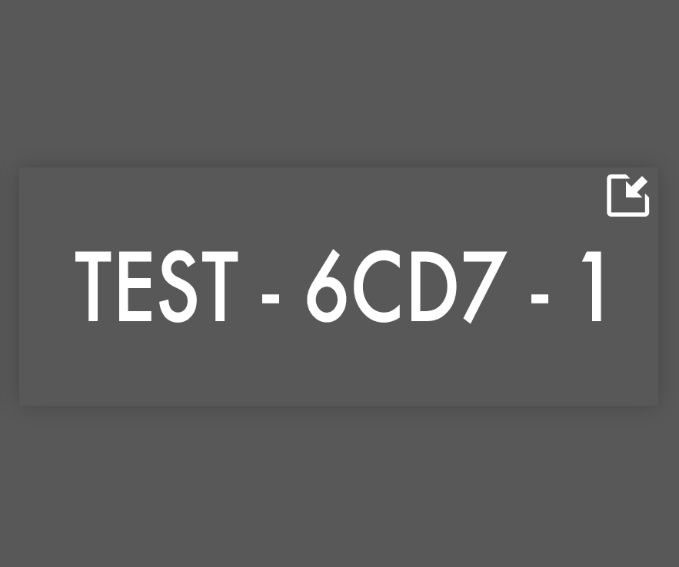
Test Delivery: TA Interface Updates
(Session Screensaver)
A new screensaver can be displayed at any time by clicking a new button in the top right corner of the Session ID widget.
Screen content is now covered, helping to hide student PII while the session is active and the proctor is not at their device.
Allows proctors to walk the room and help students get logged in; session ID is viewable from afar.
Screensaver will also display after a period of TA inactivity.

Slide 64
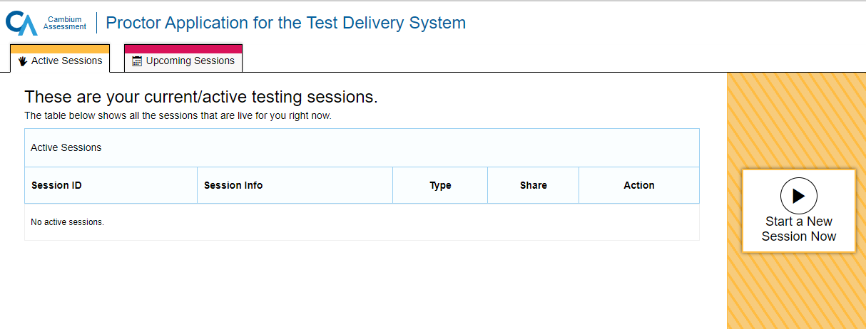
Test Delivery: TA Interface Updates
(New Session Dashboard)
New screen – “Session Dashboard”
In the past, the first screen a TA saw when logging in was the test tree where they chose the tests they wanted to add to their session.
This screen will be a one-stop-shop for all active and scheduled sessions a TA has created.
In the past, TAs could only create active sessions. Starting this year, TA will have the ability to schedule testing sessions in advance.

Slide 65
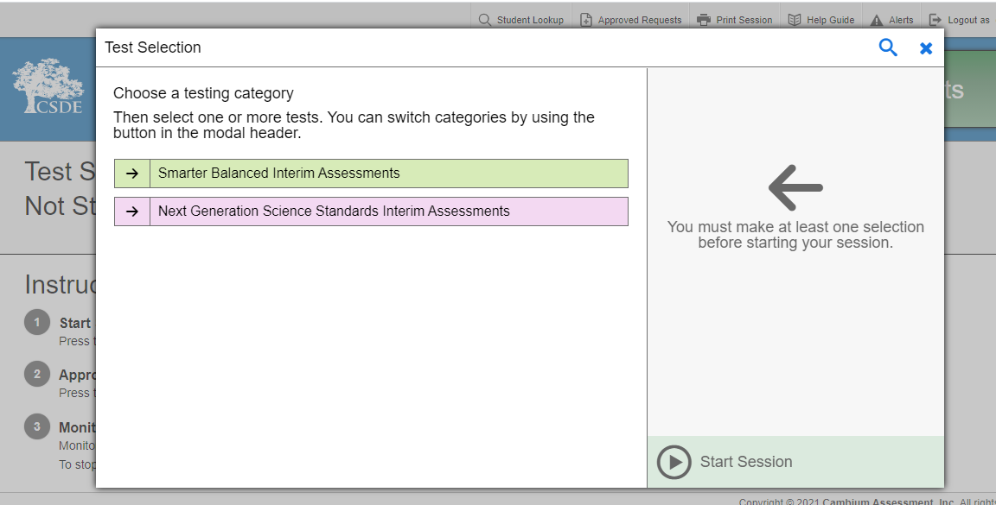
Test Delivery: TA Interface Updates
(Revamped Test Selection)
Familiar presentation, but revamped to include some quality of life improvements.
Top level categories remain as-is, retaining the same colors, names, etc.
Additional features have been added, but nothing has been removed.
Responsive design still permits use on form factors as small as a smartphone.

Slide 66
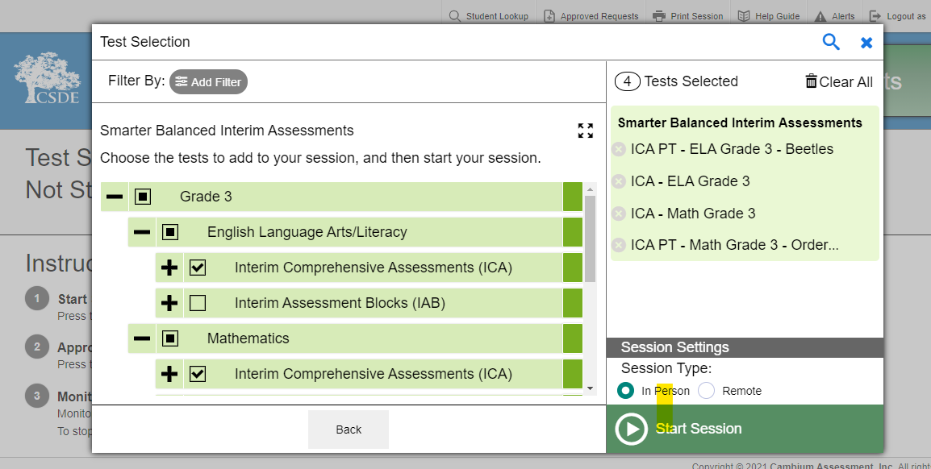
Test Delivery: TA Interface Updates
(Revamped Test Selection)
After clicking on a top-level test category, the user is taken to an expanded view of the test selection tree.
All the tests are displayed in the traditional tree structure.
A new “Selected Tests” view on the right summarizes the selections made across all categories, to be delivered in this test session.

Slide 67
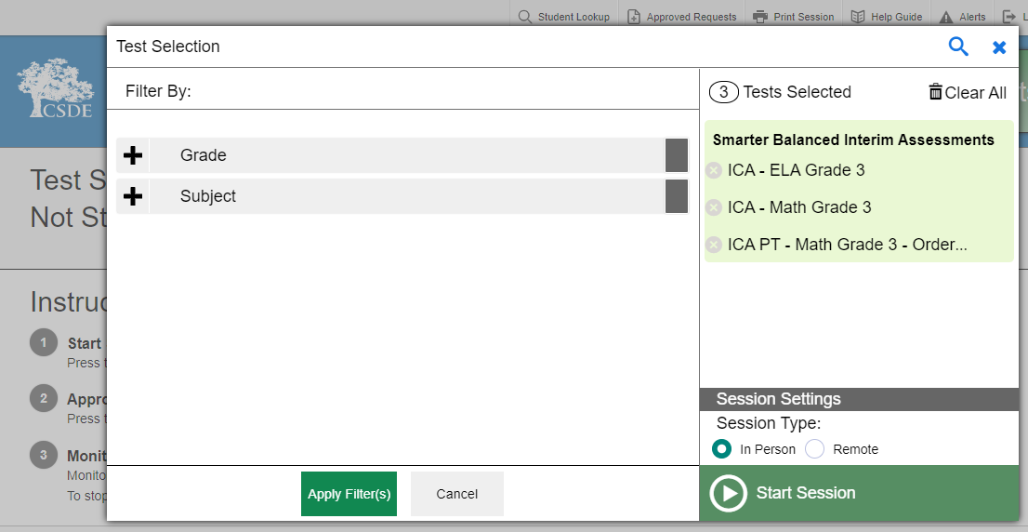
Test Delivery: TA Interface Updates
(Revamped Test Selection)
A new filter function allows users to filter the list of available tests by grade and subject.
Particularly useful for Interim Assessments, where users will encounter a large number of test titles.
The new Global Search feature is accessed from the top menu bar in the TA Interface.
Users are now able to perform a text-based search across ALL the tests they are permitted to deliver.

Slide 68
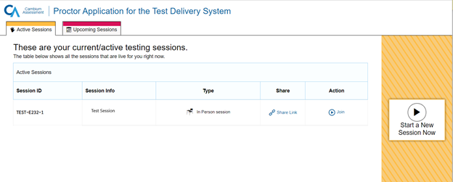
Test Delivery: TA Interface Updates
(Scheduling Session in Advance)
  To help ensure the day of testing runs as smoothly as possible, teachers can schedule test sessions in advance. When a teacher schedules a test session in advance, the online testing system provides a session ID and link to the test session. Teachers provide this information to their students so students can join the session when it begins. Students using the Secure Browser enter the session ID when they are signing in to take the test.

Slide 69
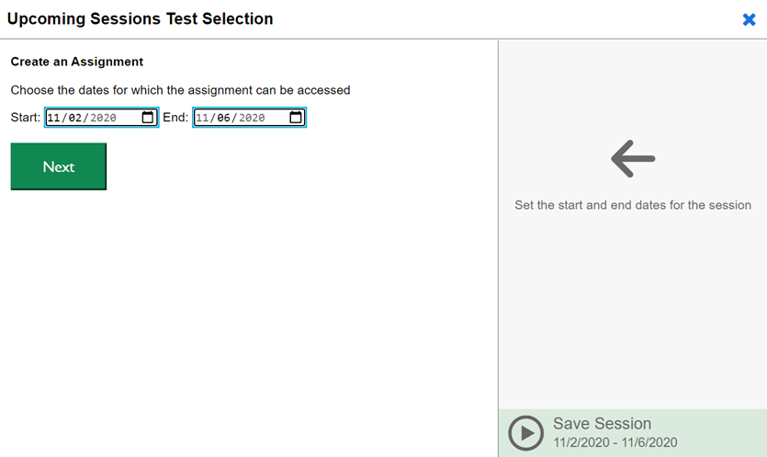
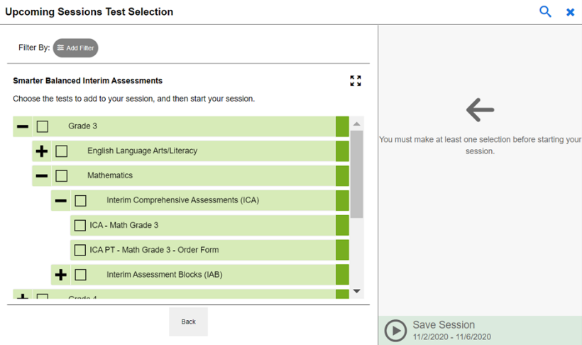
Test Delivery: TA Interface Updates
(Scheduling Session in Advance)
The TA will fill in the dates that the test(s) will be delivered to the students.
After clicking [Next] the TA will see the tests that are available.
The TA will be asked to select the test they will be administering in this future session.

Slide 70
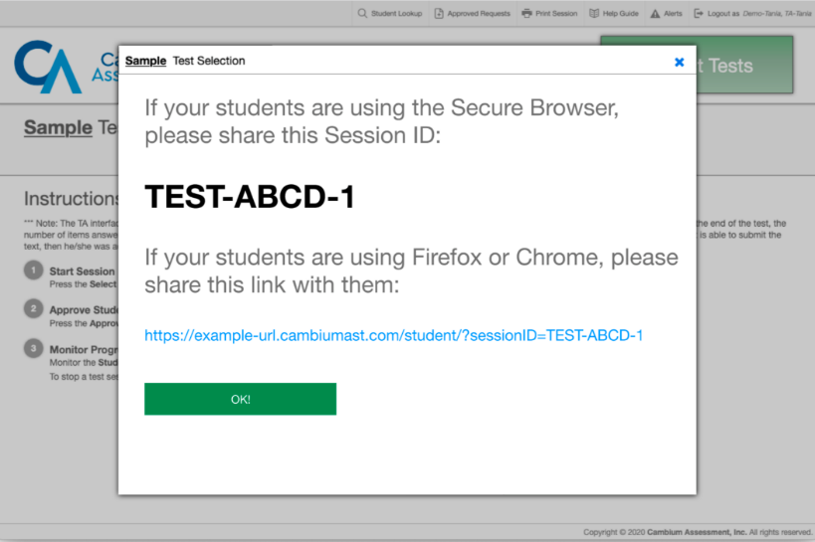
Test Delivery: TA Interface Updates
(Scheduling Session in Advance)
The Test Administration site appears again, displaying the Upcoming Sessions page. The scheduled session appears in the table.
The Session Information pop-up window appears and provides the session ID. Teachers can copy this session ID and save in a secure location in case they need it later.
The Test Administration site appears again, displaying the Upcoming Sessions page. The scheduled session appears in the table.
This feature can be used for in-class and remote testing.
The Session Information pop-up window appears. This pop-up window provides the session ID. Teachers should copy this session ID for themselves and save it in a secure location in case they need it later.

Slide 71
Test Delivery: Remote Testing
Some information about the remote testing platform:
Same platform used for in-class testing.
No additional software to purchase or install.
  Works in all Secure Browsers WITHOUT requiring permissive mode.
  TAs will be able to see and talk to all their students via broadcast or one-on-one. Students cannot see or talk to one another or know how many others are in that test session.
  Students and TAs will not need to juggle multiple pieces of software during a test administration and be forced to choose one or the other to interact with at a given time. Everything will be on the screen, and student test content will not be obscured by the new functionality.
  All embedded tools will work with the exception of Print on Demand and Online Braille/Embossing.

Slide 72
Test Delivery: Remote Testing
  Remote Testing Pilot started in November 2020.
  Over 3,500 tests have been taken using the remote proctoring features.
  This tool will be made available to all teachers and students for the interim assessments in February 2021.

Slide 73
Centralized Reporting System
All interim and summative assessments results are now available in the Centralized Reporting System (CRS).
CAI migrated all previous summative results for Smarter Balanced, NGSS, CTAA and CTAS into CRS over the summer.
The Online Reporting System (ORS) is no longer available.

Slide 74
Further Information
Connecticut Assessment Program Portal
  http://ct.portal.cambiumast.com/
Connecticut Help Desk
  Cambium Assessment, Inc. (CAI)
  1.844.202.7583
  cthelpdesk@cambiumassessment.com

Slide 75


