Slide 1
easyCBM:
Using Your K-3 Assessment Data
Feb. 10, 2026

Slide 2
Purposes for Testing with easyCBM
Examples of appropriate uses of easyCBM results:
Identify student strengths and weaknesses
Inform classroom instruction
Monitor student progress & growth
Measure performance against core standards
Implement Response to Intervention (RTI) and MTSS
Inform academic & program placement decisions
Make comparisons of student/group performance
Evaluate academic programs
Support accountability (meet school, district, & state reporting requirements)

Slide 3
After Screening
Step 1: Sort the benchmark results by risk from most to least.
Step 2: Look at Individual Scores to determine most at risk.
Step 3: Create small groups with common skill deficits.
    Name groups appropriately as students see
    Choose name based on instruction of need
Step 4: Choose the Progress Monitoring measure and determine the appropriate level.
Step 5: Set attainable goals for grade and instructional level growth.
Step 6: Track and analyze progress, continue, change, or exit intervention.

Slide 4
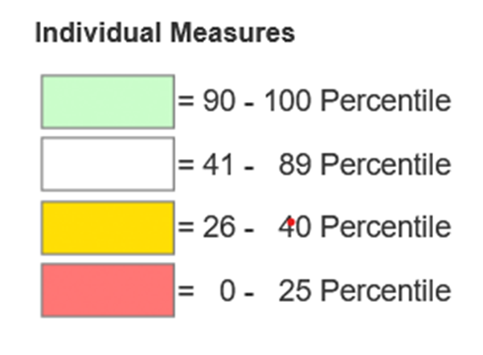
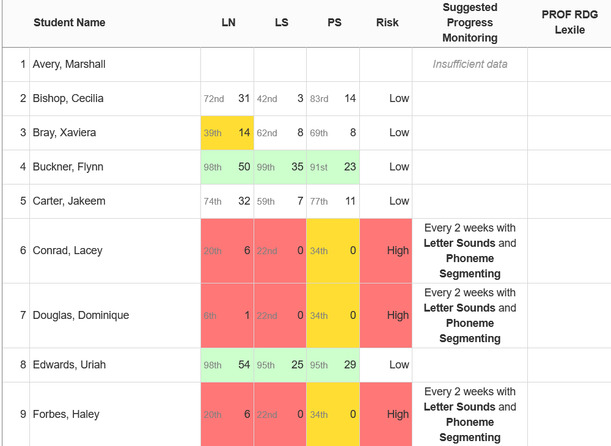
Use Benchmark Reports to Identify Risk

Slide 5
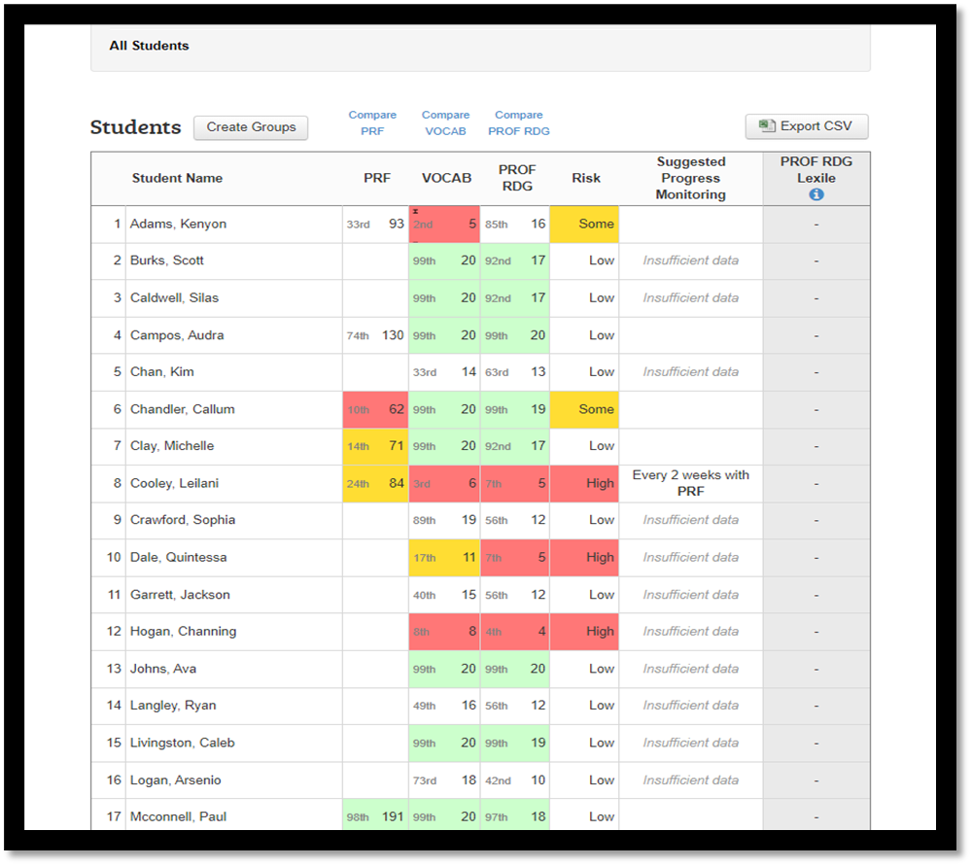
2. Look at Individual Scores to determine most at risk

Slide 6
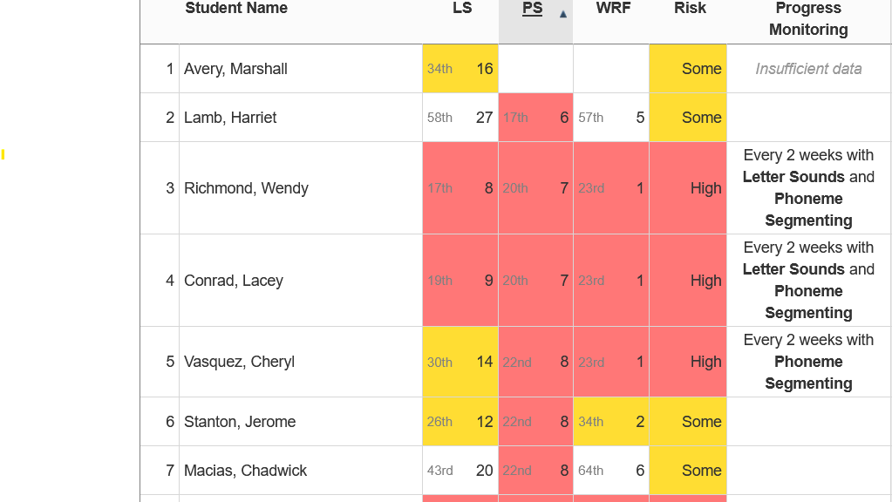
Is Phoneme Segmenting (PS) low?

Slide 7
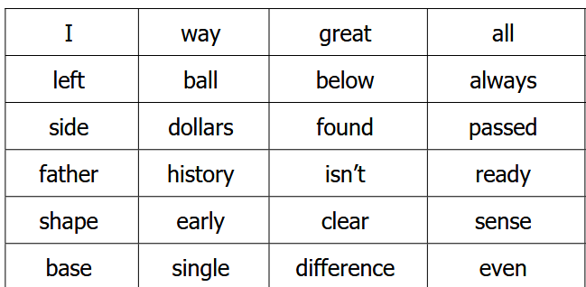
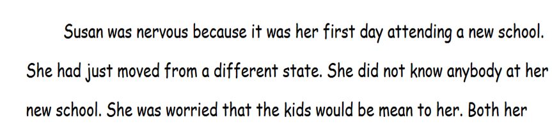
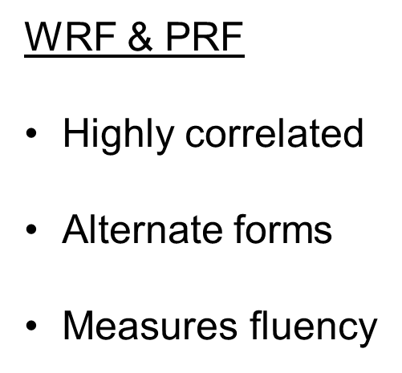
Word Reading Fluency (WRF) vs. Passage Reading Fluency (PRF)
WRF
If only reading 1 word at a time
For slow readers
To build confidence
Each row gets progressively harder

Slide 8
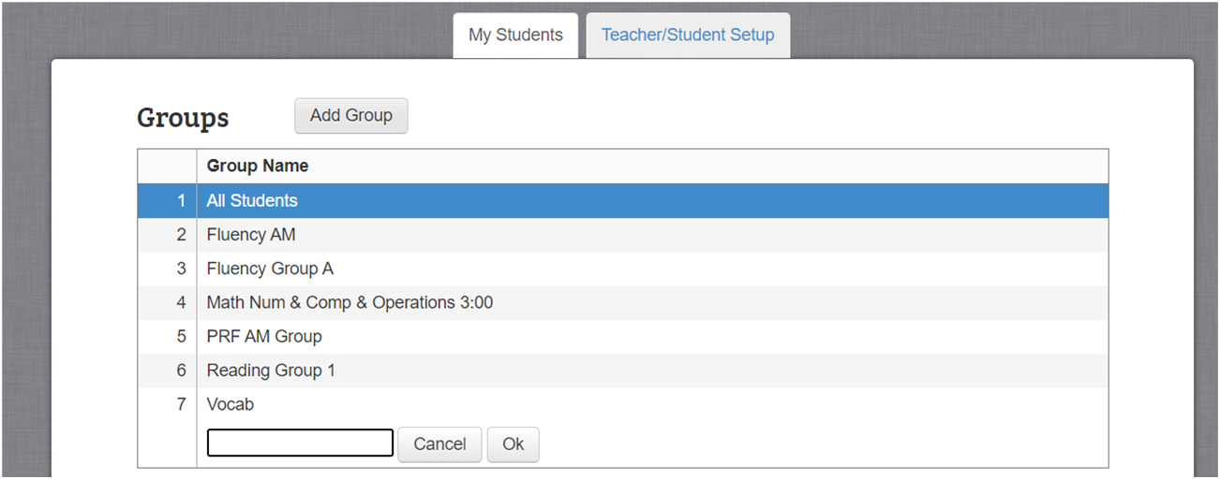
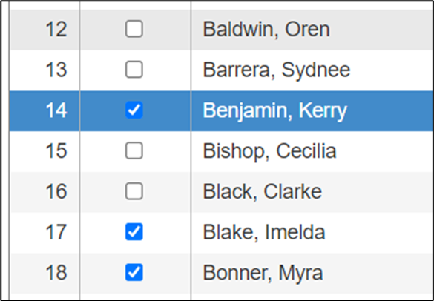
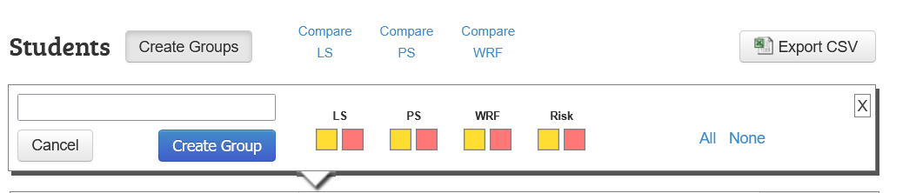
Create Groups with Shared Skill Deficits

Slide 9
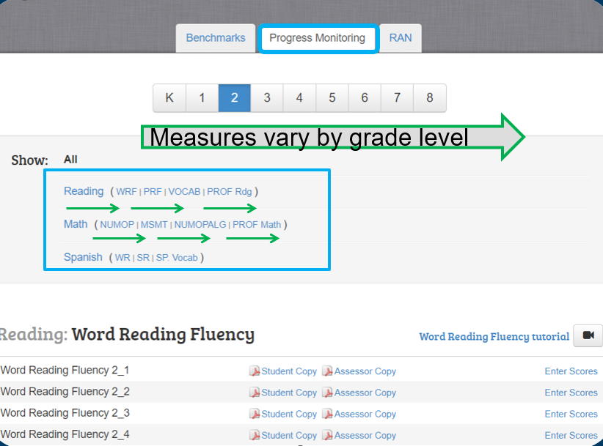
Choose Appropriate Skill and Progress Monitoring Measure
Measures are organized according to the progression of literacy skills, becoming increasingly difficult as skills advance.

Slide 10
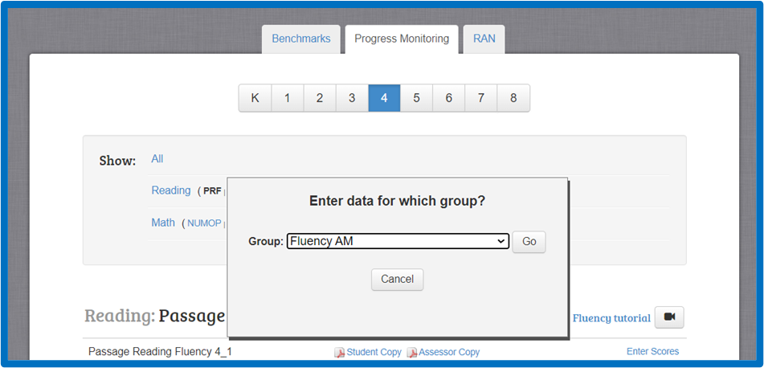
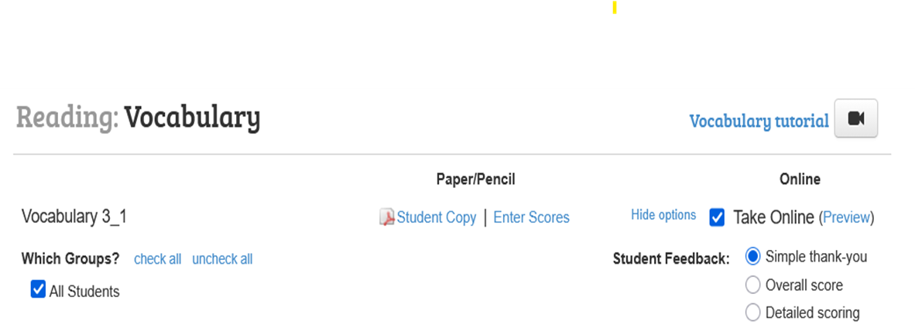
Assigning Progress Monitoring

Slide 11
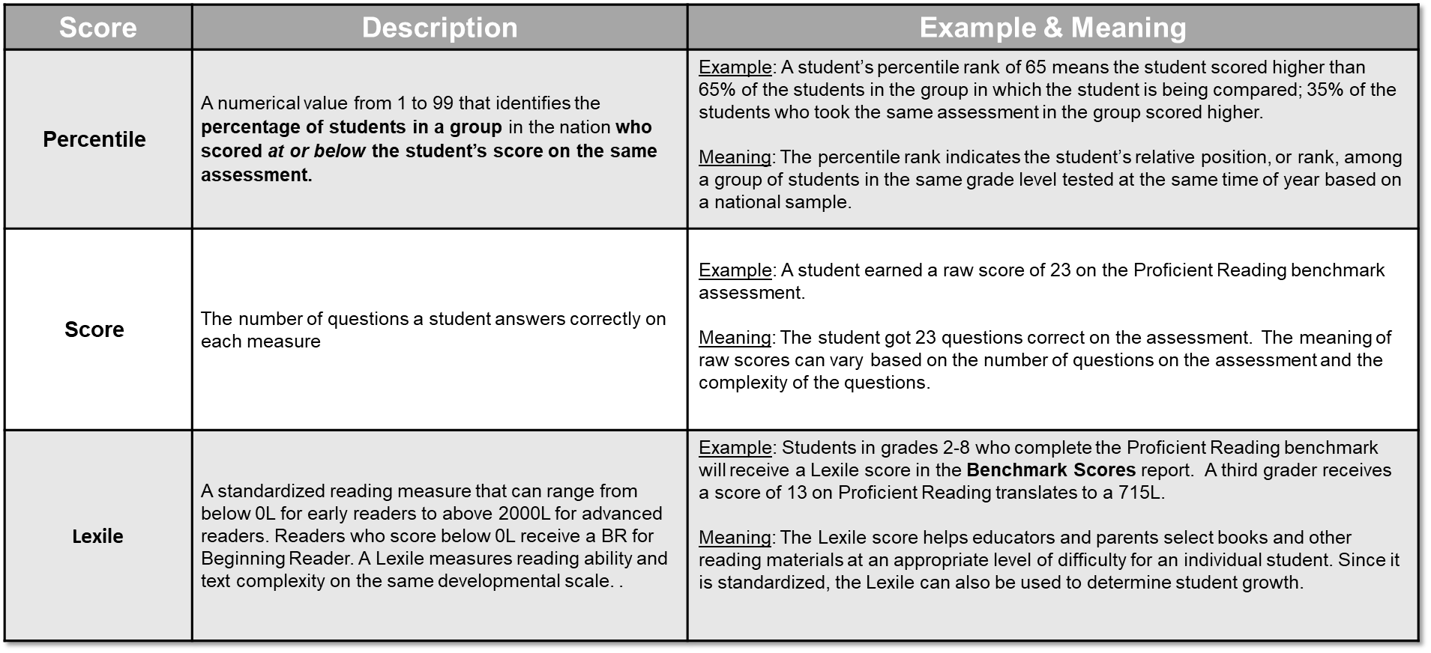
Scores in easyCBM

Slide 12
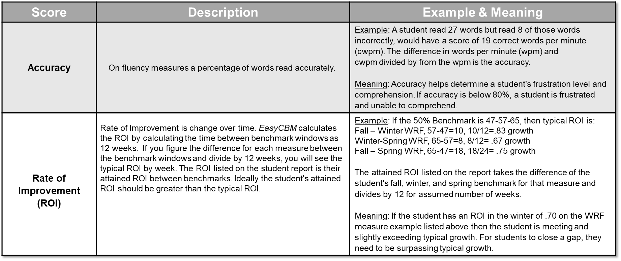
Scores in easyCBM - Continued

Slide 13
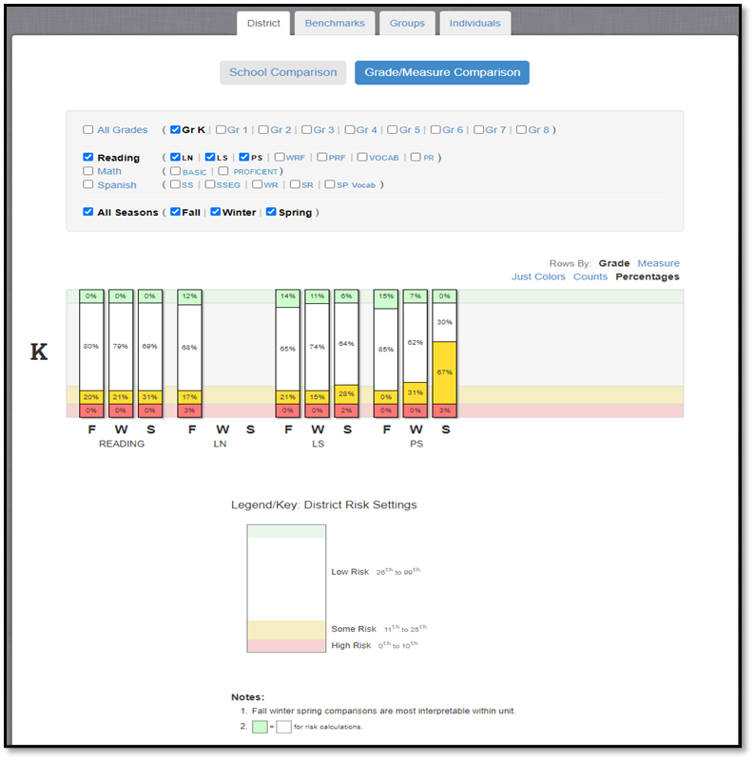
Analyze and Track Progress using Reports

Slide 14
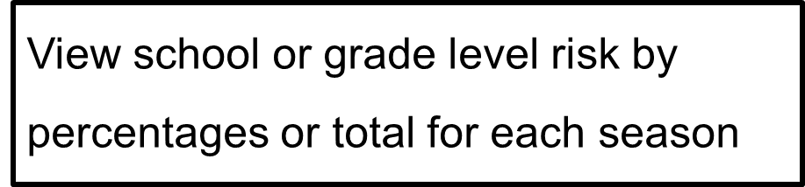
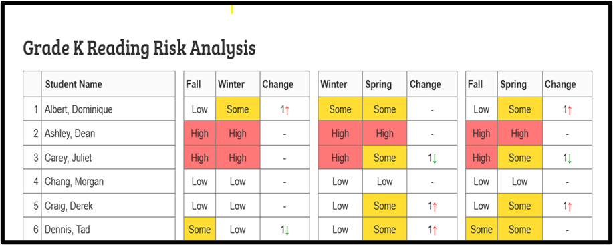
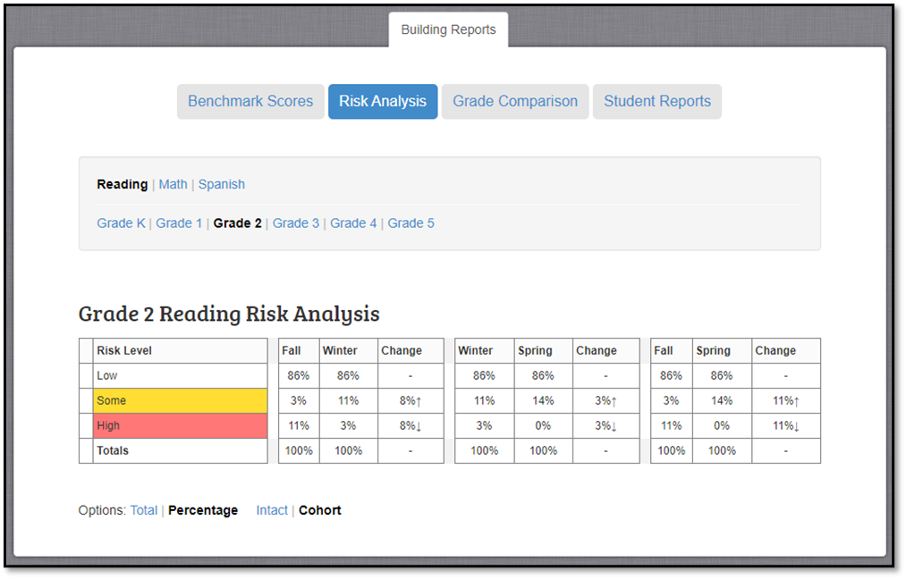
Risk Analysis Report

Slide 15
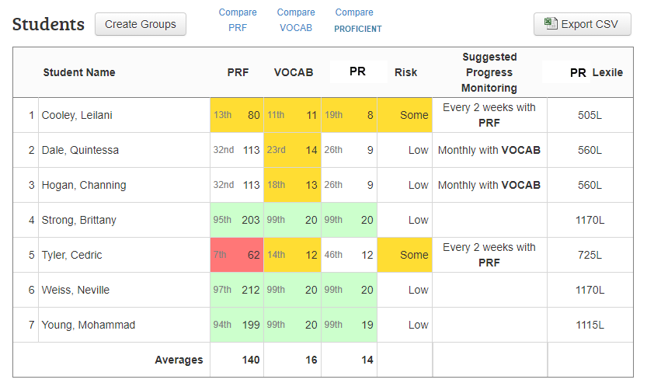
Benchmark Report
Sort any header column for quick identification

Slide 16
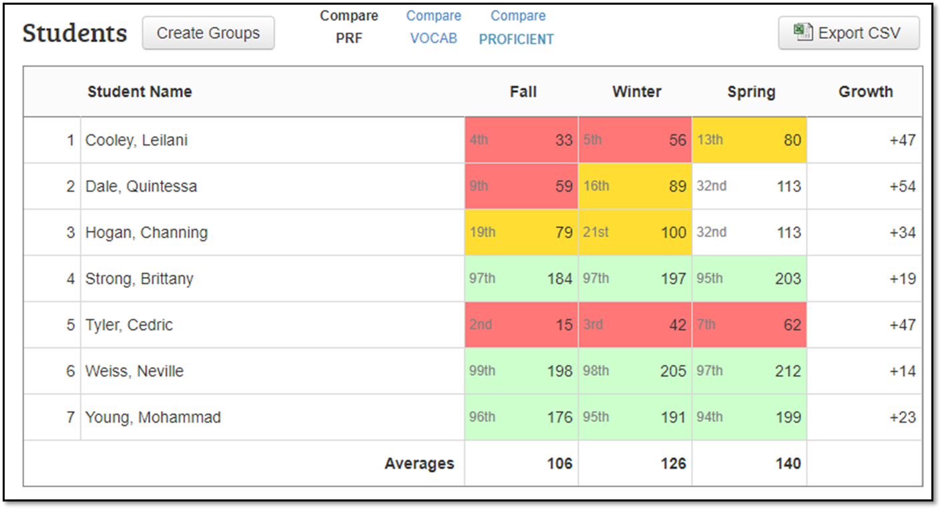
Benchmark Report – Comparing Measures

Slide 17
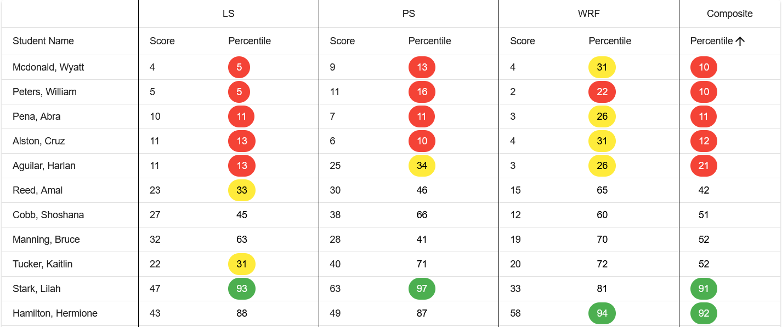
Composite Report
Reports > Composite Report > Year > Season > Grade > Building > Teacher > Group

Slide 18
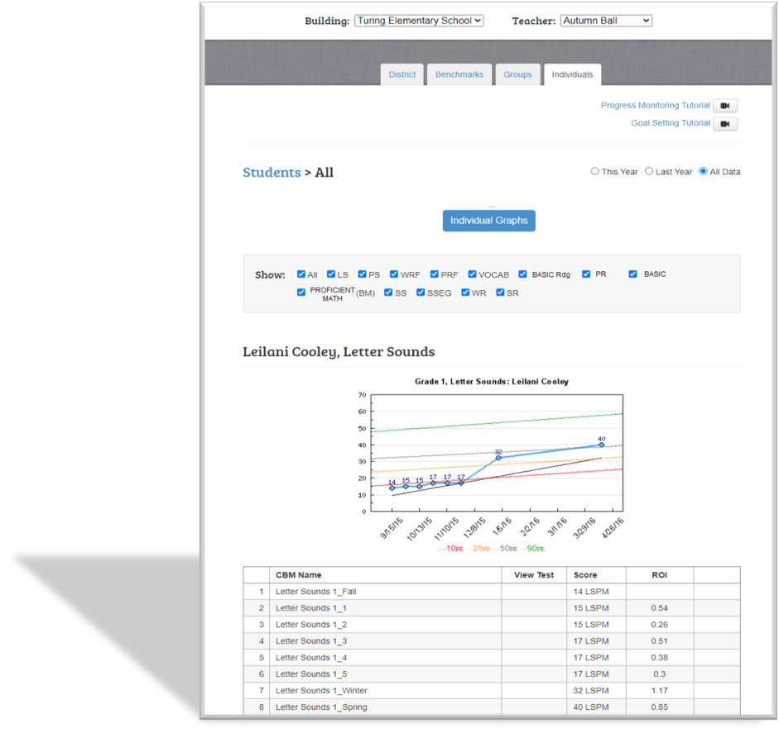
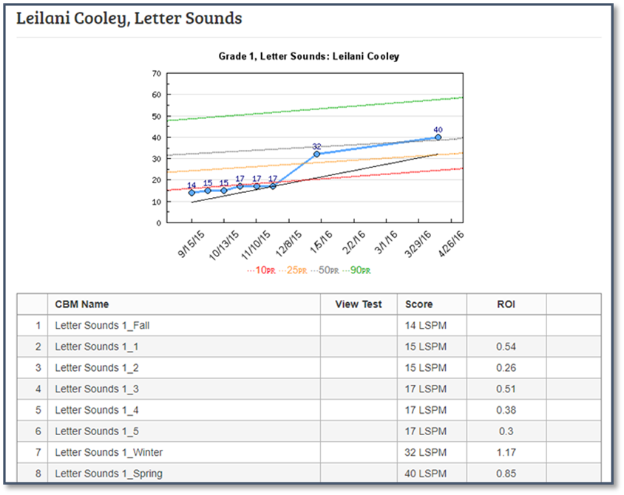

Individual Student Report

Slide 19
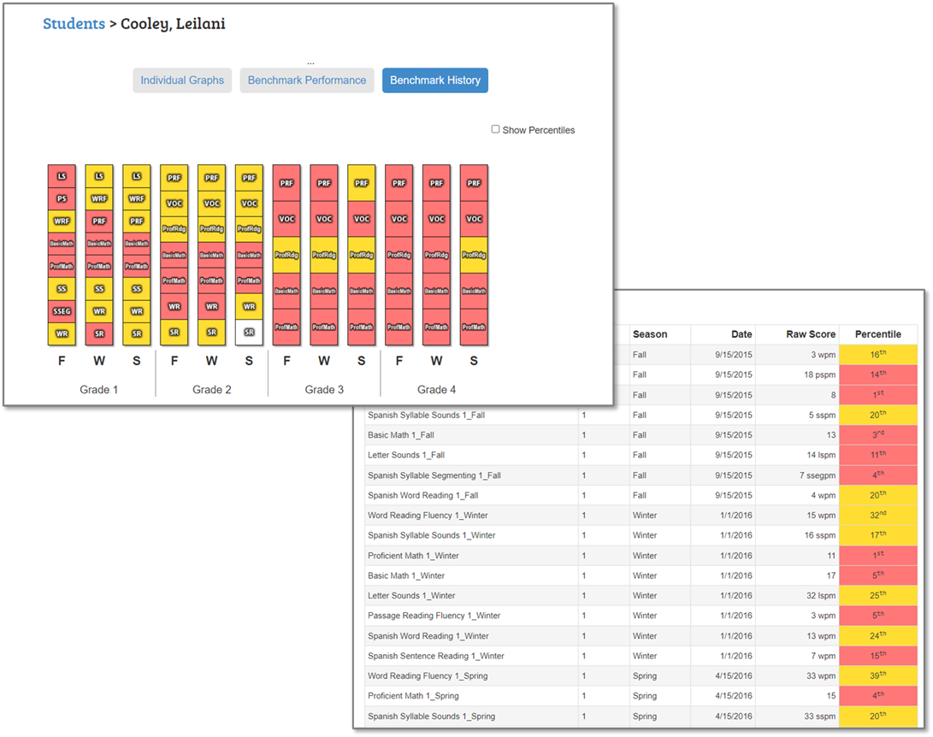
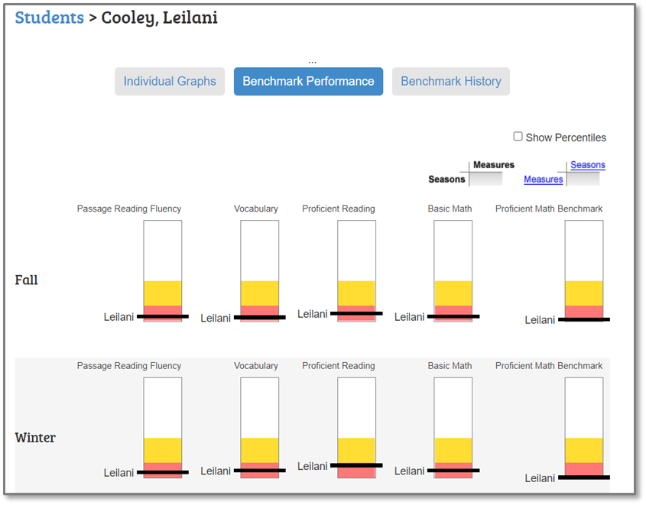
Individual Benchmark Reports

Slide 20
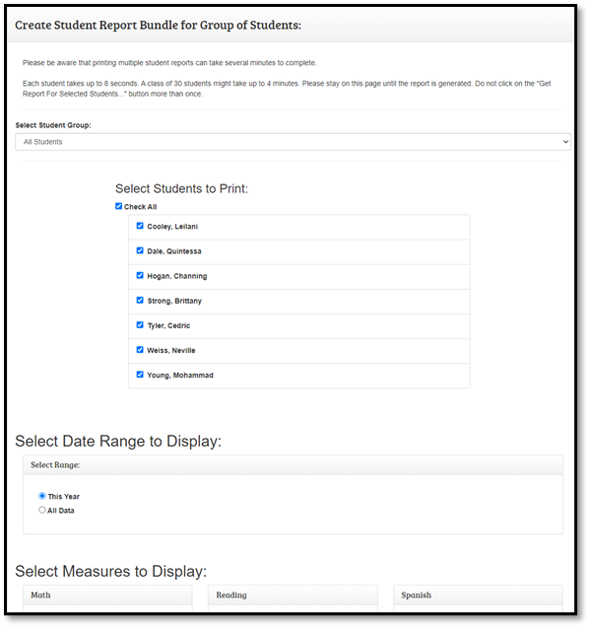
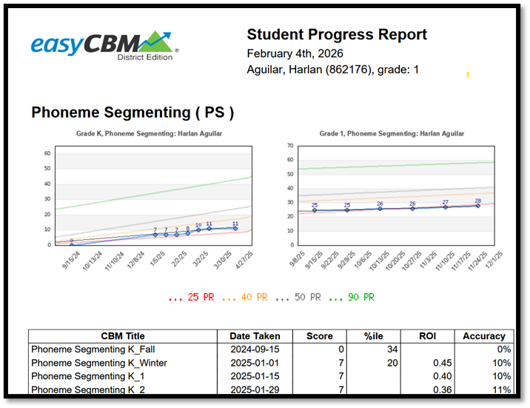
Individual Progress Report

Slide 21
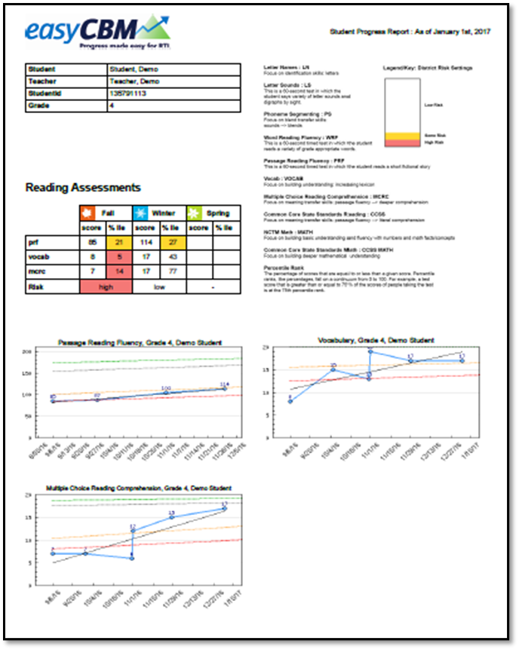
Parent Report

Slide 22
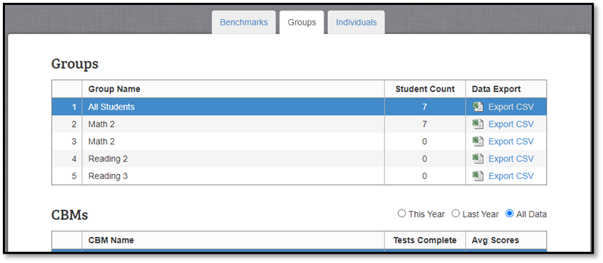
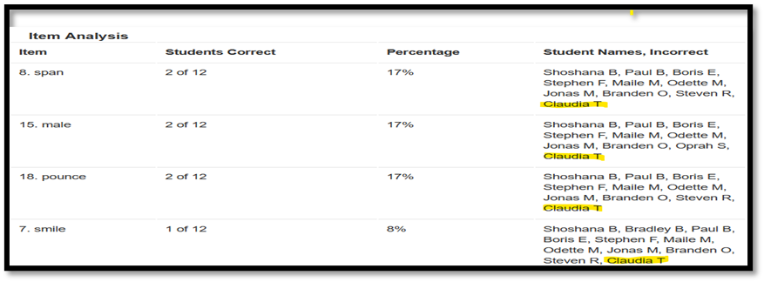
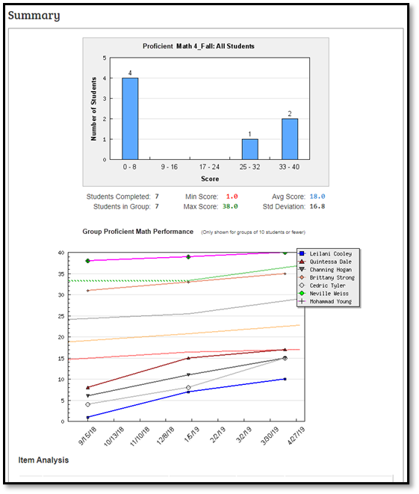
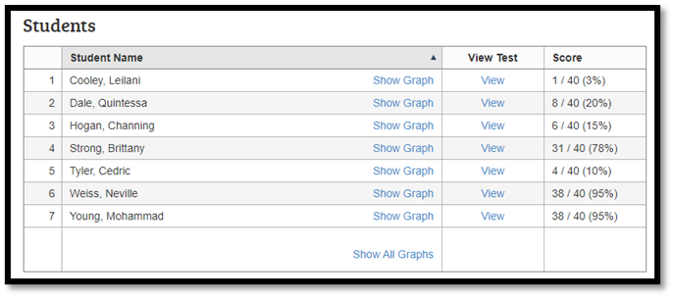
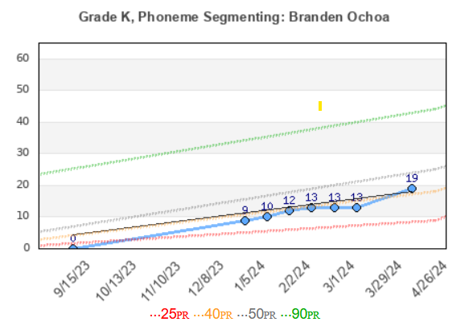
Group Reporting

Slide 23
Thank You

