Slide 1

Test Administrator Training
Smarter Balanced and NGSS Assessments
Spring 2023
Connecticut State Department of Education
Notes:
Welcome to the Connecticut State Department of Education’s Test Administrator Training the Smarter Balanced and NGSS summative assessments.
At the onset of online testing many years ago, an optional digitally narrated Test Administrator Training Course was created to familiarize Test Administrators with the student sign-in process in the Student Interface and the test session creation process. This training is still available on the Connecticut Comprehensive Assessment Program Portal (Test Administrator Training Course Video (cambiumast.com), but this Power Point covers much of the same content, and more, and it reflects current processes related to test administration. Moreover, this optional training highlights Connecticut’s statewide assessments and test administration. We will review key activities that support planning and preparation, including those activities that are pertinent during and following testing.
Though we hope the information in this session is useful, it should not replace training provided locally by your district or school.

Slide 2
Disclaimer
    This Power Point deck is intended for District Administrators (DA’s in TIDE) as an option to train test administrators within a district. It can be used (partially or as a whole) as a supplement to the information that was presented at the District Administrator Training conducted on January 18 and 20, 2023.
Notes:
Before we get started, we’d like to take the opportunity to introduce you to our small but mighty assessment team. Abe Krisst is the Bureau Chief for Student Assessment.
Cristi Alberino, ELA Consultant, oversees the Smarter Balanced and NGSS Interim Assessments, Appeals/Security Breaches, Student Alerts, and state policy test administration processes for statewide testing.
Jeff Greig, Science Consultant, oversees all aspects of the NGSS and Connecticut Alternate Science Assessments (CTAS). He also oversees state policy test administration processes.

Slide 3



Meet the Assessment Team
Bureau Chief Abe Krisst, Abe.Krisst@ct.gov; 860-713-6860
Smarter Balanced/Interims State Policy Test Administration Questions Appeals/Reporting of Security Breaches Cristi Alberino, Ph.D. Cristi.Alberino@ct.gov; (860) 713-6862
NGSS State Policy Test Administration Questions Jeff Greig Jeff.Greig@ct.gov; (860) 713-6748
Notes:
Before we get started, we’d like to take the opportunity to introduce you to our small but mighty assessment team. Abe Krisst is the Bureau Chief for Student Assessment.
Cristi Alberino, ELA Consultant, oversees the Smarter Balanced and NGSS Interim Assessments, Appeals/Security Breaches, Student Alerts, and state policy test administration processes for statewide testing.
Jeff Greig, Science Consultant, oversees all aspects of the NGSS and Connecticut Alternate Science Assessments (CTAS). He also oversees state policy test administration processes.

Slide 4



Meet the Assessment Team
Michelle Rosado Connecticut SAT School Day, PSAT, AP ED159 Collection; Testing Supports Michelle.Rosado@ct.gov; 860-713-6748
Pei-Hsuan Chiu Psychometrics Pei-Hsuan.Chiu@ct.gov; 860-713-6869
Michael Sabados English Learners Testing Supports; Assessment Data/Accountability Michael.Sabados@ct.gov; (860) 713-6856
Notes:
Michelle Rosado oversees the Connecticut SAT School Day and PSAT/AP Assessments.
Pei-Hsuan Chiu is our psychometrician that oversees all things related to data analysis and reporting.
Michael Sabados also supports the analysis and reporting of student and accountability data and is the program lead for English Language Proficiency Assessments.

Slide 5

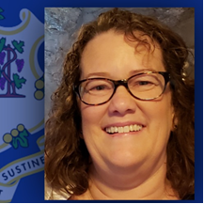
Meet the Assessment Team
Smarter Balanced/NGSS/Accessibility Supports and Accommodations and the Connecticut Alternate Assessment System (CTAA, CTAS, & CAAELP)
Deirdre Ducharme Deirdre.Ducharme@ct.gov; 860-713-6859
Janet Stuck Janet.Stuck@ct.gov; 860-713-6837
Notes:
Deirdre Ducharme and Janet Stuck are available to answer questions related to test administration processes in addition to questions about accessibility supports for all students, including language supports for multilingual learners and accommodations for students with disabilities.
They also oversee the Connecticut Alternate Assessment System for math, ELA, science, and the CAAELP, Connecticut’s alternate language proficiency assessment.

Slide 6
Know Your Contacts
Contact | Name | Phone/Email
District Test Coordinator
English Language Assessment Coordinator
School Test Coordinator
Technology Coordinator
CSDE Assessment Office |  | 860-713-6860; ctstudentassessment@ct.gov
Connecticut Help Desk (Cambium Assessment ) |  | 844-202-7583; cthelpdesk@cambiumassessment.com The Help Desk is open Monday – Friday 7:00 a.m. to 7:00 p.m. during testing.
Notes:
Prior to testing, make sure you know who your building test coordinator is as well as your primary District Administrator for Testing. These individuals will provide training and guidance along the way and will answer questions related to your individual school’s testing schedule. Your District Administrator for Testing and School Coordinator should be the first line of contact when questions arise. You may also need to collaborate with your English Language Assessment Coordinator if you have questions about language supports for your EL/MLs participating in testing.
Use this worksheet to identify the key people in your school and district assigned to these roles. Also included are the phone numbers and emails for the CSDE Assessment Office and the Connecticut Help Desk. Keep this contact information on hand during testing.

Slide 7

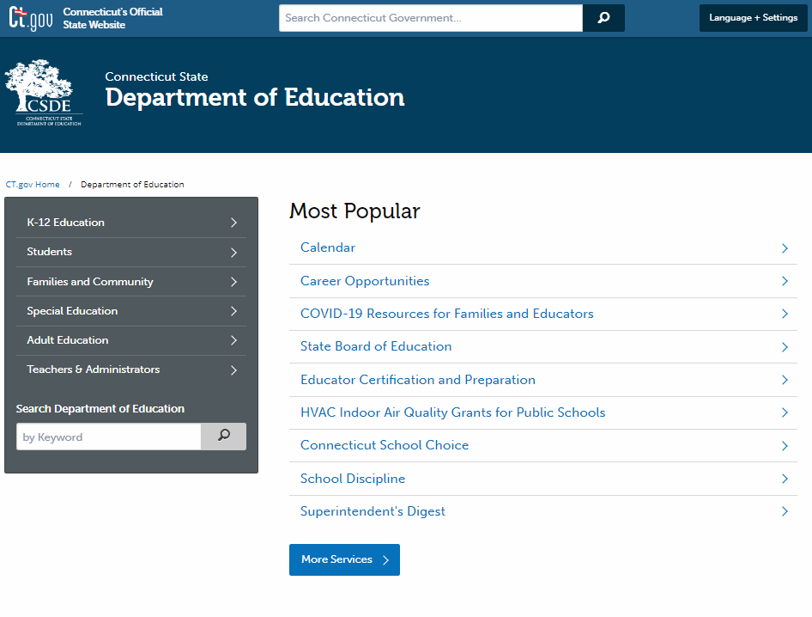

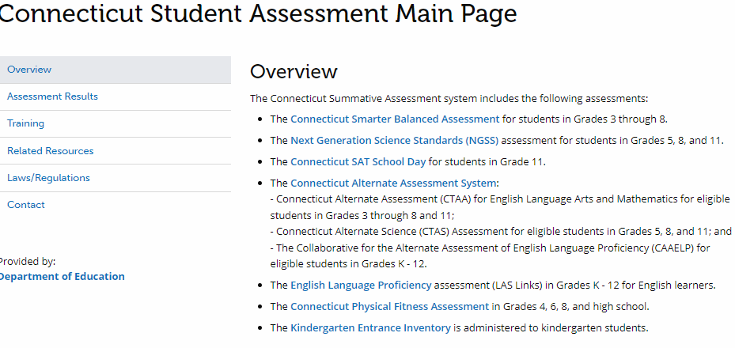
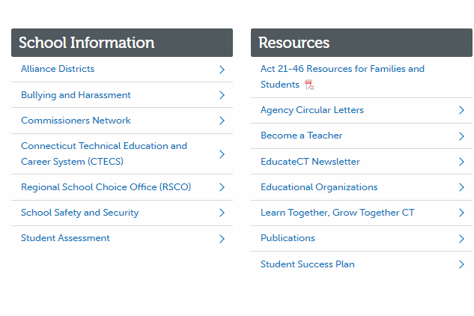

Connecticut State
Department of Education Website
CSDE Website​
https://portal.ct.gov/SDE​
Notes:
There are two primary websites available that support your understanding of summative assessments.
First, the Connecticut State Department of Education website (https://portal.ct.gov/SDE) includes the Student Assessment webpage which is fully dedicated to information and resources related to each statewide assessment. To access information on the CSDE website, navigate to the CSDE Website, by entering the URL https://portal.ct.gov/SDE in your web browser.
On the home page of the CSDE Website scroll to the bottom of the page and select/locate the School Information header. (Refer to #2 on your slide.)
Select the Student Assessment option.
On the Student Assessment webpage, you may select the any of the options under the Overview section, view the 2022-23 Assessment Calendar, or scroll down to access webinars, assessment policy overviews, and resources that support special populations.
You can also select topics using the menu on the left-side of the webpage (as indicated by the red box on the slide). (Refer to #3 above.)

Slide 8

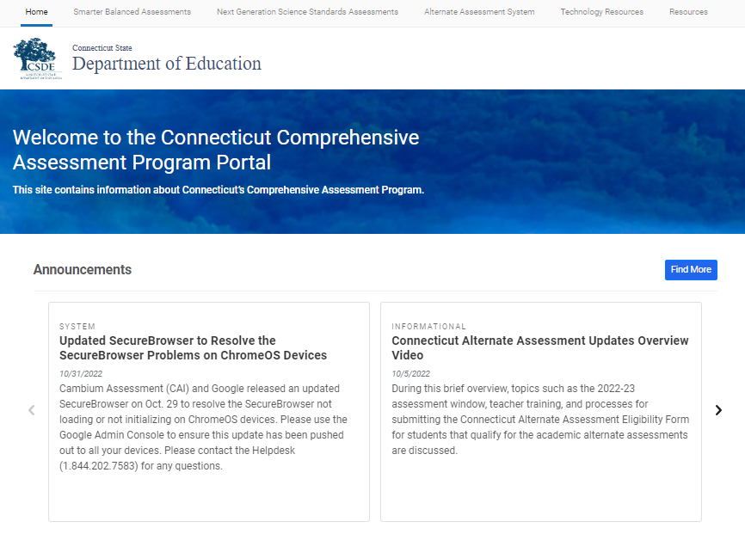
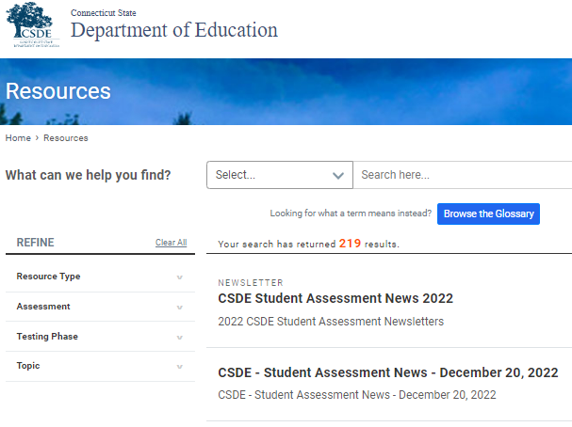
Connecticut Comprehensive Assessment Program Portal
https://ct.portal.cambiumast.com​
Notes:
The second website is for the Connecticut Comprehensive Assessment Program Portal (https://ct.portal.cambiumast.com).
This is the primary website used to access to all testing systems, resources, and user guides. This is the website that you will use to start a test, download Test Administration Manuals, and access other related programs. We will walk you through the key elements of this system later in the presentation.
As indicated by #1 on your slide, refer to the top-header or center of the webpage to choose a state assessment. From the top header, you can also choose “Resources” and search by name or resource type (as indicated by #1 and 2 on the slide).

Slide 9
Presentation Overview
Student Participation
Assessment Calendar
Overview of Connecticut Statewide Assessments
Getting to Know the Online Test Systems
Starting a Test Session
Test Monitoring/Security
Accessibility
Practice and Training
Resources
Notes:
Now that we’ve provided contact information and information to key websites, we will transition to a brief overview of the assessment system and administrative tasks. This slide provides a high-level description of topics that will be covered.
Whether you are a new or seasoned test administrator, this training provides an overview of Connecticut’s summative assessments and how to administer a test from start to finish. This training will not cover the Connecticut Alternate Assessment System or Connecticut’s English Language Proficiency Assessments. Separate trainings are available to those staff that work with students that qualify for those other assessments.
Throughout this presentation, you will find a variety of materials available to support your work. When applicable, URLs will be included in presentation for easy access to user guides, test administration manuals, brochures, or other resources. Documents within the presentation are hyperlinked.

Slide 10
Who participates in testing?
Participation expectations for Smarter Balanced, NGSS, and Connecticut SAT School Day:
  All students enrolled in the Public School Information System (PSIS) in Grades 3-8 and 11 (these students include those identified as English learners and/or students with disabilities who have an active IEP or Section 504 Plan)
  Students enrolled in PSIS attending Approved Private Special Education Programs (APSEPs)
  Students enrolled in PSIS who are being educated in out-of-state facilities, in-state facilities, and non–approved facilities
    Refer to the Students in PSIS Who Attend Out-of-State and In-State Non-Approved Facilities brochure.
Notes:
Who participates in testing?
The participation expectations for Smarter Balanced, NGSS, and Connecticut SAT School Day include:
All students enrolled in the Public School Information System (PSIS) in Grades 3-8 and 11 (these students include those identified as English learners and/or students with disabilities who have an active IEP or Section 504 Plan)
Students enrolled in PSIS attending Approved Private Special Education Programs (APSEPs)
Students enrolled in PSIS who are being educated in out-of-state facilities, in-state facilities, and non–approved facilities
Refer to the Students in PSIS Who Attend Out-of-State and In-State Non-Approved Facilities brochure.

Slide 11
Student Participation - Connecticut General Statutes 10-14n
    (b) (1) For the school year commencing July 1, 2015, and each school year thereafter, each student enrolled in grades three to eight, inclusive, and grade eleven in any public school shall, annually, take a mastery examination in reading, writing and mathematics during the regular school day.
    (3) For the school year commencing July 1, 2018, and each school year thereafter, each student enrolled in grades five, eight, and eleven in any public school shall annually take a state-wide mastery examination in science during the regular school day.
Notes:
Student Participation - Connecticut General Statutes 10-14n
Federal legislation, the Every Student Succeeds Act signed in 2015 reauthorized the Elementary and Secondary Education Act (ESEA). This act reaffirms and requires that each state institute challenging content and performance standards for its public school students. These performance standards establish the level at which students are expected to master the material included in the state’s content standards. The ESEA requires that all states have quality assessments established in reading, mathematics, and science to determine the extent to which students have mastered the material outlined in the state’s content standards. This requirement addresses a key element of the Title I program, i.e., a high-quality assessment system that is aligned with a state’s content and performance standards to ensure that all students are held to the same high academic standards.
This slide identifies the legislation that mandates state summative assessments. This legislation requires that students be assessed in Grades 3-8, and 11 in mathematics, reading, and writing, as well as science in Grades 5, 8, and 11.
Federal law requires full participation of all students on the state summative assessments. The minimum standard for the participation rate is at least 95 percent of all students and all student groups for each subject. For accountability purposes at the district and school level, the CSDE evaluates the participation rate for all students, as well as students in the "High Needs” group, for all content areas.
What are the legislatively mandated state summative assessments?
The Smarter Balanced Assessments The Smarter Balanced Assessments are aligned to the Connecticut Core Standards (CCS) in English language arts (ELA) and mathematics and measure student progress toward college and career readiness. These assessments are administered to students in Grades 3-8. The ELA assessment consists of a Computer Adaptive Test (CAT) while the mathematics assessment consists of a CAT and a performance task (PT).
The Next Generation Science Standards (NGSS) Assessments are aligned to the NGSS. These standards were adopted by the Connecticut State Board of Education in November 2015. The first operational year of the NGSS Assessments was the 2018-19 school year. The assessments are administered in Grades 5, 8, and 11.
The Connecticut SAT School Day is administered to all students in Grade 11 in Connecticut public schools. The Connecticut SAT School Day is strongly aligned to the CCS in ELA and mathematics. Scores for the Connecticut SAT School Day can also be used for the college admissions process. The Connecticut SAT School Day has two sections: evidence-based reading and writing, and mathematics. The evidence-based reading and writing section includes a reading test and a writing and language test.
The Connecticut Alternate Assessments (CTAA) support student independence to the greatest extent possible by making academic content accessible and the expected achievement levels appropriate. The CTAA for math and English language arts was developed to ensure that all students with significant cognitive disabilities are able to participate in an assessment that measures what they know and can do in relation to grade-level standards. The CTAA is only administered to eligible students with significant cognitive disabilities in Grades 3-8 and 11. It is a secure test, accessed online (or paper-pencil) with the support of a trained teacher.
The Connecticut Alternate Science (CTAS) Assessments was developed to ensure that all students with significant cognitive disabilities are able to participate in an assessment that is a measure of what they know and can do in relation to the NGSS. The CTAS includes six Performance Tasks that are intended to be administered throughout the year as teachers work with eligible students to rate student performance on the CTAS Core Extensions. This alternate science assessment is only administered to eligible students with significant cognitive disabilities in Grades 5, 8, and 11.
English Language Proficiency (ELP) Assessment is required to be administered to eligible students under the Connecticut Consolidated State Plan for the ESSA. Results of this assessment are included in Indicator 11 of the Next Generation Accountability System reports. Both Titles I and III of the ESEA require States and LEAs to annually assess the English proficiency of all ELs in the State enrolled in public schools in grades kindergarten through twelve in the domains of speaking, listening, reading, and writing (sections 1111(b)(7) and 1123(b)(3)(D) of the ESEA). Accordingly, as part of a general State assessment program, all ELs with disabilities must participate in the annual State ELP assessment with or without appropriate accommodations or by taking an alternate assessment, if necessary, consistent with their IEPs. The IDEA, Titles I and III of the ESEA, and Federal civil rights laws require that all children, including children with disabilities, take Statewide assessments that are valid and reliable for the purpose for which they are being used, and this includes the annual ELP assessment.
https://sites.ed.gov/idea/files/policy_speced_guid_idea_memosdcltrs_q-and-a-on-elp-swd.pdf
The Collaborative for the Alternate Assessment of English Language Proficiency (CAAELP) is a new alternate assessment into the existing Connecticut Alternate Assessment System. The CAAELP is designed for students with the most significant cognitive disabilities in Grades K-12 who are dually identified as an English learner/multilingual learner and receive services under the IDEA. Eligible students, determined at each annual Planning and Placement Team (PPT) meeting, may be considered for participation in the appropriate assessments associated with their grade and EL/ML identification.

Slide 12
2023 Testing Calendar
State Assessment | Grade(s) | Testing Window | Delivery Method
Collaborative for the Alternate Assessment of English Language Proficiency (CAAELP) | K – 12 | February 1 – March 31, 2023 | Online
Smarter Balanced ELA & Math | 3 – 8 | March 27 – June 2, 2023 | Online
Connecticut Alternate Assessment (CTAA) | 3 – 8 and 11 | March 27 – June 2, 2023 | Online
NGSS Assessments | 11 | February 6 – June 2, 2023 | Online
 | 5 and 8 | March 27 – June 2, 2023 | Online
Connecticut Alternate Science Assessment (CTAS) | 5, 8, and 11 | Test should be administered throughout the school year. Student ratings entered in the DEI: March 27 – June 2, 2023 | Online Upload March 27 – June 2, 2023
Connecticut SAT School Day | 11 | March 22-24 and March 28-29, 2023 Makeup Dates: April 25-27, 2023 | Online
Notes:
Here is the list of state assessments with their corresponding test windows. Keep in mind that school districts set their own test schedules as long as they fall within the state’s testing window.

Slide 13

Connecticut’s Comprehensive Assessment System
Smarter Balanced Assessments for Math and ELA
Grades 3-8
Connecticut Alternate Assessments (CTAA) for Math and ELA
Grades 3-8, & 11
Connecticut SAT School Day
Grade 11
Next Generation Science Standards (NGSS) Assessments
Grades 5, 8, & 11
Connecticut Alternate Science (CTAS)
Grades 5, 8, & 11
English Language Proficiency Assessment (LAS Links) and Connecticut Collaborative for the Alternate Assessment of English Language Proficiency (CAAELP)
Grades K-12
Additional Instructional Tools:
Smarter Balanced & NGSS Interim Assessments
Tools for Teachers
Notes:
While this presentation will focus specifically on Smarter Balanced and NGSS Assessments, we wanted to take a moment to capture the other assessments that contribute to Connecticut’s Summative Assessment System.
The Connecticut Smarter Balanced Assessment for students in Grades 3 through 8. The assessment is online and computer adaptive. The English Language Arts sections consists of computer adaptive items across reading, writing, listening, and research. There is no performance task for the ELA summative assessment. The math assessment consists of two math segments (both are computer adaptive) and a math performance task.
The Next Generation Science Standards (NGSS) assessment for students in Grades 5, 8, and 11. This is an online test and items are computer adaptive.
The Connecticut SAT School Day for students in Grade 11. This assessment is administered online using the College Board’s test platform. The CT SAT School Day is not currently computer adaptive.
The Connecticut Alternate Assessment System:
- Connecticut Alternate Assessment (CTAA) for English Language Arts and Mathematics for eligible students in Grades 3 through 8 and 11; this is an online fixed test, though it is also available in hard copy.
- Connecticut Alternate Science (CTAS) Assessment for eligible students in Grades 5, 8, and 11; this is a paper/pencil assessment administered to a student throughout the school year.
- The Collaborative for the Alternate Assessment of English Language Proficiency (CAAELP) for eligible students in Grades K – 12; this is an online test.
The English Language Proficiency assessment (LAS Links) in Grades K - 12 for English learners; this is an online test.
Additional instructional tools include the Smarter Balanced and NGSS Interim Assessments and the Tools for Teachers.
We developed the Interim Assessments: Smarter Balanced and Next Generation Science Standards (https://portal.ct.gov/-/media/SDE/Student-Assessment/Smarter-Interim-Assessments/InterimAssessments-FINAL.pdf) guide to answer questions about test format, administration, scoring, reporting, universal tools, and designated supports and accommodations. Resources in this document are directly linked to the sections in which they correspond.
Teachers can access the Tools for Teachers using their TIDE username and password. View the Quick Guide for information on how to use resources and strategies: New Tools for Teachers Quick Guides: How to Use Resources and Strategies (smarterbalanced.org); https://smarterbalanced.org/new-quick-guides/.

Slide 14
How are students tested?
Online using a computer/tablet
Built-in universal tools, designated supports and accommodations
Varied technology- enhanced items (multiple choice, constructed response, grid-in)
Adjusts item difficulty (computer adaptive) (Smarter Balanced Assessments & NGSS)
Notes:
The Smarter Balanced summative assessment for English language arts and mathematics requires students to
Participate in an online assessment comprised of two components: a computer adaptive test (CAT) for both ELA and math; and a performance task (PT) for math. The tests are not timed, however, recommended test session lengths of 40 to 120 minutes, depending on content area and grade level, are provided in the Smarter Balanced Test Administration Manual;
Demonstrate critical-thinking and problem-solving skills; and
Accurately respond to various item response types using a keyboard and mouse or touchpad.
The Next Generation Science Standards (NGSS) Assessments consists of a variety of item types and interactions, many of which students will have experienced before on the NGSS Assessment and Smarter Balanced Assessments. The NGSS is an online computer adaptive assessment. The suggested testing time of at least 90 minutes is a recommendation of how much time students will need to complete the NGSS Assessments. Students should be given additional time if needed. For details, refer to the NGSS Test Administration Manual.
The online Connecticut SAT School Day is composed of the following subtests:
Evidence-Based Reading and Writing, consisting of two subtests: a Reading Test; and a Writing and Language Test. Each test is composed of multi-paragraph passages and multiple-choice questions.
Time allotted:
65 minutes for Reading
35 minutes for Writing and Language
Math: Includes one portion that provides an embedded Desmos calculator (or use of a hand-held calculator) and one that does not. Each portion is composed of multiple-choice and student-produced response questions.
Time allotted:
25 minutes for Math Test-No Calculator
55 minutes for Math Test-Calculator
Most students will test in one or two days, and the test schedules are specified by the Connecticut SAT School Day Coordinator Manual. However, there may be some students who will require more time (refer to the Coordinator’s Manual for more detail) per an IEP or 504 Plan.

Slide 15


Getting to Know the Online Test Systems
Notes:
Cambium Assessments, CAI has a variety of systems that are linked to the test interface that ensure efficiency during test administration.
Two computer devices are used to administer the online Smarter Balanced, NGSS, and Alternate Assessments:
One computer device is used by the student to access the secure browser, which gives the student access to their test (populated based on the grade in which the student is enrolled in PSIS).
The second device is used by the test examiner to access the Test Administration Interface, which is located on the Connecticut Comprehensive Assessment Program Portal and used to set up a test administration session and monitor testing from start to finish.

Slide 16
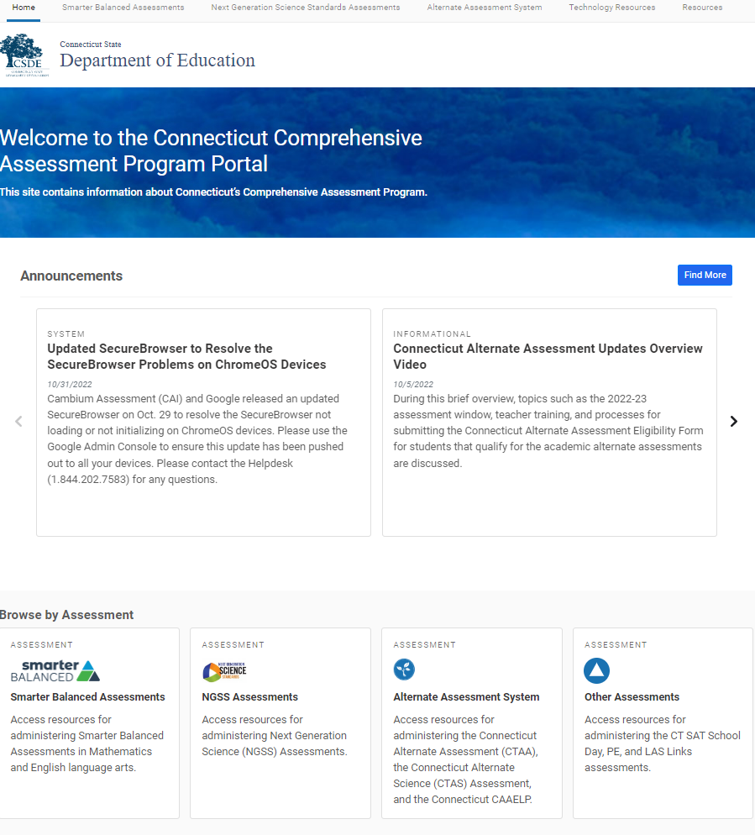

Connecticut Comprehensive Assessment Program Portal
Everything you for need for state assessments is located on the portal https://ct.portal.cambiumast.com.
Notes:
Everything you need for test administration, such as accessing test manuals, user guides, and the test administration interface, is located on the portal https://ct.portal.cambiumast.com/. As shown on this slide, you can browse by assessments as indicated by the red box on the lower section of the slide. Each assessment has its own page (Smarter Balanced, NGSS, or other assessments such as the Connecticut Alternate Assessment System) that can be accessed when you select the assessment card. By selecting the test of your choice, you can drill down based on the phase of testing. Systems are grouped by the following categories: Preparing for Testing, Administering Tests, and After Testing.
As mentioned earlier in the presentation, you can also use the Resources look-up, as referenced by the red box in the upper right corner of the portal.
To learn more about the assessment systems, let’s look at Smarter Balanced Assessments page.
The image is hyperlinked.

Slide 17
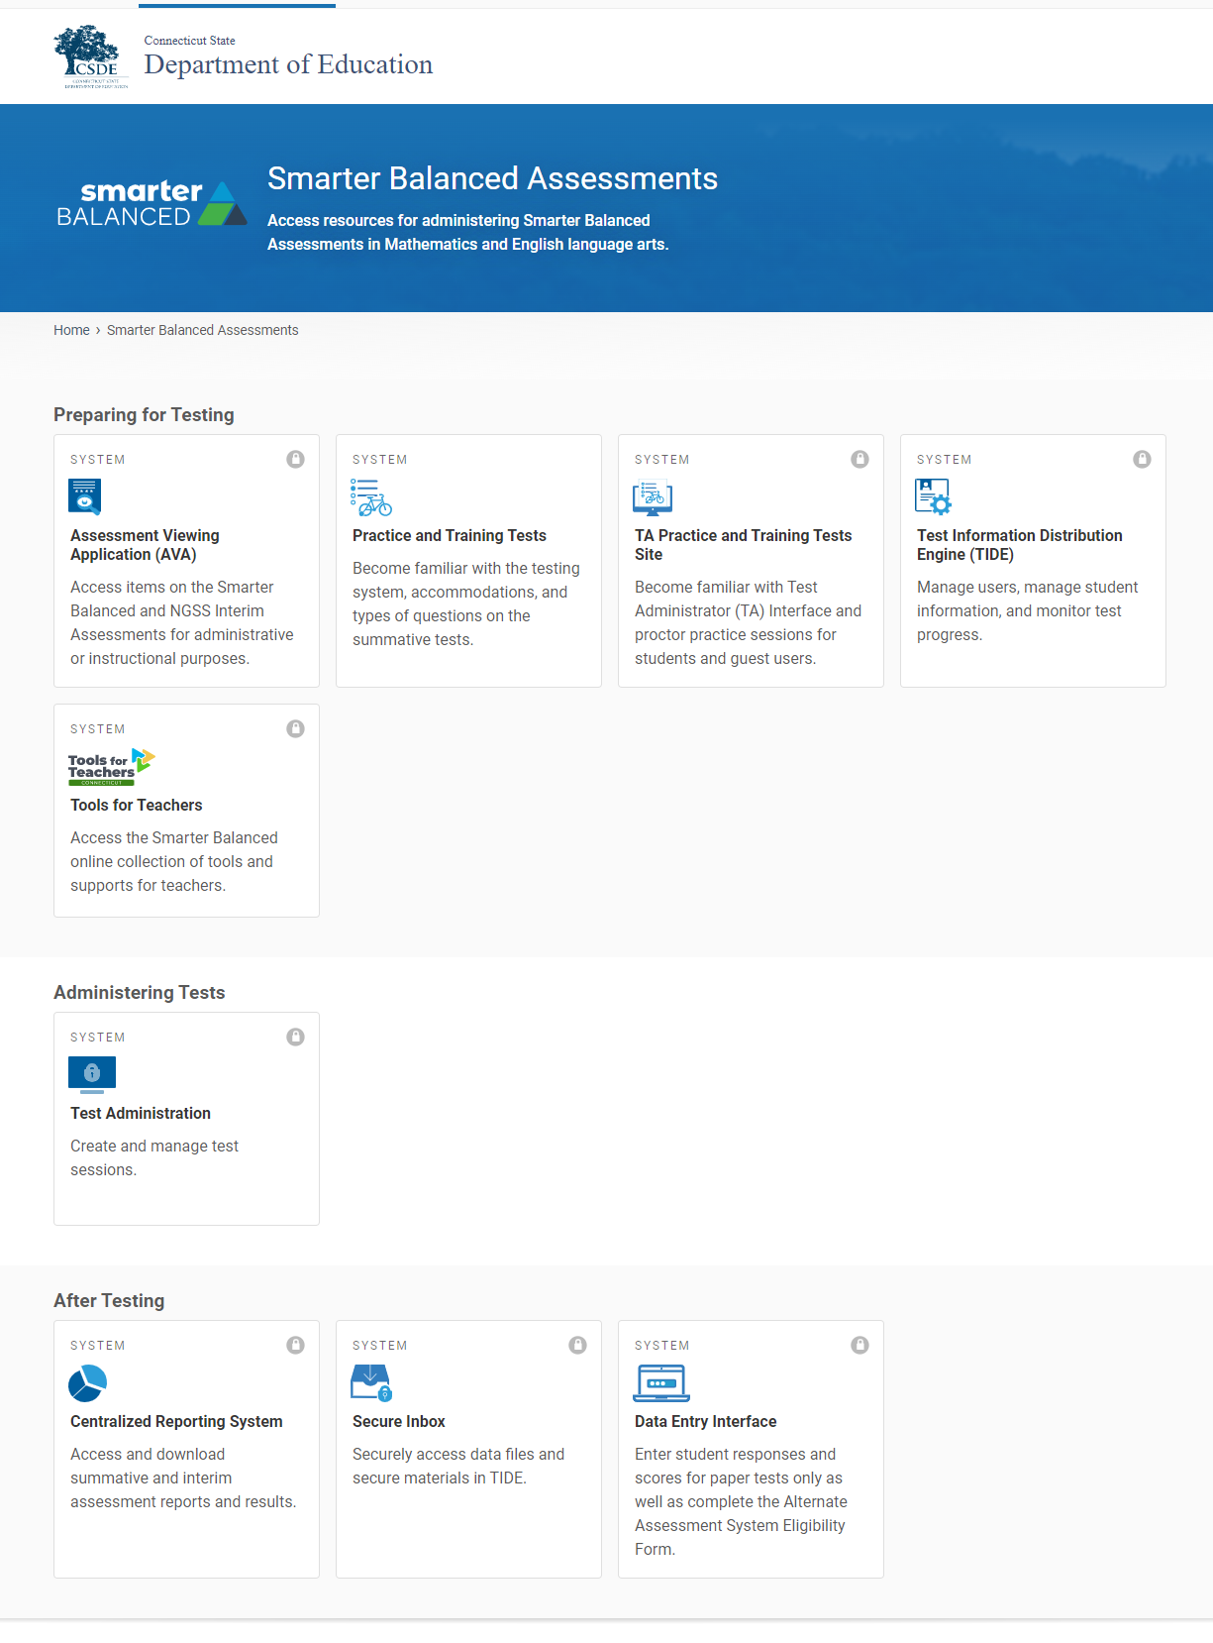
Connecticut Comprehensive Assessment Program Portal: Smarter Balanced
Practice Tests; TIDE
Test Interface
Student Results
Notes:
This is what you will see when you select the Smarter Balanced Assessment card. The organization and access to these systems are the same when NGSS and the Alternate Assessment System cards are selected.
As shown on this slide, the red rectangular boxes indicate the phases of testing. Below each category are systems that support certain functions within the phase of testing.
First, look for #1 labeled on the slide. It calls out the Preparing for Testing section. In this section, you will find the Practice and Training Tests card. This will give you (and your students) access to grade-level practice tests for Smarter Balanced and NGSS. Practice tests are also available for other assessments, such as the Connecticut Alternate Assessment System and the CAAELP.
The Test Information Delivery Engine, or TIDE, also located under the Preparing for Testing section. This is where all student information is populated from all the eligible students registered in the Public School Information System (PSIS). TIDE also includes all the school and district users for the testing systems and is populated by the District Administrator for Testing and/or the School Test Coordinator. TIDE syncs nightly with PSIS. That way, as student demographics change, they will be automatically be reflected in TIDE in real time. TIDE will be explained in further detail in just a moment.
There are other systems in the Preparing for Testing section such as the TA Practice and Training Site. Test examiners can use this resource to simulate a test administration without using the live Test Administration site.
Next, look for Number 2. When administering tests, you will select the Test Administration card to set up a live test session for summative testing.
Finally, Number 3 references “After Testing” activities and identifies the various systems that are applicable once testing is completed. For example, to view test results (e.g., interims or summative assessments), select the Centralized Reporting System card. This system will allow you to view results for students rostered to you.
There are other systems indicated on this slide that we have not highlighted. To learn more about what they are, refer to your TIDE User Guide.
Also note the “lock” icon in the upper right corner of the card. This indicates that the site is secure and requires the user to sign-in with their TIDE username and password.

Slide 18
Online Testing Requires Two Devices
Test Administrators use a device to access the secure Test Administrator (TA) Interface to administer online tests.
Students use a device to access the secure browser to take the test. Schools are required to download and install the secure browser on all student test-taking devices.
Notes:
Two devices are used for online testing.
One device is needed by the teacher administering the assessment. To start a test session, log onto the Test Administration Interface.
A second device is needed by the student. The student’s device must have the Secure Browser downloaded and installed.
The next few slides will provide more details about these applications.

Slide 19
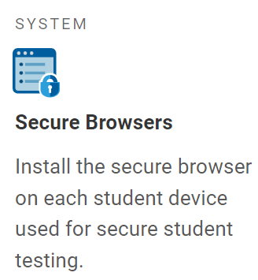
The Secure Browser
Students use the secure browser to take the test.
A Secure Browser must be installed on each computer or tablet used for student testing. Secure Browsers can be downloaded for:
Windows
macOS
Linux
iPadOS
Chrome OS
For a list of supported devices and operating systems for the Secure Browser, please visit Supported Devices.
For information about setting up student workstations and configuring networks and assistive technology, please visit the Technology Guide.
Notes:
What is the secure browser?
Students use the secure browser to take the test.
Most districts have a technology coordinator who will download the Secure Browser onto all student testing devices. However, because this is a critical step when planning for spring testing, you should know what it is and where to locate and download the browser if necessary.
Every student’s testing device will need the 2022 Secure Browser downloaded. The Secure Browser gives students access to the testing system. Secure Browser downloads are available for the computer programs listed on this screen.
For information about setting up student workstations and configuring networks and assistive technology, see your technology coordinator. You may also find the Technology Guide to be a useful resource.

Slide 20
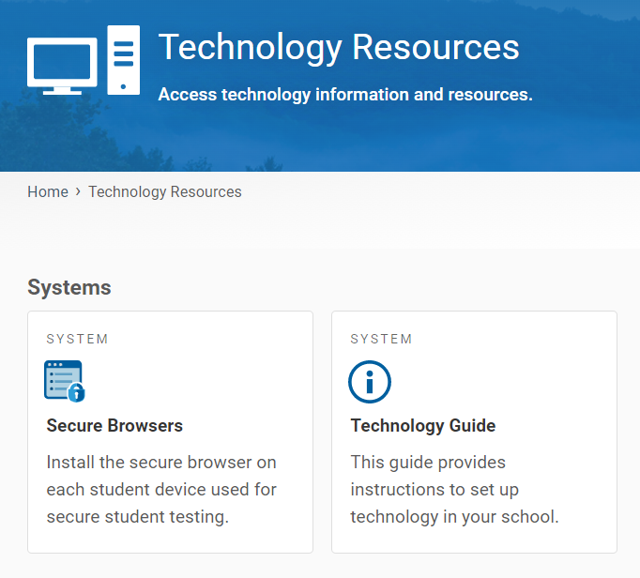
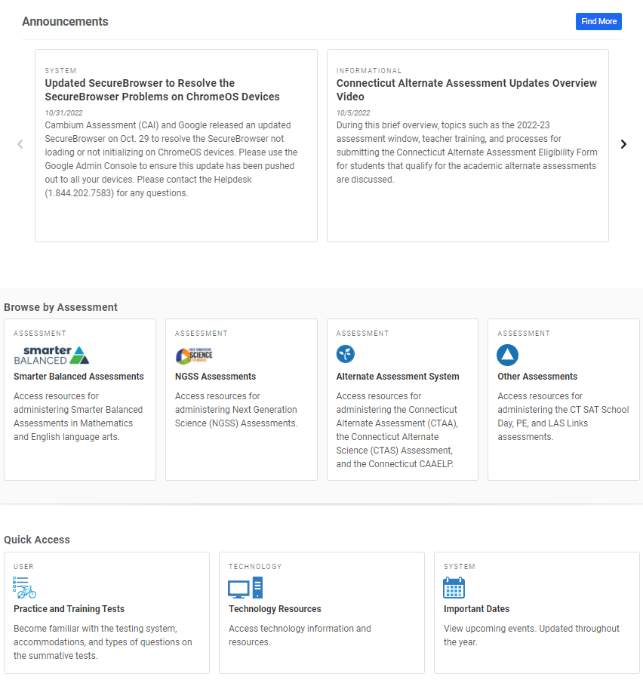
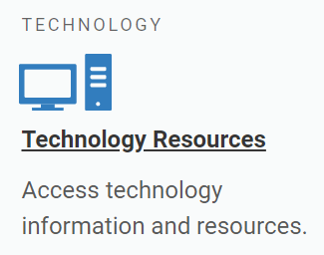
The Secure Browser
Notes:
Where is the secure browser located?
The red box on your slide indicates where to access information on the secure browser. From the main page of the portal, select Technology Resources. Your school or district technology department may already have a process in place to download the secure browser on to each of the testing devices used by students. Without a secure browser, students will not have access to statewide assessments.
Resource:
Recommended for Technology Coordinators, the Technology Guide provides information about setting up test stations for staff and students, configuring networks for online testing, and managing test sessions from any secure browser: https://ct.portal.cambiumast.com/tech-guide.html.

Slide 21
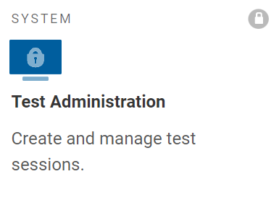
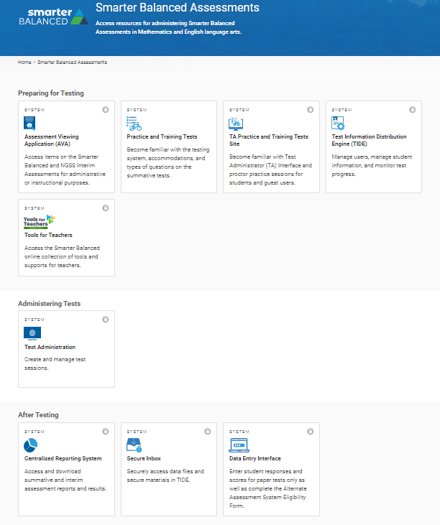
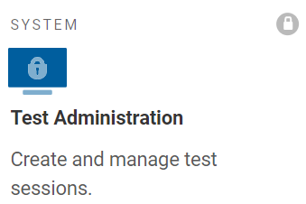
The Test Administration Interface
Notes:
The red box indicates where to access the Test Administration Interface.
You will use your device to access the TA Interface. This system allows you to create/start a test session, approve students into the test session, monitor and manage testing, and identify students who may need assistance.

Slide 22
The Test Administration Interface
The Test Administration Interface consists of:
Practice Sites
  TA Practice & Training Site: Allows TAs to practice administering tests.
  Practice & Training Tests: Allows students to practice taking tests online and using test tools. Students can log in to the testing site with their name and SASIDs or as guests. They can either take proctored tests in sessions created by TAs in the TA Practice & Training Site or they can take non-proctored tests.
Operational Testing Sites
  Test Administrator Interface: Allows TAs to administer interim and summative operational tests (Smarter Balanced, NGSS, Alternate Assessments).
  Student Interface: Allows students to take operational tests
For more information, refer to the Test Administrator User Guide.
Notes:
The Test Delivery System delivers Connecticut’s online tests and consists of practice sites and operational testing sites (Interim and Summative Assessments). The practice sites function identically to the operational testing sites. However, the tests that are available in the practice and operational sites are different. Tests administered in the TA Practice & Training Site are for practice (and do not yield scores), whereas the tests provided in the Test Administrator Interface are operational and students’ scores will be official.
Test Administrator (TA) User Guide: https://ct.portal.cambiumast.com/-/media/project/client-portals/connecticut/pdf/2019/test-administrator-ta-user-guide.pdf

Slide 23
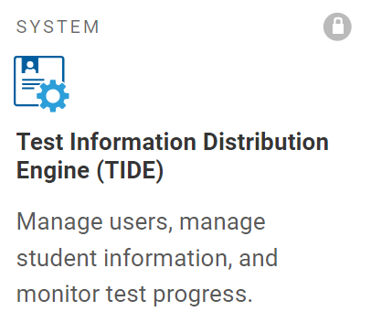
Test Information Distribution Engine (TIDE)
School administrators use TIDE to
manage user accounts, manage rosters, file and/or view appeals, monitor testing progress, and manage test settings for students who participate in online assessments.
School personnel use TIDE to
access TIDE, the Assessment Viewing Application (AVA), Test Administration (TA) Interface, TA Practice & Training Site, the Centralized Reporting System (CRS), and the Data Entry Interface (DEI).
view students rostered to them and review test settings for students with designated supports and accommodations.
For information about using TIDE, refer to the TIDE User Guide, the TIDE brochure, and the User Role Permissions for Online Testing brochure for details about user access.
Notes:
TIDE includes all the school and district users and is populated by the District Administrator for Testing and/or the School Test Coordinator. Depending on your user role in TIDE, you will have access to the Test Delivery System for test administration and the Centralized Reporting System, where you can find student test results from interim and summative assessments. While there are a variety of user roles available to teachers, most test administrators only need a TE or TA user role. If you have teacher access, you will use TIDE to create student rosters, view student test settings, such as designated supports and accommodations, and you can print test tickets.
If you are a new administrator, you will need TIDE user access from your school or district test coordinator. Refer to the TIDE User Guide for information on user roles and permissions, along with more details about this important data repository.
For information about using TIDE, refer to the TIDE User Guide and the TIDE brochure. The User Role Permissions for Online Testing brochure provides details about the various user roles and associated permissions within the system.

Slide 24
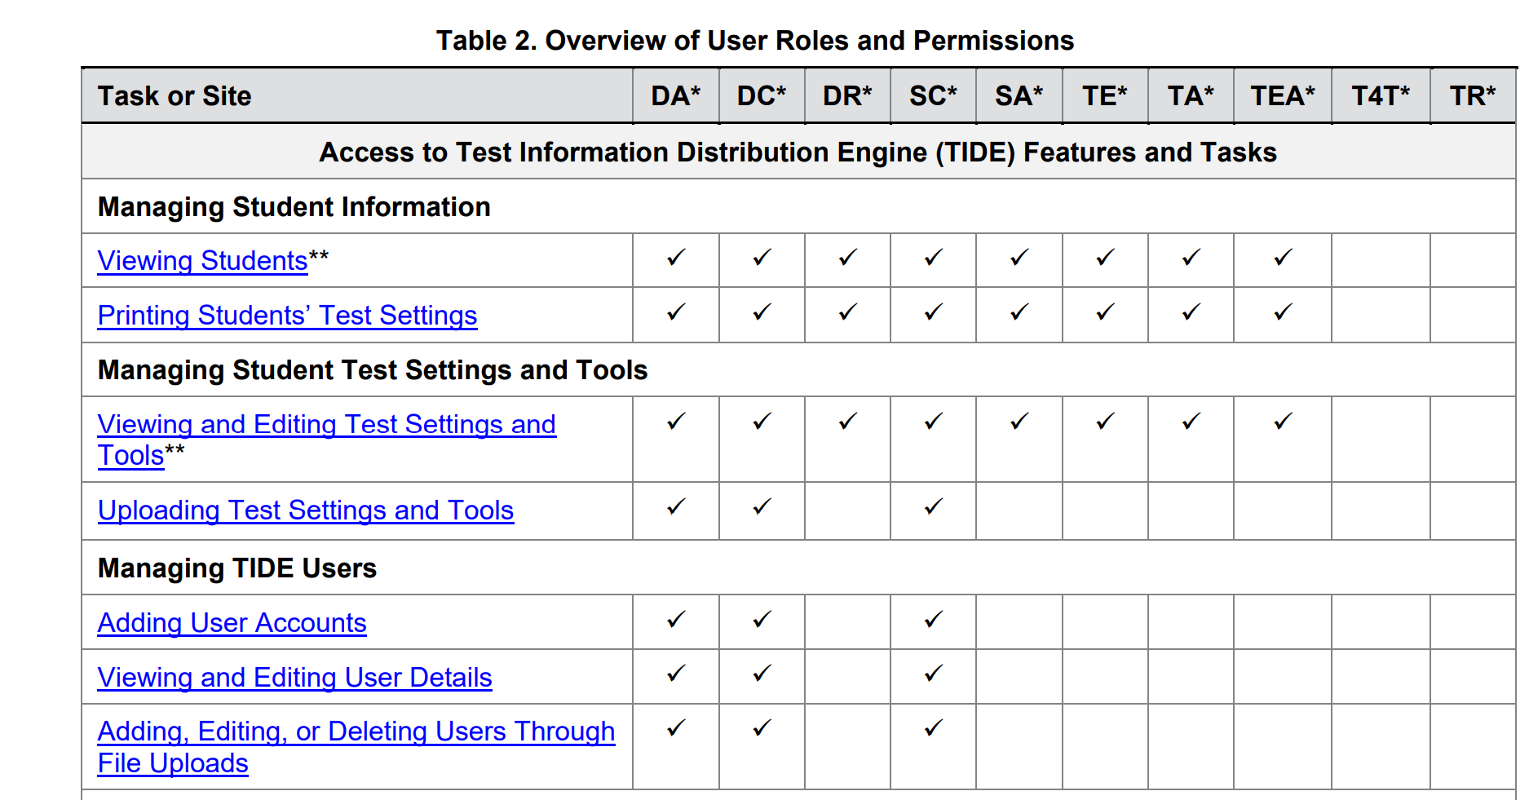
TIDE Access
To use TIDE, you need a recent version of a web browser, such as Firefox or Chrome.
Each user in TIDE has a role, such as a district-level user or a test administrator-level user. Each role has an associated list of permissions to access certain features within TIDE.
Notes:
Pages 4-6 of the TIDE User Guide defines the user roles and various permissions in TIDE. An excerpt is included on the slide.
https://ct.portal.cambiumast.com/resources/guides/test-information-distribution-engine-(tide)-user-guide

Slide 25
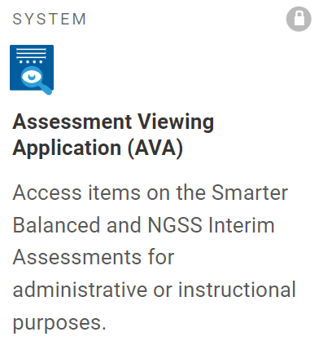
The Assessment Viewing Application
The Assessment Viewing Application (AVA)
is a secure online system is used to view the optional interim assessments for math, ELA, and science.
Interim items presented in AVA can be used by teachers as an instructional tool.
For more information, refer to the Assessment Viewing Application User Guide and the guide Interim Assessments: Smarter Balanced and Next Generation Science Standards.
Notes:
The Assessment Viewing Application (AVA) is a secure online system used to view the optional interim assessments for math, ELA, and science. This system is only for viewing interim assessments. While AVA does not score or provide answer keys for the Smarter Balanced ELA and Mathematics Interim Assessments, all item responses are provided for NGSS Interims in AVA. Answer keys for all interim assessments are provided in the Centralized Reporting System and in Tools for Teachers.
Since this application does not pertain to the administration of summative assessments, it will not be discussed in any greater detail within this presentation. However, you are welcome to use AVA if you are interested in learning more about interim assessments in the year ahead.

Slide 26

Starting a Test Session
Notes:
The next several slides will explain how to start, monitor, pause, and submit tests.

Slide 27
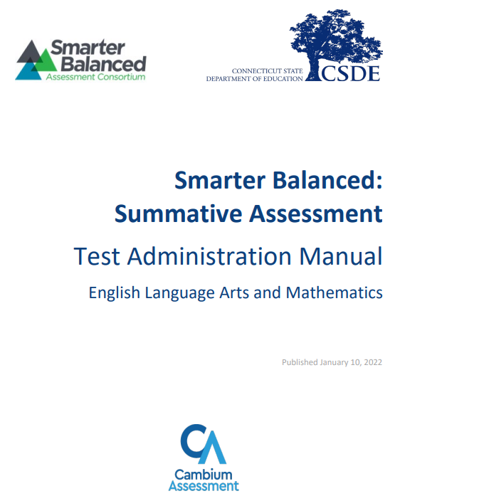
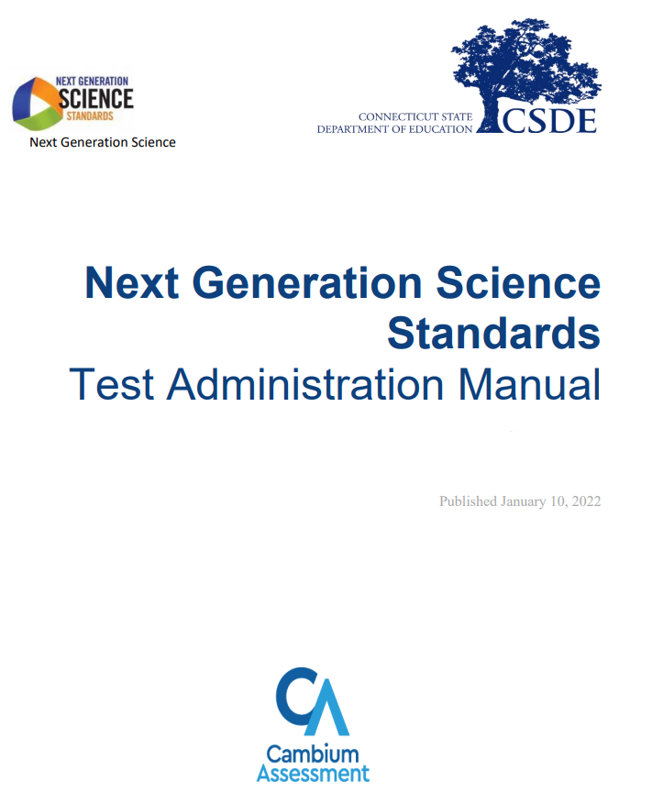
Before You Begin
To prepare for testing, download the Smarter Balanced and/or Next Generation Science Standards (NGSS) Assessment Test Administration Manuals available on the portal. They include a comprehensive overview of the test administration process, test security, and scripts that must be read to students at the time of testing.
Notes:
Before you begin testing, please download or print the Test Administration Manual (located on the portal) that is associated with the test being administered. Following the directions in the manual provides critical information for teachers when planning and preparing for testing, and when administering the tests. Following the manual and scripts with fidelity ensures a secure, reliable, and standardized process for test administration.
Test Administration Manuals are available on the Connecticut Comprehensive Assessment Program Portal for the following assessments:
Smarter Balanced Assessments: https://ct.portal.cambiumast.com/resources/smarter-balanced-assessment/smarter-balanced-summative-test-administration-manual-(tam)
NGSS: https://ct.portal.cambiumast.com/resources/ngss-assessment/ngss-test-administration-manual-(tam)
CTAA: https://ct.portal.cambiumast.com/resources/alternate-assessment-system/ctaa-test-administration-manual-(tam)
CTAS: https://ct.portal.cambiumast.com/resources/alternate-assessment-system/connecticut-alternate-science-(ctas)-assessment--test-administration-manual

Slide 28
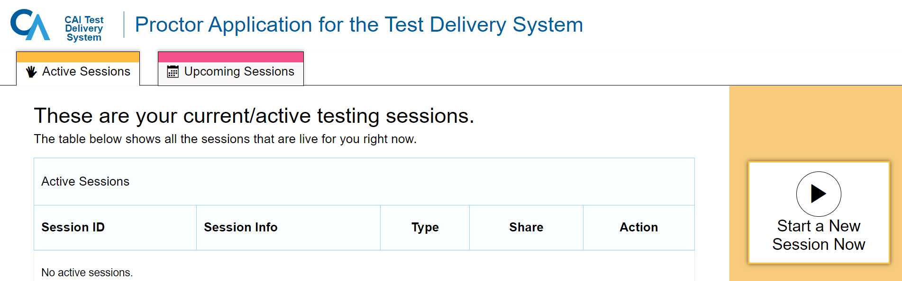
Starting a Test Session
Test administrators will log onto the Test Administration Interface using their secure TIDE username and password.
Notes:
You must create a test session before students can log in to the Secure Browser (but no more than 30 minutes prior or the system will time out unless the test session was scheduled in advance). When you create a test session, a unique Session ID is randomly generated. This Session ID must be provided to the students before they log in and should be written down.
To set up a test session in real time, select the Active Sessions tab (as shown on slide) and follow the prompts. To set up a test session in advance, choose the Upcoming Sessions tab and follow the prompts.

Slide 29
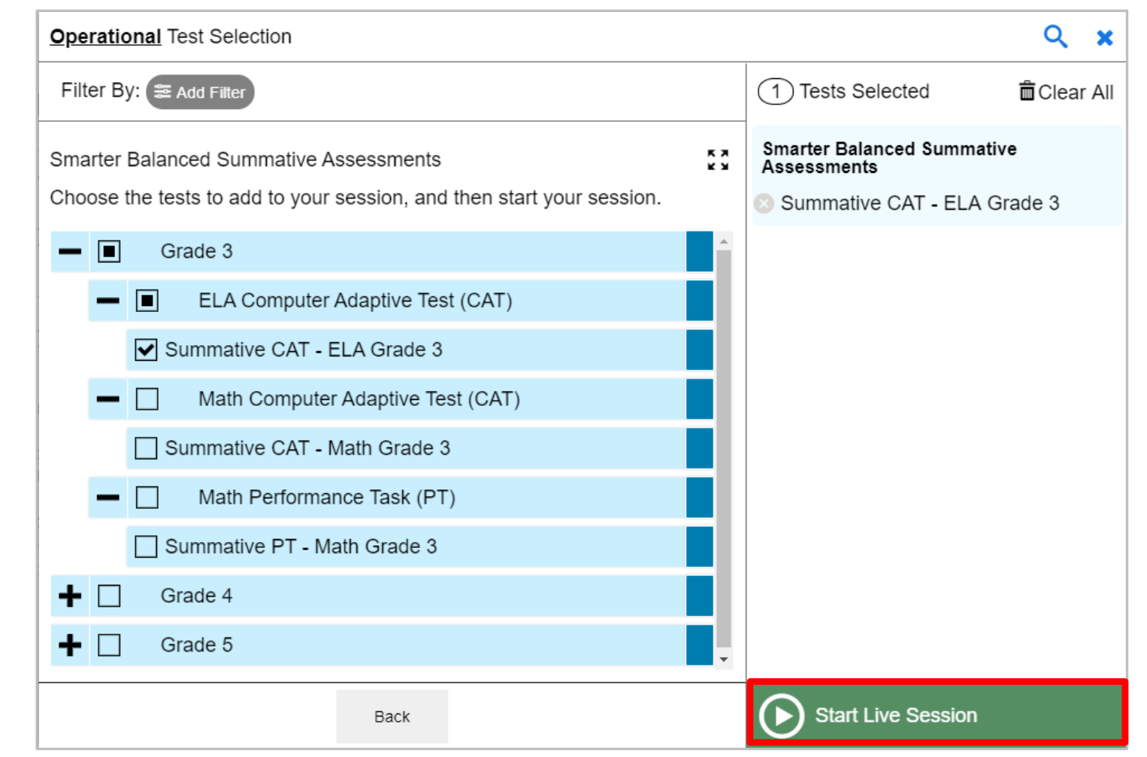
Starting a Test Session
Choose the grade and assessment(s) from the drop-down menu and select “Start Live Session.”
Notes:
When you log in to the Test Administration Interface and chooses Active Sessions, the Test Selection window opens automatically. To create a test session, select the test(s), grade(s), content area(s), and CAT(s) or PT(s) to be administered in the test session.
The Test Selection window color codes tests (summative assessments are blue). Assessments are also categorized by test, grade, content area, and type (CAT or PT). All tests appear collapsed by default. To expand a category, click (+). To collapse an expanded a category, click (−).
After selecting the assessment(s) to be administered during the test session, click the [Start Live Session] button to begin the test session and generate the Session ID that students use to join that test session. The example on this slide displays all Grade 3 summative tests and shows that the test examiner has selected the Grade 3 ELA CAT to include in the test session.

Slide 30
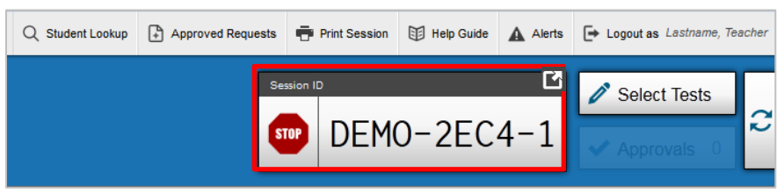
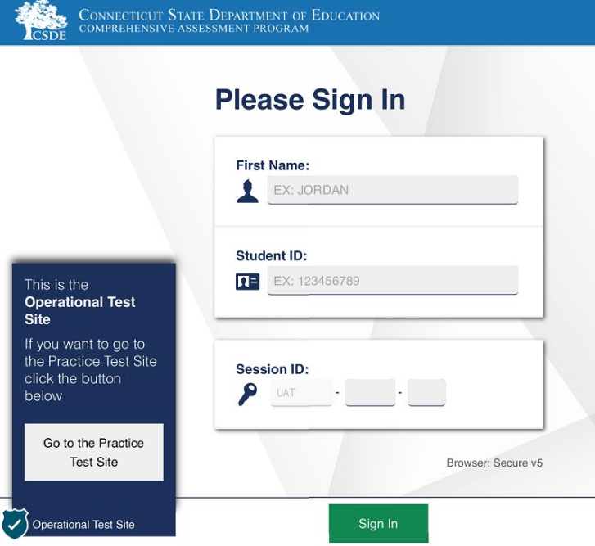
Starting a Test Session
Inform the student of the session ID.
Using the Secure Browser, the student will enter the Session ID, their full first name, and SASID.
Notes:
Provide the students with the Session ID. This ID should also be written on the chalkboard for easy reference.
Students will enter this information into the Secure Browser, along with their full first name (as indicated in the PSIS registration system) and their SASID.
Ensure that all students have successfully entered their information before they sign-in.
If you set up a test session in advance, you will enter the test date, a test name and reason for testing. After following the prompts, the system will generate a session ID and link for students to access at the time of testing. For example, the confirmation message will say something like:
“If your students will use the Secure Browser for Summative or Interim testing, please share this Session ID:
[CT-93C3-35T]
If your students are using Firefox or Chrome for Interim testing, please share this link with them:
https://ct.tds.cambiumast.com/student/?session=CT-93C3-35T.“
If you are thinking about setting up a summative test session in advance, this can be done anytime within the test window (February 7-June 2 for the Grade 11 NGSS and March 27-June 2 for Smarter Balanced and NGSS (Grades 5 and 1). Students will use the internet browser on their device (Chrome, Firefox) to access the link.

Slide 31
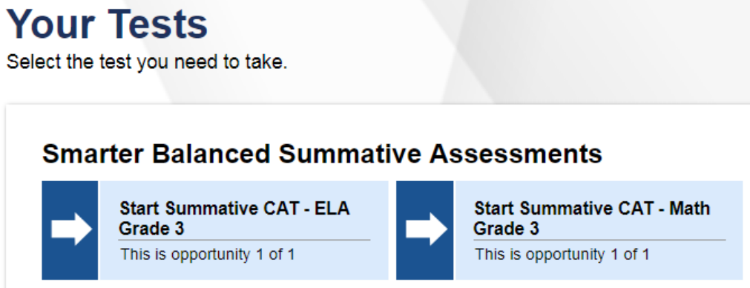
Student Test Menu
Inform students of the test session in which they will be taking.
Notes:
Once students sign in to the Secure Browser, all assessments associated with their grade of enrollment will appear. Therefore, be sure to clearly communicate which assessment the student should choose.
Look closely at the test name listed on the Test Administrator Interface prior to approving to be sure it is the correct summative test to be administered at that time.

Slide 32
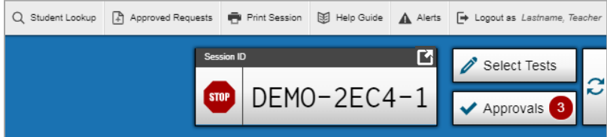
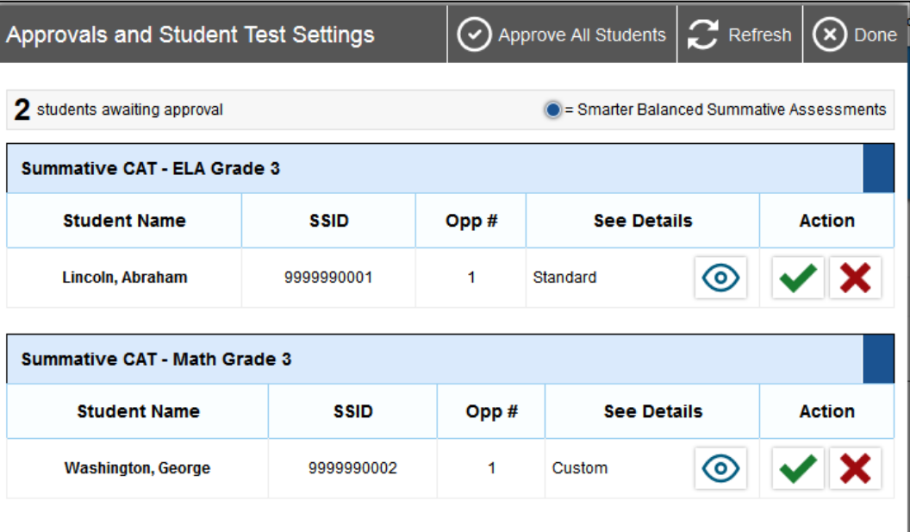
Reviewing, Approving, and Denying Tests
View students and their test settings (designated supports and accommodations) by selecting the “eye” icon. If everything is accurate, select the green check mark or choose the Approve All Students option located on the top menu bar. If there is an error with the test selected, or with the student’s demographics/test settings, choose the red x.
Notes:
If a student selects a test other than the one you plan to administer to that student that day (for example, a student selected a PT instead of a CAT or selected mathematics instead of ELA), deny the test session by selecting the red x. The student may then log in again and select the correct test.
On the Test Administration Interface, select the [Approvals (#)] button as indicated by #1 on your slide.
Then, a new window opens that shows a list of students. Review the list to ensure that students are taking the correct content area (mathematics or ELA) and type of test (CAT or PT). All tests should say “Summative” in the title. See #2 on your slide.
If a student’s settings are incorrect, do not approve that student to begin testing. You should work directly with a School or District Coordinator to correct the test settings in TIDE before approving the student to begin testing. Ensuring the test settings are correct before the student begins testing is critical to avoid the need for a test reset that may result in additional testing for the student later.

Slide 33
Monitoring Test Progress
Once students have started their tests, circulate through the room to ensure that all conditions of test security are maintained.
If you witness or suspect the possibility of a test security incident, contact the District Administrator for Testing immediately.
Notes:
Once students have started their tests, circulate through the room to ensure that all conditions of test security are maintained.
If you witness or suspect the possibility of a test security incident, pause the student’s test and contact the District Administrator for Testing immediately in accordance with the security guidance provided in this manual.

Slide 34
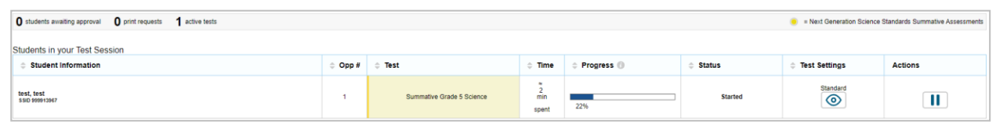
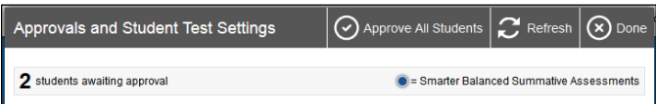
Monitoring Test Progress
Refer to the Test Administration Interface to view the testing progress of any student.
The Test Administration Interface is designed to automatically refresh every 20 seconds, but you can refresh it manually at any time by clicking the [ ] button at the top right of the screen.
Notes:
Refer to the Test Administration Interface to view the testing progress of any student. This site will not show test items or scores, but it will show how many items have been delivered to each student (e.g., question 24/40). The Test Administration Interface is designed to automatically refresh every 20 seconds, but you can refresh it manually at any time by clicking the [refresh] button at the top right of the screen (as indicated by red text box on your screen).
As a security measure, test examiners are automatically logged out of the Test Administration Interface after 30 minutes of test examiner inactivity or student inactivity in the test session, which will result in closing the test session. If this occurs, create a new session, and the students will have to log in to the new session to resume testing. When starting a new session, give the students the new Session ID so that they can log in and resume testing.

Slide 35
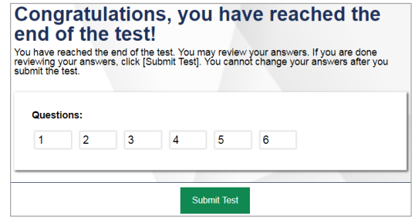
How does a student submit their test?
After answering the last item in the test session, each student is presented with a screen prompting the student to review answers (marked and unmarked) prior to submitting the test. (Refer to image on upper right)
Student should only submit their tests AFTER reviewing all their responses [SUBMIT TEST].
Once the test is submitted, the student will not be able to review answers.
Notes:
After answering the last item in the test session, each student is presented with a screen prompting the student to review answers (marked and unmarked) for all items available to the student or prior to submitting the test.
After answering the last question, students must submit their tests. If students would like to review their answers before submitting their test, they should click the number of the question they wish to review and, only after they finish reviewing, should they click [SUBMIT TEST].
Once a student clicks [SUBMIT TEST], the student will not be able to review answers.

Slide 36
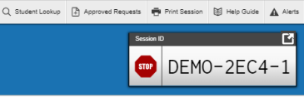
How does a test administrator end a test session?
Test administrators will click [STOP] in the Test Administration Interface to end the test session and pause any student test in the session that is still in progress. Log out of the Test Administration Interface by clicking the [Logout] button at the top right. (Refer to image on upper right)
Notes:
To end a test session, click [STOP] in the Test Administration Interface to end the test session and pause any student test in the session that is still in progress. Log out of the Test Administration Interface by clicking the [Logout] button at the top right.

Slide 37

Test Monitoring/Security

Slide 38
Test Security
Breaches of test security include, but are not limited to:
  analyzing/copying test items
  coaching students
  giving students answers, and/or changing students’ answers
  allowing students access to digital, electronic, or manual devices (except approved accommodations)
  unauthorized log-in to the Test Delivery System
    Cell phone use by students is prohibited!
Notes:
Breaches of test security include, but are not limited to:
analyzing/copying test items
coaching students
giving students answers, and/or changing students’ answers
allowing students access to digital, electronic, or manual devices (except approved accommodations)
unauthorized log-in to the Test Delivery System
This list is not comprehensive, but this represents most issues when it comes to issues in test security.

Slide 39
Test Security and Proctoring
Violation of test security is a serious matter with far-reaching consequences. Breaches of test security include, but are not limited to, copying or photographing of test materials, failing to return test materials, coaching students, giving students answers, and/or changing students’ answers. Such acts may lead to the invalidation of an entire school district’s student test scores, disruption of the test system statewide, and legal action against the individual(s) committing the breach. A breach of test security may be dealt with as a violation of the Code of Professional Responsibility for Teachers, as well as a violation of other pertinent state and federal law and regulation. The Connecticut State Department of Education will investigate all such matters and pursue appropriate follow-up action. Any person found to have intentionally breached the security of the test system may be subject to sanctions including, but not limited to, disciplinary action by a local board of education, the revocation of Connecticut teaching certification by the State Board of Education,* and civil liability pursuant to federal copyright law.
*See Section 10-145b(i) (2) (E) of the Connecticut General Statutes, which reads in relevant part as follows: The State Board of Education may revoke any certificate, permit, or authorization issued pursuant to said sections if the holder is found to have intentionally disclosed specific questions or answers to students, or otherwise improperly breached the security of any administration of a mastery examination, pursuant to section 10-14n.
Notes:
The security of assessment instruments and the confidentiality of student information are vital to maintaining the validity, reliability, and fairness of the results. All summative test items and test materials are secure and must be appropriately handled. Secure handling protects the integrity and confidentiality of assessment items, prompts, and student information. Any deviation in test administration must be reported as a test security incident to ensure that the assessment results are valid.

Slide 40
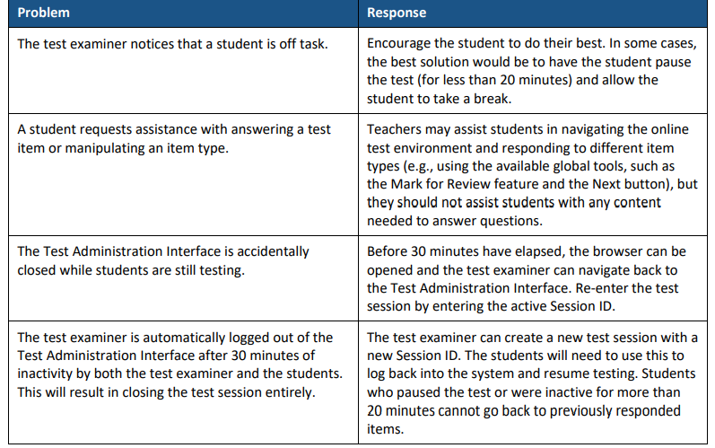
Issues that Might Arise During Testing
Notes:
The table on this slide shows appropriate responses to specific problems that may come up during testing.

Slide 41

Reminders!
Remove or cover instructional materials.
Ensure sufficient spacing between student seating.
Place a “TESTING-DO NOT DISTURB” sign on the door, or in halls.
Prepare the test setting (e.g., small group, lighting, testing devices, assistive technology etc.).
Set up a practice test experience for all students and model how to use universal tools, designated supports, and accommodations (e.g., text-to-speech, speech-to-text) with those students using them.
Ensure students have scrap paper and any non-embedded designated support/accommodation identified in TIDE. Headsets are also required on the Smarter Balanced ELA Listening Assessments.
Notes:
To ensure that all students are tested under the same conditions, it is important to strictly adhere to the script for administering the test as published in the Test Administration Manuals. These instructions are provided in the boxes on the following pages. When asked, you may answer questions raised by students but should never help the class or individual students with specific test items. No test items or passages can be read to any student for any content area, unless the student requires a designated support or accommodation as described in the Assessment Guidelines.
At the time of testing, distribute:
• scratch paper to students for all test sessions;
• graph paper to students in Grades 6, 7, and 8 for the mathematics assessments; and
• headphones to students for the listening portion of the English language arts assessments, to students who require Audio Glossaries on the mathematics assessments, and students who require text-to-speech on either assessment.
Also remember that students in Grades 6-8 will have access to the embedded Desmos calculator for math Segment 1 and the Math Performance Task. Refer to the Test Administration Manual and the Assessment Guidelines for more information.
Be sure to provide students with any non-embedded designated supports or accommodations that they are approved for.
Other reminders:
Instructional materials must be removed or covered, including but not limited to, information that might assist students in answering questions. This includes materials that may be displayed on bulletin boards, chalkboards or dry-erase boards, or on charts (e.g., wall charts that contain literary definitions, maps, mathematics formulas, etc.).
Students must be seated so there is enough space between them to minimize opportunities to look at each other’s work, or they should be provided with tabletop partitions. Students may also be tested on an individual basis as appropriate
If helpful, place a “TESTING—DO NOT DISTURB” sign on the door or post signs in halls and entrances rerouting hallway traffic in order to promote optimum testing conditions.

Slide 42

Improprieties, Irregularities, and Breaches
Notes:
Now we will cover briefly the three levels of security issues. The three levels of issues that may occur during testing.
Improprieties
Irregularities
Breaches

Slide 43
Test Security Definitions
Type | Definition
Breach | A test security incident that poses a threat to the validity of the test. Examples may include the release of secure materials or a security/system risk. These circumstances have external implications and may result in a decision to remove the test item(s) from the available, secure item bank.
Irregularity | A test security incident that impacts an individual or group of students who are testing and may potentially affect student performance on the test, test security, or test validity.
Impropriety | A test security incident that has a low impact on the individual or group of students who are testing and has a low risk of potentially affecting student performance on the test, test security, or test validity. These circumstances can be corrected and contained at the local level.
Notes:
A breach is a situation where there's a security incident that poses a threat to the test itself. An example of a breach is a student takes a snapshot of a test item and posts it on social media or circulates it their friends in a text message. If you encounter a breach situation, contact your School or District Test Administrator immediately.
An irregularity involves a group of students and that might be at a school, or in a classroom, and might affect the test security or the test validity. If an irregularity occurs, the incident can be handled by the appeals system, That should be addressed by the end of the day.
Finally, an impropriety. This is a low impact on an individual or a group of students who are testing and there's really no risk of affecting any student performance or test security or test validity. The incident really can be corrected at the local level by reporting it to your School or District Test Administrator, and contained there. If you need an appeal, you can do that yourself.

Slide 44
Appeal Types
Appeal Type | Description
Reset a Test | Removes the test and scores from the system Enables student to start a new test
Re-open a Test | Allows for a test that has already been submitted in error or has expired to be re-opened
Re-open a Test Segment | Re-opening a test segment allows a student to access the first segment of a test that was submitted in error
Grace Period Extension | Granted if a test session is unexpectedly interrupted Allows access to all previous responses
Restore a Test That Has Been Reset | Returns a test from the Reset status to its prior status Only allowed on tests that have been reset A test can be restored if it was reset in error
Invalidate a Test | Rarely Used Eliminates the test Student does not receive a score
Notes:
Depending on the test irregularity, these are the different types of requests that can be made by District Administrators.

Slide 45

Tips on Entering Appeals
Tip | What does that mean?
Enter Appeals Judiciously | Staff entering appeals should be trained. CSDE is reviewing every appeal closely and does not approve everything. Provide info if necessary, in the entry box.
Re-open or Grace Period Extension Should Only be Used When Needed | Students should not be allowed back into the test just to double check work if they already submitted their test. Students are encouraged to review items prior to ending their test.
When Unsure of What to do, Reach Out for Help | Contact the CSDE with any questions. ctstudentassessment@ct.gov; 860-713-6860; or email Cristi.Alberino@ct.gov

Slide 46
Appeals
Process for an
Accommodation Issue
If a testing irregularity occurs, and a student with an IEP or 504 Plan is not given the correct assessment, is not provided their mandated accommodations, or if any student is given an accommodation they are not entitled to, the DA must provide a letter to the CSDE on district/school letterhead.
The letter must include:
  The student’s grade, SASID, and the name of the test on which the irregularity occurred;
  The date and a detailed explanation of the irregularity;
  The name of the teacher involved;
  A description of the discussion that occurred with parents/guardians of the student explaining the irregularity, options offered, and impact on the student’s time; and
  A brief list of procedures in place to ensure the irregularity is not repeated.

Slide 47

Who is Eligible for Supports and Accommodations?

Slide 48

Smarter Balanced and NGSS Assessments offers three tiers of embedded and non-embedded accessibility resources on its interim and summative assessments to meet the varied needs of learners:
universal tools,
designed supports, and
accommodations.
Refer to the Accessibility Chart and the CSDE Assessment Guidelines for a complete listing.
Notes:
Connecticut’s statewide assessments incorporate the principles of Universal Design for Learning (UDL). Universal Design for Learning is a scientifically valid framework for guiding educational and assessment practices that provides flexibility in the ways information is presented, in the ways students respond or demonstrate knowledge and skills, and in the ways students are engaged. Incorporating the principles of UDL reduces barriers, provides appropriate accommodations, supports, and challenges, and maintains high achievement expectations for all students, including students with disabilities and students who are English learners.
For more information, refer to the:
2022-23 Accessibility Chart: Accessibility Chart (cambiumast.com); https://ct.portal.cambiumast.com/resources/accessibility-and-special-populations/accessibility-chart
Connecticut State Department of Education Assessment Guidelines: https://ct.portal.cambiumast.com/-/media/project/client-portals/connecticut/pdf/2019/csde-assessment-guidelines.pdf
Smarter Balanced Accessibility Strategies: Accessibility Strategies (smartertoolsforteachers.org); https://smartertoolsforteachers.org/landing/accessibility

Slide 49

Who is Eligible for
Universal Tools?
Universal Tools
accessibility features available to ALL students (e.g., digital notepad, line reader, highlighter)
provided digitally (embedded) through the Test Delivery System or provided from the test examiner as a non-embedded tool (e.g., scratch paper, periodic table)
to learn more, refer to the Smarter Balanced Blog Post: Five Built In Test Tools Students Should Know (and Use!)
Refer to the Accessibility Chart and Assessment Guidelines for a complete listing.
Notes:
Universal tools are accessibility features of the assessment that are either provided as digitally delivered components of the Test Delivery System or provided separately from the digital platform as a non-embedded tool. Universal tools are available to all students based on student preference and selection. Use of the universal tools yield valid scores that meet the requirements for participation and assessment identified in the ESSA when used in a manner consistent with the guidelines.
For more information, refer to the:
2022-23 Accessibility Chart: Accessibility Chart (cambiumast.com); https://ct.portal.cambiumast.com/resources/accessibility-and-special-populations/accessibility-chart
Connecticut State Department of Education Assessment Guidelines: https://ct.portal.cambiumast.com/-/media/project/client-portals/connecticut/pdf/2019/csde-assessment-guidelines.pdf
Familiarizing Students with Universal Test Tools Can Boost Confidence Smarter Balanced digitally-delivered assessments (interims, the summative test, and practice tests) include a wide array of embedded universal test tools. These are available to students as part of the technology platform. Students gain confidence with the testing software when they understand how to use these test tools and when they can be most useful. Using practice tests and/or administering interims, and coaching students on the built-in test tools are a great way to help them gain familiarity. Here’s the link to tips on using five of these universal test tools: https://smarterbalanced.org/five-built-in-test-tools-students-should-know-and-use/.
Access Practice and Training Tests on the Connecticut Comprehensive Assessment Program Portal: https://ctpt.tds.cambiumast.com/student

Slide 50

Who is Eligible for
Designated Supports?
Designated Supports
embedded accessibility features available to ANY student for whom the need has been indicated by an educator (or team of educators with parent/guardian and student) (e.g., streamline, text-to-speech of items, print size)
selected supports should be consistently used in the student’s instructional setting
non-embedded designated supports can be provided by the test examiner (e.g., read aloud of test items, simplified test directions)
must be activated in TIDE
provide opportunities for students to practice using tools and designated supports using Practice Tests
Notes:
What are designated supports?
Designated supports are those accessibility features available for use by any student for whom the need has been indicated by an educator (or team of educators with parent/guardian and student). If these supports are selected for use on statewide assessments, they should also be consistently embedded and accessed in the student’s instructional setting. It is recommended that a consistent process in each district be used to determine and communicate decisions regarding these supports for individual students. All educators making these decisions should be trained by their School or District Administrator in this determination process and should be made aware of the range and types of designated supports available. Two general types of designated supports are identified: digitally-embedded and non-embedded. Designated supports need to be identified prior to assessment administration. Embedded and nonembedded supports must be entered into TIDE. Any non-embedded designated supports must be acquired prior to testing with the assumption the student is using it during instruction.
For more information, refer to the:
2022-23 Accessibility Chart: Accessibility Chart (cambiumast.com); https://ct.portal.cambiumast.com/resources/accessibility-and-special-populations/accessibility-chart
Connecticut State Department of Education Assessment Guidelines: https://ct.portal.cambiumast.com/-/media/project/client-portals/connecticut/pdf/2019/csde-assessment-guidelines.pdf

Slide 51

Who is Eligible for Test Accommodations?
Accommodations
available for students with an active Individualized Education Program (IEP) or a Section 504 Plan
IEP/504 Plan must specify which accommodations will be used during testing (refer to the IEP), and should generally reflect similar accommodations required for instruction
embedded accommodations are provided through the Test Delivery System (e.g., text-to-speech of ELA Reading Passages, closed captioning)
non-embedded allowable accommodations are provided by the test examiner (e.g., 100 Numbers Table, Large Print Test booklet)
must be activated in TIDE
Notes:
What are accommodations?
For the purposes of statewide testing, the term “test accommodation” refers to procedures in presentation, response, and other areas during test administration that provide equitable access during the assessment for students with disabilities. These accommodations should not affect how scores are interpreted. Changes in test content generally are considered to be “test modifications.” Test modifications are changes in test administration or content such that the resulting test scores cannot be interpreted in the same way as scores from the original test administered in the standard manner.
Accommodations are available to students with an active Individualized Education Program (IEP) or Section 504 Plan.
Accommodations provided to a student during statewide testing must be accommodations also provided during classroom instruction and other assessments given throughout the school year. It is critical to note that although some accommodations may be appropriate for instructional use, they may not be appropriate for use on a standardized assessment. There may be consequences (e.g., invalidating a student’s test score) for the use of some accommodations during state assessments. It is very important for educators to become familiar with state policies regarding accommodations during statewide assessments. Refer to these resources for additional information:
2022-23 Accessibility Chart: Accessibility Chart (cambiumast.com); https://ct.portal.cambiumast.com/resources/accessibility-and-special-populations/accessibility-chart
Connecticut State Department of Education Assessment Guidelines: https://ct.portal.cambiumast.com/-/media/project/client-portals/connecticut/pdf/2019/csde-assessment-guidelines.pdf

Slide 52

Language Supports for Multilingual Learners
Language Supports
embedded supports are provided through the Test Delivery System (e.g., Spanish Presentation math stacked & science toggle, translation glossary)
non-embedded accommodations are provided by the test examiner (e.g., Smarter Balanced Translation Test Directions, Simplified Test Directions)
Notes:
Students who are advancing toward English language proficiency (including identified English learners/multilingual learners (ELs/MLs) and dually identified ELs/MLs with disabilities) may benefit from using designated supports that promote language access when participating in the Connecticut state-wide assessments. Districts should establish a systemic and consistent process for identifying, determining, recording, and providing these supports for those students that require them based on documented needs.

Slide 53
Language Supports for Multilingual Learners
Language Supports
are marked with a * on the Accessibility Chart
should be used by students during instruction if selected for use on testing
must be activated in TIDE
For a complete listing of available supports for English learners, refer to:
The Embedded and Non-Embedded Designated Supports for English Learners brochure
Translation Glossary (Math) brochure
The CSDE Assessment Guidelines
Notes:
Accessibility supports should be consistently embedded and accessed in the student’s instructional setting for familiarization, otherwise they may be a distraction and impede student performance on assessments. Communication, organization, and careful planning among test administrators, English Language Assessment Coordinators, Directors of Special Education (if applicable), and teachers are critical aspects of promoting fair, reliable, and appropriate test opportunities for students. Refer to the CSDE Assessment Guidelines for information on how to determine if these supports are appropriate for your students.

Slide 54





Universal Tools:
Available to ALL students
Designated Supports:
Accommodations:
Available to students with an IEP or 504 Plan
Embedded
Color Contrast *Updated!
Masking
Text-to-Speech- Science, Math & ELA Items (NOT ELA Reading Passages)
Turn off any universal accessibility tool
Print Size Online
Mouse Pointer
Translations Glossary (Math) (Includes Illustration Glossary as an available language support) *
Text-to-Speech-Spanish (Math, Science) *Updated!
Spanish Presentation (Science) (Toggle) *
Spanish Presentation (Math) (Stacked) *
Streamline
Available to ANY student with a need determined by educators
Desmos Calculator (Math Grades 6-8; Science Grades 5, 8, & 11)
Digital Notepad
English Glossary^
Expanded Passages/Stimuli/Items
Highlighter
Keyboard Commands
Math Tools
Strikethrough
Writing Tools
Zoom
Line Reader
Mark for Review
Breaks
Embedded
NGSS Periodic Table (Grades 8 & 11) English
Embedded
American Sign Language (Video)^
Closed Captioning (ELA Listening)
Refreshable Braille
Braille Type
Braille Transcript (ELA Listening)
Speech-to-Text
Permissive Mode (compatible third-party accessibility software)
Text-to-Speech ELA Reading Passages (Grades 3-8); Complete the Decision Guidelines for Text-to-Speech of the Smarter Balanced ELA Reading Passages
Non-Embedded
  100s Number Table (Grades 3-8)
  Abacus
  Alternate Response Options
  Braille Booklet (Only UEB/UEB Nemeth)
  Calculator (Math Grades 6-8) #
  Customized Accommodations ~# (Contact the CSDE)
  Human Signer for ELA, Math, and/or Science Items ~ #
  Human Signer for ELA Reading Passages (Grades 3-8) ~ #
  Large Print Booklet
  Manipulatives (Math, Grades 3-8) #
  Multiplication Table (Grades 3-8)
  Print on Demand # (Contact the CSDE)
  Read Aloud ELA Reading Passages (Grades 3-8) ~ # Complete the Documented Evidence for a Read Aloud of the Smarter Balanced ELA Reading Passages
  Scribe ~#
  Specialized Calculator (Braille/Talking Calculator) (Math Grades 6-8; Science Grades 5, 8, & 11)
Non-Embedded
Bilingual Dictionary (Science) *
Color Contrast
Color Overlay
Magnification
Noise Buffer
Read Aloud~ Review the Read Aloud Guidelines
Separate Setting
Translation Glossary (Math) * (Includes Illustrative Glossary as an available language support) (Note: These must be requested through Helpdesk and accompany a large-print test booklet.)
Smarter Balanced Translation Test Directions* (Math, ELA)^
Read Aloud in Spanish (Math, Science) *~ Review the Guidelines for Spanish Read Aloud, Test Reader
Simplified Test Directions^
Native Language Reader Directions (Science) *
Native Reader of Test Directions * (teacher script from the Smarter Balanced/NGSS Test Administration Manual)
Amplification
Non-Embedded
Breaks
Scratch Paper/ whiteboard with marker
Calculator (Science Grades 5, 8, &11)
NGSS Periodic Table (Grades 8 & 11) English and Spanish*
# Requires Petition for Approval of Special Documented Accommodations unless the accommodation(s) and IEP are finalized in CT-SEDS prior to March 1, 2023.
^ NOT available for Science
~ Requires Trained Educator
*Suggested for English learners/multilingual learners (ELs/MLs)
Updated 8/22/22
Refer to the CSDE Assessment Guidelines for detailed information on universal tools, supports, and accommodations.
Notes:
The Accessibility Chart identifies the range of universal tools, designated supports, and accommodations available students when accessing the Smarter Balanced and the NGSS Science Assessments.
https://ct.portal.cambiumast.com/resources/accessibility-and-special-populations/accessibility-chart

Slide 55
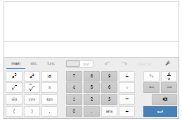
Desmos Reminders: Math Segment 1 and Performance Tasks (Grades 6-8) & NGSS
On the Assessments:
Practice sample assessment items with the Desmos Calculators on the Smarter Balanced Sample Items Website.
To help students and teachers prepare for assessments—and to support delivery of tests and quizzes in classrooms—Desmos developed a suite of "Test Mode" apps that match the configuration that students will encounter on test day.
In the Classroom:
Teach, learn, and explore mathematical concepts.
Learn how the calculator supports students on the assessment with the Tools for Teachers’ Accessibility Strategy: Calculator
Create graphs to download, print, emboss in braille, or share electronically.
Desmos has assembled a collection of unique and engaging digital activities teachers can use with students.
Notes:
Built with universal design in mind, Desmos calculators provide features and resources for students with a variety of accessibility needs. Learn more about Desmos Accessibility.
https://calculators.smarterbalanced.org/#about
Visit the Smarter Balanced Desmos page for more details!
Accessibility Features
Support for braille: Students who are blind can read and write equations using the two mathematical braille codes used in the United States: Nemeth and Unified English Braille (UEB).
Accessible graphs: Students who are blind can create their own graphs in real time and determine the shape of a graph through audio trace. The pitch of the tone increases or decreases depending on the shape of the wave or graph. Students can then emboss their graphs and share print or braille versions with classmates and teachers.
Support for screen readers: Fully supporting keyboard navigation, the calculators communicate with screen readers, which voice additional cues to indicate a student’s location within an expression or within a graph (numerator or denominator, superscript or subscript, baseline, points on the graph, etc.). Paired with a refreshable braille display, these features offer students who use braille the same opportunity as their peers to access an online calculator.
Colors that have sufficient contrast: The calculators provide support for students who have low vision or students who have difficulty with visual perceptual skills.
Adjustable font-size settings: The calculators allow students to adjust font size if they prefer larger print.
The Smarter Balanced Desmos calculators is also compliant with the latest web accessibility standards.

Slide 56
Text-to-Speech
Text-to-Speech of items is considered a designated support. It is available in ELA, Math, and Science.
Text-to-Speech of ELA Reading Passages is considered an accommodation for students who are visually impaired or have a print disability. Refer to the Decision Guidelines for Text-to-Speech to determine eligibility.
Notes:
There are a variety of reader options for students with various access needs. Begin by reviewing the Connecticut Smarter Balanced and NGSS Reader Options Table to learn more about available designated supports and accommodations. https://ct.portal.cambiumast.com/resources/accessibility-and-special-populations/connecticut-smarter-balanced-and-ngss-assessment-reader-options-table
One such accommodation is text-to-speech of the ELA Reading Passages. This accommodation allows the reading passages to be read aloud to the student via embedded text-to-speech technology. This accommodation is only for students in Grades 3-8 with a documented print disability, or for blind students who do not yet have adequate braille skills. Information on selecting this accommodation for appropriate students is found in Guidelines for Choosing Text-to-Speech or Read Aloud for Smarter Balanced.
https://ct.portal.cambiumast.com/resources/accessibility-and-special-populations/guidelines-for-choosing-text-to-speech-or-read-aloud-for-smarter-balanced-ela-summative-and-interim-assessment-reading-passages-for-students-with-disabilities-in-grades-3-8
Text-to-speech for ELA reading passages is not available for English learners (unless the EL student has an IEP or 504 Plan documenting this needed accommodation). The text-to- speech for ELA reading passages accommodation is intended for a small group of students. The PPT or 504 Team should complete (and maintain locally) the 2021-22 Decision Guidelines for Text-to-Speech of the Smarter Balanced ELA Reading Passages to confirm eligibility. https://ct.portal.cambiumast.com/-/media/project/client-portals/connecticut/pdf/2021/text-to-speech-decision-guidelines.pdf
When text-to-speech is used, appropriate headphones must be available to the student, unless the student is tested individually in a separate setting.

Slide 57

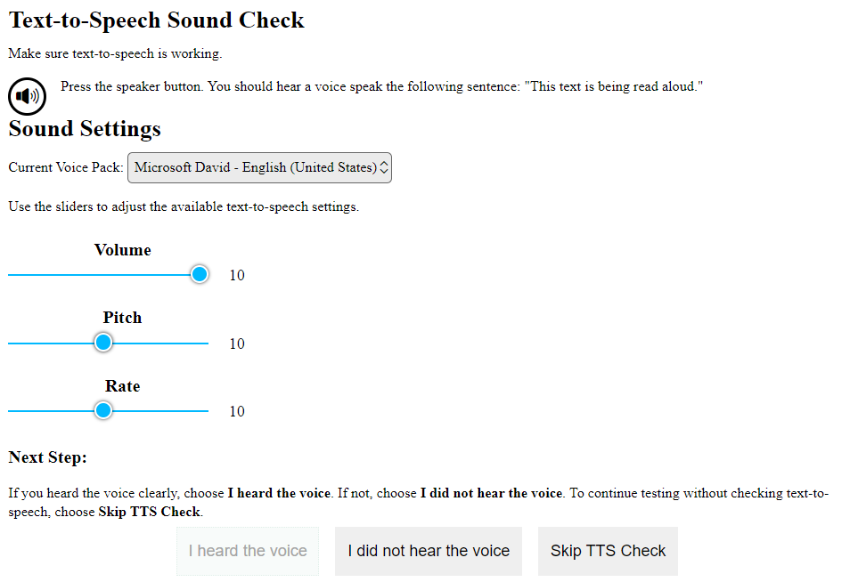

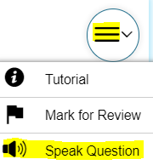
Text-to-Speech Reminders
Set up a practice opportunity for students using Text-to-Speech.
Students will need headsets unless testing in a 1:1 setting.
Ensure that students know how to control the speed, as well as raise or lower the volume of the voice via a volume control. Students can also adjust using the System Settings icon.
Show students how to activate the audio.
This audio check appears when students sign onto the test. Students can make adjustments here, or by selecting the System Settings icon (shown on the left).
Notes:
Text-to-Speech allows text to be read aloud to the student via embedded text-to-speech (TTS) technology. The student is able to control the speed, as well as raise or lower the volume of the voice via a volume control. Text-to-speech is available as an embedded designated support for science, math, and ELA items.

Slide 58
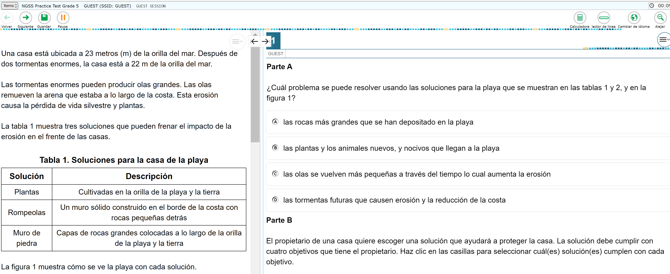
Text-to-Speech in Spanish with Math Stacked and/or Science Spanish Toggle
Text-to-Speech in Spanish is available on the NGSS and math assessments. For eligible students, set Text-to-Speech to Stimuli & Items for Science and set presentation to Spanish Toggle/Spanish Stacked. Be sure that the student’s device has the Spanish voice pack enabled/downloaded prior to testing.
Notes:
Spanish presentation will allow the literate Spanish-speaking student to toggle between a full Spanish translation of the item and the English version of the item. By default, all test directions, navigation buttons, and test content will be presented to the student in the Spanish language. This designated support must be entered in the Embedded Accommodation section of the student’s test settings in TIDE within the Presentation (Designated Supports and Accommodations) tab for Science. Select Spanish toggle. For math, select Spanish Stacked. Keep in mind that the Spanish stacked includes both the English and Spanish presentation on the same screen. Given the cognitive demands and need for additional scrolling, additional test time may be needed.
Also, prior to testing, make sure that the Spanish voice pack is enabled or downloaded to the student’s device.

Slide 59
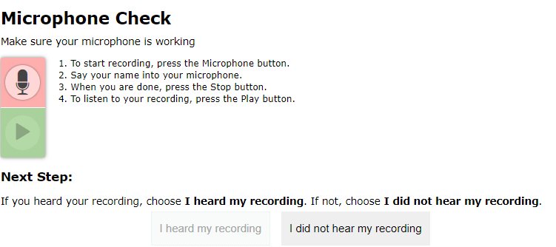

Speech-to-Text Reminders
For students that qualify for speech-to-text, activate this accommodation in TIDE.
When students access the Secure Browser, they will receive a prompt to test the functionality of their audio and microphone.
Notes:
Often used with students who have motor or processing disabilities (such as dyslexia), this accommodation allows students to orally dictate their responses to Smarter Balanced open-ended items using Cambium Assessment’s internal speech-to-text software. Any open-ended item (often associated with the Math Performance Task and the ELA reading and writing assessments) will have a speech-to-text icon that can be activated by the student and used to generate a dictated response.
Accommodation check: When applicable, ask your student to practice this accommodation on a Practice Test. When they do, be sure to look for the microphone icon. If it doesn’t appear under the open-ended item response text box, then the accommodation may not have been set in TIDE.

Slide 60
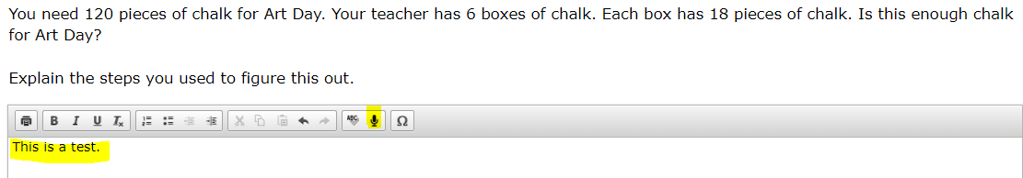
Speech-to-Text Reminders
A microphone icon will appear below any item text box that requires a written response.
When the student selects the microphone, they will dictate their verbal response as the system transcribes the voiced message in the text box.
Notes:
Students can delete or revise their response as appropriate.
Students should try this accommodation using a Practice or Interim Assessment in advance of summative testing to ensure that the student knows how to operate this function.
This feature auto punctuates and capitalizes as it transcribes a student’s dictation. Students should proofread and edit responses before moving onto the next item.
Must test in a separate 1:1 setting.

Slide 61
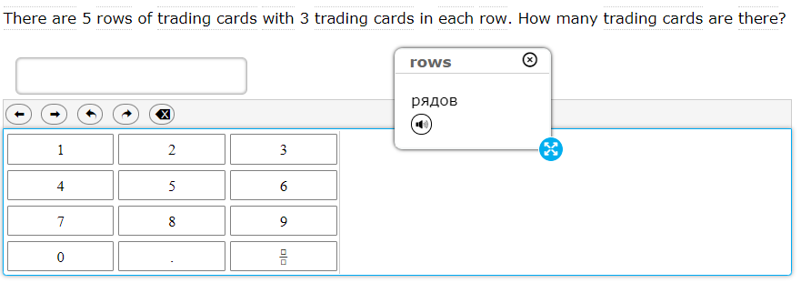

Translation Glossary: Math
Selections include
  Single native-language support (i.e., Russian Glossary, Illustration Glossary)
  Dual language supports (native language paired with English); (i.e., Russian & English Glossary); or
  Dual language supports combined with Illustration Glossary (i.e., Russian, English, & Illustration Glossary)
  The icon enables an audio translation of the word.
  Refer to the Translation Glossary Embedded Designated Support brochure for details.
A dotted line above or below a word or phrase indicates an available translation.
When students hover over the term, it becomes highlighted, and when it is selected, a pop-up window with the word translation appears.
Notes:
Notes about this designated support:
Based on differences in complexity across languages, different language Glossaries may provide support for different construct irrelevant English language terms. Therefore, if a student has access to the English and one second-language Glossary, some terms may have both Glossaries present while other terms may have only one of the two Glossaries present. Please note that not all math items contain glossary options.
The Illustration Glossary may be a useful language support for those students who are not fluent in their native language and benefit from a pictorial symbol OR if the student’s native language is not represented by the list of available language options . The provision of these dual supports may be distracting or inappropriate without careful consideration of the student’s language needs.
Also note that if the student has a dual language mode or triple language mode (i.e., Russian, English, & Illustration Glossary) enabled, the Glossary will appear with the corresponding tabs, one for each language, when appropriate.
Refer to the Translation Glossary Embedded Designated Support brochure for more details. https://ct.portal.cambiumast.com/resources/accessibility-and-special-populations/translation-(glossary)-%E2%80%93-embedded-designated-support

Slide 62
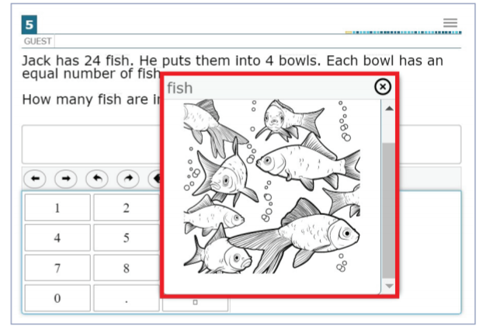
Illustration Glossary
Which students most benefit from the illustration glossary?
English learners/multilingual learners
Students with varying proficiency in one of the current translated glossary languages who would benefit from current illustration supports
Students who are deaf/hard of hearing and use sign systems other than American Sign Language
Students whose primary languages are not included in the text-based glossaries
Refer to the Illustration Glossary Accessibility Resource for Mathematics for details.
A dotted line above or below a word or phrase indicates an available illustration.
When students hover over the term, it becomes highlighted, and when it is selected, a pop-up window with the illustration appears.
Students can adjust the size and placement of each illustration depending on their needs and preferences.
Notes:
The illustration glossary is a Designated Support for mathematics to help students understand words or phrases in test questions when they may not benefit from the text-based glossaries (currently offered in English and 13 other languages) or American Sign Language videos. The illustration glossary is available for practice tests, interim assessments, and summative assessments. For paper-pencil forms, illustration glossaries are available in paper-based supplements. This must be requested when ordering the test material.
Refer to the Illustration Glossary Accessibility Resource for Mathematics for more information: https://portal.smarterbalanced.org/library/en/illustration-glossary.pdf.

Slide 63
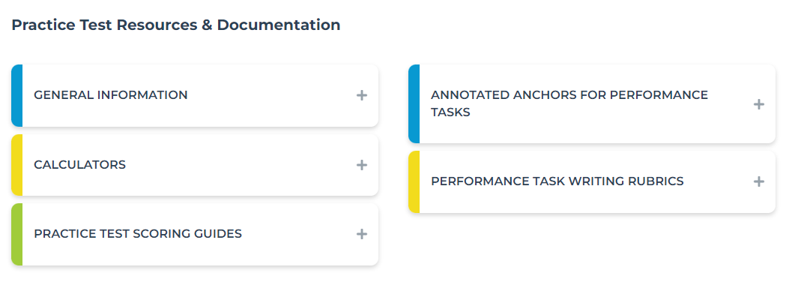
Provide Students with Opportunities to Practice
Additional resources are available on the Smarter Balanced website.
https://smarterbalanced.org/our-system/students-and-families/samples/
Notes:
As mentioned, you can use the Practice Tests to introduce the online test format, the variation in item types, and how to navigate using the universal tools, designated supports and accommodations. You can visit the Smarter Balanced website for other practice test resources: Practice Tests and Sample Questions – SmarterBalanced; https://smarterbalanced.org/our-system/students-and-families/samples/ .

Slide 64

Notes:
Thank you for your participation. As a reminder, this training does not replace training provided by your school or district coordinator.
Please reach out to your school or district administrator with questions related to local decisions and planning.
Feel free to contact the Office of Student Assessment via phone or email with any questions related to state testing.
Have a successful spring!

