Slide 1
District Administrator’s Special Populations Workshop
January 20 and 21, 2022
Notes:
Welcome.
I hope that everyone is well.
This session is being recorded and it will be posted next week. A PDF of this presentation will also be available on the Student Assessment webpage (https://portal.ct.gov/SDE/Student-Assessment/Main-Assessment/Student-Assessment)
located on the Connecticut State Department of Education Website: https://portal.ct.gov/SDE.
All District Administrator and Test Coordinator Manuals are available on the Student Assessment Webpage and the Connecticut Comprehensive Assessment Program Portal (by searching under Resources). https://ct.portal.cambiumast.com/

Slide 2
2022 District Administrator’s Special Populations Workshop Attendee Reminders
You must connect to your computer’s audio or telephone using the phone number provided in the registration response email from SDE GO TO Webinar.
All attendees will be placed on mute for the duration of the webinar.
To ask questions, please use the Question box or select the Raise your Hand button and you will be able to ask your question.
Questions will be addressed by the presenters during the session. Unanswered questions will be addressed in a follow-up email.
This session is being recorded and will be posted to the CSDE Assessment web page and the Connecticut Comprehensive Assessment Program Portal.
Notes:
This presentation reviews the background and overall components of the summative assessments with a focus on supports and accommodations available to students on statewide testing.
For more information, refer to the CSDE Assessment web page and the Connecticut Comprehensive Assessment Program Portal, both hyperlinked in this presentation.

Slide 3
CSDE Assessment Staff - Performance Office
Special Populations and Accommodations (Smarter, NGSS, Connecticut SAT School Day, Alternate Assessments) | Deirdre Ducharme Deirdre.Ducharme@ct.gov (860) 713-6859 Janet Stuck Janet.Stuck@ct.gov (860) 713-6837
Notes:
This is the contact information for our the first of our awesome team at the CSDE.

Slide 4
CSDE Assessment Staff - Performance Office
Abe Krisst, Chief Student Assessment abe.krisst@ct.gov (860) 713-6894 ctstudentassessment@ct.gov Cristi Alberino, Education Consultant cristi.alberino@ct.gov Connecticut Help Desk (844) 202-7583 cthelpdesk@cambiumassessment.com
Notes:
And here is more contact information for even more members of the awesome assessment team at the CSDE.

Slide 5
Presentation Overview
2022 Calendar for Special Considerations
Who Participates in Summative Testing?
Who is Eligible for Supports and Accommodations?
What’s New for 2021-22?
Reminders
The Special Documented Accommodations Process
The Connecticut Alternate Assessment System
Medical Exemptions
Questions
Notes:
During this presentation we will provide critical dates you should be aware of. We will explain in detail, who is participates in the summative testing and who is eligible for supports and accommodations on the testing.
We do have some new information to provide for this year and before we explain the process of the special documented accommodation, the alternate assessments, and medical exemptions.
We encourage you to write your questions in the chat as we progress through the presentation. If your question is not answered in the chat, we will address it at the end of the presentation.

Slide 6
2021-22 Calendar for Special Considerations
 | Deadline | Delivery Method
Designated Supports/Accommodations | November 19–June 3 *must be entered in TIDE prior to testing | TIDE
Special Documented Accommodations | March 1 | DA Requests Petition from CSDE
Medical Exemptions | May 6, 2022 - Connecticut SAT School Day June 10, 2022 - Smarter Balanced, NGSS, Connecticut Alternate Assessments | DA Requests Application from CSDE
Notes:
Refer to the Assessment Guidelines for procedural and policy guidance. The guidelines are located on the assessment portal, under resources.
https://ct.portal.cambiumast.com/-/media/project/client-portals/connecticut/pdf/2019/csde-assessment-guidelines.pdf
Please be aware of the following dates for designated supports and accommodations, special documented accommodations and medical exemption requests.

Slide 7
2021-22 Assessment Office Hours*
Date | Topics
February 17 3:00-4:00 | Connecticut Alternate Assessments/Accessibility and Accommodations
March 17 3:00-4:00 | Connecticut Alternate Assessments/Accessibility and Accommodations
March 31 and every Thursday (at 3 p.m.) | Smarter, NGSS, CTAS and CTAA Topics
*NOTE: There are additional Office Hours for LAS Links and Connecticut SAT School Day.
Notes:
We are providing you with office hours dates now so you can hold the date/time in your calendar. Even if you don’t have a question now, you might when the Assessment Officer Hours begin.

Slide 8
Who Participates in Summative Testing?
Participation expectations for Smarter Balanced, NGSS, and Connecticut SAT School Day include testing:
All students enrolled in the Public School Information System (PSIS) in Grades 3-8 and 11 (these students include those identified as English learners and/or students with disabilities who have an active IEP or Section 504 Plan).
Students enrolled in PSIS attending Approved Private Special Education Programs (APSEPs).
Students enrolled in PSIS who are being educated in out-of-state facilities, in-state facilities, and non-approved facilities.
Refer to the Students in PSIS Who Attend Out-of-State and In-State Non-Approved Facilities brochure.
Notes:
All students enrolled in a PSIS in Grades 3-8 and 11 including students identified as ELs or with an active IEP or 504 Plan, and those attending APSEPS or are being educated in out of state facilities or non-approved facilities.
Refer to the Connecticut General Statutes 10-14n for legislation on statewide testing.
Refer to the Students in PSIS Who Attend Out-of-State and In-State Non-Approved Facilities brochure:
https://ct.portal.cambiumast.com/resources/guides/testing-students-in-psis-who-attend-out-of-state-and-non-approved-facilities

Slide 9
Who is Eligible for Supports and Accommodations?

Slide 10
Universal Tools are…
Accessibility features available to ALL students (e.g., digital notepad, line reader, highlighter)
Provided digitally (embedded) through the Test Delivery System or provided by the test examiner as a non-embedded tool
Refer to the Smarter Balanced Blog Post for more information: Five Built In Test Tools Students Should Know (and Use!)
When administering Practice Tests, model how to locate and use universal tools!
Who is Eligible for Universal Tools?
Notes:
Familiarizing students with universal test tools can boost confidence!
Smarter Balanced digitally-delivered assessments (interims, the summative test, and practice tests) include a wide array of embedded universal test tools. These are available to students as part of the technology platform. Students gain confidence with the testing software when they understand how to use these test tools and when they can be most useful. Using practice tests and/or administering interims, and coaching students on the built-in test tools are a great way to help them gain familiarity. Here’s the link to tips on using five of these universal test tools: https://smarterbalanced.org/five-built-in-test-tools-students-should-know-and-use/.
Access Practice and Training Tests on the Connecticut Comprehensive Assessment Program Portal: https://ctpt.tds.cambiumast.com/student.

Slide 11
Designated Supports are…
Embedded accessibility features available to ANY student for whom the need has been indicated by an educator/parent/guardian and student (e.g., streamline, text-to-speech of items, print size)
Selected supports that are consistently used in the student’s instructional setting
Provided by the test examiner (e.g., read aloud of test items, simplified test directions) if the student’s needs cannot be met through digital supports
Activated in TIDE
Provide opportunities for students to practice using tools and designated supports during Practice Tests!
Who is Eligible for Designated Supports?
Notes:
Designated supports are available to all students who need these embedded features as indicated by an educator, parent, guardian, or even the student. These types of supports are those that are consistently used during the student’s instruction. They include text-to-speech of items, streamline, print size and are activated in TIDE.
If the student’s needs cannot be met via the computer, the test examiner should provide them.

Slide 12
Accommodations are…
Available for students with an active Individualized Education Program (IEP) or a Section 504 Plan
Identified on pages 8 (and 11) of the IEP or within the 504 Plan and should generally reflect similar accommodations required for instruction
Embedded through the Test Delivery System (e.g., text-to-speech of ELA Reading Passages, closed captioning)
Non-embedded when the digital options are not available or accessible. They are provided by the test examiner (e.g., 100 Numbers Table, Large Print Test booklet).
Activated in TIDE
Who is
Eligible for
Test Accommodations?
Notes:
Accommodations differ from designated supports. Accommodations are only available for students with an active IEP or 504 Plan. The accommodations are identified on pages 8 and 11 of the IEP or within the 504 Plan and should be used regularly during instruction. They are both embedded in the system, such as TTS of the ELA reading passages or closed captioning and not embedded when the digital option is either not available or inaccessible. An example might be a large print test booklet or a 100 numbers table. All accommodations must be activated in TIDE.

Slide 13
Accommodation Eligibility
Eligibility for any embedded or non-embedded accommodation requires the IDEA Indicator or Section 504 Plan field set to Yes based on the PSIS registration fields. Without this indication, accommodations cannot be set in TIDE.
Notes:
Only students those who have the IDEA indicator or Section 504 field set to yes in TIDE, can be given access to accommodations. These two fields are based on PSIS and cannot be changed directly in TIDE.

Slide 14
Universal Tools:
Available to ALL students
Designated Supports:
Accommodations:
Available to students with an IEP or 504 Plan
Embedded
Color Contrast
Masking
Text-to-Speech- Science, Math & ELA Items (Non-Reading Passages)
Turn off any universal accessibility tool
Translation Test Directions Spanish (Math, Science) *
Print Size Online
Mouse Pointer
Translations-Math (Glossary) (Includes Illustration Glossary as an available language support) *
Text-to-Speech-Spanish (Science) *
Spanish Presentation (Science) (Toggle) *
Spanish Presentation (Math) (Stacked) *
Streamline
Available to ANY student with a need determined by educators
Desmos Calculator (Math Grades 6-8; Science Grades 5, 8, & 11)
Digital Notepad
English Glossary^
Expanded Passages/Stimuli/Items
Highlighter
Keyboard Commands
Math Tools
Strikethrough
Writing Tools
Zoom
Line Reader
Mark for Review
Breaks
Embedded
NGSS Periodic Table (Grades 8 & 11) English
Non-Embedded
Embedded
American Sign Language (Video)^
Closed Captioning (ELA Listening)
Refreshable Braille
Braille Type
Braille Transcript (ELA Listening)
Speech-to-Text
Permissive Mode (compatible third party accessibility software)
Text-to-Speech ELA Reading Passages (Grades 3-8)
100s Number Table (Grades 3-8)
Abacus
Alternate Response Options
Braille Booklet (Only UEB/UEB Nemeth)
Calculator (Math Grades 6-8) #
Customized Accommodations ~#
Human Signer for ELA, Math, and/or Science Items ~ #
Human Signer for ELA Reading Passages (Grades 3-8) ~ #
Large Print Booklet
Manipulatives (Math, Grades 3-8) #
Multiplication Table (Grades 3-8)
Print on Demand #
Read Aloud ELA Reading Passages (Grades 3-8) ~ #
Scribe ~#
Specialized Calculator (Braille/Talking Calculator) (Math Grades 6-8; Science Grades 5, 8, & 11)
Non-Embedded
Bilingual Dictionary (Science) *
Color Contrast
Color Overlay
Magnification
Noise Buffer
Read Aloud
Separate Setting
Translation Glossary (Math) * (Includes Illustrative Glossary as an available language support) (Note: These must be requested through Helpdesk and accompany a large-print test booklet.)
Translation Test Directions* (Math, ELA)^
Read Aloud in Spanish (Math, Science) *
Simplified Test Directions^
Amplification
Native Language Reader Directions (Science) *
Non-Embedded
Breaks
Scratch Paper/ whiteboard with marker
Calculator (Science Grades 5, 8, &11)
NGSS Periodic Table (Grades 8 & 11) English and Spanish*
# Requires Petition for Approval of Special Documented Accommodations
^ NOT available for Science
~ Requires Trained Educator
*Suggested for English Learners
Refer to the Assessment Guidelines for detailed information on universal tools, supports, and accommodations.
Updated 7/21/2021
Notes:
The Accessibility Chart identifies the range of universal tools, designated supports, and accommodations available students when accessing the Smarter Balanced and the NGSS Science Assessments.
https://ct.portal.cambiumast.com/resources/accessibility-and-special-populations/accessibility-chart

Slide 15
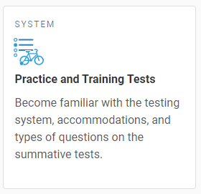
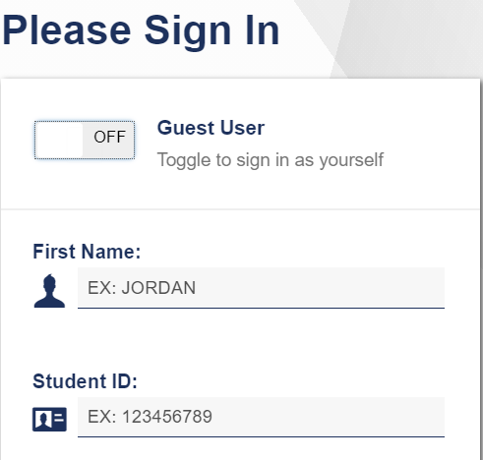
Provide Students with Opportunities to Practice
Administer Practice Tests to allow students to become familiar with online test platform, item format, universal tools, and practice with designated supports and accommodations (if applicable).
Notes:
Become familiar with the testing system, accommodations, and types of questions on the summative tests. Let the student access the practice test. No responses are saved and the student can practice more than once if they need to.
https://ctpt.tds.cambiumast.com/student

Slide 16
What’s New for 2022?

Slide 17
What is New in 2022?
Changes to the submission process for the
Decision Guidelines for Text-to-Speech of the Smarter Balanced ELA Reading Passages
Use as a screening tool
File/maintain locally
Documented Evidence for a Read Aloud of the of the Smarter Balanced ELA Reading Passages
Use as a screening tool
Submit with the petition
for special documented accommodations
Resources are available on the Guidelines for Choosing Text-to-Speech or Read Aloud Accommodations portal web page.
Notes:
Effective on November 12, 2021, the submission link to the Decision Guidelines for Text-to-Speech of the Smarter Balanced ELA Reading Passages was deactivated and this data will no longer be reported to the Connecticut State Department of Education. However, the Decision Guidelines for Text-to-Speech remains a critical document intended to be completed at the Planning and Placement Team or 504 Planning meetings to determine eligibility for certain students with a visual or print disability using this accommodation during instruction. The form should be used locally and maintained with the student’s record. Given the change to the submission process, the Decision Guidelines and associated resources have been updated on the portal to capture the revised procedures.
This is the web page to access guidance for choosing text-to-speech and read aloud accommodations:
https://ct.portal.cambiumast.com/resources/accessibility-and-special-populations/guidelines-for-choosing-text-to-speech-or-read-aloud-for-smarter-balanced-ela-summative-and-interim-assessment-reading-passages-for-students-with-disabilities-in-grades-3-8

Slide 18
Reminders

Slide 19
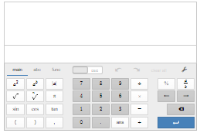
On the Assessments:
Practice sample assessment items with the Desmos Calculators on the Smarter Balanced Sample Items Website.
To help students and teachers prepare for assessments—and to support delivery of tests and quizzes in classrooms—Desmos developed a suite of "Test Mode" apps that match the configuration that students will encounter on test day.
https://www.desmos.com/accessibility
Desmos Reminders
Notes:
Built with universal design in mind, Desmos calculators provide features and resources for students with a variety of accessibility needs. Learn more about Desmos Accessibility.
https://calculators.smarterbalanced.org/#about
Visit the Smarter Balanced Desmos page for more details!
Accessibility Features
Support for braille: Students who are blind can read and write equations using the two mathematical braille codes used in the United States: Nemeth and Unified English Braille (UEB).
Accessible graphs: Students who are blind can create their own graphs in real time and determine the shape of a graph through audio trace. The pitch of the tone increases or decreases depending on the shape of the wave or graph. Students can then emboss their graphs and share print or braille versions with classmates and teachers.
Support for screen readers: Fully supporting keyboard navigation, the calculators communicate with screen readers, which voice additional cues to indicate a student’s location within an expression or within a graph (numerator or denominator, superscript or subscript, baseline, points on the graph, etc.). Paired with a refreshable braille display, these features offer students who use braille the same opportunity as their peers to access an online calculator.
Colors that have sufficient contrast: The calculators provide support for students who have low vision or students who have difficulty with visual perceptual skills.
Adjustable font-size settings: The calculators allow students to adjust font size if they prefer larger print.
The Smarter Balanced Desmos calculators is also compliant with the latest web accessibility standards.

Slide 20
Text-to-Speech Reminders
Text-to-Speech of items is considered a designated support. It is available in ELA, Math, and Science.
Notes:
Text can be read aloud to the student via embedded text-to-speech (TTS) technology. The student is able to control the speed, as well as raise or lower the volume of the voice via a volume control. Text-to-speech is available as an embedded designated support for science, math, and ELA items.

Slide 21
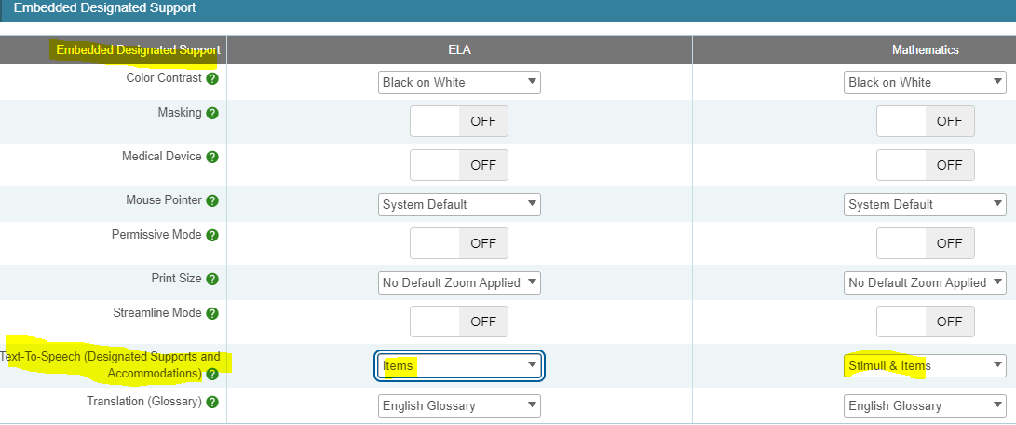
Text-to-Speech Reminders
Text-to-Speech of ELA Passages is considered an accommodation for students who are visually impaired or have a print disability. To activate, set Text-to-Speech to Passages & Items for ELA.
Notes:
There are a variety of reader options for students with various access needs. Begin by reviewing the Connecticut Smarter Balanced and NGSS Reader Options Table to learn more about available designated supports and accommodations. https://ct.portal.cambiumast.com/resources/accessibility-and-special-populations/connecticut-smarter-balanced-and-ngss-assessment-reader-options-table
One such accommodation is text-to-speech of the ELA Reading Passages. This accommodation allows the reading passages to be read aloud to the student via embedded text-to-speech technology. This accommodation is only for students in Grades 3-8 with a documented print disability, or for blind students who do not yet have adequate braille skills. Information on selecting this accommodation for appropriate students is found in Guidelines for Choosing Text-to-Speech or Read Aloud for Smarter Balanced.
https://ct.portal.cambiumast.com/resources/accessibility-and-special-populations/guidelines-for-choosing-text-to-speech-or-read-aloud-for-smarter-balanced-ela-summative-and-interim-assessment-reading-passages-for-students-with-disabilities-in-grades-3-8
Text-to-speech for ELA reading passages is not available for English learners (unless the EL student has an IEP or 504 Plan documenting this needed accommodation). The text-to- speech for ELA reading passages accommodation is intended for a small group of students. The PPT or 504 Team should complete (and maintain locally) the 2021-22 Decision Guidelines for Text-to-Speech of the Smarter Balanced ELA Reading Passages to confirm eligibility. https://ct.portal.cambiumast.com/-/media/project/client-portals/connecticut/pdf/2021/text-to-speech-decision-guidelines.pdf
When text-to-speech is used, appropriate headphones must be available to the student, unless the student is tested individually in a separate setting.

Slide 22
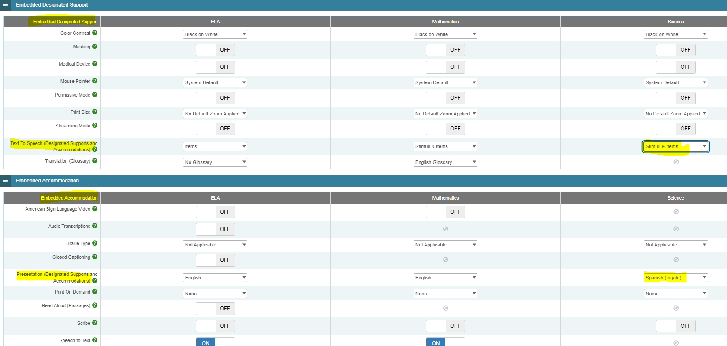
Text-to-Speech Reminders
Text-to-Speech in Spanish is available on the NGSS assessment. For eligible students, set Text-to-Speech to Stimuli & Items for Science and set presentation to Spanish Toggle.
Notes:
Spanish presentation will allow the literate Spanish-speaking student to toggle between a full Spanish translation of the item and the English version of the item. By default, all test directions, navigation buttons, and test content will be presented to the student in the Spanish language. This designated support must be entered in the Embedded Accommodation section of the student’s test settings in TIDE within the Presentation (Designated Supports and Accommodations) tab for Science. Select Spanish toggle.

Slide 23
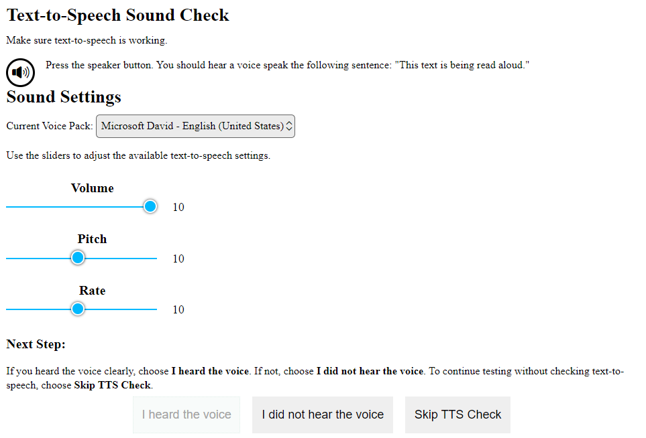
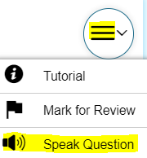
Text-to-Speech Reminders
Set up a practice opportunity for students using Text-to-Speech.
Students will need headsets unless testing in a 1:1 setting.
Ensure that students know how to control the speed, as well as raise or lower the volume of the voice via volume control. Students can also adjust using the System Settings icon.
Show students how to activate the audio.
This audio check appears when students sign onto the test. Students can make adjustments here, or by selecting the System Settings icon (shown on the left).
Notes:
Students can practice activating text-to-speech using a Practice Test.
When the student logs onto the secure browser, the system will generate an audio check, which allows the student to test the volume, pitch and rate of the automated reader. If these functions aren’t working properly, the student should alert the teacher and testing should be rescheduled once the problem is resolved.
Once a test has started, students can select the settings icon (located on the top, right corner of the screen) to adjust the audio.
Students should also know that text-to-speech will need to be activated for each item. Look for the task icon (the circle with three horizontal lines). From the drop-down menu, choose the Speak Question option to activate the audio.

Slide 24
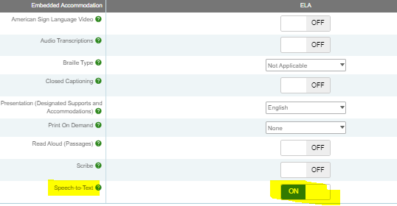
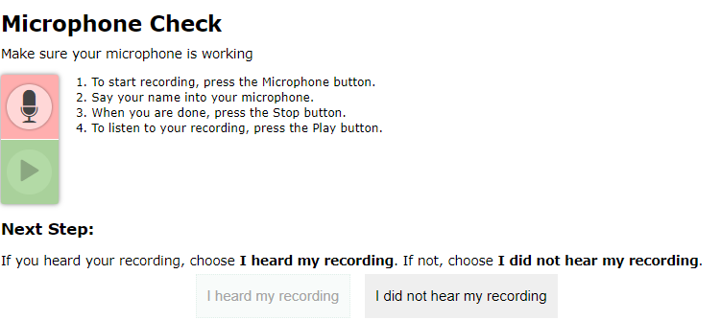
Speech-to-Text Reminders
This accommodation allows students to orally dictate their responses to Smarter Balanced open-ended items using Cambium Assessment’s internal speech-to-text software.
Activate this accommodation in TIDE.
When students access the Secure Browser, they will receive a prompt to test the functionality of their audio and microphone.
Notes:
Often used with students who have motor or processing disabilities (such as dyslexia), this accommodation allows students to orally dictate their responses to Smarter Balanced open-ended items using Cambium Assessment’s internal speech-to-text software. Any open-ended item (often associated with the Math Performance Task and the ELA reading and writing assessments) will have a speech-to-text icon that can be activated by the student and used to generate a dictated response.
Accommodation check: When applicable, ask your student to practice this accommodation on a Practice Test. When they do, be sure to look for the microphone icon. If it doesn’t appear under the open-ended item response text box, then the accommodation may not have been set in TIDE.

Slide 25
A microphone icon will appear below any item text box that requires a written response.
When the student selects the microphone, they will dictate their verbal response as the system transcribes the voiced message in the text box.
Speech-to-Text Reminders
Notes:
Students can delete or revise their response as appropriate.
Students should try this accommodation using a Practice or Interim Assessment in advance of summative testing to ensure that the student knows how to operate this function.
This feature auto punctuates and capitalizes as it transcribes a student’s dictation. Students should proofread and edit responses before moving onto the next item.
Must test in a separate 1:1 setting.

Slide 26
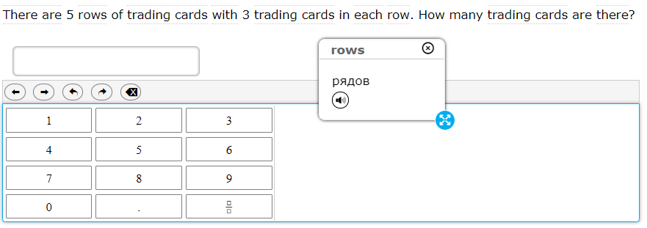
Selections include
Single native-language support (i.e., Russian Glossary, Illustration Glossary);
Dual language supports (native language paired with English); (i.e., Russian & English Glossary); or
Dual language supports combined with Illustration Glossary (i.e., Russian, English, & Illustration Glossary).
The icon enables an audio translation of the word.
Refer to the Translation Glossary Embedded Designated Support brochure for details.
Translation Glossary Math
A dotted line above or below a word or phrase indicates an available translation.
When students hover over the term, it becomes highlighted, and when it is selected, a pop-up window with the word translation appears.
Notes:
Notes about this designated support:
Based on differences in complexity across languages, different language Glossaries may provide support for different construct irrelevant English language terms. Therefore, if a student has access to the English and one second-language Glossary, some terms may have both Glossaries present while other terms may have only one of the two Glossaries present. Please note that not all math items contain glossary options.
The Illustration Glossary may be a useful language support for those students who are not fluent in their native language and benefit from a pictorial symbol OR if the student’s native language is not represented by the list of available language options . The provision of these dual supports may be distracting or inappropriate without careful consideration of the student’s language needs.
Also note that if the student has a dual language mode or triple language mode (i.e, Russian, English, & Illustration Glossary) enabled, the Glossary will appear with the corresponding tabs, one for each language, when appropriate.
Refer to the Translation Glossary Embedded Designated Support brochure for more details. https://ct.portal.cambiumast.com/resources/accessibility-and-special-populations/translation-(glossary)-%E2%80%93-embedded-designated-support

Slide 27
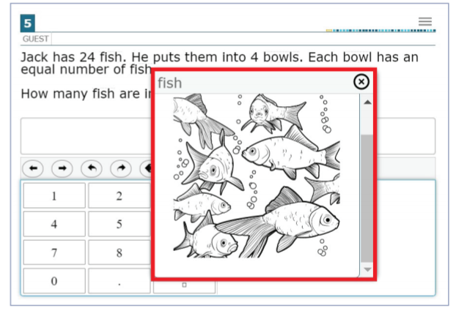
Which students benefit from the illustration glossary?
English learners (ELs)
Students with varying proficiency in one of the translated glossary languages who would benefit from current illustration supports
Students who are deaf/hard of hearing and use sign systems other than American Sign Language
Students whose primary languages are not included in the text-based glossaries
Refer to the Illustration Glossary Accessibility Resource for Mathematics for details.
Illustration Glossary
A dotted line above or below a word or phrase indicates an available illustration.
When students hover over the term, it becomes highlighted, and when it is selected, a pop-up window with the illustration appears.
Students can adjust the size and placement of each illustration depending on their needs and preferences.
Notes:
The illustration glossary is a Designated Support for mathematics to help students understand words or phrases in test questions when they may not benefit from the text-based glossaries (currently offered in English and 13 other languages) or American Sign Language videos. The illustration glossary is available for practice tests, interim assessments, and summative assessments. For paper-pencil forms, illustration glossaries are available in paper-based supplements. This must be requested when ordering the test material.
Refer to the Illustration Glossary Accessibility Resource for Mathematics for more information: https://portal.smarterbalanced.org/library/en/illustration-glossary.pdf

Slide 28
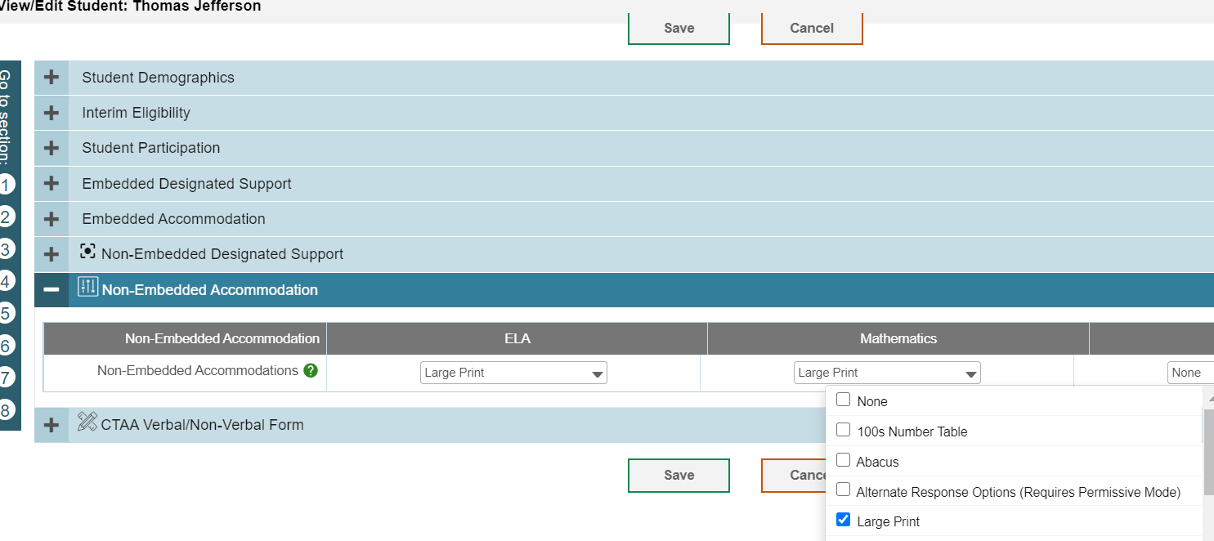
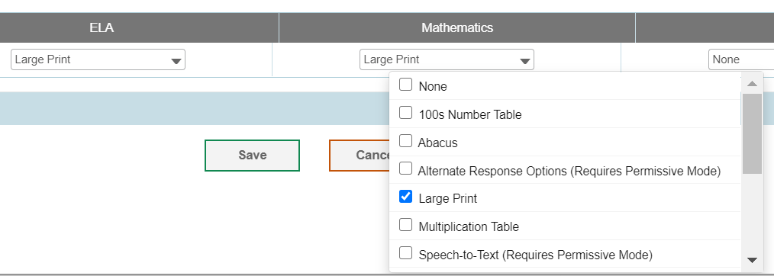
How do I Order Large-Print or Braille Test Materials?
District Administrators can order Braille and Large Print kits for Smarter Balanced and NGSS in TIDE anytime after January 25, 2022.
Confirm that the student has the non-embedded accommodation set properly in TIDE.
Notes:
DAs can order braille and large print kits for Smarter and NGSS assessments in TIDE after January 25, 2022.

Slide 29
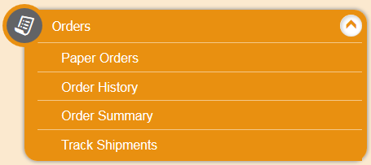
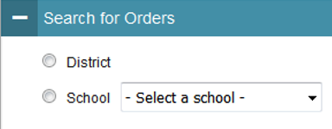
Ordering Paper Materials in TIDE
Step 1: From the Orders task menu on the TIDE dashboard, select Paper Orders.
Step 2: Search for orders by District or School.
Step 3: Enter the quantity needed for each of the materials needed.
Districts can track shipments in TIDE.
Notes:
There are three simple steps to ordering paper materials in TIDE. You can also track your shipments in TIDE.

Slide 30
What are Special Documented Accommodations
When universal tools, designated supports, and accommodations do not meet a student’s accessibility needs as described in their IEP/504 Plan, DAs can apply for a special documented accommodation for additional supports through a petition process.
Read Aloud of Reading Passages*
Human Signer/Visual Support (Items and/or passages)
Scribe
Print on Demand
Manipulatives (Math, Grades 3-8)
Hand-held calculator (Math, Grades 6-8) for calculator-allowed items
Customized
*Requires the submission of the Documented Evidence for a Read Aloud of the Smarter Balanced ELA Reading Passages with the submission of the petition.
Notes:
For a small number of students, the universal tools, designated supports, and accommodations on the Accessibility Chart and described in the Assessment Guidelines may not be enough to meet the accessibility needs of the student. In this case, the District Administrator in TIDE may submit a petition for these students to the Connecticut State Department of Education Performance Office to discuss and develop a plan for the assessment.

Slide 31
What is the Process for Submitting a Special Documented Accommodation?
Do |  | Do Not
 | DA’s should contact Deirdre or Janet regarding any student who may qualify. See Assessment Guidelines Appendix C page 57. |  | provide student names or confidential information if requesting information via email.
 | Based on initial eligibility, DAs will receive a Special Documented Accommodation Petition and access to the Cambium Secure FTP site for submitting completed paperwork documenting the need for special accommodation(s). |  | email petitions, IEPs, 504s, or any confidential information. All petitions must be submitted by the DA using Cambium’s secure FTP site.
 | CSDE will review petitions and provide a letter of approval or guidance to district via the secure FTP site. Letters of approval may also include the completion/submission of security/confidentiality agreements. |  | test students with requested accommodations without approval from the CSDE.
Notes:
To facilitate this process, the DA must contact Deirdre or Janet and provide information about the student’s specific needs per their disability and supports identified in their IEP. If appropriate, we will provide a petition to be completed by the student’s primary teacher and returned with the teacher, DA, and Special Education Director’s signature, along with a complete copy of the student’s active IEP. All Special Documented Accommodations must be submitted by March 1, 2022.
No special accommodations can be provided unless they are approved by the CSDE.
If students are approved to receive a human reader, human signer, or scribe, the teacher will need to sign the Smarter Balanced/NGSS Confidentiality/Security Agreement form and return to the District Administrator.
The DA will upload the signed form to the secure FTP site for documentation.
The Special Documented Accommodations Procedure is described in the Assessment Guidelines, Appendix C.

Slide 32
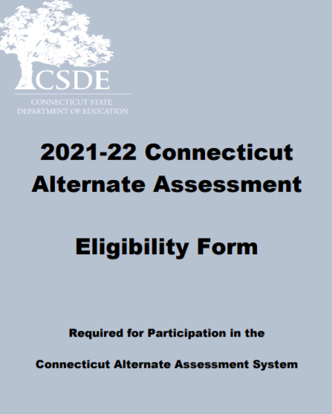
The Connecticut Alternate Assessment System for Eligible Students with Significant Cognitive Disabilities
Notes:
The Connecticut Alternate Assessment Eligibility Form has been developed to determine eligibility for the Alternate Assessment System through discussion at the Planning and Placement Team (PPT) meeting. This document is required to register students for the CTAA and the CTAS. The document may be accessed on the CSDE Comprehensive Assessment Program Portal.
The eligibility form must be submitted in the Data Entry interface (DEI) on the CSDE Comprehensive Assessment Program Portal.

Slide 33
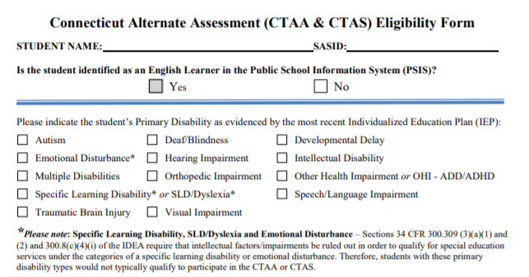
Connecticut Annotated Alternate Assessment Eligibility Form
Notes:
The Connecticut Alternate Assessment Eligibility Form was updated this school year to include a new student demographic item that captures if the student is identified as an English Learner in the Public School Information System (PSIS). This will help local administrators plan for LAS Links participation rosters for students in Grades 3-8 and 11 as well as those in Grades K-2, 9-10, and 12 who are also tested on the LAS Links.

Slide 34
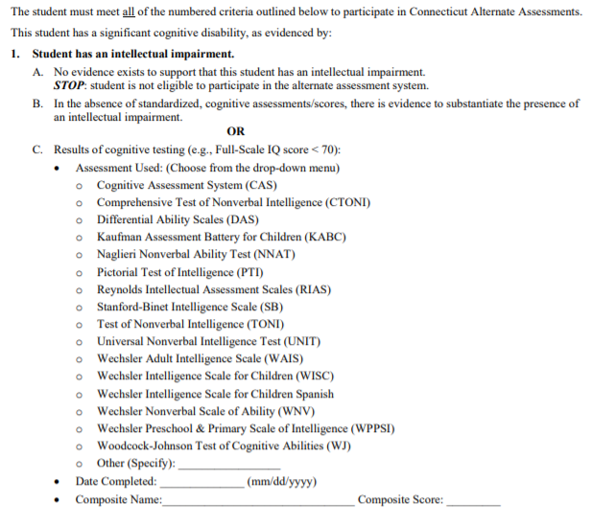
Connecticut Annotated Alternate Assessment Eligibility Form
Notes:
Item 1 on the Alternate Assessment Eligibility Form was updated to include a drop-down menu of the cognitive assessments most commonly administered and appropriate for this purpose, as determined by Connecticut's School Psychologist’s Community of Practice. This list ensures accuracy and consistency for monitoring when identifying these assessments, but it also allows the PPT to identify “Other” if the cognitive assessment is not included on this list.
Select the name of the cognitive assessment used to provide evidence of an intellectual impairment from the menu provided. (As referenced in the American Psychological Association’s Ethical Principles of Psychologists and Code of Conduct, Section 9: Assessments, these assessments should be the most current edition available).
If “Other“ is selected DO NOT use assessments or associated composite scores that do not measure broad cognitive functioning for the purpose of this alternate assessment eligibility criteria. (e.g., Adaptive Behavior Scales, Assessment of Basic Language and Learning, Comprehensive Test of Phonological Processing, file reviews, or observations).
If “Other” is selected, specify the full name of the cognitive assessment, recognizing these will be identified for additional CSDE monitoring.
Ensure that the evaluations address the degree for which a student’s second language acquisition affects validity and reliability of test findings for students who are English learners (ELs)

Slide 35
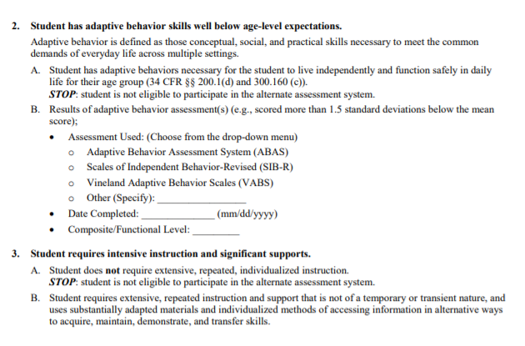
Connecticut Annotated Alternate Assessment Eligibility Form
Notes:
Item 2 on the Alternate Assessment Eligibility Form was updated to include a drop-down menu of the most commonly administered assessments for adaptive functioning. This list ensures accuracy and consistency when monitoring and identifying these assessments, but it also allows the PPT to identify “Other” if the adaptive behavioral assessment is not included on this list. An assessment must be administered with results indicating a score more than 1.5 standard deviations below the mean score to qualify for an alternate assessment.
Select name of the adaptive assessment used to provide evidence of insufficient adaptive behavior skills from the provided menu. (As referenced in the American Psychological Association’s Ethical Principles of Psychologists and Code of Conduct, Section 9: Assessments, these assessments should be the most current edition available).
If “Other“ is selected, DO NOT use assessments or associated composite scores that do not measure broad adaptive behavior skills for the purpose of this alternate assessment eligibility criteria. (e.g., Assessment of Basic Language and Learning, Autism Behavior Rating Scale, Autistic Diagnostic Observation Schedule, Behavior Assessment System for Children, file review, or observations).
If “Other” is selected, specify the full name of the adaptive behavior skill assessment, recognizing these will be identified for additional CSDE monitoring.
Ensure that the evaluations address the degree for which a student’s second language acquisition affects the validity and reliability of test findings for students who are ELs.

Slide 36
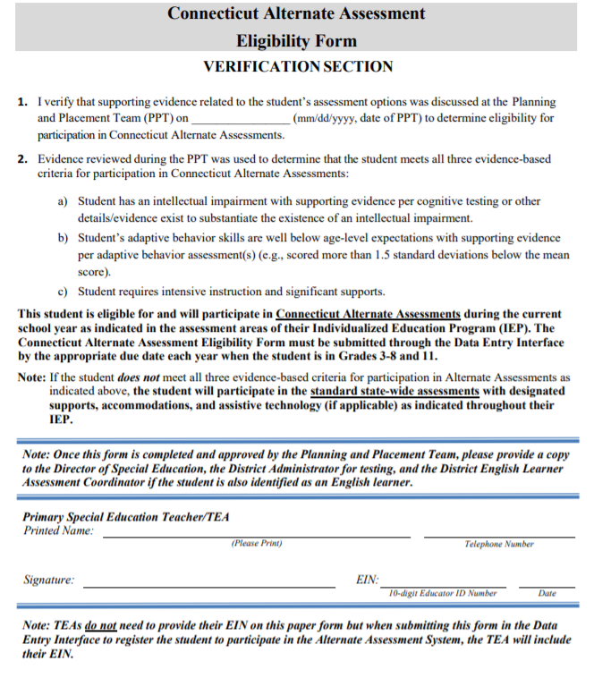
Connecticut Annotated Alternate Assessment Eligibility Form
Notes:
Once this form is completed and approved by the Planning and Placement Team, a copy should be provided to the Director of Special Education, the District Administrator for testing, and the District English Learner Assessment Coordinator (if the student is also identified as an English learner).
If it is determined that the student does not qualify for an alternate assessment, arrangements should be made to test the student on the standard assessment with the provision of accommodations and designated supports.
Finally, a hard copy of this form should be maintained locally because once information is submitted through the Data Entry Interface, it cannot be printed or easily retrieved.

Slide 37
Resources to Support the Eligibility of the Alternate Assessment System
Frequently Asked Questions and Answers about the Connecticut Alternate Assessment System
Annotated Connecticut Alternate Assessment Eligibility Form
Frequently asked Questions and Answers About the Connecticut Alternate Assessment Eligibility Form
Connecticut Alternate Assessment System Participation Guidance for Planning and Placement Teams Flowchart
For more information, visit the CSDE Website and the Connecticut Comprehensive Assessment Program Portal.
Notes:
Included on this slide are resources to help support your understanding of the purpose and eligibility for the Connecticut Alternate Assessment System.

Slide 38
2021 Calendar for Alternate Assessments
 | Grade(s) | Deadline | Delivery Method
CT Alternate Assessment Eligibility Form | 3 – 8, 11 | March 1* Eligible students in Grades 3-8; and extended deadline for newly eligible Grade 11 students | Data Entry Interface
Connecticut Alternate Assessment (CTAA) | 3 – 8 and 11 | March 28 – June 3 | Online Test Delivery System
Submission of the CTAS Student Score Worksheet | 5, 8, and 11 | March 28 – June 3 | Data Entry Interface
*Eligibility forms for eligible students in Grade 11 and dually identified English learners and students with disabilities (Grades 3-8 and 11) were due on December 22, 2021. When forms are submitted after March 1, DA’s must notify the CT Help Desk to request the activation of the Alternate Flag Indicator. Otherwise, students will not have access to the Alternate Assessments.

Slide 39
Connecticut Alternate Assessment System
 | Connecticut Alternate Assessment (CTAA) | Connecticut Alternate Science (CTAS)
Grades | 3-8 and 11 | 5, 8, 11
Test Subject Areas | English language arts Reading Writing Mathematics | Science Earth Life Physical
Test Delivery Method | Trained TEA administers the grade-specific math and ELA items via the online testing system | Trained TEA assesses eligible student with performance tasks based on Connecticut Alternate Science Assessment Essence statements
Test Window | Administered with required secure Directions for Test Administration (DTAs) March 28-June 3, 2022 | Designed to be administered through the school year: student ratings will be entered in the DEI Upload window: March 28-June 3, 2022
Security | Secure | Non-secure
Notes:
This is a comparison between the CTAA for Math and ELA and the Connecticut Alternate Science (CTAS).
The CTAA is aligned to the Connecticut Core Standards for math and English language arts for eligible students with significant cognitive disabilities in Grades 3-8 and 11.
It is a secure test accessed via an online platform during March 28-June 3, 2022.
It is designed to promote maximum student access while maintaining the integrity of the constructs being assessed
It incorporates optimal testing conditions that must be provided to all students who take the test (i.e., 1:1 test setting)
accessibility features that must be provided to students as needed (i.e., human reader, scribe).
CTAS:
Each Storyline includes a Performance Task at each assessed grade level with a series of assessment activities. Each activity provides a coherent sequence of instruction for the TEA on how to assess student performance associated with each Core Extension. The TEA assesses the eligible students on provided Performance Tasks using provided Resource Packet materials. The TEA rates the student’s performance on each activity using a 0–2 scale and provided scoring guidance. Supports include the use of communication devices and assistive technology or accommodations as described in the student’s Individualized Education Program (IEP).
The Resource Packets are to be used in conjunction with the Performance Tasks. They include materials that will be presented to the student when referenced by the teacher script in the Performance Task.
As TEAs administer each Performance Task, a paper copy of the Student Score Worksheet should be completed to record student ratings. After the CTAS is fully administered, TEAs will enter the ratings recorded on the Student Score Worksheet in the Data Entry Interface (DEI) during the testing window of March 28–June 3, 2022.

Slide 40
CTAS Description
District Administrations received paper copy CTAS test materials in the fall of 2018. These materials are to be shared among schools and teachers and used from year to year. Materials can also be downloaded and printed from the Connecticut Comprehensive Assessment Program Portal.
CTAS Required Materials
https://ct.portal.cambiumast.com/en/resources/alternate-assessment-system/ctas-required-materials
Notes:
https://ct.portal.cambiumast.com/en/resources/alternate-assessment-system/ctas-required-materials

Slide 41
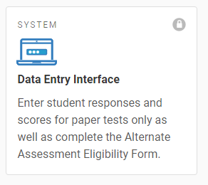
CTAS Description
Each grade-specific CTAS set contains:
Performance Tasks, which include:
a guiding question and a general overview of the task
a list of materials needed
instructions for preparing materials
step-by-step activities with built-in script and scaffolding for TEAs
scoring guidance
Resource Packets, which are specific to each Performance Task, and include required materials such as posters, graphs, sentence strips
Student Score Worksheet, which is to be completed in hardcopy and then submitted through the Data Entry Interface (DEI) during the testing window of March 28 - June 3, 2022
Notes:
Each Storyline includes a Performance Task at each assessed grade level with a series of assessment activities. Each activity provides a coherent sequence of instruction for the TEA on how to assess student performance associated with each Core Extension. The TEA assesses the eligible students on provided Performance Tasks using provided Resource Packet materials. The TEA rates the student’s performance on each activity using a 0–2 scale and provided scoring guidance. Supports include the use of communication devices and assistive technology or accommodations as described in the student’s Individualized Education Program (IEP).
The Resource Packets are to be used in conjunction with the Performance Tasks. They include materials that will be presented to the student when referenced by the teacher script in the Performance Task.
As TEAs administer each Performance Task, a paper copy of the Student Score Worksheet should be completed to record student ratings. After the CTAS is fully administered, TEAs will enter the ratings recorded on the Student Score Worksheet in the Data Entry Interface (DEI) during the testing window of March 29–June 4, 2021.

Slide 42
Data Entry Interface (DEI)
There are certain instructions for the submission of tests using the Data Entry Interface. Refer to the How to Access the Data Entry Interface brochure for details.
This system is is used for the following assessments:
Submitting the Connecticut Alternate Assessment Eligibility Form
Submitting the CTAS Student Score Worksheet
Smarter Balanced paper tests (Large Print and Braille)
NGSS paper tests (Large Print and Braille)

Slide 43
The DEI can be accessed via the portal under the Smarter Balanced, NGSS or Alternate Assessment program cards.
Trained teachers must use the DEI to submit the Alternate Assessment Eligibility Form and CTAS Student Score Worksheet.
For students who take the paper Braille and Large Print Smarter Balanced and NGSS, teacher must transcribe student’s responses from these booklets into the DEI.
The DEI does not require the secure browser. Users can access the DEI using most internet browsers (Chrome, Firefox, etc.).
All secure paper materials must be returned to Measurement Incorporated (MI) by June 3, 2022.
Data Entry Interface (DEI)

Slide 44
Alternate Assessment System Training Requirements
Connecticut Alternate Assessment Training must be completed annually by certified educators administering the alternate (TEAs).
Training is online and available on the Alternate Assessment web page on the portal.
TEAs must complete and pass the end-of-training quiz with a score of at least 80 percent or better.
Notes:
Teachers Administering the Alternate (TEAs) are intricately involved in all aspects of the selection and supervision of the Connecticut Alternate Assessment and the Alternate Science. The Connecticut Alternate Assessment System Training requirements provide for high-quality standardized administration ensuring appropriate interpretations for results about what students with significant cognitive disabilities know and can do.
All teachers who will be administering the alternate assessments must be trained via the online course regardless of previous training status. This training is required each school year. Once training and the embedded quiz is passed the TEA will have permission to;
Submit the Connecticut Alternate Assessment Eligibility Form into the DEI;
Submit the CTAS Student Score Worksheet for students in Grades 5, 8, or 11;
Access the required secure test materials for the CTAA;
Administer any alternate assessment.
District Administrators are responsible for the following tasks:
Determine who will be administering an Alternate Assessment during the 2021-22 school year.
Verify that the teacher has a TEA User Role in TIDE. Update, add, and delete accounts as appropriate.
Communicate details regarding the required online training with your TEAs. Share the Overview for Teachers Administering the Alternate resource referenced on this slide.
Verify that all TEAs complete and pass the quiz. Those with passing scores will have their Trained Status activated to Y (Yes) in TIDE.
Review the resources included on this slide for more information.

Slide 45
Alternate Assessment System Training Requirements
Resources:
Overview for District Administrators
Overview for Teachers Administering the Alternate
CTAA System User Guide
CTAA Test Administration Manual
CTAS Test Administration Manual
CTAA Assessing Students who are Blind, Deaf, or Deaf-Blind Additional Guidance
CTAS Assessing Students who are Blind, Deaf, or Deaf-Blind Additional Guidance
Notes:
Teachers Administering the Alternate (TEAs) are intricately involved in all aspects of the selection and supervision of the Connecticut Alternate Assessment and the Alternate Science. The Connecticut Alternate Assessment System Training requirements provide for high-quality standardized administration ensuring appropriate interpretations for results about what students with significant cognitive disabilities know and can do.
All teachers who will be administering the alternate assessments must be trained via the online course regardless of previous training status. This training is required each school year. Once training and the embedded quiz is passed the TEA will have permission to;
Submit the Connecticut Alternate Assessment Eligibility Form into the DEI;
Submit the CTAS Student Score Worksheet for students in Grades 5, 8, or 11;
Access the required secure test materials for the CTAA;
Administer any alternate assessment.
District Administrators are responsible for the following tasks:
Determine who will be administering an Alternate Assessment during the 2021-22 school year.
Verify that the teacher has a TEA User Role in TIDE. Update, add, and delete accounts as appropriate.
Communicate details regarding the required online training with your TEAs. Share the Overview for Teachers Administering the Alternate resource referenced on this slide.
Verify that all TEAs complete and pass the quiz. Those with passing scores will have their Trained Status activated to Y (Yes) in TIDE.
Review the resources included on this slide for more information.

Slide 46
Confirming Trained Teacher Status
1
Only the DA has access to add/change/delete a TEA User Role
2
3
Notes:
DAs can create a roster in TIDE to confirm those TEAs who have been trained. We have highlighted the steps in this slide. If a teacher indicates that they completed the training and passed the quiz, but do not have access to the Connecticut Alternate Assessment Eligibility Form or other Alternate Assessment Systems, verify their TIDE User Role. Only TEA user roles will provide teachers access to the Alternate Assessment systems.

Slide 47
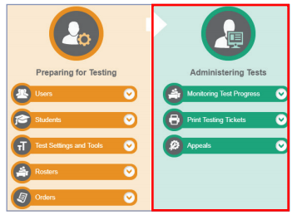
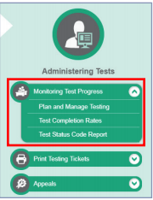
Monitoring Submissions
https://ct.portal.cambiumast.com/-/media/project/client-portals/connecticut/pdf/2019/monitoring-test-progress-brochure.pdf
Notes:
District Administrators may monitor the Completion of CT Alternate Assessment Eligibility Form through the Plan and Manage Testing drop-down menu in the Administering Test portion of TIDE.

Slide 48
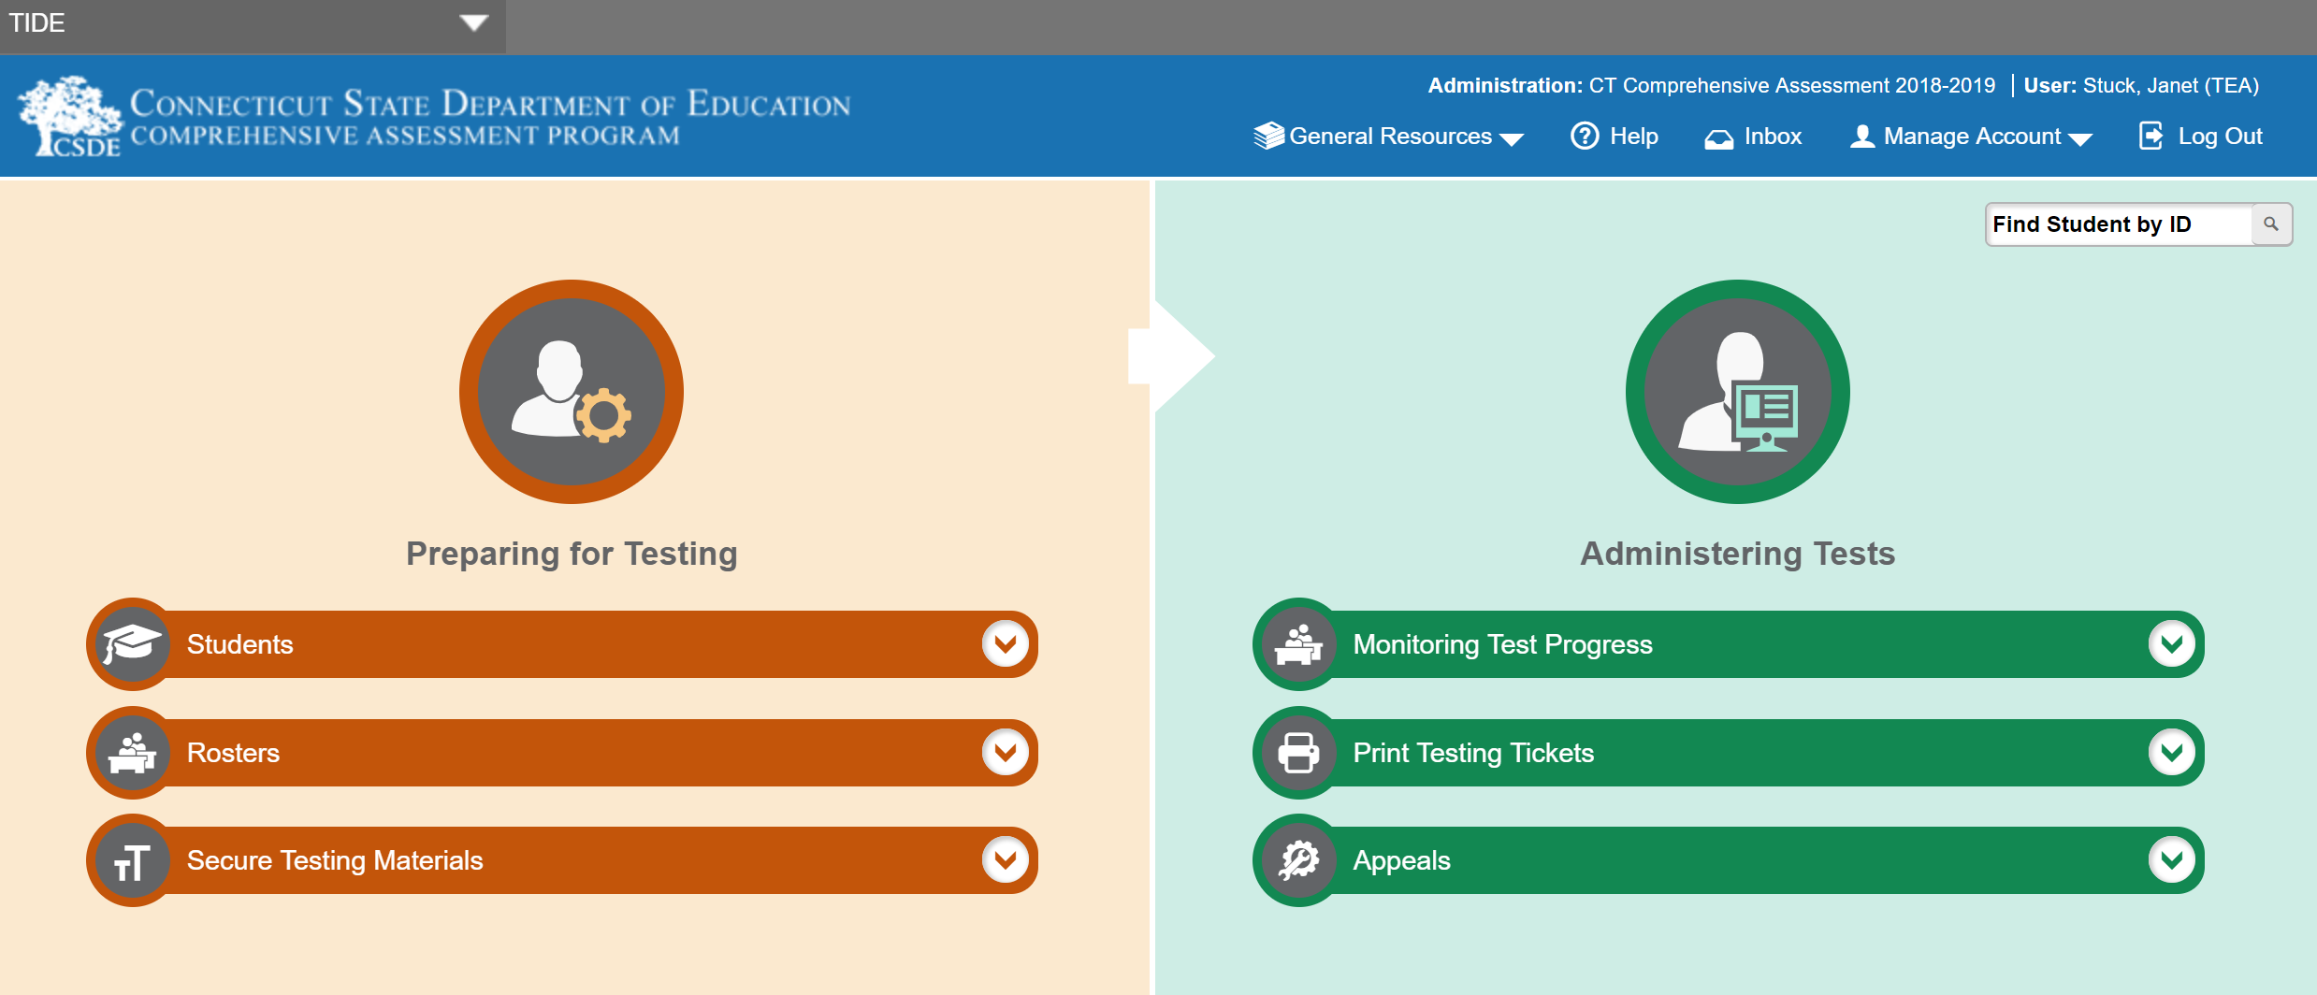
Secure Alternate Assessment Materials
Notes:
The required Connecticut Alternate Assessment (CTAA) Directions for Test Administration (DTAs) are secure testing materials and may be accessed ONLY by users with a TEA or DA role in the Test Information Distribution Engine (TIDE).
These grade-specific DTAs are required for test administration.
Additionally, secure PDFs of each grade and subject CTAA is available as an accommodation particularly for students who require the use of an eye gaze board or other communication supports.

Slide 49
Early Stopping Rule
Students who are typically eligible for the Early Stopping Rule (ESR) have characteristics representing the most complex support needs compared to their peers with significant cognitive disabilities.
Students who are typically eligible for the ESR have
an uncertain response to stimuli
the most significant adaptive behavioral needs
not yet established a mode of communication
Students who generally have a pervasive need for adult support throughout their lives may be eligible for the ESR.
For more information, see the Early Stopping Rule Flowchart.
Notes:
Typically, the students who are eligible for the Early Stopping Rule (ESR) are those students who have the most complex needs as compared to their peers with significant cognitive disabilities. Often, these students do not use oral speech, nor do they have an established communication system. They may be learning about cause and effect in order to utilize Augmentative or Alternative Communication supports. These students are not able to use objects/textures, regularized gestures, pictures, signs, etc., to communicate with consistency. Furthermore, they may have an uncertain response to sensory stimuli. The IEPs of these students often focus on medical and adaptive needs.
If you think your student may be eligible for the ESR, consider testing early in the assessment window and follow the ESR process as described in the required Alternate Assessment System training. This will ensure that there will be sufficient testing time within the window in case your student is not eligible for the ESR. Refer to the Early Stopping Rule Flowchart (hyperlinked on this slide) for more details about eligibility.

Slide 50
Medical Exemption Procedure
In Connecticut, the exemption determination for a medical emergency rests primarily on the following criteria:
The student is unable to attend school and is medically/emotionally unavailable for homebound/hospitalized instruction for the entire testing window.
Medical Exemption forms for the Connecticut SAT School Day are due by May 6, 2022; and
Medical Exemption forms for Smarter Balanced, the NGSS, and the Connecticut Alternate Assessments (CTAA/CTAS) are due no later than June 10, 2022.
See Appendix B of the Assessment Guidelines.
Notes:
Students who are hospitalized or homebound due to illness should be tested unless there are medical constraints. These students can have the test administered at home or in the hospital provided the test is administered by a certified school staff member who is fully trained in the proper test administration and security procedures for the specific assessment system (Smarter Balanced Assessments, NGSS Science, Connecticut SAT, CTAA, and CTAS).
In rare cases, there may be a student who experiences a medical emergency just prior to (or during) the testing window. There is a process whereby, the student may receive an exemption from testing due to the emergency nature of the medical condition, if the criteria for exemption are met. A medical exemption can be given to a student depending on the availability of the student during the statewide testing window.
Contact Deirdre or Janet if you think you have a student who is eligible for a medical exemption. Based on eligibility, DAs will be provided with a Medical Exemption form for completion, signature, and submission to the CSDE. Please keep in mind that there are two deadlines for receiving these forms:
Medical Exemption forms for the Connecticut SAT School Day are due by May 6, 2022; and
Medical Exemption forms for Smarter Balanced, the NGSS Science, and the Connecticut Alternate Assessments (CTAA/CTAS) are due no later than June 10, 2022.

Slide 51
Thank you for joining us! Please don’t hesitate to contact us.

