Slide 1
District Administrator’s
Special Populations Workshop
Attendee Reminders
For audio, you must connect to your computer’s audio or telephone using the phone number provided in the registration email from SDE GO TO Webinar.
All attendees will be placed on mute for the duration of the webinar.
To ask questions, please use the Question box or you may click on the Raise your Hand button and you will be able to ask your question.
Questions will be addressed by the presenters during the session. Unanswered questions will be addressed in a follow-up email.
This session is being recorded and will be posted to the CSDE Assessment web page and portal.
Notes:
Take a moment to unpack the presentation and remind your audience of the most salient/ important points for your local context.
This presentation reviews the background/ overall components of the assessment.

Slide 2


CONNECTICUT STATE DEPARTMENT OF EDUCATION
District Administrator’s
Special Populations Workshop
January 21 and 22, 2021

Slide 3
CSDE Assessment Staff -
Contact Information
Abe Krisst, Chief Student Assessment Abe.Krisst@ct.gov (860) 713-6894 ctstudentassessment@ct.gov Connecticut Help Desk 844-202-7583 cthelpdesk@cambiumassessment.com | Special Populations Accessibility & Accommodations Deirdre Ducharme Deirdre.Ducharme@ct.gov (860) 713-6859 Janet Stuck Janet.Stuck@ct.gov
Notes:
Awesome Assessment Team from CSDE.

Slide 4
Presentation Overview
2021 Calendar for Special Considerations
Who Participates in Testing?
Who Qualifies for Supports and Accommodations?
What’s New for 2020-21?
The Special Documented Accommodations Process
The Connecticut Alternate Assessment System
Medical Exemptions
Questions
Notes:
The scope of this presentation is for in-person administration. Details regarding remote testing will be addressed on April 8 at the Office Hours session. During that session, we will address the administration of remote testing and with a focus on the Remote Proctor Tool

Slide 5
2021 Calendar for Special Considerations
 | Deadline | Delivery Method
Designated Supports/Accommodations | November 24–June 4 *must be entered in TIDE prior to testing | TIDE
Special Documented Accommodations | January 22 | DA Requests Application from CSDE
Medical Exemptions | May 25, 2021 - Connecticut SAT School Day June 11, 2021 - Smarter Balanced, NGSS, Connecticut Alternate Assessments | DA Requests Application from CSDE
Notes:
We will talk about these

Slide 6
Who Participates in Testing?
Participation Expectations for Smarter Balanced, NGSS, and Connecticut SAT School Day:
  All students enrolled in the Public School information System (PSIS) in Grades 3-8 and 11 (these students include those identified as English learners and/or students with disabilities who have an active IEP or Section 504 Plan)
  Students enrolled in PSIS attending Approved Private Special Education Programs (APSEPs)
  Students enrolled in PSIS who are being educated in out-of-state facilities, in-state facilities, and non–approved facilities
Refer to the Students in PSIS Who Attend Out-of-State of In-State Non-Approved Facilities brochure.
Notes:
Refer to the Connecticut General Statutes 10-14n for legislation on statewide testing.

Slide 7
Who Is Eligible for Supports and Accommodations?

Slide 8
Who is Eligible for Universal Tools?
accessibility features available to ALL students (e.g., digital notepad, line reader, highlighter)
provided digitally (embedded) through the Test Delivery System or provided from the test examiner as a non-embedded tool
to learn more, refer to the Smarter Balanced Blog Post: Five Built In Test Tools Students Should Know (and Use!)

Slide 9
Who is Eligible for Designated Supports?
embedded accessibility features available to ANY student for whom the need has been indicated by an educator/parent/guardian and student (e.g., streamline, text-to-speech of items, print size)
selected supports should be consistently used in the student’s instructional setting
non-embedded designated supports can be provided by the test examiner (e.g., read aloud of test items, simplified test directions)
must be activated in TIDE
provide opportunities for students to practice using tools and designated supports using Practice Tests

Slide 10
Who is Eligible for Test Accommodations?
available for students with an active Individualized Education Program (IEP) or a Section 504 Plan
IEP/504 Plan must specify which accommodations will be used during testing, and should generally reflect similar accommodations needed for instruction
embedded accommodations are provided through the Test Delivery System (e.g., text-to-speech of ELA Reading Passages, closed captioning)
non-embedded accommodations are provided by the test examiner (e.g., 100 Numbers Table, Large Print Test booklet)
must be activated in TIDE

Slide 11


Accommodation Eligibility
In order to be eligible for any embedded or non-embedded accommodation, the IDEA Indicator or Section 504 Plan field must be set to Yes based on the PSIS registration fields. Without this indication, accommodations cannot be set in TIDE.

Slide 12




Universal Tools:
Available to ALL students
Designated Supports:
Accommodations:
Available to students with an IEP or 504 Plan
Embedded
Color Contrast
Masking
Text-to-Speech- Science, Math & ELA Items (Non-Reading Passages)
Turn off any universal accessibility tool
Translation Test Directions Spanish (Math, Science) *
Print Size Online
Mouse Pointer
Translations-Math (Glossary) (Includes Illustration Glossary as an available language support) *
Text-to-Speech-Spanish (Science) *
Spanish Presentation (Science) (Toggle) *
Spanish Presentation (Math) (Stacked) *
Streamline
Available to ANY student with a need determined by educators
Desmos Calculator (Math Grades 6-8; Science Grades 5, 8, & 11)
Digital Notepad
English Glossary^
Expanded Passages/Stimuli/Items
Highlighter
Keyboard Navigation
Math Tools
Strikethrough
Writing Tools
Zoom
Line Reader
Mark for Review
Breaks
Embedded
NGSS Periodic Table (Grades 8 & 11) English
Non-Embedded
Embedded
American Sign Language (Video)^
Closed Captioning (ELA Listening)
Refreshable Braille
Braille Type
Text-to-Speech ELA Reading Passages (Grades 3-8)
Braille Transcript (ELA Listening)
Speech-to-Text NEW!
Permissive Mode (compatible third party accessibility software)
  100s Number Table (Grades 3-8)
  Abacus
  Alternate Response Options
  Braille Booklet
  Calculator (Math Grades 6-8) #
  Customized Accommodations ~#
  Human Signer for ELA, Math, and/or Science Items ~ #
  Human Signer for ELA Reading Passages (Grades 3-8) ~ #
  Large Print Booklet
  Manipulatives (Math, Grades 4-8) #
  Multiplication Table (Grades 3-8)
  Print on Demand #
  Read Aloud ELA Reading Passages (Grades 3-8) ~ #
  Scribe ~#
  Specialized Calculator (Braille/Talking Calculator) (Math Grades 6-8; Science Grades 5, 8, & 11)
Non-Embedded
Bilingual Dictionary (Science) *
Color Contrast
Color Overlay
Magnification
Noise Buffer
Read Aloud
Separate Setting
Translation Glossary (Math) * (Includes Illustrative Glossary as an available language support) (Note: These must be requested through Helpdesk and accompany a large-print test booklet.)
Translation Test Directions* (Math, ELA)^
Read Aloud in Spanish (Math, Science) *
Simplified Test Directions^
Amplification
Native Language Reader Directions (Science) *
Non-Embedded
Breaks
Scratch Paper/ whiteboard with marker
Calculator (Science Grades 5, 8, &11)
NGSS Periodic Table (Grades 8 & 11) English and Spanish*
# Requires Petition for Approval of Special Documented Accommodations
^ NOT available for Science
~ Requires Trained Educator
*Suggested for English Learners
Refer to the Assessment Guidelines for detailed information on universal tools, supports, and accommodations.
Updated 8/5/2020
Notes:
Note the grade range for 100s Numbers Table, Multiplication Table
Online Resources
Embedded and Non-Embedded Designated Supports for English Learners brochure
Translation Glossary Embedded Designated Support -Math brochure

Slide 13
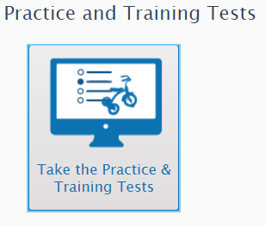
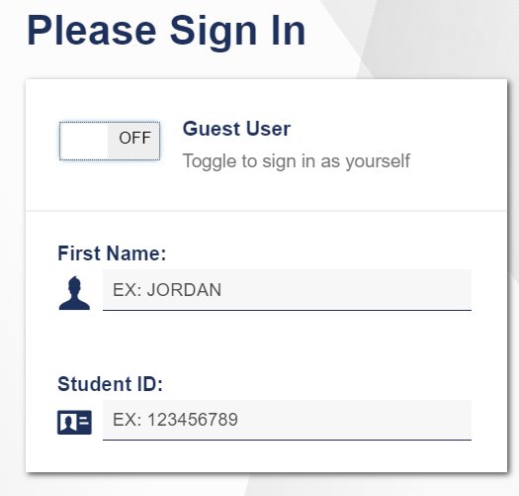
Provide Students with Opportunities to Practice
Administer Practice Tests to allow students to be familiar with online test platform, item format, universal tools, and practice with designated supports and accommodations (if applicable).

Slide 14
What’s New for 2021?

Slide 15

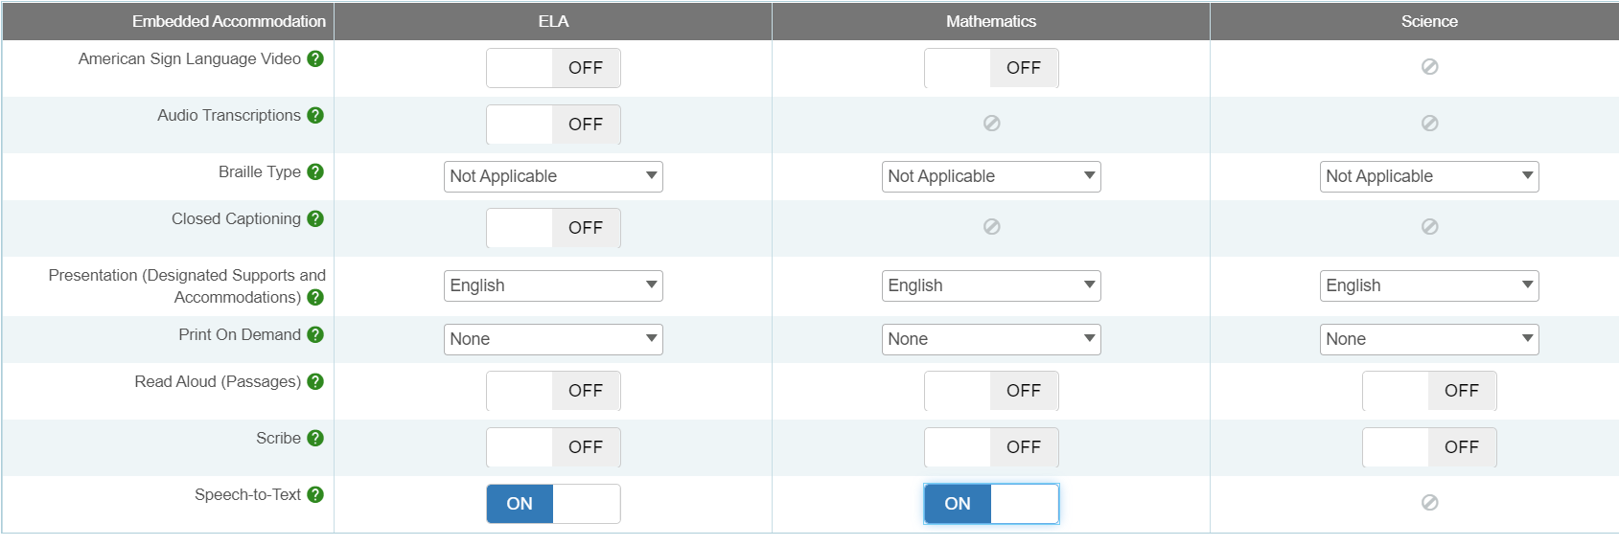
What is New in 2021?
Embedded Speech-to-Text Accommodation is available for Math and ELA open-ended items, including the Math Performance Task. It only functions when activated in TIDE.
Notes:
Replaces the need for multiple computers and transferring responses into the test delivery system by the student or teacher.

Slide 16

Speech-to-Text
A microphone icon will appear below any item text box that requires a written response.
When the student clicks on the icon for the first time, a pop-up will appear asking for permission to activate the microphone. The student should choose Yes.
When the student selects the microphone, they will dictate their verbal response as the system transcribes the voiced message in the text box.
Students can delete or revise their response as appropriate.
Notes:
Accommodation check: When applicable, ask your student to practice this accommodation on a Practice Test. When they do, be sure to look for the microphone icon. If it doesn’t appear under the open-ended item response text box, then the accommodation may not have been set in TIDE.

Slide 17
Speech-to-Text
Students should try this accommodation using a Practice or Interim Assessment in advance of summative testing to ensure that the student knows how to operate this function.
This feature auto punctuates and capitalizes as it transcribes a student’s dictation. Students should proof read and edit responses before moving onto the next item.
Must test in a separate 1:1 setting.
Notes:
Accommodation check: When applicable, ask your student to practice this accommodation on a Practice Test. When they do, be sure to look for the microphone icon. If it doesn’t appear under the open-ended item response text box, then the accommodation may not have been set in TIDE.

Slide 18
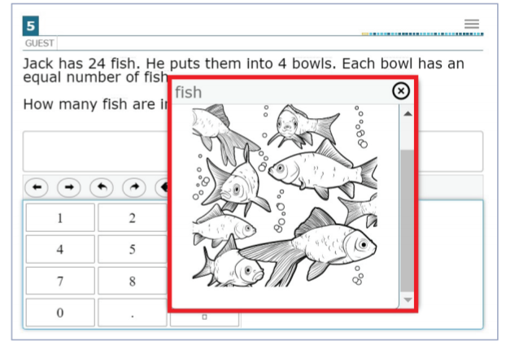
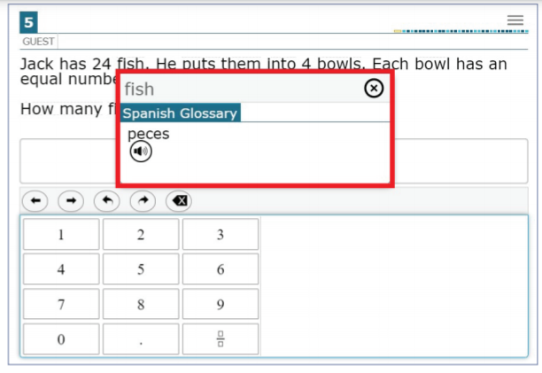
Multiple Selections for the
Embedded Translation Glossary- Math
Selections include
  Single native-language support (i.e., Spanish Glossary, Illustration Glossary)
  Dual language supports (native language paired with English); (i.e., Spanish & English Glossary); or
  Dual language supports combined with Illustration Glossary (i.e., Spanish, English, & Illustration Glossary)
Notes:
Notes about this designated support:
Based on differences in complexity across languages, different language Glossaries may provide support for different construct irrelevant English language terms. Therefore, if a student has access to the English and one second-language Glossary, some terms may have both Glossaries present while other terms may have only one of the two Glossaries present. Please note that not all math items contain glossary options.
The Illustration Glossary may be a useful language support for those students who are not fluent in their native language and benefit from a pictorial symbol OR if the student’s native language is not represented by the list of available language options . The provision of these dual supports may distracting or inappropriate without careful consideration of the student’s language needs.
Also note that if the student has a dual language mode or triple language mode (i.e. Russian, English, & Illustration Glossary) enabled, the Glossary will appear with the corresponding tabs, one for each language, when appropriate.

Slide 19
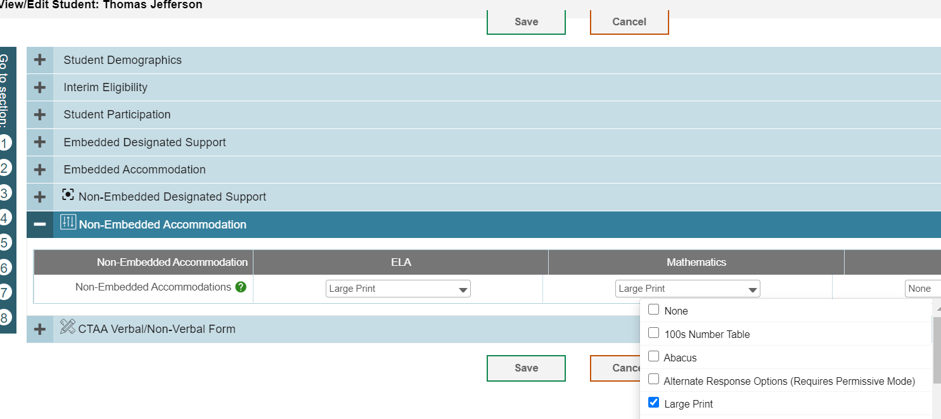
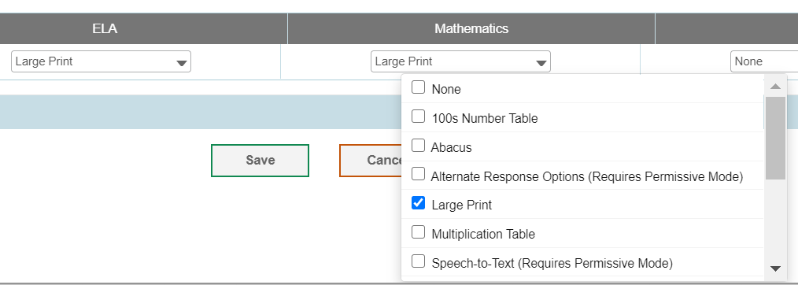
How do I Order Large Print or Braille Test Materials?
District Administrators can order Braille and Large Print kits for Smarter Balanced and NGSS in TIDE anytime after January 27, 2021.
Confirm that the student has the non-embedded accommodation set properly in TIDE.
.

Slide 20
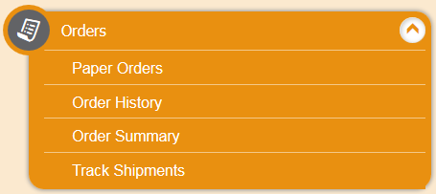
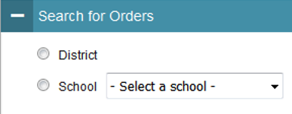
Ordering Paper Materials in TIDE
Step 1: From the Orders task menu on the TIDE dashboard, select Paper Orders.
Step 2: Search for orders by District or School.
Step 3: Enter the quantity needed for each of the materials needed.
Districts can track shipments in TIDE.

Slide 21
What are Special Documented Accommodations?
When universal tools, designated supports, and accommodations do not meet a student’s accessibility needs as described in their IEP/504 Plan, DAs can apply for a special documented accommodation for additional supports through a petition process.
Read Aloud of Reading Passages*
Human Signer (Items and/or passages)
Scribe
Print on Demand
Manipulatives (Math, Grades 4-8)
Hand-held calculator (Math, Grades 6-8) for calculator-allowed items
Customized
*Requires the submission of the Decision Guidelines for Read Aloud of the Smarter Balanced Reading Passages
Notes:
For a small number of students, the universal tools, designated supports, and accommodations on the Accessibility Chart and described in the Assessment Guidelines may not be enough to meet the accessibility needs of the student. In this case, the District Administrator in TIDE may submit a petition for these students to the Connecticut State Department of Education Performance Office to discuss and develop a plan for the assessment.

Slide 22

What is the Process for Submitting a Special Documented Accommodation?
Do |  | Do Not
 | DA’s should contact Deirdre or Janet regarding any student who may qualify. See Assessment Guidelines Appendix C page 53. |  | provide student names or confidential information if requesting information via email.
 | Based on initial eligibility, DAs will receive a Special Documented Accommodation Petition and access to the Cambium Secure FTP site for submitting completed paperwork documenting the need for special accommodation(s). |  | email petitions, IEPs, 504s, or any confidential information. All petitions must submitted by the DA using Cambium’s secure FTP site.
 | CSDE will review petitions and provide a letter of approval or guidance to district via the secure FTP site. Letters of approval may also include the completion/submission of security/confidentiality agreements. |  | test students with requested accommodations without approval from the CSDE.
Notes:
To facilitate this process, the DA must contact Deirdre or Janet and provide information about the student’s specific needs per their disability and supports identified in their IEP. If appropriate, we will provide a petition to be completed by the student’s primary teacher and returned with the teacher, DA, and Special Education Director’s signature, along with a complete copy of the student’s active IEP. All Special Documented Accommodations must be submitted by January 22, 2021.
No special accommodations can be provided unless they are approved by the CSDE.
As identified on this slide, some examples of Special Accommodations include, but are not limited to:
Read aloud ELA passages Grades 3-8;
Print on Demand;
Scribe and Human Signer/Human Signer of ELA Reading Passages;
Any alternative response option/ assistive technology device that the student typically uses that is not compatible with the Assessment platform; and
Other
The Special Documented Accommodations Procedure is described in the Assessment Guidelines, Appendix C.

Slide 23
The Connecticut Alternate Assessment System for Eligible Students with Significant Cognitive Disabilities

Slide 24
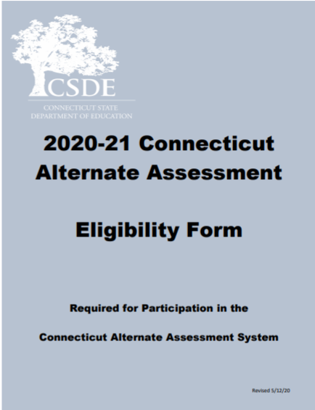
Connecticut Alternate Assessment Eligibility Form
Notes:
The Connecticut Alternate Assessment Eligibility Form has been developed to determine eligibility for the Alternate Assessment System through discussion at the Planning and Placement Team (PPT) meeting. This document is required to register students for the CTAA and the CTAS. The document may be accessed on the CSDE Comprehensive Assessment Program Portal.
The eligibility form must be submitted in the Data Entry interface (DEI) on the CSDE Comprehensive Assessment Program Portal.
Only teachers with the user role of TEA and confirmed training status may register a student to participate in the Alternate Assessment System by submitting the eligibility form into the Data Entry Interface.

Slide 25
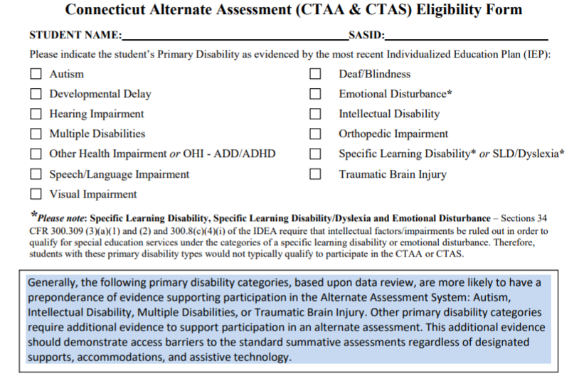
Connecticut Annotated Alternate Assessment Eligibility Form

Slide 26
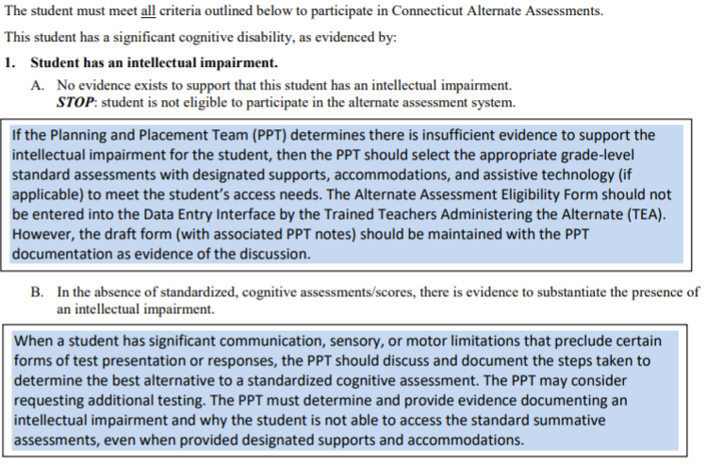
Connecticut Annotated Alternate Assessment Eligibility Form

Slide 27
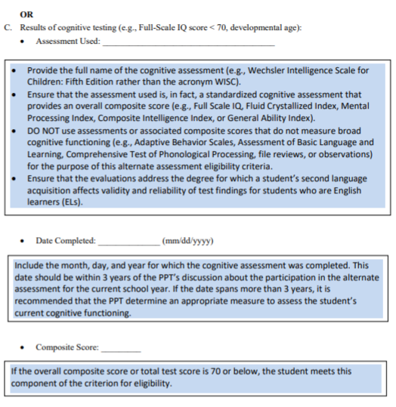
Connecticut Annotated Alternate Assessment Eligibility Form

Slide 28
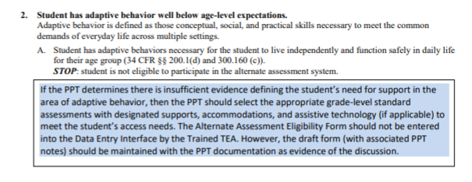
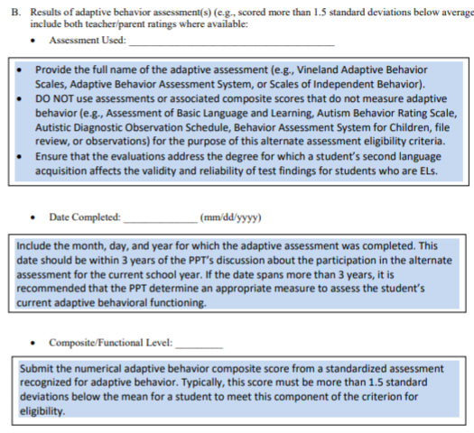
Connecticut Annotated Alternate Assessment Eligibility Form

Slide 29
Resources to Support the Eligibility of the Alternate Assessment System
Frequently Asked Questions and Answers about the Connecticut Alternate Assessment System
Annotated Connecticut Alternate Assessment Eligibility Form
Frequently asked Questions and Answers About the Connecticut Alternate Assessment Eligibility Form
Connecticut Alternate Assessment System Participation Guidance for Planning and Placement Teams Flowchart
For more information, visit the CSDE Website and the Connecticut Comprehensive Assessment Program Portal.
Notes:
Included on this slide are resources to help support your understanding of the purpose and eligibility for the Connecticut Alternate Assessment System.

Slide 30
2021 Calendar for Alternate Assessments
 | Grade(s) | Deadline | Delivery Method
CT Alternate Assessment Eligibility Form | 3 – 8, 11 | February 15 * Eligible students in Grades 3-8; and extended deadline for newly eligible Grade 11 students | Data Entry Interface
Connecticut Alternate Assessment (CTAA) | 3 – 8 and 11 | March 29 – June 4 | Online Test Delivery System
Submission of the CTAS Student Score Worksheet | 5, 8, and 11 | March 29 – June 4 | Data Entry Interface
*Eligibility forms for eligible students in Grade 11 and dually identified English learners and students with disabilities (Grades 3-8 and 11) were due on January 15, 2021. When forms are submitted after February 15, DA’s must notify the CTHelpdesk to request the activation of the Alternate Flag Indicator. Otherwise, students will not have access to the Alternate Assessments.

Slide 31
Connecticut Alternate Assessment System
 | Connecticut Alternate Assessment (CTAA) | Connecticut Alternate Science (CTAS)
Grades | 3-8 and 11 | 5, 8, 11
Test Subject Areas | English language arts Reading Writing Mathematics | Science Earth Life Physical
Test Delivery Method | Trained TEA administers the grade-specific math and ELA items via the online testing system | Trained TEA assesses eligible student with performance tasks based on Connecticut Alternate Science Assessment Essence statements
Test Window | Administered with required secure Directions for Test Administration (DTAs) March 29-June 4, 2021 | Designed to be administered through the school year: student ratings will be entered in the DEI Upload window: March 29-June 4, 2021
Security | Secure | Non-secure
Notes:
This is a comparison between the CTAA for Math and ELA and the Connecticut Alternate Science (CTAS).

Slide 32
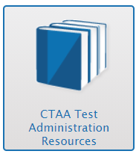
CTAA Description
is aligned to the Connecticut Core Standards for math and English language arts for eligible students with significant cognitive disabilities in Grades 3-8 and 11
is a secure test accessed via an online platform during the CSDE’s testing window
is designed to promote maximum student access while maintaining the integrity of the constructs being assessed
incorporates optimal testing conditions that must be provided to all students who take the test (i.e., 1:1 test setting)
accessibility features that must be provided to students as needed (i.e., human reader, scribe)

Slide 33
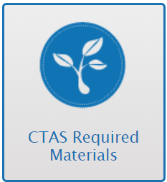
CTAS Description
District Administrations received paper copy CTAS test materials in the fall of 2018. These materials are to be shared among schools and teachers and used from year to year. Materials can also be downloaded and printed from the Connecticut Comprehensive Assessment Program Portal.
Notes:
Each Storyline includes a Performance Task at each assessed grade level with a series of assessment activities. Each activity provides a coherent sequence of instruction for the TEA on how to assess student performance associated with each Core Extension. The TEA assesses the eligible students on provided Performance Tasks using provided Resource Packet materials. The TEA rates the student’s performance on each activity using a 0–2 scale and provided scoring guidance. Supports include the use of communication devices and assistive technology or accommodations as described in the student’s Individualized Education Program (IEP).
The Resource Packets are to be used in conjunction with the Performance Tasks. They include materials that will be presented to the student when referenced by the teacher script in the Performance Task.
As TEAs administer each Performance Task, a paper copy of the Student Score Worksheet should be completed to record student ratings. After the CTAS is fully administered, TEAs will enter the ratings recorded on the Student Score Worksheet in the Data Entry Interface (DEI) during the testing window of March 29–June 4, 2021.

Slide 34
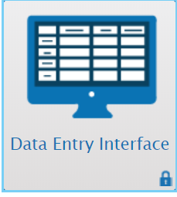
CTAS Description
Each grade-specific CTAS set contains:
  Performance Tasks, which include:
      a guiding question and a general overview of the task
      a list of materials needed
      instructions for preparing materials
      step-by-step activities with built-in script and scaffolding for TEAs
      scoring guidance
  Resource Packets, which are specific to each Performance Task, and include materials such as posters, graphs, sentence strips
  Student Score Worksheet, which is to be completed in hardcopy and then submitted through the Data Entry Interface (DEI) during the testing window of March 29, 2021-June 4, 2021
Notes:
Each Storyline includes a Performance Task at each assessed grade level with a series of assessment activities. Each activity provides a coherent sequence of instruction for the TEA on how to assess student performance associated with each Core Extension. The TEA assesses the eligible students on provided Performance Tasks using provided Resource Packet materials. The TEA rates the student’s performance on each activity using a 0–2 scale and provided scoring guidance. Supports include the use of communication devices and assistive technology or accommodations as described in the student’s Individualized Education Program (IEP).
The Resource Packets are to be used in conjunction with the Performance Tasks. They include materials that will be presented to the student when referenced by the teacher script in the Performance Task.
As TEAs administer each Performance Task, a paper copy of the Student Score Worksheet should be completed to record student ratings. After the CTAS is fully administered, TEAs will enter the ratings recorded on the Student Score Worksheet in the Data Entry Interface (DEI) during the testing window of March 29–June 4, 2021.

Slide 35
Data Entry Interface (DEI)
There are certain instructions for the submission of tests using the Data Entry Interface. Refer to the How to Access the Data Entry Interface brochure for details.
This system is is used for the following assessments:
  Submitting the Connecticut Alternate Assessment Eligibility Form
  Submitting the CTAS Student Score Worksheet
  Smarter Balanced paper tests (Large Print and Braille)
  NGSS paper tests (Large Print and Braille)

Slide 36
Data Entry Interface (DEI)
The DEI can be accessed via the portal under the Smarter Balanced, NGSS or Alternate Assessment program cards.
Trained teachers must use the DEI to complete the Alternate Assessment Eligibility Form and CTAS Student Score Worksheet.
For students who take the paper Braille and Large Print Smarter Balanced and NGSS, teacher must transcribe students responses from these booklets into the DEI.
The DEI does not require the secure browser. Users can access the DEI using most internet browsers (Chrome, Firefox, etc.).
All secure paper materials must be returned to Measurement Incorporated (MI) by the end of the window.

Slide 37
Alternate Assessment System Training Requirements
Connecticut Alternate Assessment Training must be completed annually by certified teachers administering the alternate (TEAs).
Training is online and available on the Alternate Assessment Card on the portal.
TEAs must complete and pass the end-of-training quiz with a score of at least 80 percent or better.
Resources:
Overview for District Administrators
Overview for Teachers Administering the Alternate
CTAA System User Guide
CTAA Test Administration Manual
CTAS Test Administration Manual
CTAA Assessing Students who are Blind, Deaf, or Deaf-Blind Additional Guidance
CTAS Assessing Students who are Blind, Deaf, or Deaf-Blind Additional Guidance
Notes:
Teachers Administering the Alternate (TEAs) are intricately involved in all aspects of the selection and supervision of the Connecticut Alternate Assessment and the Alternate Science. The Connecticut Alternate Assessment System Training requirements provide for high-quality standardized administration ensuring appropriate interpretations for results about what students with significant cognitive disabilities know and can do.
All teachers who will be administering the alternate assessments must be trained via the online course regardless of previous training status. This training is required each school year. Once training and the embedded quiz is passed the TEA will have permission to;
Submit the Connecticut Alternate Assessment Eligibility Form into the DEI;
Submit the CTAS Student Score Worksheet for students in Grades 5, 8, or 11;
Access the required secure test materials for the CTAA;
Administer any alternate assessment.
District Administrators are responsible for the following tasks:
Determine who will be administering an Alternate Assessment during the 2020-21 school year.
Verify that the teacher has a TEA User Role in TIDE. Update, add, and delete accounts as appropriate.
Communicate details regarding the required online training with your TEAs. Share the Overview for Teachers Administering the Alternate resource referenced on this slide.
Verify that all TEAs complete and pass the quiz. Those with passing scores will have their Trained Status activated to Y (Yes) in TIDE.
Review the resources included on this slide for more information.

Slide 38
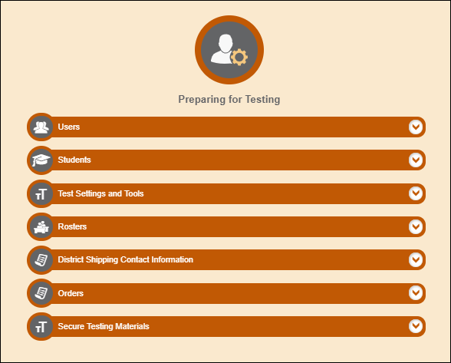
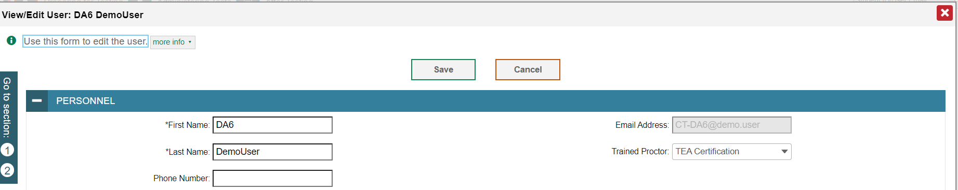
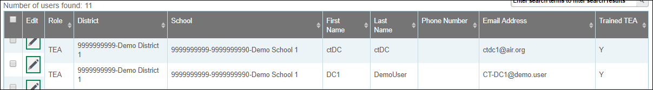
Confirming Trained Teacher Status
1
Only the DA has access to add/change/delete a TEA User Role
2
3
Notes:
DAs can create a roster in TIDE to confirm those TEAs who have been trained. We have highlighted the steps in this slide. If a teacher indicates that they completed the training and passed the quiz, but do not have access to the Connecticut Alternate Assessment Eligibility Form or other Alternate Assessment Systems, verify their TIDE User Role. Only TEA user roles will provide teachers access to the Alternate Assessment systems.

Slide 39
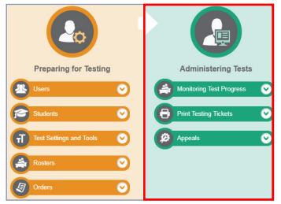
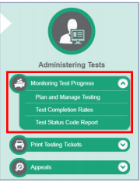
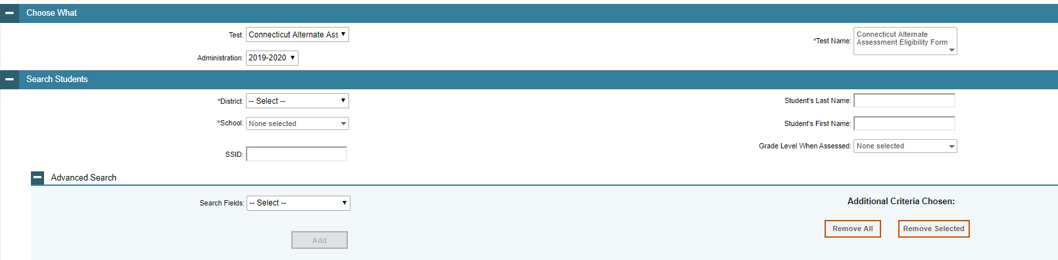
Monitoring Submissions
https://ct.portal.airast.org/core/fileparse.php/51/urlt/CT_Monitoring-Test-Progress_Brochure.pdf
Notes:
District Administrators may monitor the Completion of CT Alternate Assessment Eligibility Form through the Plan and Manage Testing drop-down menu in the Administering Test portion of TIDE.

Slide 40
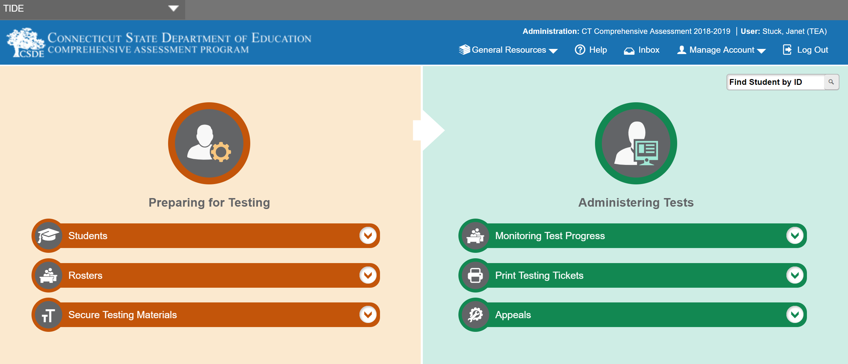
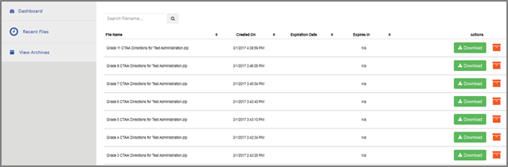
Secure Alternate Assessment Materials
Notes:
The required Connecticut Alternate Assessment (CTAA) Directions for Test Administration (DTAs) are secure testing materials and may be accessed ONLY by users with a TEA or DA role in the Test Information Distribution Engine (TIDE).
These grade-specific DTAs are required for test administration.
Additionally, secure PDFs of each grade and subject CTAA is available as an accommodation particularly for students who require the use of an eye gaze board or other communication supports.

Slide 41
Early Stopping Rule
Students who are typically eligible for the Early Stopping Rule (ESR) have characteristics representing the most complex support needs compared to their peers with significant cognitive disabilities.
Students who are typically eligible for the ESR have
  an uncertain response to stimuli
  the most significant adaptive behavioral needs
  not yet established a mode of communication
Students who generally have a pervasive need for adult support throughout their lives may be eligible for the ESR.
For more information, see the Early Stopping Rule Flowchart.
Notes:
Typically, the students who are eligible for the Early Stopping Rule (ESR) are those students who have the most complex needs as compared to their peers with significant cognitive disabilities. Often, these students do not use oral speech, nor do they have an established communication system. They may be learning about cause and effect in order to utilize Augmentative or Alternative Communication supports. These students are not able to use objects/textures, regularized gestures, pictures, signs, etc., to communicate with consistency. Furthermore, they may have an uncertain response to sensory stimuli. The IEPs of these students often focus on medical and adaptive needs.
If you think your student may be eligible for the ESR, consider testing early in the assessment window and follow the ESR process as described in the required Alternate Assessment System training. This will ensure that there will be sufficient testing time within the window in case your student is not eligible for the ESR. Refer to the Early Stopping Rule Flowchart (hyperlinked on this slide) for more details about eligibility.

Slide 42
Medical Exemption Procedure
In Connecticut, the exemption determination for a medical emergency rests primarily on the following criteria:
The student is unable to attend school and is medically/emotionally unavailable for homebound/hospitalized instruction for the entire testing window.
Medical Exemption forms for the Connecticut SAT School Day are due by May 25, 2021; and
Medical Exemption forms for Smarter Balanced, the NGSS, and the Connecticut Alternate Assessments (CTAA/CTAS) are due no later than June 11, 2021.
See Appendix B of the Assessment Guidelines.
Notes:
Students who are hospitalized or homebound due to illness should be tested unless there are medical constraints. These students can have the test administered at home or in the hospital provided the test is administered by a certified school staff member who is fully trained in the proper test administration and security procedures for the specific assessment system (Smarter Balanced Assessments, NGSS Science, Connecticut SAT, CTAA, and CTAS).
In rare cases, there may be a student who experiences a medical emergency just prior to (or during) the testing window. There is a process whereby, the student may receive an exemption from testing due to the emergency nature of the medical condition, if the criteria for exemption are met. A medical exemption can be given to a student depending on the availability of the student during the statewide testing window.
Contact Deirdre or Janet if you think you have a student who is eligible for a medical exemption. Based on eligibility, DAs will be provided with a Medical Exemption form for completion, signature, and submission to the CSDE. Please keep in mind that there are two deadlines for receiving these forms:
Medical Exemption forms for the Connecticut SAT School Day are due by May 25, 2021; and
Medical Exemption forms for Smarter Balanced, the NGSS Science, and the Connecticut Alternate Assessments (CTAA/CTAS) are due no later than June 11, 2021.

Slide 43
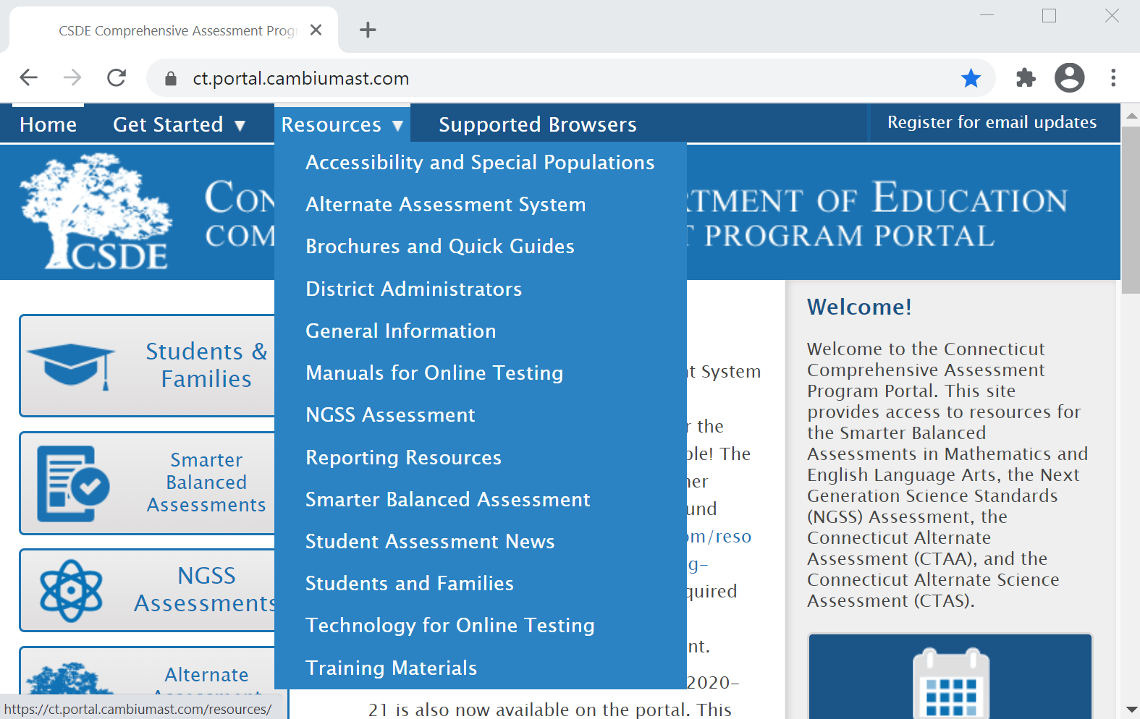
Special Populations Resources
Notes:
A variety of forms, brochures, manuals and supports related to accessibility and accommodations are available under the Resources tab on the Connecticut Portal.

Slide 44
2020 - 21 Assessment Office Hours*
Date | Topics
February 16 3:00-4:00 | Connecticut Alternate Assessments/Accessibility and Accommodations
March 15 3:30-4:30 | Connecticut Alternate Assessments/Accessibility and Accommodations
April 1 and every Thursday (3 p.m.) | Smarter, NGSS, CTAS and CTAA Topics (April 8 – Remote Proctoring Tool)
*NOTE: There are additional Office Hours for LAS Links and Connecticut SAT School Day.

Slide 45
Remote Testing for Smarter Balanced and NGSS Assessments
Administration Hierarchy (Smarter Balanced and NGSS):
Students attending school fully in-person or in hybrid mode must be tested in-person.
Students who are fully remote and can be tested in-person or in an alternate secure district location (i.e., in a suitable room in a school or district-operated building), should be tested in this manner.
Remote administration is available only to those students who are fully remote and cannot test in person or in an alternate secure district location.
Note: Accommodations for remote administration need to be carefully considered.

Slide 46
Is There a Remote Proctoring Option for CTAS and CTAA?
  There is no remote proctoring tool for the CTAS and CTAA due to the complexities of the test design and test administration.
  The CSDE recommends that the CTAS and CTAA be administered in a school environment by following district safety protocols.
  Scores for the CTAS can be submitted through the Data Entry Interface between 3/29/21 - 6/4/21.
  If a student is a fully-remote student, it would be possible to administer the tests only if a trained teacher is available in person to administer the alternate assessments in a one-to-one situation in the remote environment over as many sessions as the student requires.
Notes:
CSDE expects universal participation on its state summative assessments in 2020-21 in almost all situations. Ideally, all students should be tested safely in-person; remote testing is available but should be used as a last resort. The alternate assessments (CTAA and CTAS) are too complex to be administered remotely, so if a student attends school remotely and cannot participate in the alternate assessments in-person due to safety considerations, then the student would not be tested.

Slide 47
Resources/Trainings Prior to the
Remote Summative Administration?
Yes, more guidance and resources are coming.
Office Hours Remote Proctoring Tool,
April 8, 3:00-4:00

Slide 48
Questions

Slide 49

Notes:
Thank you.

