Slide 1
Training Resources and Help Desks
Notes:
Now let’s shift to how the CT-SEDS Support team can help you and your end users as implementation begins.

Slide 2
CT-SEDS District Experts are First Tier of Support
School personnel should first leverage their District and School Level CT-SEDS Experts to assist in any end user concern
This is the recommended method of operation because the knowledge of these School Level Experts demonstrates to their colleagues both “buy-in” and expertise with the new system.
Many questions from the users are special education process-related, not system-related, and can be best answered by the District/School Level Experts.
For special education process-related questions, the District/School Level Experts escalate the need for support to PCG or the CSDE/RESCs Help Desk.
Notes:
We know and understand that the new IEP and the CT-SEDS system are a lot to adapt to at once. The CSDE, the RESCs and the CT-SEDS Support team are working closely and talking with each other. Districts should feel comfortable reaching out and together we will get the answers and assistance you need to be successful.

Slide 3
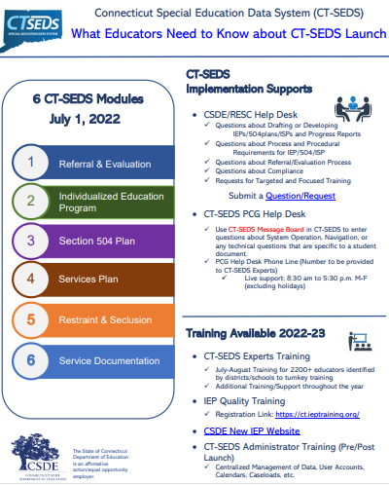
Implementation Supports Available
CSDE/RESC Help Desk
✓ Questions about Developing IEPs/504plans/ISPs and Progress Reports
✓ Questions about Process and Procedural Requirements for IEP/504/ISP
✓ Questions about Referral/Evaluation Process
✓ Questions about Compliance
✓ Requests for Targeted and Focused Training
https://ctieptahelp.atlassian.net/servicedesk/customer/portal/1/group/1/create/17
Notes:
CSDE and the RESCs are offering technical assistance and support for the new IEP process and much more. They can be leveraged to help you address the questions raised here and going to the website on the screen will take you to a support request form where you can arrange for a consultation.

Slide 4
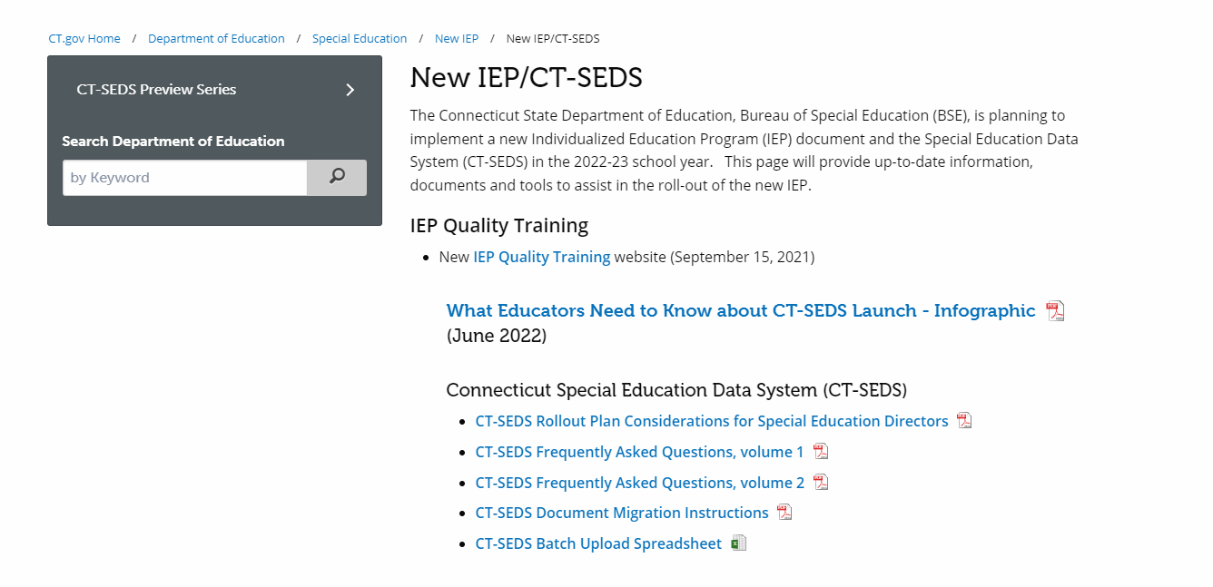
CSDE New IEP Website
CSDE New IEP Website
https://portal.ct.gov/SDE/Special-Education/New-IEP/New-IEP-CT-SEDS
Notes:
The CSDE will continue to maintain and add to the NEW IEP Website shown here throughout the coming year. All of the planning tools and communications shared with the field so far are posted here, and more are coming. The table we looked at a moment ago comes from the CT-SEDS Planning Considerations for Special Education Directors document at the top of this list.

Slide 5
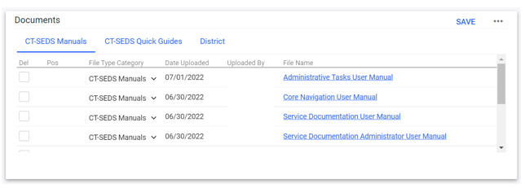
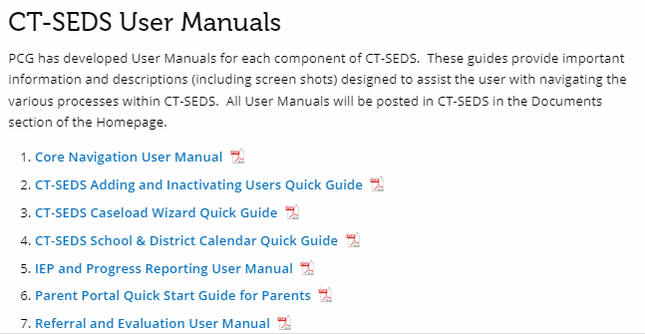
CT-SEDS User Manuals and Quick Guides
CT-SEDS Manuals and Videos available in the Documents Widget on the Home Page.
User Manuals also posted to the CSDE Website
Notes:
Please note, all of the Modules have a specific user manual that will help with navigation as well as processes for using the system. The general Core Navigation user manual is also very useful for people as they are starting out in the system. All of the manuals are found in the Documents widget on the home page under the CT-SEDS Manuals tab.
All videos shared today are available as videos. Links to each video are in a document posted to the Documents widget on the home page under the CT-SEDS Quick Guides heading.
Please also note there are also additional Quick Guides posted under CT-SEDS Quick Guides. Quick guides are short ‘how-to’ instructions to help with common tasks. The Caseload Wizard quick guide is a good one to put into users hands as they are just starting out as most will need to have students on their caseloads to get started in their work. The guide also includes instructions for the Caseload Admin wizard, which Administrative users will have access to. This wizard works similarly to the one end users use, but it allows a person with administrative rights the ability to manage other caseloads as well as copy and move caseloads from one user to another. Other current quick guides include Adding and Inactivating Users, School and District calendars, and the Parent Portal Quick Start Guide for Parents.
Please also ensure that you are watching the Announcements board in the system. As more quick guides are created and other modules are released, announcements will be made and documents will be posted. Quick guides are often created from questions that come from users, so we strongly encourage you to pay attention to the Announcements widget. Please note, if you have a suggestion or request for a new guide, you can use the message board to request one.

