Slide 1
504 Process

Slide 2
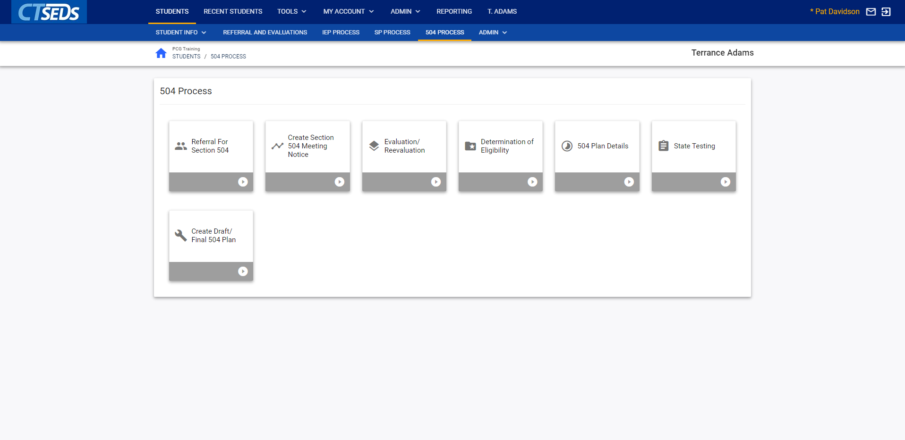
Notes:
When entering the Section 504 Plan Process, the first page serves as a landing page for all items that are required to create a Section 504 Plan. To enter any of the pages, the user should click on the tile. The Section 504 Process includes seven tiles. Creating a FINAL Section 504 Plan requires that all required information on each tile is complete. The standard functionality for the 504 Process is the same as in the other modules: Referral and Evaluation, IEP Process, and SP Process.

Slide 3
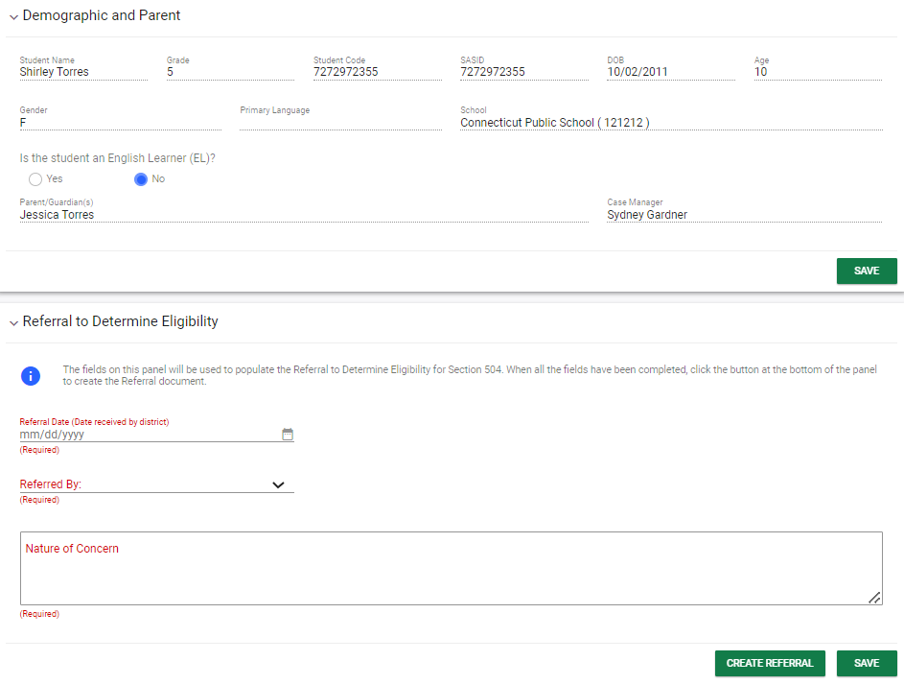
Notes:
Begin an Initial Referral for Section 504 by clicking into the first tile, Referral for Section 504. Within this initial step, the user will complete the required fields marked in red to start the referral. When the user reaches the bottom of the section, the user should click SAVE, and then click CREATE REFERRAL to generate the referral document.

Slide 4
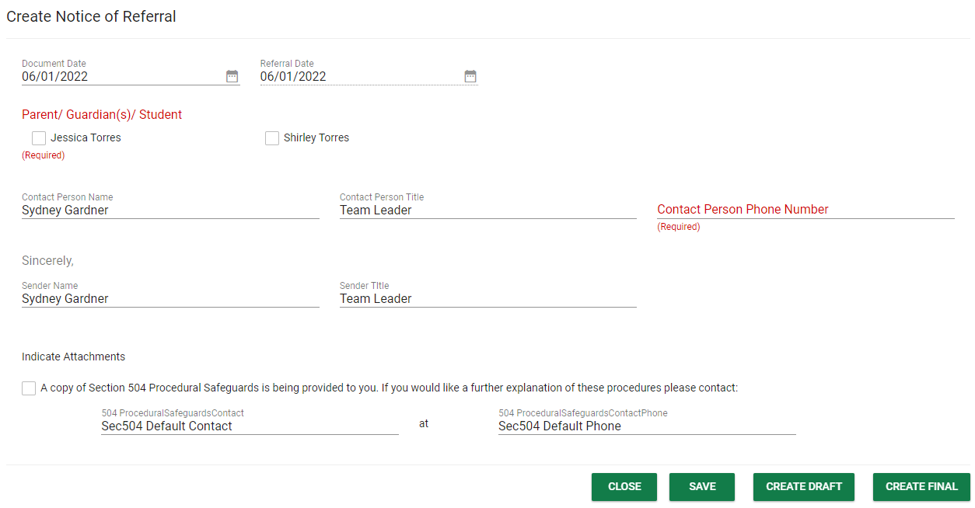
Notes:
From here, a pop-up panel will prompt the user to Create Notice of Referral. Default information, including the date and the user’s contact information, will pull into the notice, but should be updated manually as needed. The contact for Section 504 Procedural Safeguards can populate if set up by administrators, but users can also edit this information manually as needed. Please Note, Section 504 Procedural Safeguards are written and maintained by local education agencies (LEAs) and are not a standard CT-SEDS document. LEAs will need to send the Procedural Safeguard document to parents/guardians separately.

Slide 5
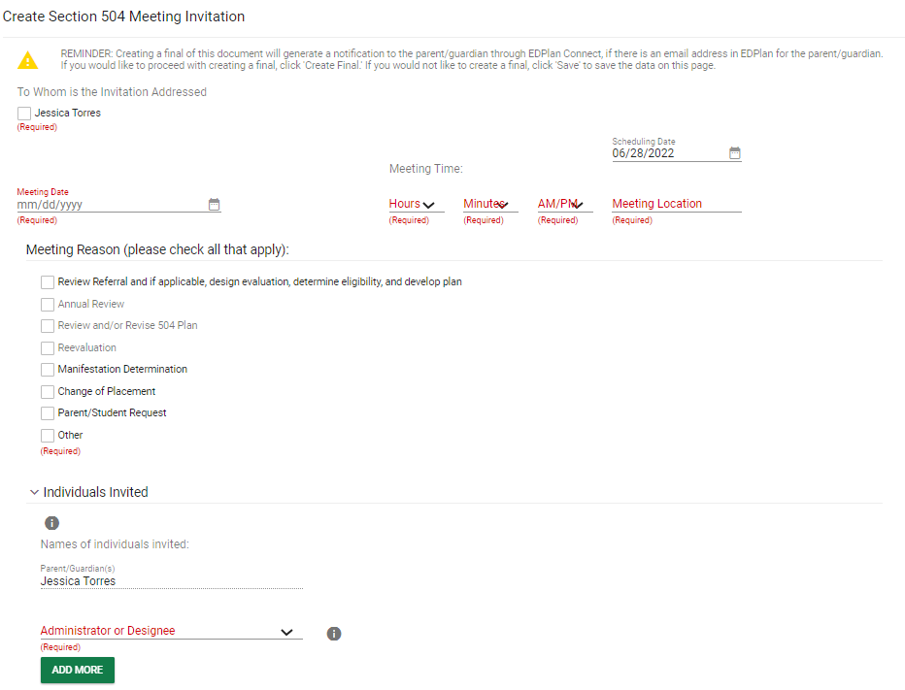
Notes:
The second step of the Section 504 Process will guide the user through creating the Section 504 Meeting Notice. Follow the on-screen guidance to complete the Notice. Please note, the Meeting Reason drives the process for completing the Section 504 Process. Please select the Administrator or Designee invited from the drop-down menu. The user should add the additional attendees by clicking the green ADD MORE button. This will add another drop-down menu where the user should select the participant’s title and type in the participant’s name in the accompanying textbox.

Slide 6
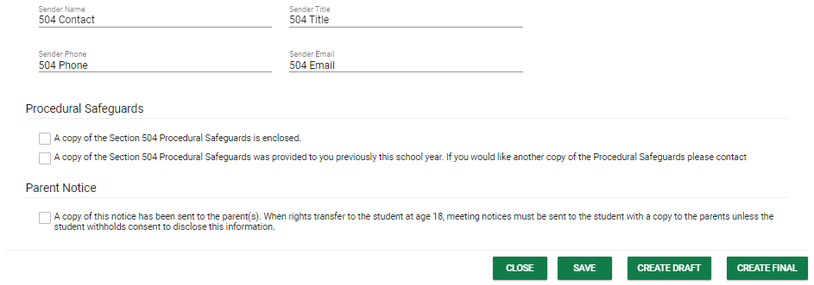
Notes:
At the end of this page, the user generates a document in PDF format that can be downloaded, saved, and printed. When creating documents, click SAVE first. Next, it is advised that the user click CREATE DRAFT to look at the document and check it for any typos or mistakes. Each time the user clicks CREATE DRAFT the new draft document will replace the previous one. When the user is satisfied that the information is correct, click CREATE FINAL. This version will replace the draft document and will be saved in CT-SEDS as part of the student’s history. Only certain administrative users can remove finalized documents, so the draft feature should be used to check work before finalizing.

Slide 7
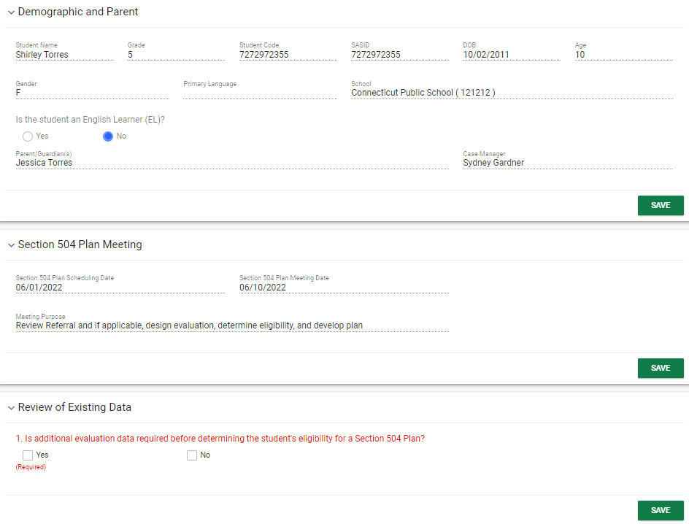
Notes:
When the user selects the Evaluation/Reevaluation tile, the user will see that demographic information about the student and parents appears in the first panel. If changes to the parents or guardians need to be made, navigate to the Personal Info menu, and click either Team or Parents to make the changes. The information the user entered on the previous page will populate under the Section 504 Meeting panel.
Once the user has confirmed the information in the Demographic and Parent panel and the Section 504 Plan Meeting panel are accurate, proceed to the Review of Existing Data panel and check whether the Section 504 team has determined that additional assessments are needed in order to determine eligibility.
If no is selected on the Review of Existing Data panel, the user will be required to describe existing data that is used to make an eligibility determine in the eligibility section.

Slide 8
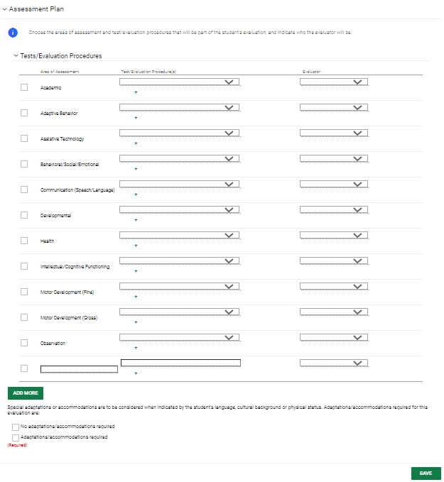
Notes:
If yes is selected, the user will check which Tests/Evaluation Procedures are necessary and use the drop-down menus to identify procedures and evaluators. If the assessment needed is not in the drop-down menu, the user can select Other and type in the assessment. Should more than one assessment be needed in the same area, click on the green plus sign and it will populate another drop-down menu. Please note, the Evaluators drop-down menu is populated with the Titles in the system for all the users on the team. If the user does not see the appropriate title, select Other and type in the title. After entering assessment information, check whether or not adaptions/accommodations are required at the bottom of the panel and click SAVE.

Slide 9
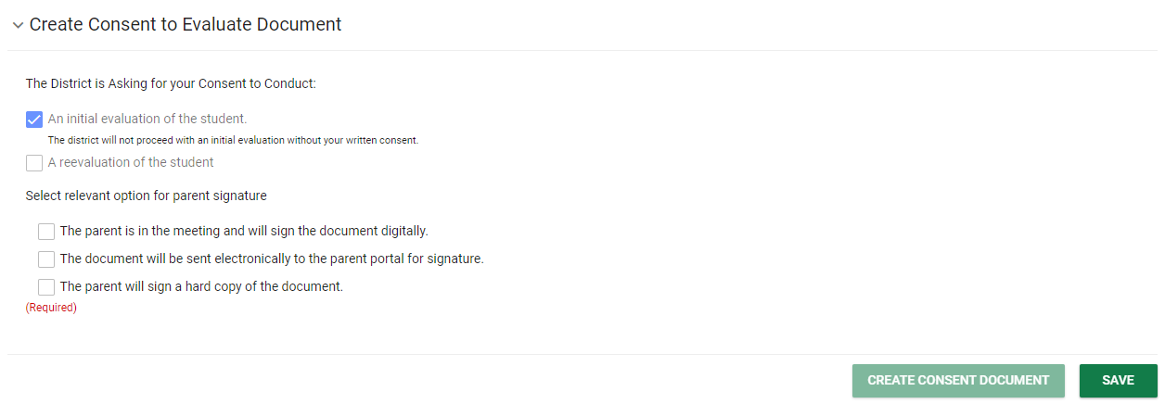
Notes:
The next step is to generate the Consent to Evaluate Document on this page. Users have three choices to acquire consent: have the parent/guardian sign on-screen immediately, send the document electronically to the parent portal for the parent/guardian to review and sign, or generate a hard copy of the document to send or give to the parent/guardian. Once an option is selected, the CREATE CONSENT DOCUMENT button will turn green and the user will able to generate the requested document.

Slide 10
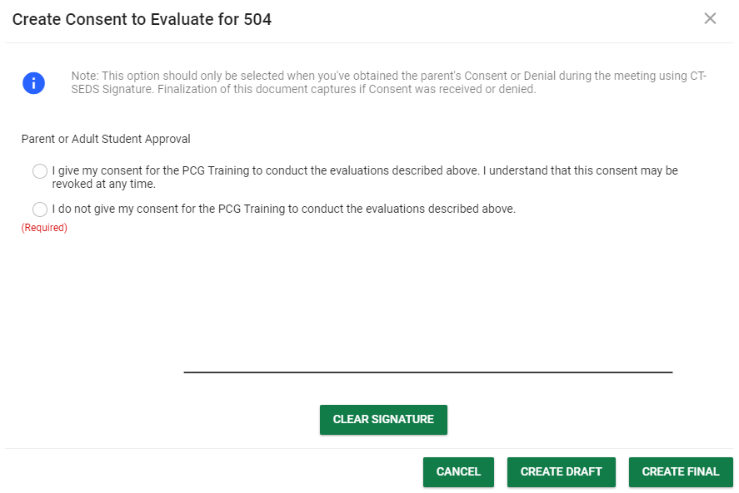
Notes:
When the parent/guardian is in the meeting and will sign digitally, a pop-up will appear when the user clicks CREATE CONSENT DOCUMENT for immediate signature. The parent/guardian will be able to select whether they give consent and sign using a computer mouse or by touching the screen if the user is using a touch screen device.
When the document is sent to the Parent Portal for signature, the parent/guardian email address under the Parents tab will be emailed with a link to access the document. The parent/guardian can access the portal, review the document, and sign digitally.

Slide 11
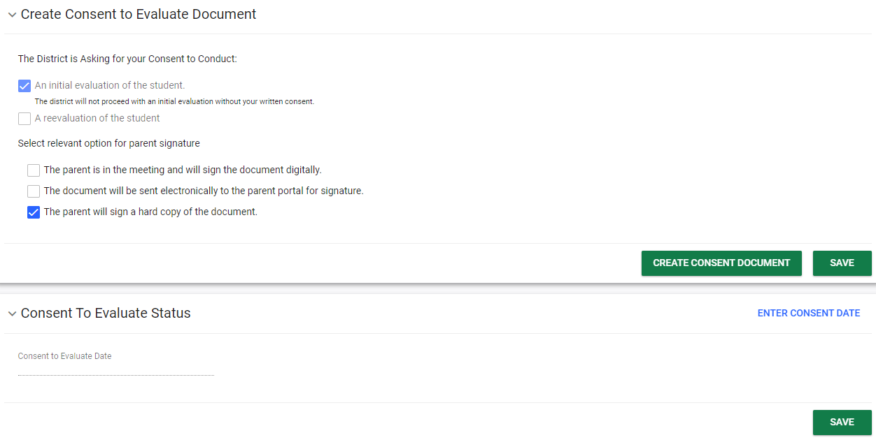
Notes:
When the “parent will sign a hard copy of the document” option is selected, a pop-up will appear to enter the date sent and create a final document. After the user creates the final document, the document will generate in a separate browser tab and the user will be able to print the document. Another panel will also appear in the system where the user will be able to enter the date of consent when received. The user should also upload the signed consent document onto the student’s record and click the blue link ENTER CONSENT DATE to enter the date the parent signed.

Slide 12
Notes:
Please note, after consent is received, this panel is also where the user would notate if consent is revoked.

Slide 13
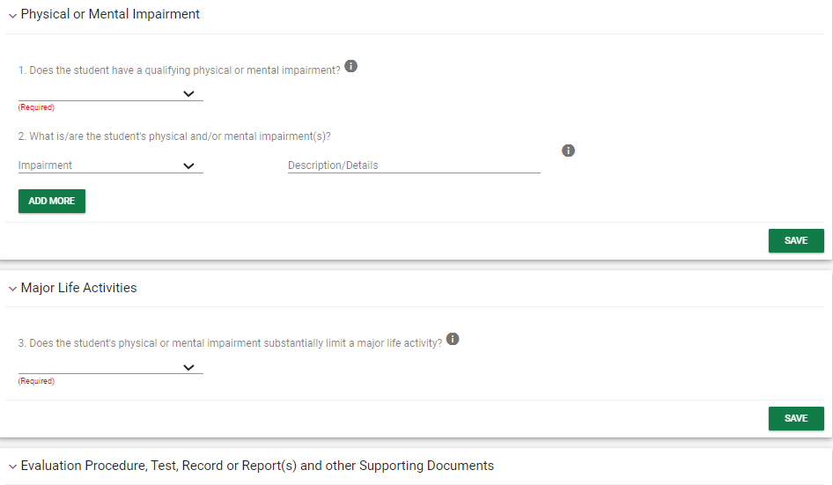
Notes:
The next step in the process is the Determination of Eligibility. Follow the questions in determining if the student has a qualifying physical or mental impairment. Enter the major life activities affected, add evaluation information, select whether the student has an Individual Health Plan, and enter the Eligibility Determination. Finding the student eligible will also open up another panel to provide Consent for the Initial Provision of Section 504 Services, which can be completed by having the parent sign on-screen, sending the document to the parent portal, or printing the document and having the parent sign manually.

Slide 14
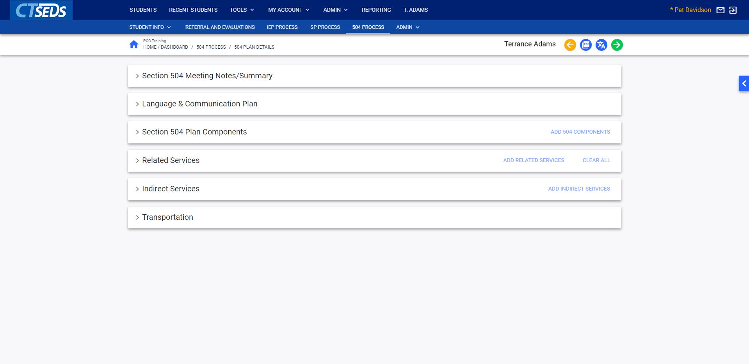
Notes:
The next page is the 504 Plan Details. We have collapsed all of the panels so we can look at each part of the 504 Plan Details. The page will guide the user through adding Meeting Notes and adding what is needed to the plan including: a Language and Communication Plan, Section 504 Plan Components, Related Services, Indirect Services, and Transportation. Not all of these may be necessary for every student, so fill out the panels as needed.

Slide 15
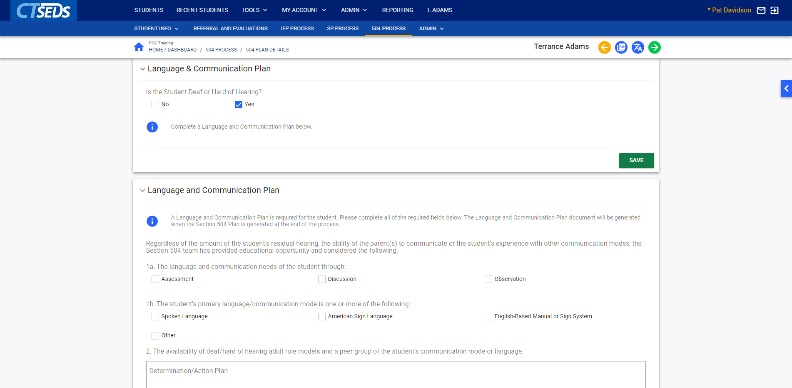
Notes:
If Yes is checked for the Language and Communication panel, an additional panel will be opened for completion. If No is appropriate, it must be checked and saved in order to complete the page.

Slide 16
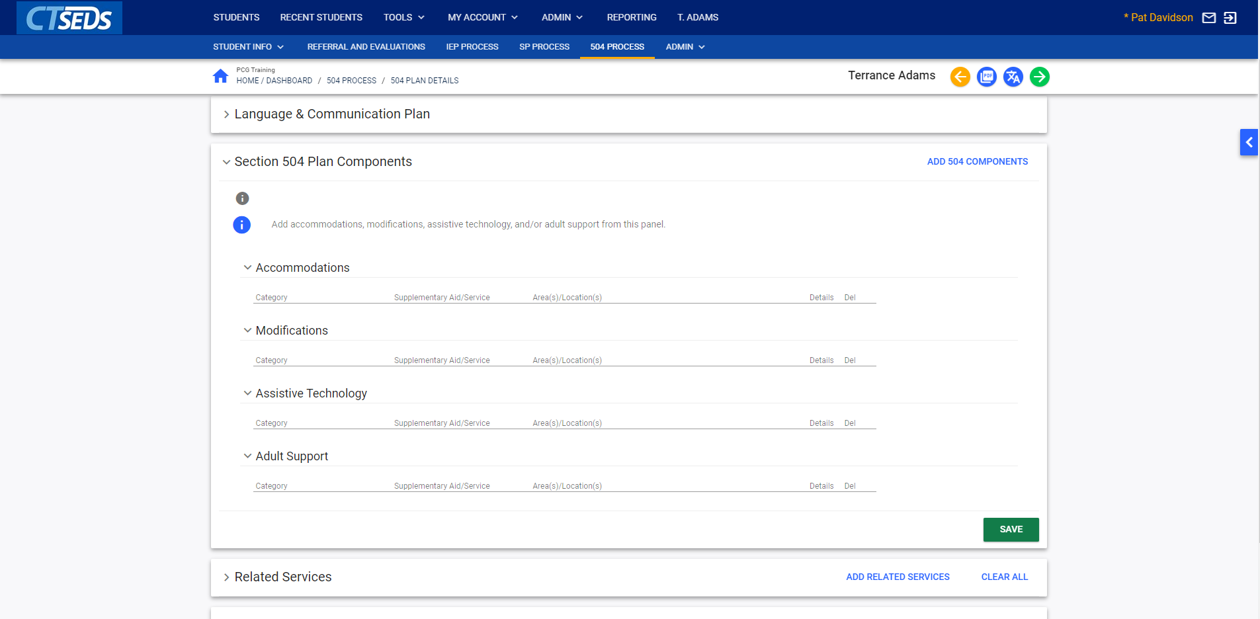
Notes:
If applicable, Section 504 Plan Components include Accommodations, Modifications, Assistive Technology, and Adult support. To add a component, click the blue Add 504 Components link in the upper right-hand corner of the tile.

Slide 17
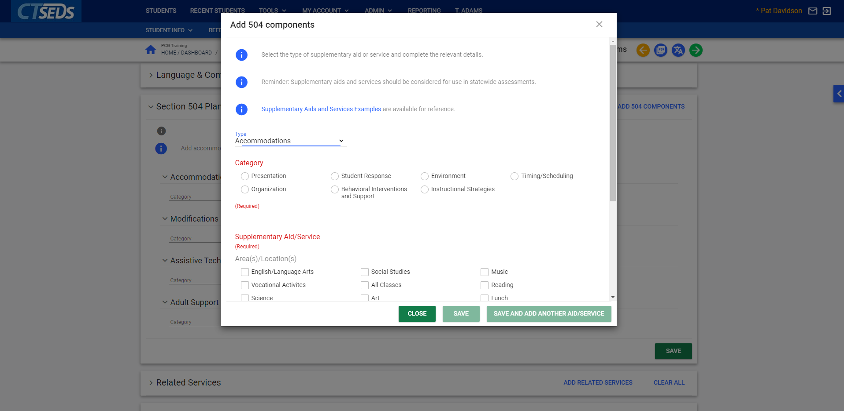
Notes:
Similar to the IEP process, once an item is selected from the Type dropdown, specific categories and details can be entered. Complete the page and then click Save or Save and Add Another Aid/Service to add more 504 Plan Components.

Slide 18
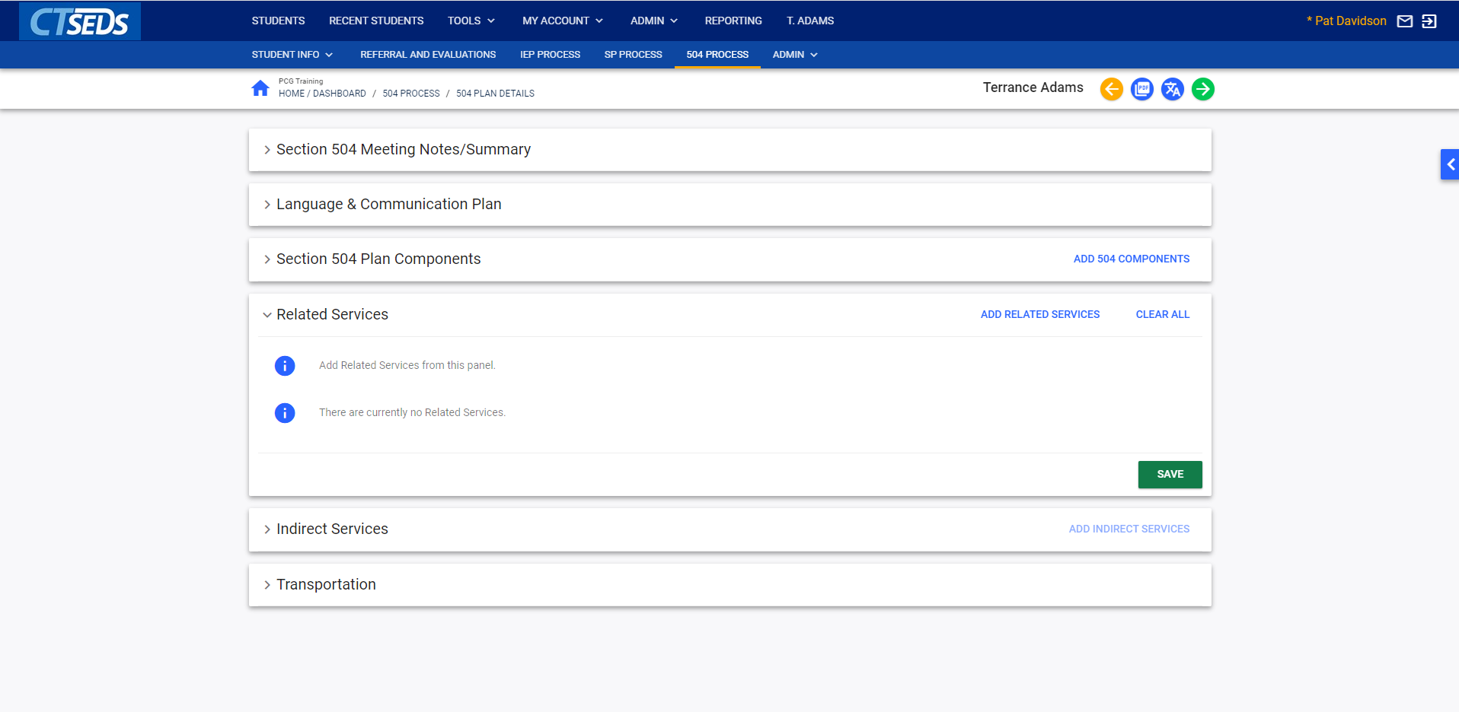
Notes:
Related Services can be added to a Section 504 Plan if applicable. Click the Add Related Services link in the upper right corner of the tile.

Slide 19
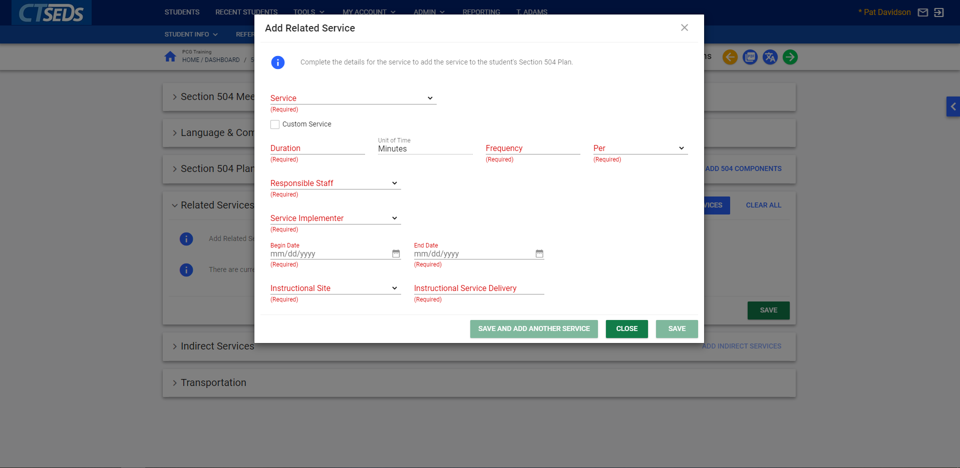
Notes:
Complete the required fields to add a related service. You can save and close, or Save and Add Another Service as necessary.

Slide 20
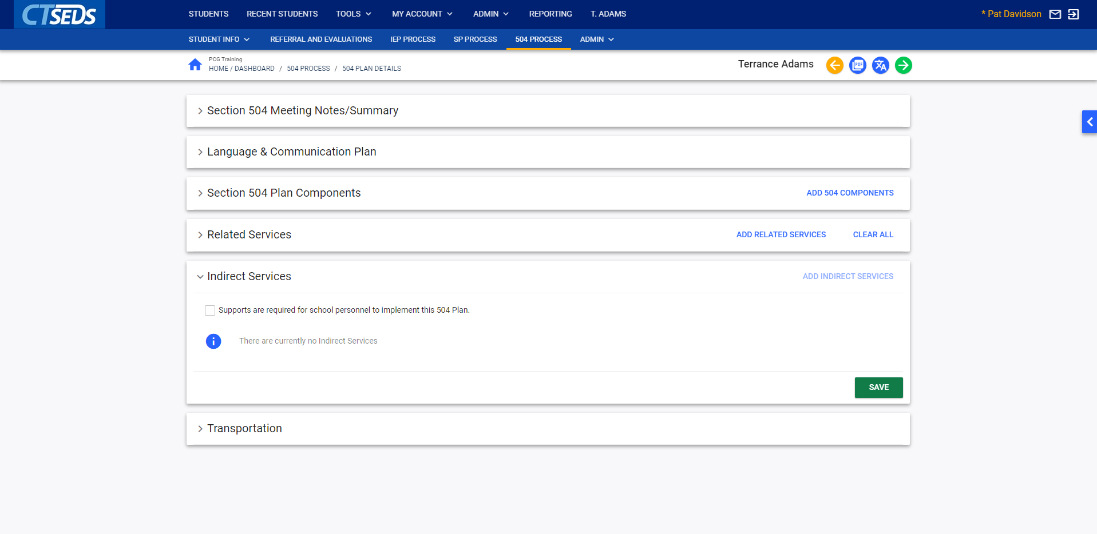
Notes:
For Indirect Services, please note the user will need to check the box that says, “Supports are required for school personnel to implement this Section 504 Plan,” click SAVE, and then add any Indirect Services.
Note: If the user does not click save on this tile before clicking the link to add the services, the Indirect Services will not be added.

Slide 21
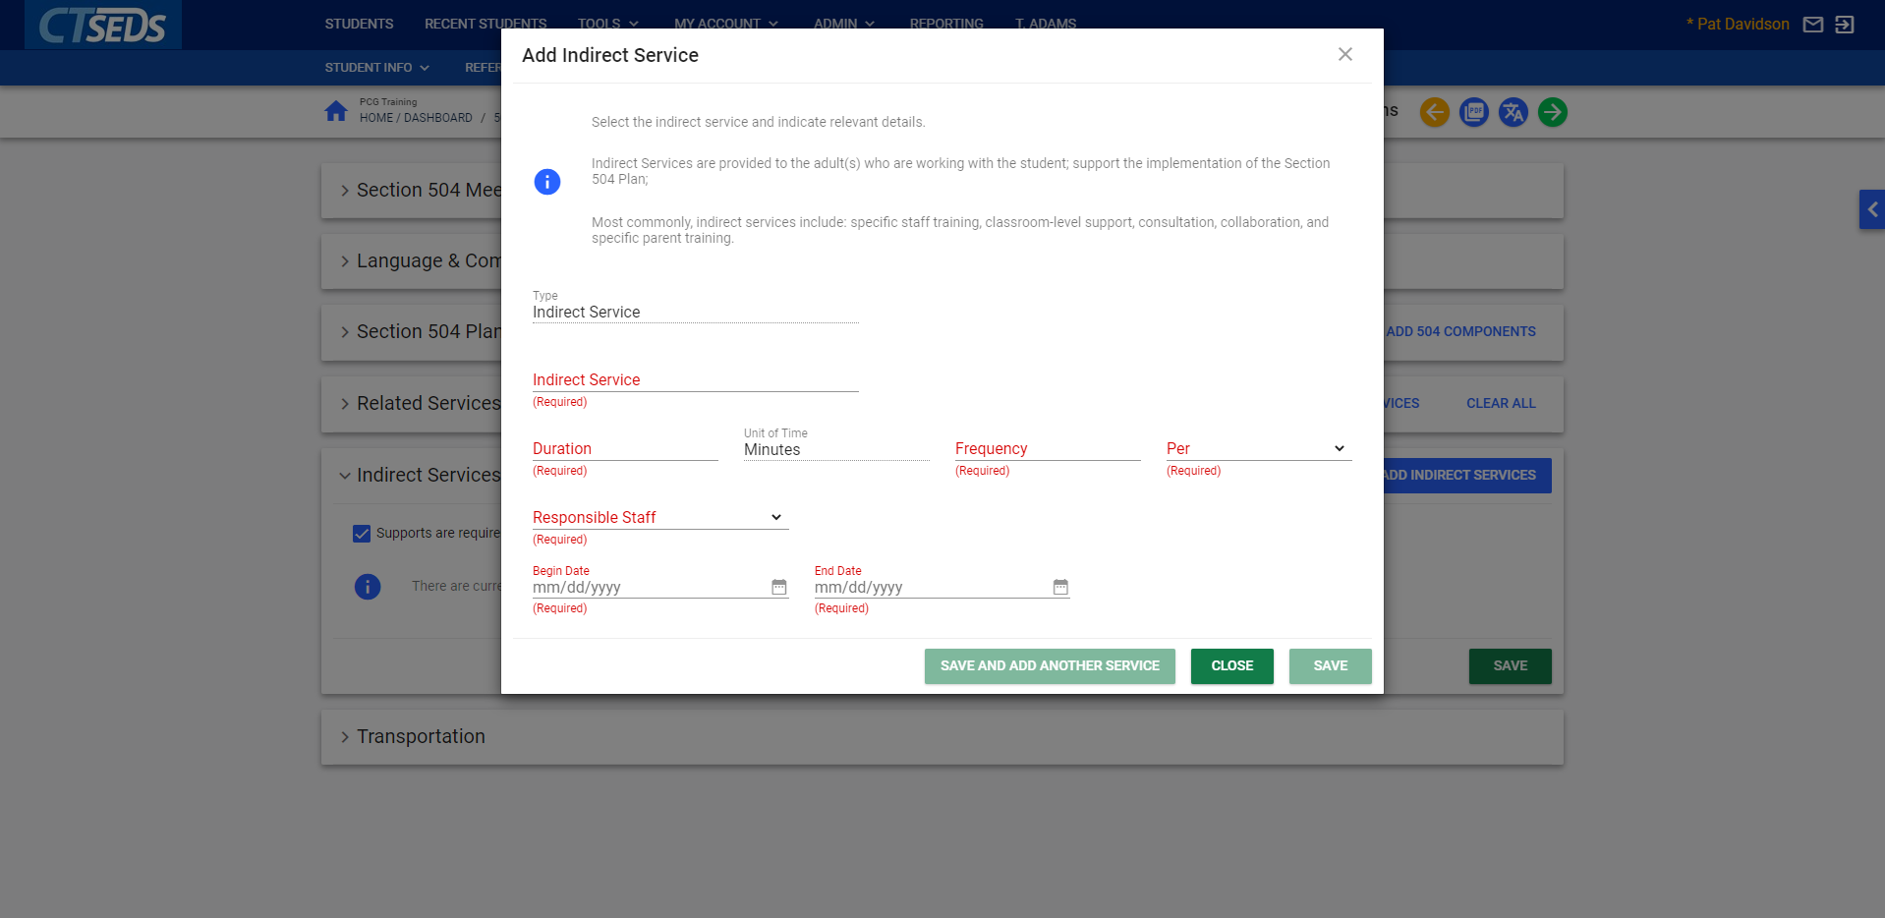
Notes:
Indirect services are detailed as the others have been. Complete the required fields, then save and close or Save and Add another as appropriate.

Slide 22
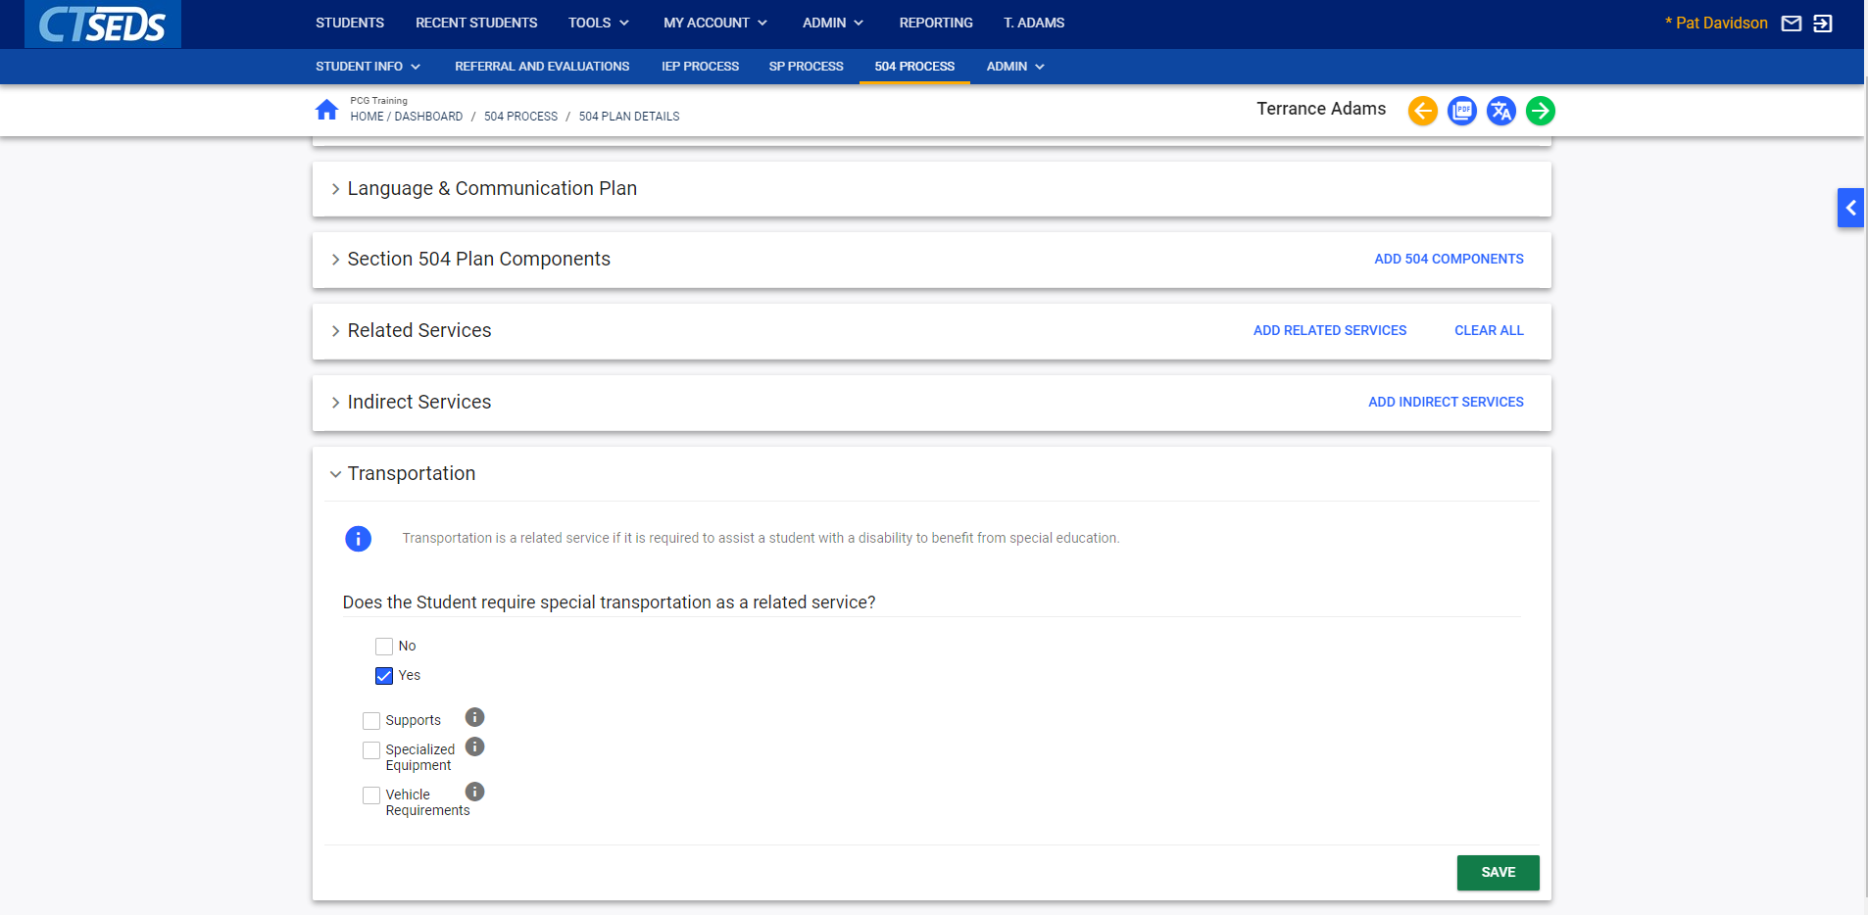
Notes:
The final tile on the 504 Plan Details step is Transportation. If no Transportation is needed, select No and click SAVE. If Transportation is needed, select yes. The user will then need to check whether Supports, Specialized Equipment, or Vehicle Requirements apply, enter the details, and click SAVE.
Note: For additional guidance, the information icon will provide the user with more information regarding Supports, Specialized Equipment, and Vehicle Requirements.

Slide 23
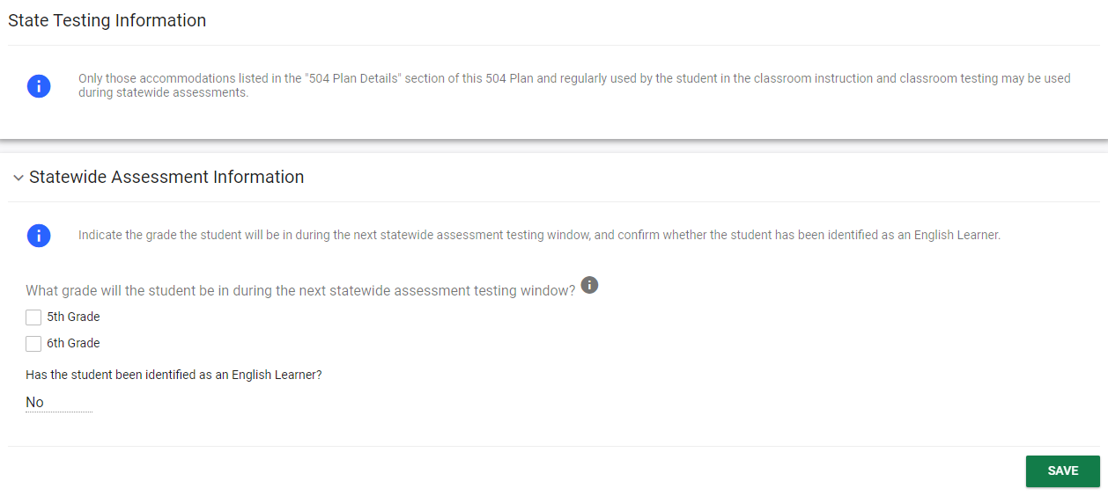
Notes:
The State and District Testing page allows the user to record District and State Testing accommodations.

Slide 24
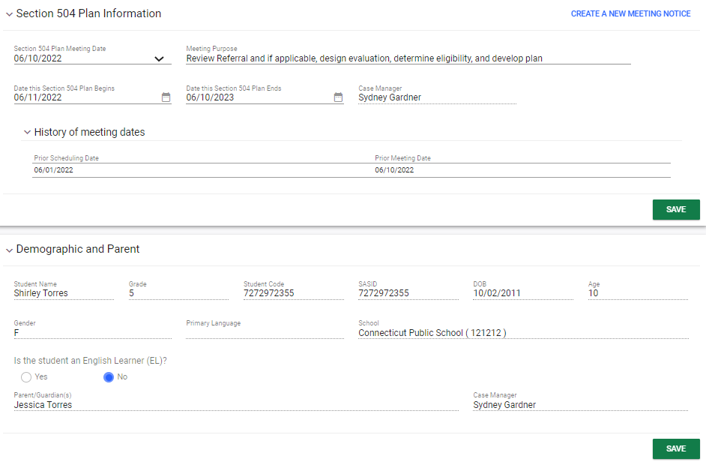
Notes:
On the final tile of the process, the user will review the Section 504 Plan information, review Demographic and Parent Information, note the Meeting Participants, and Create the Draft and Final Section 504 Plan. Pay special attention to the Section 504 Plan Begin and End Dates. The begin and end dates, which can be adjusted as needed.

Slide 25
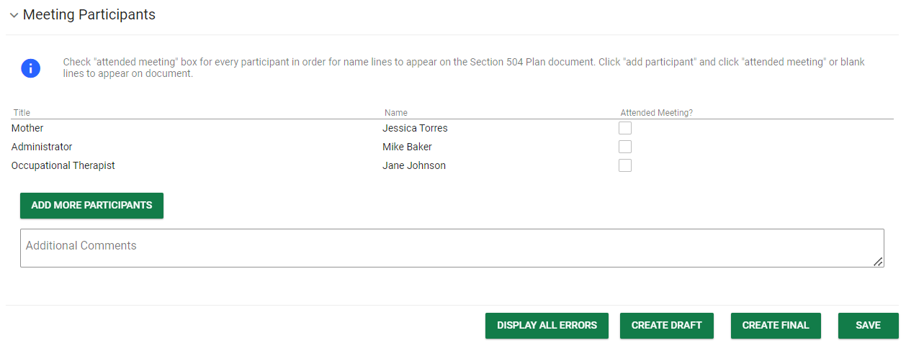
Notes:
After review demographic and plan information, enter Meeting Participants, click SAVE, and then click DISPLAY ALL ERRORS. Anything that was not completed in the Section 504 Process will be identified for correction. After correcting errors, it is recommended to create a Draft document and review to ensure details are accurate. The last step is to click CREATE FINAL in order to create a Final Section 504 Plan. For more information on the Section 504 Process, please see the Section 504 User Manual.

