Slide 1
The Opioid Epidemic & Naloxone (Narcan)
CT Prevention Network consists of the 5 Regional Behavioral Health Action Organizations. CPN promotes best practices in substance use prevention and behavioral health across the lifespan and continuum of care in all of the diverse communities that comprise the great State of Connecticut.
This presentation is adapted from Susan (Wolfe) Bouffard, PhD, DMHAS.
Disclosure statement: We have no relevant financial relationships with commercial interests now nor within the last 12 months.

Slide 2
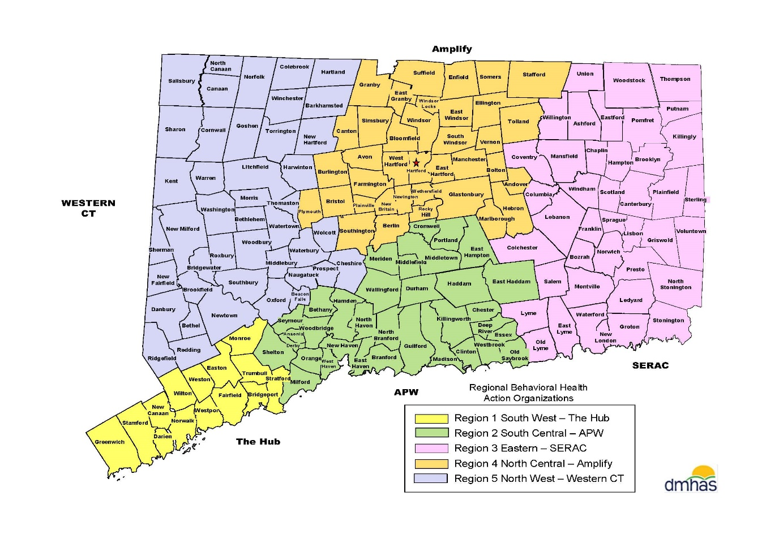
Regional Behavioral Health Action Organization (RBHAO)
Notes:
THE RBHAO’s are your local entity that can provide Naloxone trainings and also assistance with securing Naloxone kits.

Slide 3
In today’s training, you will learn about:
Opioid use and misuse
Risk factors for opioid use disorder
Prevention Strategies
Signs and symptoms of an overdose
How to obtain and administer naloxone or Narcan
Good Samaritan Law and other legislative prevention efforts
Treatment and recovery support resources

Slide 4
3 Waves of the Opioid Epidemic
1999
1st wave: began with prescription opioids
Over prescribing, little knowledge of addiction, expensive on streets
2010
2nd wave: began with heroin
Cheaper to buy compared to pills
2013
3rd wave: Synthetics
Synthetic opioids, illicitly manufactured fentanyl(cheaper to buy and make)
Notes:
1st- 1999-2010: poor science, <1% become addicted, prescription pill use quadrupled – American Journal of Medicine has a footnote that opioids have little to no risk for dependence of addiction for patients
2nd- heroin is much cheaper to buy ($10/bag vs. $80/pill) ~ $1 per milligram street value (Percocet 30 mg=$30)
3rd- Currently we are in the 3rd wave, with fentanyl (not medical-grade/hospital-grade fentanyl) illicit fentanyl that is coming in from oversees and being pressed into pills
-cheap to buy on the black market/dark web, make and sell
-coming from China (Asian countries) and Mexico
-bought over internet and shipped through regular mail

Slide 5
Notes:
Video is optional. If you choose to use it, test the video and audio before the training.

Slide 6
Which is NOT an opioid?
Oxycontin
Heroin
Valium
Fentanyl
All of these are opioids
Notes:
Poll is optional.

Slide 7
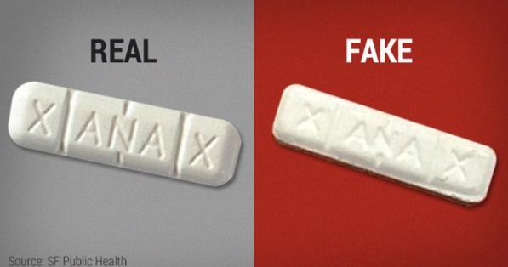
Opioids
Opioids are a class of drugs naturally found in the opium poppy plant. Opioids include hydrocodone, oxycodone, morphine, codeine and fentanyl.
Fentanyl is a powerful synthetic opioid analgesic similar to morphine but is 50 to 100 times more potent.
Non-medical fentanyl is often mixed with or substituted for heroin or sold as tablets that mimic other opioids.
Notes:
Remember fentanyl does have a legitimate medical use but be sure to highlight that illicitly manufactured fentanyl is dangerous and is commonly being found in street drugs and fake pills.

Slide 8
Heroin
Illegal and highly addictive opioid drug
A heroin overdose can cause slow and shallow breathing
Leading to death
People often use heroin along with other drugs or alcohol
Benzodiazepines(suppressant)
Heroin can be snorted, smoked or injected

Slide 9
Prescription Opioids
2018: 15% of the US population filled at least one opioid prescription.
Avg. number of prescriptions filled by those who filled = 3.4 prescriptions
From 2006 to 2018…
29% decrease in the prescribing rate of all opioids
38% increase in avg. days supply per prescription
The longer the initial opioid prescription, the greater the risk of long-term use.
An initial prescription for 1 day of opioids resulted in a 6% chance of being on opioids at one year
People may start with prescribed opioids then transition to illicit use.
Most prescription opioids that are misused come from family and friends.
Sources: IQVIA™ Total Patient Tracker, 2018. Data extracted in 2019, CDC: MMWR Mar 17, 2017/66 (10): 265-9, 2019 Annual Surveillance Report of Drug-Related Risks and Outcomes, U.S., 2006 - 2018

Slide 10
Past Month Substance Use among Persons 12 and Older: (in millions) 2019
Notes:
Highlight the 109.8 million people with no past month use!! Emphasize the positive.
Reminder: alcohol is still the top used and misused substance
Prescription opioids are the fourth most used substance. Even though it’s a small bar, it’s still 2.8 million people!
Prescription sedatives and stimulants are on this graph as well. Prescription drug misuse is still a concern.
Remember very few people start using heroin/fentanyl without using other substances first. We can’t ignore the role substances like alcohol, tobacco and marijuana play in illicit drug use.

Slide 11
Warning Signs of an Opioid Use Disorder
The strong desire to use opioids
The inability to control or reduce use of opioids
Development of a tolerance
Showing signs of withdrawal after stopping or reducing use of opioids
Difficulty meeting social and/or work commitments
Experiencing legal problems due to substance use
Spending large amounts of time accessing opioids
drugfreect.org

Slide 12
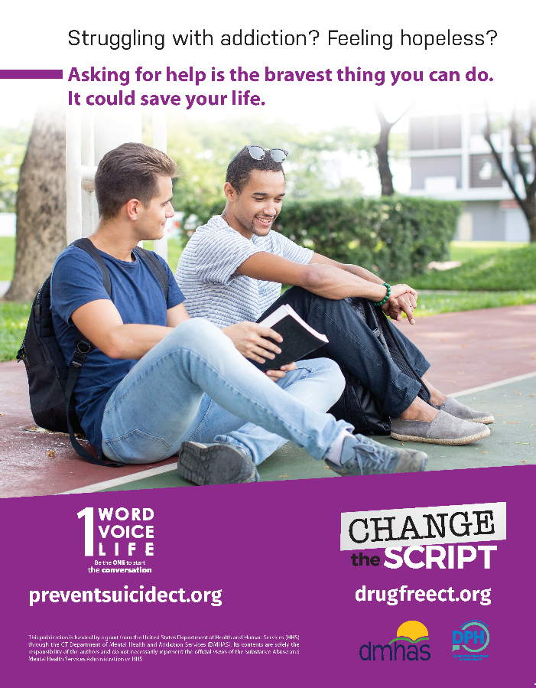
Opioids and Suicide Shared Risk Factors
Chronic Pain
Pain diagnoses/severity
Desire to escape pain
Insomnia
Passive coping strategies
Access to prescription opioids
Concurrent prescriptions
Prescription opioid abuse
Co-morbidity with a mood disorder
Depression
Substance use disorders
Financial problems
Lack of social supports (peer, family conflict/rejection)
Academic/work failure
Prior suicide attempt/loss
National Suicide Prevention Lifeline 1-800-273-8255
Crisis Text Line: Text CT to 741-741
Notes:
The main shared risk factor is pain.
Some experts estimate that up to 30% of opioid overdoses may be suicides.

Slide 13
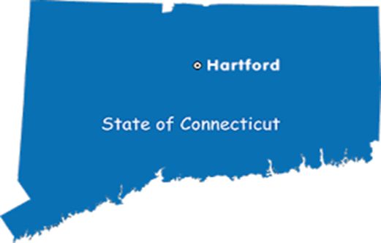
CT Accidental OD Deaths
2015: 723
2016: 917
2017: 1,036
2018: 1,018
2019: 1,200
2020: 1,374
Opioids Involved | 93%
Fentanyl/Analogue | 84%
Heroin | 19%
Prescription Opioid (oxycodone, oxymorphone, hydrocodone, hydromorphone & tramadol) | 13%
Total ODs involving alcohol | 29%
Total ODs involving BZDs | 22%
Total ODs involving cocaine | 39%
Notes:
Increase in OD deaths each year with the exception of 2017-2018
Don’t forget about polysubstance use (opioids and alcohol, opioids and benzos, opioids and cocaine, etc.)
Mixing opioids with alcohol or benzos is dangerous. Multiple depressants = high risk for overdose
Increase in cocaine ODs: increase in cocaine use, increase in cocaine being laced with fentanyl
Citation for new numbers: https://portal.ct.gov/OCME/Statistics 2015 to 2020 (town/city) Accidental Drug Intoxication

Slide 14
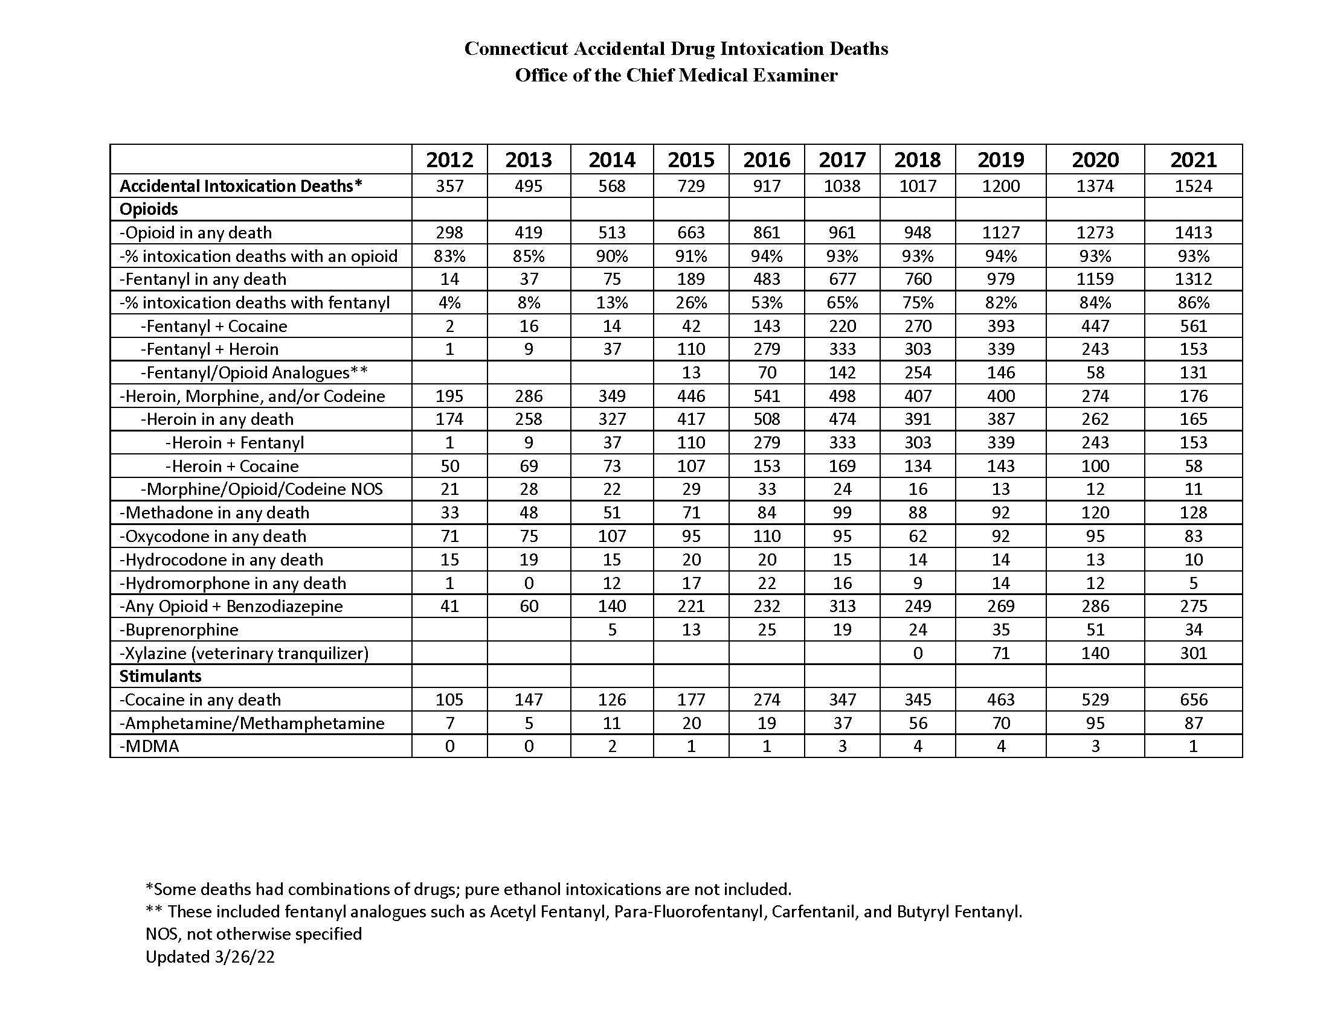
Notes:
Key points of watching the increase in Fentanyl and also seeing the increase in stimulants

Slide 15
2020 OCME data (N=1374)
Accidental Drug Related Deaths
Males: 75% | Females: 25%
White/Non-Hispanic | 69%
White/Hispanic | 15%
Black/Non-Hispanic | 15%
< 20 | <1%
20s | 15%
30s | 30%
40s | 21%
50s | 24%
60s | 12%
70+ | 1%
Who was a typical overdose victim in CT in 2020?
A non-Hispanic white male between the ages of 30 – 59 who was using opioids, probably fentanyl and other substances. On the day he overdosed, so did at least two other people.
Notes:
Underlined numbers are the majority for each category
Large percentage of overdose deaths occur in a residence or hotel/motel

Slide 16
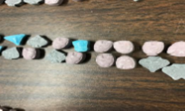
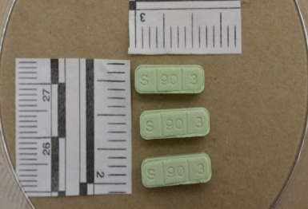
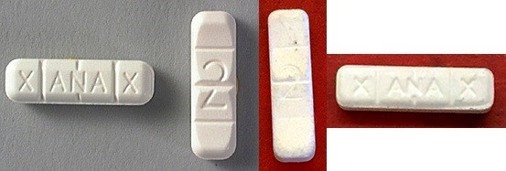
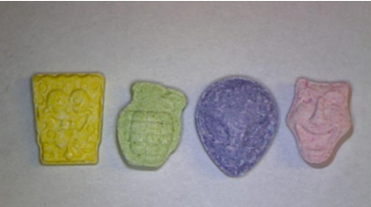
Counterfeit Drug Seizures
Methamphetamine pills sold as MDMA 2019
Methamphetamine pills, Rhode Island 2019
REAL OXYCODONE
VS COUNTERFEIT
REAL XANAX
VS COUNTERFEIT
Sold as and included Xanax (Alprazolam) but two also with fentanyl, a third included cocaine
Acknowledgment: R. Lawlor, CT HIDTA
Dava Pharma Stock Photo
Acknowledgment: R. Lawlor, CT HIDTA

Slide 17
CT Counterfeit Pills
CT Counterfeit Pills
Seized in Tolland County 2021
Contained: Etizolam
Should contain: Alprazolam
Acknowledgment: R. Lawlor, CT HIDTA
Notes:
Etizolam – CNS depressant. Different than a Xanax benzodiazepine

Slide 18
CT Counterfeit Pills
Seized in Tolland County 2020 contained:
Fentanyl, Tramadol, Lidocaine
Should contain;
Oxycodone Hydrochloride
Acknowledgment: R. Lawlor, CT HIDTA
Acknowledgment: R. Lawlor, CT HIDTA
Notes:
Tramadol – CNS
Lidocaine – local anesthetic numbing agent

Slide 19
Who is at Risk with Opioids?
Children/Adolescents/Adults who access unsecured medications
People who are experimenting/partying (lack of perceived risk)
Seniors prescribed multiple medications who may have cognitive & medical issues
Chronic pain patients on long-term opioids
Medicaid patients prescribed more opioids
Young adults (18-25) who use at higher rates
Individuals who are accessing opioids any way other than a pharmacy
Notes:
Children may take opioids by accident, thinking they are food or candy
Older adults prescribed multiple medications are at risk – it’s easy to accidentally take multiple pills.

Slide 20
Greatest Risk of Overdose
History of Overdose
History of Substance Use Disorder (SUD)
Taking Opioids and Benzodiazepines (BZDs)
↓ Tolerance for opioids due to a break in use (incarceration, detox, hospitalization, rehab)
On doses of opioids > 50 MME/day
World Health Organization
Notes:
Remember opioids and benzodiazepines can be dangerous, both depressants
Lowered tolerance = high risk
MME/day = morphine milligram equivalents per day

Slide 21
CDC Guidelines for Prescribing Opioids for Chronic Pain
Don’t start with an opioid
Set goals for pain and for function
Discuss risks/benefits & provider/patient responsibilities
Start with immediate release (not ER/LA)
Start with lowest effective dose (avoid > 90 MME)
Prescribe for expected duration of pain
Regularly assess risks & benefits
Assess risk factors and take steps to reduce risk
Check PDMP (web-based database of CS dispensed)
Urine drug screening
Don’t combine Opioids and Benzodiazepines
Arrange for MAT (methadone/suboxone) for those who develop Opioid Use Disorder
Notes:
Only highlight a few, no need to read the whole list
ER = extended release
LA = long acting
PDMP = Prescription Drug Monitoring Program
MAT = Medicated Assisted Treatment

Slide 22
Notes:
Video is optional. If you choose to use it, test the video and audio before the training.

Slide 23
Naloxone Distribution Programs
Naloxone has been around since 1971
Naloxone Distribution Programs started in 1996
All 50 states now have naloxone access laws
Strategies/legislation vary by state
Education is an expectation
Notes:
Some type of education must accompany naloxone distribution but type of education can vary.

Slide 24
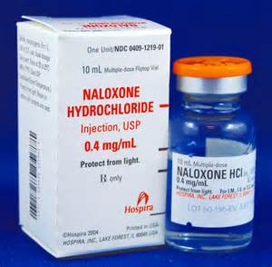
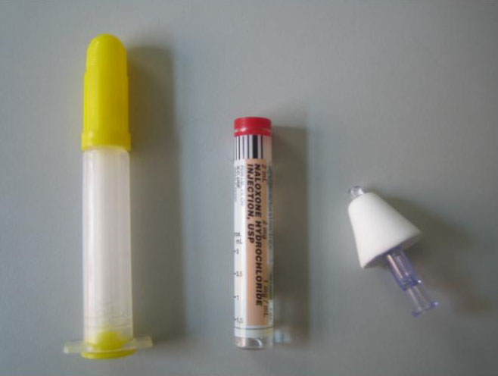
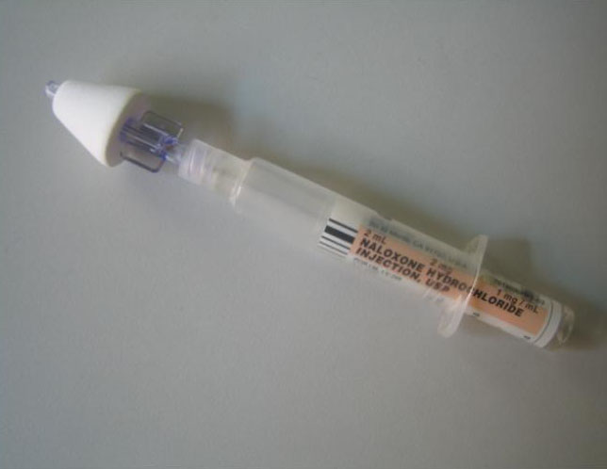
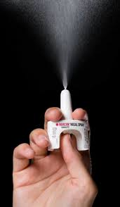
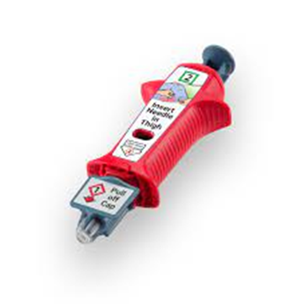
Naloxone (Narcan): IM & IN
Notes:
4 types of naloxone, will discuss each in detail later

Slide 25
Anyone can get a prescription for naloxone.
True
False
Notes:
Optional

Slide 26
Naloxone only works on opioids.
True
False
Notes:
Optional

Slide 27
Naloxone (Narcan)
Prescription medication
Safe medication
Only has an effect if the person has opioids in their system
You cannot get high from it, it has no abuse potential/street value, and if you are dependent, it causes withdrawal
Its only function is opioid overdose reversal
Works on any opioid
Notes:
Presentation uses naloxone and Narcan interchangeably
Narcan = name brand
naloxone = chemical name
SAFE medication

Slide 28
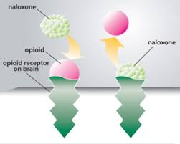
How does Narcan Work?
In an opioid overdose, the automatic drive to breathe is diminished
Narcan “steals the spot” of the opioid in the brain receptor site for 30 – 90 minutes - so breathing resumes while the Narcan lasts
Notes:
Refer to the SAMHSA video if it was played.
Works on prescription opioids and illicit opioids.

Slide 29
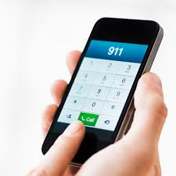
Standard Training on Naloxone (Narcan)
Identifying an opioid overdose
Calling 911
Naloxone (Narcan) administration
Resuscitative efforts
Recovery position
Notes:
We will go into each step in detail.

Slide 30
Identifying an Opioid Overdose
Unresponsive or minimally responsive
Blue or gray face
Fingernails and lips can also become discolored
Shallow breathing with rate less than 10 breaths per minute or not breathing at all
Pinpoint pupils
Loud, uneven snoring or gurgling noises
Other evidence: known opioid user, track marks, syringes, pills or pill bottles, information from bystanders

Slide 31
When NOT to Narcan: Other Substances
If the person is not unconscious or barely breathing, DO call 911, but DO NOT Narcan
Not a necessity
Marijuana “Overdose”
*Not fatal*
Signs include:
extreme confusion
anxiety
paranoia
panic
fast heart rate
delusions or hallucinations
increased blood pressure
severe nausea or vomiting
(Retrieved from: https://www.cdc.gov/marijuana/faqs.htm#:~:text=If%
Alcohol Poisoning:
Similar presentation (Difficulty breathing, blue/gray skin, unconsciousness)
ADD:
Alcohol smell
Vomiting
Low body temperature/hypothermia
(Retrieved from: https://www.niaaa.nih.gov/publications/brochures-and-fact-sheets/understanding-dangers-of-alcohol-overdose)
*If unconscious, or struggling to breathe, 911 first then Narcan!*

Slide 32
Try to Rouse Them
Call
Call their name and shake them
Check
Check for a pain response: rub hard up and down on the person’s sternum with your knuckles
CALL
IF NO RESPONSE: CALL 911 and administer naloxone

Slide 33
Call 911
Start by providing the address
Give as much information as possible, including about the person’s breathing
Describe exactly where the person is located
They may provide instructions
Notes:
This is a crucial step! Please emphasize the importance of calling 911!
The operator can talk people through the process of administering naloxone, putting the person in a safe position, etc. It’s very helpful for people who are alone or might be nervous.

Slide 34
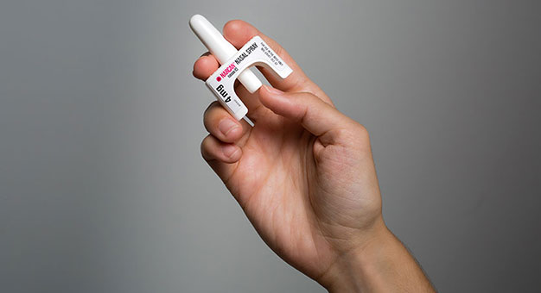
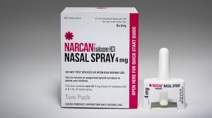
Narcan Nasal Spray
Tilt
With one hand under their neck, tilt their head back
Insert
With the other hand, insert the device into one nostril until top of fingers touch bottom of nose
Press
Press firmly on the plunger & spray into nose
Notes:
Most commonly used by laypeople/general public
Very user friendly
Pick one nostril, don’t need to do half/half
No need to test or prime
Narcan gets absorbed into the nasal membrane, no need for the person to actually inhale it

Slide 35
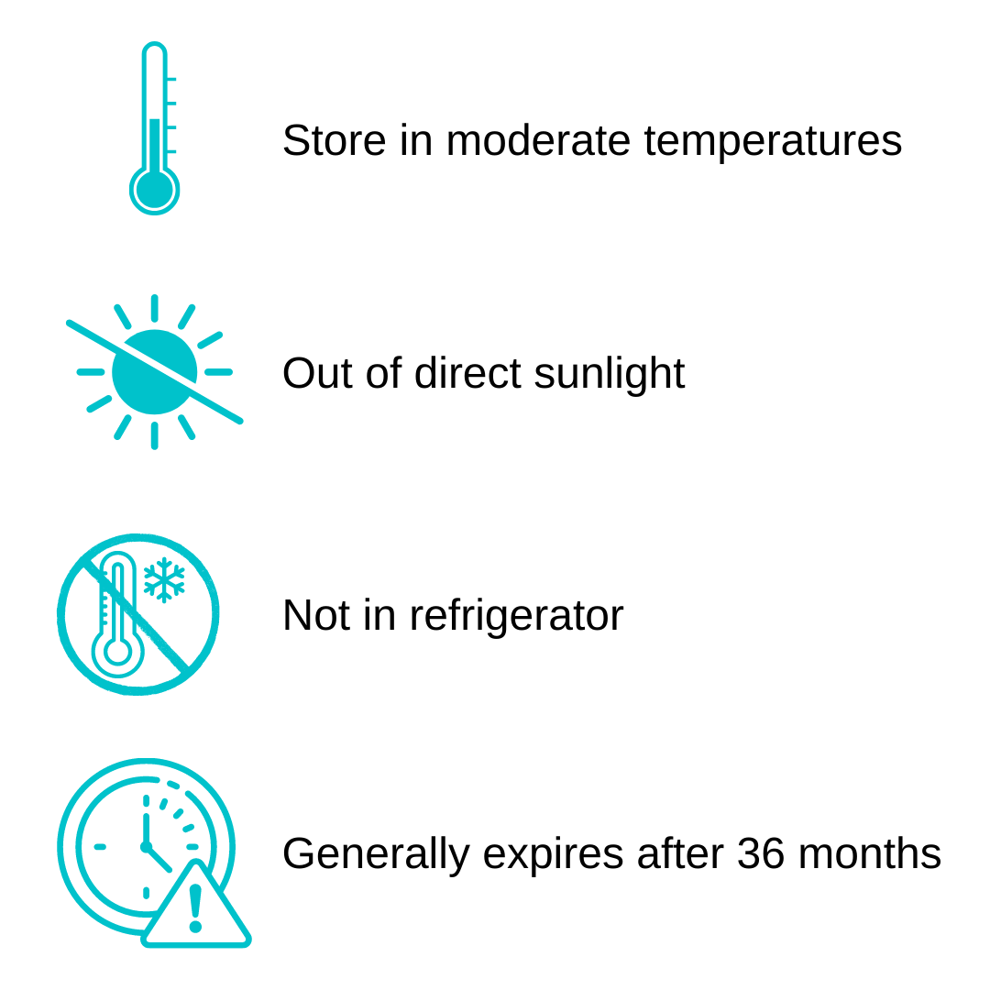
Storage and Expiration
Notes:
Avoid keeping it in the car (CT always too hot or too cold)
Expired Narcan is better than no Narcan. Don’t dispose of expired Narcan until you’ve replaced your kit with a new one.

Slide 36
Naloxone Administration & Personal Safety
The decision to withhold naloxone is equivalent to withholding (CPR) to an unresponsive person who may have had a heart attack.
Personal protective equipment (PPE) like gloves, masks, etc. should be worn whenever available.
Toxicity cannot occur from simply being in proximity to fentanyl. For opioid toxicity to occur, the drug must enter the blood and brain from the environment.
It is critical that naloxone continue to be administered in a way that keeps everyone involved as safe as possible.
Notes:
Main points here: “The decision to withhold this lifesaving drug is equivalent to withholding cardiopulmonary resuscitation (CPR) to an unresponsive person who may have had a heart attack.”
Use the 2 recommended types. They keep both the person administering and the person who has overdosed safe.
Fentanyl exposure citation Michael J. Moss, Brandon J. Warrick, Lewis S. Nelson, Charles A. McKay, Pierre-André Dubé, Sophie Gosselin, Robert B. Palmer & Andrew I. Stolbach (2018) ACMT and AACT position statement: preventing occupational fentanyl and fentanyl analog exposure to emergency responders, Clinical Toxicology, 56:4, 297-300, DOI: 10.1080/15563650.2017.1373782

Slide 37
Resuscitation
Rescue Breathing
AHA Guidelines for suspected Opioid OD:
If the person is unresponsive and is breathing normally
This person does not need CPR
Roll them onto their side (if you don’t think they have a neck or back injury)
Stay with the person until advanced help arrives
If the person is unresponsive and not breathing normally or is only gasping
This person needs CPR
Make sure the person is lying on their back on a firm, flat surface
Begin CPR
Notes:
If someone is CPR certified and it’s necessary, they would begin CPR.
Recommend participants also get trained in CPR.

Slide 38
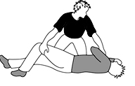
Rescue Position

Slide 39
Afterwards
People usually revive in 2 – 3 minutes, feeling dazed and/or confused and not realizing that they’ve overdosed
They might be in withdrawal (about 1% are agitated)
If the person doesn’t respond to the naloxone within 2-3 minutes, give a second dose
The person could re-overdose based on how much they used and how long the naloxone lasts; don’t let them use more opioids
They should be monitored for at least one hour
Notes:
People may not realize they overdosed. People experiencing withdrawal feel terrible and might be confused.
Don’t leave the person alone but feel free to give them some space to wake up and acclimate themselves.
With the levels of fentanyl we are seeing, multiple doses will probably needed, hence the importance of calling 911!
If 911 isn’t called for whatever reason, stay with the person, don’t leave them alone!
For everyone’s safety, do not touch any drugs or paraphernalia at the scene!

Slide 40
Next Steps
Help
Treatment: If someone is ready for detox and treatment, help them to find a treatment program.
DMHAS 24/7 Access Line: 1-800-563-4086
Addiction Services Bed Availability: ctaddictionservices.com/
Restock on
Restock on naloxone: Head to your local pharmacy or connect with your RBHAO to make sure you’ll always have naloxone on hand.
Stay
Stay connected: Follow up with a visit, a phone call or a card, and in whatever way feels comfortable to you, let the person know you care about what happens to them. Caring may save a life.
Notes:
Not everyone will be ready for detox or treatment. We don’t force people into treatment but we make sure we have resources available if they are ready!

Slide 41
CT Narcan Legislation
PA 11-210: Good Samaritan Law; ↑ calls to 911
The Good Samaritan Law was passed to address people’s unwillingness to call 911 for an overdose situation.
This law protects people who call 911 seeking emergency medical services for an overdose from arrest for possession of drugs/paraphernalia.
The law limits protection to this situation. It doesn’t protect someone from other charges or stop the police from serving a search or arrest warrant if that was already in process.
Notes:
Refer to the 2 page CT legislation document. Share electronically or print out for participants.
Good Samaritan Law – people wouldn’t call 911 out of fear of getting arrested for drugs/paraphernalia. If you call to save someone’s life, you won’t be arrested for possession. This protection is limited to this situation.

Slide 42
Prevention Efforts

Slide 43
Does your town have a medication drop box?
Yes
No
I’m not sure, but I’ll find out!
Notes:
Optional

Slide 44
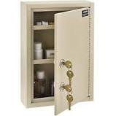
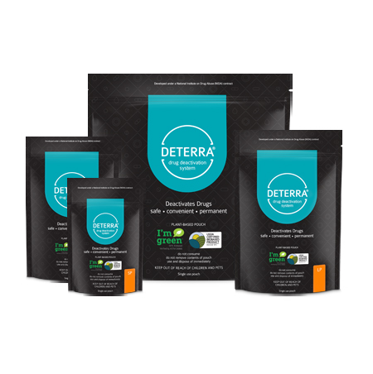
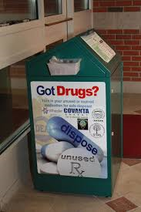
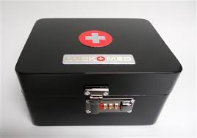
Medication Security & Disposal
Medication lock boxes
Medication drop boxes
DEA drug take back days
Pharmacy disposal bags
Notes:
Link to find your local dropbox: https://portal.ct.gov/DCP/Drug-Control-Division/Drug-Control/Local-Drug-Collection-Boxes

Slide 45
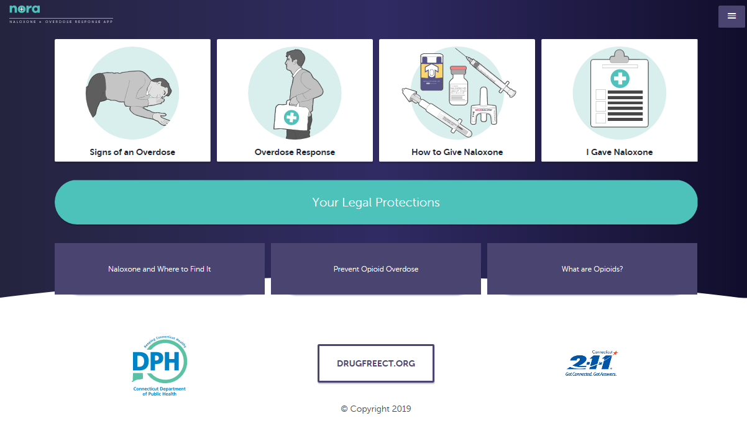
NORA (Naloxone + Overdose Response App)
A free tool from the CT Department of Public Health
A progressive website, rather than an app per se, for desktop or phone use
Go to www.norasaves.com to add to your phone (instructions also on the website)
Covers everything you need to know, including how to access Narcan, how to administer it, legislation, submitting data, etc.
Notes:
Share instructions in the follow up email: https://egov.ct.gov/norasaves/#/about

Slide 46
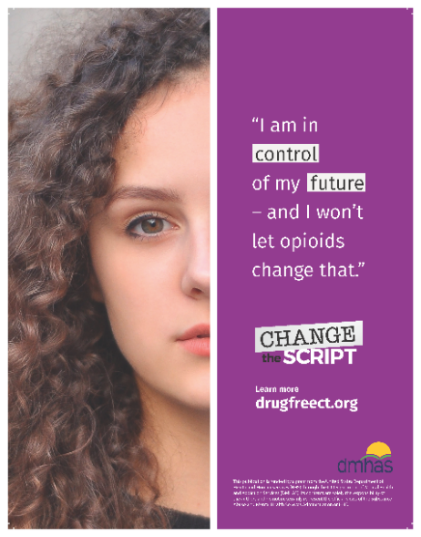
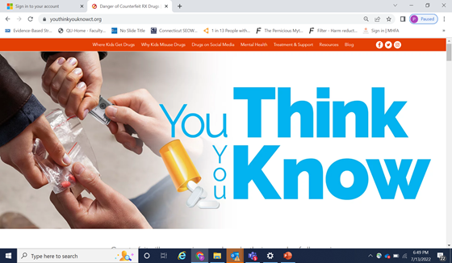
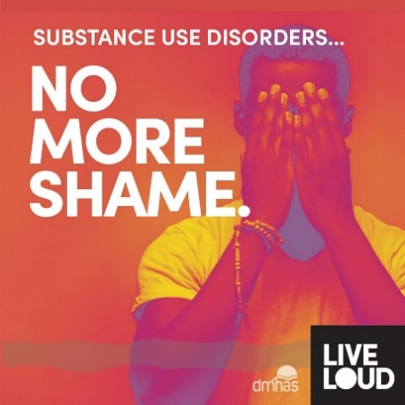
Statewide Efforts
Awareness of risks of prescription drugs, information on safe medication storage and disposal
Statewide campaign to increase awareness of was designed to target youth, young adults, and parents/caregivers, raising awareness about how teens and young adults are accessing prescription drugs, why they are using them, the lethal risks of obtaining counterfeit pills, and available prevention, treatment, and support resources.
Information about opioids, treatment connections, recovery supports & harm reduction
Notes:
Change the Script: upstream, primary prevention. How to talk to your doctor, safe medication storage and disposal, etc. Can be found on drugfreect.org
Live LOUD: prevention and harm reduction for those currently using, getting people into treatment and recovery
Drugfreect.org: easy to read and understand information on a wide range of substances, The campaign, “You Think You Know”, was designed to target youth, young adults, and parents/caregivers, raising awareness about how teens and young adults are accessing prescription drugs, why they are using them, the lethal risks of obtaining counterfeit pills, and available prevention, treatment, and support resources. One area of focus was social media safety, since many teens and young adults are using it to purchase drugs. The campaign launched in September 2021 and has received a great deal of attention locally, statewide, and nationally.

Slide 47
Guidance on Safe Storage
Identify location in the school in which the Naloxone is accessible by for all those trained in usage at all times of the day to include co-curricular (day, evening, weekends) events. It is important to remember that staff, students, visitors, and vendors are all at risk for a potential overdose.
Places where the nasal naloxone is to be stored, should be identified, with the following consideration of the need for storage:
At one or more places where students may be most at risk (may include having a kit for the athletic trainers)
In such a manner as to allow rapid access by authorized persons
In a place accessible only to authorized persons. The storage location(s) should be secure, but not locked during those times when nasal naloxone is most likely to be administered

Slide 48
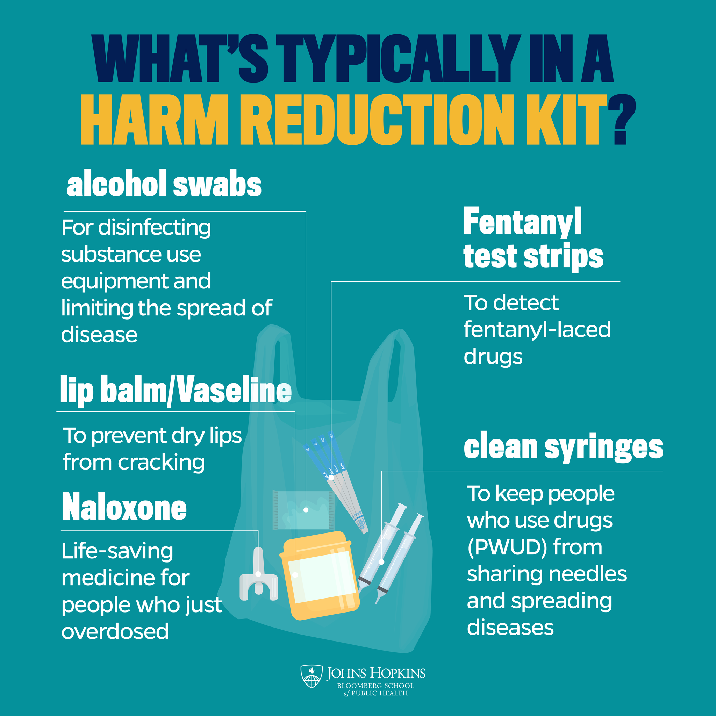
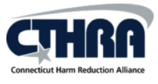
Harm Reduction
“Harm reduction is exactly what it sounds like: reducing the harm associated with using drugs through a variety of public health interventions. But the concept relies on more than these tools and begins, at the most fundamental level, with recognizing that all people deserve safety and dignity. It does not treat drug use as a moral failing.”
Notes:
https://publichealth.jhu.edu/2022/what-is-harm-reduction?fbclid=IwAR2pujFchbnPoMoLaLsommEuD4aGle88I_9yafbhGYGEwispyFsR6soIKPg

Slide 49
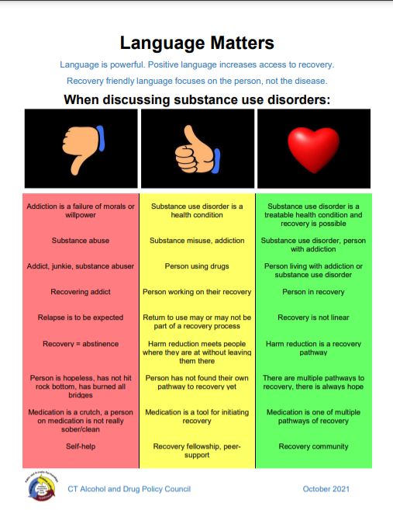
Language Matters
Person-first language maintains the integrity of individuals as whole human beings—by removing language that equates a person to their condition or has negative connotations.
For example, “person with a substance use disorder” has a neutral tone and distinguishes the person from his or her diagnosis.
Notes:
Remember that the language we use as trainers sets a precedent for how our participants will speak about addition and people with substance use disorders.
Person-first, respectful language always!

Slide 50
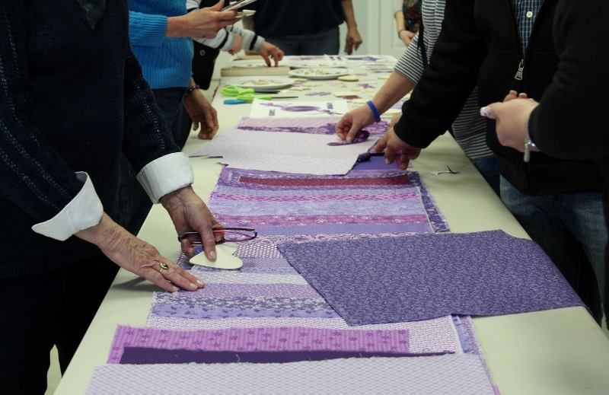
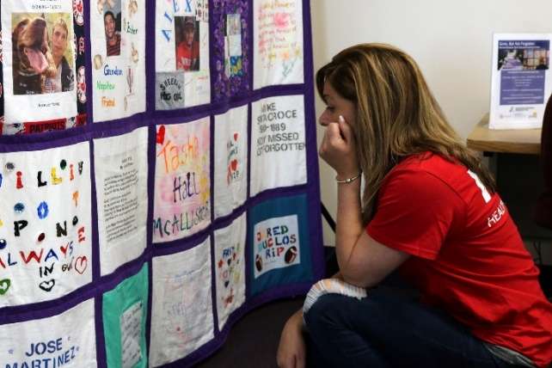
Remembrance Quilts
Remembrance Quilt Initiative
Notes:
5 completed quilts, each square made in honor of someone lost to substance abuse
Remember, even when we talk about data/statistics, we are talking about human beings.

Slide 51
Questions/Discussion

Slide 52
Thank you!
List of RBHAOs
Region 1: The Hub: Behavioral Health Action Organization for Southwestern CT, A Program of RYASAP, Janice Anderson Region 2: Alliance for Prevention Wellness – BHCare, Pamela Mautte
Region 3: SERAC, Angela Duhaime Region 4: Amplify, Inc., Allyson Nadeau Region 5: Western CT Coalition, Allison Fulton
Notes:
Try to be the last person to leave the training or Zoom meeting. People almost always have questions or things to share they don’t want to share in front of the group.

