Slide 1


CONNECTICUT STATE DEPARTMENT OF EDUCATION
2018
TCS Application Training
Keryn Felder
Education Consultant
(860) 713-6833
Keryn.Felder@ct.gov

Slide 2

Topics to be Covered
Background Information
The basics: 5W’s of TCS
The record layout
Field definitions
Reporting rules
Course code structure
Security
FERPA
Using the application
Error correction
Data verification
Certification
Help Site
User questions
CONNECTICUT STATE DEPARTMENT OF EDUCATION

Slide 3

THE BASICS

Slide 4
What is TCS?
TCS: Teacher Course Student
TCS collects information on students courses and grades The specific fields collections are defined in the User Guide
The TCS application is the tool we use to collect this date
CONNECTICUT STATE DEPARTMENT OF EDUCATION

Slide 5

Learn a New Language!
CONNECTICUT STATE DEPARTMENT OF EDUCATION

Slide 6
ACRONYMS
APSEP (Approved Private Special Education Program)
CECS (Connecticut Educator Certification System)
DM (Directory Manager)
EIN (Educator Identification Number)
PPR (Profile and Performance Report)
PSIS (Public School Information System)
SASID (State Assigned Student ID)
SIS (Student Information System)
TCS (Teacher-Course-Student)
CONNECTICUT STATE DEPARTMENT OF EDUCATION

Slide 7
PSIS – Public School Information System
SIS – Student Information System
PSIS
CONNECTICUT STATE DEPARTMENT OF EDUCATION

Slide 8
PSIS – Public School Information System
PSIS is and ALL Student data collection containing:
Demographics
School/District Information
Special Program Status codes
Membership/Attendance
SASID’s (State Assigned Student Identification Numbers)
CONNECTICUT STATE DEPARTMENT OF EDUCATION

Slide 9
PSIS - Used by TCS to:
Take a “live” look at which students are currently registered to your district or were enrolled in your district long enough to be reported (>90 days).
Validate records against registration information: SASID, District Entry and Exit Dates, Nexus District, Nexus District Entry and Exit Dates.
Used by TCS to match SASID, DOB, Facility Code 1, Reporting District and reasonability of session start/end dates.
CONNECTICUT STATE DEPARTMENT OF EDUCATION

Slide 10
CECS - Connecticut Educator Certification System
The online system where teachers apply for certification. CECS also assigns Educator Identification Numbers and maintains the status of teachers’ certifications (active or expired). Updated continuously.
Used by TCS to:
  Confirm EIN is active/current
  If a teacher has an invalid certification, the EIN will throw an error: “Not Valid EIN.” Use uncertified codes (200’s) when not including the EIN.
CONNECTICUT STATE DEPARTMENT OF EDUCATION

Slide 11
DM – Directory Manager
The Directory Manager (DM) is located in the Portal Applications website. DM is the official listing of all districts, schools and other educational facilities. DM is also used to manage users and their roles for all Portal Applications.
Used by TCS to:
  Verify application credentials
CONNECTICUT STATE DEPARTMENT OF EDUCATION

Slide 12
APSEP – Approved Private Special Education Facility
APSEP’s provide appropriate services and supports to special Education students when a LEA finds it necessary to contract with a private facility to meet their statutory obligation.
CONNECTICUT STATE DEPARTMENT OF EDUCATION

Slide 13
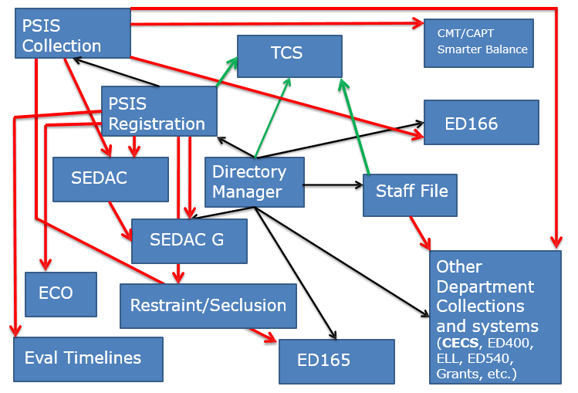
CSDE Data Collections
CONNECTICUT STATE DEPARTMENT OF EDUCATION

Slide 14
5 W’s of TCS

Slide 15
Who reports TCS Data?
Who gets reported?
Public schools in CT are required to report TCS information. This includes:
  All students in grades PreK – 12 including regional districts, charter schools and the CT Technical High School System.
  Outplaced Students
  Students taking courses outside of the district (arts, agriculture, vocational, online, etc.)
  Students who are homebound or expelled
  This equates to reporting all students registered to your district in the Public School Information System (PSIS) PK through age 21.
CONNECTICUT STATE DEPARTMENT OF EDUCATION

Slide 16
What about Students in an Approved Private Special Education Program (APSEP)?
Report: | Do Not Report:
Students who are placed by a District and have an IEP Students in General Education courses who were placed by DCF or DMHAS | Students who are unilaterally placed by a parent Students for whom the home district has NOT accepted programmatic responsibility for the child’s education through the development and implementation of an IEP
CONNECTICUT STATE DEPARTMENT OF EDUCATION

Slide 17
What (course) grades do we report?
All final outcome grades earned at any point during the current school year
  Half year courses
  Full year courses
Note that CSDE wants final grades, not semester or trimester grades.
CONNECTICUT STATE DEPARTMENT OF EDUCATION

Slide 18
What don’t we report?
TCS data from a previous school district for students who transferred into your district;
Students placed by another state into your school;
Students unilaterally placed by their parents where the district has not accepted programmatic responsibility for the child’s education through the development and implementation of an IEP; or
Services Plan students
CONNECTICUT STATE DEPARTMENT OF EDUCATION

Slide 19
Why do we report to TCS?
C.G.S. 10-10a - Section 10-10a - Public school information system. Definitions. Development and implementation. Types of data collected. Access to data maintained under system.
(a) As used in this section:
(1) “Teacher” means any certified professional employee below the rank of superintendent employed by a board of education for at least ninety days in a position requiring a certificate issued by the State Board of Education;
(2) “Teacher preparation program” means a program designed to qualify an individual for professional certification as an educator provided by institutions of higher education or other providers approved by the Department of Education, including, but not limited to, an alternate route to certification program.
(b) The Department of Education shall develop and implement a state-wide public school information system. The system shall be designed for the purpose of establishing a standardized electronic data collection and reporting protocol that will facilitate compliance with state and federal reporting requirements, improve school-to-school and district-to-district information exchanges, and maintain the confidentiality of individual student and staff data. The initial design shall focus on student information, provided the system shall be created to allow for future compatibility with financial, facility and staff data. The system shall provide for the tracking of the performance of individual students on each of the state-wide mastery examinations under section 10-14n in order to allow the department to compare the progress of the same cohort of students who take each examination and to better analyze school performance. The department shall assign a unique student identifier to each student prior to tracking the performance of a student in the public school information system.
(c) On or before July 1, 2013, the department shall expand the state-wide public school information system as follows:
(1) Track and report data relating to student, teacher and school and district performance growth and make such information available to local and regional boards of education for use in evaluating educational performance and growth of teachers and students enrolled in public schools in the state. Such information shall be collected or calculated based on information received from local and regional boards of education and other relevant sources. Such information shall include, but not be limited to:
(A) In addition to performance on state-wide mastery examinations pursuant to subsection (b) of this section, data relating to students shall include, but not be limited to, (i) the primary language spoken at the home of a student, (ii) student transcripts, (iii) student attendance and student mobility, and (iv) reliable, valid assessments of a student’s readiness to enter public school at the kindergarten level;
(B) Data relating to teachers shall include, but not be limited to, (i) teacher credentials, such as master’s degrees, teacher preparation programs completed and certification levels and endorsement areas, (ii) teacher assessments, such as whether a teacher is deemed highly qualified pursuant to the No Child Left Behind Act, P.L. 107-110, or deemed to meet such other designations as may be established by federal law or regulations for the purposes of tracking the equitable distribution of instructional staff, (iii) the presence of substitute teachers in a teacher’s classroom, (iv) class size, (v) numbers relating to absenteeism in a teacher’s classroom, and (vi) the presence of a teacher’s aide. The department shall assign a unique teacher identifier to each teacher prior to collecting such data in the public school information system;
(C) Data relating to schools and districts shall include, but not be limited to, (i) school population, (ii) annual student graduation rates, (iii) annual teacher retention rates, (iv) school disciplinary records, such as data relating to suspensions, expulsions and other disciplinary actions, (v) the percentage of students whose primary language is not English, (vi) the number of and professional credentials of support personnel, and (vii) information relating to instructional technology, such as access to computers.
(2) Collect data relating to student enrollment in and graduation from institutions of higher education for any student who had been assigned a unique student identifier pursuant to subsection (b) of this section, provided such data is available.
(3) Develop means for access to and data sharing with the data systems of public institutions of higher education in the state.
(d) On or before July 1, 2011, and each year thereafter until July 1, 2013, the Commissioner of Education shall report, in accordance with the provisions of section 11-4a, to the joint standing committee of the General Assembly having cognizance of matters relating to education on the progress of the department’s efforts to expand the state-wide public school information system pursuant to subsection (c) of this section. The report shall include a full statement of those data elements that are currently included in the system and those data elements that will be added on or before July 1, 2013.
(e) The system database of student information shall not be considered a public record for the purposes of section 1-210. Nothing in this section shall be construed to limit the ability of a full-time permanent employee of a nonprofit organization that is exempt from taxation under Section 501(c)(3) of the Internal Revenue Code of 1986, or any subsequent corresponding internal revenue code of the United States, as from time to time amended, and that is organized and operated for educational purposes, to obtain information in accordance with the provisions of subsection (h) of this section.
(f) All school districts shall participate in the system, and report all necessary information required by this section, provided the department provides for technical assistance and training of school staff in the use of the system.
(g) Local and regional boards of education and preschool programs which receive state or federal funding shall participate, in a manner prescribed by the Commissioner of Education, in the state-wide public school information system described in subsection (b) of this section. Participation for purposes of this subsection shall include, but not be limited to, reporting on (1) student experiences in preschool by program type and by numbers of months in each such program, and (2) the readiness of students entering kindergarten and student progress in kindergarten. Such reporting shall be done by October 1, 2007, and annually thereafter.
(h) On and after August 1, 2009, upon receipt of a written request to access data maintained under this section by a full-time permanent employee of a nonprofit organization that is exempt from taxation under Section 501(c)(3) of the Internal Revenue Code of 1986, or any subsequent corresponding internal revenue code of the United States, as from time to time amended, and that is organized and operated for educational purposes, the Department of Education shall provide such data to such requesting party not later than sixty days after such request, provided such requesting party shall be responsible for the reasonable cost of such request. The Department of Administrative Services shall monitor the calculation of such fees charged for access to or copies of such records to ensure that such fees are reasonable and consistent with those charged by other state agencies. The Department of Education shall respond to written requests under this section in the order in which they are received.
(i) The superintendent of schools of a school district, or his or her designee, may access information in the state-wide public school information system regarding the state-wide mastery examination under section 10-14n. Such access shall be for the limited purpose of determining examination dates, examination scores and levels of student achievement on such examinations for students enrolled in or transferring to the school district of such superintendent
CONNECTICUT STATE DEPARTMENT OF EDUCATION

Slide 20
Where do we report to TCS?
TCS Application: http://csde.ct.gov
TCS is a PORTAL application
CONNECTICUT STATE DEPARTMENT OF EDUCATION

Slide 21
When do we report to TCS?
Timely: August 15, 2018 (not July)
  All data you have has been reported
Accurate: September 15, 2018
  Any additional records have been reported and all issues have been resolved
Freeze Date: October 1, 2018
CONNECTICUT STATE DEPARTMENT OF EDUCATION

Slide 22
SECURITY

Slide 23
Security
Security is set up in Directory Manager
TCS User
TCS Certifier – Administrator only!
CONNECTICUT STATE DEPARTMENT OF EDUCATION

Slide 24
Security – Gaining Access
Contact your DM Security Manager
Should have more than one TCS User per LEA
CONNECTICUT STATE DEPARTMENT OF EDUCATION

Slide 25
Family Educational Rights and Privacy Act of 1974 (FERPA)
Educational equivalent of HIPAA
Do not email student names
  Use SASID’s

Slide 26
REPORTING PREPERATION

Slide 27
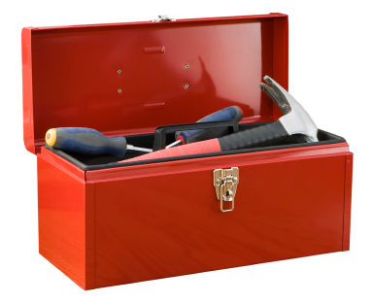
Toolkit:
User Guide/Record Layout
NCES Code Lists
Course Code Structure
Help Site:
http://portal.ct.gov/SDE/Performance/Data-Collection/Help-Sites/TCS
CONNECTICUT STATE DEPARTMENT OF EDUCATION

Slide 28
User Guide/Record Layout
Field specifications
Field definitions
Code Lists
Reporting Rules
CONNECTICUT STATE DEPARTMENT OF EDUCATION

Slide 29
User Guide Time!
Available on the Help Site
CONNECTICUT STATE DEPARTMENT OF EDUCATION

Slide 30
NCES Code Lists
Prior-to-Secondary (K-8)
Secondary (9-12)
CONNECTICUT STATE DEPARTMENT OF EDUCATION

Slide 31
Course code structure
Prior-to-Secondary (include grades) and Secondary codes are structured slightly differently:
Prior-to-Secondary | Secondary
Course Description | Course Description
Course Code Rigor Level | Course Code Rigor Level
Grade Span | Available Credit
Sequence | Sequence
000000000000 | 0000000.0000
CONNECTICUT STATE DEPARTMENT OF EDUCATION

Slide 32
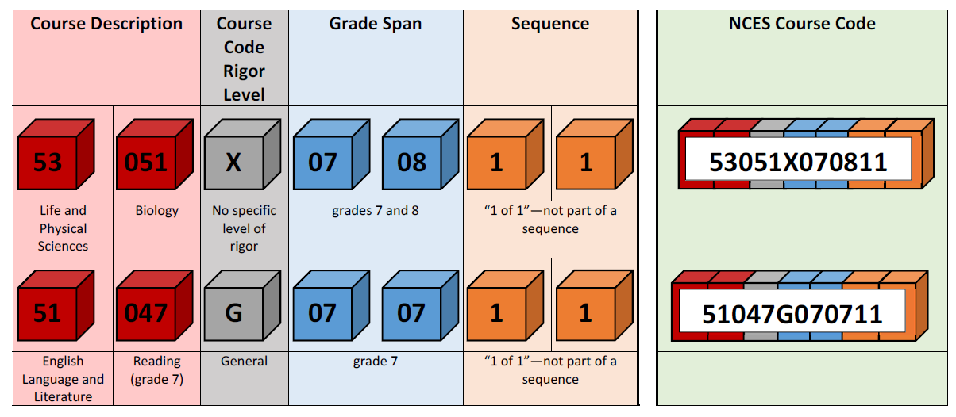
Course code structure:
Prior-To-Secondary
CONNECTICUT STATE DEPARTMENT OF EDUCATION

Slide 33
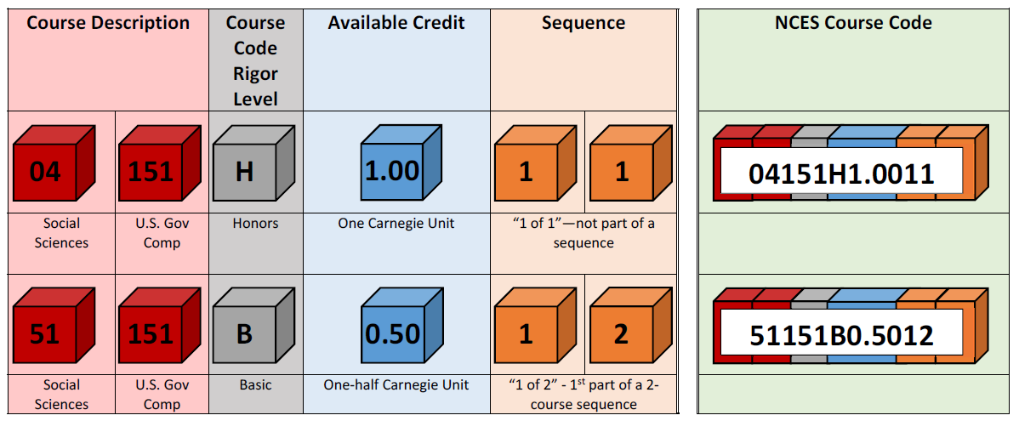
Course code structure:
Secondary
CONNECTICUT STATE DEPARTMENT OF EDUCATION

Slide 34
NCES Codes: Course Credits Earned
Cannot be blank when the NCES Code is in the SECONDARY FORMAT
Can be 0.00
CONNECTICUT STATE DEPARTMENT OF EDUCATION

Slide 35
Help Site
url: http://portal.ct.gov/SDE/Performance/Data-Collection/Help-Sites/TCS
From CSDE Home Page:
Search “TCS”
or
K-12 Education →
Accountability-Assessment-Data →
Data Collection →
Data Collection Information
CONNECTICUT STATE DEPARTMENT OF EDUCATION

Slide 36
REPORTING RULES

Slide 37
90 Day Rule
Any student who has been in your district for at least 90 days must be reported in TCS.
The Missing SASID report will help you with identifying these students.
CONNECTICUT STATE DEPARTMENT OF EDUCATION

Slide 38
How Many Records Should be Reported for Each Student?
  PK – Grade 6: Grade level data (1 record per student)
  Grades 7- 12: Course level data (1 record per course)
CONNECTICUT STATE DEPARTMENT OF EDUCATION

Slide 39
Facility Code 1 vs. Course Facility Code
Facility Code 1 (FC1)
  MUST Match FC1 reported in PSIS Registration
Course Facility Code
  Where the course is taken
  Matches FC1 in over 95% of cases
  Can also match FC2
  Any other facility
    Students taking courses in both a program and the public school
    Students who attend part-time magnets
    Students who attend public school and college
CONNECTICUT STATE DEPARTMENT OF EDUCATION

Slide 40
What about 8th graders taking high school courses?
Use Secondary NCES Codes
Use the appropriate Facility Course Code

Slide 41
Session Start and End Dates
Session start and end dates MUST reflect the length of time of the Outcome Grade that is being reported.
  Do not report 8/31 to 6/15 for records reporting Semester or Quarter Course Grades.
  Session Start and End Dates are used to identify Duplicate Records!
Should not overlap
Will create an error in 18-19
Will be a warning this year
CONNECTICUT STATE DEPARTMENT OF EDUCATION

Slide 42
Outcome Grade vs. Outcome Grade Status
Outcome Grade is a DISTRICT LEVEL Field.
  Report whatever you want…85%, S, B+, 2…
Outcome Grade Status is a STATE Field.
  This is a standardized reporting field. It allows us to know, regardless of the district adopted grading scale, if the student passed the course.
  Allowable Statuses:
P | Completed the course/section with a PASSING grade
F | Completed the course/section with a FAILING grade
R | RETAINED (for use in ONLY grades PK-3)
W | WITHDREW from course/section
TR | TRANSFERRED to/from course/section
I | Course/section requirements for grading are INCOMPLETE
AU | AUDIT course, no grade issued
NG | NO GRADE, per IEP requirements
SE | Working towards IEP Goals and Objectives (for outplaced students only)
CONNECTICUT STATE DEPARTMENT OF EDUCATION

Slide 43
Dual Enrollment Codes
These are CSDE assigned facility codes for Higher Education Institutions (Colleges and Universities)
Field cannot be blank if district wants to count that record toward the Next Generation Accountability Indicator #5
CONNECTICUT STATE DEPARTMENT OF EDUCATION

Slide 44
USING TCS

Slide 45
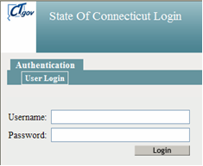
How to Access the TCS System
Authorization for the State of Connecticut Login website at https://csde.ct.gov
You have an account and TCS role assigned in Directory Manager (DM). Your District controls your access and account, not the CSDE.
CONNECTICUT STATE DEPARTMENT OF EDUCATION

Slide 46
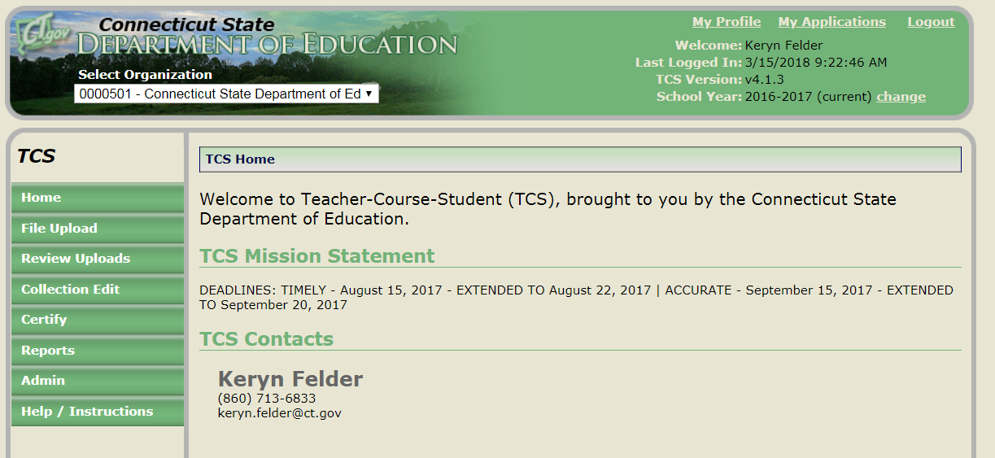
TCS Home Page
CONNECTICUT STATE DEPARTMENT OF EDUCATION

Slide 47
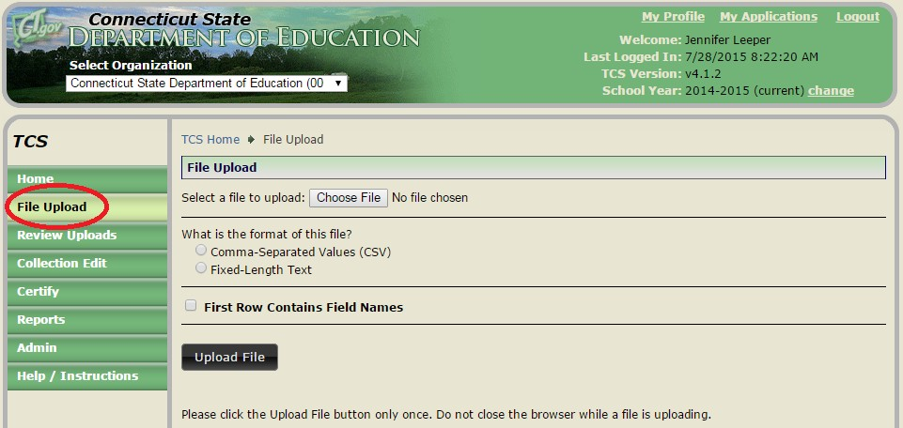
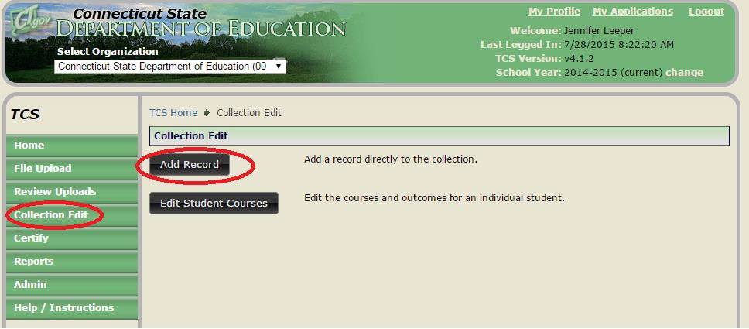
How to Submit Data
Upload
o data uploaded from vendor program into TCS.
Manual Entry
o data entered manually into TCS.
CONNECTICUT STATE DEPARTMENT OF EDUCATION

Slide 48
Uploading
Only .csv and .txt files can be uploaded. Other file types will be rejected
Use caution when opening your file in Excel
  Leading zeros will be dropped
If the Reporting District in the file does not match your Reporting District the file will be rejected
CONNECTICUT STATE DEPARTMENT OF EDUCATION

Slide 49
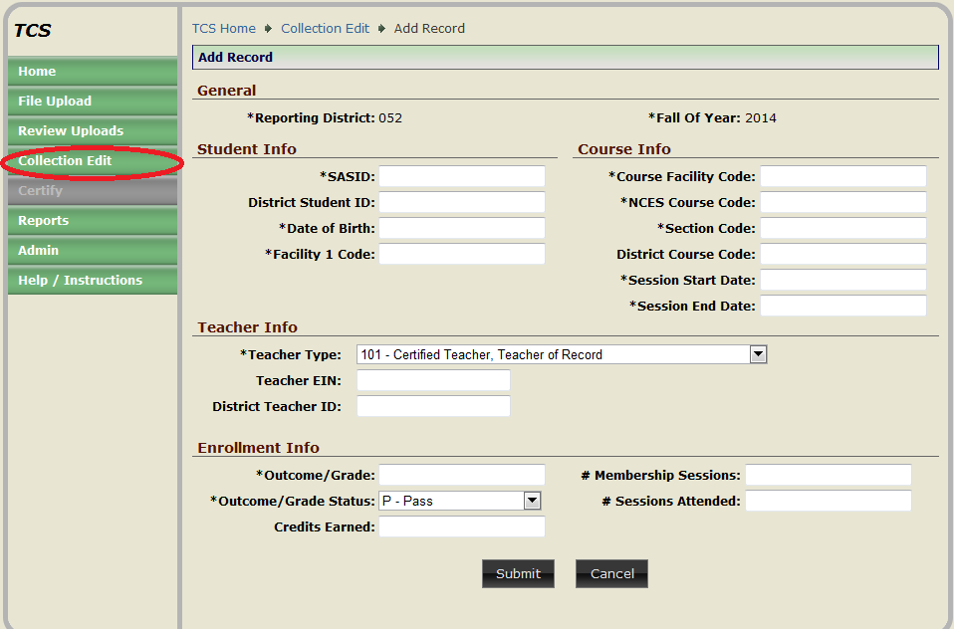
Manual Entry
If you enter data with errors, when you click Submit, an error message will appear in the window. You cannot submit the record until the error is corrected.
CONNECTICUT STATE DEPARTMENT OF EDUCATION

Slide 50
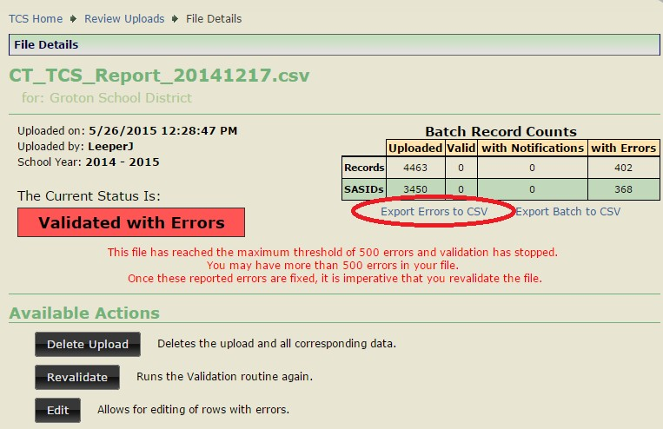
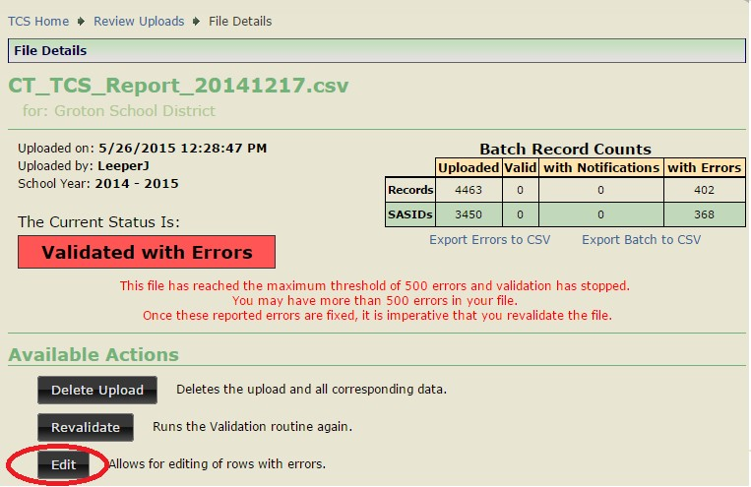
Cleaning TCS Data
Once data is submitted, TCS validates the data and identifies errors in the data (if any). There are 2 ways to review errors:
Export Errors to CSV
Save the Error Message Report to your computer.
Review & Edit Errors within TCS
CONNECTICUT STATE DEPARTMENT OF EDUCATION

Slide 51
Export Errors to CSV
Review the export and look for the Error Messages.
•
These messages are quite specific to help
you pinpoint the error.
The system stops validating your file
when it hits 500 errors.
Examples:
NCES Course Code (022247G0.511) is invalid.
SASID (**********) and DOB (01012001) does not match a student registered in your district.
Facility 1 Code (1234567) does not match PSIS Registration (reg:7654321).
•
•
CONNECTICUT STATE DEPARTMENT OF EDUCATION

Slide 52
Most Common TCS ERRORs
NCES Course Codes
  Reporting Secondary Code with Prior-to-Secondary
code format or vice versa.
  Using EIN for expired initial certificates.
  Session Start and End dates that do not encompass
any dates the student was registered to your district.
  Reporting PSIS Facility Code 2 as the facility code in TCS instead of using FC1 as facility code and FC2 as course facility code.
  Using year long Session Start and End dates for semester or quarter grades.
CONNECTICUT STATE DEPARTMENT OF EDUCATION

Slide 53

Fixing Errors
You need to make a decision, either : Correct each error in your Student Information System
•
•
Once your errors are fixed, export your file, and upload to TCS again.
Keep in mind that if you had 500 errors, once you upload this file, validation will continue and you may get additional errors.
OR
Correct each error directly within TCS
Then RE-VALIDATE and Process the file.
Best practice is to always fix errors in your SIS, too.
CONNECTICUT STATE DEPARTMENT OF EDUCATION

Slide 54
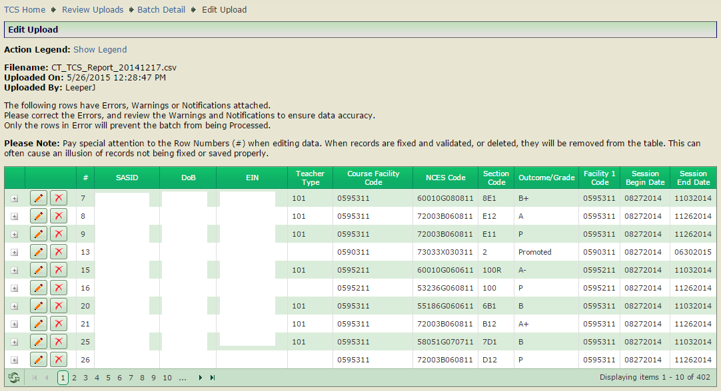
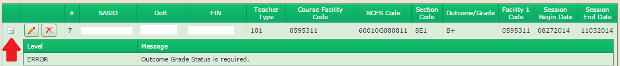
Manually Fixing Errors
If you manually Edit your records, hit Revalidate when finished.
CONNECTICUT STATE DEPARTMENT OF EDUCATION

Slide 55
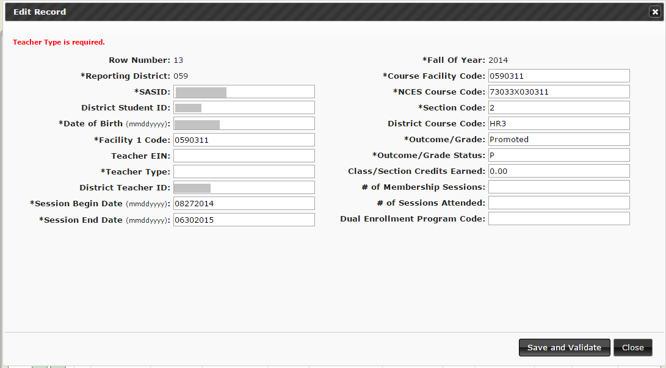
Manually Fixing Errors
Click the
icon to see the Edit Record screen. This is where you
manually edit the record’s error. When you are done making edits, click
Save and Validate.
CONNECTICUT STATE DEPARTMENT OF EDUCATION

Slide 56

Revalidate
Once errors are corrected, you will need to click the Revalidate
button.
CONNECTICUT STATE DEPARTMENT OF EDUCATION

Slide 57
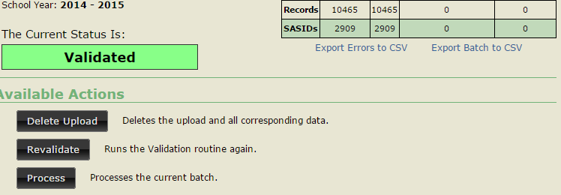
Validated
Once there are 0 errors, your data is Validated.
This means that your data passed through all of the validation
rules and edit checks successfully.
CONNECTICUT STATE DEPARTMENT OF EDUCATION

Slide 58
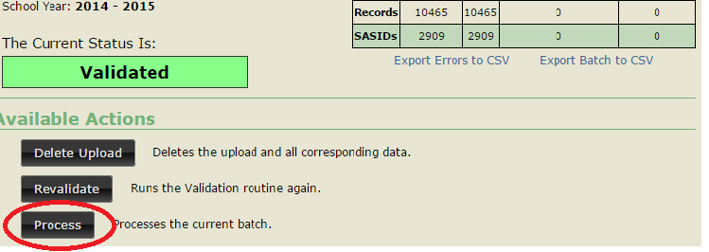
Process
Once your data is Validated, click Process.
•
All the Reports run off of Processed data only. If your data has not been Processed, the reports will look like you have not submitted any data.
CONNECTICUT STATE DEPARTMENT OF EDUCATION

Slide 59
How to Process
You will have to select one of the following actions
per Facility Code 1:
Merge will process all batch records into the collection, updating any records that already exist or adding new records that do not exist in the collection.
Overwrite will delete all existing records in the collection. The batch records will then be added to the collection as if there have not been any previous records processed.
Ignore batch records will NOT be processed and
existing collection records will remain.
Click Process
CONNECTICUT STATE DEPARTMENT OF EDUCATION

Slide 60


Process Screen
TCS Home • Review Uploads • Batch Detail • Process
Process
The table below shows the record counts for the Batch you are about to process grouped by Facility 1. For each Facility 1,it also shows counts of what has already been processed into the TCS Collection.
Merge:will append new records from this Batch into the Collection as well as update the values for any records that already exist for the indicated Facility 1.This is the
recommended option.
Overwrite: WILL DELETE all existing records for that Facility 1which are already in the Collection for the current school year. They will then be replaced by the new
records in this Batch. Unless you are sure you want to Overwrite these records,it is recommended that the Merge option be used.
Ignore:will cause all batch records for that Facil ty 1to not be Processed. Any existing records in the Collection for that Facility 1will remain untouched.
Filename:Groton059_2013-2014_ValidProcessi ngTestBatch02.csv
Uploaded By: DicksonM1 Uploaded On: 5/6/2015 1:23:52 PM
Facility 1
Code Facility Name
0590311 Claude Chester School
Batch Record
Count
Batch Sasid Count
Batch Date Range
Ex sting Record
Count
Ex sting Sasid Count
Existing Date
Range
Action
® ^{Merge}
1
1
08/29/2013 -
11/30/2013
364
364
08/ 28/2013 -
06/29/2014
0Overwrite
0 Ignore
08/29/2013 -
11/30/20 13
08/28/20 13 -
06/29/2014
® ^{Meroe}
0591211
Pleasant Valley School
1
1
287
287
Q 0verwnte
0 Ignore
® Merge
0591711
Mary Morrisson School
2
2
08/29/2013 -
11/30/2013
421
420
08/ 28/20 13 -
06/29/2014
0Overwnte
0 ^{Ignore}
Northeast Academy Elementary
School
08/29/2013 -
11/30/2013
08/ 28/2013 -
06/29/2014
® Merge
0591911
1
1
412
412
Q Overwnte
0 Ignore
® ^{Meroe}
0595211
West Side Middle School
15
2
08/29/2013-
11/30/2013
11405
505
08/ 28/20 13 -
06/30/2014
0Ovenvrite
0 ^{Ignore}
08/29/2013 -
11/30/2013
08/ 28/20 13 -
06/30/2014
® ^{Merge}
0595311
Cart C. Cutter Middle School
5
1
10128
463
Q Overwnte
0 Ignore
® Merge
0596111
Fitch Senior High School
34
4
08/23/2013-
12/31/2013
16740
1129
08/28/2013 -
06/29/2014
0Ovenvrite
0 ^{Ionore}
CONNECTICUT STATE DEPARTMENT OF EDUCATION

Slide 61
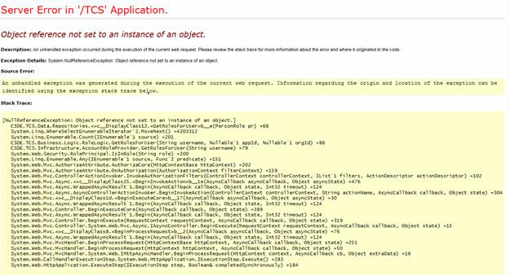
TCS Systems “ISSUES”
When to Use the “Back” Arrow/Button:
– Many times when you hit a button for a report, you will see a system or server error/warning. Simply hit the back arrow and reselect the report. Occasionally this process is required 2 times but usually 1 fixes it.
CONNECTICUT STATE DEPARTMENT OF EDUCATION

Slide 62
TCS REPORTS

Slide 63
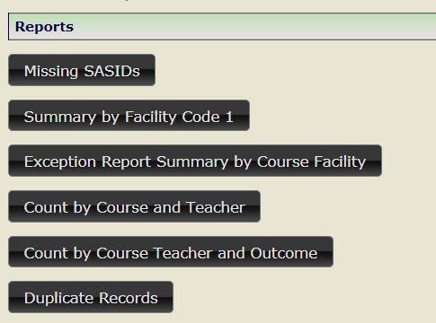
TCS Reports
Used for verification and data cleaning
Be sure to review your reports!
CONNECTICUT STATE DEPARTMENT OF EDUCATION

Slide 64
Missing SASIDs Report
Until you PROCESS your data, this report will not change.
This report lists every SASID for which the
CSDE expects to received at least one record.
Missing SASIDs EXCEPTIONs (pull-down):
  01: preschool related services only. (Itinerant)
  02: Student receiving transition services only and
engaged in Workplace Experience (TVSPs)
  03: Not enrolled long enough to earn a final grade

Slide 65
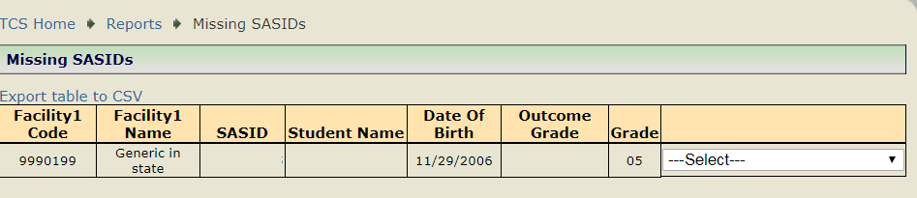
Missing SASID Report
01: Pre-K student – Related Services Only
02: Student receiving transition services only and engaged in Workplace Experience
03: Student not in district long enough to earn final outcome/grade
CONNECTICUT STATE DEPARTMENT OF EDUCATION

Slide 66
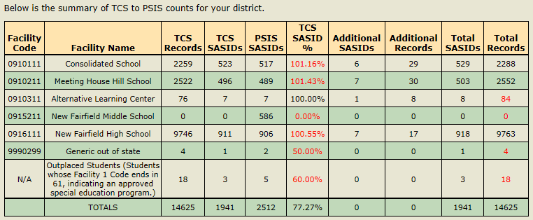
Summary by Facility Code 1

Slide 67
Summary by Facility Code 1
Key elements on the report:
  Number of PSIS SASIDs
  Number of TCS SASIDs
    Remember we do not use June PSIS.
    This uses PSIS Registration and expects data for any student reported by your district for over 90 days. If the student left your district, but was not reported by another PSD, we will expect a record if enrolled over 90 days. If student in your district majority of year but transferred districts late in the year, they will be on the new district’s SASID list. (Hence reason for >100% reporting.)
  Percent SASIDs Reported
  Number of Records Reported
    Is this reasonable or did you accidently merge the same data twice and create duplicates?

Slide 68
Exception Report Summary by Course Facility
  Includes the response counts from the missing SASID Report:
  01: preschool related services only. (Itinerant)
  02: Student receiving transition services only and engaged in Workplace Experience (TVSPs)
  03: Not enrolled long enough to earn a final grade

Slide 69
Count by Course and Teacher
  Includes the following fields:
  NCES Course Code Grouping
  Course Facility Code
  Course Facility Name
  NCES Course Name
  Section
  EIN
  Teacher Name
  Teacher Type
  Records

Slide 70
Count by Course Teacher and Outcome
  Includes the following fields:
  NCES Course Code Grouping
  Course Facility Code
  Course Facility Name
  NCES Course Name
  Section
  EIN
  Teacher Name
  Teacher Type
  Outcome
  Records

Slide 71
Duplicate Records Report
From this report, you can see and edit where you have reported what appears to be duplicate records for a SASID.
If you “merge” the same file twice, it will create duplicate records. Easiest way to resolve is to process a third time and OVERWRITE the file to replace all the duplicates created in the merge process.
Remember this report looks at SASID, FC1, Course Code, Section Number, Session Start and End Dates and Teacher Type!

Slide 72
Outplaced Students

Slide 73
Outplaced Students
Who is legally responsible to report?
Public Schools are responsible for all CSDE reporting
Who is responsible for issuing grades/credits?
Non-public schools and APSEPs should recommend grades/credits; however, the LEA holds the legal responsibility and is the final decision maker for reviewing/approving student grades and issuing credits. (Connecticut General Statutes 10-221a(f)).
What are APSEPs required to provide LEAs?
Section B of the APSEP standards require LEAs to comply with all relevant federal and state reporting laws/requirements. Therefore APSEPs must provide everything required in TCS to the LEA.

Slide 74
Outplaced Students cont.
How can the state help with obtaining relevant data from non-public schools?
Educational services for public school students in non-public schools are contractual arrangements between LEAs and non- publics/APSEPs.
LEAs should consider including information regarding data needed for their TCS and other state reporting requirements in their contracts along with any other requirements necessary to implement the district’s IEP.
BSE has issued official guidance to APSEPs that all TCS data should be submitted to LEAs no later than June 30th for school year data and within 5 days of the end of the Summer Session.

Slide 75
Outplaced Students cont.
How do we know if students are earning grades, earning credits and which courses they are enrolled in – in a timely manner?
This is all part of the conversation by the PPT, between the LEA and non-public school. At the PPT meeting, districts should be discussing the appropriate coursework for the student. On page 8 of the IEP it should be noted if the student is to receive grading accommodations (e.g., is graded or ungraded) and if the student will be earning credits for completed coursework.
Note that public school students who are not issued credits by the LEA for their coursework cannot earn a standard high school diploma from their LEA
(C.G.S. 10-221a(b)).
CONNECTICUT STATE DEPARTMENT OF EDUCATION

Slide 76
TCS Data and Next Generation
Accountability

Slide 77
What are next Generation Indicators?
Connecticut’s Next Generation Accountability System is a broad set of 12 indicators that help tell the story of how well a school is preparing its students for success in college, careers and life.
The system moves beyond test scores and graduation rates and instead provides a more holistic, multifactor perspective of district and school performance and incorporates student growth over time.
CONNECTICUT STATE DEPARTMENT OF EDUCATION

Slide 78
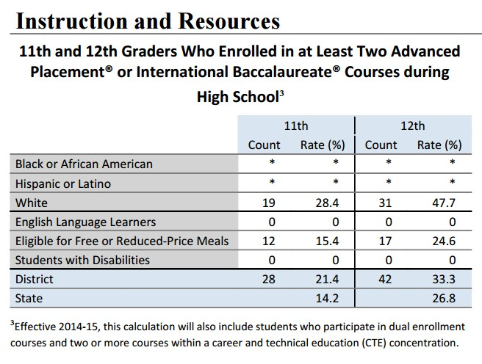
Profile and Performance Report (PPR)
TCS Data Fields: NCES Course Code
In the future: Course Credits Earned

Slide 79
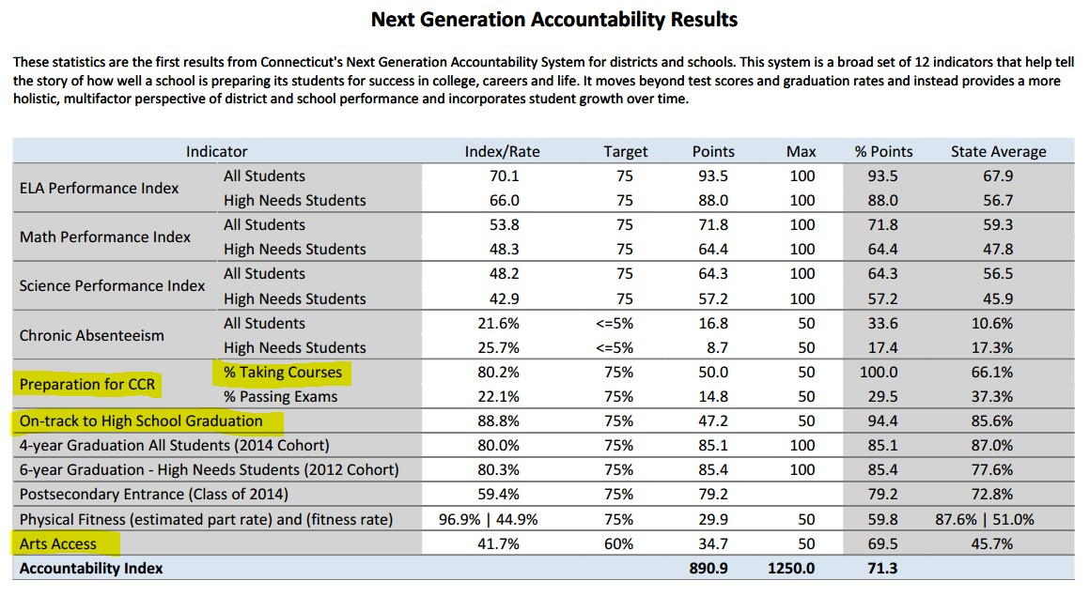
Next Generation Accountability

Slide 80
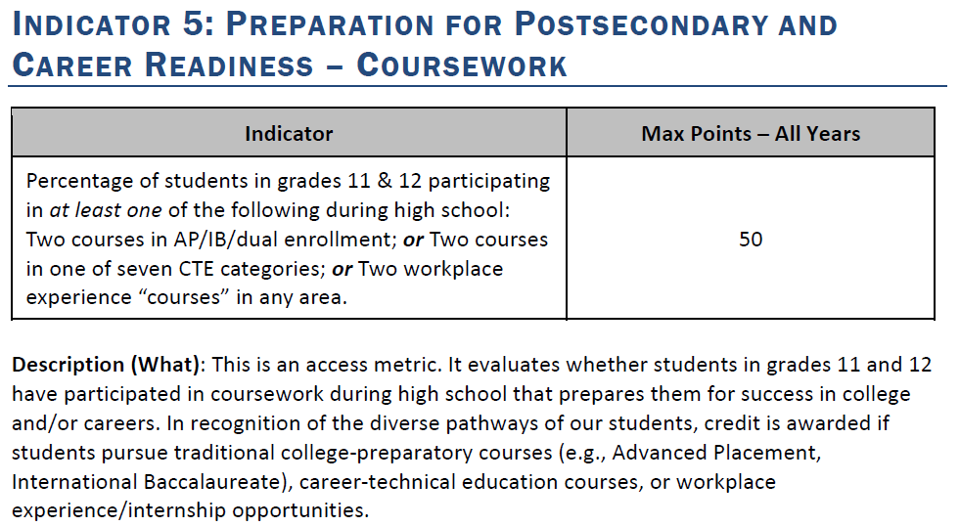
Next Generation Accountability

Slide 81
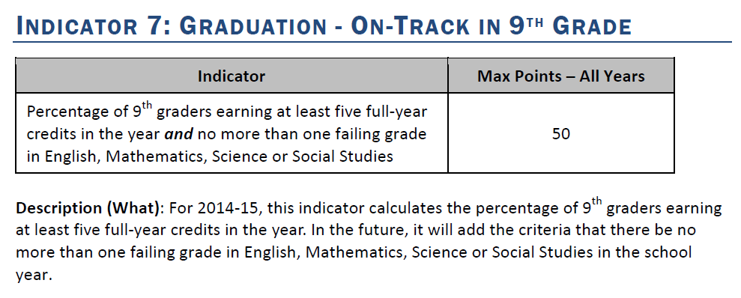
Next Generation Accountability

Slide 82
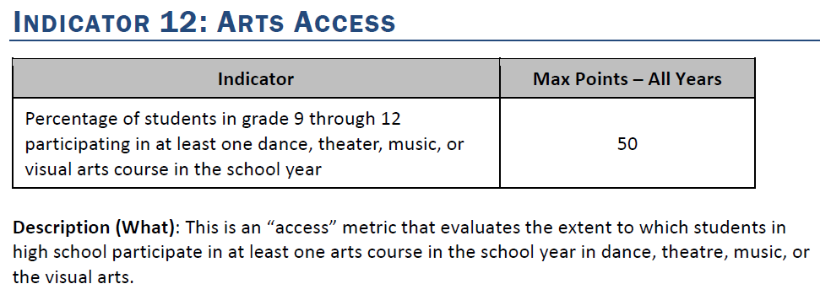
Next Generation Accountability

Slide 83
Verification Reports
These three reports must reviewed by superintendents before TCS is frozen!
College and Career Readiness Report (similar to Indicator 5)
On-Track in Grade 9 Report (similar to Indicator 7)
Arts Access Report (similar to Indicator 12)

Slide 84
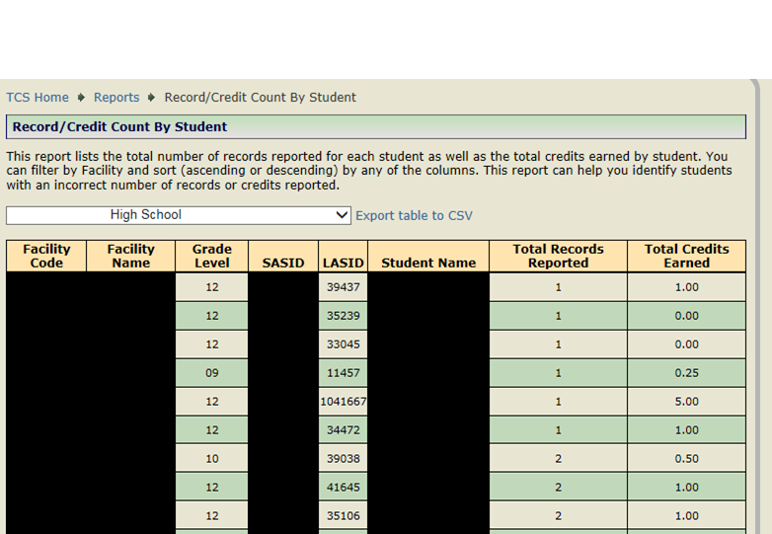
Other Reports: Record/Credit Count by Student
CONNECTICUT STATE DEPARTMENT OF EDUCATION

Slide 85
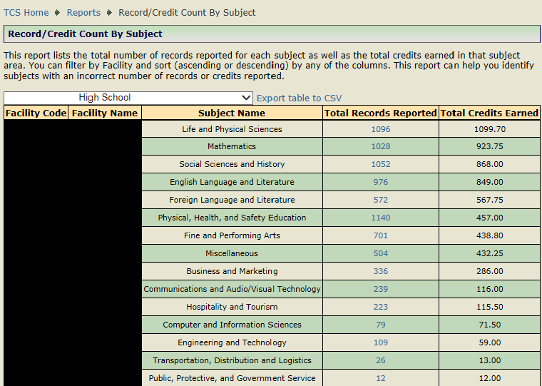
Other Reports: Record/Credit Count by Subject
CONNECTICUT STATE DEPARTMENT OF EDUCATION

Slide 86
Data Cleaning Reports
Available Credit vs. Credit Earned
Course Credits earned are Greater than 3.0
CONNECTICUT STATE DEPARTMENT OF EDUCATION

Slide 87
CERTIFICATION

Slide 88

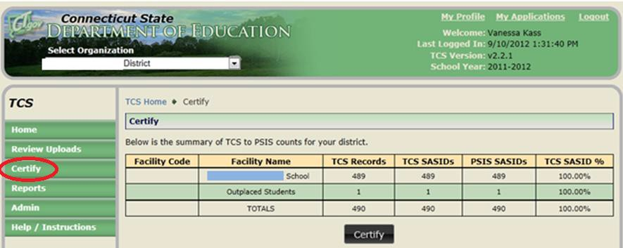
How to Certify
Note: Only Certified Administrators with the TCS Certifier role assigned in Directory
Manager have access to certify these data.
Note: Districts must report 100% (or greater) of their students.
Using the navigation menu on the left of the screen, select the Certify menu option. The system displays the Certify screen.
The CSDE will not “turn on” the Certification button until every facility is equal or above 100% of sasids reported.
If all facilities are 100% or greater, the district can Certify.

Slide 89
Certification
Timely: August 15, 2018
  Check box
Accurate: September 15, 2018
  TCS Certifier only
CONNECTICUT STATE DEPARTMENT OF EDUCATION

Slide 90

When will TCS Open?
CONNECTICUT STATE DEPARTMENT OF EDUCATION

Slide 91

User Questions
CONNECTICUT STATE DEPARTMENT OF EDUCATION

Slide 92


