Slide 1
Using EdSight Secure with TCS Data
March 25, 2025

Slide 2
What’s the difference between the EdSight portals?
Often called EdSight Public
Accessible to all
Provides detailed information about schools and districts
Some suppression for small n sizes
Offers information on key performance measures that make up Connecticut’s Next Generation Accountability System
Contains a variety of reports, including the Connecticut Report Cards
EdSight Secure is accessible to designated school and district users via a secure log-in
Provides unsuppressed, longitudinal student-level data
Offers views to detailed, unsuppressed information about schools and districts
Contains a variety of reports, including the Early Indication Tool and Student Summary
http://edsight.ct.gov/
https://secure-edsight.ct.gov/
Notes:
Connecticut has two portals to facilitate the public and secure reporting of data. The public portal, EdSight public, contains tables, charts, graphs, links to other reports, and suppression of small N sizes to protect confidentiality. The secure portal allows authorized users access to student-level data for students registered to their district and schools. When students move from one school or district to another, that student's data are transferred to the new district and school for access the following morning.

Slide 3
How do I gain access to EdSight Secure?
Designated by Superintendent
LEA Security Manager creates account or assigns role
Wait one hour to login
Find your LEA Security Manager at: https://public-edsight.ct.gov/overview/find-contacts
Notes:
For those of you who do not have access, and may want access, we’ve included this slide that outlines the steps required to gain access.
First, an individual needs to be designated by their Superintendent. Once designated, the district’s LEA Security Manager will create an account or assign the appropriate role. There are two levels of access for an EdSight Secure user. A user may be a district data analyst and have permission to view data for all students within the district, or a user may be a school data analyst and only have permission to view data for students attending a school or group of schools.
If you need assistance in locating your user ID or resetting your password, you can contact your LEA Security Manager.
We’ve included a link to look up your LEA Security Manger on this slide.

Slide 4
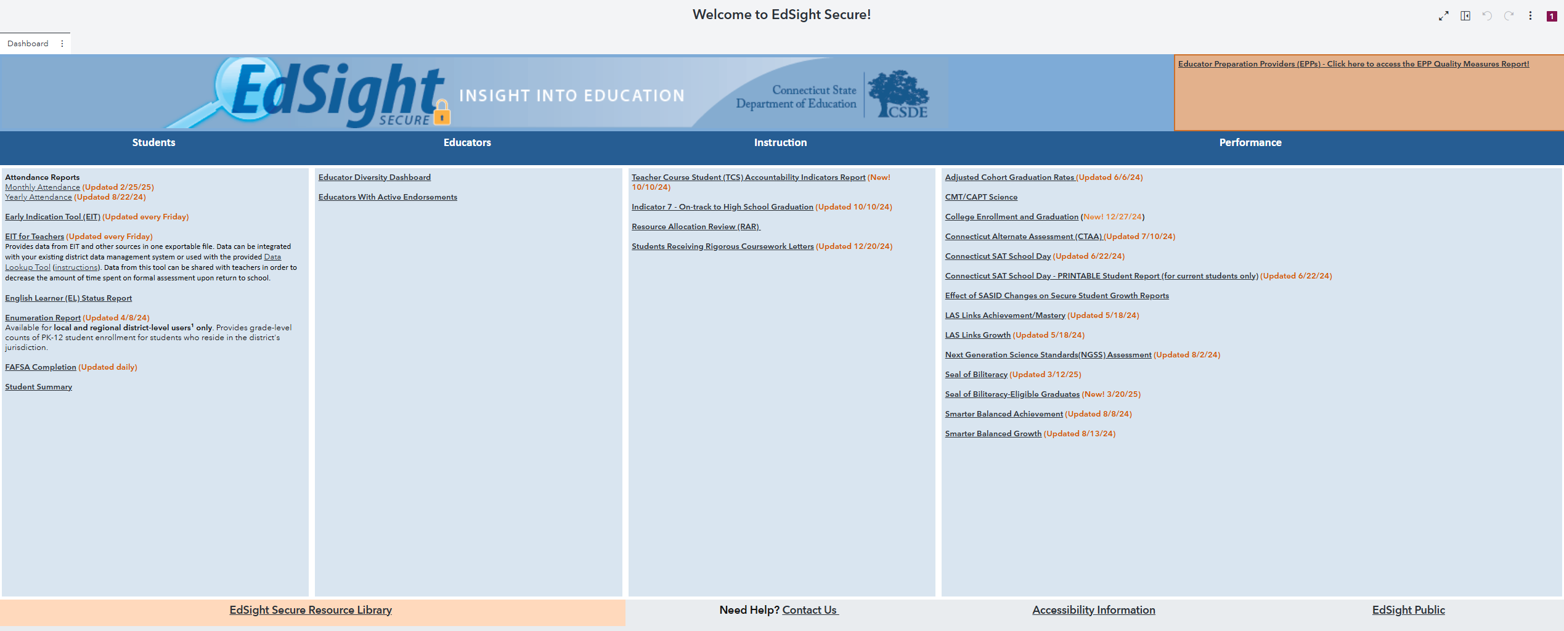
EdSight Secure Resource Library
Click the link on the EdSight Secure welcome page to access the Resource Library. Additional videos are available on the CSDE YouTube channel.

Slide 5
EdSight Secure Enhancements

Slide 6
Student Summary Course History Page
The Course History page has been added and includes a listing of all prior year courses for students currently enrolled in grades 7-12 that were reported to the CSDE by all public schools that the student attended within the State of Connecticut.
Course data include the NCES Course name, course grade earned, credits earned, course dates, and the school where the course was taken.

Slide 7
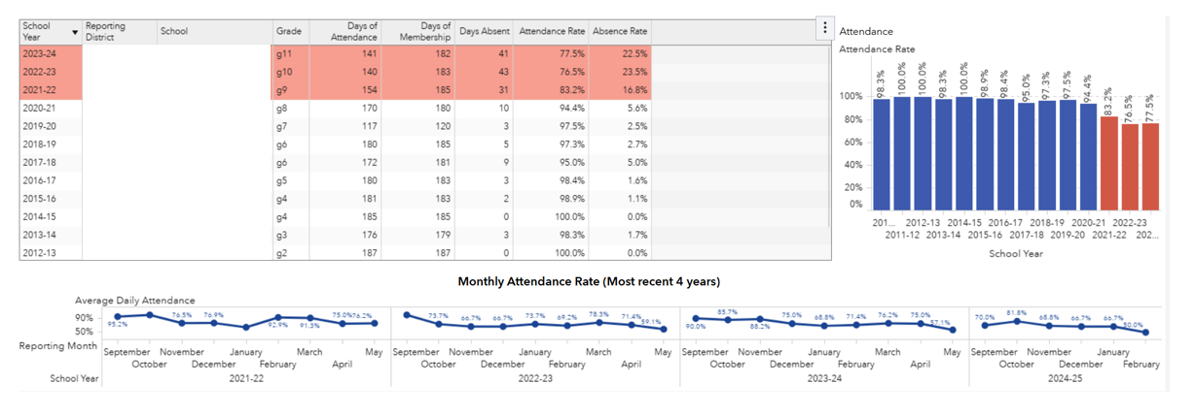
Student Summary Attendance History Page
The Attendance History page now includes the monthly attendance pattern for the student for the four most recent years including the current year.

Slide 8
Student Summary Assessment History Page
The Assessment History page now indicates whether students currently enrolled in grades 8 to 10 have demonstrated the potential to succeed in rigorous courses in high school.

Slide 9
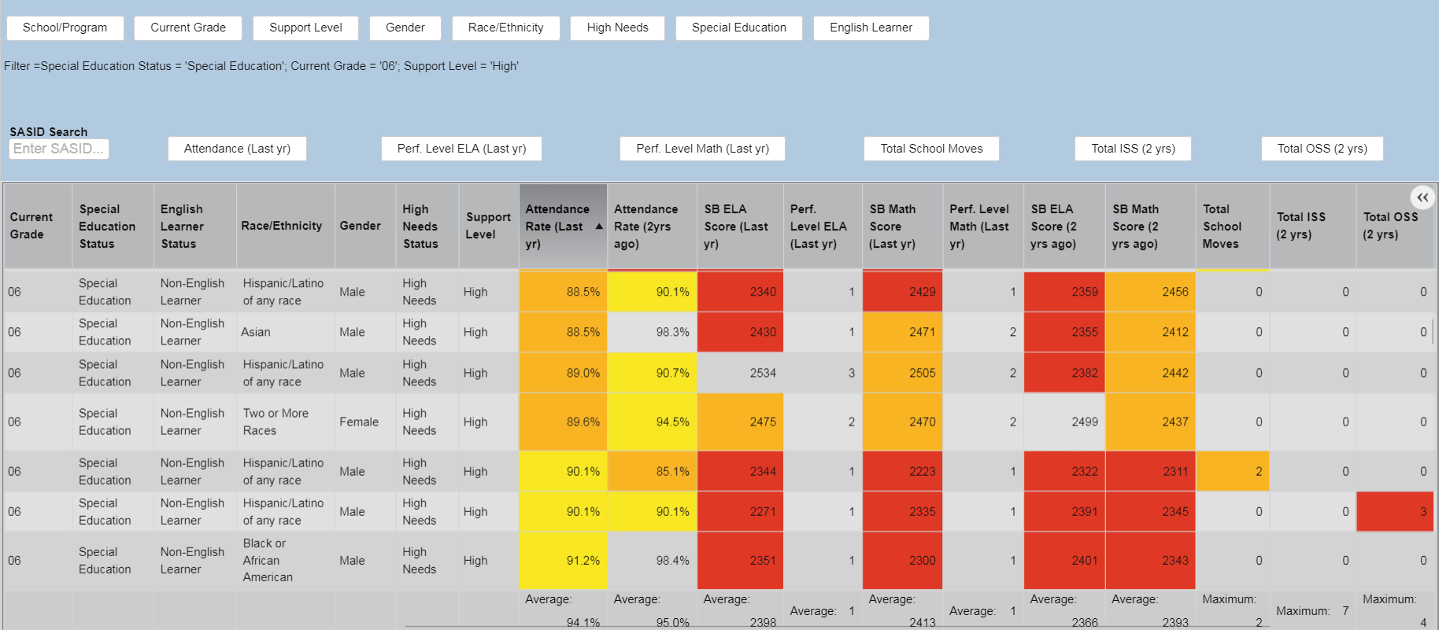
Early Indication Tool (EIT)
OVERVIEW
The EIT is a K-12 system that uses statistical methods to identify clusters of students who are at-risk of missing milestones and/or dropping out, and ultimately facilitates more timely interventions by assigning targeted student support levels.
INFORMATION & ACCESS
The EIT provides color-coded longitudinal data and visualizations to school and district users in a secure fashion via EdSight Secure.
THE DASHBOARD
Filters
Options to maximize, save, and export
One row per student (*)
Summary
data by
column
Demographics and special populations status fields
Two years of attendance, achievement, mobility, discipline, and retention
* Additional fields, including student ID, name, and date of birth, are displayed in the EIT
Targeted Student Support Level
(as determined by the EIT model)
Please email questions and comments to
the EdSight Help Desk at EdSight.SDE@ct.gov

Slide 10
Early Indication Tool (EIT) Now Updated Weekly
The Early Indication Tool (EIT) is now updated every Friday to include students who were not enrolled at the time EIT was last run.
Support level designations do not change as part of this weekly update, but all available data will be populated for all students.
TCS tie-in: For students in grades 8 to 12, the longitudinal view includes a list of any core courses failed.
Users can double-click a student record to access the Student Summary for additional information.

Slide 11
FAFSA Completion Report Updated Nightly
The CSDE receives FAFSA completion status for high school seniors from the Connecticut Office of Higher Education (OHE).
The public FAFSA completion report is updated weekly and the student-level FAFSA Completion Status is updated nightly in EdSight Secure.
Please see FAFSA Completion Resources for additional information to support students and families completing the FAFSA.

Slide 12
College Enrollment and Graduation New Report
CSDE tracks college enrollment, persistence, and graduation via data from National Student Clearinghouse.
These data are shared with districts, without suppression, in the new College Enrollment and Graduation Report for the students who graduated from your district.
Users can view data for individual students on the Student-level Data Table page.
These data are similar to those presented in the public College Enrollment, Persistence, and Graduation Dashboard.

Slide 13
Attendance Reports
The Yearly Attendance Report shows attendance data collected during June PSIS.
The Monthly Attendance Report shows data collected during the monthly attendance collections.
These dashboards mirror the graphs available on the Attendance report on EdSight public.

Slide 14
Seal of Biliteracy Report Updated New Graduate Report Available
Starting in 2021-22, the CSDE began collecting student-level results for the students who took assessments in Grades 10, 11, or 12 in a language other than English to demonstrate their proficiency in those languages.
The data for 2023-24 have been processed and are now visible in the Seal of Biliteracy report.
In addition, a new graduate report is available which shows Seal of Biliteracy eligibility for graduates from Connecticut public schools.
Authorized users in EdSight Secure can view the counts and percentages of Seal-Eligible Graduates starting with the graduation class of 2024.

Slide 15
Next Generation Accountability TCS Reports Available in Secure

Slide 16
Next Generation Accountability
Three Next Generation Indicators relate to TCS:
Indicator 5: Postsecondary Preparation
also known as: College and Career Readiness Course Taking
Indicator 7: On-Track to High School Graduation
Indicator 12: Arts Access
EdSight Secure uses three reports to help schools/districts understand these indicators.
For more information on Next Generation Accountability, visit the Next Gen dashboard on EdSight or check out the Using Accountability Results Guide.

Slide 17
Indicator 5: Postsecondary Preparation
Percentage of students in grades 11 and 12 participating in at least one of the following during high school: ​
Two courses in AP/IB/dual credit; or ​
Two CTE courses in one of 17 career clusters; or​
Two workplace experience “courses” in any area.​
Note: CT uses a modified list of CTE courses. Be sure you are checking the CT spreadsheet and not the one from NCES/SCED.

Slide 18
Indicator 5: Postsecondary Preparation
Quick reminders on Indicator 5:
A student must take two courses of the same type. For CTE courses, they must be taken in the same cluster.
Courses may count toward multiple course types and/or clusters.
Courses from grades 9-12 are included.
Be sure AP and IB courses are coded using the correct codes.
Two courses taken in the same school year with the same SCED code will count as only one course.

Slide 19
Indicator 7: On-Track to High School Graduation
Percentage of 9th graders earning at least six full-year credits in the year.
New this year: Streamlined approach to summing credits for students.
Allows credit counts to match between TCS and Next Gen.
Two new checks in TCS:
Students earning over 12 credits will be flagged.
Courses with both year-long and semester records will be flagged.

Slide 20
Indicator 7: On-Track to High School Graduation
Which students are included in Indicator 7?
On-track status is applied to the school/district the student attended in 9th grade as well as the school/district the student attended for 8th grade the prior year.
For schools/districts that have both 8th and 9th grade, those students will count twice toward Indicator 7.
For more detailed examples:
Get a graphical explanation of Indicator 7 on the TCS Help Site.
Get a graphical example in the Indicator 7 Preview Notes.
View the Behind the Numbers webinar on TCS (beginning at 11:25).

Slide 21
Indicator 12: Arts Access
Percentage of students in grades 9 through 12 participating in at least one dance, theater, music, visual arts, or media arts course in the school year​
To be considered an arts course, the SCED subject code (the first two digits of the SCED code) must be 05. For example:
Web Design (05254) = Arts Course
Web Page Design (10201) = Not an Arts Course
See a complete list of Arts Courses by selecting “05 – Visual and Performing Arts” in the Browse Tool of the NCES SCED Finder.

Slide 22
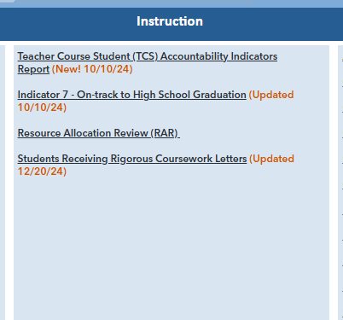
Next Gen TCS Reports in Secure
Teacher Course Student (TCS) Accountability Indicators Report
Indicator 7 – On-track to High School Graduation
Available all year in the “Instruction” section
Updated after TCS is frozen
Use to check prior accountability years
TCS Accountability Indicators Preview
Only available in early September
Updated every few days before TCS is frozen
Use to check the accuracy of the current TCS load

Slide 23
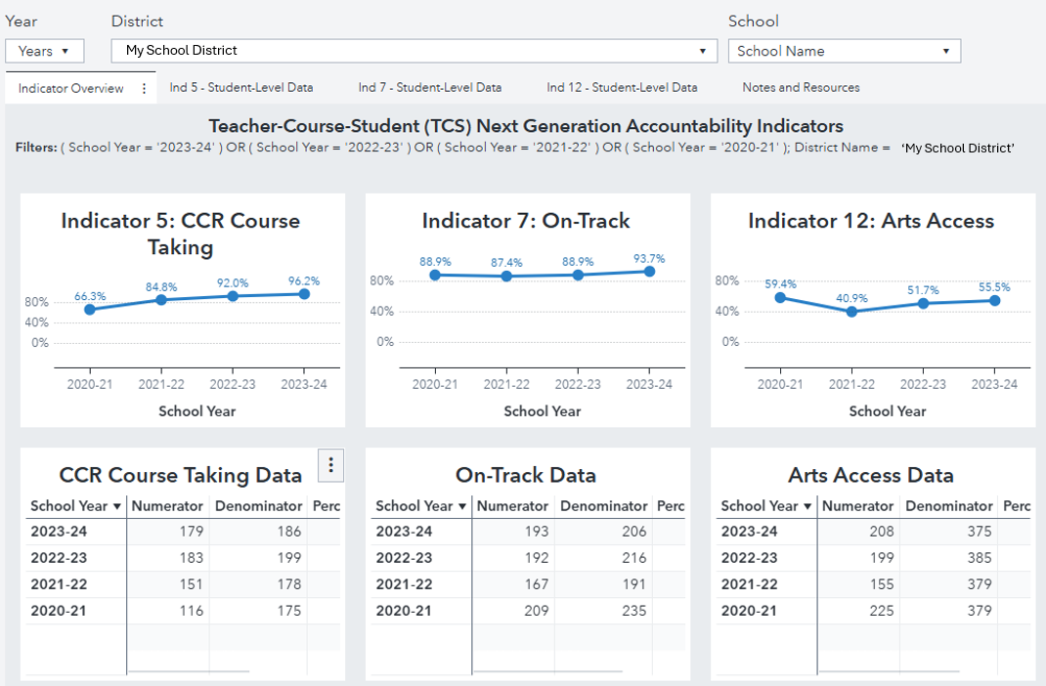
TCS Accountability Indicators Report
Use the TCS Accountability Indicators Report to view trends and see student-level data for each indicator.
Use the tabs to select either the Indicator Overview or the Student-Level Data for one of the indicators.

Slide 24
TCS Accountability Indicators Report
1
Use the Year filter to select the school year(s) you want to view.
Use the school filter to select the school you want to view (district users only). Leave blank to see the district view.
View your selected filters in the center of the page.
2
3

Slide 25
TCS Accountability Indicators Report
Indicator Overview:
Use this tab to view school/district trends on each indicator across time.

Slide 26
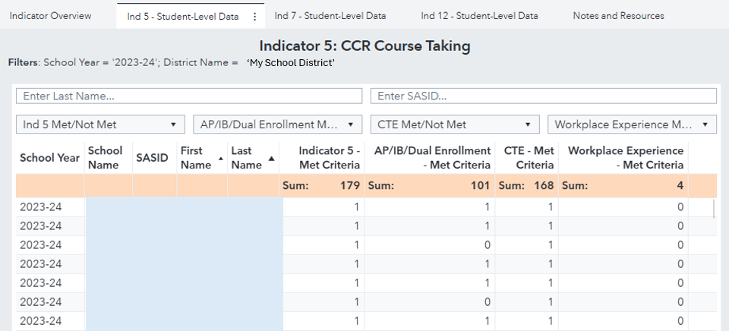
TCS Accountability Indicators Report
Indicator 5 – Student-Level Data Tab
1 = Met criteria
0 = Did not meet criteria
Filter by whether or not students met the criteria for Indicator 5 and by which category.
Select a specific student by Last Name or SASID.

Slide 27
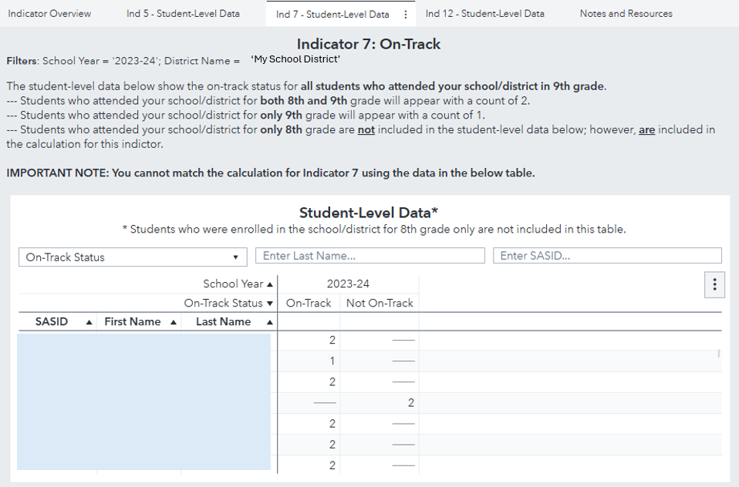
TCS Accountability Indicators Report
Indicator 7 –
Student-Level Data Tab
2 = Student attended your school/ district for both 8th and 9th grade
1 = Student attended your school/ district for 9th grade only
Students who attended your school/ district for 8th grade only will not appear in the data table.
Filter by On-Track status, Last Name, or SASID.

Slide 28
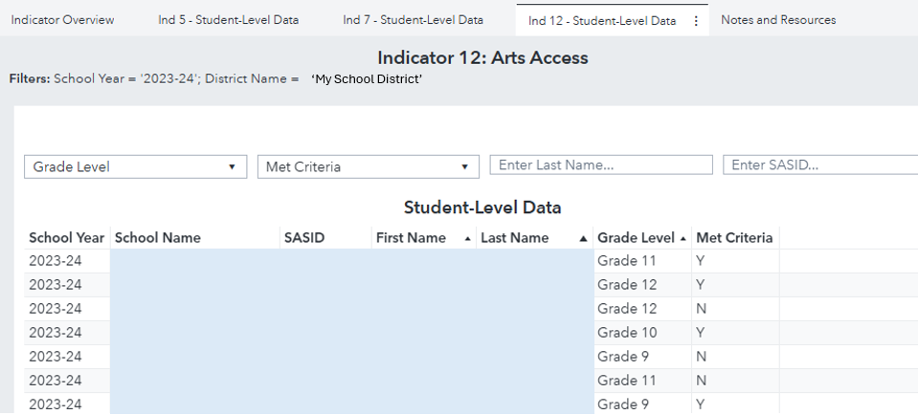
TCS Accountability Indicators Report
Indicator 12 – Student-Level Data Tab
Filter on Grade Level,
Last Name, SASID, and whether or not the student met the criteria for Indicator 12.

Slide 29
Indicator 7 Report
Example:
First Row: Students in your school/district for 8th grade during the previous school year (2022-23) and were in any CT school/district for 9th grade during the current school year (2023-24).
Second Row: Students in your school/district for 9th grade during the current school year (2023-24).
Students who were in your district for both 8th grade during the previous year and 9th grade during the current year appear in both rows. These students count twice in the totals.

Slide 30
Indicator 7 Report
Example:
First Group: Students who did not earn at least 6 credits (not on-track) in 9th grade during the current year. These students are counted in the denominator, but not the numerator.
Second Group: Students who did earn at least 6 credits (on-track) in 9th grade during the current year.
These students are counted in both the numerator and denominator.
The On-Track Percentage is calculated by dividing the On-Track Subtotal by the Total.

Slide 31
Indicator 7 Report
Example:
Double click any cell in this table to open a student-level table of the students included in that cell.
Note: Students that were in your school/district for Grade 8 during the prior school year only (i.e., they were not in your school district for Grade 9 during the current school year) will not appear in the student-level tables due to FERPA regulations.

Slide 32
Preview Report
School Year Comparison (top of each tab)
Chart compares current results to the previous year.
If the difference is >10% (in either direction), the cell will turn red.
Other components in the preview report resemble those from the Accountability Indicator and Indicator 7 reports.

Slide 33
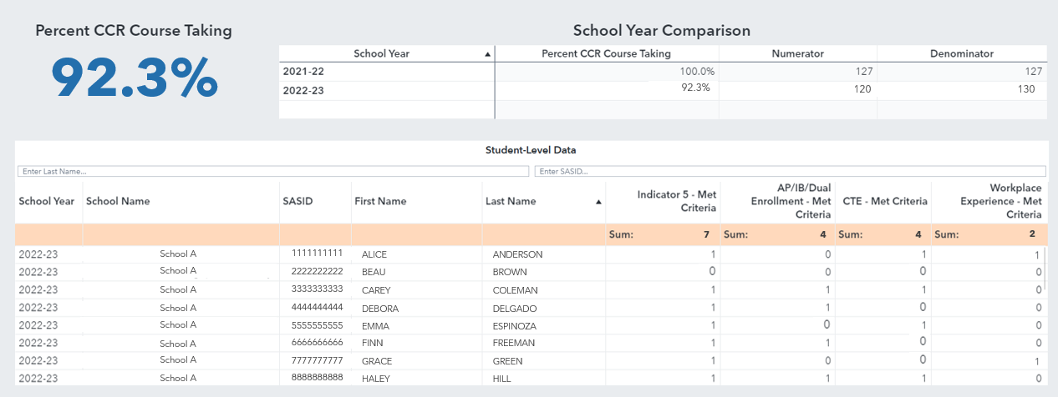
Preview Report
Indicator 5:

Slide 34
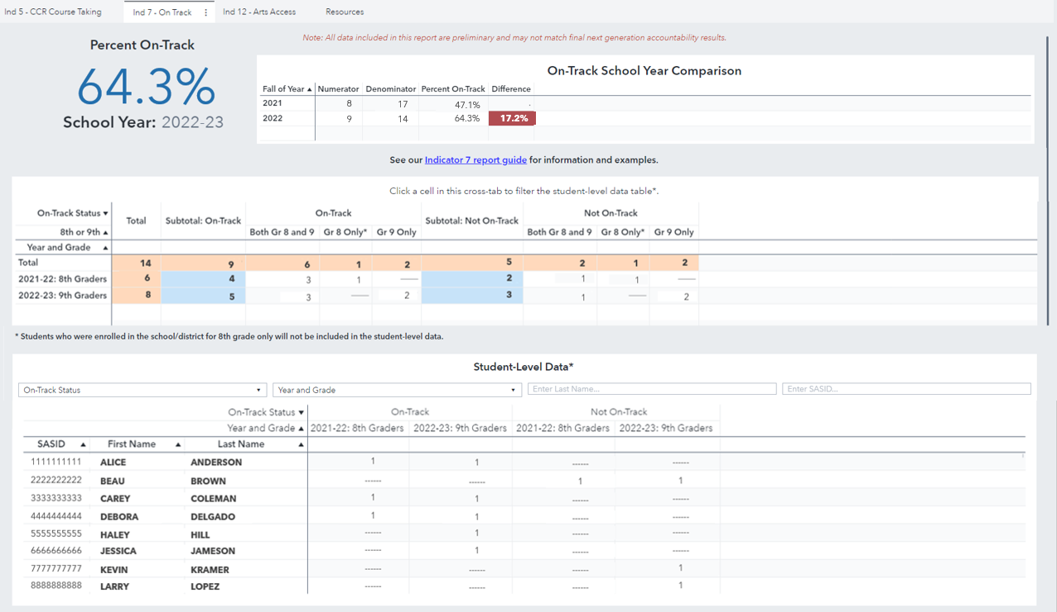
Preview Report
Indicator 7:

Slide 35
Preview Report
Indicator 12:

Slide 36
Additional Slides

Slide 37
Indicator 5: Postsecondary Preparation
To count toward Indicator 5, a student must take two courses within the same course type.
AP course + IB course = YES
AP course + Workplace Experience = NO
Many courses count toward more than one course type.
AP Computer Science Principles (AP and CTE-Information Technology cluster)
Business Law course taken for college credit (Dual Enrollment course, CTE-Business Management course, CTE-Law/Public Safety course)
Notes:
DANIELLE

Slide 38
Indicator 5: Postsecondary Preparation
Indicator 5 is a cumulative lookback across all courses taken in grades 9-12, however only 11th and 12th graders are included.
For example, a student who takes two AP courses in 9th grade
Will not be counted toward (or against) Indicator 5 in either 9th or 10th grade
Will be counted toward Indicator 5 in both 11th and 12th grade, even if they didn’t take any other AP/IB/DE classes after 9th grade.
When a student repeats a grade, courses taken in both school years will count toward indicator 5.
Notes:
DANIELLE

Slide 39
Indicator 5: Postsecondary Preparation
AP, IB, CTE, and Workplace Experience are all course-level properties. Dual Enrollment is a student-course record property.
A student-course record should only be indicated as dual enrollment if the student is registered to receive college credit.
Ensure that the dual enrollment field is completed for all dual enrollment records.
Notes:
DANIELLE

Slide 40
Indicator 5: Postsecondary Preparation
Be sure that you are using the correct course codes for AP or IB courses. For example, the courses below have very similar course titles and descriptions, but only 02203 will be counted as an AP course.
SCED Code | Course Title | Description
02203 | AP Statistics | Following the College Board's suggested curriculum designed to parallel college-level statistics courses, AP Statistics courses introduce students to the major concepts and tools for collecting, analyzing, and drawing conclusions from data. Students are exposed to four broad conceptual themes: exploring data, sampling and experimentation, anticipating patterns, and statistical inference.
02205 | Statistics | Statistics courses involve the major concepts and methods used to collect, analyze, and draw conclusions from data. Topics typically include populations and samples, measures of central tendency and variability, hypothesis testing, presentation, and making statistical inferences.
Notes:
DANIELLE

Slide 41
Indicator 5: Postsecondary Preparation
To count toward Indicator 5, both CTE courses must be taken in the same cluster. In the example below, Mechatronics + Refrigeration would not count toward Indicator 5, but Mechatronics + Marine Mechanics or Mechatronics + Industrial Art would (see quick links for CTE Course Mapping).
Course | Architecture/Construction | Manufacturing | Transportation
Mechatronics |  | YES | YES
Refrigeration | YES
Marine Mechanics |  |  | YES
Industrial Art |  | YES
For the purpose of Indicator 5, two courses taken in the same school year with the same SCED code will count as only one course.
Notes:
DANIELLE

Slide 42
Indicator 7: Schools/Districts with Grade 9 (not Grade 8)
Denominator: Number of students enrolled in your school/district for Grade 9 during the current accountability year
Numerator: Of the students in the denominator, those who earned at least 6 credits in Grade 9.
Notes:
DANIELLE

Slide 43
Indicator 7: Schools/Districts with Grade 8 (not Grade 9)
Denominator: Number of students enrolled in your school/district for Grade 8 during the previous accountability year who were also enrolled in any CT public school for Grade 9 during the current accountability year
Numerator: Of the students in the denominator, those who earned at least 6 credits in Grade 9.
Notes:
DANIELLE

Slide 44
Indicator 7: Schools/Districts with BOTH Grades 8 and 9
Denominator: Number of students enrolled in your school/district for Grade 9 during the current accountability year PLUS the number of students enrolled in your school/district for Grade 8 during the previous accountability year who were also enrolled in any CT public school for Grade 9 during the current accountability year.
Students who were enrolled in your school/district during both 8th and 9th grade will count twice toward Indicator 7.
Notes:
DANIELLE

Slide 45
Indicator 7: Example
 | On-Track? | 8th Grade (2023-24) | 9th Grade (2024-25)
Student A | Yes | My District | My District
Student B | No | My District | My District
Student C | Yes | My District | Other District
Student D | No | My District | My District
Student E | Yes | My District | My District
Student F |  | My District | Out of State
Student G | Yes | Other District | My District
Student H | Yes | Other District | My District
Student I | No | Other District | My District
Denominator |  | 5 – (A, B, C, D, E) | 7 – (A, B, D, E, G, H, I)
Numerator |  | 3 – (A, C, E) | 4 – (A, E, G, H)
District % On-Track = (3+4)/(5+7) = 7/12 = 58.3%
Notes:
DANIELLE
Note that “My District” will not know the On-Track status of Student C because Student C was in “Other District” for Grade 9
We should probably say something about how only one of the columns would apply if the school/district only had grade 8 or grade 9 but not both.
Mention link at the end to full Indicator 7 report (Quick links)

Slide 46
Indicator 7: On-Track to High School Graduation
Students who Repeat Ninth Grade:
Credits will only count toward Indicator 7 if they were earned in the current accountability school year.
Since they were not in Grade 8 during the previous accountability year, they will not count towards either the school they attended for Grade 8 nor the school they attended for their initial Grade 9 year.
Notes:
DANIELLE

